Slide 1
Advancements in the UFS Applications based on GFS, GEFS and SFS
¹Cristiana Stan and ²Avichal Mehra
¹George Mason University, ²NOAA/EMC

Slide 2
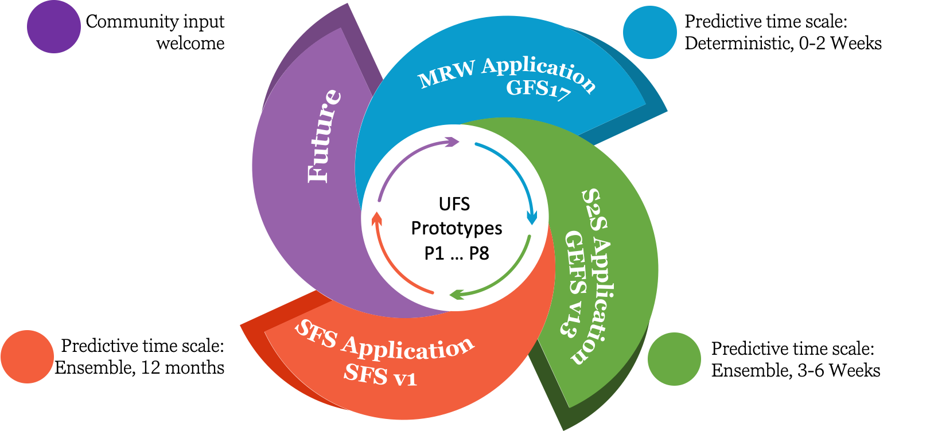
UFS Global Coupled Applications

Slide 3
Coupled UFS Prototypes
Prototype | Atmospheric Model C384 (~0.25 degree) horizontal resolution |  |  | Ocean Model Tripolar ~0.25 degree horizontal resolution | Wave Model Regular lat/lon 0.5 degree grid | Ice Model Tripolar ~0.25 degree horizontal resolution | Mediator
 | Dynamical Model | Physics Settings & Driver | Land Model
P1 | FV3 64 layers, Non- Fractional grid (model top at 54km) | GFSv15.2, IPD driver | Noah LSM | MOM6 | N/A | CICE5 | NEMS
P2
P3.1
P4 |  | GFSv15.2, CCPP driver |  |  | WW3
P5 |  |  |  |  |  | CICE6 (Mushy TD not turned on) | CMEPS
P6 | FV3 127 layers, Fractional grid (model top at 80km) | GFSv16
P7 |  | Modified GFSv16 | Noah-MP LSM |  |  | CICE6 (Mushy TD turned on)
P8 |  | Further Modified GFSv16 | Modified Noah-MP LSM
(P8+ includes one-way coupled aerosols)

Slide 4
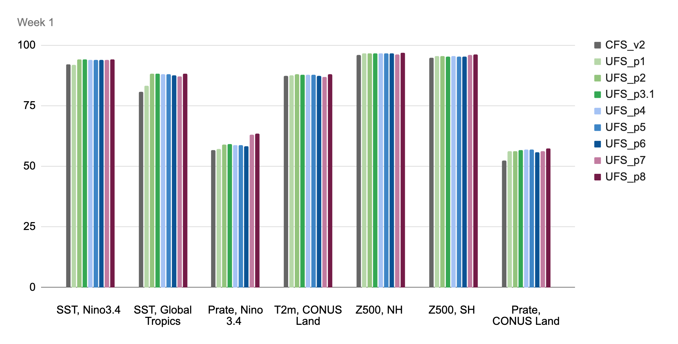
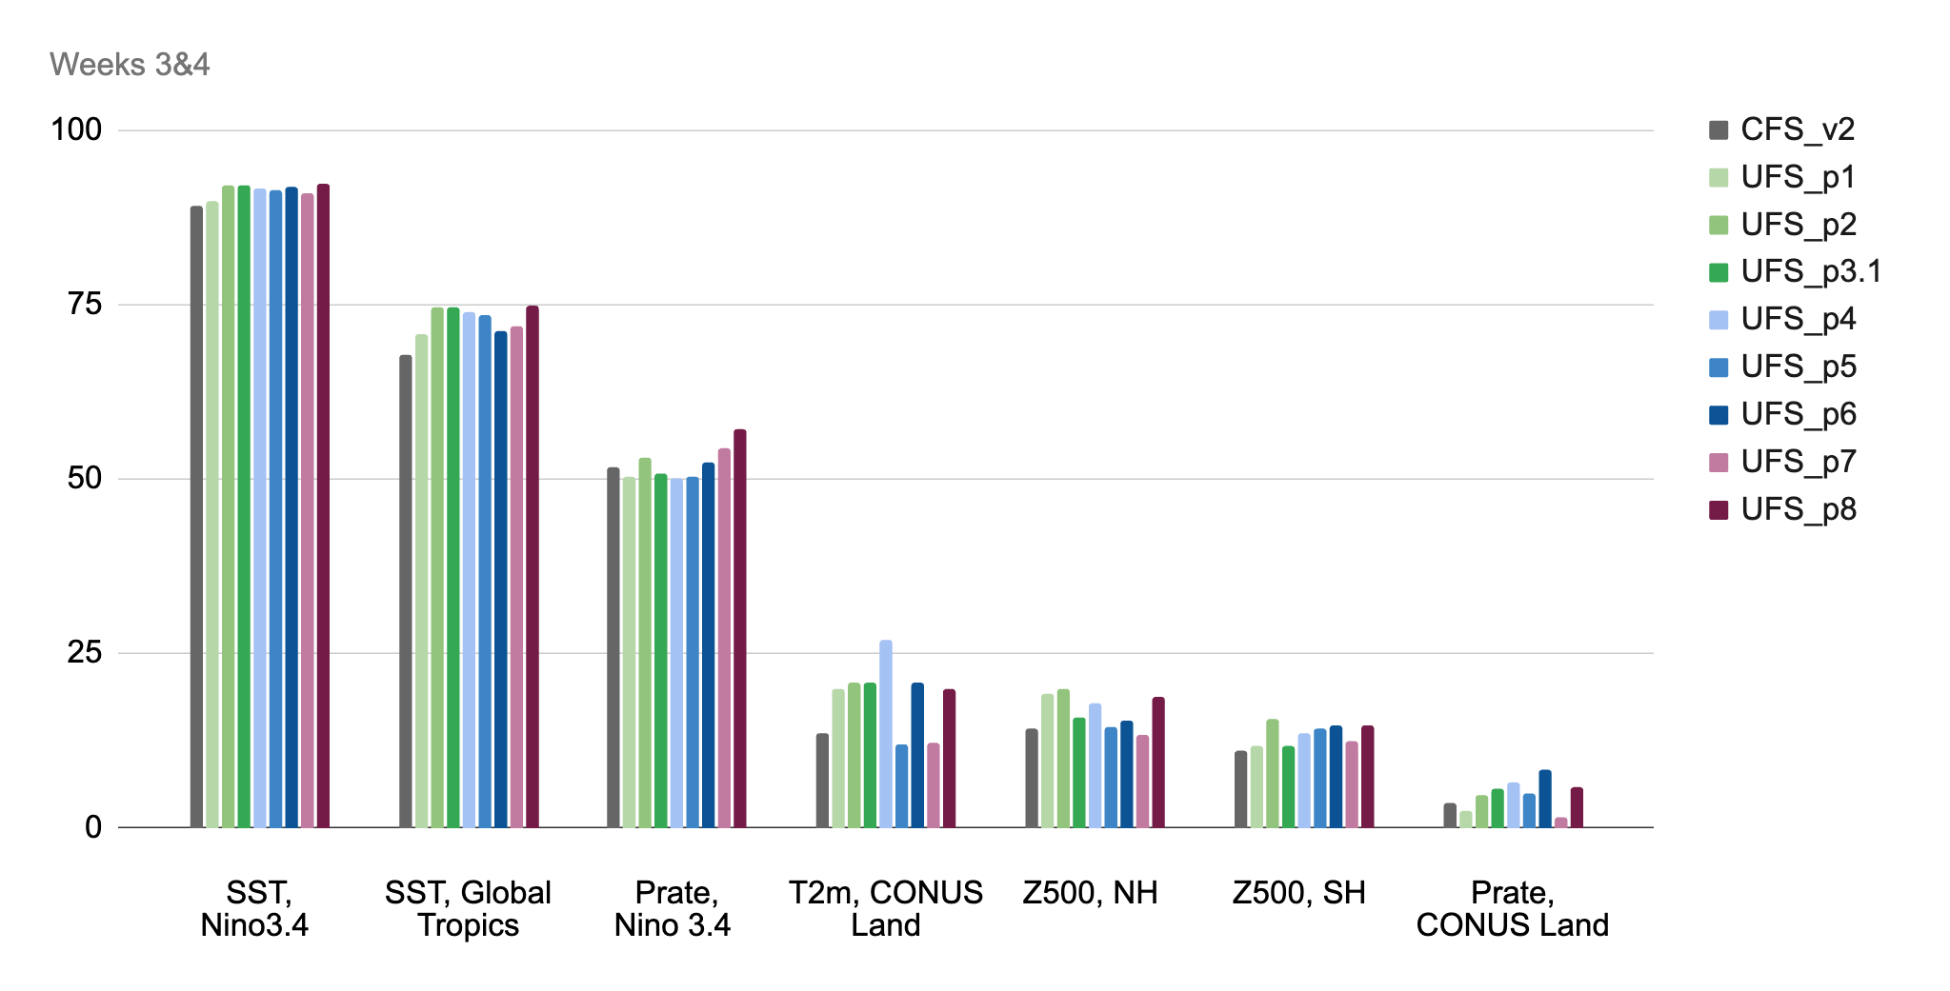
Anomaly correlations in P1-P8 Prototypes
AC: Global Tropics SST

Slide 5
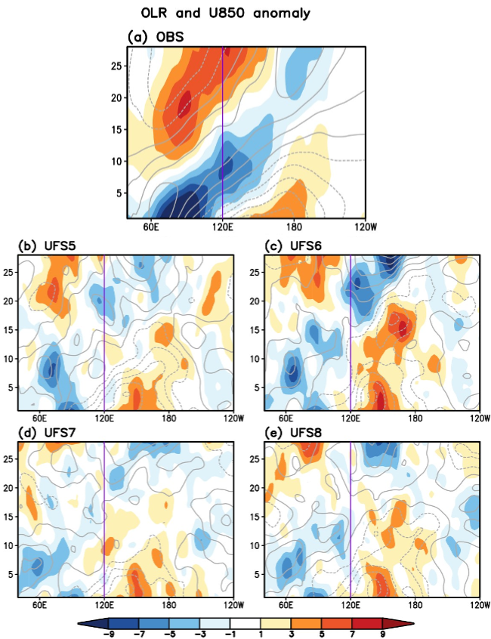
Madden Julian Oscillation
MJO prediction skill for P 5-8 reforecasts initialized with active MJO events during boreal winter (NDJFM).
MJO events initialized in phases 2 and 3.
Courtesy of Hyemi Kim

Slide 6
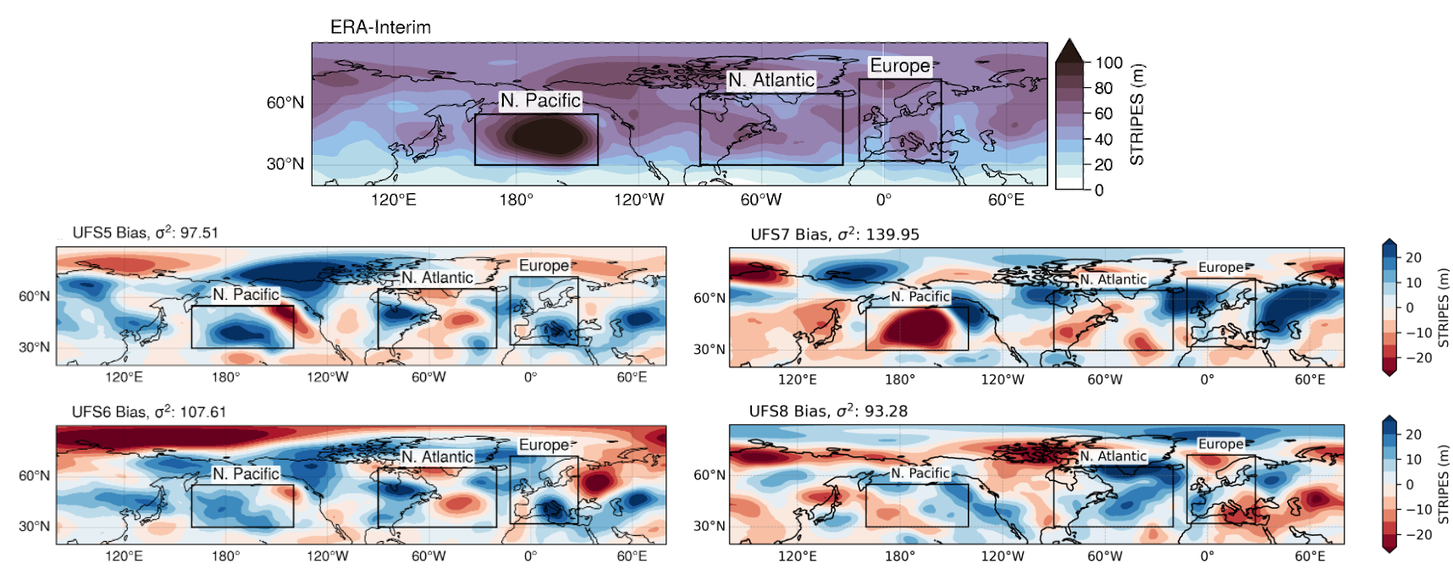
MJO Teleconnections

Slide 7
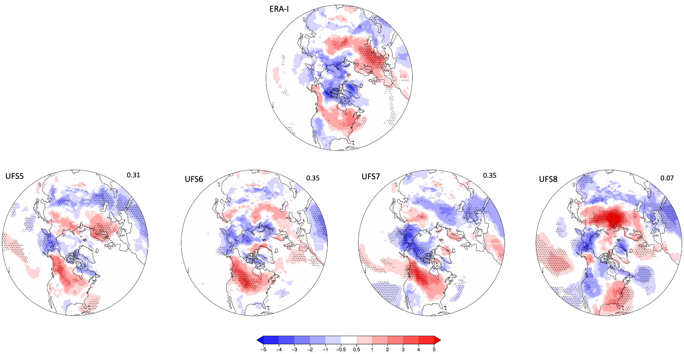
MJO Teleconnections to T2m
Week 3 after
MJO in phase 3
P5 - P7 capture the sign, amplitude, and approximate location of temperature anomalies. Over the North America the response is consistent with the positive NAO phase.
Changes in P8 degraded the response of T2m to MJO teleconnections. Over the North America, the response is similar to the negative PNA.

Slide 8
Progress towards GFSv17
Overall:
Improved skill (larger AC) for heights, winds, upper tropospheric temperature
MJO
Improved skill (larger AC and smaller RMSE)
Improved amplitude and propagation speed
Improved propagation across the Maritime Continent
Land
T2m biases improved over areas covered by high vegetation and grass
Reduced biases in the surface fluxes
Improved PBL height over the NH
Cycled experiments with weakly coupled DA system
Initial stage

Slide 9
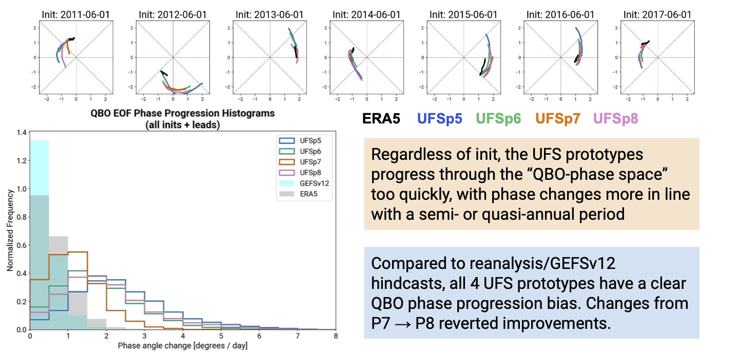
QBO
Courtesy of Zachary Lawrence and collaborators.

Slide 10
Progress towards GEFSv13
Overall
Improved skill compared to operational GEFSv12
MJO
Higher skill (RMM1+RMM2) than GEFSv12 for longer lead times (extend skill for 4-5 days)
Ensemble spread is slightly reduced
CONUS Precipitation
Week 1 bias: reduced dry bias over Central and Southeast compared to operational GEFSv12; increased slightly over the Northwest around the coastline
RPSS in week 3 and 4 over Central South slightly lower than in GEFSv12
SST
Reduced bias over the tropical oceans
Slightly increased bias over the NH midlatitudes

Slide 11
Model Evaluation Sub-Task Team
How to become involved?
Develop/Adapt diagnostic packages for process level evaluation of forecast data
Design and conduct numerical experiments addressing model errors and biases
Engage in international projects that coordinate modeling and observational efforts aiming to enhance the accuracy and reliability of predictive models. (e.g., ESMO/WGSIP/S2S Panel, ESMO/ WGNE, APARC)
Contact: Juliana Dias (Juliana.Dias@noaa.gov) and/or Cristiana Stan (cstan@gmu.edu)

