Slide 1
NOAA’s Seasonal Forecast System (SFS) Development Plan: A Community Modeling Approach to Increase Forecast Skill and to Meet User Needs
Yan Xue¹, Avichal Mehra ³, Philip Pegion⁴, Neil Barton ³, Jason Anderson¹, Kevin Garrett¹, Mark Olsen²
¹ NOAA NWS Office of Science and Technology Integration
² NOAA OAR Weather Program Office
³ NOAA NWS Environmental Modeling Center
⁴ NOAA OAR Physical Science Laboratory
NATIONAL WEATHER SERVICE
SUIFCW24, July 22-26, 2024

Slide 2
FY23 Congressional Appropriations → Funding
In response to the congressional appropriation, the Office of Science and Technology Integration (OSTI) in NOAA's NWS, and the Weather Program Office (WPO) in NOAA's Oceanic and Atmospheric Research (OAR) jointly established an SFS Application Team (AT), composed of participants from NCEP centers, OAR labs, NCAR and academia partners.
The SFS Project formally launched on October 1, 2023.
$5.0M
$7.1M
National Weather Service (NWS)
Oceanic & Atmospheric Research (OAR)
Development of Seasonal Forecast System (SFS)
Weather Program Office’s S2S Research Program

Slide 3
NOAA’s SFS Development Plan
Objectives:
Coupled reanalysis should provide balanced initializations across interfaces between coupled model components that maximize source of long-term predictability, e.g. from ocean, sea ice and land
Coupled model should minimize systematic drift from initial conditions and minimize false alarms for extreme events, e.g. overconfident in El Nino forecast
Ensemble forecasts should provide best estimation of uncertainties
Improvements in physics/dynamics and model components should reduce systematic biases and improve forecast skill
SFS infrastructure should provide critical support to model coupling, testing, evaluation and eventual transition to operations on both on-premise and cloud

Slide 4
SFS Development Plan: Major Goals
Frequency of above-normal
Develop SFSv1 as a replacement of the more than decade-old Climate Forecast System version 2 (CFSv2)
Address common errors in CFSv2 and NMME
MJO propagation across Maritime Continent
False ENSO alarms
Positive SST trend errors in tropical Pacific
Too frequent above-normal temperature forecast
Too infrequent below-normal temperature forecast
Release the coupled SFS system to the public
Release reanalysis & reforecast data sets to the community
NMME
OBS
Becker et al. 2022

Slide 5
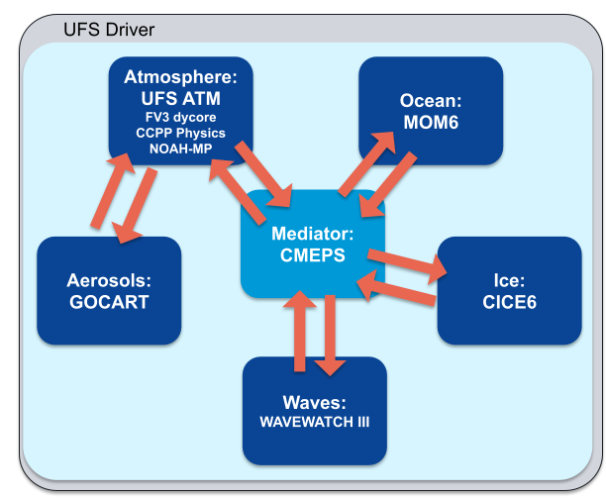
Unified Forecast System
UFS Research-to-Operations (UFS R2O) Project
Jointly supported by NWS/OSTI and OAR/WPO
Developing the next-generation global and regional forecast systems and transition to NOAA operations in FY23 and beyond
The Unified Forecast System (UFS) is a community-based coupled Earth modeling system, designed to support the Weather Enterprise and also be the source system for NOAA’s operations.
Community components in UFS
Model infrastructure: ESMF, NUOPC, CMEPS
Atmosphere model: FV3 dycore, CCPP Physics
Ocean model: MOM6
Ice model: CICE6
Wave model: WW3
Aerosol model: GOCART
Land model: Noah-MP
Data assimilation: Joint Effort for Data assimilation Integration (JEDI)
Each component has its own authoritative repository.
MRW/S2S Applications:
GFSv17, GEFSv13, SFSv1

Slide 6
SFS Application Team: Ten Focus Areas
Physics & Dynamics
Ensemble Development
Coupled DA and Obs. Processing
Land
SFS Design, Testing and Analysis
Reanalysis & Reforecast
Ocean, Sea Ice and Waves
Verification & Product Development
Atmospheric Composition
Process-Level Evaluation (GFS/GEFS/SFS)
SFS Infrastructure and
Cloud Strategy
We seek community inputs and collaboration!

Slide 7
SFS Design, Testing and Analysis
(Leads: Neil Barton, Phil Pegion, Avichal Mehra)
SFSv1 - Planned Baseline Experiments
 | Spatial Resolution |  |  | Ensemble | Duration
 | Atm/Land/Aerosols | Ocn/Sea Ice | Waves | Members | Time period | Starts (Month) | Forecast length
Phase I | 100 kms (1 deg) | 1 deg | 1 deg | 11 | 1994-2016 (2023) | 2 (May, Nov) | 4 months
Phase II | 100 kms (1 deg) | 1 deg | 1 deg | 21 | 1993-2016 (2023) | 2 (May, Nov) | 12 months
Phase III | 50 kms (1/2 deg) | 1/4 deg | 1/4 deg | 21 | 1993-2023 | 2 (May, Nov) | 12 months
The model configuration would be frozen at the end of Phase III, following which the reanalysis and reforecasts will be produced and realtime and retrospective experiments will be performed.

Slide 8
Physics and Dynamics Improvements
(Leads: Fanglin Yang, Lisa Bengtsson, Ligia Bernardet)
Main Tasks:
Assess the suitability of hydrostatic dycore option for SFS
Reduce cloud and radiation biases in the tropics
Improve the MJO, QBO, ENSO, polar jet streams and stratosphere/troposphere coupling
Improve the boundary layer processes and shallow cumulus
Improve the mixed-phase clouds and radiation balance in the Arctic
Develop aerosol-cloud interaction algorithm and improve aerosol-radiation interactions
Update historical trace gas (e.g. CO2) and volcanic background aerosol datasets
Improve O3 and water vapor predictions in the upper atmosphere

Slide 9
Land Model Improvement and Land Initialization
(Leads: TBD, Clara Draper)
Main Tasks:
Optimize existing land physics
Optimize phenology, snow, agriculture and soil composition
Introduce new land physics
Medium-complexity urban canopy model
Improve representation of hydrologic cycle
Explore advancements in couplings
Land-atmosphere, land-composition and land-ocean
Land initialization (SFSv1)
Real-time: Operational coupled DA for GFSv17/GEFSv13
Reforecast: Offline Noah-MP forced with ERA5 bias-corrected to match the climatology of the operational GFSv17/GEFSv13 I.C.

Slide 10
Ocean and Sea-Ice Model Improvements
(Leads: Shan Sun, Neil Barton, Wanqiu Wang)
Main Tasks:
Test sensitivities of SFS skill to different ocean and sea ice initial conditions
Increase near surface vertical resolution in the ocean model to reduce SST biases
Mitigate deficiencies in oceanic circulations (e.g. Atlantic Meridional Overturning Circulation)
Improve coupling between CICE6 and MOM6 by adopting the C-grid
Add the ability to couple aerosols to CICE; Test different melt-pond schemes in CICE
Explore economical alternatives to the costly wave model

Slide 11
SFS Infrastructure and Cloud Strategy
(Leads: Rahul Mahajan, Jun Wang)
Main Tasks:
Implement exchange grids in CMEPS for computing air-sea fluxes
Extend CMEPS diagnostic capabilities and test global energy conservation
Develop management systems for running prototype experiments
Creat regression test and integrate SFS features into UFS weather model
Extend GFSv17 and GEFSv13 global-workflow to SFSv1 configurations
Port the infrastructure to various cloud platforms (AWS, GCP, Azure)
Support for reanalysis, reforecasts, retrospective and real-time experiments
Notes:
Figure upper right: SST from current model and SST differences when computing flux on Atm grid, ocean grid and exchange grid.
Figure middle right: The run time (in s) of atm, ocn and ice at slow coupling steps in a coupled test. The sparks are the IO time.

Slide 12
We welcome feedback and seek collaboration!
Contact: Yan.Xue@noaa.gov
NOAA’s Subseasonal and Seasonal Applications Workshop:
Toward Increasing Collaborations among Users, Modelers and Researchers
SFS Development Plan
Workshop Date: Sep 4-6, 2024
Location: College Park, MD, with remote option available
In-Person Registration deadline: August 20, 2024
Virtual Attendance Registration deadline: August 28, 2024

Slide 13
SFS Application Team (Co-Leads: Neil Barton, Phil Pegion)
SFS Design, Testing and Analysis (Leads: Neil Barton, Phil Pegion, Avichal Mehra)
Physics and Dynamics Improvements (Leads: Fanglin Yang, Lisa Bengtsson, Ligia Bernardet)
Land Model and Land Initialization Improvement (Leads: TBD, Clara Draper)
Ocean, Waves and Sea-Ice Model Improvements (Leads: Shan Sun, Neil Barton, Wanqiu Wang)
Aerosol and Atmospheric Composition Improvements (Lead: Ivanka Stajner)
Coupled Ensemble Strategies, Design and Development (Leads: Philip Pegion, Neil Barton)
Coupled Data Assimilation Developments and Observation (Leads: Daryl Kleist, Sergey Frolov)
SFS Reanalysis & Reforecast (Leads: Sergey Frolov, Daryl Kleist, Jeff Whitaker, Phil Pegion)
SFS Infrastructure and Cloud Strategy (Leads: Rahul Mahajan, Jun Wang)
Product Developments & Verification (Leads: Wanqiu Wang, Jason Levit, Tara Jensen)

Slide 14
Global Forecast System v17 Upgrade
(Deterministic Forecast up to 16 days)
 | GFSv16: Implementation Mar 2021 | GFSv17: Target Implementation Mar 2026
Model | FV3/Noah WW3 (one-way coupling) | FV3/Noah_MP MOM6/CICE6/WW3 (two-way coupling)
Resolution | C786L127 (13km, 80km top) | C786L127 or C1152L127 (13km or 9km, 80km top)
Physics | GFDL MP, sa-TKE-EDMF, non-orographic GWDs | Thompson MP, CA, UGWD, tuning of convection, surface and PBL physics schemes (See Slide 10 for details)
Forecast Cadence | GSI, GLDAS 16 days from 00Z, 06Z, 12Z and 18Z | Weakly Coupled DA (GSI, JEDI Ocean/Sea Ice, JEDI Snow) 16 days from 00Z, 06Z, 12Z and 18Z

Slide 15
Global Ensemble Forecast System v13 Upgrade
(Ensemble Forecast up to 48 days)
 | GEFSv12: Implementation Sep 2020 | GEFSv13: Target Implementation Mar 2026
Model | FV3/Noah WW3/GOCART (one-way coupling) | FV3/Noah_MP MOM6/CICE6/WW3/GOCART (two-way coupling)
Resolution | C384L64 (~25km, 55km top) | C384L127 (~25km, 80km top)
Physics | GFDL MP, Stochastic physics (SPPT, SKEB) | GFSv17 physics + Stochastic physics (SPPT, SKEB, ocean)
Realtime (31 members) | GSI, GLDAS 16 days (06Z, 12Z and 18Z), 31 members 35 days (00Z), 31 members | Weakly Coupled DA (GSI, JEDI Ocean/Sea Ice, JEDI Snow) 16 days (06Z, 12Z and 18Z), 31 members 48 days (00Z), 31 members
31-years Reforecast (6/11 members) | GEFSv12 reanalysis (CFSR) in 2000-2019 (1989-1999) 16 days, every day, 5 members 35 days, every Wednesday, 11 members | Replay to ERA5 Atmos, ORAS5 Ocean/Sea Ice, Noah_MP spin up, snow DA in 1994-2024 16 days, every day, 6 members 48 days, every Monday, Thursday, 11 members

Slide 16
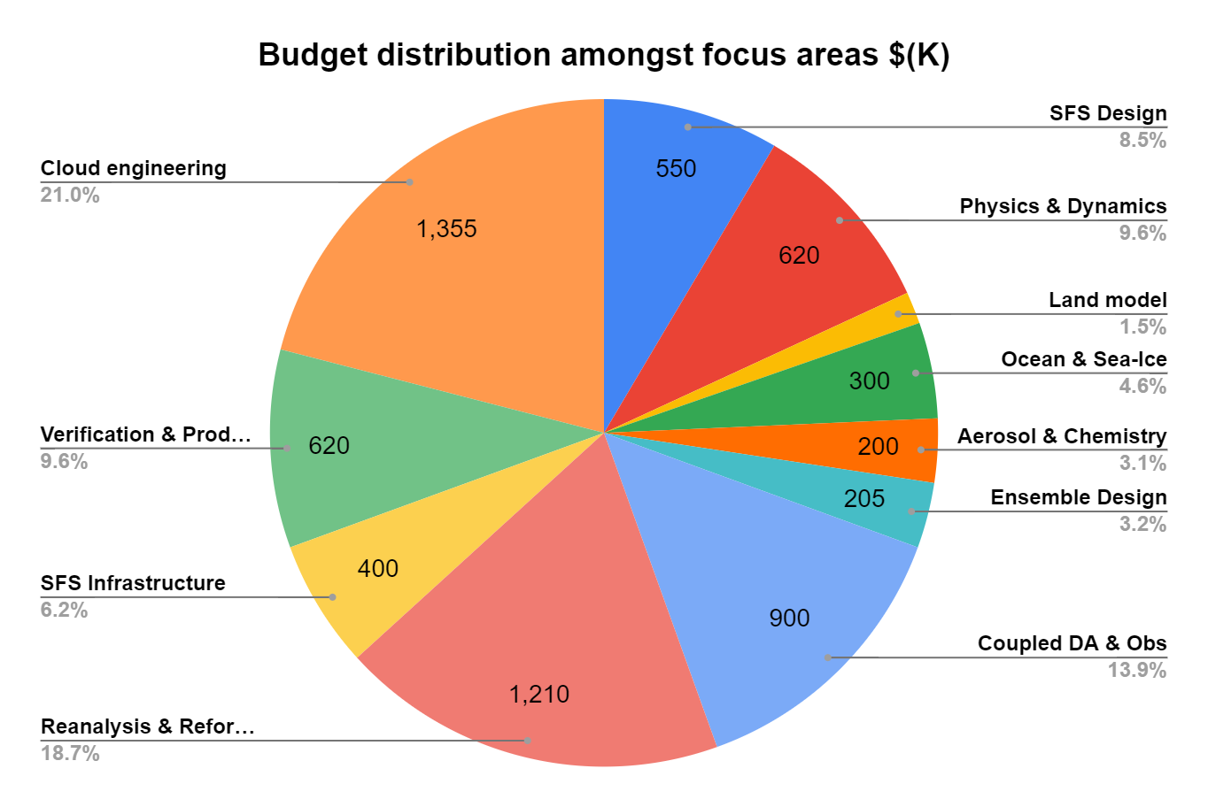
FY23 Budget for SFS Development:
$5.0M (NWS)
$1.46M (OAR)
PSL

Slide 17
NWS Weather, Subseasonal, Seasonal Forecast Systems:
Transition to Global Coupled UFS-based Systems
Current Systems
GFS v16 (since March 2021)
Weather (0-14 days), deterministic, no coupling with ocean/ice. FV3
GEFS v12 (since September 2020) Subseasonal (0-35 days), ensemble, no coupling with ocean/ice. FV3
CFS v2 (since March 2011)
Seasonal (0-9 months), ensemble,
coupled with ocean/ice. Spectral Atm/MOM4 Ocean/SIS1 Sea ice
Future UFS Systems
GFS v17
(T2O Phase)
GEFS v13
(T2O Phase)
SFS v1
(R2O Phase)
UFS System Configuration

Slide 18
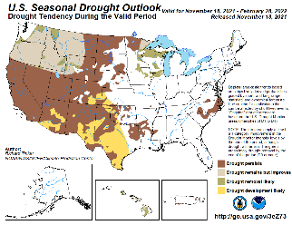
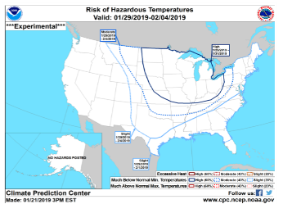
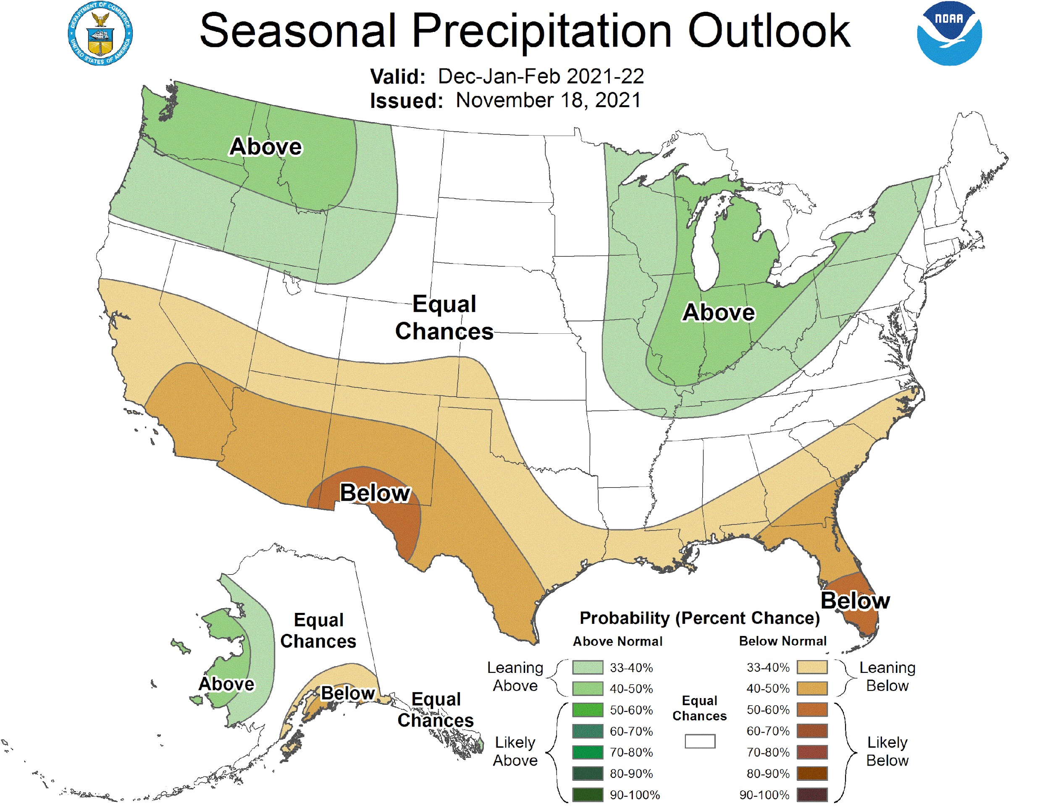
NWS Subseasonal-to-Seasonal Forecast
Temperature and Precipitation Outlooks (CONUS, AK, HI)
Week 2, Week 3-4, Monthly, and Seasonal
Monthly and Seasonal Drought Outlooks (CONUS, AK, HI)
US Hazards Outlook
Week 2 extremes of temperature, precipitation, and wind
Global Tropics Hazard Outlook
Weeks 2-3 extremes of temperature and precipitation, and potential of tropical cyclones
Seasonal Hurricane Outlook
ENSO Prediction
Arctic Sea Ice Prediction
Weeks 1-6, Monthly, and Seasonal

