Slide 1
A Unified Representation of Convective Mixing on Subgrid Scales in the UFS
Jian-Wen Bao, Sara Michelson, Haiqin Li, Sungsu Park
In collaboration with
Stefan Tulich, I-Kuan Hu, Lisa Bengtsson
The 2024 UIFCW
July 24, 2024

Slide 2
Two potential issues in the representation of
subgrid convection in the UFS
A theoretical ambiguity in making conventional subgrid convection parameterization schemes scale aware for applications at the so-called gray-zone resolutions
The ad hoc separation of vertical scales of parameterization subgrid convection into, e.g., deep/shallow and PBL convection

Slide 3
Outline of this presentation
Ambiguity (physical inconsistency) in scale-aware convection schemes in the UFS
Full prognostic system for the mass-flux parameterization
Conventional parameterization as an asymptotic limit: steady plume model
A pathway for avoiding the ambiguity: A unified scale-adaptive plume perspective
Preliminary numerical examples in the UFS
Summary

Slide 4
A widely-used approach for implementing scale-aware convection schemes (Arakawa et al., 2011)
For the case of a top-hat PDF, we can show that
$\overline{w^{′}ψ^{′}}=σ(1−σ)ΔwΔψ$, (1)
where
$\overline{( )}=σ{( )}_{c}+\left(1−σ\right)\left(\tilde{ }\right)$and $Δ\left( \right)≡{\left( \right)}_{c}−$ , (2)
σ is the fractional area covered by the updraft, an overbar denotes a domain mean, the subscript c denotes a cloud value, and a tilde denotes an environmental value.
Define ${(\overline{w^{′}ψ^{′}})}_{E}$ as the flux required to maintain quasi-equilibrium. The closure assumption used to determine σ is
$σ=\frac{{(\overline{w^{′}ψ^{′}})}_{E}}{{ΔwΔψ+(\overline{w^{′}ψ^{′}})}_{E}}$ . (3)
The quantities on the right-hand side of (3) are expected to be independent of σ . Eq. (3) is guaranteed to give
$0≤σ≤1$ . (4)
By combining (3) and (1), we obtain
$\overline{w^{′}ψ^{′}}={(1−σ)}^{2}{(\overline{w^{′}ψ^{′}})}_{E} .$ (5)
In the SAS scheme, ${(\overline{w^{′}ψ^{′}})}_{E}$is specified by a conventional parameterization formulation with a steady/diagnostic cloud model.
Adapted from a class note of Prof. Dave Randall

Slide 5
Ambiguity in implementing scale-aware convection schemes
A theoretical explanation for the observed smallness of the fractional area covered by cumulus updrafts was provided by Bjerknes (1938, QJRMS, 64, 325-330).
Convection takes place physically by rapid rising motion in the cloudy region, and slow sinking motion in the clear region.
In a grid box, mass conservation dictates that rapid rising motion and slow sinking motion can only be achieved physically, for a given value of ${(w}_{c}−\tilde{w})$, by making the updraft narrow, and the downdraft broad, i.e., $σ≪1$.
Adapted from Arakawa et al. (2011, ACP)

Slide 6
Ambiguity in implementing scale-aware convection schemes
The conventional convection parameterization using a steady cloud model for full adjustment to maintain quasi-equilibrium in the gray-zone resolution: (a) inconsistent with the assumption of $σ≪1$, and (b) coarse-graining statistics only relevant to deep convection.
A good cloud model to determine $(ψ_{x}−\overline{ψ})$ and a reasonable closure to determine the magnitude of${(\overline{w′ψ′}) }_{E}$: What are practical metrics for being “good“ and “reasonable”?
Adapted from Arakawa et al. (2011, ACP)

Slide 7
Full prognostic system
All the prognostic equations of atmospheric motion can be summarized into the following form:
$$\frac{∂}{∂t}φ+∇∙uφ+\frac{1}{ρ}\frac{∂}{∂z}ρwφ=F$$
for an arbitrary prognostic variable $φ$.
Parameterization: Statement of the problem
$\frac{∂}{∂t}\overline{φ}+\overline{∇}∙\overline{uφ}+\frac{1}{ρ}\frac{∂}{∂z}ρ\overline{wφ}=Q$,
where $Q$ is the so-called apparent source defined in terms of the sub-scale variables and resolved forcing as $Q=−\overline{∇∙u^{′}φ^{′}}−\frac{1}{ρ}\overline{\frac{∂ρw^{′}φ^{′}}{∂z}}+\overline{F}$.

Slide 8
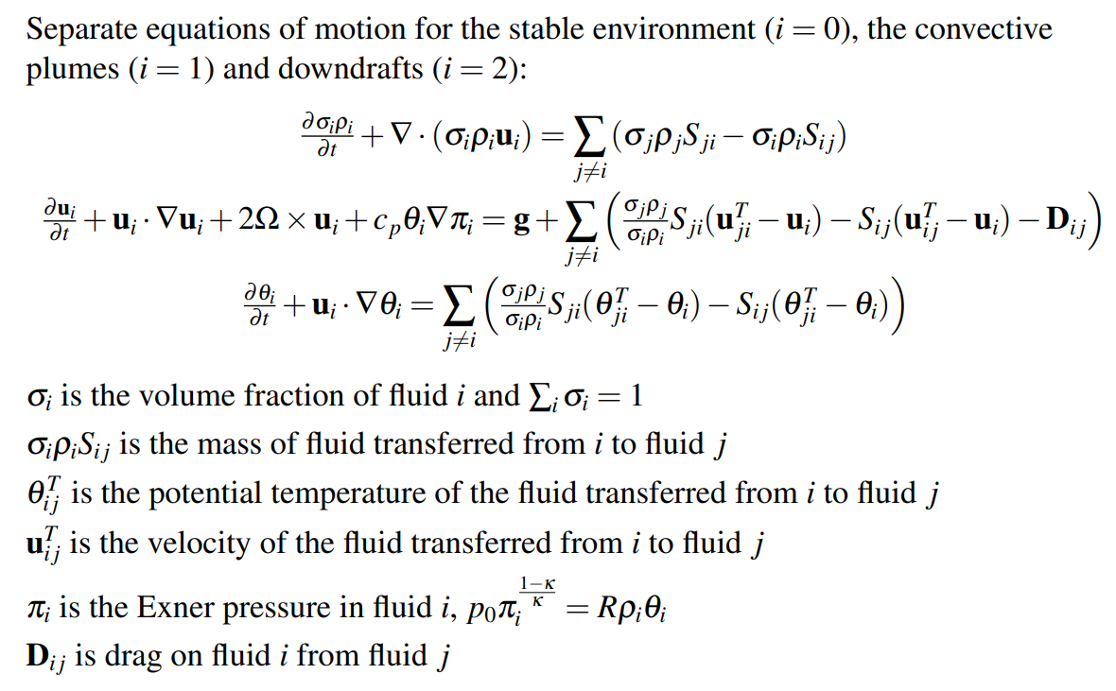
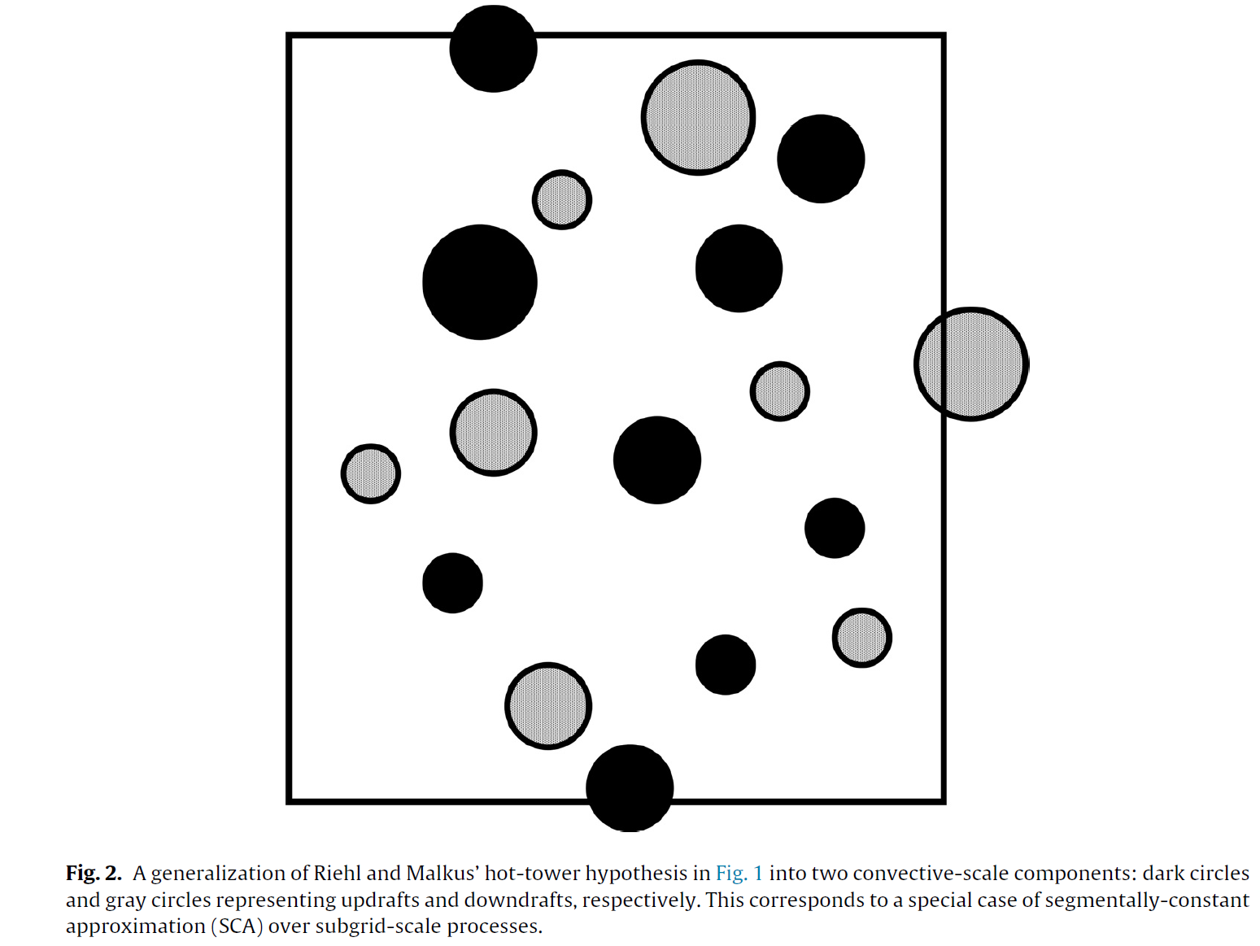
Segmentally-constant approximation:
Multi-fluid system
From Yano (2014)
From Weller et al. (2020)

Slide 9
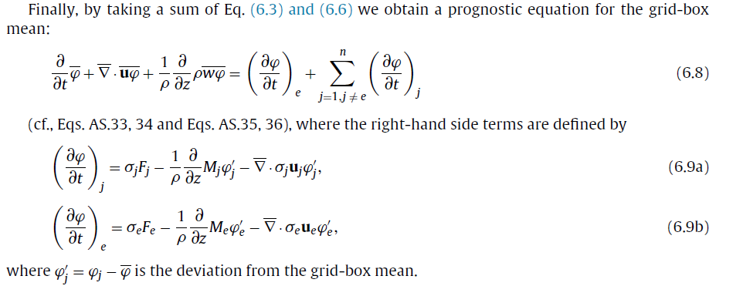
Mass flux and separation of convection and environment
From Yano (2014, Dynamics of Atmospheres and Oceans )

Slide 10
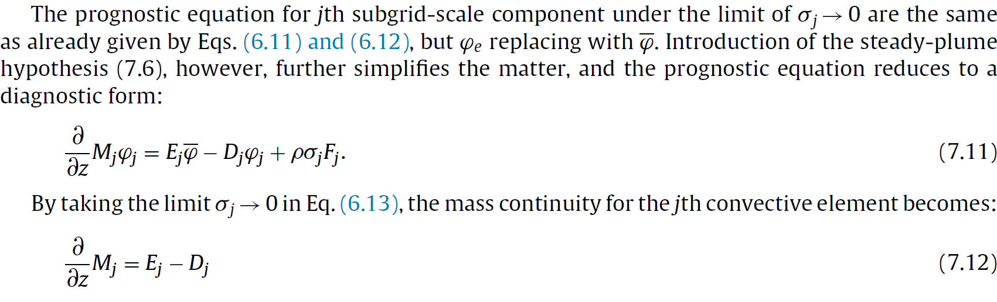
Conventional formulation as the asymptotic limit of
$\sum_{i}{σ_{i}}=σ≪1$
That is, in a conventional parameterization scheme with a steady/diagnostic cloud model in which the mass conservation is expressed by (7.12), $σ≪1$ is assumed.
From Yano (2014, Dynamics of Atmospheres and Oceans )

Slide 11
A pathway for avoiding the ambiguity:
A unified scale-adaptive concept
by Park (2014)

Slide 12
In Contrast to the Conventional Formulation
Conventional formulation
The convection scheme simulates the actual convective motion on the subgrid scale.
The model grid mean vertical velocity is defined in terms of the multi-fluid average by
Scale-adaptive formulation
The convection scheme simulates unresolved convective motion and treats it as the subfilter/unresolved solution of the model relative to the filtered/resolved solution.
The model grid mean vertical velocity is treated as the filtered solution of the model, i.e.,
$\overline{w}=(1−σ){\overline{w}}_{env}+σ{\overline{w}}_{con}$ (${\overline{w}}_{con}≥0,{\overline{w}}_{env}≈{\overline{w}}_{model} when σ≪1)$
$$\overline{w}={\overline{w}}_{model}$$

Slide 13
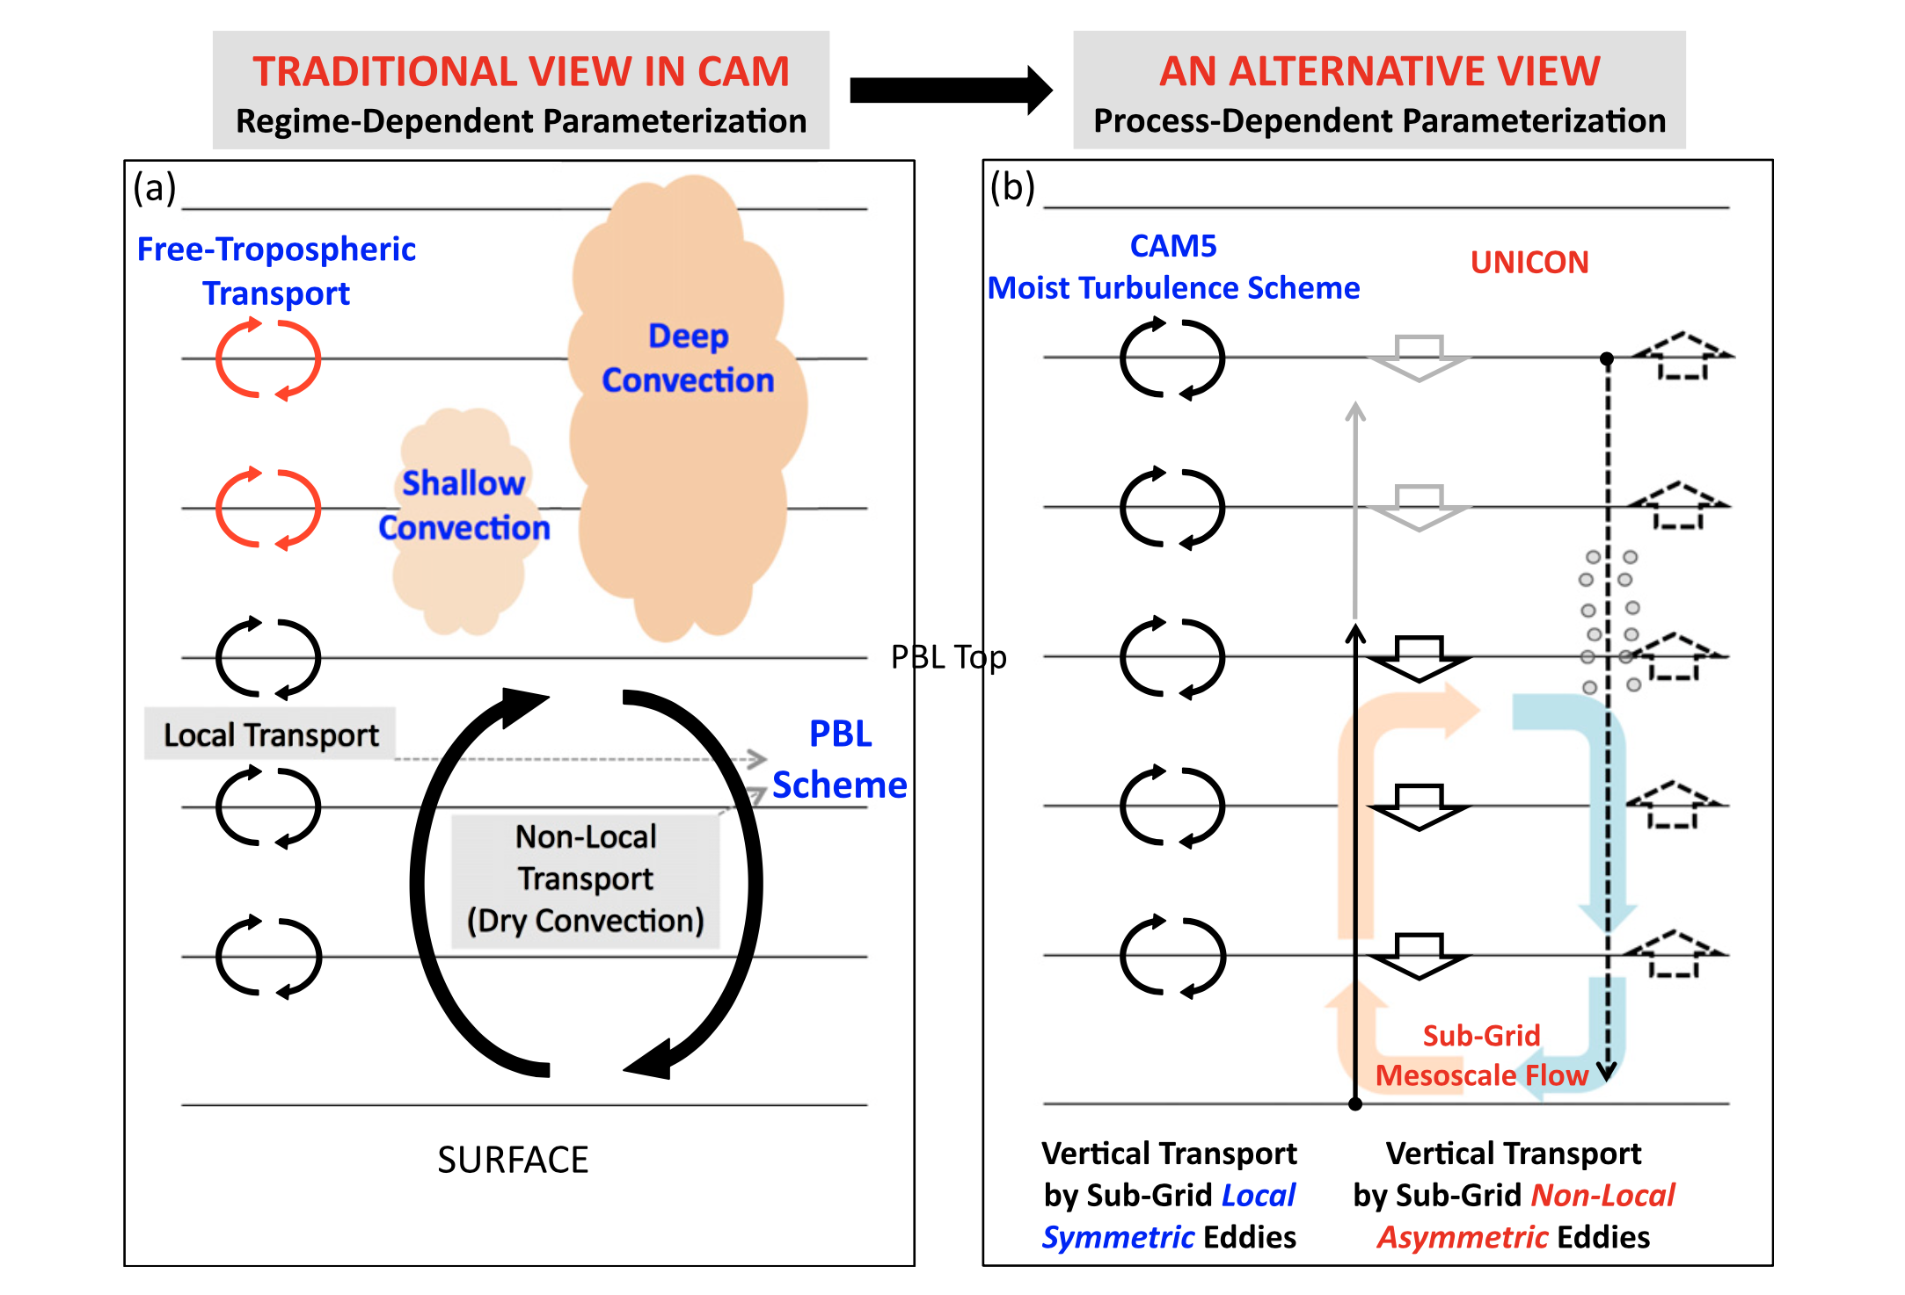
A Unified Plume Model for Process-Dependent Parameterization
Unified Plume Model
Adapted from Park (2014)

Slide 14
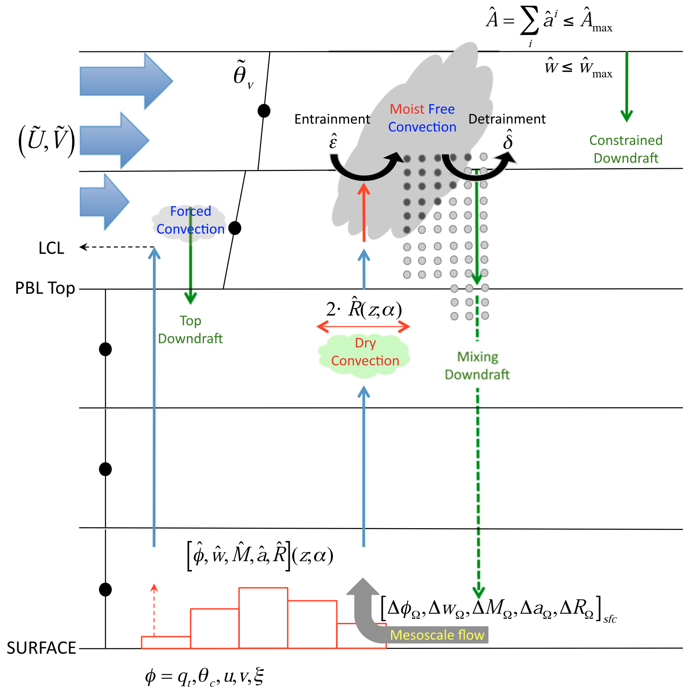
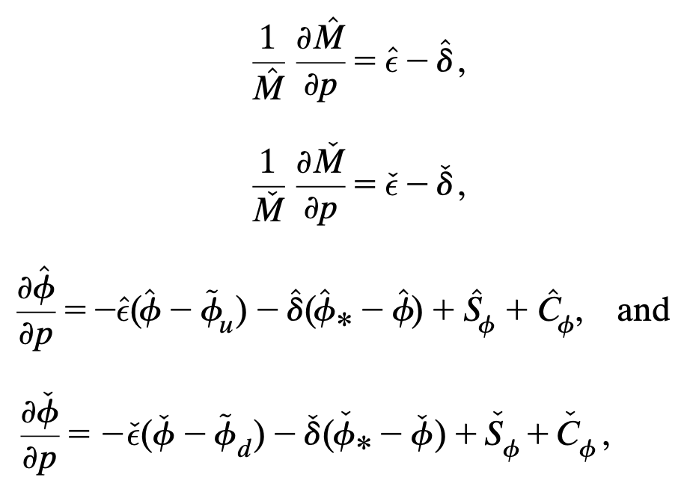
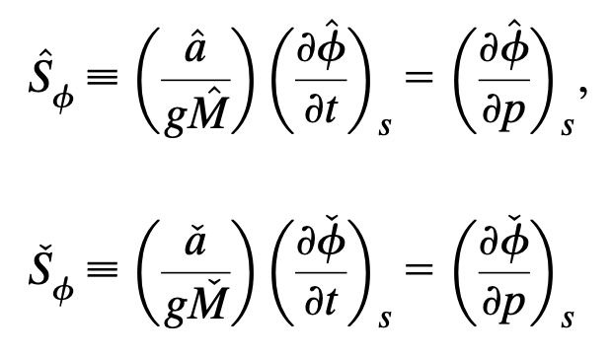
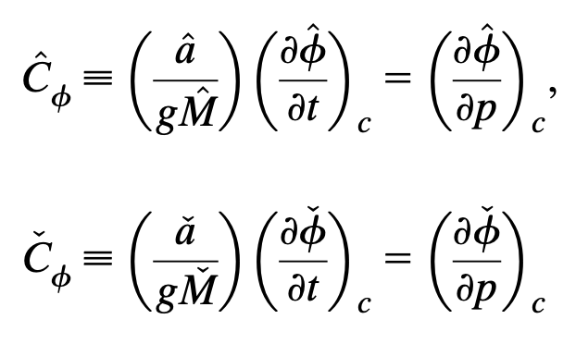
Governing Equations
Adapted from Park (2014)

Slide 15
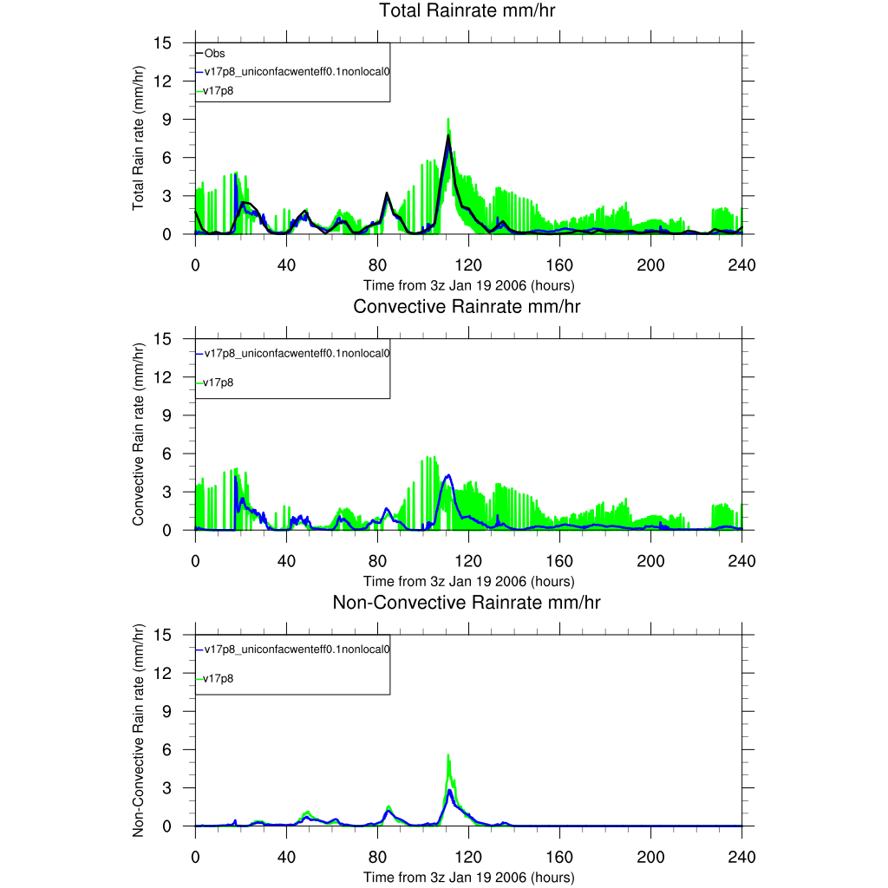
A case of a 10-day period during the Tropical Warm Pool – International Cloud Experiment (TWP-ICE)

Slide 16
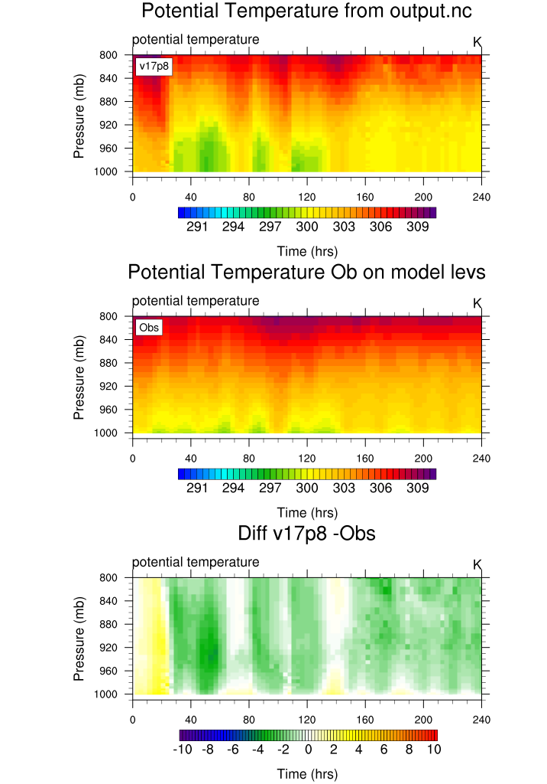
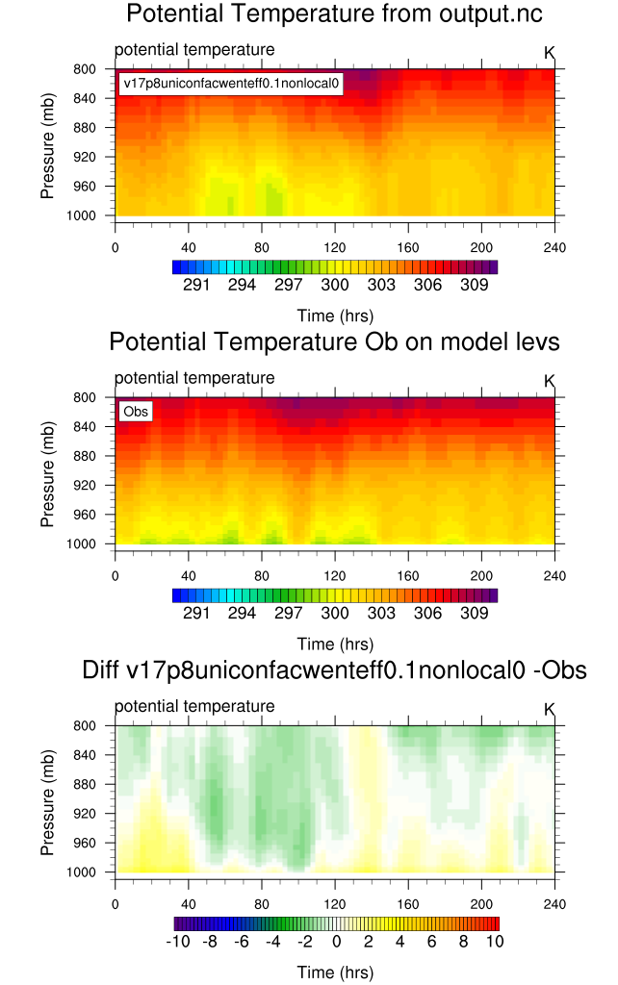
Potential temperature: GFSv17P8 run
Potential temperature: UNICON run
Diff: GFSv17p88-Obs
Diff: Unicon-Obs

Slide 17
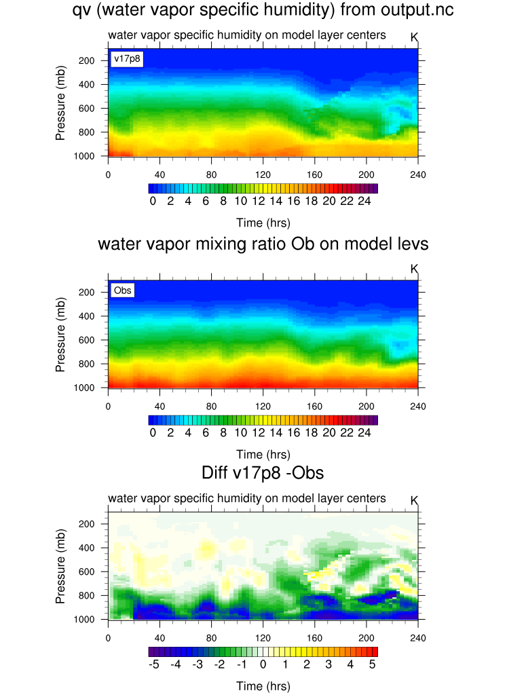
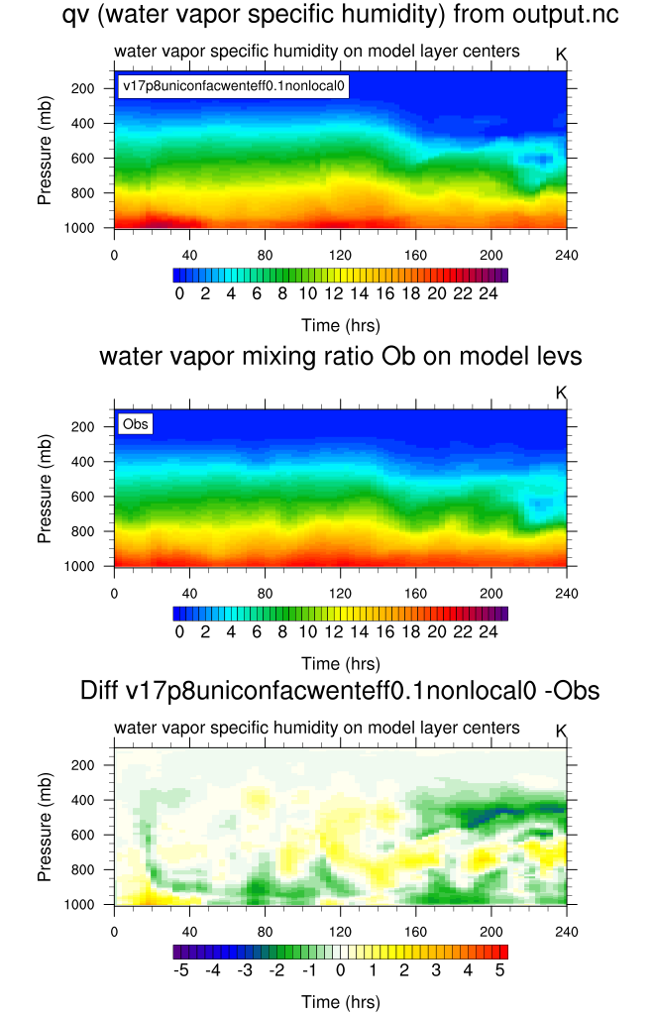
Specific humidity: GFSv17P8 run
Specific humidity: UNICON run
Obs
Obs
Diff: GFSv17p8-Obs
Diff: Unicon-Obs

Slide 18
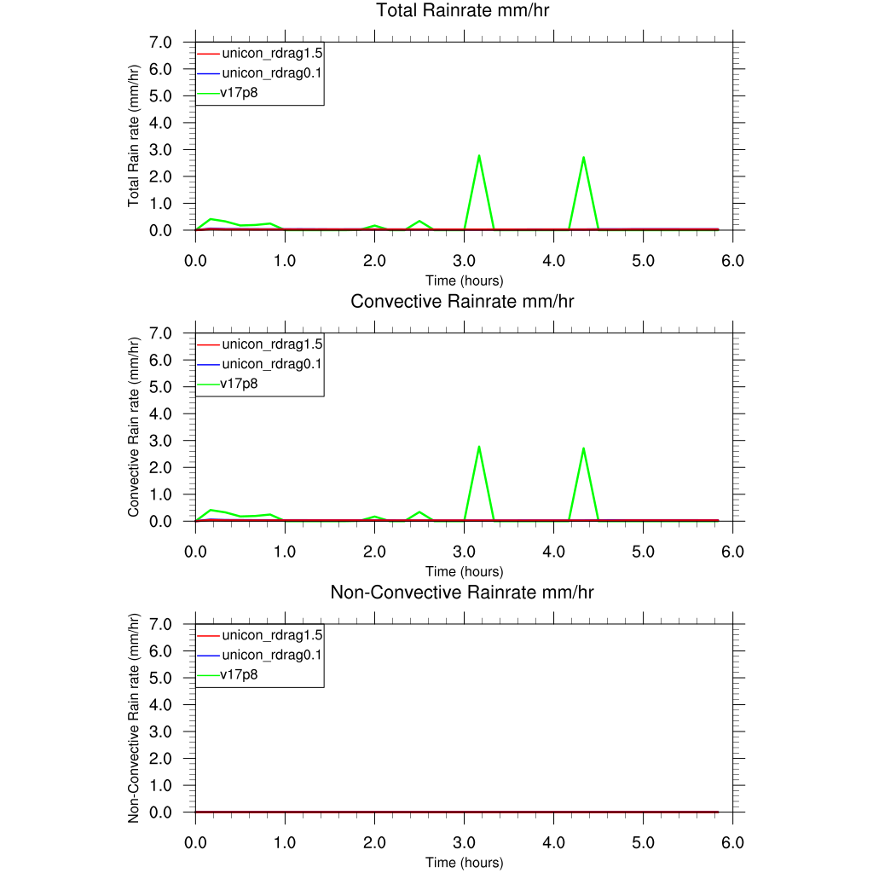
The case of the undisturbed BOMEX period (Siebesma and Cuijpers 1995)

Slide 19
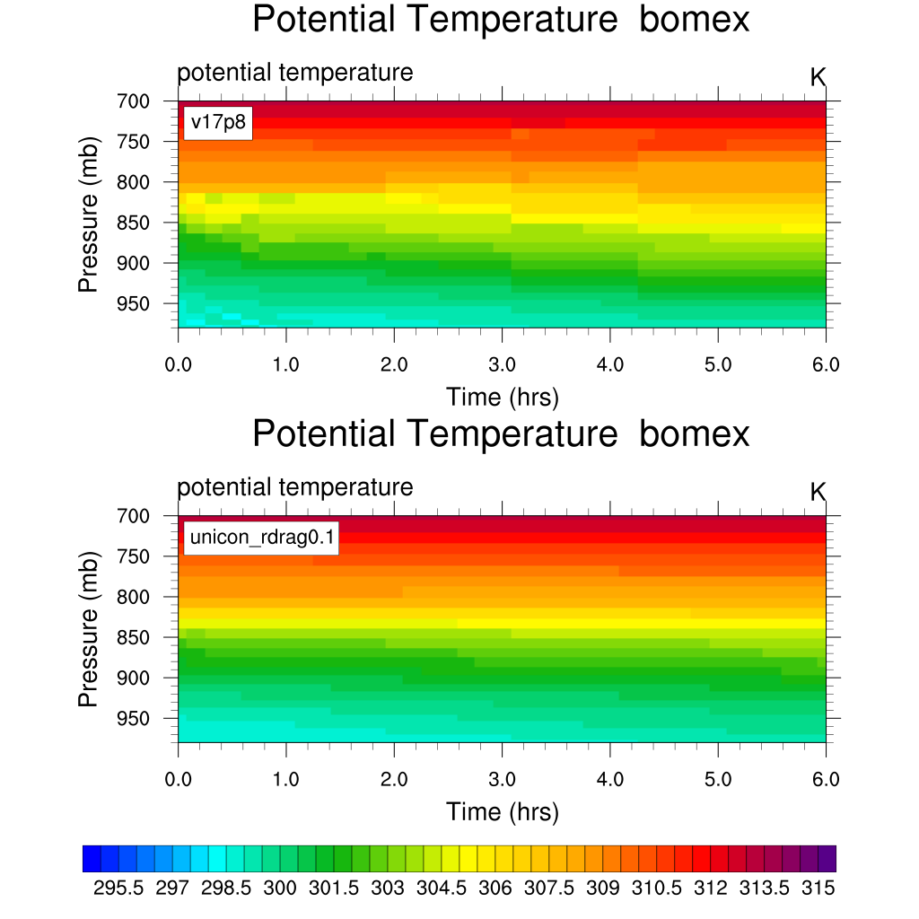
Potential temperature: GFSv17P8 run
Potential temperature: GFSv17P8 run
Potential temperature: UNICON run
Potential temperature: UNICON run

Slide 20
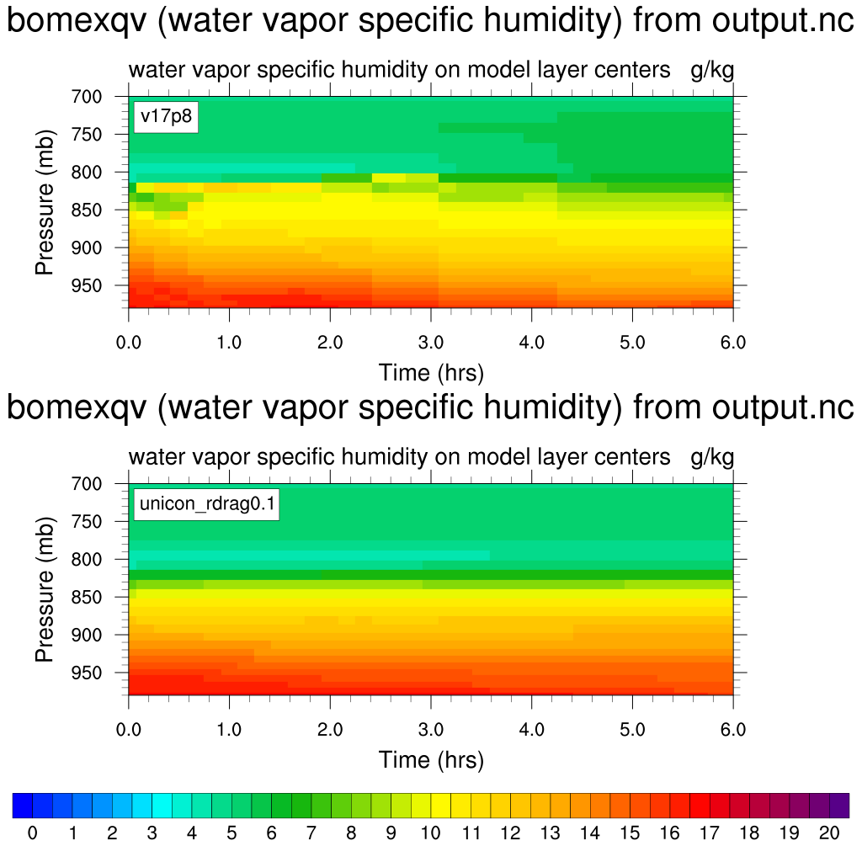
Specific humidity: GFSv17P8 run
Specific humidity: GFSv17P8 run
Specific humidity: UNICON run
Specific humidity: UNICON run

Slide 21
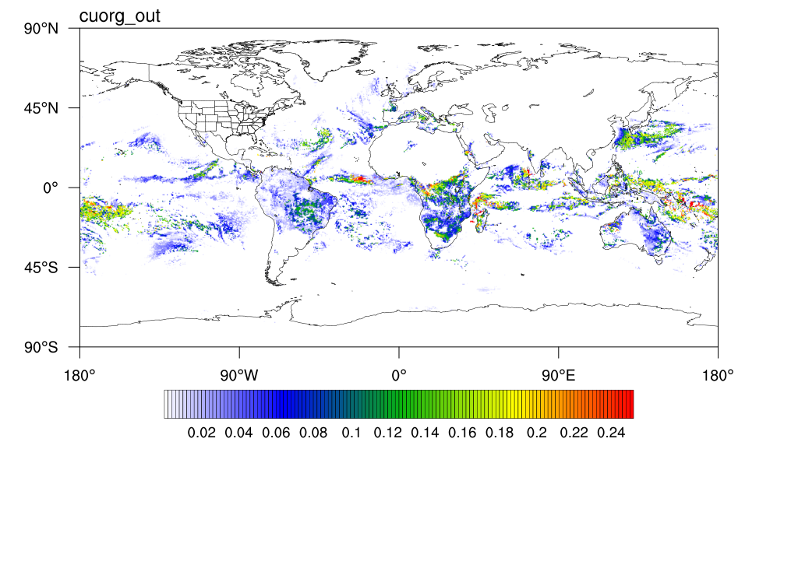
GFSv17P8 Run
UNICON Run: Cold Pool Fraction
UNICON Run

Slide 22
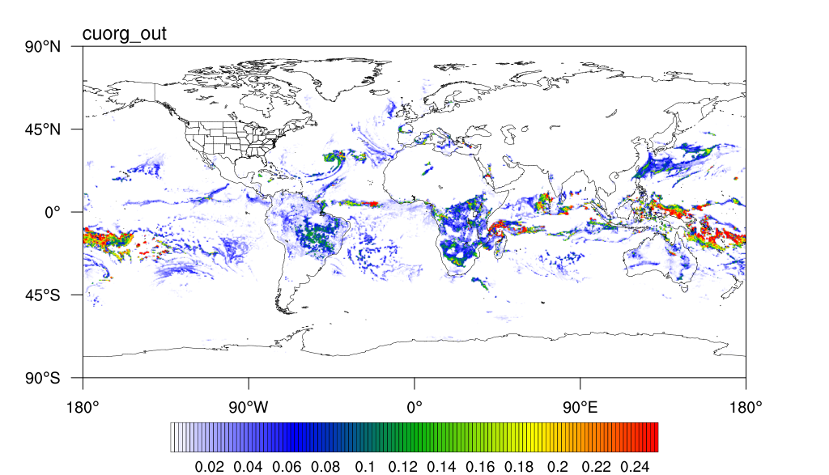
GFSv17P8 Run
UNICON Run: Cold Pool Fraction
UNICON Run

Slide 23
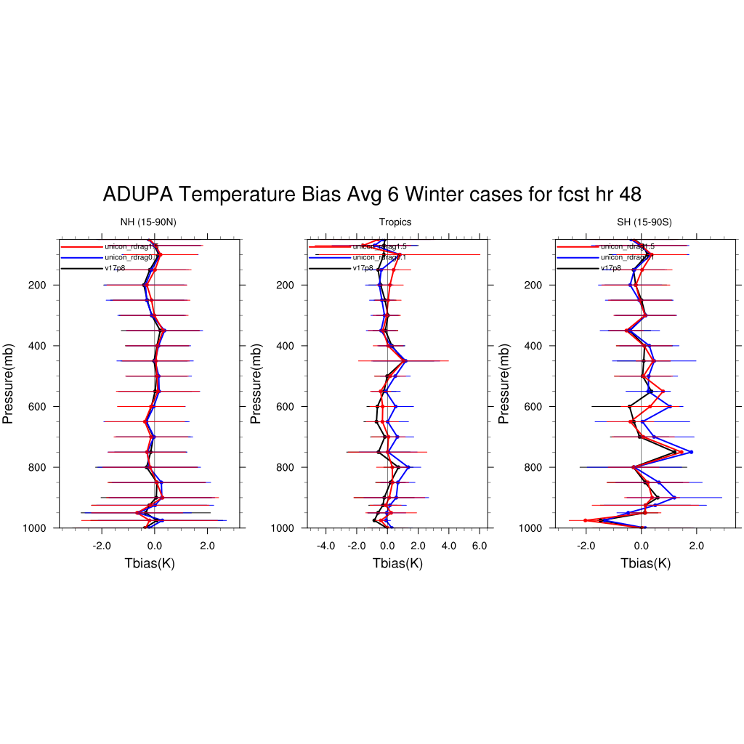
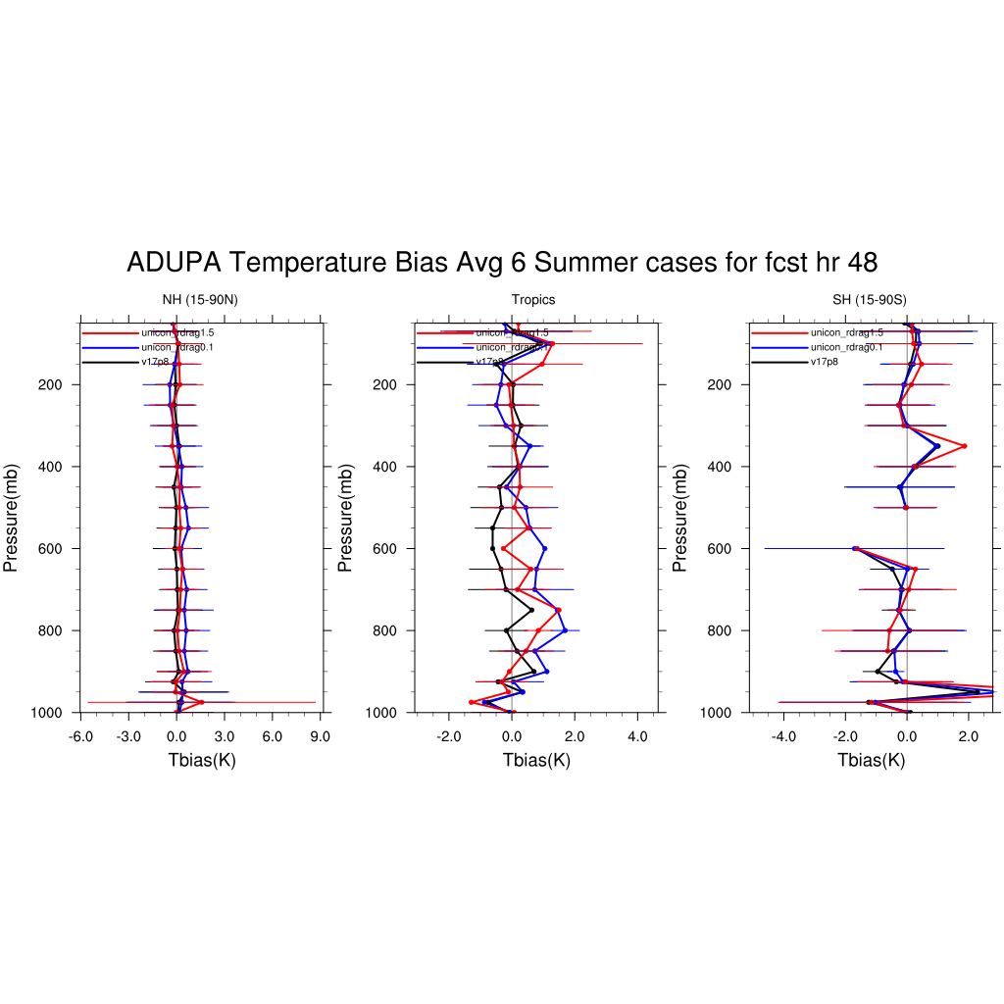
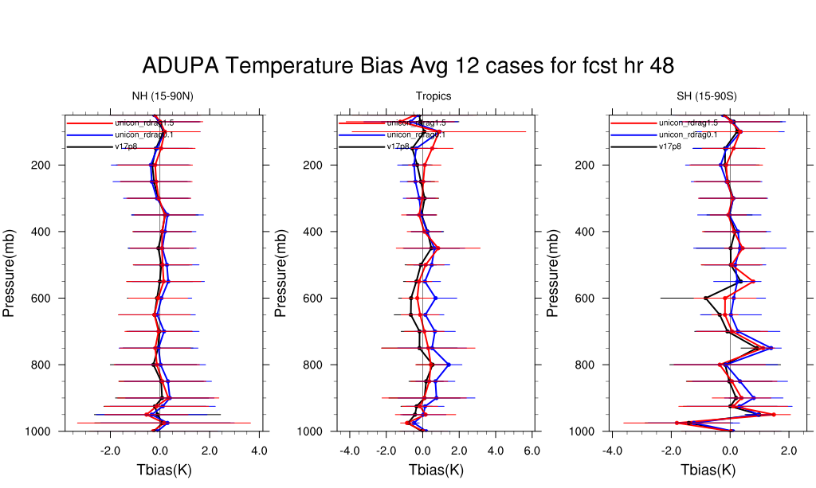

Slide 24
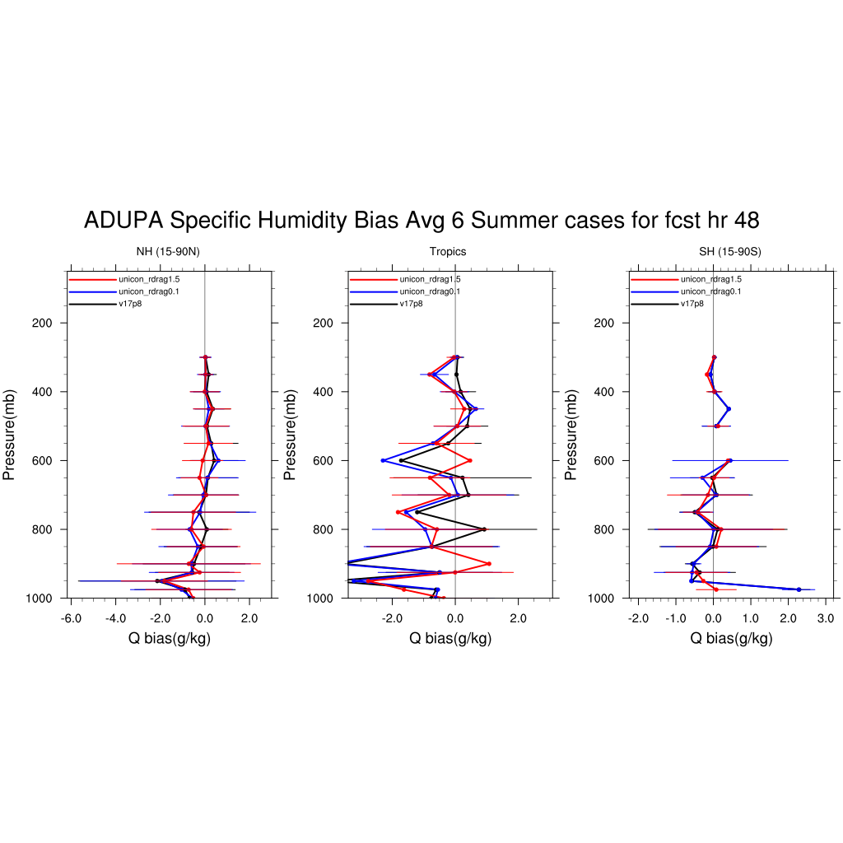
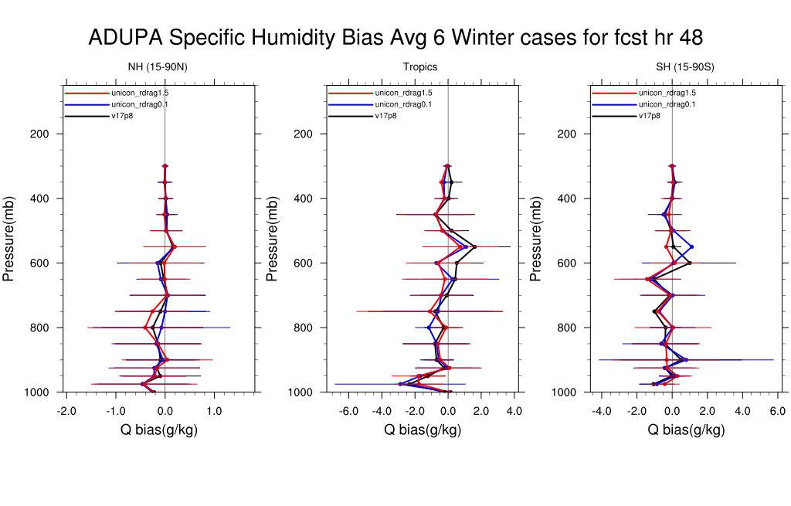
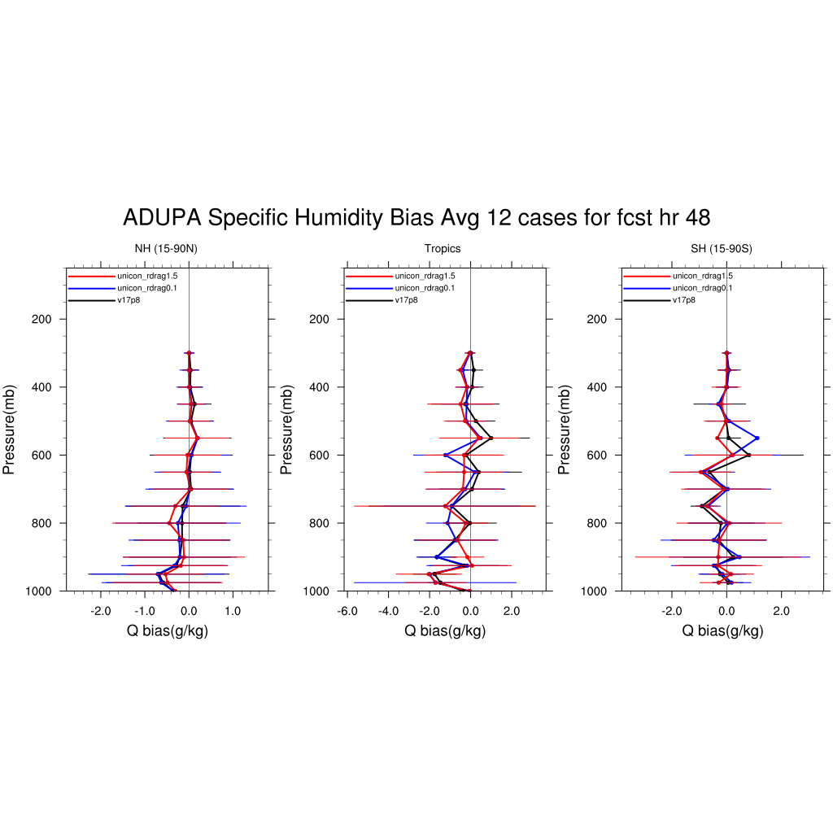

Slide 25
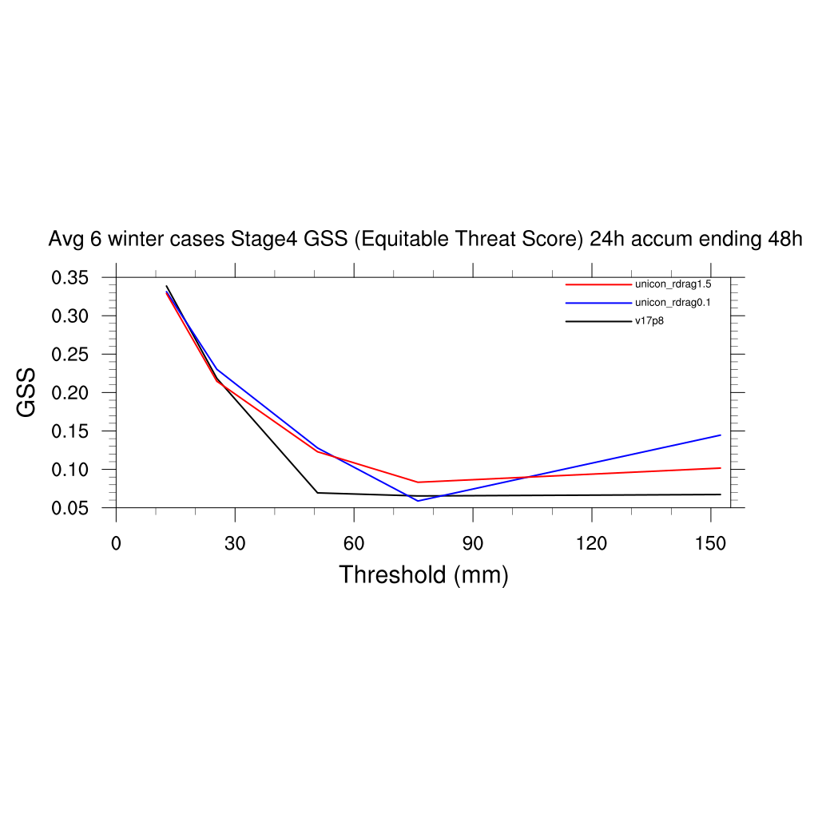
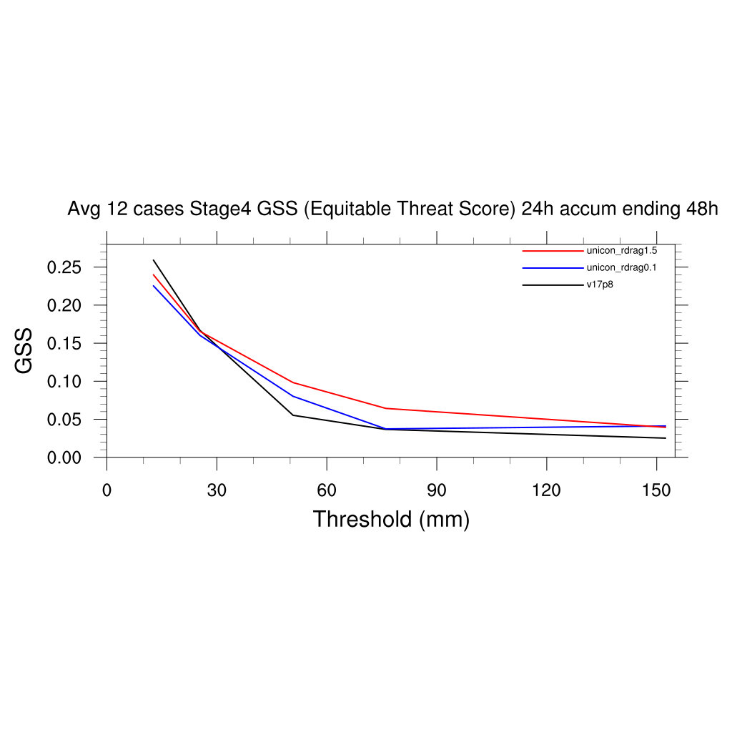

Slide 26
Summary
There is a theoretical ambiguity in the approach for implementing scale-awareness in the SAS scheme (and in any similarly-scaling convection schemes using the conventional parameterization formulation).
It is also ambiguous to separately represent deep, shallow and PBL convection in the SAS scheme.
A pathway forward to circumvent the ambiguity and unify the representation of subgrid convection in the UFS is to use the unified scale-adaptive approach developed by Park (2014) based on a unified plume model.
The experiment using the unified approach in the UFS shows its promising potential as a research and development direction.

