Slide 1
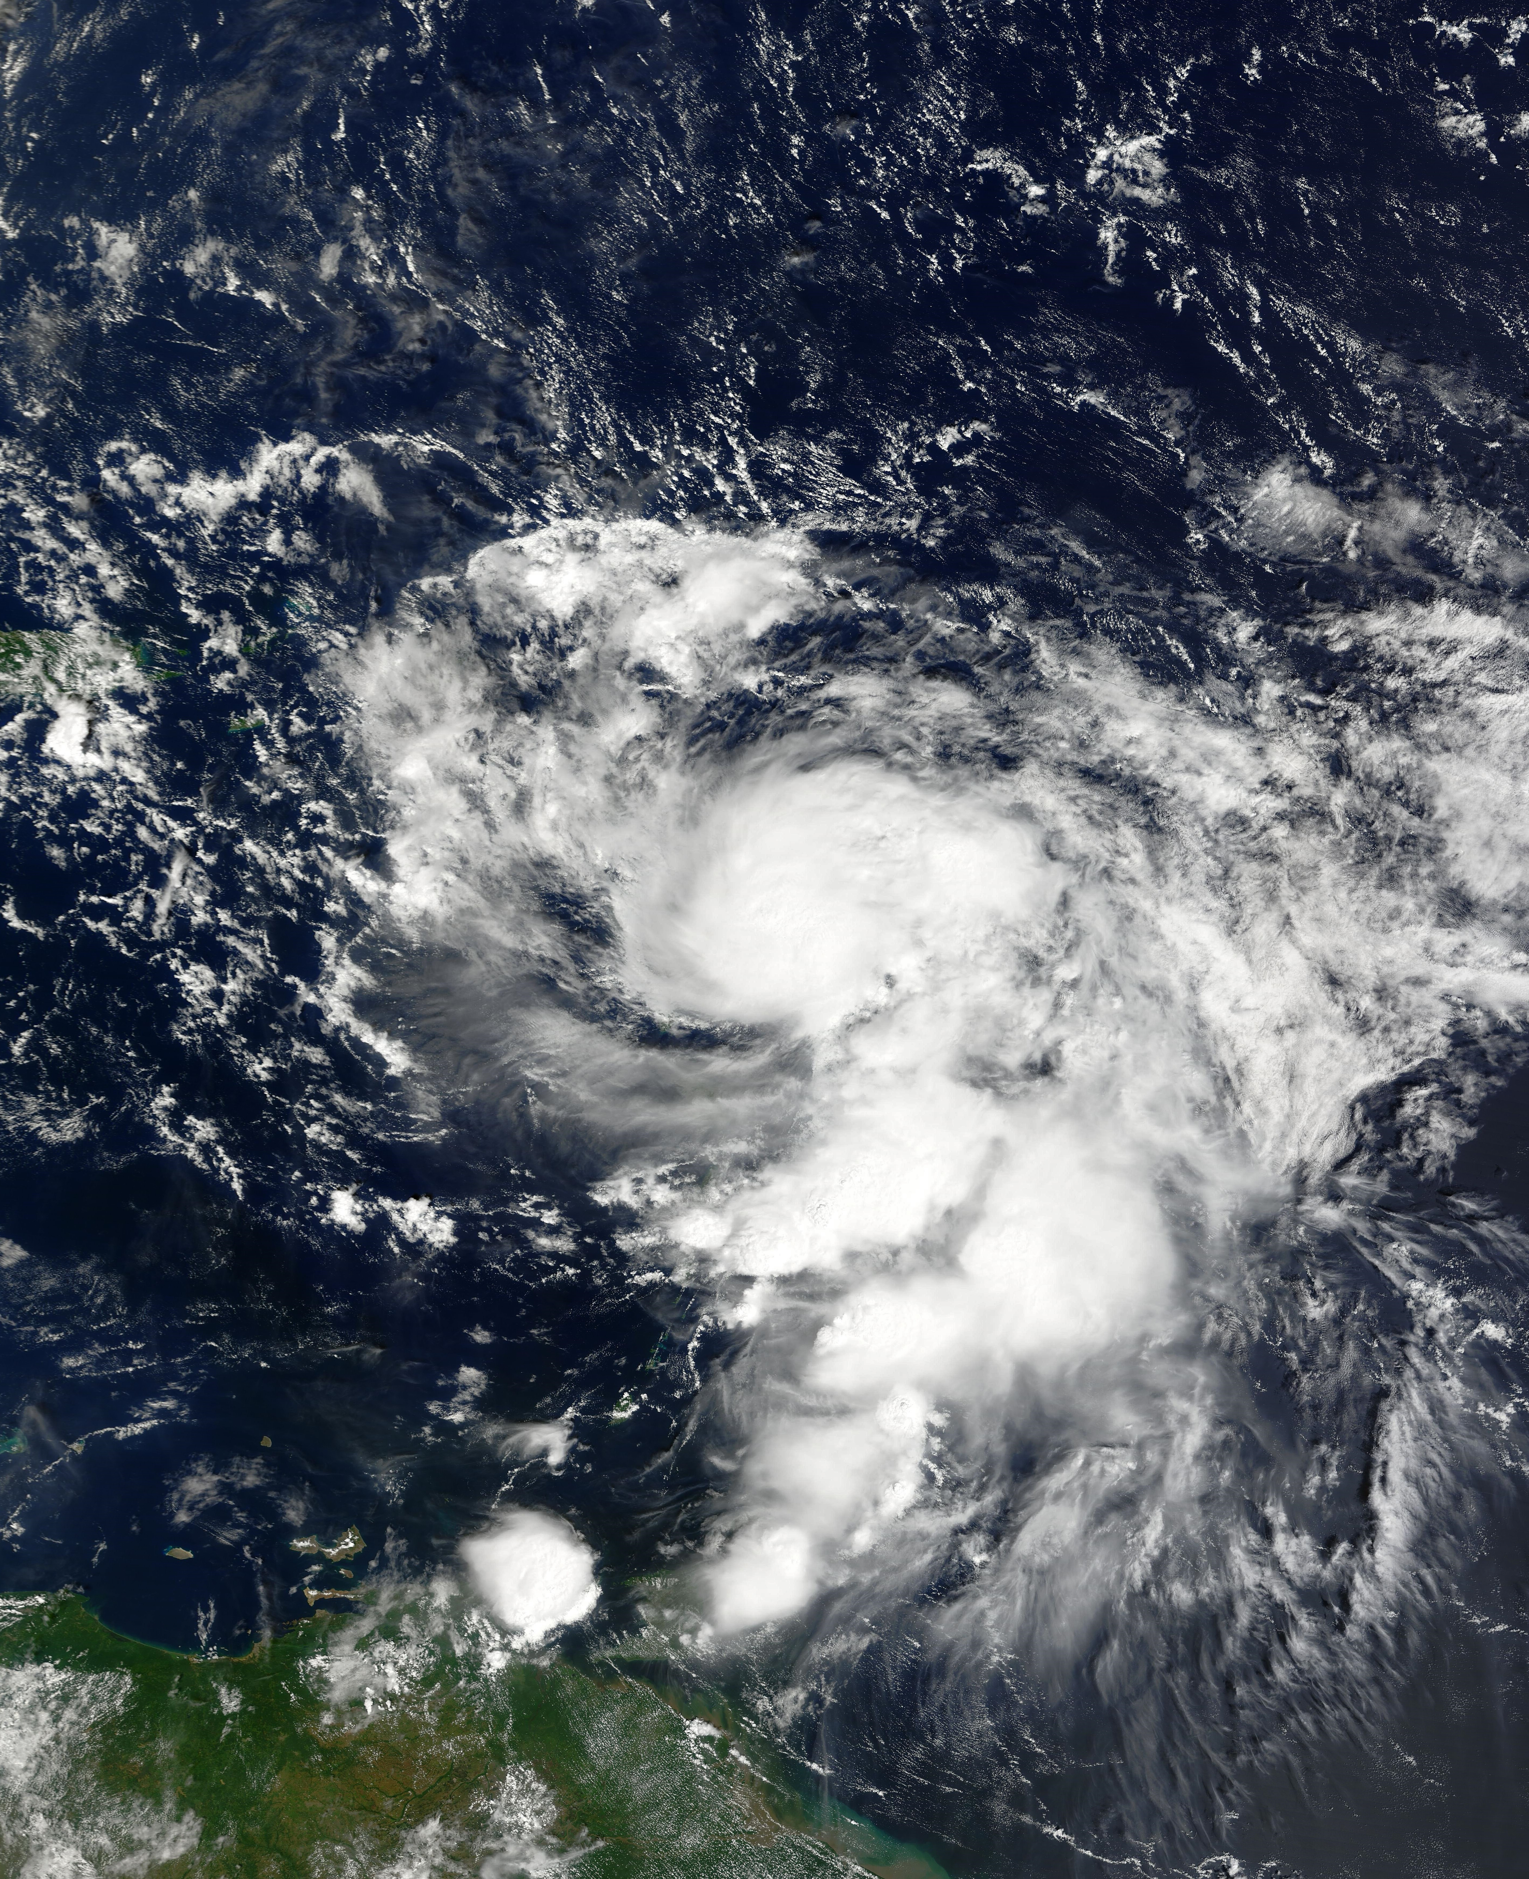
Evaluation of Hurricane Analysis and Forecast System (HAFS) Error Statistics Stratified by Internal Structure and Environmental Metrics
(Trey) George Alvey
CIMAS / University of Miami
NOAA / AOML Hurricane Research Division
Ghassan Alaka, Lew Gramer, Andrew Hazelton

Slide 2
Introduction
The largest error distributions with rapid intensification (RI) occur in favorable environments (Trabing and Bell 2020)
Therefore, a better understanding of inner core dynamics is necessary for improvement of intensity forecast, and in particular, RI
No known study has examined forecast error distributions for large multi—year sample in association with both environmental and internal storm dynamics.
Background
environment
TILT
SPATIAL TILT

Slide 3
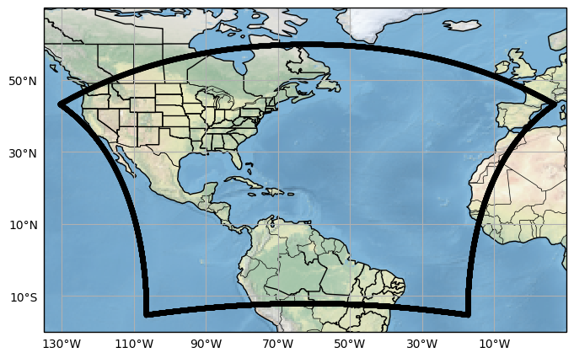
Introduction
HAFS-B (“AOML” version) and HAFS-A
Thompson & GFDL microphysics
3 Year retrospective – All Atlantic TCs 2020–2022
Background
environment
TILT
SPATIAL TILT

Slide 4
Wind shear errors
Largest intensity errors occur in favorable or moderate vertical wind shear
A UFS Collaboration Powered by EPIC
Background
environment
TILT
SPATIAL TILT

Slide 5
Wind shear errors
A UFS Collaboration Powered by EPIC
Background
environment
TILT
SPATIAL TILT

Slide 6
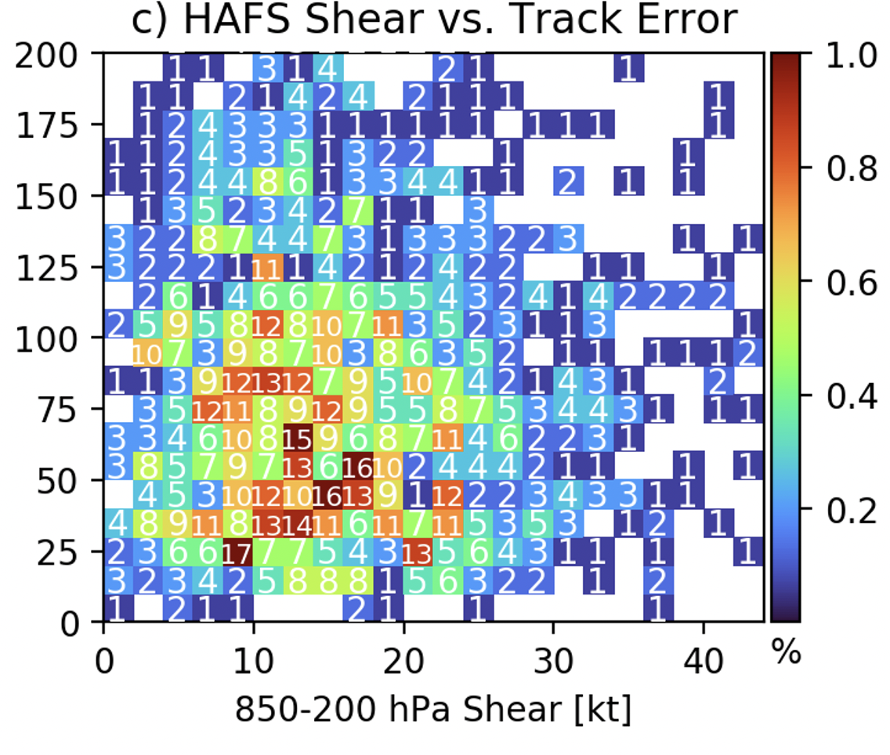
Wind shear errors
Very little correlation between track error and vertical wind shear magnitude
36 h Track error [km]
Background
environment
TILT
SPATIAL TILT

Slide 7
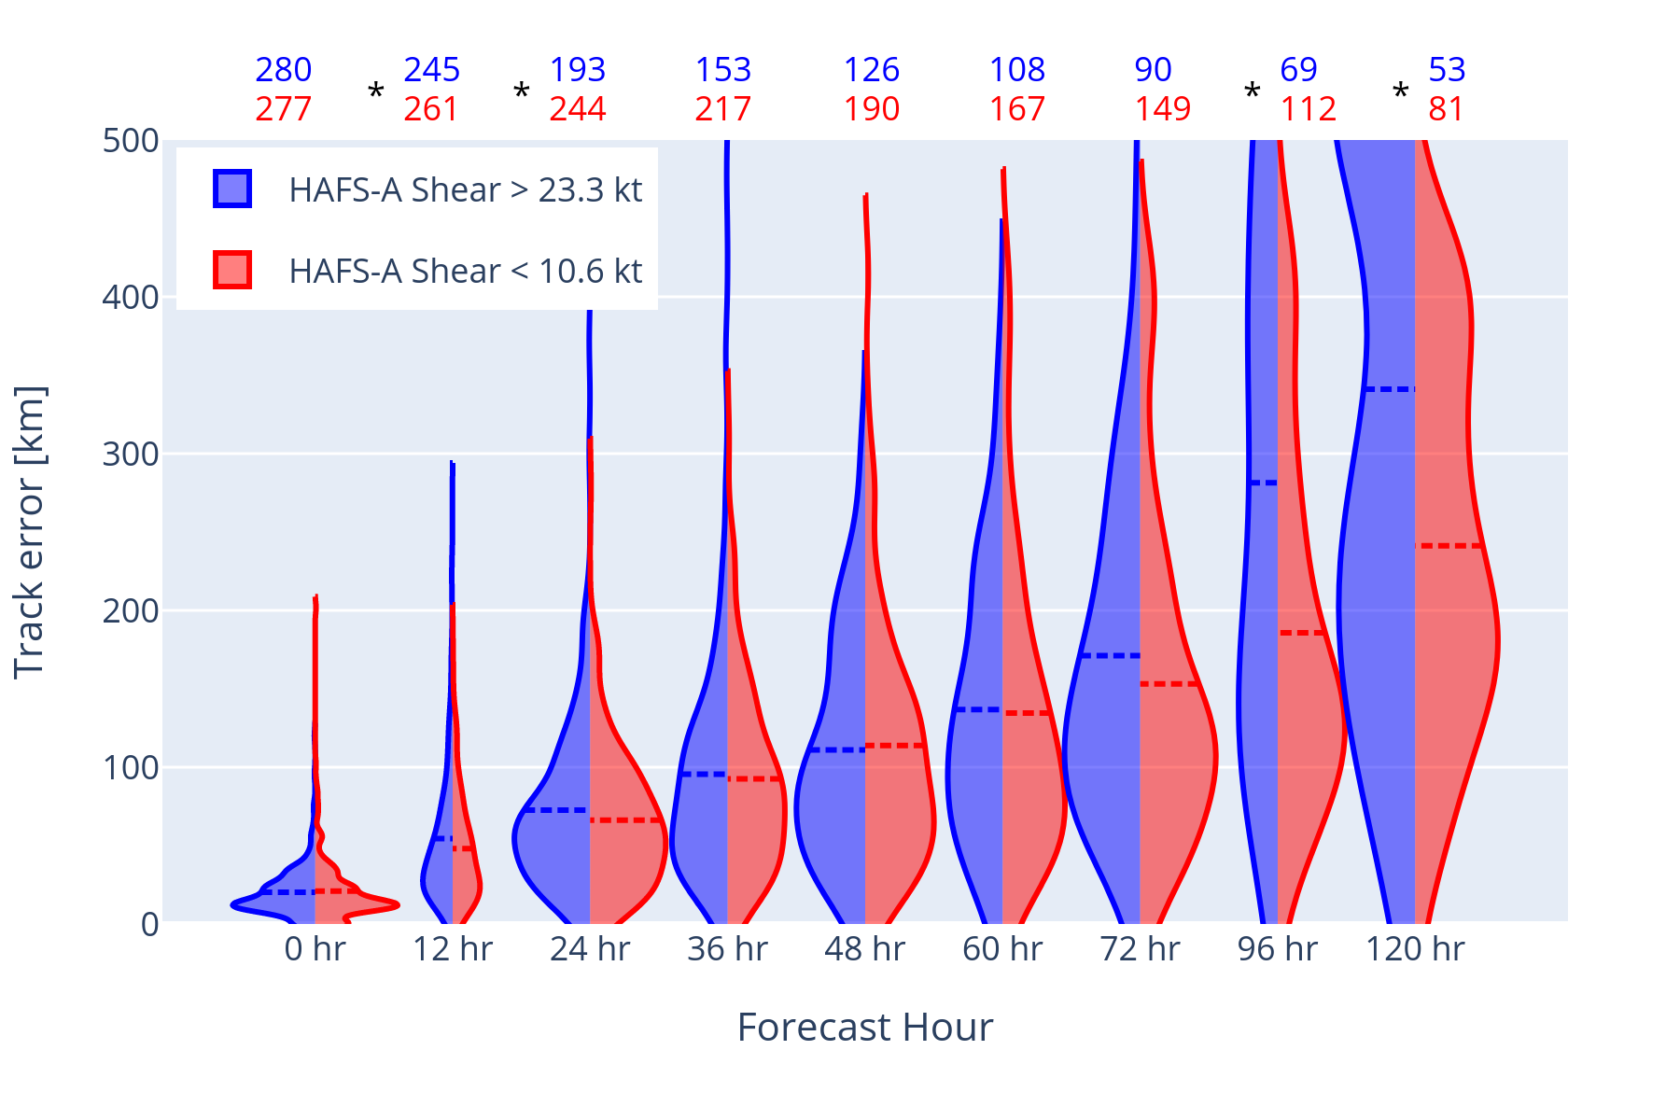
Wind shear errors
850-200 hPa Vertical wind shear stratified by lowest (25th%) and highest (75th%) quartiles
Background
Environment
TILT
SPATIAL TILT

Slide 8
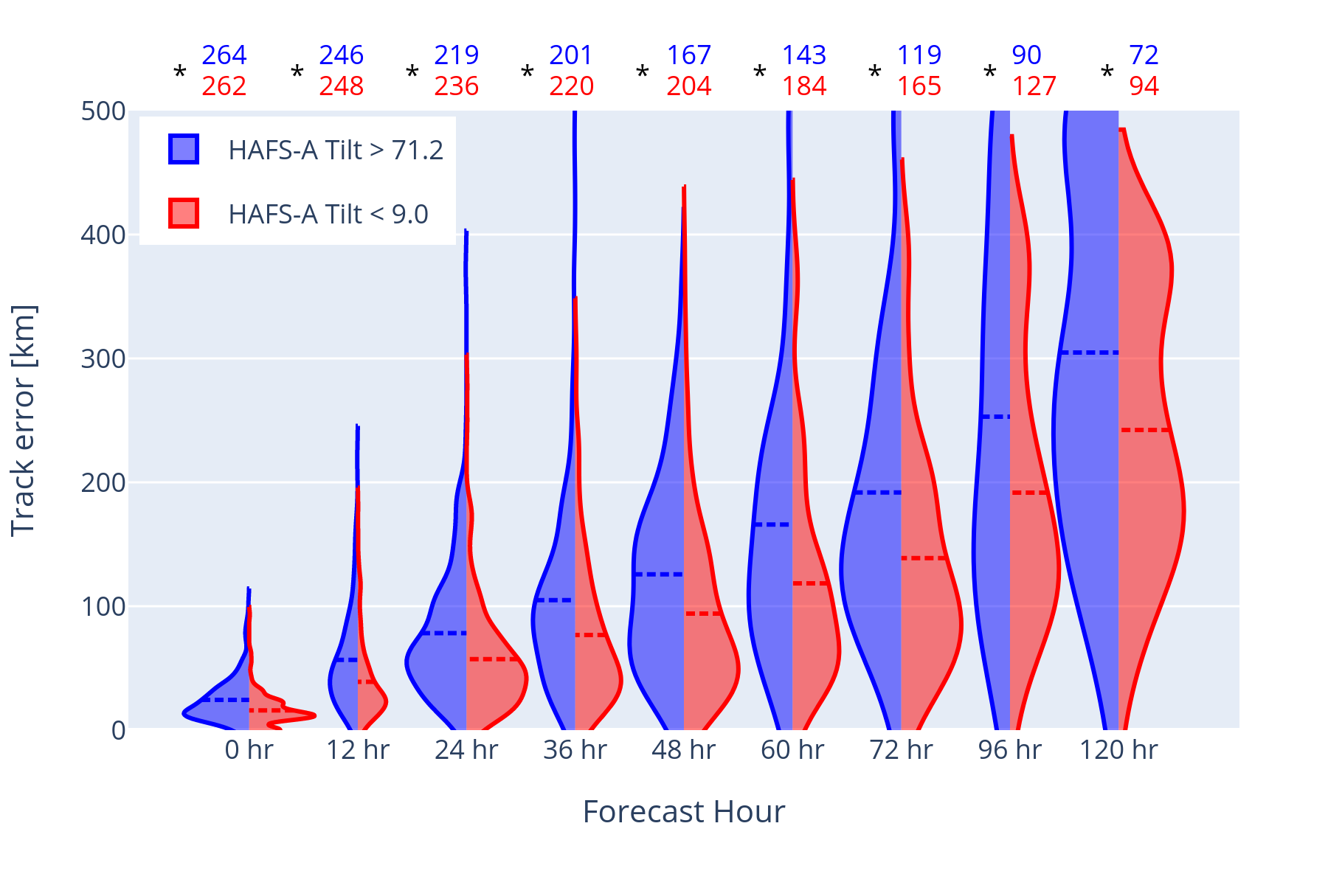
tILT errors - Track
km
On average TCs with larger initial tilt magnitudes have larger track errors
km
Background
environment
TILT
SPATIAL TILT

Slide 9
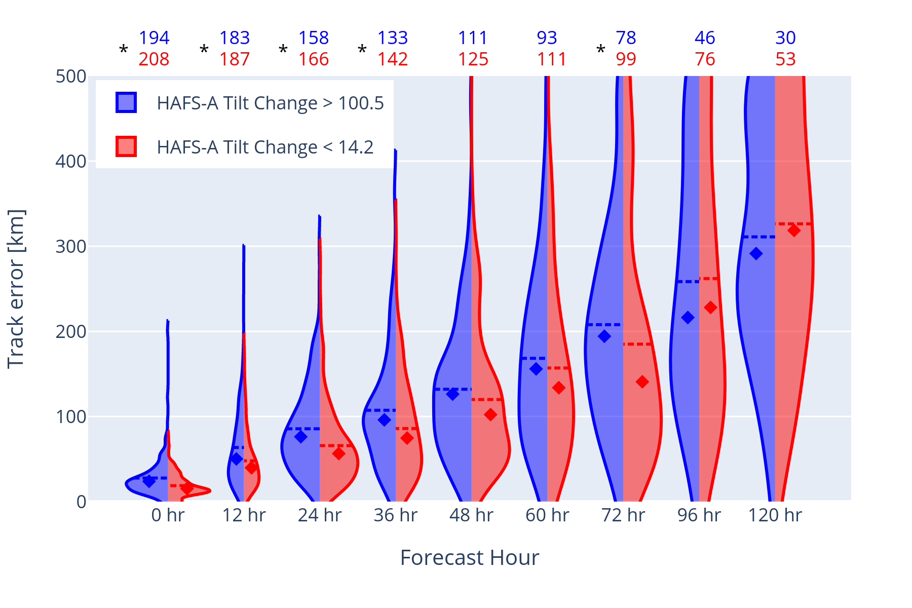
Δ tILT errors - Track
On average TCs with larger initial tilt changes have larger track forecast errors
km
km
Background
environment
TILT
SPATIAL TILT

Slide 10
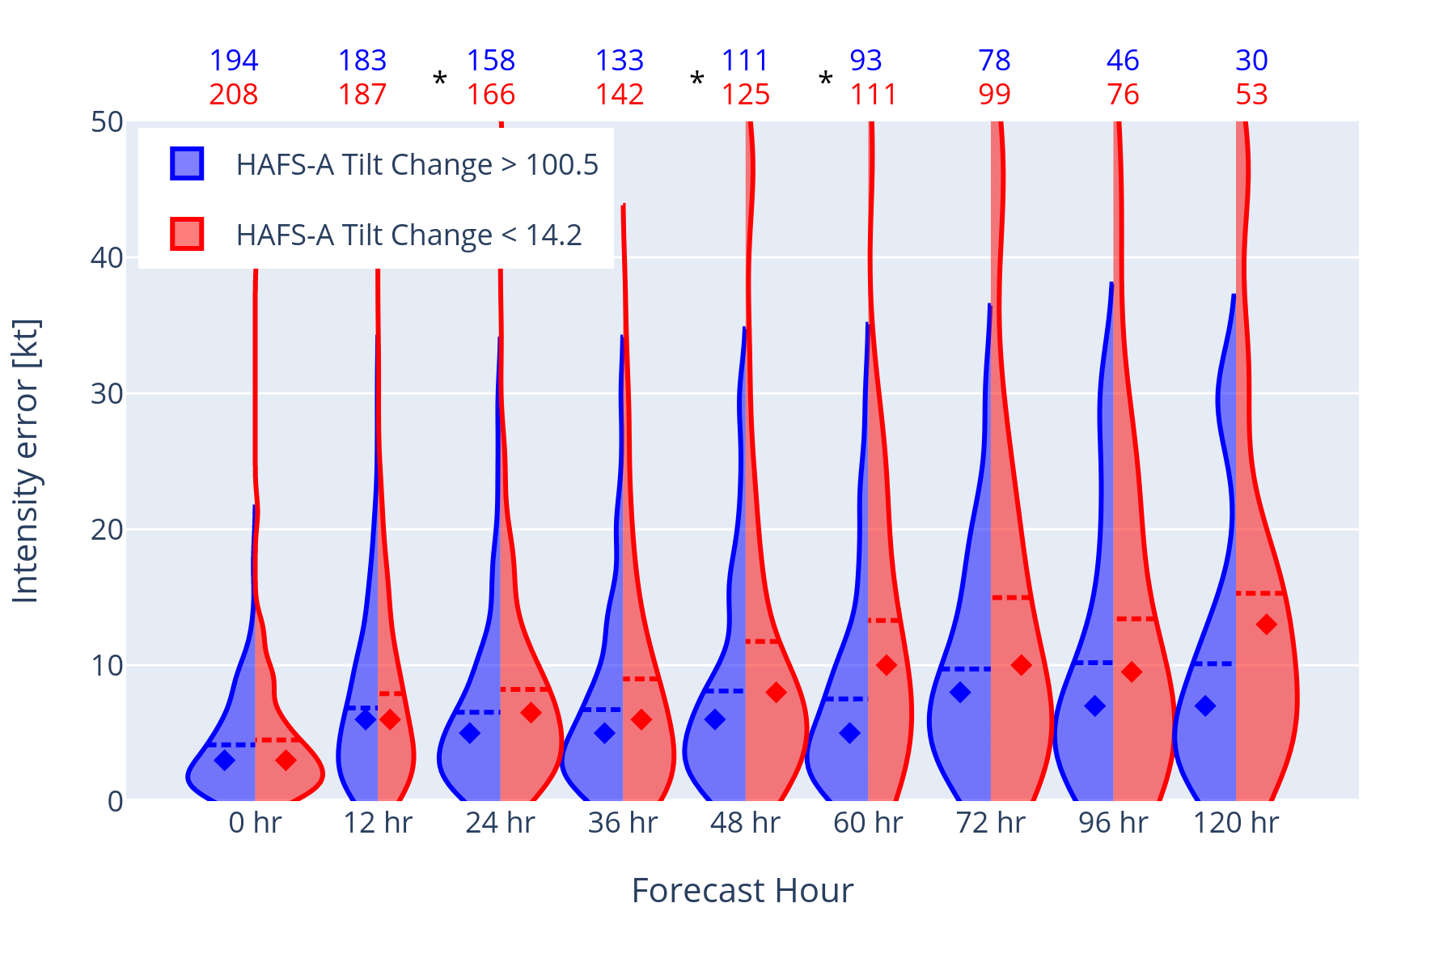
Δ tILT errors - Track
On average TCs with smaller initial tilt changes have larger intensity forecast errors
km
km
Background
environment
TILT
SPATIAL TILT

Slide 11
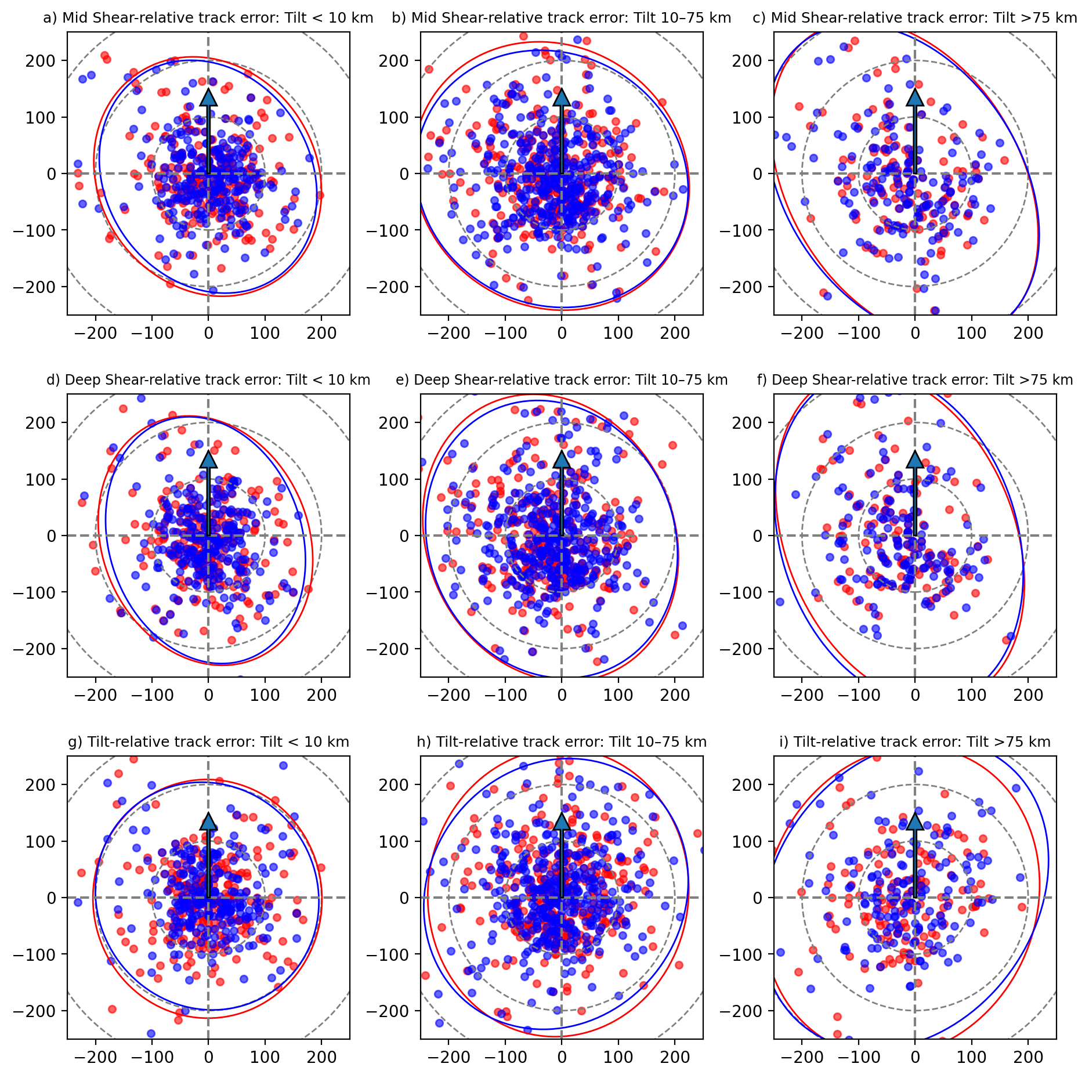
sPATIAL tILT errors
HAFS-A = Blue
HAFS-B = Red
Points are the forecasted position relative to the official track position rotated with respect to the shear or tilt direction (pointing up).
A UFS Collaboration Powered by EPIC
Background
environment
TILT
SPATIAL TILT

Slide 12
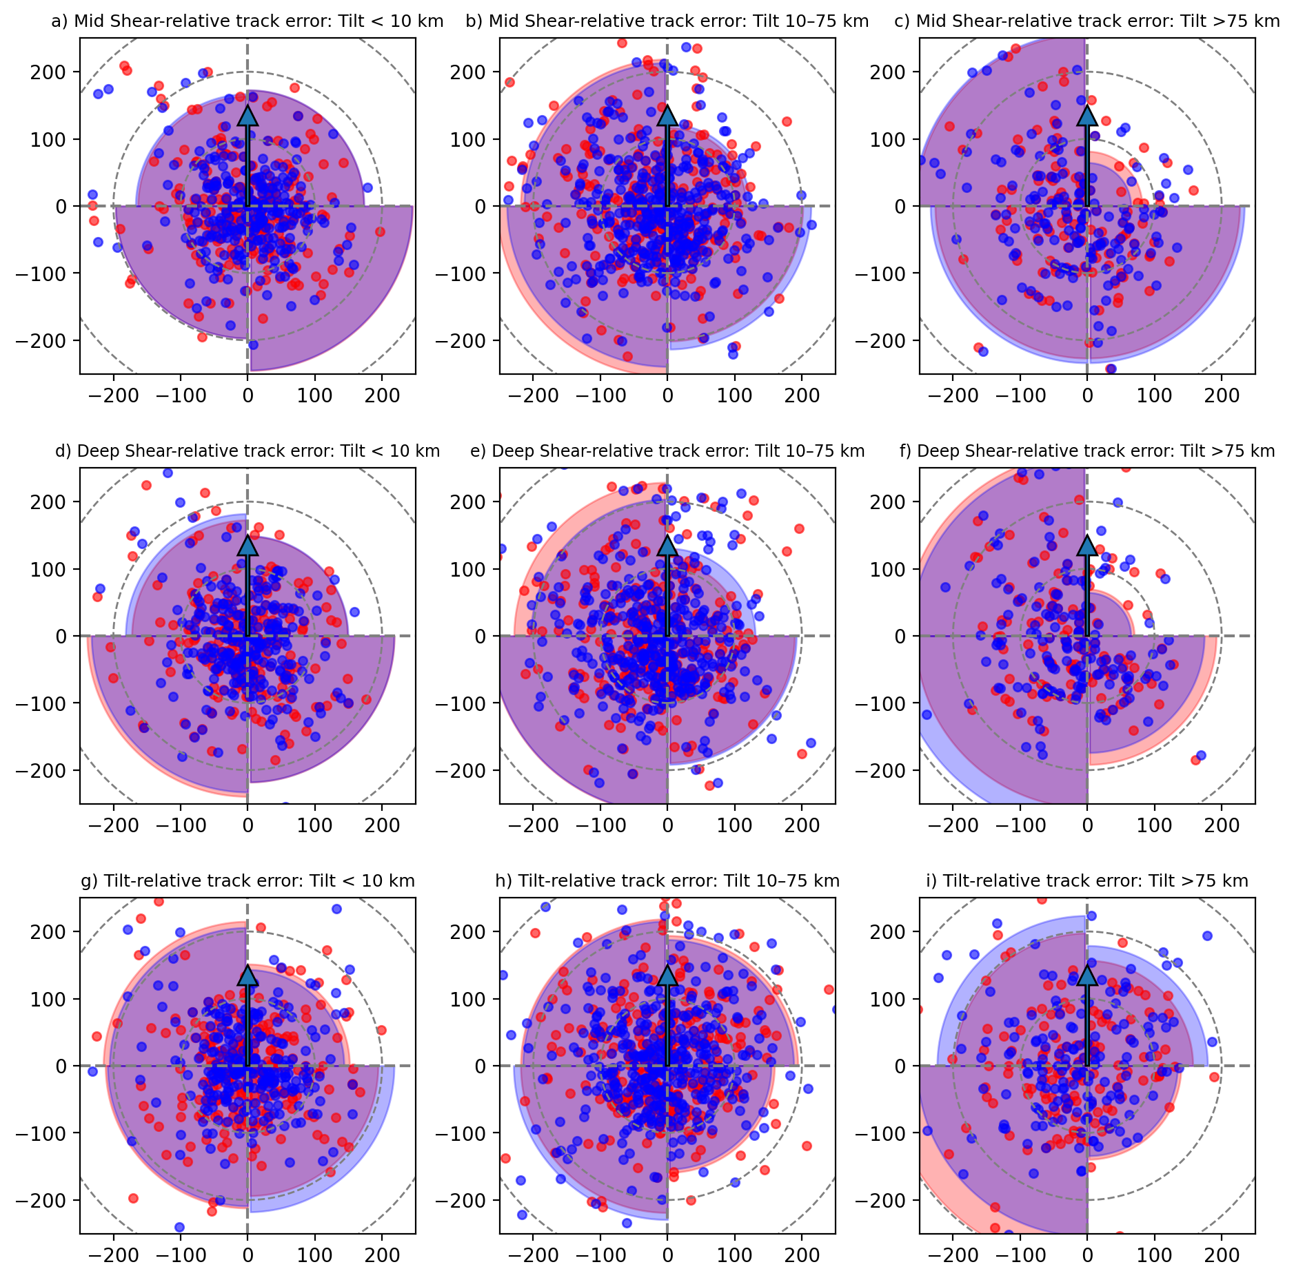
sPATIAL tILT errors
HAFS-A = Blue
HAFS-B = Red
Points are the forecasted position relative to the official track position rotated with respect to the shear or tilt direction (pointing up).
A UFS Collaboration Powered by EPIC
Background
environment
TILT
SPATIAL TILT

Slide 13
sPATIAL tILT errors
Hypothesis: The TC simulations with DSL track errors and positive intensity biases likely also have more convection (than model avg), which results in more center reformation and alignments than observed.
-Negative intensity biases dominate the upshear quadrants & smaller track errors
-Downshear positional biases tend to skew towards positive intensity biases
Background
environment
TILT
SPATIAL TILT
Points are the forecasted position relative to the official track position rotated with respect to the shear or tilt direction (pointing up).

Slide 14
SPATIAL tILT errors
Downshear track biases also have more convection (and speculate that it’s overactive) on average than errors in other quadrants
A UFS Collaboration Powered by EPIC
Background
environment
TILT
SPATIAL TILT

Slide 15
Recommendations
Predictive value of Internal storm dynamic metrics like vortex tilt:
Larger track forecast errors are associated with larger vortex mis-alignment
TCs with a tilted vortex are shown to have directionally oriented positional track biases with respect to both the shear and tilt vectors. On average the model position forecasts are too far left of shear (and maximize DSL).
If a HAFS simulation is producing more convection (than the model average), it is more likely to over intensify the TC and have a position error too far downshear.
Future model improvements should focus on better capturing the [vertical] structure of the vortex (e.g., through DA improvements, physics, high-res ensemble, etc.)
A UFS Collaboration Powered by EPIC
Background
environment
TILT
SPATIAL TILT

Slide 16
Questions?
QUESTIONS?
Alvey III, G. R., Alaka Jr., G. J., Gramer, L., Hazelton, A., 2024. Evaluation of Hurricane Analysis and Forecast System (HAFS) Error Statistics Stratified by Internal Structure and Environmental Metrics. Weather and Forecasting, in review.
This research was supported by National Science Foundation Grant AGS-2241605.
Background
environment
TILT
SPATIAL TILT

Slide 17
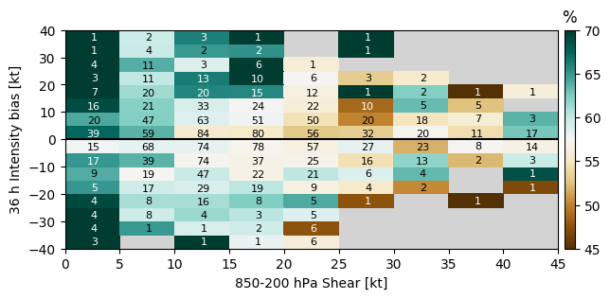
RH + shear errors
700–500 hPa Relative Humidity [200-800 km]
Background
environment
TILT
SPATIAL TILT

Slide 18
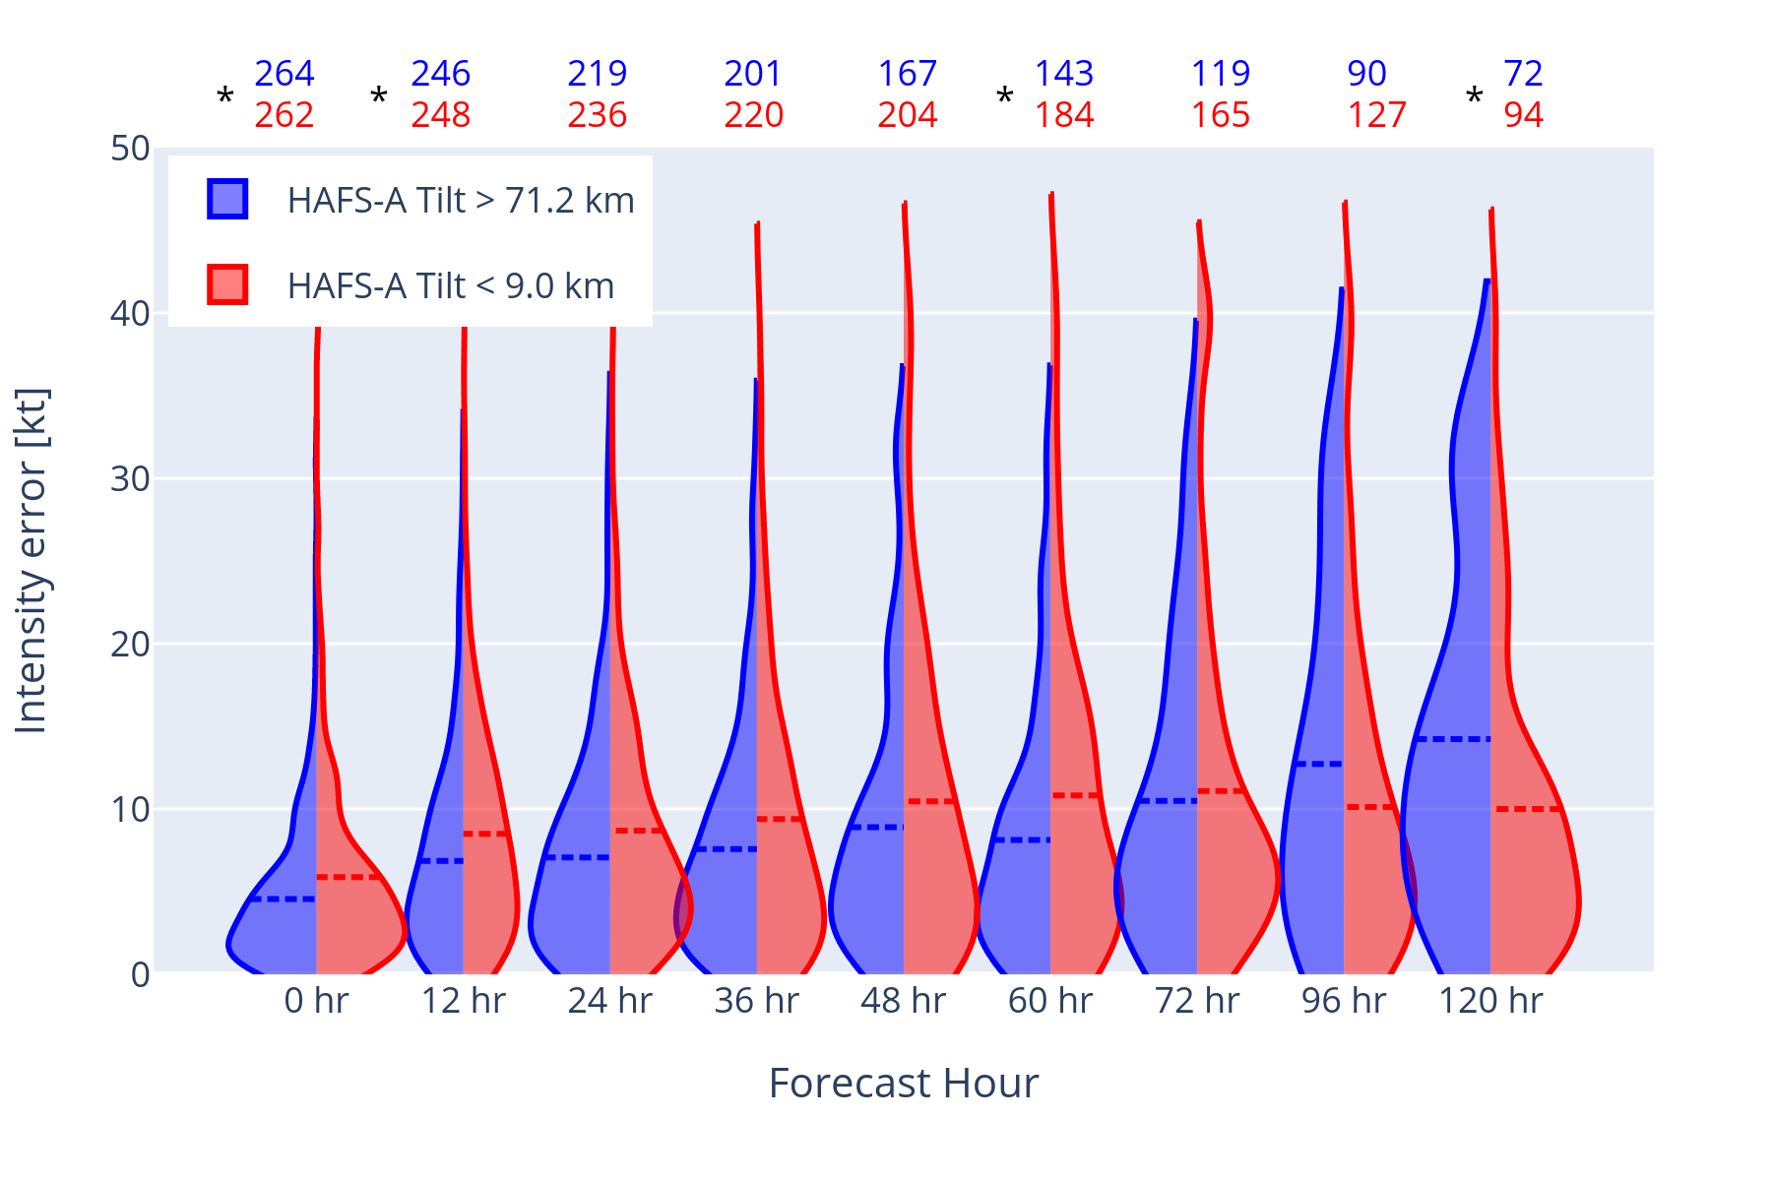
tILT errors - Track
On average TCs with smaller initial tilt magnitudes have larger short range intensity errors
Background
environment
TILT
SPATIAL TILT

Slide 19
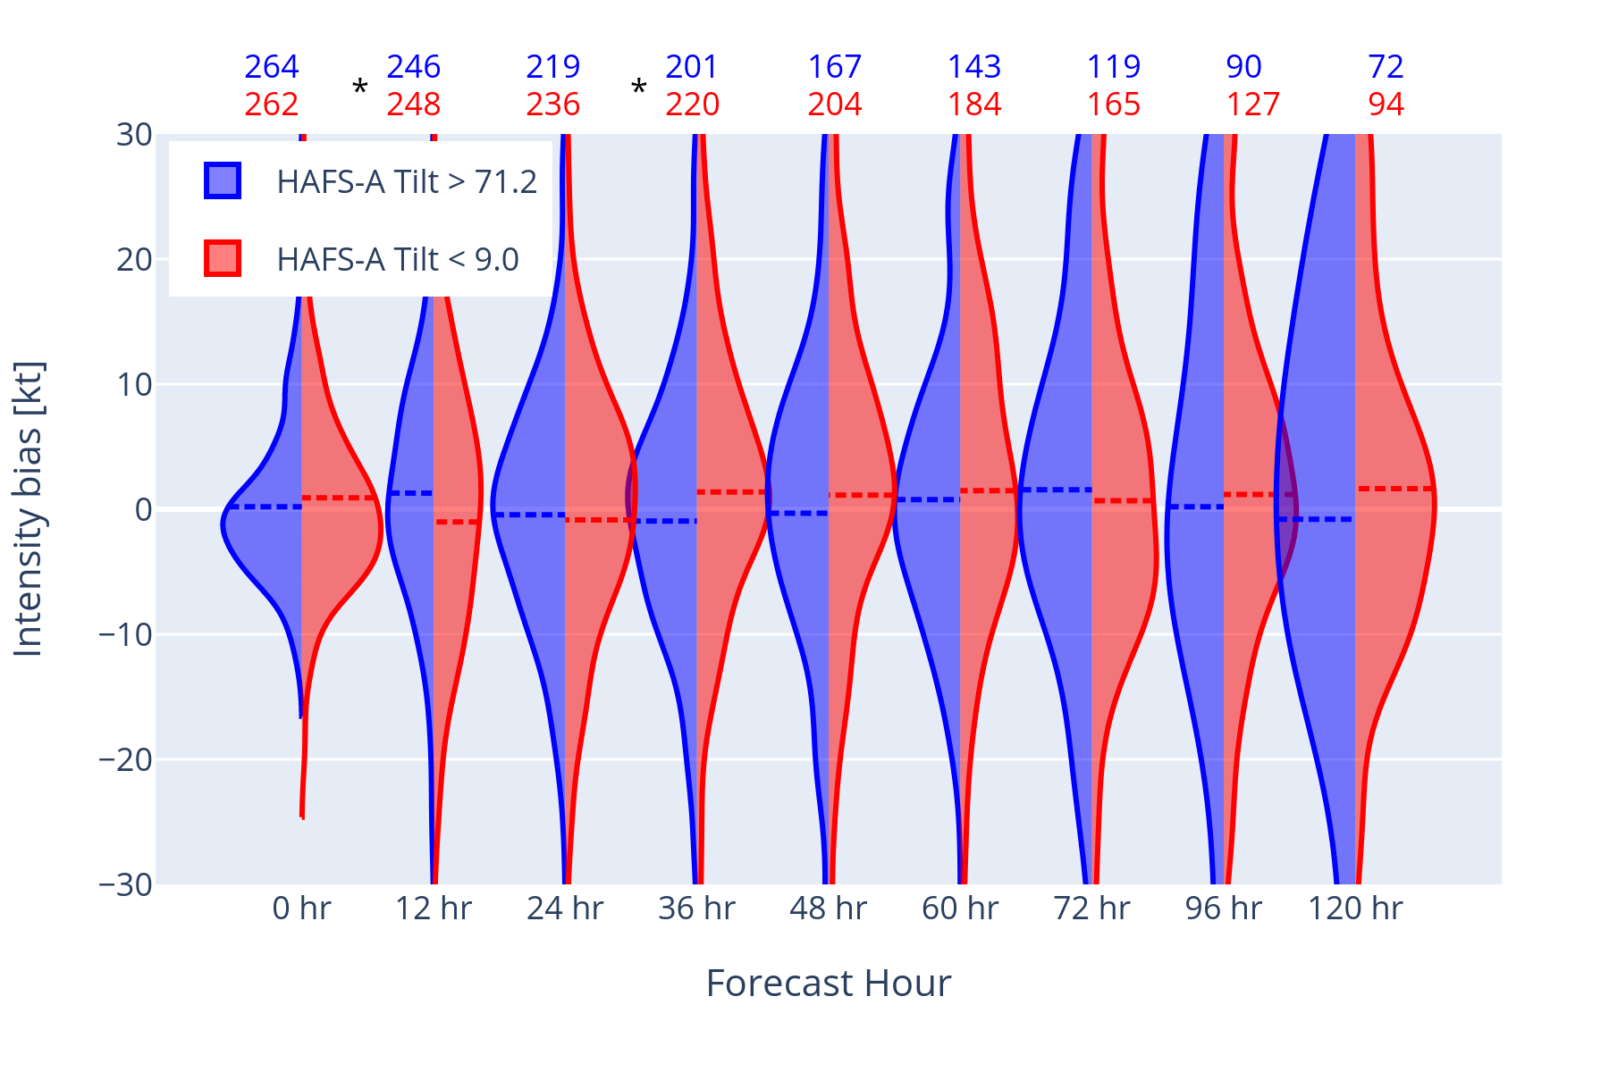
tILT errors - Intensity
Background
environment
TILT
SPATIAL TILT

Slide 20
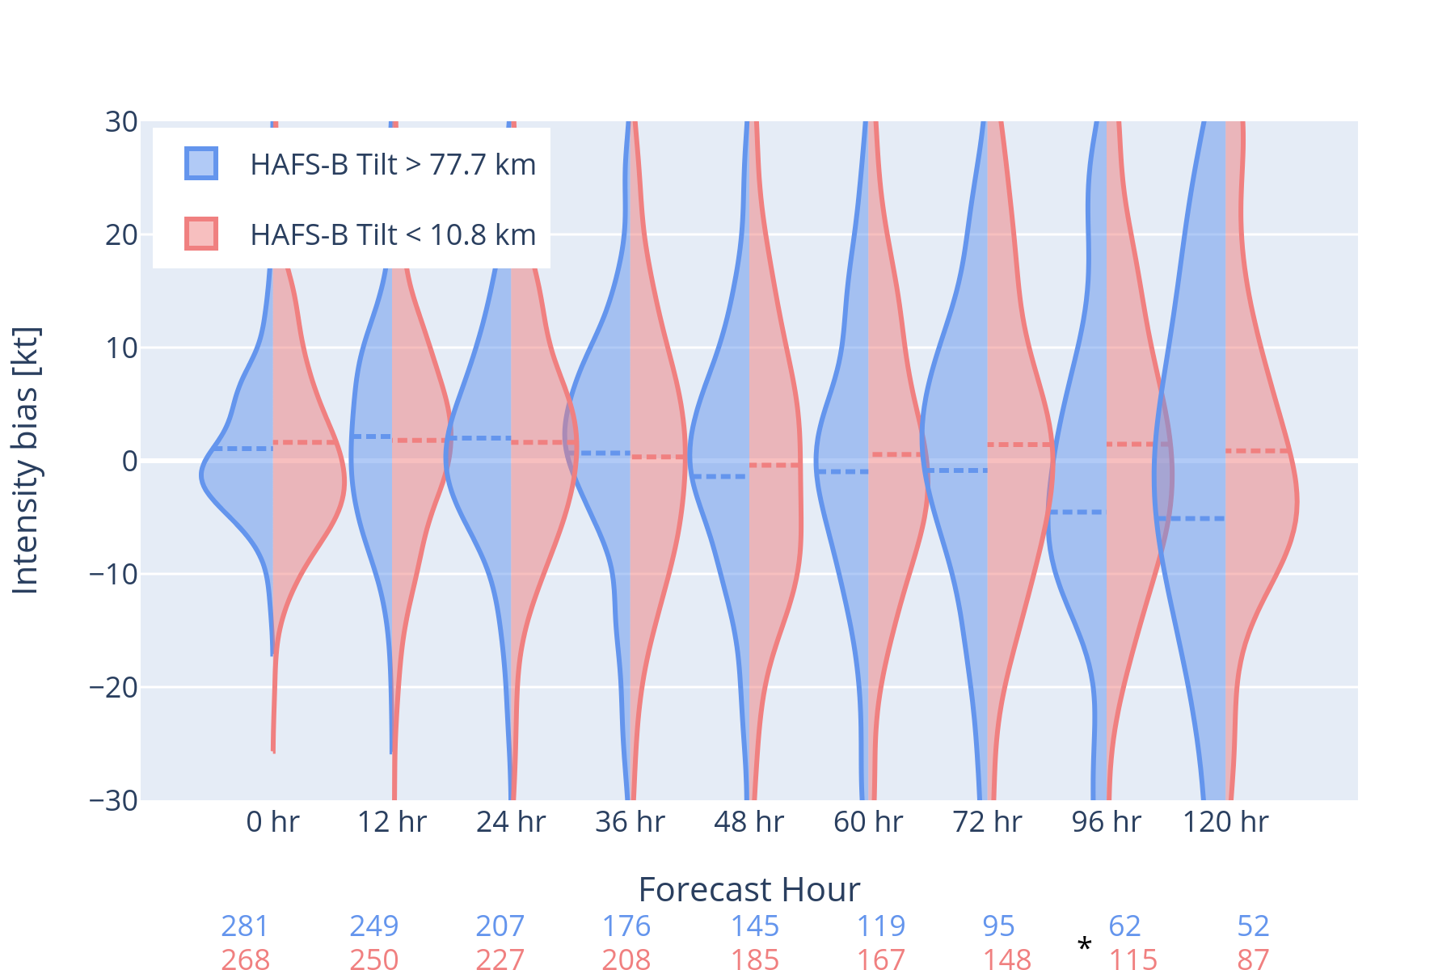
tILT errors - Intensity
Background
environment
TILT
SPATIAL TILT

