Slide 1
The Sensitivity of the Impact of G-IV Reconnaissance Data to HAFSv1 Version
Background
Composite Results
HU Lee (2023)
Fin.
Sarah Ditchek^{1,2}, Jason Sippel², Ryan Torn³, Lisa Bucci⁴, & Wallace Hogsett⁴
¹Cooperative Institute for Marine and Atmospheric Studies (CIMAS) | University of Miami (UM)
²Hurricane Research Division (HRD) | Atlantic Oceanographic and Meteorological Laboratory (AOML)
³Department of Atmospheric and Environmental Sciences | University at Albany, SUNY
⁴National Hurricane Center (NHC)
Funding: NOAA Award NA22OAR4590534

Slide 2
Motivation
Background
Composite Results
HU Lee (2023)
Fin.

Slide 3
Motivation
Background
Composite Results
HU Lee (2023)
Fin.
NOAA’s Gulfstream IV-SP (G-IV) flight-track strategy was recently modified.

Slide 4
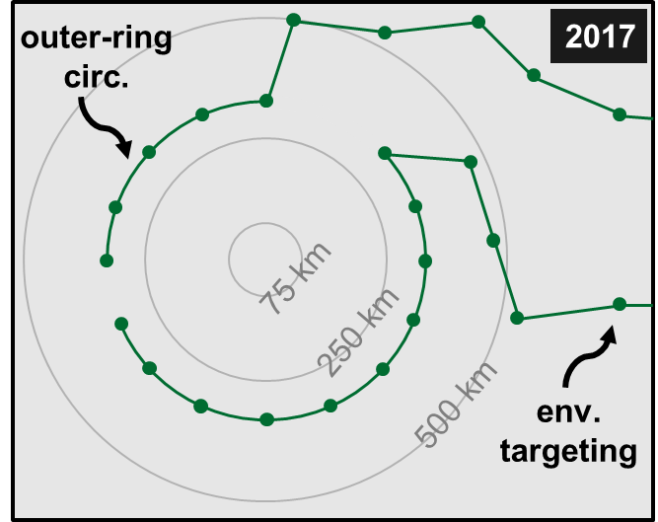
Motivation
Background
Composite Results
HU Lee (2023)
Fin.
NOAA’s Gulfstream IV-SP (G-IV) flight-track strategy was recently modified.
TYPICAL G-IV SURVEILLANCE PATTERN

Slide 5
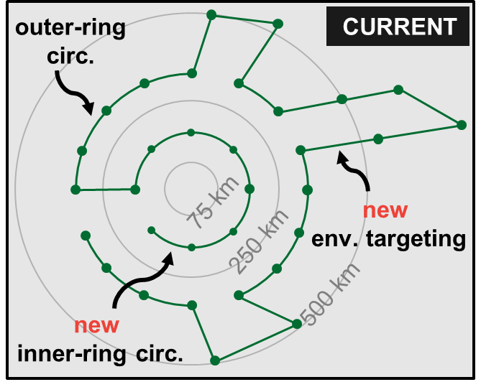
Motivation
Background
Composite Results
HU Lee (2023)
Fin.
NOAA’s Gulfstream IV-SP (G-IV) flight-track strategy was recently modified.
TYPICAL G-IV SURVEILLANCE PATTERN

Slide 6
Motivation
Background
Composite Results
HU Lee (2023)
Fin.
NOAA’s Gulfstream IV-SP (G-IV) flight-track strategy was recently modified.
TYPICAL G-IV SURVEILLANCE PATTERN
The impact of these changes on TC forecasts need to be quantified
and ways to further optimize the strategy should be assessed!

Slide 7
Background
Composite Results
HU Lee (2023)
Fin.
Original Project Plan Snapshot
OBJECTIVE: To quantify the overall impact of G-IV reconnaissance on
TC forecasts of track, intensity, and size, using HAFSv1A

Slide 8
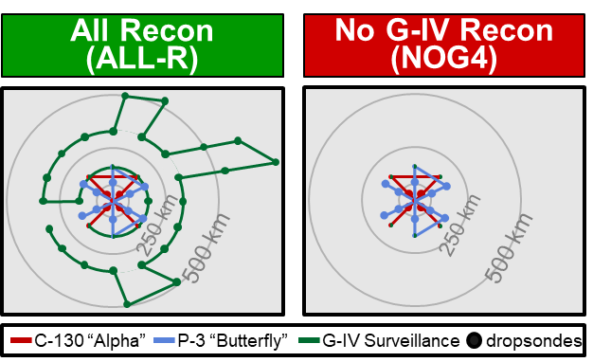
Background
Composite Results
HU Lee (2023)
Fin.
Original Project Plan Snapshot
OBJECTIVE: To quantify the overall impact of G-IV reconnaissance on
TC forecasts of track, intensity, and size, using HAFSv1A
ASSIMILATED RECON DATA
ALL-R: all (i.e., C-130, P-3, & G-IV)
NOG4: only C-130 & P-3 (i.e., no G-IV)
EXPERIMENT
SUITE

Slide 9
Background
Composite Results
HU Lee (2023)
Fin.
Original Project Plan Snapshot
OBJECTIVE: To quantify the overall impact of G-IV reconnaissance on
TC forecasts of track, intensity, and size, using HAFSv1A
ASSIMILATED RECON DATA
ALL-R: all (i.e., C-130, P-3, & G-IV)
NOG4: only C-130 & P-3 (i.e., no G-IV)
EXPERIMENT
SUITE
OTHER ASSIMILATED DATA
all operationally assimilated
conventional & radiance data

Slide 10
Background
Composite Results
HU Lee (2023)
Fin.
*GFS input data does not exist for Eta, which had G-IV flights
Original Project Plan Snapshot
OBJECTIVE: To quantify the overall impact of G-IV reconnaissance on
TC forecasts of track, intensity, and size, using HAFSv1A
ASSIMILATED RECON DATA
ALL-R: all (i.e., C-130, P-3, & G-IV)
NOG4: only C-130 & P-3 (i.e., no G-IV)
EXPERIMENT
SUITE
OTHER ASSIMILATED DATA
all operationally assimilated
conventional & radiance data
YEAR | TCS (w/ tasked G-IV missions) | CYCLES | G-IV MISSIONS
2020* | Isaias, Laura, Marco, Delta, & Zeta | 129 | 19
2021 | Elsa, Henri, Ida, & Sam | 141 | 10
2022 | Fiona, Ian, Nicole | 85 | 13
2023 | Franklin, Idalia, Lee | 114 | 14
4 | 15 | 469 | 56
EXPERIMENT
SCOPE

Slide 11
Background
Composite Results
HU Lee (2023)
Fin.
Direct G-IV Impact
Track/Intensity: TS forecast impr & HU forecast degr

Slide 12
Background
Composite Results
HU Lee (2023)
Fin.
SS: W/ TS (42) | W/ H (64)
Direct G-IV Impact
Track/Intensity: TS forecast impr & HU forecast degr
W/ G-IV RECON & INITIAL CLASSIFICATION
TS
HU
TRK
VMAX
PMIN
Ditchek et al.
(2023b)

Slide 13
Background
Composite Results
HU Lee (2023)
Fin.
SS: W/ TS (42) | W/ H (64)
Direct G-IV Impact
Track/Intensity: TS forecast impr & HU forecast degr
W/ G-IV RECON & INITIAL CLASSIFICATION
TS
HU
TRK
VMAX
PMIN
impr
degr
Ditchek et al.
(2023b)

Slide 14
Background
Composite Results
HU Lee (2023)
Fin.
SS: W/ TS (42) | W/ H (64)
Direct G-IV Impact
Track/Intensity: TS forecast impr & HU forecast degr
W/ G-IV RECON & INITIAL CLASSIFICATION
TS
HU
TRK
VMAX
PMIN
impr
degr
POTENTIAL EXPLANATIONS FOR HU DEGR
Ditchek et al.
(2023b)

Slide 15
Background
Composite Results
HU Lee (2023)
Fin.
SS: W/ TS (42) | W/ H (64)
Direct G-IV Impact
Track/Intensity: TS forecast impr & HU forecast degr
W/ G-IV RECON & INITIAL CLASSIFICATION
TS
HU
TRK
VMAX
PMIN
impr
degr
POTENTIAL EXPLANATIONS FOR HU DEGR
1) DA Sophistication in HAFS
Ditchek et al.
(2023b)

Slide 16
Background
Composite Results
HU Lee (2023)
Fin.
SS: W/ TS (42) | W/ H (64)
Direct G-IV Impact
Track/Intensity: TS forecast impr & HU forecast degr
W/ G-IV RECON & INITIAL CLASSIFICATION
TS
HU
TRK
VMAX
PMIN
impr
degr
POTENTIAL EXPLANATIONS FOR HU DEGR
1) DA Sophistication in HAFS
2) HAFS Version Used
Ditchek et al.
(2023b)

Slide 17
Background
Composite Results
HU Lee (2023)
Fin.
SS: W/ TS (42) | W/ H (64)
Direct G-IV Impact
Track/Intensity: TS forecast impr & HU forecast degr
W/ G-IV RECON & INITIAL CLASSIFICATION
TS
HU
TRK
VMAX
PMIN
impr
degr
POTENTIAL EXPLANATIONS FOR HU DEGR
1) DA Sophistication in HAFS
2) HAFS Version Used
Ditchek et al.
(2023b)
ACTIONABLE PATH
Rerun experiments with HAFS-B

Slide 18
Background
Composite Results
HU Lee (2023)
Fin.
New Project Plan Snapshot
OBJECTIVE: To quantify the sensitivity of the impact of G-IV recon
to HAFSv1 version - A or B

Slide 19
Background
Composite Results
HU Lee (2023)
Fin.
New Project Plan Snapshot
OBJECTIVE: To quantify the sensitivity of the impact of G-IV recon
to HAFSv1 version - A or B
ASSIMILATED RECON DATA
ALL-R: all (i.e., C-130, P-3, & G-IV)
NOG4: only C-130 & P-3 (i.e., no G-IV)
EXPERIMENT
SUITE
OTHER ASSIMILATED DATA
all operationally assimilated
conventional & radiance data

Slide 20
Background
Composite Results
HU Lee (2023)
Fin.
*Orion’s Rocky9 transition occurred before Isaias with HAFSv1-B finished | GFS input data does not exist for Eta, which had G-IV flights
New Project Plan Snapshot
OBJECTIVE: To quantify the sensitivity of the impact of G-IV recon
to HAFSv1 version - A or B
ASSIMILATED RECON DATA
ALL-R: all (i.e., C-130, P-3, & G-IV)
NOG4: only C-130 & P-3 (i.e., no G-IV)
EXPERIMENT
SUITE
OTHER ASSIMILATED DATA
all operationally assimilated
conventional & radiance data
YEAR | TCS (w/ tasked G-IV missions) | CYCLES | G-IV MISSIONS
2020* | Isaias, Laura, Marco, Delta, & Zeta | 98 | 16
2021 | Elsa, Henri, Ida, & Sam | 141 | 10
2022 | Fiona, Ian, Nicole | 85 | 13
2023 | Franklin, Idalia, Lee | 114 | 14
4 | 14 | 438 | 53
EXPERIMENT
SCOPE

Slide 21
Background
Composite Results
HU Lee (2023)
Fin.
Assimilated Recon Observations

Slide 22
Background
Composite Results
HU Lee (2023)
Fin.
Assimilated Recon Observations
G-IV RECON: 25% of total assimilated recon observations

Slide 23
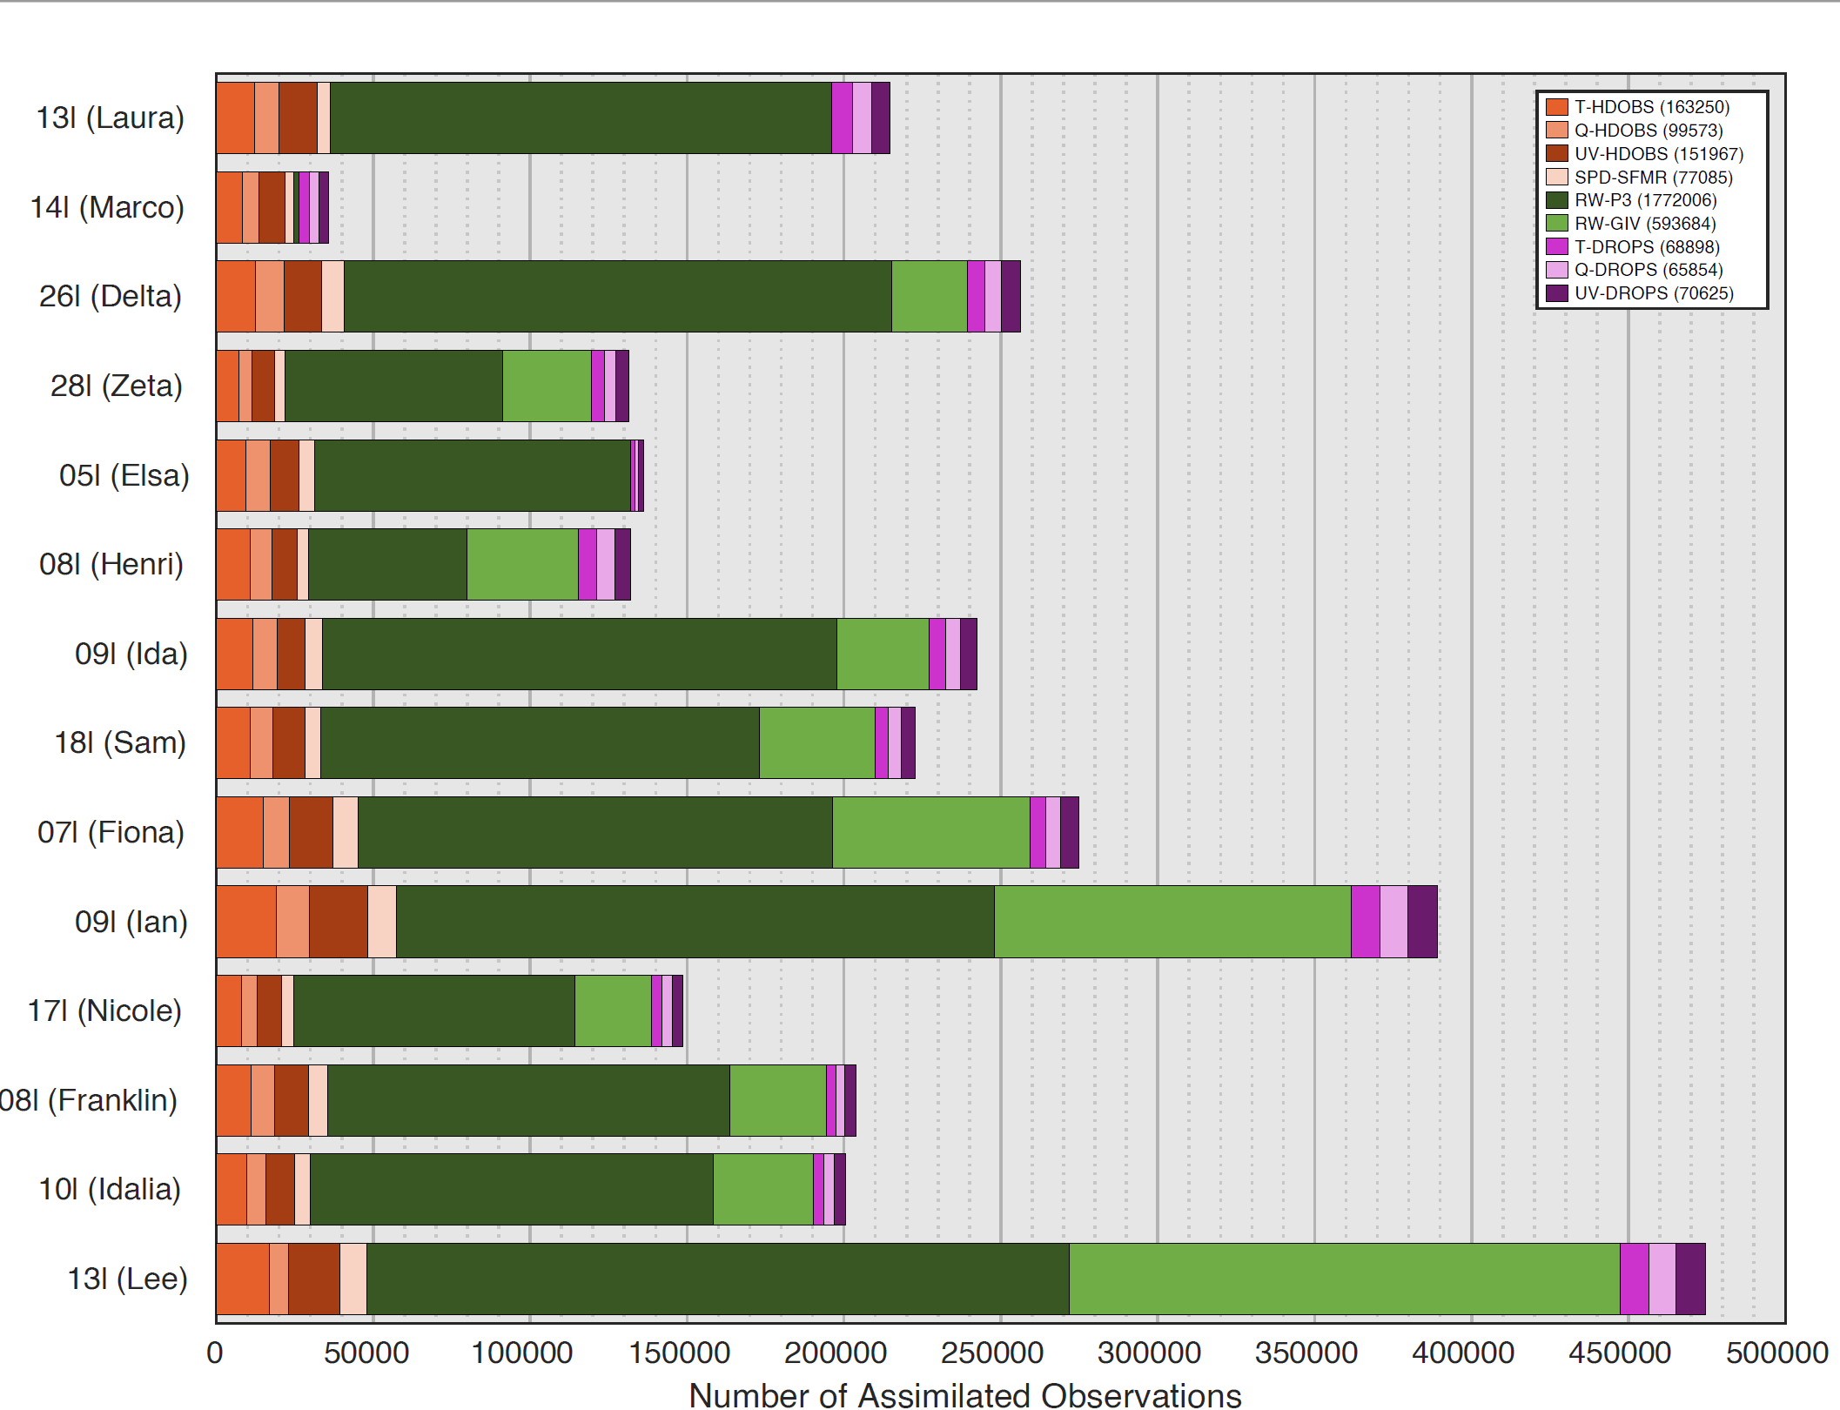
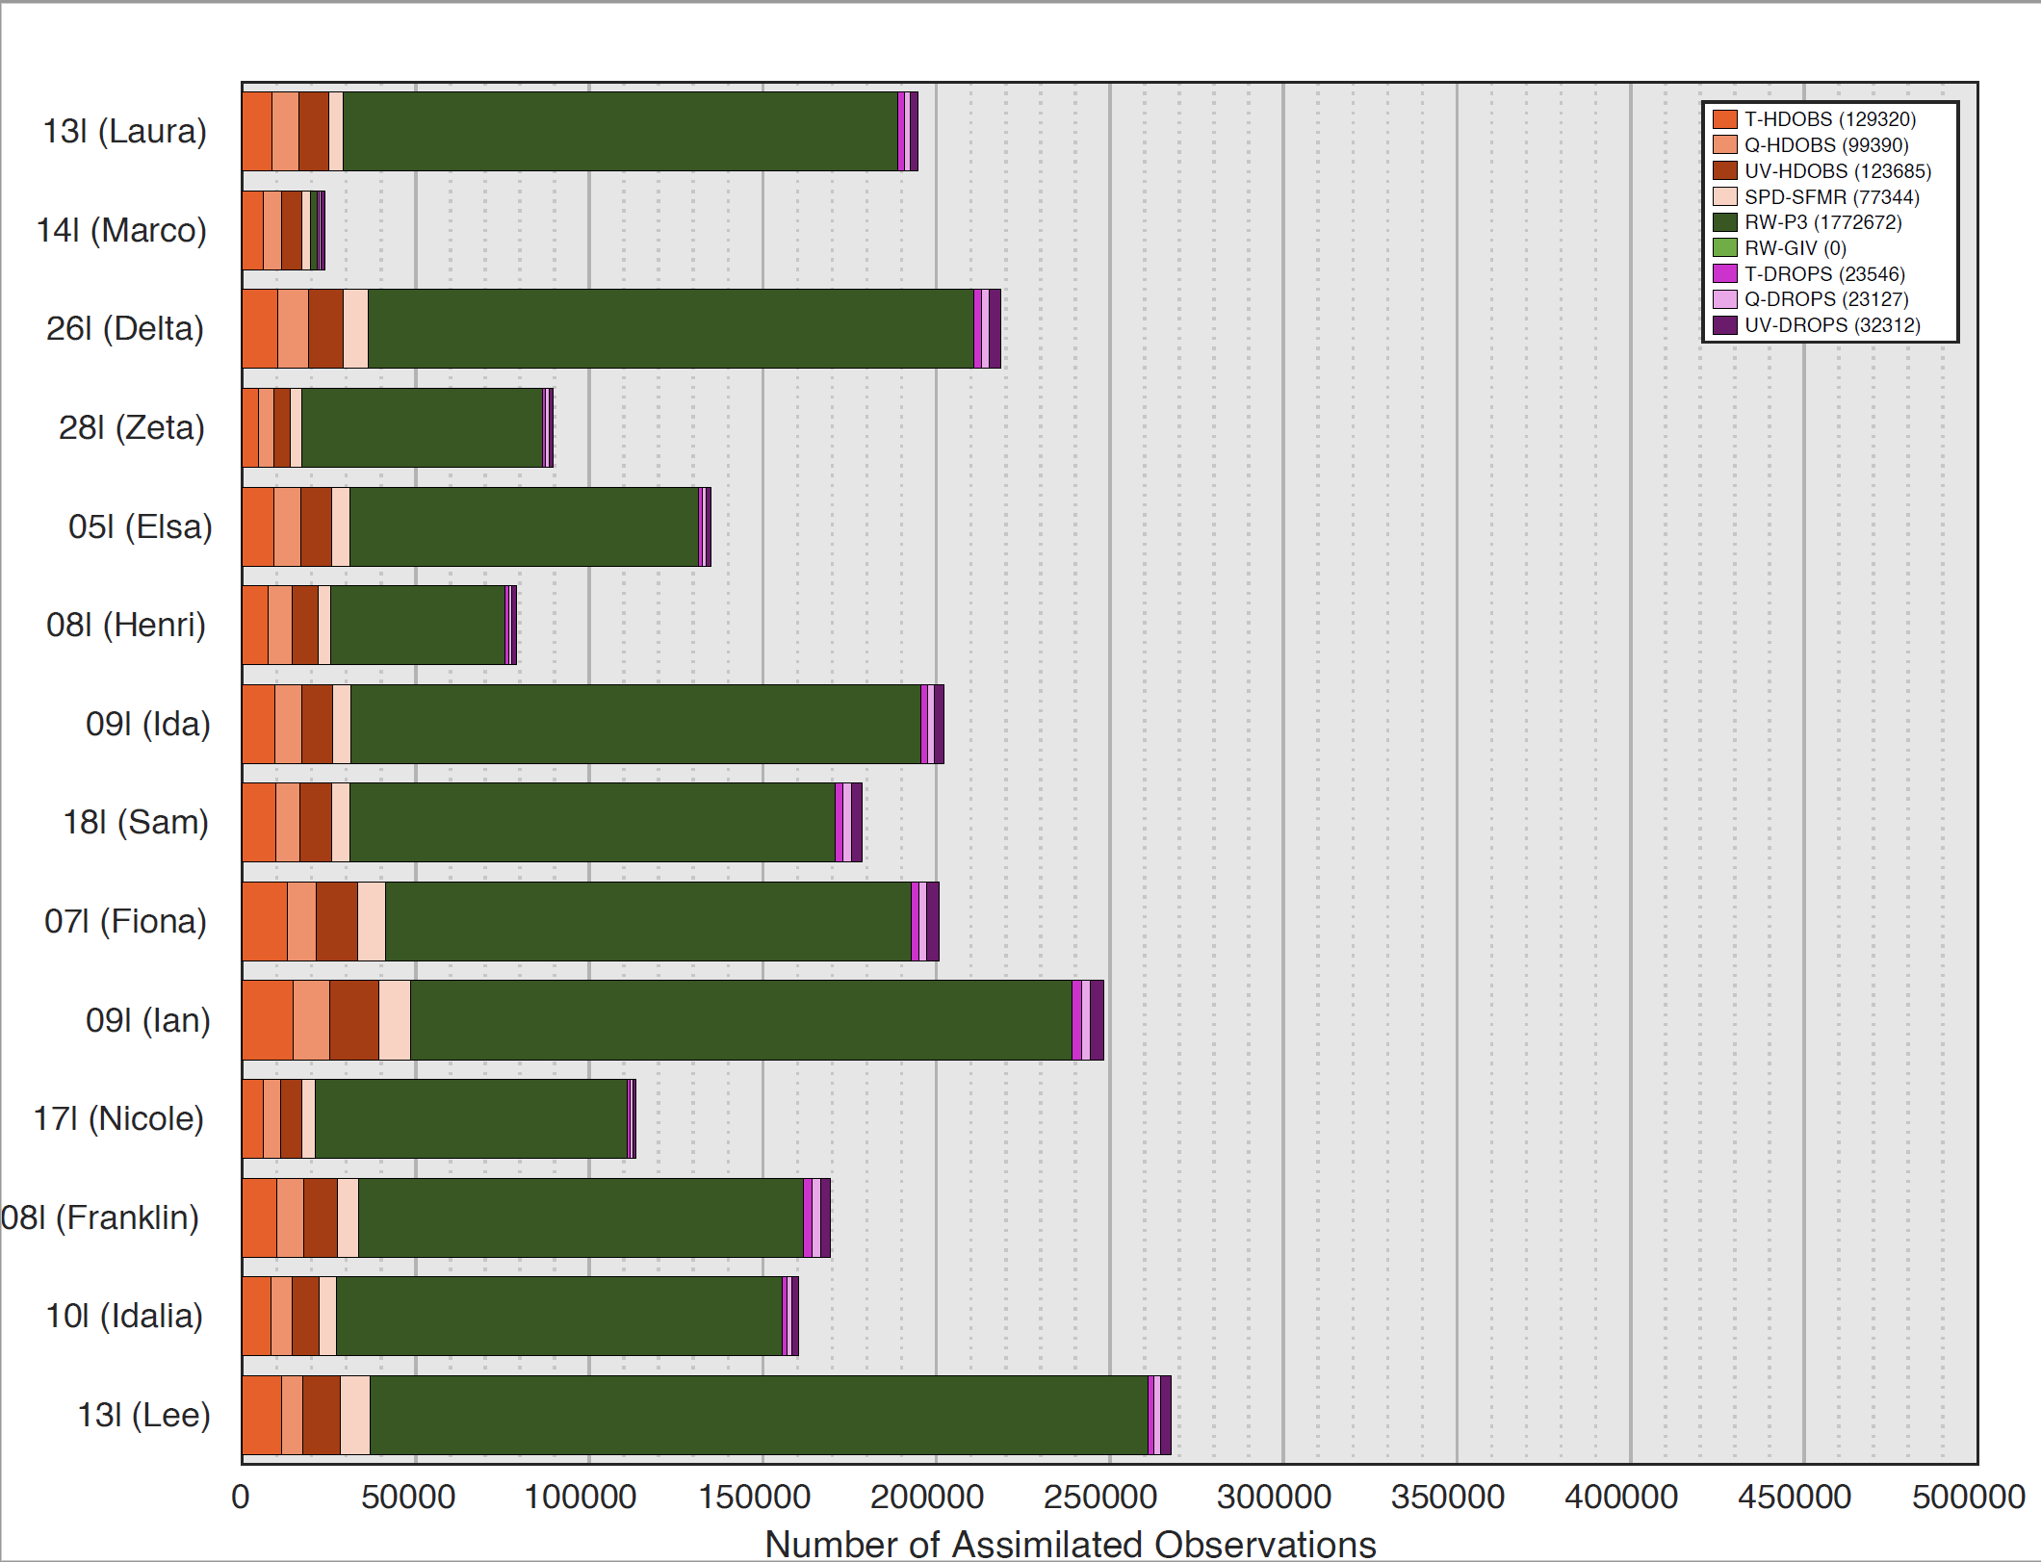
Background
Composite Results
HU Lee (2023)
Fin.
*Values represent HAFSv1-A. HAFSv1-B values are similar: ALL-R had 1,126 more & NOG4 had 874 fewer
Assimilated* Recon Observations
G-IV RECON: 25% of total assimilated recon observations
ALL-R
NOG4
13L (LAURA)
14L (MARCO)
26L (DELTA)
28L (ZETA)
05L (ELSA)
08L (HENRI)
09L (IDA)
18L (SAM)
07l (FIONA)
09L (IAN)
17L (NICOLE)
08L (FRANKLIN)
10L (IDALIA)
13L (LEE)
N=3,062,942
N=2,281,396

Slide 24
Background
Composite Results
HU Lee (2023)
Fin.
*Values represent HAFSv1-A. HAFSv1-B values are similar: ALL-R had 1,126 more & NOG4 had 874 fewer
Assimilated* Recon Observations
G-IV RECON: 25% of total assimilated recon observations
ALL-R
NOG4
13L (LAURA)
14L (MARCO)
26L (DELTA)
28L (ZETA)
05L (ELSA)
08L (HENRI)
09L (IDA)
18L (SAM)
07l (FIONA)
09L (IAN)
17L (NICOLE)
08L (FRANKLIN)
10L (IDALIA)
13L (LEE)
N=3,062,942
N=2,281,396
% REMOVED IN NOG4
<75 km: 2.6% | 75-250 km: 19.7% | >250 km: 70.7%
579,402 🡪 564,120
1,939,816 🡪 1,558,144
543,724 🡪 159,132

Slide 25
Background
Composite Results
HU Lee (2023)
Fin.
G-IV recon generally directly degr HU in HAFS-A & impr HU in HAFS-B.

Slide 26
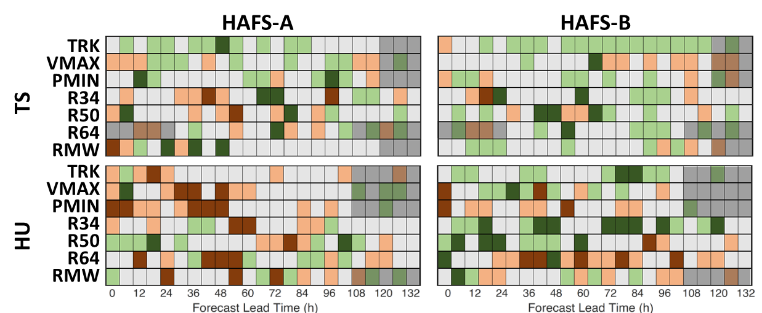
Background
Composite Results
HU Lee (2023)
Fin.
SS: W/ TS (40) | W/ H (60)
G-IV recon generally directly degr HU in HAFS-A & impr HU in HAFS-B.
W/ G-IV RECON & BY INITIAL CLASSIFICATION

Slide 27
Background
Composite Results
HU Lee (2023)
Fin.
SS: W/ TS (40) | W/ H (60)
G-IV recon generally directly degr HU in HAFS-A & impr HU in HAFS-B.
W/ G-IV RECON & BY INITIAL CLASSIFICATION

Slide 28
Background
Composite Results
HU Lee (2023)
Fin.
SS: W/ TS (40) | W/ H (60)
G-IV recon generally directly degr HU in HAFS-A & impr HU in HAFS-B.
W/ G-IV RECON & BY INITIAL CLASSIFICATION

Slide 29
Background
Composite Results
HU Lee (2023)
Fin.
SS: W/ TS (40) | W/ H (60)
G-IV recon generally directly degr HU in HAFS-A & impr HU in HAFS-B.
W/ G-IV RECON & BY INITIAL CLASSIFICATION

Slide 30
Background
Composite Results
HU Lee (2023)
Fin.
SS: W/ TS (40) | W/ H (60)
G-IV recon generally directly degr HU in HAFS-A & impr HU in HAFS-B.
W/ G-IV RECON & BY INITIAL CLASSIFICATION
What is driving degr in HAFS-A but impr in HAFS-B for HU?

Slide 31
Background
Composite Results
HU Lee (2023)
Fin.
HU Lee (2023) drove most of the disparities between HAFS versions!

Slide 32
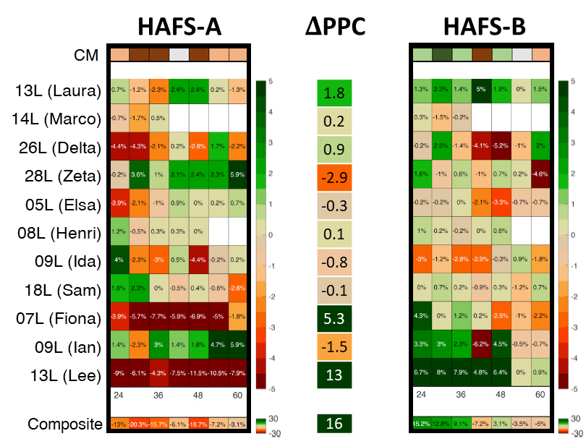
Background
Composite Results
HU Lee (2023)
Fin.
HU Lee (2023) drove most of the disparities between HAFS versions!
A REPRESENTATIVE EXAMPLE - VMAX

Slide 33
Background
Composite Results
HU Lee (2023)
Fin.
HU Lee (2023) drove most of the disparities between HAFS versions!
A REPRESENTATIVE EXAMPLE - VMAX

Slide 34
Background
Composite Results
HU Lee (2023)
Fin.
HU Lee (2023) drove most of the disparities between HAFS versions!
A REPRESENTATIVE EXAMPLE - VMAX

Slide 35
Background
Composite Results
HU Lee (2023)
Fin.
HU Lee (2023) drove most of the disparities between HAFS versions!
A REPRESENTATIVE EXAMPLE - VMAX

Slide 36
Background
Composite Results
HU Lee (2023)
Fin.
HU Lee (2023) drove most of the disparities between HAFS versions!
A REPRESENTATIVE EXAMPLE - VMAX
What if we stratified the sample a different way?

Slide 37
Background
Composite Results
HU Lee (2023)
Fin.
G-IV recon led to degr for SS TCs in HAFS-A, but not HAFS-B.

Slide 38
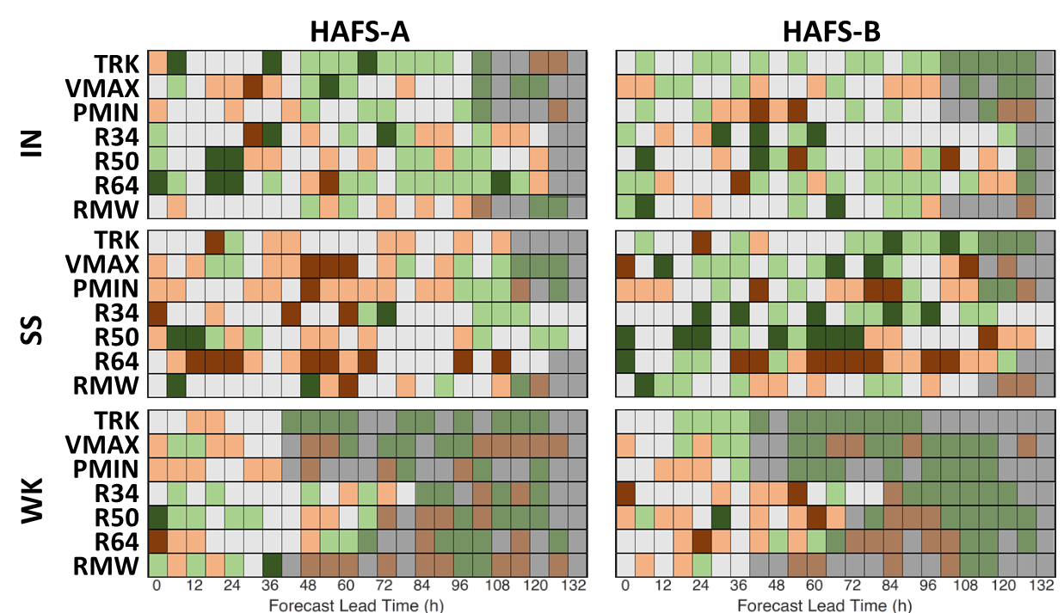
Background
Composite Results
HU Lee (2023)
Fin.
SS – 0 h: IN (40) | SS (47) | WK (15)
G-IV recon led to degr for SS TCs in HAFS-A, but not HAFS-B.
W/ G-IV RECON & BY ONGOING INTENSITY CHANGE

Slide 39
Background
Composite Results
HU Lee (2023)
Fin.
SS – 0 h: IN (40) | SS (47) | WK (15)
G-IV recon led to degr for SS TCs in HAFS-A, but not HAFS-B.
W/ G-IV RECON & BY ONGOING INTENSITY CHANGE

Slide 40
Background
Composite Results
HU Lee (2023)
Fin.
SS – 0 h: IN (40) | SS (47) | WK (15)
G-IV recon led to degr for SS TCs in HAFS-A, but not HAFS-B.
W/ G-IV RECON & BY ONGOING INTENSITY CHANGE
What is driving degr in HAFS-A but impr in HAFS-B for SS?

Slide 41
Background
Composite Results
HU Lee (2023)
Fin.
HU Lee (2023) again drove most of the disparities between versions!

Slide 42
Background
Composite Results
HU Lee (2023)
Fin.
HU Lee (2023) again drove most of the disparities between versions!
A REPRESENTATIVE EXAMPLE - VMAX

Slide 43
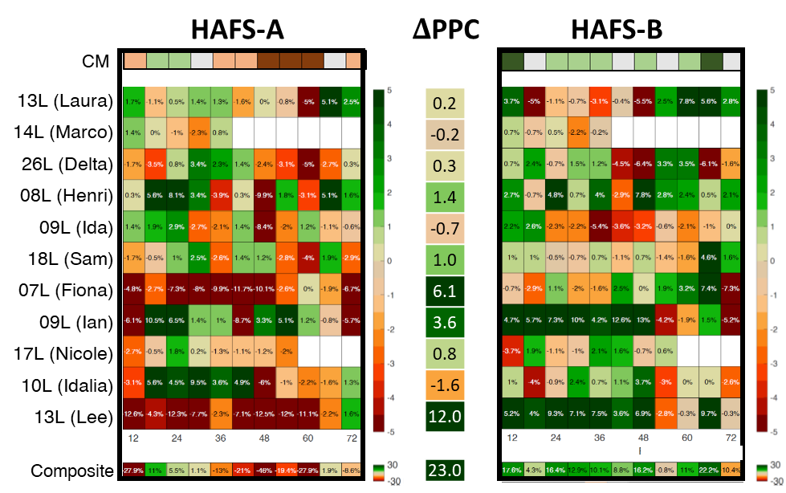
Background
Composite Results
HU Lee (2023)
Fin.
HU Lee (2023) again drove most of the disparities between versions!
A REPRESENTATIVE EXAMPLE - VMAX

Slide 44
Background
Composite Results
HU Lee (2023)
Fin.
HU Lee (2023) again drove most of the disparities between versions!
A REPRESENTATIVE EXAMPLE - VMAX
Let’s dig into HU Lee (2023)!

Slide 45
Background
Composite Results
HU Lee (2023)
Fin.
Assimilated Recon Observations

Slide 46
Background
Composite Results
HU Lee (2023)
Fin.
Assimilated Recon Observations
G-IV CYCLES: 20/22 | G-IV RECON: 44% of total assimilated recon observations

Slide 47
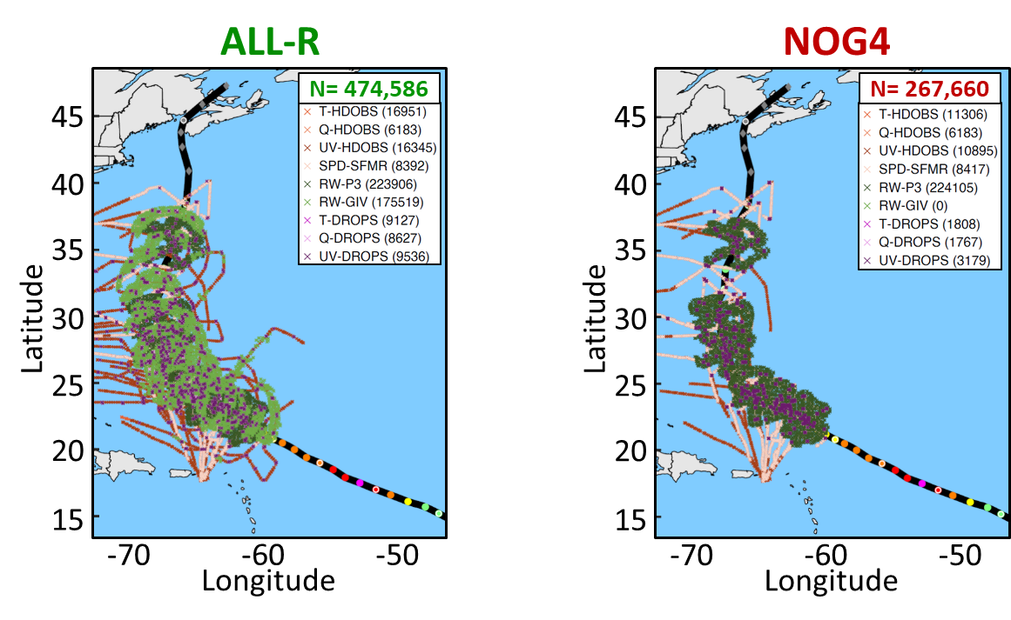
Background
Composite Results
HU Lee (2023)
Fin.
*Values represent HAFSv1-A. HAFSv1-B values are similar: ALL-R had 887 more & NOG4 had 522 more
Assimilated* Recon Observations
G-IV CYCLES: 20/22 | G-IV RECON: 44% of total assimilated recon observations

Slide 48
Background
Composite Results
HU Lee (2023)
Fin.
*Values represent HAFSv1-A. HAFSv1-B values are similar: ALL-R had 887 more & NOG4 had 522 more
Assimilated* Recon Observations
G-IV CYCLES: 20/22 | G-IV RECON: 44% of total assimilated recon observations

Slide 49
Background
Composite Results
HU Lee (2023)
Fin.
Differences between HAFS versions are most pronounced
for TRK, VMAX, and outer-wind radii.

Slide 50
Background
Composite Results
HU Lee (2023)
Fin.
Differences between HAFS versions are most pronounced
for TRK, VMAX, and outer-wind radii.
CONSISTENCY SCORECARDS

Slide 51
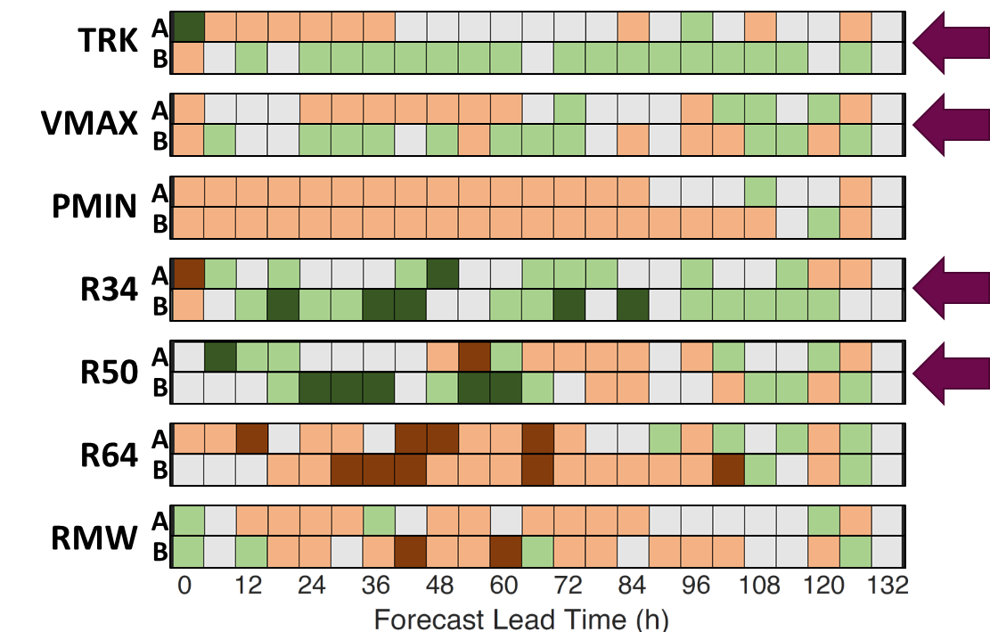
Background
Composite Results
HU Lee (2023)
Fin.
Differences between HAFS versions are most pronounced
for TRK, VMAX, and outer-wind radii.
CONSISTENCY SCORECARDS

Slide 52
Background
Composite Results
HU Lee (2023)
Fin.
Differences between HAFS versions are most pronounced
for TRK, VMAX, and outer-wind radii.
CONSISTENCY SCORECARDS

Slide 53
Background
Composite Results
HU Lee (2023)
Fin.
Differences between HAFS versions are most pronounced
for TRK, VMAX, and outer-wind radii.
CONSISTENCY SCORECARDS

Slide 54
Background
Composite Results
HU Lee (2023)
Fin.
Differences between HAFS versions are most pronounced
for TRK, VMAX, and outer-wind radii.
CONSISTENCY SCORECARDS

Slide 55
Background
Composite Results
HU Lee (2023)
Fin.
Differences between HAFS versions are most pronounced
for TRK, VMAX, and outer-wind radii.
CONSISTENCY SCORECARDS

Slide 56
Background
Composite Results
HU Lee (2023)
Fin.
Differences between HAFS versions are most pronounced
for TRK, VMAX, and outer-wind radii.
CONSISTENCY SCORECARDS

Slide 57
Background
Composite Results
HU Lee (2023)
Fin.
Differences between HAFS versions are most pronounced
for TRK, VMAX, and outer-wind radii.
CONSISTENCY SCORECARDS

Slide 58
Background
Composite Results
HU Lee (2023)
Fin.
G-IV recon impr TRK forecasts in HAFS-B but not in HAFS-A,
likely due to a reduction in along-track bias.

Slide 59
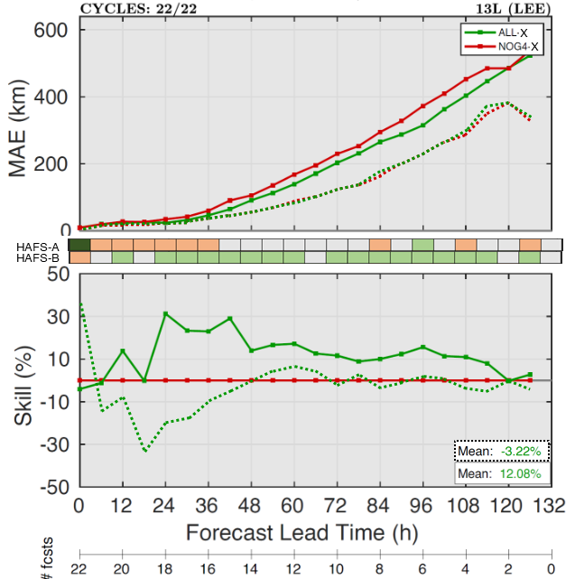
Background
Composite Results
HU Lee (2023)
Fin.
G-IV recon impr TRK forecasts in HAFS-B but not in HAFS-A,
likely due to a reduction in along-track bias.
MAE, MAE SKILL, & CONSISTENCY METRIC | ATE PERFORMANCE

Slide 60
Background
Composite Results
HU Lee (2023)
Fin.
G-IV recon impr TRK forecasts in HAFS-B but not in HAFS-A,
likely due to a reduction in along-track bias.
MAE, MAE SKILL, & CONSISTENCY METRIC | ATE PERFORMANCE

Slide 61
Background
Composite Results
HU Lee (2023)
Fin.
G-IV recon impr TRK forecasts in HAFS-B but not in HAFS-A,
likely due to a reduction in along-track bias.
MAE, MAE SKILL, & CONSISTENCY METRIC | ATE PERFORMANCE

Slide 62
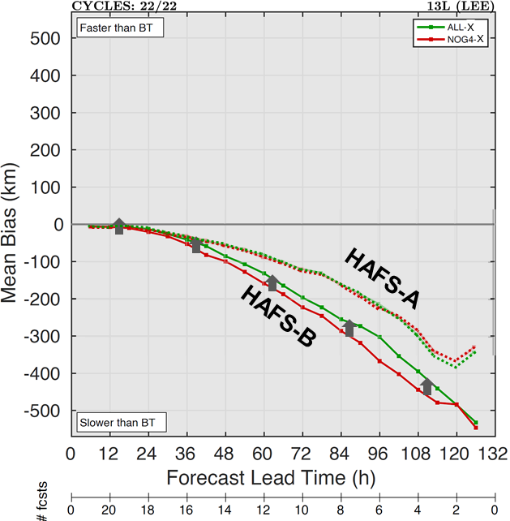
Background
Composite Results
HU Lee (2023)
Fin.
G-IV recon impr TRK forecasts in HAFS-B but not in HAFS-A,
likely due to a reduction in along-track bias.
MAE, MAE SKILL, & CONSISTENCY METRIC | ATE PERFORMANCE

Slide 63
Background
Composite Results
HU Lee (2023)
Fin.
G-IV recon impr TRK forecasts in HAFS-B but not in HAFS-A,
likely due to a reduction in along-track bias.
MAE, MAE SKILL, & CONSISTENCY METRIC | ATE PERFORMANCE
G-IV recon also reduced the bias in HAFS-B for R34 & R50.

Slide 64
Background
Composite Results
HU Lee (2023)
Fin.
VMAX MAE were low & similar across HAFS versions,
but G-IV recon impacts were distinctly different.

Slide 65
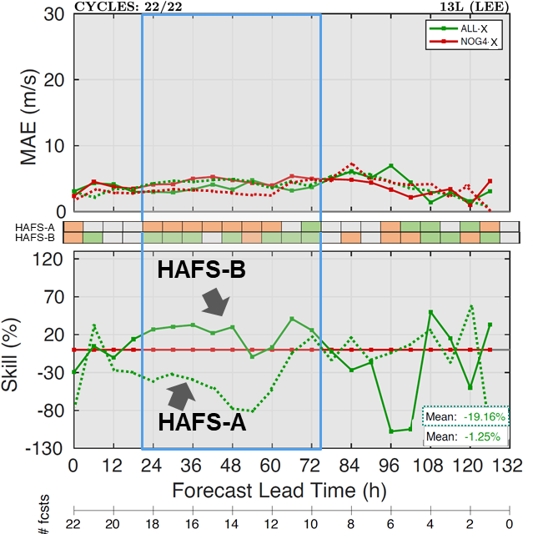
Background
Composite Results
HU Lee (2023)
Fin.
VMAX MAE were low & similar across HAFS versions,
but G-IV recon impacts were distinctly different.
MAE, MAE SKILL, & CONSISTENCY METRIC

Slide 66
Background
Composite Results
HU Lee (2023)
Fin.
G-IV recon reduced the VMAX bias in HAFS-B, but not in HAFS-A.

Slide 67
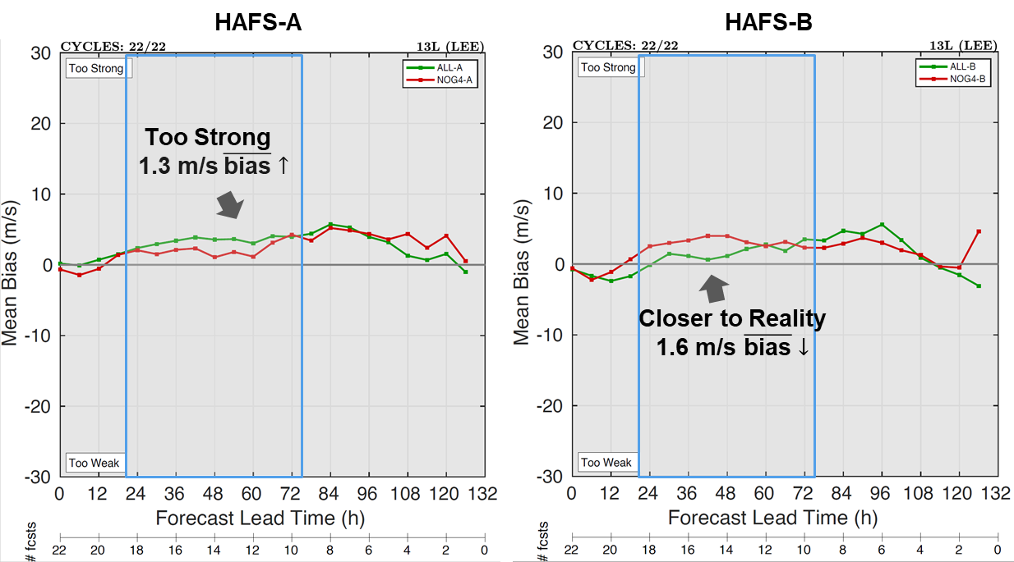
Background
Composite Results
HU Lee (2023)
Fin.
G-IV recon reduced the VMAX bias in HAFS-B, but not in HAFS-A.
BIAS PERFORMANCE

Slide 68
Background
Composite Results
HU Lee (2023)
Fin.
Can Guidance Be Delivered?

Slide 69
Background
Composite Results
HU Lee (2023)
Fin.
Can Guidance Be Delivered?
SOME THOUGHTS
G-IV RECON IMPACT Valuable in HAFS-B, but not so much in HAFS-A.

Slide 70
Background
Composite Results
HU Lee (2023)
Fin.
Can Guidance Be Delivered?
SOME THOUGHTS
G-IV RECON IMPACT Valuable in HAFS-B, but not so much in HAFS-A.
IS THAT FAIR? No! Baseline MAE is larger in HAFS-B - better “fix” to “First Guess”?

Slide 71
Background
Composite Results
HU Lee (2023)
Fin.
Can Guidance Be Delivered?
SOME THOUGHTS
G-IV RECON IMPACT Valuable in HAFS-B, but not so much in HAFS-A.
IS THAT FAIR? No! Baseline MAE is larger in HAFS-B - better “fix” to “First Guess”?
IMPLICATIONS Results might still suggest a suboptimal DA system

Slide 72
Background
Composite Results
HU Lee (2023)
Fin.
Can Guidance Be Delivered?
SOME THOUGHTS
G-IV RECON IMPACT Valuable in HAFS-B, but not so much in HAFS-A.
IS THAT FAIR? No! Baseline MAE is larger in HAFS-B - better “fix” to “First Guess”?
IMPLICATIONS Results might still suggest a suboptimal DA system
FUTURE WORK Vital to conduct OSEs with both HAFS versions!

Slide 73
Background
Composite Results
HU Lee (2023)
Fin.
Can Guidance Be Delivered?
SOME THOUGHTS
G-IV RECON IMPACT Valuable in HAFS-B, but not so much in HAFS-A.
IS THAT FAIR? No! Baseline MAE is larger in HAFS-B - better “fix” to “First Guess”?
IMPLICATIONS Results might still suggest a suboptimal DA system
FUTURE WORK Vital to conduct OSEs with both HAFS versions!
This last point has some broader impacts!

Slide 74
Background
Composite Results
HU Lee (2023)
Fin.
Broader Impacts
OSE IMPLICATIONS

Slide 75
Background
Composite Results
HU Lee (2023)
Fin.
Broader Impacts
OSE IMPLICATIONS
PRE-HAFS HWRF was the only operational model to use all transmitted recon

Slide 76
Background
Composite Results
HU Lee (2023)
Fin.
Broader Impacts
OSE IMPLICATIONS
PRE-HAFS HWRF was the only operational model to use all transmitted recon
CURRENTLY Both HAFS versions assimilate recon, so OSEs should be conducted in both HAFS versions to provide an accurate understanding of their impact

Slide 77
Background
Composite Results
HU Lee (2023)
Fin.
Broader Impacts
OSE IMPLICATIONS
PRE-HAFS HWRF was the only operational model to use all transmitted recon
CURRENTLY Both HAFS versions assimilate recon, so OSEs should be conducted in both HAFS versions to provide an accurate understanding of their impact
RESOURCE DEMAND Large samples are vital for OSEs but are already expensive, both computationally (core hours and space) and temporally (actual hours).

Slide 78
Background
Composite Results
HU Lee (2023)
Fin.
Summary
OBJECTIVE: Quantify the sensitivity of G-IV recon impact to HAFSv1 version

Slide 79
Background
Composite Results
HU Lee (2023)
Fin.
Summary
OBJECTIVE: Quantify the sensitivity of G-IV recon impact to HAFSv1 version
TAKEAWAYS
COMPOSITE IMPACT OVERALL: G-IV recon generally degr HAFS-A forecasts, but impr HAFS-B forecasts STRATIFICATIONS: HU and SS forecasts were degr in HAFS-A but impr in HAFS-B DRIVER: HU Lee (2023) drove most disparities found

Slide 80
Background
Composite Results
HU Lee (2023)
Fin.
Summary
OBJECTIVE: Quantify the sensitivity of G-IV recon impact to HAFSv1 version
TAKEAWAYS
COMPOSITE IMPACT OVERALL: G-IV recon generally degr HAFS-A forecasts, but impr HAFS-B forecasts STRATIFICATIONS: HU and SS forecasts were degr in HAFS-A but impr in HAFS-B DRIVER: HU Lee (2023) drove most disparities found
CASE STUDY IMPACT - HU LEE (2023) OVERALL: G-IV recon impr TRK, VMAX, & outer-wind radii forecasts in HAFS-B by reducing the bias VMAX ODDITY: G-IV recon decreased the bias in HAFS-B, but increased it in HAFS-A

Slide 81
Background
Composite Results
HU Lee (2023)
Fin.
Summary
OBJECTIVE: Quantify the sensitivity of G-IV recon impact to HAFSv1 version
TAKEAWAYS
COMPOSITE IMPACT OVERALL: G-IV recon generally degr HAFS-A forecasts, but impr HAFS-B forecasts STRATIFICATIONS: HU and SS forecasts were degr in HAFS-A but impr in HAFS-B DRIVER: HU Lee (2023) drove most disparities found
CASE STUDY IMPACT - HU LEE (2023) OVERALL: G-IV recon impr TRK, VMAX, & outer-wind radii forecasts in HAFS-B by reducing the bias VMAX ODDITY: G-IV recon decreased the bias in HAFS-B, but increased it in HAFS-A
FUTURE WORK
1) Dig into other TCs where differences existed
2) Investigate omg and omg differences between versions
3) Asses “First Guess” differences (i.e., prior to DA)

Slide 82
Background
Composite Results
HU Lee (2023)
Fin.
The Sensitivity of the Impact of
G-IV Reconnaissance Data to HAFSv1 Version
TAKEAWAYS
COMPOSITE IMPACT OVERALL: G-IV recon generally degr HAFS-A forecasts, but impr HAFS-B forecasts STRATIFICATIONS: HU and SS forecasts were degr in HAFS-A but impr in HAFS-B DRIVER: HU Lee (2023) drove most disparities found
CASE STUDY IMPACT - HU LEE (2023) OVERALL: G-IV recon impr TRK, VMAX, & outer-wind radii forecasts in HAFS-B by reducing the bias VMAX ODDITY: G-IV recon decreased the bias in HAFS-B, but increased it in HAFS-A
THANK YOU FOR LISTENING!
Dr. Sarah D. Ditchek
Email: sarah.d.ditchek@noaa.gov
Website

Slide 84
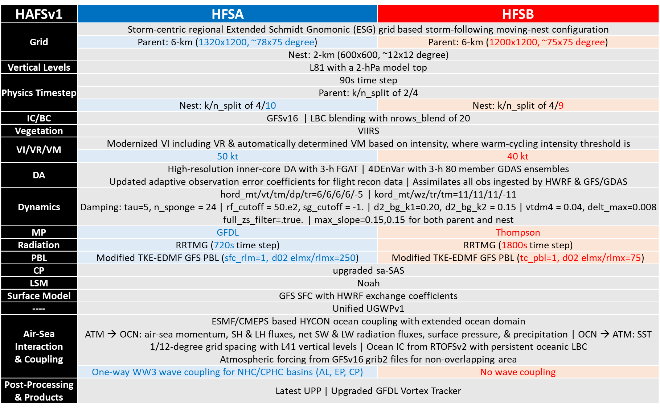
BONUS SLIDES
HAFSv1 Model | Specs

Slide 85
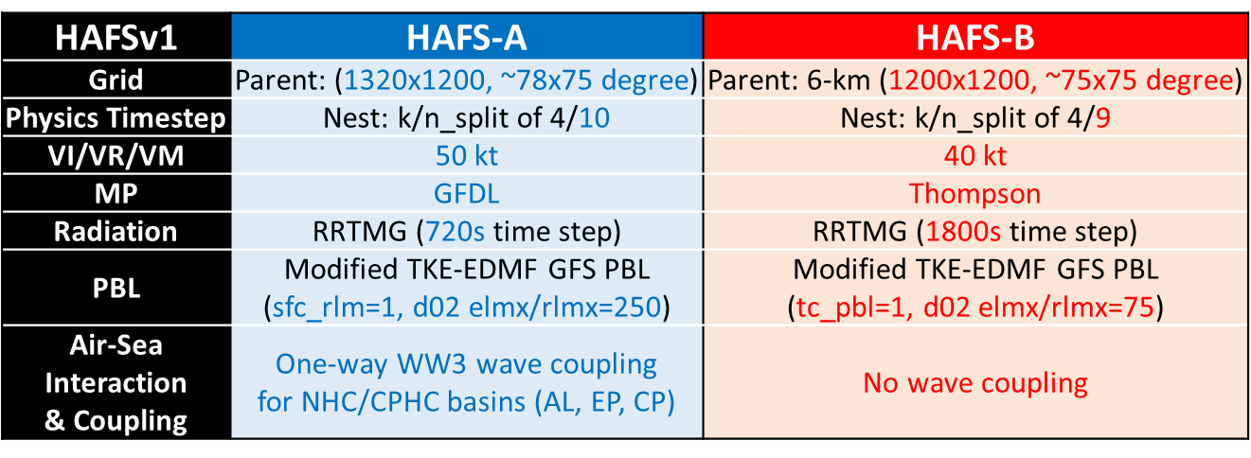
BONUS SLIDES
HAFSv1 Model | Differences Isolated

Slide 86
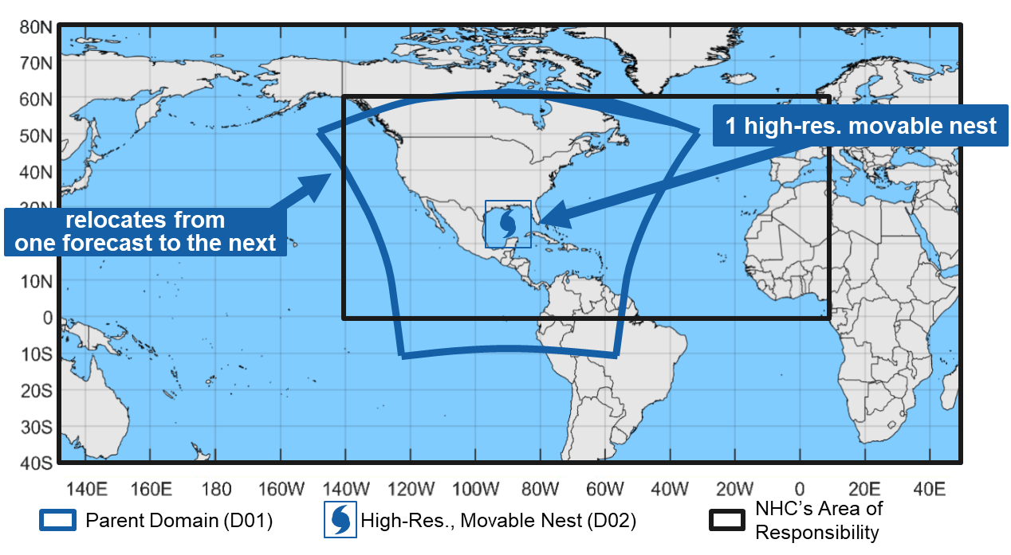
BONUS SLIDES
HAFSv1 Model | Domain

Slide 87
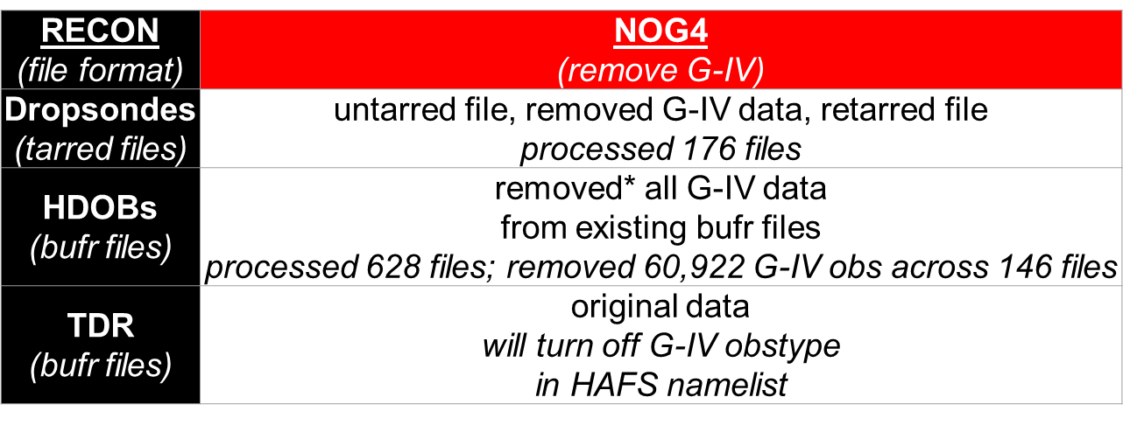
BONUS SLIDES
*HDOB bufr-modification scripts provided by Kathryn Sellwood (CIMAS/AOML)
Partitioning G-IV Recon
Needed to manually partition G-IV recon (dropsondes, HDOBs, TDR)
Identified each cycle 1) with G-IV flights, 2) with G-IV flights that had
standard patterns, and 3) with G-IV flights that had an inner-circs

Slide 88
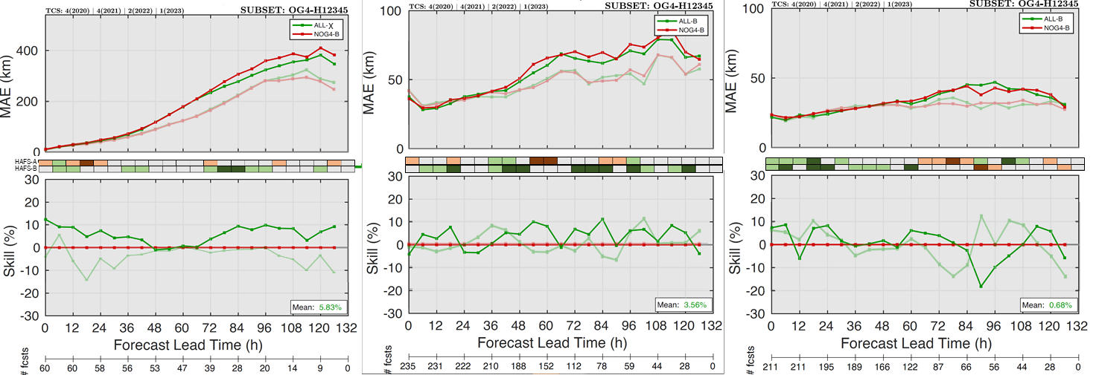
BONUS SLIDES
MAE characteristics btw HAFS versions differ for TRK, R34, & R50.
FULL SAMPLE STRATIFIED BY HU W/ G-IV RECON

Slide 89
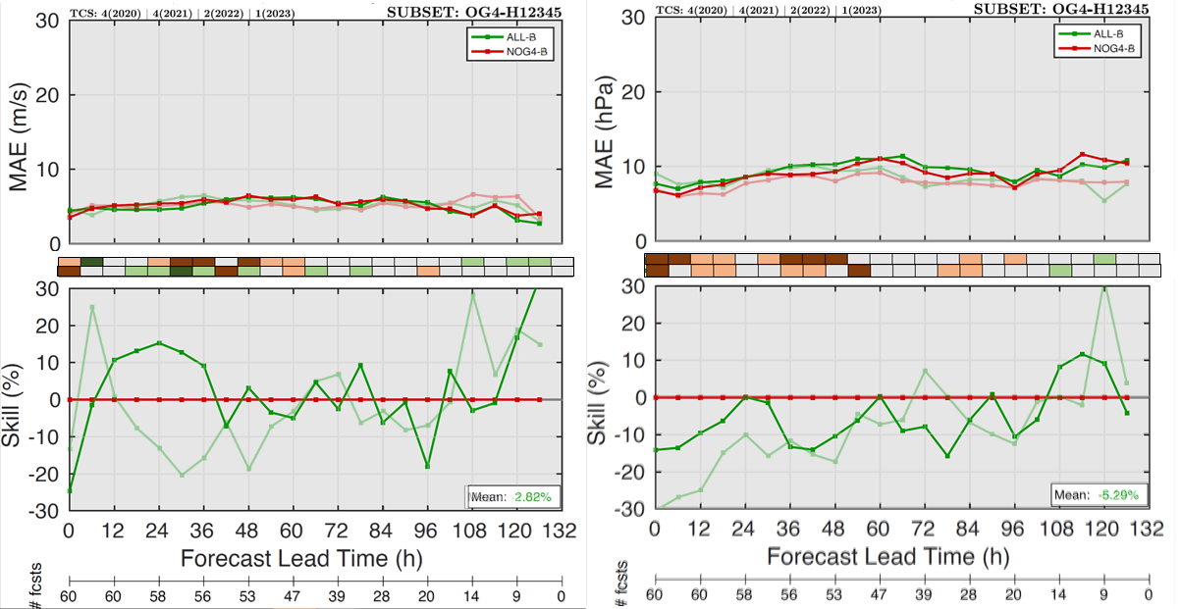
BONUS SLIDES
MAE characteristics btw HAFS versions are more similar for intensity.
FULL SAMPLE STRATIFIED BY HU W/ G-IV RECON

Slide 90
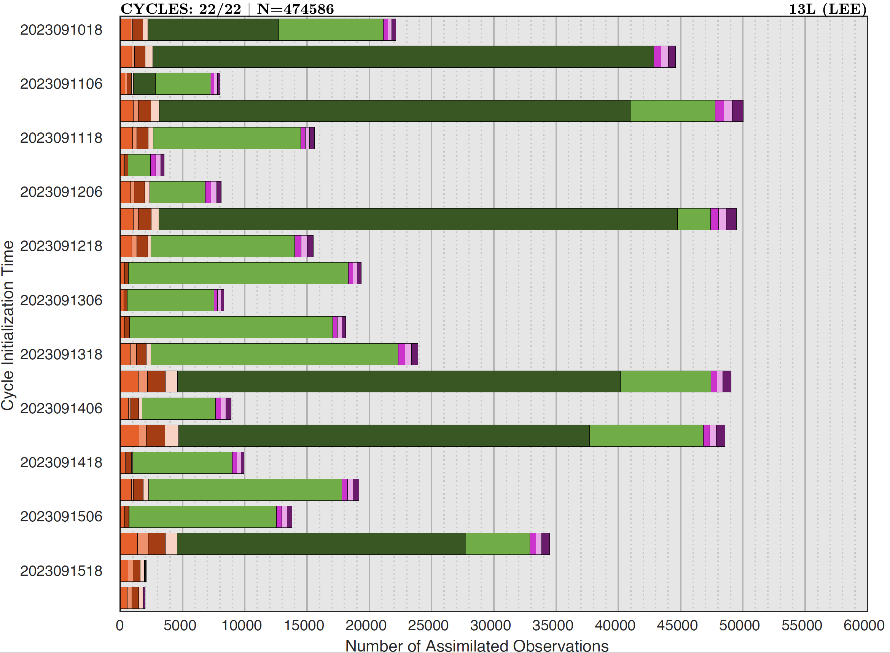
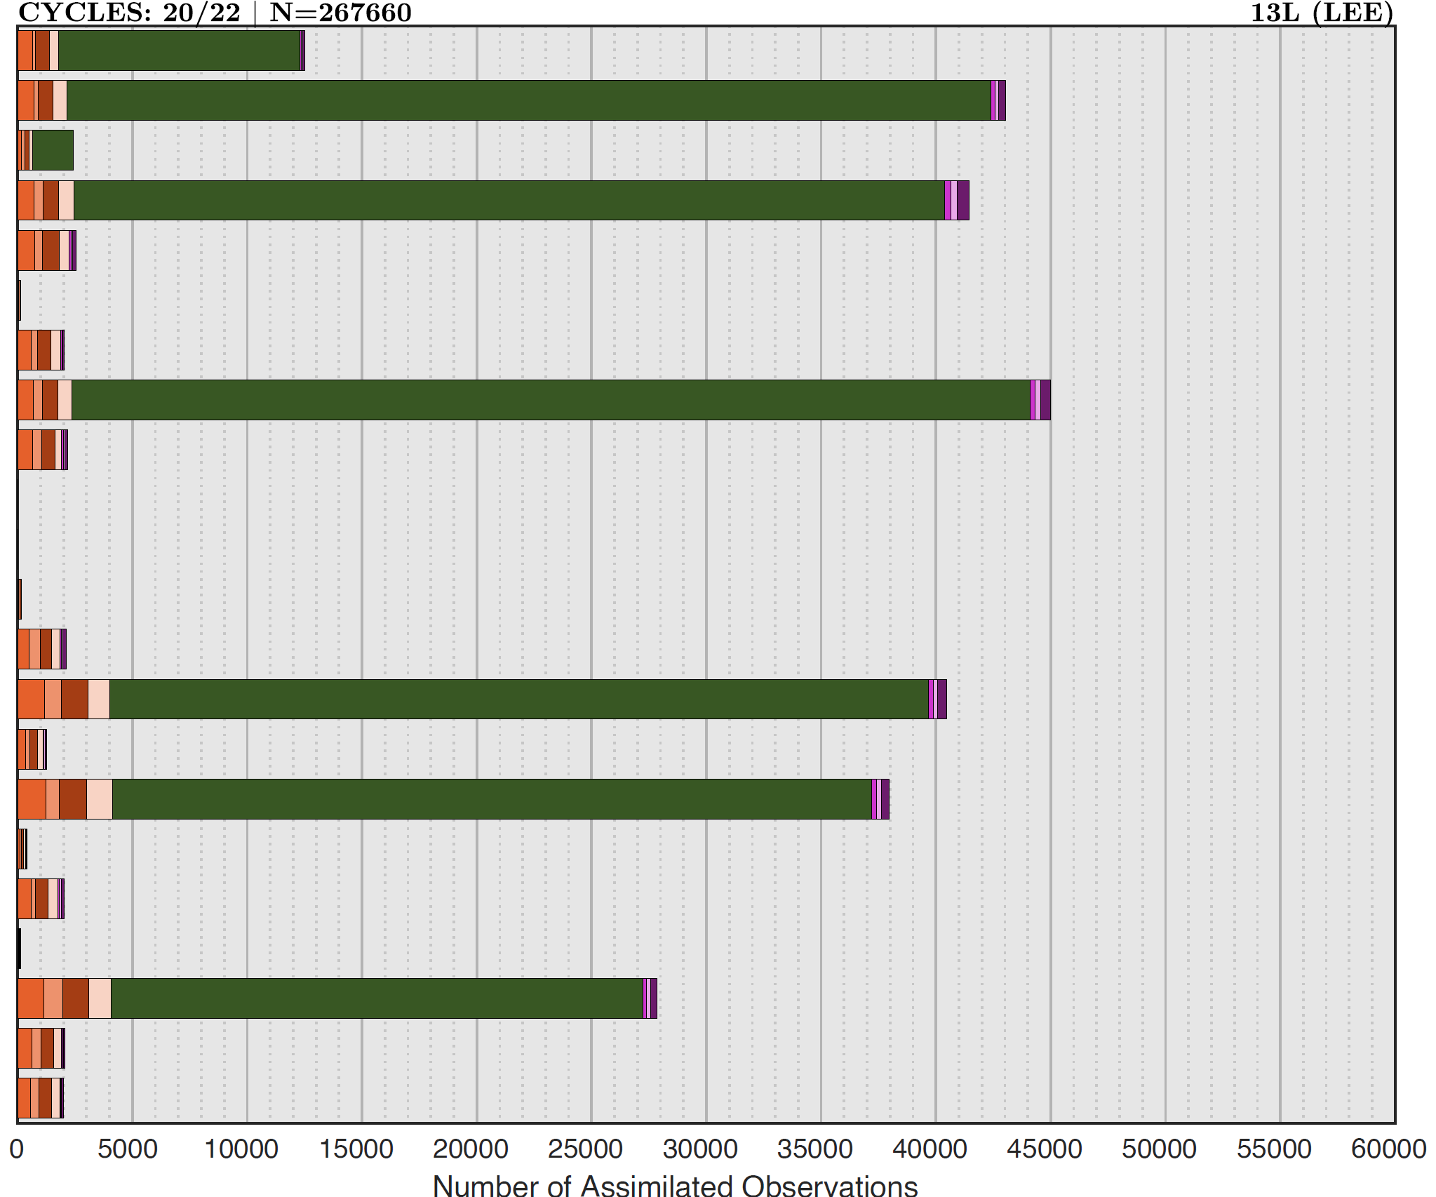
BONUS SLIDES
*Values represent HAFSv1-A. HAFSv1-B values are similar: ALL-R had 887 more & NOG4 had 522 more
Assimilated* Recon Obs | HU Lee (2023)
G-IV CYCLES: 20/22 | G-IV RECON: 44% of total assimilated recon observations

Slide 91
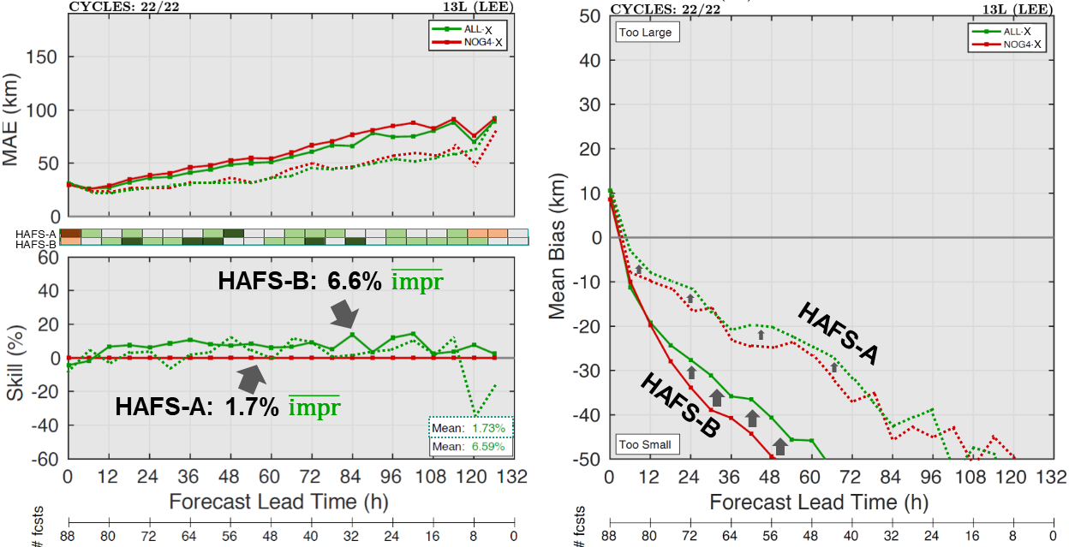
BONUS SLIDES
G-IV recon impr R34 forecasts in HU Lee (2023), likely by reducing the size bias. Both the impr and bias reduction was greater in HAFS-B.
MAE, MAE SKILL, & CONSISTENCY METRIC | BIAS PERFORMANCE

Slide 92
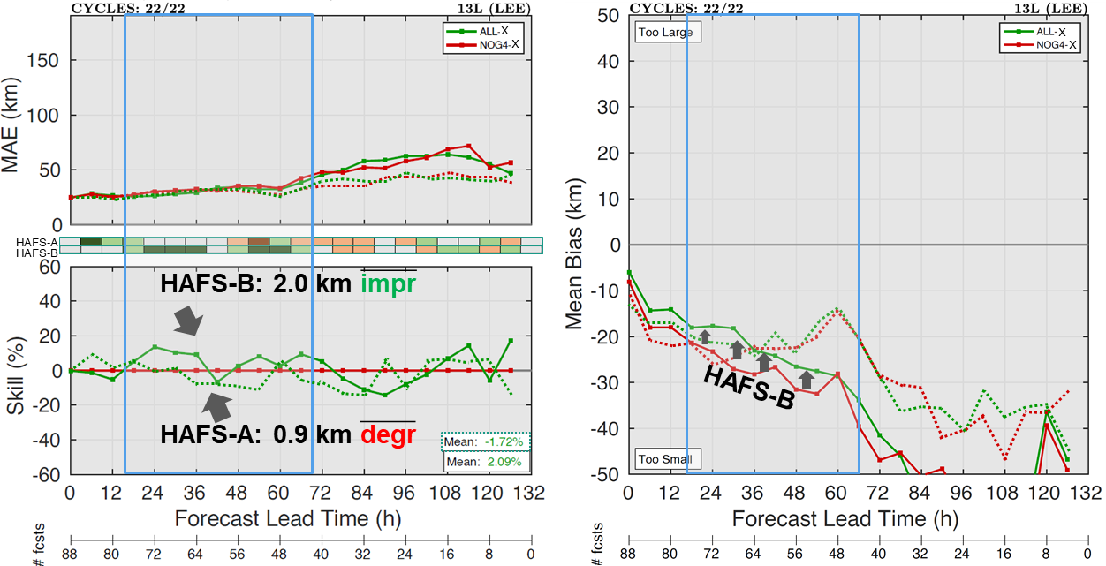
BONUS SLIDES
G-IV recon impr R50 HAFS-B forecasts at SLT in HU Lee (2023),
likely by reducing the size bias.
MAE, MAE SKILL, & CONSISTENCY METRIC | BIAS PERFORMANCE

Slide 93
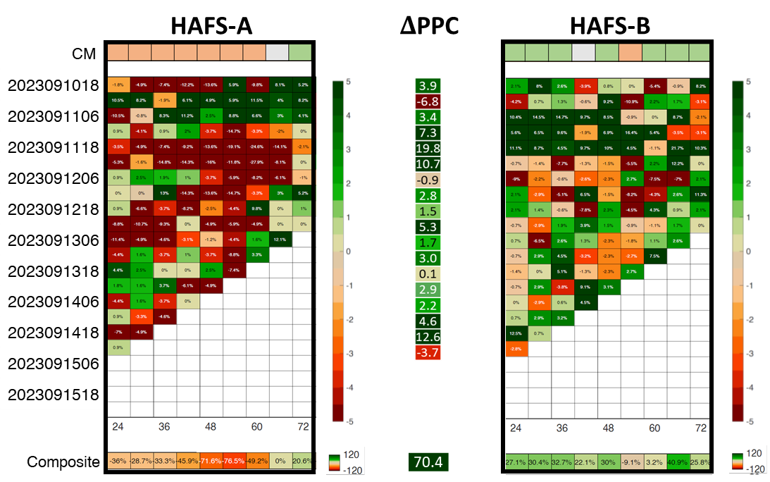
BONUS SLIDES
Relative to HAFS-A, HAFS-B had VMAX impr
in nearly every cycle of HU Lee (2023).
PPC GRAPHIC

Slide 94
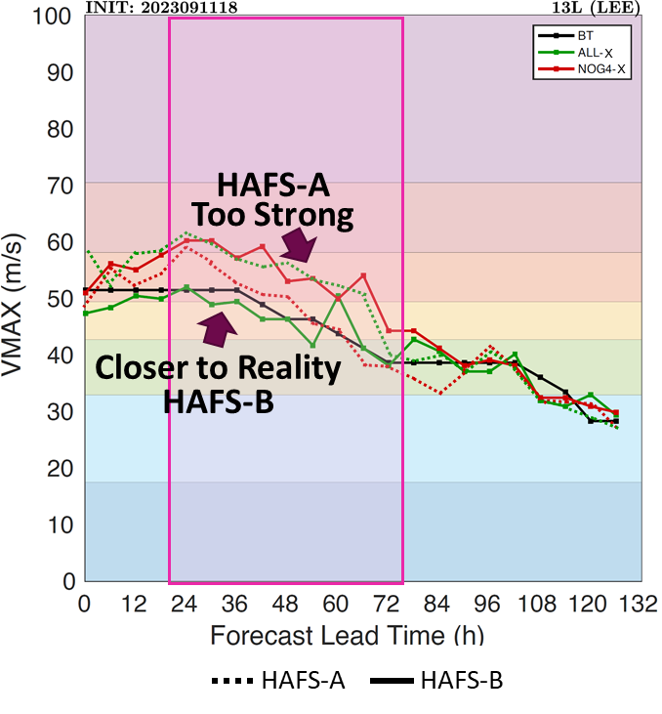
BONUS SLIDES
HU Lee (2023) | VMAX Trace
CYCLE WITH LARGEST 𝚫PPC

Slide 95
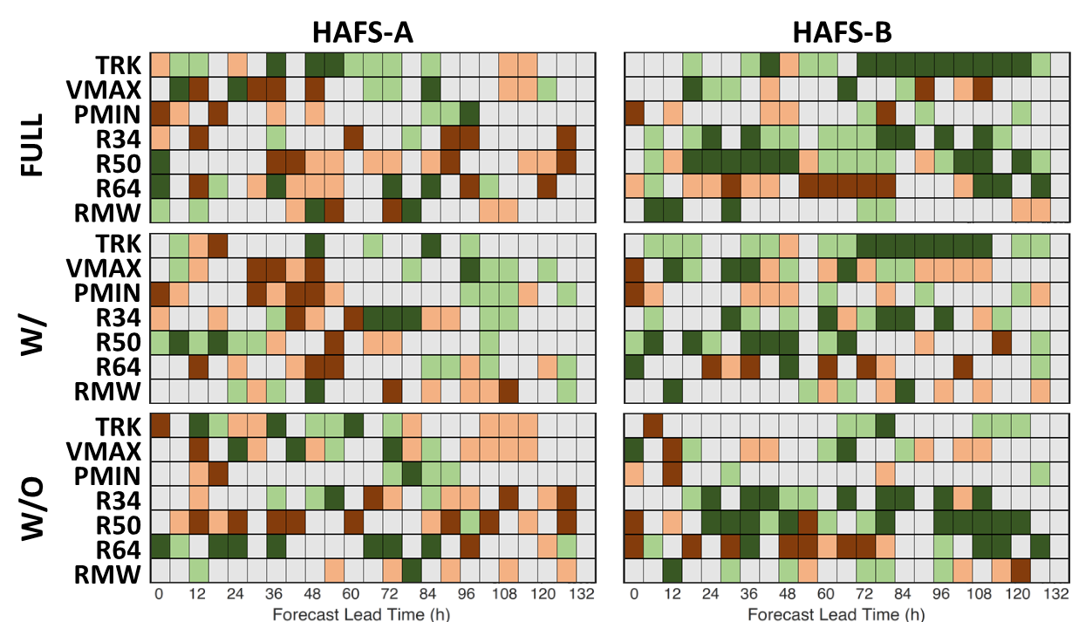
BONUS SLIDES
SS – 0 h: FULL (297) | W/ (102) | W/O (195)
Overall, G-IV recon impr TC forecasts if assimilated in HAFS-B.
FULL SAMPLE & BY G-IV RECON AVAIL

