Slide 1
Development of the Cloud and Vertical Velocity Initialization Process in the HAFS Vortex Initialization
JungHoon Shin¹, Zhan Zhang², Bin Liu¹, Yonghui Weng¹, Chuan-Kai Wang³, Qingfu Liu², Avichal Mehra², Vijay Tallapgrada²
¹Lynker at NOAA/NWS/NCEP/EMC; ²NOAA/NWS/NCEP/EMC; ³Readline at NOAA/NWS/NCEP/EMC

Slide 2
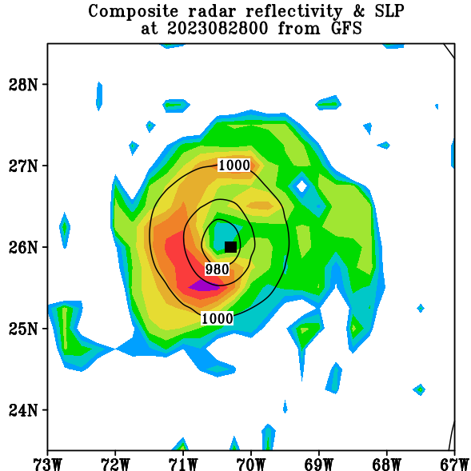
1. Introduction
VI issue in the previous operational HAFS
Example: Hurricane Franklin 08L cycle 2023082800: 85 kt/964 hPa
GFS analysis
Previous operational HAFSv1A
HAFS uses the HWRF-type Vortex initialization (VI) that modifies the horizontal wind, temperature, specific humidity, and pressure fields (NOT cloud and vertical wind fields)
Cloud and vertical wind fields are not zero in the initial condition of HAFS
TC vortex from HAFS
VI needs to be upgraded for HAFS to improve cloud and vertical wind fields
Improved initial cloud field can provide rooms for further DA development (e.g., cloud radiance DA)
GFS cloud in wrong position
Black square: Best track position

Slide 3
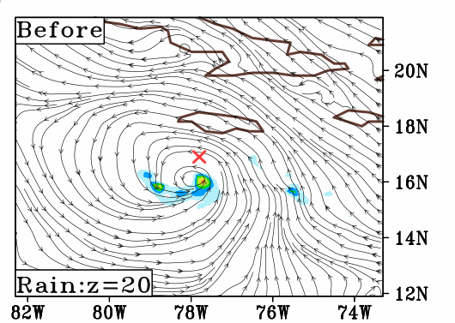
2. Cloud relocation/cycling in HAFS-VI
Cold start cycle example: 2020 26L Delta (TD stage, cycle: 2020100506)
Cold start cycle (The GFS vortex is relocated and modified): VI relocates the GFS cloud and vertical velocity fields.
Warm start cycle (The HAFS vortex from the previous cycle is used for the initial TC vortex): VI replaces the GFS cloud/vertical velocity fields with the HAFS field from the previous forecast cycle.
Improves cloud water, rain water, graupel, snow, and cloud ice
(+cloud ice water and rain number concentration for Thompson MP)
(Right) VI analysis field
GFS rain water mixing ratio (g/kg) in the lower troposphere, X: Best track position

Slide 4
2. Cloud relocation/cycling in HAFS-VI
Warm start cycle example: 2020 26L Delta (MH stage, cycle: 2020100618)
a) Cloud ice mixing ratio (g/kg) of the GFS background
b) Cloud ice mixing ratio (g/kg) from the HAFS 6-h forecast
c) Final VI analysis
X: Best track position
6 degree
6 degree
6 degree
The cloud (vertical velocity) field within the 6 degrees (3 degrees) from the TC center is replaced by the cloud (vertical velocity) field from the HAFS 6-h forecast

Slide 5
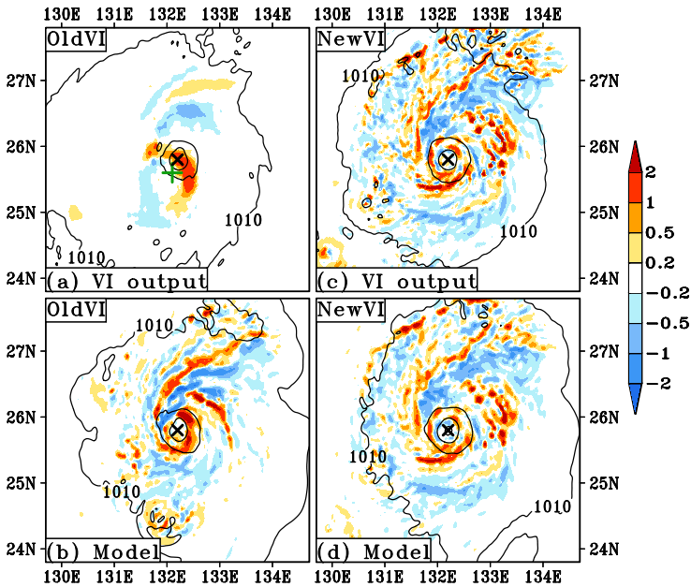
3. Vertical velocity relocation/cycling in HAFS-VI
Warm start cycle example: 2022 20W Roke (TY stage, cycle: 2022092906)
Vertical velocity (shaded: m/s) near 800-hPa level and SLP (hPa)
X: Best track position
+: GFS vortex location
a-b) Old VI (operational VI): No vertical velocity update/HAFS generates its own vertical velocity
c-d) New VI: HAFS uses the improved vertical velocity

Slide 6
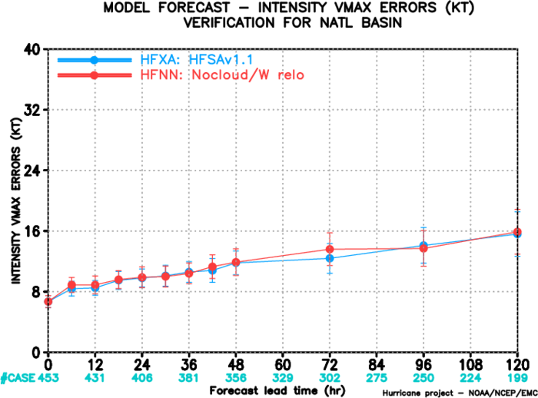
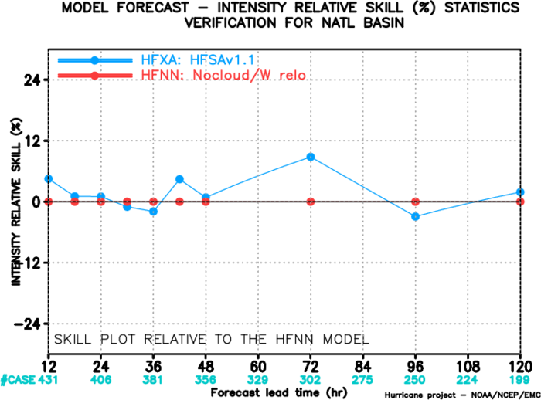
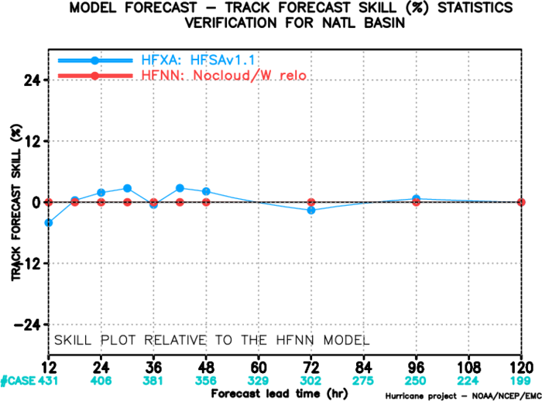
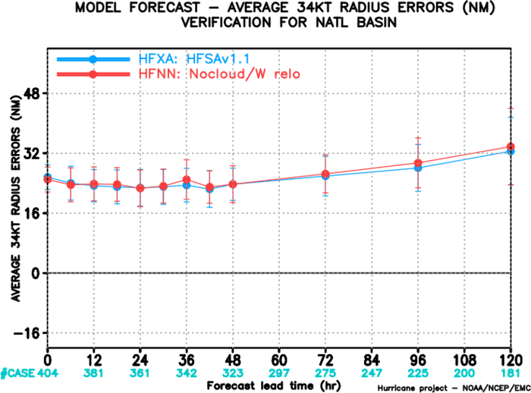
4. Results from the HAFSv1.1A real-time exp configuration
Exp | Cloud relocation/cycling | Vertical velocity relocation/cycling | Description
HFXA | Yes |  | HAFSv1.1A configuration with new VI
HFNN | No |  | HAFSv1.1A configuration with old VI
Selected TC cases
2021: Elsa, Grace, Henri, Ida, Sam
2022: Danielle, Earl, Fiona, Ian
2023: Franklin, Lee, Margot, Nigel

Slide 7
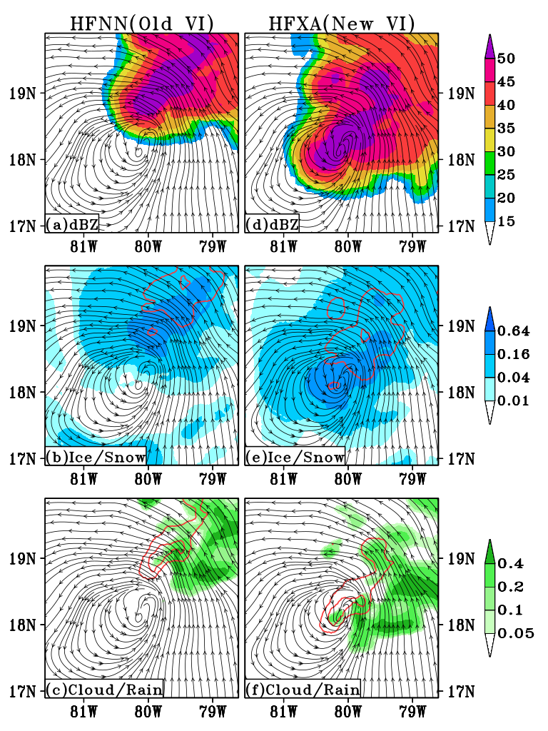
5. Cloud field improvement in the initial condition-cold start case/2021 09L Ida, Cycle: 2021082700 (35 kt)
Original vortex location
X
a-d: 850-hPa streamline with composite radar reflectivity (shaded)
b-e: 850-hPa streamline with
200-hPa cloud ice (shaded), 450-hPa snow (red contours, interval 1 g/kg)
c, f: 850-hPa streamline with
600-hPa cloud water (shaded), 700-hPa rain water (red contours, interval 1 g/kg)

Slide 8
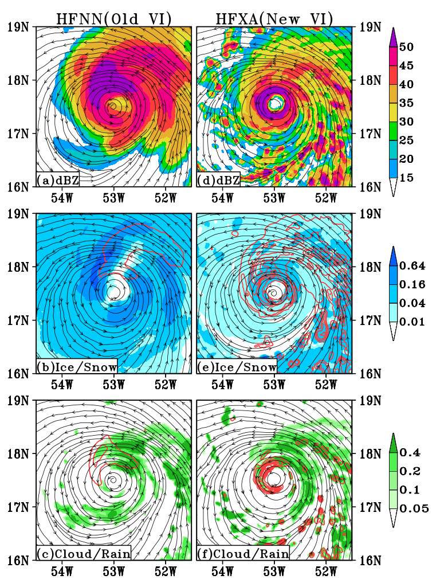
5. Cloud field improvement in the initial condition-warm start case/2023 13L Lee, cycle: 2023090806 (145 kt)
a-d: 850-hPa streamline with composite radar reflectivity (shaded)
b-e: 850-hPa streamline with
200-hPa cloud ice (shaded), 450-hPa snow (red contours, interval 1 g/kg)
c, f: 850-hPa streamline with
600-hPa cloud water (shaded), 700-hPa rain water (red contours, interval 1 g/kg)

Slide 9
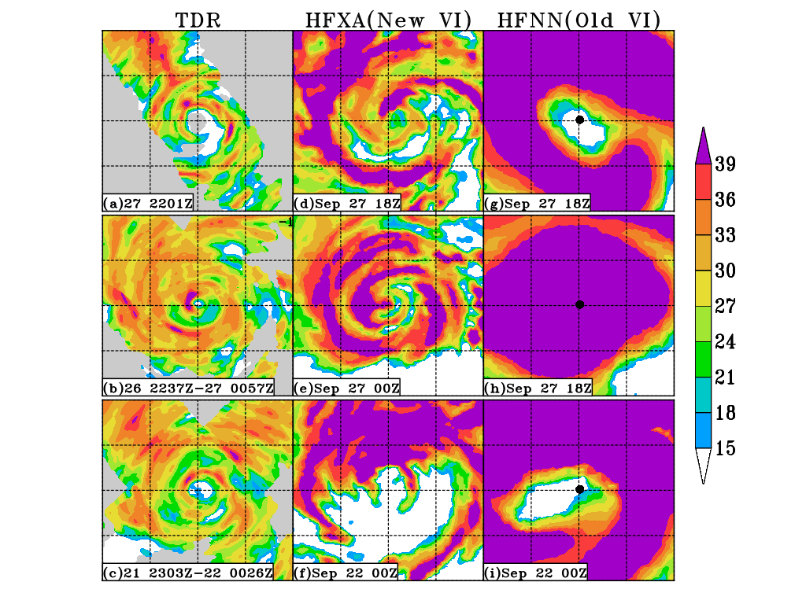
6. Model initial condition validation against TDR data (Strong TCs) 2-km radar reflectivity (dBZ)
Each grid indicates 50 by 50 km region (200 by 200 km)
2022 09L Ian
2022092718 (105 kt)
2021 18L Sam
2021092700 (130 kt)
2022 07L Fiona
2022092200 (115 kt)

Slide 10
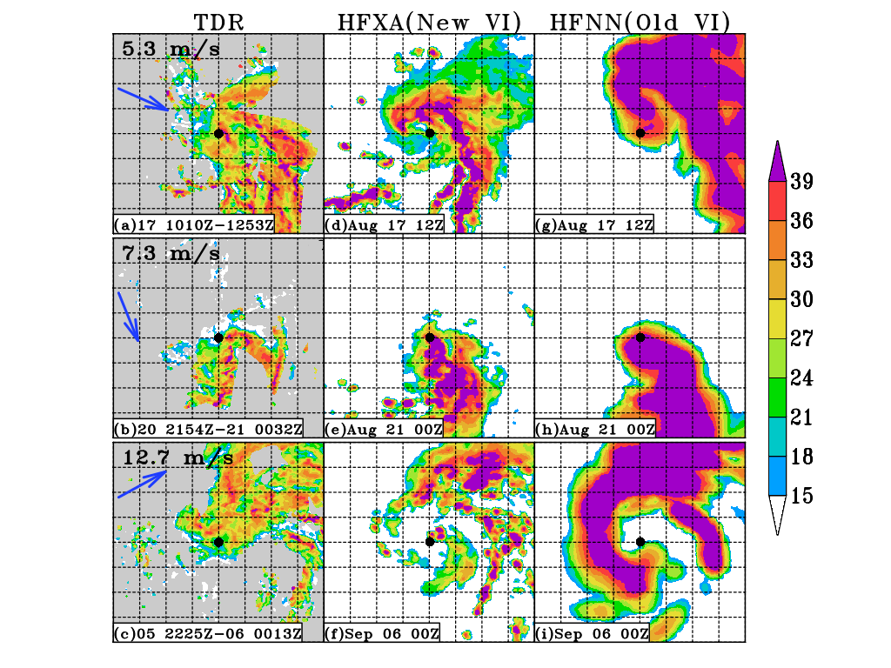
6. Model initial condition validation against TDR data (Weak TCs) 2-km radar reflectivity (dBZ)
Each grid indicates 50 by 50 km region (400 by 400 km)
Blue arrow (Vertical shear vector)
2021 07L Grace
2021081712 (45 kt)
2021 08L Henri
2021082100 (60 kt)
2022 06L Earl
2022090600 (60 kt)

Slide 11
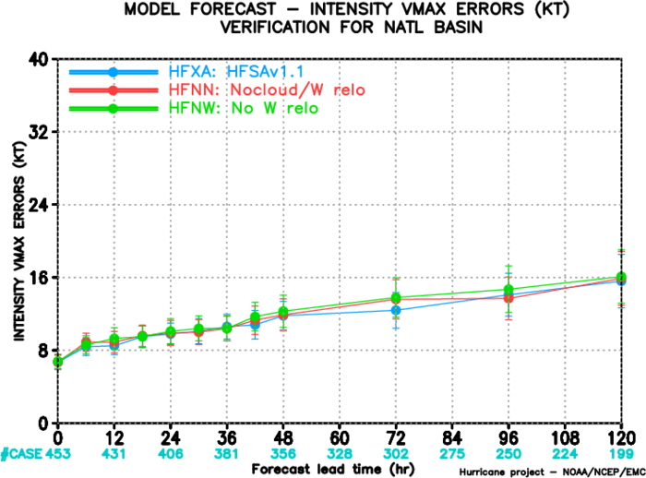
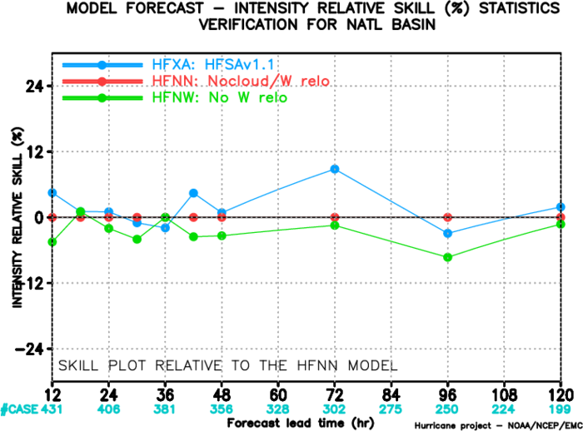
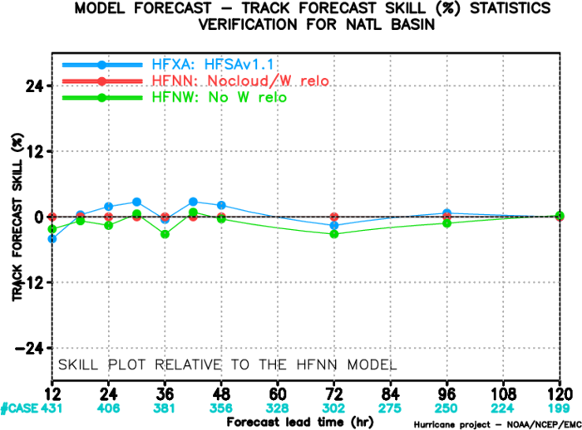
7. The impact of vertical velocity on the HAFS forecast
Cloud variables are important!! (e.g., for DA) Is vertical velocity also important??
Exp | Cloud relocation/cycling | Vertical velocity relocation/cycling | Description
HFXA | Yes |  | HAFSv1.1A configuration with new VI
HFNN | No |  | HAFSv1.1A configuration with old VI
HFNW | Yes | No | For testing the impact of vertical velocity

Slide 12
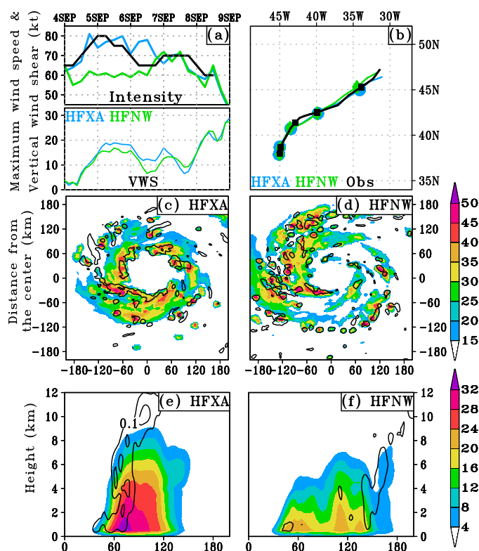
7. The impact of vertical velocity on the HAFS forecast
Case: 2022 05L Danielle (Cycle 2022090400)
Initial vortex!
c-d) Radar reflectivity (shaded) & vertical velocity (contoured at 0.3 m/s) at 2-km level
e-f) Radius-vertical cross section of azimuthally averaged radar reflectivity (shaded) & vertical velocity contoured at 0.1 and 0.3 m/s

Slide 13
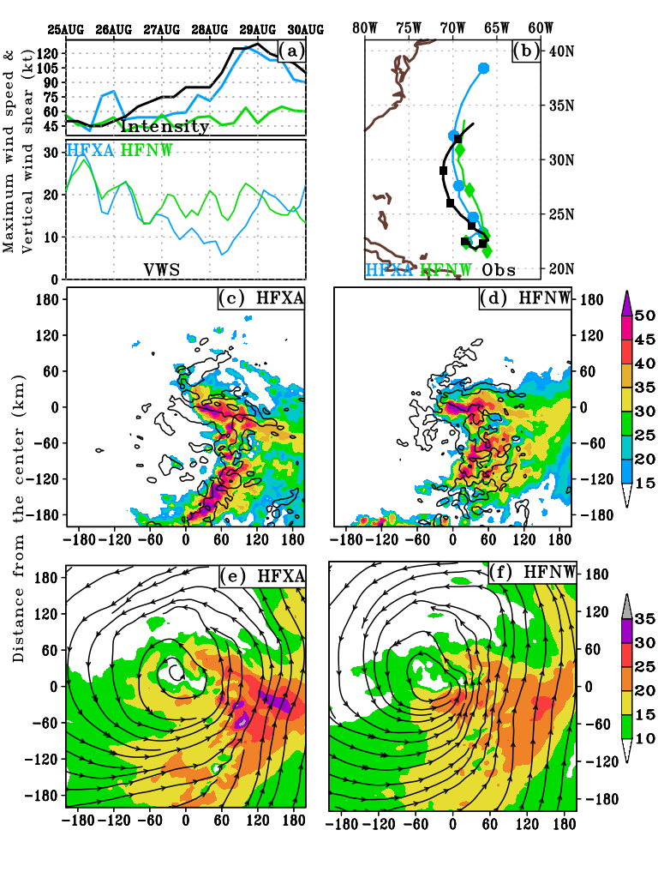
7. The impact of vertical velocity on the HAFS forecast
Case: 2023 08L Franklin (Cycle 2023082500)
Track!
c-d) Radar reflectivity (shaded) & vertical velocity (contoured at 0.3 m/s) at 2-km level
e-f) Wind speed (m/s) and streamline at 2-km level

Slide 14
8. Conclusion
Cloud and vertical velocity relocation/cycling system of HAFS-VI has been developed and tested for the 2023 real-time HAFS experiment configuration
The new HAFS-VI provides much more realistic initial cloud/convective structure than the old VI (i.e., the VI system of previous operational HAFSv1A)
This new HAFS-VI has been implemented into the operational HAFSv2A for year 2024 hurricane season.
Expect to provide the better background for further DA development
Relocating/cycling cloud field without the vertical velocity relocation/cycling in the new HAFS-VI degrades the intensity forecast (Each storm has a different story.. Need more study..)

Slide 15
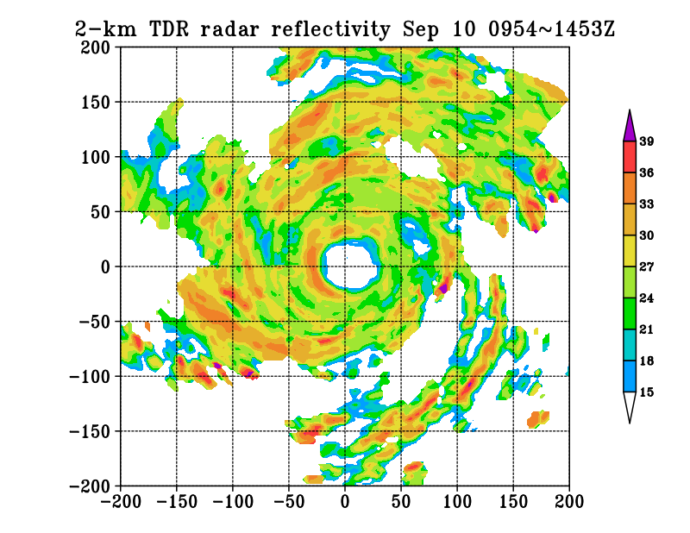
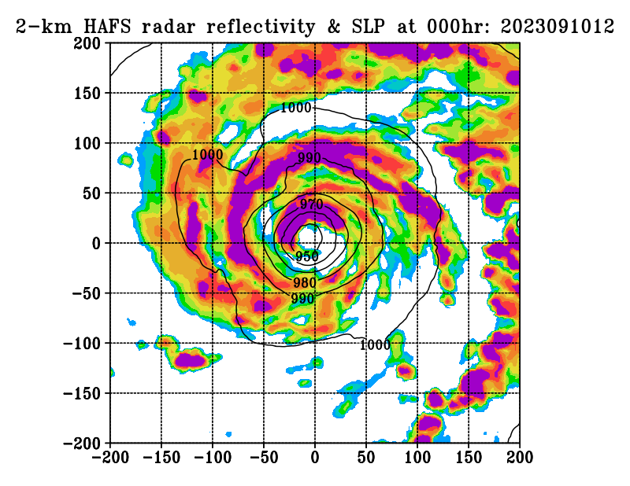
Thank you for your attention!! Any questions or comments?
Hurricane Lee (13L) HAFSAv2 model initial condition validation at Sep 10 12Z (double eyewall structure)
Distance from the TC center (km)
Obs: TDR data
HAFSAv2

Slide 16
Description for cloud relocation/cloud cycling in HAFS VI
Cold start: GFS cloud relocation
1. Cloud variables of GFS are relocated based on the storm center shifting. The GFS cloud field within in the 6 degrees from the TC center moves along the storm. (e.g., If the storm center moves 0.5 degrees northeast during VI, the cloud field moves together.)
Red X: Best track position
Red circle: The area (6 degrees) where the cloud will be relocated
Green X: GFS Vortex center from the ATCF file
Green circle: The range (6 degrees) of GFS cloud field that will be moved
30 by 30 degree GFS data for VI input
1 degree
6 degree
2. After the GFS cloud field is relocated, 9 point smoothing is performed 5~10 times in a ring-shaped area with a width of 1 degree along the boundary of the area (where the cloud has been changed) to reduce the sharp gradient of field.

Slide 17
Description for cloud relocation/cloud cycling in HAFS VI
Warm start: Cycling HAFS cloud field from previous cycle
1. The GFS cloud field within in the 6 degrees from the best track TC center is replaced by the HAFS cloud field from the previous 6-h forecast. In other words, the HAFS cloud field is merged into the GFS cloud field
Red X: Best track position
Red circle: The area (6 degrees) where the GFS cloud will be removed (replaced)
Green X: HAFS Vortex center from the ATCF file
Green circle: The range (6 degrees) of HAFS cloud field that will replace the GFS cloud field
30 by 30 degree GFS data for VI input
2. After the HAFS cloud field is merged into the GFS cloud field, 9 point smoothing is performed 5~10 times in a ring-shaped area with a width of 1 degree along the boundary of the area (where the cloud has been changed) to reduce the sharp gradient of field. This is the same procedure as previously mentioned in the cold start case.
30 by 30 degree HAFS forecast data for VI input

