Slide 1
Using Novel Observations at the Air-Sea Interface to Evaluate the Coupled Ocean-Atmosphere Background Ensemble Forecasts from a Self-Cycled HAFS Data Assimilation System for Hurricane Fiona (2022)
Tsung-Han Li¹, Xuguang Wang¹, Xu Lu¹, Yue Yang¹, Jun A. Zhang², Hyun-Sook Kim³, HeeSook Kang³, and Yongzuo Li⁴
¹Multiscale data Assimilation and Predictability (MAP) lab, University of Oklahoma
²HRD, NOAA Atlantic Oceanographic and Meteorological Laboratory (AOML)
³POD, NOAA Atlantic Oceanographic and Meteorological Laboratory (AOML)
⁴ SAIC at NOAA/NCEP/EMC
July 24, 2024
July 22-26, 2024 at Jackson, MS
2024 Unifying Innovations in Forecasting Capabilities Workshop

Slide 2
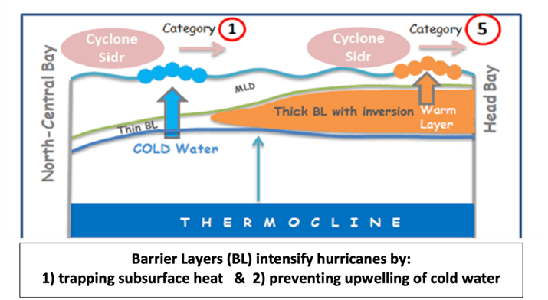
Introduction
Oceans are vital heat and energy sources that play a critical role in the development of hurricanes, working in conjunction with atmospheric changes.
Tropical cyclone (TC) intensification is highly influenced by the air–sea interactions, which can be complex when a TC interacts with oceanographic thermal distribution and profile (e.g., Lin et al. 2005, 2008; Lee and Chen 2014; Halliwell et al. 2015; Hlywiak and Nolan 2019).
https://open.substack.com/pub/stephenheins/p/critical-examination-of-hurricane?utm_campaign=post&utm_medium=web

Slide 3
Introduction
However, current data assimilation (DA) practices tend to treat the ocean and atmospheric components separately, causing inconsistencies at the air-sea interface.
Strongly coupled DA provides an avenue to obtain a consistent analysis for the coupled atmosphere-ocean system.
One critical aspect of strongly coupled DA is to establish a physically and dynamically consistent background error covariance across the air-sea boundaries.
The overall goal of this study is to advance the background ensemble covariance at the air-sea interface toward the eventual UFS HAFS fully coupled DA.

Slide 4
Specific objective of this talk
Evaluate the background ensemble at the air-sea interface from state-of-art hurricane ensemble DA system, using novel field campaign observations

Slide 5
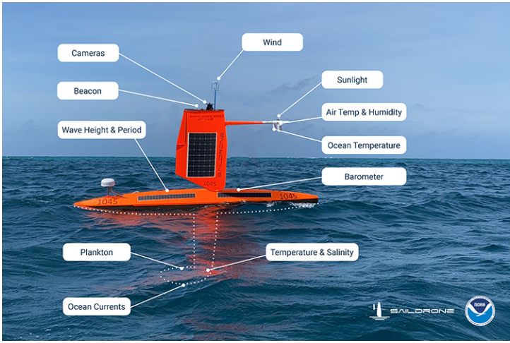
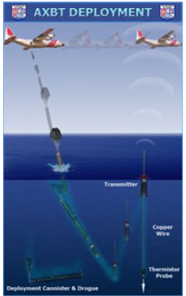
Introduction
A field campaign was conducted during Hurricane Fiona (2022) where unique observations sampling the properties at the air-sea interface were collected.
These observations included saildrone, glider, SFMR, and paired dropsonde and AXBT.
Saildrone measured air-sea interface variables including atmospheric parameters and oceanic parameters (e.g., wind, air temperature, water temperature, and salinity)
Paired dropsonde and AXBT allowed coherent measures of atmospheric boundary layer and ocean thermal structure data to depths of approximately 400 meters.
Saildrone
AXBT
https://hurricanescience.org/science/observation/aircraftrecon/expendableairborneinstruments/index.html
https://www.pmel.noaa.gov/saildrone-hurricane/

Slide 6
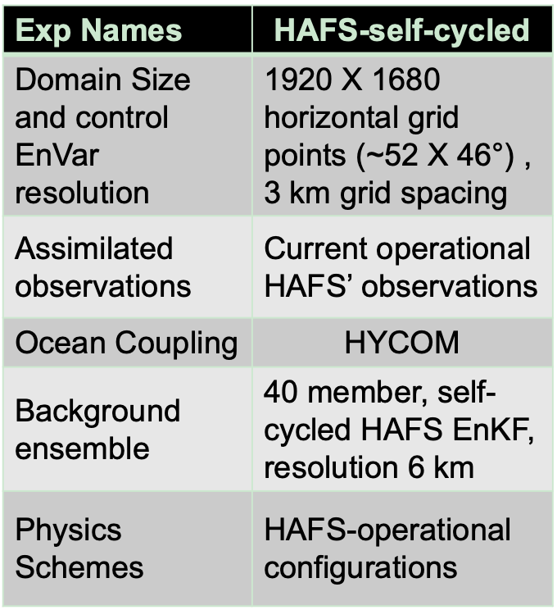
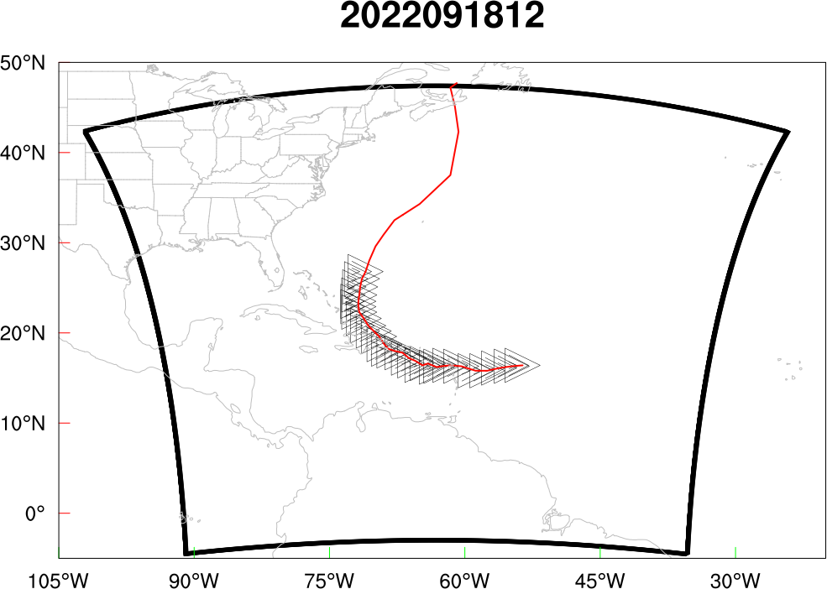
Experiment Design
Vmax, m/s
Self-consistent, self-cycled HAFS dual-resolution EnVar atmospheric DA (coupled with the HYCOM ocean model for Fiona (2022)).
Cycle Starts
Cycle Ends
HAFS domain

Slide 7
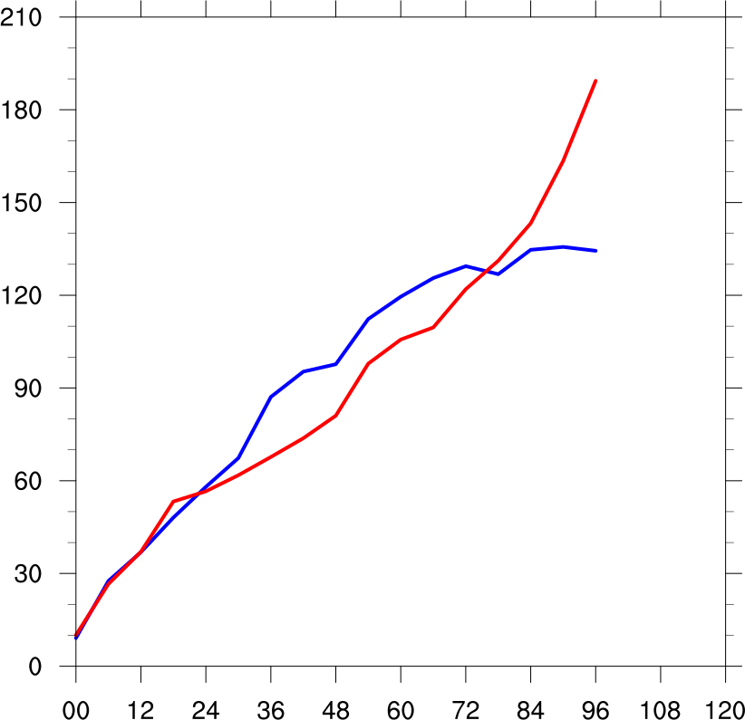
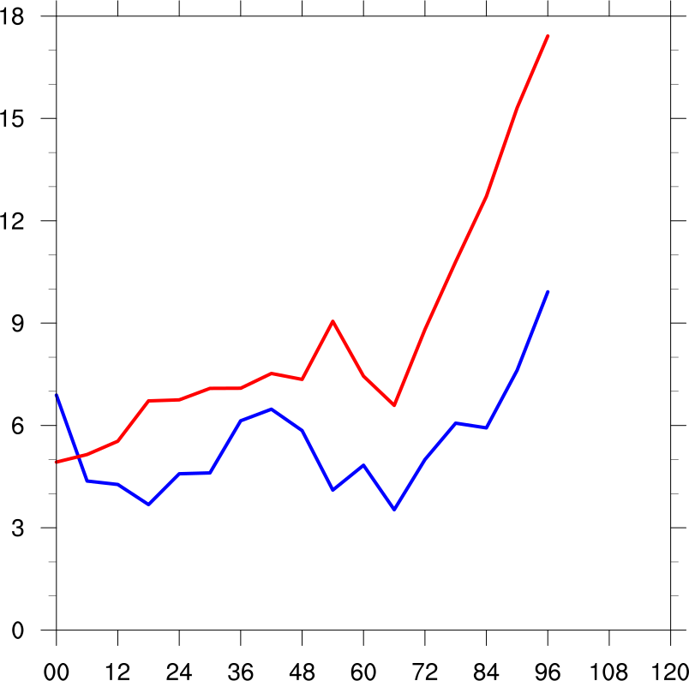
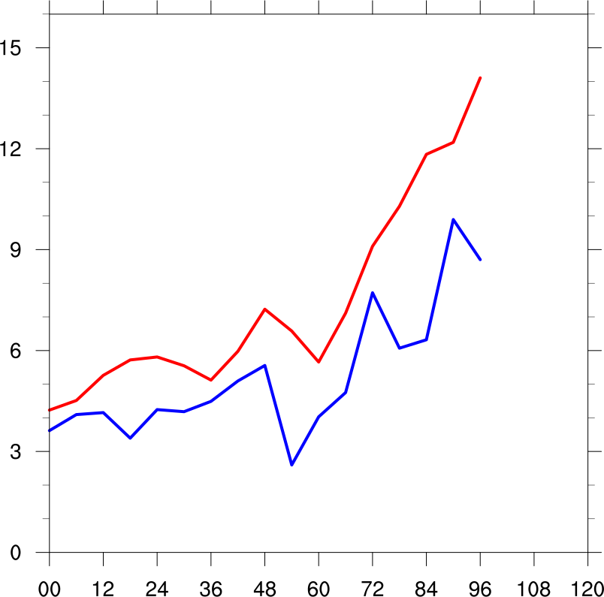
Overall Root Mean Square Error of 5-Day Forecast
km
hPa
m/s
Track
MSLP
Vmax
__ HAFS-SC
__ OPE
errors
Forecast hours
HAFS-self-cycled (HAFS-SC) outperforms the OPE run for MSLP and Vmax over 96 forecast hours.
The HAFS-SC is comparable to the HAFS operational run (OPE) for track forecast.

Slide 8
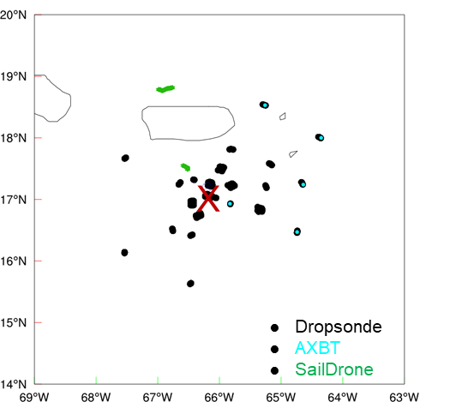
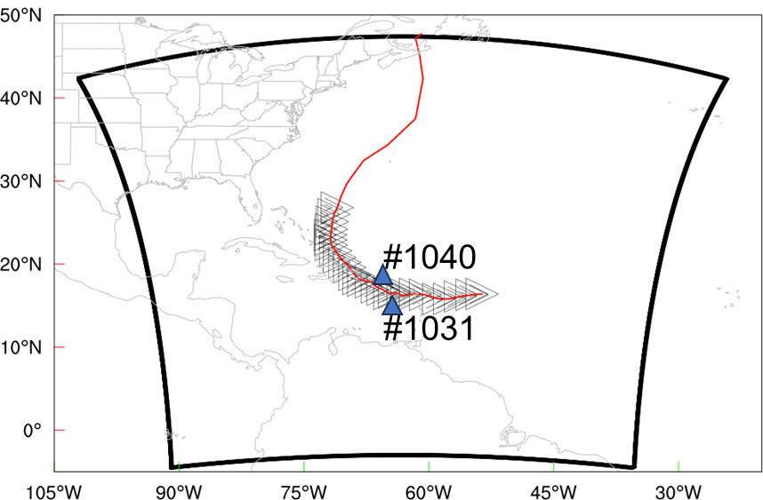
Verifying Observations
Leverage ocean and atmosphere observations near/within TC from the Fiona (2022) field campaign to verify the 6-h background and background ensemble at the air-sea interface.

Slide 9
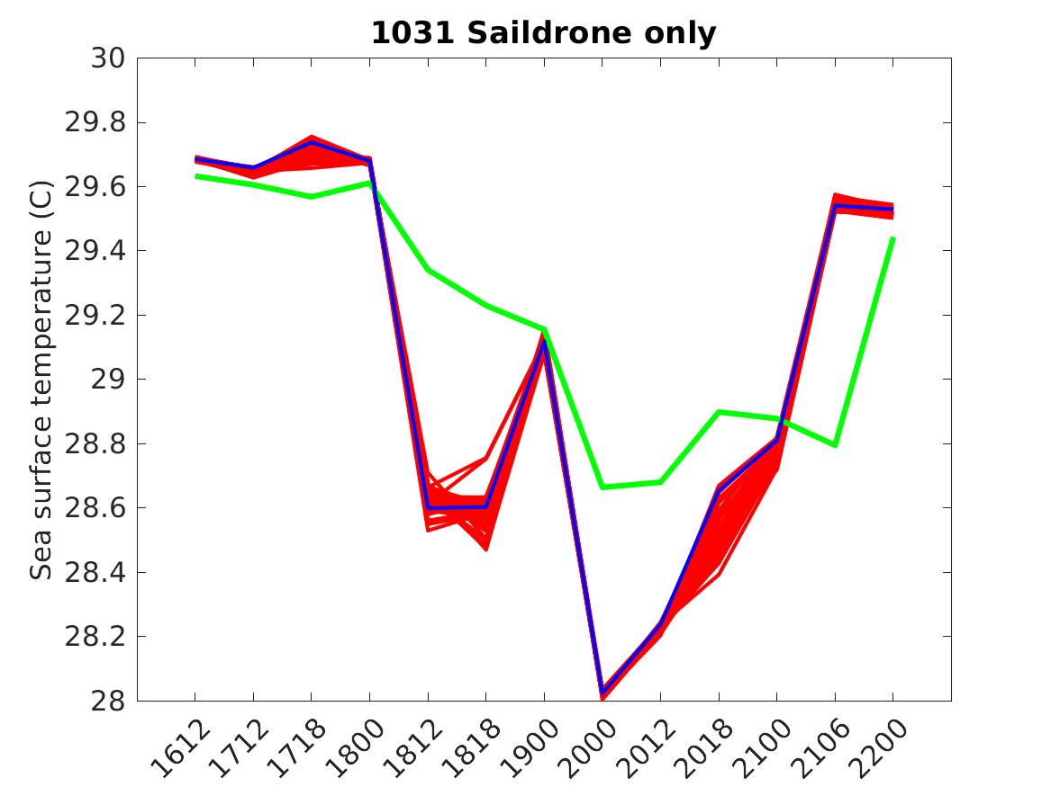
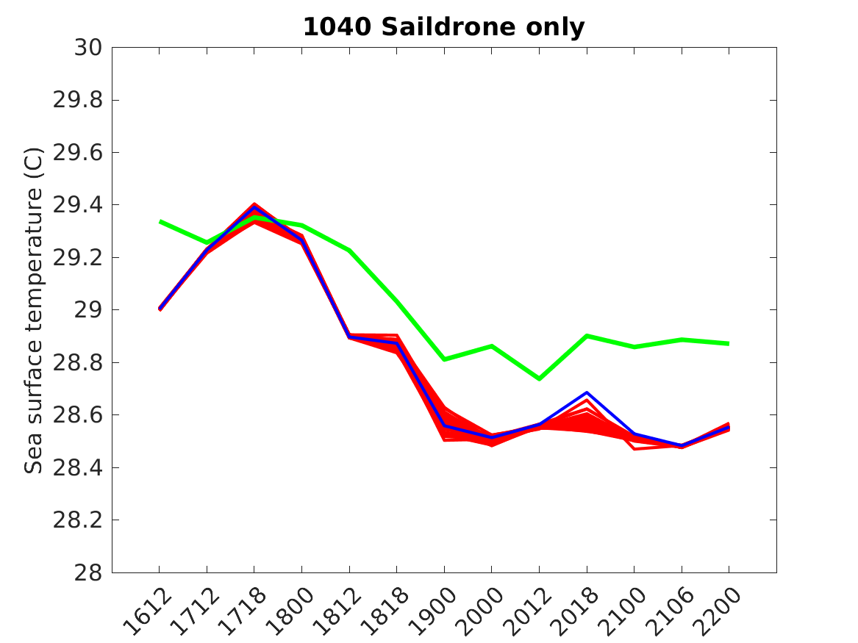
Verification against Saildrone Observations (SST)
Saildrone #1031 & 1040
When this saildrone is very close to the TC center
__ HAFS-SC-control
__ HAFS-SC-ens
__ Saildrone
Model captures the variation pattern well.
Mostly lower bias in SST from the model compared to observation.
The bias became larger when the saildrone is very close to the TC center.
The ensemble spread is too low to cover the observation.
9

Slide 10
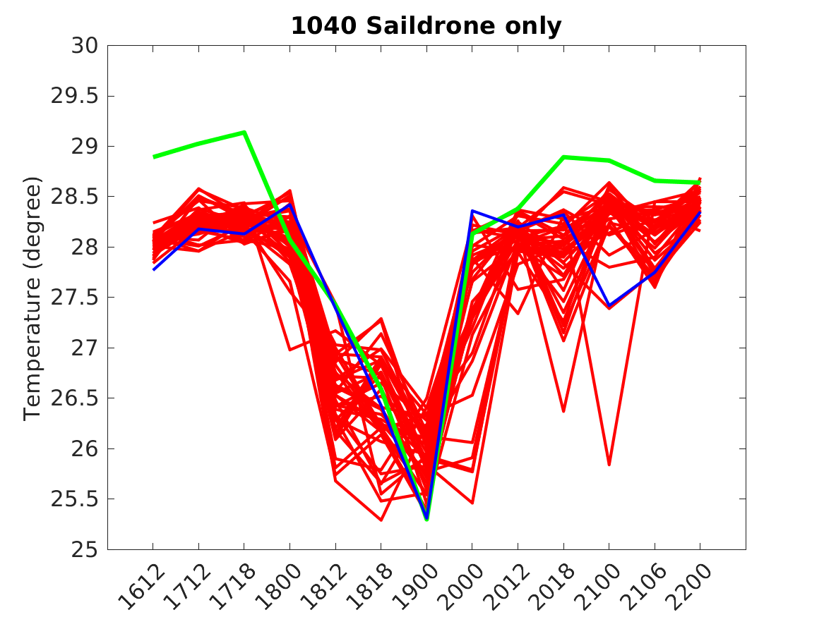
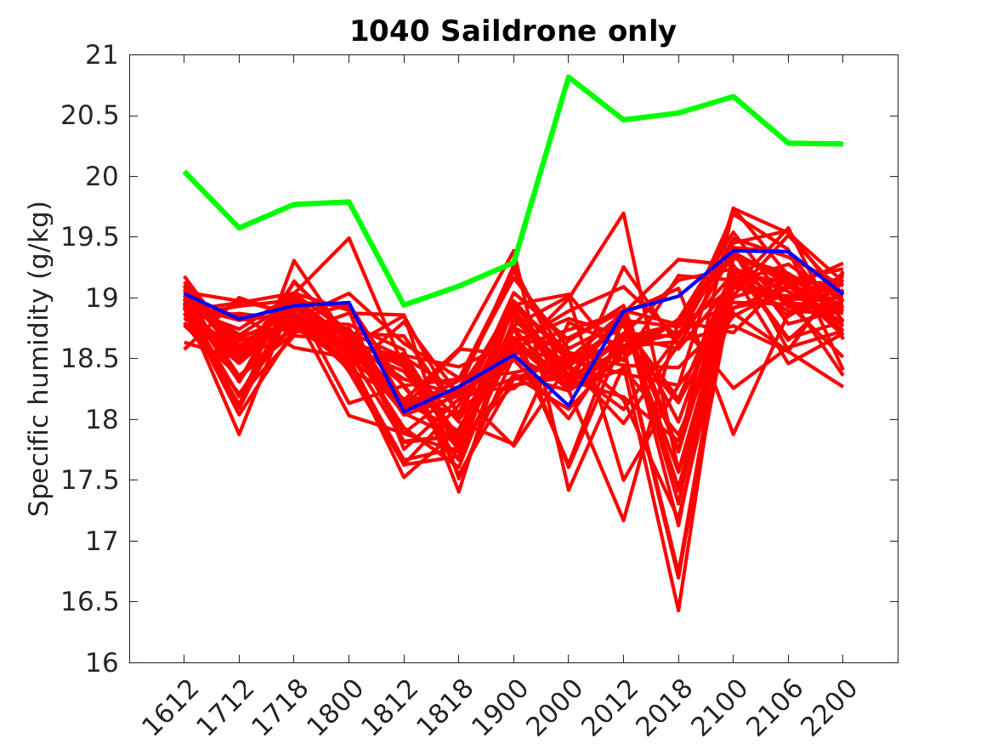
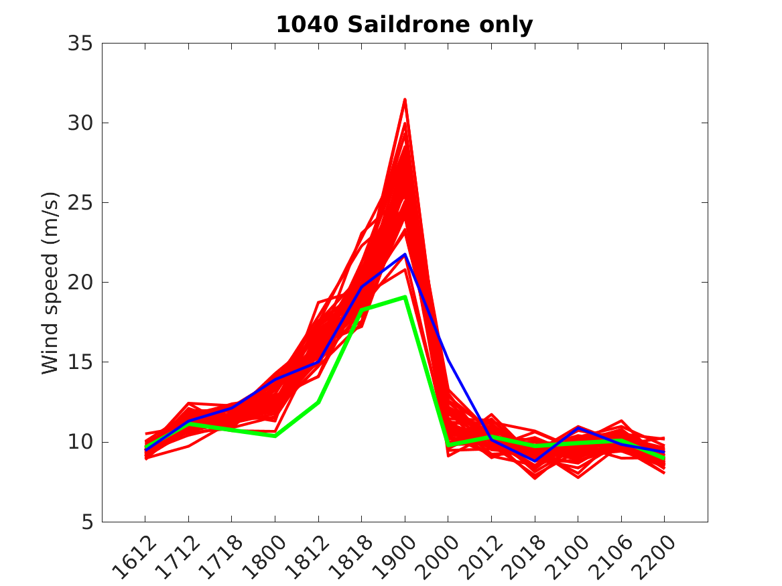
Verification against Saildrone Observations
(near sea-surface atmosphere variables)
Saildrone #1040
SAT (C)
Moisture (g/kg)
Wind Speed (m/s)
Q (g/kg)
__ HAFS-SC-control
__ HAFS-SC-ens
__ Saildrone
Model captures the variation well.
Model wind speed and SAT performs better than moisture.
Observation falls outside of the ensemble envelope due to low bias for early stage SAT and overall moisture.

Slide 11
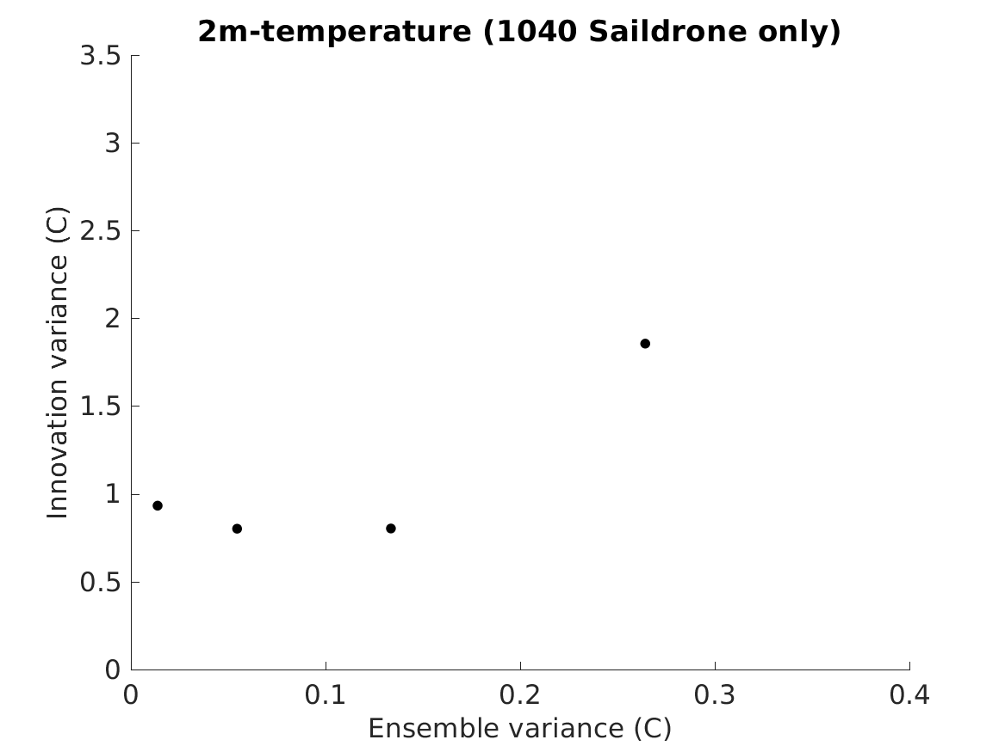
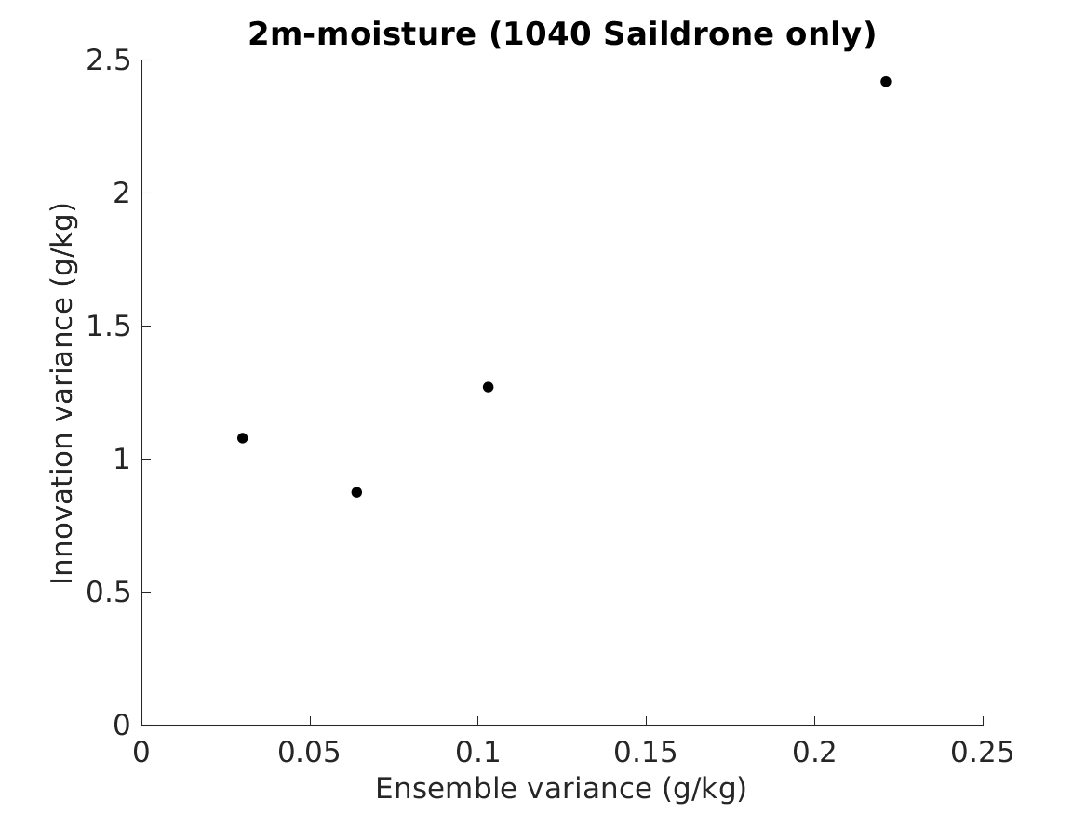
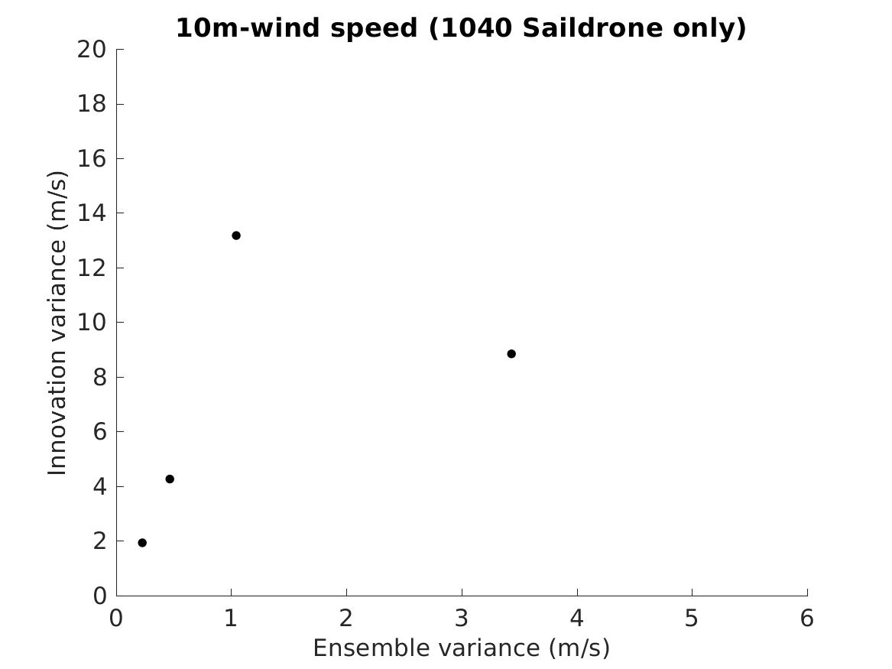
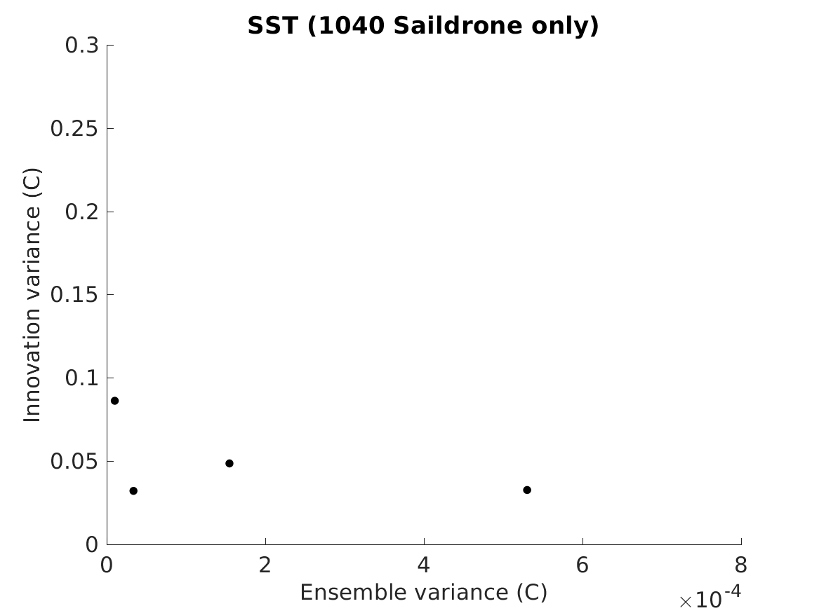
Innovation variance against background ensemble variance
Saildrone #1040
Following approach of Wang* and Bishop (2003) to qualitatively verify background ensemble variance
In general, the innovation variance increases with increasing background ensemble variance for SAT, moisture, and wind speed
Background ensemble variances underpredict innovation variance (after ob error variance is considered), especially for relatively small ensemble variance
The background ensemble variance of SST is too low and anti-correlated with innovation variance, indicating the most inferior SST background ensemble performance
SAT (C)
Moisture (g/kg)
Wind Speed (m/s)
SST (C)
* denote OU MAP authors

Slide 12
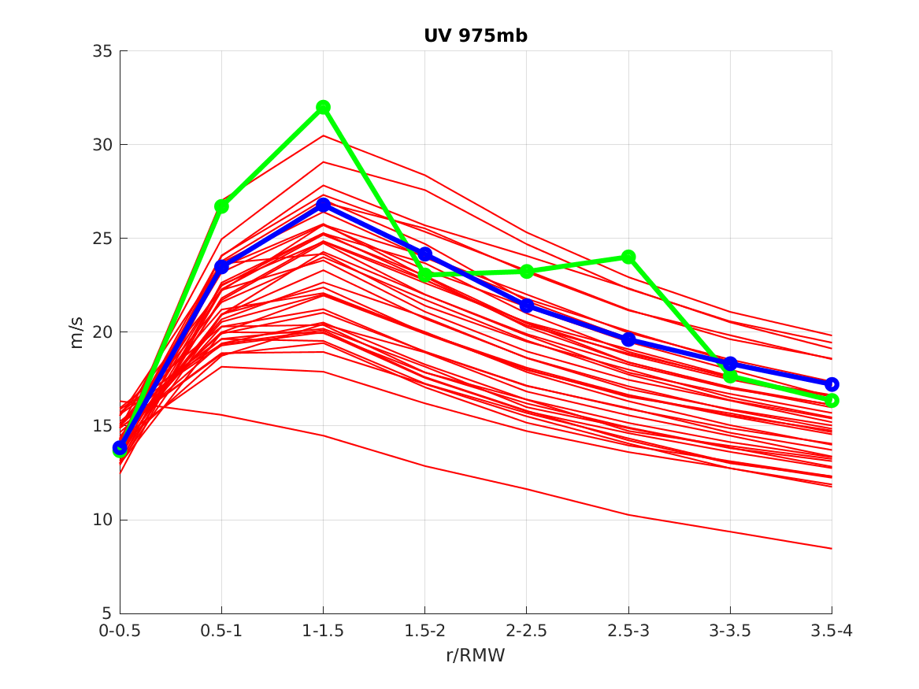
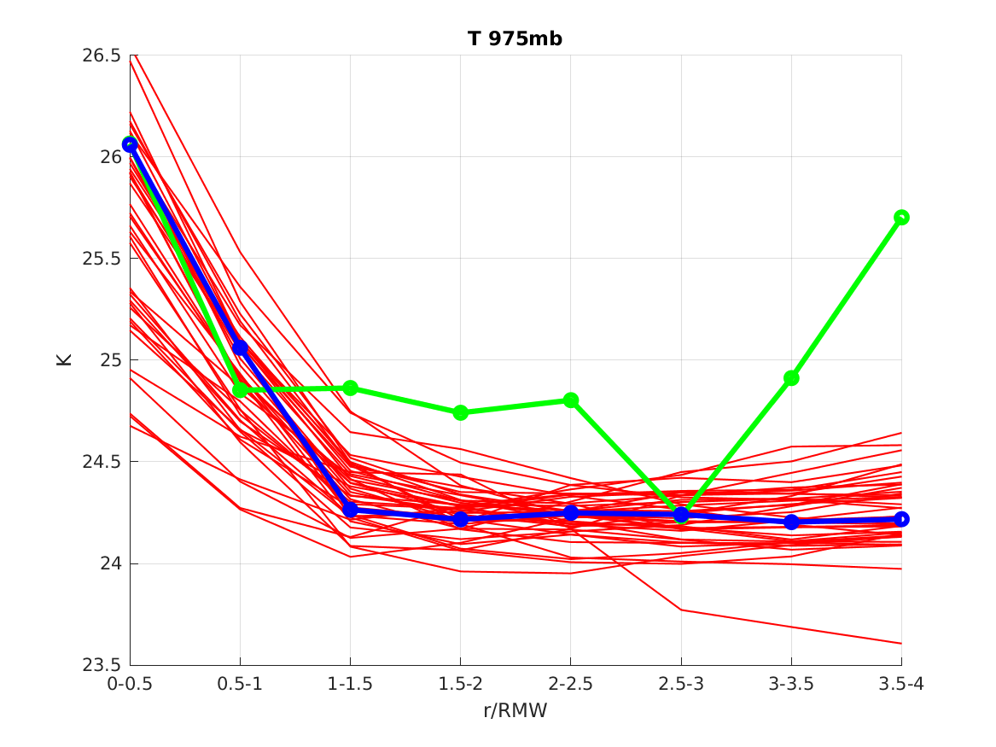
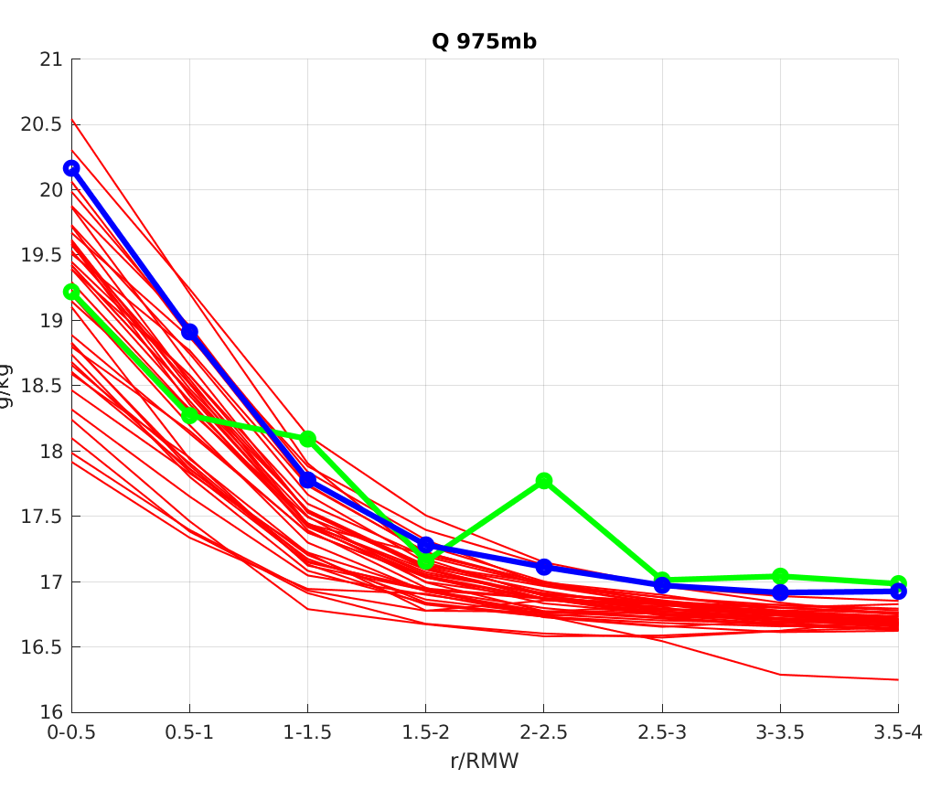
Azimuthal mean verifications of background PBL structure against dropsondes
6-h forecasts valid from 1200 UTC Sept 16 to 1200 UTC Sept 18
Averaged@975 hPa when dropsondes are available
Wind Speed (m/s)
T (C)
Q (g/kg)
Model captures the variation well.
Observation falls outside of the ensemble envelope for temperature outside of RMW.
__ HAFS-SC-control
__ HAFS-SC-ens
__ Saildrone
PBL @ 975 hPa

Slide 13
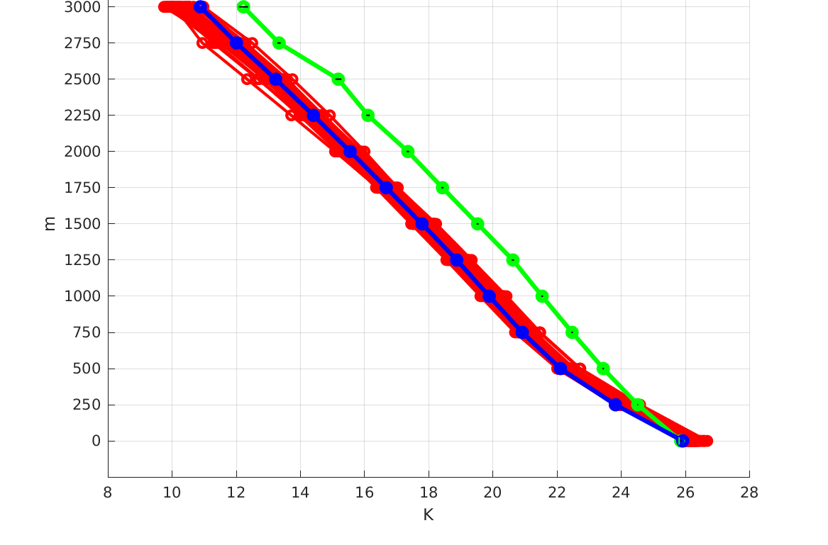
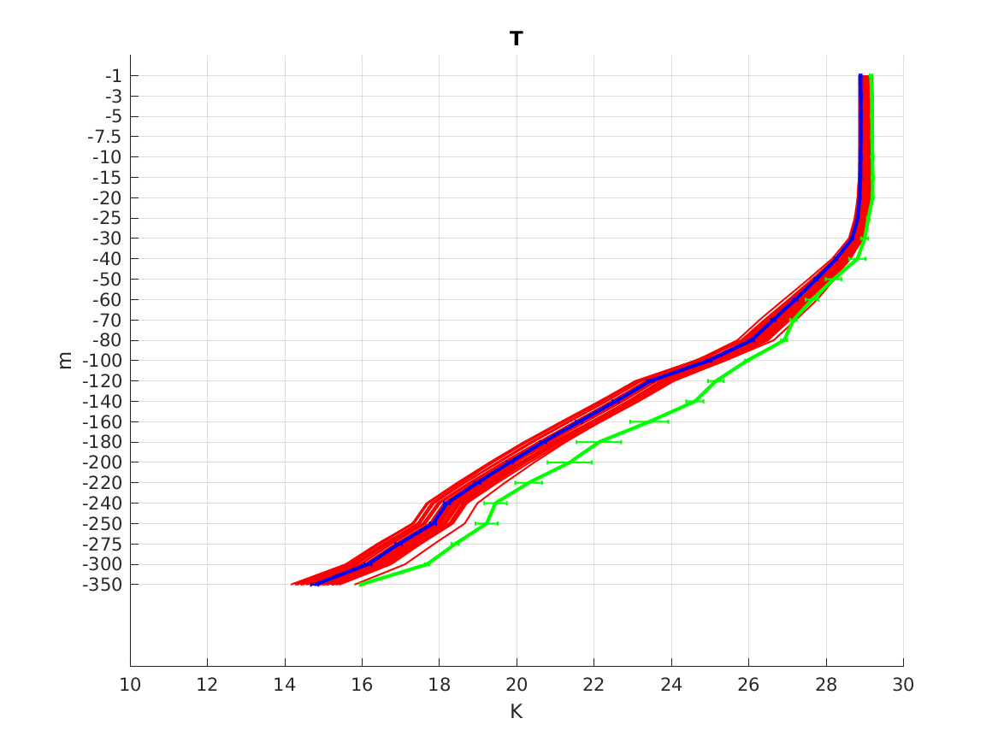
Height-dependent verification against paired dropsondes and AXBT
6-h forecasts valid from 1200 UTC Sept 16 to 1200 UTC Sept 18
Height-dependent profile on atmosphere and ocean depth @ 1 RMW
For air temperature at the air-sea interface, HAFS-SC-control is very close to the observation.
For air temperature in the atmospheric boundary layer, observation falls outside of the ensemble envelope.
For temperature in the ocean mixing layer, HAFS-SC-control is close to the observation.
For temperature in the deep ocean layer, observation falls outside of the ensemble envelope.
Improvement of background ensemble sampling/model bias reduction is needed for ensemble DA.
T (C) @ ATMO
Sea surface
T (C) @ ocean
__ HAFS-SC-control
__ HAFS-SC-ens
__ Saildrone

Slide 14
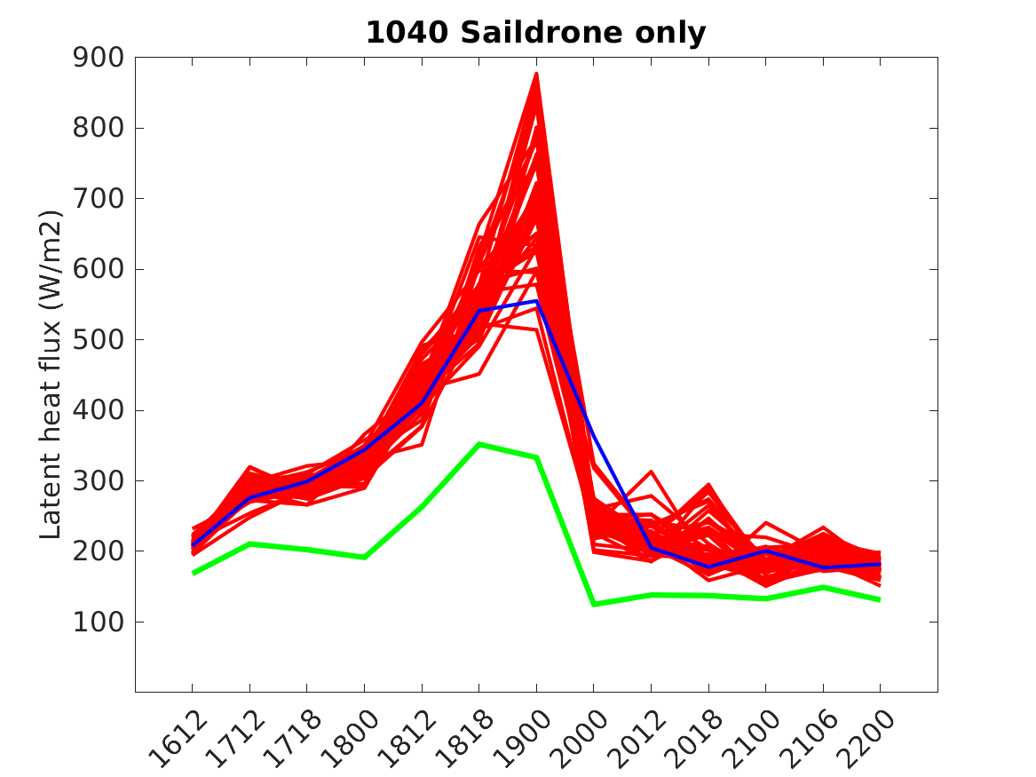
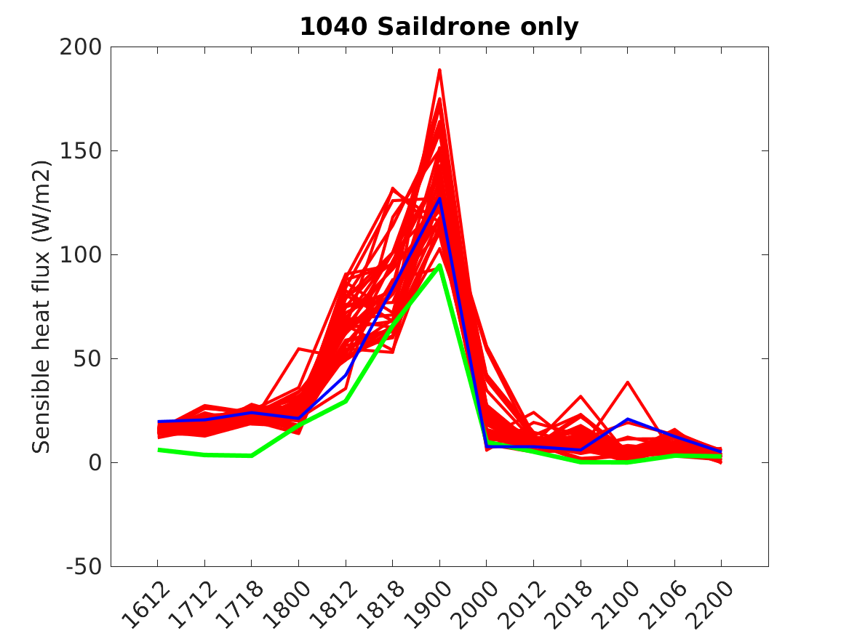
Heat flux verification against saildrone
__ HAFS-SC-control
__ HAFS-SC-ens
__ Saildrone
Latent heat flux
Sensible heat flux
Time
Time
When the storm is close to the saildrones
Model captures the variation well
Both heat flux have low bias compared to the observation.
The latent heat flux has larger bias compared to the sensible heat flux due to larger moisture bias.
When the storm is close to saildrones, all heat flux increase due to higher wind speed near TC center.

Slide 15
Summary and Future Work
Summary
Background ensemble in general captures the variation pattern at air-sea interface.
Negative biases and under-dispersiveness exist in background ensemble, especially for SST and moisture.
Latent heat flux has larger bias compared to the sensible heat flux.
Background ensemble variance of SAT, moisture, and wind speed are positively correlated with innovation variance in general, while those of SST are incorrectly correlated.
Future work
Further advance the background ensemble sampling at the air-sea interface through improved initial atmo. and ocean condition perturbations and model physics perturbations (See Yue Yang poster)
Evaluate improved background ensemble for weakly coupled DA
Develop strongly coupled DA

