Slide 1
Toward Turbulence-permitting Simulation of the Entire Hurricane Vortex with FV3
Kun Gao¹, Joseph Mouallem¹, Lucas Harris²
1 Program in Atmospheric and Oceanic Sciences, Princeton University
2 Geophysical Fluid Dynamics Laboratory, NOAA

Slide 2
Objectives
To introduce an efficient multi-level nesting modeling framework for facilitating 100m-scale simulations of the entire hurricane;
To understand fine-scale finger-like features in the hurricane inner core region

Slide 3
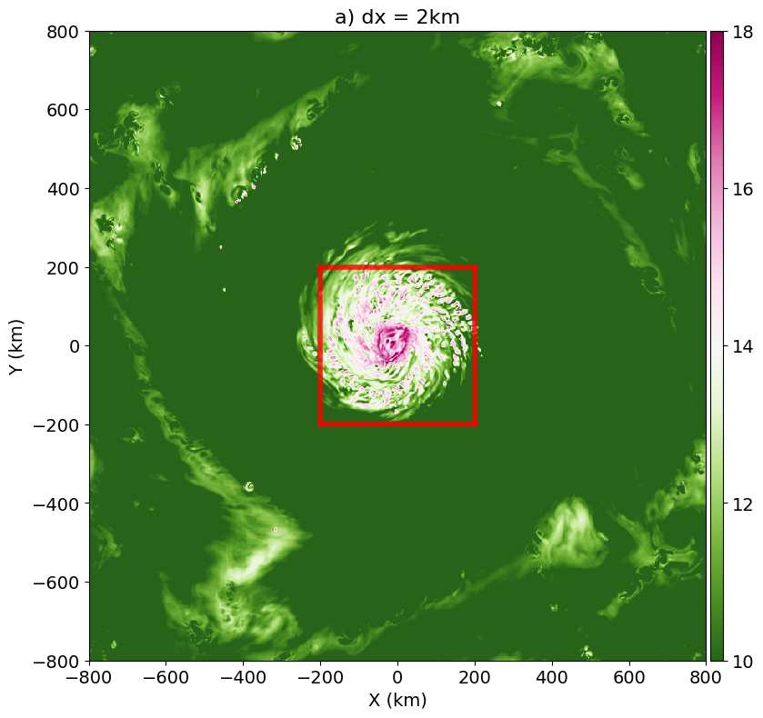
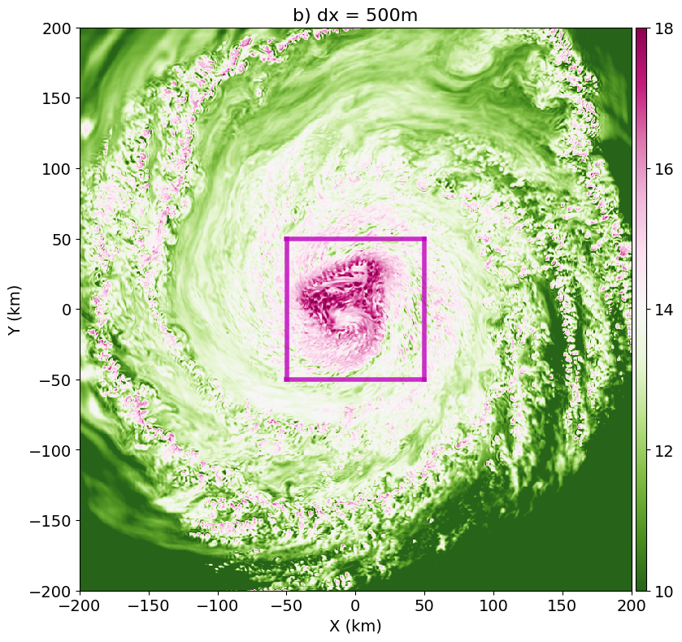
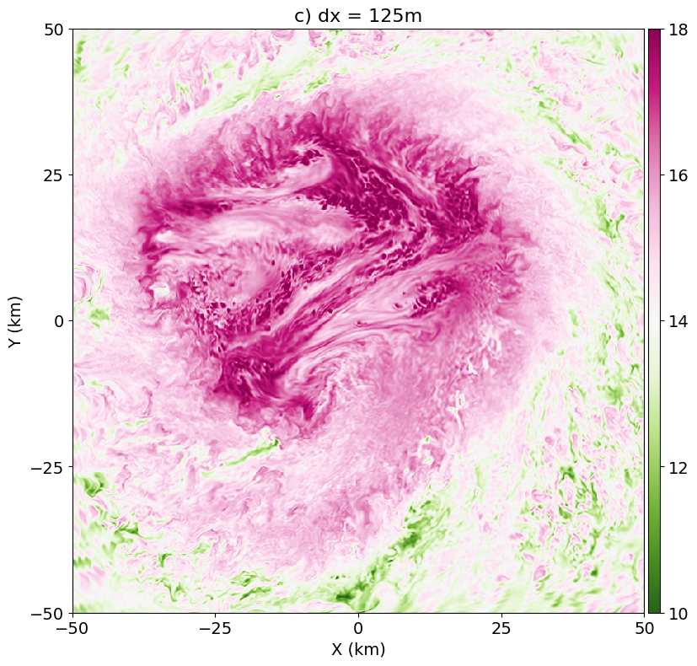
Multi-level nests that covers the entire TC
GFDL SHiELD model (FV3 as dynamical core)
Two-level nesting: 2km -> 500m -> 125m (same vertical levels)
Idealized TC that evolves freely on f-plane
96-hour simulation that covers entire intensification period
Q850 (g/kg)
Level 0 grid
16 x 16 deg
dx = 2km
Level 1 nest
4 x 4 deg
dx = 500m
Level 2 nest
1 x 1 deg
dx = 125m

Slide 4
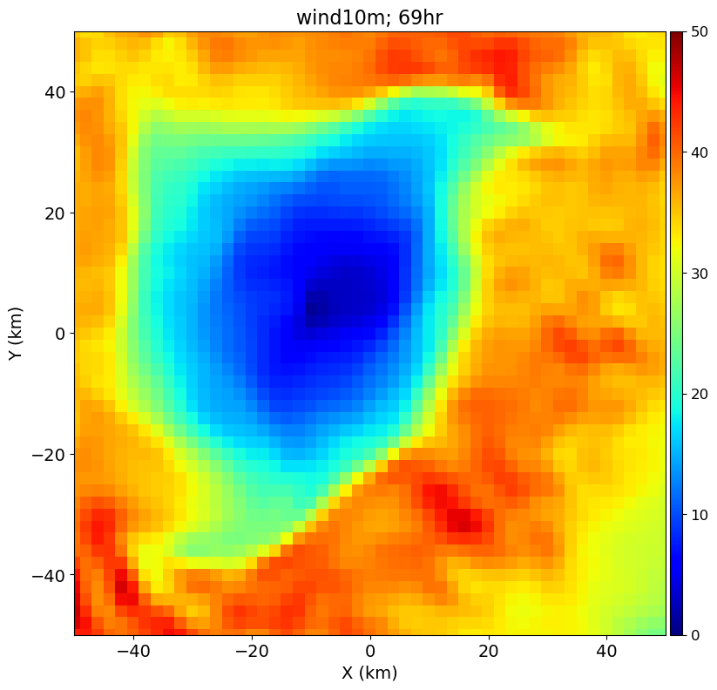
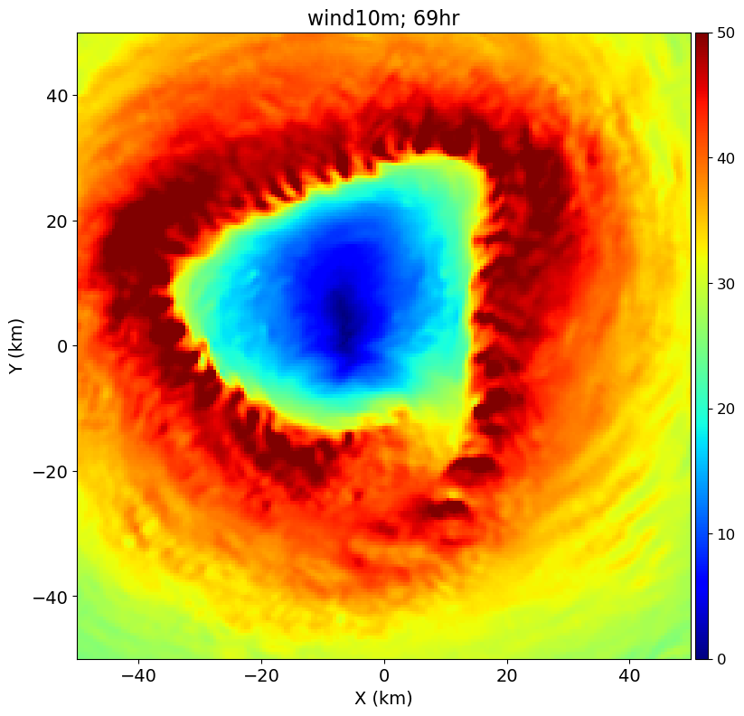
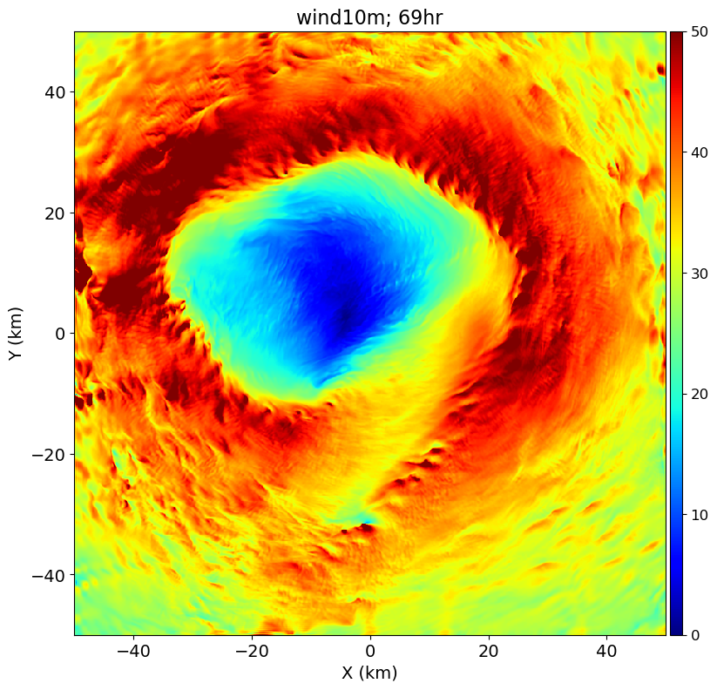
Surface wind snapshots at Hour 66
Level 0 grid; dx=2km
Level 1 nest; dx=500m
Level 2 nest; dx=125m
Finer structure can be seen in finer-resolution grids
Similar flow geometry in the Level 1 and Level 2 nests

Slide 5
TC Evolution
Max Azimuthal-mean Surface Wind
Radius of Maximum Wind
Plots only show the period (Hour 48-96) when core region is well contained in Level 2 nest
Similar intensification process in the Level 1 and Level 2 nests

Slide 6
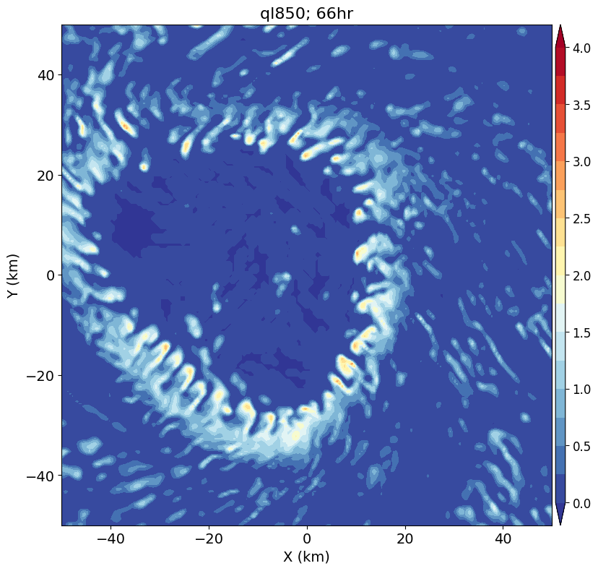
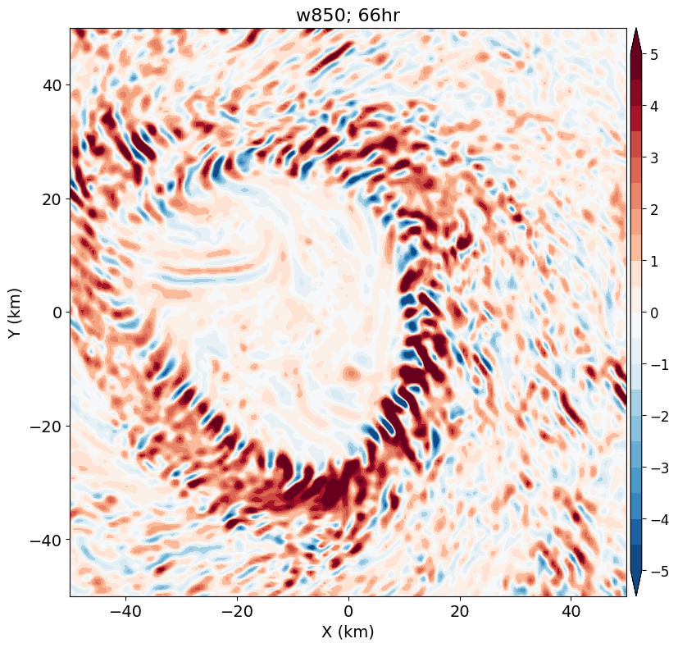
Identifying feature of interest: Finger clouds
Snapshots at Hour 66 from dx = 500m
Cloud water at 850mb
W at 850mb
Fine-scale clouds (a few km wide) along the inner edge of eyewall
Alternating updrafts and downdrafts
Emerges at Hour 60 and occurs frequently throughout the simulation

Slide 7
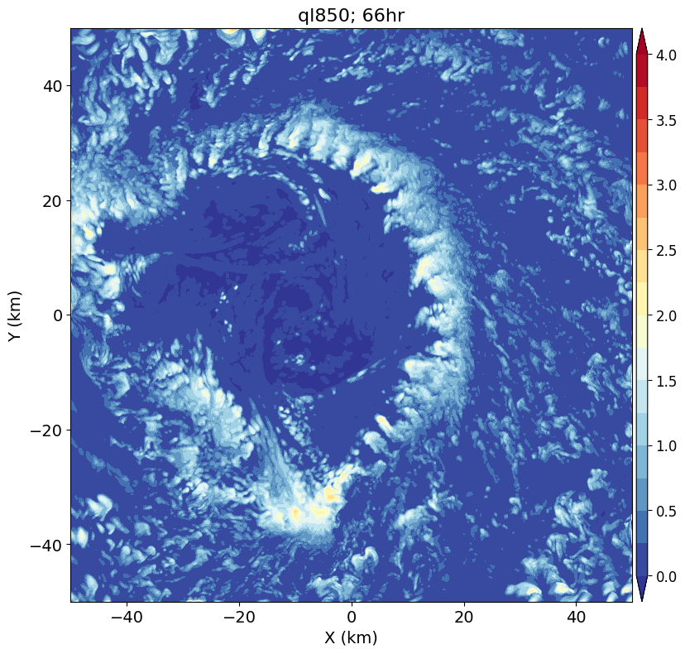
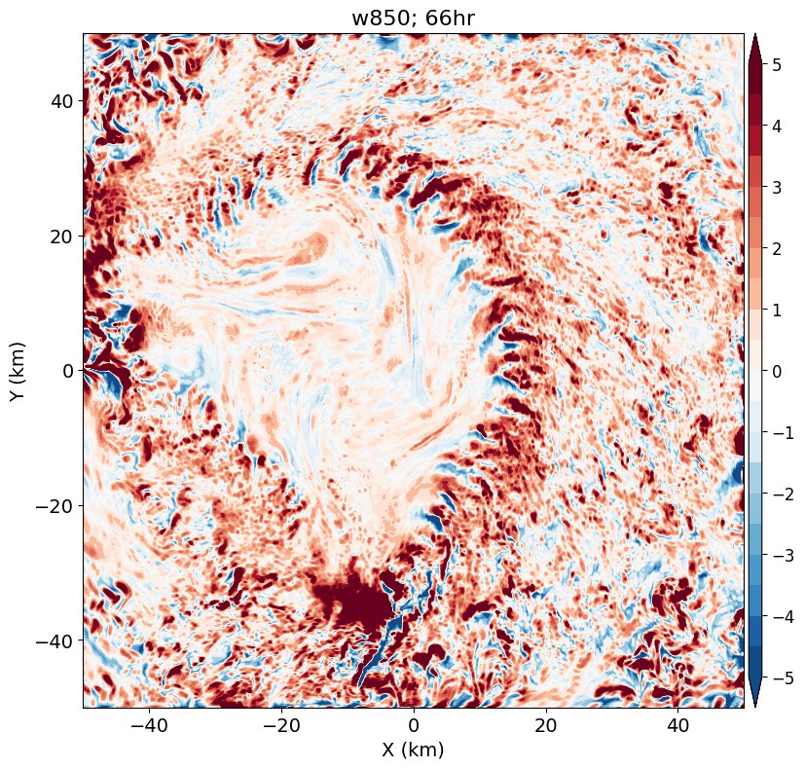
Identifying feature of interest: Finger clouds
Snapshots at Hour 66 from dx = 125m
Cloud water at 850mb
W at 850mb
Similar characteristics to those at dx = 500m
Have finer-scale details

Slide 8
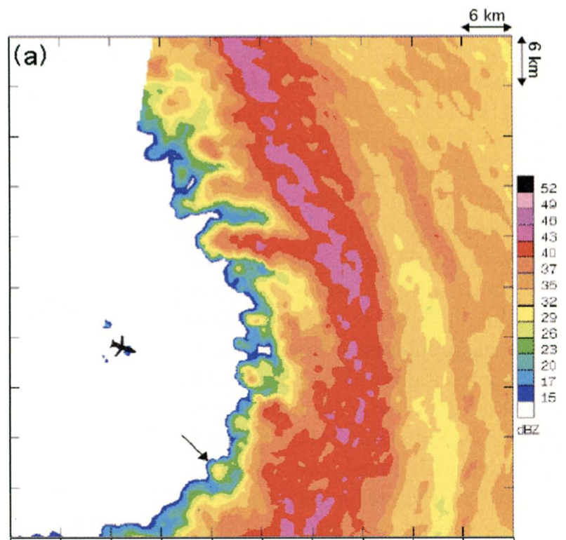
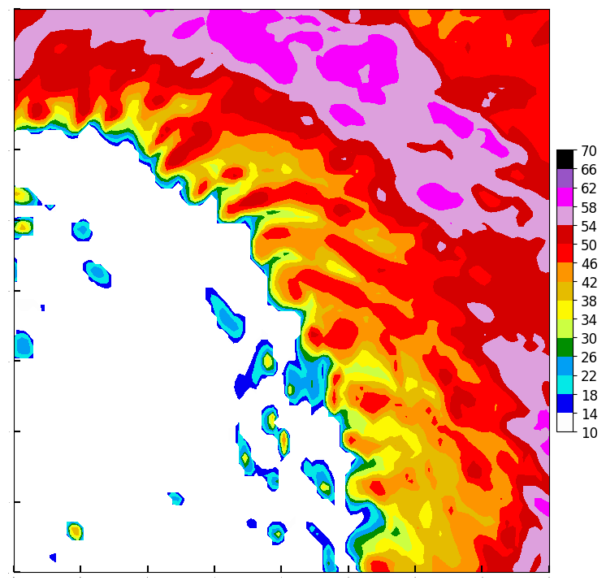
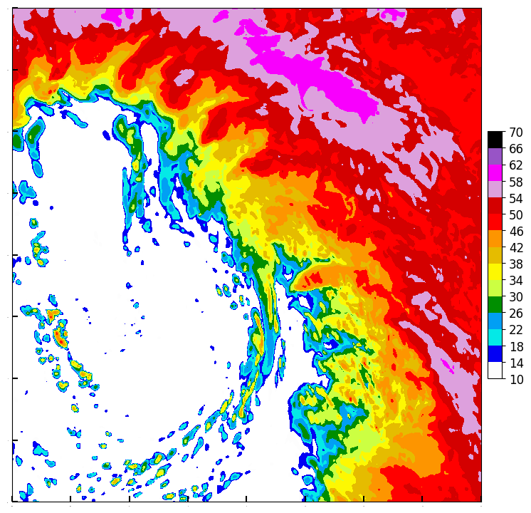
Comparison with observed features
Radar-observed Reflectivity
Hurricane Isabel (2003)
From Aberson et al. 2006 BAMS
Simulated Reflectivity
dx = 500m
Simulation Reflectivity
dx = 125m

Slide 9
Selected Case: Solutions at Hour 66 from dx = 500m

Slide 10
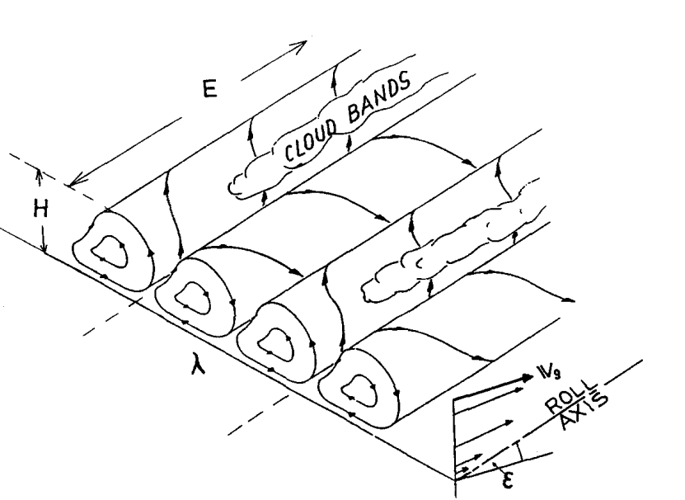
Eddy Structure: Plane view
Shading: V’θ
Contours: W’
Roll-like structure
Elongated along r
Overturning circulations along θ-z
Radial extent: ~10 km
Azimuthal wavelength: ~4 km
Roll diagram from
Etling and Brown (1993)

Slide 11
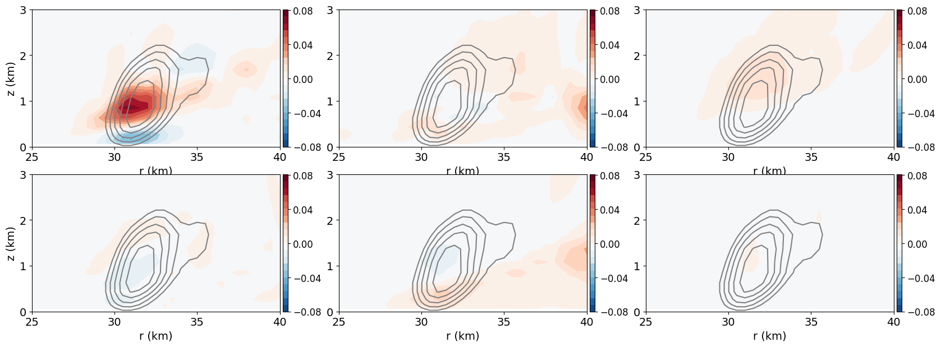
Eddy Kinetic Energy Budget
Vertical shear
prod.
terms
dVθ / dz
dVr / dz
dW / dz
Contours:
Eddy KE
Radial
Shear
prod.
terms
dVθ / dr
dVr / dr
dW / dr
The EKE production due to the vertical shear of tangential wind is dominant
-> implies shear instability related to the tangential wind

Slide 12
Is there a strong tangential shear layer in TC inner-core?
Gray Contours: Eddy Kinetic Energy

Slide 13
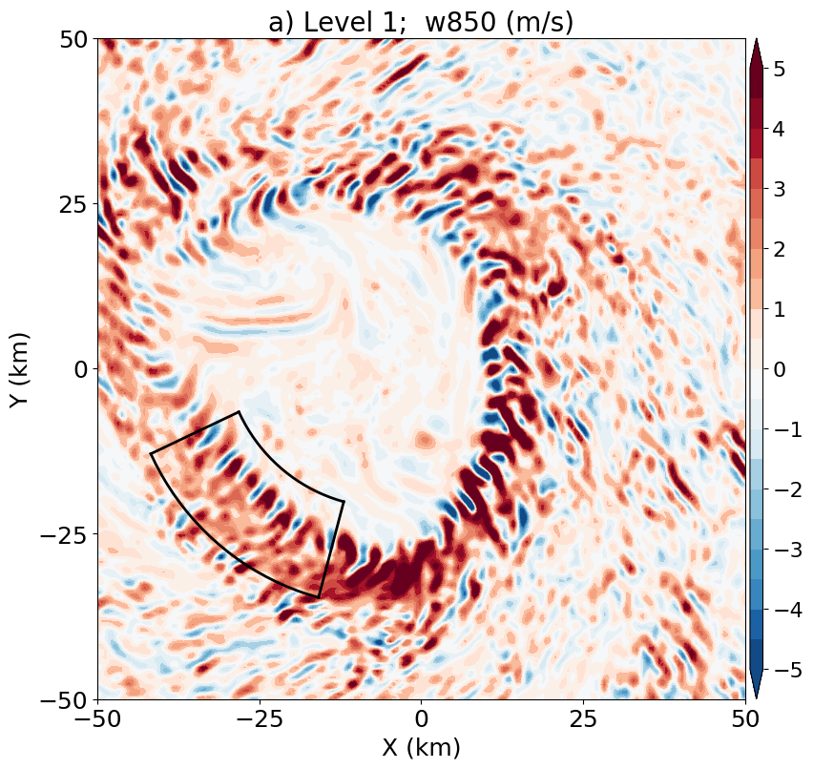
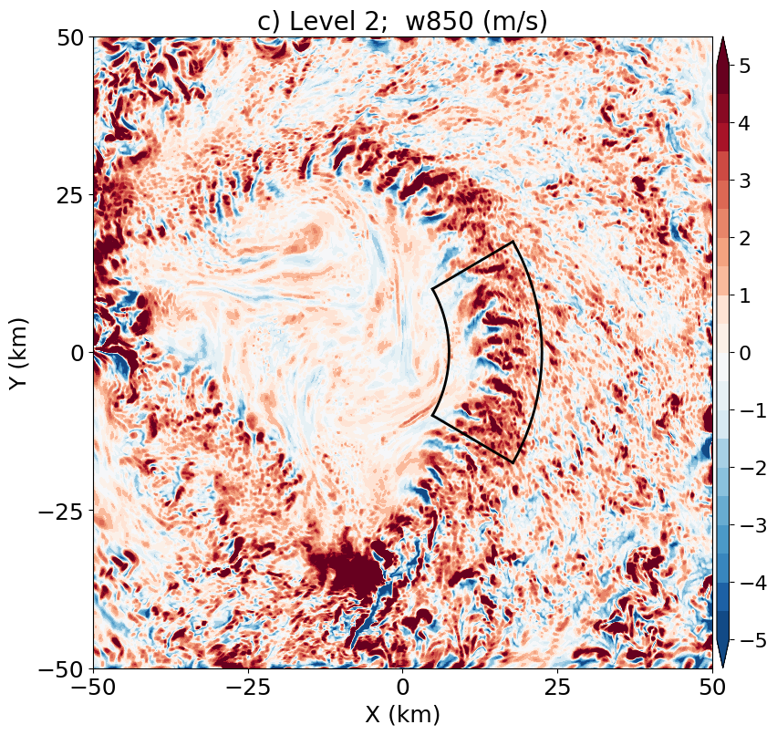
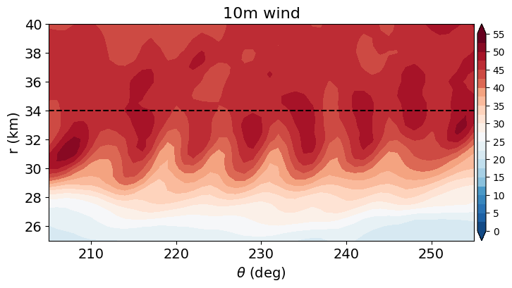
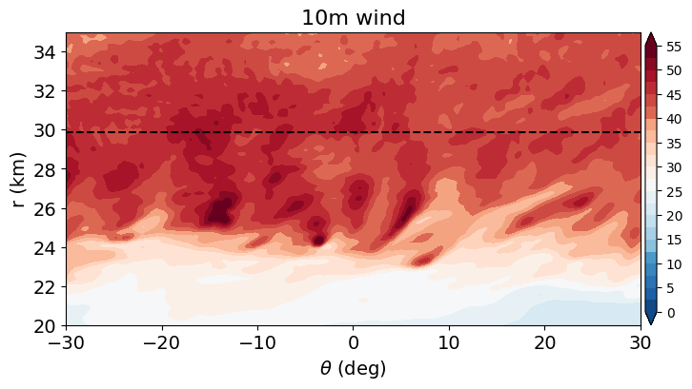
Impact of the finger-like features: Surface wind gusts
dx = 500m
dx=125m
RMW
RMW

Slide 14
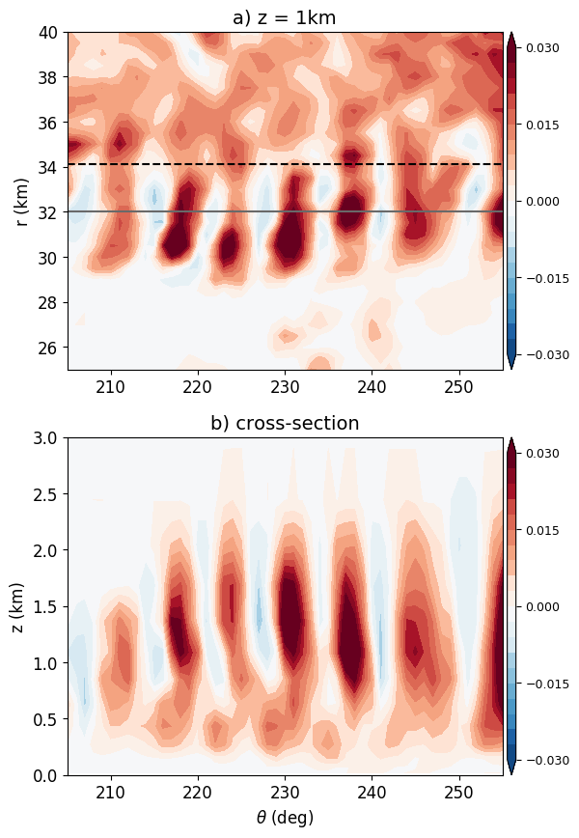
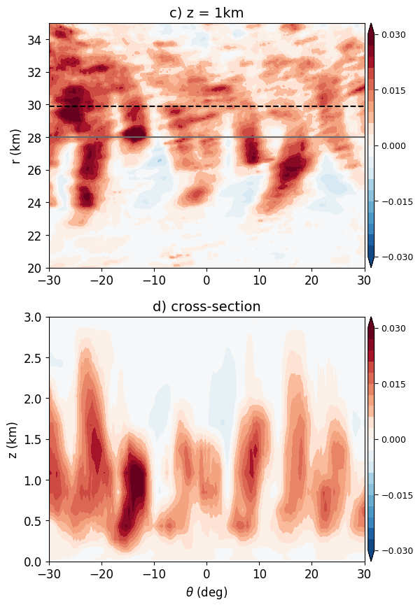
Impact of the finger-like features: Diabatic heating
dx = 500m
dx=125m
RMW
RMW

Slide 15
Summary
We conducted O(100m) simulation of the entire hurricane using a multi-level nesting framework -> can be extended to realworld simulations with moving nest
Our idealized simulation captures realistic finger-like features along the eyewall inner edge.
Ongoing work: Integrating a 3-D TKE-based diffusion scheme into FV3 for O(10m) simulations, in collaboration with Ping Zhu (FIU)

Slide 16
Backup

Slide 17
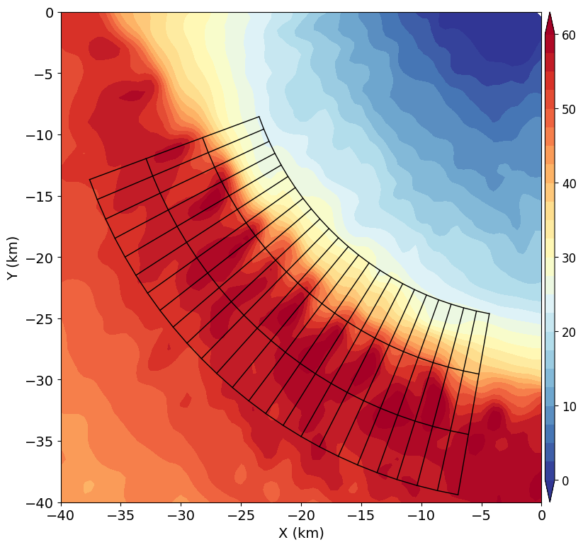
Mean-Eddy Separation: Step 1 Data selection
Do not attempt to separate TC flow and perturbations on the whole domain
Instead, we perform regional analysis: select a box and remap data onto a r-θ mesh
radius
azimuthal angle

Slide 18
Mean-Eddy Separation: Step 2 Running average along θ
TC-scale flow has significant variation along r, but less variation along θ
Therefore, we apply running average along θ to get the mean TC-scale flow
radius
azimuthal angle

