Slide 1
2024 HAFS-A Configuration Based Real-Time Parallel Experiment with Upgrades in Model Initialization, Physics, Dynamics and Coupling
Bin Liu,* JungHoon Shin,* Biju Thomas,* Hyun-Sook Kim,# Zhan Zhang,% Weiguo Wang,& Lin Zhu,& Chuan-Kai Wang,$ Yonghui Weng,* Jing Cheng,@ Xu Lu,* Bin Li,* Maria Aristizabal,* Yongzuo Li,& Nathalie Rivera-Torres,& Avichal Mehra,% Vijay Tallapragada%
*Lynker at NOAA/NWS/NCEP/EMC, College Park, MD; #NOAA/OAR/AOML/PhOD, Miami, FL; %NOAA/NWS/NCEP/EMC, College Park, MD; &SAIC at NOAA/NWS/NCEP/EMC, College Park, MD; $RedLine at NOAA/NWS/NCEP/EMC, College Park, MD; @Axiom at NOAA/NWS/NCEP/EMC, College Park, MD
Unifying Innovations in Forecasting Capabilities Workshop 2024 (UIFCW24)
Jackson State University, Jackson, MS and online, July 22-26, 2024

Slide 2
UFS HAFS Development and Operational Transition Milestones
~11/2018 HFIP Annual Meeting
HAFS development planned and started
2020 HAFS.v0.1A, B, J, and E real-time parallel experiments
Major upgrades: ESMF/NUOPC based HYCOM ocean coupling, regional ESG grid, regional ensemble
2022 HAFS.v0.3A, B and E real-time parallel experiments
Major upgrades: Regional moving-nesting, vortex initialization, inner-core data assimilation, two HAFS physics suites
07/16/2024: HAFSv2 upgrade and operational transition
2024 HAFSv2.0.1A, B, E and M real-time parallel experiments
2018
2019
2020
2021
2022
2023
2024
2019 HAFS.v0.0.1A and B real-time parallel experiments
Major features: ~3-km resolution; regional standalone (HAFS-A), global-nesting (HAFS-B), cold start from GFS, no coupling/VI/DA
2021 HAFS.v0.2A, B, D, and E real-time parallel experiments
Major upgrades: ESMF/CMEPS based HYCOM ocean coupling, DA, regional ensemble
06/27/2023: HAFSv1 Initial Operational Capability (IOC) implementation with two configurations of HFSA and HFSB
2023 HAFS.v1.1A, B, D and E real-time parallel experiments

Slide 3
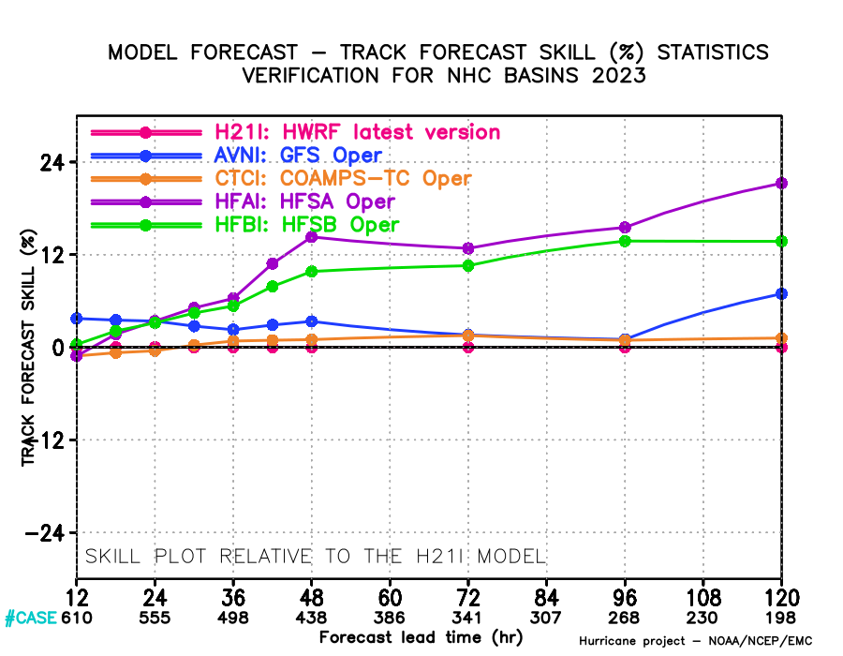
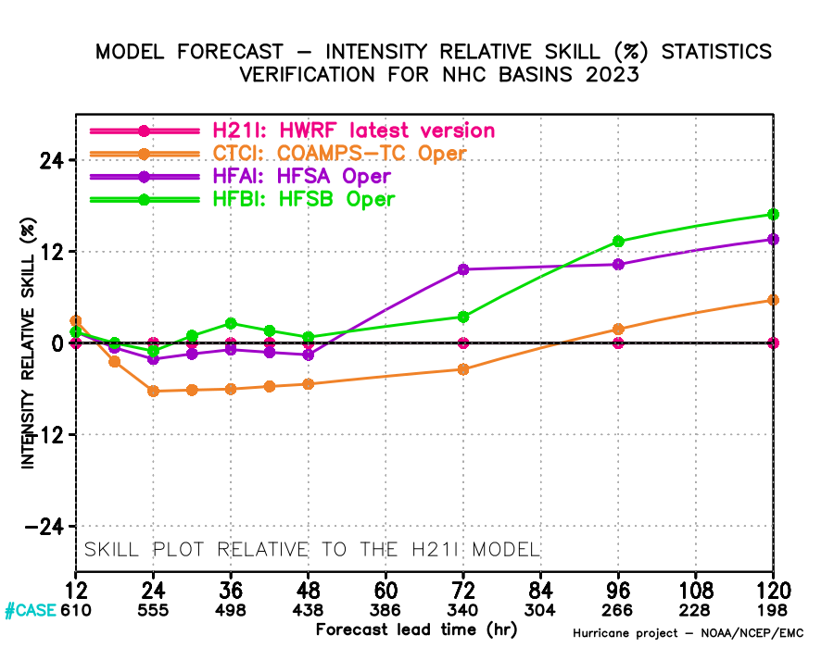
FY2023 HAFSv1 Operational Implementation and Performance
Operational model performance for 2023 AL/EP storms
Highlights of HAFS Initial Operational Capability (IOC) implementation (June 27, 2023)
Two HAFS configurations including HAFS-A (HFSA) and HAFS-B (HFSB) to succeed the two legacy regional HWRF and HMON hurricane forecast systems, respectively.
First ufs-weather-model based regional hurricane forecast system (UFS hurricane application), with shared subcomponents and infrastructure with other UFS applications.
First UFS application with high resolution storm-following moving-nesting capability using the regional Extended Schmidt Gnomonic (ESG) grid.
Advanced and diversified CCPP-based physics suites for (HFSA and HFSB, respectively) with optimized physics schemes for high resolution hurricane forecasting.
Modernized vortex initialization (VI) together with high-resolution inner-core DA with 3-hourly FGAT, and 4DEnVar with GDAS ensembles.
ESMF/CMEPS based HYCOM ocean coupling for all global TC basins with extended ocean domains.
Unified hurricane application workflow to support both research and development Rocoto workflow and operational Ecflow workflow.
~15% more skillful after day-2
HWRF
GFS
CTCX
HFSA
HFSB
Track skill
~12% to ~15% more skillful than HWRF
Intensity skill

Slide 4
Highlights of FY2024 Operational HAFSv2 Upgrade
(More details from Zhan Zhang et al’s Poster on HAFSv2)
HAFSv2 upgrade was operationally implemented on July 16, 2024
Updated HAFS submodules/subcomponents, infrastructure, and workflow
Improved model efficiency and stability
Higher resolution moving-nesting (5.4-1.8 km) configuration (HFSA only)
Cloud variable and vertical velocity vortex relocation and warm-cycling capability (HFSA only)
Updated HFSA-based composite vortex for VI (HFSA only)
Enable using Scale-Dependent Localization (SDL) for innercore DA
Assimilate high-resolution GOES-R mesoscale floater AMVs
Refined DA for the GPS Radio Occultation data.
Updated GFS TKE-based EDMF PBL scheme and SA-SAS CP scheme with vertical wind shear impacts
Switch to use the latest Thompson MP for NATL with dt_inner=45s and sedi_semi=.true. for HFSA. Meanwhile, keep using GFDL MPv1 for HFSA EPAC/CPAC and JTWC. (HFSA only)
Reduce the model time step from 90s to 72s, and radiation calling time step from 1800s to 720s (HFSB only)
Use the hord=1 horizontal advection scheme options with fine-tuned lim_fac values for different TC basins
First UFS application with regional MOM6 ocean coupling: (HFSA only)
Innovated and unified UFS regional coupling through CMEPS with inline-CDEPS for MOM6 ocean coupling
Use time-varying GFS-forecasted SST (every 3-h) in non-overlapped atmospheric domain area
Take into account sea surface current (SSC) in atmosphere-ocean coupling when estimating air-sea fluxes
MOM6 utilizes 55 vertical levels and uses the KPP mixed layer scheme

Slide 5
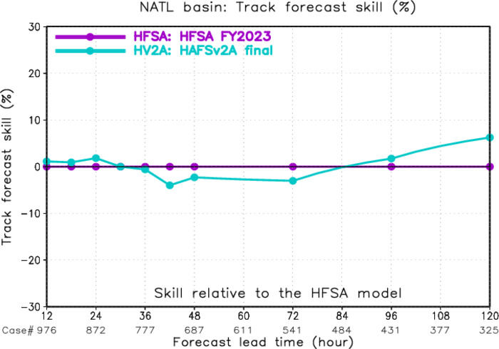
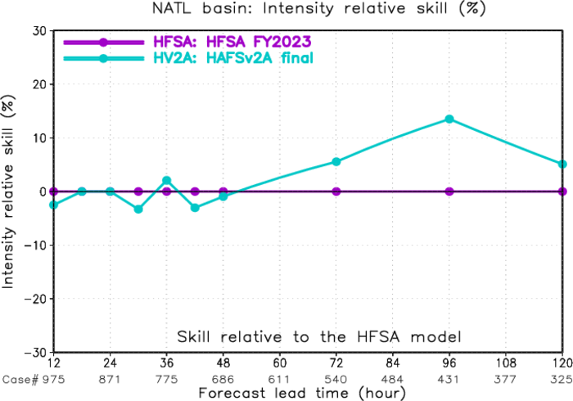
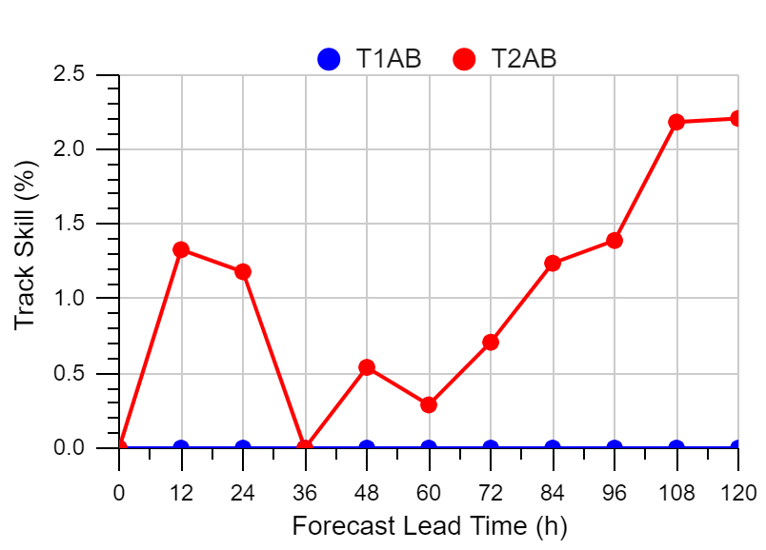
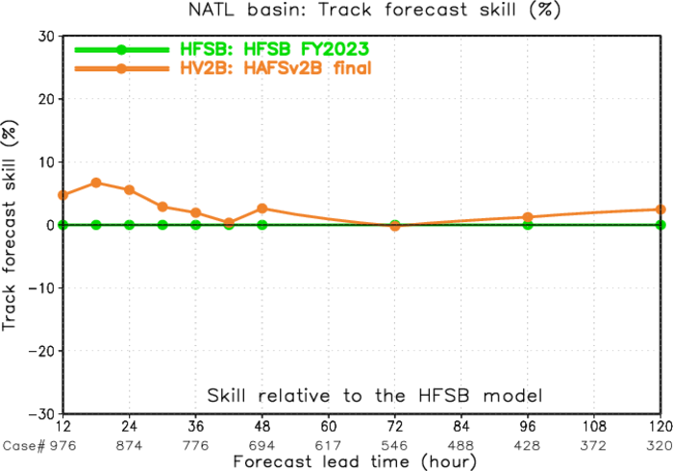
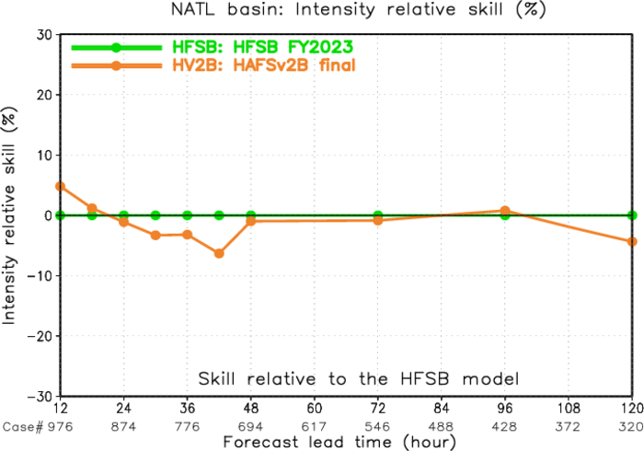
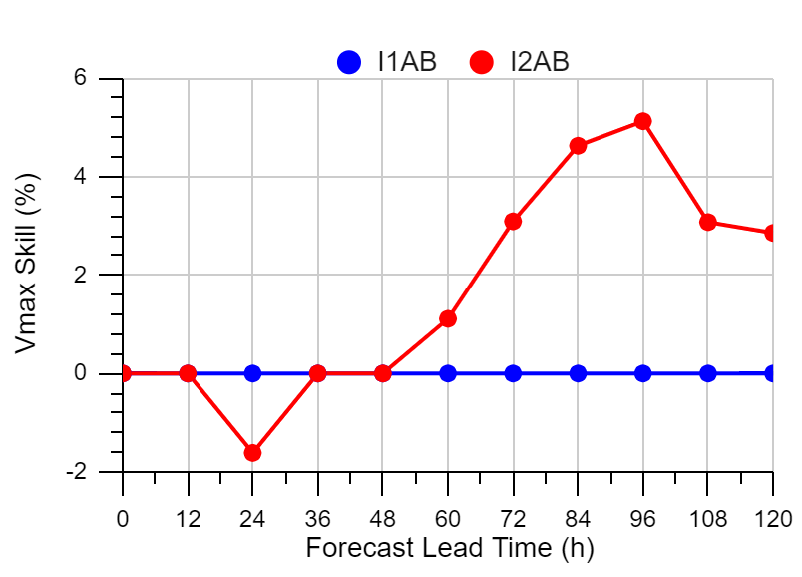
HAFSv2 (HV2A and HV2B) Performance
for 2021-2023 NATL Storms
Track Skill
Intensity Skill
Impact of HAFSv2 on Consensus
HFSA
HV2A
Track Skill
HFSA
Mixed
Improved
HFSB
HV2B
Intensity Skill
HFSB
Improved
Mixed
Notes:
Impact of HAFS v2 on Consensus Results
Models included in
NHC consensus
Track (TVCN):
GFSI + EGRI + EMXI + CTCI + EMNI + HFSA + HFSB
Intensity (IVCN):
DSHP + LGEM + CTCI +HFSA + HFSB

Slide 6
2024 HAFSv2.0.1A Real-time Parallel Experiment Configurations
System and infrastructure
Synced HAFS submodules and subcomponents (including UFS_UTILS, GSI, ufs-weather-model, UPP, etc.) with their latest authoritative branches as of 07/03/2024
Vortex initialization and data assimilation
Further improved Vortex Initialization by improving the Pmin enhancement
Newly developed storm-following 3DIAU (Three-Dimensional Incremental Analysis Update) in innercore DA
Assimilate NOAA-20 and other GFS/GDAS assimilated new observations
Upgrade to use CRTMv2.4.0.1
Physics and dynamics
Adopt the scale-adaptive convective cloud water calculation in saSAS and reduce the minimum background diffusivity in the inversion layer near the PBL top
Turn on the prognostic sigma closure in sa-SAS for NATL storms
Use the Exponential-Random cloud overlap approach in RRTMG
Optimize and unify the horizontal advection scheme of hord=1 with lim_fac of 2.7
Air-sea interaction and coupling
Use new RTOFSv2.5 input data
Switch to use MOM6 ePBL mixed layer scheme
Turn on wave-ocean coupling

Slide 7
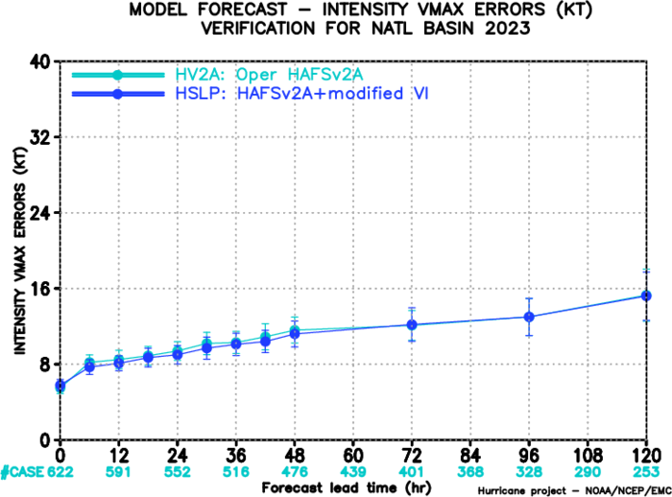
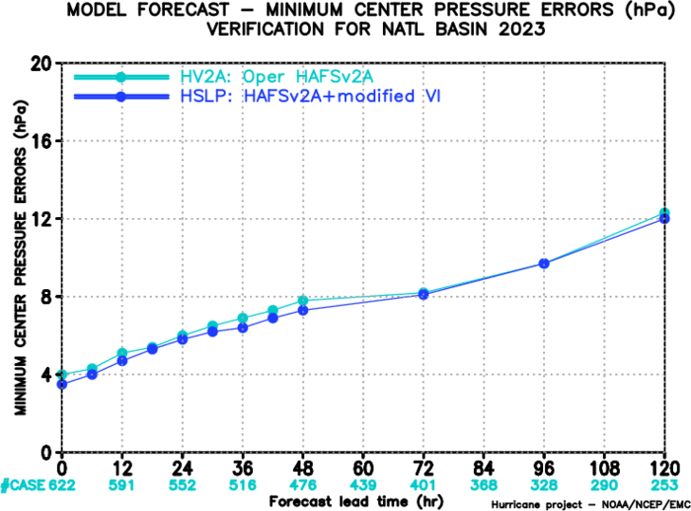
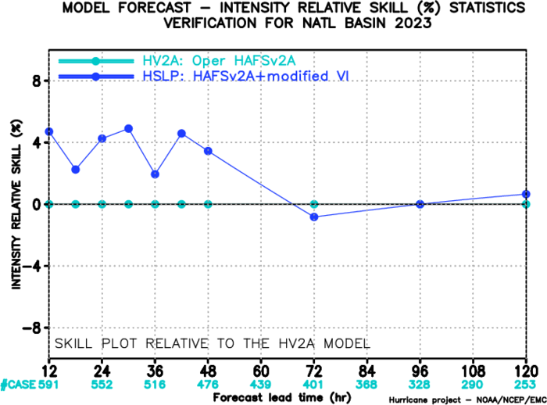
Impacts of VI Improvement on HAFS Forecast
for selected 2021-2023 NATL storms (from JungHoon Shin)
Example of storm/cycle of Lee 13L
VI intensity enhancement was improved to reduce Pmin error
HV2A
HSLP
Vmax error
Pmin error
Intensity skill
Notes:
For 19 2021-2023 NATL storms including TS (4), Cat 1-2 HU (7), MH (8)

Slide 8
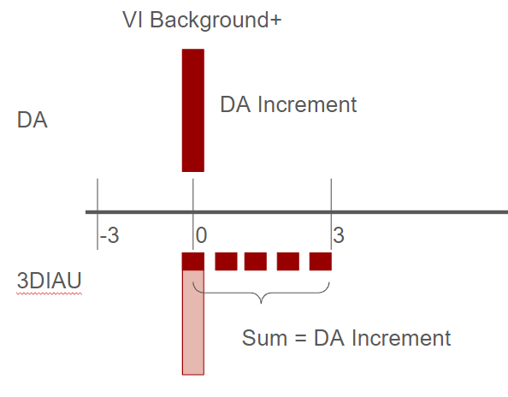
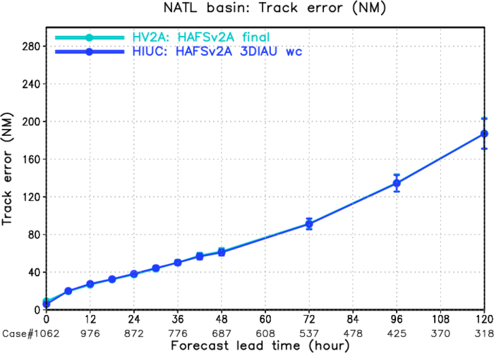
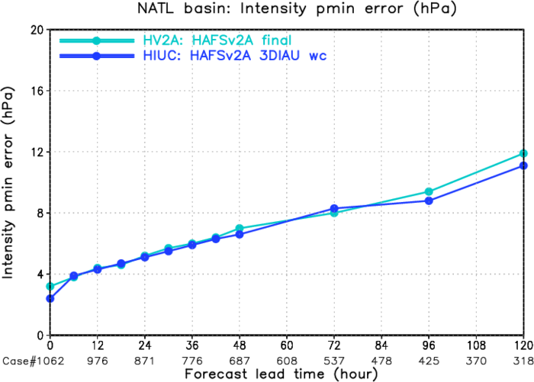
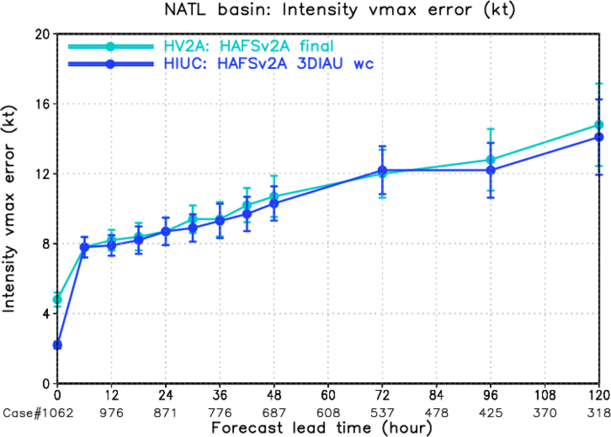
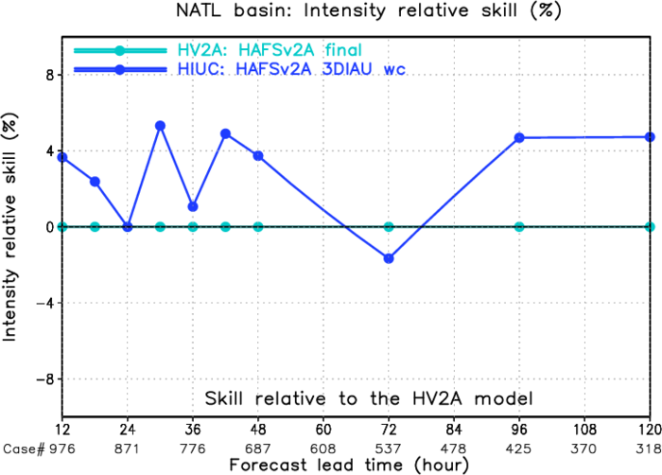
Impact of Storm-following 3DIAU on HAFS Forecasting
for 2021-2023 NATL Storms (from Xu Lu)
HV2A
HIUC
Track error
Pmin error
HIUC (3DIAU) improves intensity predictions over HV2A for almost all forecast lead times, except forecast lead time of day-3.
Vmax error
Intensity skill
Notes:
Methodology
The Three-Dimensional Incremental Analysis Update (3DIAU) uses the increment as an additional but continuous forcing to the model integration (Bloom et al. 1996).
The continuous but relatively small forcing added to each model integration time step is designed to maximally maintain the dynamical balance of the mass and momentum fields of the model, and therefore reduce the shocks caused by the intermittent DA
A feature-relative approach is used to add the increments only relative to the storm in the storm-following nest-domain configuration to avoid nonlinear issues (Lu and Wang 2021)
Bloom, S.C., Takacs, L.L., Da Silva, A.M. and Ledvina, D., 1996. Data assimilation using incremental analysis updates. Monthly Weather Review, 124(6), pp.1256-1271.
Lu, X. and Wang, X., 2021. Improving the four-dimensional incremental analysis update (4DIAU) with the HWRF 4DEnVar data assimilation system for rapidly evolving hurricane prediction. Monthly Weather Review, 149(12), pp.4027-4043.

Slide 9
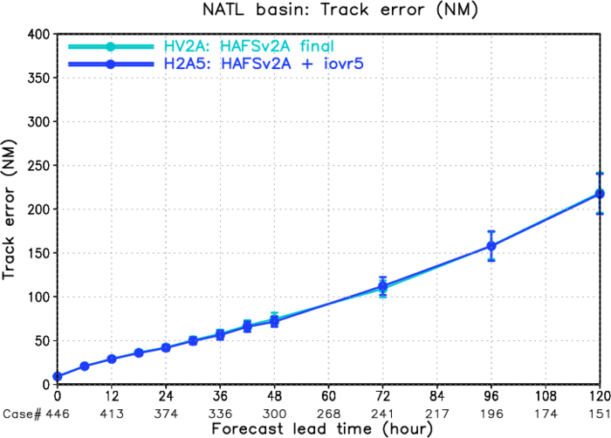
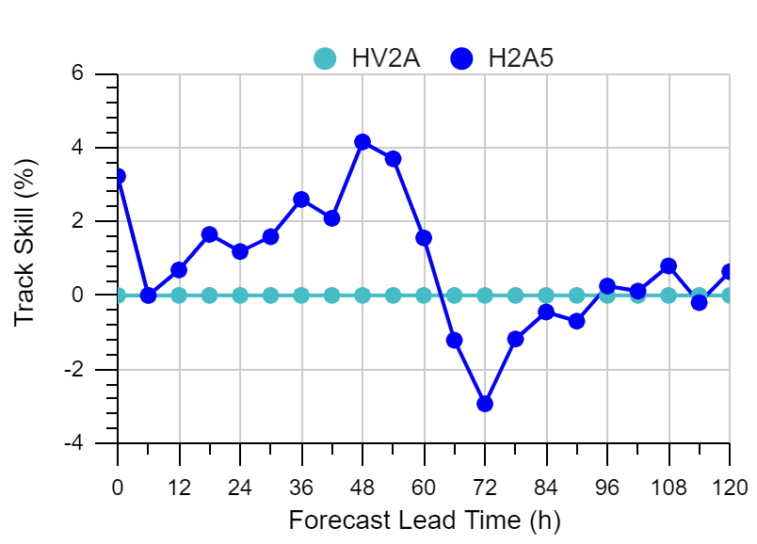
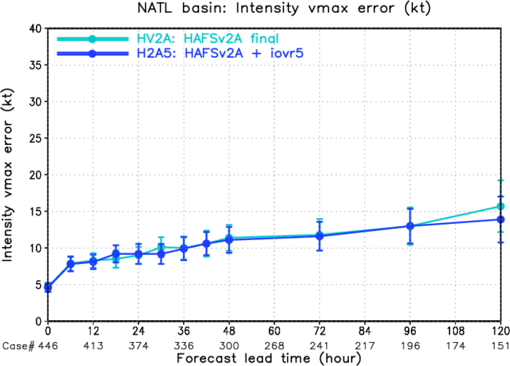
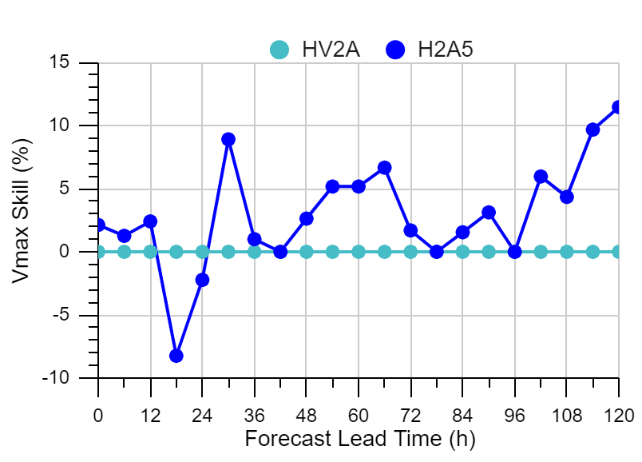
Impact of RRTMG Cloud Overlap Approach
For 2023 NATL storms (Collaboration among AER/DTC/EMC)
Use the Exponential-Random cloud overlap approach
Maximum-Random (MR) – iovr=1 HAFS default
Continuous cloud layers overlap as much as possible
Blocks of cloud layers with clear between are oriented randomly
Exponential-Random (ER) – iovr=5
Overlap transitions exponentially from maximum to random through continuous cloud layers
Blocks of cloud layers with clear between are correlated randomly
HV2A
H2A5
Track error
Track skill
Vmax error
Intensity skill

Slide 10
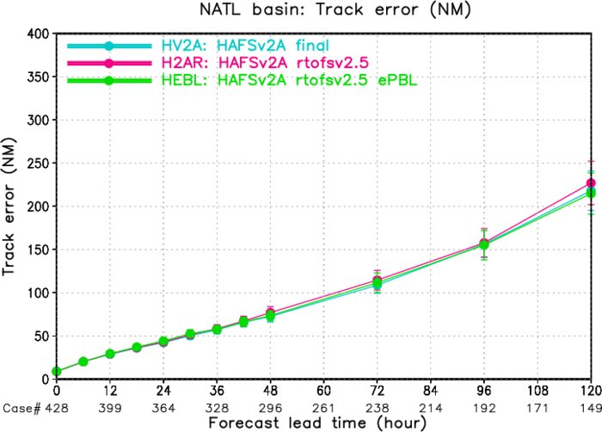
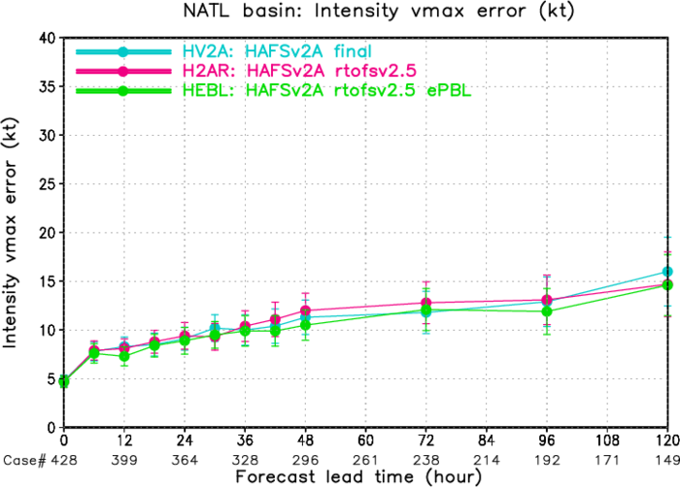
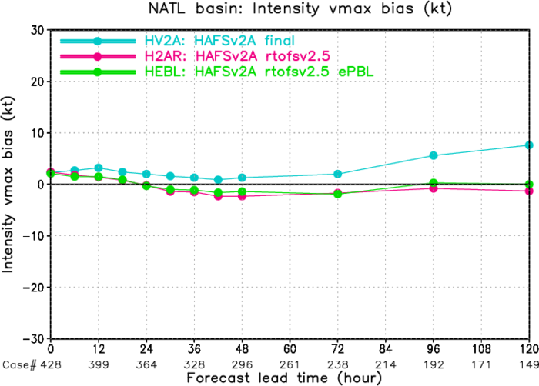
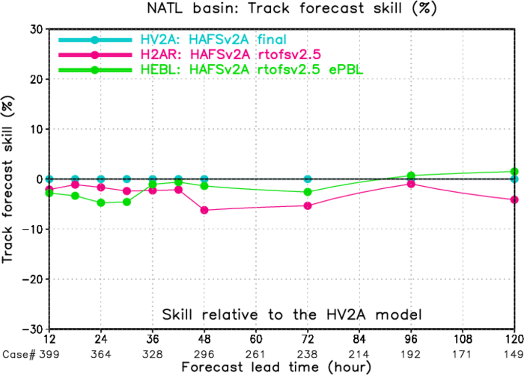
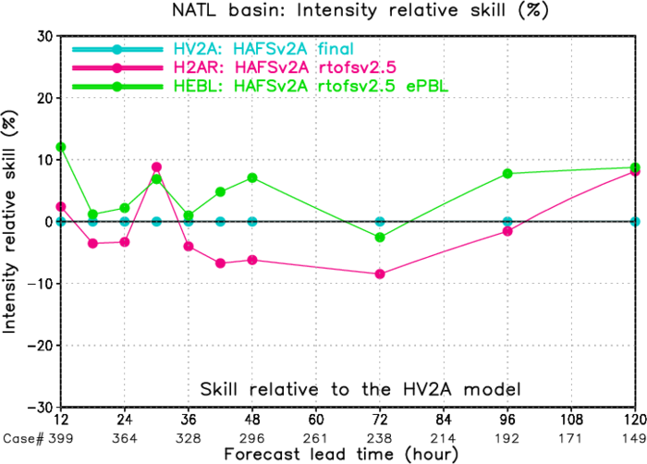
Ocean Coupling Related Upgrades and Impacts
For 2023 NATL storms (02-21L)
HV2A: FY2024 HAFSv2
H2AR: HV2A+RTOFSv2.5
HEBL: H2AR+MOM6 ePBL
Track error
Vmax error
Vmax bias
Using new RTOFSv2.5 input data
Using MOM6 Energetic Planetary Boundary Layer (ePBL) scheme (instead of KPP)
Track skill
Intensity skill

Slide 11
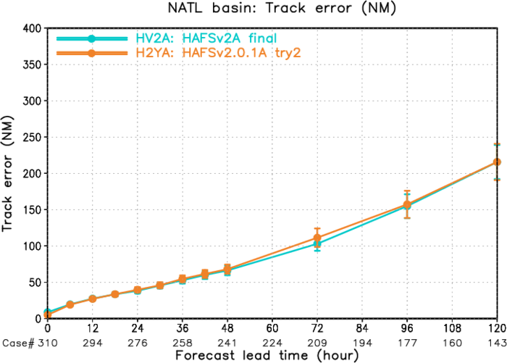
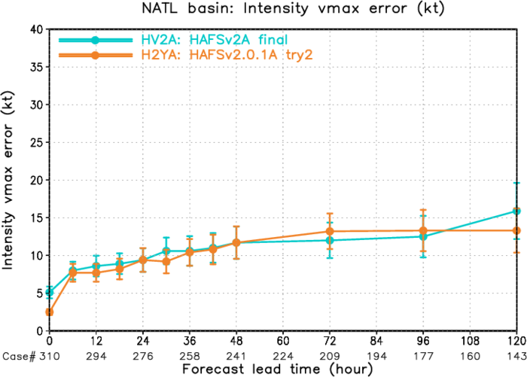
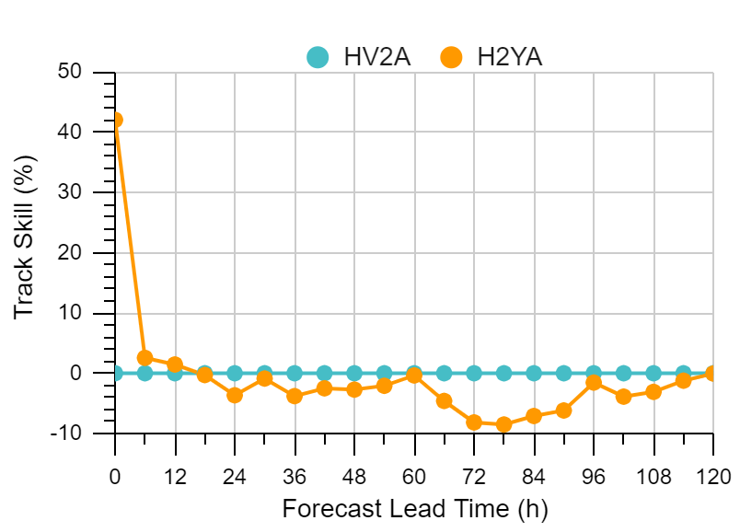
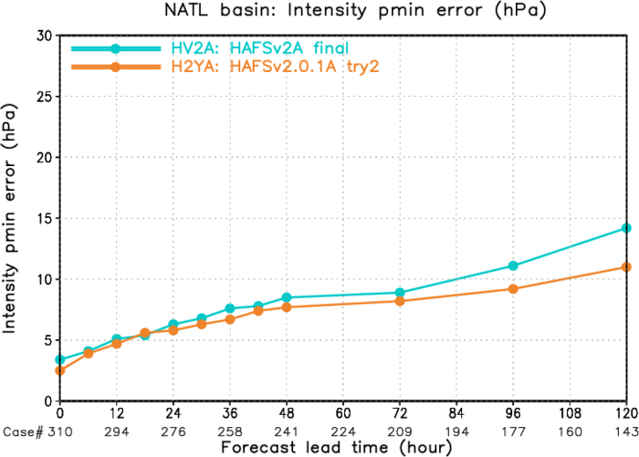
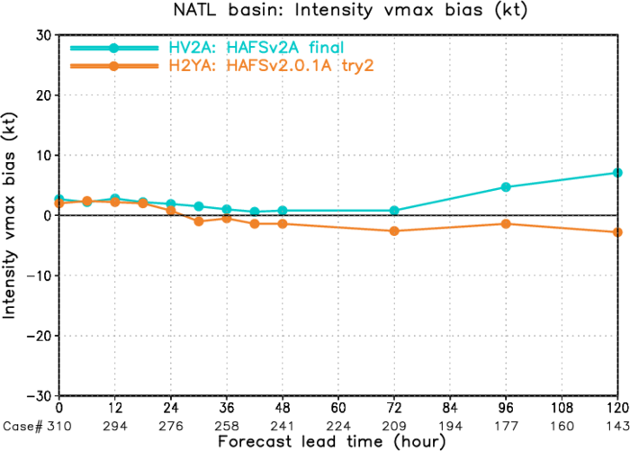
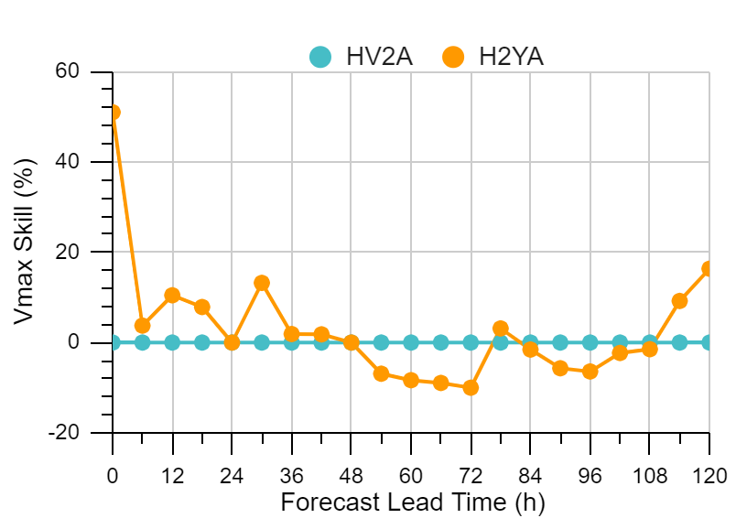
HAFSv2.0.1A Retrospective Test Results
For 2023 priority NATL storms
Track skill
HV2A: HAFSv2A
H2YA: HAFSv2.0.1A
Track error
Vmax error
Intensity skill
Pmin error
Vmax bias

Slide 12
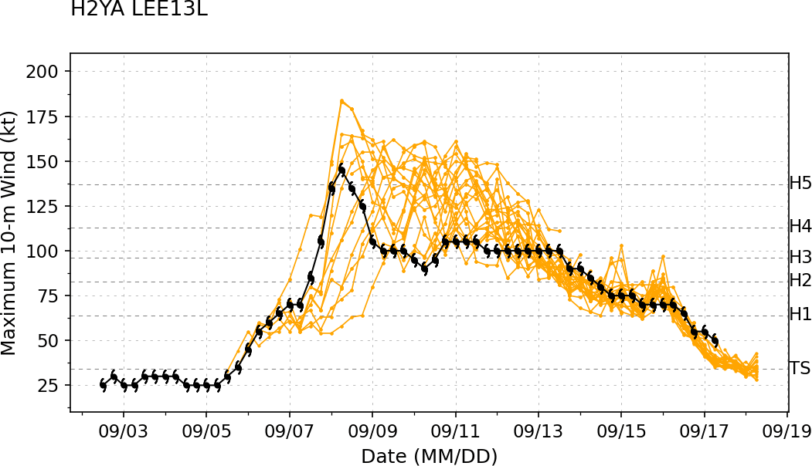
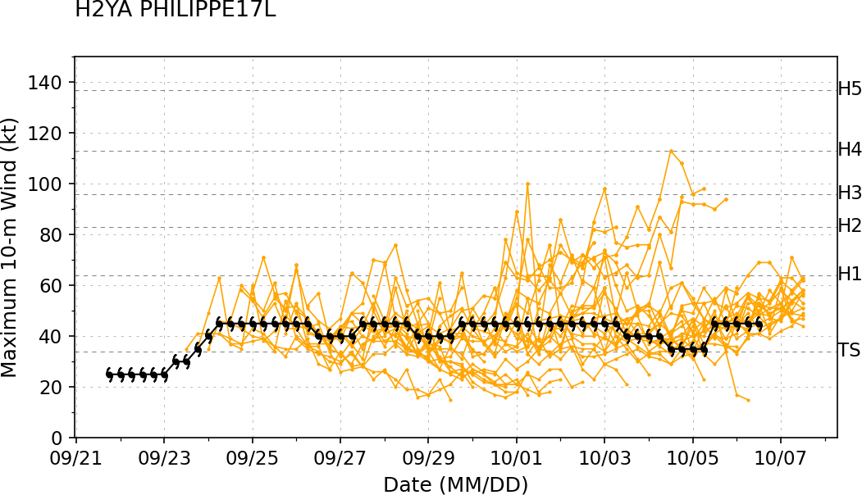
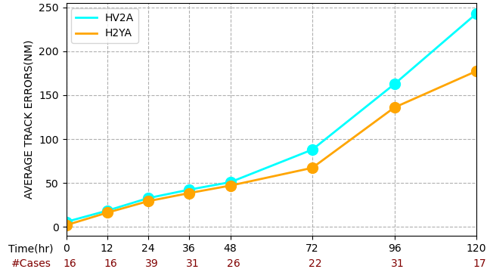
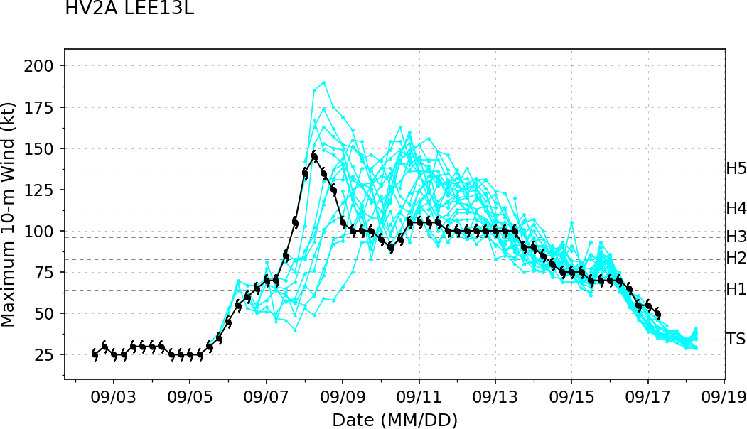
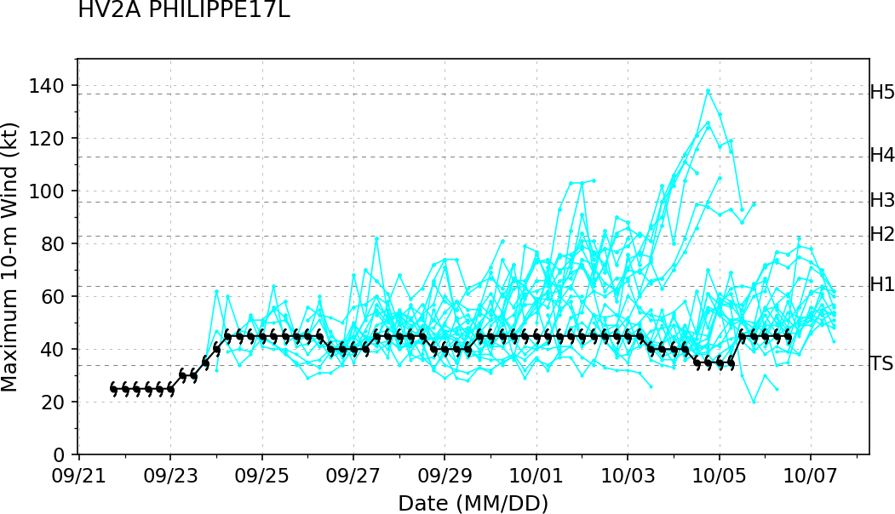
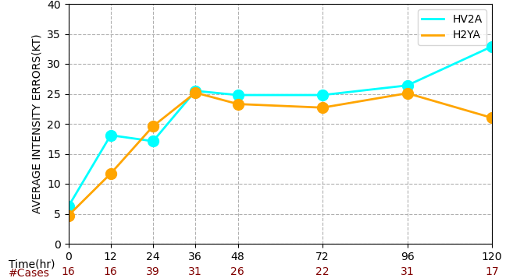
HAFSv2.0.1A (H2YA) VS HAFSv2A (HV2A)
Lee13L
Philippe17L
Performance for RI cycles
H2YA
Track error
HV2A
Vmax error

Slide 13
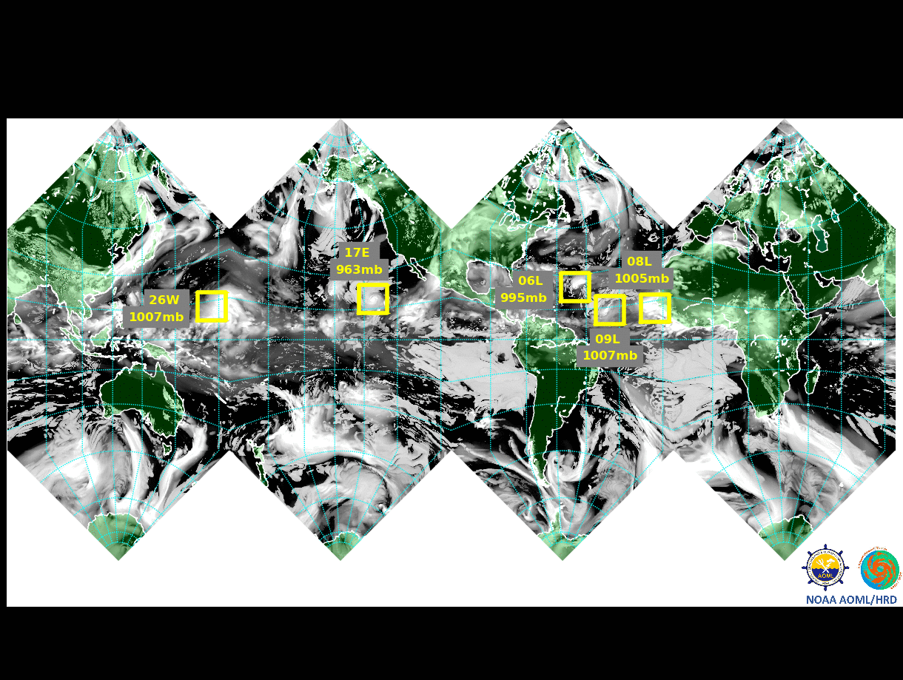
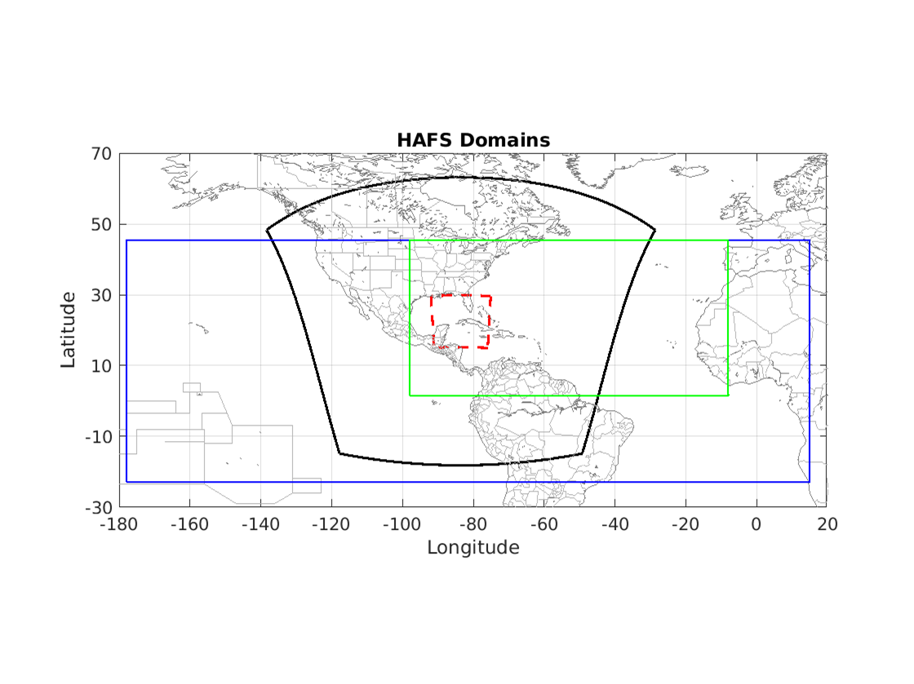
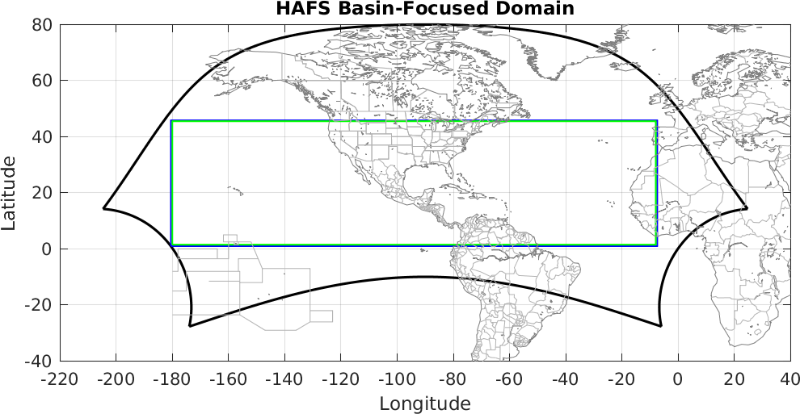
Summary and Future HAFS Development
The HAFSv2A configuration based HAFSv2.0.1A real-time parallel experiment has been developed and tested. It will be kicked off ~ August 1st as one of the 2024 HFIP real-time demo projects.
Future HAFS developments and advancements include
Downstream upgrades for the upcoming RTOFSv2.5 upgrade and GFSv17 upgrade
HAFS JEDI-based DA transition with both atmospheric and oceanic DA, eventually coupled DA
HAFS-based ensemble analysis and forecast capabilities
Three-way atmosphere-wave-ocean coupling towards earth-system coupling
Storm-focused following triple moving nesting capability; Basin-focused multiple storm moving nesting capability; and eventually global multiple moving nesting capability
Storm-focused triple-moving-nesting
Basin-focused multi-storm moving-nesting
Global multi-storm moving-nesting
Notes:
VI and DA upgrades, physics and dynamics optimizations, as well as new ocean coupling capabilities.

Slide 14
Thanks!

Slide 15
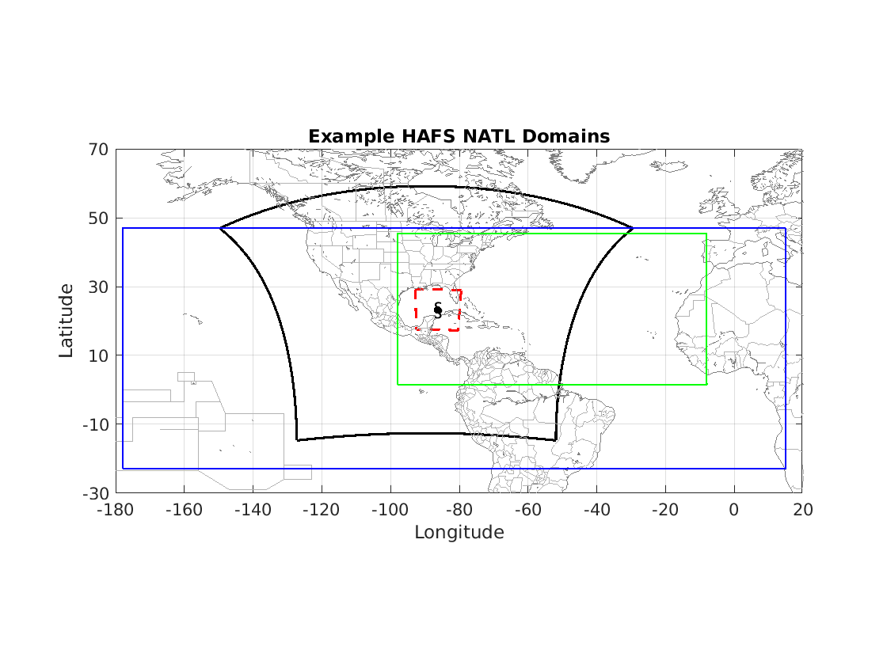
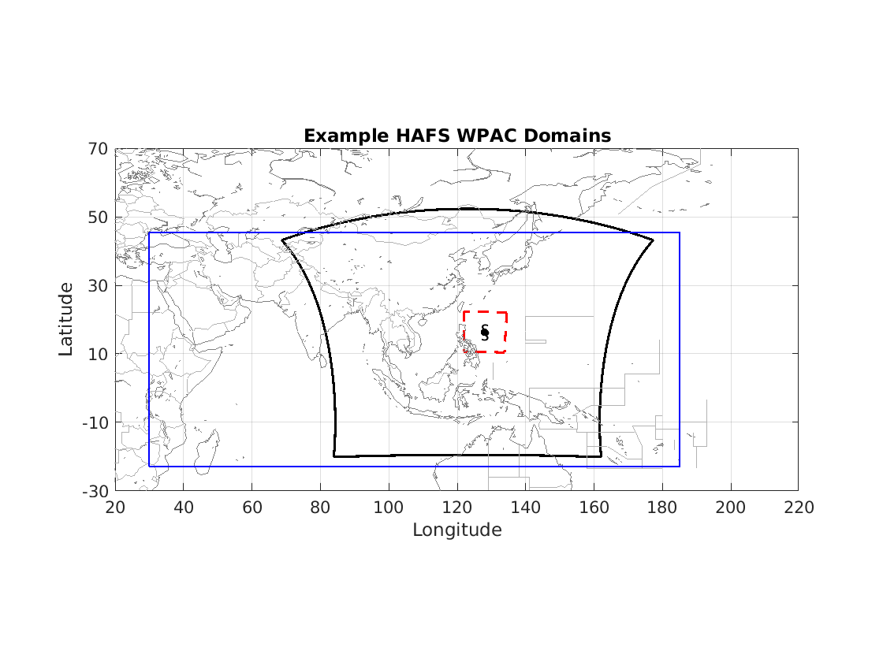
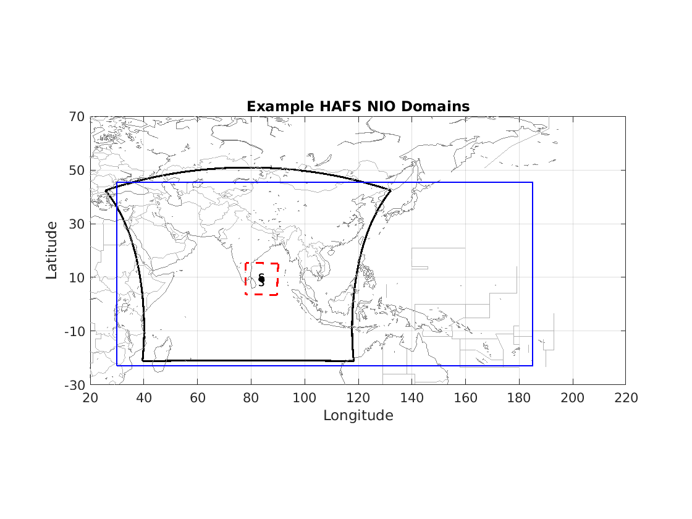
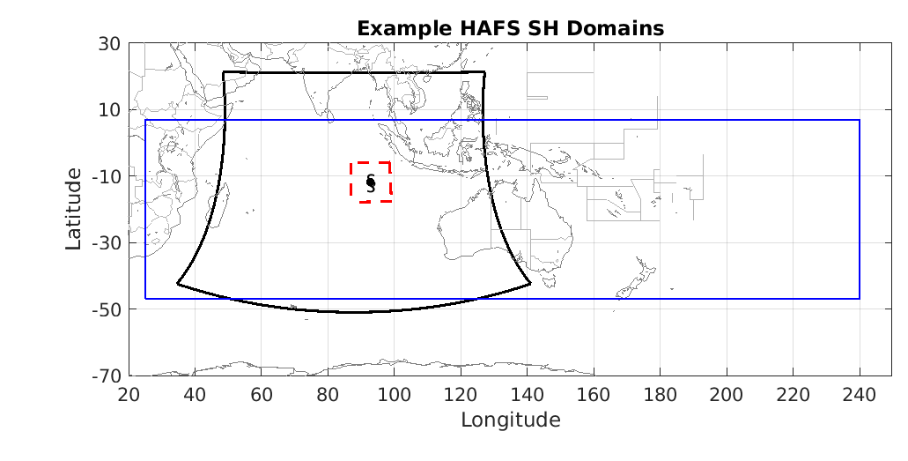
Two HAFSv2 Configurations (HFSA and HFSB)
HAFSv2.0 | Domain & Dynamics | Resolution | DA/VI | Ocean/Wave Coupling | Physics | Basins
HFSA | parent: 77x74 deg. nest: 11.8x11.8 deg. dt_atmos=90s hord_mt/vt/tm/dp/tr=1/1/1/1/-5 with lim_fac of 3.1 (AL), 2.9 (EP) | Regional (ESG), ~5.4/1.8 km, L81, ~2 hPa model top | Vmax > 40 kt warm-cycled VI Updated comp. vortex vi_cloud=1 Vmax adj: always 4DEnVar DA,SDL on | Two-way MOM6 (L55, KPP, Ri=0.2, updated CEMPS, SST(t) in non-overlapping atms domain, SSC) one-way WW3 coupling for NHC/CPHC basins | suite-1 | All global Basins NHC/CPHC/JTWC Max 7 Storms
HFSB | parent: 75x75 deg nest: 12x12 deg dt_atmos=72s hord_mt/vt/tm/dp/tr=1/1/1/1/-5 with lim_fac of 2.8 | Regional (ESG), ~6/2 km, ~L81, ~2 hPa model top | Vmax > 40 kt warm-cycled VI V1 comp. vortex vi_cloud=0 Vmax adj: auto 4DEnVar DA,SDL on | Two-way HYCOM (L41, KPP, Ri=0.25, CMEPS-based regional coupling, SST(t0) in non-overlapping atms domain, no SSC) No Wave coupling | suite-2 | NHC/CPHC Max 5 Storms
NATL/EPAC Basins
WPAC Basin
NIO Basin
SH Basin
atmospheric domain, ocean domain, wave domain

Slide 16
Two HAFSv2 Physics Suites (HFSA and HFSB)
 | Suite 1 (HFSA) | Suite 2 (HFSB) | References
Land/ocean Surface | NOAH LSM VIIRS veg type, MOM6 | NOAH LSM VIIRS veg type HYCOM | Ek et al. (2003) Reichl et al. (2018) Domingues et al. (2019)
Surface Layer | GFS, HWRF TC-specific sea surface roughnesses | GFS, HWRF TC-specific sea surface roughnesses | Miyakoda and Sirutis (1986); Long (1984, 1986)
Boundary Layer | Sa-TKE-EDMF: sfc_rlm=1; tc_pbl=0 elmx/rlmx=250 (nest) | Sa-TKE-EDMF: sfc_rlm=0; tc_pbl=1 elmx/rlmx=75 (nest) | Han et al. (2019) Chen et al. (2022)
Microphysics | Thompson, dt_inner=45s (AL) GFDL MPv1 (EP) | Thompson, dt_inner=36s | Thompson et. al, 2008 and 2014
Radiation | RRTMG Calling frequency 900 s | RRTMG Calling frequency 720 s | Iacono et al. (2008)
Cumulus convection (deep & shallow) | sa-SAS; progsigma=false (AL), true (EP); clam_deep=0.15 | sa-SAS; progsigma=false (AL), true (EP); clam_deep=0.1 | Han et al. (2017)
Gravity wave drag | Improved UGWPv1 (orographic on/convective off) | Improved UGWPv1 (orographic on/convective off) | Toy et al. (2024)

