Slide 1
Numerical Simulations of Tropical Cyclones using a Scale-Aware Three-Dimensional TKE Turbulent Mixing Scheme
Ping Zhu
Florida International University (FIU)
Kwun Samuel Fung, Xuejing Zhang, Jun Zhang
Atlantic Oceanographic and Meteorological Laboratory (AOML), NOAA
Zhan Zhang, Bin Liu
Environmental Modeling Center (EMC), NOAA
Jianwen Bao
Physical Sciences Laboratory (PSL), NOAA
07/22/2024

Slide 2
Turbulence Parameterization Problem
Governing equations of grid-box mean variables
$\frac{∂\overline{u}}{∂t}+\overline{u}\frac{∂\overline{u}}{∂x}+\overline{v}\frac{∂\overline{u}}{∂y}+\overline{w}\frac{∂\overline{u}}{∂z}=−\frac{1}{\overline{ρ}}\frac{∂\overline{p}}{∂x}+ f\overline{v}−\frac{∂(\overline{u^{′}u^{′}})}{∂x}−\frac{∂(\overline{u^{′}v^{′}})}{∂y}−\frac{∂(\overline{u^{′}w^{′}})}{∂z}$ $\frac{∂\overline{v}}{∂t}+\overline{u}\frac{∂\overline{v}}{∂x}+\bar{v}\frac{∂\overline{v}}{∂y}+\overline{w}\frac{∂\overline{v}}{∂z}=−\frac{1}{\overline{ρ}}\frac{∂\overline{p}}{∂y}−f\overline{u}−\frac{∂(\overline{v^{′}u^{′}})}{∂x}−\frac{∂(\overline{v^{′}v^{′}})}{∂y}−\frac{∂(\overline{v^{′}w^{′}})}{∂z}$ $\frac{∂\overline{w}}{∂t}+\overline{u}\frac{∂\overline{w}}{∂x}+\overline{v}\frac{∂\overline{w}}{∂y}+\overline{w}\frac{∂\overline{w}}{∂z}=−\frac{1}{\overline{ρ}}\frac{∂\overline{p}}{∂z}−g−\frac{∂\left(\overline{w^{′}u^{′}}\right)}{∂x}−\frac{∂\left(\overline{w^{′}v^{′}}\right)}{∂y}−\frac{∂\left(\overline{w^{′}w^{′}}\right)}{∂z}$
$\frac{∂\overline{θ}}{∂t}+\bar{u}\frac{∂\overline{θ}}{∂x}+\overline{v}\frac{∂\overline{θ}}{∂y}+\overline{w}\frac{∂\overline{θ}}{∂z}=−\frac{∂(\overline{u^{′}θ^{′}})}{∂x}−\frac{∂(\overline{v^{′}θ^{′}})}{∂y}−\frac{∂(\overline{w^{′}θ^{′}})}{∂z}+\overline{Q_{θ}}$
$\frac{∂\overline{q}}{∂t}+\bar{u}\frac{∂\overline{q}}{∂x}+\overline{v}\frac{∂\overline{q}}{∂y}+\overline{w}\frac{∂\overline{q}}{∂z}=−\frac{∂\left(\overline{u^{′}q^{′}}\right)}{∂x}−\frac{∂\left(\overline{v^{′}q^{′}}\right)}{∂y}−\frac{∂\left(\overline{w^{′}q^{′}}\right)}{∂z}+\overline{S_{q}}$
Numerical models use discretized grids to simulate continuous atmosphere, the nonlinear interaction between the resolved and sub-grid-scale fields results in the second-order flux moments that must be represented parametrically to close the governing equations.

Slide 3
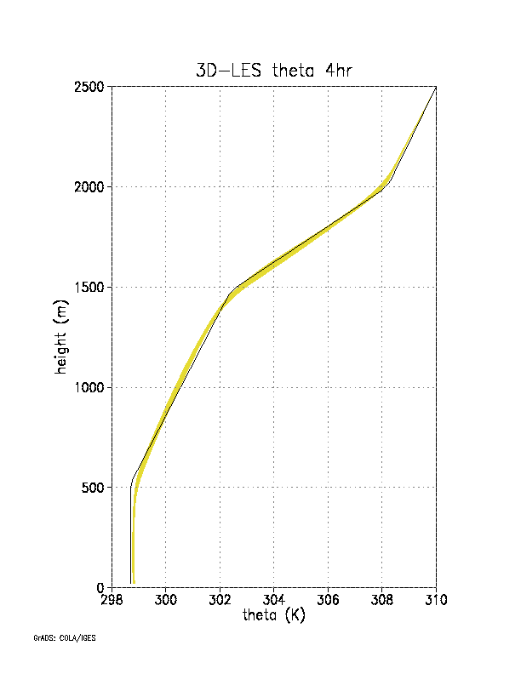
Turbulence in unsaturated or shallow convection regimes
BOMEX
DYCOMS
15:30 LST
12:30 LST
09:30 LST
06:30 LST
295 300 305
θ (K)
300 302 304 306 308
θ (K)
Southern Great Plains
Typical CBL
Typical nocturnal SBL
Subtropical trade-wind MBL
Stratocumulus-topped MBL
The turbulent BL is cleanly separated from the free atmosphere by a capping inversion.
Vertical turbulent mixing is much stronger than the horizontal turbulent mixing.

Slide 4
Turbulence parameterization in mesoscale and large-scale models
Horizontal and vertical turbulent mixing is parameterized separately with the former being handled in a model’s dynamic solver and the latter treated by a standalone 1D module outside the dynamic core.
Most of model physics, such as, microphysics and radiation, is parameterized in a 1D vertical column framework, thus, it is natural to parameterize vertical turbulent mixing in the same 1D framework so that different model physics can be bundled together in a so-called model physics package.
Unresolved large energy containing turbulent eddies are anisotropic.
Vertical gradient is much larger than horizontal gradient.
There are unique vertical turbulent processes associated with shallow clouds and non-local mixing, which require special treatment in the vertical.

Slide 5
Unique thermodynamic and turbulence structures and characteristics in the eyewalls of tropical cyclones (TCs)
(a) $θ (K)$ in the eyewall
(Lorsolo et al. 2010)
(Zhu et al. 2019)
No inversion exists to separate the BL from the free atmosphere above in the eyewall.
Large Turbulent kinetic energy (TKE) extends from the BL to the upper troposphere in the eyewall.

Slide 6
3D turbulent transport in the inner core of TCs
(b) ${\left(\frac{∂{\overline{u}}_{i}}{∂x_{j}}+\frac{∂{\overline{u}}_{j}}{∂x_{i}}\right)\frac{∂{\overline{u}}_{i}}{∂x_{j}}−\left[{(\frac{∂\overline{u}}{∂z})}^{2}+{(\frac{∂\overline{v}}{∂z})}^{2}\right](s}^{−2})$
(a) $q_{t} (g{kg}^{−1})$ & velocity vectors
(c) Vertical profiles of $S^{2}$ at R=38 km
(Zhu et al. 2023)
$\left(\frac{∂{\overline{u}}_{i}}{∂x_{j}}+\frac{∂{\overline{u}}_{j}}{∂x_{i}}\right)\frac{∂{\overline{u}}_{i}}{∂x_{j}}$
Large turbulent eddies at the edge of eyewall
${(\frac{∂\overline{u}}{∂z})}^{2}+{(\frac{∂\overline{v}}{∂z})}^{2}$
Large eddy simulation of Hurricane Isabel (2003)
Turbulent eddies experience large lateral contrast across the edge of the eyewall, which is comparable to the vertical gradients.
3D shear production of TKE is important in the inner core of TCs.

Slide 7
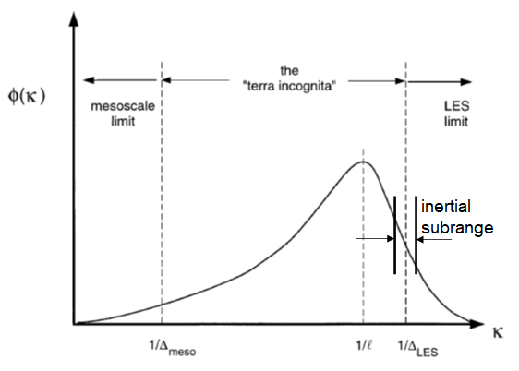
Parameterization of turbulent mixing in the gray zone
after Wyngaard (2004)
Turbulent eddies in the gray zone possess both isotropic and anisotropic characteristics.
The separated parameterization strategy becomes problematic as turbulent mixing is really three dimensional.
Turbulent eddy energy spectrum
Anisotropic large eddies
Isotropic eddies
Eddy scale

Slide 8
Development of a Scale-Aware 3D TKE scheme in HAFS
$\frac{de}{dt}=−\overline{u_{\text{i}}^{′}u_{\text{j}}^{′}}\frac{∂{\overline{u}}_{i}}{∂x_{j}}+δ_{i3}\frac{g}{\overline{θ_{v}}}\overline{{u_{\text{i}}^{′}θ}_{v}^{′}} − \frac{∂}{∂x_{i} }\left[\overline{u_{\text{i}}^{′}\left(e+\frac{p^{′}}{\overline{ρ}}\right)}\right]−$ ε
3D TKE budget:
Transitioning a 3D TKE scheme at the LES limit to 1D TKE scheme at the MS limit using the blending method proposed by Zhang et al. (2018)
Unique features of the new scheme
i. It considers full 3D TKE shear production tensor $−\overline{u_{i}^{′}u_{j}^{′}}\frac{∂{\overline{u}}_{i}}{x_{j}},\overline{u_{i}^{′}u_{j}^{′}}=−k_{m}\left(\frac{∂{\overline{u}}_{i}}{∂x_{j}}+\frac{∂{\overline{u}}_{j}}{∂x_{i}}\right)$
ii. It considers 3D TKE turbulent transport and pressure correlation $−\frac{∂}{∂x_{i} }\left[\overline{u_{\text{i}}^{′}\left(e+\frac{p^{′}}{\overline{ρ}}\right)}\right]=k_{e}\frac{∂e}{∂x_{i}}$
iii. Scale aware: achieved by blending LES limit with mesoscale limit via a partition function.
iv. Treatment of non-local mixing: ${\overline{w^{′}φ^{′}}}^{∆, NL}={\overline{w^{′}φ^{′}}}^{NL}P_{NL}\left(∆/{z_{i}}\right).$
${\overline{w^{′}φ^{′}}}^{NL}$ at the mesoscale limit is determined by the mass-flux approach following 1D EDMF TKE scheme (Han et al. 2019). Non-local flux at the LES limit is assumed to be zero.

Slide 9
v. Treatment of horizontal mixing
Horizontal divergence damping in FV3 dynamic core
${\overline{u}}^{n+1}={\overline{u}}^{n}+⋯+\frac{δ(∆tD_{T})}{δx}=…+{\frac{δ}{δx}(ν}_{d}∇^{2N}D)+\frac{δ}{δx}(ν_{2d}D)$,
${\overline{v}}^{n+1}={\overline{v}}^{n}+⋯+\frac{δ\left(∆tD_{T}\right)}{δy}=…+{\frac{δ}{δx}(ν}_{d}∇^{2N}D)+\frac{δ}{δy}(ν_{2d}D)$,
$∆tD_{T}=ν_{d}∇^{2N}D+ν_{2d}D$(m²s⁻¹), $ν_{2d}=∆A_{min}d_{s}∆t\sqrt{D^{2}+ς^{2}}$(m²), $D:divergence, ς$: vorticity
Horizontal diffusion with K-closure: $\frac{∂{\overline{u}}_{i}}{∂t}=⋯+\frac{∂}{∂x_{j}}\left(k_{m}{\overline{S}}_{ij}\right)=$ $⋯+\frac{∂}{∂x_{j}}\left[k_{m}\left(\frac{∂{\overline{u}}_{i}}{∂x_{j}}+\frac{∂{\overline{u}}_{j}}{∂x_{i}}\right)\right]$
${\overline{u}}^{n+1}={\overline{u}}^{n}+⋯+∆t\left[k_{m}∇^{2}\overline{u}+\frac{1}{2}\frac{∂k_{m}}{∂x}\left(S_{11}−S_{22}\right)+\frac{∂k_{m}}{∂y}S_{12}\right]+\frac{∂}{∂x}\left(∆tk_{m}D\right)$,
${\overline{v}}^{n+1}={\overline{v}}^{n}+⋯+∆t\left[k_{m}∇^{2}\overline{v}+\frac{1}{2}\frac{∂k_{m}}{∂y}\left(S_{22}−S_{11}\right)+\frac{∂k_{m}}{∂x}S_{21}\right]+\frac{∂}{∂y}\left(∆tk_{m}D\right)$,
$ν_{2d} \sim ∆tk_{m}$, $k_{m}=c_{m}l\sqrt{e}$, e: predicted TKE by the 3D scheme
This provides a way to parameterize the LES-3D component of the first-order damping in terms of the predicted TKE consistent with the vertical diffusion parameterization.

Slide 10
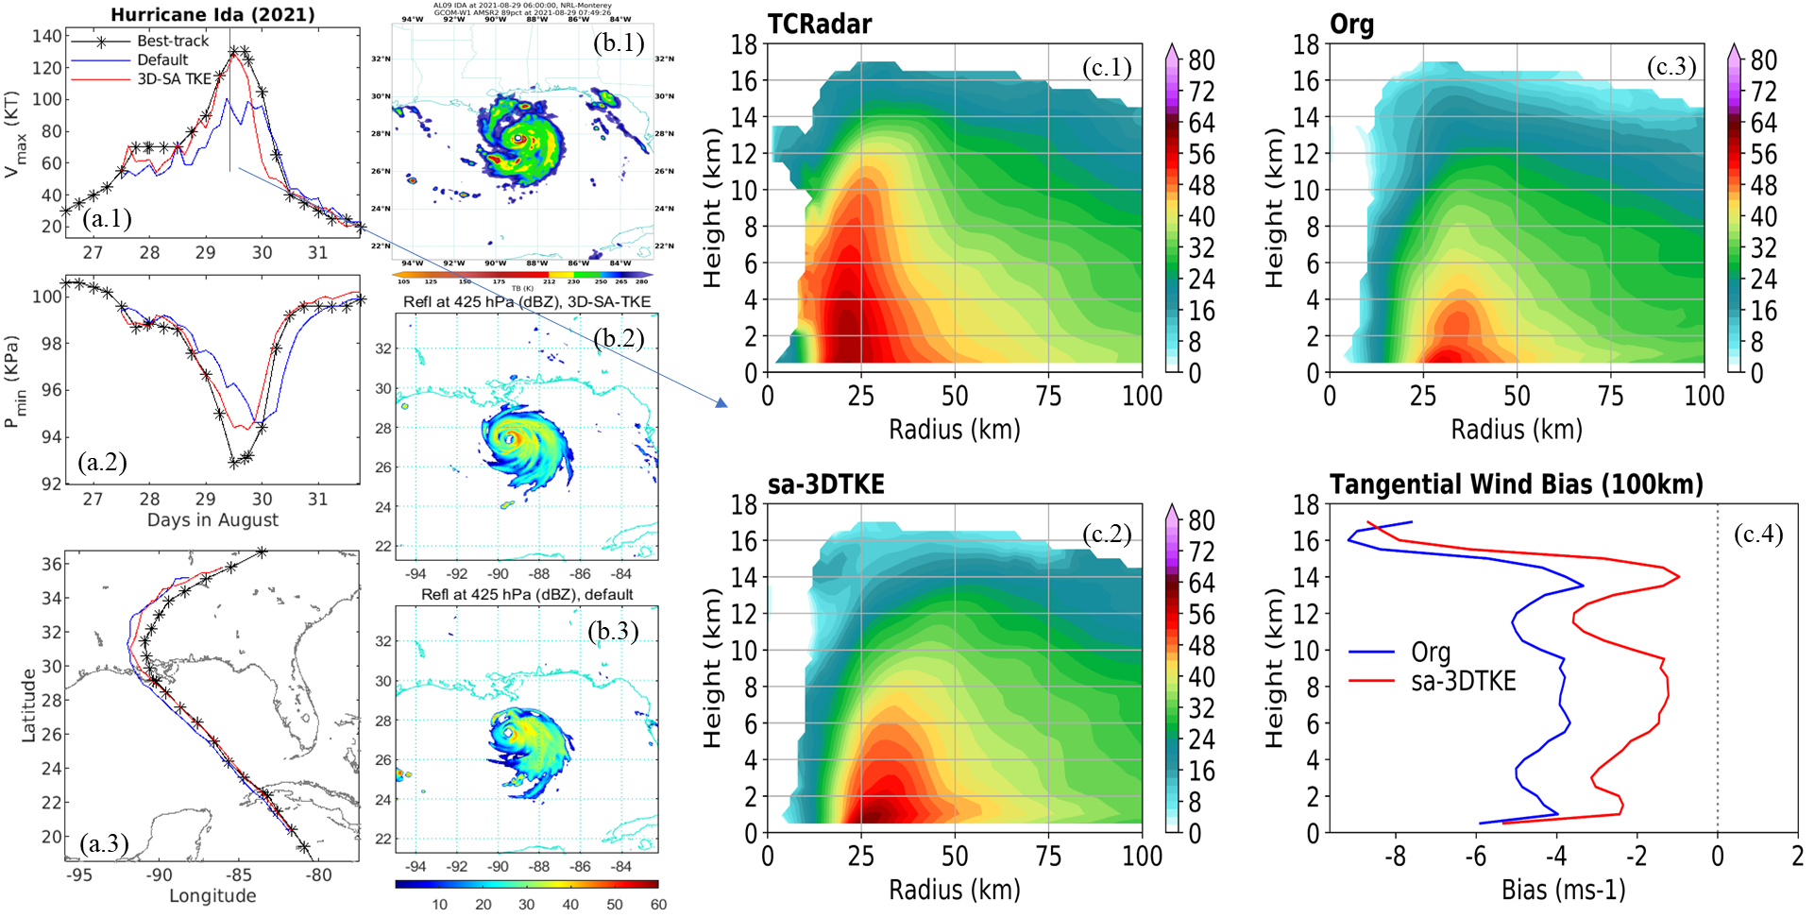
Validation of SA-3D TKE scheme

Slide 11
Bias error of five simulation cycles of Hurricane Danielle (2022)
Bias error of four simulation cycles of Hurricane Fiona (2022)

Slide 12
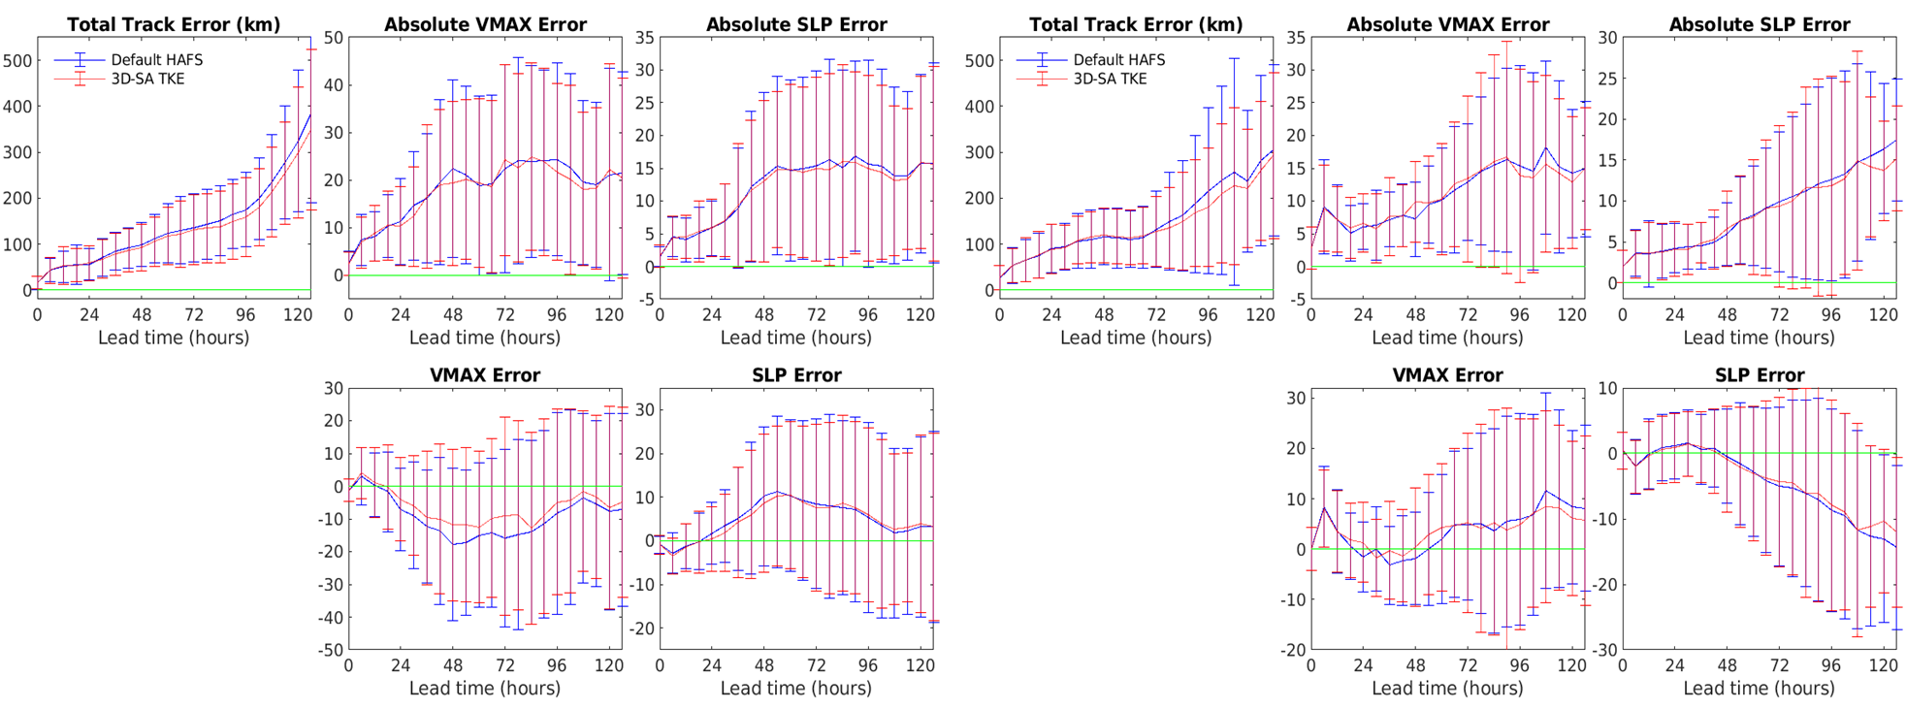
Statistical Evaluations of HAFS Simulations
Major storms (>=CAT-3):
2021: Grace (4C), Ida (6C), Larry (4C), Sam (4C); 2022: Fiona (4C), Ian (8);
2023: Franklin (4C), Idalia (5C), Lee (4C),
totaling 43 cycles.
Weak storms (<CAT-3):
2021: Elsa (4C), Fred (4C), Henri (4C);
2022: Danielle(5C), Earl (4C);
2023: Margot (4C), Philippe (4C), Tammy (8C),
totaling 37 cycles

Slide 13
Summary
A scale-aware 3D TKE scheme applicable to the gray zone has been developed and implemented in HAFS. Simulations of historical storms show that the scheme improves the forecasting skill of HAFS in simulating tracks and intensities of tropical cyclones.
Ongoing and Future Work
Working with EMC, we are currently transitioning the scheme from research to operations.

