Slide 1
Enhancing Ionospheric Forecasting In Egypt: Utilizing GNSS Data and Deep Neural Networks
Authors:
Hassan Nooreldeen 1, Ayman Mahrous 2, Ayman Ahmed 1, Mohamed Yossuf 3, Amira Hamdy1, Abdalla Shaker 1,
1- Egyptian space agency (EgSA), Egypt.
2- Egypt-Japan university of science and technology (EJUST) ), Egypt.
3- Faculty of science, Helwan university, Egypt.

Slide 2
Introduction
Ionosphere
Challenges in Ionospheric Forecasting
GNSS Data Utilization
Deep Neural Networks for Forecasting
Implementation and Results
Challenges and Future Directions
Conclusion

Slide 3
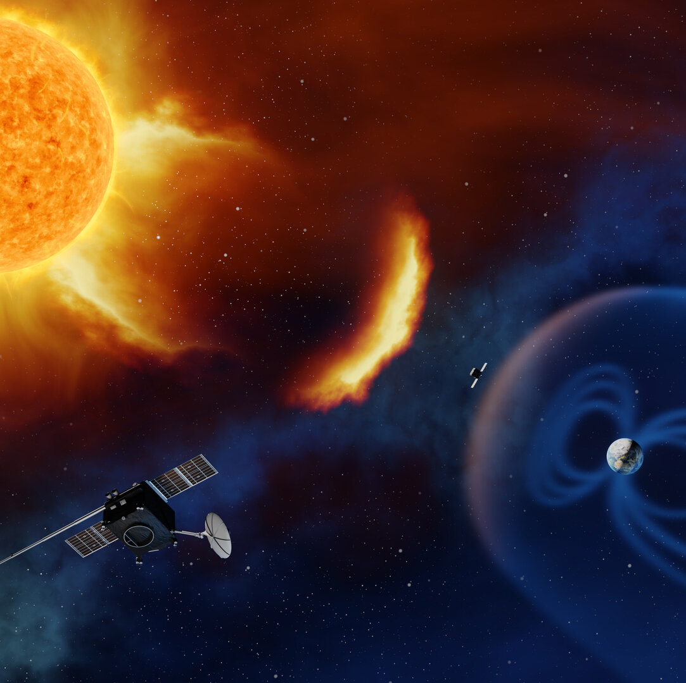
Introduction
Definition of Space Weather:
Space weather refers to the dynamic and ever-changing conditions in the space environment surrounding Earth, influenced by solar activity and other celestial phenomena.

Slide 4
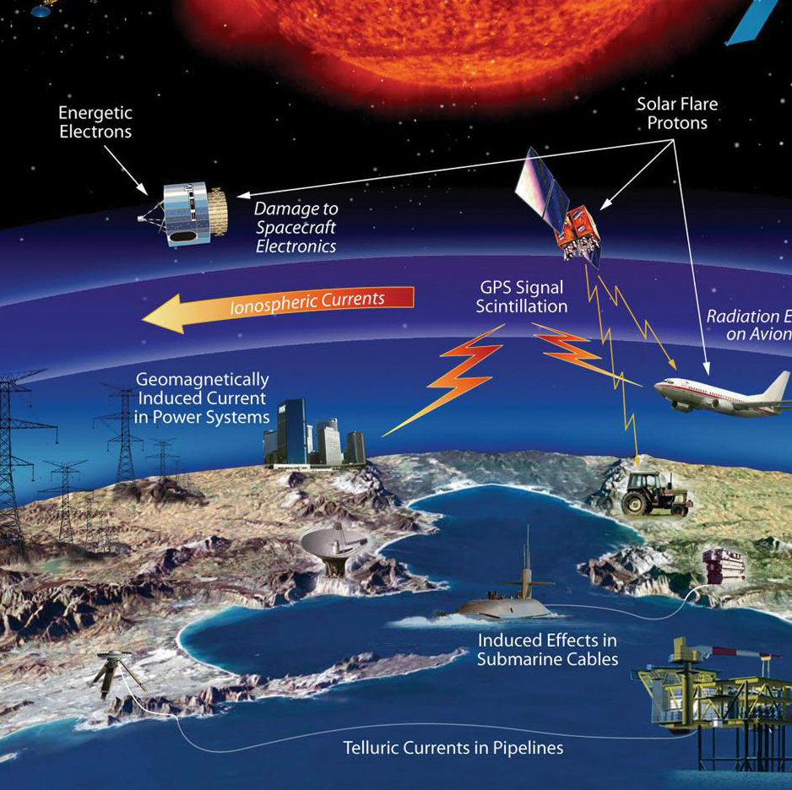
Introduction
Impact on Earth and Technological Systems:
Effects on Earth systems and technology: Geomagnetic storms can affect a wide range of Earth systems and technology, including:
Communication: Geomagnetic storms can disrupt radio signals and satellite communication.
Navigation: Geomagnetic storms can cause errors in GPS and other navigation systems by disrupting the ionosphere.
Power systems: Geomagnetic storms can induce electrical currents in power grids, causing blackouts and equipment damage.
Aviation: Geomagnetic storms can pose a radiation hazard to astronauts and aircrew at high altitudes.
- Spacecraft: Geomagnetic storms can cause spacecraft anomalies, radiation damage, and mission failure.

Slide 5
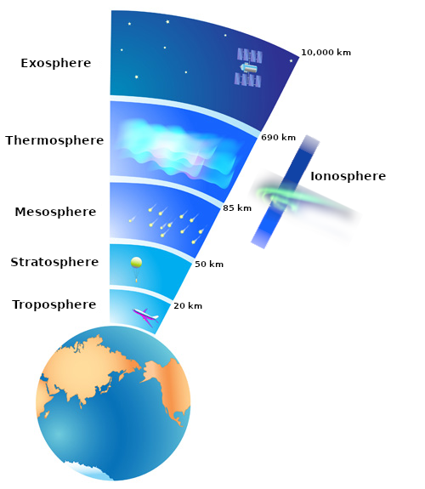
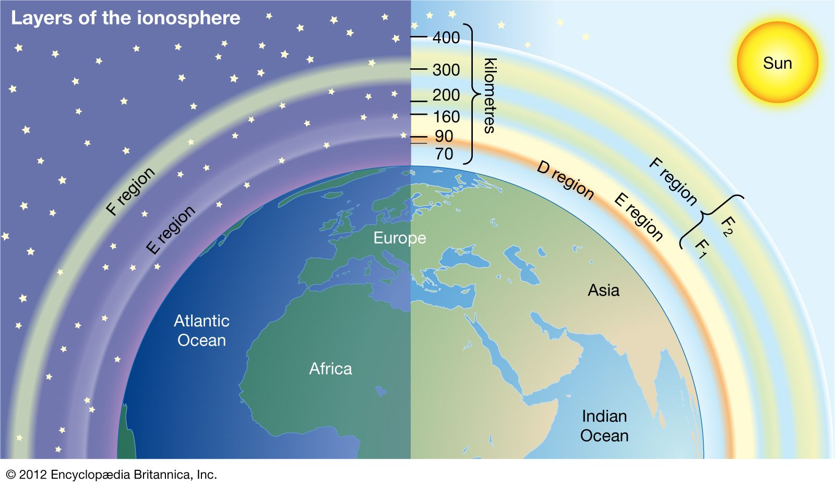
Ionosphere
Formation: The ionosphere is a layer of the Earth's atmosphere that is ionized by solar radiation. It starts at an altitude of about 60 km and extends up to 1,000 km.
Structure: The ionosphere is divided into several layers, each with its own ionization characteristics. The layers include the D layer, E layer, F1 layer, and F2 layer. The ionosphere is also affected by the Earth's magnetic field, which can cause irregularities in its structure.

Slide 6
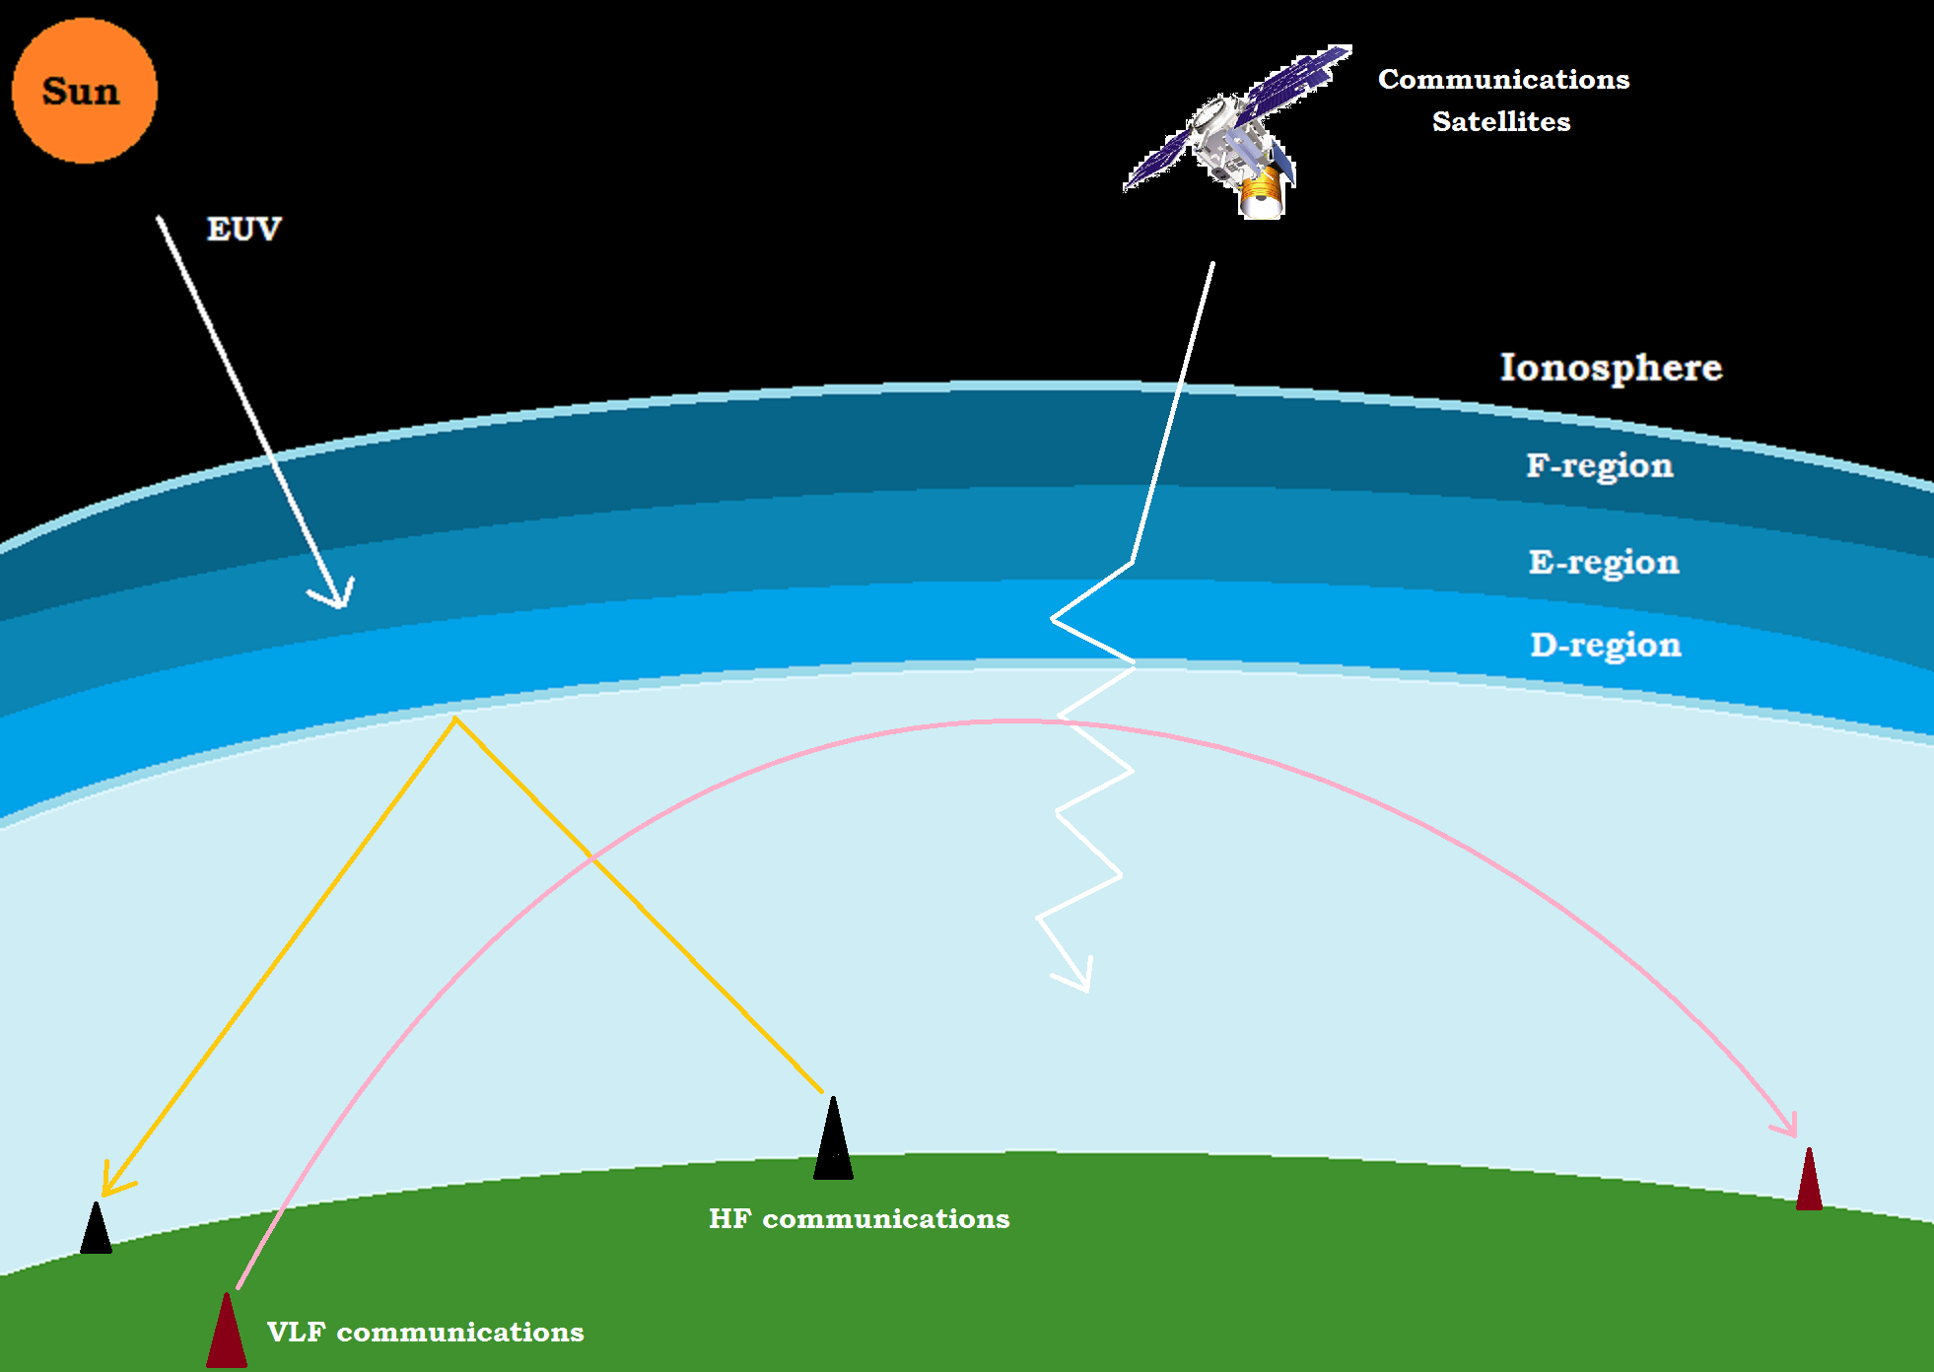
Ionosphere
c. Effects of the Ionosphere on Radio Wave Propagation:
The ionosphere reflects and refracts radio waves, but its ionization characteristics can also cause signal attenuation, distortion, and interference. Some effects include:
• Absorption: D layer absorbs radio waves with frequencies below 10 MHz, making them unusable for long-distance communication.
• Reflection: E and F layers reflect radio waves with frequencies between 3 and 30 MHz, allowing them to travel around the world.
• Refraction: Radio waves are refracted by the ionosphere's varying density, causing signal distortion and multipath interference.
• Scintillation: The ionosphere causes rapid fluctuations in amplitude and phase of radio signals, causing errors in navigation and communication systems.

Slide 7
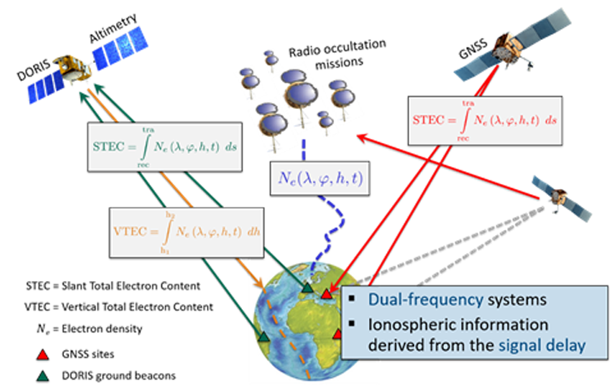
Ionosphere
d. Monitoring and modeling the ionosphere: To mitigate the effects of the ionosphere on radio wave propagation, it is important to monitor and model its structure and ionization characteristics.
This requires a combination of ground-based and satellite-based instruments, as well as computer models that simulate the ionosphere's behavior.
By understanding the ionosphere's behavior, we can develop better communication and navigation systems that are less affected by its effects.

Slide 8
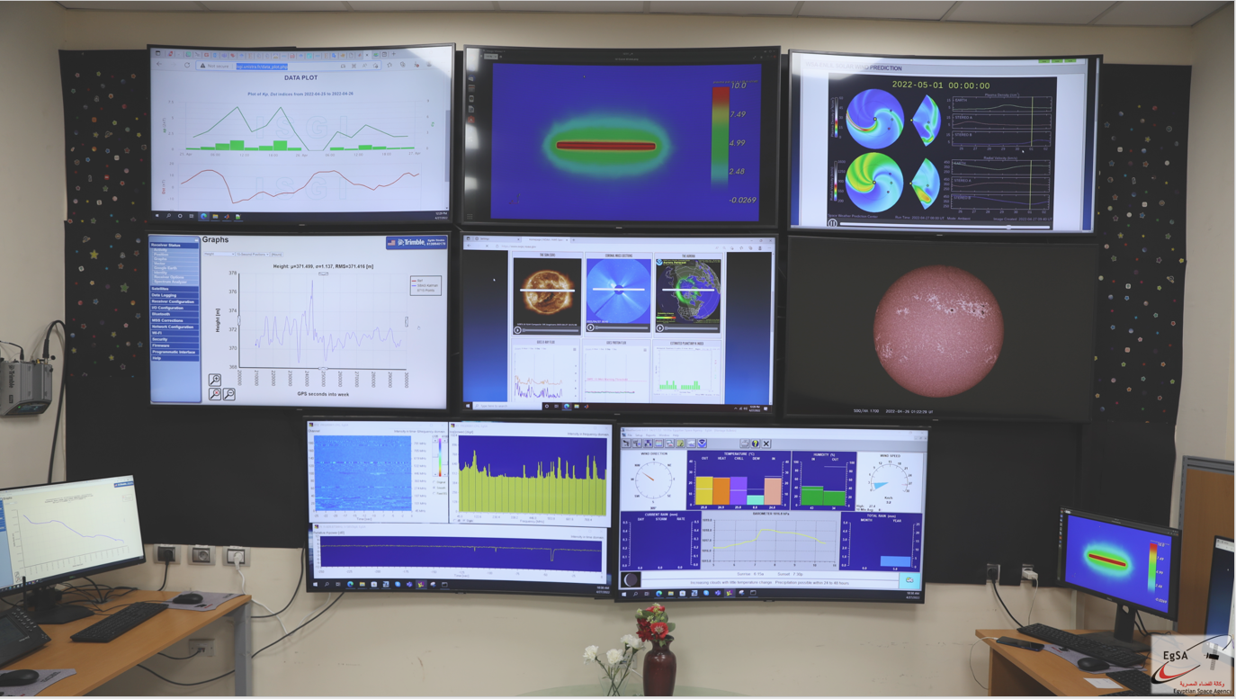
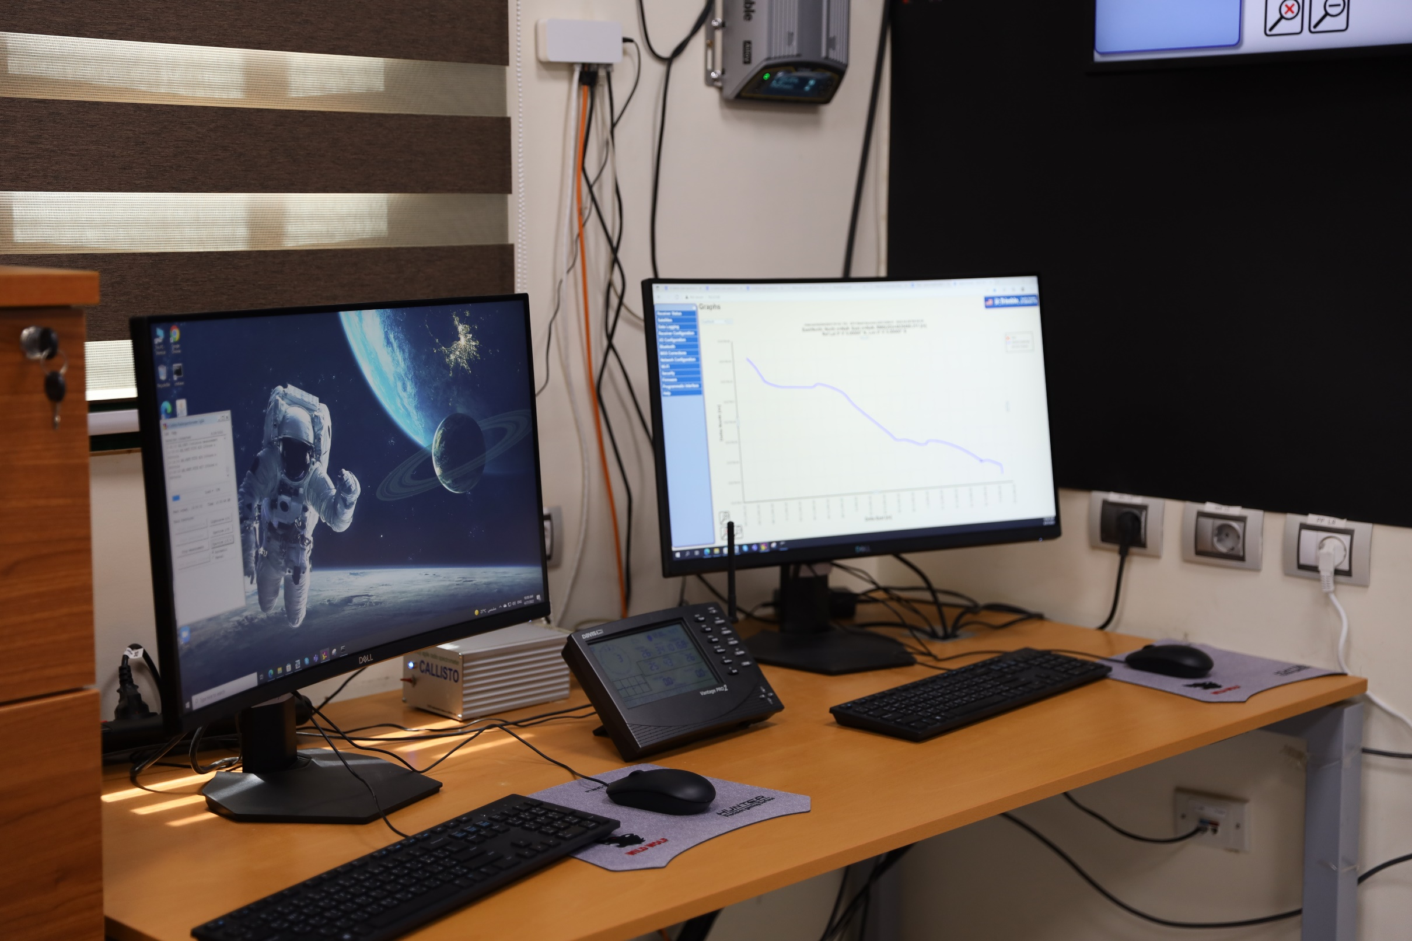
Challenges in Ionospheric Forecasting
a. Sparse Data Availability:
The Middle East often have fewer ionospheric monitoring stations compared to the other regions. This sparse data coverage can limit the accuracy and resolution of ionospheric models and forecasts.

Slide 9
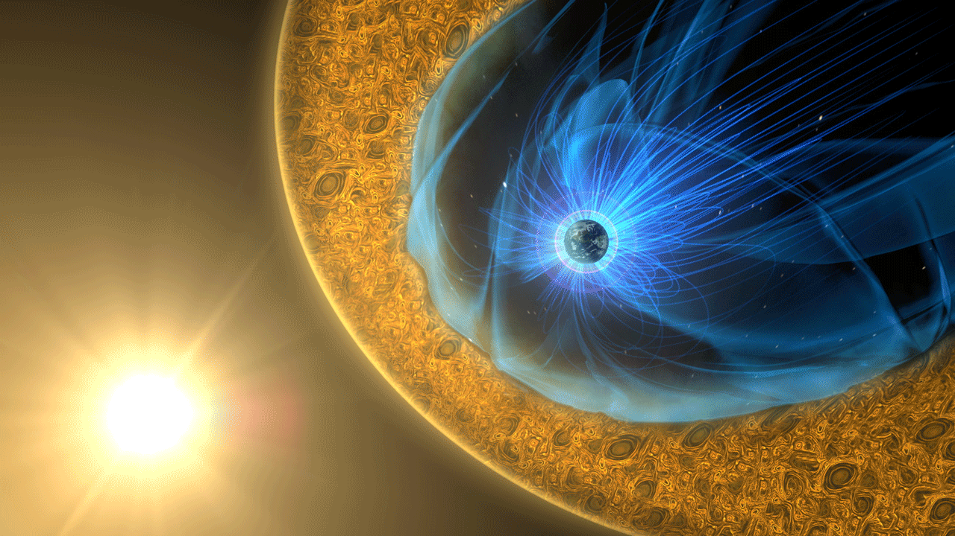
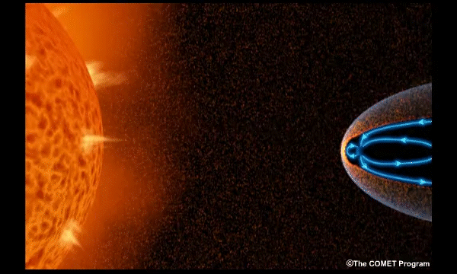
Challenges in Ionospheric Forecasting
b. Space Weather Events:
Solar activity, such as solar flares and coronal mass ejections (CMEs), can cause sudden and severe ionospheric disturbances.
Predicting these space weather events and their impact on the ionosphere over Egypt is complex and requires real-time monitoring and advanced modeling techniques.
c. Ionospheric Model Limitations:
Existing ionospheric models may not be perfectly tuned for regions like Egypt, where specific local conditions can influence ionospheric behavior. Tailoring models to regional conditions is necessary but challenging.

Slide 10
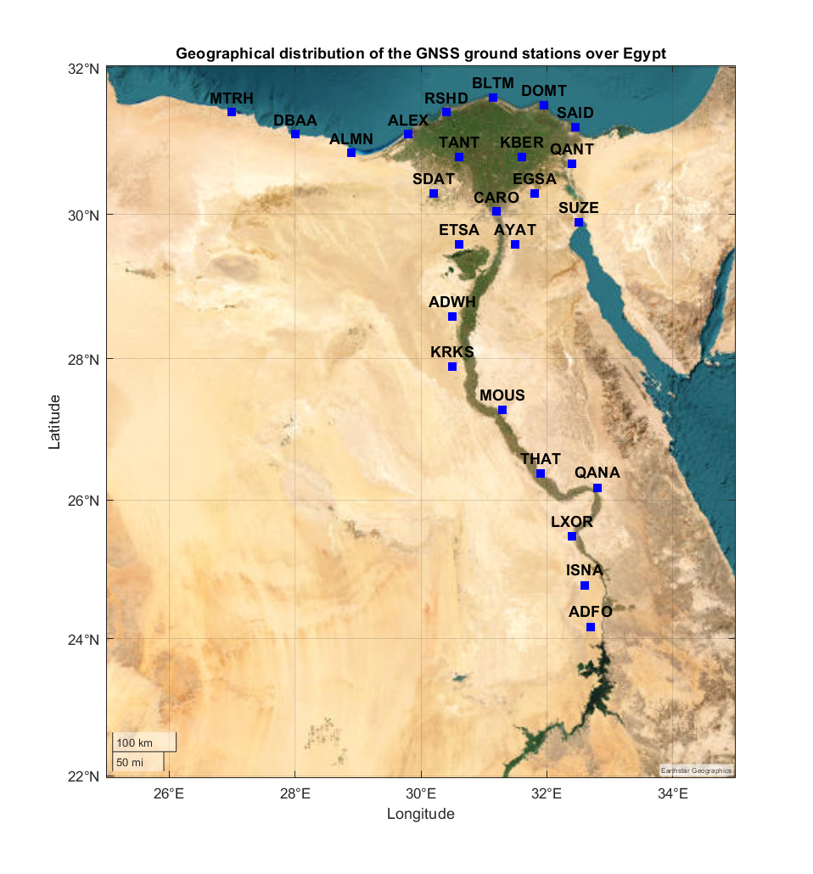
GNSS Data Utilization
For this study, we utilized GNSS observational data collected over a Egypt of three years from approximately 50 GNSS reference stations.
These stations are operated by the Egyptian Space Agency and the Egyptian General Survey Authority.
The primary purpose of collecting this data was to derive the Vertical Total Electron Content (VTEC), which serves as a critical input for training our deep neural network model.
The VTEC values were meticulously computed from the GNSS observations, ensuring the reliability and precision required for effective training of the neural network.

Slide 11
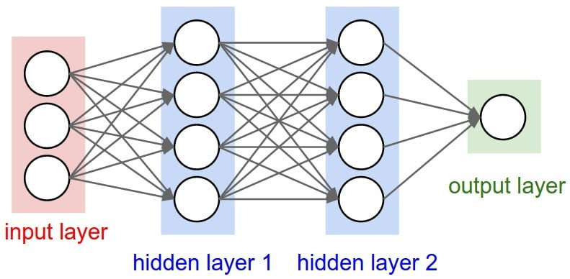
Deep Neural Networks for Forecasting
Neural Networks:
Neural networks are complex algorithms designed to mimic the structure of the human brain.
Deep Learning:
Deep learning is a subset of machine learning that involves the use of intricate neural networks with multiple layers for data processing.
1- Multi-Layer Perceptrons (MLP):
2- Recurrent Neural Networks (RNN):
3- Convolutional Neural Networks (CNNs):

Slide 12
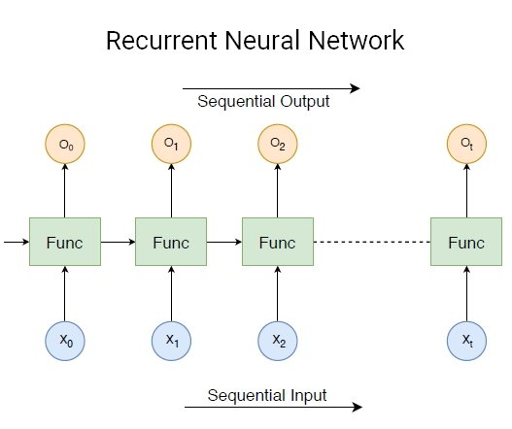
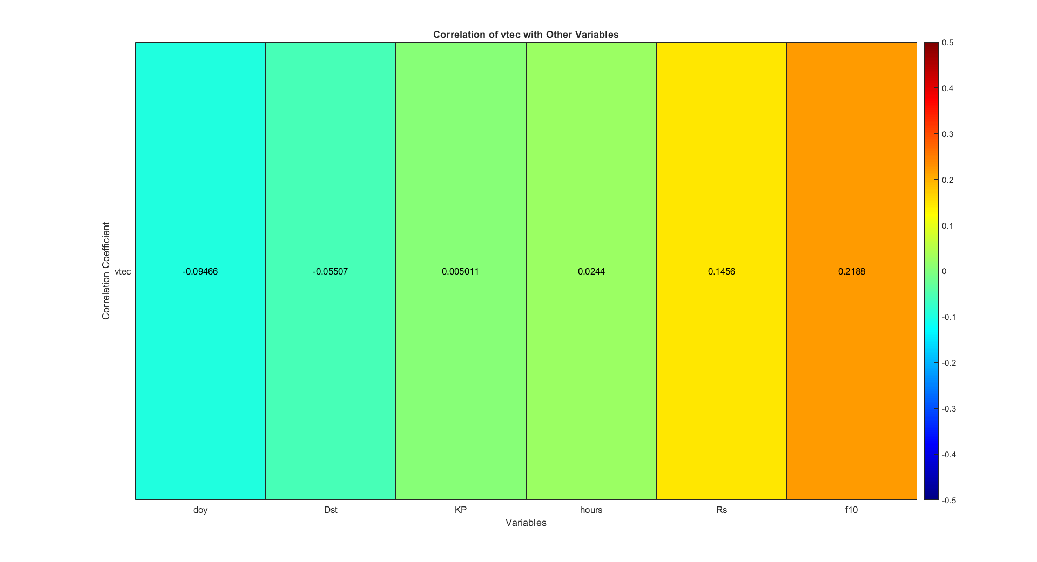
Deep Neural Networks for Forecasting
Recurrent Neural Networks (RNN):
RNNs are specialized neural networks tailored for handling sequential data. They find applications in tasks like time series analysis, including the study of solar activity. An example of an RNN subtype is the Long Short-Term Memory Networks (LSTM).
Collection of Geomagnetic Indices: Geomagnetic indices (Kp index, Dst index, R, F10.7) were collected from OMNIWeb data center to enhance the accuracy of the prediction model.

Slide 13
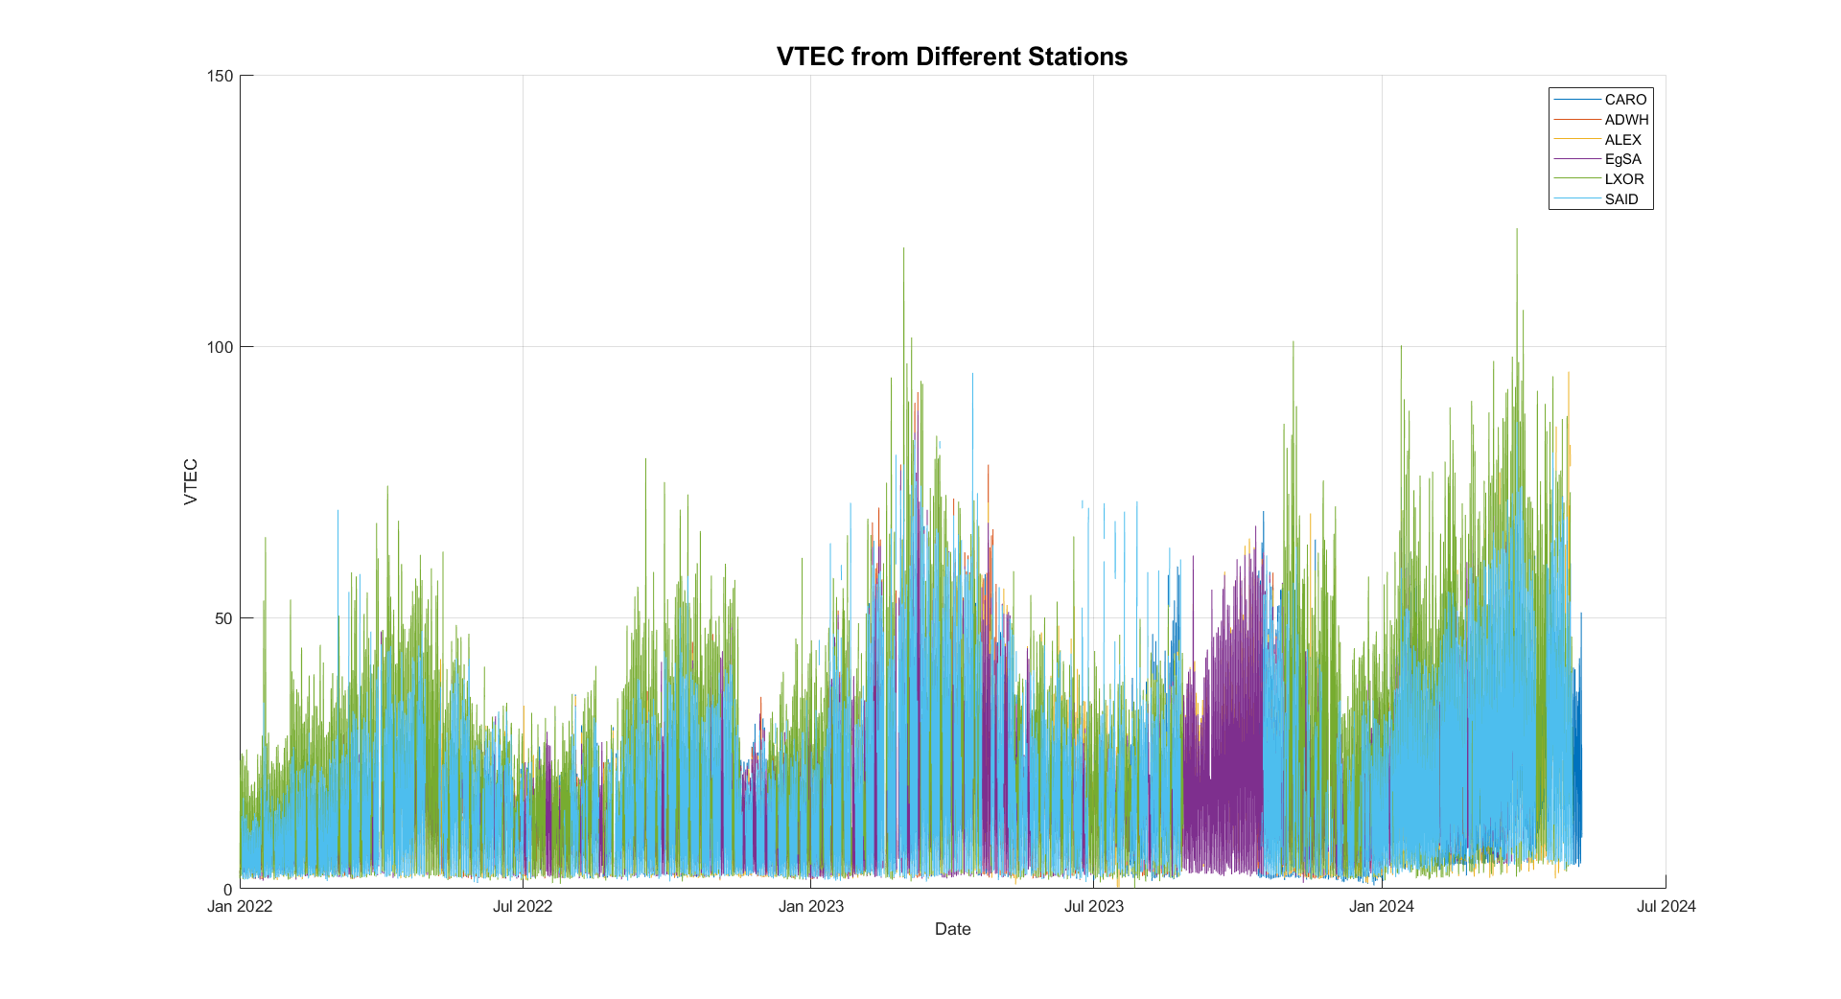
Implementation and Results
This figure displays the VTEC over time from 7 GNSS stations, illustrating the behavior and trends of VTEC from various data sources.

Slide 14
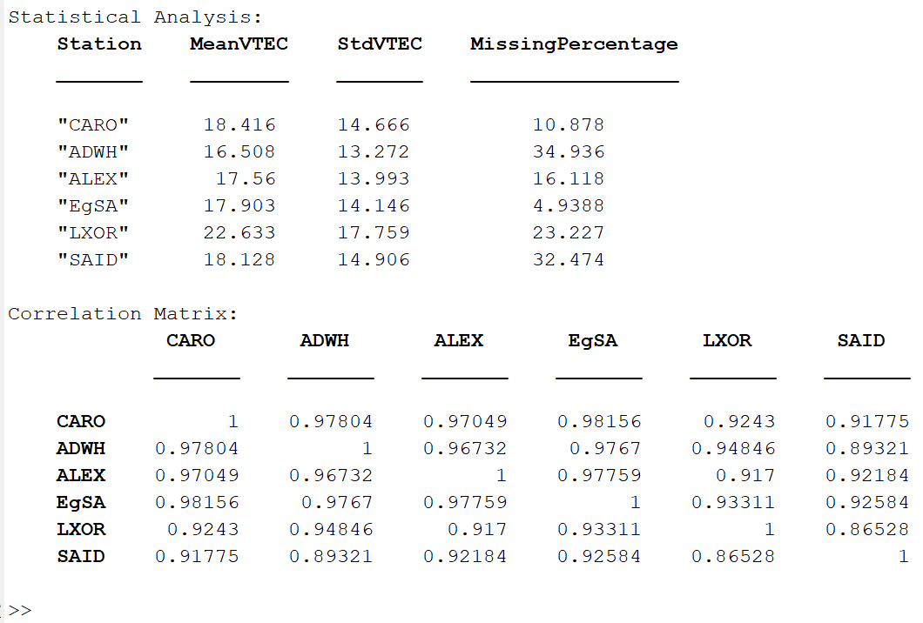
Implementation and Results
This figure presents the statistical analysis of VTEC data from 7 GNSS stations, highlighting the mean, standard deviation, missing values, and the correlation between VTEC data from all stations.

Slide 15
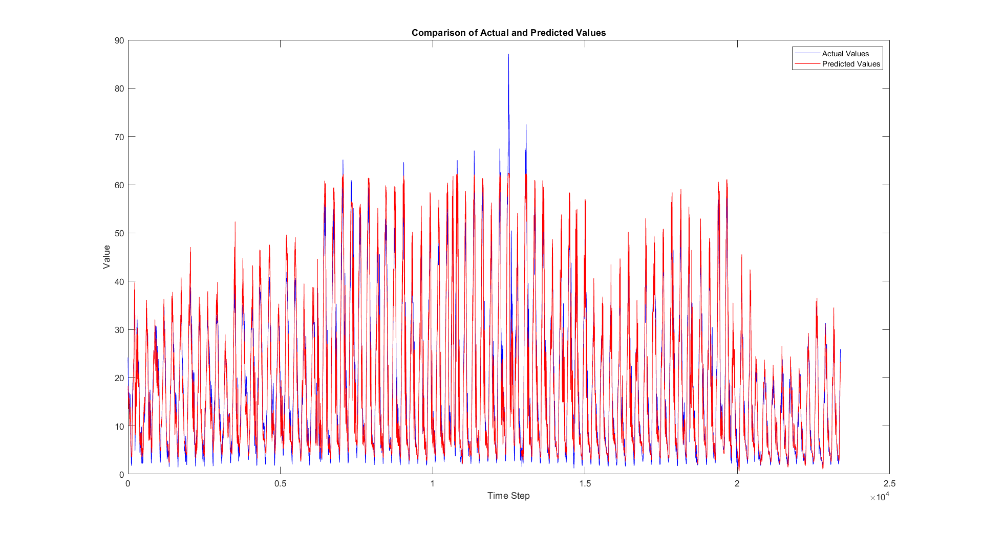
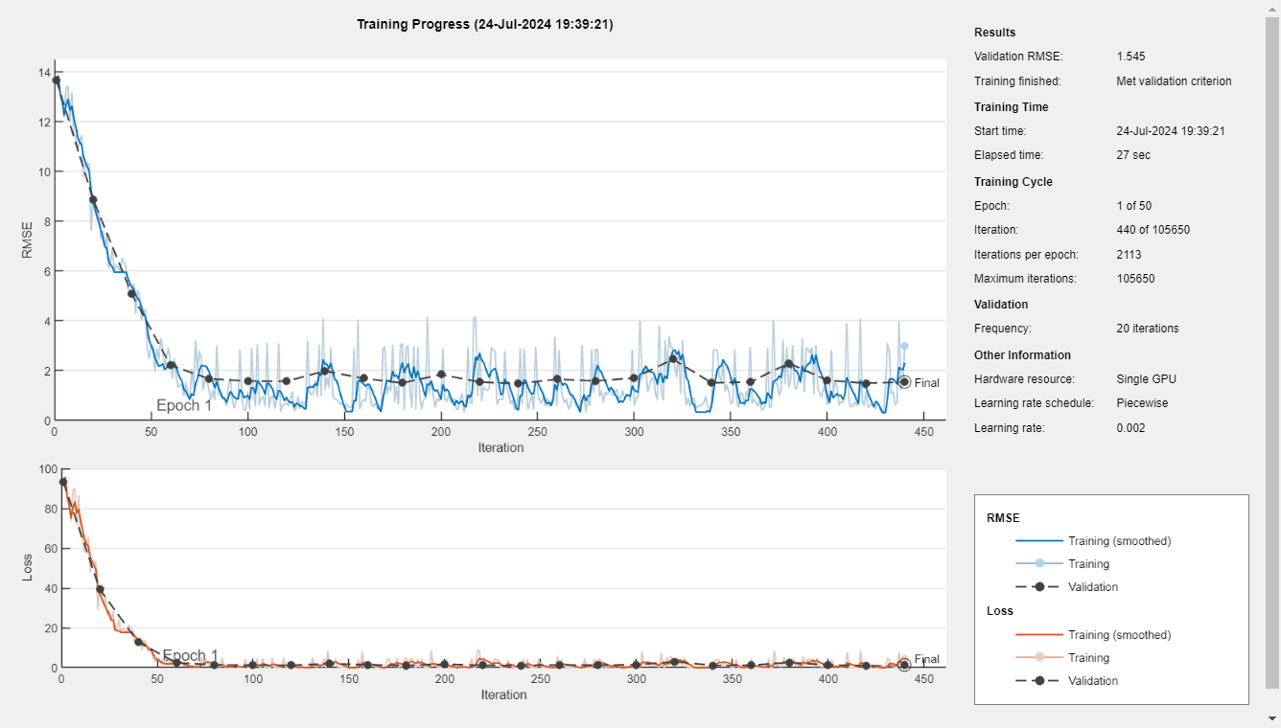
Implementation and Results

Slide 16
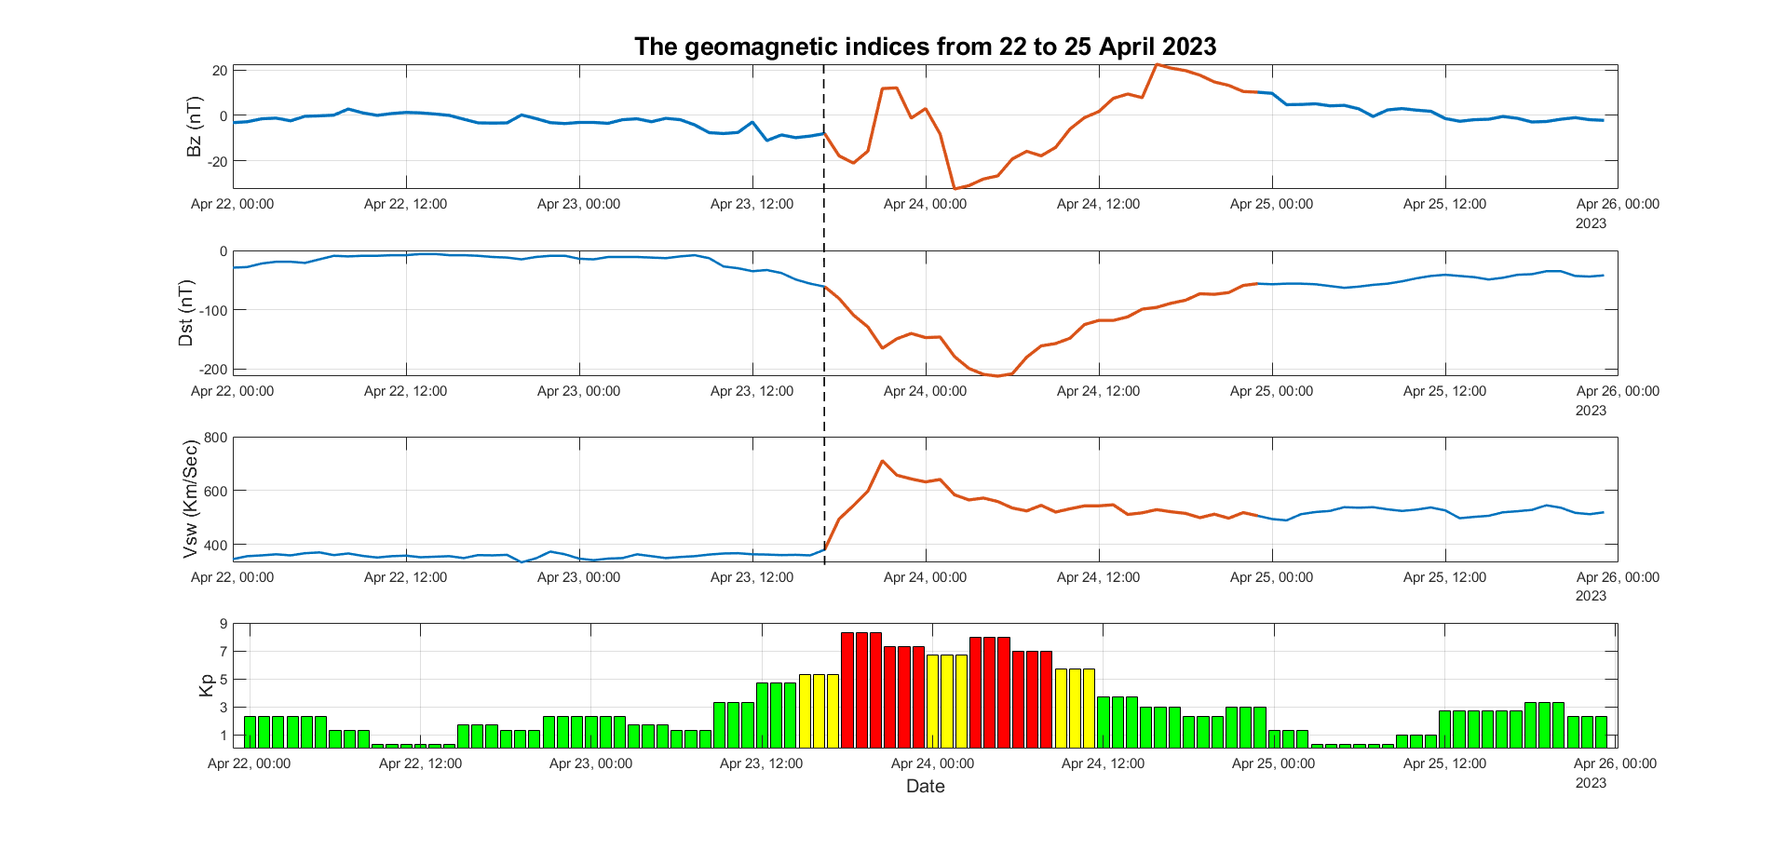
Implementation and Results

Slide 17
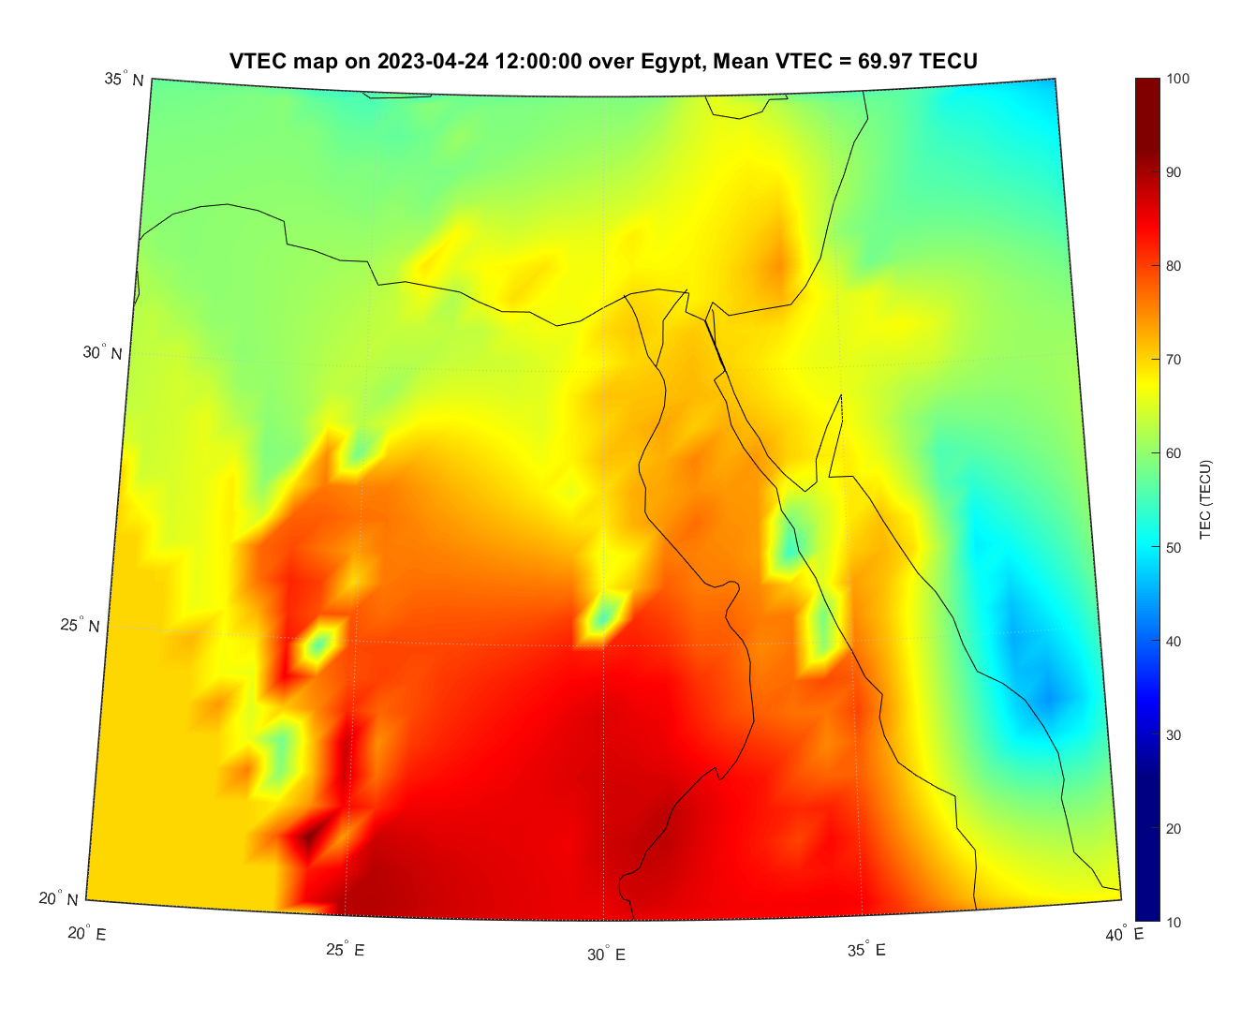
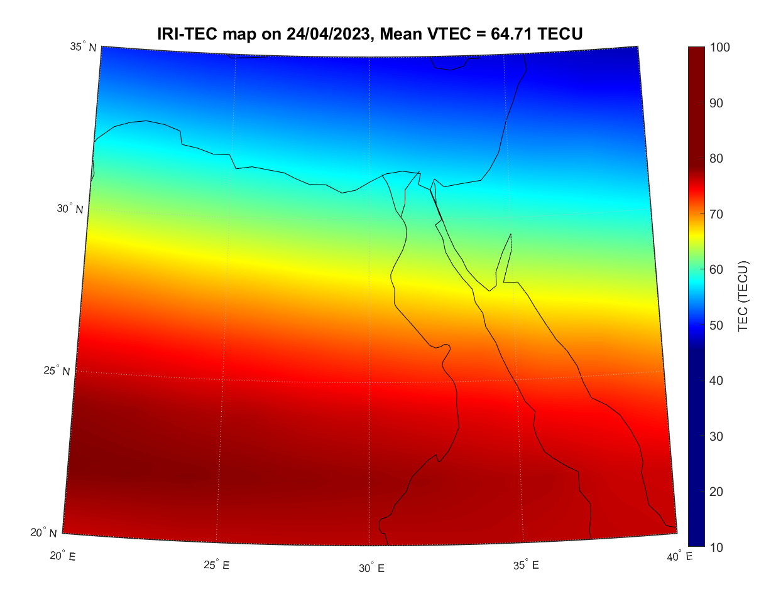
Implementation and Results
The predicted mean VTEC from the neural network from all stations over Egypt on 2023-04-24 12:00:00 = 60 TECU

Slide 18
Challenges and Future Directions
In our ongoing effort to enhance ionospheric forecasting in Egypt, our current model shows promising results but requires further development.
Specifically, additional feature engineering and refined data handling processes are essential to improve its accuracy and reliability.
Furthermore, extending the data collection period will significantly benefit the model's ability to predict ionospheric conditions during both quiet and disturbed periods.
By incorporating these improvements, we aim to develop a more robust and comprehensive forecasting system that can better support various applications and mitigate the impacts of ionospheric disturbances.

Slide 19
Conclusion
In conclusion, our work on enhancing ionospheric forecasting in Egypt through the utilization of GNSS data and deep neural networks marks a significant step forward in understanding and predicting ionospheric dynamics.
Our preliminary results demonstrate the potential of this approach to provide more accurate and timely forecasts, which are crucial for various applications, including navigation, communication, and space weather monitoring.
However, to fully realize this potential, further advancements are necessary. This includes refining our models through additional feature engineering and more sophisticated data handling processes, as well as extending our data collection period to capture a broader range of ionospheric conditions.
By addressing these challenges, we aim to develop a comprehensive and reliable ionospheric forecasting system that can serve as a valuable tool for both scientific research and practical applications

