Slide 1
Investigation and Prediction of Ionospheric Irregularities over Egypt
Hager M. Salah ^{a,b*}, Rabiu Babatunde ^{d}, Daniel Okoh ^{c,d}, M. Youssef ª, Ayman Mahrous ^{e,f}
ª Space Weather Monitoring Center, Physics Dept., Faculty of Science, Helwan University, Cairo, Egypt
^{b} Canadian International College in Cairo, Cairo, Egypt
^{c} National Institute of Geophysics and Volcanology, Rome, Italy
^{d} United Nations African Regional Centre for Space Science and Technology Education – English (UN-ARCSSTE-E), Obafemi Awolowo University Campus, Ile Ife, Nigeria
^{e} Physics Dept., Faculty of Science, Helwan University, Cairo, Egypt
^{f} Department of Space Environment, Institute of Basic and Applied Science, Egypt Japan University of Science and Technology, Alexandria, Egypt

Slide 2
Outlines
Background Theory
Data Acquisition and Processing
Artificial Neural Network Approach
Results

Slide 3
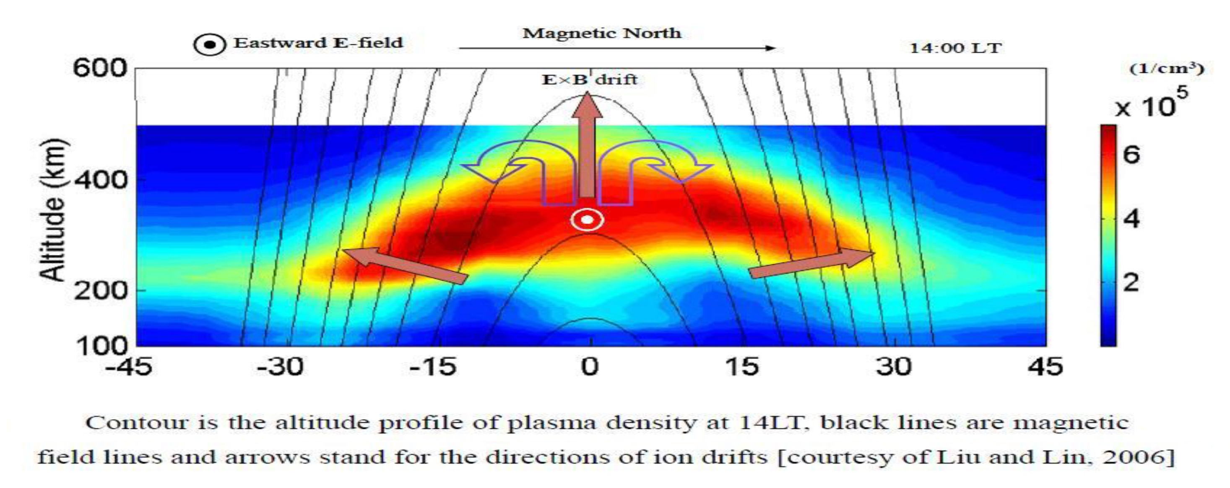
Equatorial Ionization Anomaly
Liu and Lin, 2006

Slide 4
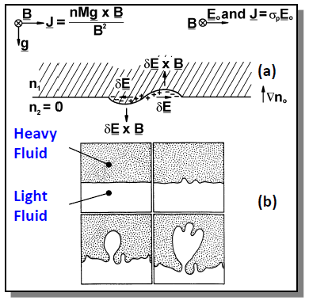
Rayleigh-Taylor instability and Bubbles
(a) Schematic diagram of the plasma analog of the Rayleigh-Taylor instability in the equatorial geometry.
(b) Sequential sketches made from shots of the hydromagnetic Rayleigh–Taylor instability. A heavy fluid is initially supported by a transparent light fluid
Bubbles are an ionospheric phenomenon near the geomagnetic equator at nighttime. They affect radio waves by interrupting the radio wave communication by producing fluctuations in the amplitude and phase of the radio signal which are known as scintillations.
Kelley, 2009

Slide 5
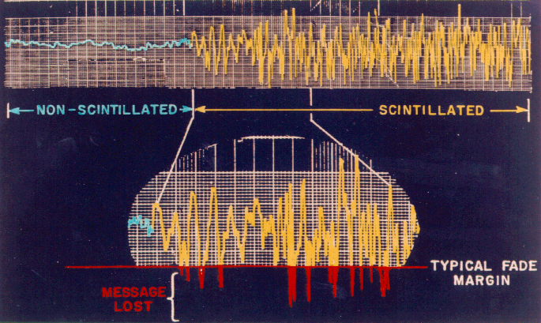
Ionospheric Scintillation
Rapid fluctuations in amplitude and phase of radio signals due to ionospheric perturbations.

Slide 6
Data Acquisition and Processing
Ionospheric Irregularities
ROTI Index
Temporal Variations
F2-Layer Variations
DOY, HR
hmF2, FoF2
Solar and Geomagnetic
Activities
F10.7, SSN
Kp, SYMH

Slide 7
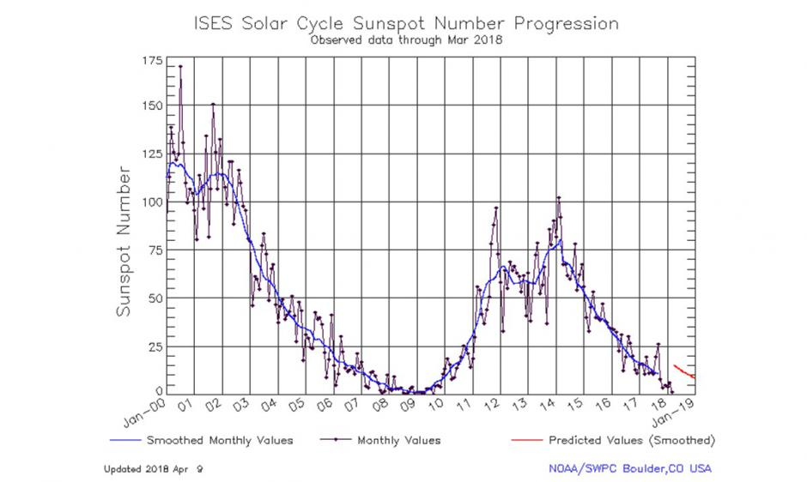
Data Acquisition and Processing
Source: https://www.swpc.noaa.gov/news/solar-cycle-24-status-and-solar-cycle-25-upcoming-forecast

Slide 8
The Architecture Schematic Diagrams for Predicting the ROTI Index

Slide 9
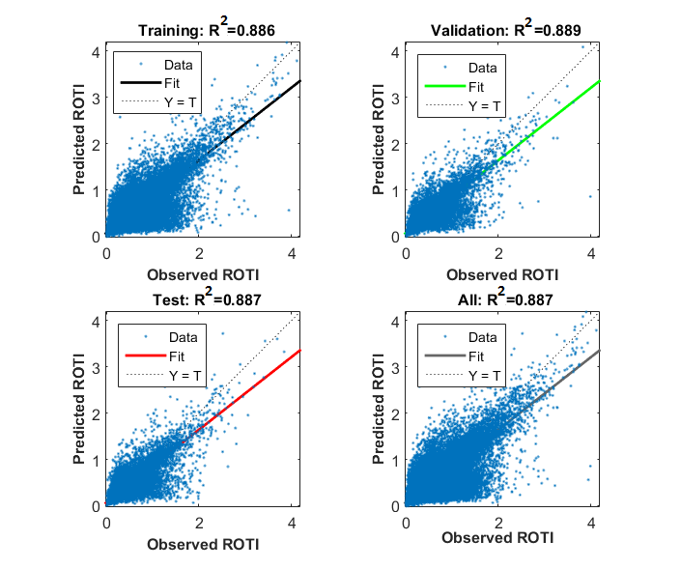
Evaluating the NN approach
The Predicted ANN-ROTI is highly correlated with the observed GPS-ROTI, as shown in Figure.
The R² coefficient between the predictions and the observations is 0.887.
The RMSE is 0.106, and PE of 95%.
The fitting equation is:
$$y=0.78x+0.069$$

Slide 10
Evaluating the Results - Diurnal Variations - Quiet Days

Slide 11
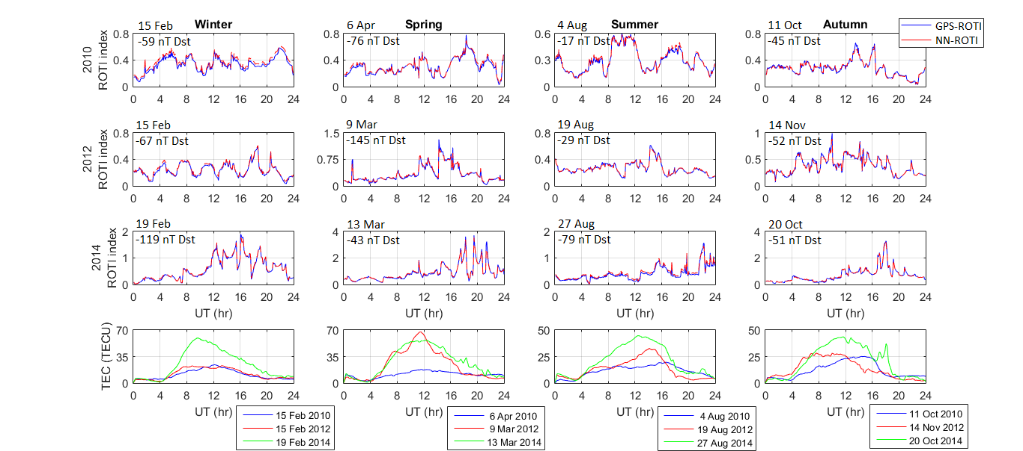
Evaluating the Results - Diurnal Variations - Disturbed Days

Slide 12
Evaluating the Results - Seasonal Variations

Slide 13
Evaluating the Results - Solar Cycle Variations

Slide 14
Thanks for your Attention
Hager M. Salah
hager.m.salah.92@gmail.com
hager.m.salah.92@science.Helwan.edu.eg

