Slide 1
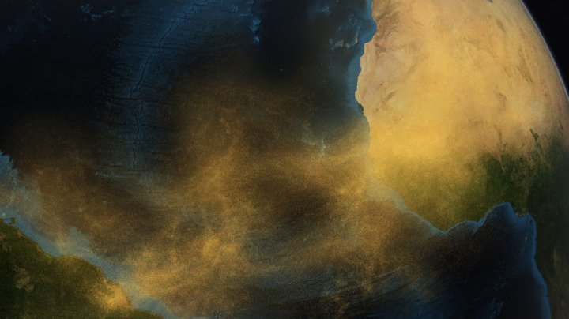
A Generic Model Interface for
the Community Radiation Transfer Model (CRTM)
Cheng Dang*, Benjamin Johnson† (Joint Center for Satellite Data Assimilation/UCAR)
Quanhua (Mark) Liu, Yingtao Ma (NOAA)
Nicholas Nalli (NOAA; now at NGA)
Isaac Moradi (NASA/UMD)
Patrick Stegmann (formerly JCSDA)
*Presenter: dangch@ucar.edu
†CRTM Team Lead | bjohns@ucar.edu
Notes:
Check date/title/author

Slide 2
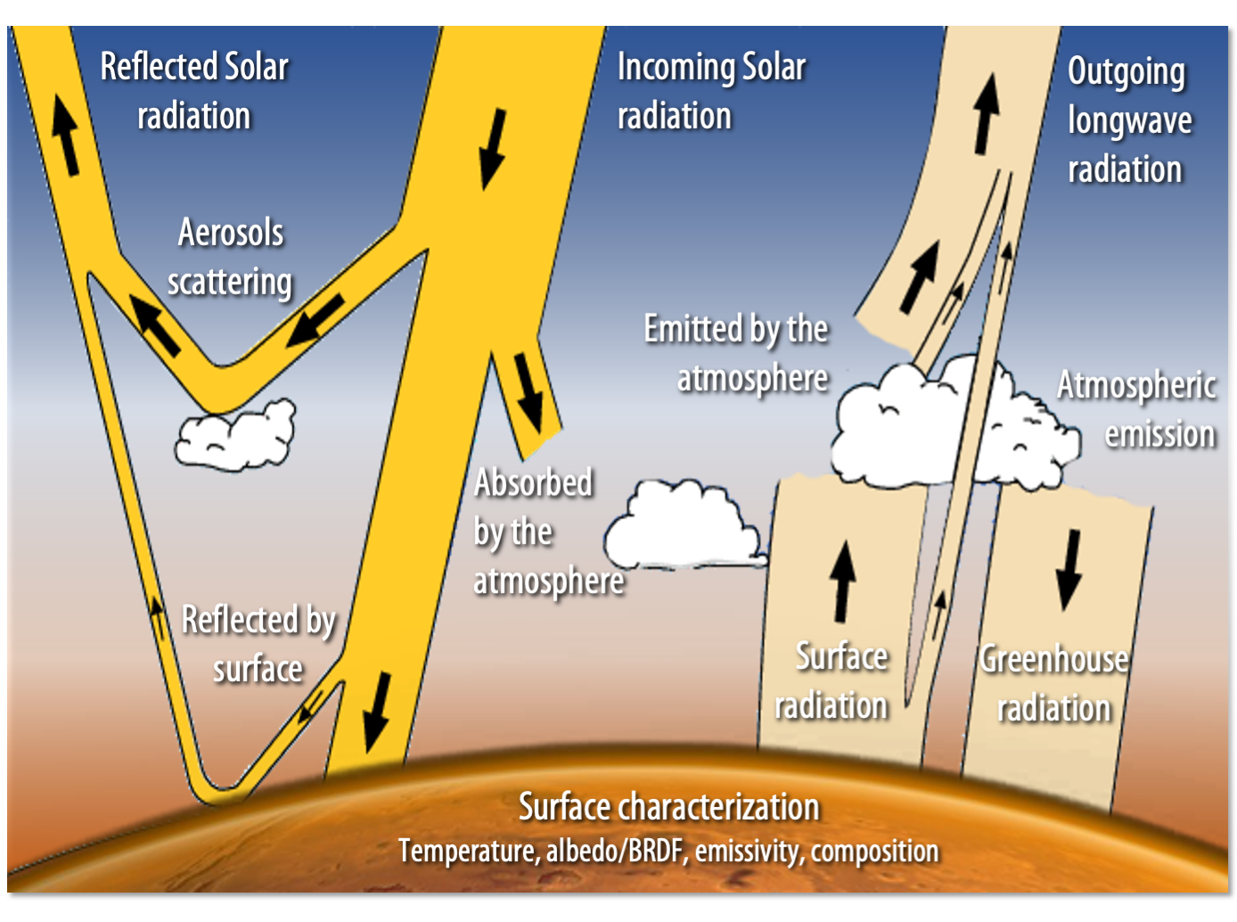
Community Radiative Transfer Model (CRTM)
The Community Radiative Transfer Model (CRTM) is a fast, multi-layer, 1-D radiative transfer model used operationally in numerical weather prediction, calibration, and validation across multiple federal agencies and universities.
Support scalar radiative transfer simulation for UV, VIS, IR, Microwave
Gaseous species H₂O, CO₂, O₃, N₂O, CO etc.
Aerosols: dust, sea salt, organic carbon, black carbon, sulfate, nitrate, volcanic ash.
Clouds: ice cloud, water cloud, and precipitation.
Surface properties: land, ocean, snow, ice.
Spaced-based and aircraft-based sensors.
‹#›

Slide 3
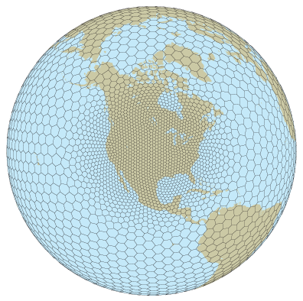
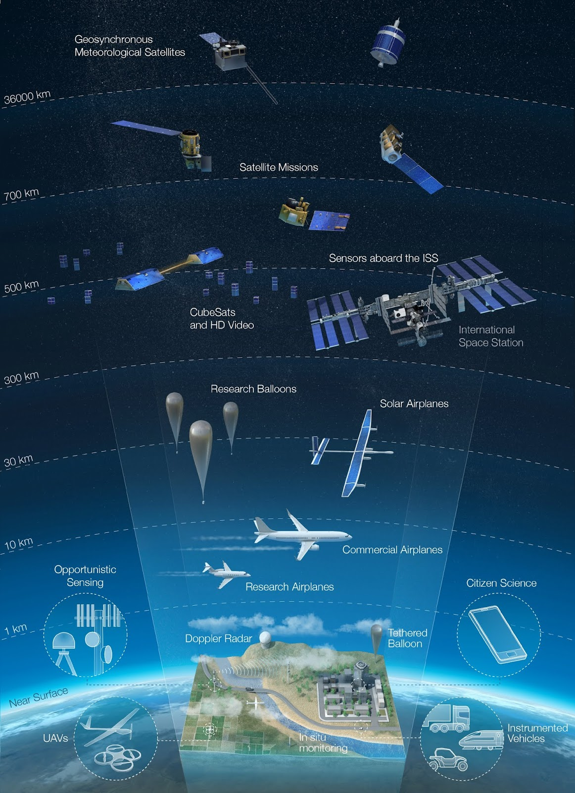
Observation Operator in DA Systems
Observation operator: given the atmospheric/surface conditions, what radiance/AOD value do we expect to observe from a particular satellite sensor?
CRTM is widely adopted in U.S. data assimilation (DA)/weather forecasting systems, such as NOAA UFS, UCAR JEDI/UFO, and NASA GEOS.
Europe: Radiative Transfer for TOVS (RTTOV) model
China: Advanced Radiative transfer Modeling System (ARMS)
Joint Effort for Data assimilation Integration (JEDI) system is a unified and versatile data assimilation (DA) system for Earth System Prediction. Currently under developed at the Joint Center for Satellite Data Assimilation (JCSDA), UCAR.
Model State
Observations
Observation Operator CRTM
Modeled geophysical variables
Remote sensing retrievals
‹#›

Slide 4
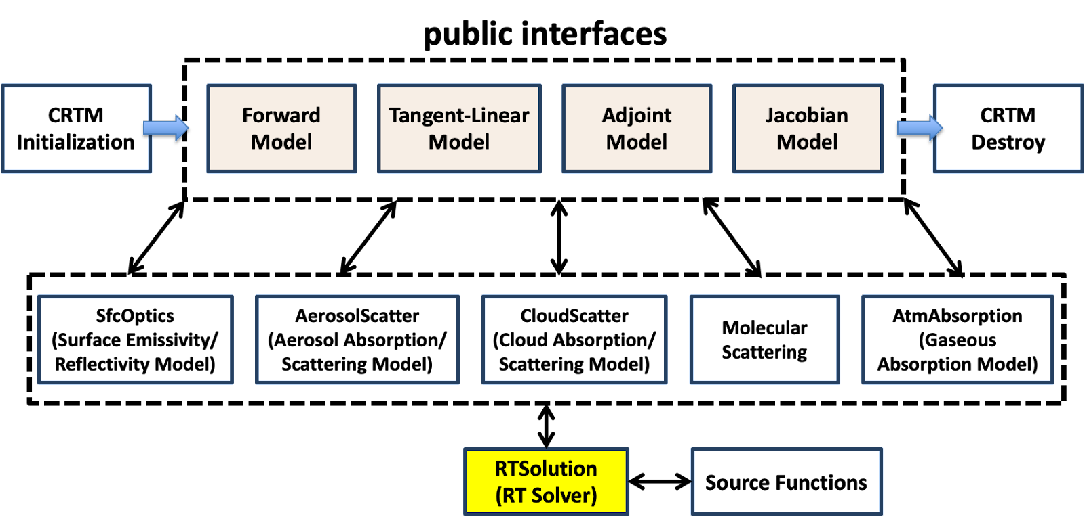
A Brief History of CRTM Development
Johnson et al., 2023
Version 1.0 (2006)
absorption and scattering from various types of hydrometeors and aerosols.
surface emissivity and reflectivity over land, ocean, ice and snow surfaces for both the microwave and infrared spectral regions.
Version 2.0 (2010)
ODAS (Optical Depth in Absorber Space) and ODPS (Optical Depth in Pressure Space) transmittance algorithm for gaseous absorption and emission.
Specular surface reflection option; Ocean emissivity.
Version 2.1 (2012)
Clear sky simulations.
Surface emissivity: Ocean (FASTEM1~6 over the years) and land.
Successive Order of Interaction (SOI) radiative transfer algorithm.
NLTE simulations applied to infrared sensors.
Version 2.2 (2015)
Overcast radiances in fully cloud-covered conditions.
Cloud optical property.
Snow emissivity
Version 2.3.0 (2017)
Cloud fraction/all sky radiance capabilities.
Sea ice emissivity.
Version 2.4.0 (2020)
Aerosol coefficient table based on CMAQ specifications.
WSM-6, Thompson, and GFDL cloud microphysics schemes.
NetCDF modules for cloud and aerosol coefficients.
CRTM transmittance and spectral coefficient generation package, Version 1 (2021)
Versions 2.4.1 and 3.0 were released in 2022 and 2023 for internal testing.
Version 3.1, released Jan 2024.

Slide 5
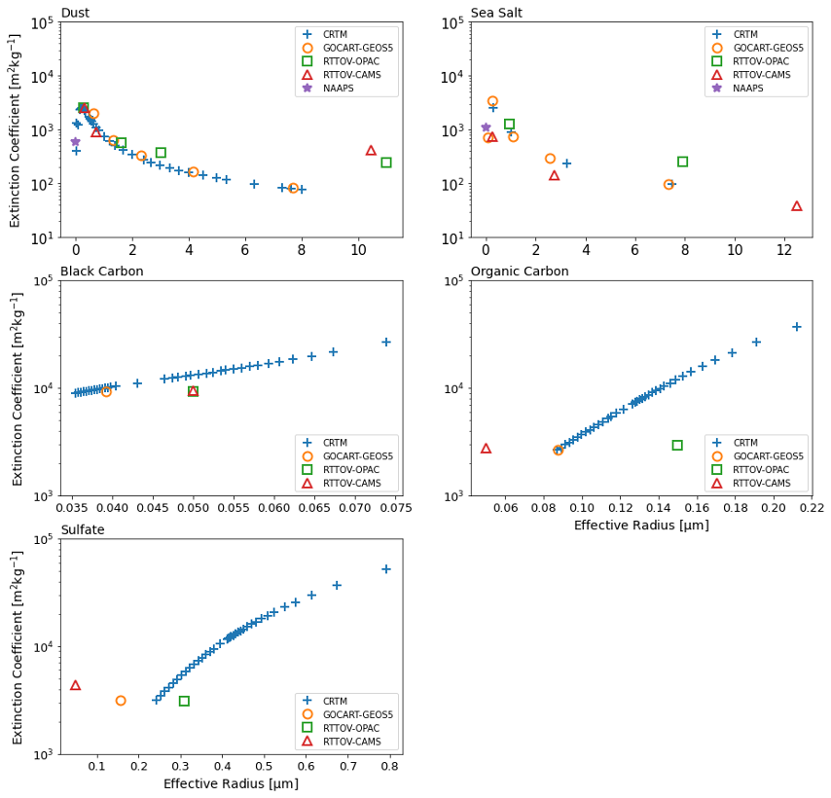
Aerosol
CRTM Version | Aerosol model | Aerosol species | Aerosol properties
All versions Binary | CRTM (Default) Chin et al., 2002; Han, 2006 | dust, sea salt, organic carbon, black carbon, sulfate | effective radius, hygroscopicity (implicit)
v2.4 – v3.1 NetCDF | CMAQ Binkowski and Roselle, 2003; Liu and Lu 2016 | dust, sea salt, water-soluble, soot, sulfate, water, insoluble, dust-like | effective radius, hygroscopicity (implicit) radius standard deviation
v2.4.1 – v3.1 | GOCART -GEOS5 Colarco et al., 2010 | dust, sea salt, organic carbon, black carbon, sulfate, nitrate | effective radius, hygroscopicity
v2.4.1 – v3.1 | NAAPS Lynch et al., 2016 | Bulk aerosol properties: dust, sea salt, smoke, anthropogenic and biogenic fine particles | hygroscopicity
v2.4.1 – v3.1 (internal) | RTTOV-OPAC RTTOV-CAMS RTTOV v13 | dust, sea salt, organic carbon, black carbon, sulfate, nitrate CAMS: aerosol climatology developed by Copernicus Atmosphere Monitoring Service | effective radius, hygroscopicity
Dust and Sea Salt: dry particle, RH = 0 for all schemes
BC, OC, Sulfate
•CRTM: for all effective radii available.
•The rest: dry particle, RH = 0.
Figures: Aerosol extinction coefficients of selected species across the CRTM default, GOCART-GEOS5, NAAPS, and RTTOV LUTs. [550nm]

Slide 6
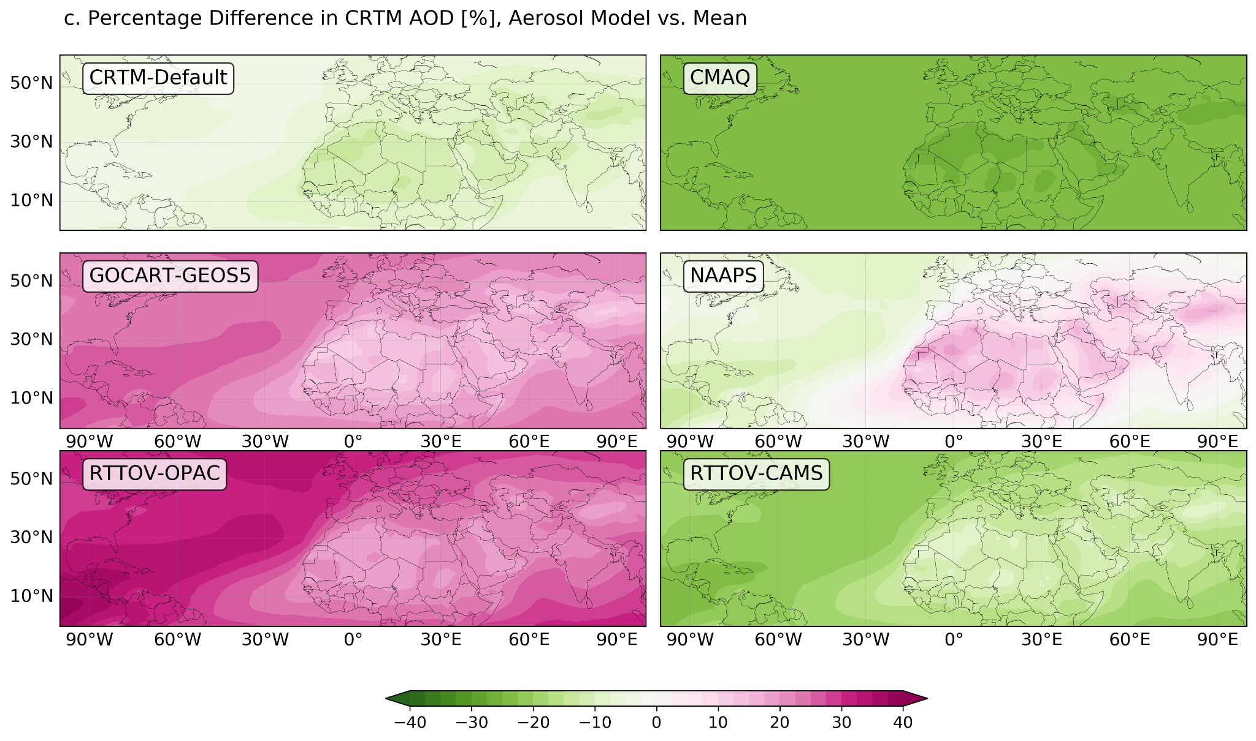
AOD and Radiance
Dust
The AOD simulated using different schemes can vary significantly, with differences of up to ±40%.
The Community Radiative Transfer Model (CRTM) enables users to flexibly examine the assumptions of aerosol parameters used in multiple major aerosol models.
Dust
Sea Salt
Figures: Brightness temperature simulated by CRTM with different aerosol schemes for IASI metop-a between 750 to 1500 cm-1.
Figures: a. Column total aerosol concentration of May (MERRA-2 climatology) and b. the corresponding AOD (550nm) simulated using CRTM, averaged over six aerosol schemes. c. percentage differences in AOD computed using each aerosol scheme.

Slide 7
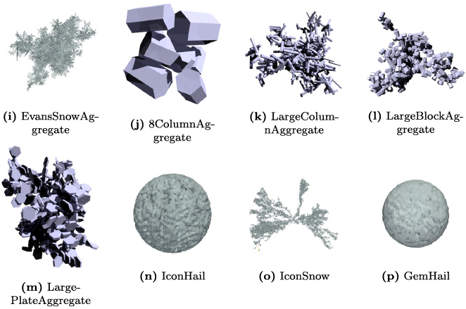
Cloud
CRTM Version | Cloud Schemes | Table Content/Highlight
All versions Binary | CRTM (Default) Liu and Lu, 2016 | Water, rain, snow, graupel, ice/hail Spherical assumptions all hydrometeors. Mie-Lorenz theory. Single-scattering properties and phase functions. Temperature (liquid only), effective radius, and frequency.
v2.4 – v3.1 NetCDF | PSU | Experimental tables with liquid and solid hydrometeors based on scheme (1) GFDLFV3 (2)Thompson08 (3) WSM6. Microwave bands only.
v2.4.1 – v3.1 | Moradi Moradi et al., 2022 | Non-spherical hydrometeors in the microwave bands. Discrete Dipole Approximation (DDA) technique. ARTS Single scattering database from Eriksson et al (2018) Introduces cloud water content as model input. Adds new parameter backscattering coefficients. Higher resolution for temperature, water content and frequency.
v3.2 (incoming) | TAMU Tong et al., 2023 | Non-spherical particle shape for graupel/snow over UV/VIS/IR/MW spectral ranges. Temperature-dependent ice refractive index for MW frequencies. Extended spectral range and particle size range. Polarized phase matrix.
Example of aggregates from the ARTS database included in the CRTM cloud lookup tables. [Moradi et al., 2022]
Figures: ATMS observed versus CRTM simulated Tbs for Hurricane Irma using IFS as input and different CRTM lookup tables. The first row in top panel shows ATMS observations and all other rows show simulations performed using CRTM with either ARTS or Mie lookup tables. [Moradi et al., 2022]
Notes:
Send an email to Yingtao
Issac’s cloud table? What are the differences between Yingtao’s table versus Issac’
Add experimental tables

Slide 8
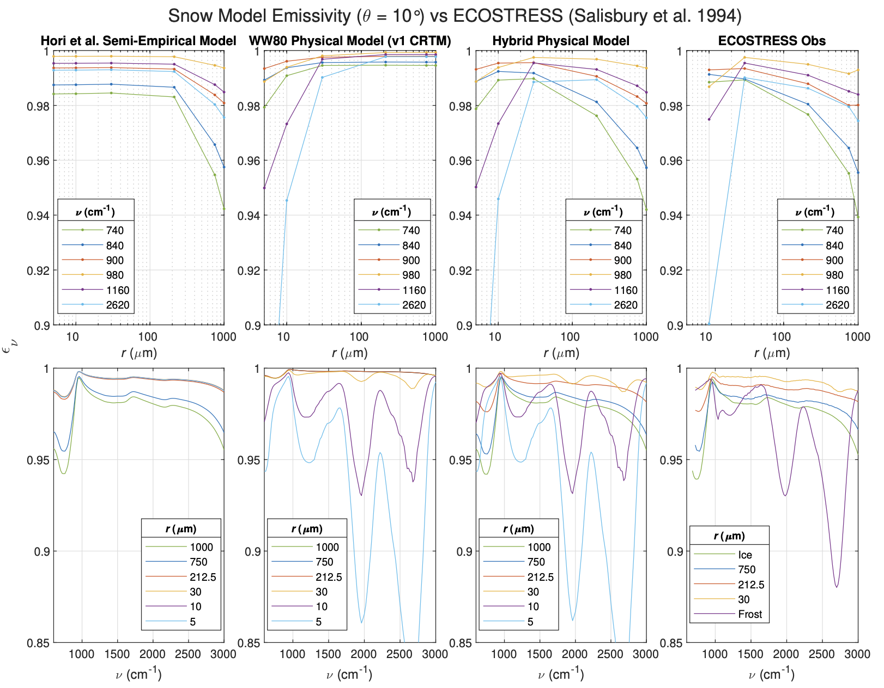
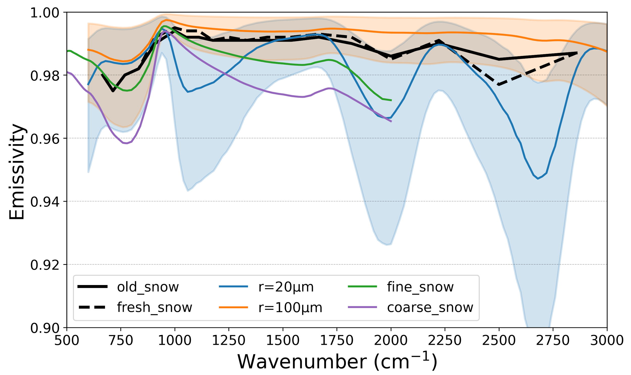
Surface
CRTM Version | Surface | Table Content/Highlight
All versions Binary | Water Land Ice Snow Liu and Lu, 2016 | Visible, IR, MW Land types Ice/Snow age Water
v2.4.1 – v3.1 NetCDF | TIR Water Nalli et al., 2023a | Infrared Sea Surface Effective-Emissivity (IRSSE) Model Temperature-dependent water optical constants modeling thermal IR “effective emissivity” in a manner that accounts for both surface emission and quasi-specular reflectance.
v2.4.1 – v3.1 | TIR Snow Nalli et al., 2023b | Physically based snow/ice emissivity model A hybrid of layer-scattering model and specular-facet model. Temperature-dependent ice optical constants Zenith-angle/snow grain size dependence.
Figures: TIR snow/ice model spectral emissivity calculations versus ECOSTRESS laboratory measurements for an observer zenith angle of 10. [Nalli et al., 2023b]
Figures: snow spectral emissivity:
1. CRTM (old/fresh snow)
2. Nalli ( r=20 and 100 microns)
Orange and blue shades: zenith angle from 0 – 75 degrees
3. U Michigan (fine/coarse snow)
Notes:
Check Nick’s paper!

Slide 9
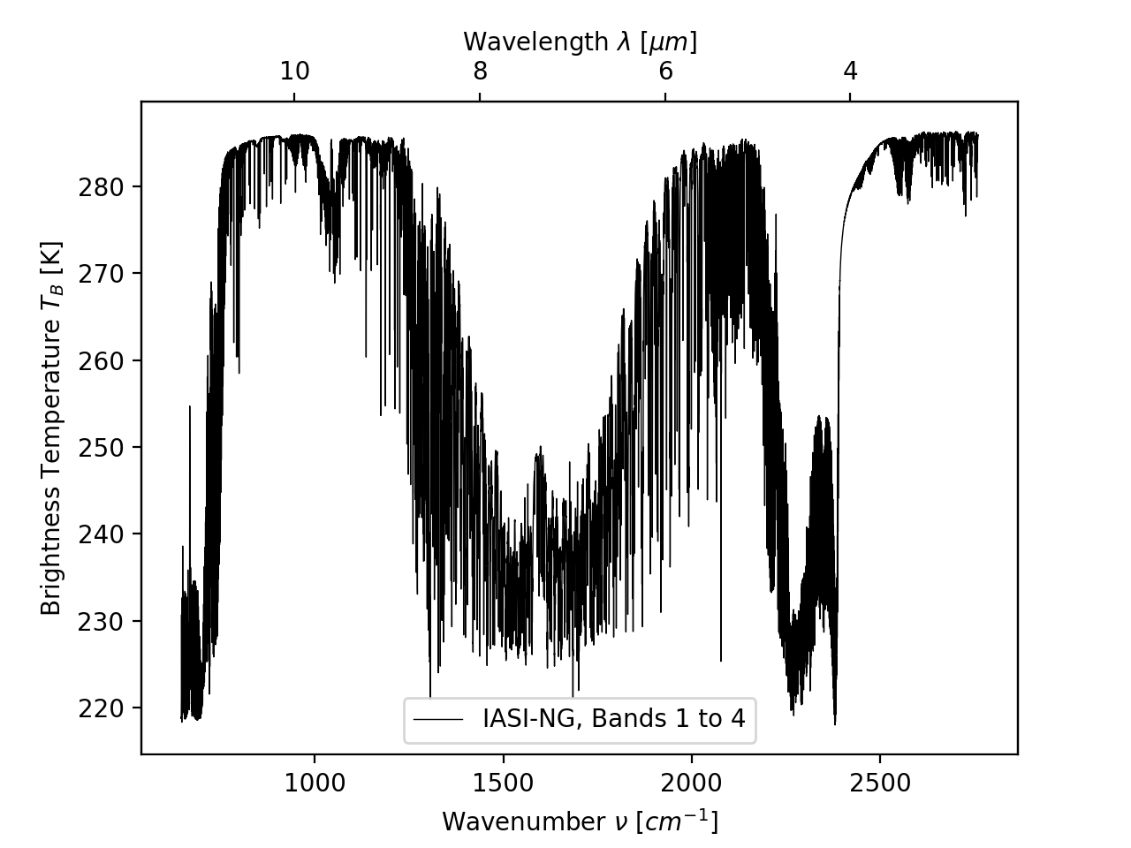
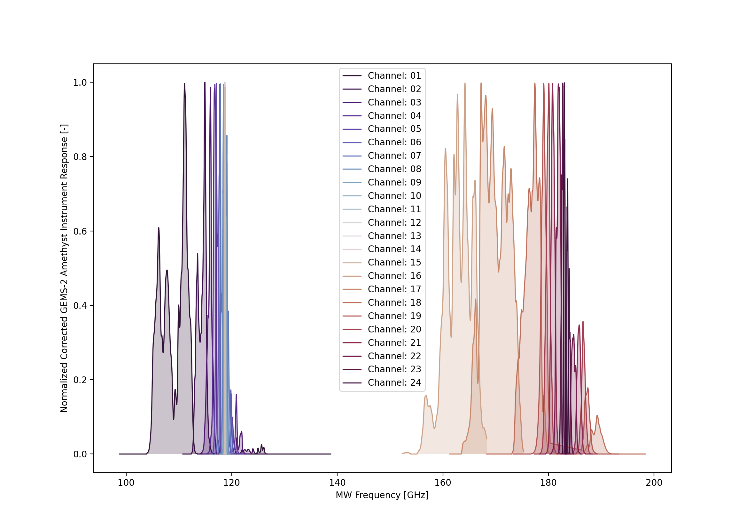
Instrument Coefficients
CRTM transmittance/spectral coefficient generation package: https://github.com/JCSDA-internal/CRTM_coef
(please email us for access to this internal repository)
Selected list of recently developed instrument coefficients
- TROPICS (the entire constellation)
- GEMS 1&2
- ATMS-NG (hyperspectral MW concept study)
- IASI-NG
- ATMS NOAA-21
- VIIRS NOAA-21
Notes:
Check Nick’s paper!

Slide 10
Community Request
CRTM Version | Aerosol model | Aerosol species | Aerosol properties
All versions Binary | CRTM (Default) Chin et al., 2002; Han, 2006 | dust, sea salt, organic carbon, black carbon, sulfate | effective radius, hygroscopicity (implicit)
v2.4 – v3.1 NetCDF | CMAQ Binkowski and Roselle, 2003; Liu and Lu 2016 | dust, sea salt, water-soluble, soot, sulfate, water, insoluble, dust-like | effective radius, hygroscopicity (implicit) radius standard deviation
v2.4.1 – v3.1 | GOCART -GEOS5 Colarco et al., 2010 | dust, sea salt, organic carbon, black carbon, sulfate, nitrate | effective radius, hygroscopicity
v2.4.1 – v3.1 | NAAPS Lynch et al., 2016 | Bulk aerosol properties: dust, sea salt, smoke, anthropogenic and biogenic fine particles | hygroscopicity
v2.4.1 – v3.1 (internal) | RTTOV-OPAC RTTOV-CAMS RTTOV v13 | dust, sea salt, organic carbon, black carbon, sulfate, nitrate CAMS: aerosol climatology developed by Copernicus Atmosphere Monitoring Service | effective radius, hygroscopicity
Expert users:
Self-defined aerosol optical properties?
Notes:
Check Nick’s paper!

Slide 11
Generic Interface
Model Interface
By default, to simulate the aerosol/cloud radiative impacts, CRTM require users to provide the following aerosol/cloud variables via input data structure atm. These state variables are later used in CRTM modules to interpolate the aerosol/cloud optical properties based on select coefficient LUTs.
atm%n_Clouds, number of cloud types
For cloud type i:
atm%Cloud(i)%Type
atm%Cloud(i)%Water_Content(n_Layers)
atm%Cloud(i)%Effective_Radius (n_Layers)
atm%n_Aerosols, number of aerosol species
For aerosol type i:
atm%Aerosol(i)%Type
atm%Aerosol(i)%Effective_Radius (n_Layers)
atm%Aerosol(i)%Concentration (n_Layers)
With the generical optical interface, users do not need to provide these state variables, by setting the number of cloud and/or aerosol types as zero: atm%n_Clouds = 0; atm%n_Aerosols = 0.
To input the optical profiles, users need to provide the profiles of optical properties through a new data structure op , where the optical properties can be of aerosol only, cloud only, or aerosol and cloud combined.
Optical depth op%tau (n_Channels, n_Layers)
Volume scattering coefficient op%bs (n_Channels, n_Layers)
Backscat. coefficient (active sensor only) op%kb (n_Channels, n_Layers)
Phase function coefficient op%pcoeff (n_Channels, n_Layers,
n_Phase_Elements, n_Legendre_Terms)
Where, n_Channels is the number of channels to simulate by CRTM.
n_Phase_Elements is the number of phase function element, equals to the number of stokes.
n_Legendre_Term is the number of Legendre coefficients of phase function.
The optical data structure op needs to be stored in the existing data structure options. Depending on the applications, the users may set input op as optical profiles of cloud, aerosol, or total scatters. If the users wish to only use self-defined aerosol (cloud) optical profiles, they can continue using the CRTM cloud (aerosol) LUTs with the default approach.
Notes:
Check Nick’s paper!

Slide 12
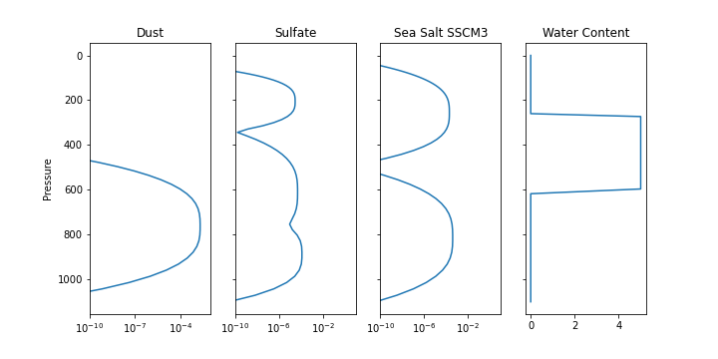
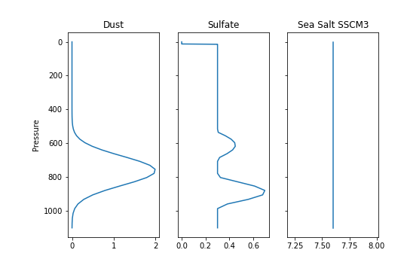
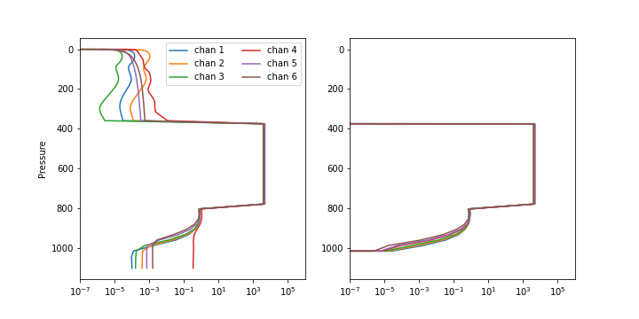
Generic Interface
Model Interface
Example
By default, to simulate the aerosol/cloud radiative impacts, CRTM require users to provide the following aerosol/cloud variables via input data structure atm. These state variables are later used in CRTM modules to interpolate the aerosol/cloud optical properties based on select coefficient LUTs.
Examples of CRTM required inputs with the default interface and with the optical-profile interface. Either method produces identical CRTM results.
Default interface: aerosol and cloud state variables as inputs
atm%n_Clouds, number of cloud types
For cloud type i:
atm%Cloud(i)%Type
atm%Cloud(i)%Water_Content(n_Layers)
atm%Cloud(i)%Effective_Radius (n_Layers)
atm%n_Aerosols, number of aerosol species
For aerosol type i:
atm%Aerosol(i)%Type
atm%Aerosol(i)%Effective_Radius (n_Layers)
atm%Aerosol(i)%Concentration (n_Layers)
With the generical optical interface, users do not need to provide these state variables, by setting the number of cloud and/or aerosol types as zero: atm%n_Clouds = 0; atm%n_Aerosols = 0.
To input the optical profiles, users need to provide the profiles of optical properties through a new data structure op , where the optical properties can be of aerosol only, cloud only, or aerosol and cloud combined.
Aerosol loading and water content[kg/m²]
Aerosol effective radius [microns]
OP interface: optical profiles as inputs (6 visible channels of GOES ABI, phase coefficients not show here)
Optical depth op%tau (n_Channels, n_Layers)
Volume scattering coefficient op%bs (n_Channels, n_Layers)
Backscat. coefficient (active sensor only) op%kb (n_Channels, n_Layers)
Phase function coefficient op%pcoeff (n_Channels, n_Layers,
n_Phase_Elements, n_Legendre_Terms)
Where, n_Channels is the number of channels to simulate by CRTM.
n_Phase_Elements is the number of phase function element, equals to the number of stokes.
n_Legendre_Term is the number of Legendre coefficients of phase function.
The optical data structure op needs to be stored in the existing data structure options. Depending on the applications, the users may set input op as optical profiles of cloud, aerosol, or total scatters. If the users wish to only use self-defined aerosol (cloud) optical profiles, they can continue using the CRTM cloud (aerosol) LUTs with the default approach.
Optical depth
Volume scattering coefficient
Notes:
Check Nick’s paper!

Slide 13
Generic Interface
In CRTM version 3.2, we will release the newly developed CRTM generic interface. The new generic interface will enable optical profiles as input for CRTM AOD and radiance simulations, independent of the existing CRTM framework, and will be of no impact to the existing CRTM users.
The primary optical variables required from users are profiles of optical depth, single-scattering albedo, phase coefficients, and directional surface emissivity. For mixture of gaseous, aerosols, and cloud, the input values should be the weighted summary at each layer, for which CRTM will provide packages for demonstration.
The forward generic modules are under testing. More development is under planning for the corresponding tangent liner and K-matrix modules.
Notes:
Check Nick’s paper!

Slide 14
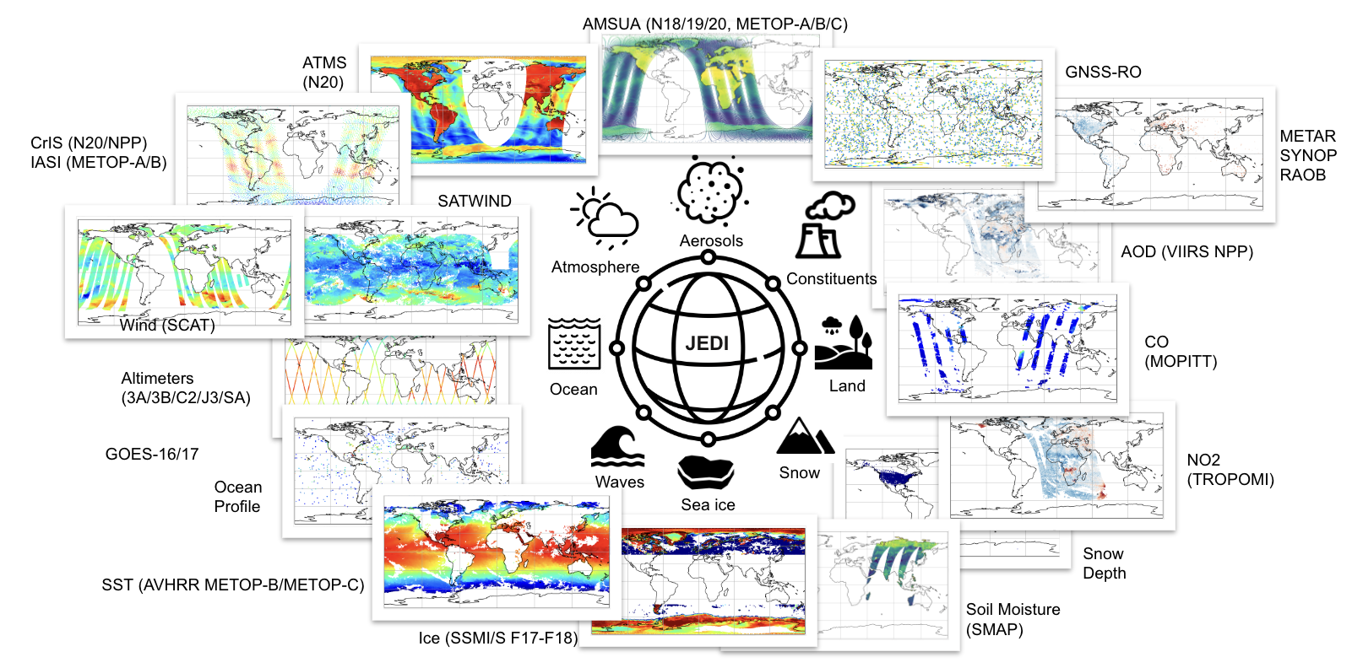
JCSDA JEDI-SkyLab
Slide courtesy of JCSDA core team
JEDI-Skylab v8 release (04/17/2024)
skylab-aerosol-weather-8_0 experiment:
The SkyLab 4DEnVar aero-weather v8 now uses CRTM AOD using NASA LUTs for aerosol providing more consistent optical properties with the GEOS model for aerosol assimilation. This change has been possible with the AOD (Aerosol Optical Depth) CRTM UFO interface which is now much more generic. It allows users to bring in their aerosol look-up tables for experiments.
Experiment results of this and past releases: https://skylab.jcsda.org

Slide 15
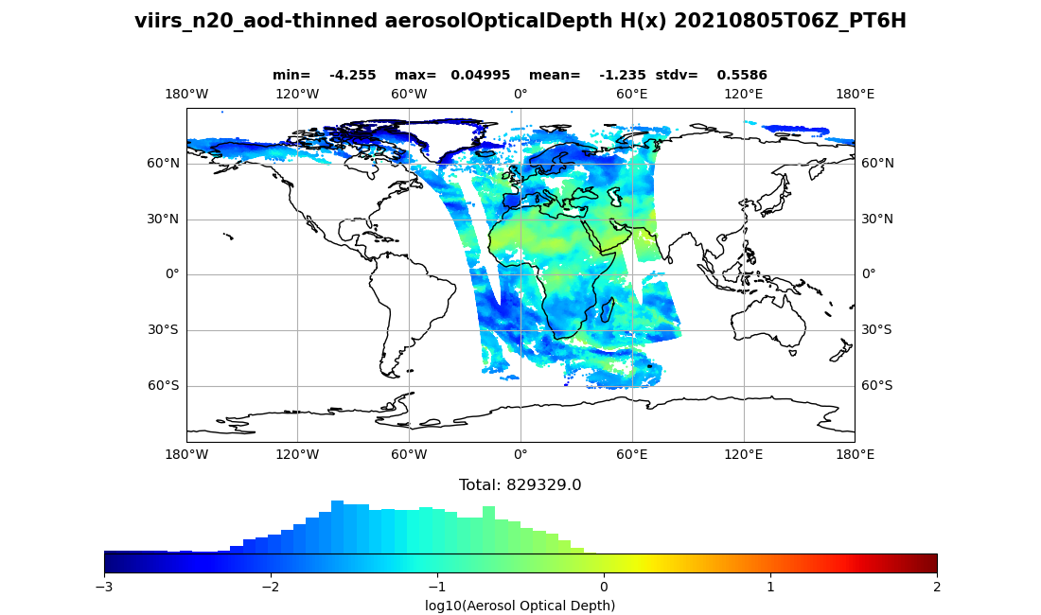
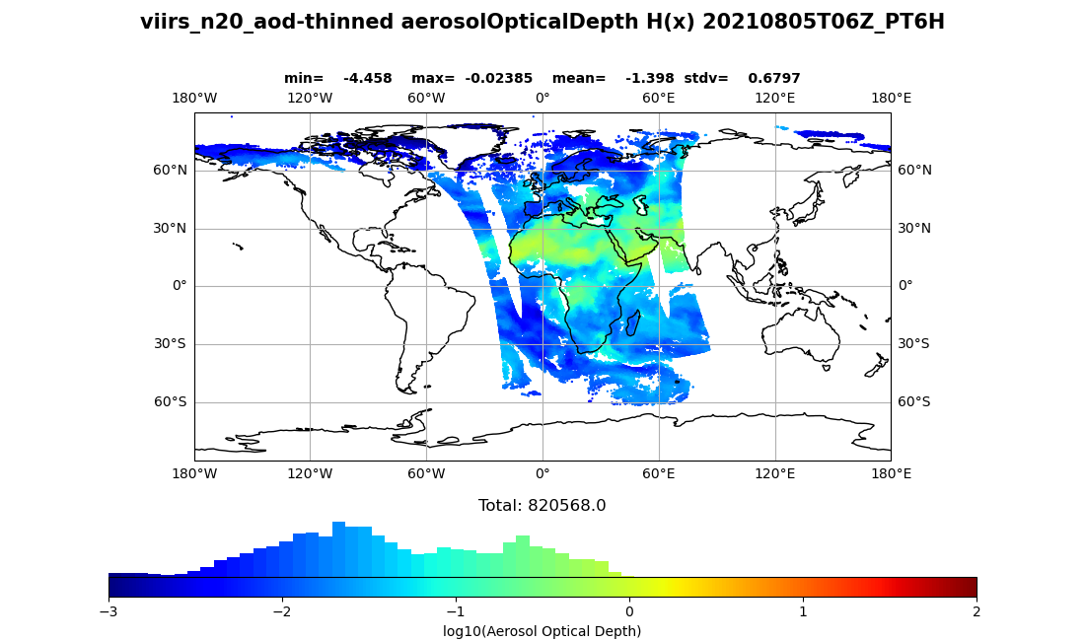
JEDI-SkyLab v8
Slide courtesy of JCSDA core team
SkyLab v8: example of aerosol optical depth simulated by JEDI/UFO with the CRTM default LUT and NASA-GEOS5 LUT.
H(x) with default CRTM LUT
H(x) with NASA-GEOS LUT
skylab-aerosol-weather-8_0 experiment The SkyLab 4DEnVar aero-weather v8 now uses CRTM AOD using NASA LUTs for aerosol providing more consistent optical properties with the GEOS model for aerosol assimilation. This change has been possible with the AOD (Aerosol Optical Depth) CRTM UFO interface which is now much more generic. It allows users to bring in their aerosol look-up tables for experiments.

Slide 16
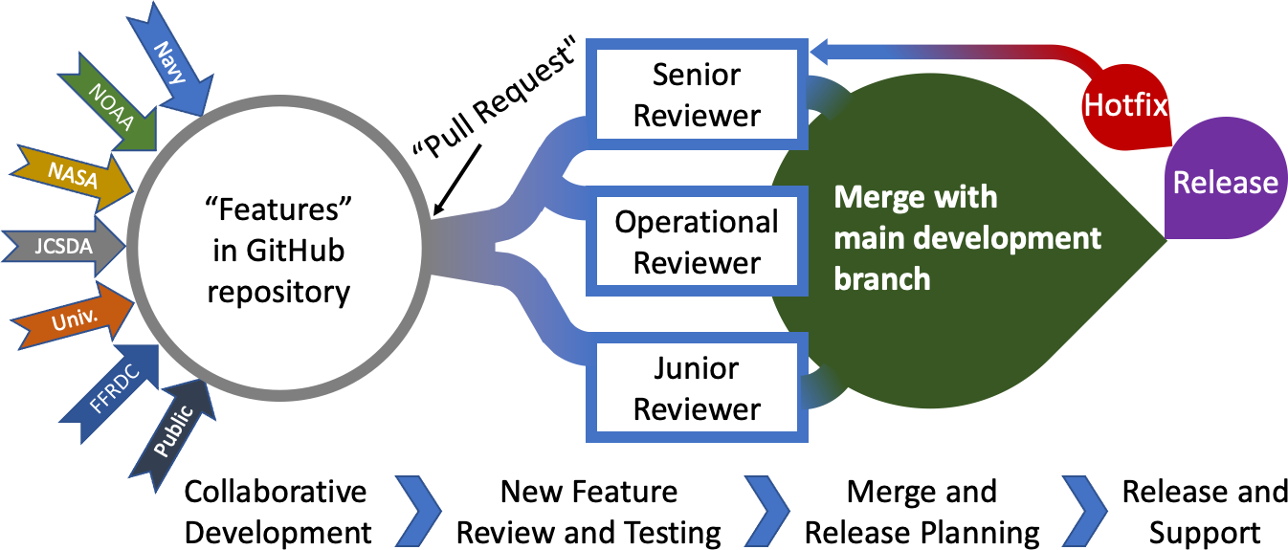
Community Radiative Transfer Model
Open source on GitHub.
Collaborative development, testing, review, and release workflow.
Standalone radiative transfer model.
Useful links
CRTM release note: https://www.jcsda.org/crtm
CRTM public repository: https://github.com/JCSDA/CRTMv3
PyCRTM: https://github.com/JCSDA/pycrtm
CRTM transmittance/spectral coefficient generation package: https://github.com/JCSDA-internal/CRTM_coef (please email us for access)
JCSDA: https://www.jcsda.org/
Skylab releases: https://www.jcsda.org/jediskylab
Provide high-quality radiative transfer simulations to enable increased utilization of satellite observations. Ensure consistency, flexibility, and accuracy.
Notes:
Add jedi information or added it as a separate slide.

Slide 17
References
Thank you!
Johnson, B., C. Dang, P. Stegmann, Q. Liu, I. Moradi, T. Auligne (2023): The Community Radiative Transfer Model (CRTM): Community-Focused Collaborative Model Development Accelerating Research to Operations, Bulletin of the American Meteorological Society.
Ren, T., Yang, P., Garrett, K., Ma, Y., Ding, J. and Coy, J., 2022. A Microphysics-scheme Consistent Snow Optical Parameterization for the Community Radiative Transfer Model. Monthly Weather Review.
Nalli, N. R.,, J. A. Jung., R. O. Knuteson, J. Gero, C. Dang, B. T. Johnson, and L. Zhou (2023a): Reducing biases in thermal infrared surface radiance calculations over global oceans, IEEE Trans. Geosci. Remote Sens.
Nalli, N. R., C. Dang, J. A. Jung, R. O. Knuteson, E. E. Borbas, B. T. Johnson, K. Pryor, and L. Zhou (2023b): Physically based thermal infrared snow/ice surface emissivity for fast radiative transfer models" Remote Sens., 15(23): 5509, https://doi.org/10.3390/rs15235509
Moradi, I., Stegmann, P., Johnson, B., Barlakas, V., Eriksson, P., Geer, A., ... & Mccarty, W. (2022). Implementation of a Discrete Dipole Approximation Scattering Database Into Community Radiative Transfer Model. Journal of Geophysical Research: Atmospheres, 127(24), e2022JD036957. Moradi, I., Stegmann, P., Johnson, B., Barlakas, V., Eriksson, P., Geer, A., ... & Mccarty, W. (2022). Implementation of a Discrete Dipole Approximation Scattering Database Into Community Radiative Transfer Model. Journal of Geophysical Research: Atmospheres, 127(24), e2022JD036957.
Mian Chin, Paul Ginoux, Stefan Kinne, Omar Torres, Brent N Holben, Bryan N Duncan, Randall V Martin, Jennifer A Logan, Akiko Higurashi, and Teruyuki Nakajima. Tropospheric aerosol optical thickness from the gocart model and comparisons with satellite and sun photometer measurements. Journal of the atmospheric sciences, 59(3):461–483, 2002.
Yong Han. Jcsda community radiative transfer model (crtm): Version 1. 2006.
Francis S Binkowski and Shawn J Roselle. Models-3 community multiscale air quality (CAMQ) model aerosol component 1. model description. Journal of geophysical research: Atmospheres, 108(D6), 2003.
Quanhua Liu and Cheng-Hsuan Lu. Community radiative transfer model for air quality studies. In Light Scattering Reviews, Volume 11, pages 67–115. Springer, 2016.
Peter Colarco, Arlindo da Silva, Mian Chin, and Thomas Diehl. Online simulations of global aerosol distributions in the nasa geos-4 model and comparisons to satellite and ground-based aerosol optical depth. Journal of Geophysical Research: Atmospheres, 115(D14), 2010.
Peng Lynch, Jeffrey S Reid, Douglas LWestphal, Jianglong Zhang, Timothy F Hogan, Edward J Hyer, Cynthia A Curtis, Dean A Hegg, Yingxi Shi, James R Campbell, et al. An 11-year global gridded aerosol optical thickness reanalysis (v1. 0) for atmospheric and climate sciences. Geoscientific Model Development, 9(4):1489–1522, 2016.
Wei, S.W., Lu, C.H., Johnson, B.T., Dang, C., Stegmann, P., Grogan, D., Ge, G. and Hu, M., 2022. The influence of aerosols on satellite infrared radiance simulations and Jacobians: Numerical experiments of CRTM and GSI. Remote Sensing, 14(3), p.683.
Lu, C-H, Q. Liu, S-W Wei, B. T. Johnson, C. Dang, P. G. Stegmann, D. Grogan, G. Ge, M. Hu, and M. Lueken (2022): The Aerosol Module in the Community Radiative Transfer Model (v2. 2 and v2. 3): accounting for aerosol transmittance effects on the radiance observation operator. Geoscientific Model Development 15, no. 3: 1317-1329.
Karpowicz, B.M., Stegmann, P.G., Johnson, B.T., Christophersen, H.W., Hyer, E.J., Lambert, A. and Simon, E., 2022. pyCRTM: A Python Interface for the Community Radiative Transfer Model. Journal of Quantitative Spectroscopy and Radiative Transfer, p.108263.

