Slide 1
Evaluating the SAMI2 Model’s Performance in the Brazilian Sector During the December 2015 Geomagnetic Storm
Authors:
Oladayo Oladayiwola Afolabi 1,2; Fabio Becker-Guedes 2, Claudia M.N. Candido, Christine Amory-Mazaudier 3
1 National Space for Research and Development Agency, Nigeria.
2 National Institute for Space Research, Brazil.
3 Laboratoire de Physique des Plasmas (LPP), Sorbonne Université, Ecole Polytechnique, Institut Polytechnique de Paris, Université Paris Saclay, Observatoire de Paris, CNRS, 75005 Paris, France;

Slide 2
OUTLINE
State of Interplanetary Medium from 18 to 20 December 2015
Development of Magnetic Signature of Disturbance Dynamo
Brief Description of the SAMI2 Model
Presentation of Results
Conclusion and Recommendation

Slide 3
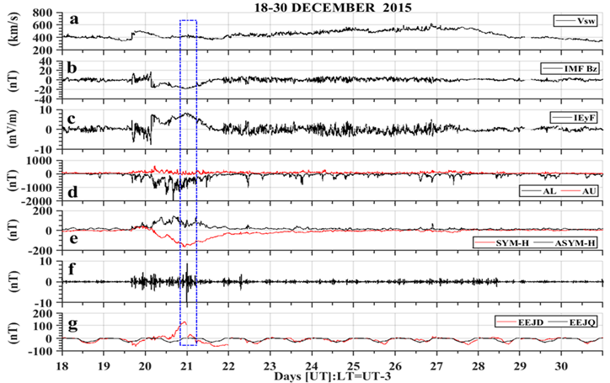
The variation in solar wind speed, interplanetary parameters, Auroral electrojet, DP2 fluctuations, and EEJ from 18-30 December 2015
A CME drove the geomagnetic storm in December 2015.
The IMF Bz was southward from 04:00 UT to 23:00 UT
The westward auroral electrojet intensified from the late hour on December 19 to 20, 2015.
The SYM-H index reached a minimum amplitude of -170 nT at 23:00 UT on December 20.
DP2 fluctuated close to the period of PRE in the Brazilian sector on December 20, 2015.
The eastward PPMEF enhanced the eastward EEJ amplitude.
.

Slide 4
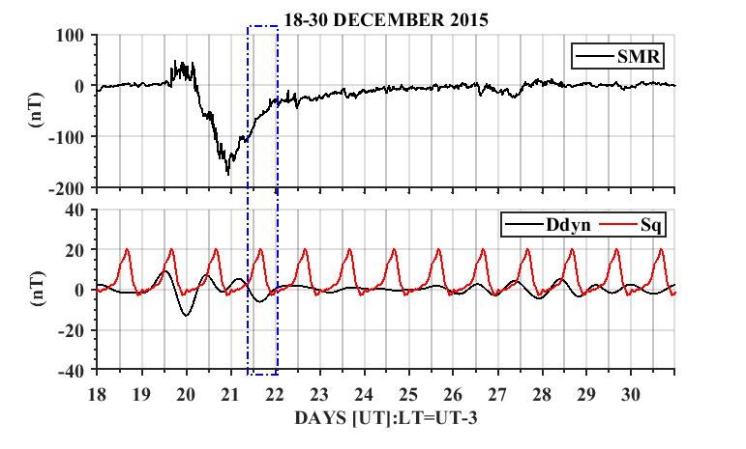
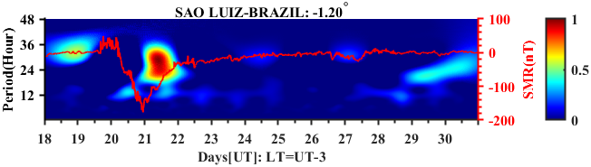
Development of Magnetic Signature of Disturbance Dynamo in the Brazilian Equatorial Latitude
Semblance cross-correlation wavelet analysis

Slide 5
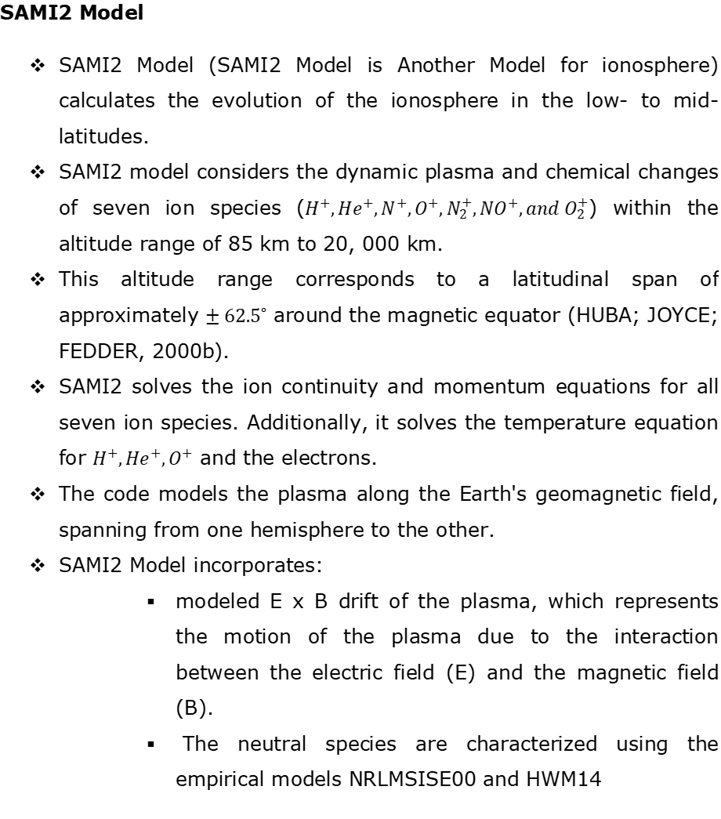
SAMI2 MODEL

Slide 6
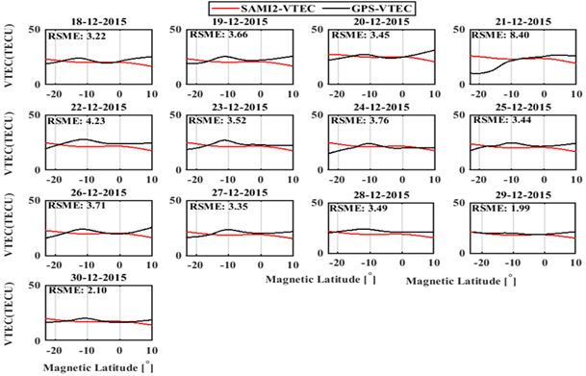
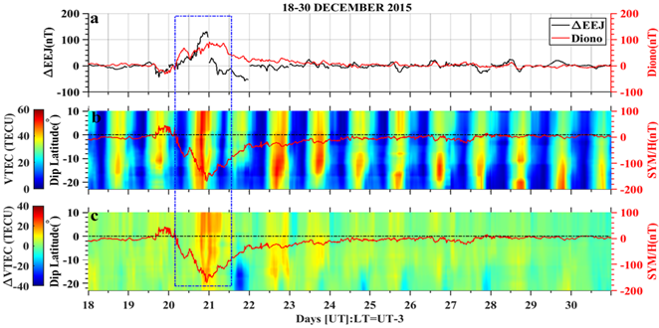
Observation and SAMI2 Model VTEC

Slide 7
Conclusion
It is suggested that the SAMI2 Model should include disturbance wind to accurately simulate the impact of the disturbance dynamo on the ionospheric electric field in low latitudes.

Slide 8
References
AFOLABI, O. O. et al. Study and modelling of the impact of June 2015 geomagnetic storms on the Brazilian ionosphere. Atmosphere, v. 15, n. 5, p. 597, 2024.
COOPER, G. R. J.; COWAN, D. R. Comparing time series using wavelet-based semblance analysis. Computers & Geosciences, v. 34, n. 2, p. 95–102, 2008.
HUBA, J. D.; JOYCE, G.; FEDDER, J. A. Sami2 is Another Model of the Ionosphere (SAMI2): a new low-latitude ionosphere model. Journal of Geophysical Research, v. 105, n. A10, p. 23035–23053, 2000b.
YOUNAS, W. et al. Magnetic signatures of ionospheric disturbance dynamo for CME and HSSWs generated storms. Space Weather, v. 19, n. 9, 2021.

