Slide 1

Supporting Model Design Decisions and Innovations via Model Hierarchies
Christiane Jablonowski (University of Michigan)
in collaboration with Lou Wicker (NSSL), Kevin Viner (NOAA EMC) and
many other NOAA & NCAR scientists
Jackson, MS, July 25, 2024

Slide 2
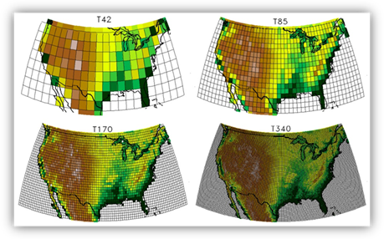
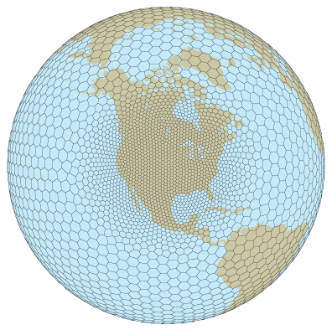
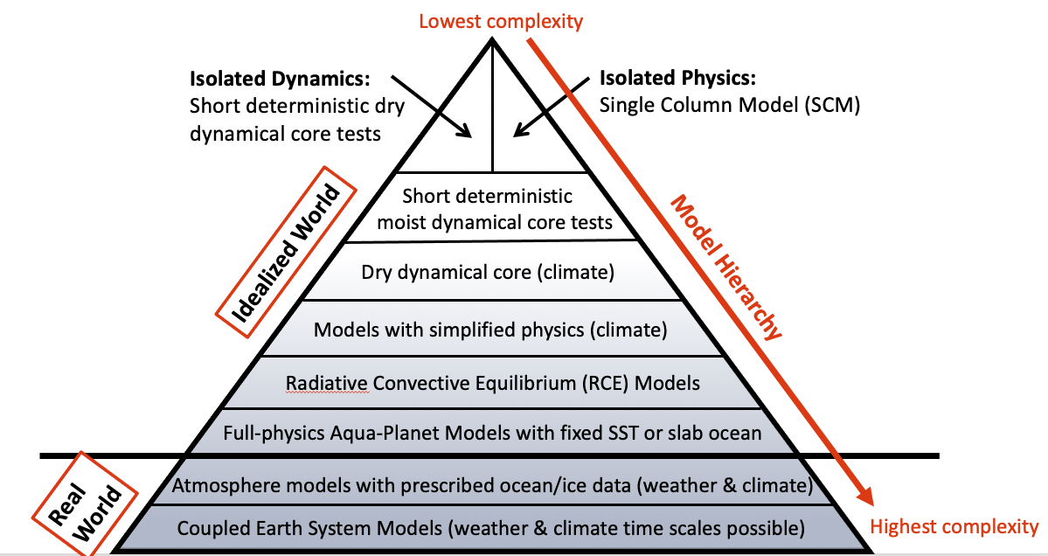
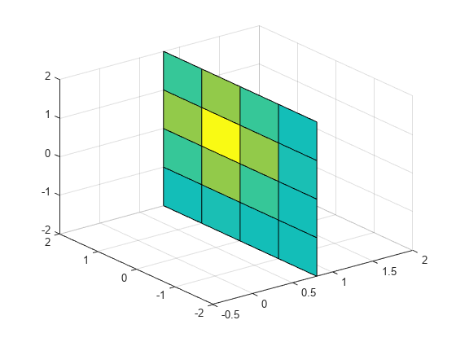
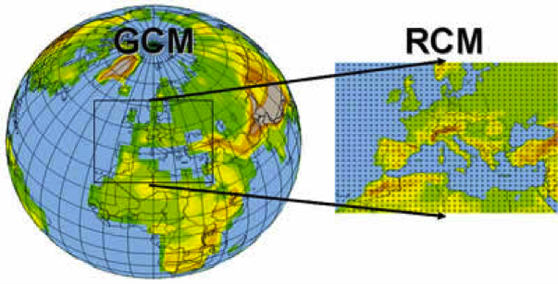
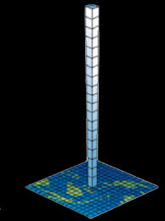
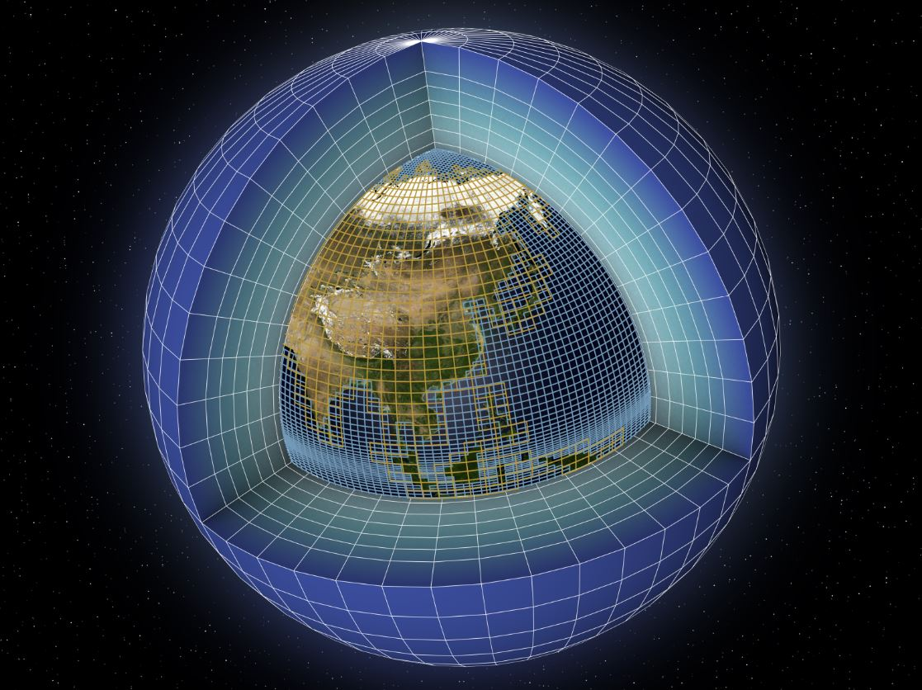
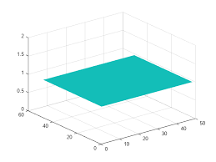
Model Hierarchies: Multiple Approaches Exist
Complexity
Resolution
Dimensionality
Domain Size
1D
Single Column Model
2D
3D
x-z slice
Supported via CCPP/
SCM UFS
x-y slice

Slide 3
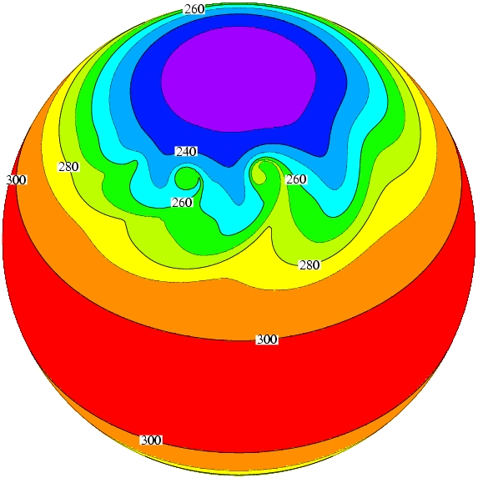
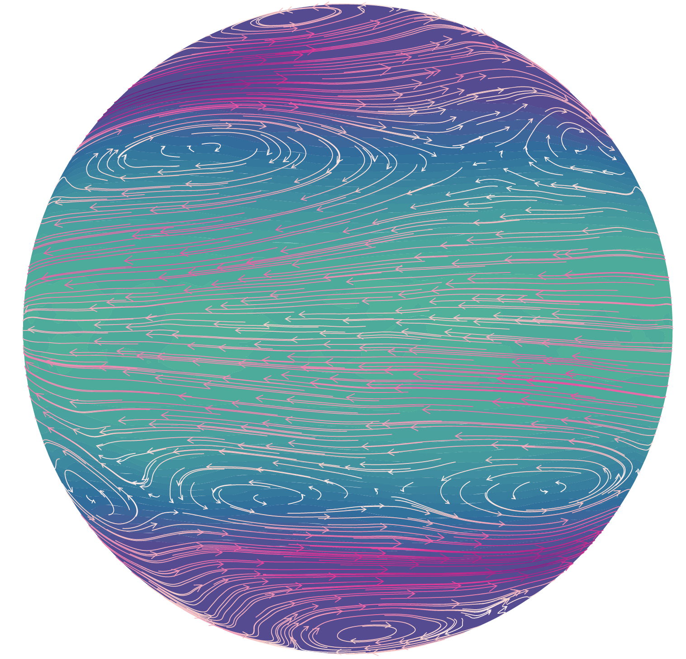
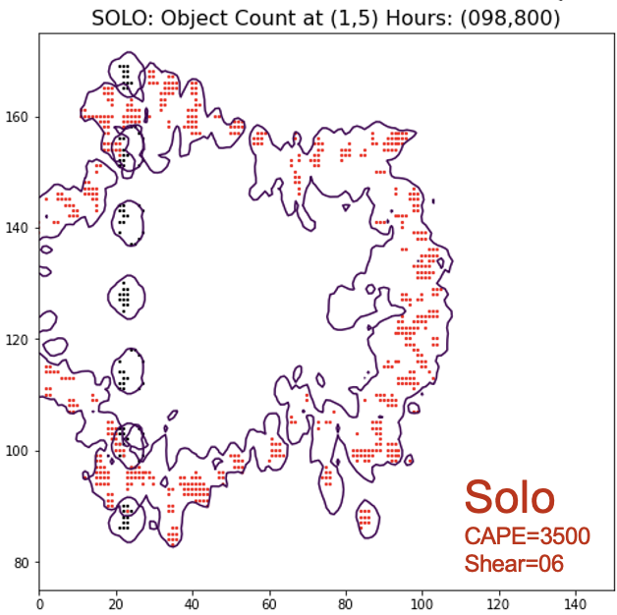
Complexity: Dynamical Core & Aqua-Planet Tests
Dynamical core tests without/with rotation
GCM with complex physics
Idealized squall lines or bubble tests with simple moisture, no rotation
Baroclinic waves with rotation
(dry or with simple moisture)
Aqua-planet
(ocean-covered earth with prescribed SSTs)
FV3 dycore with Kessler physics
1 hour
5 hours
Source: Lou Wicker (NSSL)

Slide 4
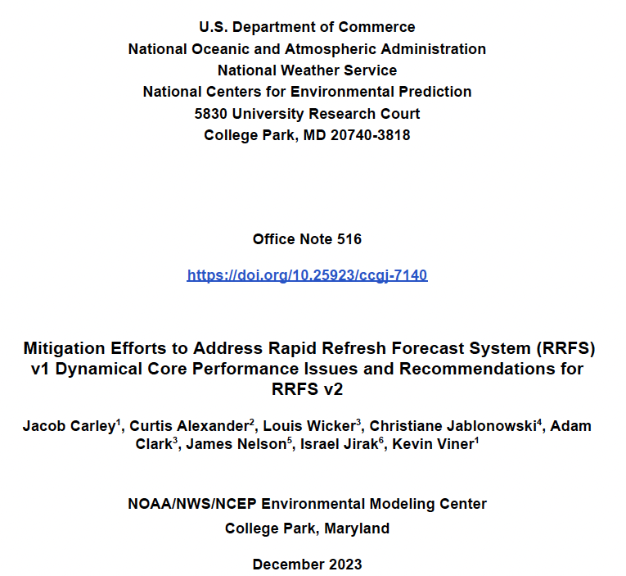
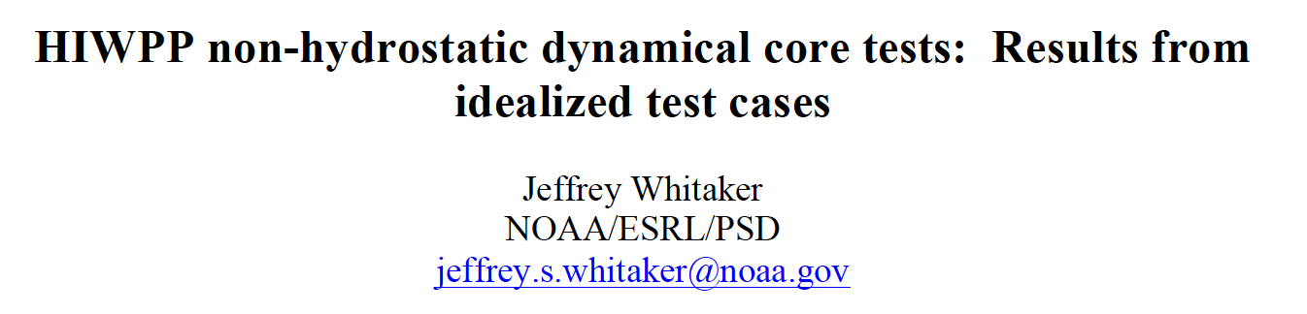

Model Hierarchies are Used to Inform the UFS
2015
2023
2016

Slide 5
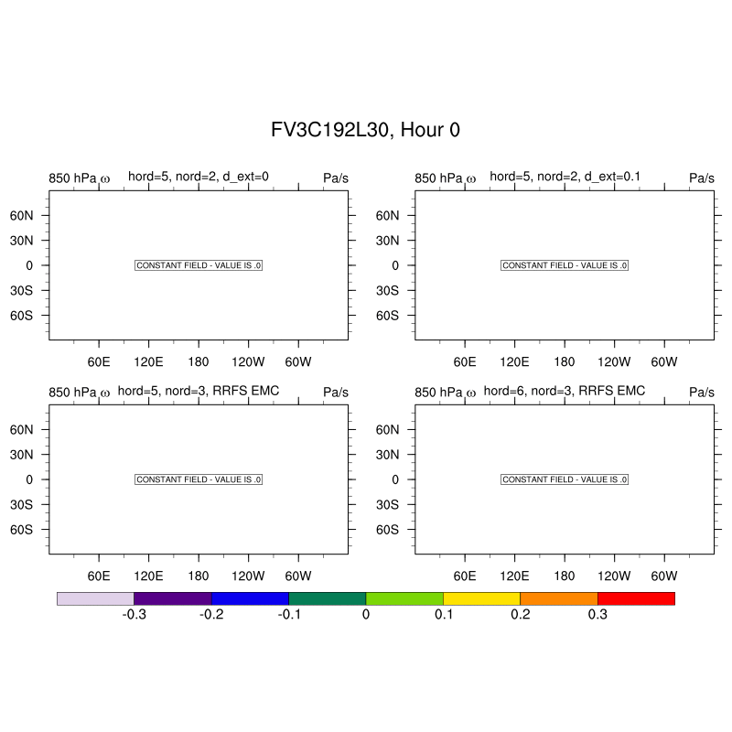
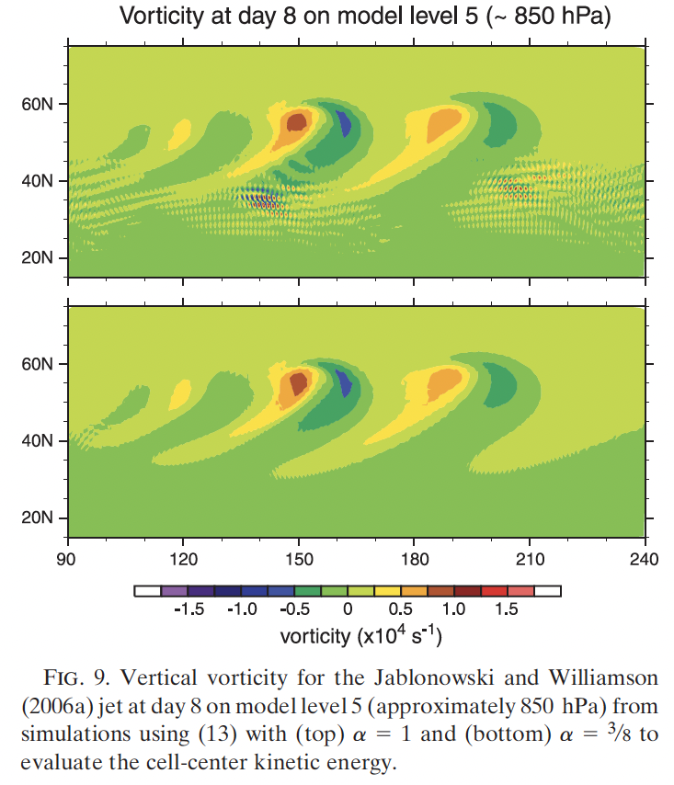
Inform the Design Decisions in UFS’ Dycores
Moist baroclinic wave test with topography: Diffusion properties in FV3
Dry baroclinic wave test: Diffusion properties in MPAS
Skamarock et al (2012): https://doi.org/10.1175/MWR-D-11-00215.1
RRFS EMC: nord=3, d4_bg=0.12, vtdm4 = 0.02, dddmp = 0.1, d_con = 1, delt_max = 0.008, d_ext = 0 (in 2022)

Slide 6
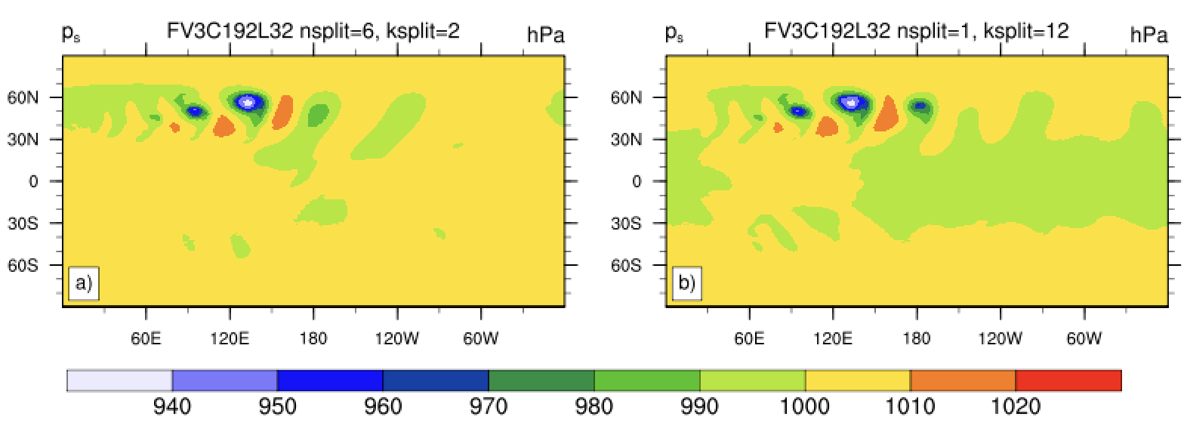
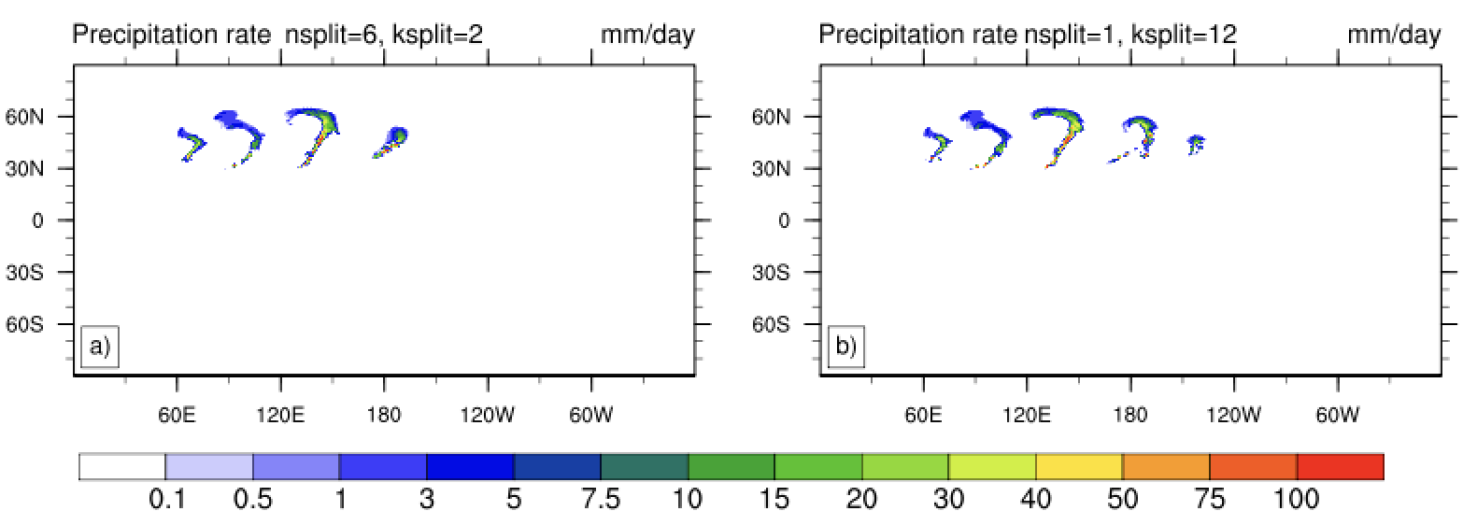
Inform the Design Decisions: FV3 Physics Time Step
Experiments with FV3C192L32 (50 km) with
  nsplit=6, ksplit=2: Physics time step 900 s, dynamics time step 75 s, remap time step 450 s
  nsplit=1, ksplit=12: Physics, dynamics and remap time steps are 75 s
Noticeable effects on both the surface pressure and precipitation rate at day 10
No time step convergence
Motivates more FV3 physics-dynamics coupling research, e.g. by Kevin Viner (NOAA EMC)
Moist DCMIP2016 baroclinic wave at day 10
Long physics time step
Short physics time step

Slide 7
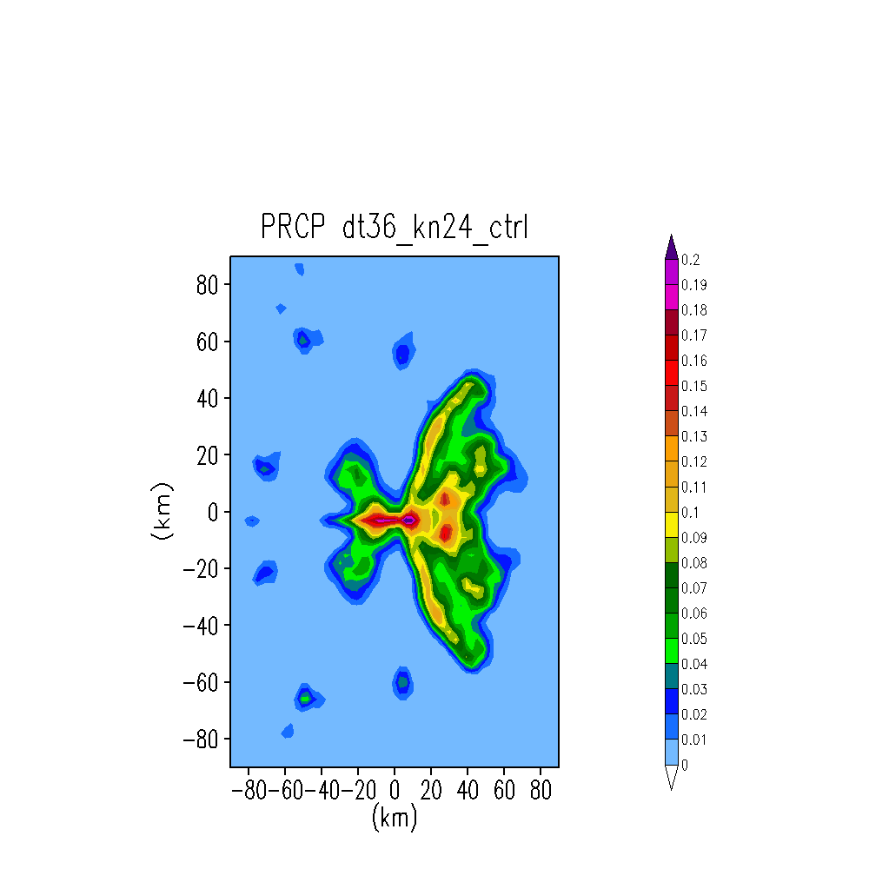
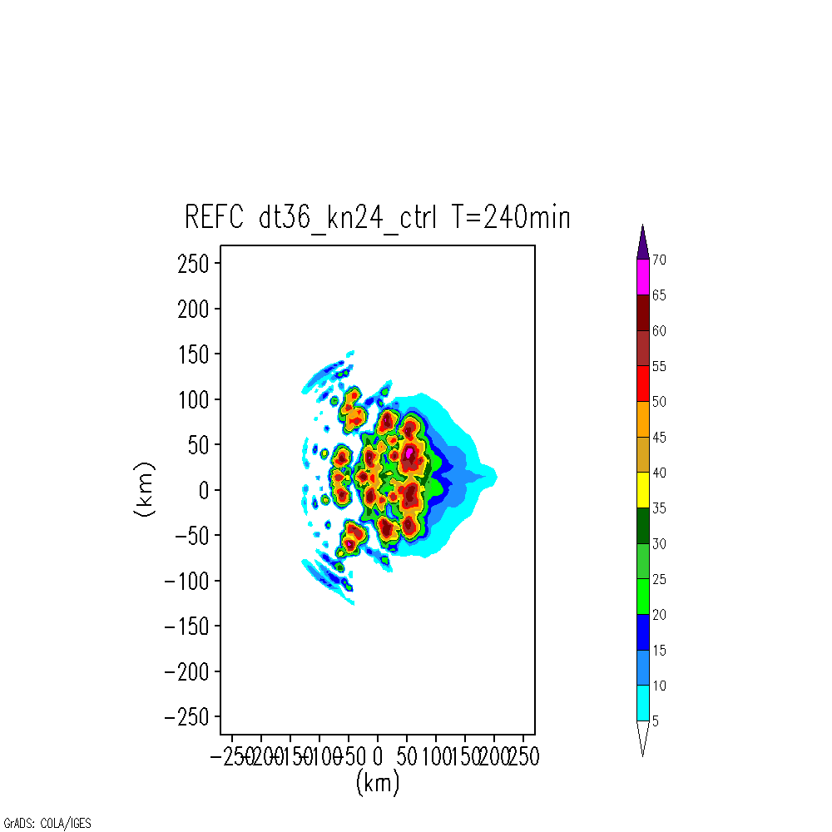
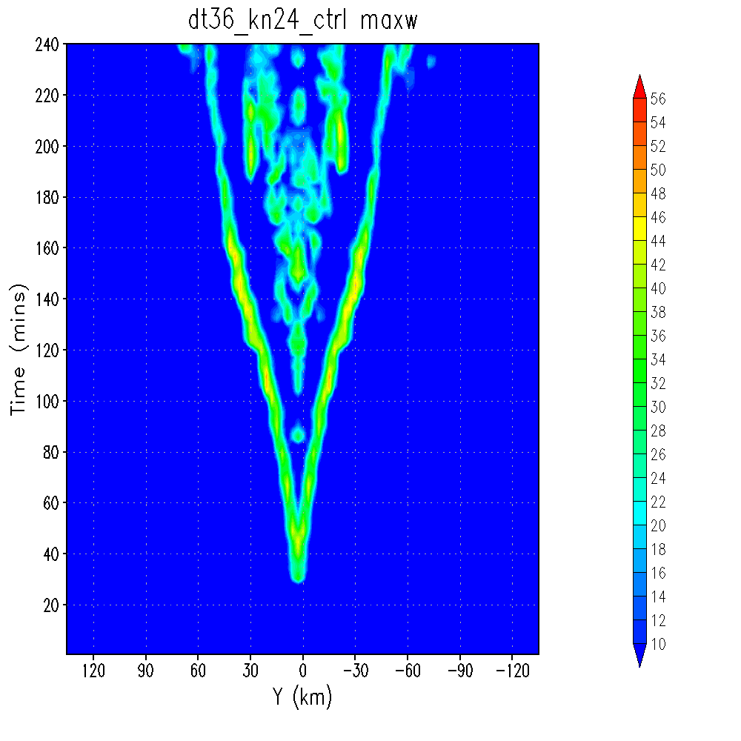
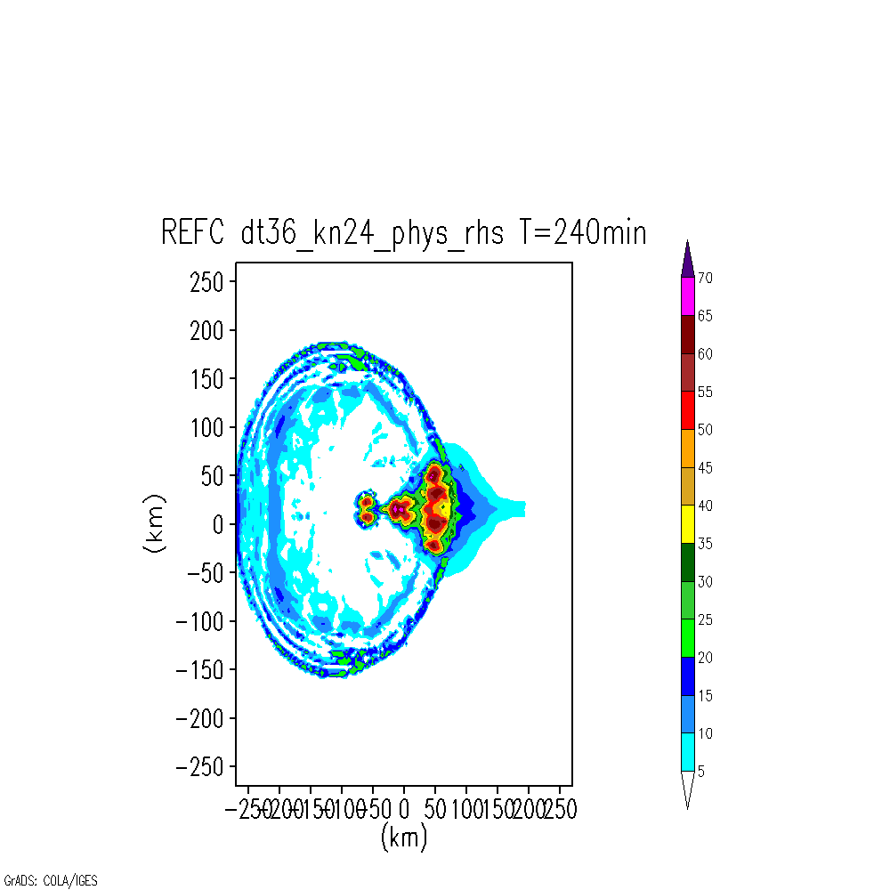
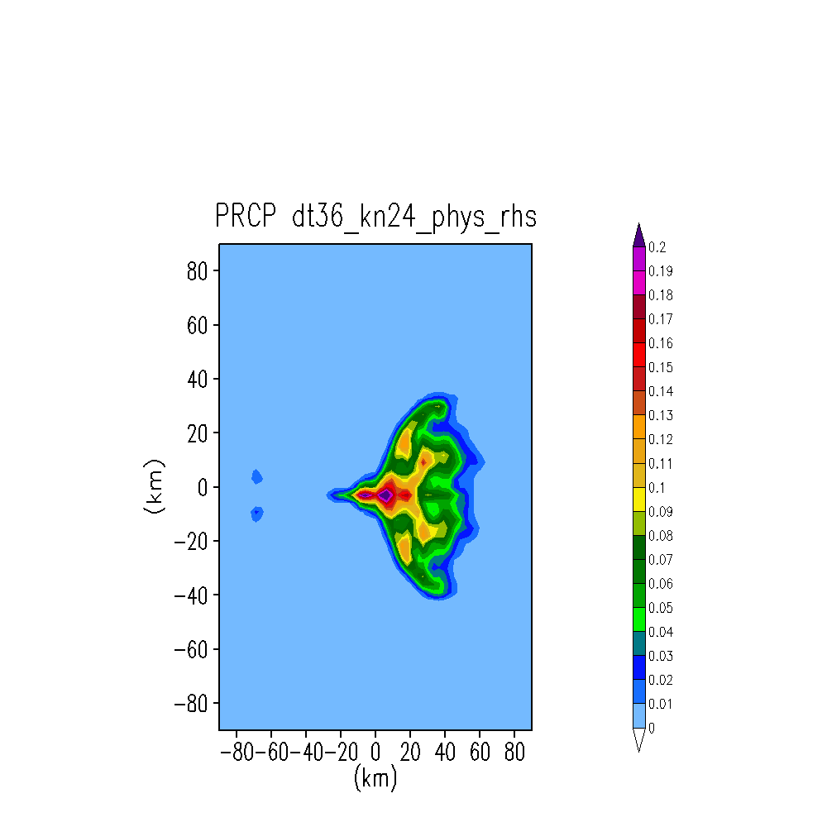
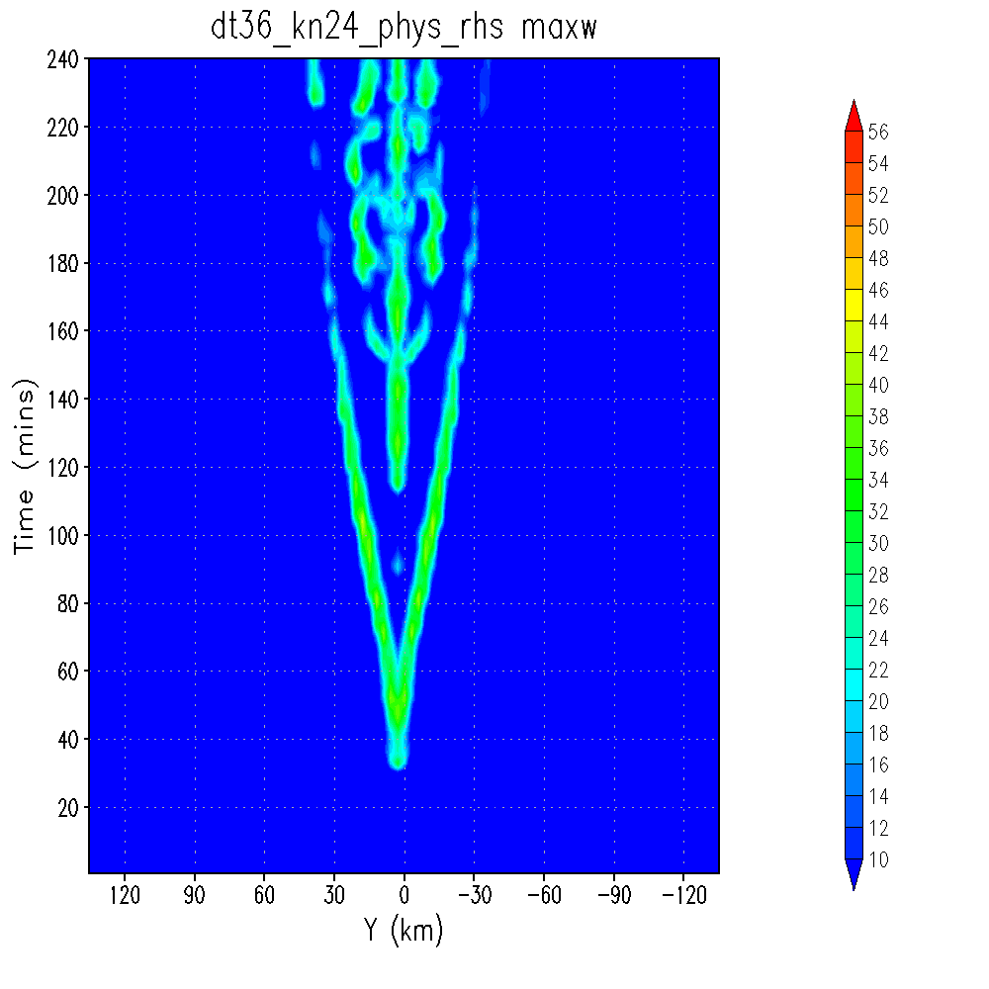
Inform the Design Decisions: FV3 Physics Δt & Coupling
Moist bubble test with FV3: left: max w (all levels)
Accumulated Precipitation
Reflectivity after 4 hours
Control:
physics tendency applied every
dt_{phys} = 36 s
Time (min)
Physics updates
every
dt_{phys} = 36 s
dt_{phys} = 36 s
dt_{dyn} = 4.5 s
The shorter dribbling period changes the radar reflectivity: signature of a cold pool
Time (min)
Dribbling the partial physics tendency with
the acoustic time step:
dt_{phys}/(ksplit*nsplit) = 4.5 s
Physics updates
every
dt_{dyn} = 4.5 s
dt_{phys} = 36 s
dt_{dyn} = 4.5 s
Results/figures from
Kevin Viner (EMC)

Slide 8
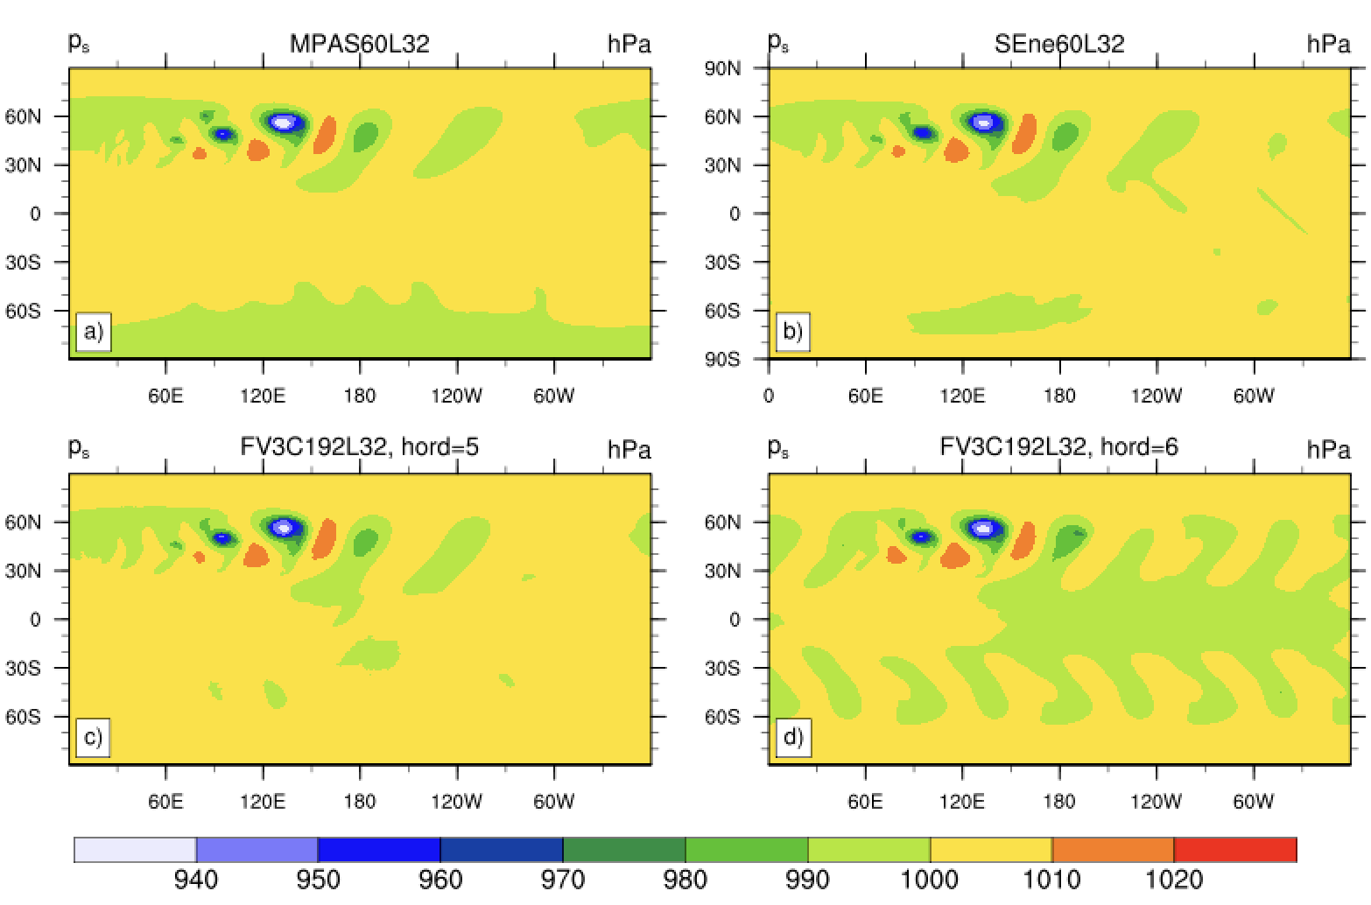
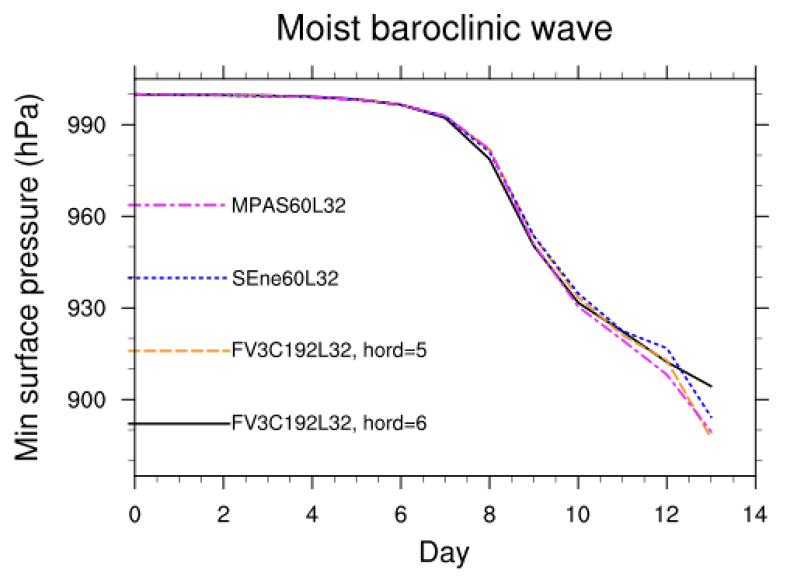
Moist Baroclinic Wave Intercomparison: Surface Pressure
Inform the Design Decisions: FV3 Implicit Diffusion
Increased FV3 dissipation (hord=6) leads to distinct surface pressure and precipitation differences at day 10, mainly driven the growing wavenumber 4 (cubed sphere signal) in FV3 (hord=6)
55-60 km grid spacing
(coef=0.25)
Least diffusive (GFS)
More diffusive (RRFS)
Wave 4 grows quickly
Evolution of the minimum surface pressure of the moist baroclinic wave with Kessler physics:
MPAS intensifies the wave the most after day 9

Slide 9
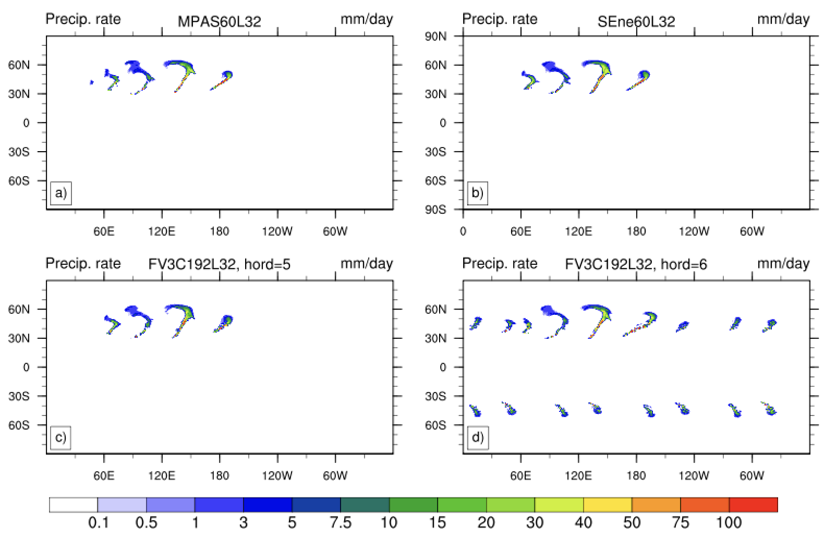
Inform the Design Decisions: FV3 Implicit Diffusion
Increased FV3 numerical dissipation (hord=6) leads to distinct surface pressure and precipitation differences at day 10, mainly driven the growing wavenumber 4 (cubed sphere signal) in FV3 (hord=6)
More diffusive setting (used in RRFS)
Note: grid imprinting decreases at higher RRFS resolution & RRFS is only run for short multi-day time periods
Least diffusive setting
(used in the GFS)
growing wave-4 lets it rain, undesirable

Slide 10
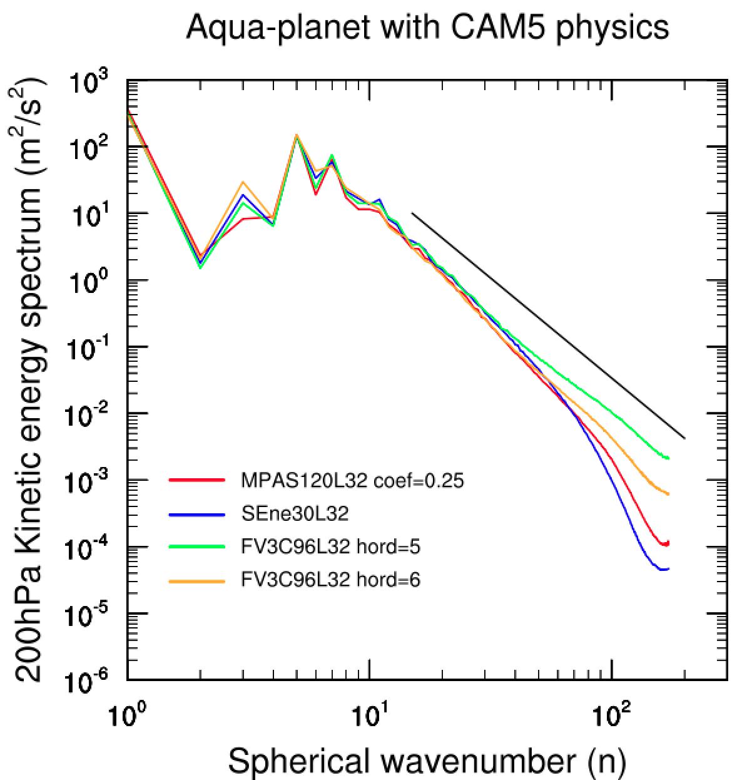
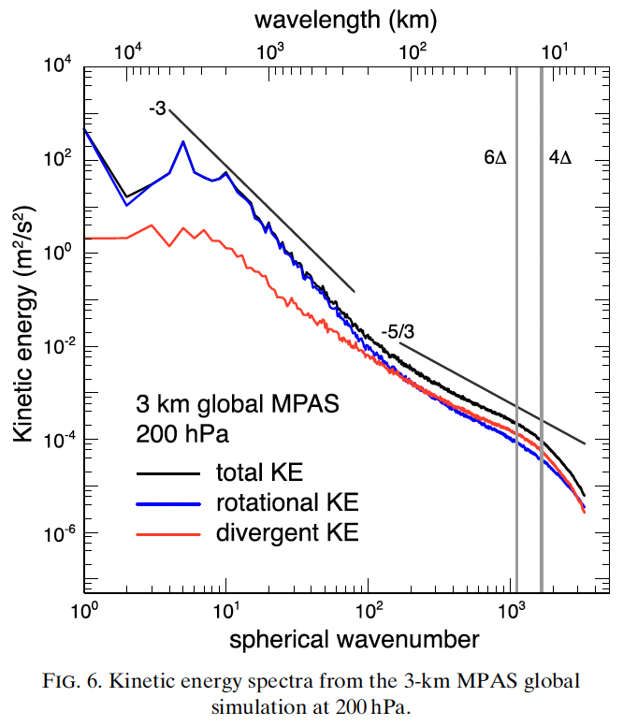
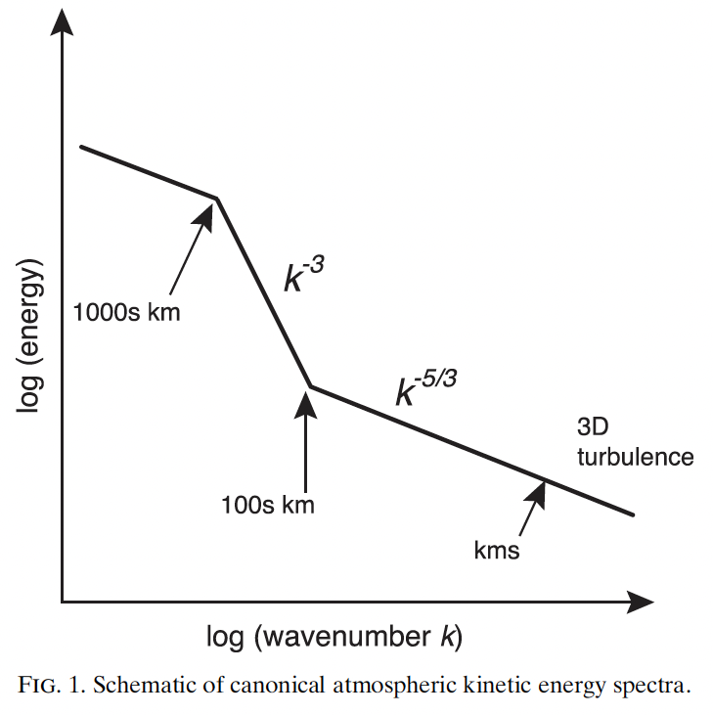
Assess the Dynamical Core Diffusion in Aqua-Planets
Unexpected: the tails of the MPAS and SE KE spectra drop off faster than FV3 in aqua-planet simulations with Δx=110-120 km simulations
Might not be the case for 3 km mesh spacings (see plots from Skamarock et al., 2014)
Slopes need to be checked in the UFS (MPAS) at high resolution
Δx=110-120 km
Expected: n⁻³
Expected curves:
Skamarock et al. (2014)
FV3
2D turbulence
FV3
MPAS
SE
steeper than -3

Slide 11
FV3 Diffusion in Aqua-Planets: Divergence Damping
Comparison of five 200 hPa KE spectra with hord=5 and various orders of the horizontal divergence damping: 2, 4, 6, 8 (via nord)
nord causes deviations from wavenumber 50 onwards
nord=0 and 1 (div2 and div4) show a steeper decline of KE at high wavenumbers
nord=2 (6th-order div damping div6) follows the theoretical n⁻³ slope (gray line) very accurately
nord=3 (8th-order) simulations bend upwards, accumulate energy at the smallest scale (omitted from now on)
nord=3 without additional (EMC) damping settings blows up after 3 years
Accumulation of energy at the grid scale, problematic

Slide 12
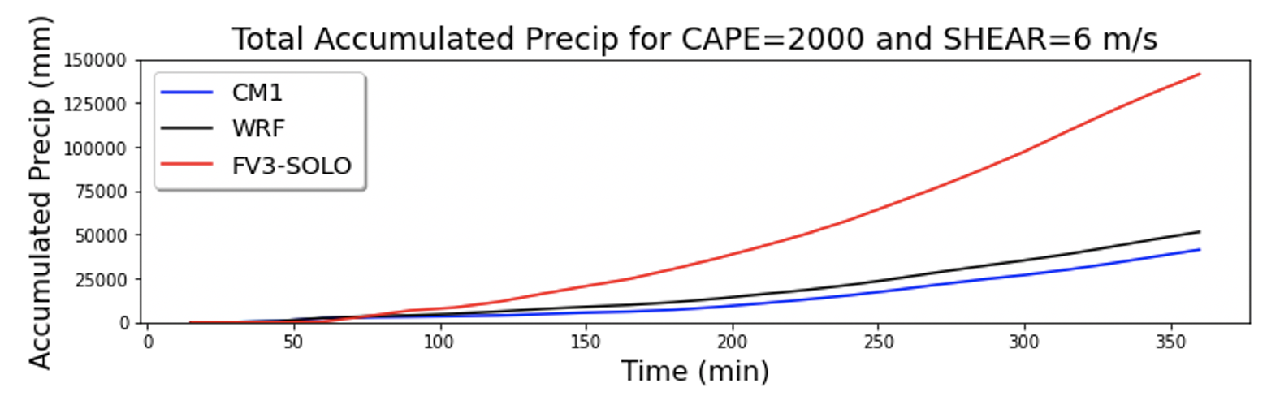
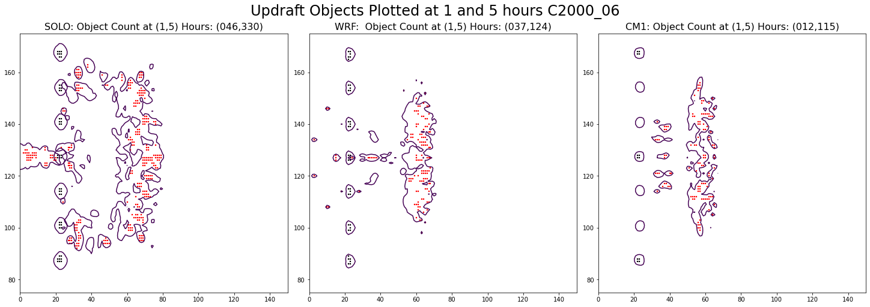
Squall Line: Reveals the FV3 Issues With Convection
Squall-line experiment:
Very different FV3 precipitation and vertical updraft characteristics for low-shear environments and moderate CAPE = 2000 J/kg
All figures from Lou Wicker
FV3
WRF
CM1
Hour 1
Hour 5
Hour 1
Hour 5
Hour 1
Hour 5

Slide 13
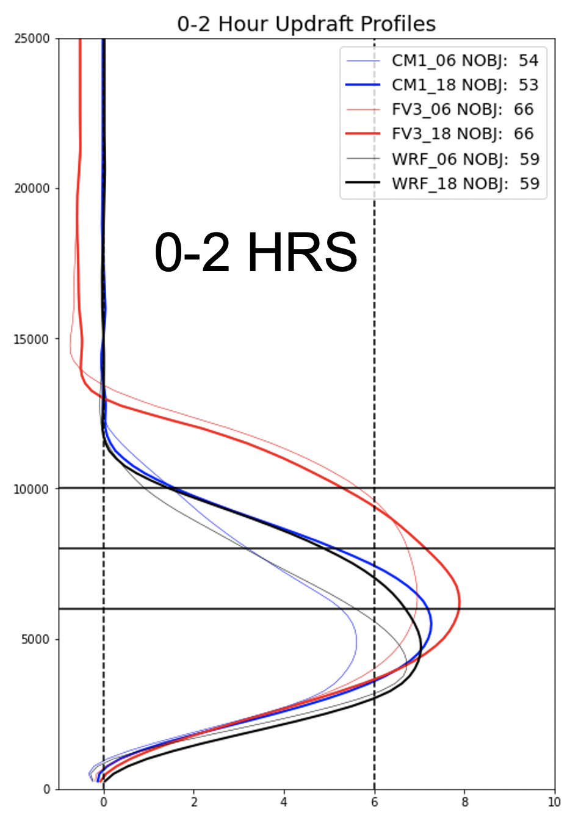
Squall Line: Reveals the FV3 Issues With Convection
Results from Lou Wicker (NSSL):
Idealized squall line test discovered a bug
in FV3’s computation of the vertical
velocity (fixed in 2023)
3 updraft objects are ~1.5-2x larger in size
in low shear environments than updrafts in WRF/CM1
FV3 generates more storm objects at
lower shears (like 6 m/s)
This reproduces the current RRFSv1 biases: HWT testbeds and Carley et al (2024)
  Reflectivity high bias (convection cells too intense)
  Low precipitation scores
  Deficiencies in storm structures (too big)
  Informs decision to switch to MPAS in RRFSv2
# objects
WRF
CM1
FV3
6, 18: shear
Height (m)
Updraft profiles of objects in an idealized squall line simulation with CAPE = 2000 J/kg
Issues to linked to the numerical characteristics of the FV3 dycore
m/s

Slide 14
Conclusions: Idealized Testing Hierarchy
Focus here: Hierarchy in model complexity assessed via idealized test cases
Idealized tests
  reproduce features seen in full-complexity UFS simulations
  shed light on cause-and-effect relationships, easier to interpret
  bugs have been found (and fixed)
  easy and quick to run (caveat: if supported by the workflow, not currently the case for the default UFS workflows, desirable!)
  inform design and tuning decisions for the UFS
  contributed to the decision to explore MPAS for RRFSv2
  highly beneficial for the model development process
  highly beneficial for community engagement (easier and cheaper)
  ideal teaching tool at universities: helps widen the community

