Slide 1
Overview of NOAA Coastal Ocean Operational Forecast System
Aijun Zhang
Center for Operational Oceanographic Products and Services NOAA/NOS
July 22-26, 2024
Unifying Innovations in Forecasting Capabilities Workshop (UIFCW24)

Slide 2
National Operational Coastal Modeling Program
User needs at the coast: Safe and efficient navigation; protecting human health; coastal resilience; managing living marine resources; mapping and coastal management; and spill response and search and rescue.
Goal: build nation’s capacity for a true operational oceanographic system by combining observations, models, predictions, and projections with the ability to readily disseminate high-quality information based on documented user needs.
Provide high resolution and 3D forecast guidance of oceanographic conditions for high priority ports and approaches to ensure safe and efficient navigation to head of tide while enabling support for emergency response and ecological forecasting
Complete CONUS coverage and priority ports in OCONUS and U.S. Territories.
NOAA/National Ocean Service Modeling Strategy

Slide 3
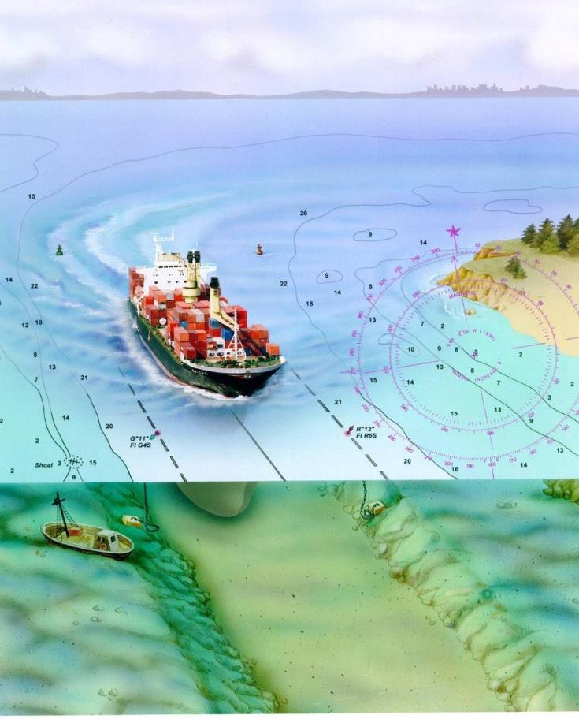
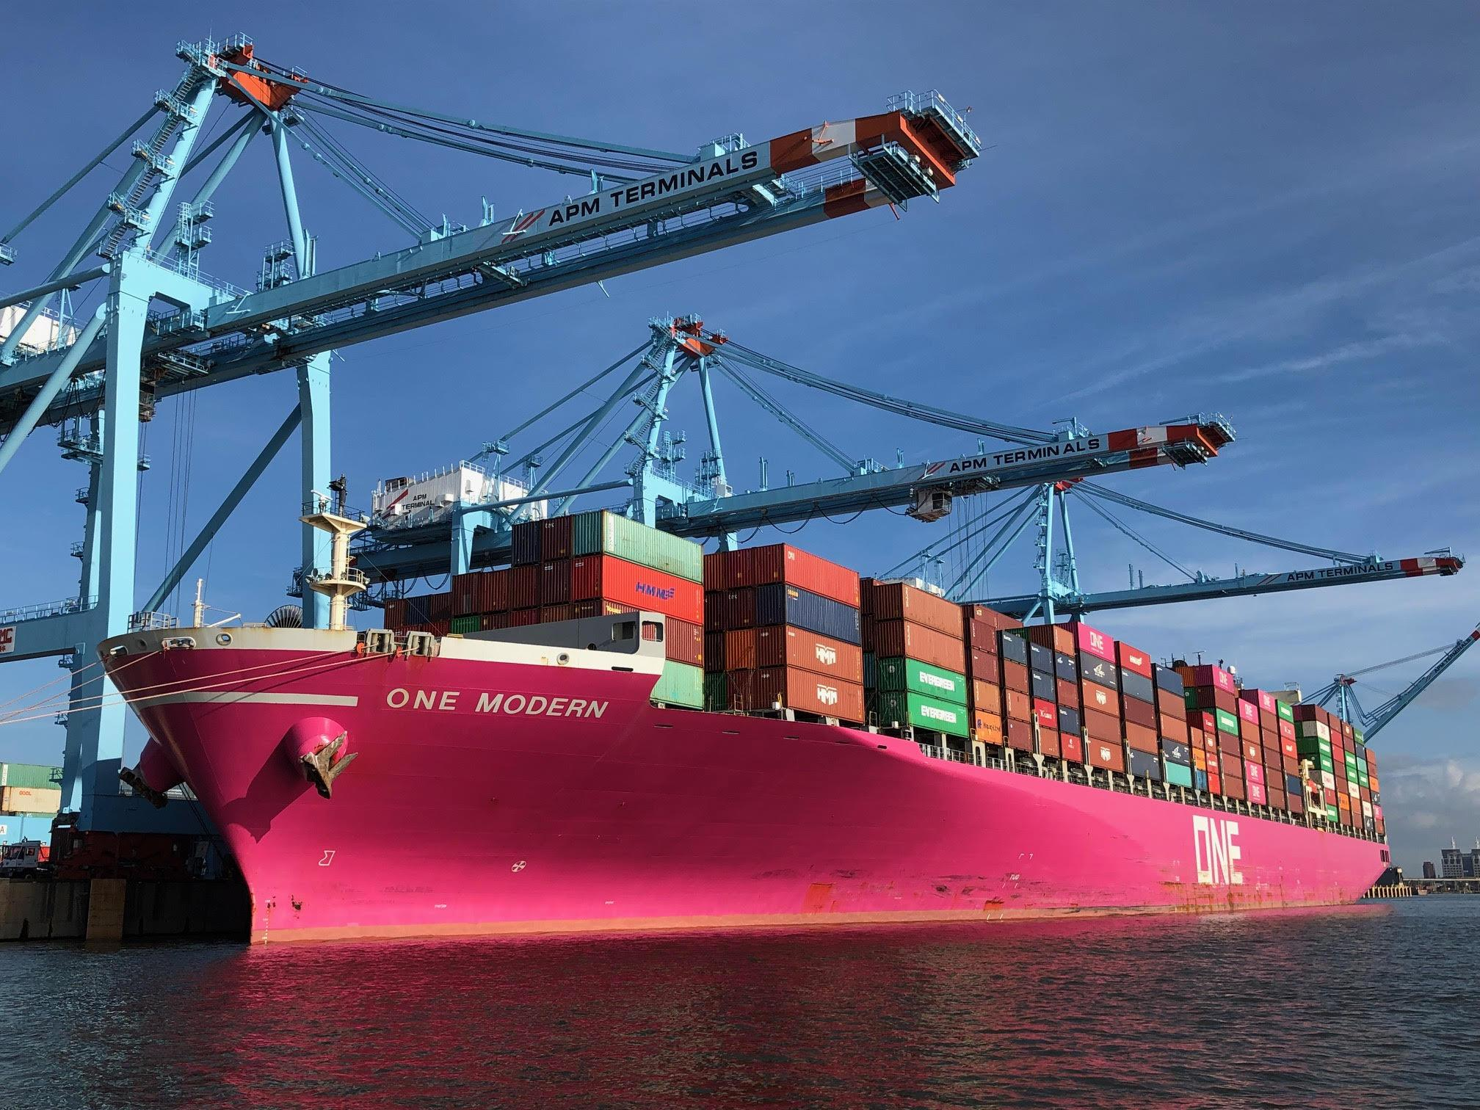
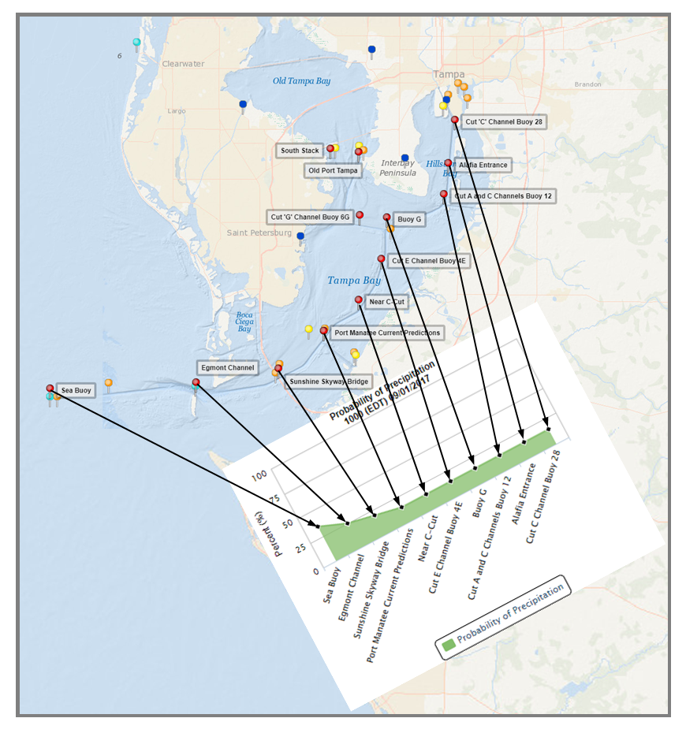
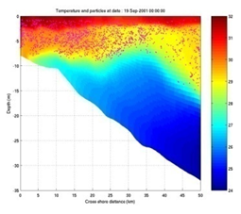
Major Services and Stakeholders
Safe & efficient navigation
Navigation management (Navigation managers, ports managers, pilots, etc.)
Marine Channel Forecasting
Water levels for under-keel clearance
Currents for USCG right-of-way decision-making and pilot maneuverability
Emergency response (OR&R, USCG, FEMA)
Inundation dashboard
Hazardous spills
Search & Rescue
Homeland Security
Enable management of the coastal zone
Ecosystem and water quality modeling
Coastal and fishery management
HAB forecasts in Gulf of Mexico

Slide 4
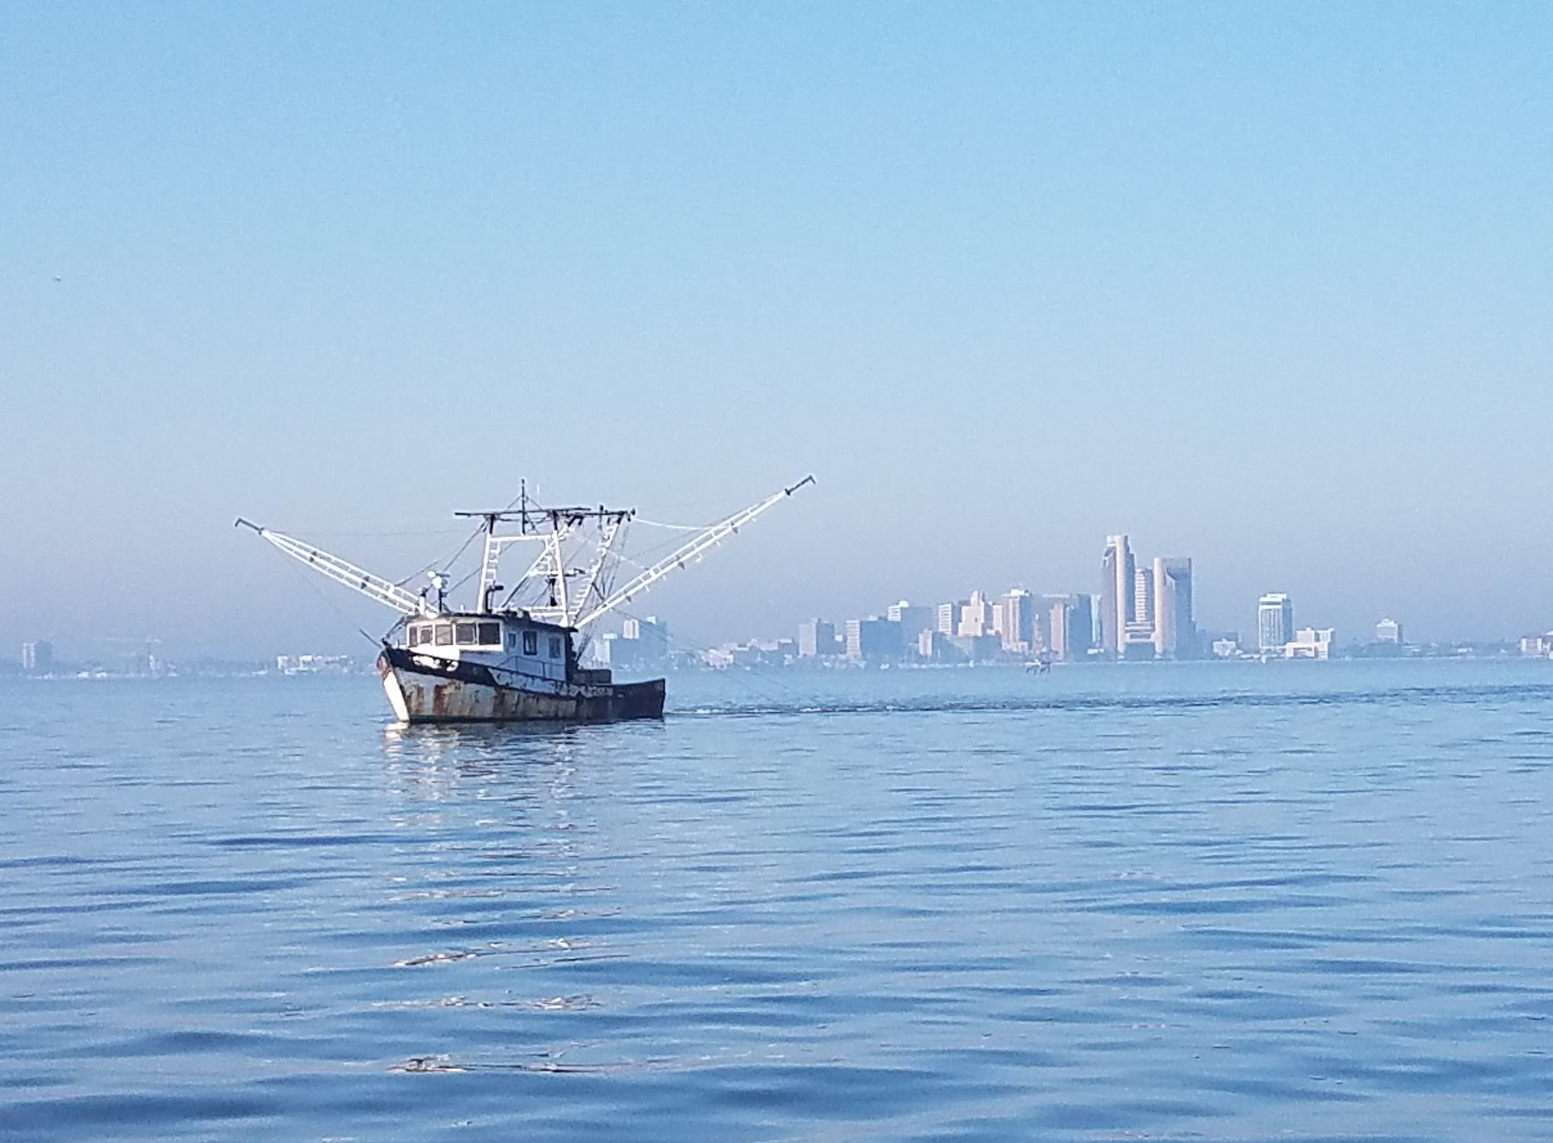
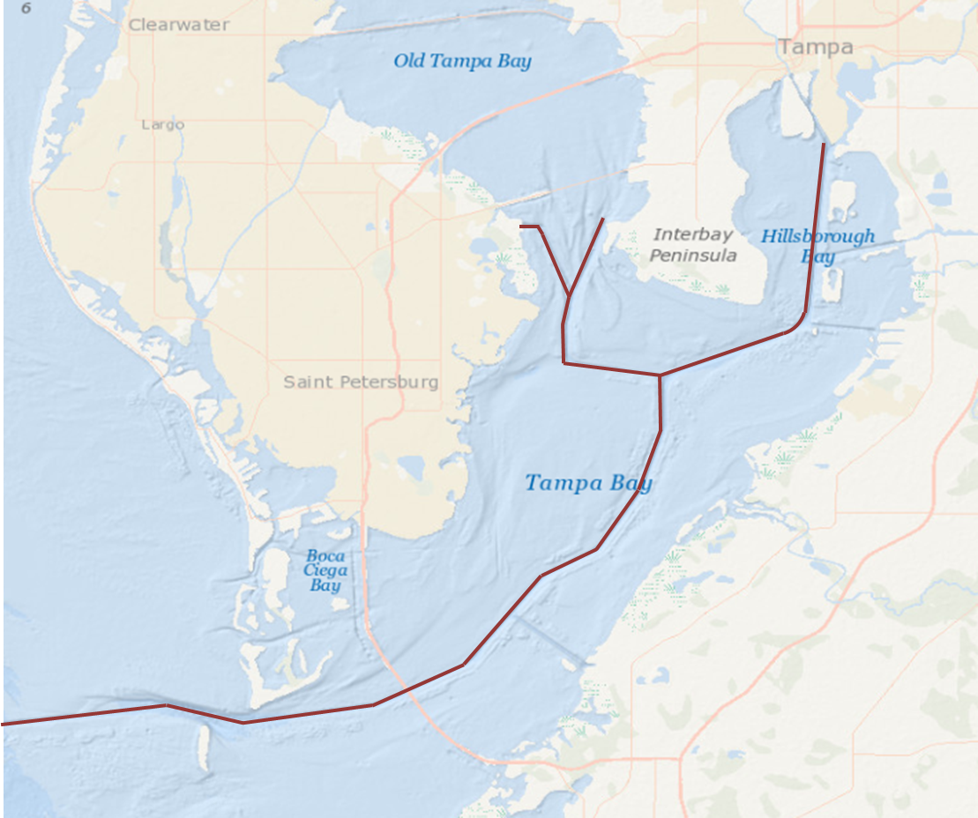
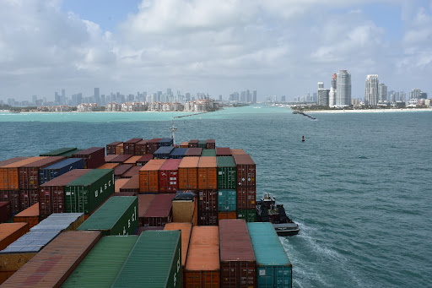
NOS OFS Requirements Guidelines
Core Ocean Model: Open sourced community based system
FVCOM (Finite Volume Community Ocean Model), ROMS (Regional Ocean Modeling System), SCHISM (Semi-implicit Cross-scale Hydroscience Integrated System Model) are currently used as core hydrodynamic models
Must be compatible with latest official release of model software code
Capabilities:
Nested subgrids and wetting/drying process
Incorporating data assimilation approaches
Minimum output variables: water levels, currents, water temperature and salinity
Coverage/Resolution:
Grid should extend upstream to head of tide and navigation channel
Highly resolve navigational channels (100 meters or less to meet pilots’ needs)
Skill: Meet NOS standards of model performance and stability
Operations: Meet NWS/NCO standards for operational implementation on WCOSS

Slide 5
Coastal Ocean Modeling Framework (COMF-HPC)
COMF is a set of standards and common tools to develop, operate, and assess NOS OFS. It is standardized and shared for any model and any domain
Single common framework for all OFS
Facilitate ease of operations and interoperability
Minimize redundant efforts and ensure a high time-and-cost efficiency for OFS development, transition, and O&M
Standard tools for data handling & maintenance
Standard tools for graphics and web products
Standard skill assessment and evaluation tools
Various core models allowed in COMF:
ADCIRC, ECOM, EFDC, FVCOM, POM, ROMS, SCHISM

Slide 6
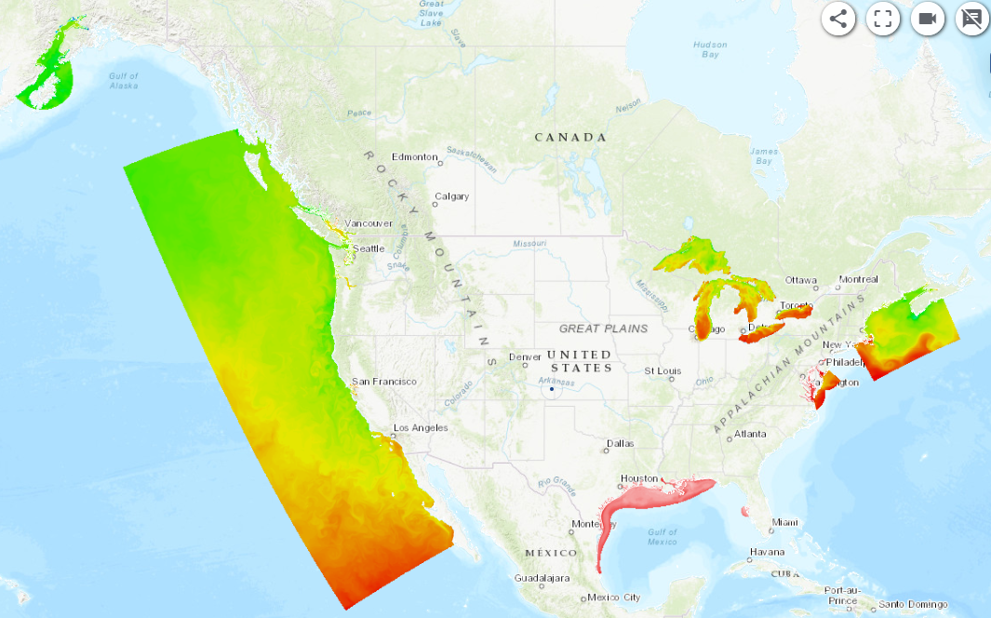
Current Coverage of Operational Forecast Systems
Cook Inlet OFS
Salish Sea and Columbia River OFS
Lake Superior OFS
West Coast OFS
Lake Ontario OFS
Lake Michian and Huron OFS
Gulf of Maine OFS
Lake Erie OFS
San Francisco OFS
Chesapeake and Delaware Bay OFS
Tampa Bay OFS
Northern Gulf of Mexico OFS

Slide 7
Links to Access OFS Products
OFS dataset is disseminated on multiple platforms
CO-OPS THREDDS (full dataset of the most recent 31 days)
https://opendap.co-ops.nos.noaa.gov/thredds/catalog.html
NCEP Web Services (full dataset of the most recent 24 hours)
https://nomads.ncep.noaa.gov/pub/data/nccf/com/nosofs/prod/
ftp://ftp.ncep.noaa.gov/pub/data/nccf/com/nosofs/prod/
NOAA Open Data Dissemination (NODD) Cloud S3 Bucket
https://noaa-nos-ofs-pds.s3.amazonaws.com/index.html
NCEI Web service and THREDDS (3 day delayed and no 3D forecast files – long term at least 5 years)
https://www.ncei.noaa.gov/thredds/model/model.html
https://www.ncei.noaa.gov/data/operational-nowcast-and-forecast-hydrodynamic-model-systems-co-ops/access/
Visualization
T&C - https://tidesandcurrents.noaa.gov/models.html
IOOS EDS - https://eds.ioos.us
OceansMap – oceansmap.nos.noaa.gov/ (under development)

Slide 8
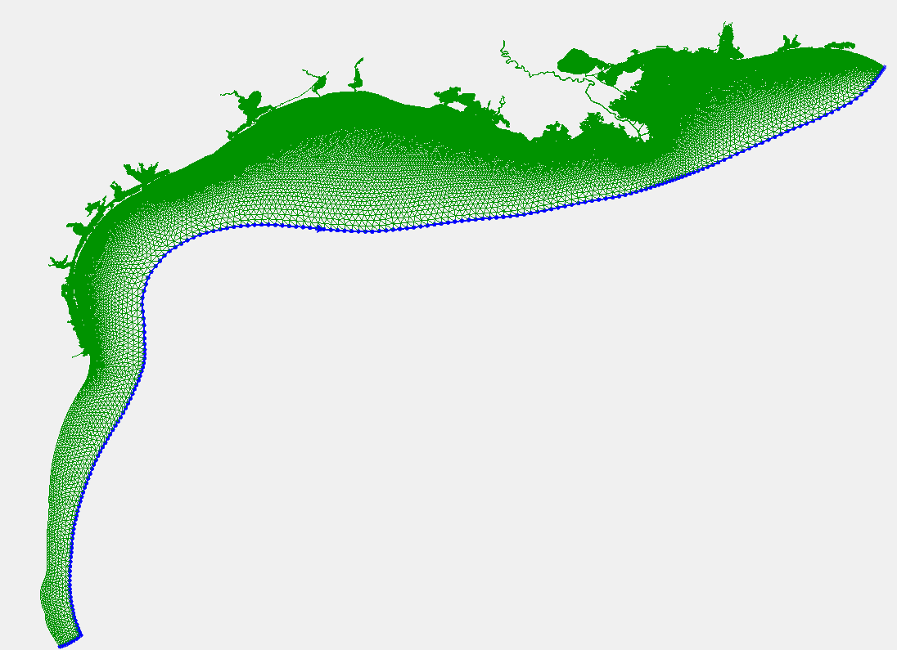
OFS Example - Gulf of Mexico Operational Forecast System
Matagorda Bay PORTS
70 m – 550 m
Mobile Bay PORTS
45 m – 1.5 km
FVCOM-based with a high resolution unstructured grid to cover 10 PORTS and extends into:
(1) Lower Miss. River
(2) Lake Pontchartrain
(3) Barataria Bay
(4) Lower Atchafalaya River
(5) TX coastal inlets
(6) Mexican coastal waters
Texas Coastal Embayments
Baton Rouge
Lake Charles PORTS
70 -560 m
Lake Pontchartrain
Sabine Neches PORTS
60 – 540 m
Lower Miss. River
Houston/Galveston PORTS
80-530 m
Barataria Bay

Slide 9
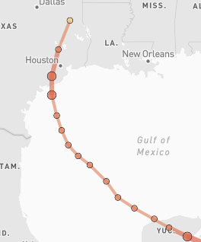
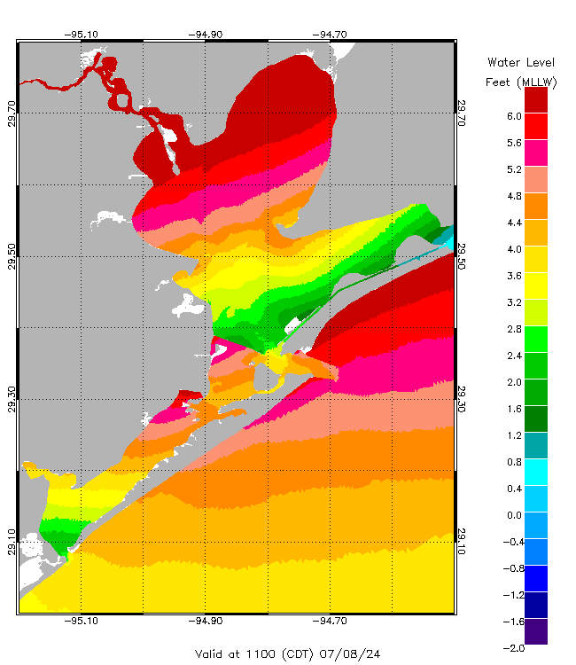
NGOFS2 Water Level Forecasts During Hurricane Beryl
RED - Observations; BLACK - Nowcasts; GREEN - Forecasts
Hurricane Beryl track

Slide 10
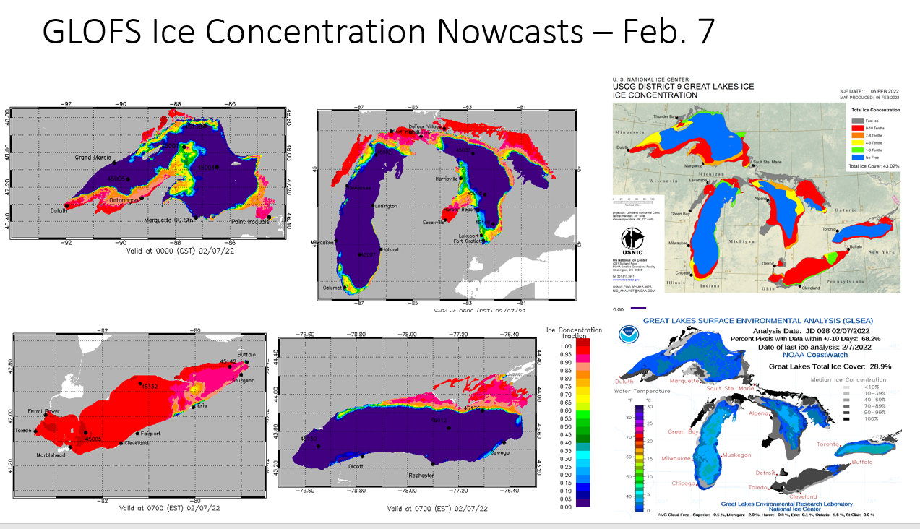
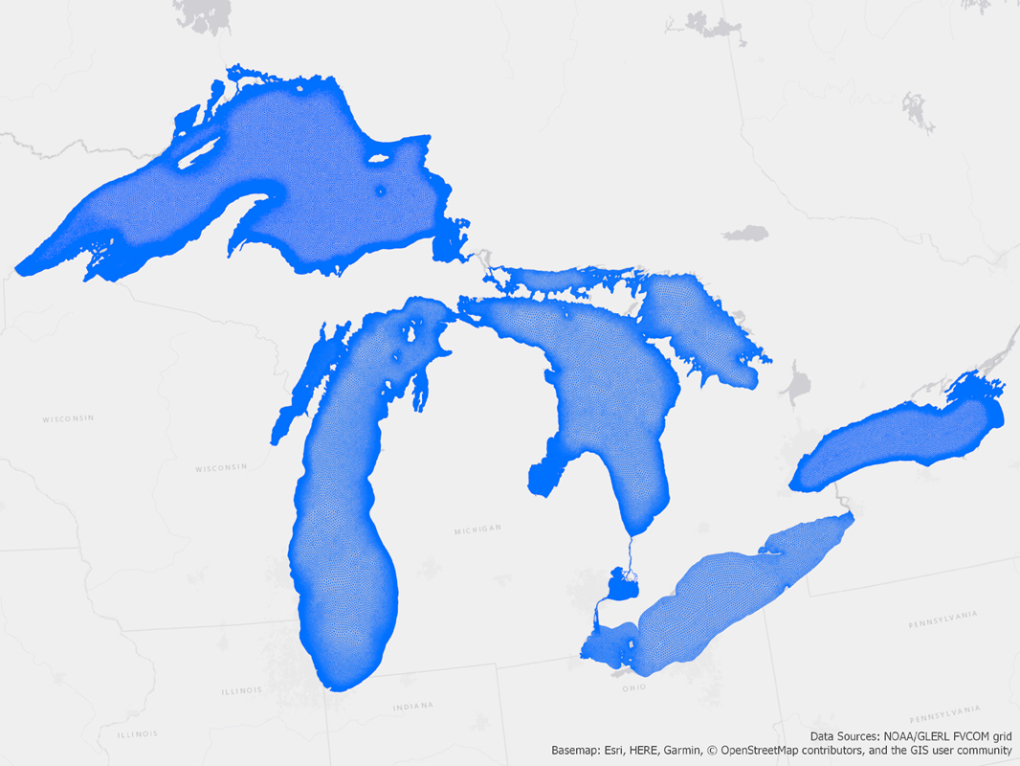
OFS example - Great Lakes OFS
Core Ocean Model: FVCOM
200 m high resolution coastlines
Grid resolution: unstructured grid from 30 m nearshore to 5 km offshore
120-hour forecasts, updating 4 times/day
Coupled with the Los Alamos Sea Ice Model (CICE)
Forecasting: water levels; currents; temperature; and ice concentration, thickness, and velocity
LSOFS
2022
LOOFS
2022
LMHOFS
2019
LEOFS
2017
GLOFS Ice concentration nowcasts on 2/7/2022
Satellite observed Ice concentration

Slide 11
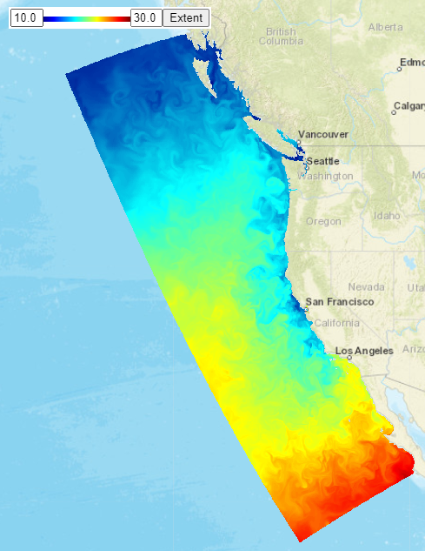
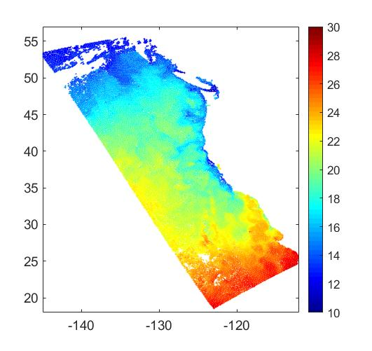
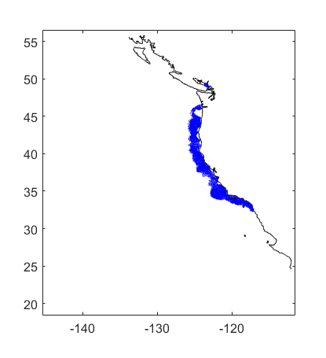
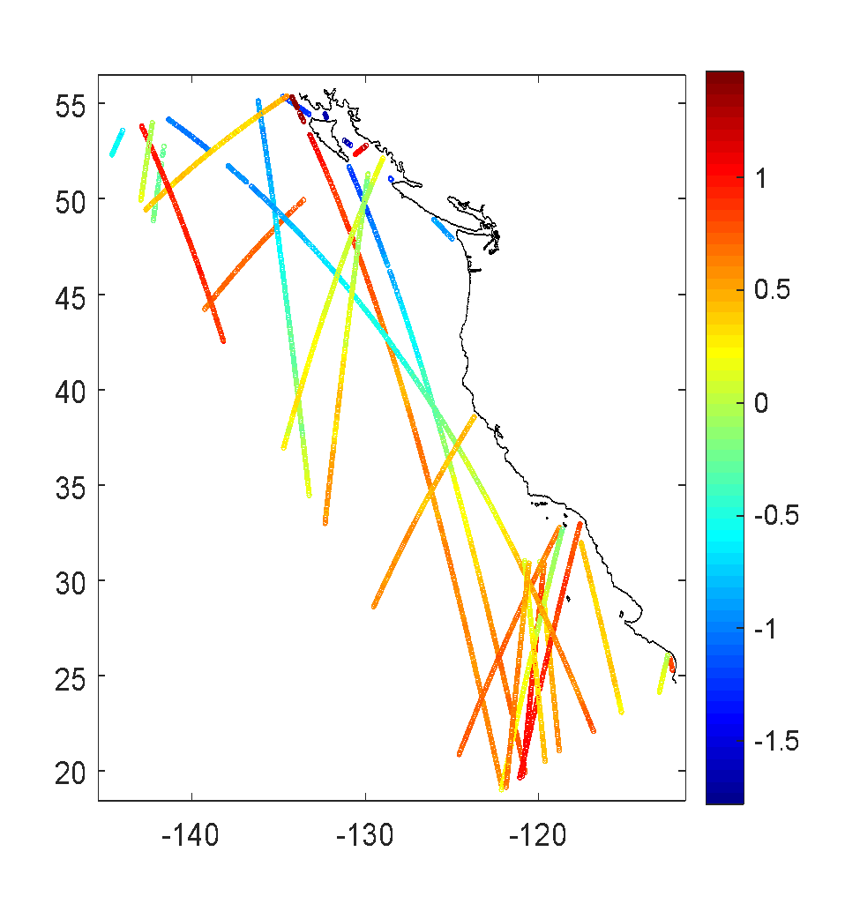
West Coast Operational Forecast System (WCOFS)
ROMS 4DVAR Data Assimilation System
~4 km horizontal resolution; 40 vertical layers
Observations:
Satellite Sea Surface Temperature (SST)
Satellite Sea Surface Height (SSH)
High Frequency (HF) Radar surface currents
SST
3-Satellites
WCOFS domain
SST 10/1/2020,
Day-1 forecast
SSH
5-Satellites
HF Radar
surface current

Slide 12
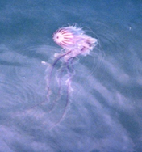
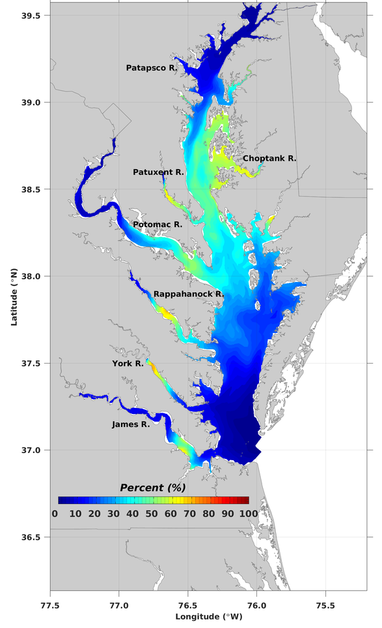
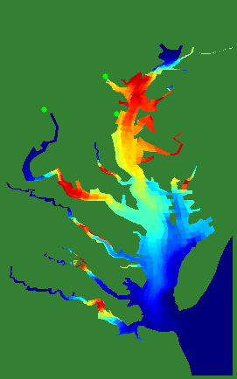
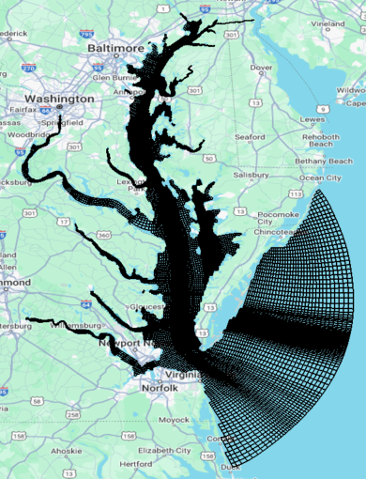
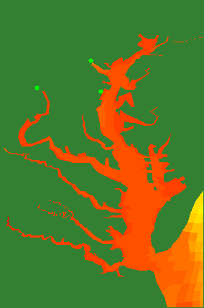
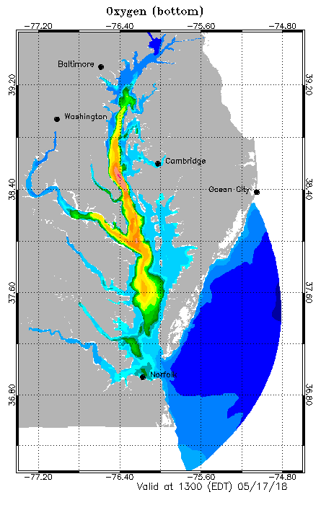
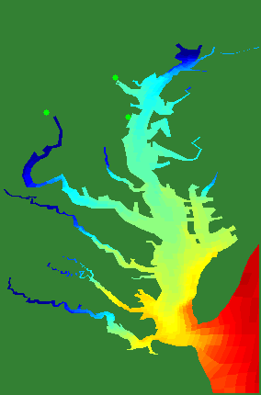
Ecosystem Applications based on CBOFS
Dissolved Oxygen
Sea Nettle Probabilities
Likelihood of Chrysaora
ROMS-based with curvilinear grid of resolution from 30 m – 5 km.
Forecasting products of Sea nettle, Harmful Algal Blooms (HAB), Hypoxia, Pathogens by combining CBOFS forecasts of currents, water temperature, and salinity with ecological models
Temperature
Salinity
Vibro

Slide 13
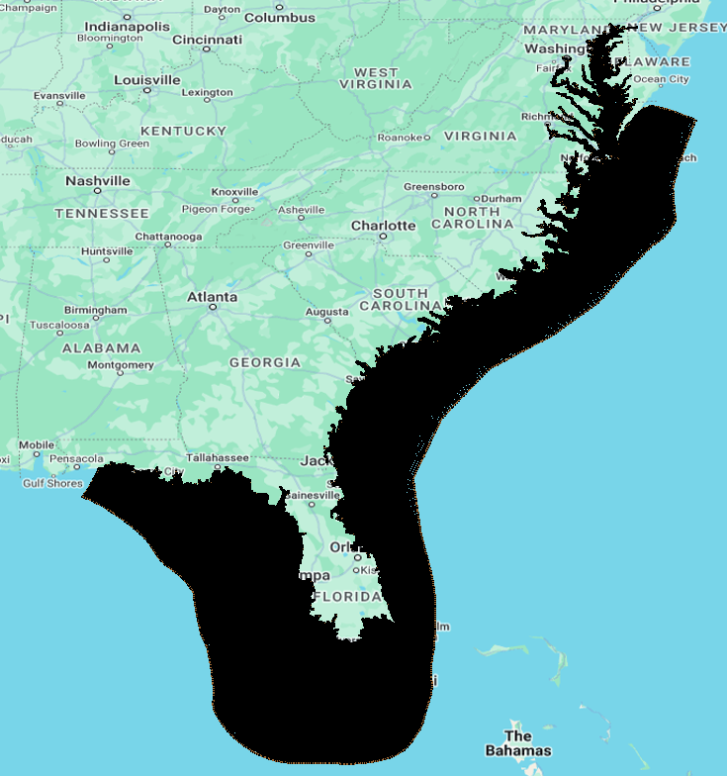
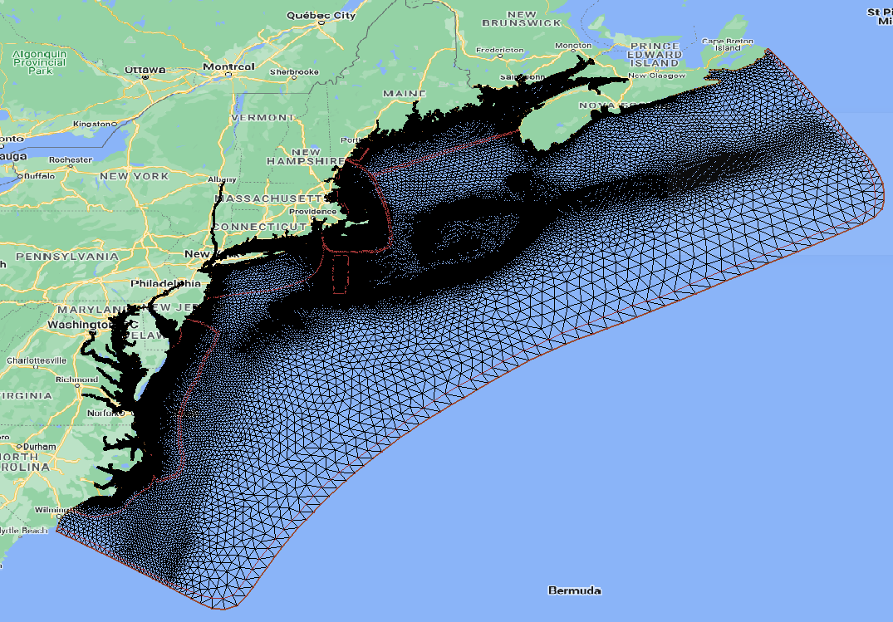
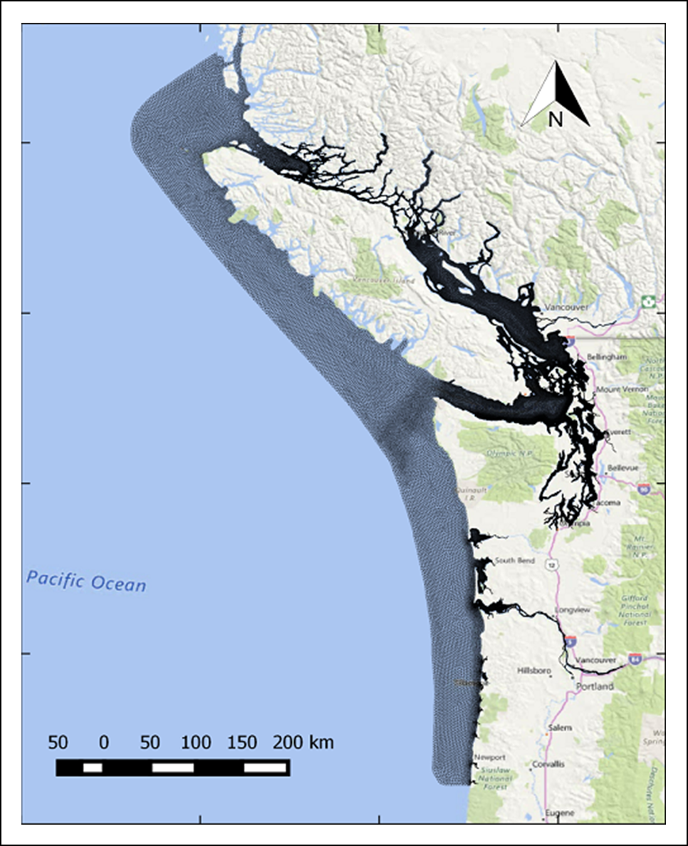
Future Plans
Q4 FY26 – FVCOM-based Northeast Coast OFS with data assimilation (NECOFS)
Q4 FY24 – FVCOM-based Salish Sea and Columbia River OFS (SSCOFS)
Q4 FY27 – SCHISM-based Southeast Coast OFS (SECOFS)
Q4 FY28 – ROMS 4DVAR based East Coast OFS (ECOFS)

Slide 14
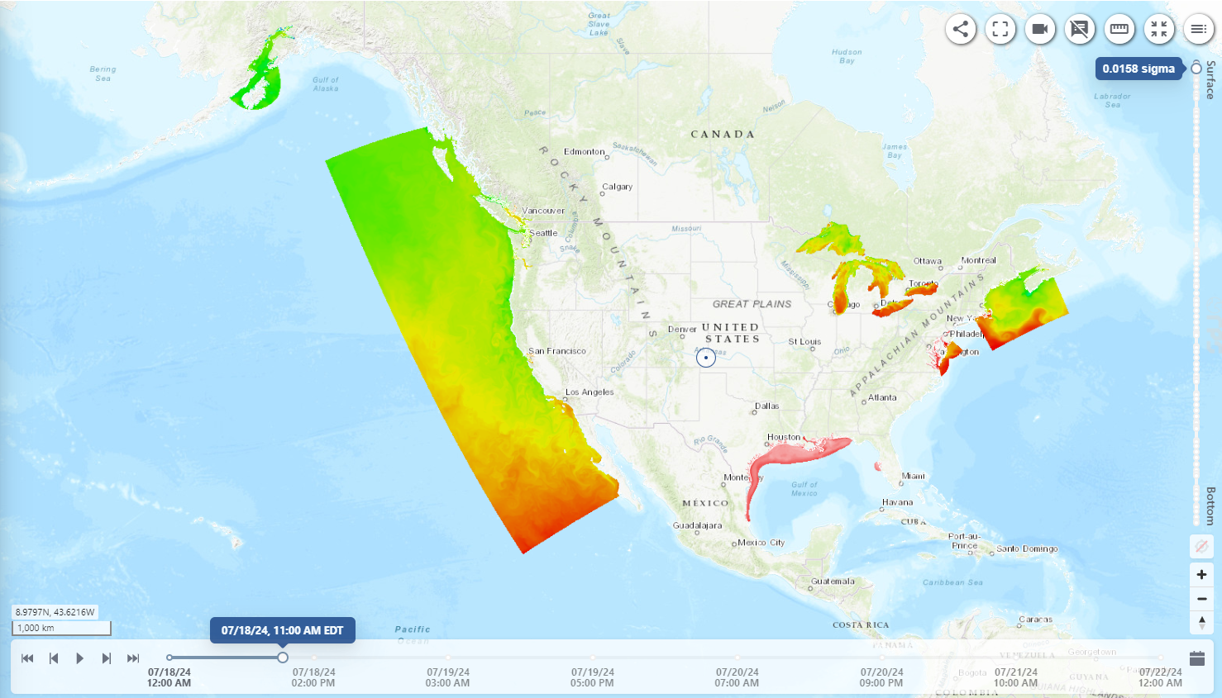
Modernized OFS Web Products:OceansMap
Oceansmap.nos.noaa.gov
OceansMap is a new tool providing visualizations of OFS output and observation data
Nationwide visualizations of Surface water temperature forecast
Turn on/off multiple variables
Zoom in/out
Virtual Station
Display forecasts at different vertical depths

Slide 15
Scientific and Technological Challenges
Lack of real-time observations for data assimilation and model skill assessment
Better connection with observing systems: IOOS/RA, research community and academics, etc.
Adequately resolving physical phenomena for both shelf deeper waters and shallow estuaries within same model domain (e.g. mixing, eddies, stratification)
Accuracy of forcing conditions of freshwater, winds, precipitation, heat flux, and offshore ocean boundaries
Standard applicable methodology of skill assessment for global and regional/basin operational forecast systems (NOS has been working on development of shared cyberinfrastructure of skill assessment.
Emerging requirements from ecological, fishery, and ice forecasting, climate changes

Slide 16
Thank you for your attention.
Questions?

