Slide 1
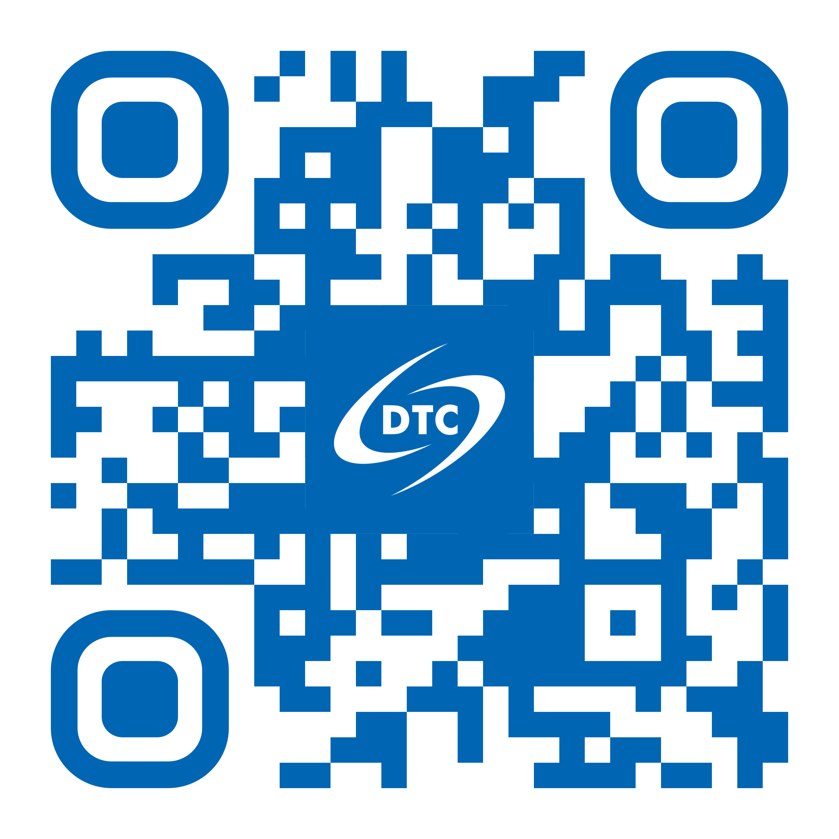
Developmental Testbed Center: Informing Earth System Model Development through Model Testing and Evaluation Solutions
Louisa Bogar Nance
DTC DIRECTOR
July 25, 2024

Slide 2

Who we are…
The DTC is a partnership between NOAA (NWS and OAR), US Air Force and NSF NCAR
Vision:
Empower the Earth system science community with model testing and evaluation solutions
Mission:
Bridge research and operations to accelerate understanding of and prediction of the Earth system by advancing collaborative model assessments and developing indispensable software tools.
OAR
NWS
NCAR
AF

Slide 3
Who we are…
MULTI-INSTITUTIONAL TEAM
NSF NCAR Leads
Kathryn Newman, Deputy Director, RAL (HAFS T&E, Stochastics/Deterministic Physics T&E)
Lulin Xue, RAL (CCPP)
Tara Jensen, RAL (METplus)
Michelle Harrold, RAL (RRFS T&E, AF V&V)
Weiwei Li, RAL (UFS Physics T&E, MMM physics T&E)
Will Mayfield, RAL (MPAS stochastic physics)
NOAA Leads
Jeff Beck, Deputy Director, GSL (RRFS T&E, MPAS stochastic physics)
Ligia Bernardet, GSL (CCPP)
Molly Smith, CU-CIRES and GSL (METplus)
Man Zhang, CU-CIRES and GSL (UFS Physics T&E)
NCAR
NOAA
DTC

Slide 4
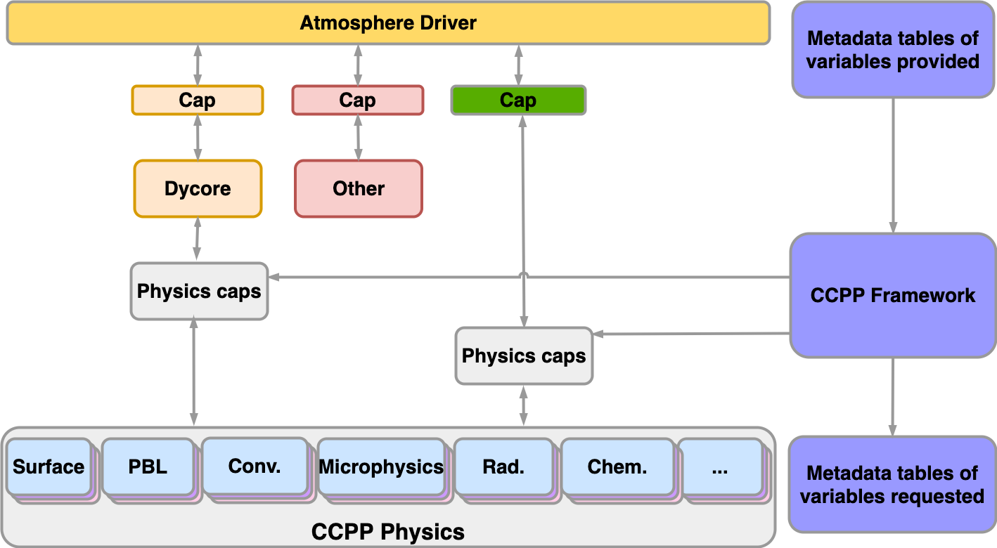
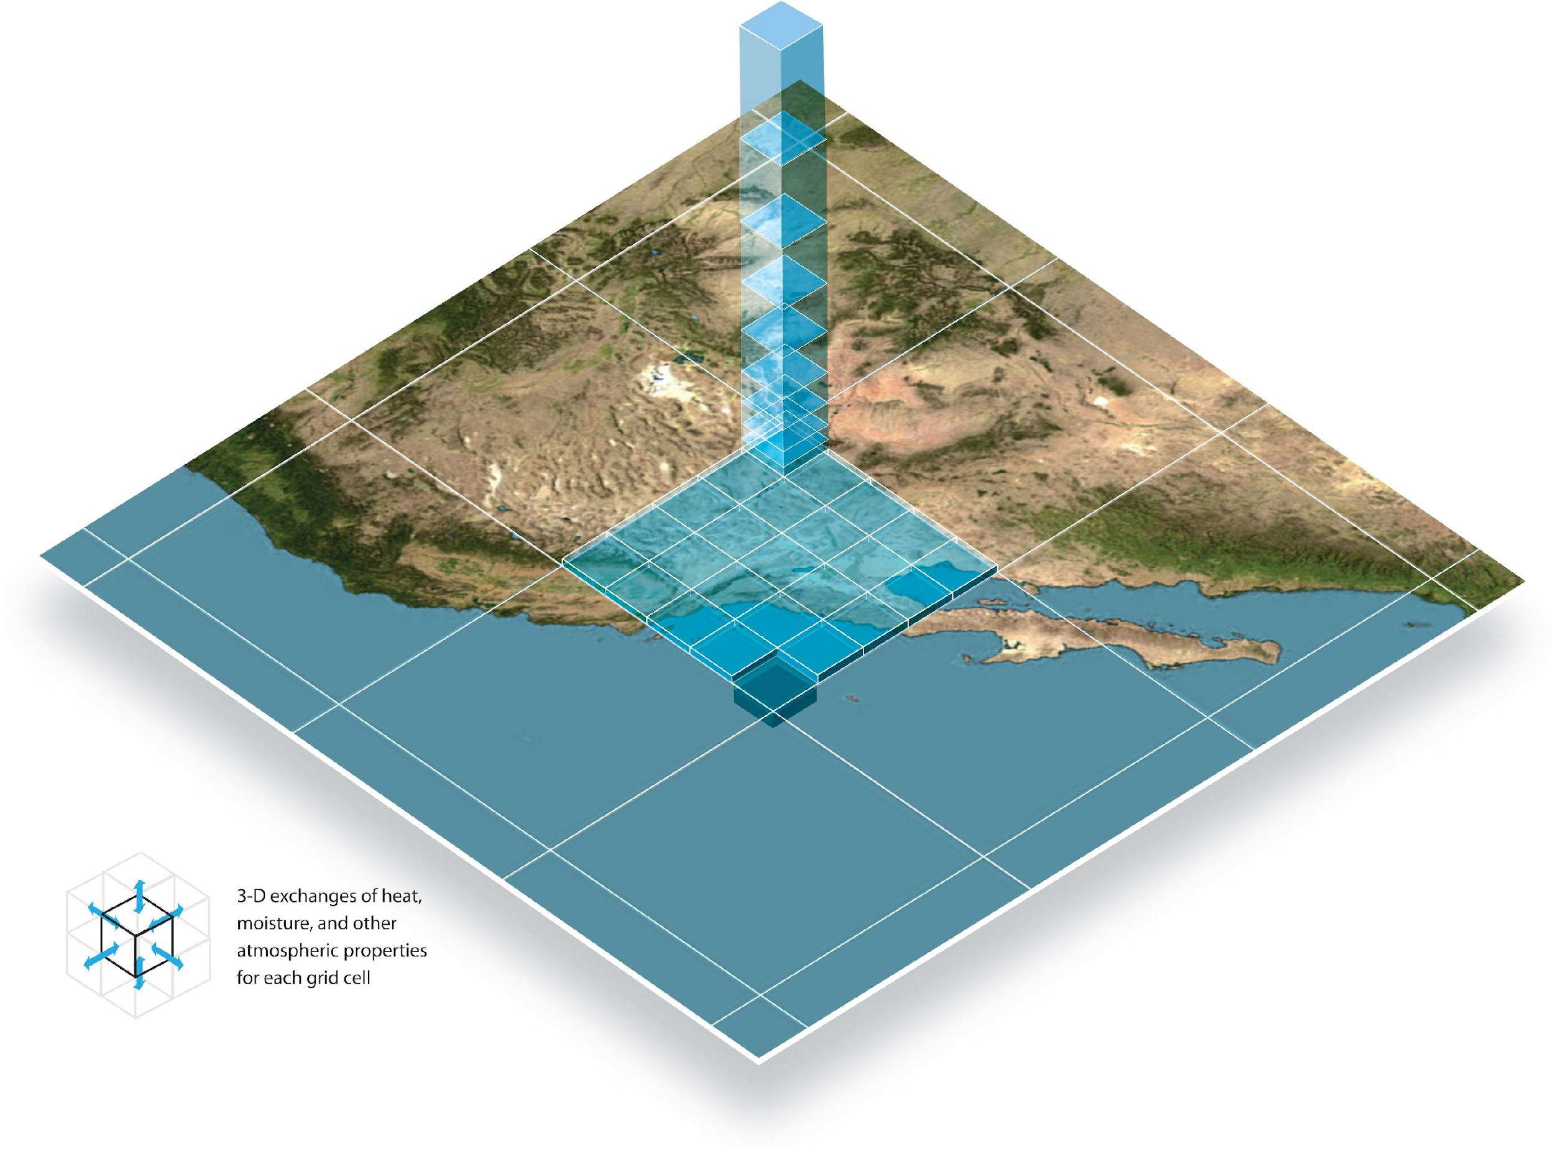
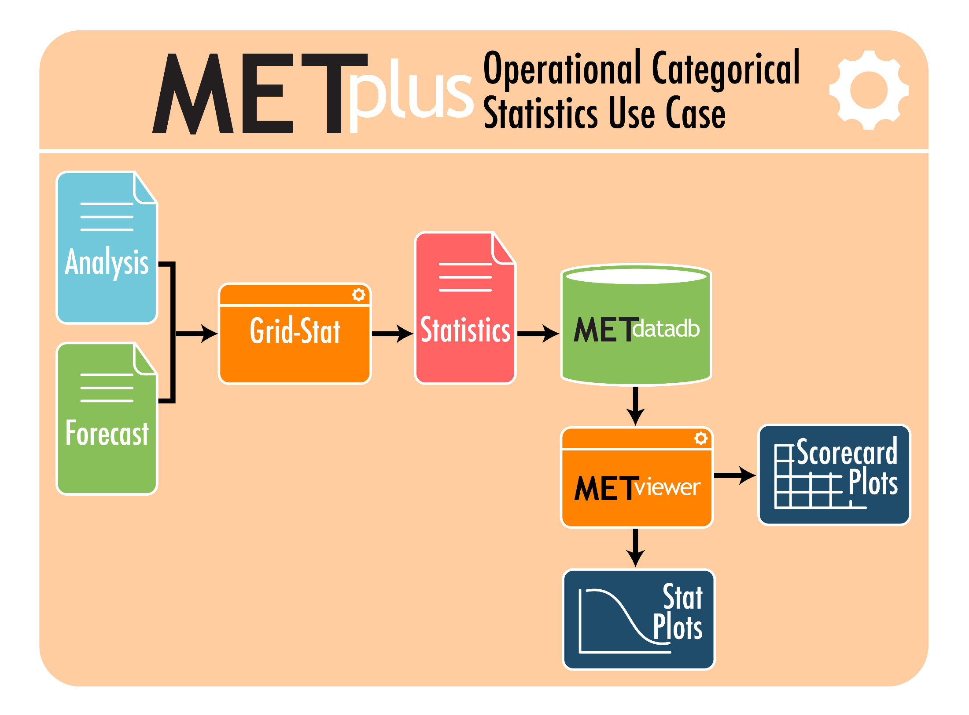
What we do…
Conduct testing and evaluation directed at informing Earth system model design (i.e., initialization, component model configurations, ensemble techniques, post-processing, etc…) across multiple scales (temporal and spatial)
Develop and support community tools to provide a framework for broad community engagement in the process of advancing Earth system understanding and prediction
Common Community Physics Package
(CCPP)
CCPP Single Column Model
(CCPP SCM)
Enhanced Model Evaluation Tools (METplus)
Multi-agency collaboration: NOAA, NCAR, and NRL
Multi-agency collaboration: NOAA, NCAR, AF, NRL, UKMO
Building blocks for Hierarchical System Development (HSD)

Slide 5
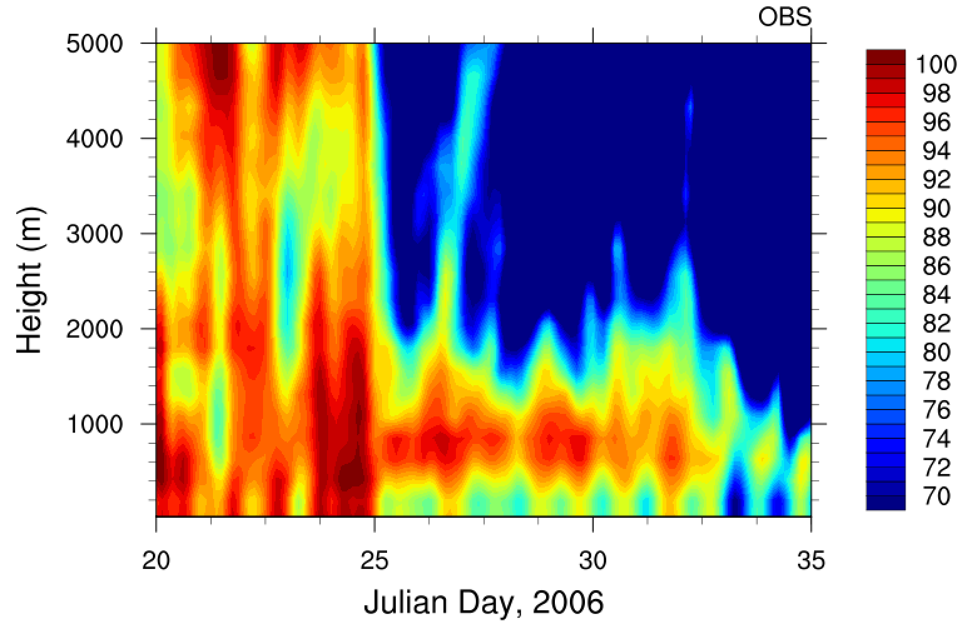
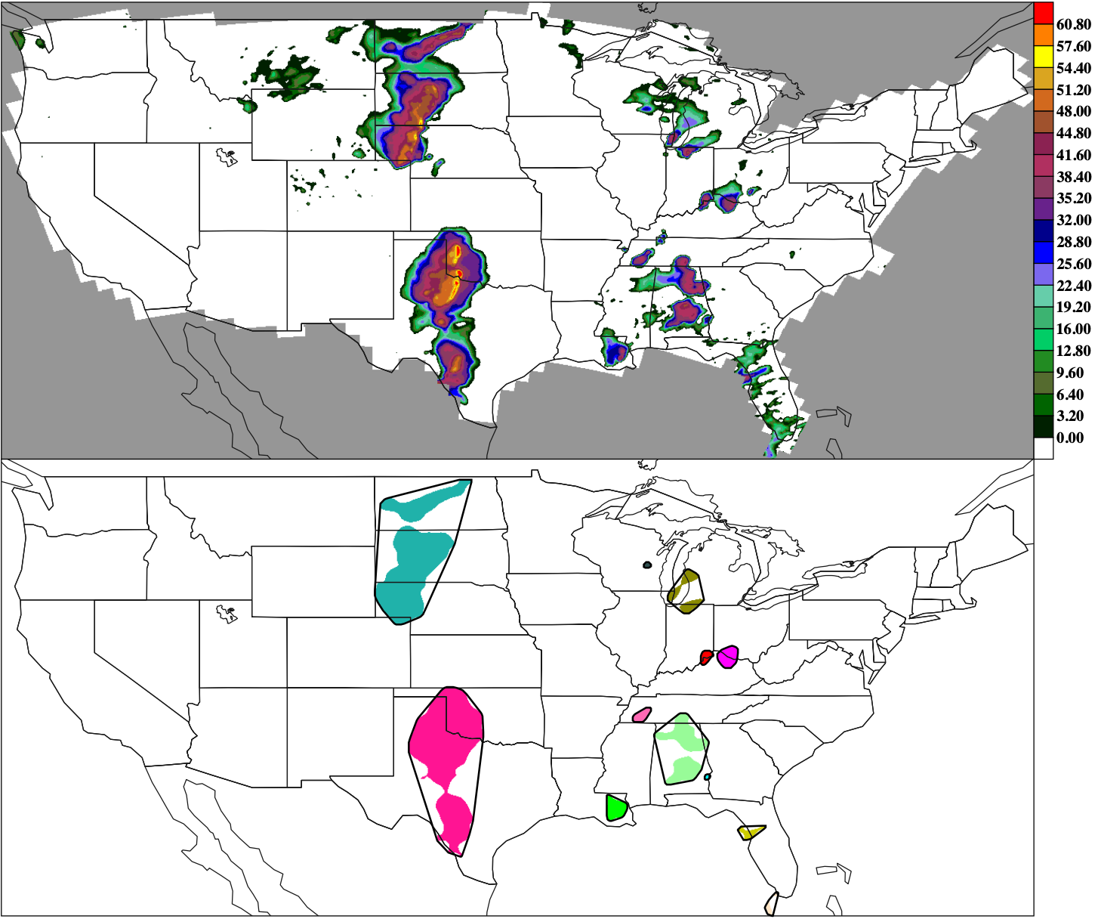
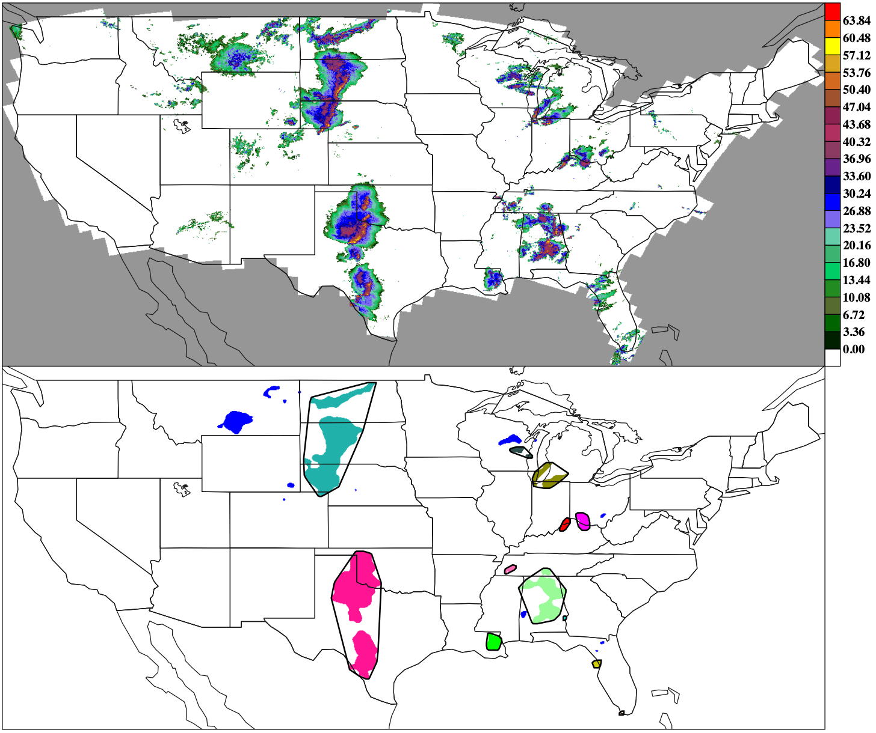
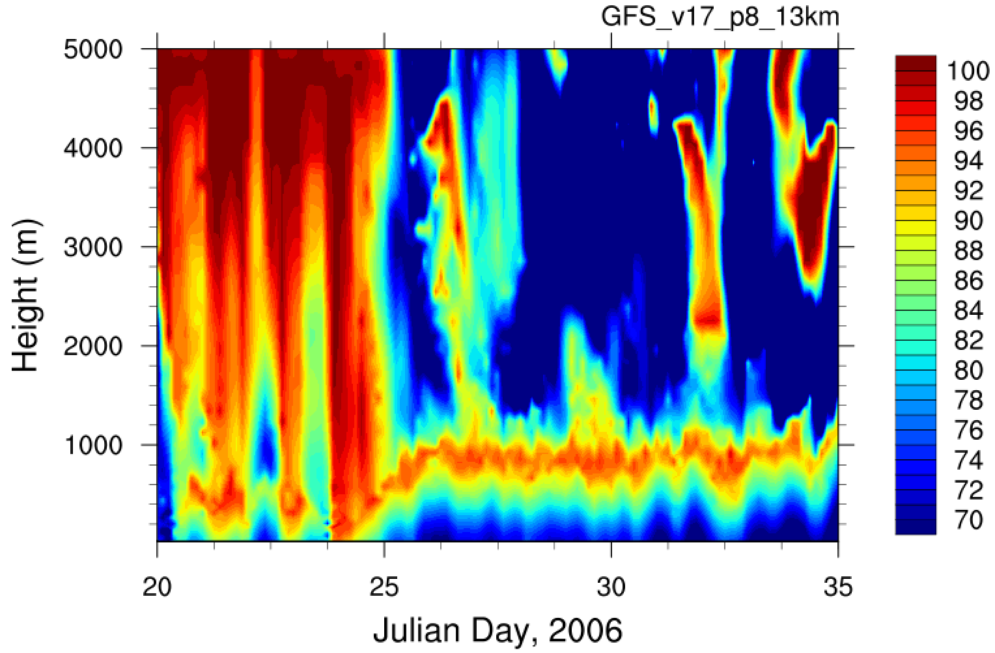
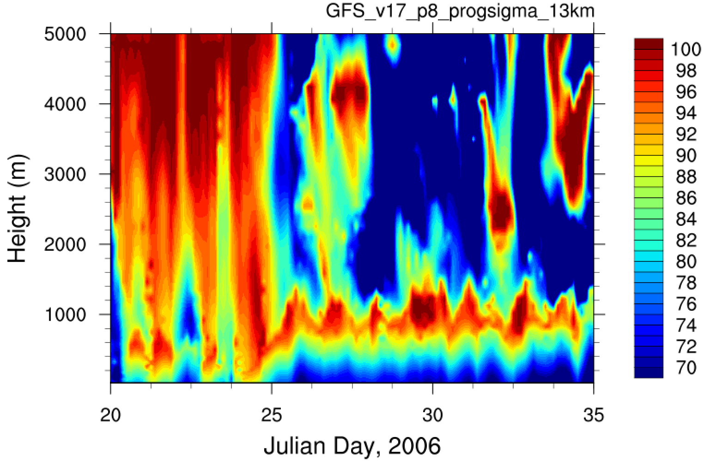
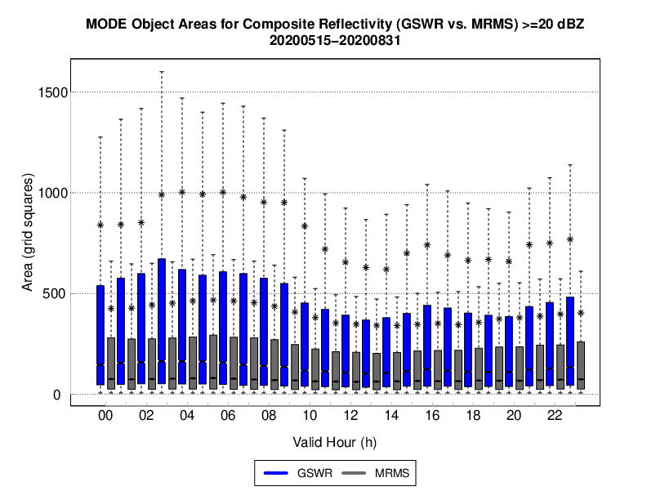
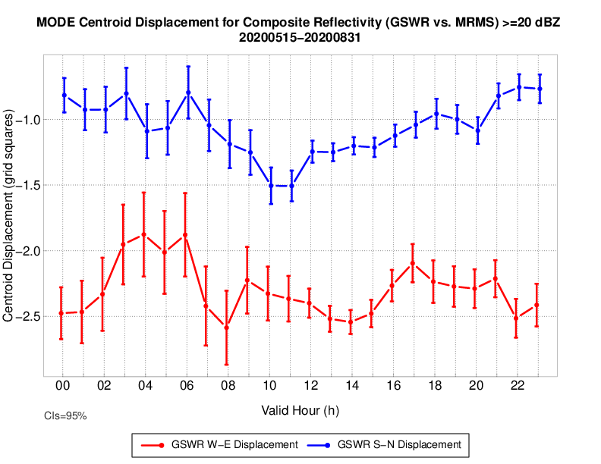
How we do it…
In-depth diagnostic studies
Ex: SCM studies of physics innovations
Exploratory verification metrics
New observations, user-focused metrics and advanced verification approaches
Obs
MODE: Object-based Verification
Comp. Refl. Product Objects
MRMS Comp. Refl. Objects
TWP-ICE case:
Relative humidity in marine stratocumulus regime shows more pronounced diurnal amplitude using prognostic closure scheme with P8 suite (Bengtsson et al. 2022)
P8
P8+Prog closure
Object
areas
Centroid
displacement

Slide 6
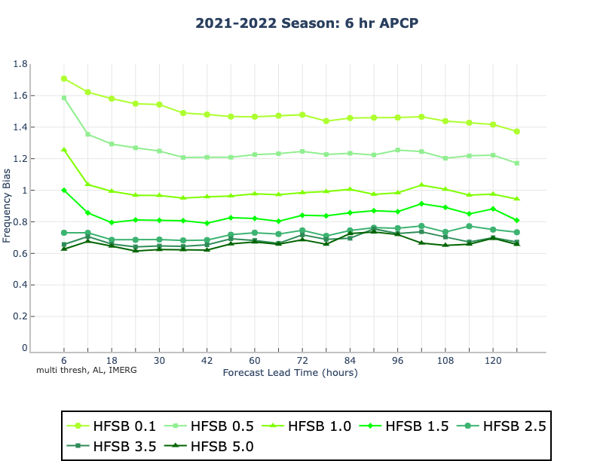
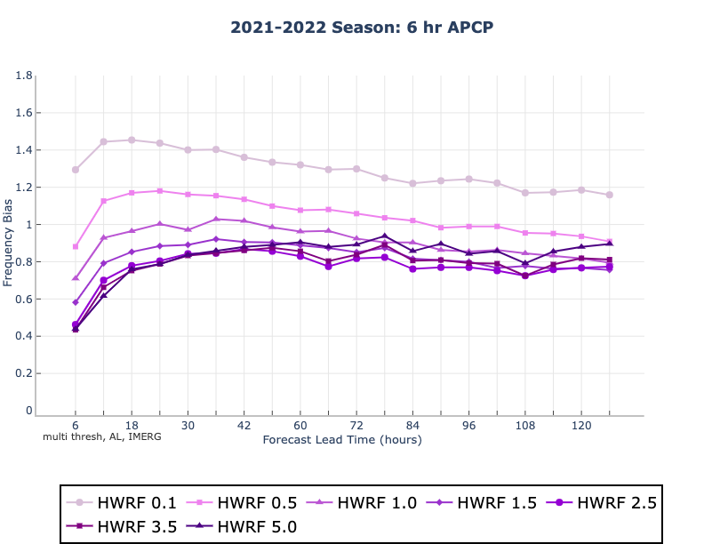
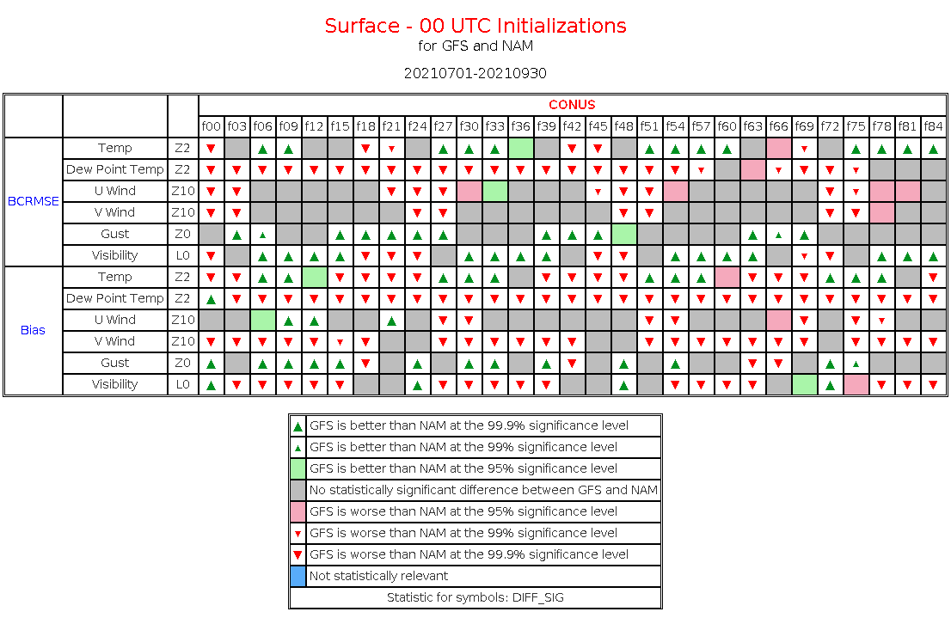
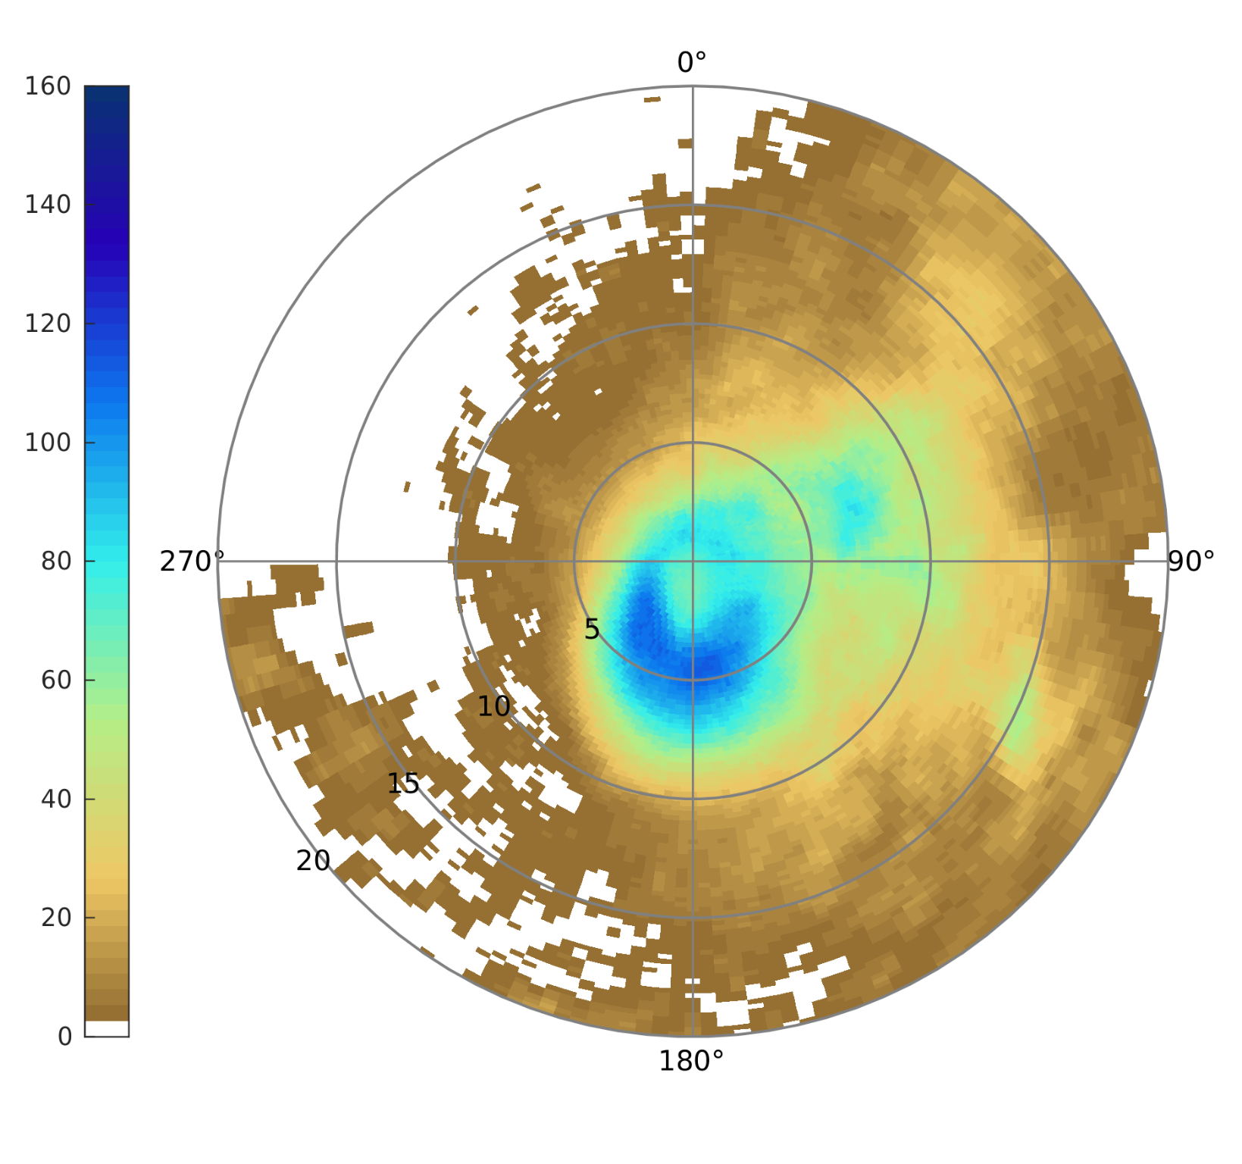
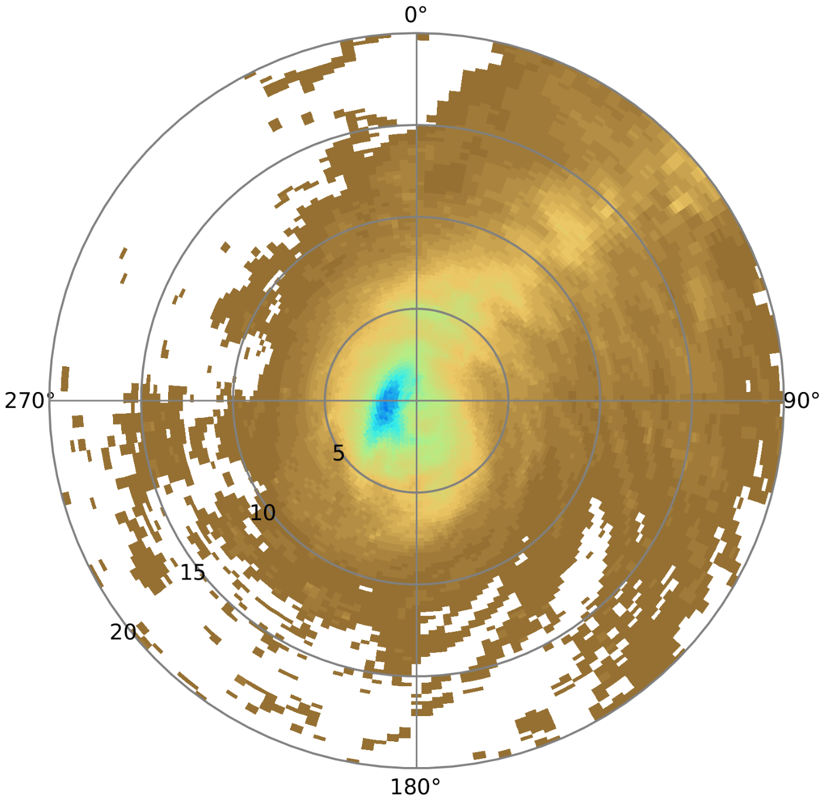
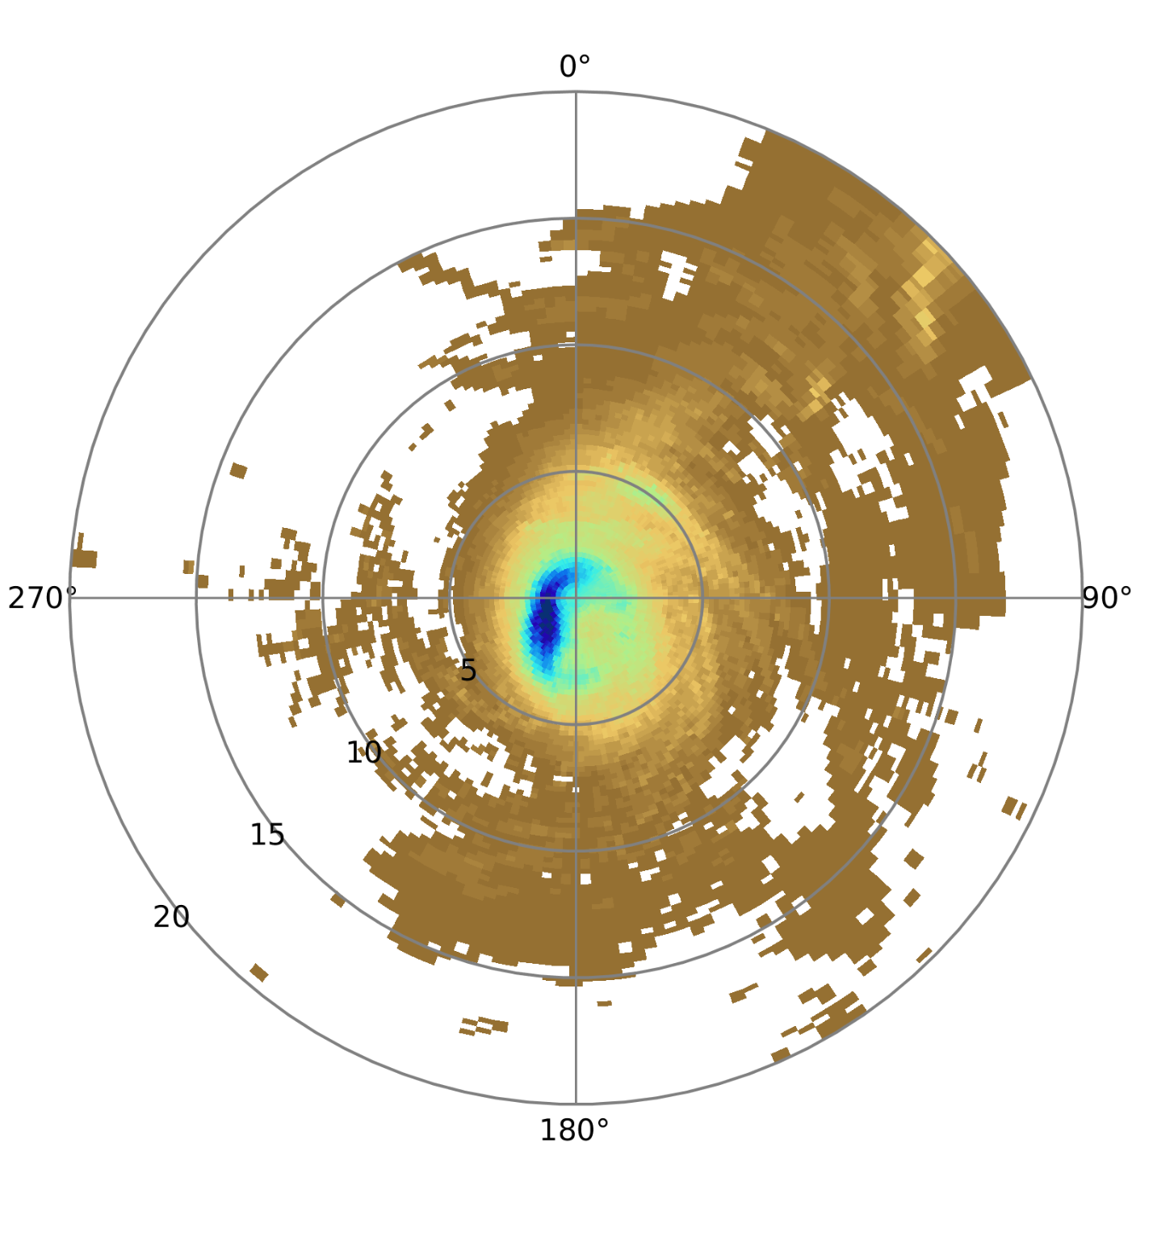
How we do it…
Agile testing frameworks
Workflow (init-to-vx or just vx) that facilitates rapid, straightforward comparisons of prototypes and operational benchmarks
Proto-type documentation, plus quick-look results (scorecards) and in-depth verification results
Tests with robust sample sizes
Ex: Retrospective sample for 2021 and 2022 Hurricane seasons
Frequency Bias:
6-h accum
Shifted tracks verified against IMERG
IMERG
HFSB
HWRF
Hurricane Ian: 12-hr forecast composites (storm relative) for 6-h accum
Notes:
right hand:
Top panels: Frequency bias based on sample for all storm from 2021 and 2022 hurricane seasons. Track shifted to account for track error.
Bottom panels: 6- accumulations of composites of 12-h forecasts - composite of storm relative features.

Slide 7

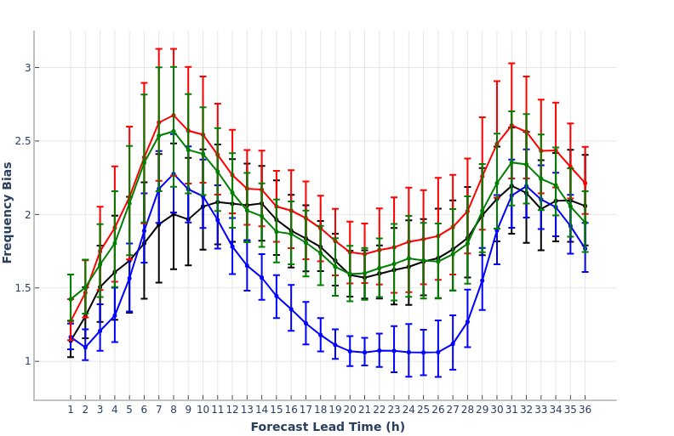
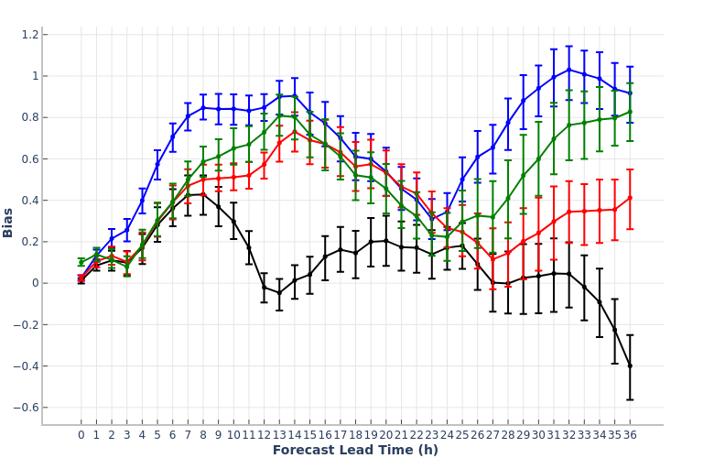
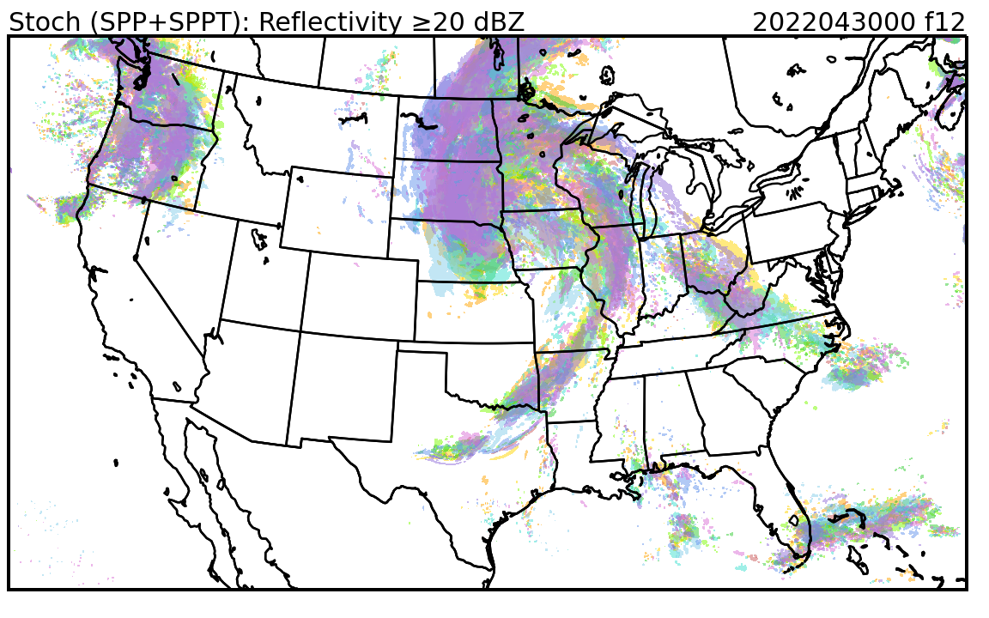
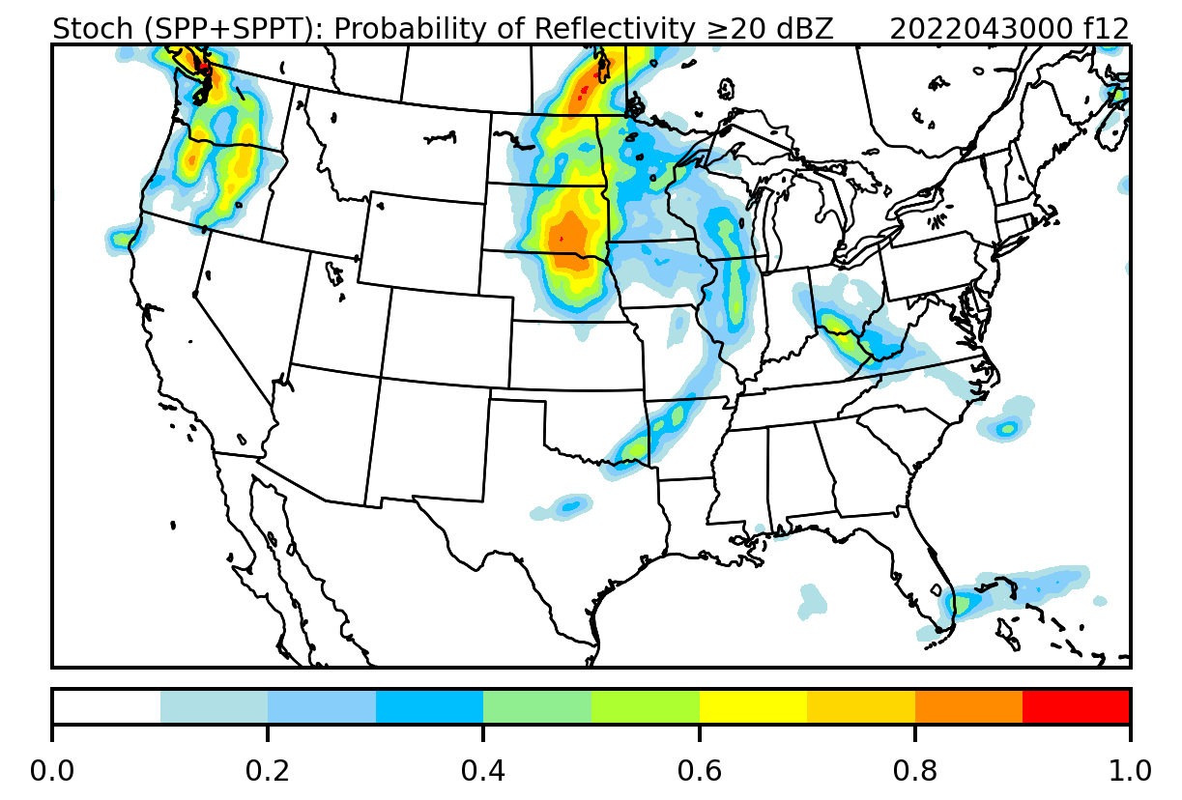
Supporting UFS application development
Rapid Refresh Forecast System (RRFS)
2024 HWT-SFE (29 April – 31 May 2024, 12 UTC)
Composite Reflectivity ($≥$30 dBZ): Frequency Bias
2-m Temperature (K) Bias
Rapid evaluation against operational benchmarks to provide developers with timely information on current performance and areas for potential improvement
Testing directed at informing ensemble design - time-lagging, initial condition perturbations, stochastic physics, and ensemble probabilities
Current Avenues of Engagement
Evaluating MPAS-based convective-allowing configurations from the 2024 Hazardous Weather Testbed – Spring Forecast Experiment (HWT-SFE)
Implementing, testing, and evaluating stochastic physics in MPAS
HRRR NSSL-MPAS-HN NSSL-MPAS-HT NSSL-MPAS-RT
Stochastic Physics Testing
Neighborhood ensemble probabilities (NEP)

Slide 8
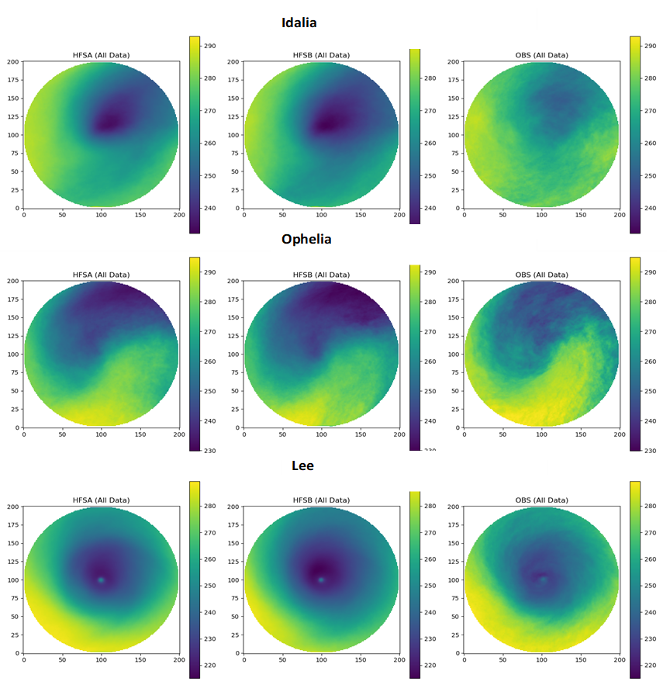
Supporting UFS application development
Hurricane Analysis and Forecast System (HAFS)
Advanced verification, process-based studies, and testing innovations from the broader research community.
        Michael Iacono & John Henderson (AER): cloud overlap methods
      Shaowu Bao (CCU): evaluating microphysics using GOES-R and SCM
      METplus-based framework for rapid performance evaluation.
HAFS-A
HAFS-B
Hurricane Lee: 12-h forecasts for 6-h precip accumulation (mm) compared to IMERG. Newman et al. 2024 (in review)
Intensity skill relative to HAFSv2A: Exponential random cloud overlap and spatially varying decorrelation length - 2023 North Atlantic Basin storms. Courtesy of Bin Liu, Lynker and NOAA/EMC
Average brightness temperature - Hurricane Lee forecasts for HFSA (left), HFSB (middle), and synthetic GOES-R (10.3 µm). Courtesy of Shaowu Bao, CCU

Slide 9
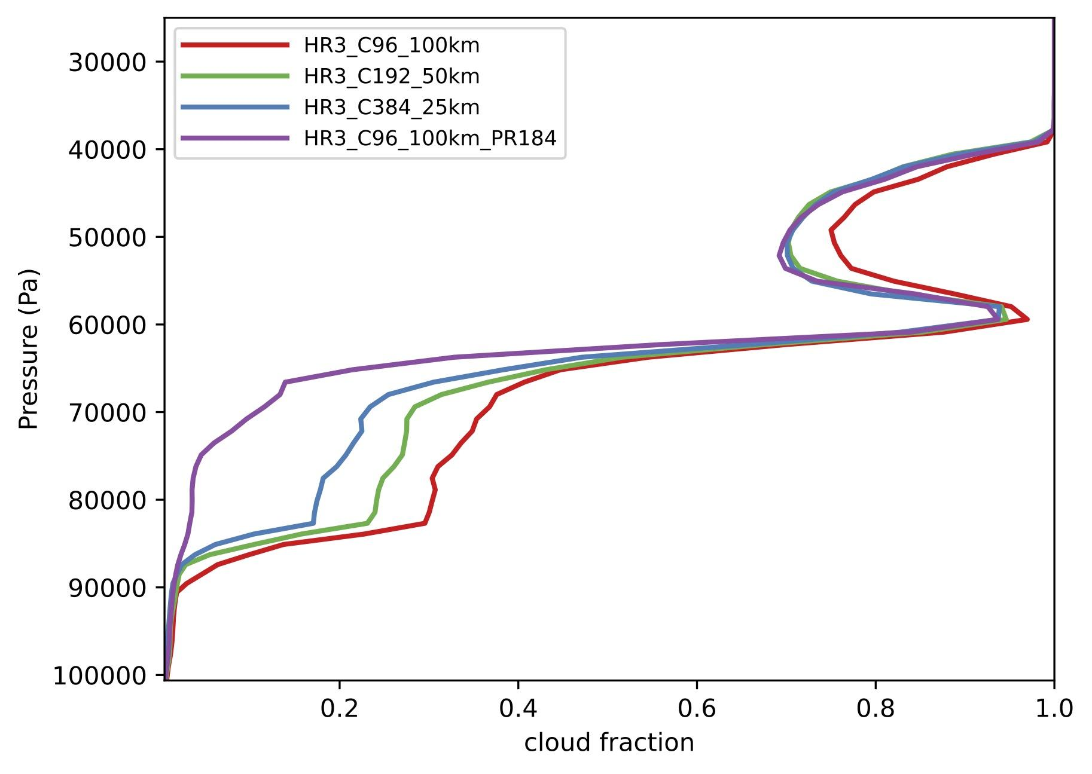
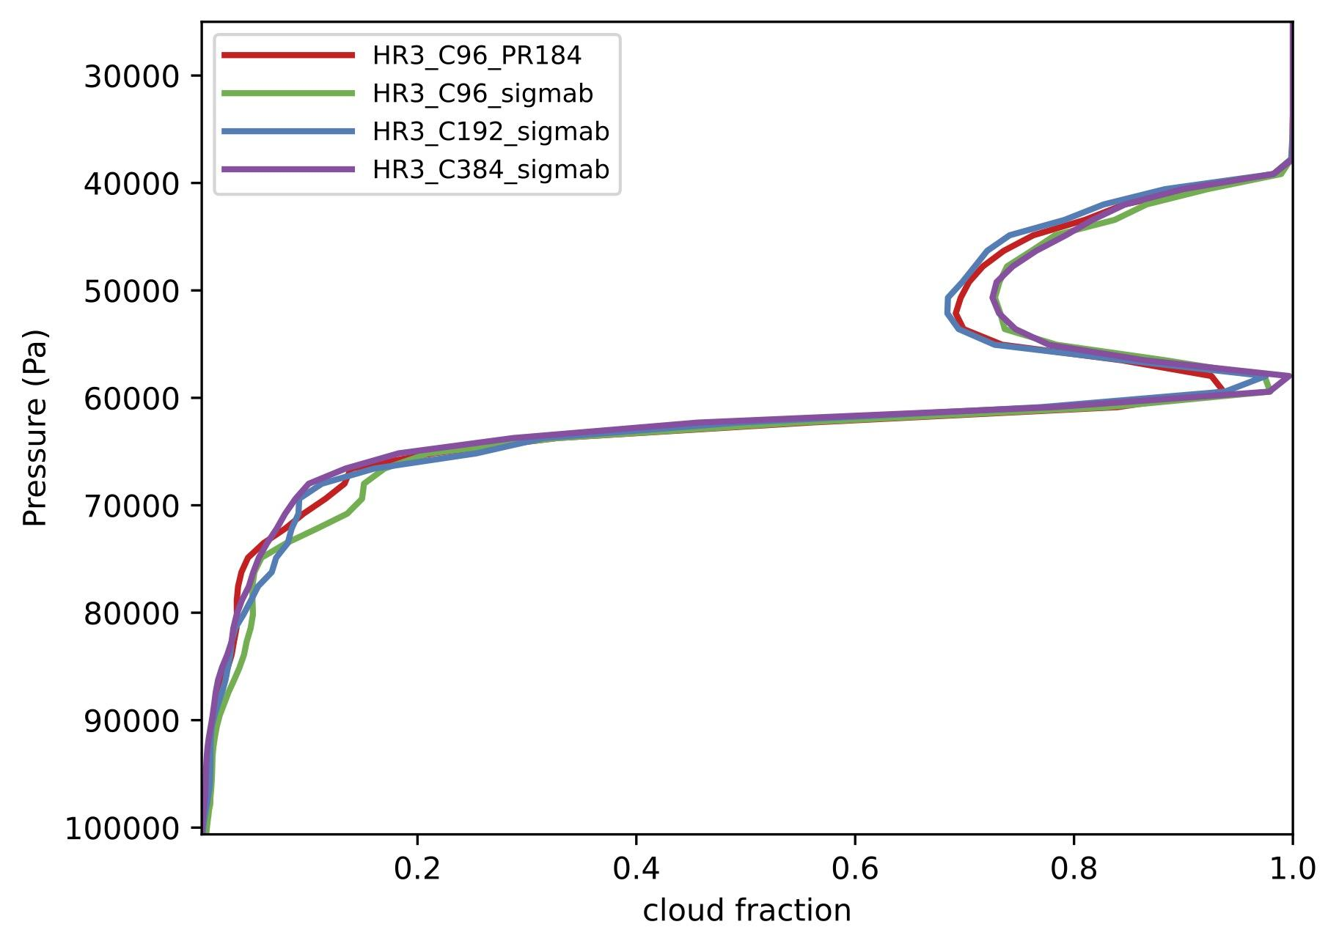
Supporting UFS application development
Physics suites across applications
Close collaboration with UFS physics developers
Applying aspects of hierarchical testing framework to
  Facilitate physics unification across UFS applications
  Identify sources of systematic forecast biases related to model physics
  Key tool – CCPP SCM
SFS example: Facilitated investigation of SST cooling bias in fully coupled forecast using DYNAMO case – collaboration with Shan Sun (GSL)
Conducted iterative SCM experiments for improving cloud-radiation interaction and SST issue across scales especially at 100 km – results facilitated scale adaptive solution by physics developer Lisa Bengtsson (PSL), which will be included in all applications.
New method – consistent cloud fraction across scales from 100 to 25 km

Slide 10
Key ingredient to success…
Close collaborations with research scientists, especially model developers
National and international research laboratories (e.g., NOAA, NCAR, NRL, etc..)
Operational centers (EMC, AF Weather, UK Met Office, etc..)
Academia (US and international institutions)
Private sector
Also includes close collaborations with other NOAA Testbeds when appropriate!

Slide 11
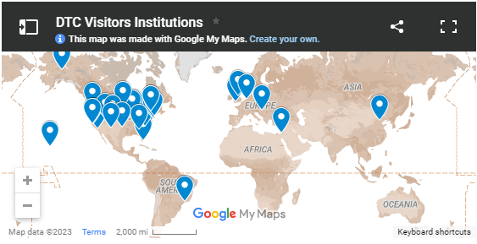
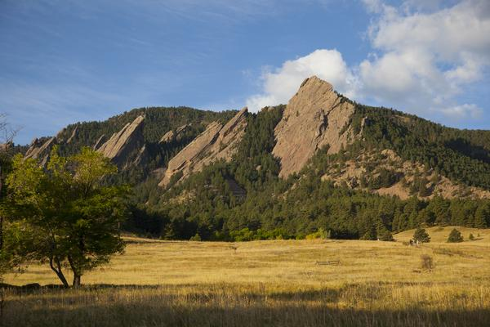
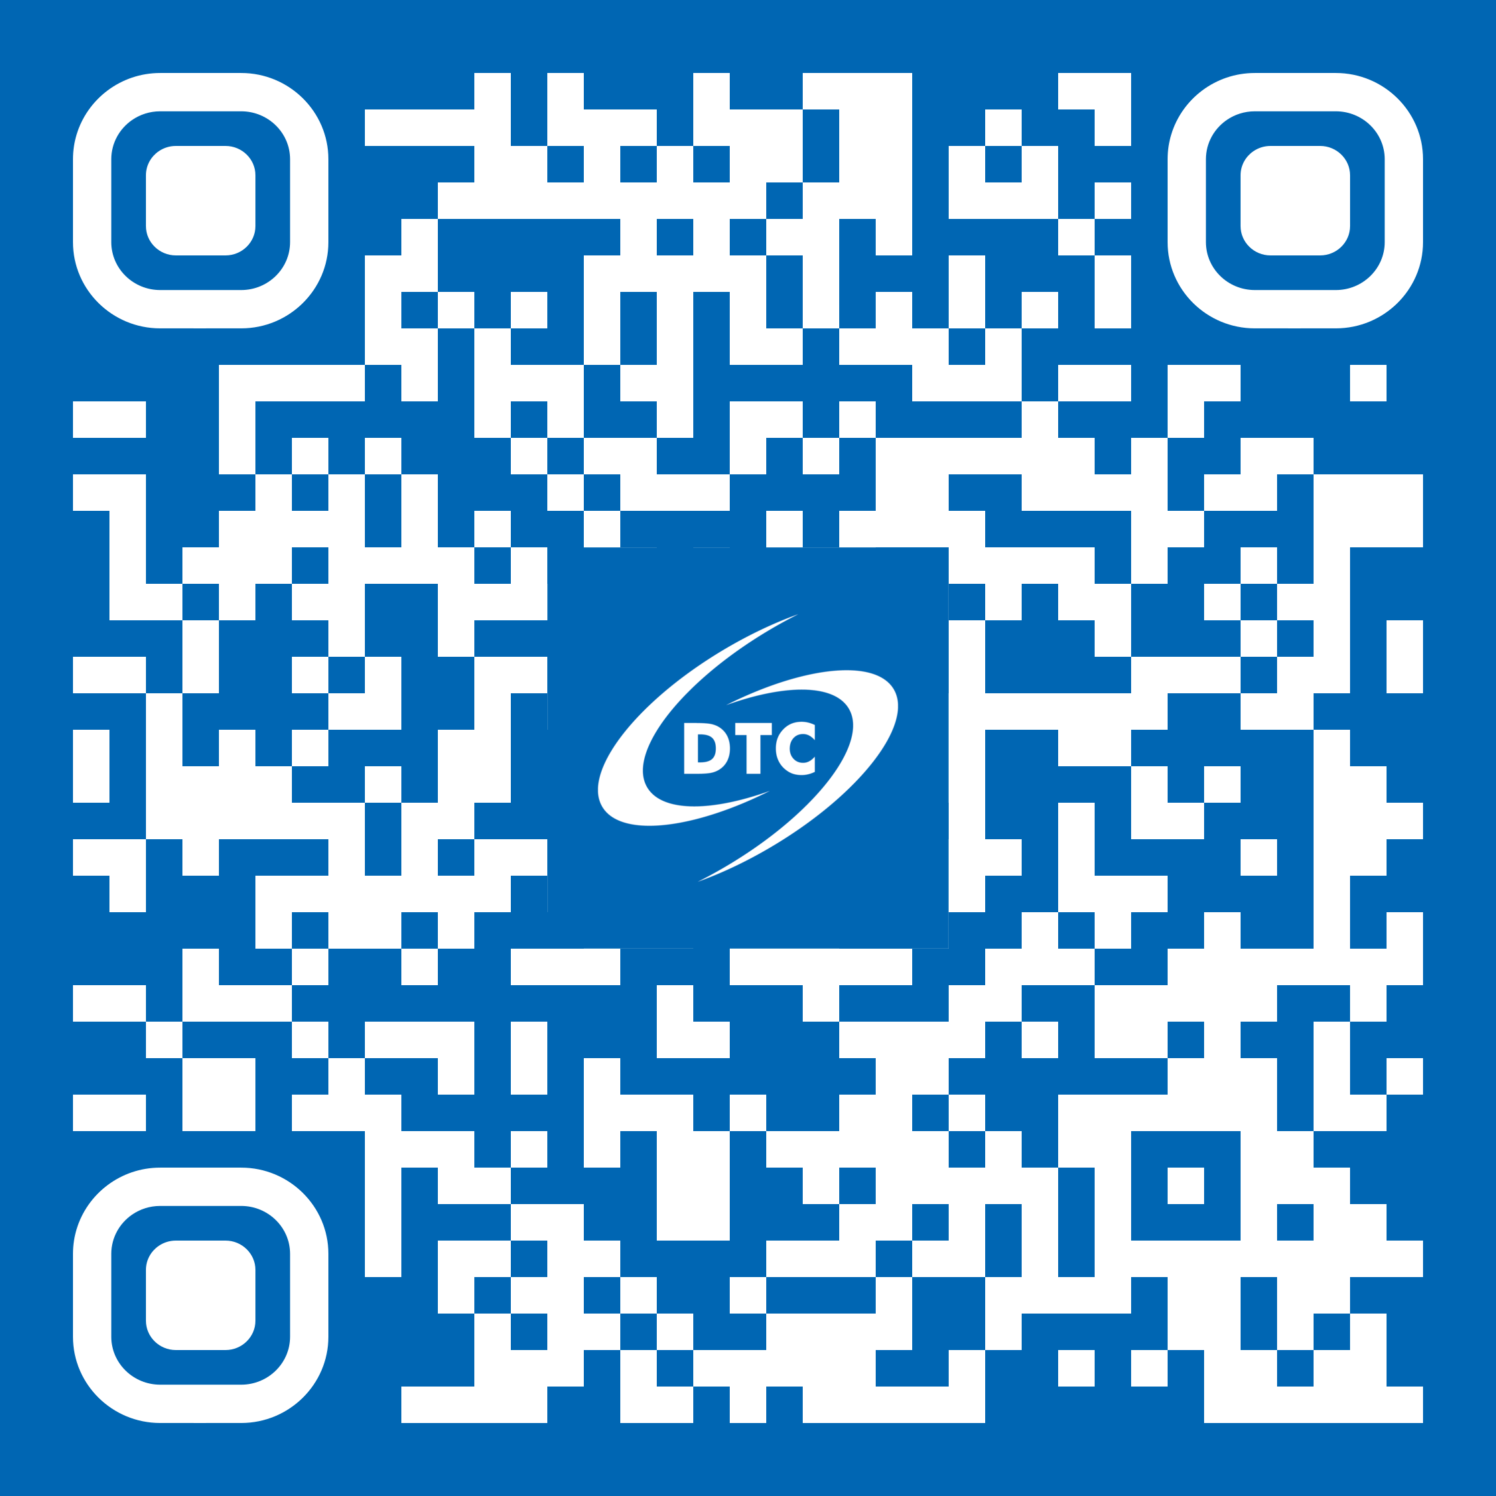
DTC Visitor Program
https://dtcenter.org/visitor-program
Propose a project to work on with us!
Types of visitor projects:
PI - Up to 2 months honorarium, travel and per diem - can be split into multiple visits
Graduate Student - Up to 1 year of temporary living per diem and travel expenses for graduate student, plus support for advisor visits
See Announcement of Opportunity on DTC website for more information on how to apply and guidance on topics of interest

