Slide 1
Improving Baroclinic Coupling and Tidal Forcing Functions in STOFS 2D⁺ Global,
NOAA’s Fast Integrated Multi-Scale Multi-Process Operational Water Level Model
Joannes J. Westerink^{1*}, Damrongsak Wirasaet¹, Albert Cerrone¹, Aman Tejaswi¹, Dylan Wood¹, Zach Cobell², Edward Myers³, Saeed Moghimi³, Greg Seroka³, Yuji Funakoshi³
¹Department of Civil and Environmental Engineering and Earth Sciences, University of Notre Dame, Notre Dame IN
²Water Institute of the Gulf, Baton Rouge LA
³NOAA/NOS/Office of Coast Survey/Coast Survey Development Laboratory, Silver Spring MD

Slide 2
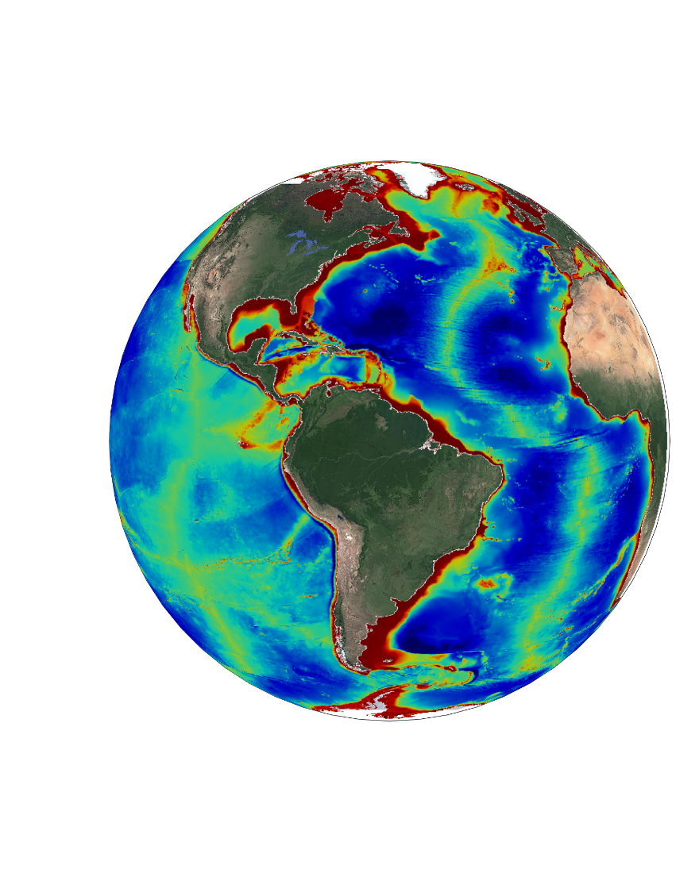
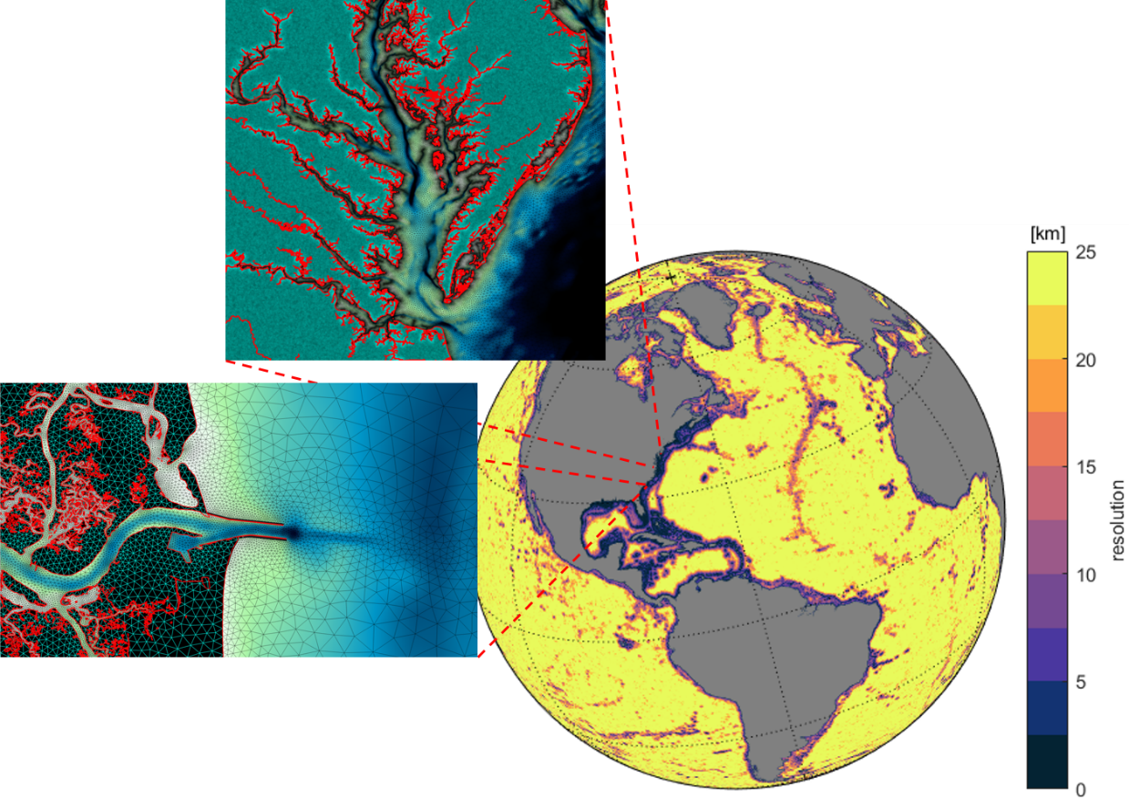
STOFS 2D Global - NOAA’s Fast and High Fidelity Operational Storm and Tide Model
System overview
STOFS 2D+ Global upgrades – refined internal tide dissipation in baroclinic simulations using scaled tidal energy to total energy
  Needed to focus dissipation only to tidal frequencies
Implementation of full luna-solar tidal potential
  Needed to more comprehensively represent total tidal energy
At NCEP https://polar.ncep.noaa.gov/estofs/glo.htm
At Notre Dame https://dylnwood.github.io/GSTOFS-develop/

Slide 3



STOFS 2D⁺ Global: Thermohaline forcing refinements
Coupling of ADCIRC, GFS-FV3, and G-RTOFS /HYCOM using downscaling over a unified domain on heterogeneous meshes/grids
GFS-FV3 Global Atmospheric Model
ADCIRC Circulation with ice
2D⁺ SWE with baroclinic pressure gradient term
HYCOM 3D Global Circulation Model
CICE Global Sea Ice Model

Slide 4
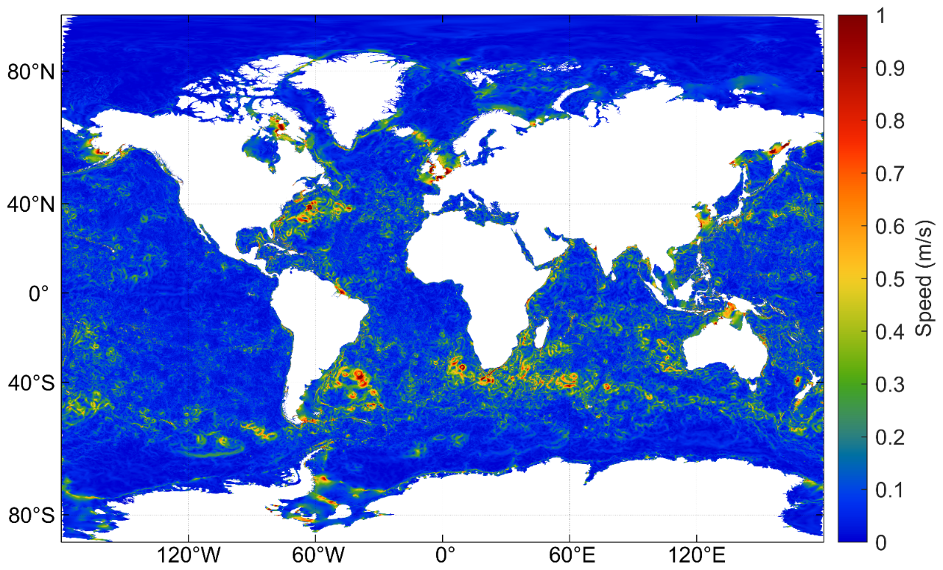
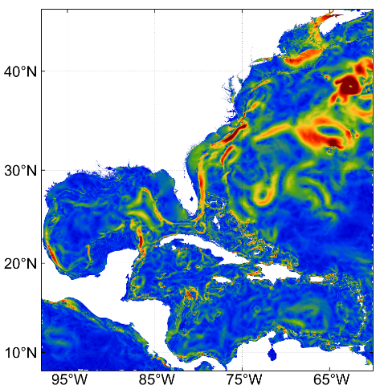
STOFS 2D⁺ Global: Thermohaline forcing refinements
Thermohaline circulation has significant geostrophic impact on coastal zone water levels
Gulf Stream pulls water away from the U.S. east coast
Currents in STOFS 2D⁺ Global

Slide 5
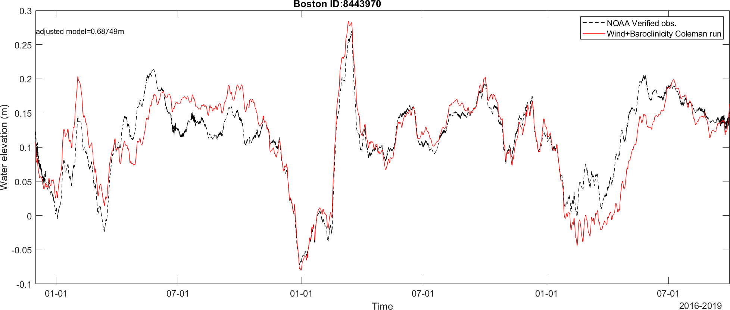
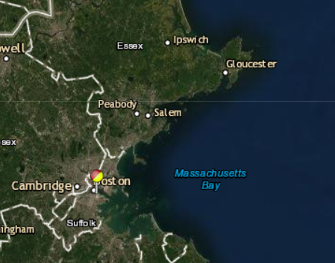
STOFS 2D⁺ Global: Thermohaline forcing refinements
30 day mean water levels compared at NOS Boston station

Slide 6
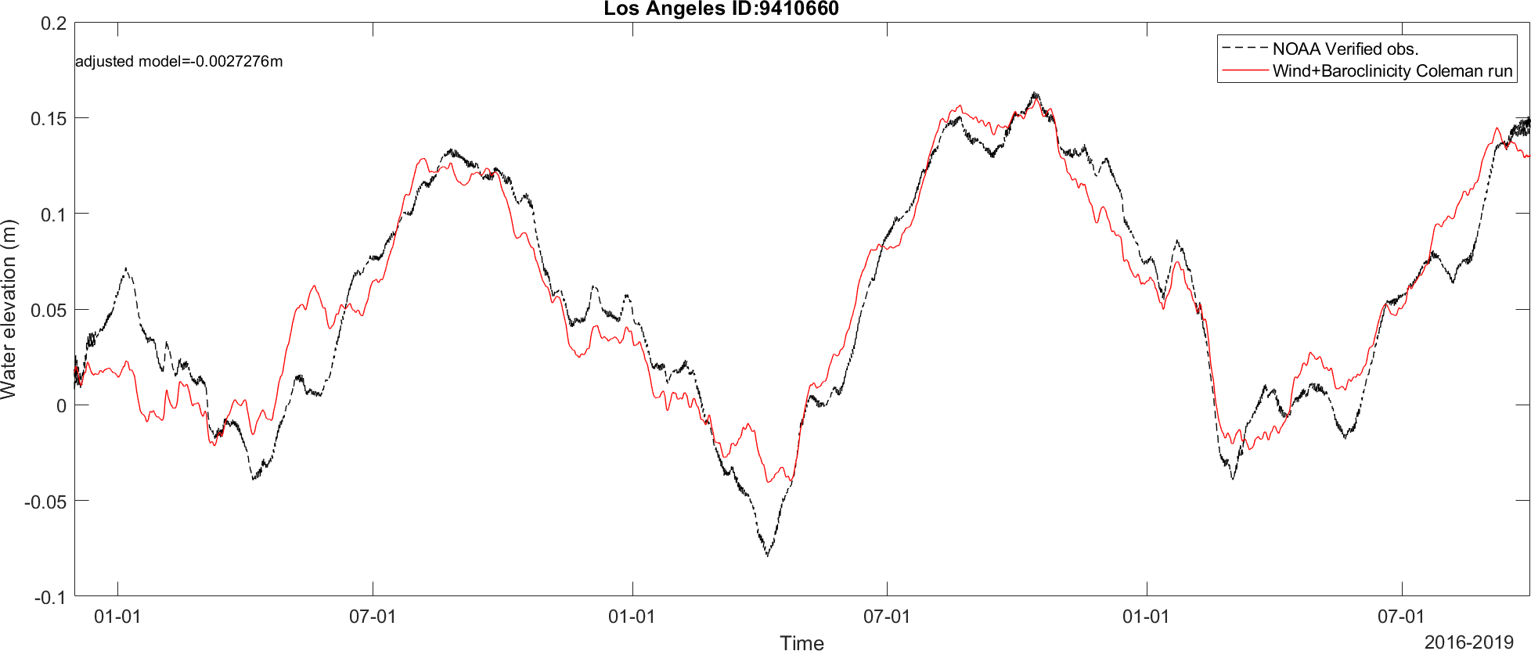
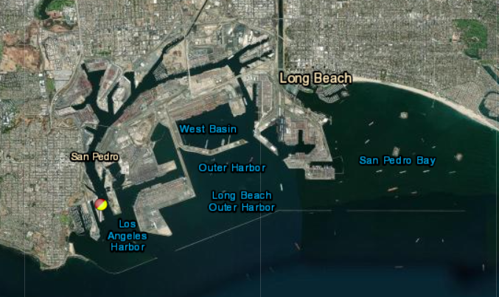
STOFS 2D⁺ Global: Thermohaline forcing refinements
30 day mean water levels compared at NOS Los Angeles station

Slide 7
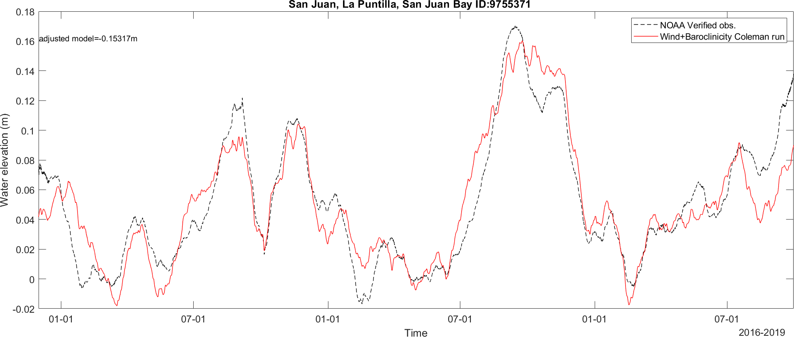
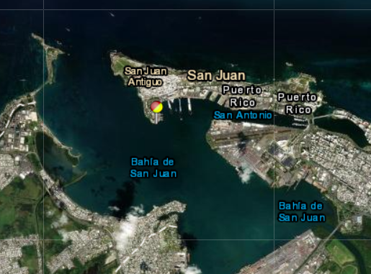
STOFS 2D⁺ Global: Thermohaline forcing refinements
30 day mean water levels compared at NOS San Juan PR station

Slide 8
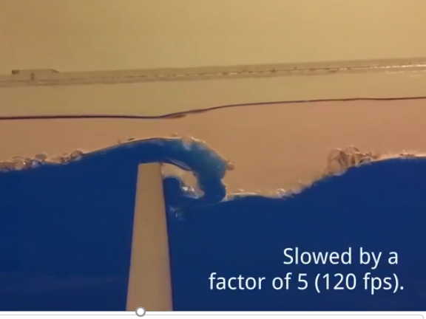
STOFS 2D⁺ Global: Thermohaline forcing refinements
Coupling of ADCIRC, GFS-FV3, and G-RTOFS /HYCOM using downscaling over a unified domain on heterogeneous meshes/grids
GFS-FV3 Global Atmospheric Model
ADCIRC Circulation with ice
2D⁺ SWE with baroclinic pressure gradient term
HYCOM 3D Global Circulation Model
Internal waves are driven at tidal frequencies
CICE Global Sea Ice Model
Pringle et al., 2018 (derived from Lyard, 2006 and Zaron and Egbert, 2006)

Slide 9
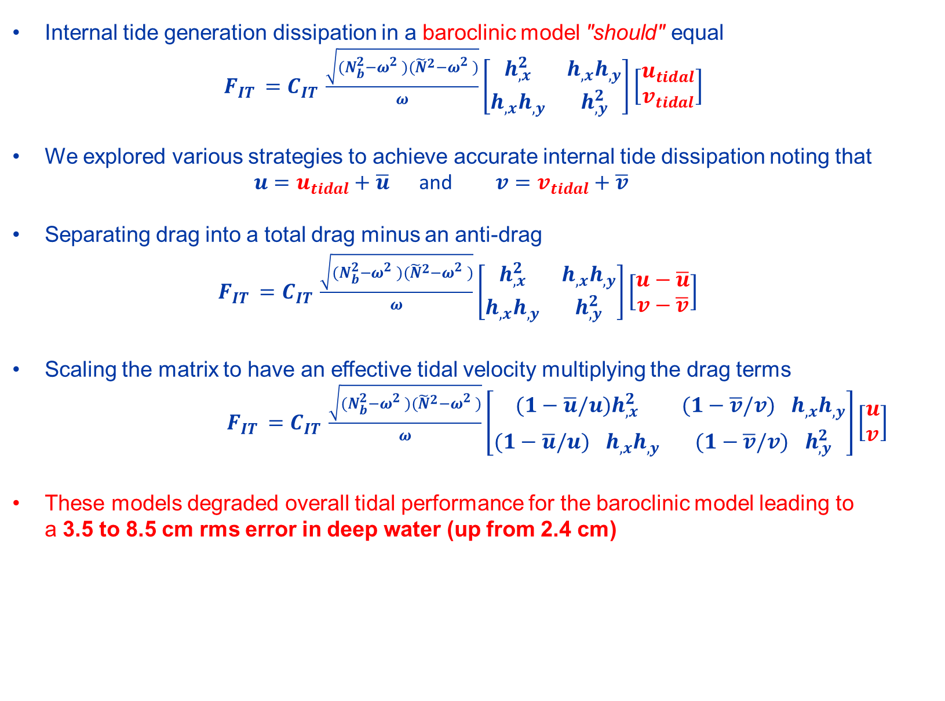
STOFS 2D⁺ Global: Thermohaline forcing refinements
Internal tide generation dissipation in a baroclinic model "should" equal
$F_{IT }=C_{IT }\frac{\sqrt{(N_{b}^{2}−ω_{}^{2})({\tilde{N}}^{2}−ω_{}^{2})}}{ω}\left[\begin{matrix}h_{,x}^{2} & h_{,x}h_{,y} \\ h_{,x}h_{,y} & h_{,y}^{2}\end{matrix}\right]\left[\begin{matrix}u_{tidal} \\ v_{tidal}\end{matrix}\right]$
We explored various strategies to achieve accurate internal tide dissipation noting that
$u=u_{tidal}+\overline{u}$ and $v=v_{tidal}+\overline{v}$
Separating drag into a total drag minus an anti-drag
$F_{IT }=C_{IT }\frac{\sqrt{(N_{b}^{2}−ω_{}^{2})({\tilde{N}}^{2}−ω_{}^{2})}}{ω}\left[\begin{matrix}h_{,x}^{2} & h_{,x}h_{,y} \\ h_{,x}h_{,y} & h_{,y}^{2}\end{matrix}\right]\left[\begin{matrix}u−\overline{u} \\ v−\overline{v}\end{matrix}\right]$
Scaling the matrix to have an effective tidal velocity multiplying the drag terms
$F_{IT }=C_{IT }\frac{\sqrt{(N_{b}^{2}−ω_{}^{2})({\tilde{N}}^{2}−ω_{}^{2})}}{ω}\left[\begin{matrix}(1−\overline{u}/{u)h}_{,x}^{2} & (1−\overline{v}/v)_{}^{}h_{,x}h_{,y} \\ (1−\overline{u}/{u)}_{}^{}h_{,x}h_{,y} & (1−\overline{v}/v)_{}^{}h_{,y}^{2}\end{matrix}\right]\left[\begin{matrix}u \\ v\end{matrix}\right]$
These models degraded overall tidal performance for the baroclinic model leading to a 3.5 to 8.5 cm rms error in deep water (up from 2.4 cm)

Slide 10
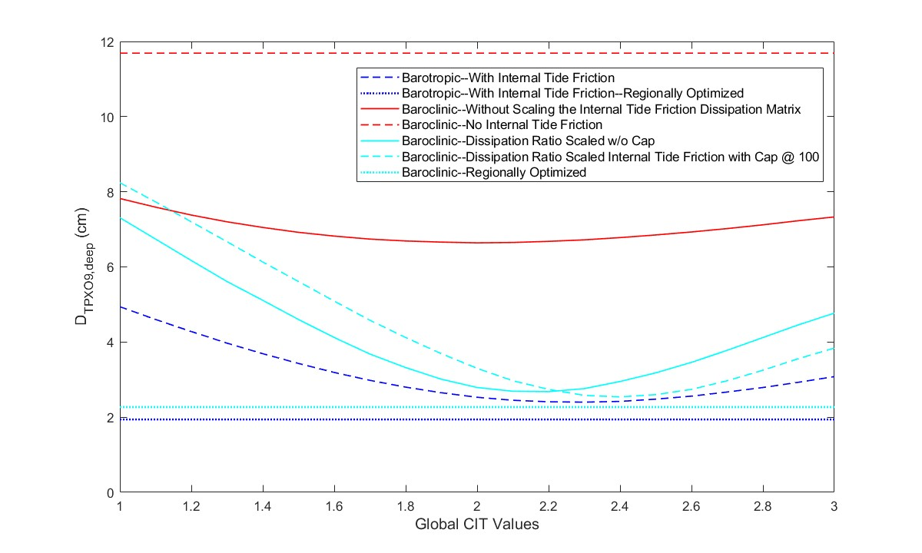
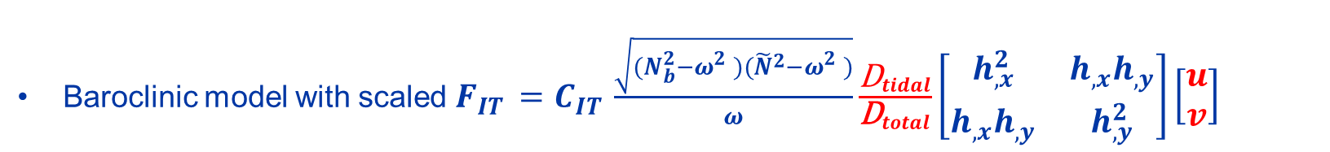
STOFS 2D⁺ Global: Thermohaline forcing refinements
Baroclinic model with scaled $F_{IT }=C_{IT }\frac{\sqrt{(N_{b}^{2}−ω_{}^{2})({\tilde{N}}^{2}−ω_{}^{2})}}{ω}\frac{{\text{D}}_{tidal}}{{\text{D}}_{total}}\left[\begin{matrix}h_{,x}^{2} & h_{,x}h_{,y} \\ h_{,x}h_{,y} & h_{,y}^{2}\end{matrix}\right]\left[\begin{matrix}u \\ v\end{matrix}\right]$

Slide 11
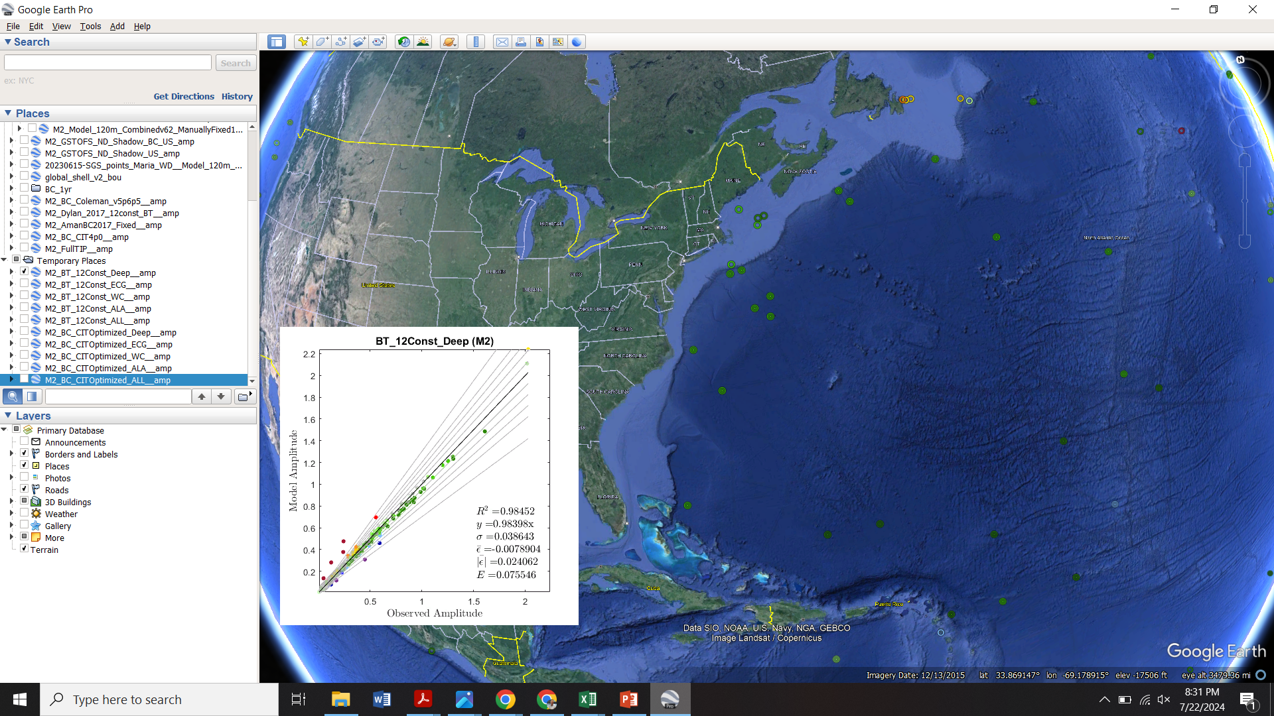
Barotropic: Global all deep ocean stations

Slide 12

Baroclinic: Global all deep ocean stations

Slide 13
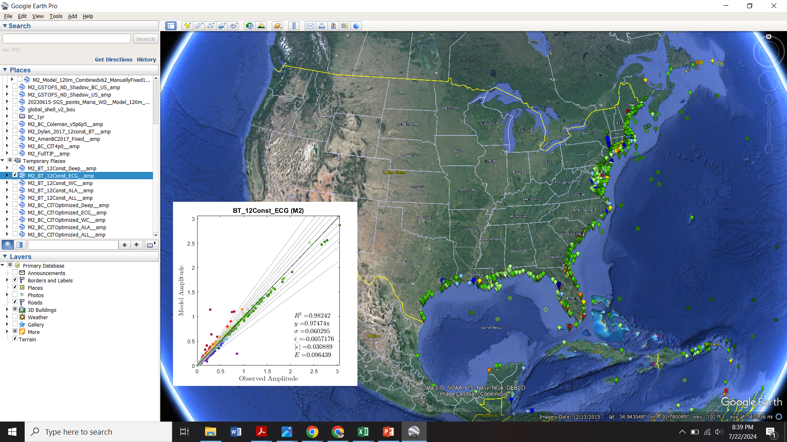
Barotropic: U.S. East and Gulf of Mexico coasts

Slide 14
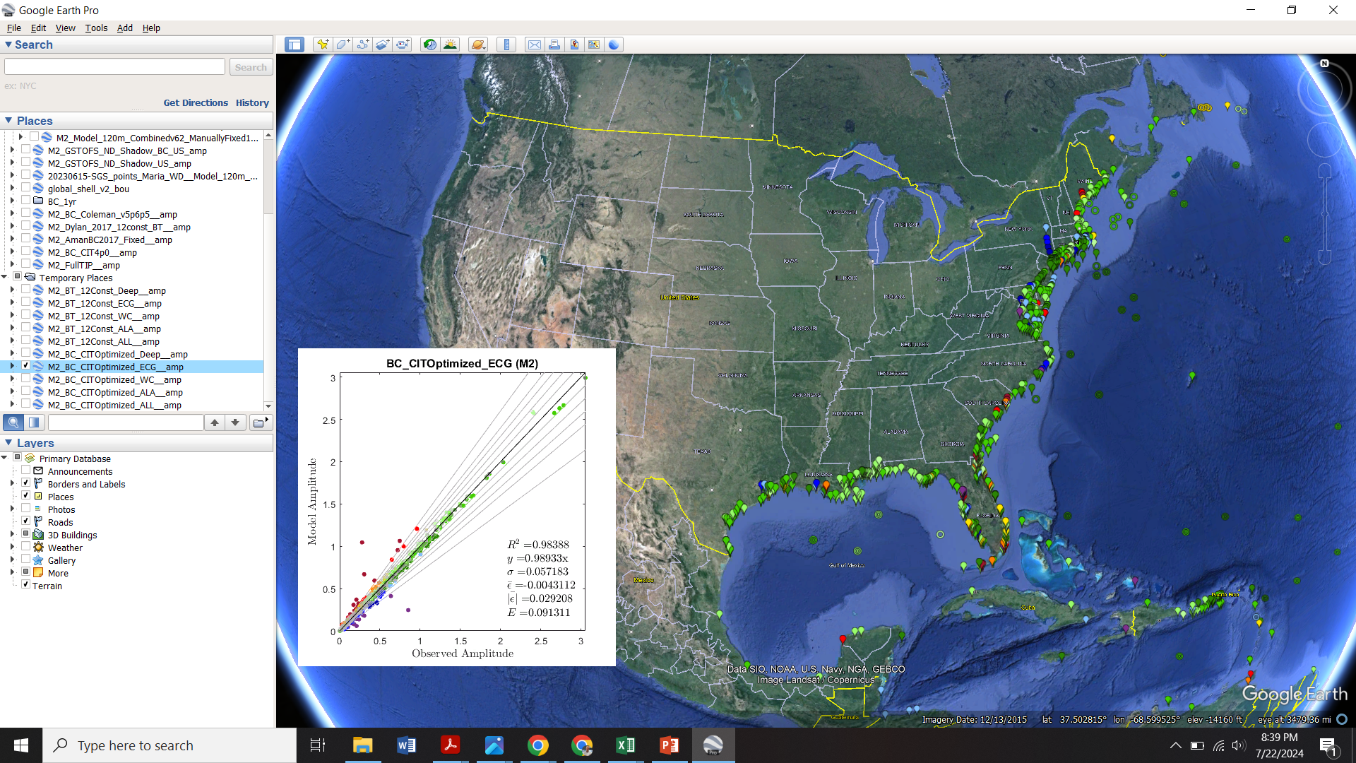
Baroclinic: U.S. East and Gulf of Mexico coasts

Slide 15
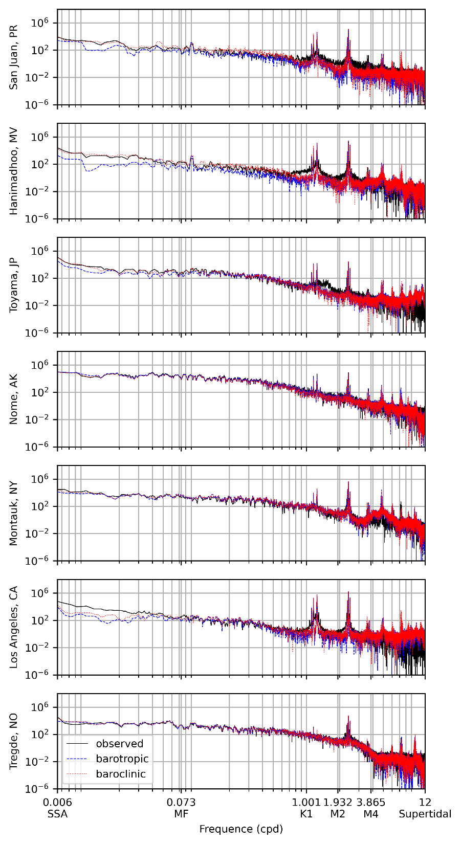
STOFS 2D⁺ Global: Power Spectral Density - Low frequency response improves

Slide 16
STOFS 2D Global: Power Spectral Density - What about intra-tidal frequencies?

Slide 17
STOFS 2D⁺ Global: Implementation of full luna-solar tidal potential
How much does moving from 8 main tidal forcing contituents to the full NOAA standard 37 constituents change water levels?
Compare signal synthesized using NOAA's harmonic constituents with nodal factors and equilibrium arguments to NOAA's "Predicted Tide" (using same constituents)
  Major 8: M₂, S₂, N₂, K₂, O₁, K₁, P₁ and Q₁ (8)
  Add 5 long term constituents Ssa, Sa, Mm, Mf, Msf (13)
  Add 10 nonlinear overtides and compound tides (23)
  Add 13 secondary astronomical constituents (36)
Max Error (cm)
Station | Major 8 | 13 | 23 | 36
Cedar Key | 24.5 | 10.2 | 10.1 | 2.3
Bar Harbor | 31.3 | 29.6 | 28.9 | 4.1
Freeport | 21.1 | 6.6 | 5.7 | 2.2
Gloucester | 17.0 | 8.2 | 7.6 | 1.1

Slide 18
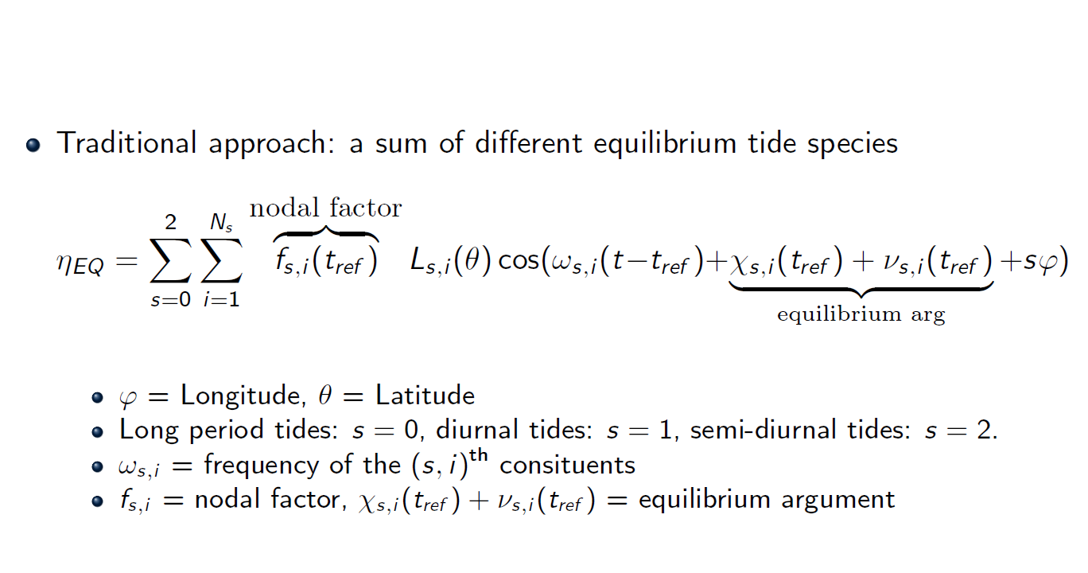
STOFS 2D⁺ Global: Implementation of full luna-solar tidal potential

Slide 19
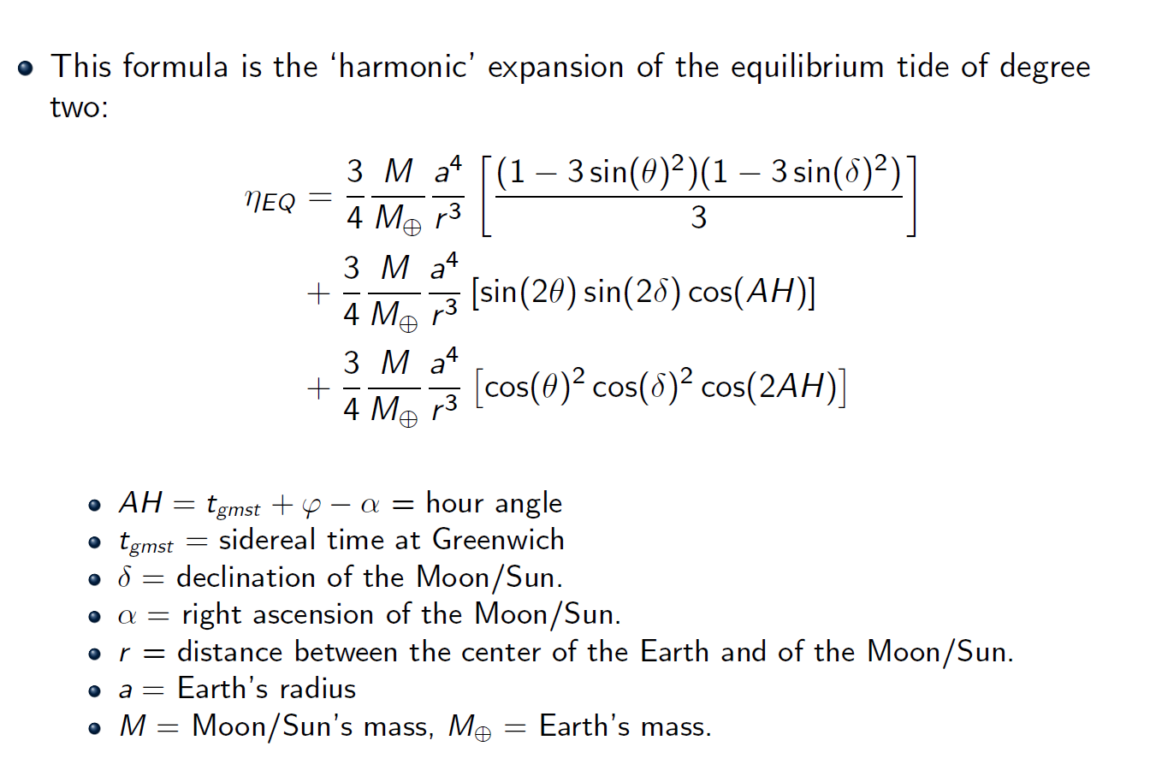
STOFS 2D⁺ Global: Implementation of full luna-solar tidal potential

Slide 20
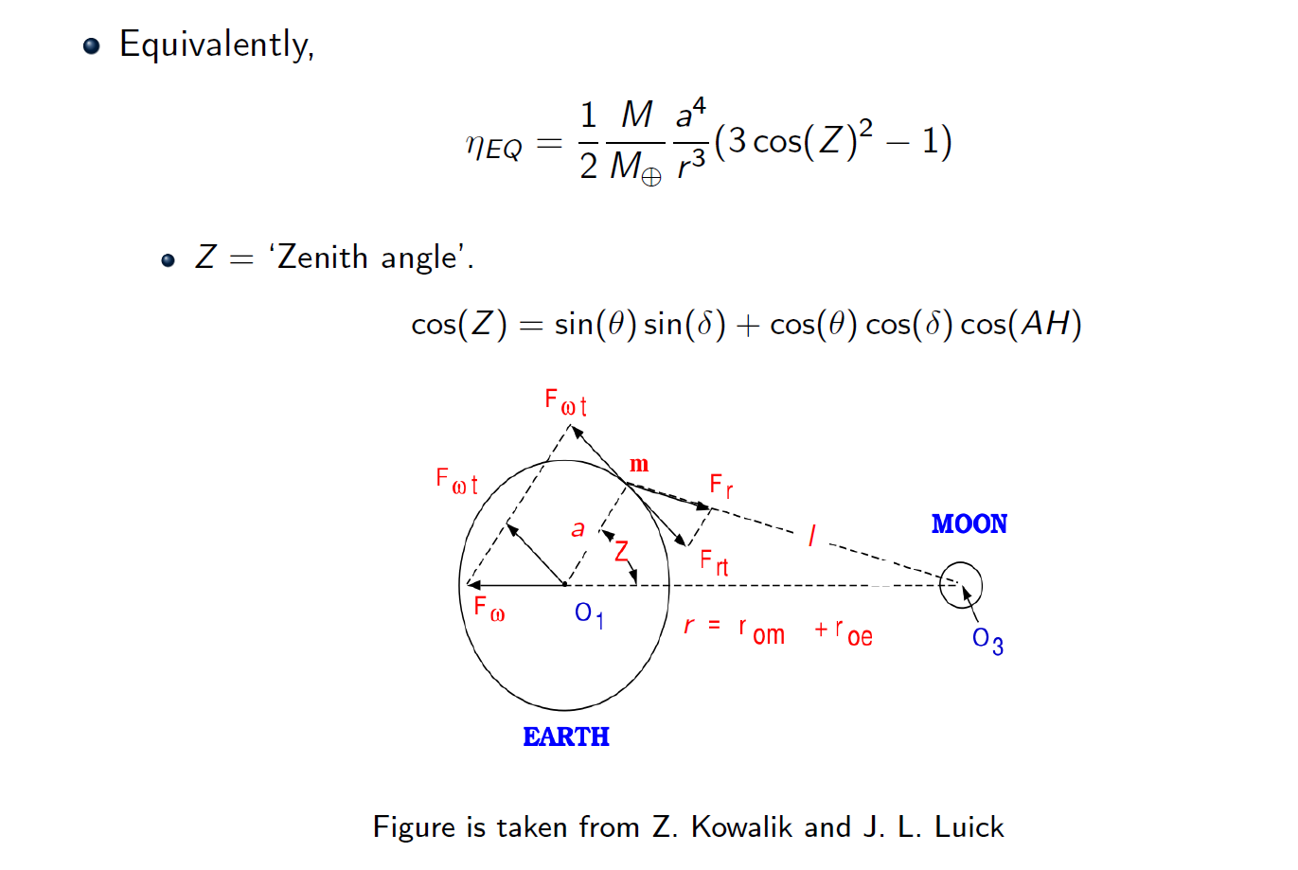
STOFS 2D⁺ Global: Implementation of full luna-solar tidal potential

Slide 21
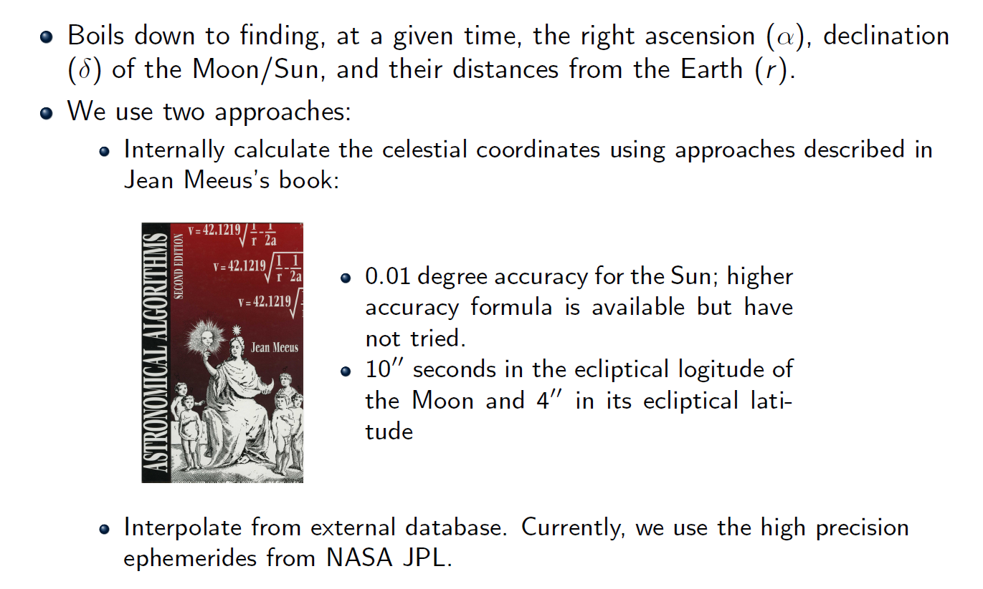
STOFS 2D⁺ Global: Implementation of full luna-solar tidal potential

Slide 22
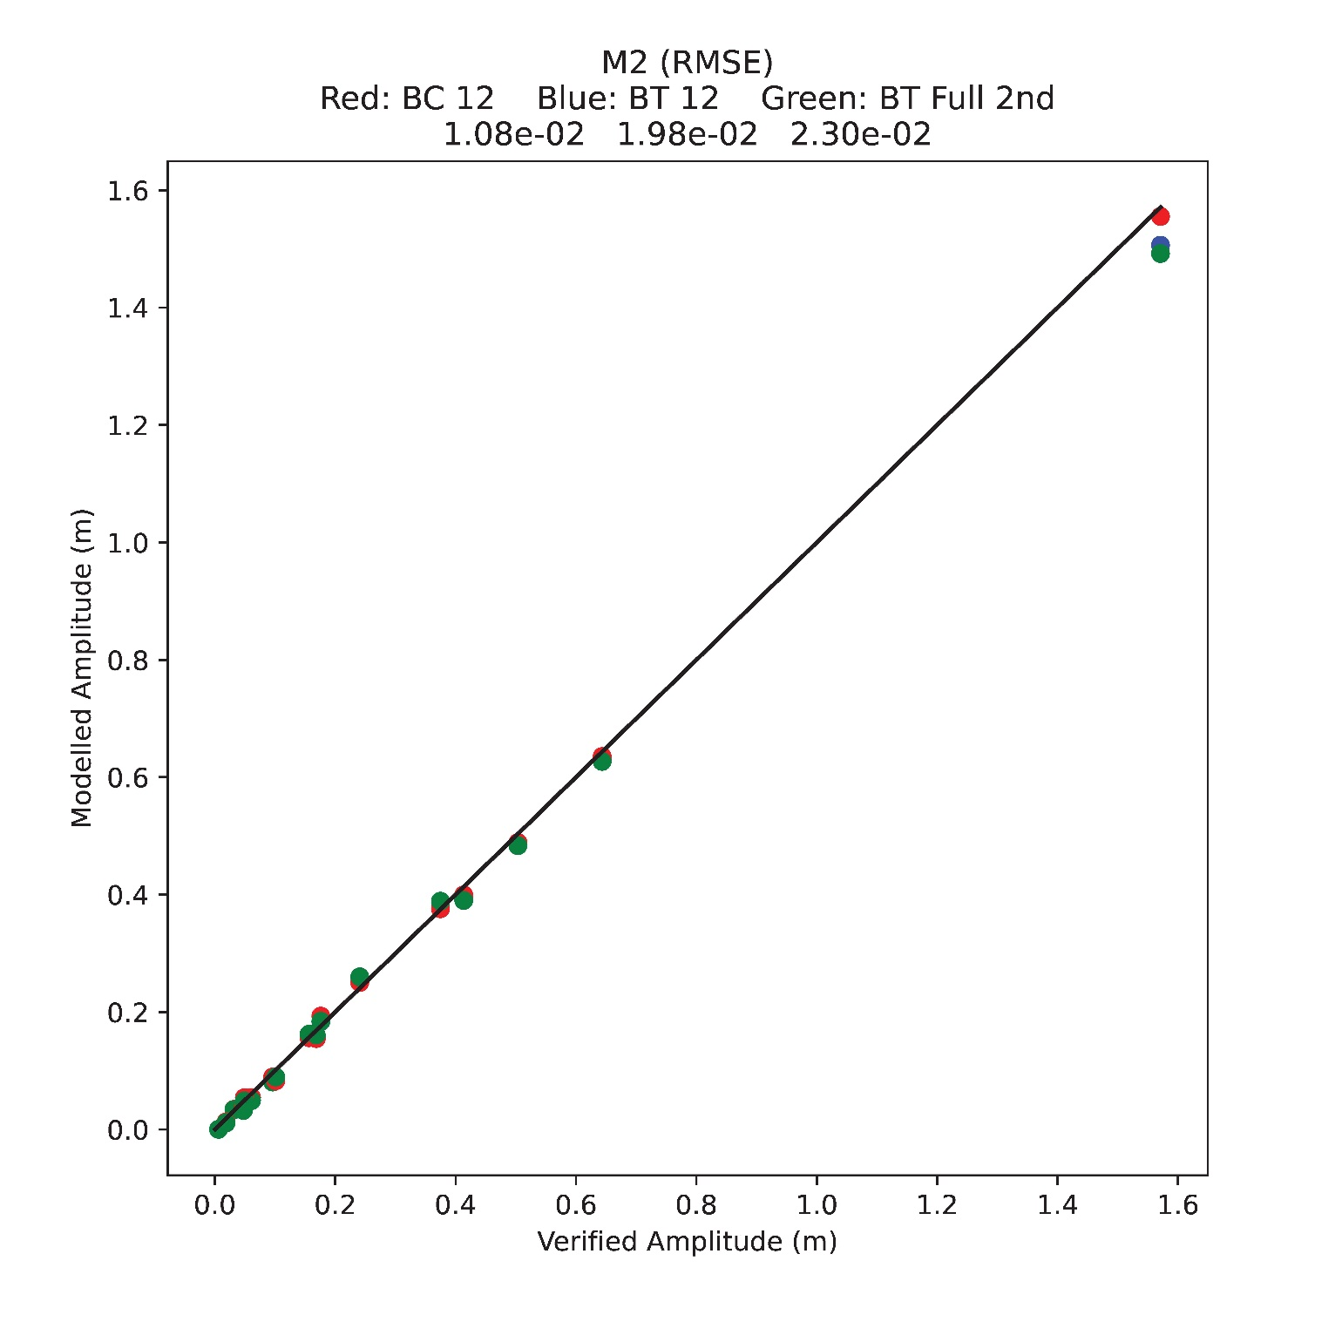
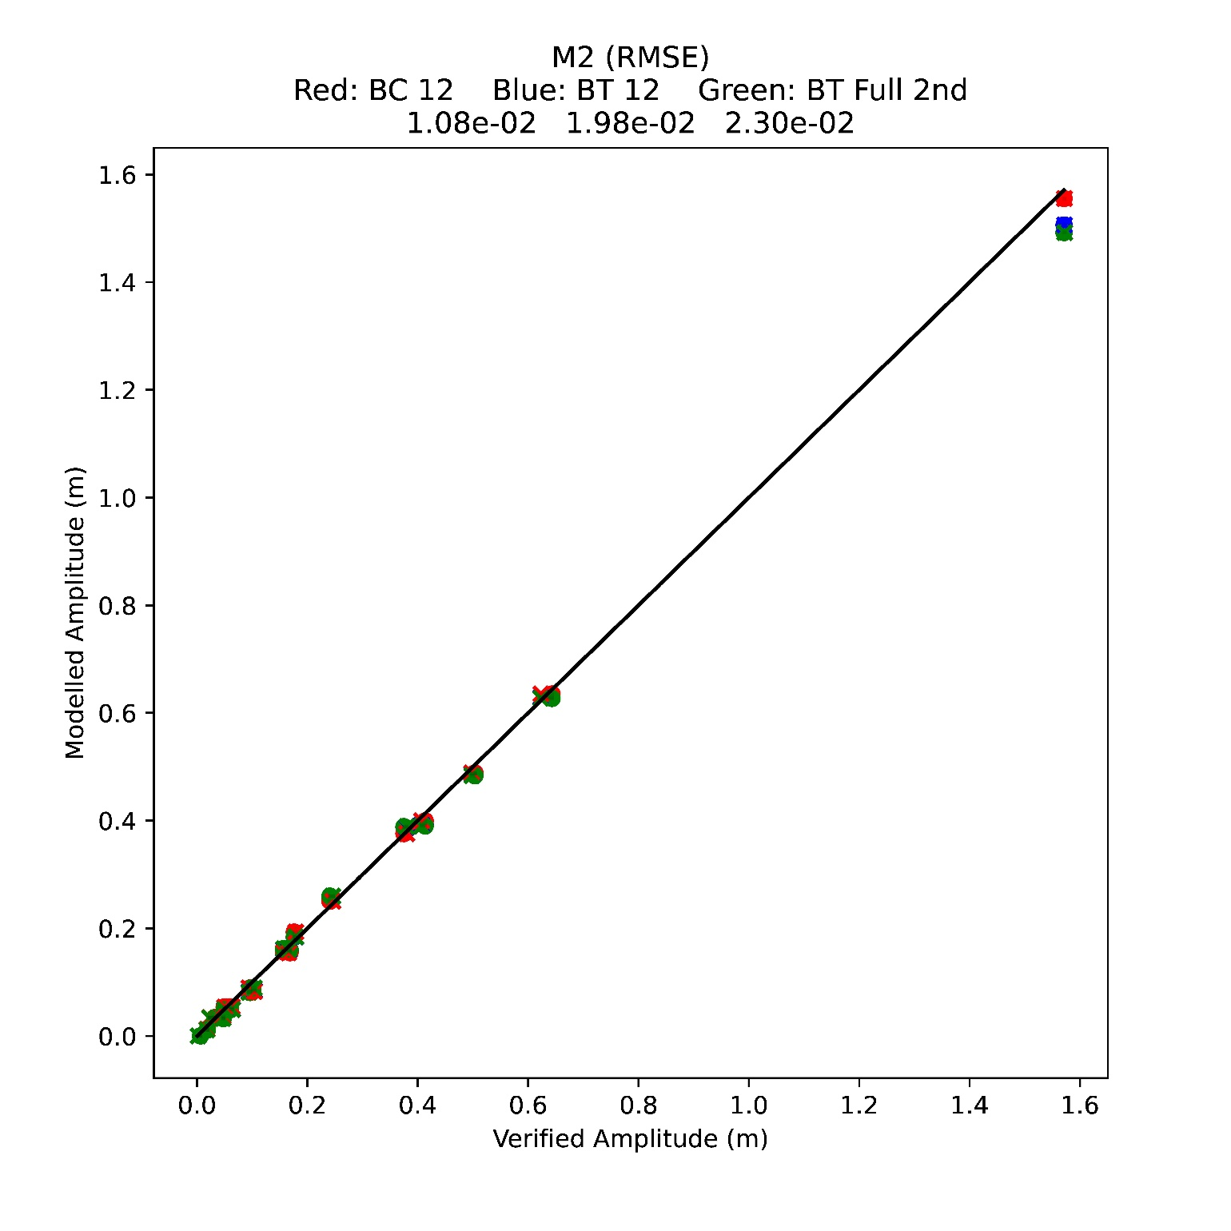
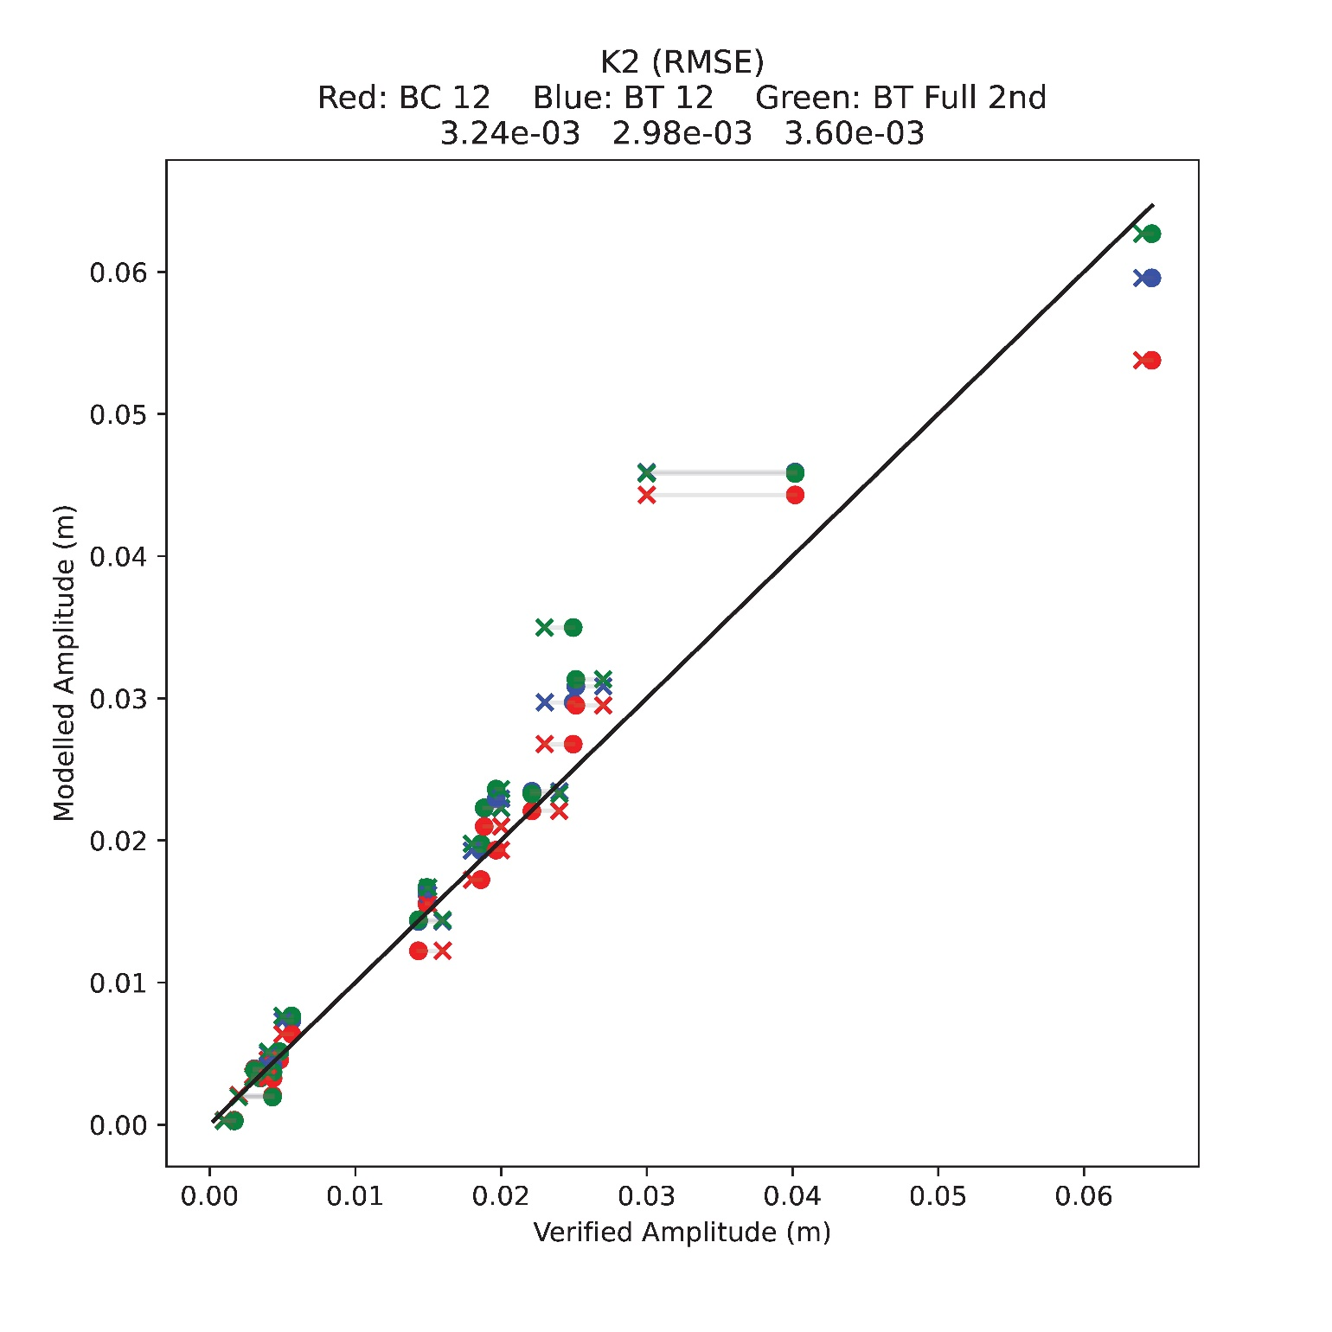
STOFS 2D⁺ Global: Implementation of full luna-solar tidal potential
37 constituent Pytide analysis of 2017
NOAA Co-op published values
Baroclinic 12 forced harmonics constituents
Barotropic 12 forced harmonic constituents
Barotropic Full 2nd order

Slide 23
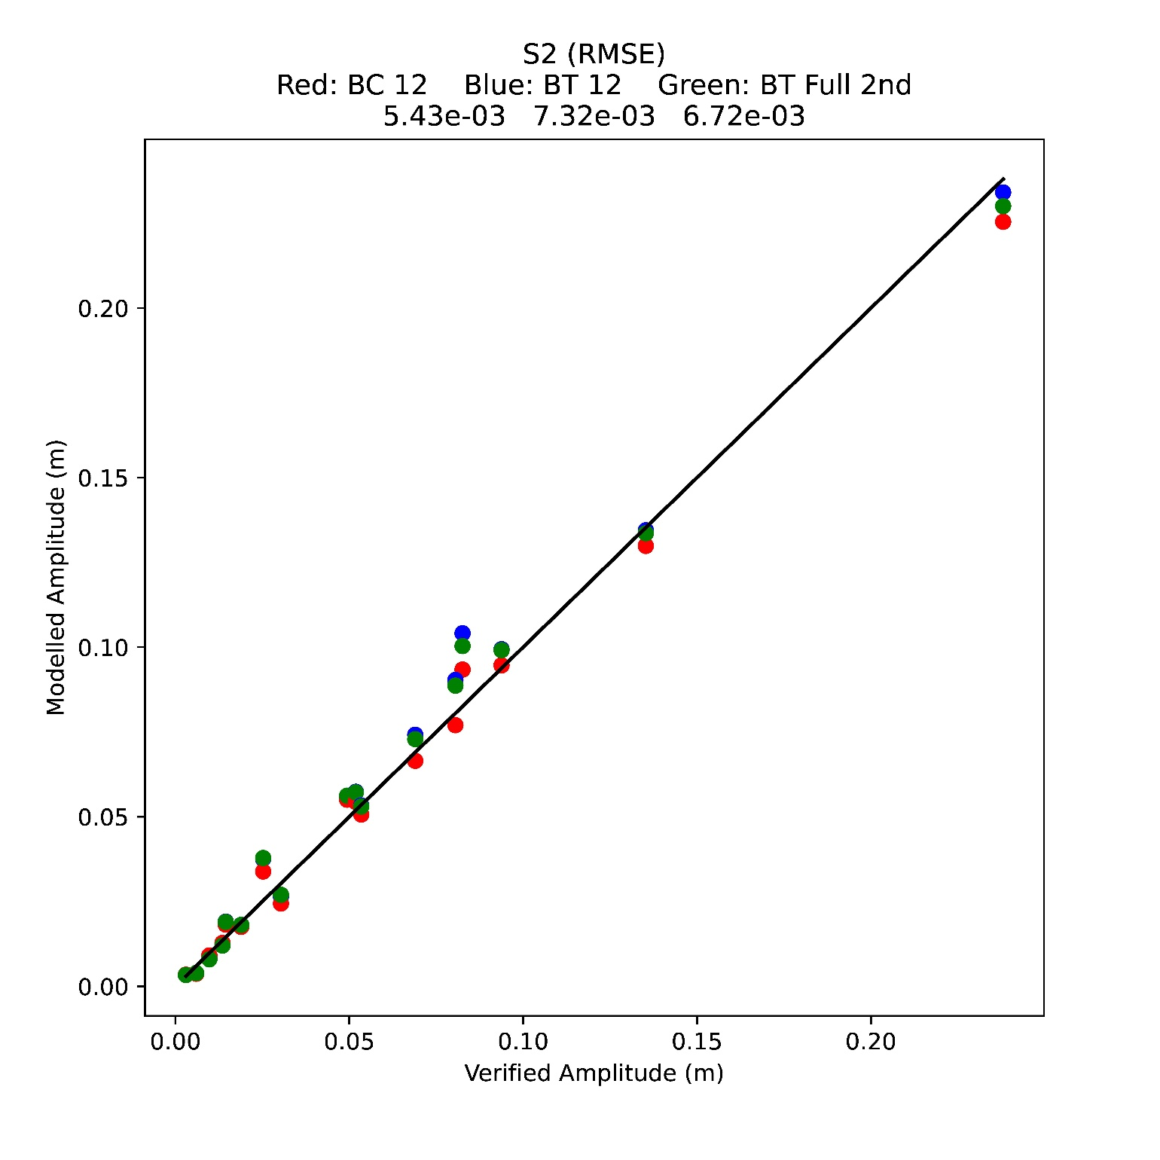
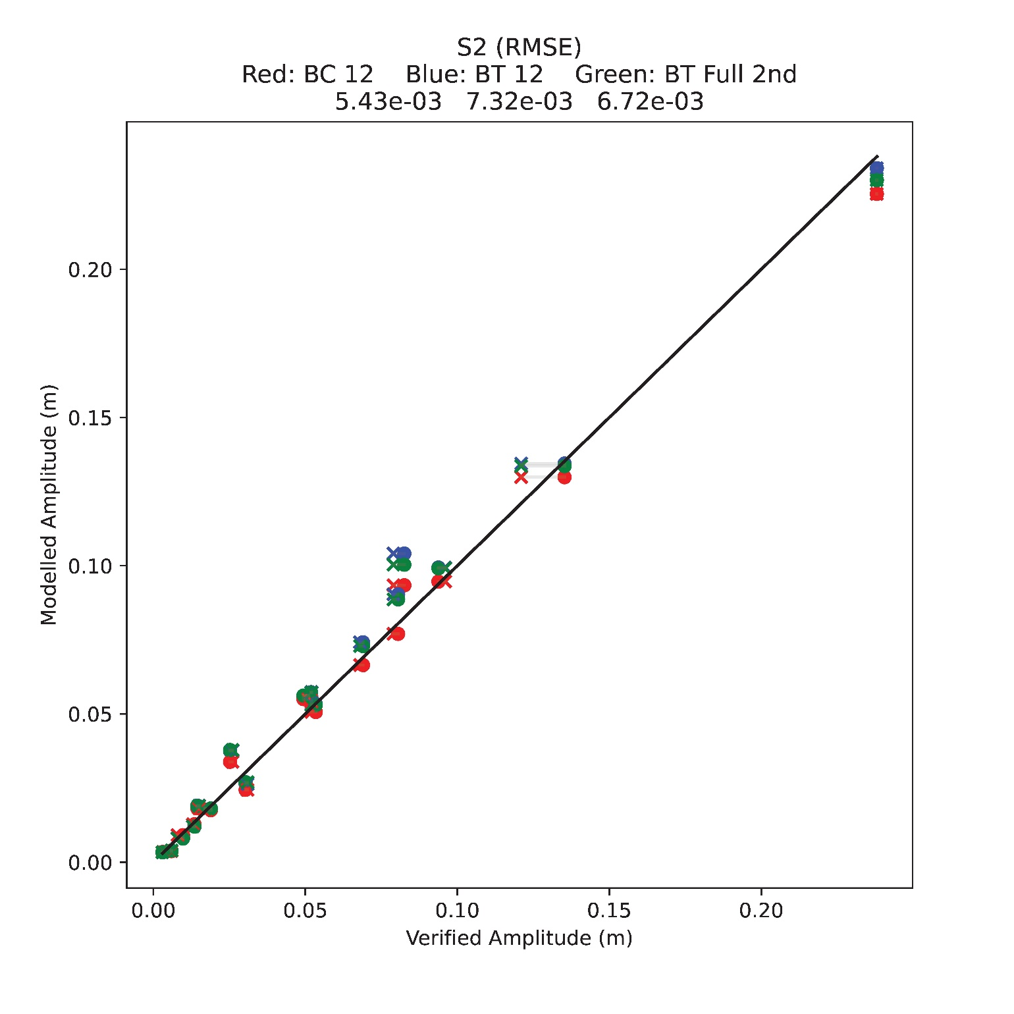
STOFS 2D⁺ Global: Implementation of full luna-solar tidal potential
37 constituent Pytide analysis of 2017
NOAA Co-op published values
Baroclinic 12 forced harmonics constituents
Barotropic 12 forced harmonic constituents
Barotropic Full 2nd order

Slide 24
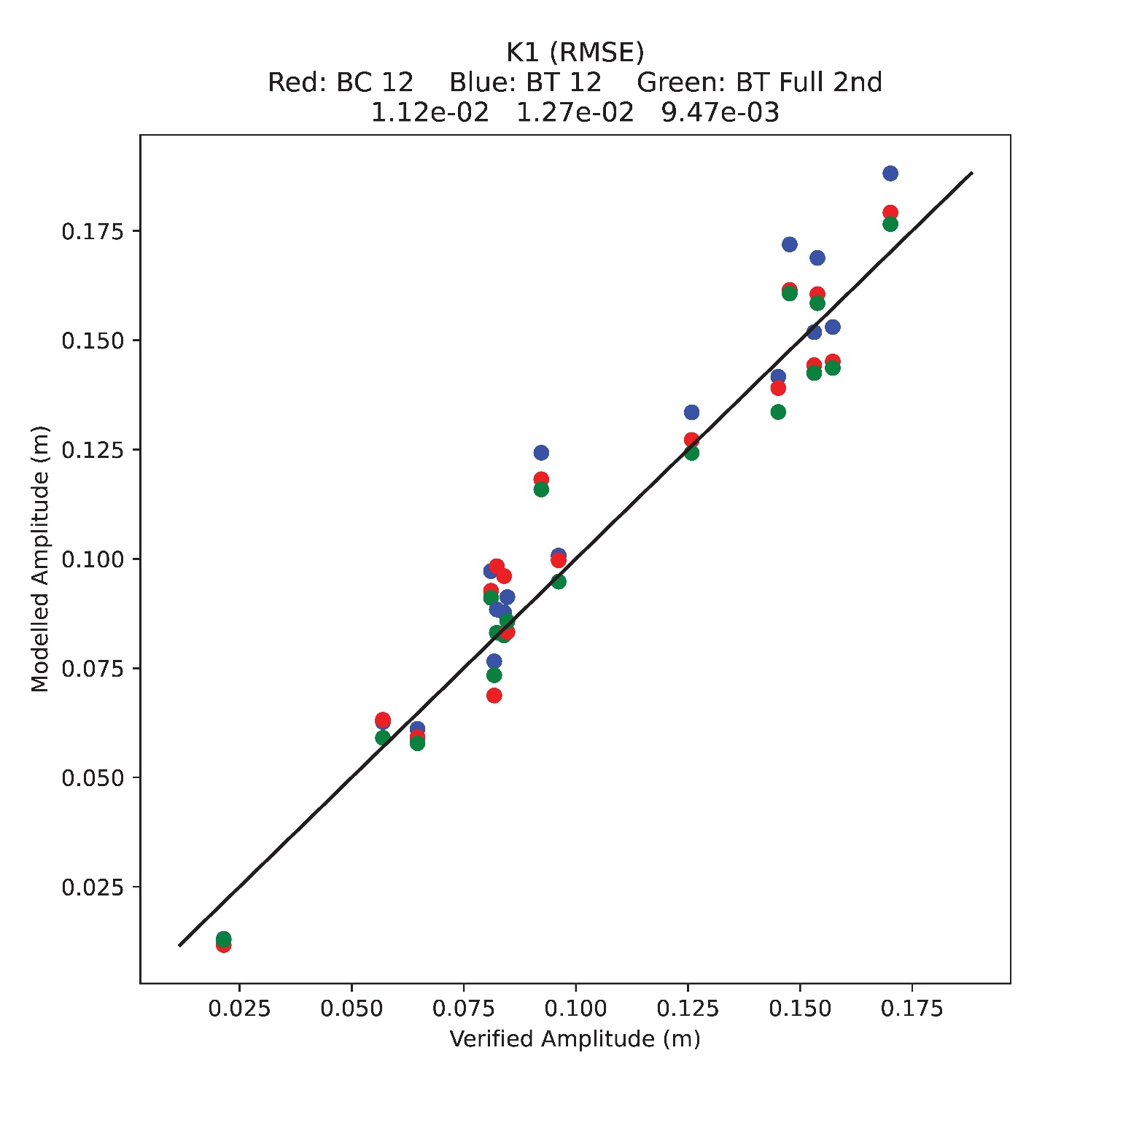
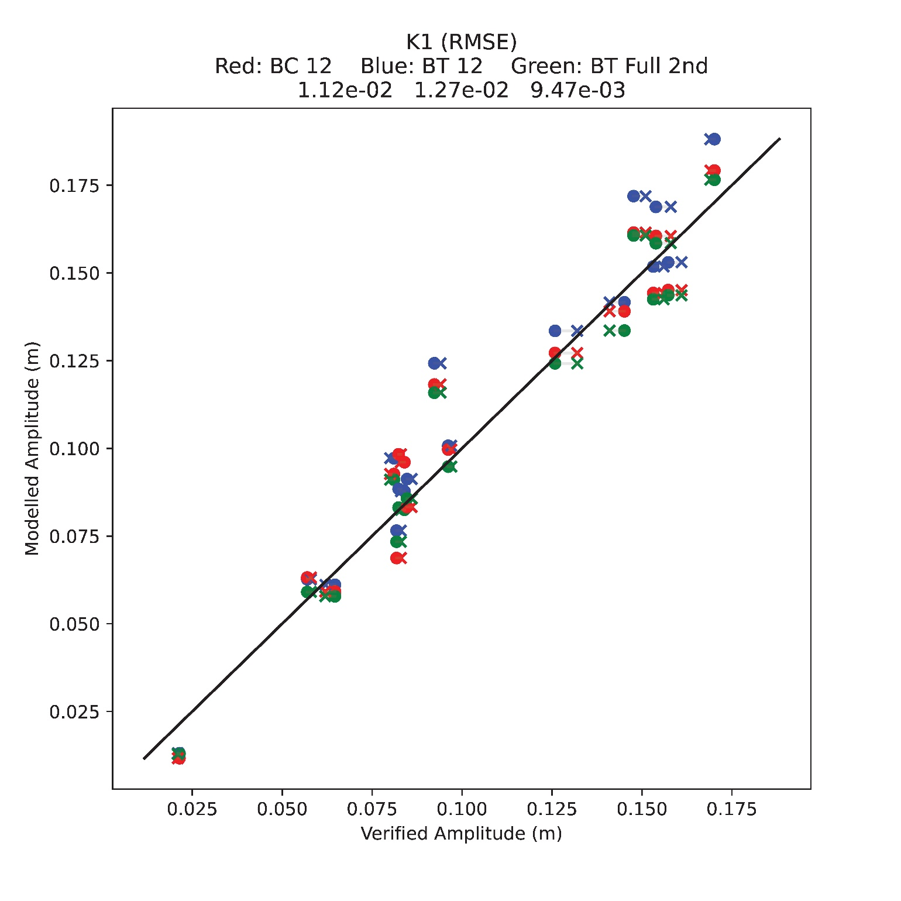
STOFS 2D⁺ Global: Implementation of full luna-solar tidal potential
37 constituent Pytide analysis of 2017
NOAA Co-op published values
Baroclinic 12 forced harmonics constituents
Barotropic 12 forced harmonic constituents
Barotropic Full 2nd order

Slide 25
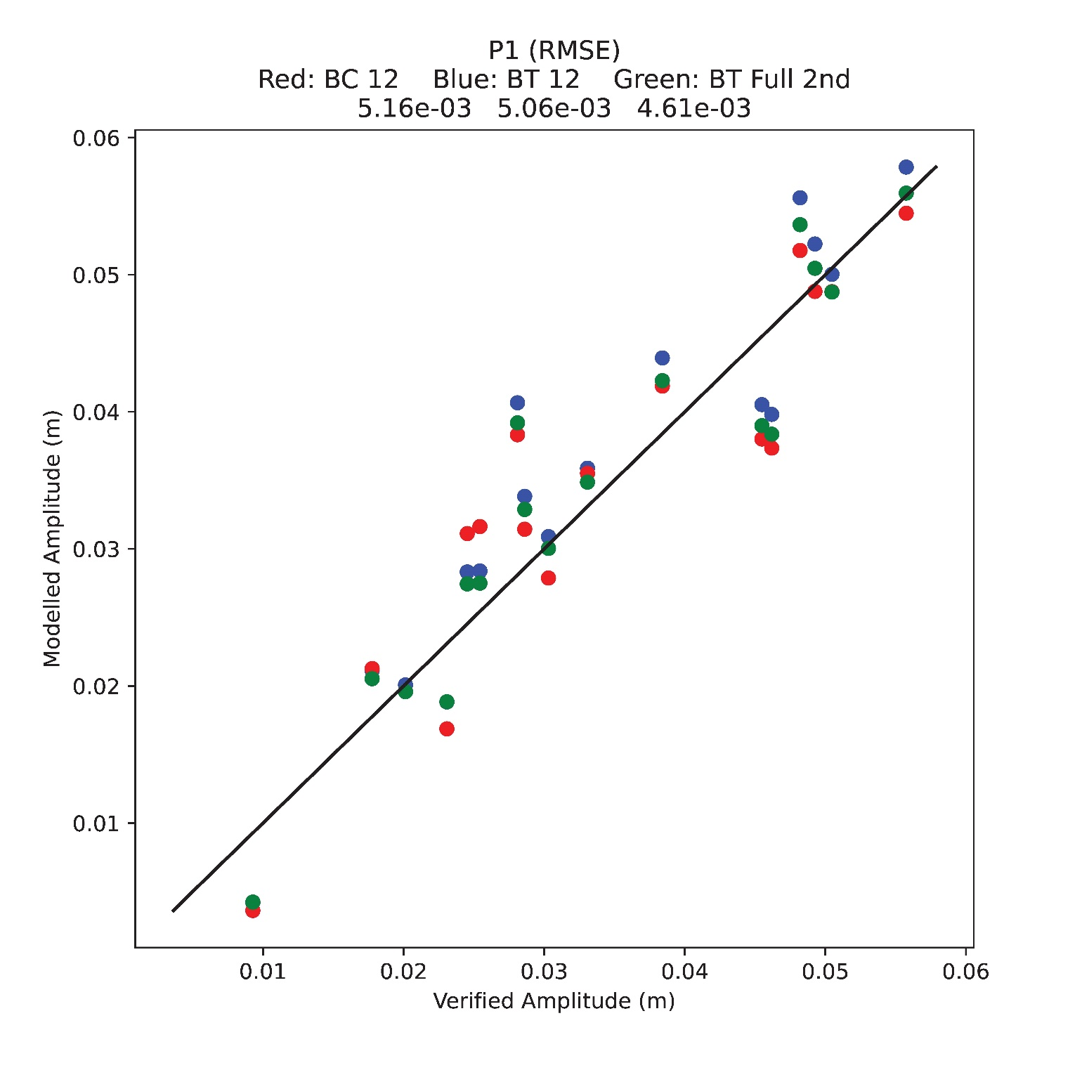
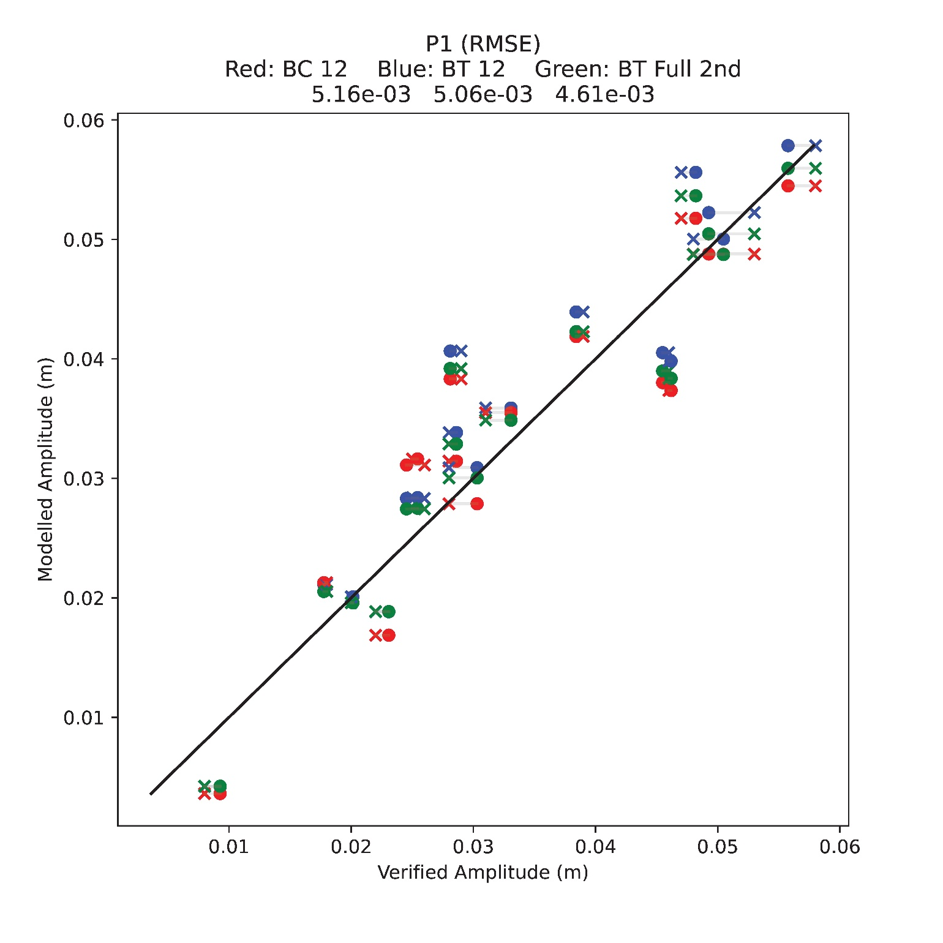
STOFS 2D⁺ Global: Implementation of full luna-solar tidal potential
37 constituent Pytide analysis of 2017
NOAA Co-op published values
Baroclinic 12 forced harmonics constituents
Barotropic 12 forced harmonic constituents
Barotropic Full 2nd order

Slide 26
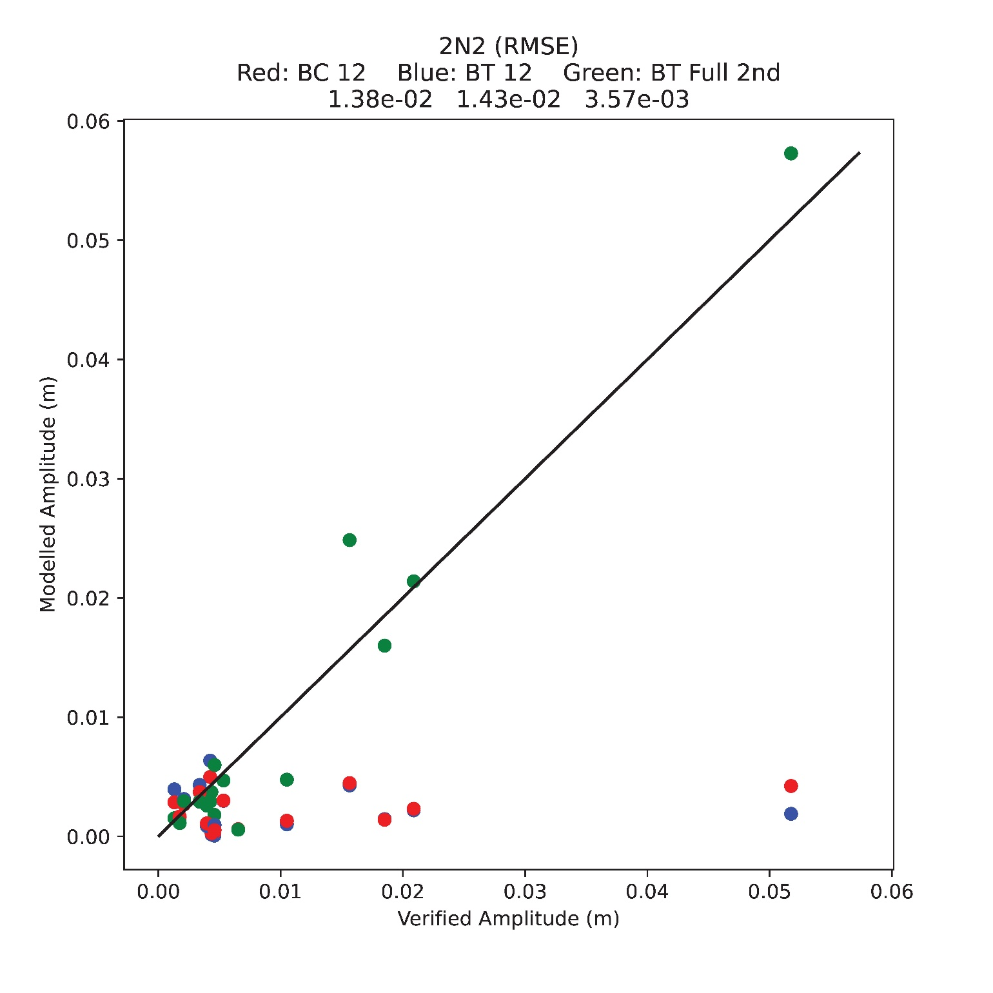
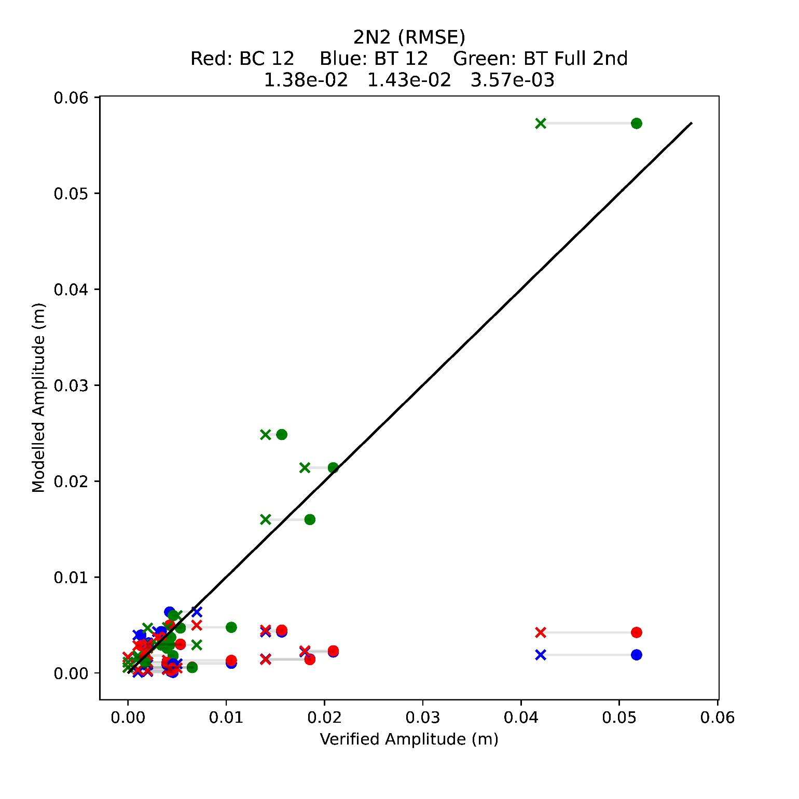
STOFS 2D⁺ Global: Implementation of full luna-solar tidal potential
37 constituent Pytide analysis of 2017
NOAA Co-op published values
Baroclinic 12 forced harmonics constituents
Barotropic 12 forced harmonic constituents
Barotropic Full 2nd order

Slide 27
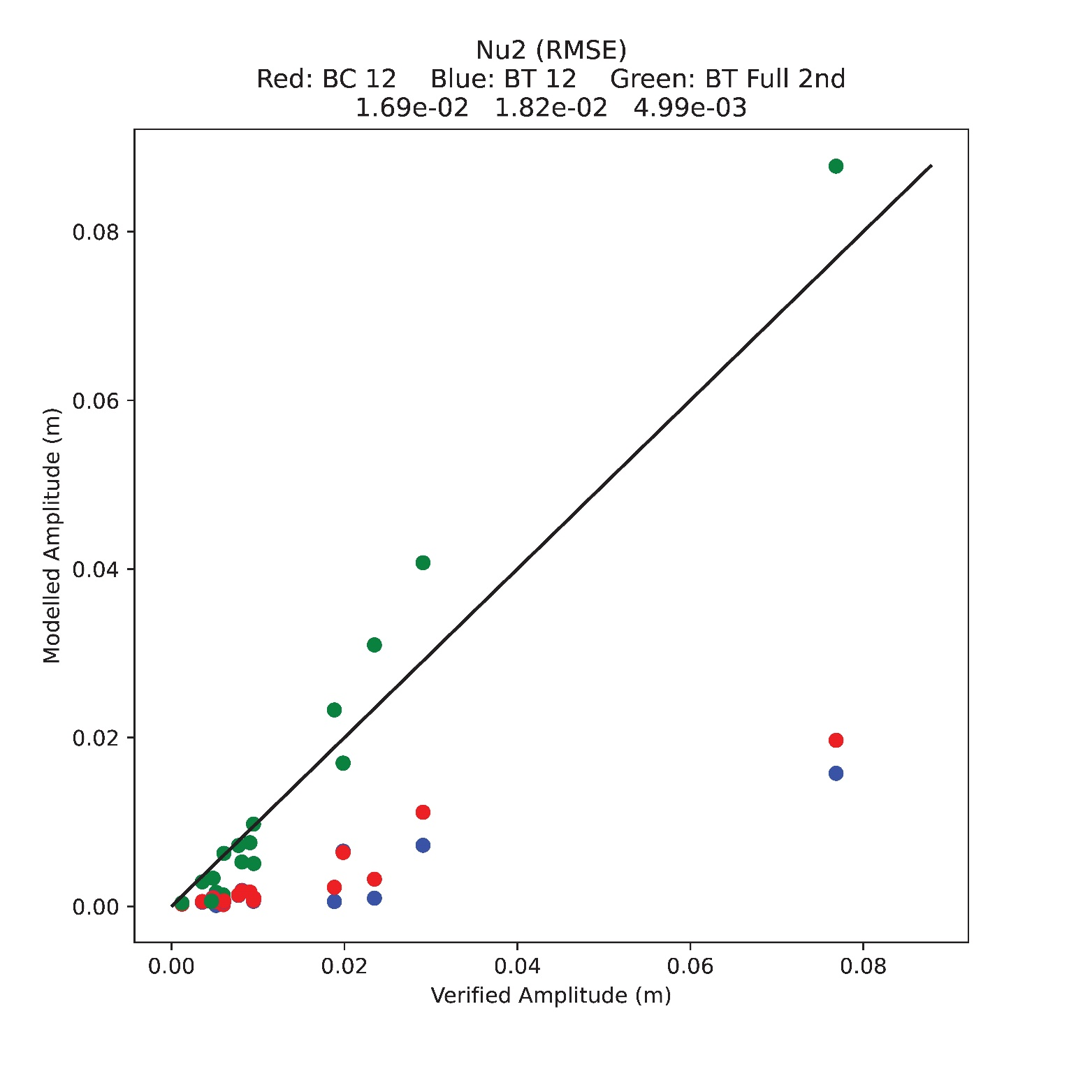
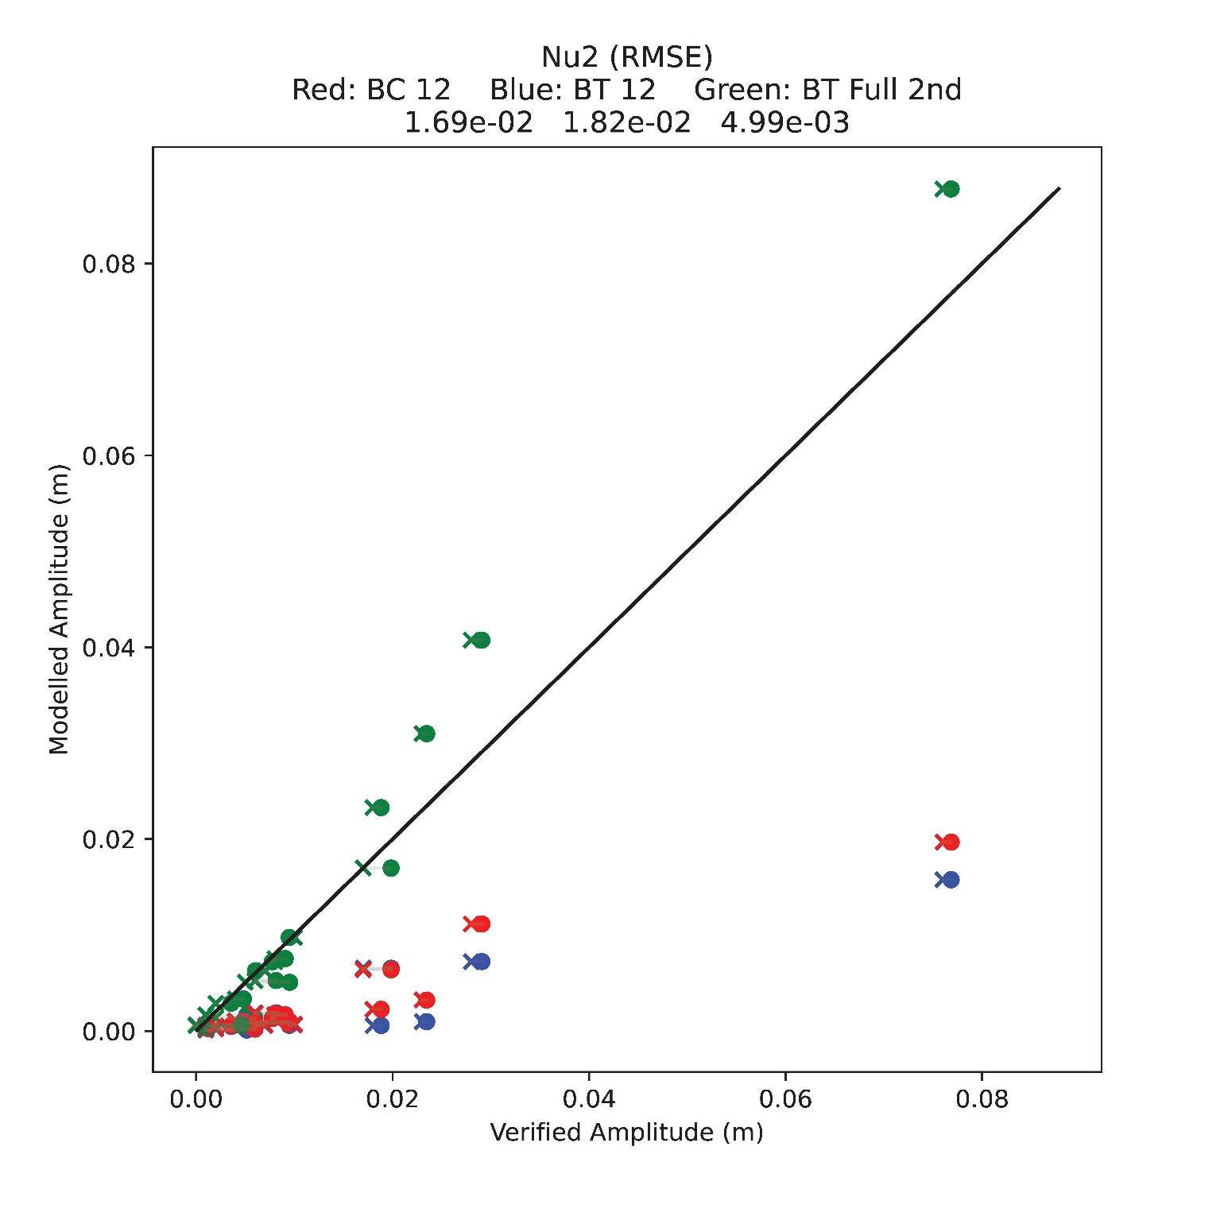
STOFS 2D⁺ Global: Implementation of full luna-solar tidal potential
37 constituent Pytide analysis of 2017
NOAA Co-op published values
Baroclinic 12 forced harmonics constituents
Barotropic 12 forced harmonic constituents
Barotropic Full 2nd order

Slide 28
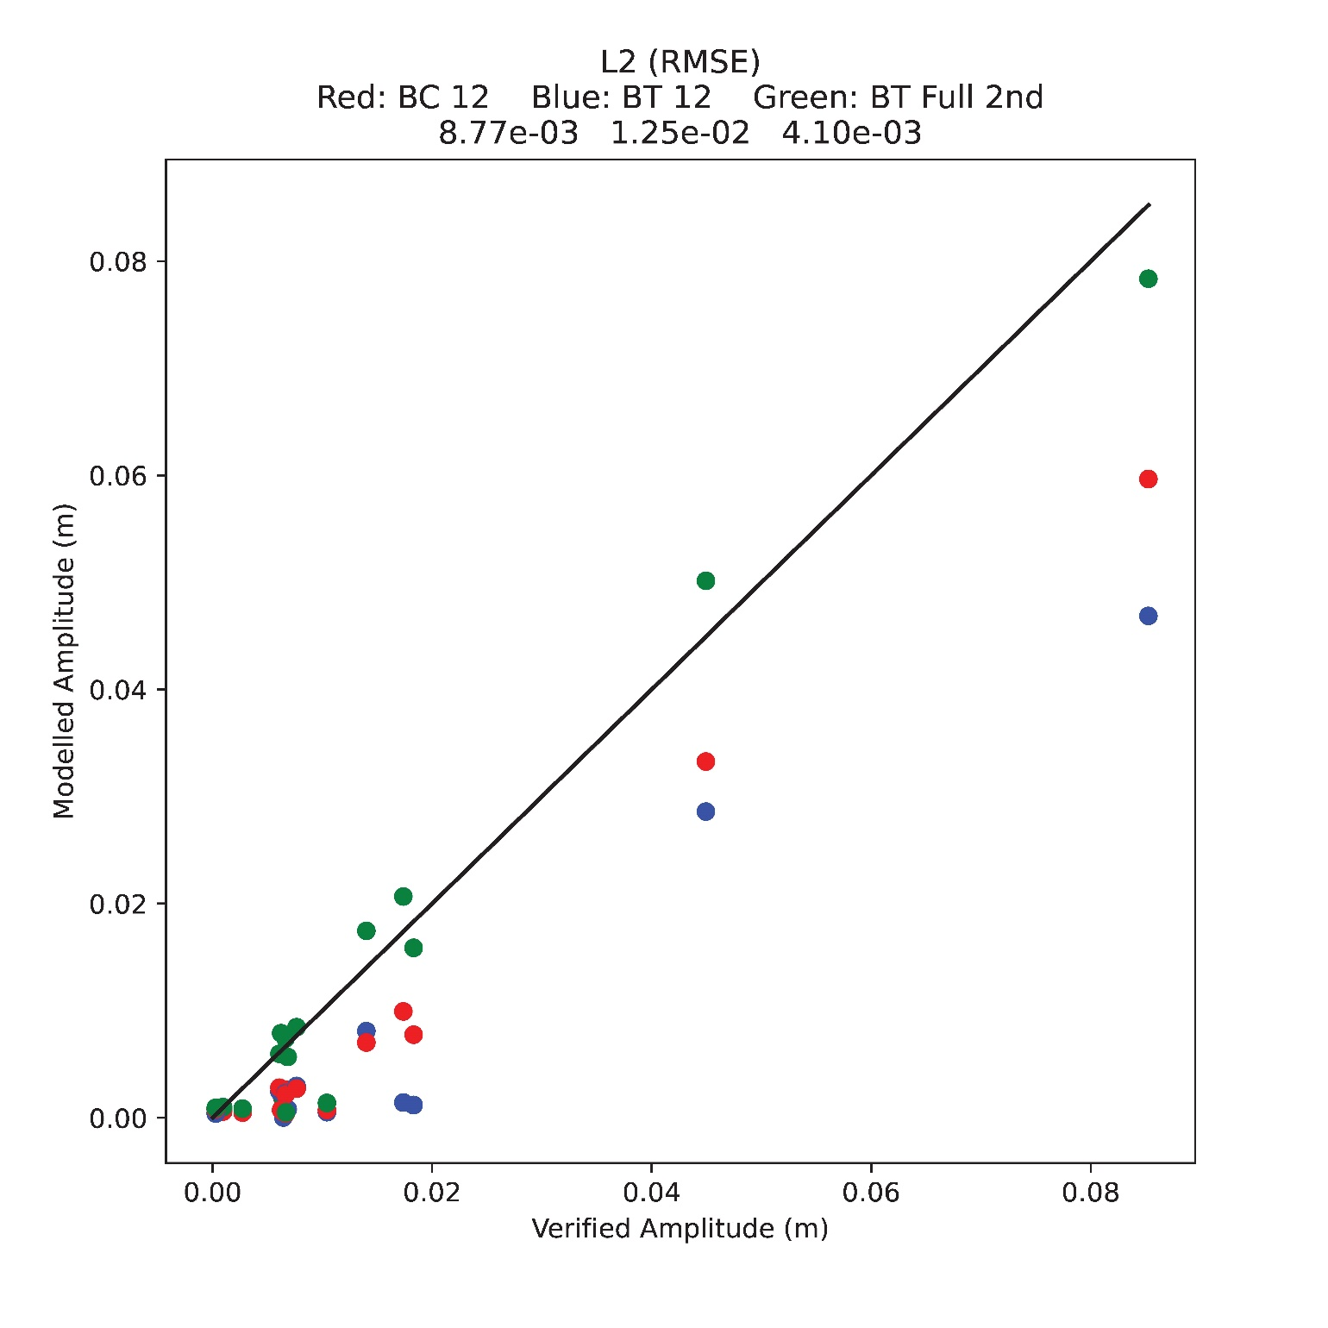
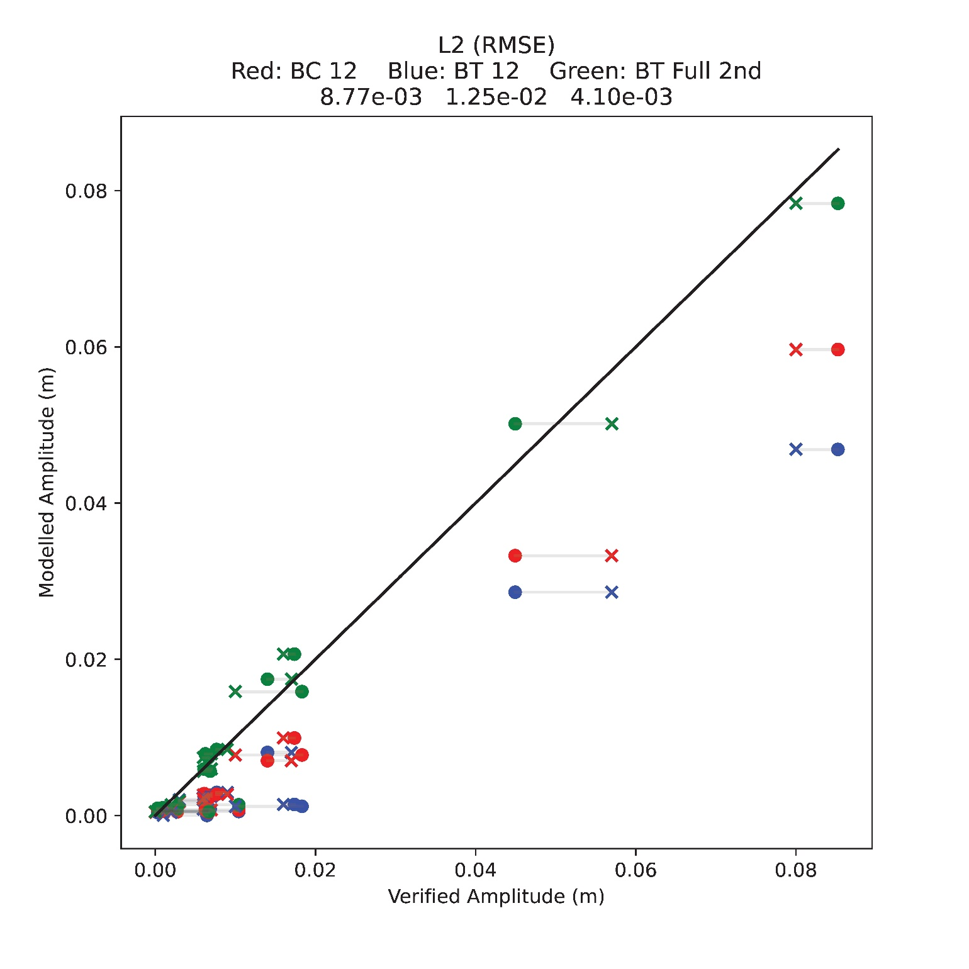
STOFS 2D⁺ Global: Implementation of full luna-solar tidal potential
37 constituent Pytide analysis of 2017
NOAA Co-op published values
Baroclinic 12 forced harmonics constituents
Barotropic 12 forced harmonic constituents
Barotropic Full 2nd order

Slide 29
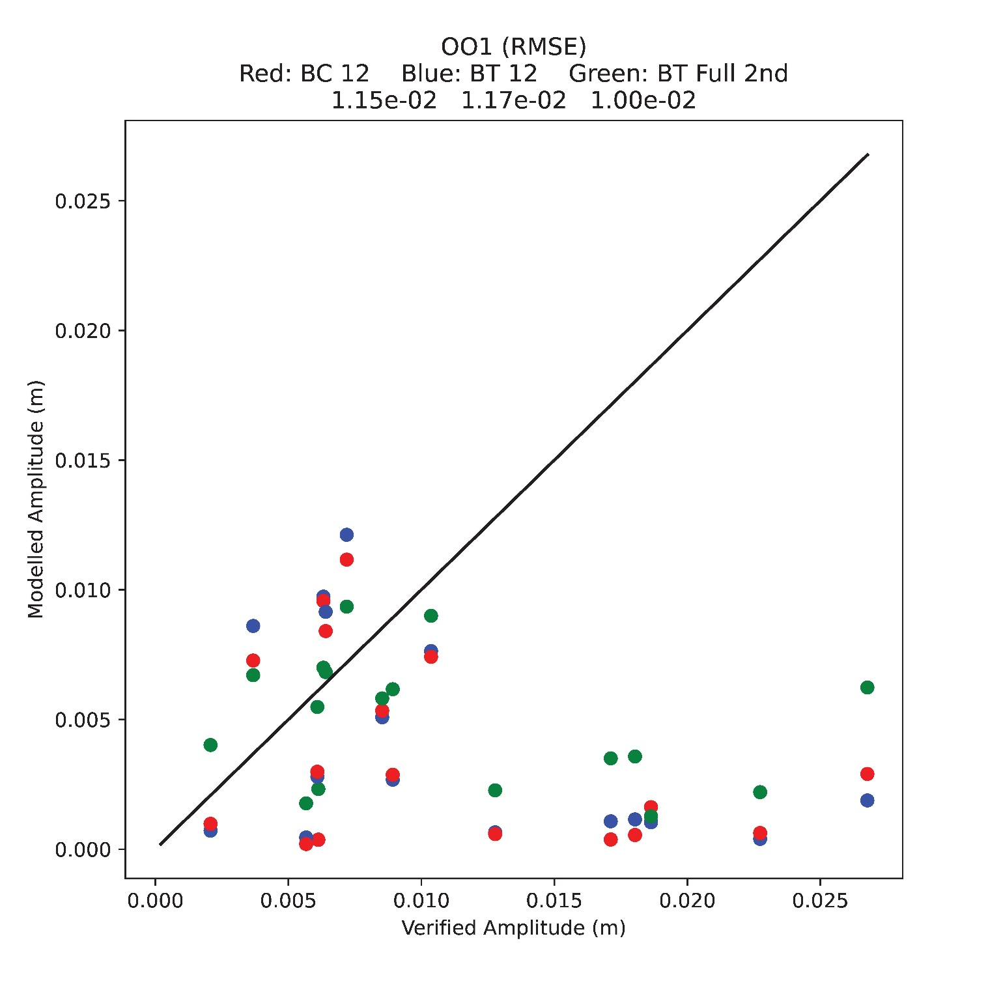
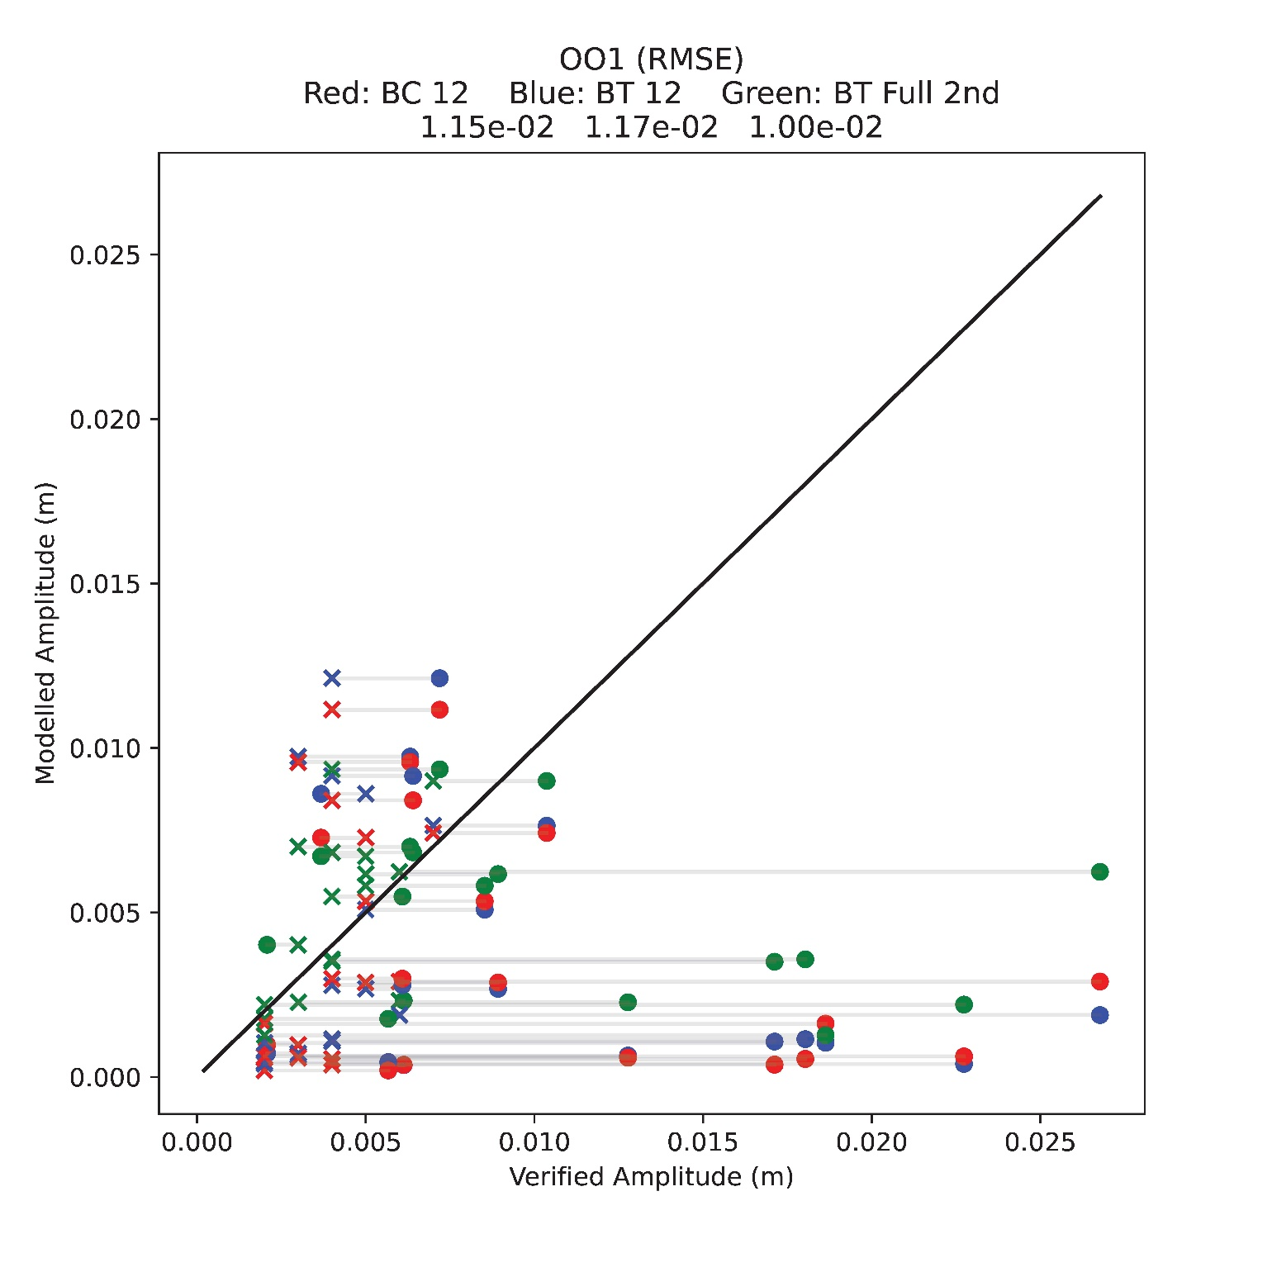
STOFS 2D⁺ Global: Implementation of full luna-solar tidal potential
37 constituent Pytide analysis of 2017
NOAA Co-op published values
Baroclinic 12 forced harmonics constituents
Barotropic 12 forced harmonic constituents
Barotropic Full 2nd order

Slide 30
STOFS 2D⁺ Global: Thermohaline + full luna-solar tidal potential
Baroclinicity significantly modifies water levels relative to the model's Geoid. Comparing the 12 constituent baroclinic to the 12 constituent barotropic simulations:
  At 214 NOAA CO-OPS stations peak water levels for 2017 changed by as much as 0.82 m and on average 23% (ranging from 0.4% to 240%)
Full lunar solar direct tidal forcing significantly modifies water levels relative to the model's Geoid. Comparing the full second order barotropic to the 12 constituent barotropic simulations:
  At 214 NOAA CO-OPS stations peak water levels for 2017 changed by as much as 0.33 m and on average 4.6% (ranging from 0.03% to 30%)

