Slide 1
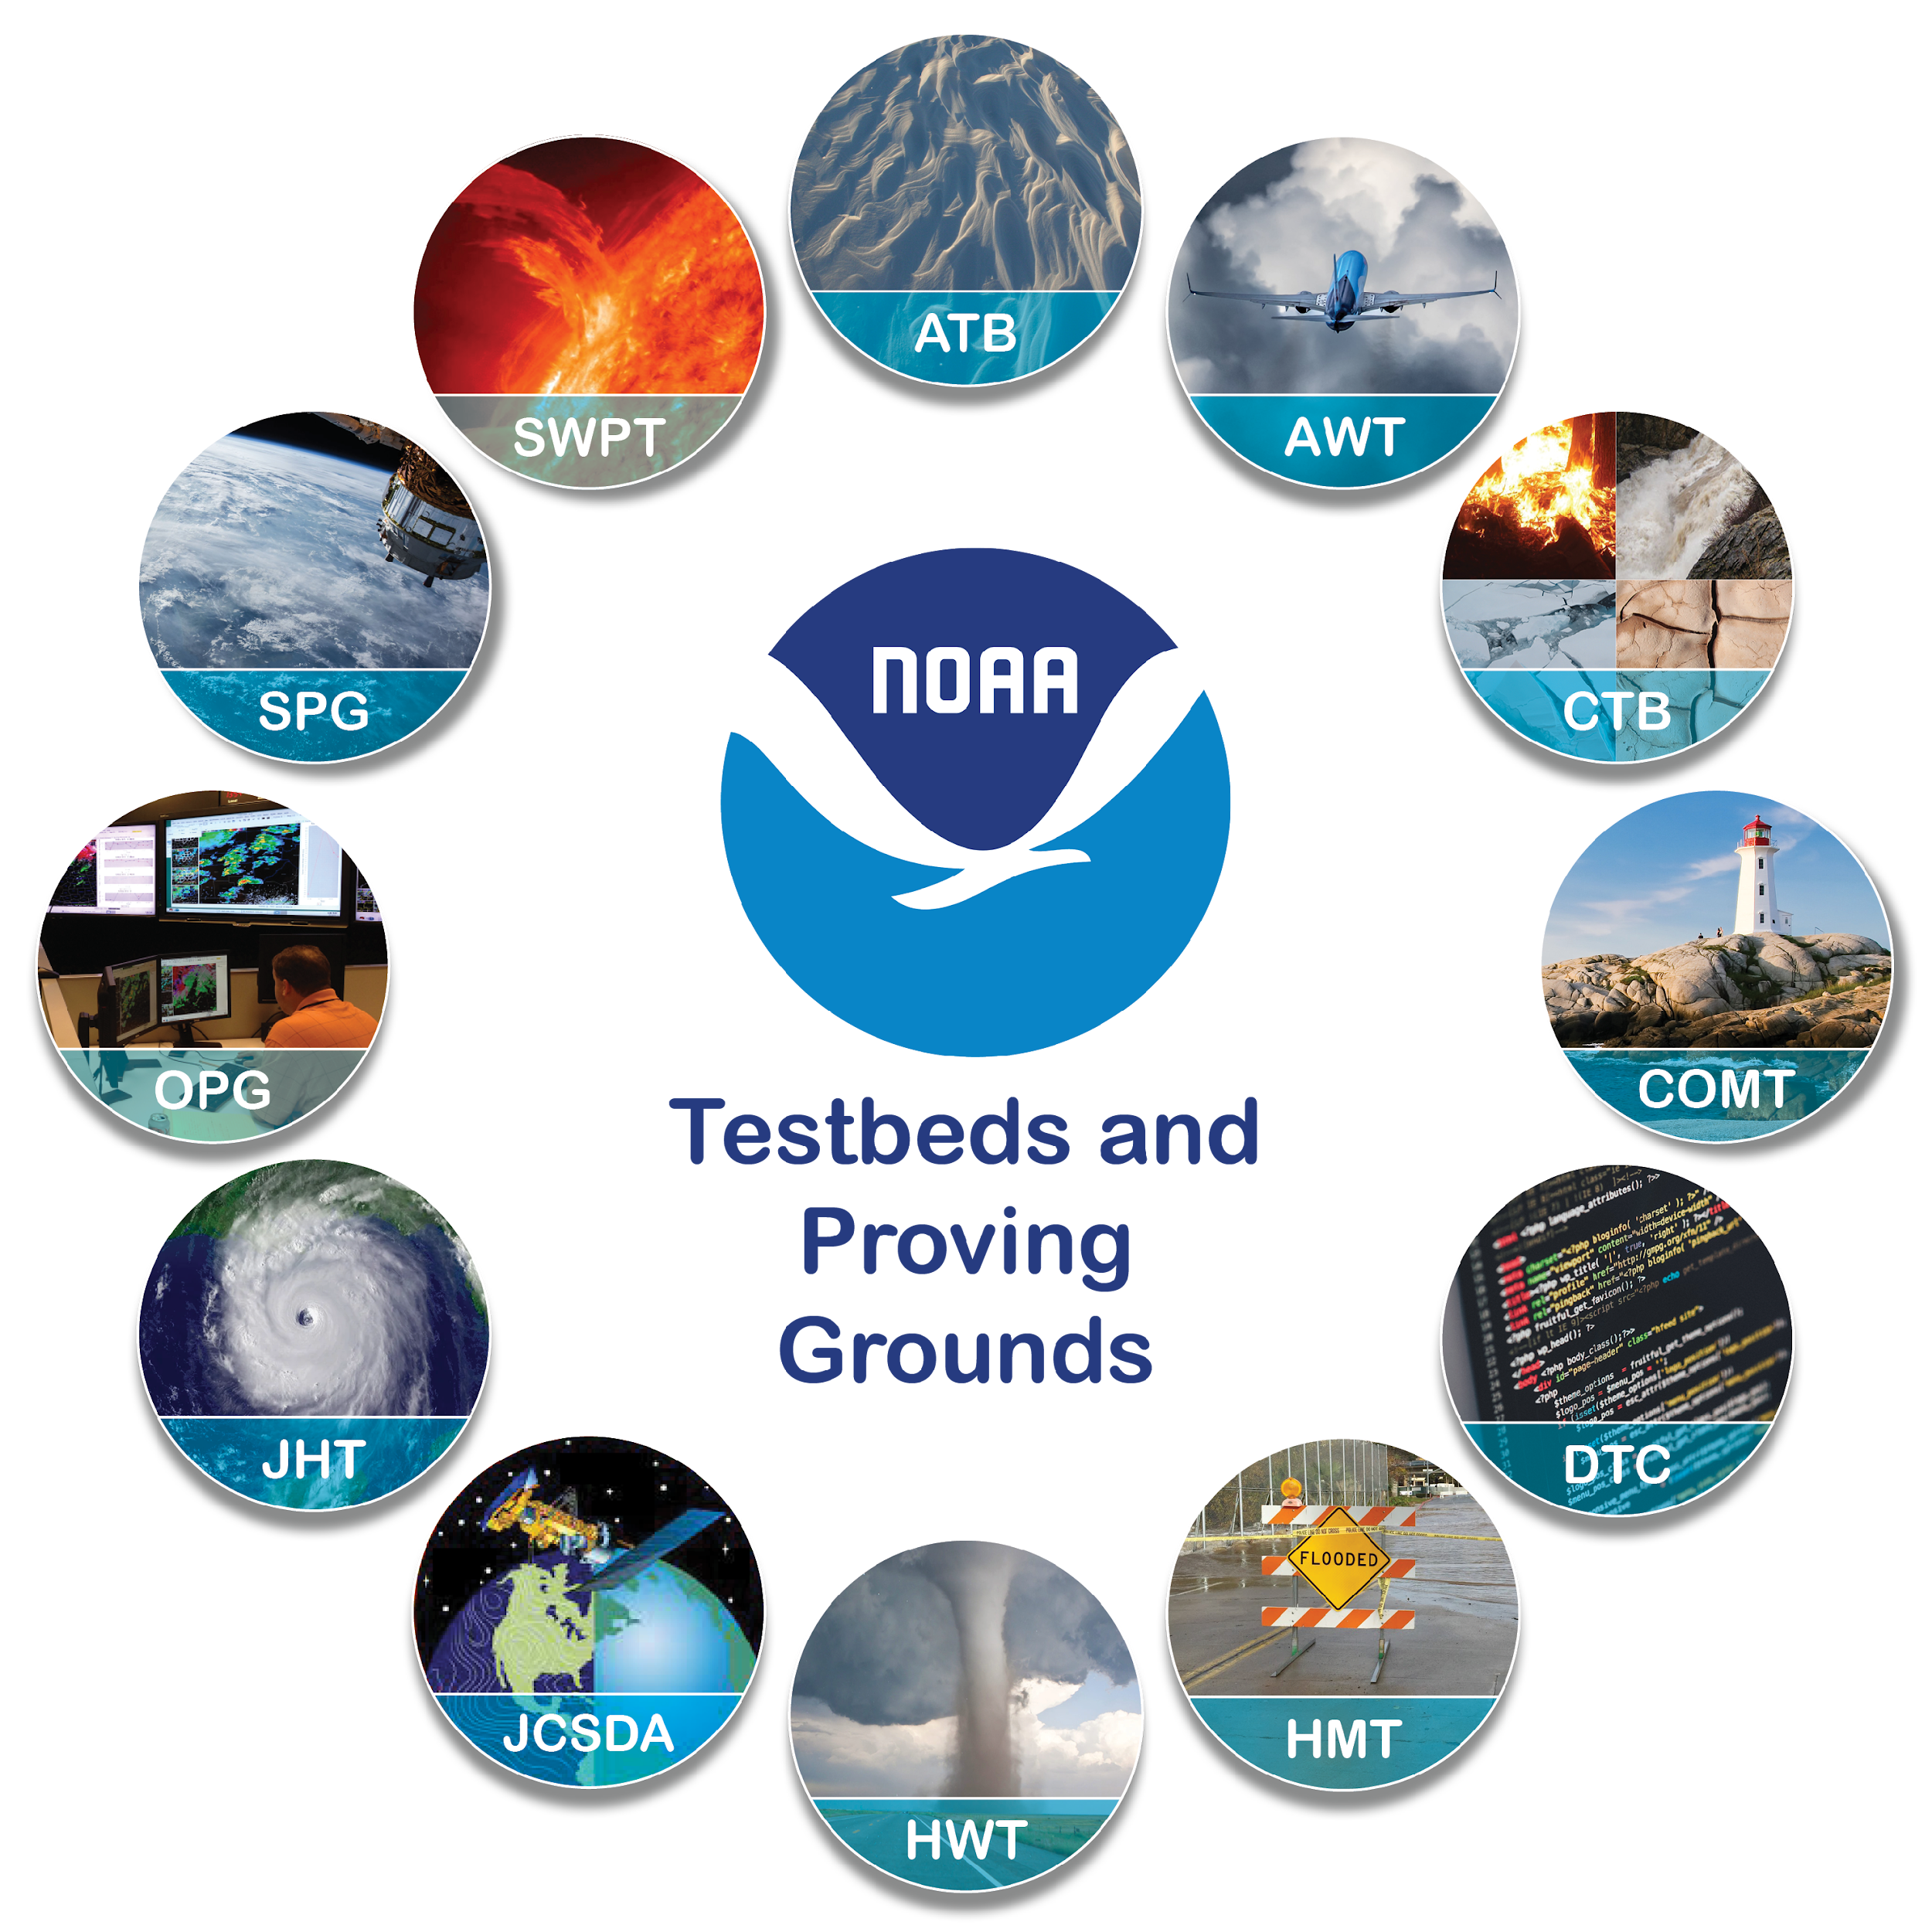
The NOAA Testbeds & Proving Grounds: A Crucible for Transitions between
Research & Operations
Andrea Ray, Chair, TBPG Coordinating Committee (OAR/PSL & HMT)
J.J. Brost, Vice-Chair (NWS/STI/OPG)
Arctic Testbed, Aviation Weather Testbed
Climate Testbed, Coastal & Ocean Modeling Testbed, Developmental Testbed Center,
Fire WeatherTestbed, Hazardous Weather Testbed, Hydrometeorology Testbed, Joint Center for Satellite Data Assimilation, Hurricane Ocean Testbed, Operations Proving Ground
Satellite Proving Ground, Space Weather Testbed
UICFW, draft for 2024
Notes:
Presentation for the NOAA Booth at AMS, Jan 11,, 2023

Slide 2
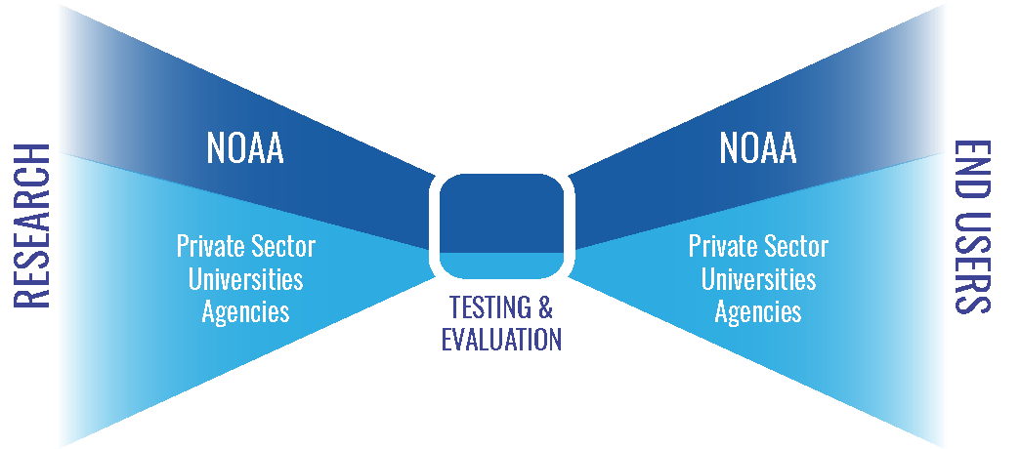
Testbeds & Proving Grounds (TBPGs) sit at a
critical node in NOAA Research to Operations (R2O)
and iteration with research (O2R)
TB & PG terms are used in other contexts, these are:
Multi-project efforts that are ongoing partnerships between research & operations, aimed at improving or creating new operations & operational products in NWS (incl WFOs and National Centers), NOS and NESDIS
TBPG’s facilitate the orderly transition of research capabilities to operational implementation through testing and evaluation (T&E)
They are a major facilitator of R2O, moving through “funnel” – and of O2R, operations informing research
T&E
“Brings tech stuff to the world” - including post-processed and IDSS-relevant variables from model output including UFS
Online Portal: Charters & links to the 12 NOAA TB & PGs: www.testbeds.noaa.gov
Notes:
After slide from Readiness Levels workshop, May 2020, presentation by Dr. Gary Matlock; graphic from that presentation
NOAA’s mission: science, service, and stewardship
1. To understand and predict changes in climate, weather, oceans and coasts
2. To share that knowledge and information with others
3. To conserve and manage coastal and marine ecosystems

Slide 3
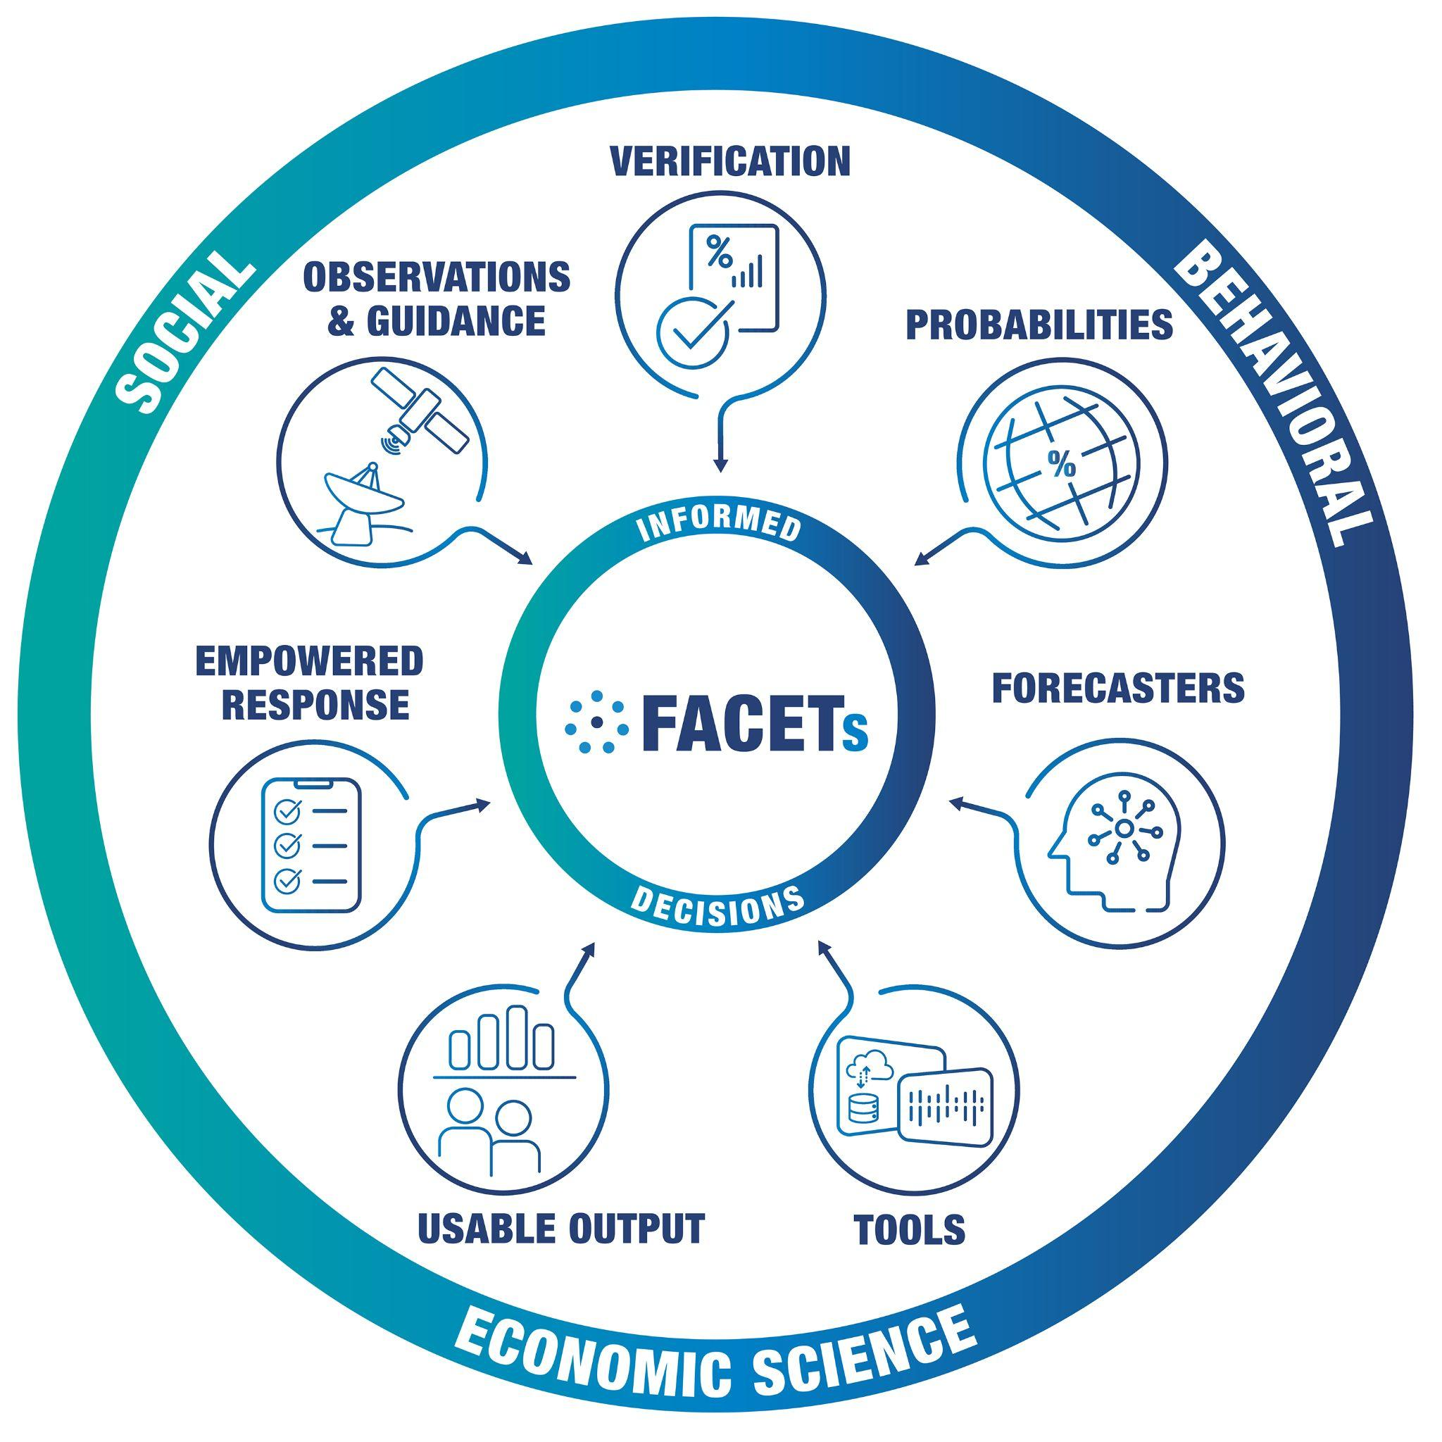
Why?? TBPGs “bring tech stuff into the world”
Foundation for Impact-Based Decision Support Services (IDSS)
Gaps Filled by Probabilistic Datasets & products
Use Probabilistic Impact Information to Drive Messaging
Outlooks raise awareness and guides Watch issuance collaboration
Watches issued at moderate probability of event or impact
Warnings issued at high probability of event or impact
Forecasting a continuum of
environmental threats (FACETS)
Notes:
Forecasting a continuum of environmental threats

Slide 4
R2O2R in Testbeds: Integral to UFS development
Data assimilation (COMT DA algorithms, DTC*, JCSDA*)
Physics testing (multiple TBs, incl CTB)
Verification - includes how innovations affect IDSS-relevant variables and products
Hurricane and Ocean TB (HOT) , DTC*, HMT, HWT
RRFS testing across mult TBs, incl Aviation Wx, HWT, HMT
RRFS “Mitigation efforts” white paper - result of T&E back to 2017
HMT UFS modifications to alleviate issues (RRFS precip rates)
Diagnostics packages tailored to UFS - DTC*, Climate TB diagnostics for S2S
Develop, demonstrate/evaluate probabilistic products & ProbIDSS based on UFS output - most TBs
Not just, and probably rarely, linear – eval over multiple years, comparison among multiple innovations, iteration with researchers and developers “O2R”
Engage community - forecasters, universities, external to NWS
*note: DTC and JCSDA will be discussed in other talks in this session
Notes:
verification, in particular, how do model innovations influence
specifics, see notes: https://docs.google.com/document/d/1xCup_TGgBkKgW5sylvQscpNkQ8Zr_kornS3GBv--q2U/edit
Some activities beyond “testing in a quasi-operational environment”
Identify new techniques, tools, models, observing systems, etc. with potential for improving forecast guidance and products
Software development to prepare for testing
Prepare documentation, assist with training
Engage other TBPGs, EMC, NCEP Central Ops, NOS OCS & COOPS and others as needed for the path for transition to occur
…and their NOAA and external collaborators

Slide 5
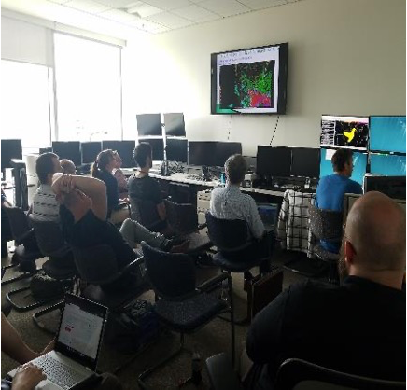
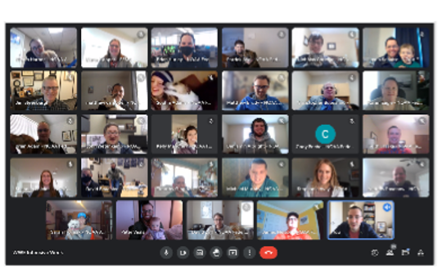
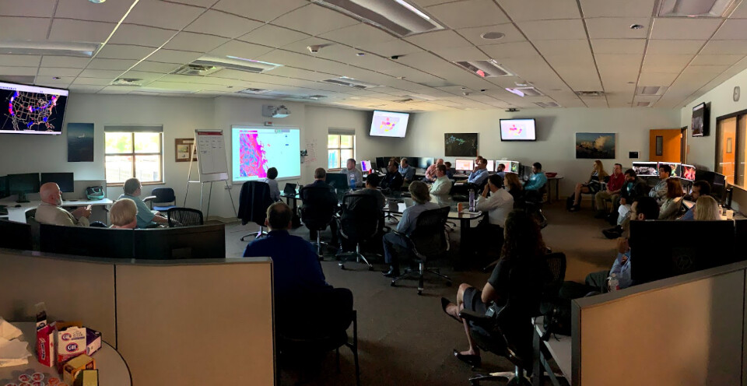
How do they do this?
Most conduct experiments for T&E, many have training component, e.g.
HMT Winter Weather and Flash Flood & Intense Rainfall Expts
HWT Experimental Forecast & Experimental Warning Programs
Aviation weather, Arctic, and Space Wx experiments with airlines
Operations PG: Readiness evaluations of innovations in a realistic environment mirroring WFOs, before formal deployment
and/or extended retrospective tests focused on robust sample sizes and objective verification metrics
A lot of collaboration among TBPGs, in particular OPG and SPG with others
Hands-on, and increasingly hybrid; WFO & forecasters often involved; and forecast-users, e.g. emergency managers, media, airlines
Notes:
https://www.testbeds.noaa.gov/ ; develops new Collaborative Forecast ProcessesMany have or developing social science components Most conduct experiments to test
HMT Winter Weather and Flash Flood & Intense Rainfall Expts
others: Arctic TB & PG > NWS Alaska Region
Coastal & Ocean Modeling TB > NOS coastal forecasting
Operations Proving Ground > WFO’s

Slide 6
T&E goes beyond quantitative
Often includes forecasters at National and WFO levels -
subjective evaluation of utility
Increasingly, bringing in external end users, e.g. emergency
managers, broadcasters, transportation managers
Focus groups - next slide
Integrating Social, Behavioral and Economic Sciences
results of these inform product development
and qualitative or subjective evaluation methods
For example, feedback from testbed experiments has proven to be an effective strategy for model developers to build into the annual development cycle of next-generation CAM systems. Feedback was systematically collected, assessed and addressed…testbeds brought in diverse stakeholders (i.e., operations, research, and academia) from their respective communities to offer an honest and unbiased perspective on the performance of CAM systems in a real-time, real-world setting - From Carley et al, 2023
Notes:
Thank you Kodi Berry for these findings on benefits; and to Wallace Hoggsett for the photo of HOT
Some findings of HWT on benefits of bringing end users in (from Kodi Berry, HWT)
Realism in testing helps identify, address, & mitigate factors that create the “valley of death” in transitioning R2O (Karstens et al. 2018)
Interaction between NWS forecasters and end users enables the generation of useful, usable, and understandable information (Karstens et al. 2018)
End-user engagement to the level of co-production results in a parallel increase in the use of products developed in those projects (Nygren et al. 2018)

Slide 7
Focus Groups with forecasters:
Hydromet TB Winter Wx Expt
Development of a Decision Support tool that provides a 0 - 100% probability that roads are subfreezing. (ProbSR; Reeves et al. JTTI)
Development of a Travel Component to the Winter Storm Severity Index (WSSI)
Based on 1h HRRR data
3 WSSI components
Snow amount (since initialization)
Snow rate (hourly)
Ice accumulation (since initialization)
Feedback on ensemble visualization & tools (Radford & Lackman, https://doi.org/10.1175/BAMS-D-22-0193.1)
Notes:
Feedback on ensemble visualization & tools (Radford & Lackman - published?)

Slide 8
Recent TBPG R2O2R related to UFS:
A few examples
Coastal and Ocean Modeling TB (COMT) - DA
Climate TB (CTB)- Physics testing
Hurricane and Ocean TB (HOT) - HAFS
Aviation Weather TB, Hydrometeorological TB (HMT) & Hazardous Wx TB - RRFS
*note: DTC and JCSDA will be discussed in other talks in this session
…and their NOAA and external collaborators

Slide 9
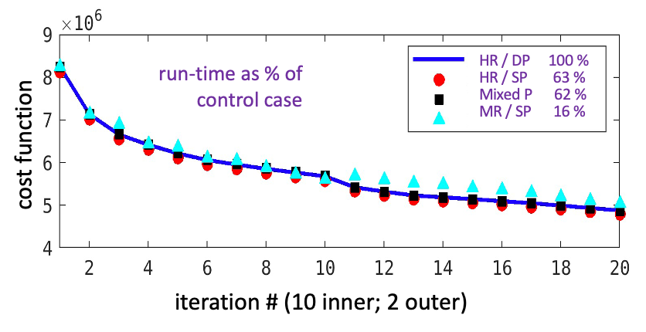
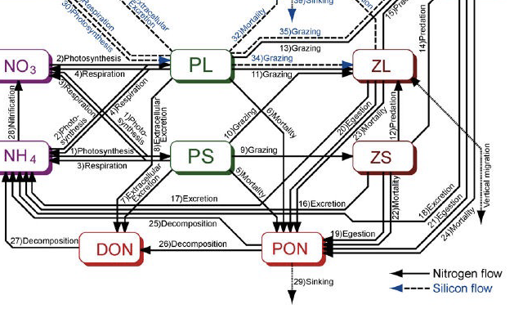
Coastal and Ocn Modeling TB: Improving DA algorithms for U.S. West & East coast ocean forecast systems
Multi-resolution & mixed precision ROMS 4D-Var
• Faster run time and/or more resolution
Time- and space-averaged observation operators
• Maximize information content: of time and space averaged data (e.g., low-passed HF-radar, gridded mesoscale altimetry, microwave satellite SST)
Ecosystem/BGC modeling with WCOFS
• Better physics to inform better bio: UC Santa Cruz NEMURO coupled BioGeoChem model with physics DA
ROMS 4D-Var sandbox
• Community crowdsourced development
Transition activities (make it relevant)
• (i) Stakeholder workshop – prioritize opportunities for follow-on products & capacity building; (ii) Training on use of ROMS 4D-Var using Cloud Sandbox
Mixed Resolution Single Precision (MR/SP) takes only 16% the runtime of operational WCOFS HR/DP (High Res. Double Precision) to obtain same DA solution.
Biogeochemical model run in WCOFS domain with physics initial/boundary conditions from operational DA
*see coastal and marine talks, Wednesday
Notes:
updated July 2024

Slide 10
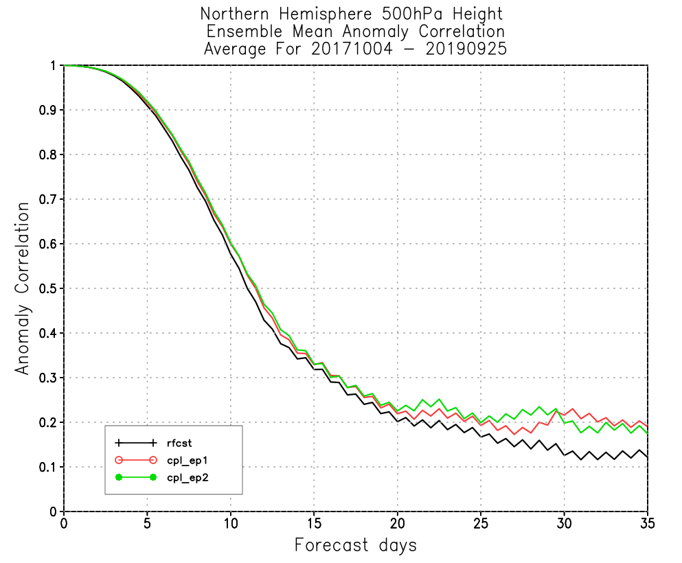
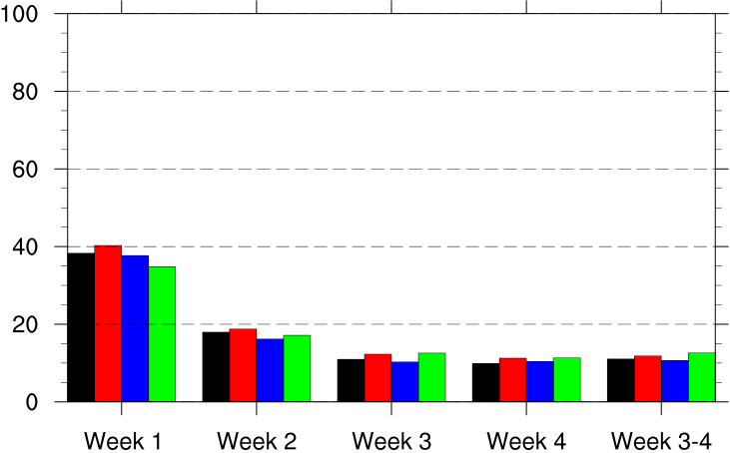
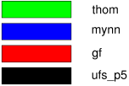
Climate TB PhysicsTesting & Diagnostics
OAR/WPO funded projects with development directly targeting UFS improvements
Swapping out physics schemes in UFS prototypes. Thompson was tested, evaluated well, and is being implemented in NCEPs GEFSv13/GFSv17 (left)
Making the prototypes into Ensembles (EP1, EP2, EP3). Ensembling strategy worked out by CTB is being used for GEFSv13 (right)
Developing MJO-Teleconnections diagnostics packages tailored for S2S
Thanks to M. Rosencrans, CTB and Dr. B. Green, GSL
Notes:
The two projects from this slide & see below for update for 2024:
Ben Green (PI) and Vijay Tallapragada - Swapping out physics schemes in UFS prototypes (most work done with P3 and P5, some with P7, then contractor turnover and funding lapse hit before P8 was finalized. Thompson was tested, evaluated well, and is being implemented in NCEPs GEFSv13/GFSv17.
Xin-Zhong Liand (PI) and Yuejian Zhu - Making the prototypes into Ensembles (EP1, EP2, EP3). Ensembling strategy worked out in this project is being used for GEFSv13.

Slide 11
Hurricane & Ocean Testbed (HOT):
Role in the Operational HAFSv2 Evaluation
HAFSv2 in Cloud AWIPS
In advance of the operational HAFSv2 implementation, the HOT team worked with National Hurricane Center (NHC) staff and the NOAA Environmental Modeling Center (EMC) to:
Acquire a 3-year sample of retrospective forecasts
Assess critical performance metrics for operational use
Track, intensity, structure, rapid intensification, etc.
Evaluate the impact of HAFSv2 on downstream multi-model statistical guidance
Implement upgrades to the NHC model suite on WCOSS
Test and configure HAFS data in Cloud AWIPS system to prepare for operational implementation
Evaluation was led by Jon Martinez (CIRA/NHC) and NHC’s Technology and Science Branch (TSB)
Will be evaluating HAFS ensemble this season in HOT (Jaiyi Peng’s talk)
Notes:
to be updated for 2024 by Wallace Hoggsett, NHC & HOT; note Sarah Ditchek's project is a WPO-funded Testbed project, so we're working very closely with her. Jiayi Peng's talk on the HAFS ensemble is highly relevant -- we'll be evaluating it this year in cloud AWIPS via the HOT.

Slide 12
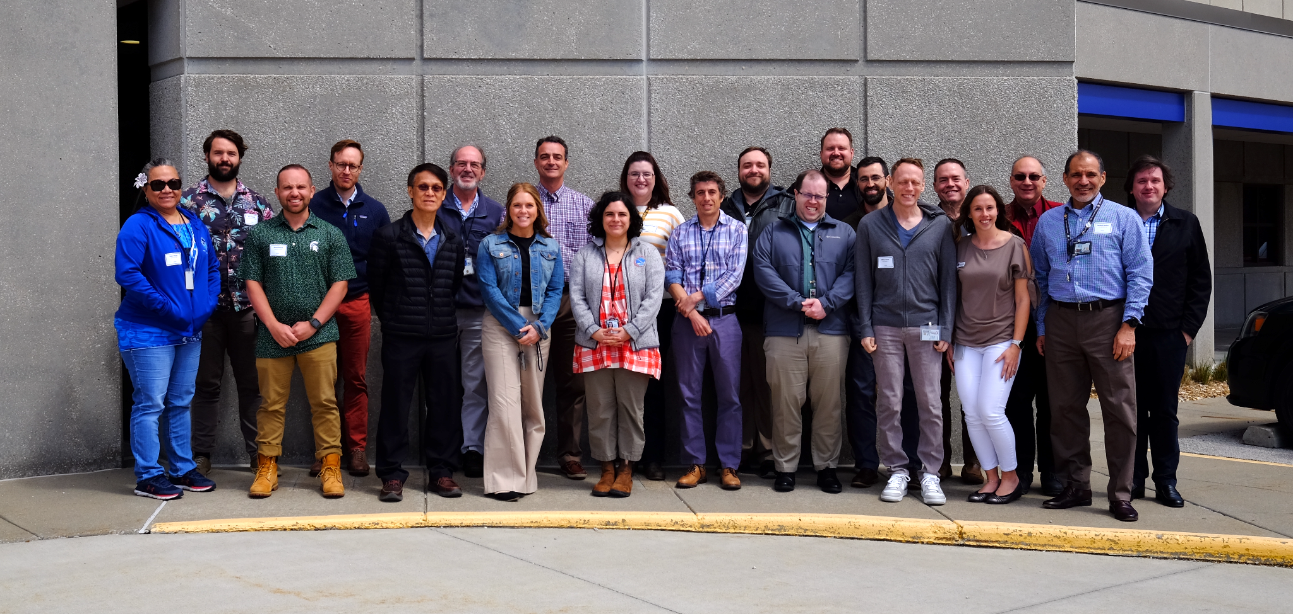
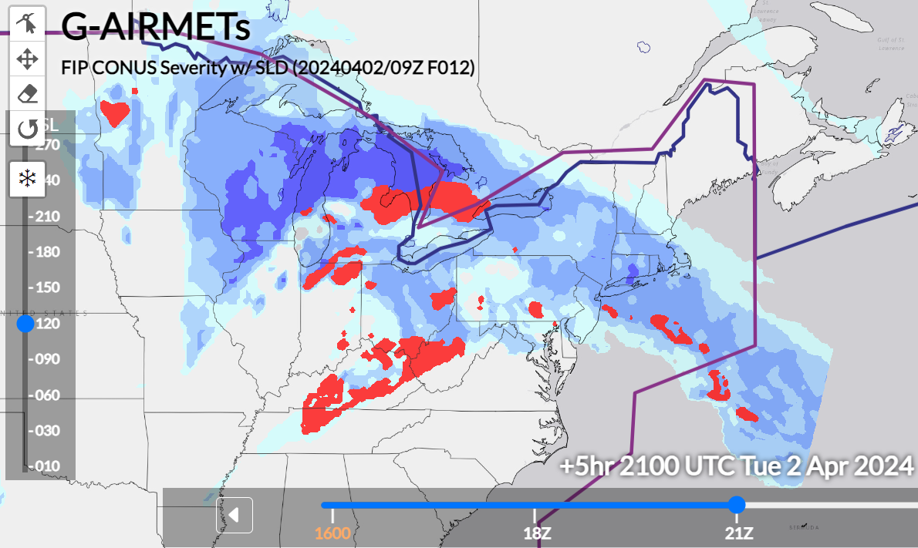
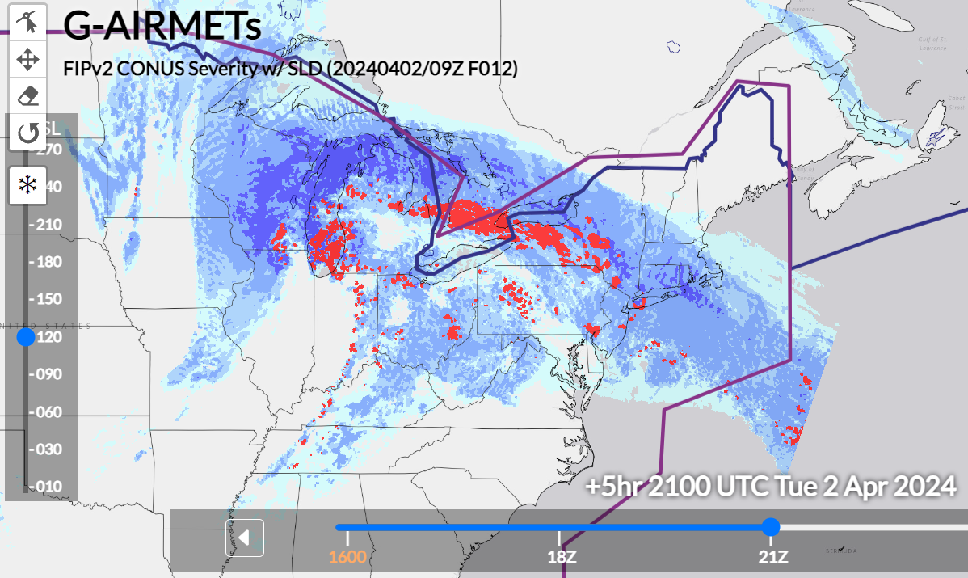
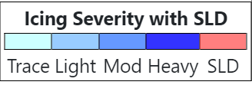
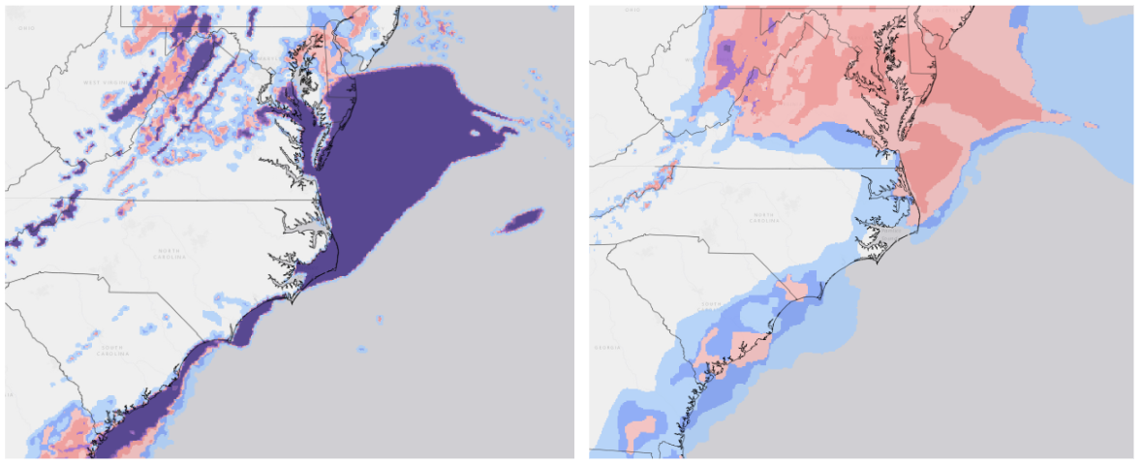
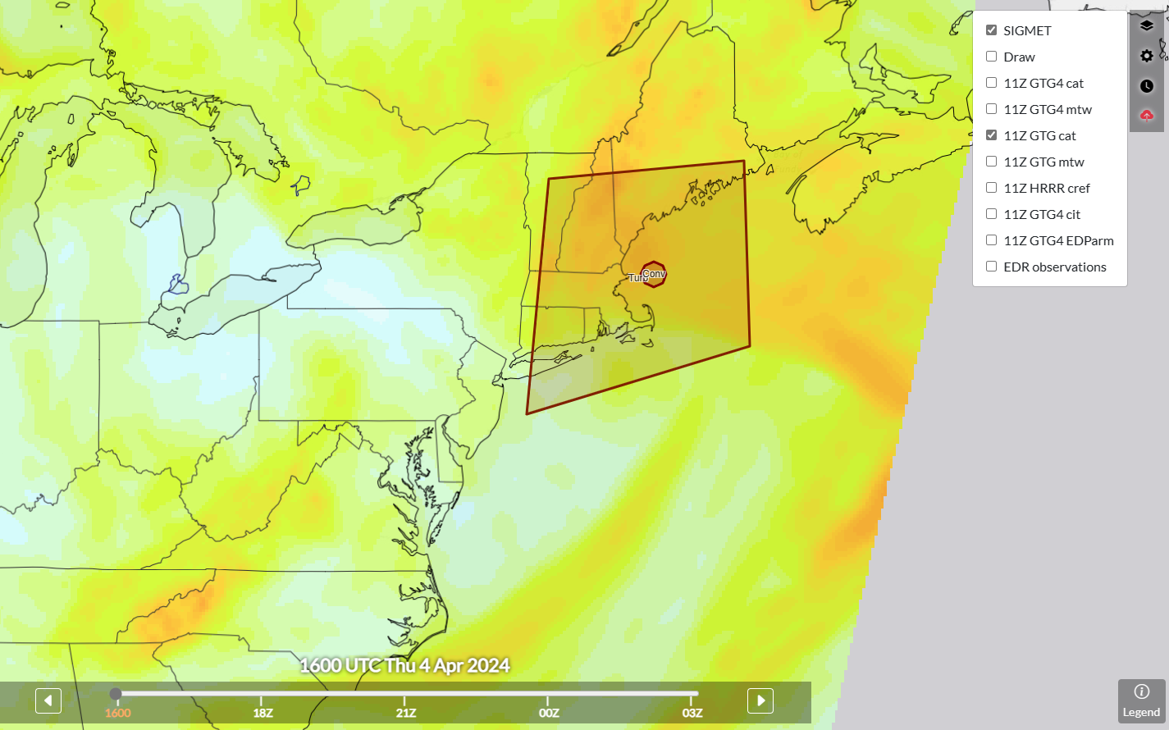
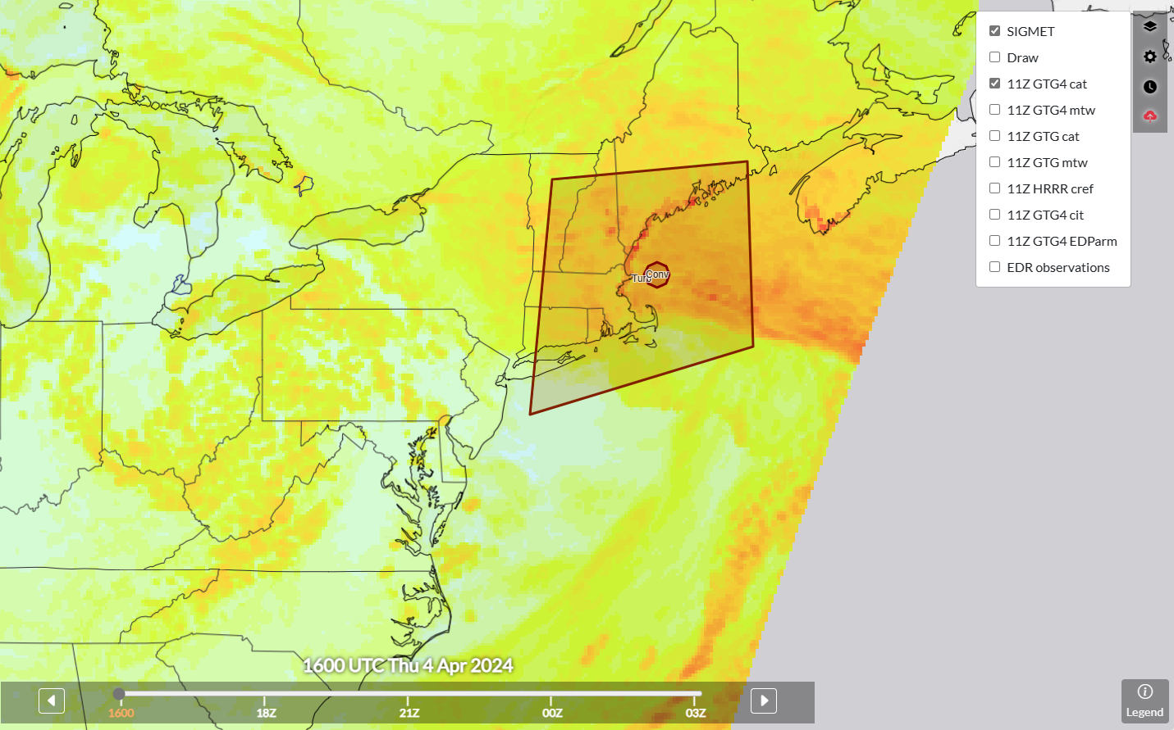
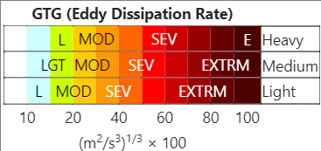
Aviation Wx TB Spring Experiment
April 2-4, 2024
Themes
Examine ways to enhance collaboration between AWC and CWSUs/WFOs
Evaluate Rapid Refresh Forecast System (RRFS) and RRFS post processed algorithms (FIPv2 and GTG4) for use in AWC G-AIRMET production (Icing, IFR, Turbulence)
RAP based FIPv1 (left) and RRFS based FIPv2 (right) icing severity output
RRFS (left) and LAMP (right) deterministic visibility output
RRFS output can often be very binary with its depiction of flight restrictions, especially over bodies of water, often going from no restrictions to the lowest threshold over a very short spatial distance.
RAP based GTG3 (left) and RRFS based GTG4 (right) EDR output
RRFS based FIPv2 & GTG4 capture large scale details very similarly to their RAP based predecessors. Increased resolution helps capture finer scale influences of convection & terrain.
Notes:
Thanks to Stephanie Avey of AWT for these slides

Slide 13
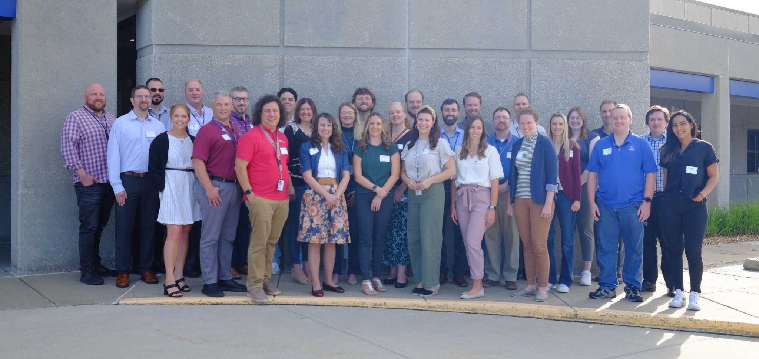
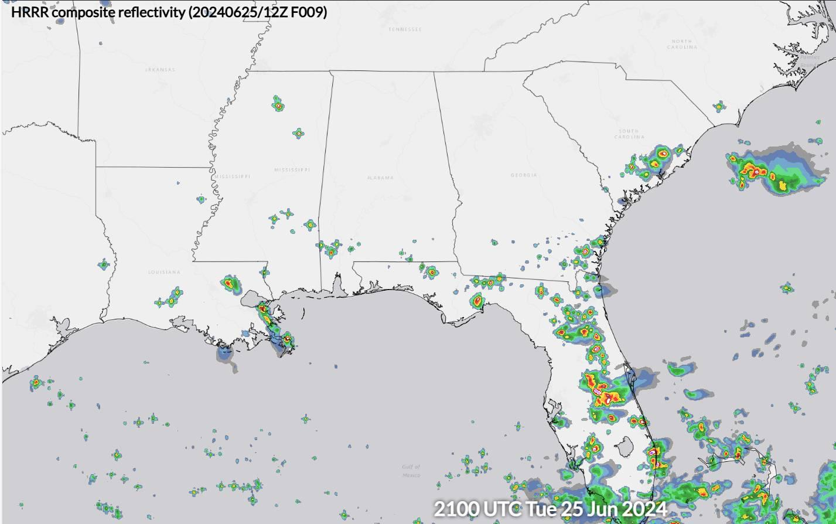
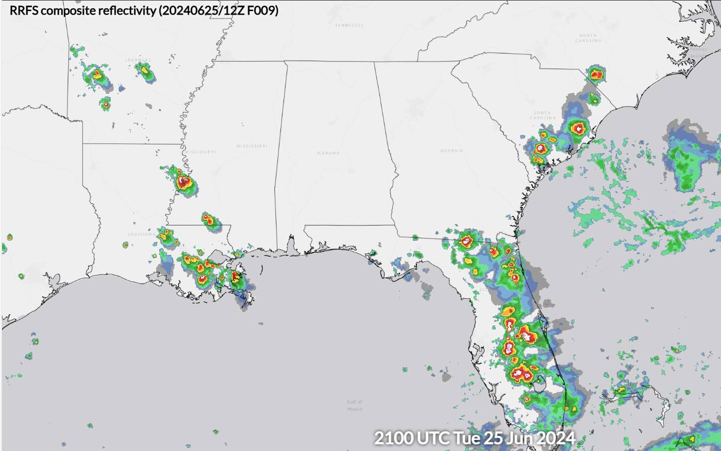
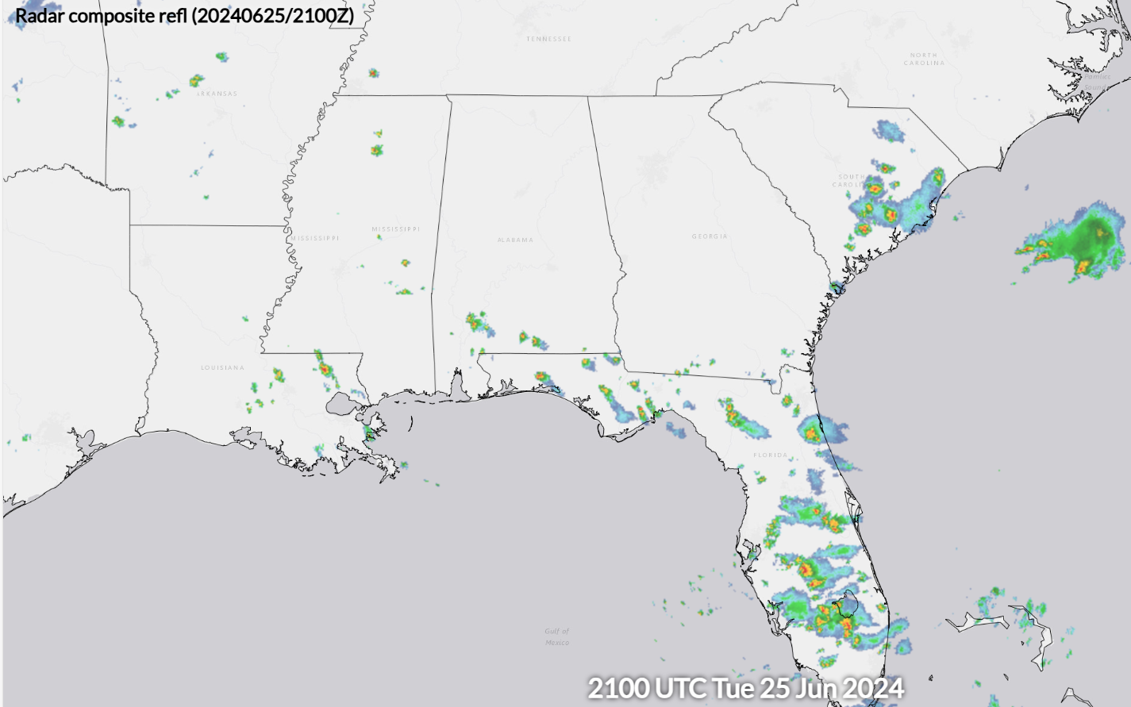
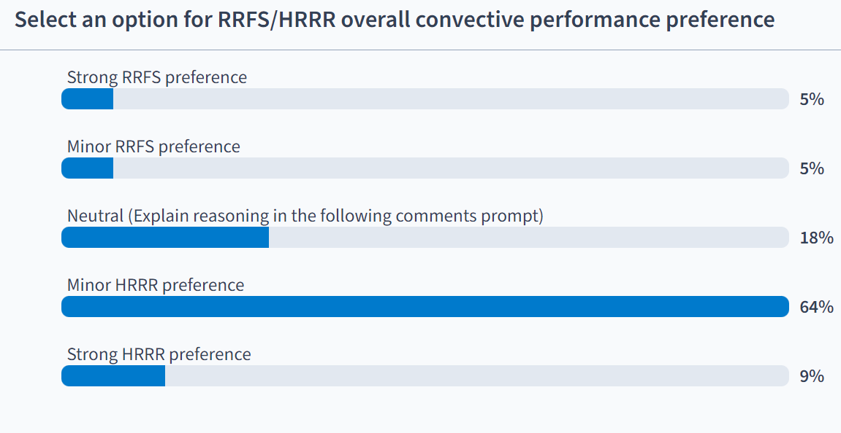
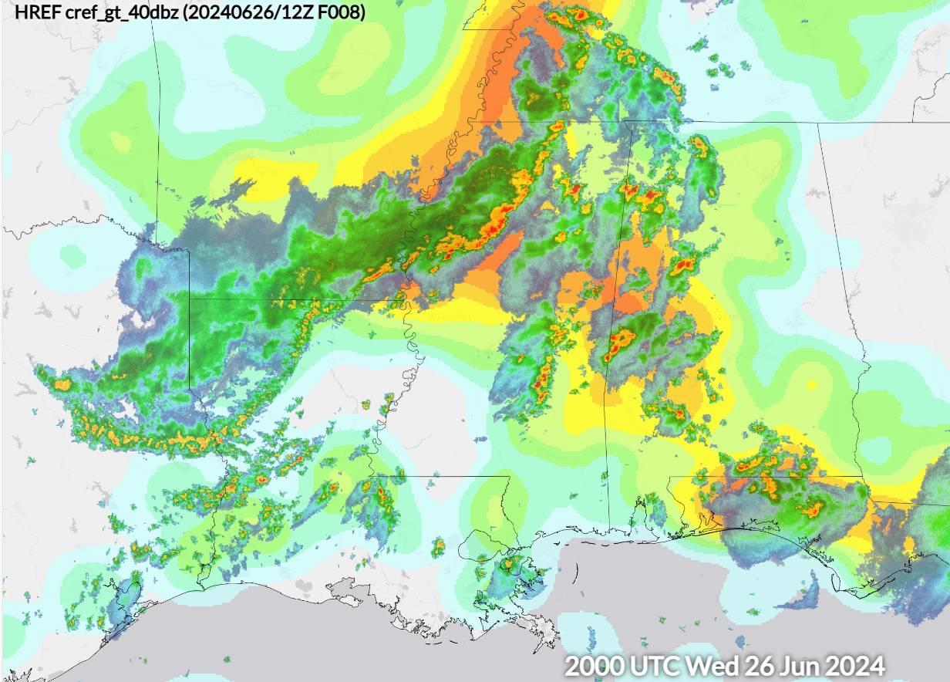
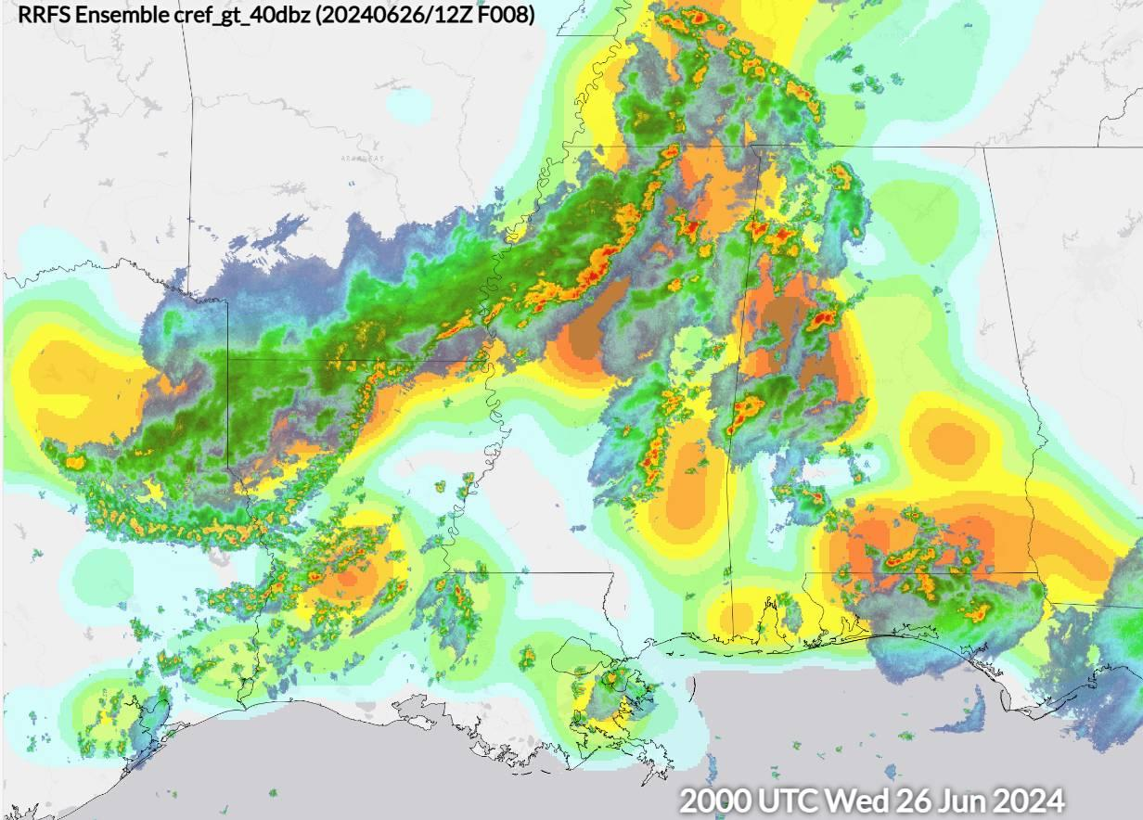
AWT Summer Experiment
June 25-27, 2024
Themes
Evaluate workflows of proposed AWC Collaborative Aviation Forecast (CAF) and National Aviation Operations Center (NAOC) desks
Evaluate RRFS convective guidance suite for use in AWC Traffic Flow Management Convective Forecast (TCF) production process
Deterministic RRFS & REFS individual ensemble members
REFS post processed probabilistic composite reflectivity and echo top guidance
Participants found the REFS probabilistic output generally did as well as the HREF, often even capturing things which the HREF missed. When looking at the 5 individual RRFS based REFS members, significant differences were noted between members which used NSSL and Thompson microphysics.
Participants found the deterministic RRFS produced too much convection with overly large cores in the southeast. This behavior would have a large impact on AWC TCF forecasts, of which convective coverage is a primary focus.

Slide 14
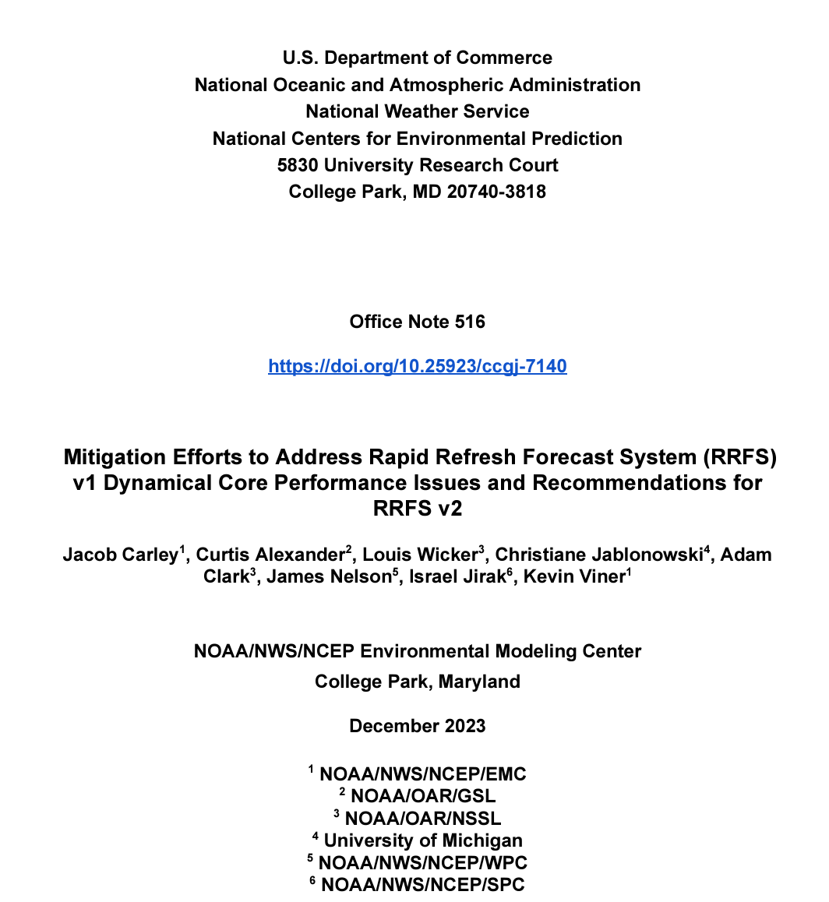
Hydromet TB & Hazardous Wx TB evaluate RRFS
Beginning in 2017, HWT, and in 2018, HMT have evaluated FV3 CAMS runs in a series of Spring Forecast Expts and Flash Flood and Intense Rainfall Experiments.
Contributed to and co-authors of RRFS White Paper*
*Carley et al,,2023, https://repository.library.noaa.gov/view/noaa/56514
Notes:
Jirak and Clark will talk about 2024 SFE Thurs a.m.

Slide 15
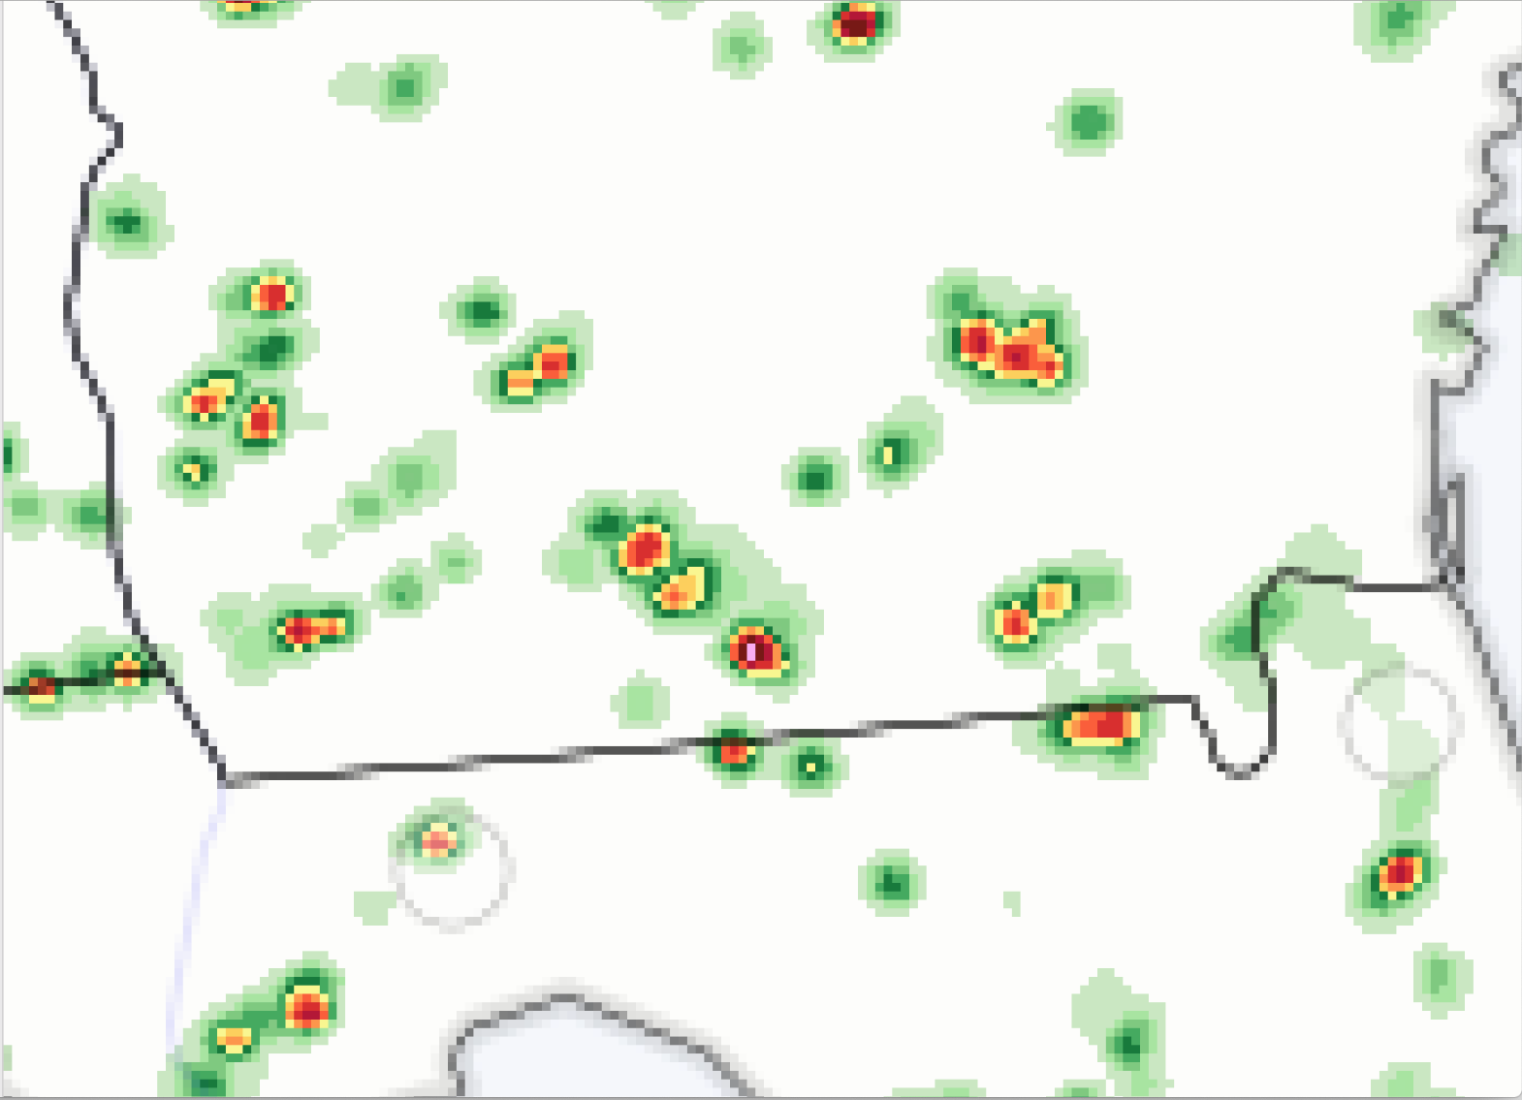
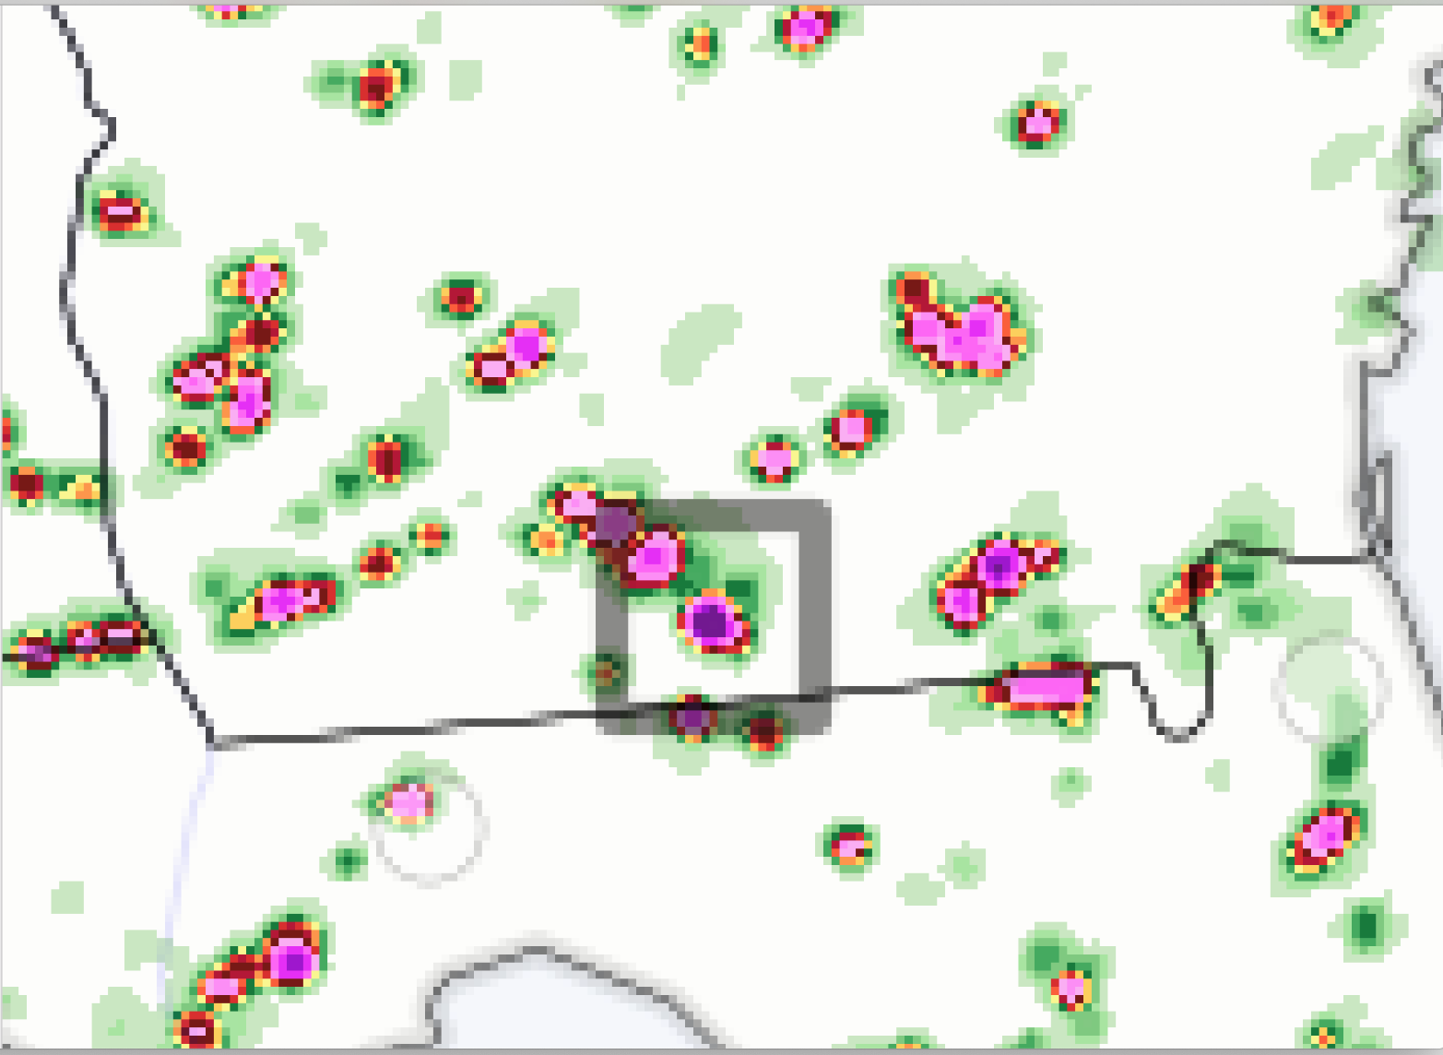
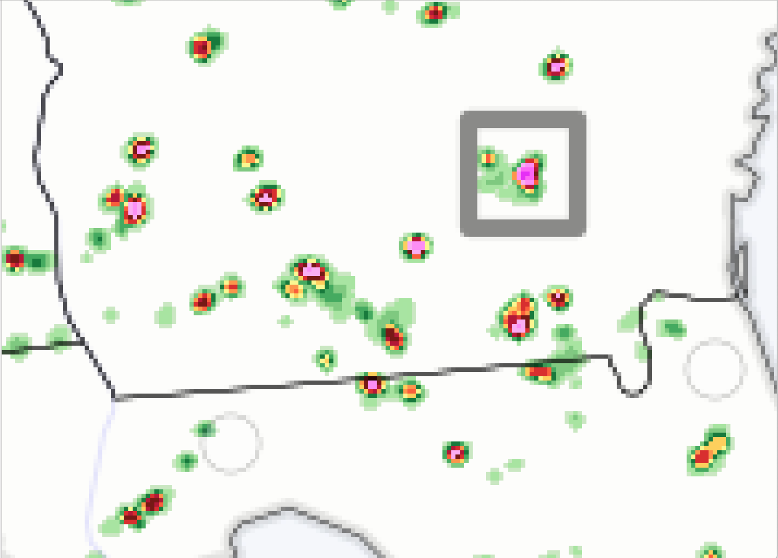
Hydrometeorology Testbed (HMT)
The Hydrometeorological Testbed Mission: To evaluate & potentially implement new technology, research results, and other scientific advancements from the research & development (R&D) communities to enhance NWS products & services.
Precip
Contributions in the R2O2R FV3 dycore (GFS and RRFS)
Evaluation of RRFS since 2018 (winter and summer precipitation forecasts)
Evaluation of HAFS QPF
WoFs Evaluation
Contribute to development of the Weather Prediction Center’s Excessive Rainfall Outlook (ERO, next slide)
Realistic Or Not? Large amounts of rain in a short period of time with these storms
4-5”
PMAX
Prate
10.63”
31.15”
3-4”

Slide 16
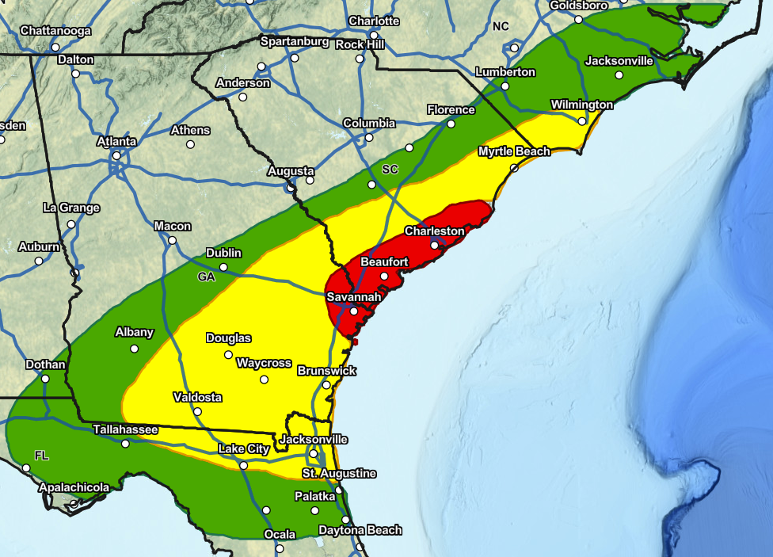
ERO Day 1: MAKE COPY OF SLIDE, then edit blurb and crop/zoom into the main threat area (optional)
MODERATE
RISK OF EXCESSIVE RAINFALL
Monday, July 1
FLOOD POTENTIAL
A Moderate Risk (Level 3 of 4) is in effect Monday across portions of eastern Georgia and southern South Carolina. Potent slow moving thunderstorms Monday afternoon and evening will be capable of producing hourly rain totals up to 3 inches. Areas most at risk to flooding are poor drainage areas, along creeks and streams, and in more urbanized environments. Some flooding may be significant.
Be Prepared!
Stay weather aware and have multiple ways to receive warning notifications
NEVER drive or enter into a flooded road
Turn Around, Don’t Drown
Risk of excessive rainfall leading to flash flooding:
HIGH: At Least 70% SLIGHT: At Least 15%
MODERATE: At Least 40% MARGINAL: At Least 5%
For more info visit: www.wpc.ncep.noaa.gov
NOAA NWS Weather Prediction Center
ISSUED: Sunday, June 30 2024
Notes:
ERO Day 1:

Slide 17
Engaging the Community: over 700 indiv/year
experiments-trainings-workshops-other activities
~100 WFO, CWSU & NCEP forecasters/year, Alaska Aviation Wx Unit (AAWU)
Many universities including NCAR & Coop Institutes
Broadcast meteorologists
Diverse emergency managers
Airlines (Flight Operations, Flight Safety, Dispatch, Meteorology), Pilots Union & Air Traffic Management and Communications Groups
NASA, USAir Force, USNavy, FAA, USForest Service & Nat’l Interagency Fire Ctr
MITRE & other private sector incl space wx providers;
International: UK Met Office, Australian Met Bureau; Space Weather Operations and Scientists from Canada, and the UK
North American Ice Services (US National Ice Center, Canadian Ice Services, and Alaska Sea Ice Program), Alaska Ocean Observing System, Alaska communities & indigenous groups, Alaska Marine Exchange and Skipper's Science (NGO)
Notes:
draft
Coastal and Ocean Modeling TB (COMT)
Developmental Testbed Center (DTC)
Satellite Proving Ground (SPG)
Hydrometeorological TB (HMT)
Climate TB (CTB)
…and their NOAA and external collaborators

Slide 18
NOAA TBPG Coordinating Committee
A venue for coordination, collaboration, synergies &
learning among individual TB/PGs
Identify opportunities for collaboration
Network for addressing common issues and opportunities
Annual & monthly meetings
Subcommittee of the NOAA Line Office Transition
Manager Committee (LOTMC)
Online Portal includes Charters & links to the TB & PGs https://www.testbeds.noaa.gov/
Notes:
https://www.testbeds.noaa.gov/

Slide 19
In closing
Most TBPGs already have activities supporting UFS development or UFS-based products & are willing partners
Only a few examples here
Have capabilities that can directly support/benefit UFS
Robust T&E processes already being used for UFS
Access to forecasters and other users who can provide meaningful feedback to UFS development at different stages for different hazard scenarios & IDSS-relevant metrics
Engaged with SBES - both implementing findings and generating SBES science
Probabilistic products are a major focus
Work with us - start talking to us early so we know your schedule for innovations needing T&E, so we can get activities on calendars, and talk with our funders about your priorities
NOAA Weather Program Office (WPO) funding opportunity expected out in August includes Testbeds

Slide 20
Thank you
https://testbeds.noaa.gov
Andrea Ray (Chair, OAR/PSL & HMT)
J.J. Brost (Vice-Chair, NWS/STI/OPG)
For the TBPG community: Kodi Berry (OAR/NSSL & HWT), Chris Siewert (NWS/SWPC & SWTB), Jordan Dale (OAR/WPO), Tracy Fanara (NOS/IOOS & COMT), Dan Lindsey (NESDIS & SPG), Satya Kalluri (NESDIS), Patrick Marsh (NWS/SPC & HMT), Gene Petrescu & Rebecca Mazur (NWS/Alaska Region & ATB),
Louisa Nance (NCAR/RAL & DTC), Jim Nelson (NWS/WPC), Matt Rosencrans, (NWS/CPC & CTB), Joshua Scheck (NWS/AWC & AWT), Peter Stone (NOS), Jim Yoe (NCEP & JCSDA), Wallace Hogsett (NWS/NHC, JHT/HOP), & our support staff: Abby Arnold (Exec. Sec, FedWriters, Inc. & Katie Geddes, Groundswell, both supporting OAR/ORTA)
Presentation at the UICFW, July 24, 2024

Slide 21
EXTRAS and other examples
Notes:
this prompted an idea that TBPGs are more a carpool lane than an express lane – with all the collaboration and interaction of a getting in a car for a road trip!

Slide 22
What else are they?
Interactive- Crucible - Facilitator
Developers
Forecasters (National center)
Public(s)
Forecasters (WFO)
and like a road trip together, there are often discoveries along the way
Notes:
Thanks to J. Correia for the upper left graphic, originally for HMT

Slide 23
Subjective & qualitative evaluation of RRFS: comments from Hydromet TB 2022 experiment participants
“The RRFSs generally performed similar to the NAM. They both had pros and cons. One thing that stuck out for me was that while the NAM has high rain rates, the RRFSs have even higher rain rates.”
“One bias I generally noticed from the RRFSp1 and p2 was the tendency to over forecast coverage and rainfall maxima pockets for the pulse thunderstorm convection over the Texas/Louisiana/Arkansas Gulf Coast area. Otherwise it handled the northeast CONUS convection and southwest convection fairly well.”
“RRFS seemed to really overdo precip accums, especially in moist air masses like with the tropical system or the southeast.”
“Overall, I thought it was too popcorny and wasn't showing enough more organized thunderstorm clusters.”
“Toward the end of the week, I gained some confidence in relying more on them (RRFSp#s) for guidance in my forecasting.”
“Most of the time the smaller clusters of convection were drier/smaller in area than the MRMS verification, but the overall max on the grid seemed high/wetter.”
“The RRFS models tended to show heavy precipitation totals over a larger areal extent than was observed.”
“I am a bit sketchy on my memory, but I seem to recall being impressed by all of the RRFS runs.”
Another role & benefit: Introduce innovations to forecasters at national & WFO levels
Notes:
From Trojniak 2022 AMS talk
General feedback - wet biased, storms seem to be more isolated than clustered, but overall impressed with the RRFSp’s
differing from other years we are seeing the potential in the RRFS but still seeing some issues

Slide 24
However, no two are alike
Two are Multi-agency partnerships:
JCSDA: NOAA (NWS & NESDIS), NASA, Navy and US Air Force
DTC: NOAA, NCAR and US Air Force
COMT is a National Ocean Service grant program to support transition of models from research to operations in partnership with NOS modeling teams
NESDIS Enterprise Proving ground
The OAR Weather Program Office runs competitions aimed at four: CTB, HWT, HMT and HOT (formerly JHT); JTTI also funds projects at TBPGs
NWS/STI funds some NWS personnel and specific projects
Most are small and highly leveraged- the weather TBs in particular - operate on ~<$1M & 1-3 FTEs & soft-funded contractors, including some in-kind from OAR lab & NWS/NCEP center base
Most have SBES (social-behavioral-economic science) aspects, varying ways, e.g.
HWT and HMT have embedded social science staff
AWT works closely with FAA’s Aviation Weather Demonstration & Evaluation Services (AWDE) - Social sciences - user aspect.
Most are using the findings of social science funded separately
Both engaging in and using SBES
Notes:
https://www.testbeds.noaa.gov/ ; develops new Collaborative Forecast ProcessesMany have or developing social science components Most conduct experiments to test
HMT Winter Weather and Flash Flood & Intense Rainfall Expts
others: Arctic TB & PG > NWS Alaska Region
Coastal & Ocean Modeling TB > NOS coastal forecasting
Operations Proving Ground > WFO’s

Slide 25
TBPG R2O contributing to UFS - part 2
Some activities beyond “testing in a quasi-operational environment”
Identify new techniques, tools, models, observing systems, etc. with potential for improving forecast guidance and products
Software development to prepare for testing
Prepare documentation, assist with training
Engage other TBPGs, EMC, NCEP Central Ops, NOS OCS & COOPS and others as needed for the path for transition to occur
Notes:
external engagement moved to another slide
Coastal and Ocean Modeling TB (COMT)
Developmental Testbed Center (DTC)
Satellite Proving Ground (SPG)
Hydrometeorological TB (HMT)
Climate TB (CTB)
…and their NOAA and external collaborators

Slide 26
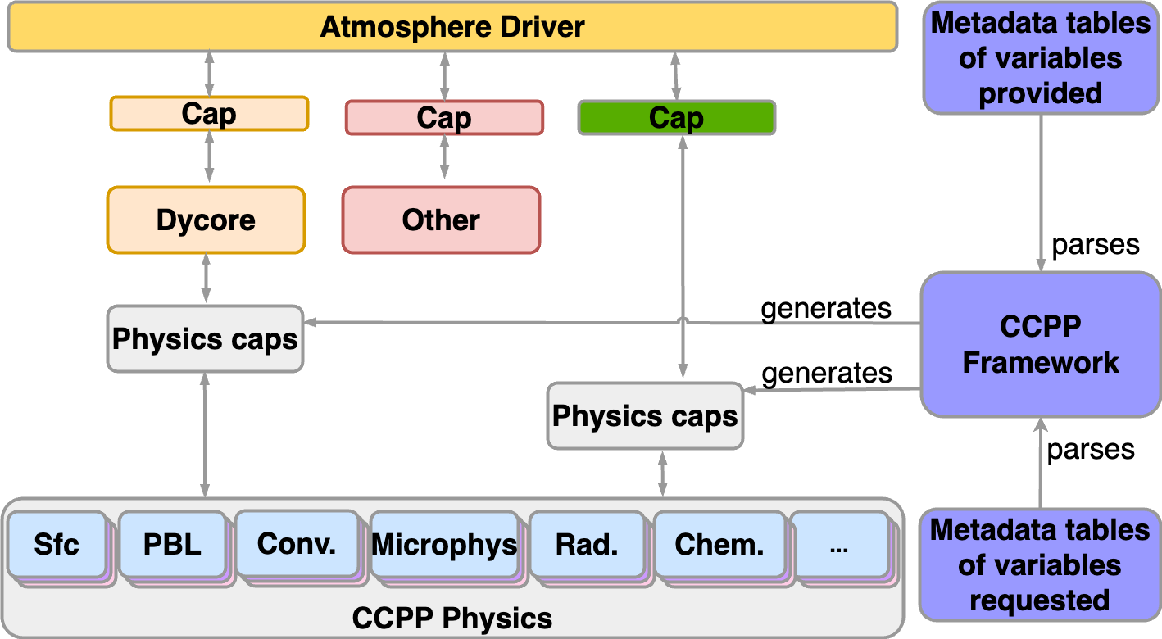
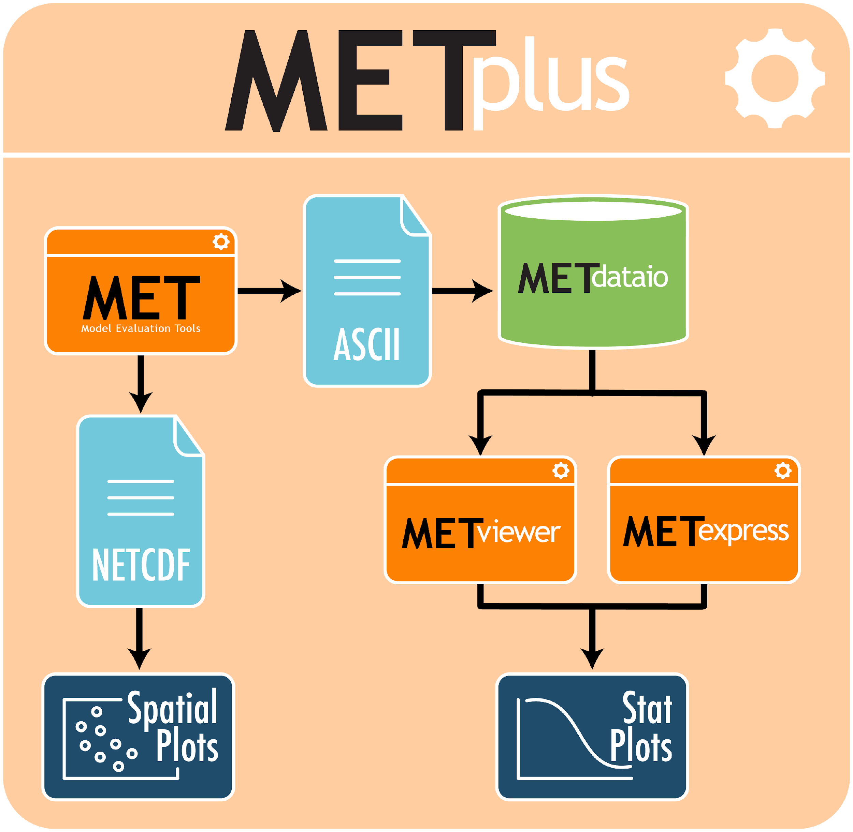
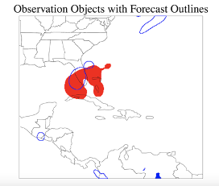
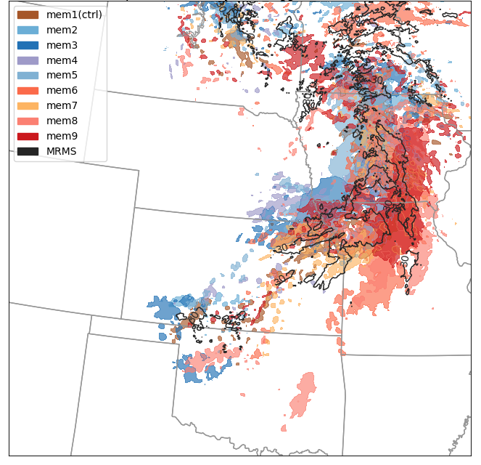
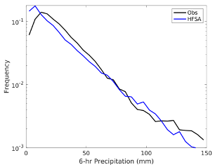
Developmental Testbed Center (DTC)
Supporting R2O for multiple UFS applications
Software infrastructure
Common Community Physics Package (CCPP)
Includes Single Column Model (SCM) for simplified testing of physics interactions
Supported implementation of 2 HAFS configurations
Advanced Model Evaluation Tools (METplus)
Community verification system
Standard metrics plus more advanced tools
Testing and Evaluation
RRFS
Agile testing framework - timely feedback to developers
Testing informing ensemble design
HAFS
Evaluations in support of 2023 HAFS implementation
QPF and storm structure evaluations
Global Forecast System (GFS)
In-depth testing of innovations being considered for GFS proto-types
Feedback to developers on issues with schemes
Time-lagged ensemble -
Composite Reflectivity >30 dBZ
warm colors: 00z initialized
cool colors: 12-h time lagged
black contours: MRMS obs
Method for Object Based Diagnostic Evaluation:
HAFS: Too much light precip / lower for heavier
NOAA Booth at AGU, 13 Dec ‘23

Slide 27
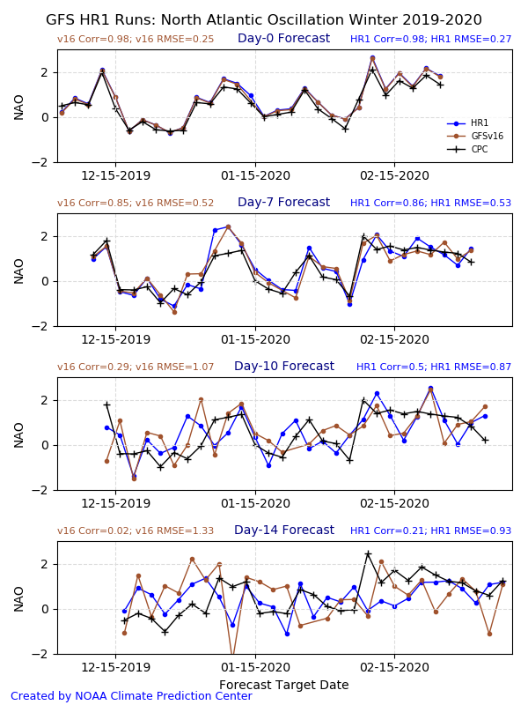
CPC Supporting UFS
Development (draft slide)
CPC is involved in the development of UFS-MRW/S2S
Evaluation of prototypes
Evaluation of retrospectives
Structure of reforecast/real-time delivery
Evaluation of reforecasts for final science review/approval at NCEP.
Notes:
Our eval of the HR1 retrospectives.
I have other figures if you want.

Slide 28
Funding
From a number of sources varies among TBPG
NWS Science and Technology Integration Office (STI) and NOAA/OAR Weather Program Office (WPO)
Competitive grants/Coop agreements support PIs on projects to be evaluated in TBs
STI – funds some NWS personnel and TB Milestones for ATPG, AWT, JHT, OPG, HWT, HMT, FWTB
WPO funds infrastructure for their
NESDIS GOES-R and POES satellite programs
also funds satellite liaison positions at HWT, JHT/HOT, WPC
COMT, Space Wx TB and some others run their own competitions.

Slide 29
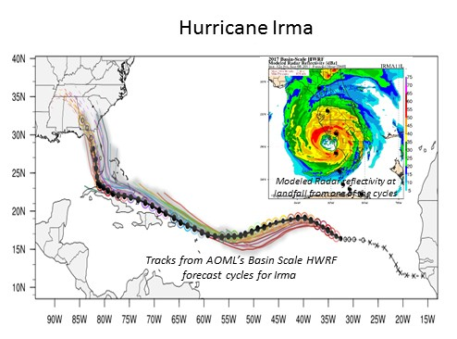
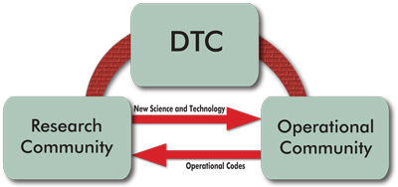
Developmental Testbed Center & Innovations to HWRF
The Hurricane Weather Research & Forecast system (HWRF) is NOAA’s operational hurricane forecasting model. It continues to be refined and improved in collaboration with agency and university researchers.
The Developmental Testbed Center has facilitated the transition of innovations into the HWRF through sustained focus over a number of years.
HWRF forecast plume 3-km resolution regional model
Iterative testing & evaluation of innovations by DTC staff in collaboration with researchers external innovations on one side, and by NOAA EMC which implements HWRF – example of bundling innovations on next slide
Notes:
Say this: HWRF Originally developed by NWS Environmental Modeling Center (EMC), in collaboration with NOAA GFDL, NOAA AOML, and the University of Rhode Island,
Nance: experience has shown us that sometimes innovations need to be bundled to produce improvement - so instead of including Iacono/Henderson in this block - perhaps the RRTMG and partial cloudiness bundle would make more sense to call out since RRTMG by itself did not do the trick
Nance: Fovell performed diagnostics that brought to light a problem with current scheme and some case studies using RRTMG showed that it would fix the deficiency - RRTMG was already available in the WRF framework, which enabled the testing. But more robust testing showed that simply replacing the operational radiation scheme with RRTMG led to degradations in track and intensity skill - more diagnostics demonstrated need for partial cloudiness scheme which then the DTC engaged a model developer at NCAR to implement - bundle of RRTMG and partial cloudiness led to improvements in track and intensity forecasts.
“One way of bringing in innovations into HWRF is the DTC, is a visitor program….”

Slide 30
Satellite Proving Ground & NWS transition major innovation: HRRR-Smoke
Societal impacts of smoke include:
Human health – both near fire and distant; Aircraft operations; Fire Operations; Transportation – Amtrak & highways; Recreational & school sports; Visual
“Users overwhelmingly need higher resolution meteorological model fields in complex terrain and the tools and input data to understand fire behavior and smoke dispersion.” (2011 OFCM, 4.1.a.)
Motivated by new parameters available from JPSS VIIRS, SPG organized a Fire and Smoke Initiative to address this need, including NWS scientists and forecasters, OAR Global Systems Lab, NESDIS and key stakeholders
“Orange sky” smoke event, San Francisco Bay area, September 9, 2020
Notes:
Motivated by attributes of the JPSS VIIRS fire radiative power (FRP) product and NWS recognized the FRP could improve smoke forecasts with higher spatial resolution to address smoke forecast deficiencies in complex terrains.
Stakeholders include US Forest Service National Interagency Fire Center, WFO IMETs

Slide 31
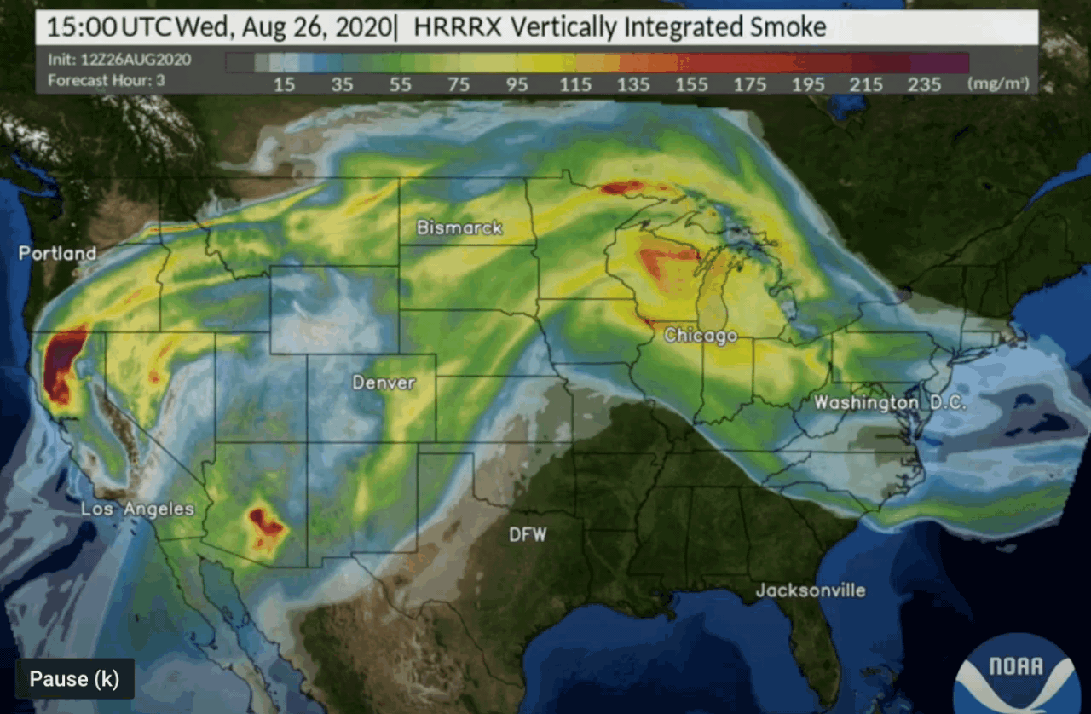
NOAA HRRR-Smoke Nowcasting/Forecasting
SPG worked with NOAA/NWS and NOAA Research Global Systems Lab to develop and test a HRRR-Smoke Model in which smoke and weather are fully interactive
HRRR Smoke is a combo of HRRR model upgraded with aerosols and improved Fire Radiative Power (FRP) capability from JPSS VIIRS
Uses high resolution satellite obs of fires (location & intensity)
WFO and Public acceptance very high - animations are a huge selling point!
36 hour 3km animations
HRRR-Smoke Forecast
https://rapidrefresh.noaa.gov/hrrr/HRRRsmoke
Notes:
Good example of the value of sat obs based on their impact on modeling/forecasting
JPSS VIIRS = Visible Infrared Imaging Radiometer Suite (VIIRS)

Slide 32
TBPGs engage the community: another contribution to UFS
Engaging the community
in experiments (also have a training/exposure component)
trainings - e.g. DTC, Satellite Proving Ground
workshops (examples? )
DRAFT #s
WFO & NCEP forecasters
over
univs/ CI’s
other (?)
Notes:
see my notes: https://docs.google.com/document/d/1cNBu0xanxrkR7UASVbXjupTNFJOFva2FfVsIXKjKo0A/edit

Slide 33
Changes in UFS inspired by HMT
Flash Flood & Intense Rainfall Expt
Recommended UFS modifications to alleviate the precip rates:
Microphysics adjustments
Divergence damping nord2 -> nord3 (ramifications on MCSs?)
Energy conservation
We requested to add hourly max precip rate to understand this further
Situation has improved (Still seeing sporadic HM rates up to 130”/hr)
Hourly maximum has proven to be a decent diagnostic for detection of subhourly issues.
Thanks to J. Correia, HMT EPIC presentation
Notes:
Also – from HWT Accomplishment of UFS R2O project: “HWT + FFaIR testbeds & feedback for RRFS and 3DRTMA”

Slide 34
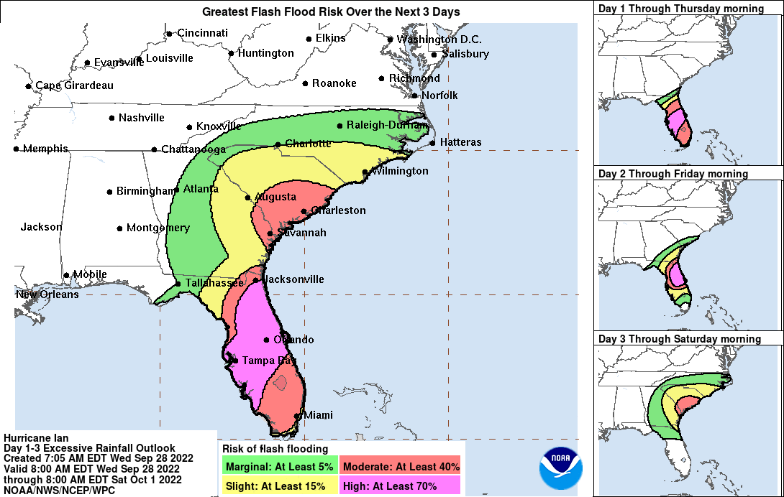
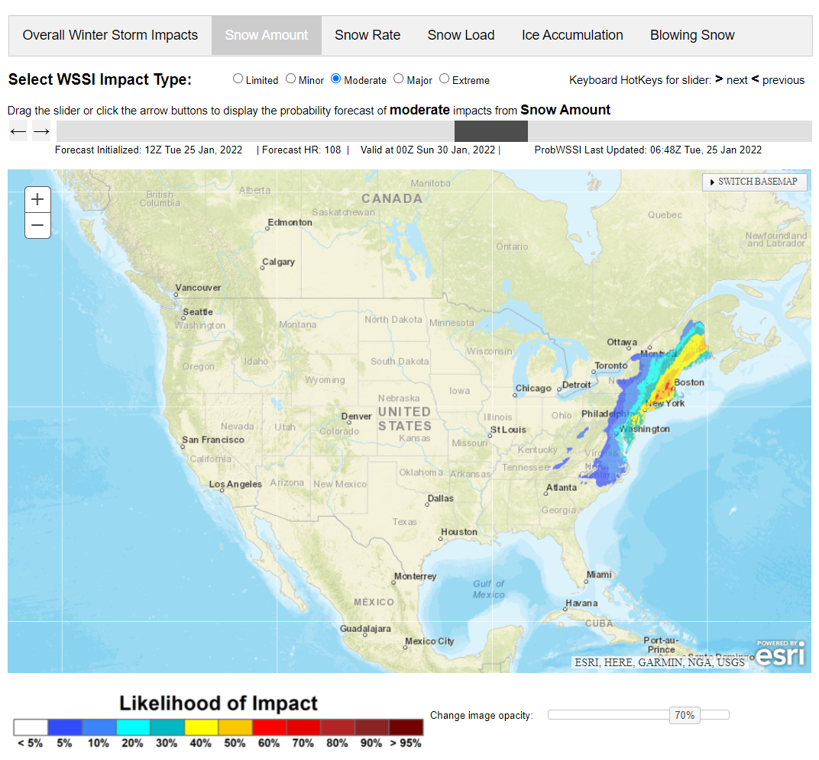
Hydrometeorology Testbed (HMT)
HMT is a group of scientists who bridge the gaps between research & operations, with a goal of improving precipitation forecasting, especially extremes, in a human centered way.
The Hydrometeorological Testbed Mission: To evaluate & potentially implement new technology, research results, and other scientific advancements from the research & development (R&D) communities to enhance NWS products & services.
Continuum of Heavy Rainfall Services – HMT contributed to development and evaluation of these FACETs-Based Products
(ERO, MPD, ProbQPF)
Continuum of Winter Services - HMT contributed to evaluation of Probabilistic WSSI as a tool to help communicate a general level of potential societal impacts and their spatial distribution
ERO for Hurricane Ian valid Sept 28 2022 – calibrated to probability of impactful event
Probabilistic WSSI
NOAA Booth at AGU, 13 Dec ‘23

Slide 35
Key Messages for Early April ‘24 Nor’easter
Updated Apr 2, 2024
5:00 AM EDT
Significant snow and gusty winds for the Great Lakes and the Northeast
Long-duration winter storm
A large storm system will produce gusty winds and late-season heavy snow across portions of the Great Lakes and the Northeast beginning later today and continuing through midweek.
Western Great Lakes heavy snow later today
Heavy snow will likely develop over Wisconsin by this afternoon and expand into Upper Michigan overnight. Snow will continue over much of the region through Wednesday, with additional heavy snow across portions of Upper Michigan, before ending on Thursday.
Northeast snow and wind Wednesday-Friday
Secondary low pressure development along the Mid-Atlantic coast will likely bring heavy, wet snow and some sleet to the Northeast Wednesday afternoon through Friday. Significant snow accumulations are likely over northern New York and New England.
Significant impacts from heavy snow and wind
The combination of heavy snow rates and gusty winds will likely result in hazardous travel due to low visibility and snow-covered roads. The wet snow and high snow load may also damage trees and impact infrastructure.
Probability of at least 8” of snow (through Friday)
10 %
30
50
70
90
Chances of Moderate Winter Impacts
Wednesday through Friday
Moderate Impacts include:
Hazardous driving conditions expected
Some disruptions and closures possible

Slide 36
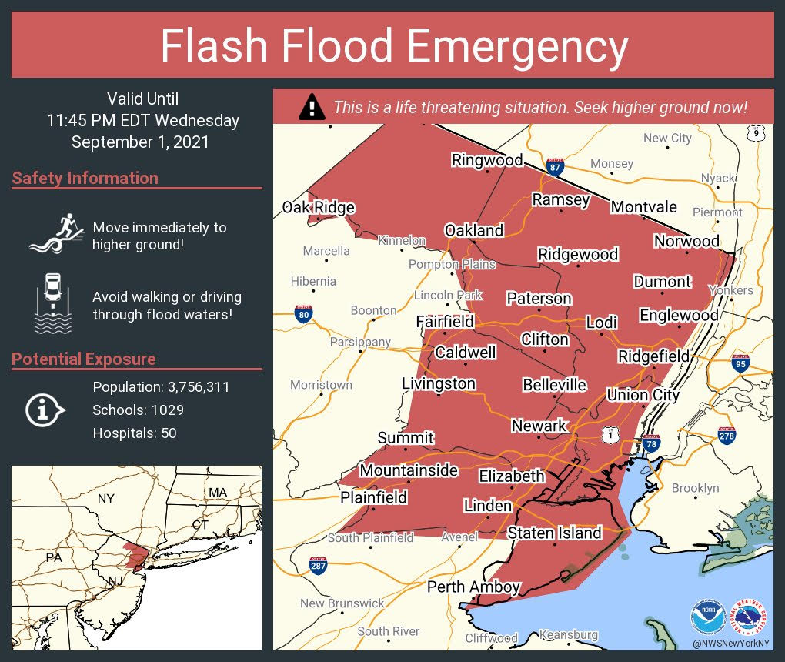
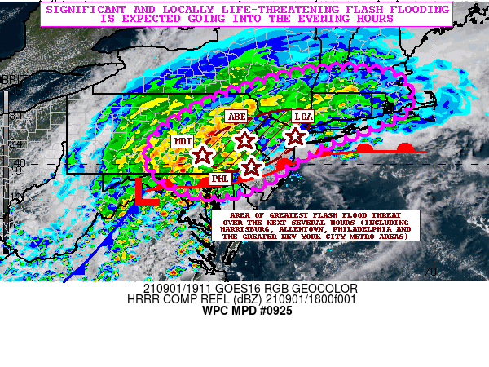
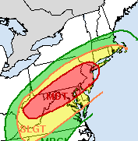
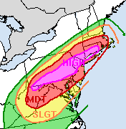
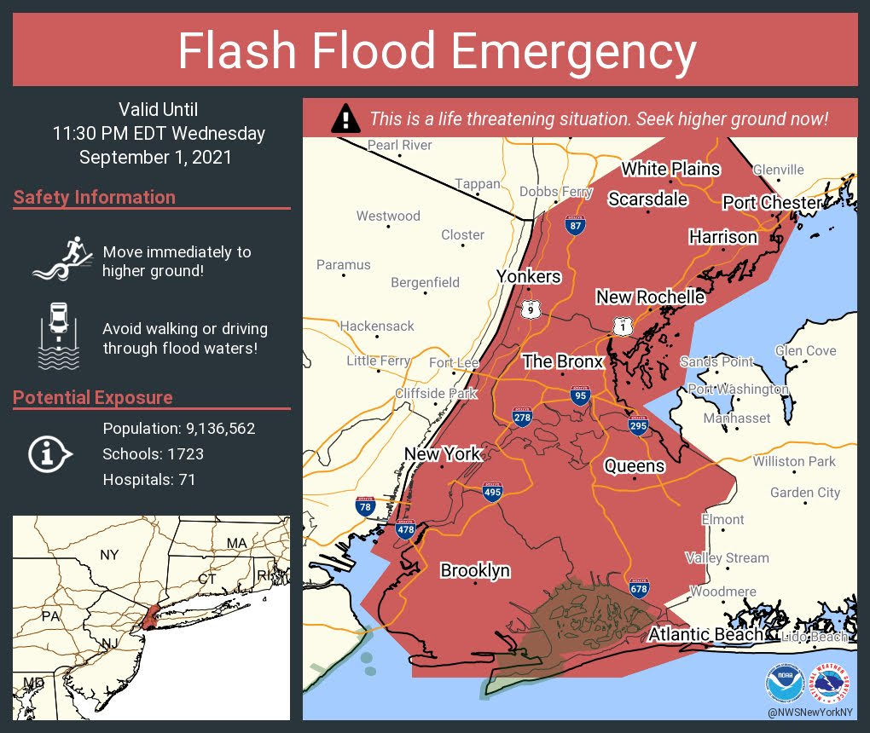
Newark/NYC Extreme Rainfall Event Time Line
3 to 6 inches with isolated higher amounts
3 to 8 inches with isolated higher amounts
Significant and life-threatening flash flooding is possible from the Mid-Atlantic into southern New England, especially across highly urbanized metropolitan areas
1 pm Landfall
8:41 pm Flash Flood Emergency (NJ)
4 pm: WATCHES
5 pm Public Advisory
6 pm First Flash Flood Warning for EWR
Sunday
Monday
Tuesday
Wednesday
3 pm Collaborated UPGRADE to HIGH
3:22 pm
9:28 pm Flash Flood Emergency (NYC)
5 am: secondary QPF Maximum anticipated in Mid-Atlantic BEFORE landfall
6 am: MDT Risk
NYC
Philly
NYC
Philly
“Flash flood emergency level rainfall impacts will be possible..including I-95 urban corridor from Philadelphia to New York City…”

