Slide 1
Advancements in the Assimilation of Spaceborne Microwave and Radar Observations
Isaac Moradi^{1,2}, R. Gelaro², B. Johnson³, Satya Kalluri⁴,
Nancy Okeudo¹, B. Ruston³, A. da Silva², Y. Zhu²
1- ESSIC/CISESS, University of Maryland, College park, MD
2- NASA Global Modelling and Assimilation Office, Greenbelt, MD
3- Joint Center for Satellite Data Assimilation, UCAR, Boulder, CO
4- Office of Low Earth Orbit Observations, NOAA, Greenbelt, MD
Unifying Innovations in Forecasting Capabilities Workshop (UIFCW24)
July 22 - 26, 2024, Jackson State University. Jackson, MS, USA

Slide 2


Funding Sources:
JPSS Proving Ground and Risk Reduction Program
Enhancing Assimilation of Microwave Observations
NASA Modeling, Analysis, and Prediction Program (MAP) Assimilation of Radar Observations in the NASA GEOS Model

Slide 3
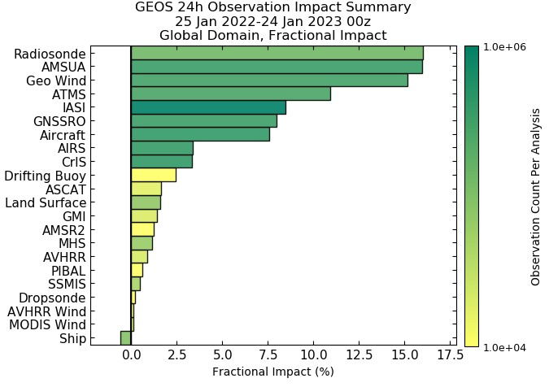
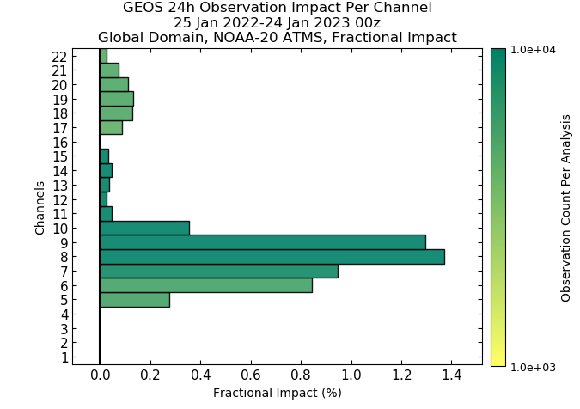
Impact of Observations on NWP Forecasts

Slide 4
Hurricane Jerry
Impact of Assimilating Different Observations on Hurricane Jerry's Intensity Analysis in Terms of Sea Level Pressure.
The Impact of Various Observations on Hurricane Jerry’s Track Error in GEOS Forecasts up to Five Days.

Slide 5
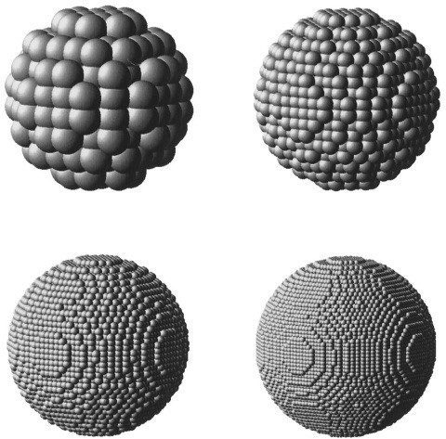
The Discrete Dipole Approximation
In the DDA technique, scattering and absorption are approximated by a finite array of small polarized dipoles. DDA was originally introduced by DeVoe in 1964.
The dataset was developed by Eriksson et al (2018) using the Amsterdam DDA (ADDA, Yurkin et al., 2020) and includes single scattering properties of a large number of frozen and liquid habits.
Laczik et al., Appl. Opt. 35, 3736-3745 (1996) Used with permission

Slide 6
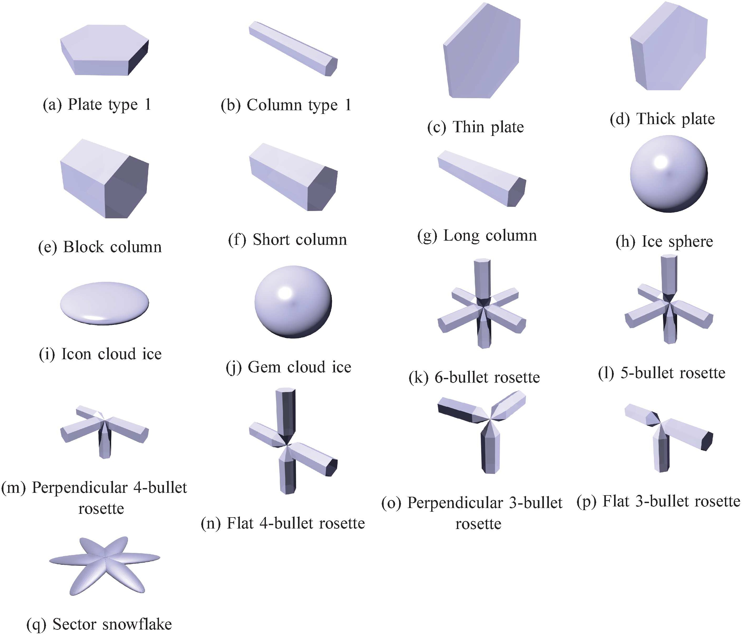
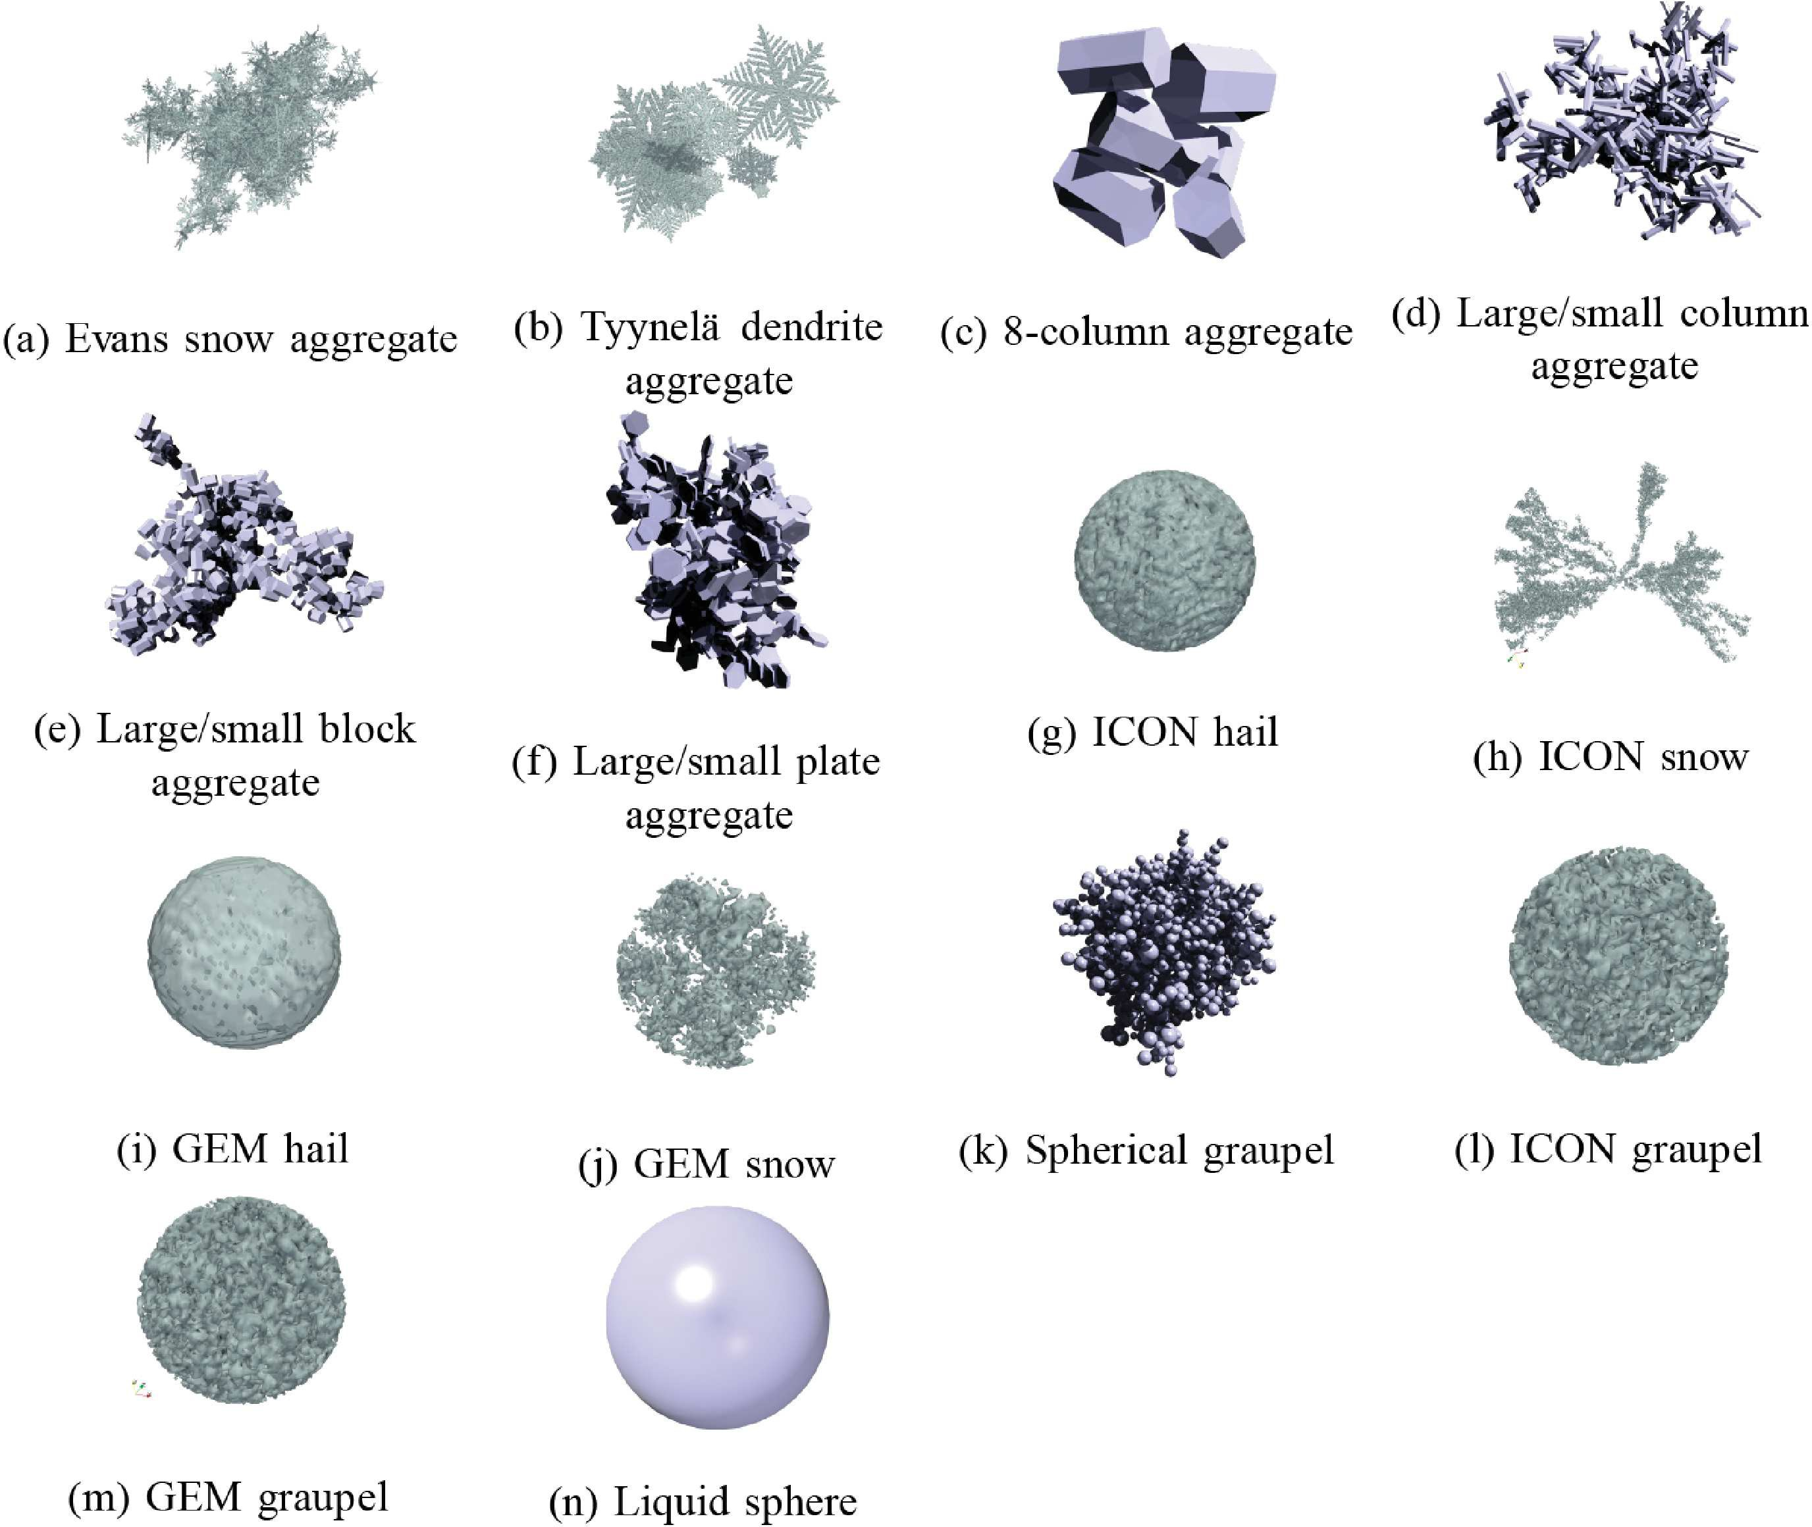
ARTS DDA Database
(a) Single crystal. (b) Aggregates and liquid habits
Single crystal, aggregate, and liquid habits included in the
database generated by Eriksson et al. (2018).

Slide 7
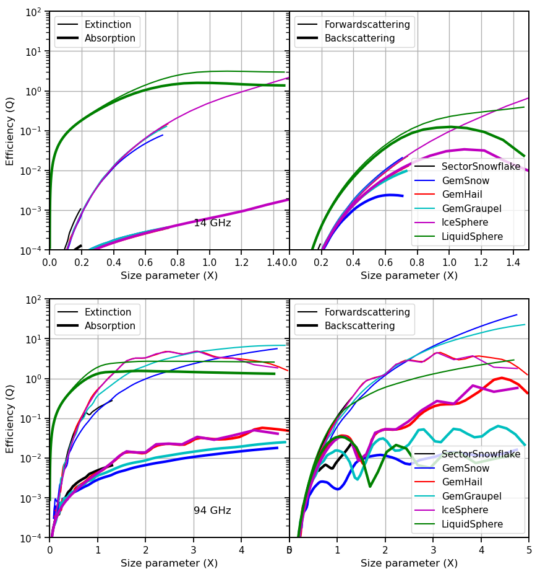

Backscattering Coefficients
$$Q_{λ}= \frac{σ_{λ}}{{πr}^{2}}$$
$$x=\frac{πD}{λ}$$
Extinction and backscattering efficiencies from the ARTS database for several different habits (Temp: 260 K )

Slide 8
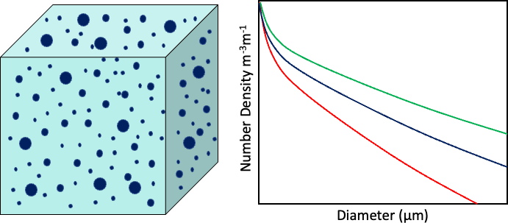

Particle Size Distribution
Particle size distribution is used to compute bulk scattering properties from single scattering data
Modified Gamma Size Distribution:
Mass Scattering Coefficients:
$$N\left(D\right)=N_{0}D^{μ}\exp\left(−ΛD^{γ}\right) m^{−3}m^{−1}$$
$$k_{x}=\frac{\int{σ_{x}\left(D\right)n\left(D\right)dD}}{\int{m\left(D\right)n\left(D\right)dD}}=\frac{\int{σ_{x}\left(D\right)n\left(D\right)dD}}{\int{ρ\left(D\right)V\left(D\right)n\left(D\right)dD}} m^{2}.{kg}^{−1}$$

Slide 9
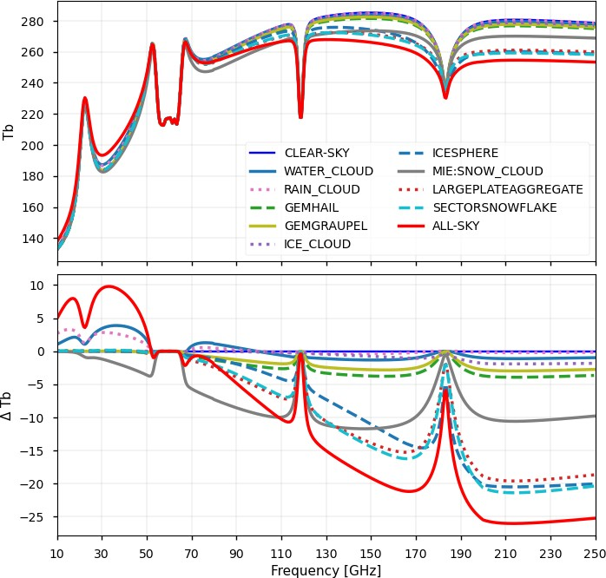
Sensitivity of MW frequencies to clouds

Slide 10
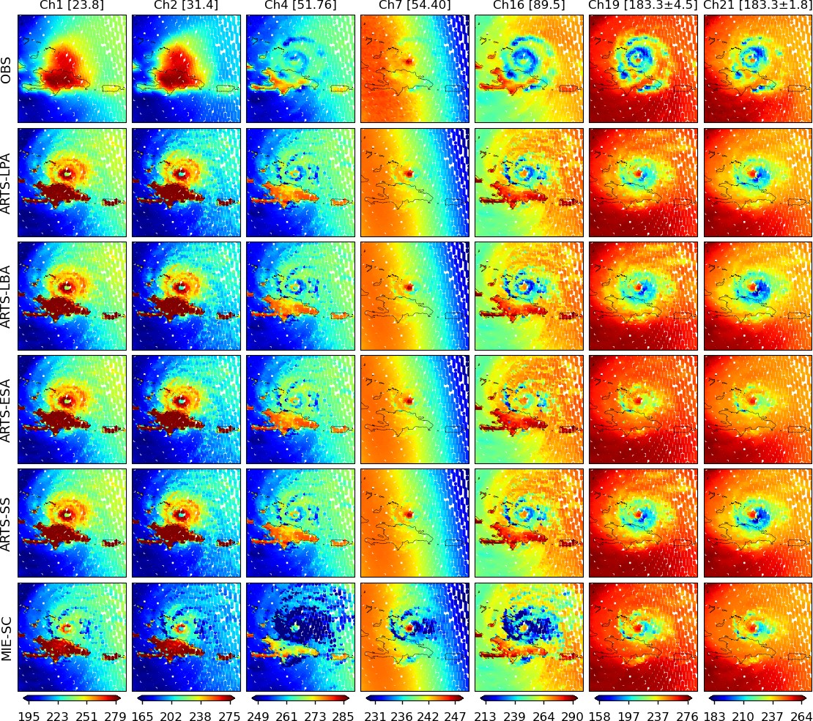
ATMS Observations vs CRTM Simulations
ATMS observed vs. CRTM simulated Tbs for Hurricane Irma, Sept 07, 2017 at 18 UTC, using IFS as input (all clouds considered) and different CRTM CloudCoef files.

Slide 11




The Radar Equation
The radar equation can be formalized as follows:
$$R=\frac{{10}^{18}λ^{4}}{π^{5}{\left|k_{w}\right|}^{2}}β_{b} m^{4} m^{2}m^{−4}m^{1}⇒mm^{6} m^{−3}$$
$$R_{a}=\frac{{10}^{18}λ^{4}}{π^{5}{\left|k_{w}\right|}^{2}}Γβ_{b} m^{4} m^{2}m^{−4}m^{1}⇒mm^{6} m^{−3}$$
$$β_{b}=\int_{0}^{∞}{σ_{b}\left(D\right)n\left(D\right)dD} m^{2}m^{−4}m^{1}⇒m^{−1}$$
The unit for R (reflectivity) and R_{a} attenuated reflectivity are in m⁶ m⁻³ and 10¹⁸ is used to convert the unit to mm⁶ m⁻³. This is in turn converted to dBz or decibels by taking R_{e} = 10log₁₀ (R) or R_{ea} = 10log₁₀ (R_{a}). The dielectric factor (k_{w} ) is calculated using the complex permittivity of the liquid water, |k_{w} |² = 0.75 .
Transmittance (attenuation) depends on both scattering and absorption coefficients.
$$Γ\left(r\right)=\exp\left(−2\int_{r_{1}}^{r_{sat}}{k_{e}\left(r\right)dr}\right)=\exp\left(−2\sum_{i=r_{1}}^{r_{sat}}{τ\left(i\right)}\right)$$

Slide 12
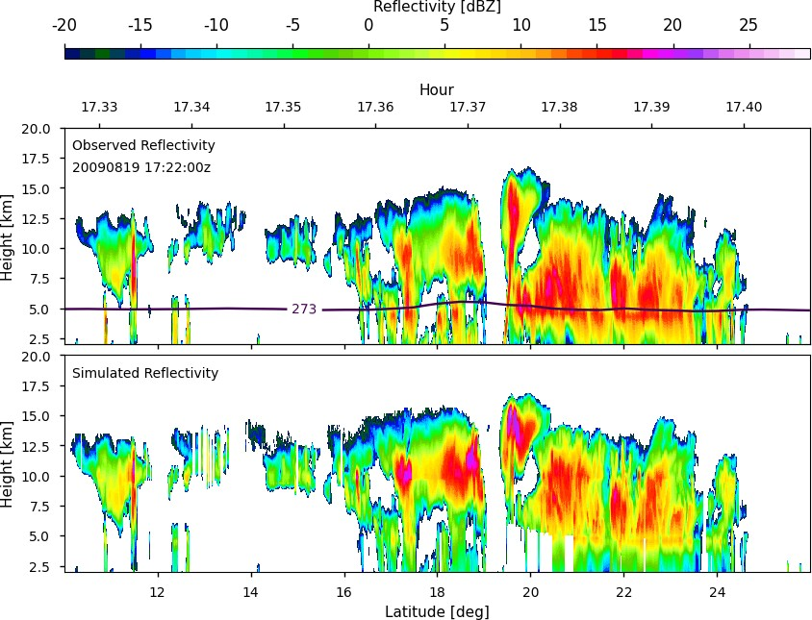
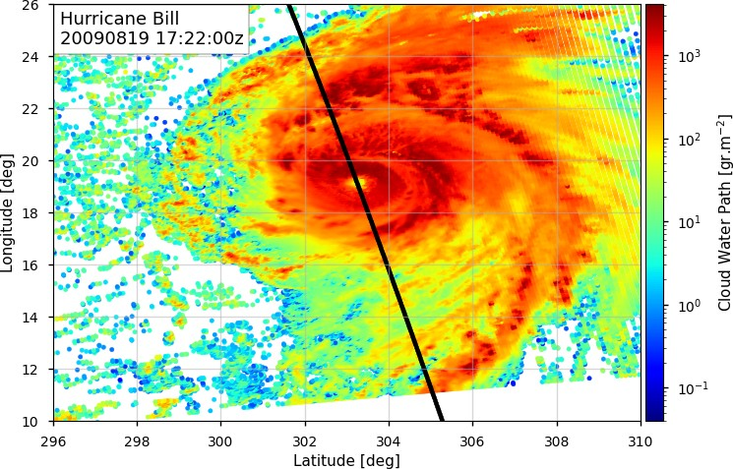
Simulated vs. Observed Reflectivity
Observed and simulated reflectivities for Hurricane Bill.

Slide 13
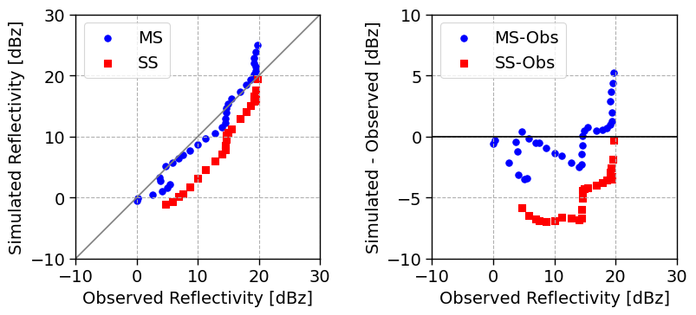
Effect of multiple scattering

Slide 14
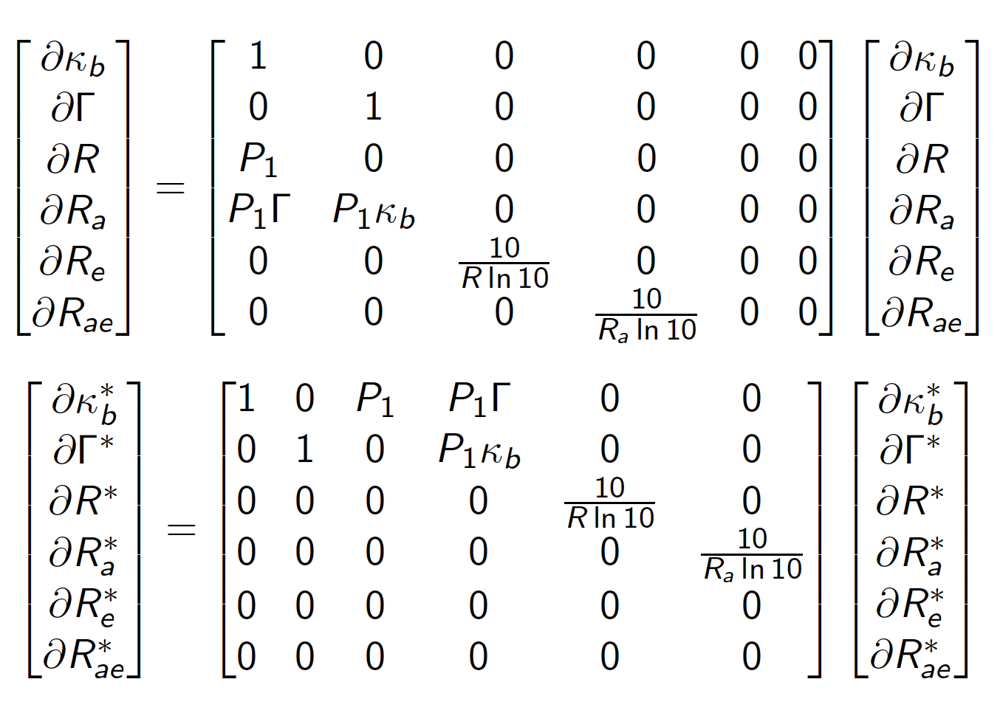
Adjoint & Tangent Linear

Slide 15
CRTM Simulated Reflectivity
Radiance
Adjoint
Brightness_Temperature
CRTM
RTSolution
Tangent Linear
Reflectivity
Jacobians
Reflectivity_Attenuated

Slide 16
Joint Effort for Data assimilation Integration (JEDI)
UFO
Obs operators
IODA
Obs Database
SABER
B-Matrix
CRTM
OOPS
Generic DA
RTTOV
GEOS
…
FV3 GFS

Slide 17
Conclusions
CRTM radar simulator as well as its adjoint and tangent linear are implemented and tested
A new scattering dataset generated using the DDA method was implemented into CRTM and evaluated using a collocated reanalysis and satellite dataset
The radar module takes advantage of different CRTM atmospheric absorption and cloud scattering modules
The radar module can be used for the assimilation of observations from instruments such as CloudSat CPR, GPM DPR, and EarthCare CPR.
The active module is implemented within JEDI/UFO and ready to go!
Work is in progress to evaluate the active module within the JEDI DA system

Slide 18
Thank you for your attention!
Moradi et al. (2022): Implementation of a discrete dipole approximation scattering database into community radiative transfer model. JGR-Atmospheres, 127, DOI: 10.1029/2022JD036957
Moradi et al. (2023): Developing a Radar Signal Simulator for the Community Radiative Transfer Model. IEEE TGRS, Accepted.
Moradi et al. (2020): Assimilation of Satellite Microwave Observations over the Rainbands of Tropical Cyclones. Mon. Wea. Rev., 148, 4729–4745, DOI: 10.1175/MWR-D-19-0341.1.

