Slide 1
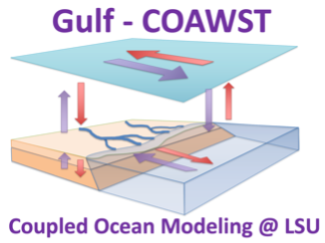
Detangling the Elevated Sea-surface pCO₂ in a River-Dominated Continental Shelf Using a High-Resolution Regional Ocean Model
Ogooluwa Adeagbo¹, Z. George Xue^{1,2,3}, Le Zhang¹ and Yanda Ou^{1,2}
¹ Department of Oceanography and Coastal Sciences, Louisiana State University, Baton Rouge, LA 70803, USA
² Center for Computation and Technology, Louisiana State University, Baton Rouge, LA 70803, USA
³ Coastal Studies Institute, Louisiana State University, Baton Rouge, LA 70803, USA

Slide 2
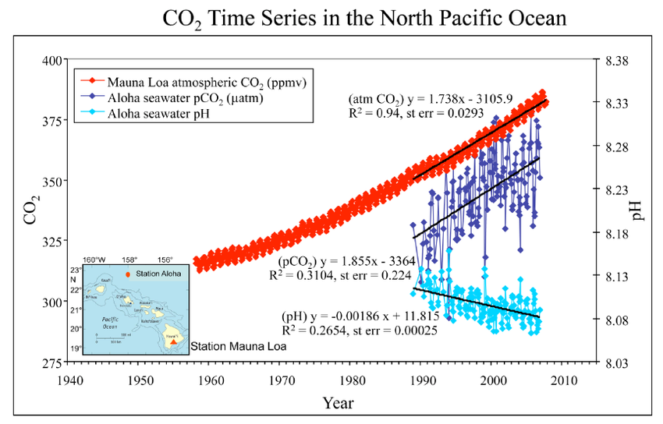
Introduction- Global
Fabry et al (2008)

Slide 3
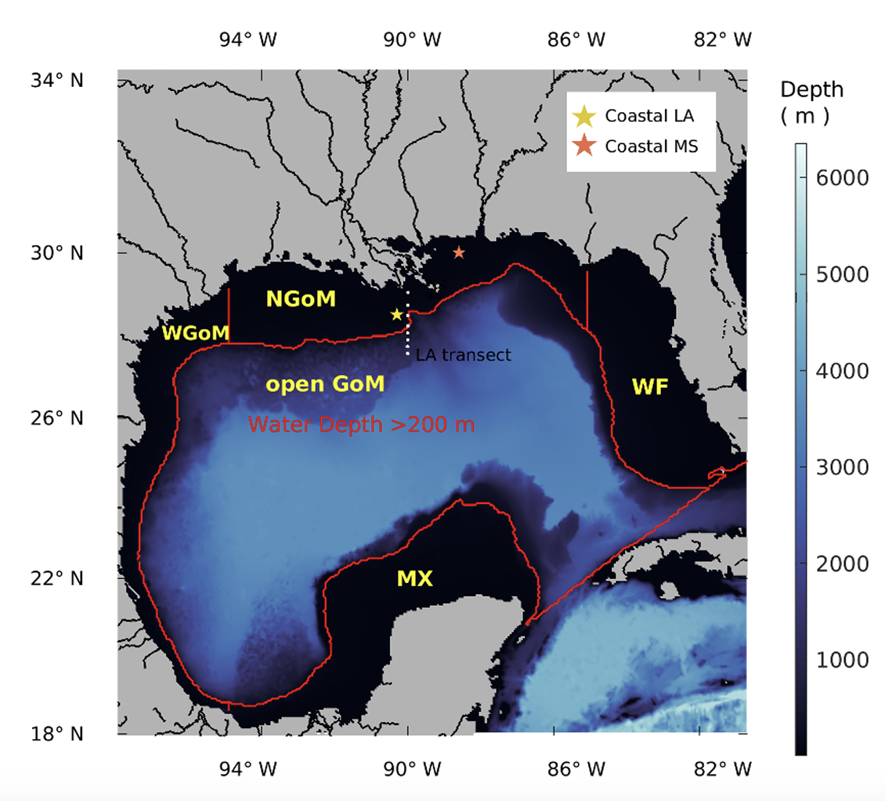
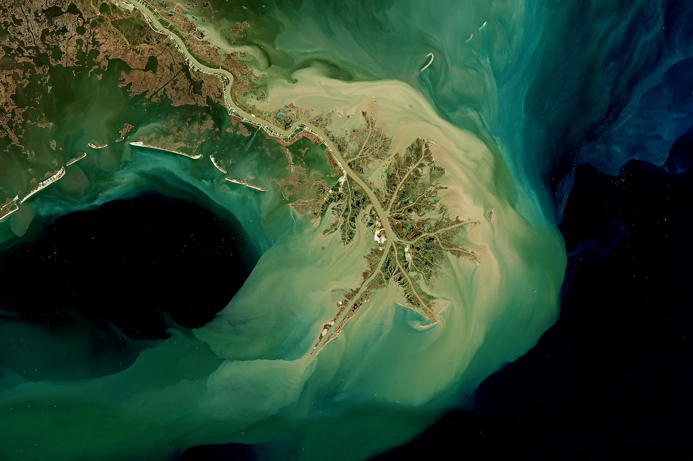
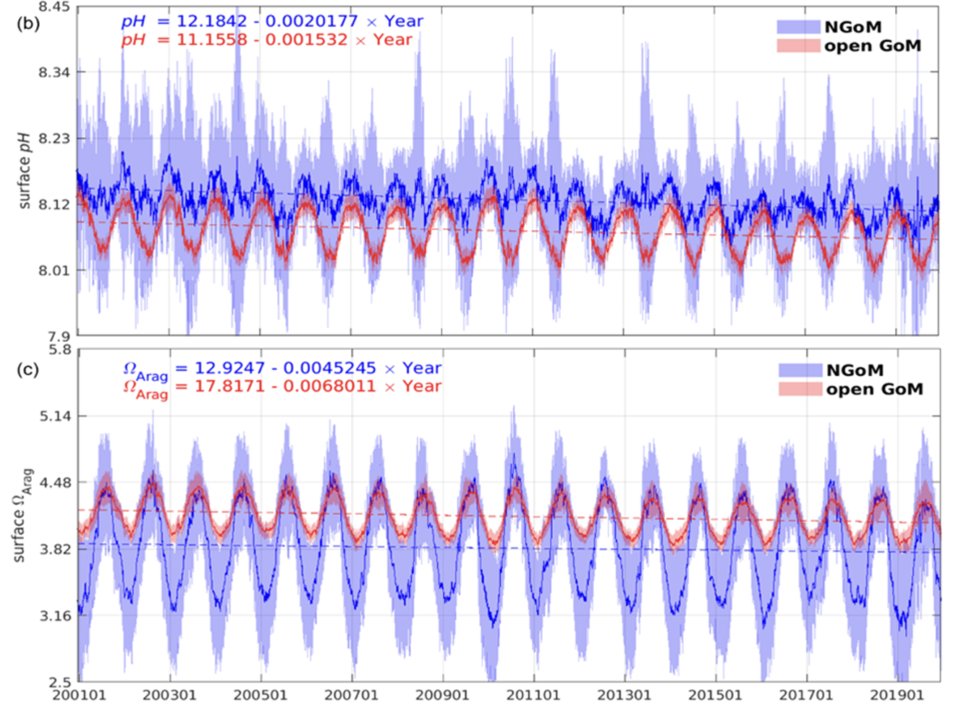
What about the Gulf?
Zhang and Xue (2022)
Image from Worldatlas.com

Slide 4
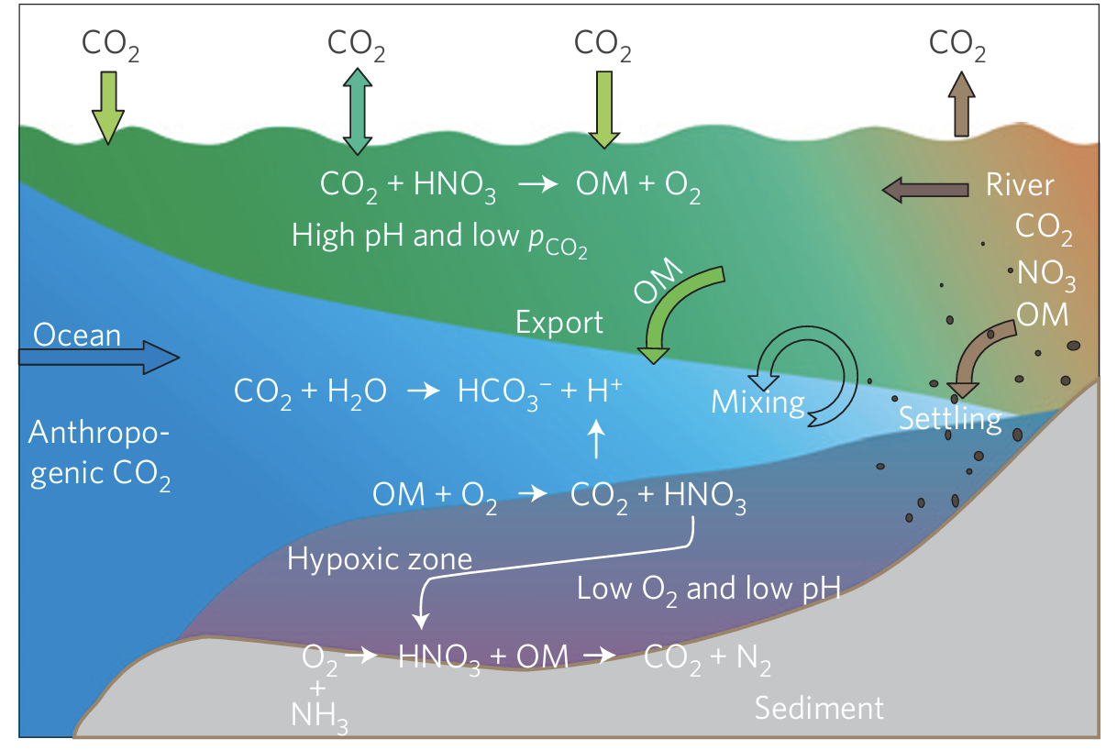
Objectives
Identify and quantify contribution from warming effect (air and ocean), river (chemistry and biology ) to pCO₂ trend
Under future scenarios, what will the trend of pCO₂ be?
Cai et al 2011

Slide 5
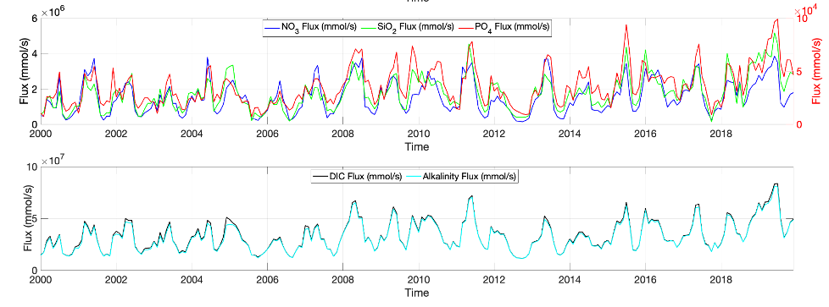
Coupled Physical-Biogeochemical Modeling
Mississippi River Discharge Timeseries
Mississippi River flux Timeseries
Domain of Regional Ocean Modeling System (ROMS)

Slide 6
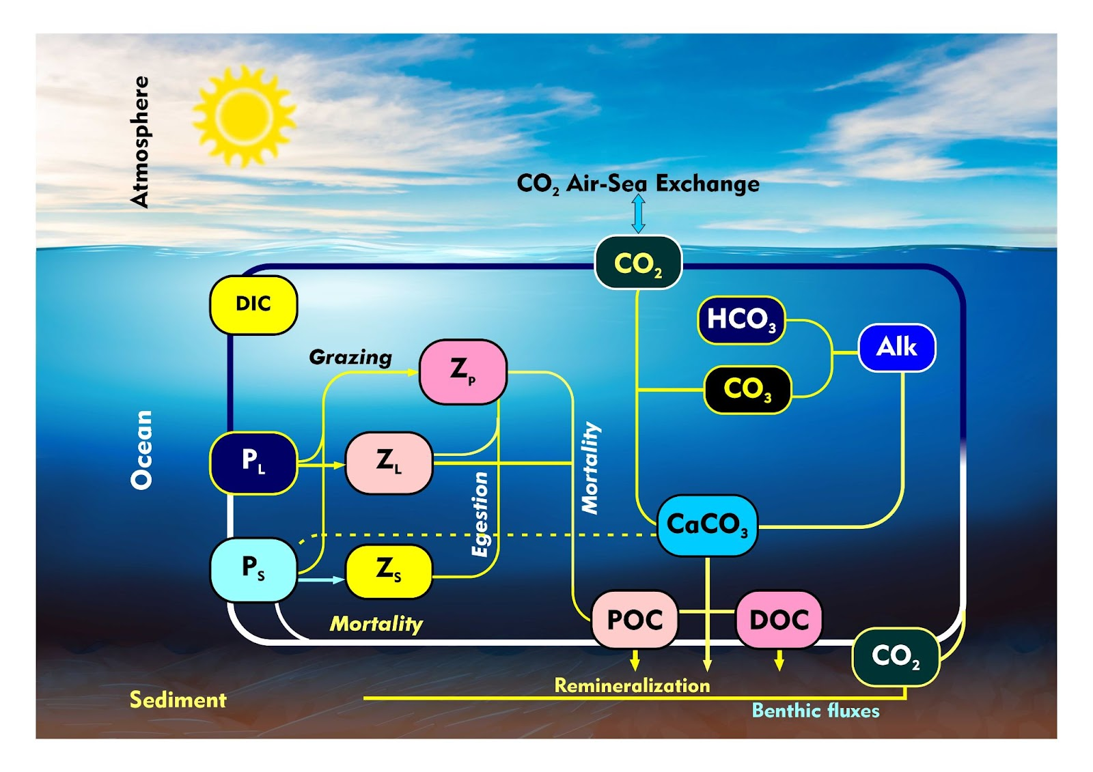
Biogeochemical Cycling
Schematic illustrating the carbon cycle in the Gulf-COAWST model( Revised NEMURO Model).

Slide 7
Experiment Design
Equations for Assessing Trend Contribution
OC (Ocean Chemistry), OB (Ocean Biology), RC (River Chemistry; DIC and Alkalinity), RB (River Biology; Nutrients)
Control Run: OC+OB+RC+RB
No Bio Run: OC+RC
No River Run: C=OC+OB
No Bio, No River Run: OC
No Warming Run: OC_{nw}+OB_{nw}+RC_{nw}+RB_{nw}
River discharge increase Run: F=OC+OB+RC₁₆₀+RB₁₆₀
Component | Equation
River Chemistry | No Biology run-No biology,No river run
River Biology | Control run - (No river run + No biology run - No biology,No river run)
Ocean Biology | No river run - No biology,No river run
Warming Effect | Control run - No warming run
River discharge Impact | River discharge increase Run - Control run

Slide 8
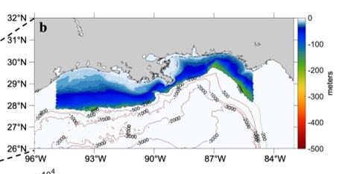
Preliminary Results
Timeseries of surface pCO₂ for No warming Run
Control run Trend: 1.19 μatm/year
No Warming run Trend: 0.70 μatm/year
Component Contribution to trend
Warming effect: 0.48718 μatm/year
Ocean chemistry: 2.0843 μatm/year
In NGOM, the contribution of ocean chemistry is four times that of the global warming effect.
NGOM – Northern Gulf of Mexico

Slide 9
Preliminary Results
Timeseries of surface pCO₂ for No River Run
Component Contribution to trend
River Chemistry: 0.2724 μatm/year
River Biology: -0.8467 μatm/year
Control run Trend: 1.19 μatm/year
No River run Trend: 1.76 μatm/year
River discharge plays a major role in the carbonate chemistry dynamics of NGOM
What do you think would happens to the trend of pCO₂ if river discharge was set at 160% for the year 2001-2019?

Slide 10
Preliminary Results
Timeseries of surface pCO₂ for River discharge increase Run
Control run Trend: 1.19 μatm/year
River Discharge Increase run Trend: 1.57 μatm/year
Component Contribution to trend
River discharge increase: 0.3773 μatm/year
Under future Scenario, there is the possibility of pCO₂ trend to increase.
How will the role of river biology change?
Will river chemistry have more impact?

Slide 11
Conclusion
Five significant components modulating the sea surface pCO₂ in a river-dominated shelf were considered: ocean chemistry, ocean biology, river chemistry, river biology, and warming effects.
River chemistry, along with increased river discharge and warming effect played a role in increasing surface pCO₂ levels in NGOM.
Ocean and river biology significantly contribute to reducing surface pCO₂ levels.
River discharge increase(160%) also significantly increase trend of surface pCO_{2.}

Slide 12
Thank you !!

