Slide 1
Storm-Based Verification and Intercomparison of Warm-Season Forecasts from the HRRR, RRFS, C-SHiELD, and NSSL MPAS models
Corey Potvin^{1,5}, Larissa Reames^{1,2}, Adam Clark^{1,5}, David Dowell³, Michael Duda⁴, Thomas Jones^{1,2}, Kent Knopfmeier^{1,2}, Ted Mansell¹, Bill Skamarock⁴, Yunheng Wang^{1,2}, Lou Wicker¹, Nusrat Yussouf^{1,2}
(1) NOAA/OAR/National Severe Storms Laboratory
(2) CI for Severe and High-Impact Weather Research and Operations
(3) NOAA/OAR/Global Systems Laboratory
(4) National Center for Atmospheric Research (5) OU School of Meteorology

Slide 2
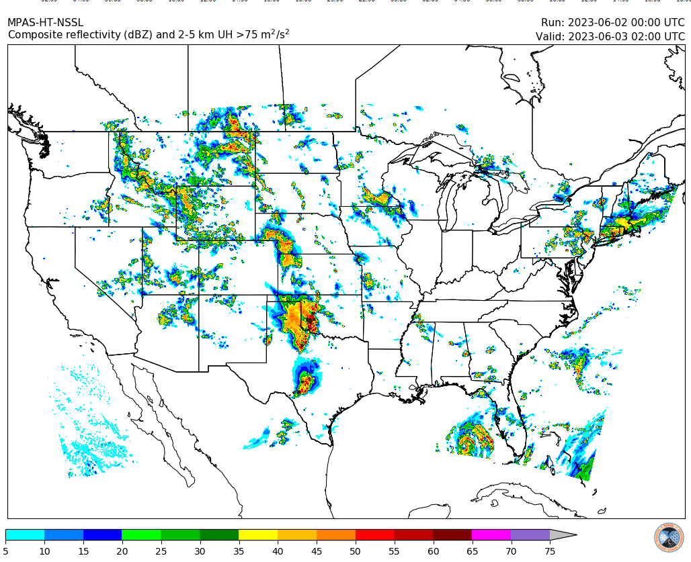
Background
NSSL is running three Model for Prediction Across Scales (MPAS) configs over CONUS at 3-km grid spacing. Initialized 00/12 Z, run for 48 h.
The 00Z NSSL MPAS runs were subjectively compared to NCEP High-Resolution Rapid Refresh (HRRR) and Rapid-Refresh Forecast System (RRFS) 12–36-h forecasts during the 2023 HWT Spring Forecasting Experiment (SFE).
SFE participants rated 00Z HRRR, MPAS significantly higher than RRFS. Objective verification and model intercomparisons (some shown herein) support the subjective evaluations.
MPAS will replace the WRF-ARW in the Warn-on-Forecast System (WoFS). The WoFS is a rapidly-updating 3-km ensemble targeting 0–6-h lead times. The current (ARW-based) WoFS is planned for operational transition 2027+.
See NSSL presentations at 2023 WRF-MPAS Workshop, WAF/NWP/Meso Conference, AMS Annual Meeting
https://cams.nssl.noaa.gov

Slide 3
Objectives
Contribute to evaluation of MPAS as WoFS dycore
Identify weaknesses relative to ARW that could be exacerbated by rapid DA (none identified)
Contribute to ongoing intercomparisons of HRRR, RRFS and MPAS
Inform UFS CAM strategy by assessing impacts of dycore, driving model, physics
My work focuses on intra-storm fields and near-storm environment; Larissa Reames is focusing on storm object properties, precip, surrogate severe verification
Companion papers to be submitted to Wea. and Forecasting

Slide 4
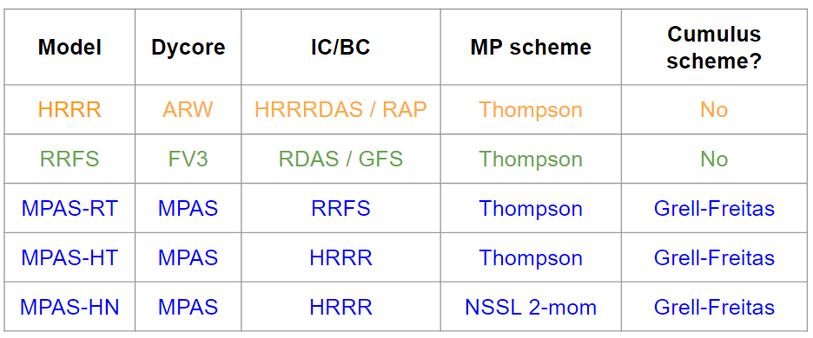
Model Data & Storm Objects
Models: Five focused models use MYNN PBL scheme, RUC land surface model, RRTMG radiation; differ in dycore, ICs/BCs, microphysics, cumulus scheme (see Table). The 3 NSSL MPAS models differ only in driving model and microphysics. The GFDL C-SHIELD is disparate from these models but provides context for RRFS performance (only subset of fields available).
Analysis Domain: CONUS E of Rockies, 59 days in May-June 2023 (same as Larissa); 1–36 h leads; within latest SPC General Thunderstorm Outlook issued near/prior to model initialization
Storm objects (from Larissa): 99.5th CREF %tile, min size = 15 grid cells, merge threshold = 3 grid lengths; only using ORDINARY and SUPERCELL objects as classified by Potvin et al. (2022) scheme
*Thompson, MYNN schemes vary between models
C-SHIELD | FV3 | GFS (no DA on nest) | GFDL Inline Cloud MP | NCEP 2017 Scale-Aware SAS
*TKE-EDMF, Noah-MP
Provided by GFDL

Slide 5
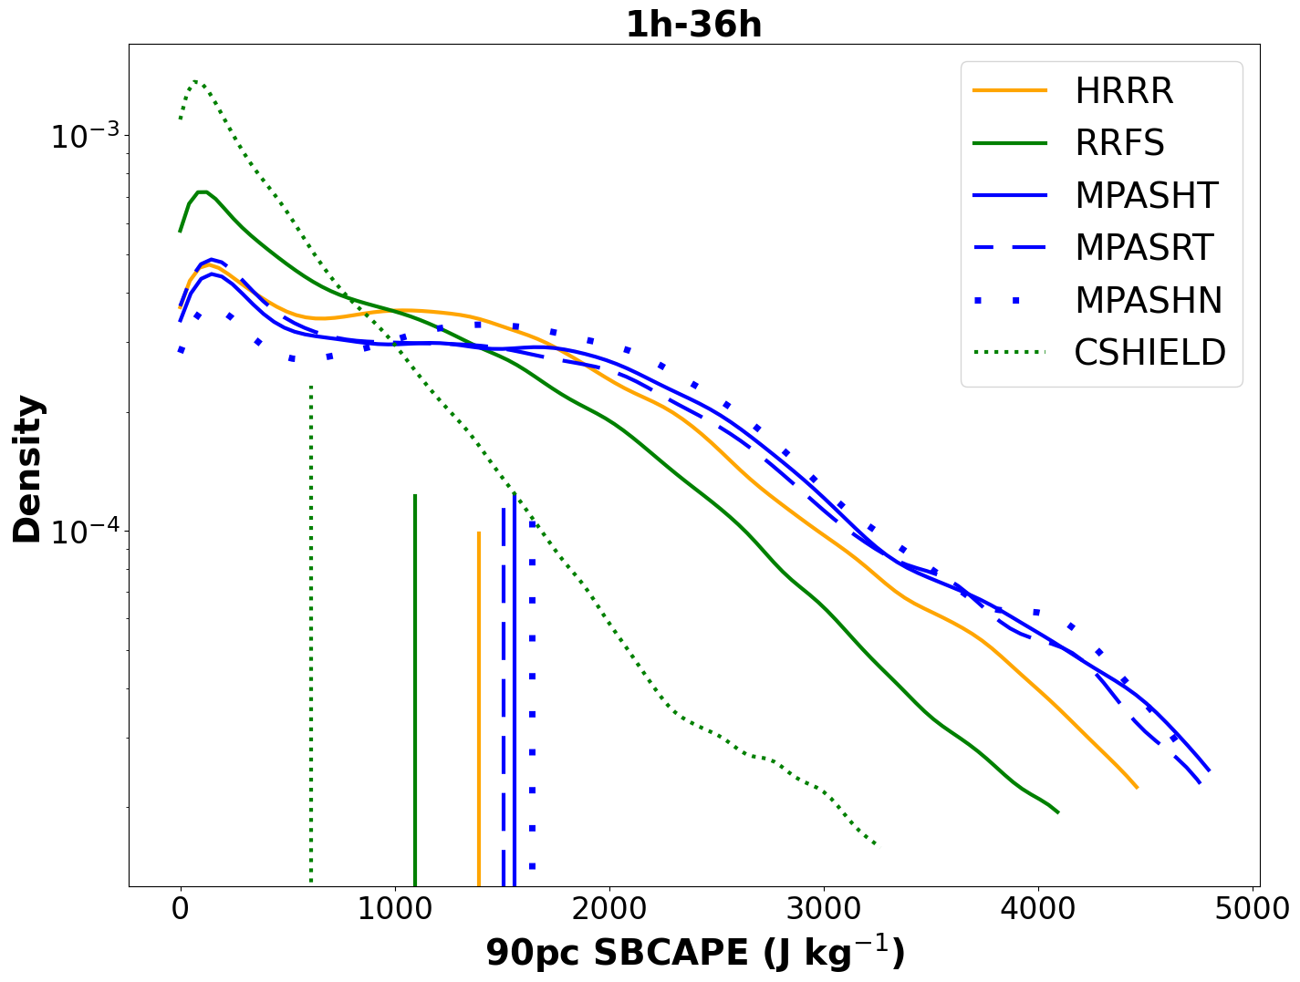
Analysis & Verification
Storm patches: 120-km square domains centered on storm objects. Used to compute kernel density estimates (KDEs) of near-storm environment (NSE) statistics and probability-matched composite means (PMMs) of NSE fields as in Potvin et al. (2019, 2020).
Proximity criteria: Verification is segregated into near-storm (NEAR) vs. far-from-storms (FAR). NEAR (FAR) means within (not within) 120 km of a storm. Proxies for pre-convective and post-convective environments.
Sample SBCAPE PMM (left) and KDEs (right)
Observations: ASOS/RAOBs only used if they satisfy the proximity criterion (NEAR or FAR) and majority of models satisfy proximity criterion. This mitigates sampling biases among models.
Sounding parameters: SHARPpy (Blumberg et al. 2017)

Slide 6
ASOS & RAOB verification

Slide 7
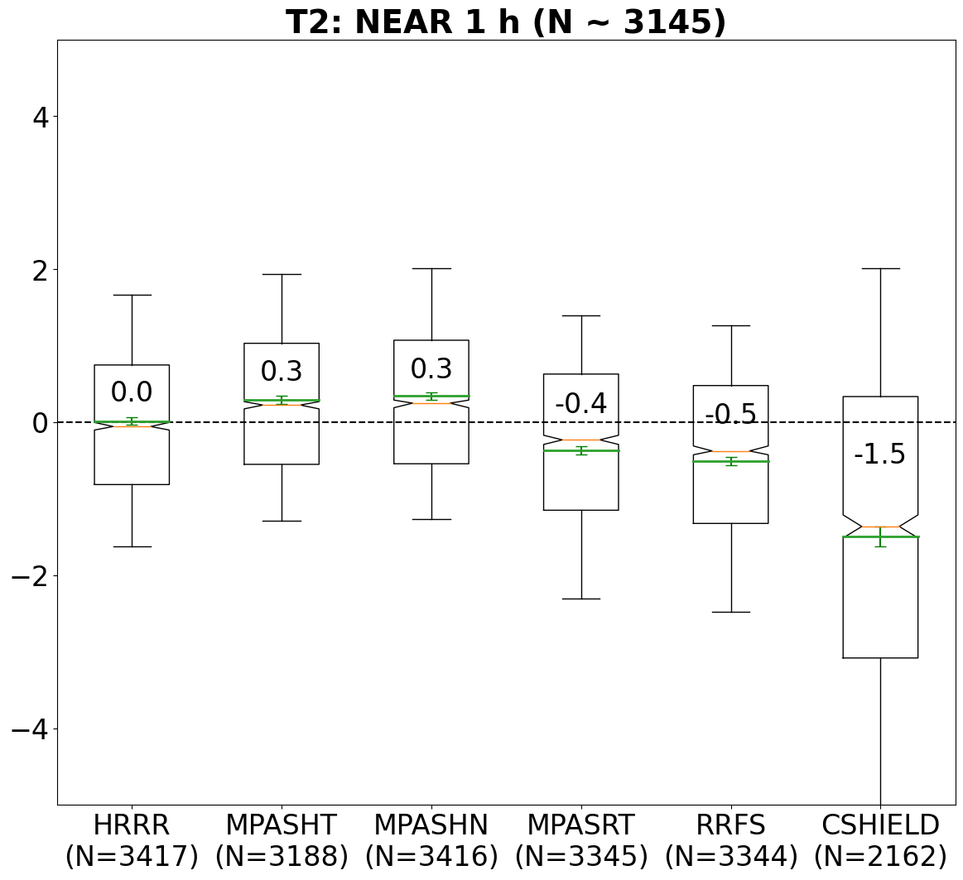
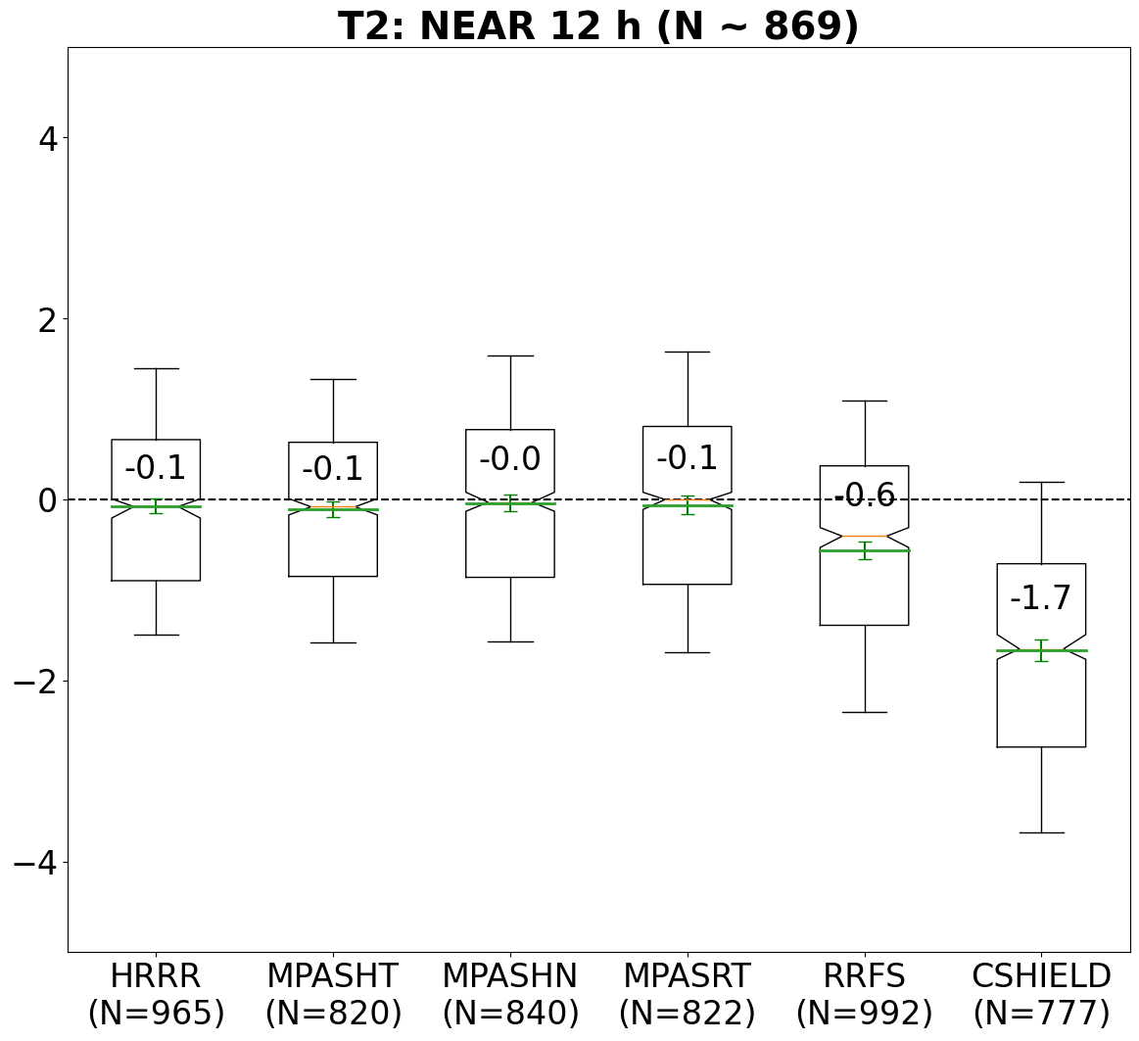
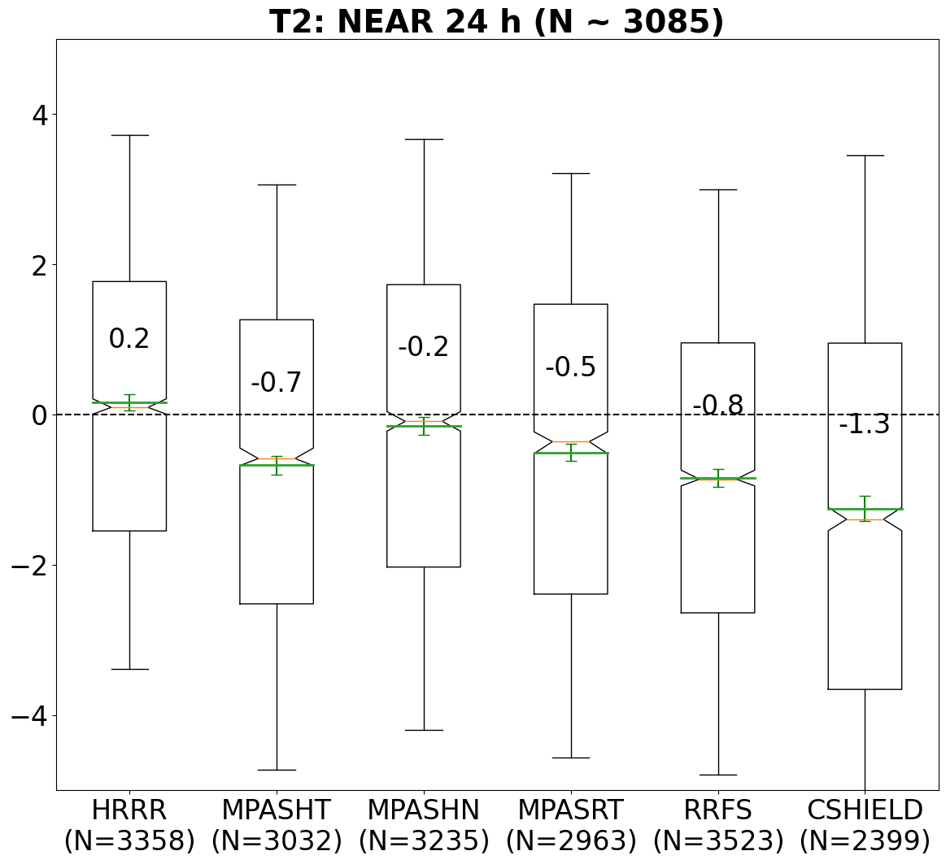
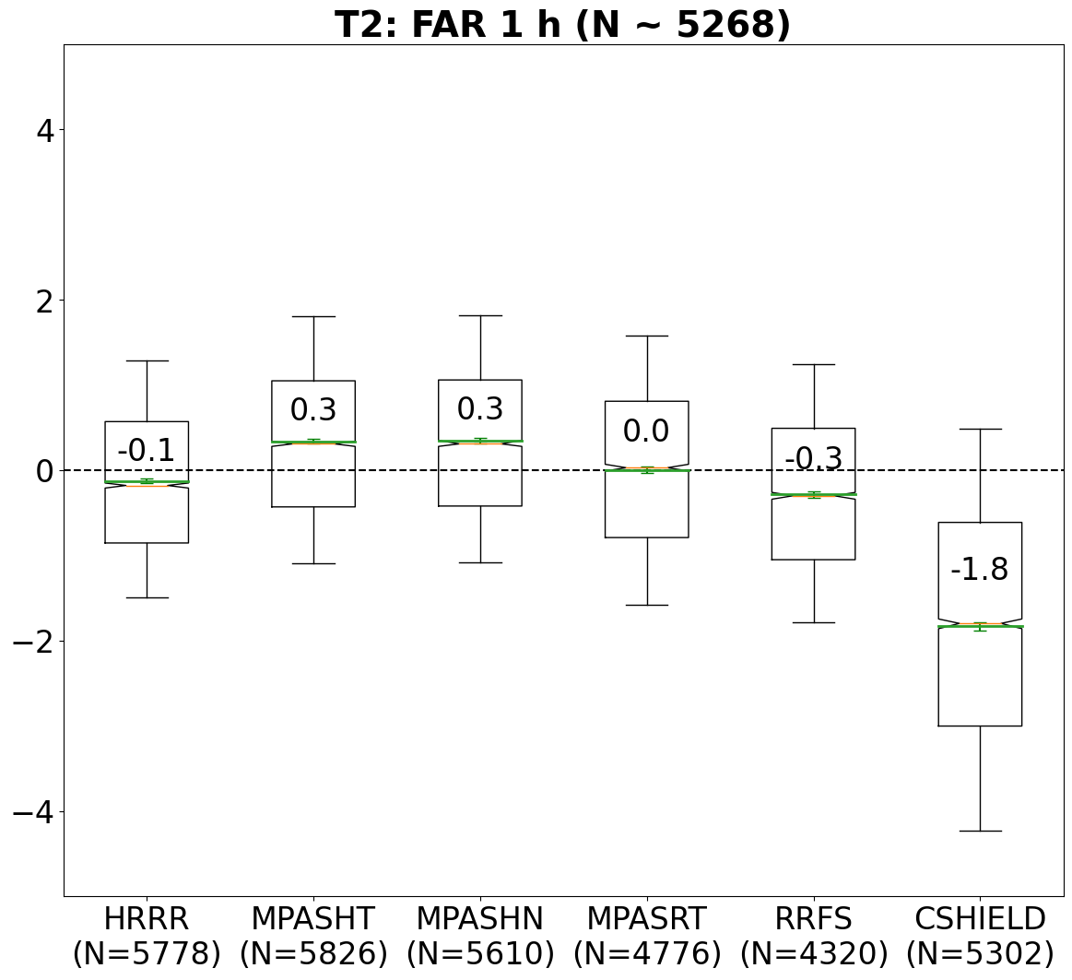
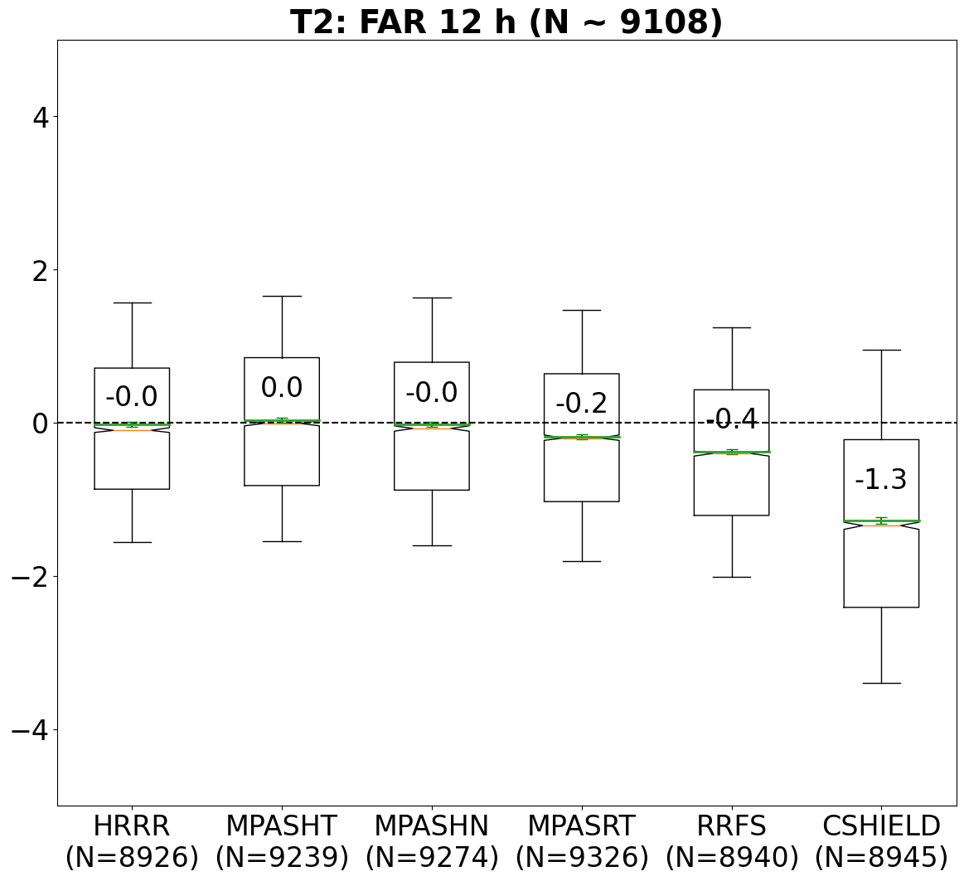
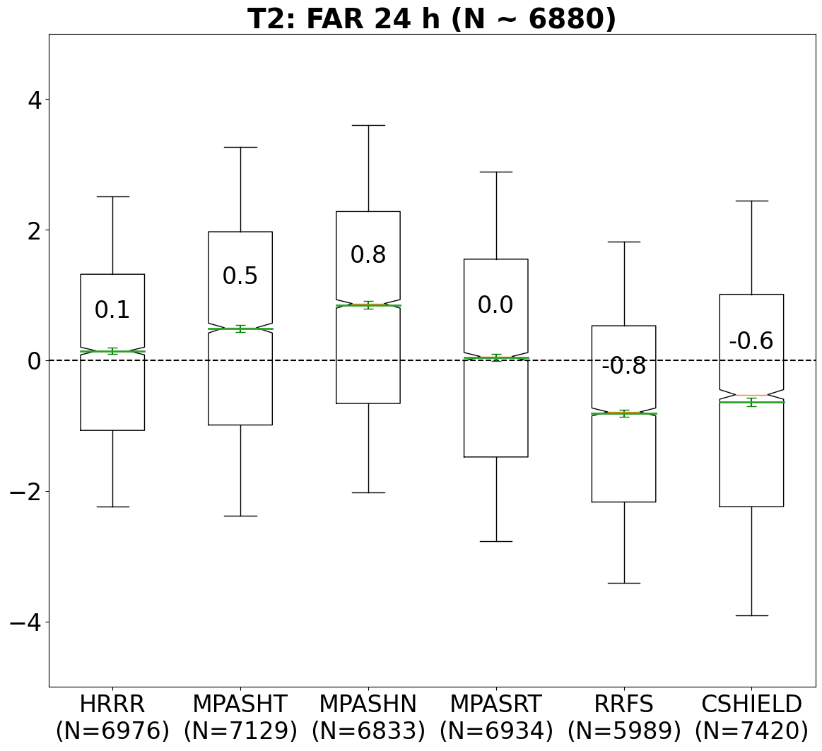
ASOS error boxplots: 2-m T (℃)
Bottom/top of boxes = 25th, 75th percentiles
Whiskers = 10th, 90th percentiles.
Yellow line = median, Green line = mean.
Box notches indicate 95% CI of median
Green whiskers indicate 95% CI of mean.
Biases are annotated.
HRRR was clear top performer for 2-m T, consistent with subjective SFE evaluations.
MPAS-RT inherits some of RRFS cold bias
Intermodel differences tend to persist into forecast, and are similar for post- vs. pre-convective environments.

Slide 8
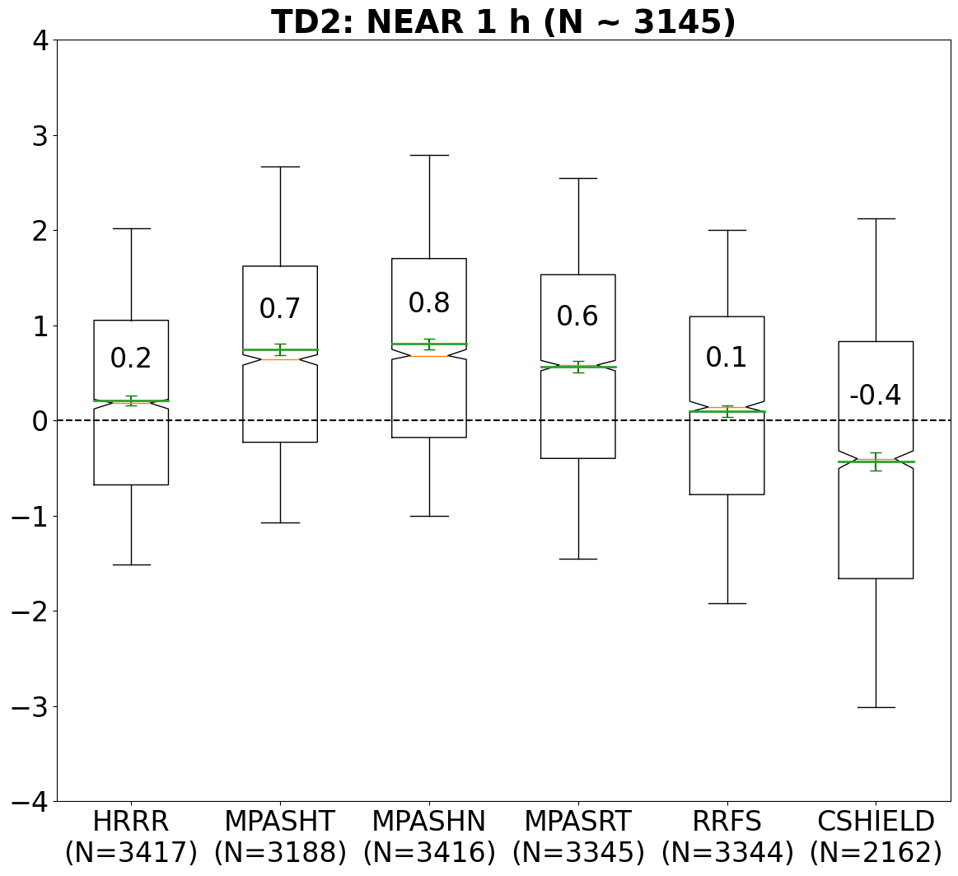
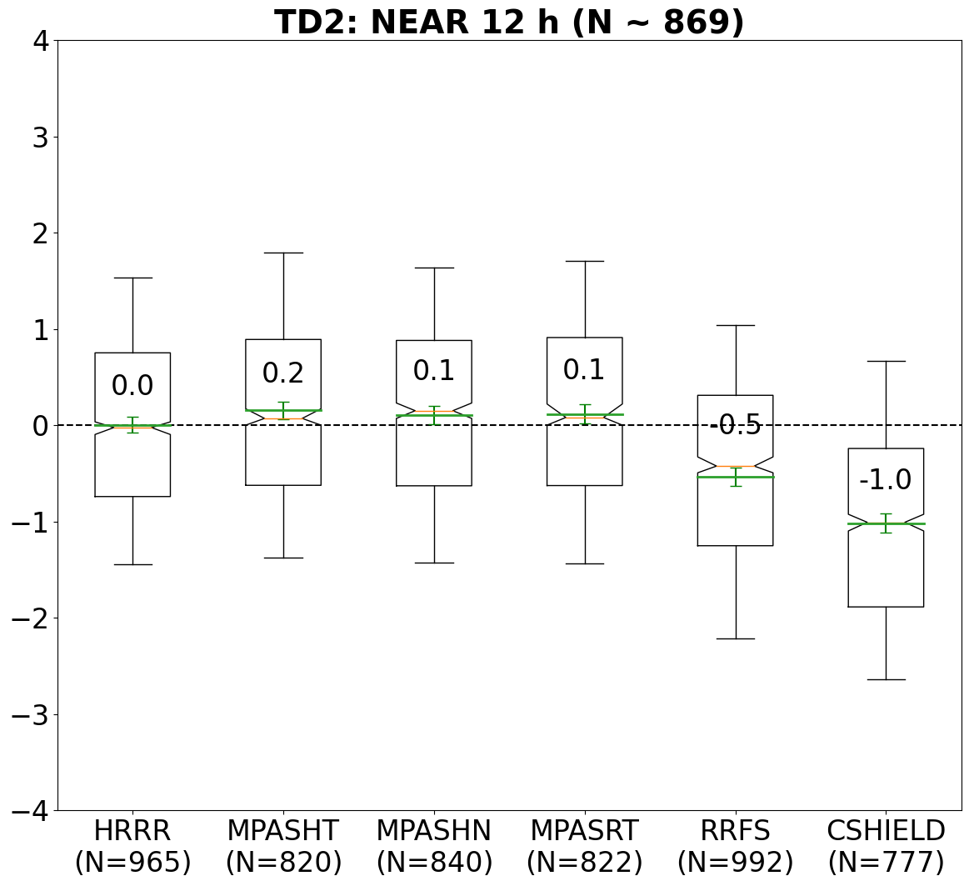
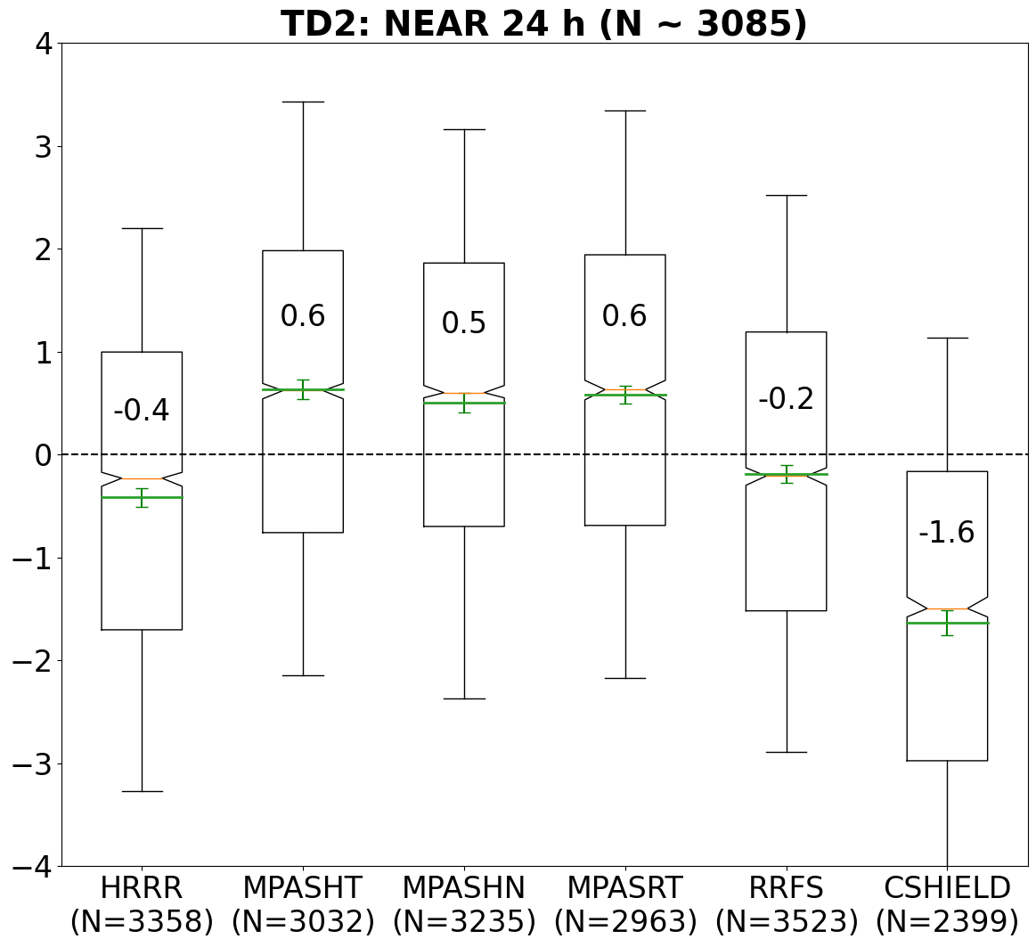
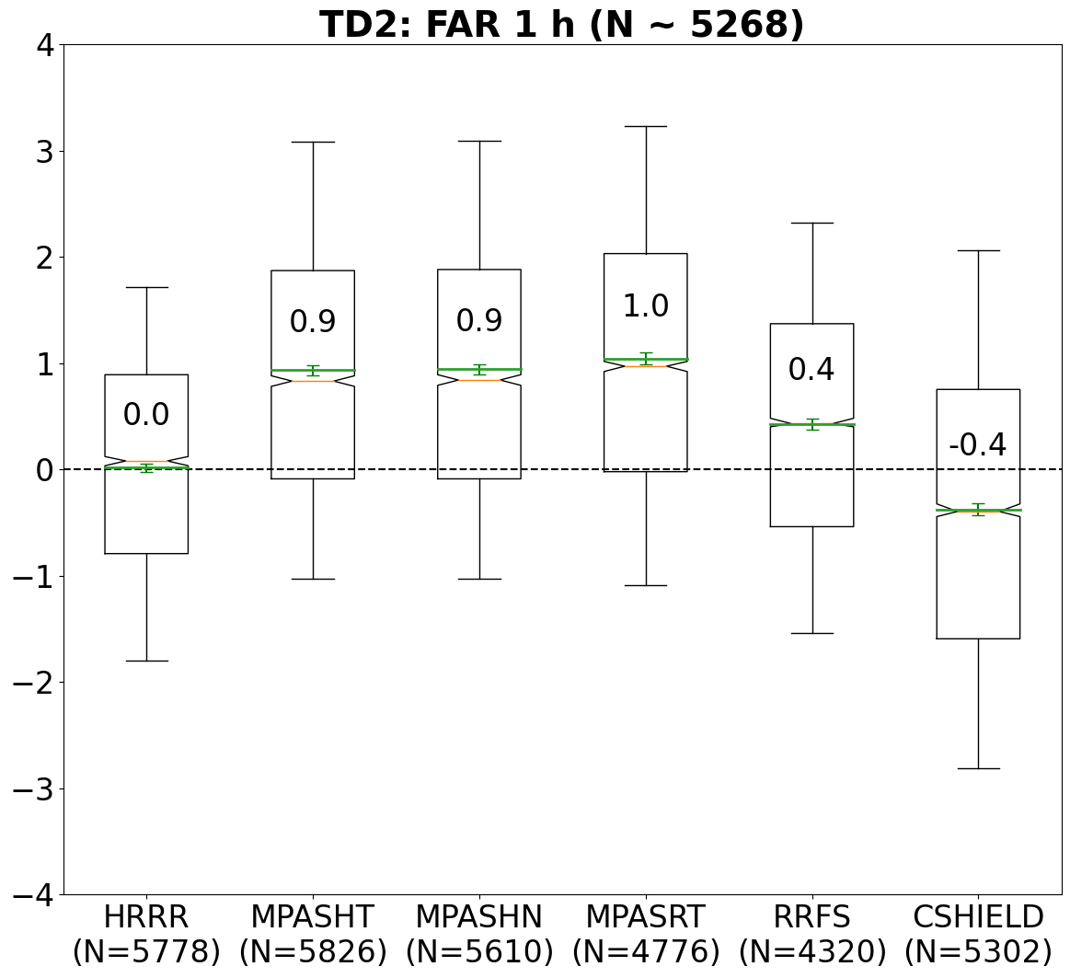
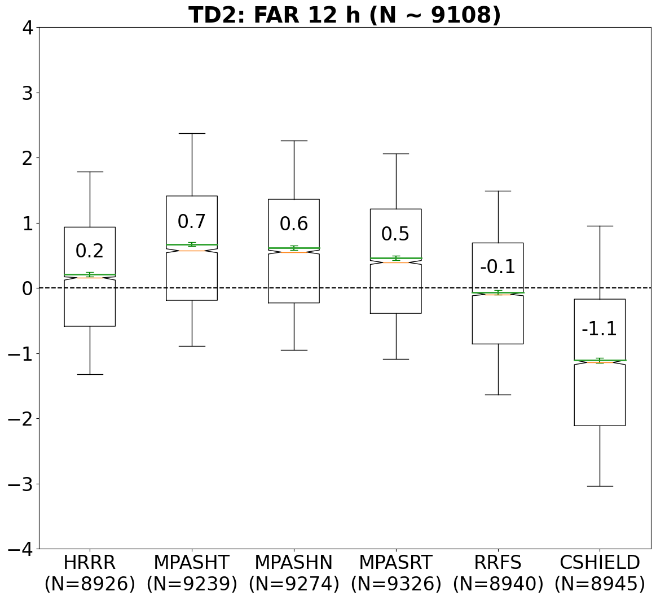
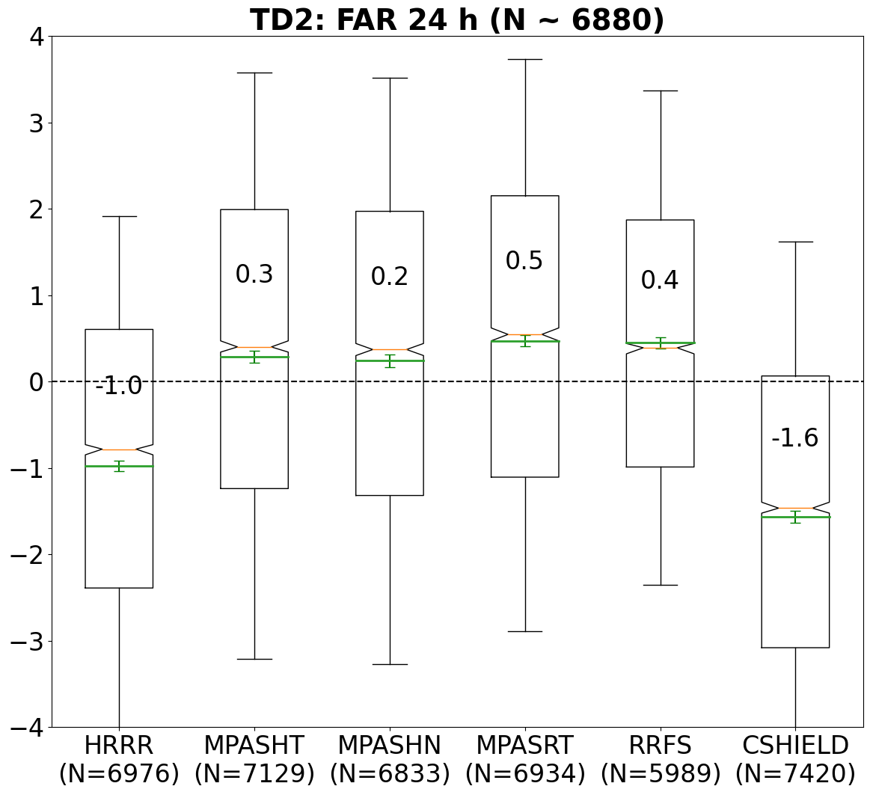
ASOS error boxplots: 2-m TD (℃)
Bottom/top of boxes = 25th, 75th percentiles
Whiskers = 10th, 90th percentiles.
Yellow line = median, Green line = mean.
Box notches indicate 95% CI of median
Green whiskers indicate 95% CI of mean.
Biases are annotated.
RRFS was clear top performer for 2-m TD, consistent with subjective SFE evaluations.
MPAS models too moist, but bias reduced upon updating soil type dataset in small set of May reruns
HRRR much too dry away from storms at t = 24 h

Slide 9
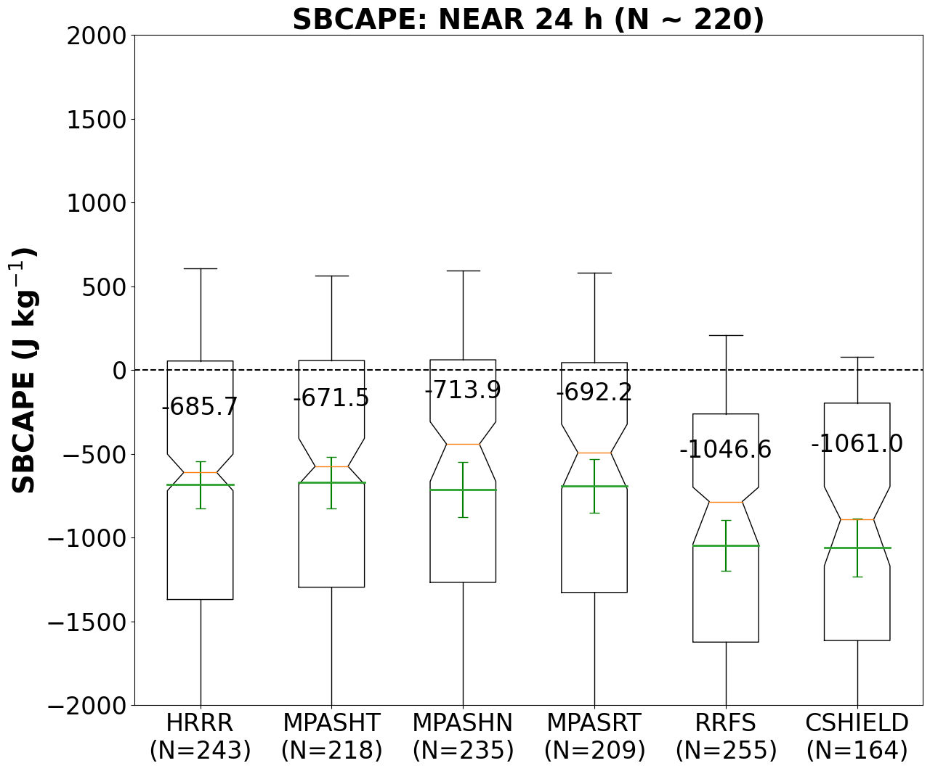
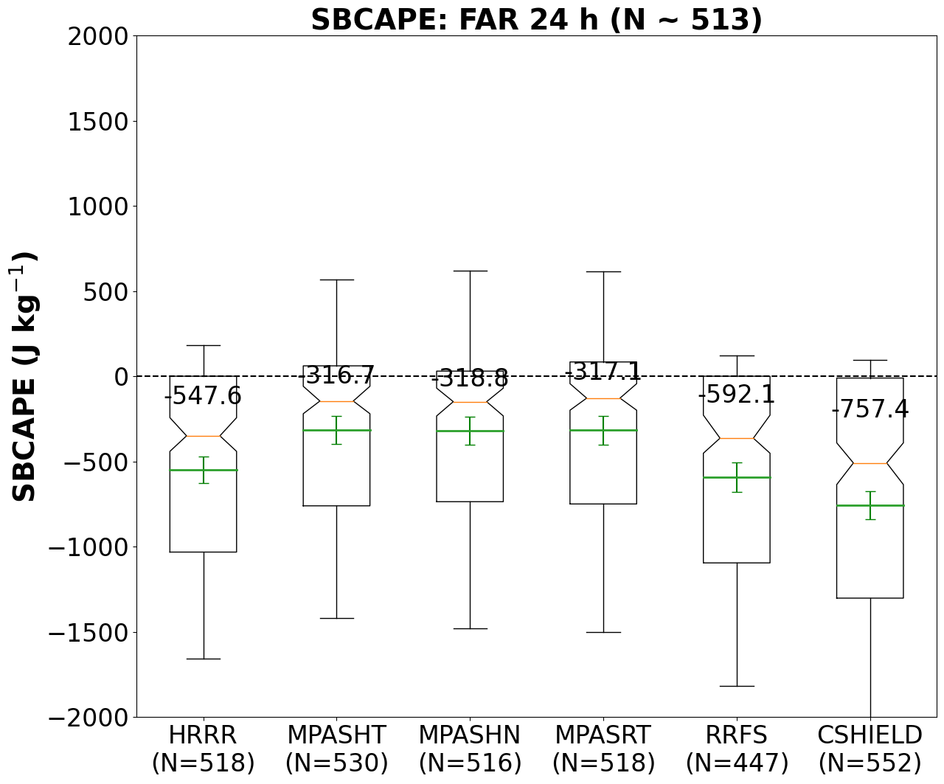
RAOB error boxplots: SBCAPE
All models too stable, especially near storms; could be due primarily to known positive storm frequency biases in HRRR/MPAS/RRFS models, but C-SHiELD has too few storms

Slide 10
Environmental biases (by lead time, storm proximity)
MPAS-RT biases more similar to HRRR-driven MPAS models than to RRFS, and MPAS-HT biases more similar to MPAS-RT biases than to HRRR → driving model has much less influence than dycore.
All MPAS models have similar performance overall; driving model has more influence than microphysics scheme.

Slide 11
Storm patch intercomparisons

Slide 12
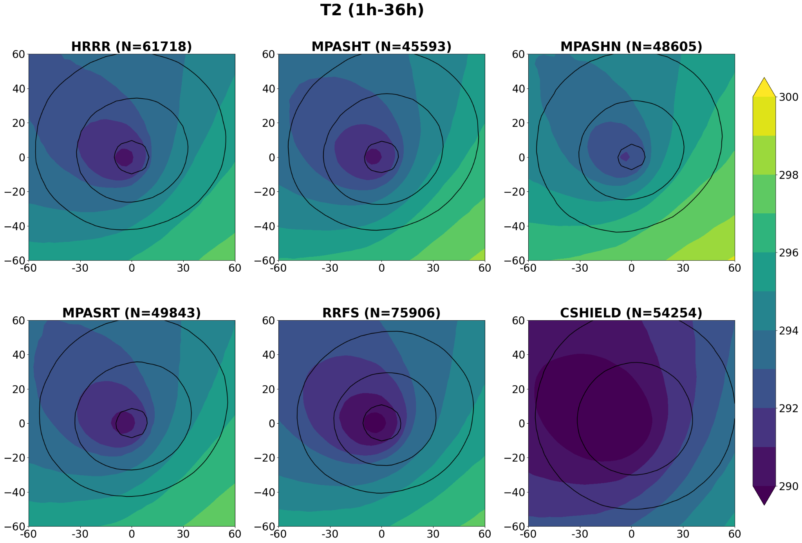
Probability-matched means (PMMs): SBCAPE, 2-m T
Probability matching preserves the mean frequency distribution of individual cases
FV3 models have notably stabler near-storm environments and colder cold pools

Slide 13
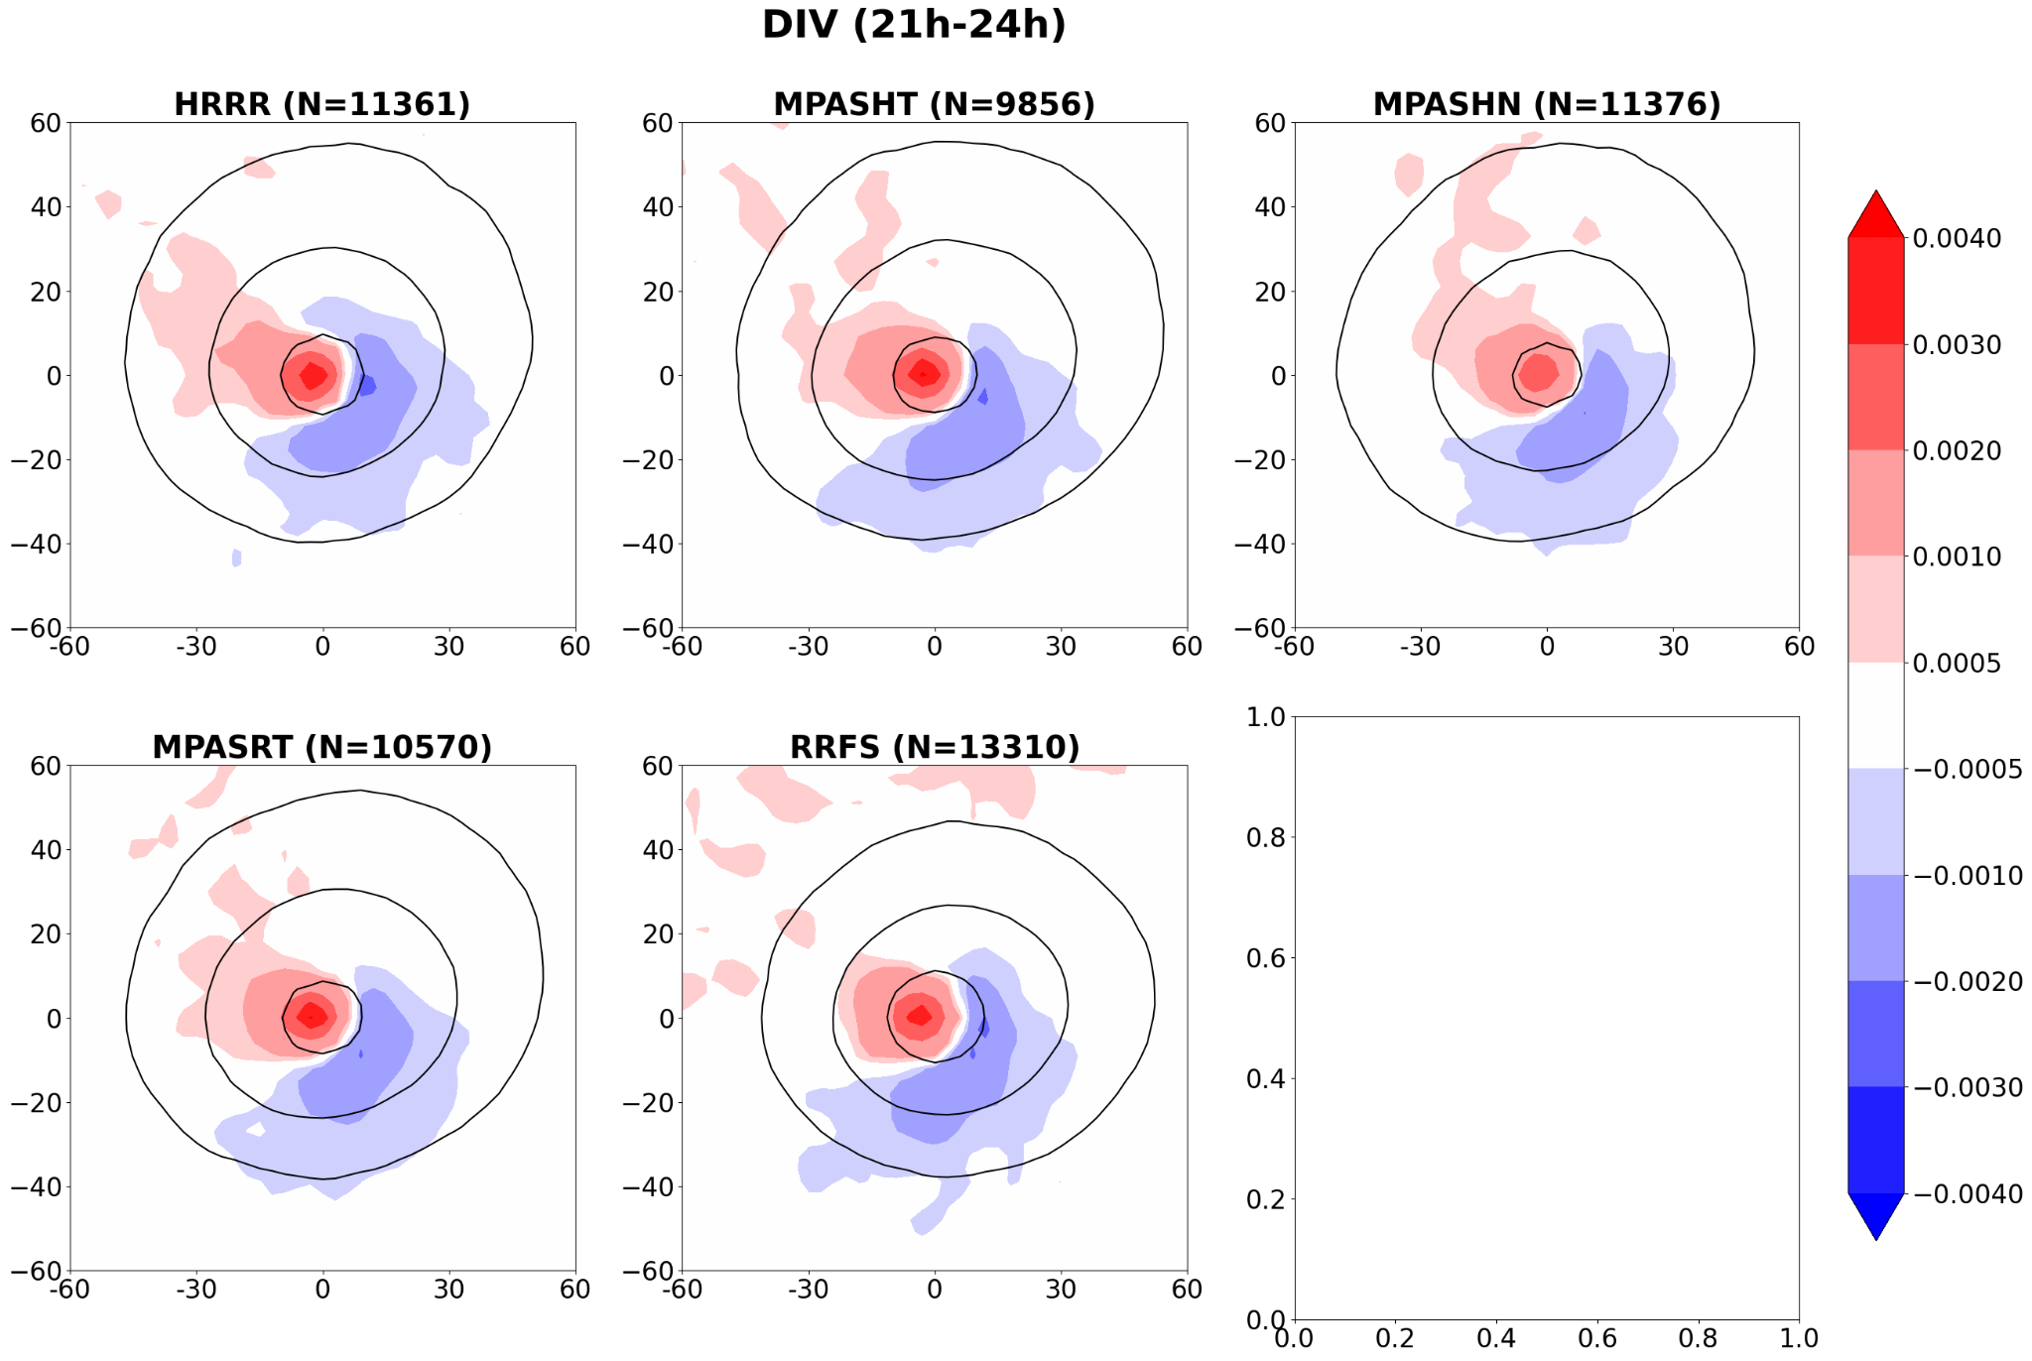
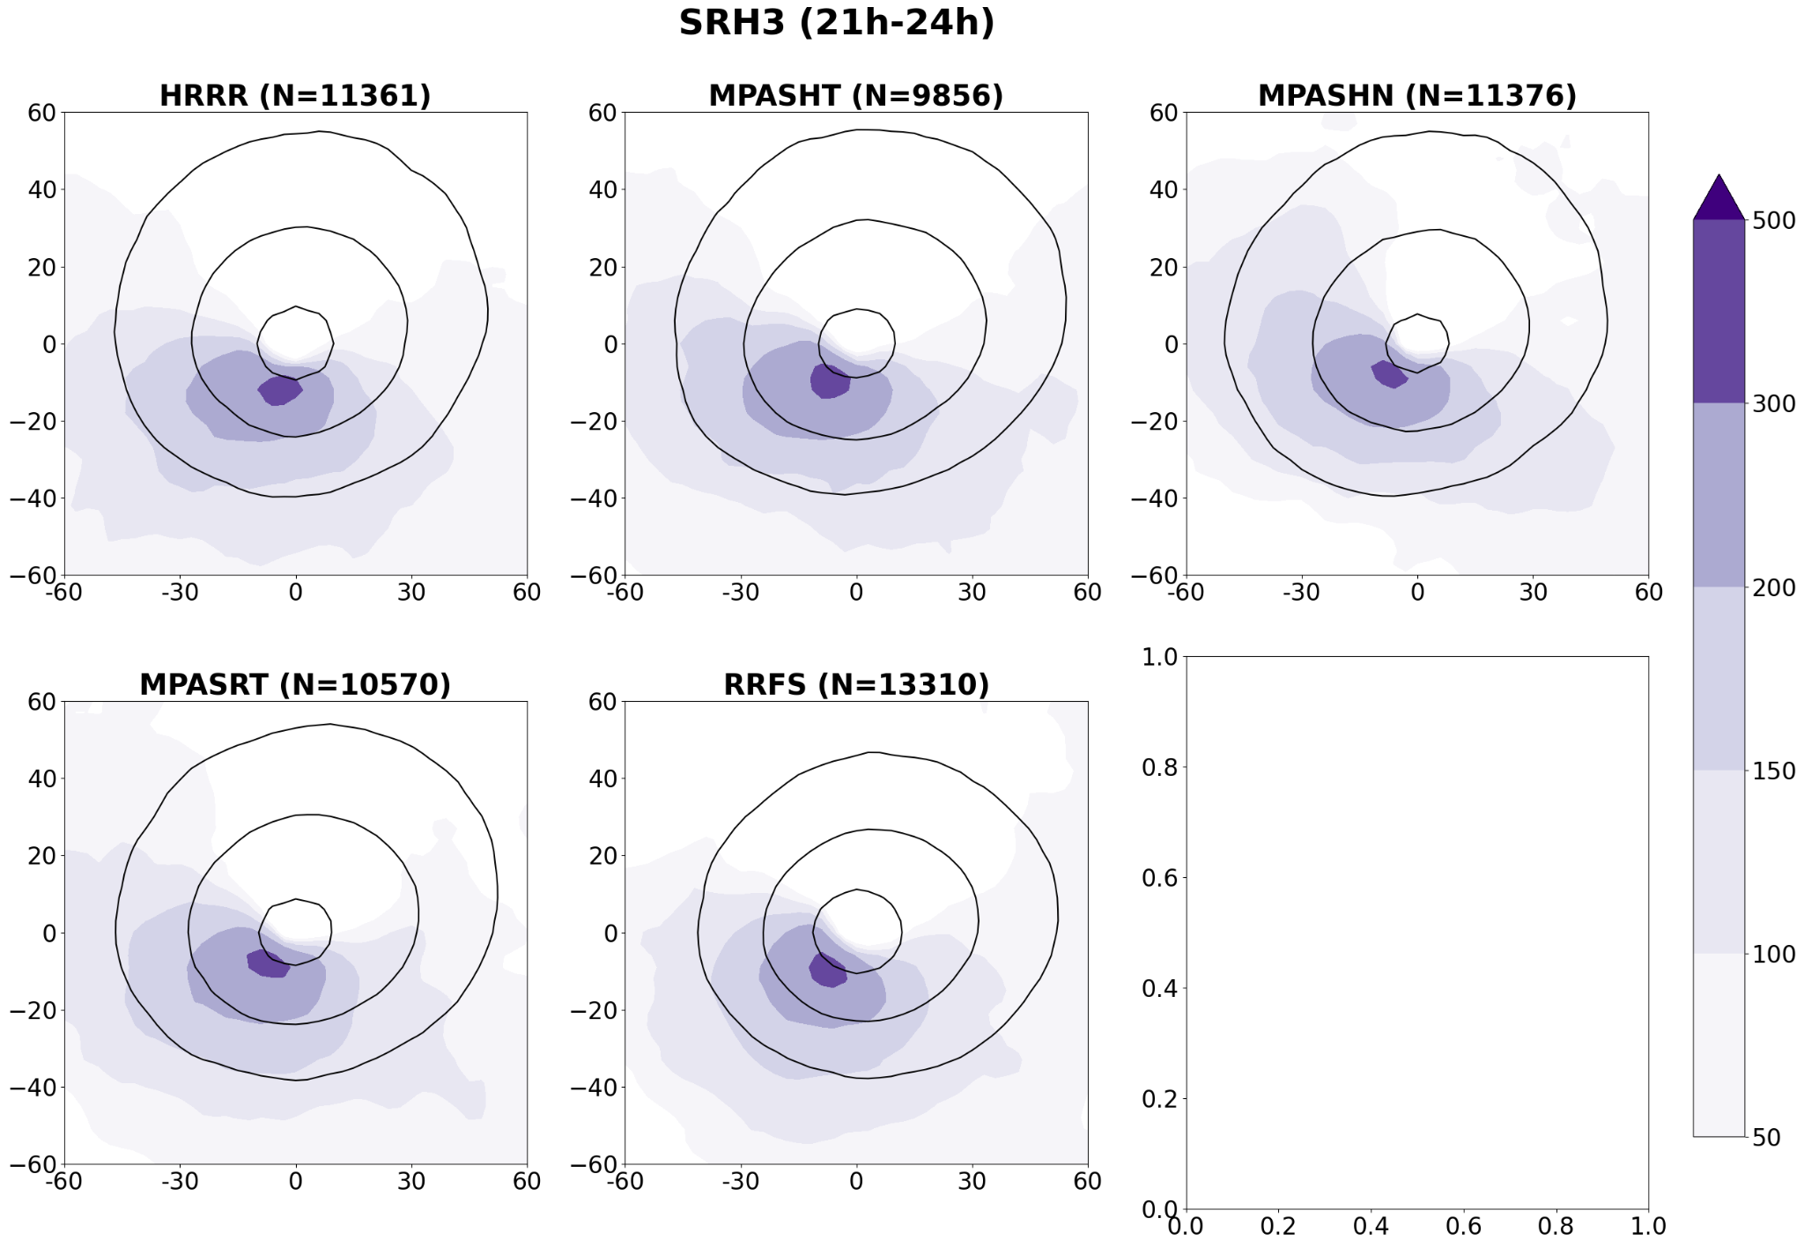
PMMs: 10-m DIV, 0–3-km SRH
Spatial patterns are very similar for five models for all examined fields

Slide 14
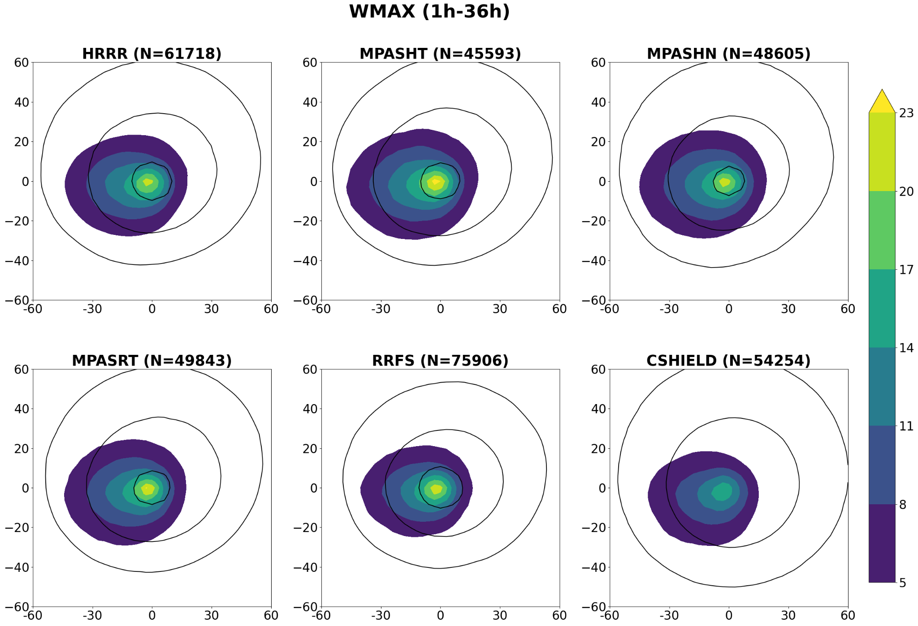
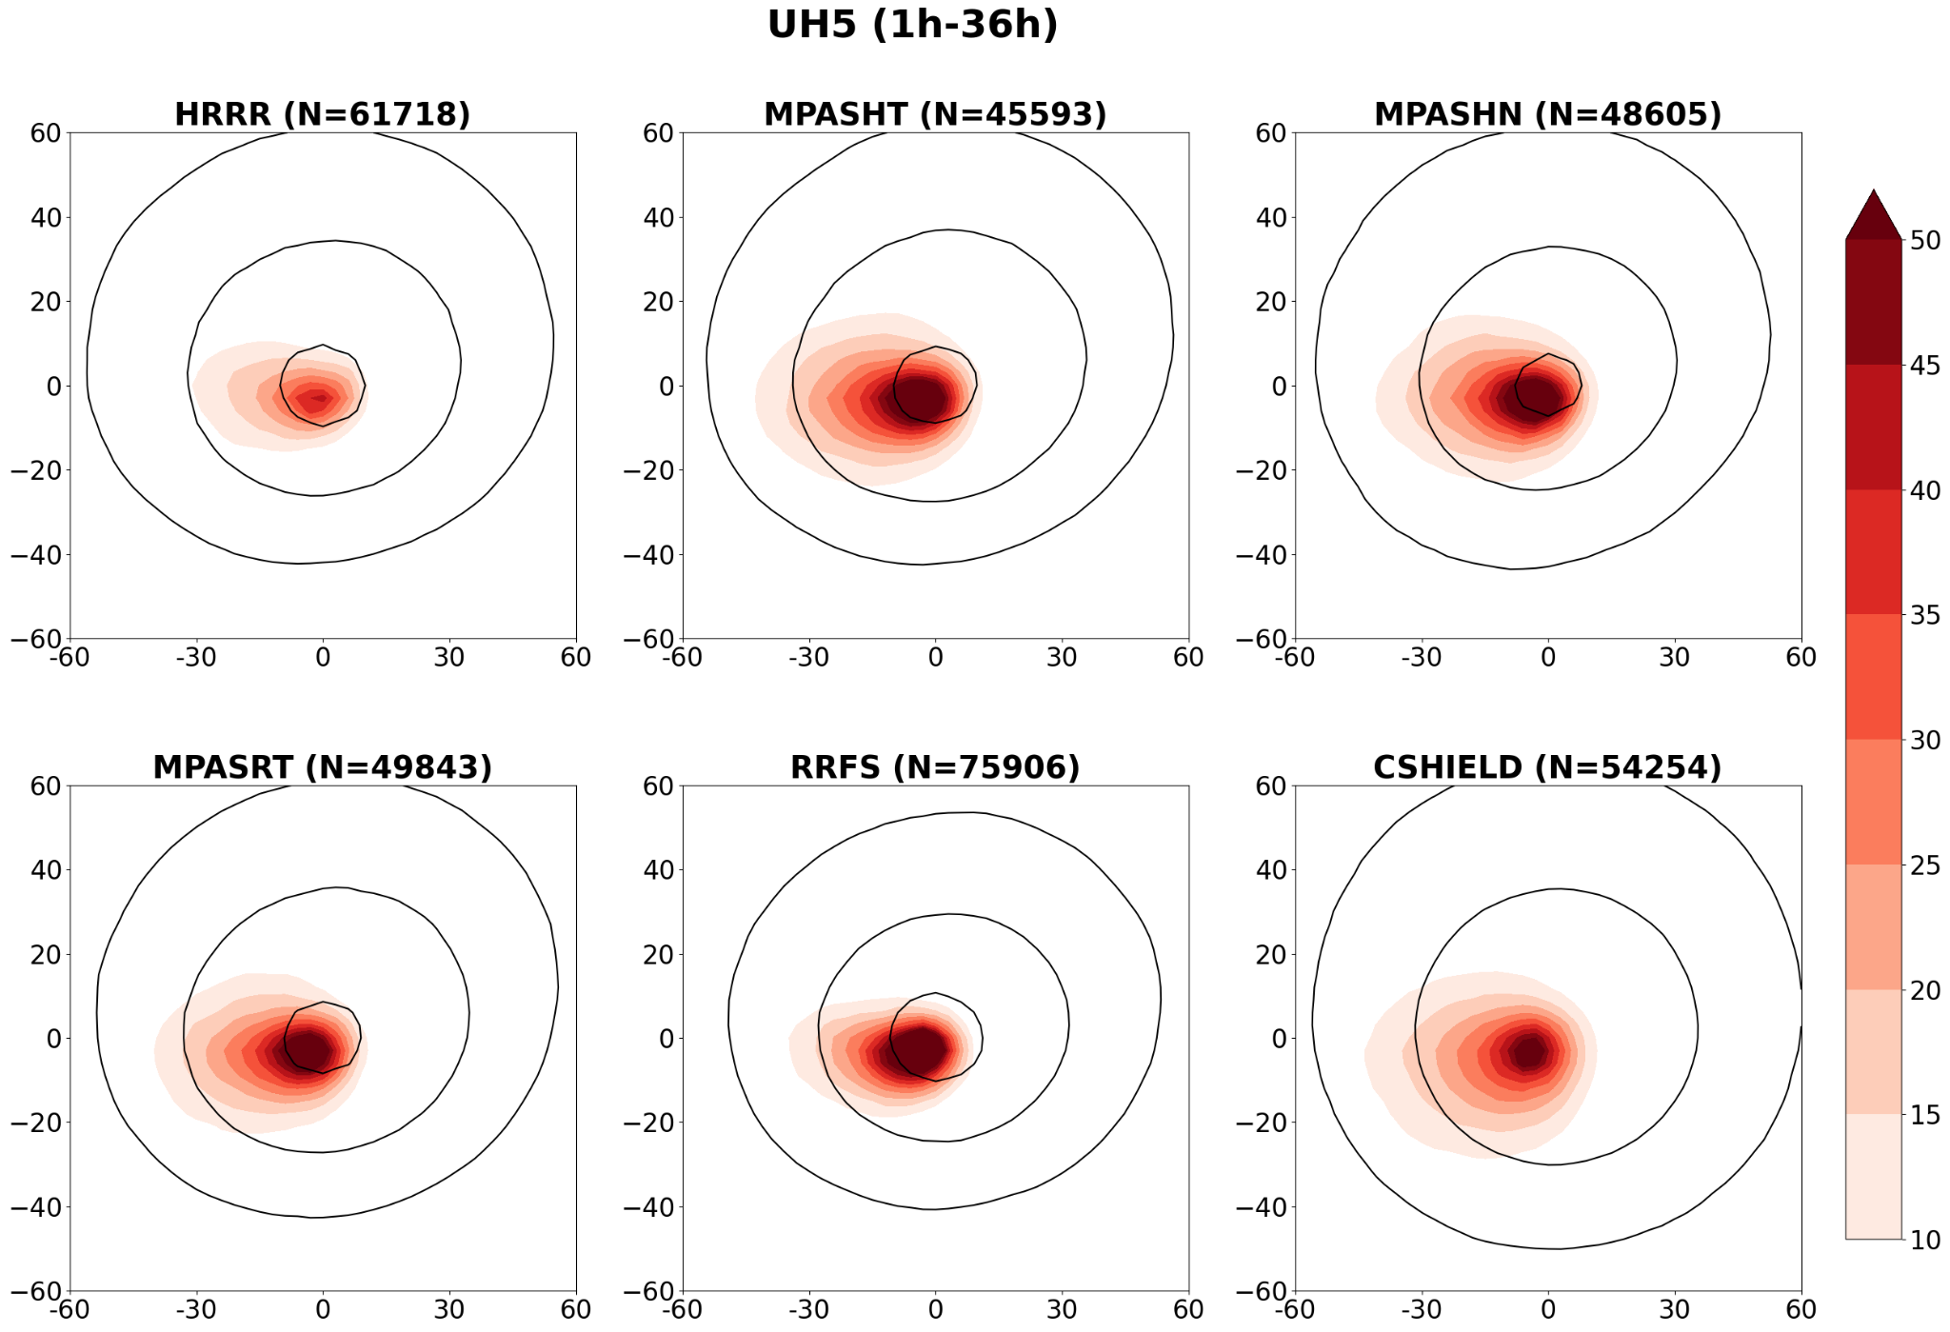
PMMs: max W, 2–5-km UH
Max updrafts similar except C-SHIELD relatively weak.
UH much lower for HRRR due primarily to post-hoc smoothing.
RRFS UH strongest due to better resolution of vertical vorticity on D-grid.

Slide 15
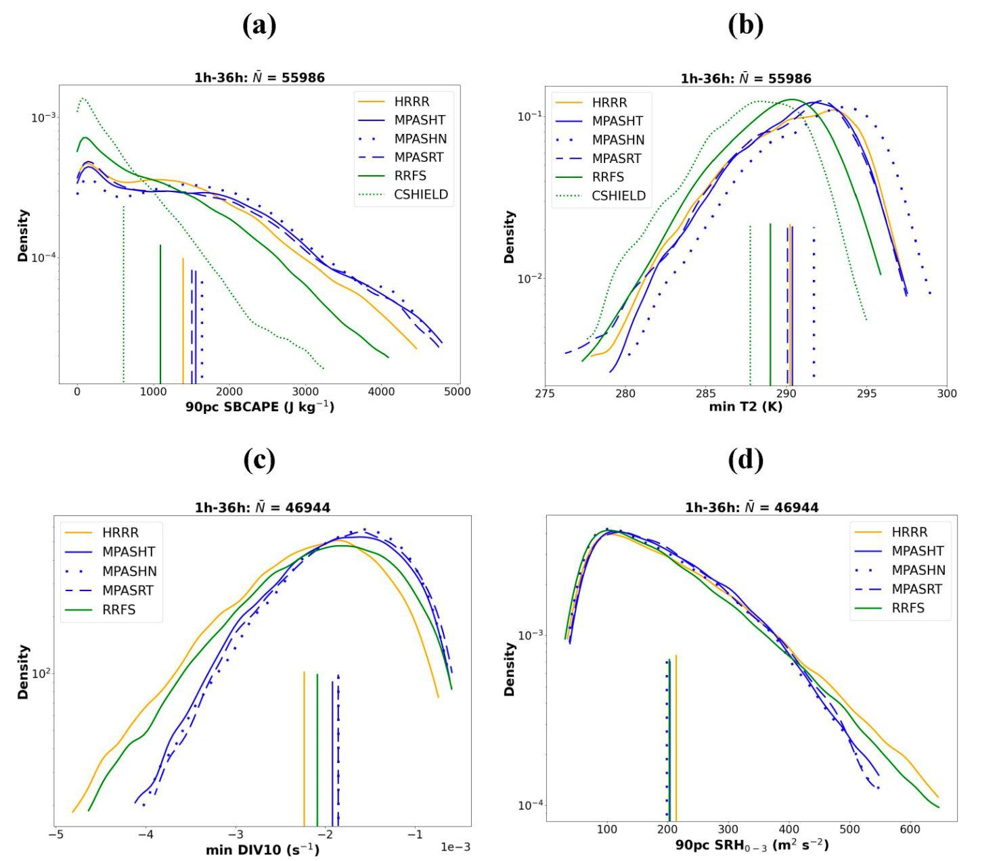
KDEs
KDE means (vertical lines) reflect differences in PMM extrema
90pc SBCAPE > 3000 are much more common in HRRR & MPAS models than in RRFS, and very rarely occur in C-SHiELD

Slide 16
Conclusions
RRFS has cool/stable bias, but it’s much smaller than in C-SHiELD, perhaps due partly to the more storm-tailored physics in RRFS
RRFS had least-biased TD2 of all models; HRRR much too dry during PM
Dycore much more impactful than driving model on MPAS forecasts
MPAS models were comparable overall to HRRR for environmental verification
All models substantially underforecast SBCAPE at t = 24 h, esp. near storms; consistent with RRFS/HRRR/MPAS models producing too many storms (but C-SHiELD produces too few)
Near-storm environments had similar patterns for all models; only magnitudes differed
Intermodel differences are generally similar across 0–36-h lead times, near vs. far from storms; suggests differences are not exacerbated by differing storm characteristics
Many more results at (or scan QR code): https://www.nssl.noaa.gov/users/potvin/
public_html/MPAS_images_General_May-June/data_details.html

