Slide 1
Development and Code Infrastructure of The Coastal Modeling Framework Based on Unified Forecast System (UFS-Coastal-App)
Ufuk Turuncoglu & UFS Coastal Team*
NCAR/CGD/CSEG/ESMF
July 24, 2024
Notes:
NOTE: Background image can be used as is or changed for a particular presentation. Click: Slide > Edit master.

Slide 2
UFS Coastal Model Development Team
Hernan G. Arango | Rutgers Department of Marine & Coastal Sciences (RUTGERS)
Changsheng Chen | University of Massachusetts Dartmouth (UMASSD)
Carsten Lemmen | Helmholtz-Zentrum Hereon (HEREON)
Siqi Li | University of Massachusetts Dartmouth (UMASSD)
Saeed Moghimi | NOAA National Ocean Service, Office of Coast Survey (NOAA/NOS/OCS)
Edward Myers | NOAA National Ocean Service, Office of Coast Survey (NOAA/NOS/OCS)
Jianhua Qi | University of Massachusetts Dartmouth (UMASSD)
Yunfang Sun | Earth Resources Technology (ERT/SFI) NOAA National Ocean Service, Office of Coast Survey (NOAA/NOS/OCS)
Ufuk Turuncoglu | National Center for Atmospheric Research (NCAR)
Panagiotis Velissariou | NOAA National Weather Service, National Hurricane Center, Storm Surge Unit (NOAA/NWS/NHC/SSU)
Joannes Westerink | University of Notre Dame (UND)
Damrongsak Wirasaet | University of Notre Dame (UND)
Y. Joseph Zhang | Virginia Institute of Marine Science (VIMS)
and others …

Slide 3
Simplifying NOAA’s Operational Forecast Suite
https://epic.noaa.gov/who-we-are/community-modeling/

Slide 4
UFS Coastal Project
Support: EPIC Program & NOAA/NOS/OCS
1st phase ended on March, 2024
2nd phase started on last April (18-months SoW)
The project aims to advance the coupling interface for UFS Coastal Application to support variety of different coastal specific model configurations
Including forecasts, hindcasts, and products for Safe and Efficient Navigation, Risk Reduction, and Total Water Level prediction
Updating the existing Coastal Application with the recent development done in UFS Weather Model
Extending the regional modelling capabilities to support various configurations
Supporting UFS Coastal Model specific components be use them under UFS WM

Slide 5
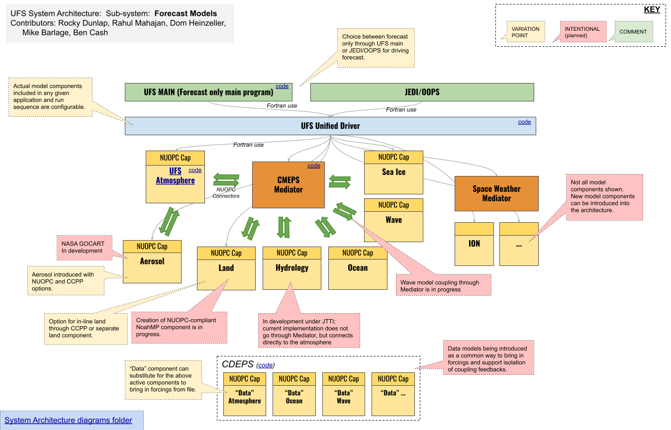
UFS Weather Model Fork for Coastal Applications
Additional Components:
Ocean:
Atmosphere:
SCHISM
ADCIRC
PaHM
ROMS
FVCOM
The UFS WM fork used for UFS Coastal is the same code base and uses same build and RT infrastructure. It is also regularly synced with the UFS WM.

Slide 6
Current Status of The Model
Additional components are already part of the UFS Weather Model
Integrated with UFS Weather Model build and RT system
Compatible with CMEPS mediator (it was especially tricky for unstructured grid)
Each component has at least one RT defined in ufs_coastal.conf
Regularly testing on two platform: Hercules (Intel + GNU) and Frontera (Intel)
Currently has no any configuration that use active atmospheric model component and rather forced with CDEPS provided data atmosphere
SCHISM has two-way coupled ocean-wave configuration
wav -> radiation stress components -> ocn
ocn -> wind and current components -> wav

Slide 7
New Model Components
Component | Build | Tested* | RTs
ADCIRC | Yes | Yes | DATM+OCN
FVCOM | Yes | Yes | DATM+OCN - FVCOM runs in 2d mode and has issue with reproducibility
PAHM | Yes | Yes | Still under development
ROMS | Yes | Yes | DATM+OCN and working with both GNU and Intel compilers The CDEPS data atmosphere forced (ERA5) 3D Irene case is used for the initial implementation.
SCHISM NUOPC cap | Yes | Yes | DATM+OCN and DATM+OCN+WAV It is working with both GNU and Intel compilers
WW3 | Yes | Yes | NUOPC cap is fixed for radiation stress components - PR DATM+WAV and DATM+OCN+WAV
The status of RTs can be found in the ufs-coastal repository wiki page. This is updated regularly.

Slide 8
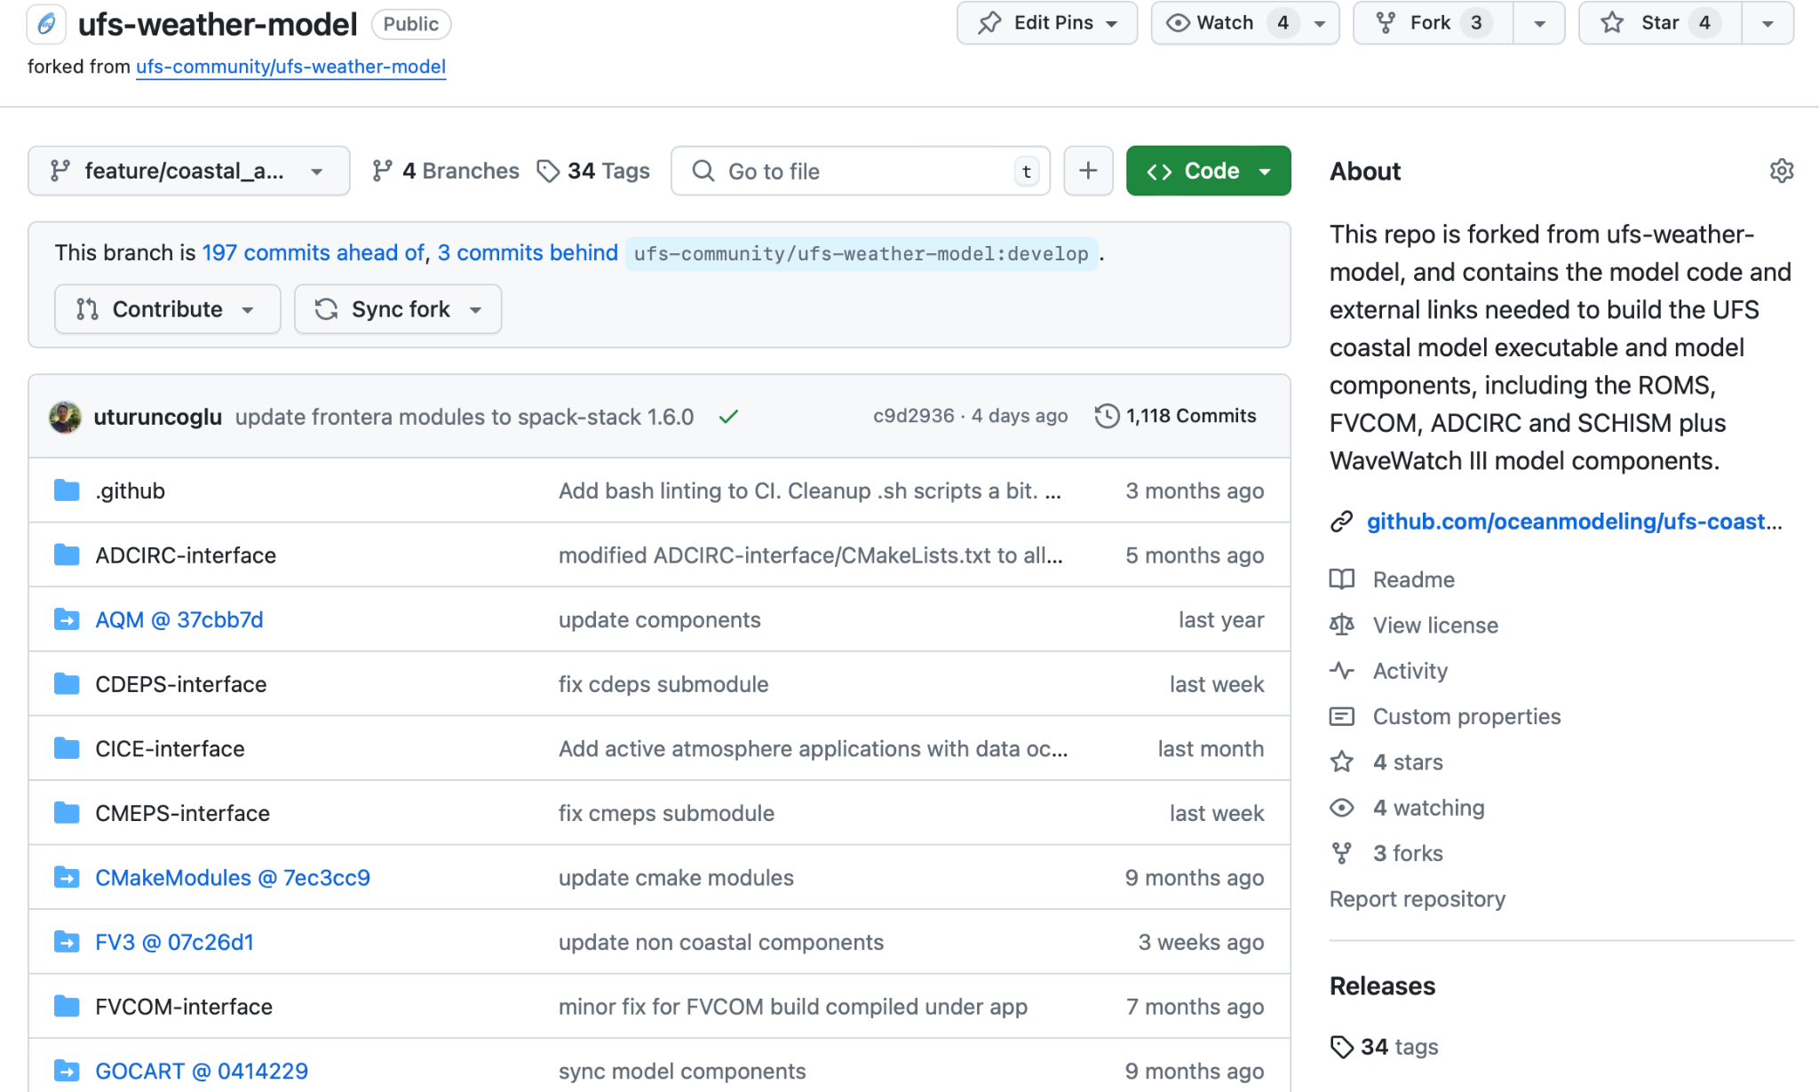
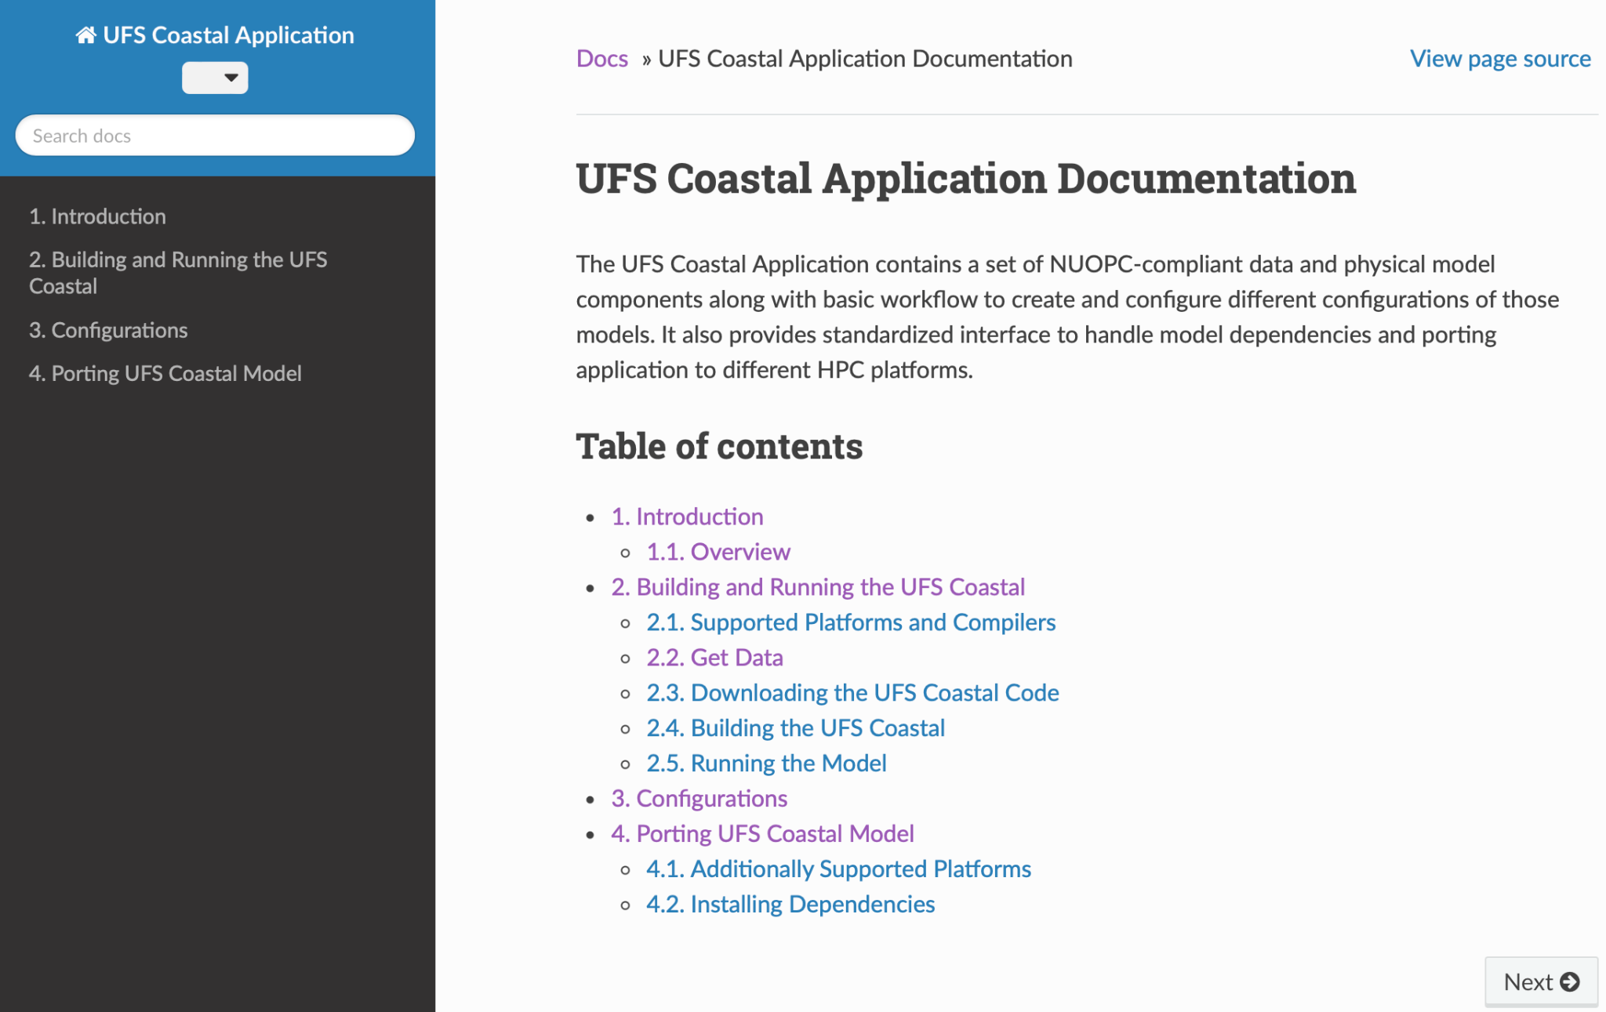
Repository and Documentation
https://github.com/oceanmodeling/ufs-weather-model/tree/feature/coastal_app
https://oceanmodeling.github.io/ufs-coastal-app/versions/main/html/index.html

Slide 9
UFS Coastal Application
The current version of application (ufs-coastal-app);
Uses ufs-weather-model as a submodule
A top level CMake build system is implemented - uses UFS WM modules
A Sphinx based documentation - needs to be extended
Implementation of application level workflow - development branch
It is based on UWTools
Active collaboration between UWTools and Coastal Modeling team
CDEPS, SCHISM and WW3 support is already implemented
Initial target is to run DATM+SCHISM configuration via workflow

Slide 10
Plans
Focus on only SCHISM and ROMS model components (SCHISM <-> WW3 3d couple)
Keep supporting all UFS coastal specific components
Complete initial implementation of application level workflow (UWTools)
Enhance documentation:
porting and building model configurations, using workflow etc.
Transition to new generic NUOPC driver (ESMX)
Initial implementation will be done to test one or two components
Develop robust testing framework by taking advantage of CI/CD type automatized testing - EPIC team is helping to implement initial Jenkins based workflow

Slide 11
Q/A ?
Contact: Ufuk Turuncoglu
turucu@ucar.edu

