Slide 1
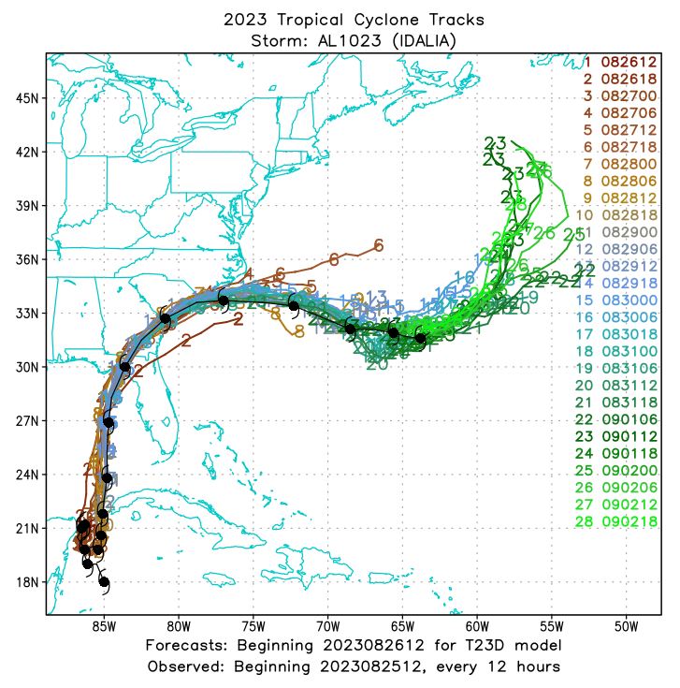
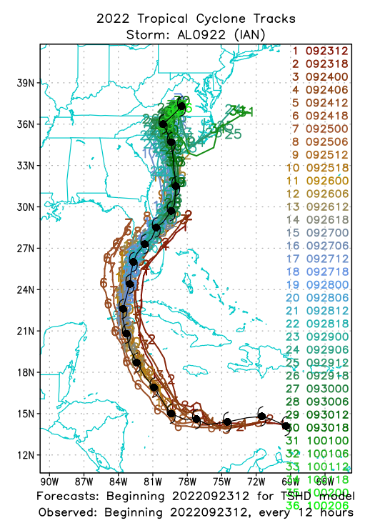
Use and distribution of the GFDL Vortex Tracker as part of the Unified Forecast System
Tim Marchok – NOAA / GFDL
Caitlyn McAllister – SAIC @ NOAA/GFDL
Unifying Innovations in Forecast Capabilities Workshop
Jackson State University
Jackson, MS
July 24, 2024

Slide 2
Outline
Overview of the tracker
Metrics diagnosed by the tracker
Inclusion as part of the Unified Forecast System

Slide 3
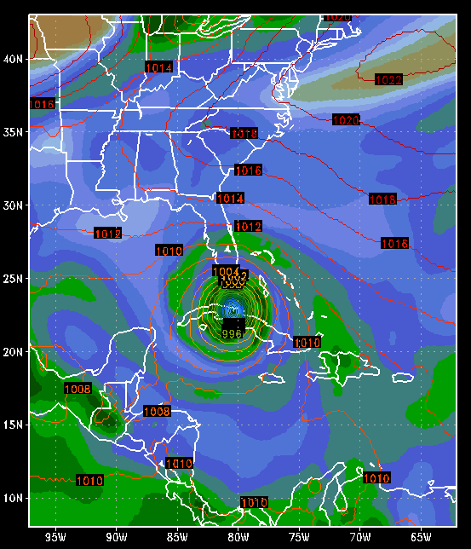
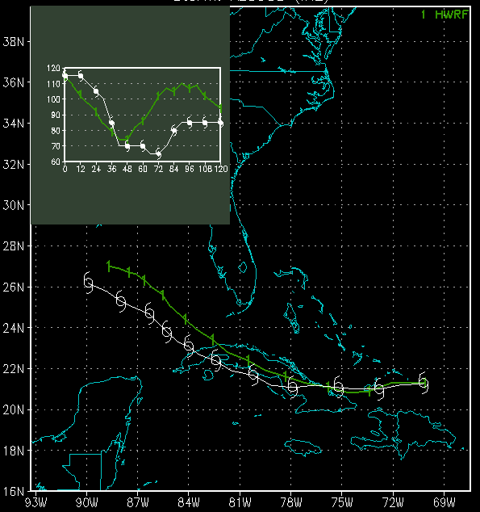
Purpose of a vortex tracker
.
.
11000100100100101010
00010010011110010010
11001110001101010001
00001010010011001011
10101110101100011001
10001110100100010100
.
.
Goal: Efficient diagnosis of model cyclone guidance
Two different modes of running the tracker
Forward tracking: Track known, RSMC-numbered storms
Genesis tracking: Detect & track new storms in a forecast

Slide 4
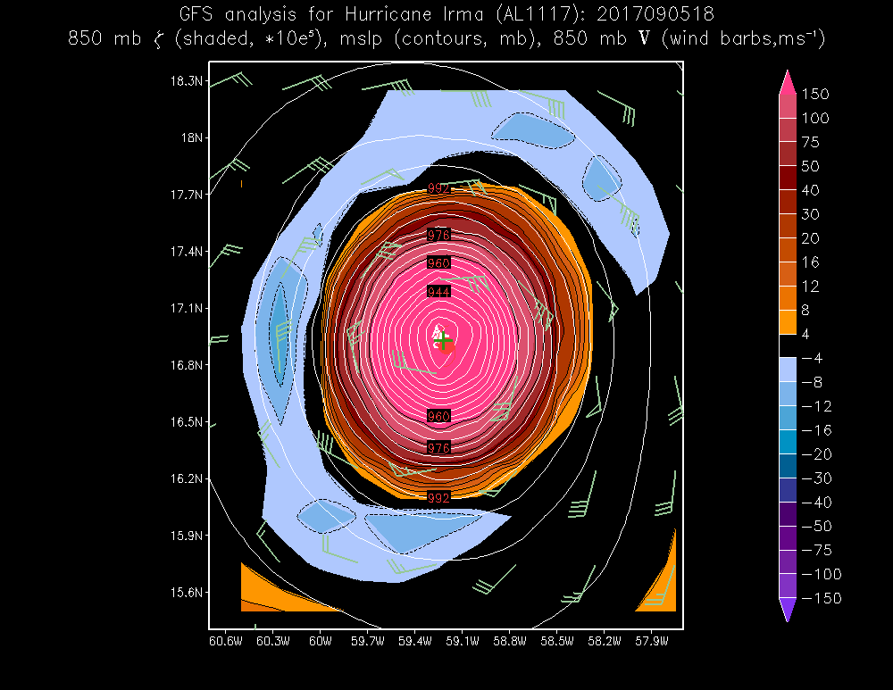
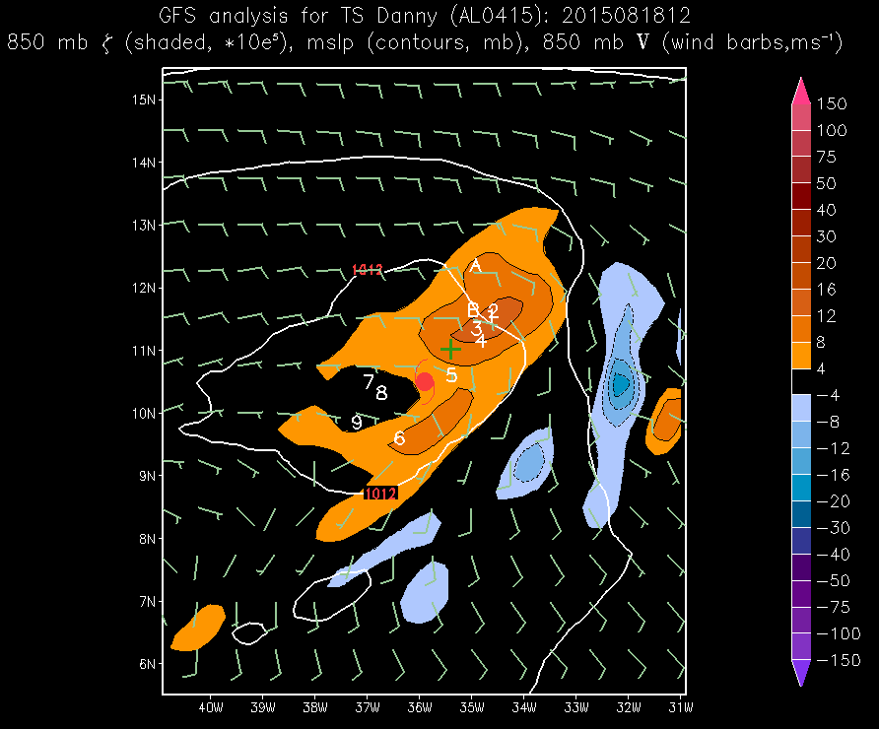
Use of multiple parameters to help fix a center position
700 mb rel vort
Irma (2017) in GFS
850 mb rel vort
Danny (2015) in GFS
10-m rel vort
700 mb gp height
850 mb gp height
MSLP
700 mb wind circ
850 mb wind circ
10-m wind circ
The MSLP center fix is located 281 km from the 850 mb relative vorticity fix
9-parameter fix
NHC observed fix
Center positions for intense storms (Irma, left panel) are easier to fix since the centers for various parameters are vertically stacked.
For weaker storms with a poor model representation (Danny, right panel), an average of multiple parameters helps to fix a central storm position.

Slide 5
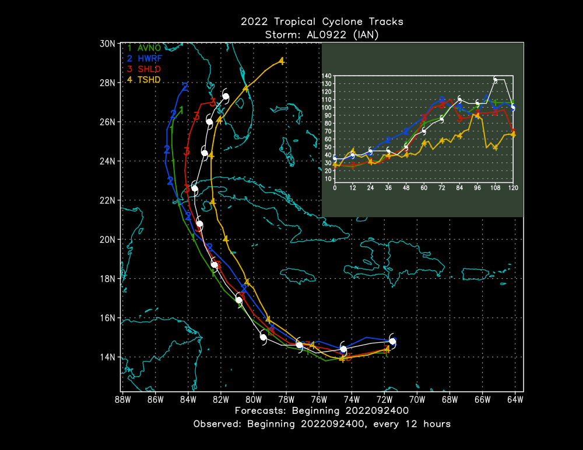
Tracker diagnostics (forward or genesis mode)
Storm position
Storm intensity (max wind)
MSLP
Quadrant wind radii
R34
R50
R64
RMW: Point-based
RMW: Axisymmetric
ROCI

Slide 6
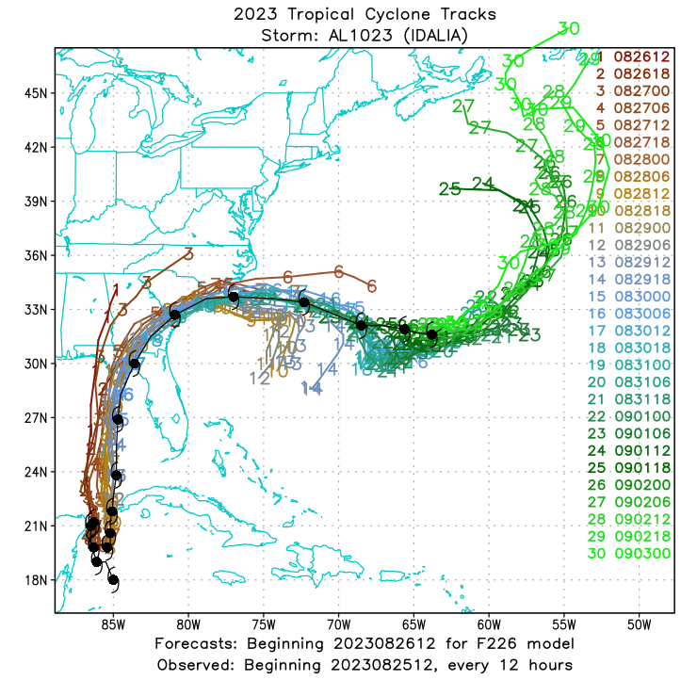
Tracker diagnostics (cont’d)
Direction of storm movement
Storm translation speed
850-200 mb vertical shear (magnitude & direction, using SHIPS method)
Area-averaged SST under storm
Cyclone Phase Space diagnostics
Warm core determination in 300-500 mb layer

Slide 7
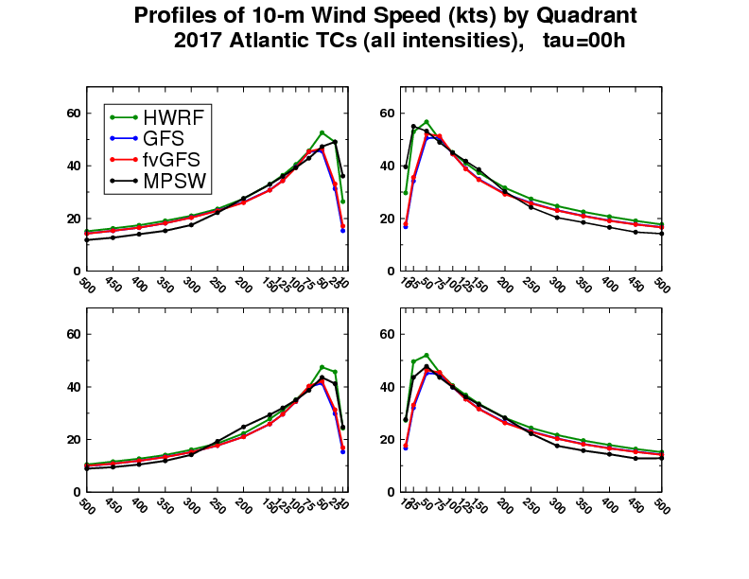
Tracker diagnostics (cont’d)
10-m wind structure
Radial profiles of 10-m wind in each quadrant
Fractional coverage of 10-m winds in each quadrant
Integrated Kinetic Energy of the 10-m wind field
PDF of the 10-m winds in each quadrant

Slide 8
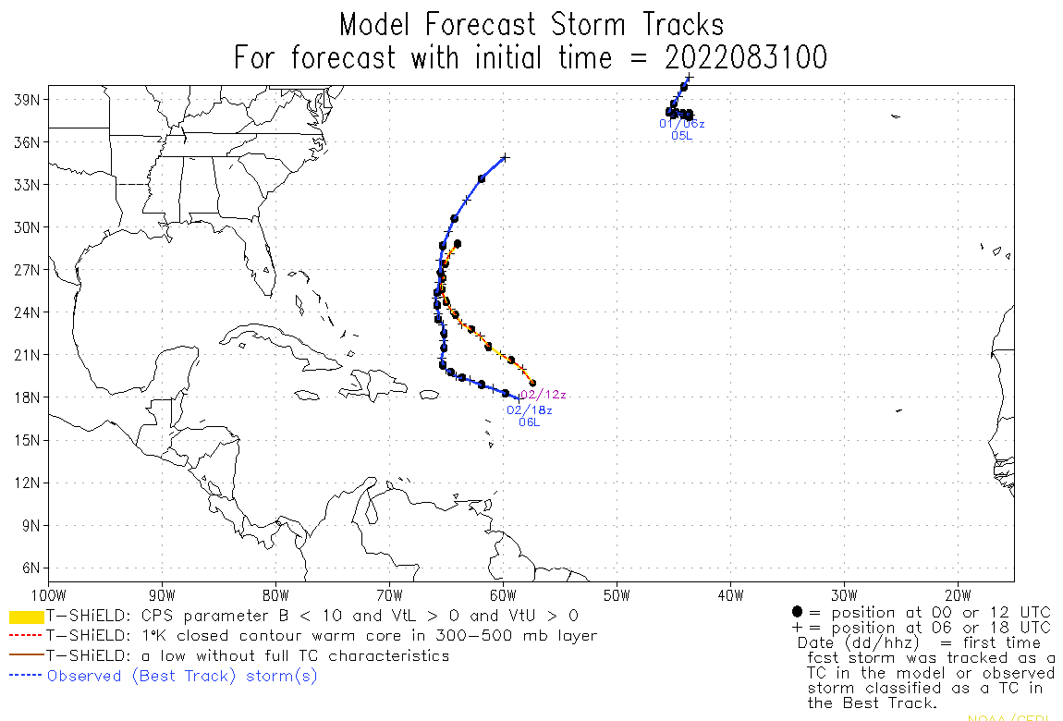
Genesis tracking & genesis diagnostics
Genesis diagnostics produced in addition to standard tracker metrics
850 mb convergence
850 mb moisture convergence
Mean RH: 800-600 mb layer
Mean RH: 1000-925 mb layer
500 mb omega
For genesis tracking, the criteria to determine if a new model TC exists are more stringent than for forward tracking of known TCs.

Slide 9
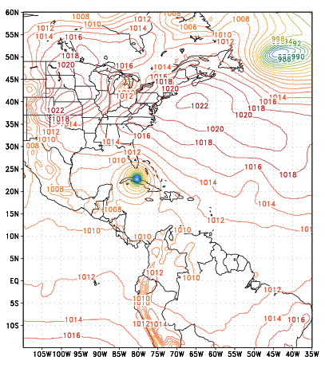
Tracker inputs: Model synoptic data
Data can be in NetCDF, GRIB1 or GRIB2 format.
Data points must increment from northwest (1,1) to southeast (imax, jmax).
(1,1)
Data must be on a lat/lon grid.
Model grid can be global, regional (and moveable).
Data lead time intervals do not need to be evenly spaced.
(imax,jmax)

Slide 10
Use of the tracker in operations
Operational use at NCEP since 1998 for these models:
GFS, and GFS Ensemble (GEFS)
ECMWF, and ECMWF Ensemble (EEPS)
CMC, and CMC Ensemble (GEPS)
HWRF
HAFS-A, HAFS-B
GFDL Hurricane Model (retired)
Operational use at Navy / FNMOC since ~2003 for these models:
NAVGEM / NOGAPS-(retired)
COAMPS-TC, and COAMPS-TC Ensemble
ESPC

Slide 11
Inclusion of the GFDL Vortex Tracker in the UFS
The tracker was previously released to the public via DTC, but that support ended in 2021.
Numerous versions of the GFDL Vortex Tracker exist in operations.
A need exists to coalesce divergent versions of the GFDL Vortex Tracker into a single version so that it can be properly supported as a community-developed GitHub project.

Slide 12
Goals of the UFS / GFDL Vortex Tracker project
Maintain and update automatic build system for the tracker.
Establish & maintain GitHub repository for the tracker:
https://github.com/NOAA-GFDL/GFDL-VortexTracker
Ensure compatibility with UFS Tier-1 supported platforms & compilers:
Gaea, Hera, Jet, PPAN, WCOSS2, Orion, Hercules
Encourage interaction with the community / respond to user queries
Development of an array of test run scripts

Slide 13
Goals of the UFS / GFDL Vortex Tracker project (cont’d)
Coalesce all divergent versions into a single, supported vortex tracker.
HAFS-A/B, GFS, GEFS, EMC extratropical cyclone tracking
Develop & maintain unit tests for the tracker
Update the documentation to keep it current with scientific developments.

Slide 14
Summary
GFDL Vortex Tracker provides tracking diagnostics for existing TCs as well as new TCs that develop during a model forecast.
Big part of the effort with this UFS project is to coalesce various versions of the GFDL Vortex Tracker into a single version.
GitHub repository has been established to support code development and foster community interaction:
https://github.com/NOAA-GFDL/GFDL-VortexTracker

