Slide 1
WoFSCast:
AI-NWP for storm-scales
Montgomery Flora¹², Corey Potvin², and Randy Chase³
¹Cooperative Institute for Severe And High-Impact Weather Research and Operations, ²National Severe Storms Laboratory, ³Cooperative Institute for Research of the Atmosphere

Slide 2
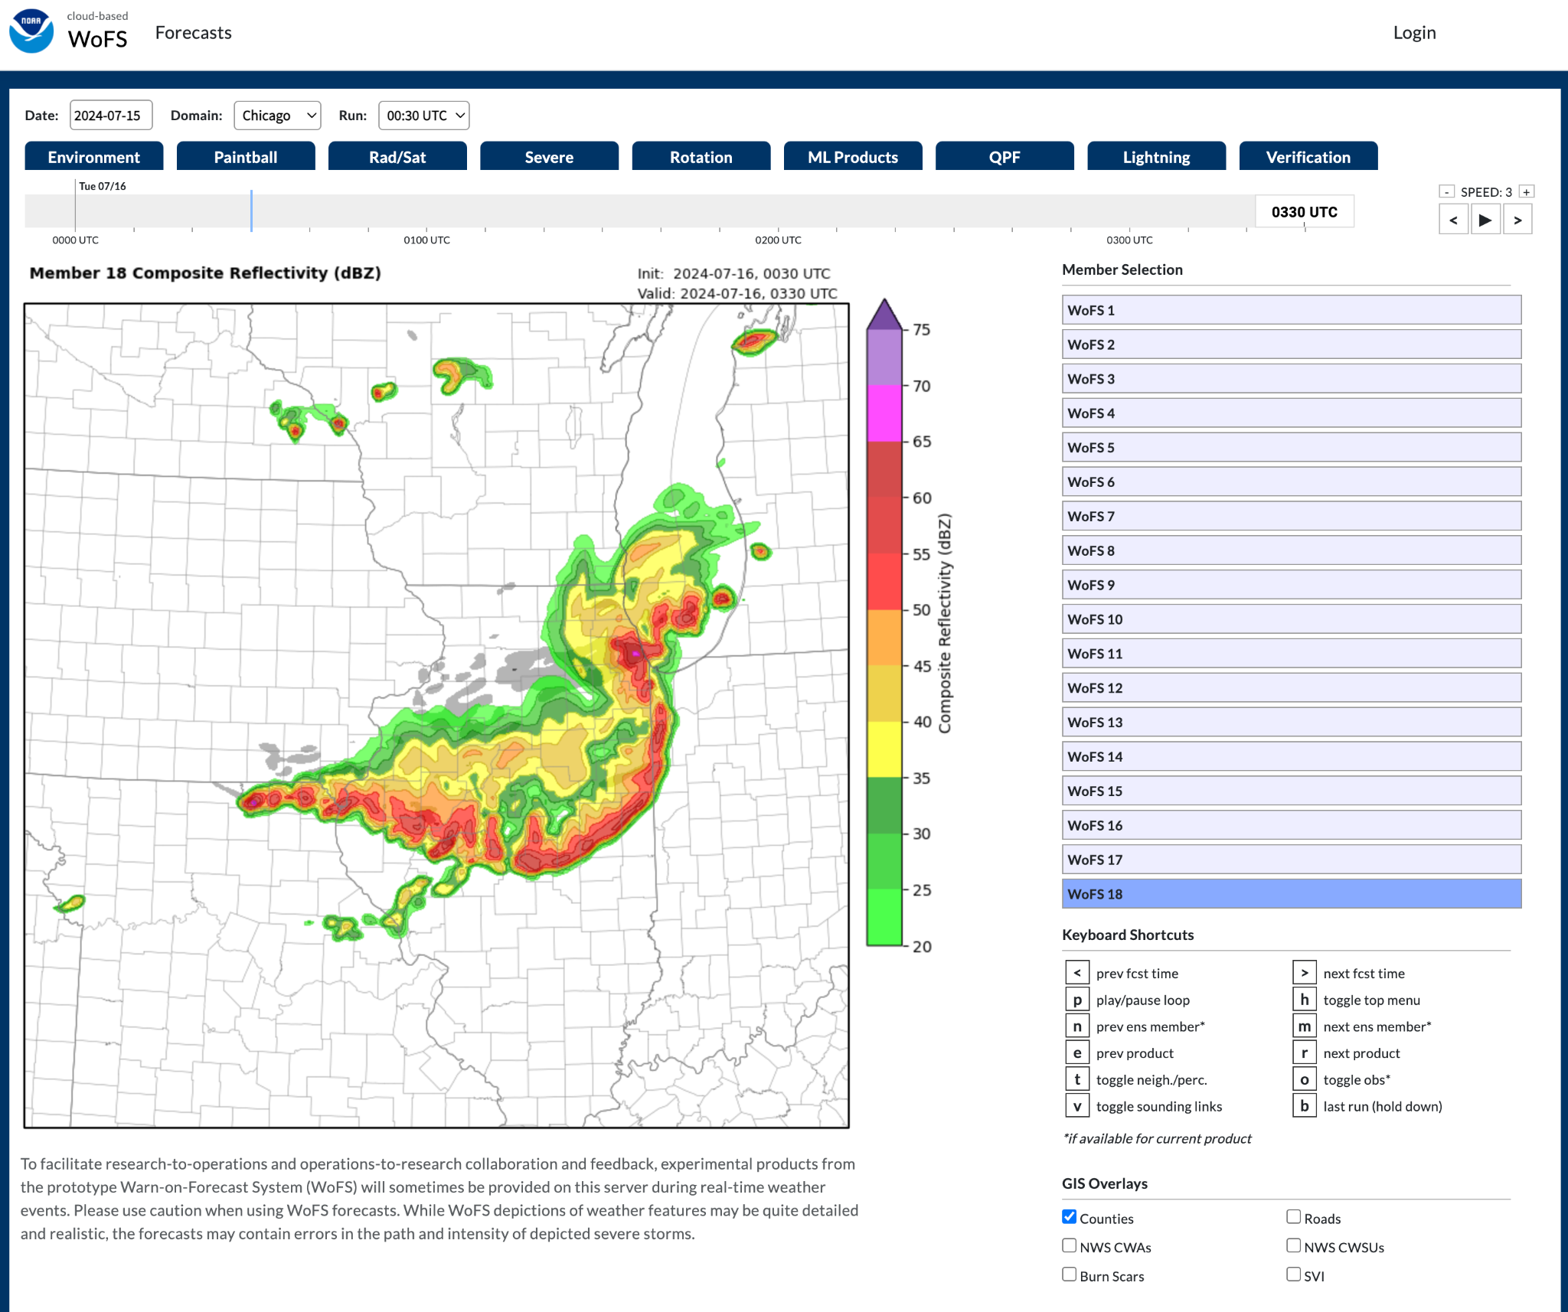
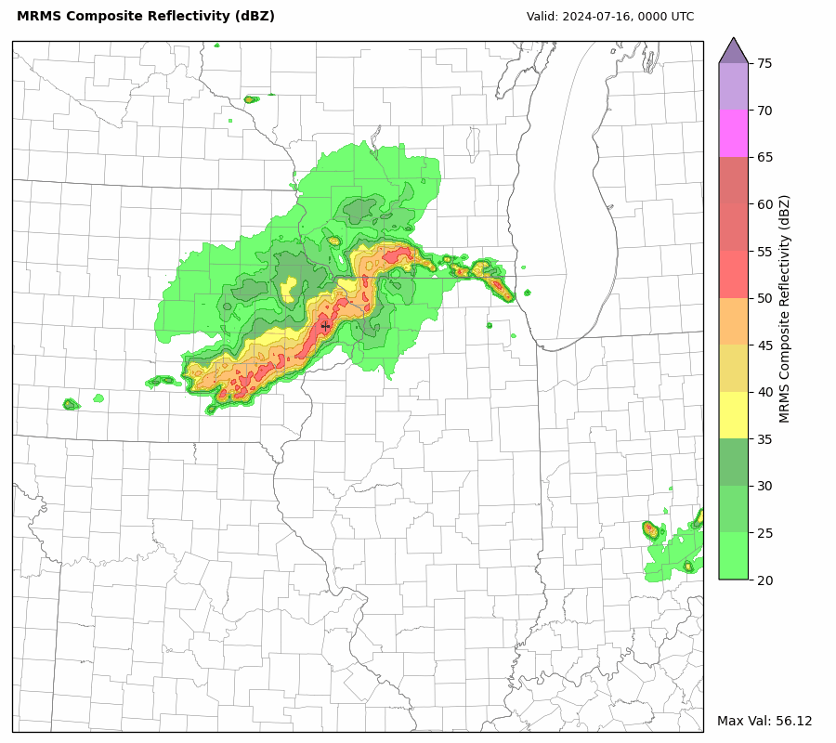
The Warn-on-Forecast System (WoFS)
Cloud-Based WoFS Web Viewer
Numerical guidance for thunderstorm hazards (e.g., flash flooding, tornadoes, large hail, etc) for 0-6 hr lead times (“Watch-to-Warning”) is limited.
Using a convection-allowing ensemble, WoFS provides rapidly-updating probabilistic guidance for individual thunderstorm hazards in the 0-6 hr range
Notes:
How is the watch-to-warning gap typically defined? WoFs certainly addresses 0-1-h lead times, but I consider those warning lead times, not watch-to-warning (which I’d consider to be more like 1-4, maybe 1-6, hours).

Slide 3
Motivation of AI-NWP for WoFS
We have the data, some GPUs, and it sounds like a cool idea!
BUT in all seriousness, WoFS is a unique dataset for this application
→ Multiple years of 18-mem 5-min forecast output & 36-mem 15-min analyses
Immediate:
Cheaply producing additional ensemble members to augment the existing WoFS
Improve data assimilation, ensemble forecast calibration, etc.
Down the road:
Improving upon the NWP dynamical core and producing more skillful predictions of short-term thunderstorm evolution
Leveraging GPU compute to cheaply produce higher-resolution (<= 1 km) forecasts (Fortunato et al. 2022)
Notes:
Also emphasize that the WoFS dataset is unique (5-min/15-min)

Slide 4
Refactoring GraphCast for Regional Modeling
AI-based NWP is quickly challenging traditional global NWP skill, and NOAA is focused on developing AI-NWP for regional predictions
We’ve refactored Google’s JAX-based GraphCast code and begun training AI-NWP on WoFS data → WoFSCast
Courtesy of Tensorflow GNN Blog

Slide 5
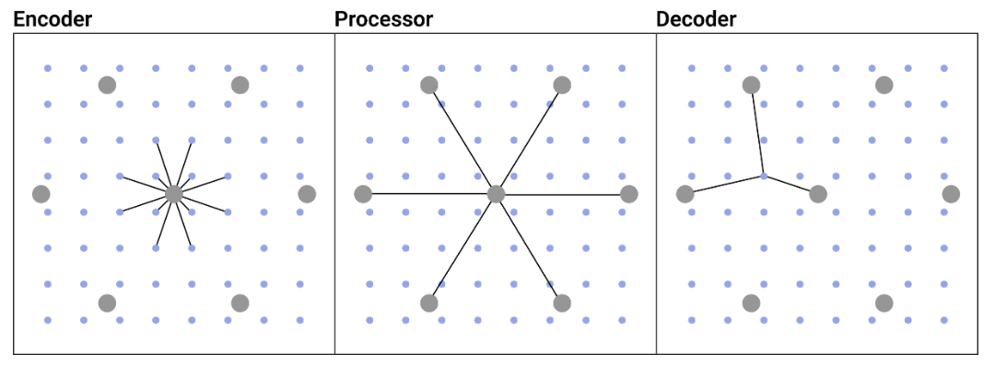
GraphCast: Graph-based Encoder-Processor-Decoder
*modified from Fig. 2 in Keisler (2022)
Mesh Nodes
NWP Nodes
Combine information from multiple NWP nodes to a mesh node
Process information between connected mesh nodes
Transfer mesh information back to the NWP grid

Slide 6
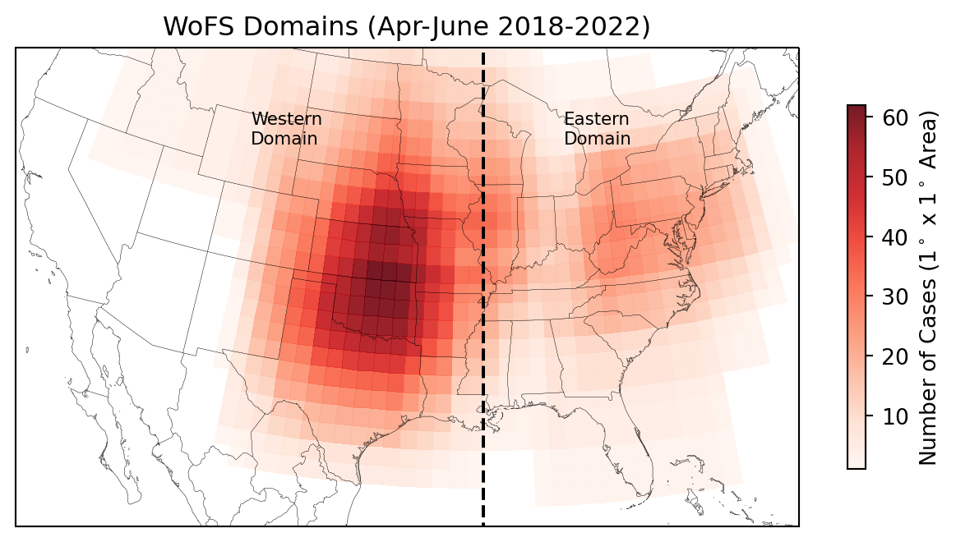
WoFS Dataset
136 cases from Spring 2019-2021 (see right*)
Forecast output every 5 min on a limited area 300 x 300 grid point domain with 3-km grid spacing
18 forecast members
Training: 2019, 2020, Testing: 2021
Inputs:
3D: U,V,W,T, GEOPOT, QVAPOR
17 vertical levels
2D: 2-m T, Comp. Refl. and Rain Rate
Static: land-ocean mask, elevation
Forcing: sin, cosine of local solar time
Limited data to inner most 150 x 150 grid points and using a 10-min time step
Avoids boundary conditions
Speeds up initial exploration!
*Does not align with time frame, but distributions are representative

Slide 7
Good correspondence between WoFS and WoFSCast for most variables
WoFSCast gets spatial context correct, but lower magnitudes
Reflectivity
Rain
WoFSCast is performant on
“near-storm” environmental fields (e.g., generating cold pools)
T2
Updraft
Probability-Matched Mean Patches centered on storm objects
Notes:
These are valid for match storm pairs only.

Slide 8
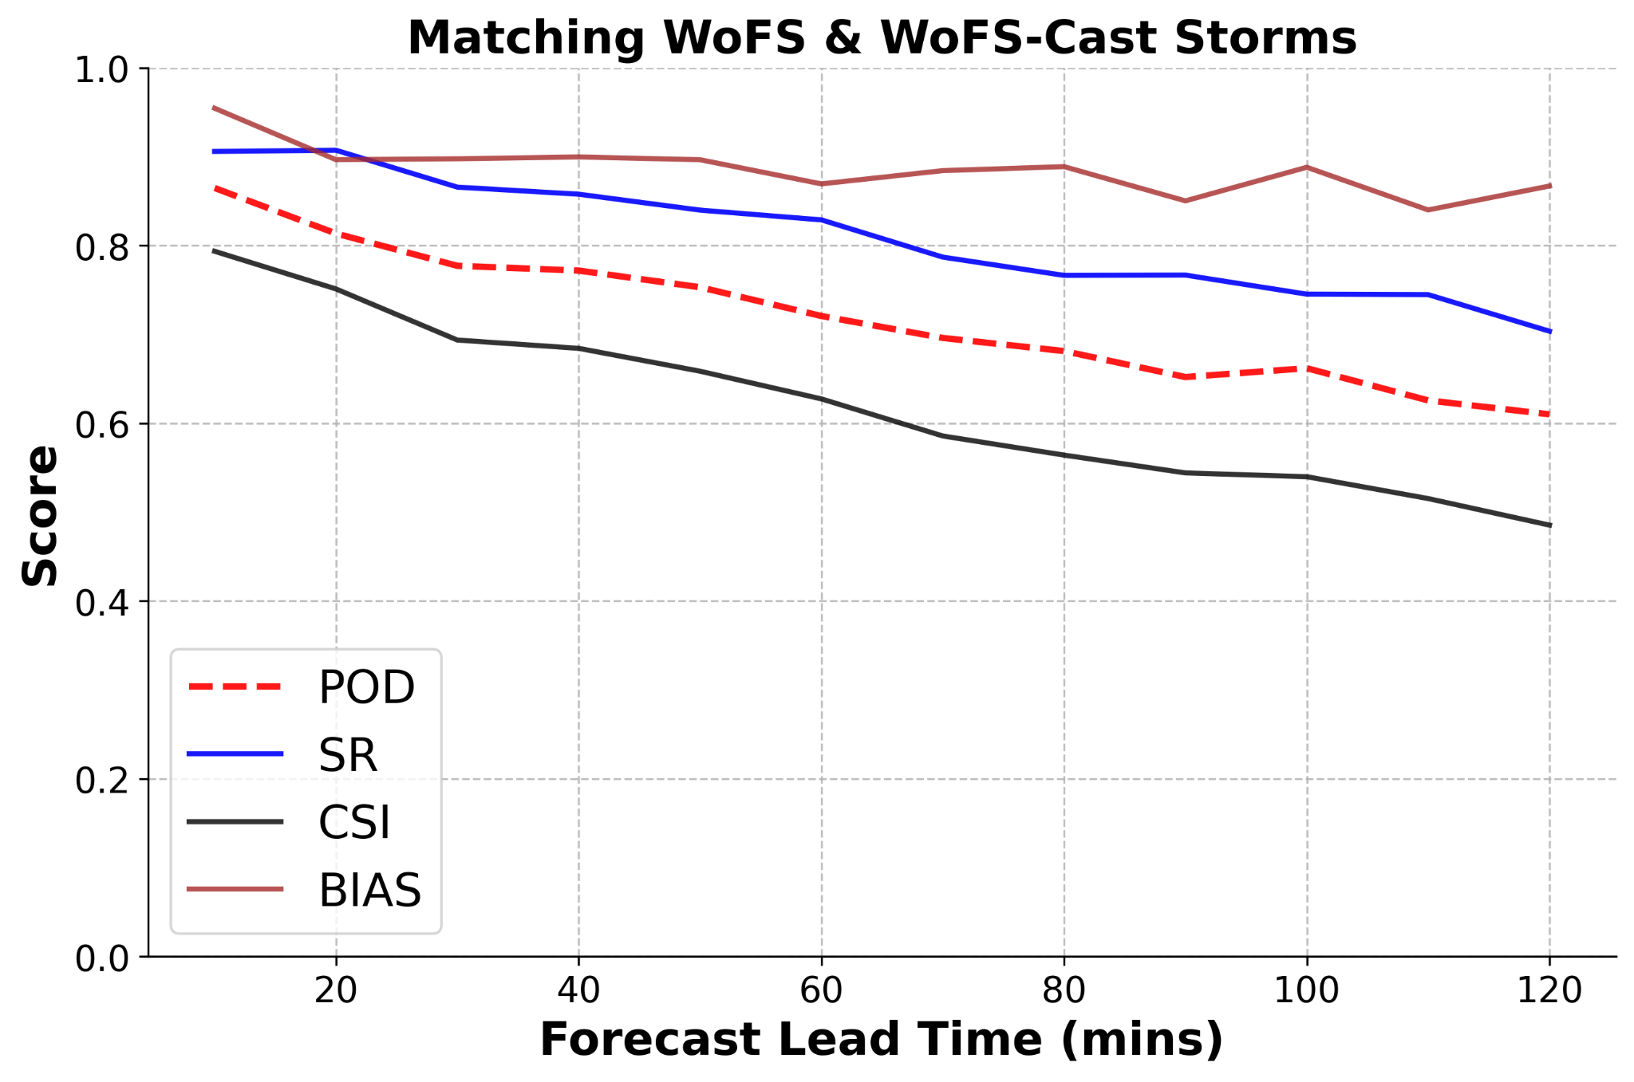
Object-based Verification Results
MSE is inappropriate for verifying storm predictions due to the double penalty → opt for matching storm objects
High POD through 2 hrs, but does decay due to
→
1. WoFSCast errors
2. Unavoidable errors due to intrinsic predictability

Slide 9
Thoughts on intrinsic predictability and machine learning
Intrinsic predictability limits @ storm scales + Minor differences in initial conditions
→ large uncertainty in future storm progression
Speculation: Given a sufficient sized model, training data, and reduced time step, it's possible to greatly collapse that uncertainty
Caveat: Some uncertainty is unavoidable due to predictability limits.
Uncertainty →
placing “weak” storms in multiple locations →
premature dissipation of storms

Slide 10
Possible Solution: Generative AI
Up to this point, our goal is to minimize the prediction error. BUT minimizing prediction errors of discrete features (e.g., storms) has the deleterious effect of dissipating those features.
Goal: Combine the existing model with a generative AI model, whose task is to ensure the prediction matches the same distribution of values as found in the training data.
Similar to the Generative Correction Diffusion approach from Nvidia

Slide 11
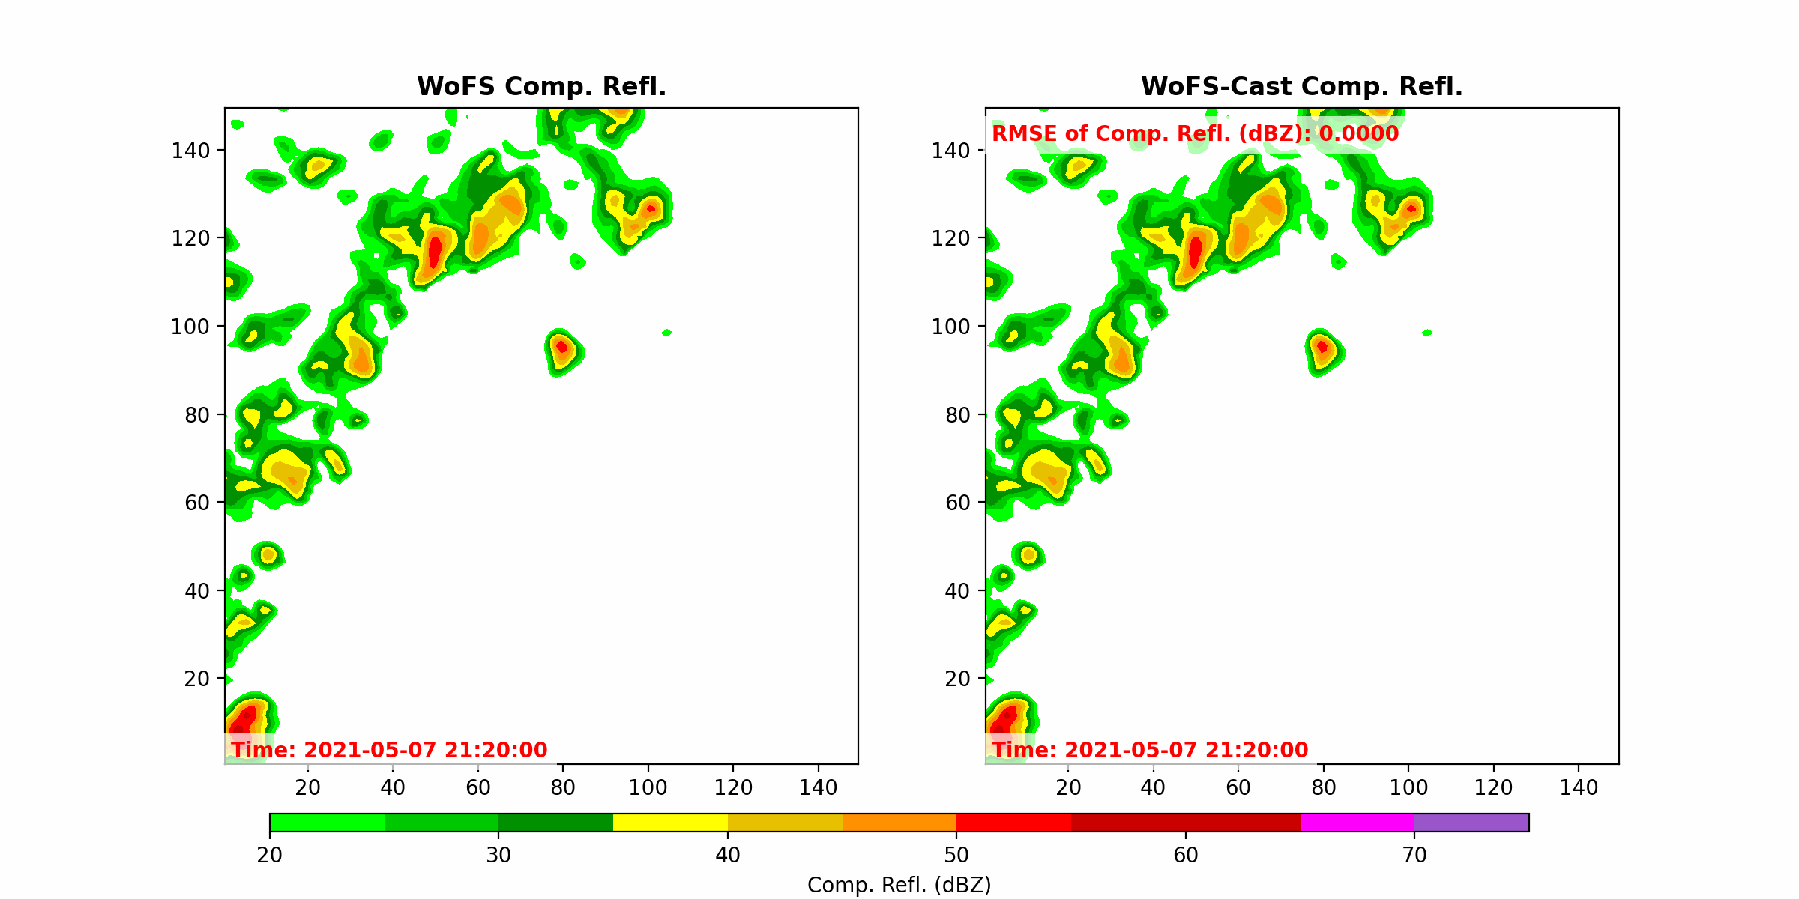
Incorporating corrective diffusion greatly improves the storm evolution
NWP
WoFSCast
WoFSCast + Diff.

Slide 12
Limitation of a Deterministic Approach for Storm-Scale AI
Though diffusion improved the storm evolution, the evolution still failed to match the NWP 1-to-1.
Alternative NWP
WoFSCast + Diff.
However, the AI forecast does better match the forecast of a different ensemble member
Due to limited storm-scale predictability
(Potvin et al. 2017, JAS) the best AI-NWP for storm-scales ought to incorporate ensemble forecasting into the training and evaluation.
Ongoing Goal: Leveraging diffusion to create
skillful ensemble forecasts (like GenCast)

Slide 13
Challenges Going Forward
The AI-NWP developer community must make a more concerted effort to document lessons learned. Each new study either adopts a completely new method or when it builds off an existing method fails to discuss their deviations
Though GNNs can accomplish more with fewer parameters, sufficient access to compute is necessary. We’ve successfully leveraged 2 GPUs, but it’s quite limited for efficiently processing the full WoFS data catalogue and exploring more advanced generative AI approaches.
What time step data is required for training storm-scale AI-NWP? Is sub-hourly a necessity (thinking of the HRRR archive)?
How can we best leverage ensemble information in the training and evaluation of AI-NWP?
Given storm-scale DA errors, how can we best leverage forecasts and analyses in model training?
Wanna reach out and discuss? Email: monte.flora @ noaa.gov

