Slide 1
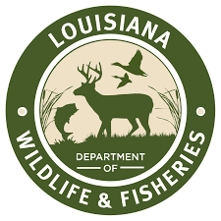
A numerical study of eastern oyster (Crassostrea Virginia) larvae growth and dispersal in Barataria Bay, Louisiana
Zhengchen (John) Zang^{1,2,3}, Z. George Xue^{1,2,3}, Shaye E. Sable⁴, Megan K. La Peyre⁵, Timothy A. Stephens⁴, David C. Lindquist⁶, Kenneth A. Rose⁷, Yanda Ou^{1,2}
¹ Department of Oceanography and Coastal Sciences, Louisiana State University, Baton Rouge, LA ² Center for Computation and Technology, Louisiana State University, Baton Rouge, LA ³ Coastal Studies Institute, Louisiana State University, Baton Rouge, LA ⁴ Dynamic Solutions, LLC, Baton Rouge, LA, USA ⁵ U.S Geological Survey, Louisiana Fish and Wildlife Cooperative Research Unit, School of Renewable Natural Resources,
Louisiana State University Agricultural Center, Baton Rouge, LA
⁶ Coastal Protection and Restoration Authority of Louisiana, Baton Rouge, LA
⁷ Horn Point Laboratory, University of Maryland Center for Environmental Science, Cambridge, MD

Slide 2
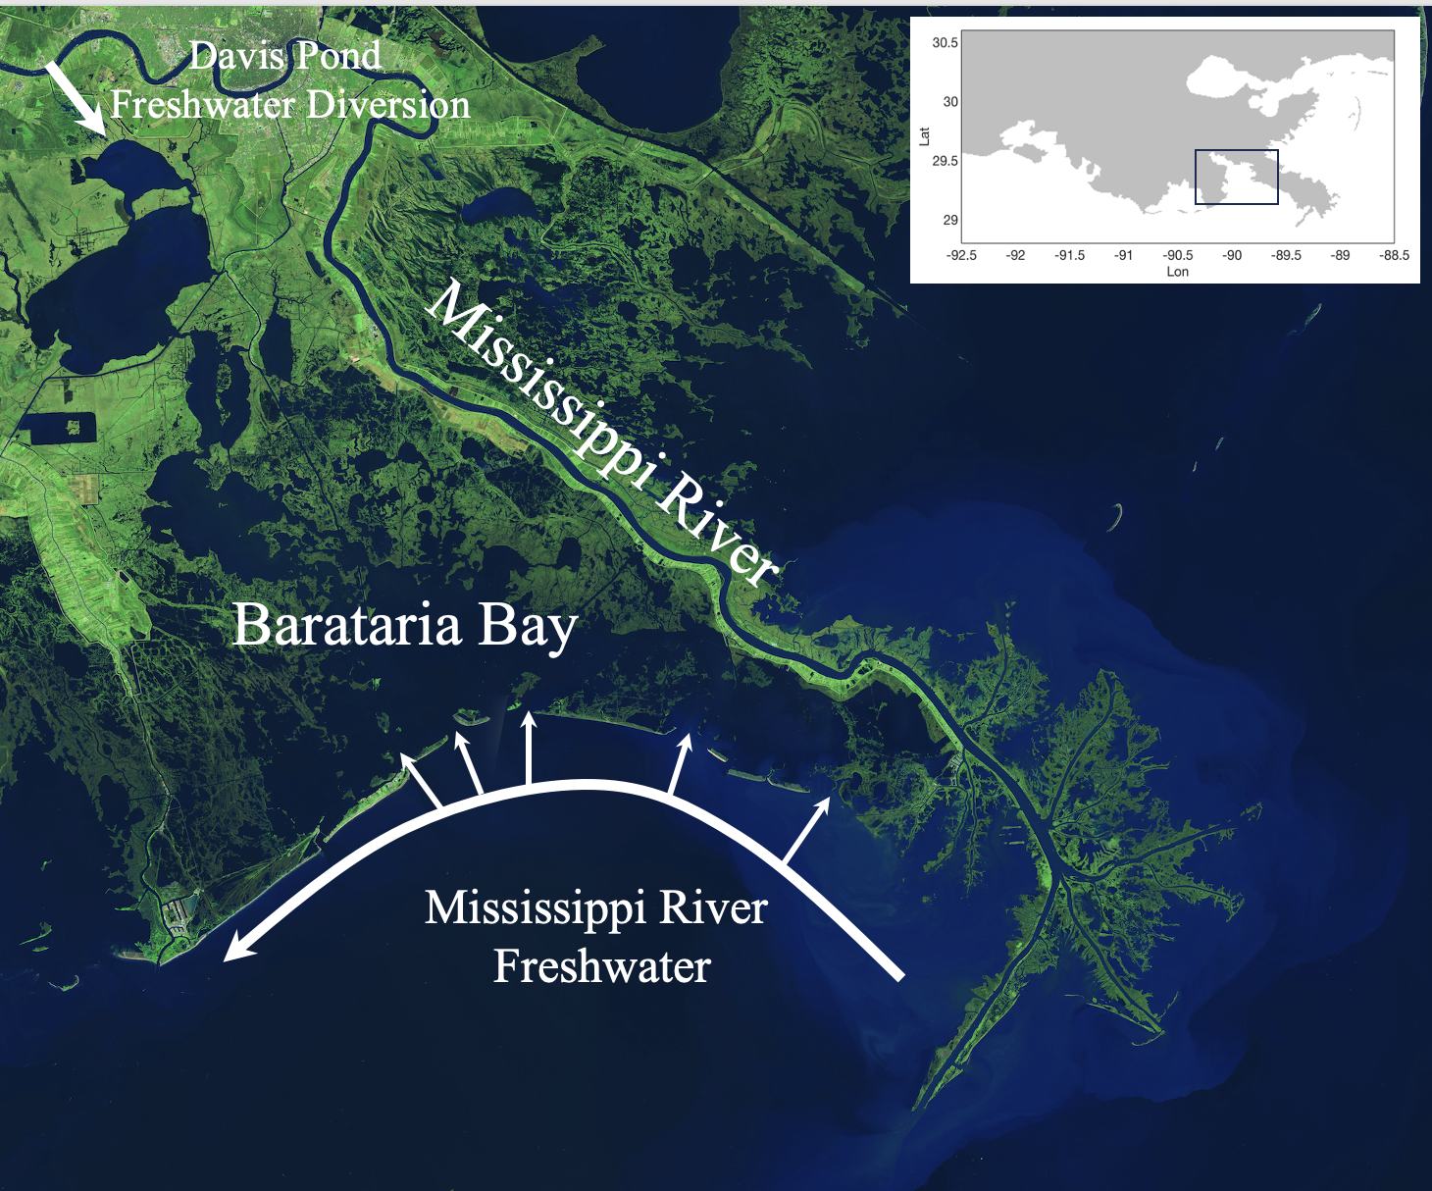
Eastern Oyster in Barataria Bay, LA
Total area: ~6,300 km²
Average Depth: ~ 2 m
Two primary freshwater sources:
~23% of total harvest in LA (Banks et al., 2016)
Oyster larval growth, dispersal, and settling
are important for oyster aquaculture in
Barataria Bay
Davis Pond Freshwater Diversion
Mississippi River discharge
Mississippi River Discharge

Slide 3
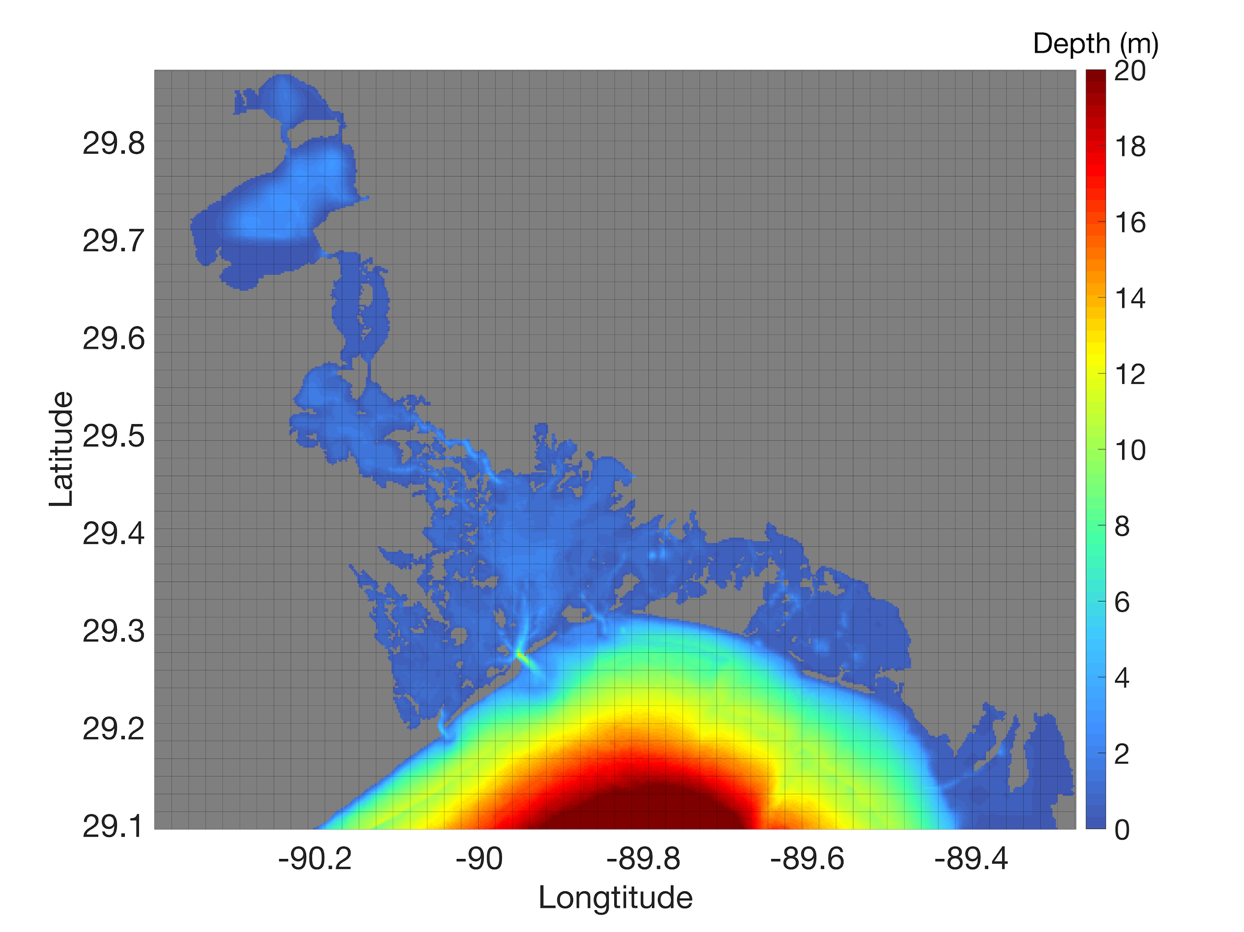
Model Setup (physical + larval transport)
Physical Model (Ou et al., 2020)
Regional Ocean Modeling System (ROMS)
200 m resolution; 8 vertical layers
Atmospheric Forcing: 6 hourly CFSR data
River Discharge: USGS measurements
Open boundary: 1-km nGoM simulation (Zang et al., 2019)
Larval Transport Model (Narváez et al., 2012)
Lagrangian Particle Tracking Model
Larvae Growth-Behavior Model (Dekshenieks et al., 1993)
Growth ~ Temperature and Salinity
Size-dependent vertical movement

Slide 4
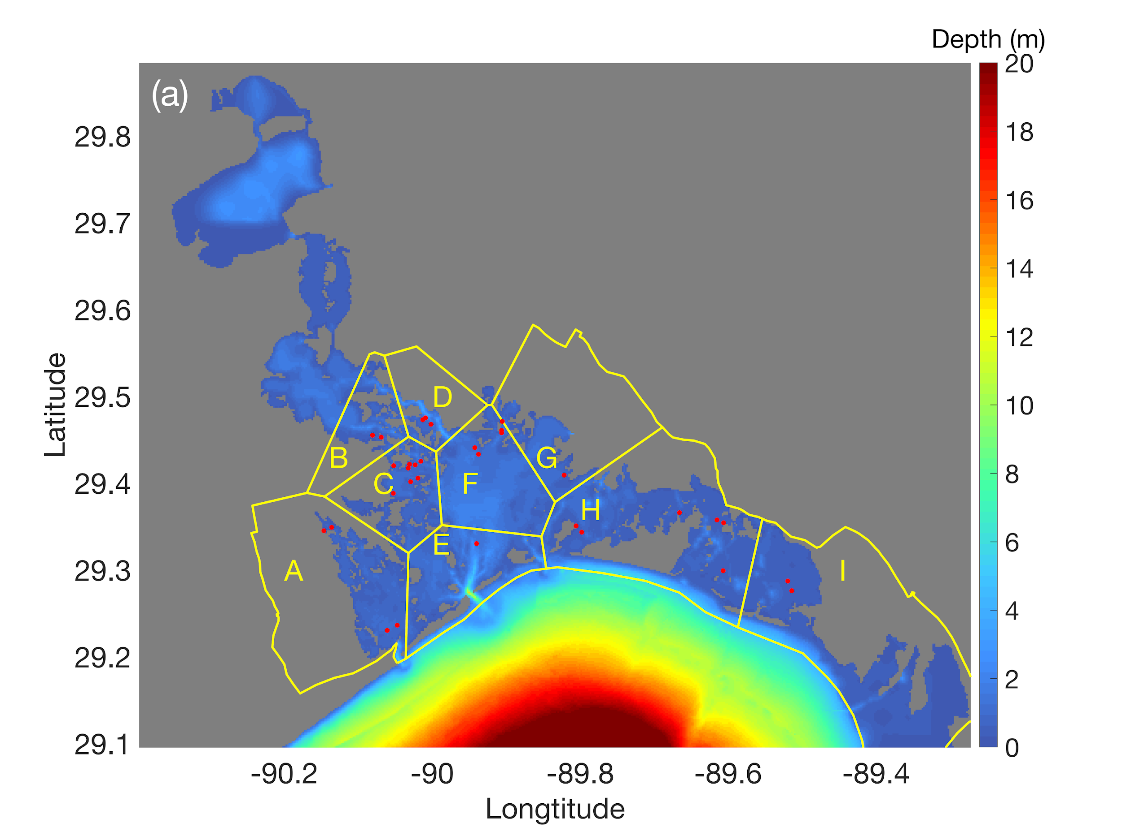
Model Setup (experiment design)
Larvae Release Time: Apr 15th - Jul 10th (2014-2018)
Maximum Larvae Period: 21 days
Simulation Period: Apr 15th - Aug 1st (2014-2018)
Larvae Release Time Interval: 3 hours
Larvae Release Location: 33 oyster reefs (9 subregions)
Initial Larvae Size: 50 um
Larvae Settling Size: 300 um
Yellow: 9 subregions
Red: 33 oyster reefs

Slide 5
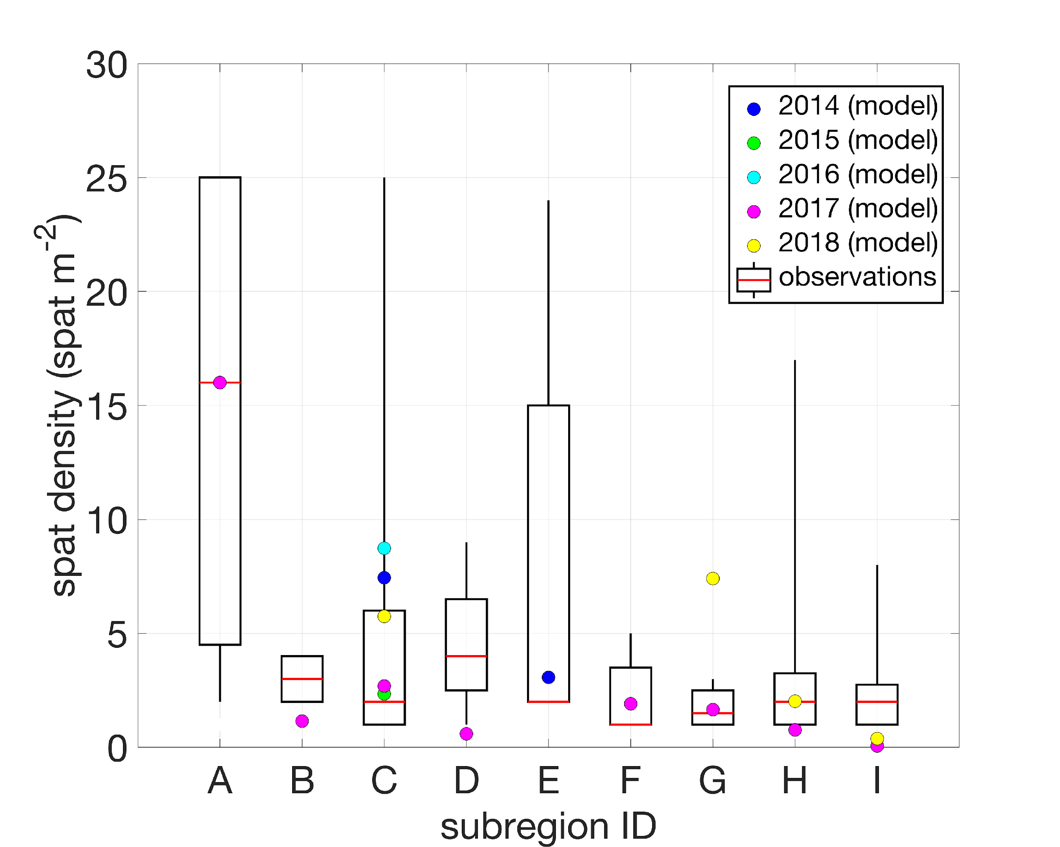
Results (model-data comparison)
Field data: spat density (< 25 mm) on the reefs
Model data: density of settled larvae near reefs (normalized following Kim et al. (2010))

Slide 6
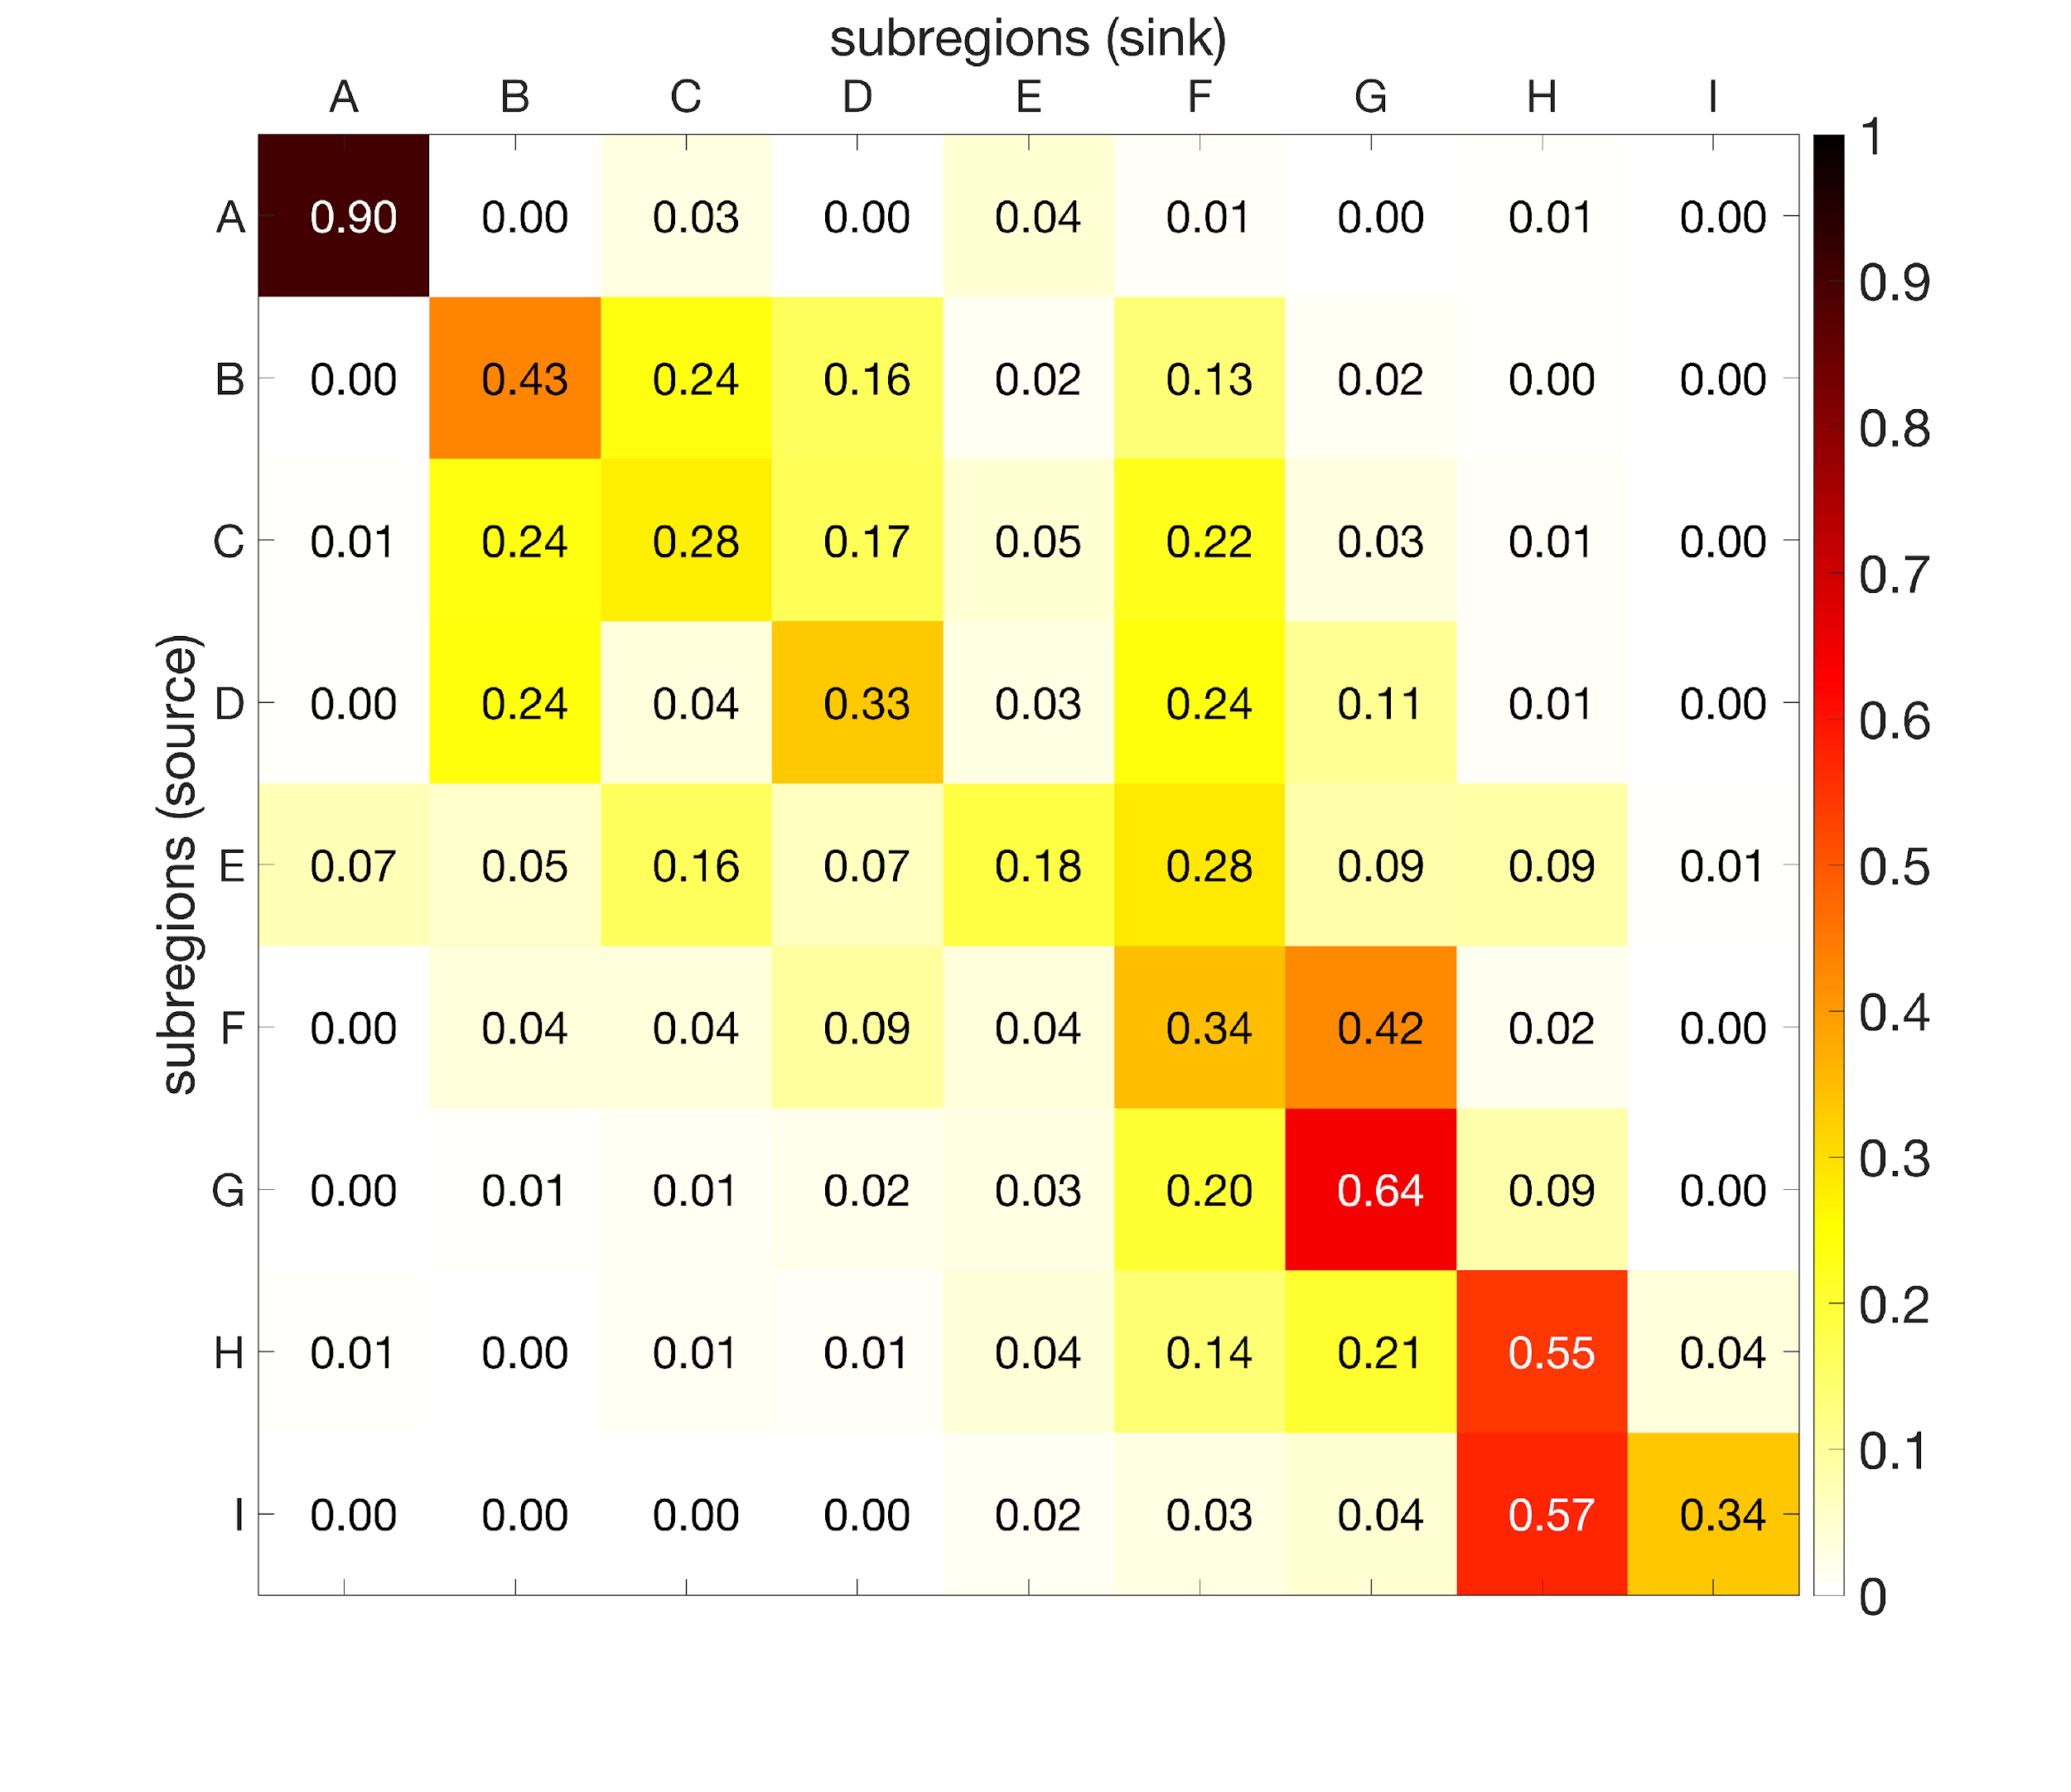
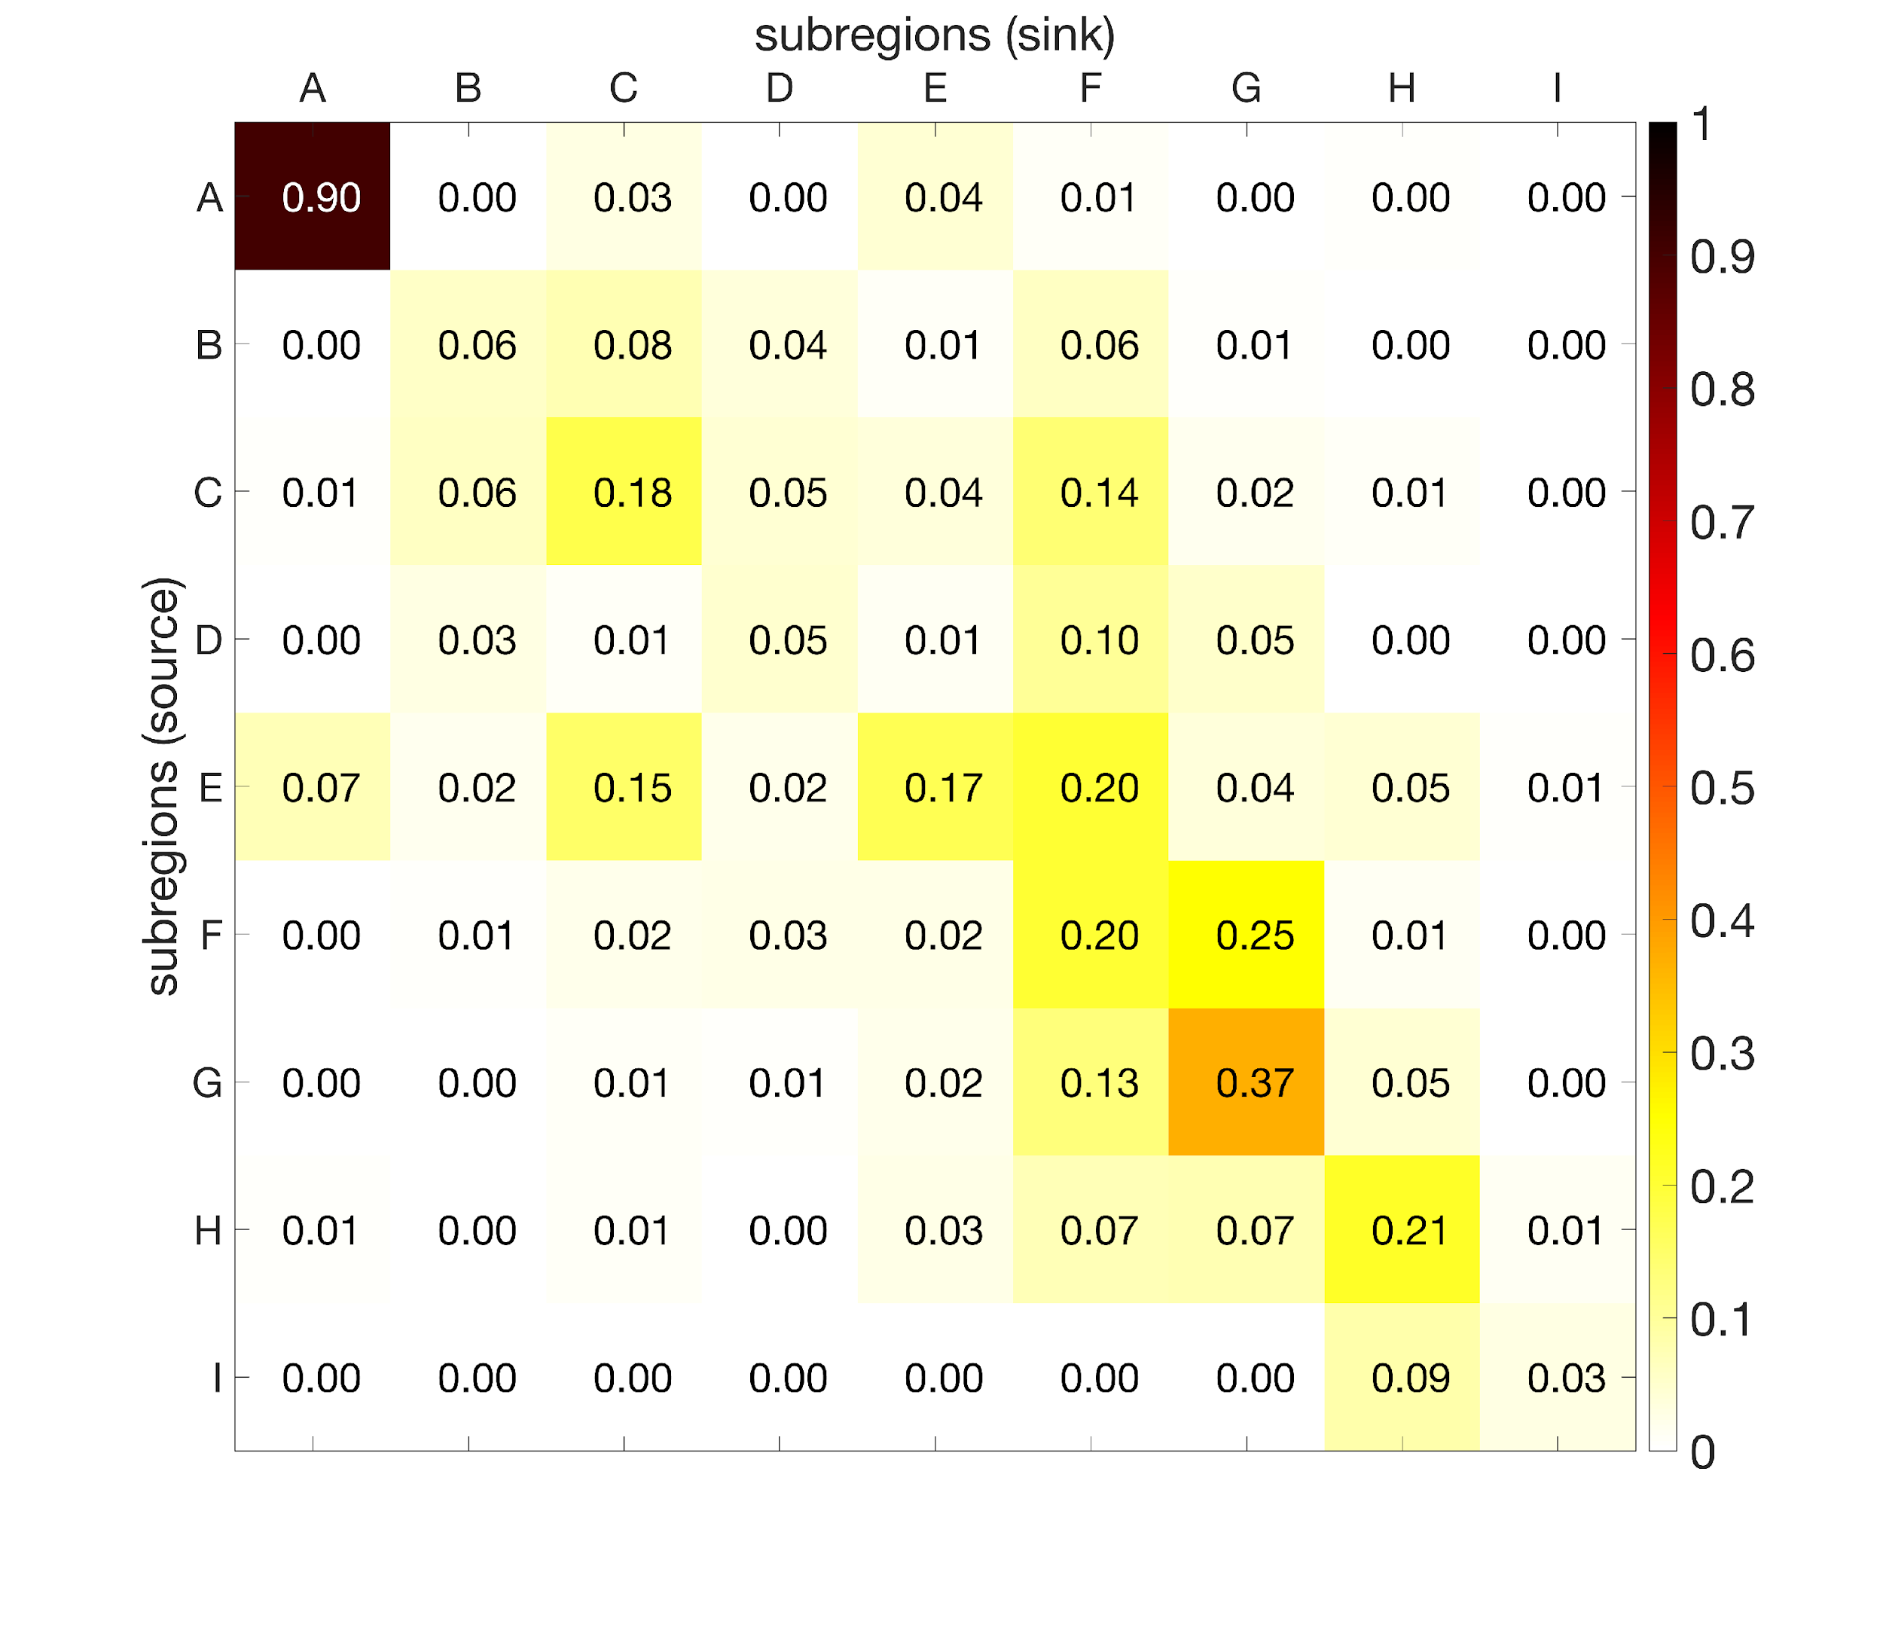
Results (connectivity)
all larvae (settled + dead)
settled larvae only
Most subregions are self-sustained
Lower connectivity if only successfully settled larvae are considered
Notes:
Strong connections between subregions
Lower connectivity if only successfully settled larvae are considered

Slide 7
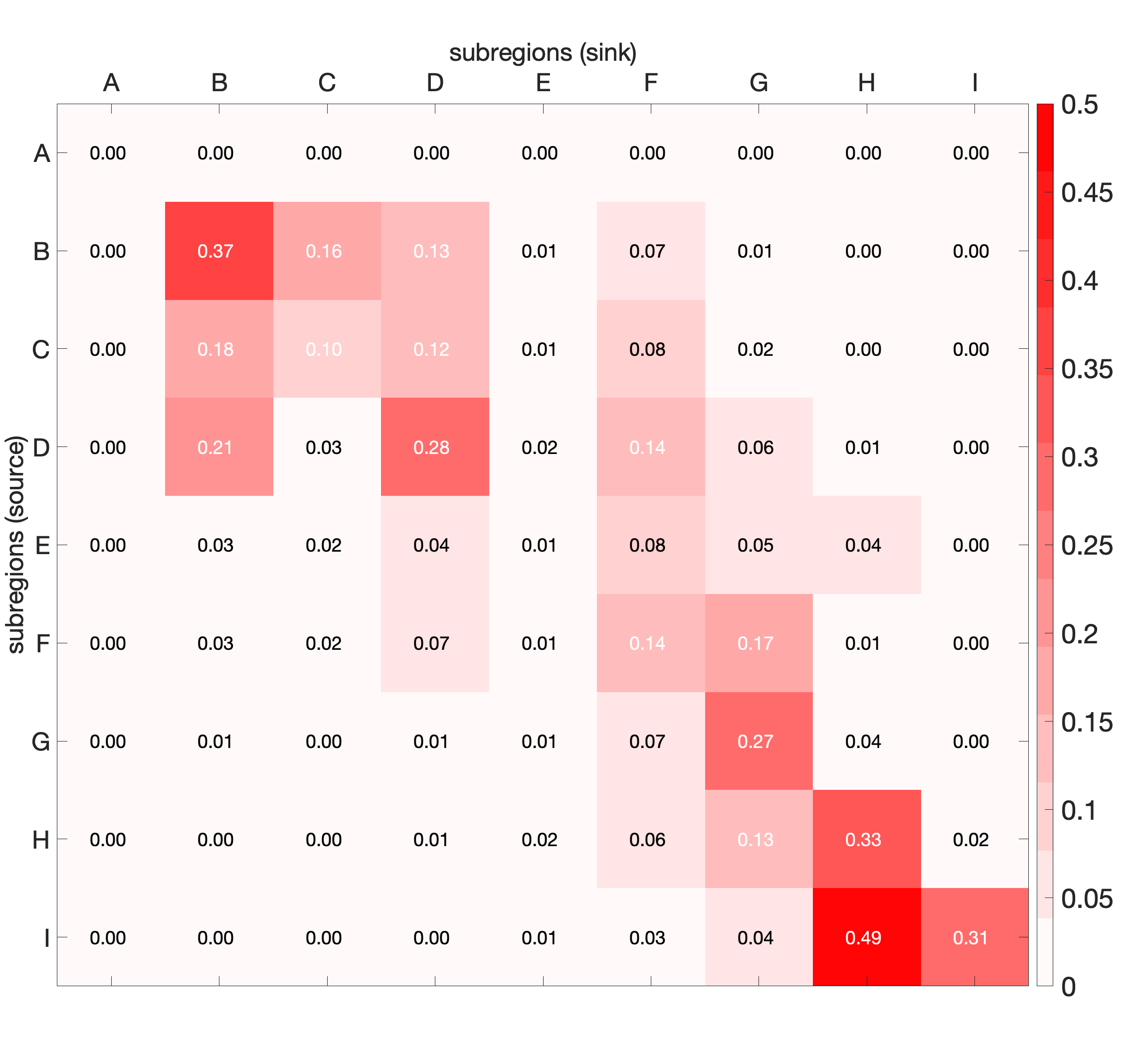
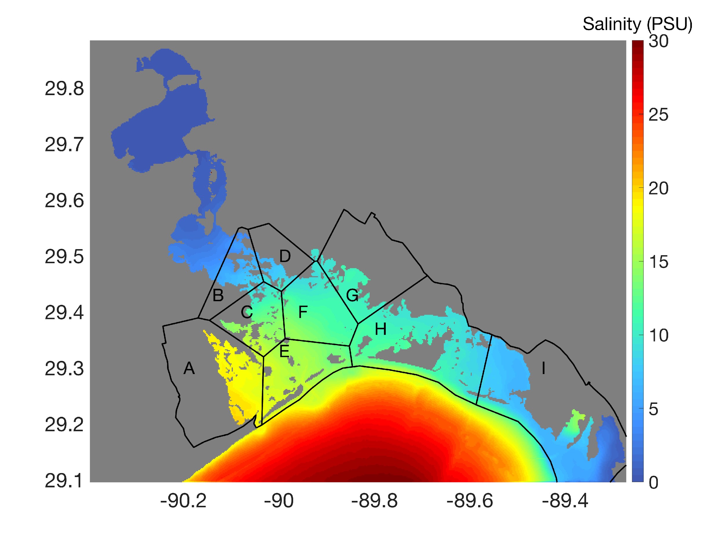
Results (connectivity)
connectivity matrix difference (all larvae – settled larvae)
Depth-averaged salinity
freshwater input
freshwater input

Slide 8
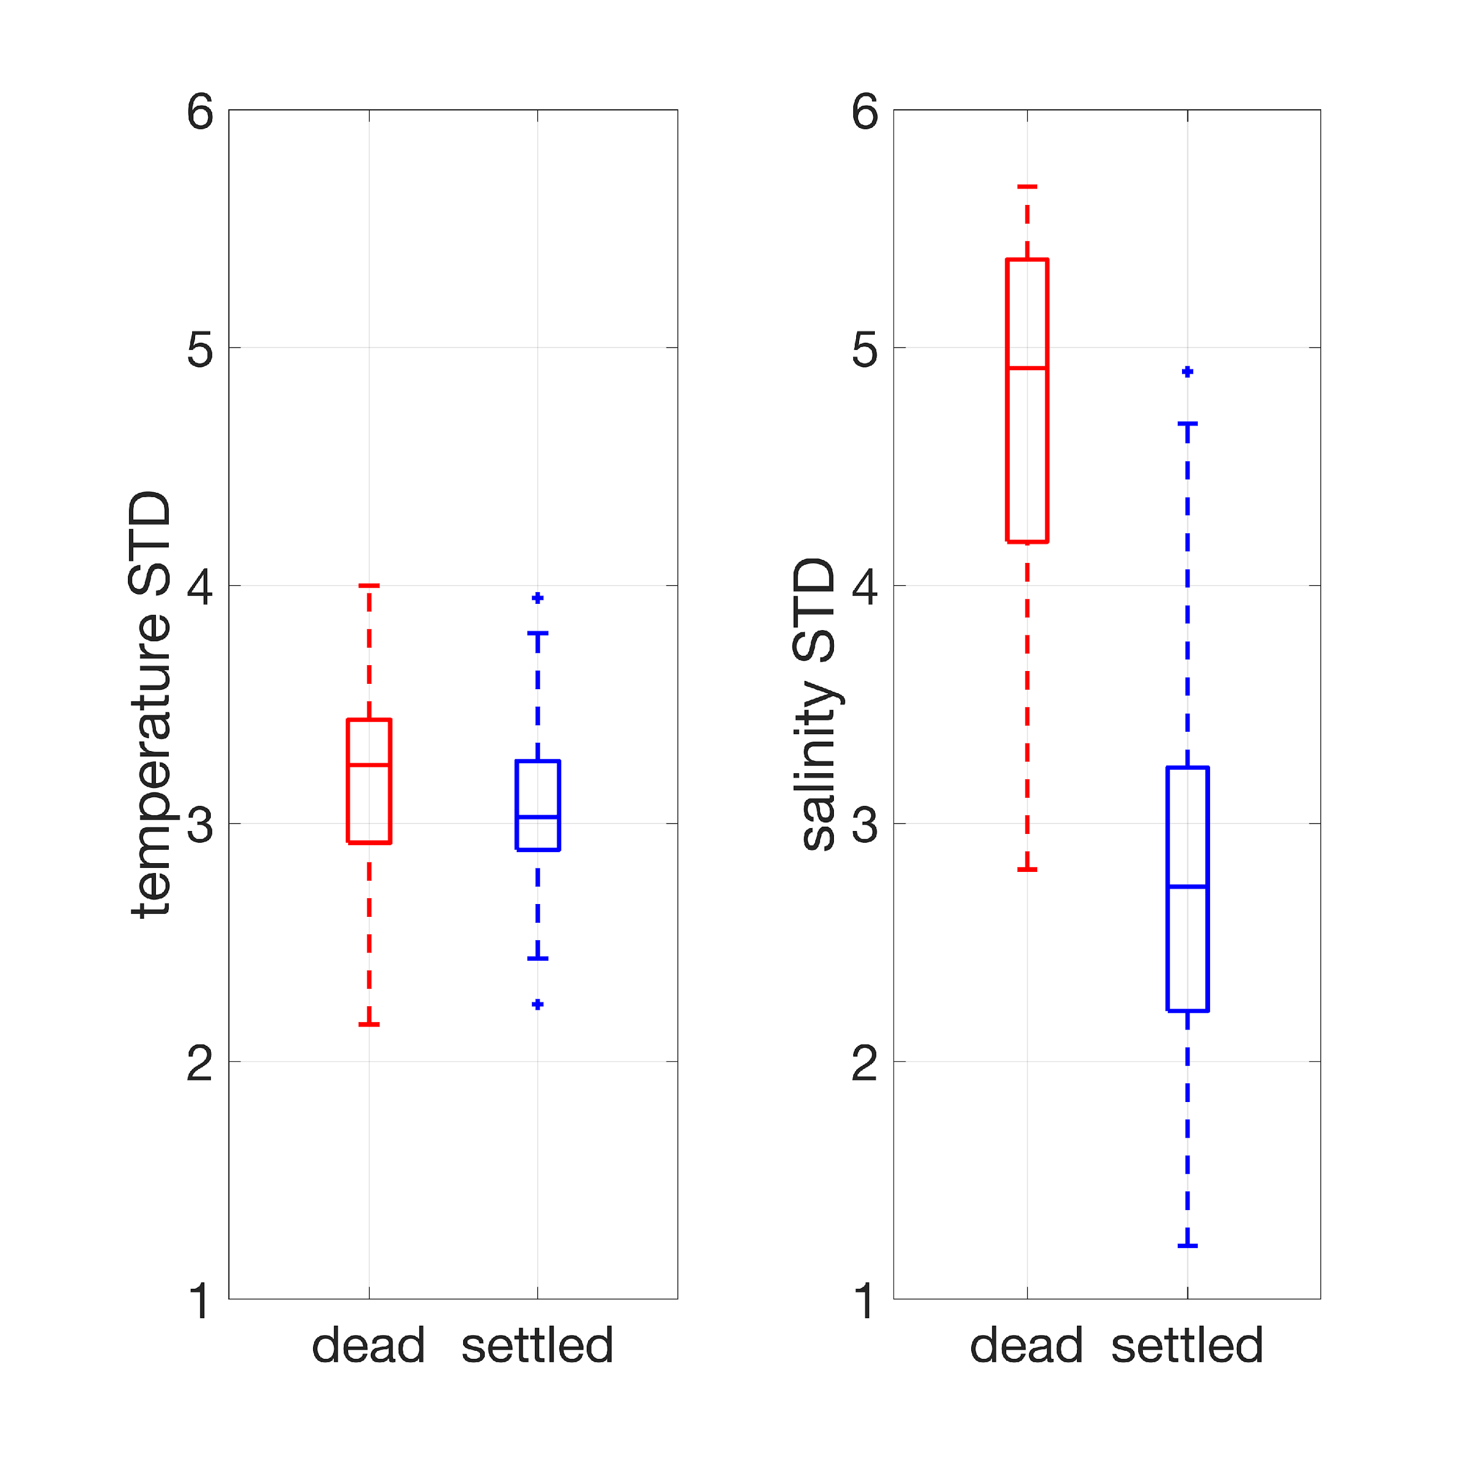
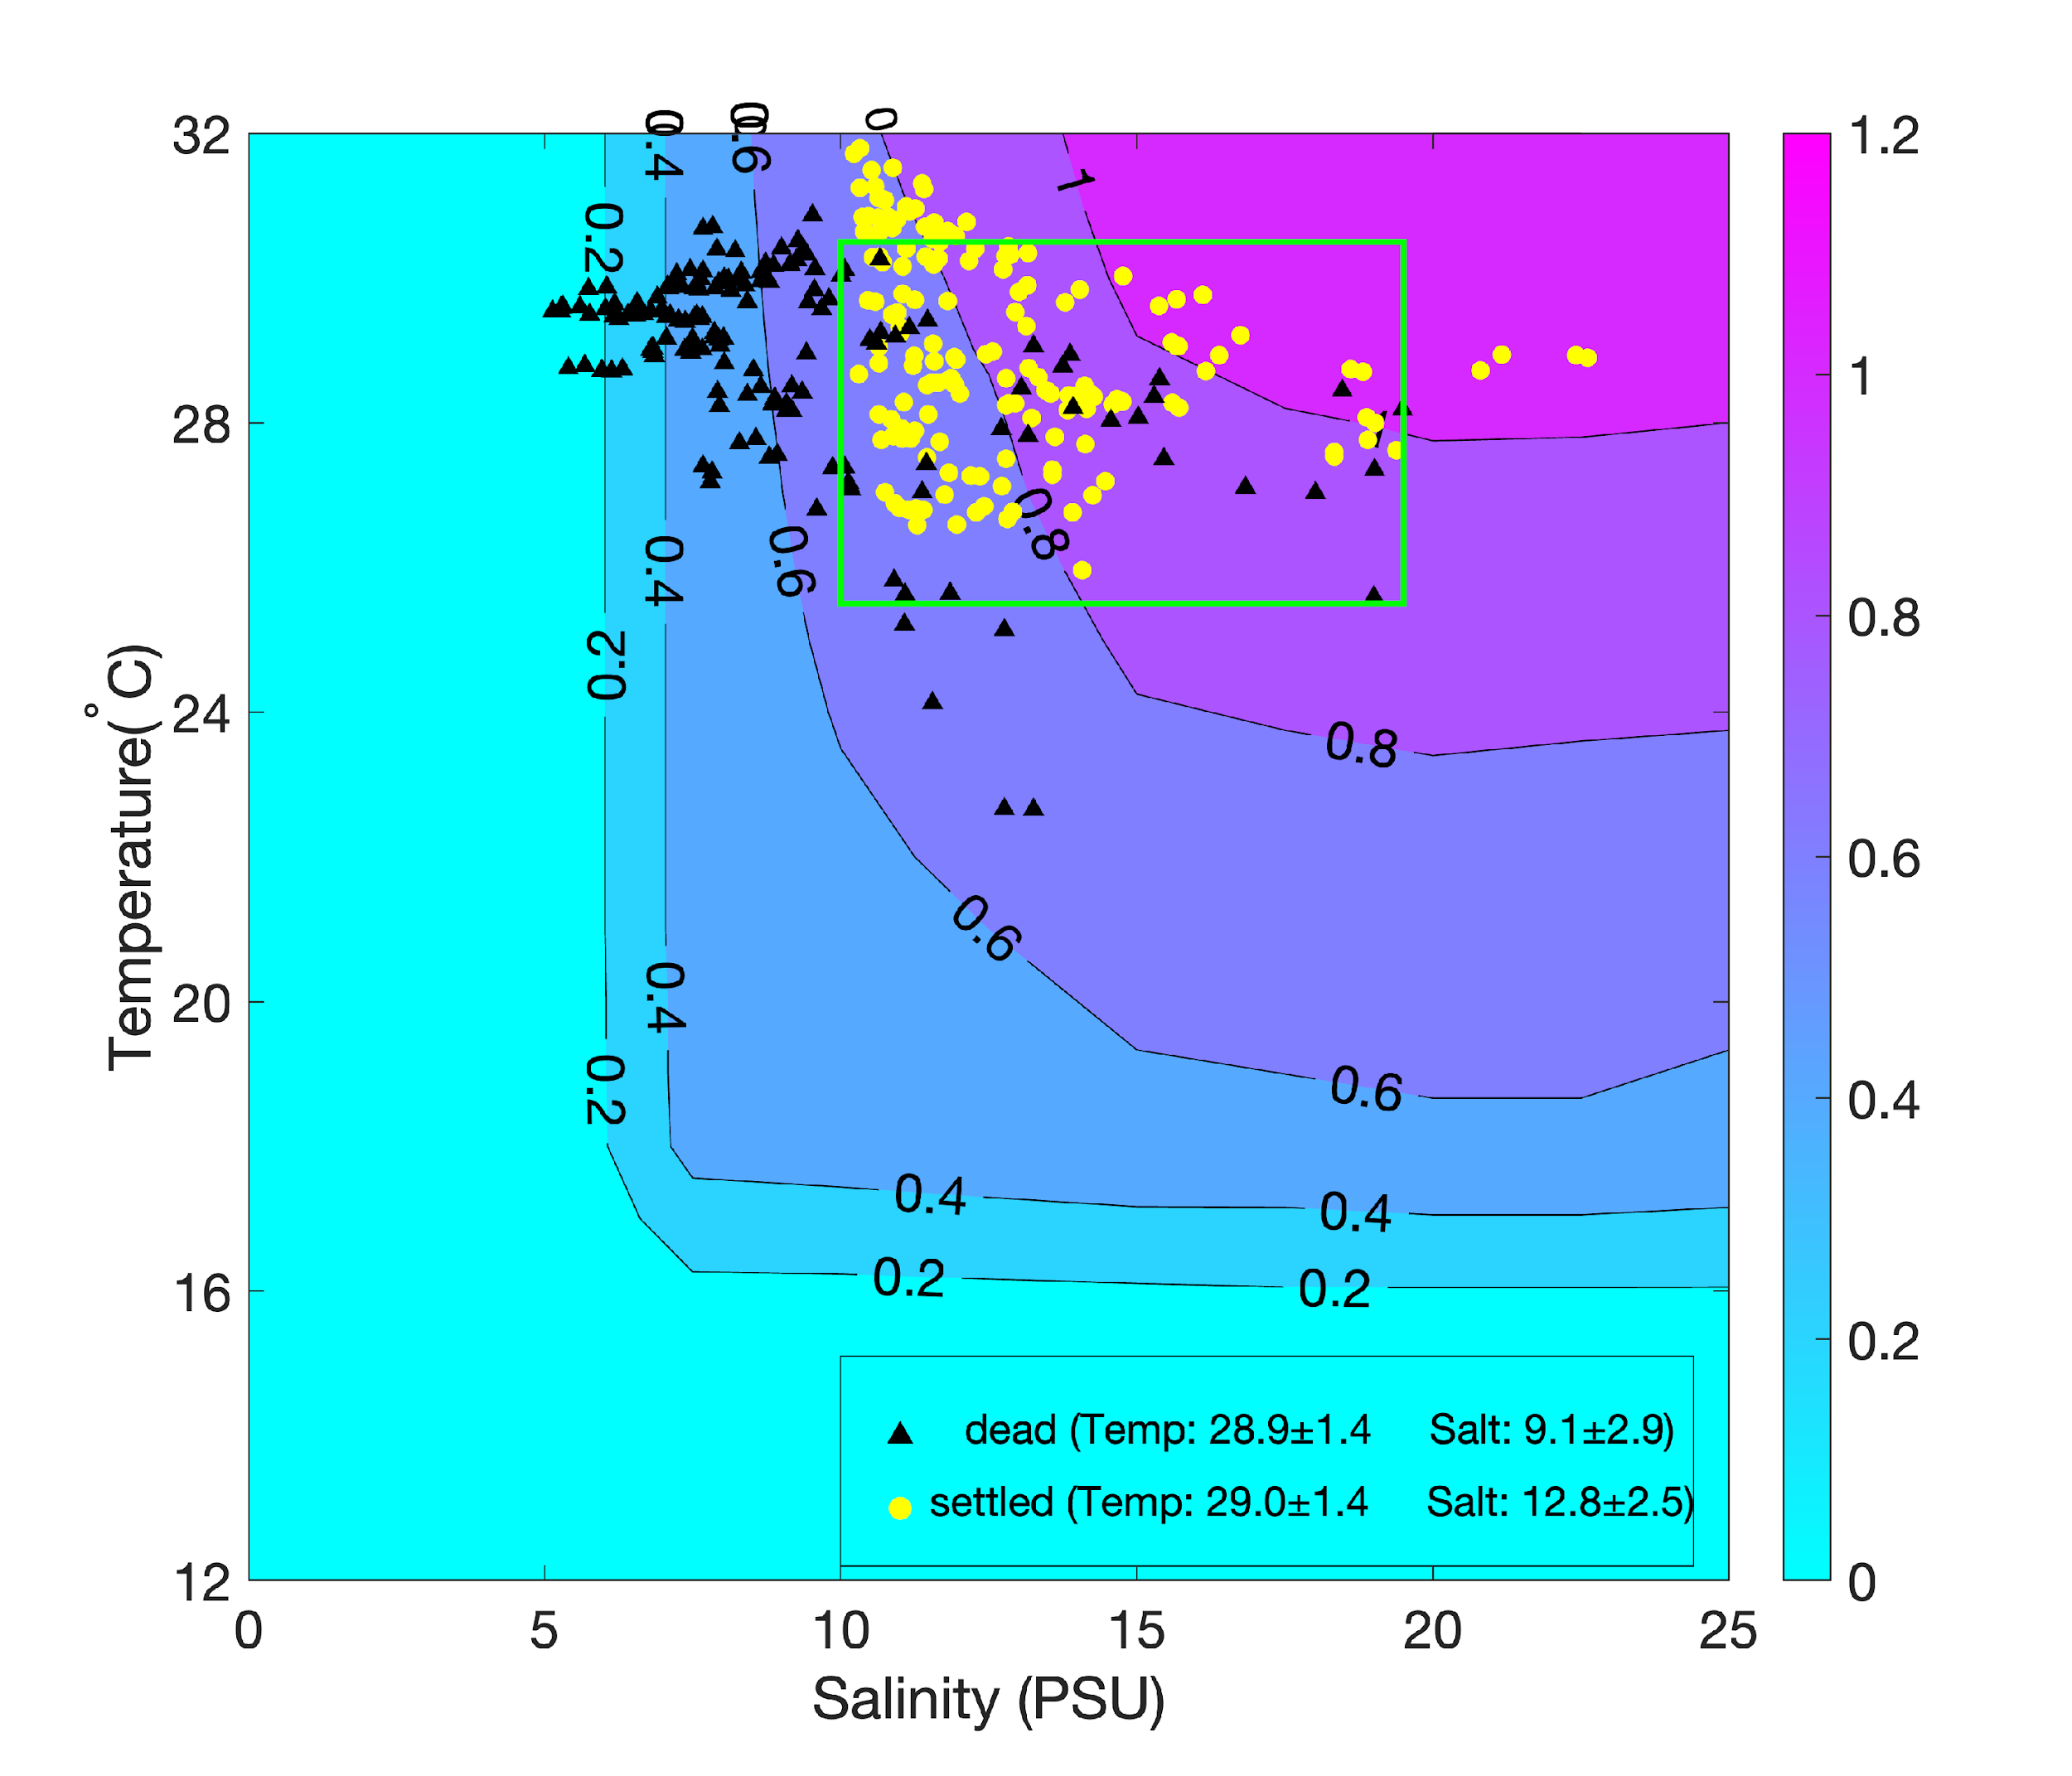
Results (Temperature & Salinity Impacts)
Dead larvae experienced lower mean salinity.
Larvae experienced similar mean T&S might settle or die (green box).
Dead larvae experienced higher salinity fluctuations than settled larvae.
Hypothesis: salinity variation modulates oyster larval
growth/settling
mean T & S the larvae experienced during larval stage
Comparisons of T (left) and S (right) standard deviations between dead (red) and settled larvae (blue)

Slide 9
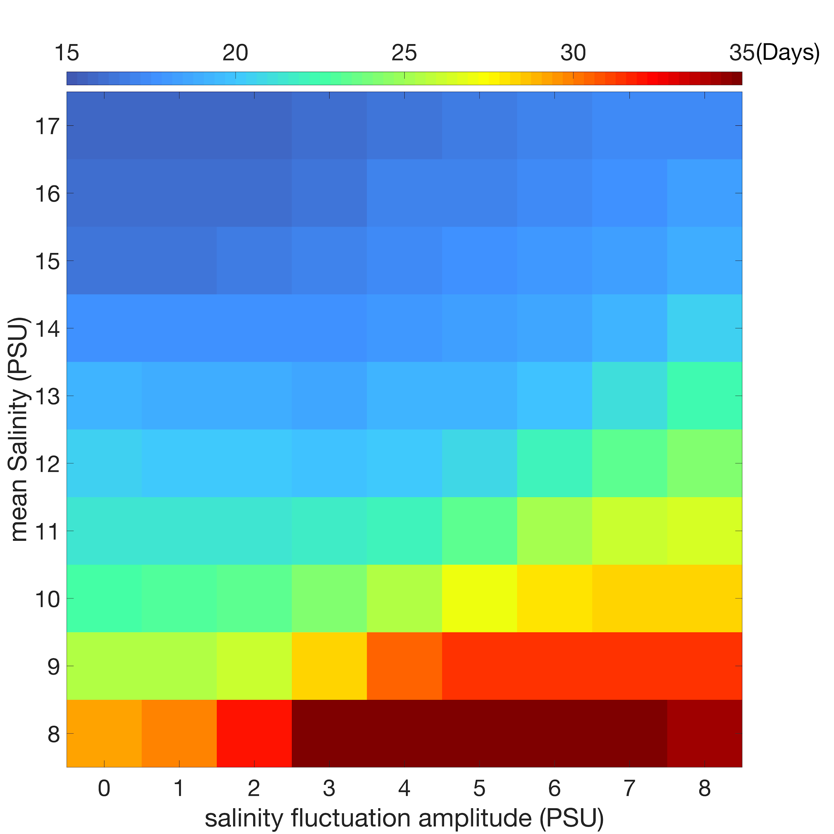
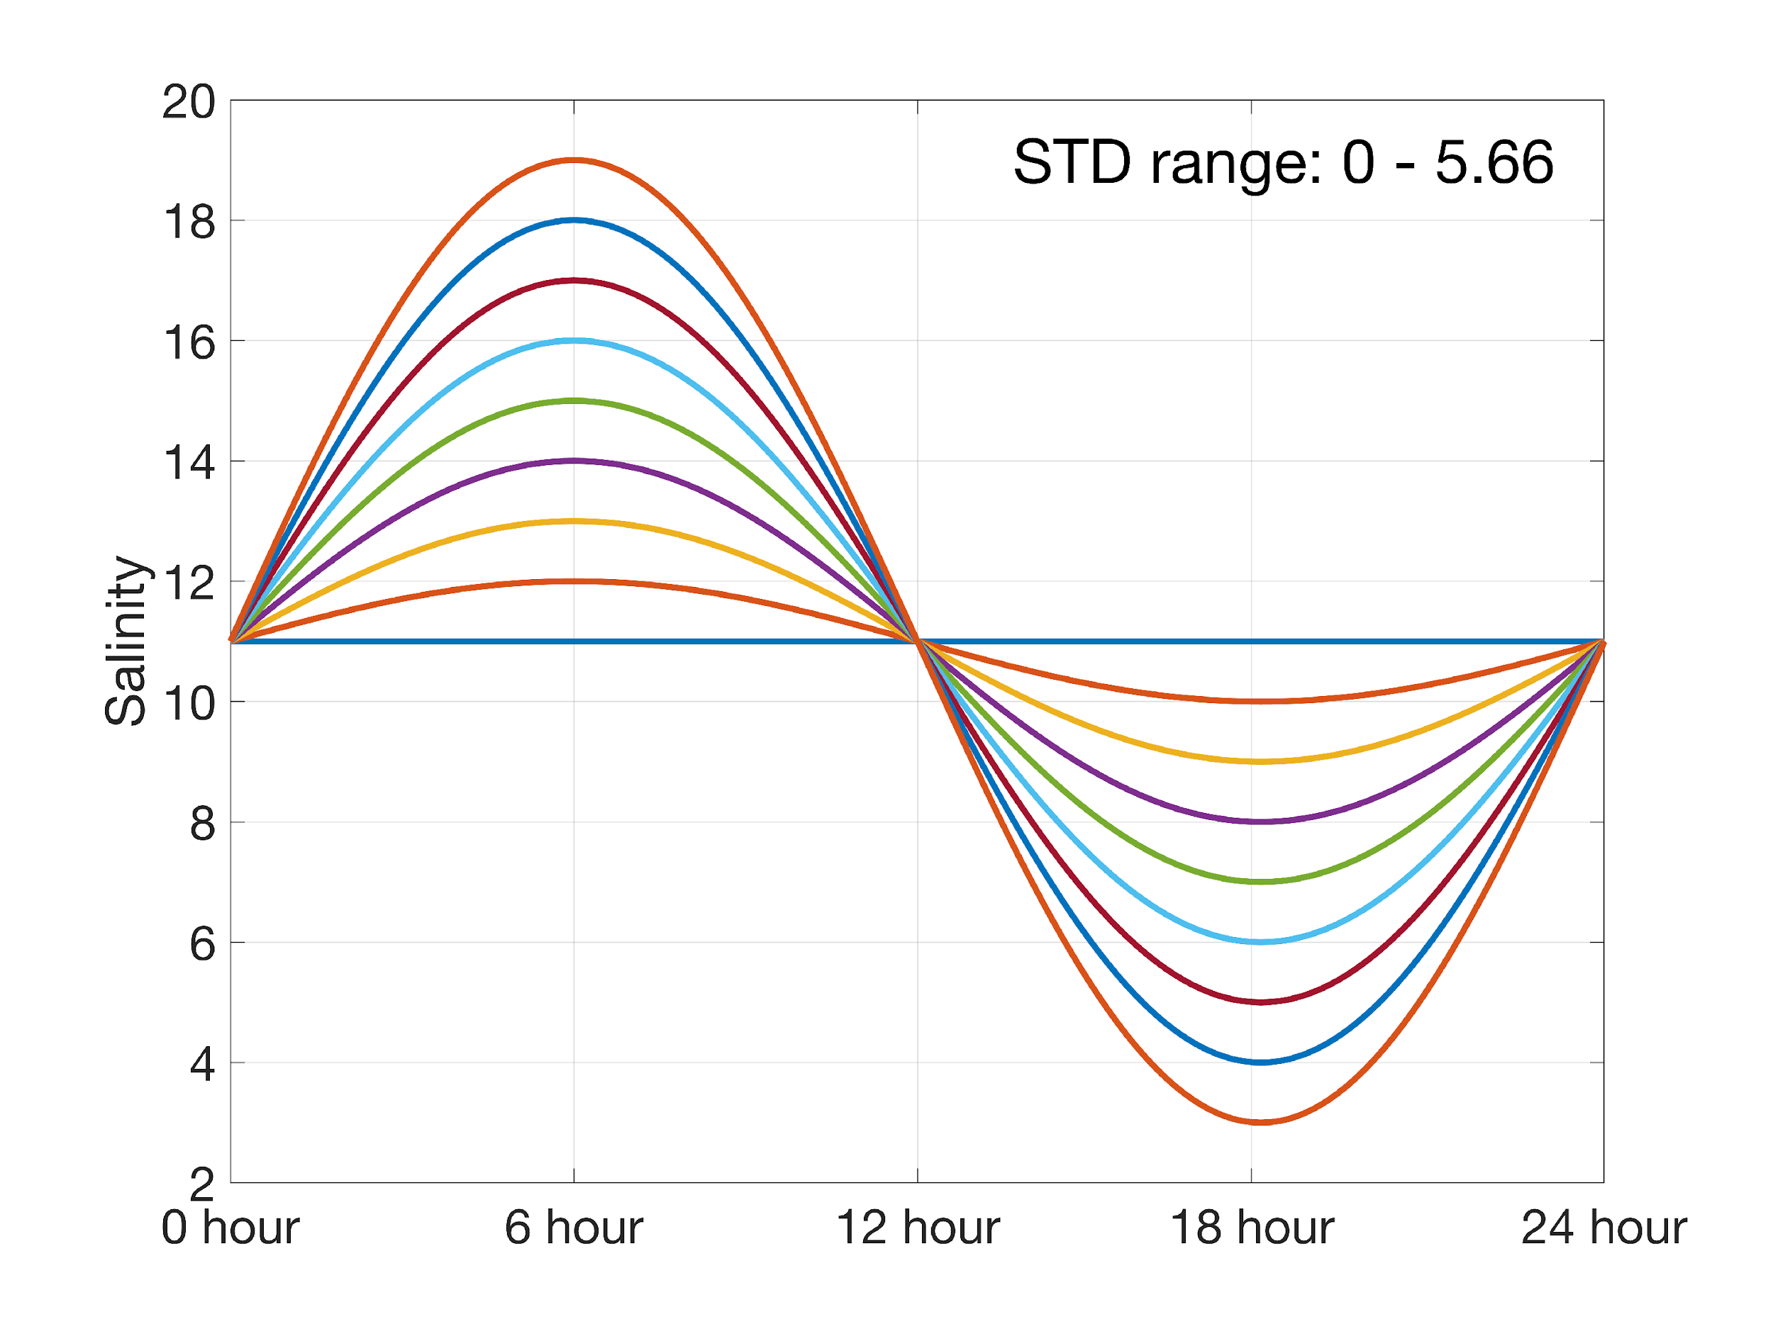
Results (Temperature & Salinity Impacts)
0-D Idealized Oyster Larvae Growth Model
Idealized inputs
Temp: 28 ºC
Mean Salt: 8-17 PSU (10 scenarios)
Salt fluctuation amplitude : 0-8 PSU (9 scenarios)
Salt fluctuation period: 1 day
Total number of experiments: 10*9=90
Model output: duration of larvae stage
Lower Salinity & Higher Salinity Variation

Slide 10
Conclusions
Oyster larvae settlement shows strong spatial heterogeneity with the highest settlement in western Barataria Bay.
Low salinity due to freshwater inputs weakened the connectivity between oyster habitats in the northern and eastern Barataria Bay.
Mean salinity and the magnitude of salinity fluctuation jointly modulate the growth and settling of oyster larvae.

