Slide 1
Status and plans for developing UFS Coastal model and coupled applications
Saeed Moghimi (NOAA/NOS/OCS), Maoyi Huang (NOAA/OAR/WPO/EPIC), Jana Haddad (NOAA/NOS/OCS), Ufuk Turuncoglu (UCAR/NCAR), Ann Tsay (UCAR/NCAR), Panagiotis Velissariou (NOAA/NWS/NHC), Yunfang Sun (NOAA/NOS/OCS), Bahram Khazaei (NOAA/NOS/OCS), Soroosh Mani (NOAA/NOS/OCS), Fariborz Daneshvar (NOAA/NOS/OCS), Armaghan Abed-Elmdoust (NOAA/NOS/OCS), Alexander Kurapov (NOAA/NOS/OCS), Ed Myers (NOAA/NOS/OCS), Lucila Houttuijn-Bloemendaal (NOAA/NOS/CO-OPS), Corey Allen (NOAA/NOS/OCS), Greg Seroka (NOAA/NOS/ OCS), Ayumi Fujisaki-Manome (CIGLR), Shachak Peeri (NOAA/NOS/NGS), Tracy Fanara (NOAA/NOS/IOOS), Derrick Snowden (NOAA/NOS/ IOOS), Patrick Burke (NOAA/NOS/CO-OPS), Ali Salimi-Tarazouj (NOAA/NWS/EMC), Saeideh Banihashemi (NOAA/NWS/EMC), Avichal Mehra (NOAA/NWS/EMC), Denise Worthen(NOAA/NWS/EMC), Ali Abdolali (Army/ERDC), Carsten Lemmen (Hereon), Joseph Zhang (VIMS), Damrongsak Wirasaet (UND), Joannes Westerink (UND), Hernan G. Arango (Rutgers), Scott Durski (OSU), Jihun Jung (OSU), and …
UIFCW24 - July 2024
Notes:
STOFS history
STOFS success
How we support:
NOS
NOAA
Our challenges

Slide 2
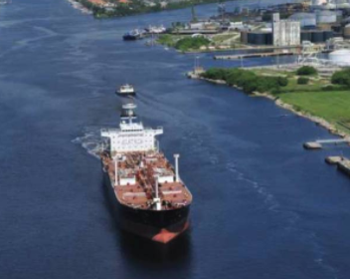
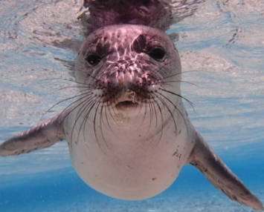
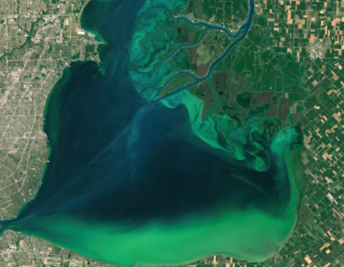
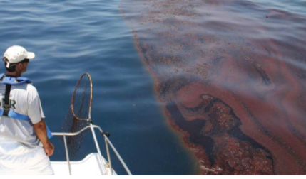
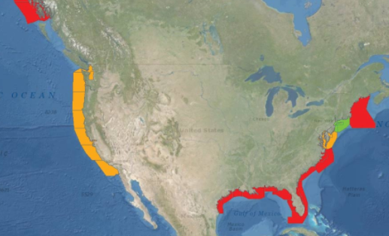
Safe, Efficient Navigation
Managing Marine Living Resources
Protecting Human Health
NOS Modeling Vision
Spill Response & Search & Rescue
Coastal Resilience
Mapping & Coastal Mngmt
Protecting our coastal communities and the nation’s economy
Courtesy: Tracy Fanara;
Notes:
opportunity to serve all of these missions

Slide 3
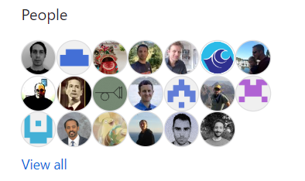
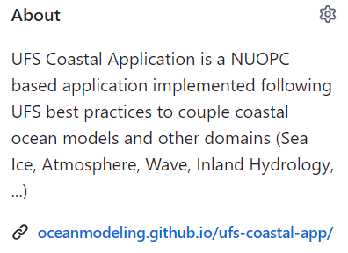
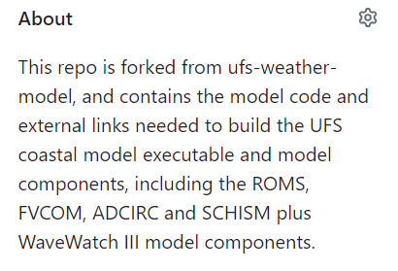
Community-owned collaborative environment
https://github.com/oceanmodeling

Slide 4
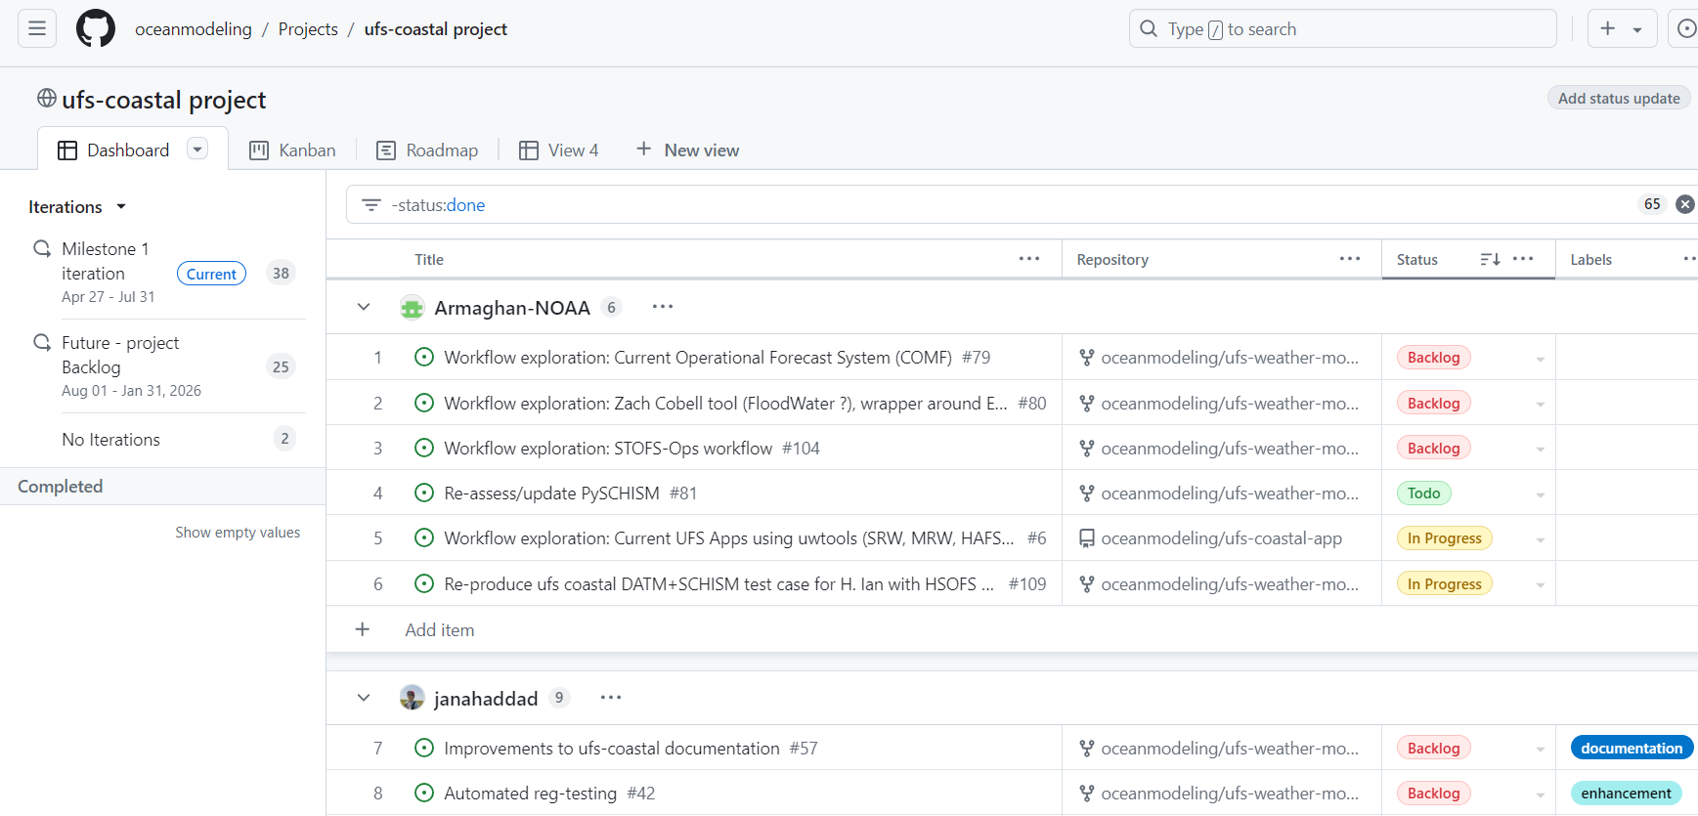
Code development, sharing, and communication on Github

Slide 5
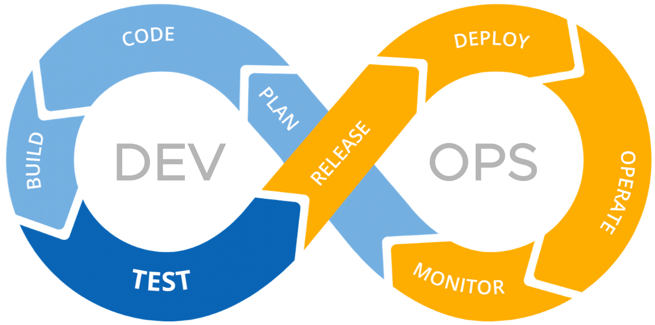
Practicing DevSecOps
Building CI/CD pipeline:
In partnership With EPIC, we are building the 1st version of the CI/CD pipeline for UFS Coastal Application (i.e. Compiling code base plus a few light weight RTs)

Slide 6
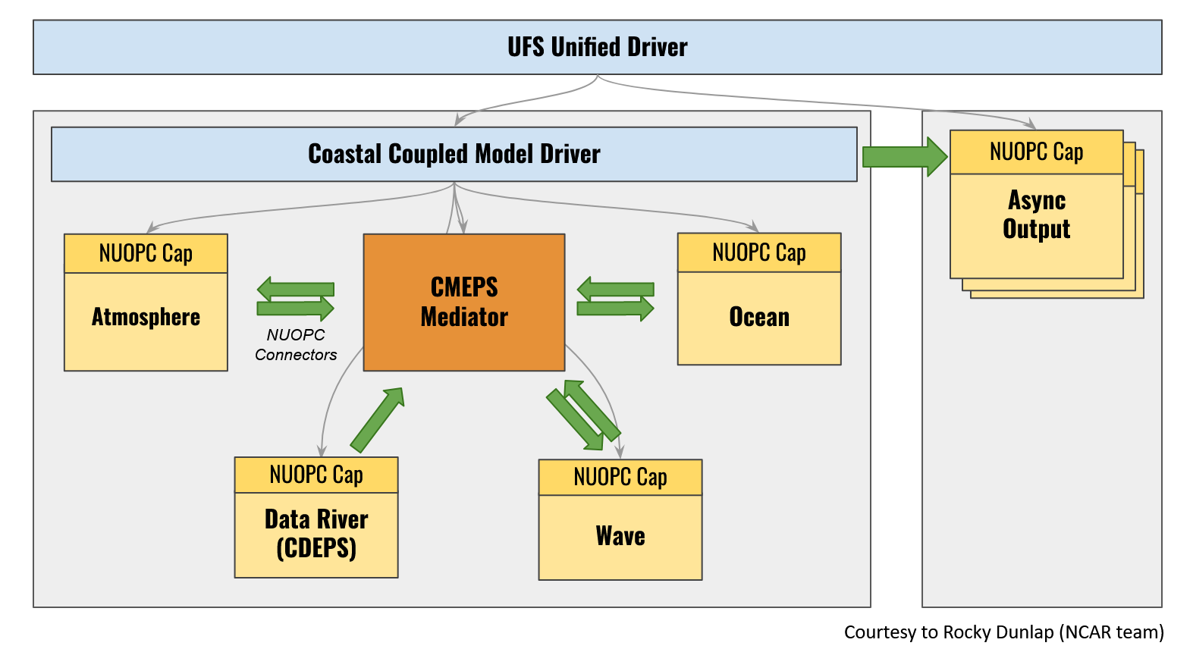
UFS-Coastal infrastructure development
(IIJA/BIL partnerships)
“Data” models for integrating forcing datasets
Component-level testing and cap optimization
Configurable driver
Coastal Mediator component
Asynchronous output & regridding
Computational performance optimization
https://github.com/oceanmodeling/ufs-coastal/tree/feature/coastal_app
ufs-coastal one-way coupled to inland-hydrology until NextGen become a UFS ready model (i.e. to have ESMF/NUOPC capability)

Slide 7
UFS-Coastal and inland-hydrology (i.e. NextGen)
Dynamical coupling possibilities
CMEPS
Mediator
CMEPS
Mediator
NUOPC Cap
NextGen-
Hydrology module
NUOPC Cap
NUOPC Cap
NUOPC Cap
UFS-Coastal-
OCN
NextGen
UFS-Coastal-
OCN
BMI Cap
NUOPC Cap
NextGen - Coastal module
1) UFS-Coastal to be connected to NextGen modules to exchange information similar to Coastal Act project.
2) UFS-Coastal and NextGen connection through NUOPC cap that wraps entire NextGen.

Slide 8
UFS Coastal Applications (plans)
SECOFS: DATM+SCHISM+WW3 (NOAA / funded)
STOFS-3D-Alaska: DATM+SCHISM+CICE+WW3 (NOAA / partially funded)
Bering Sea: DATM+ROMS+CICE (NASA / partially funded)
Hurricane-Surge: PAHM+SCHISM+WW3 (NOAA / partially funded)
STOFS workflow: To unify and upgrade current STOFS workflow (NOAA / partially funded)
STOFS-2D-Global: DATM+ADCIRC+WW3 (not funded)
…

Slide 9
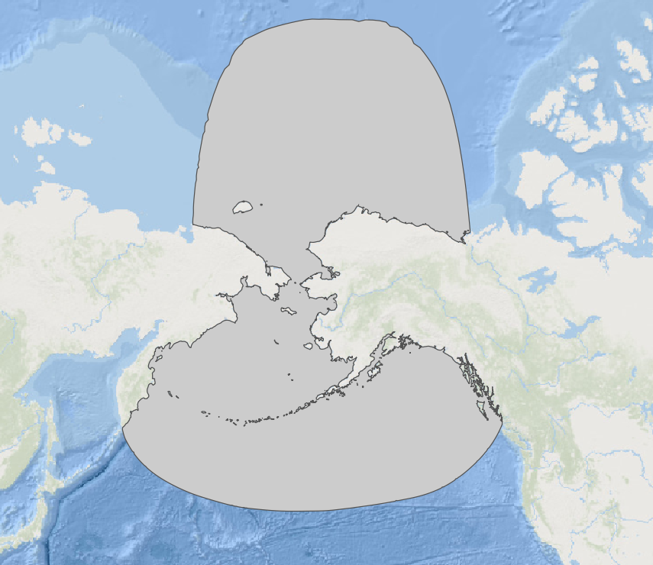
STOFS-3D-Alaska: DATM+SCHISM+CICE+WW3
NUOPC Cap
Sea Ice
CICE
CMEPS
Mediator
NUOPC Cap
DATAM (CDEPS)
NUOPC Cap
Wave
WW3
NUOPC Cap
Ocean SCHISM
Surge & Tide Operational Forecast System (STOFS)

Slide 10
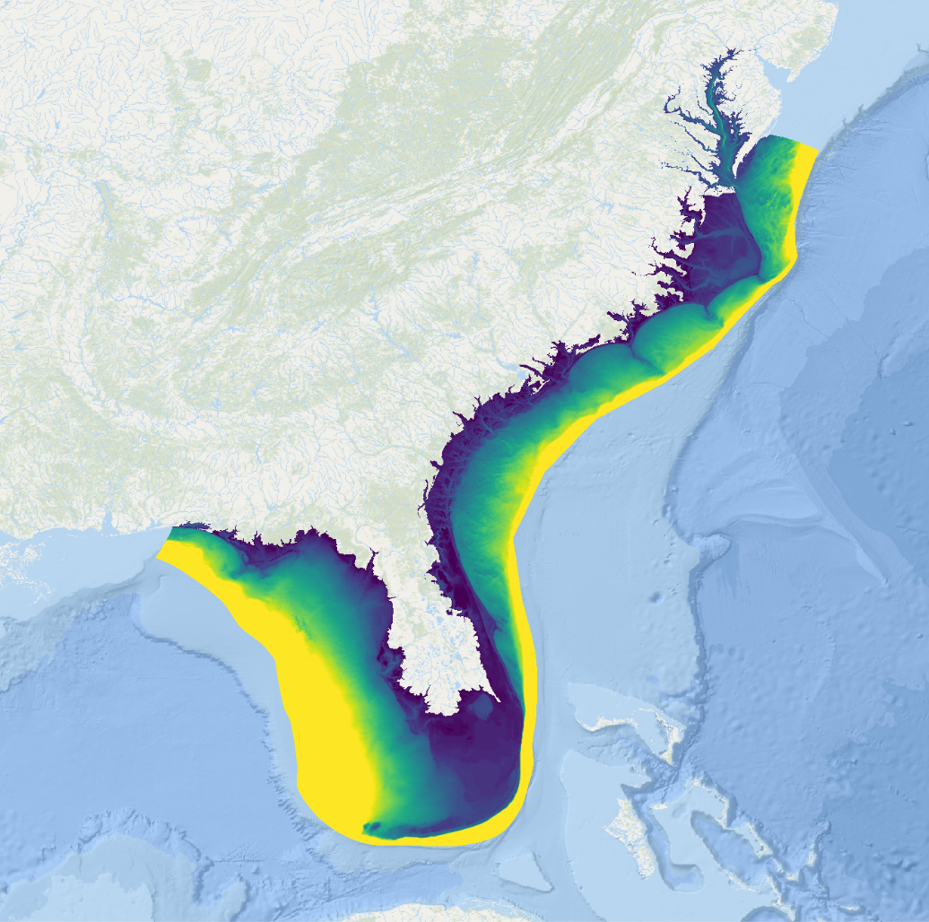
SECOFS: DATM+SCHISM+WW3
CMEPS
Mediator
NUOPC Cap
DATAM (CDEPS)
NUOPC Cap
Wave
WW3
NUOPC Cap
Ocean SCHISM
Southeast Coastal Operational Forecast System

Slide 11
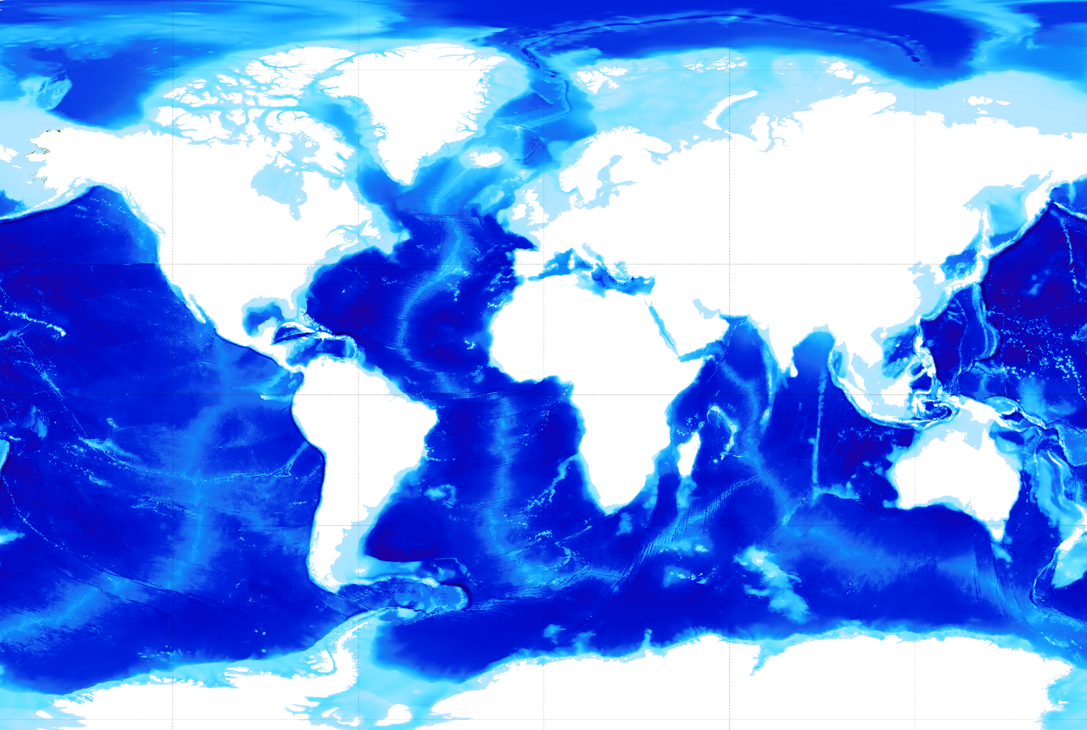
STOFS-2D-Global: DATM+SCHISM+WW3
STOFS-2D-Global coverage
CMEPS
Mediator
NUOPC Cap
DATAM (CDEPS)
NUOPC Cap
Wave
WW3
NUOPC Cap
Ocean ADCIRC
Surge & Tide Operational Forecast System (STOFS)

Slide 12
STOFS workflow:
To unify and upgrade current STOFS workflow
To review and leverage ongoing work e.g. uwtools and the UFS Weather Model and other workflows
The envisioned workflow to allow multi-model coupling, such as STOFS-3D-Alaska (SCHISM-CICE-WW3), STOFS-2D-Global (ADCIRC-WW3) and …
Explore ways to make workflow flexible to support utilizing the Continuous Integration and Continuous Delivery (CI/CD) pipeline
The project and code is going to be managed using GitHub
Team communication through Github Issues and Discussions

Slide 13
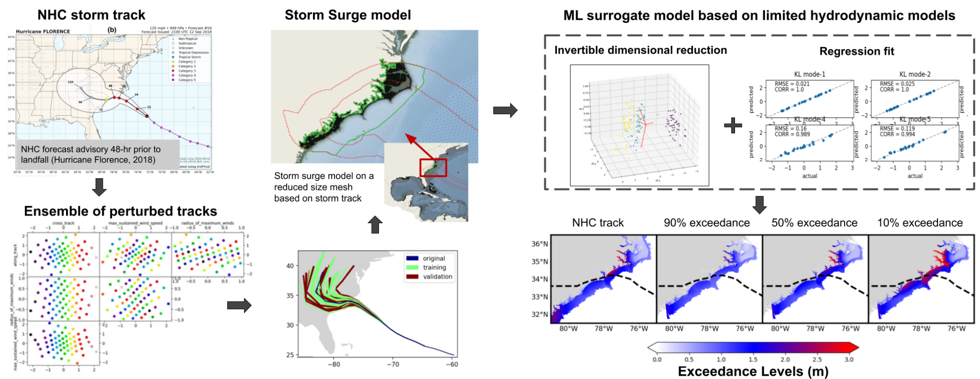
GenAI pilot project: Next Generation Probabilistic Coastal Flooding Forecast System
Machine Learning workflow for probabilistic prediction of coastal flooding (Case study: Hurricane Florence, 2018)
[1] Pringle et al. (2023), Efficient Probabilistic Prediction and Uncertainty Quantification of Tropical Cyclone–Driven Storm Tides and Inundation.
Artificial Intelligence for the Earth Systems, 2(2), e220040.
NOAA / OCS / NOS Storm Surge Modeling Team
Contact: Saeed.Moghimi@noaa.gov
Notes:
As a part of BIL and DRSA efforts, the NOS Storm Surge Modeling Team at the NOS Office of Coast Survey in partnership with NWS National Hurricane Center are developing the next generation of NOAA’s Probabilistic storm Surge model (NHC’s PSurge) to provide efficient and reliable prediction of coastal flooding in limited time. We are utilizing cutting-edge technology and capabilities of AI/ML to conduct probabilistic prediction of coastal flood extent and inundation depths based on limited physical modeling of storm tide and surge. Outcomes of this work will benefit emergency evacuation and decision making before and during storms.

Slide 14
Outlook
Funding:
Effective developments of the ufs-coastal-model and applications
Develop and maintain ufs-coastal workflow
Active engagement and support from EPIC project
With current partial funded opportunities:
To extend CI/CD pipeline as much as possible
Support limited number of components
Support limited number of coupling strategies

Slide 15
Thank you

Slide 16
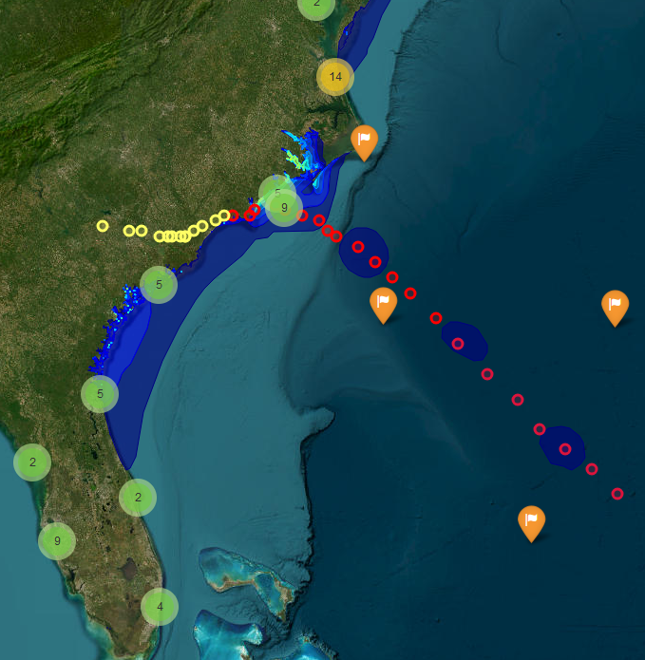
Hurricane-Surge: PAHM+SCHISM+WW3
CMEPS
Mediator
NUOPC Cap
ATM
PaHM
NUOPC Cap
Wave
WW3
NUOPC Cap
Ocean SCHISM

Slide 17
UFS Coastal
Coastal Ocean Model Components
Model component | Registered users | Active developers and contributors | Notes
ROMS | > 8000 | >1000
ADCIRC | > 750 | > 100
SCHISM | > 500 | > 60
FVCOM | > 3000 | >

Slide 18
Inland-hydrology and coastal ocean models coupling (for BIL/CIFIM)
draft
Phases | Action items | Coupling modes | Expected time
Phase 1 | OWP develops and validate the first version of NextGen NOS develops and validate the first version of ufs-coastal | Stand alone model development | 2024
Phase 2 | NextGen developes BMI data models to import NOS coastal ocean models to enable one-way coupling from ufs-coastal to NextGen The ufs-coastal to develop CDEPS NUOPC data wrapper to enable one-way coupling from NextGen to ufs-coastal The ufs-coastal team to support NextGen team in designing NextGen NUOPC cap / BMI connection | One-way coupled | 2025
Phase 3 | NOS team will support OWP to start implementing NUOPC connectivity to BMI system Basic testing of two way exchange among ufs-coastal and NextGen will be done Prototype testing of the two-way coupled system Preoperational testing of the two-way coupled system | Two-way coupled | 2026 and beyond (in accordance with NextGen and ufs-coastal timelines)

