Slide 1
An Evaluation of AI-Generated Global NWP Emulators in the NOAA HWT Spring Forecasting Experiment
David Harrison^{1,2,3}
Tim Supinie², Israel Jirak², Adam Clark⁴
¹Cooperative Institute for Severe and High-Impact Weather Research and Operations, University of Oklahoma
²NOAA/NWS/Storm Prediction Center
³School of Meteorology, University of Oklahoma
⁴NOAA/OAR/National Severe Storms Laboratory

Slide 2
Background
Multiple private-sector companies have recently explored and developed AI for global weather prediction
AI models have demonstrated similar or improved statistical skill to ECMWF’s Integrated Forecast System (IFS)
Much faster than traditional NWP with fewer computational resources
Research Questions:
How do the AI forecasts compare to traditional NWP?
Do the AI forecasts provide value at extended lead times for severe weather forecasting?

Slide 3
NVIDIA’s FourCastNet V2
Fourier Forecasting Neural Network
Applies an Adaptive Fourier Neural Operator (ANSO) model architecture
Trained on a subset of ERA5 reanalysis from 1979 – 2015 at single pressure levels
Produces autoregressive 6-h forecasts at 0.25º resolution
Publicly available at https://github.com/NVlabs/FourCastNet

Slide 4
Huawei Cloud’s Pangu-Weather
Applies a 3D Earth-Specific Transformer (3DEST) model architecture
Trained on ERA5 reanalysis from 1979 – 2017 at 1-h, 3-h, 6-h, and 24-h lead times
Iteratively runs 1-h, 3-h, 6-h, and 24-h models to get desired forecast hour
Produces 0.25º forecast at lead times of 1-h to 1 week
Publicly available at https://github.com/198808xc/Pangu-Weather

Slide 5
Google’s GraphCast
Will focus on the “operational” version of GraphCast
Applies a Graph Neural Network (GNN) model architecture
Trained on ERA5 reanalysis from 1979 – 2017
Produces autoregressive 6-h forecasts at 0.25º resolution
Publicly available at https://github.com/google-deepmind/graphcast

Slide 6
Experiment Design
Each AI model run experimentally at the Cooperative Institute for Research in the Atmosphere (CIRA)
Each model initialized using GFS initial conditions – may result in some performance degradation compared to what was reported in the literature
Produced the following fields out to F240 (10 days) for evaluation:
500 mb wind and geopotential heights
850 mb wind and geopotential heights
2-m temperature
6-h QPF (only available from GraphCast)
Live experimental forecasts available at https://aiweather.cira.colostate.edu/

Slide 7
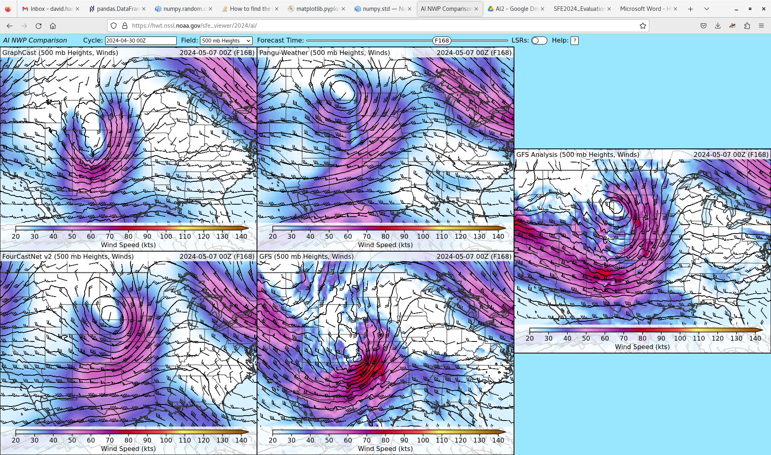
Experiment Design
AI models compared to operational GFS and GFS analysis at 0.25º resolution
Interactive webpage designed by Tim Supinie

Slide 8
2024 HWT Spring Forecasting Experiment
2024 HWT Spring Forecasting Experiment held April 29 – May 31
Participants evaluated the AI forecasts and their usefulness for severe weather forecasting each day and provided subjective scores via an online survey
Focused on the Day 7 forecast (F156 – F180) for the previous day
Participants could view the full North American domain, but were asked to focus on areas of observed severe weather when evaluating
Subjective scores were provided on a 10-point Likert scale in comparison to GFS analysis

Slide 9
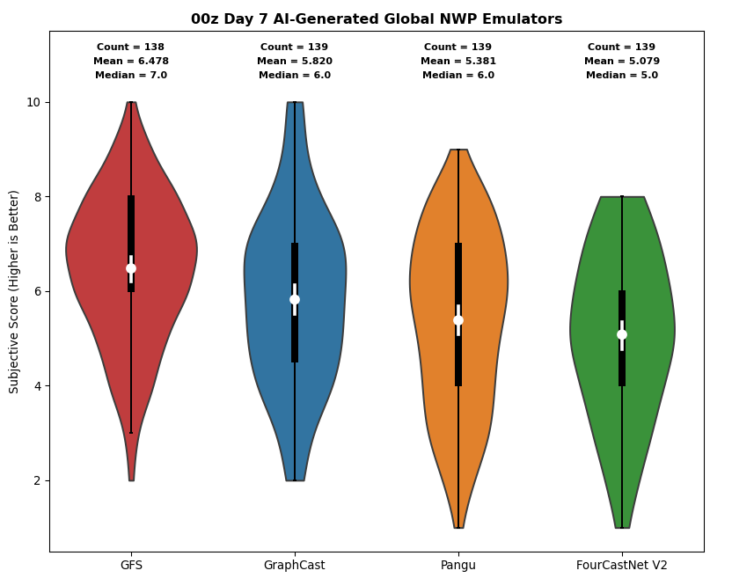
Results
When compared to GFS Analysis at Day 7 lead times:
GFS rated the highest on average
GraphCast rated statistically similar to GFS (at 95% confidence interval)
Pangu and FourCastNet rated statistically lower than GFS
GFS
GraphCast
Pangu
FourCastNet

Slide 10
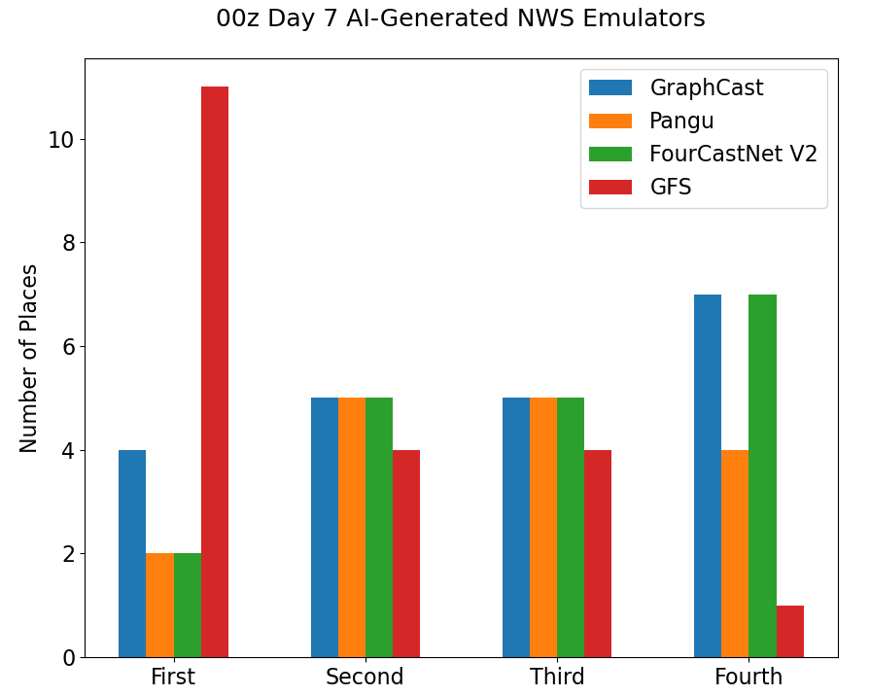
Results
GFS rated the best model on 11 of 20 days
GraphCast rated the best on 4 days
No clear winner among AI models
Pangu rated the worst model less often than the other AI models

Slide 11
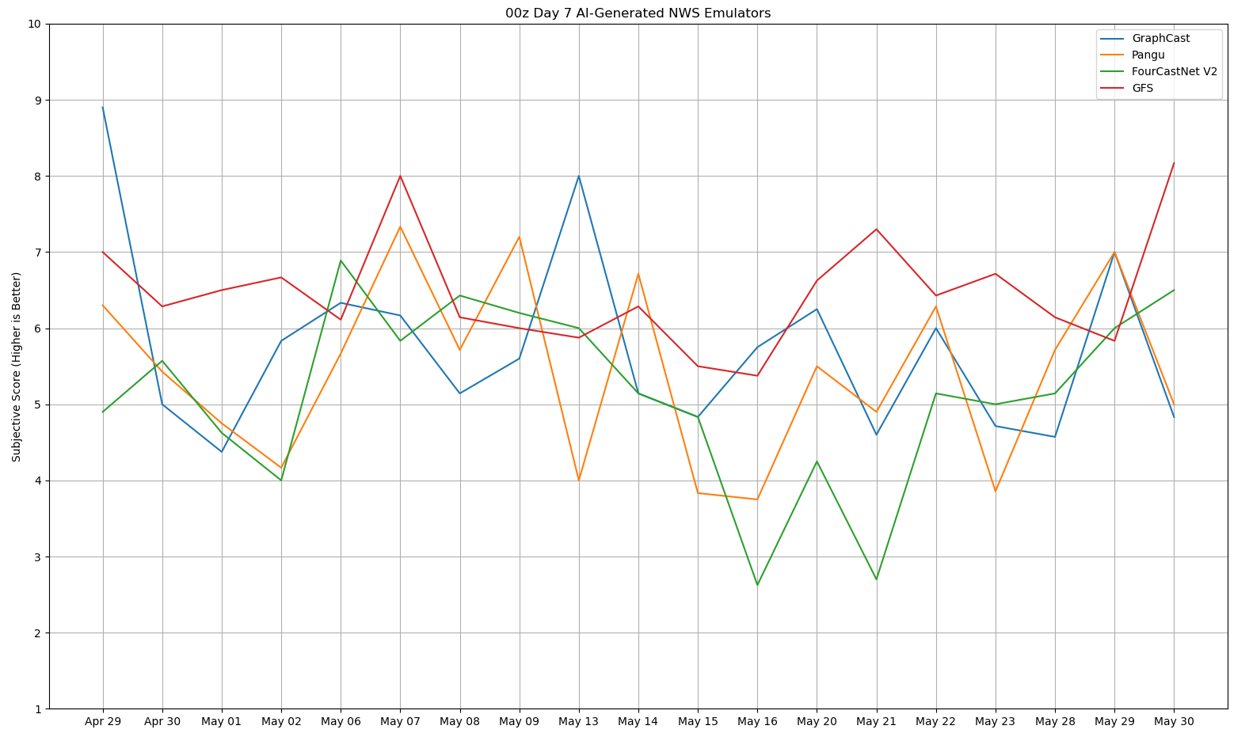

Slide 13
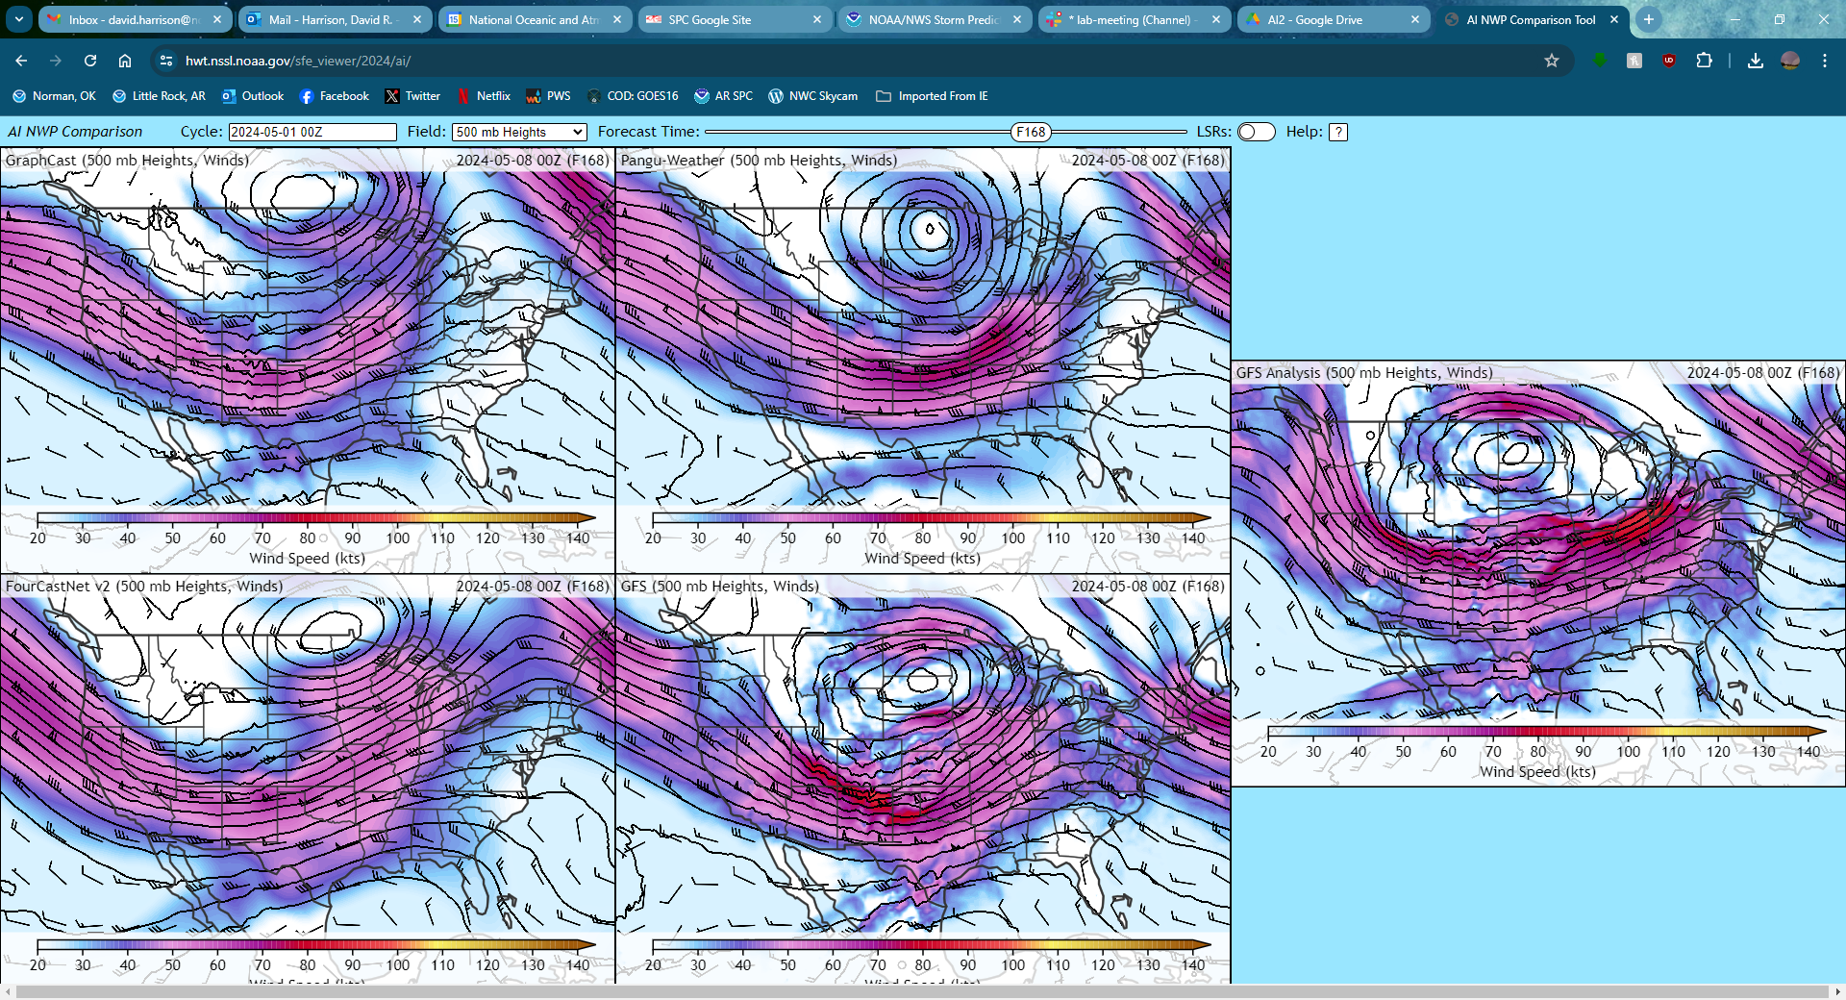
Experiment Design
May 8, 2024 (F168)
GraphCast
Pangu-Weather
Analysis
FourCast Net
GFS
AI models generally seemed to perform better in strongly-forced environments
Handled broad synoptic patterns well

Slide 15
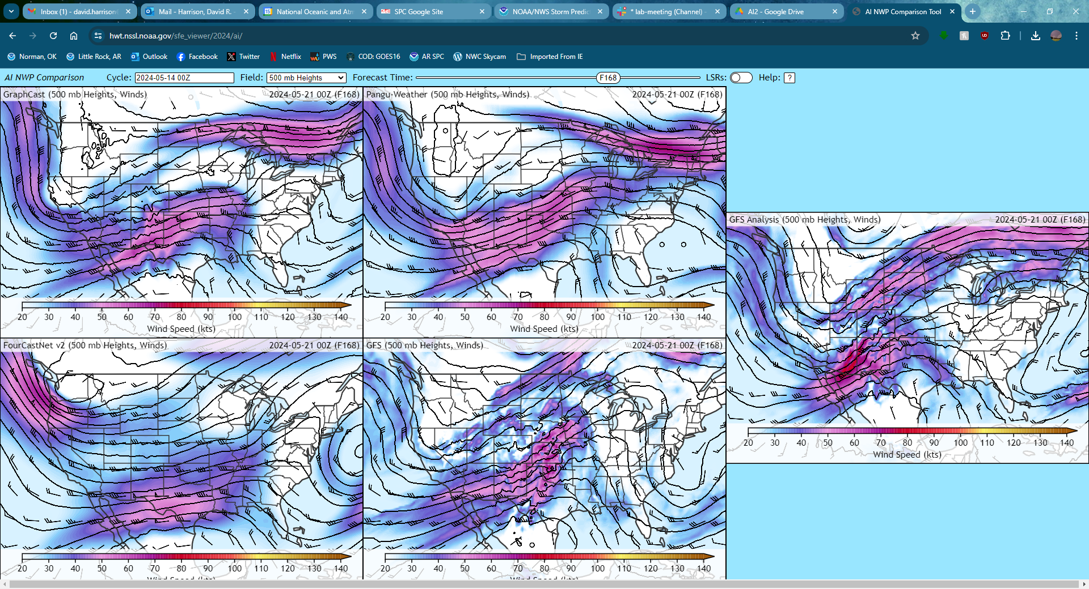
Experiment Design
May 21, 2024 (F168)
GraphCast
Pangu-Weather
Analysis
FourCast Net
GFS
AI models struggled to capture more subtle forcing
Particularly noticeable in split-flow regimes
Participants felt the wind and height fields were often too smoothed

Slide 16
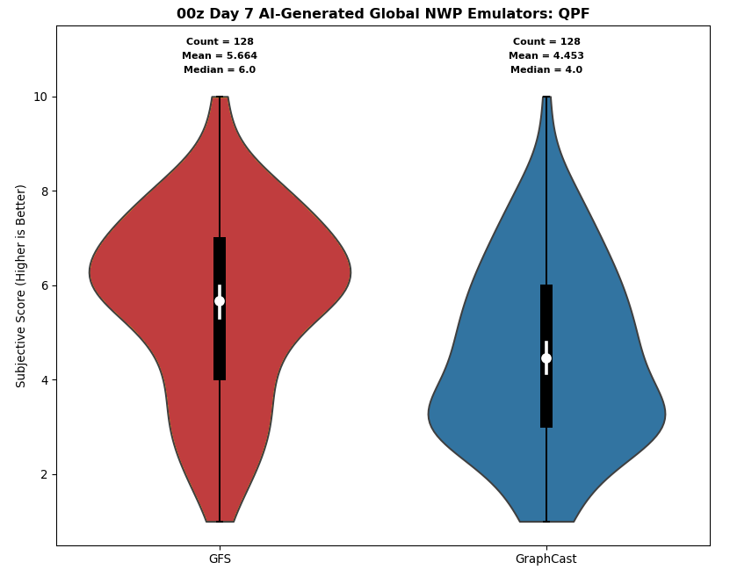
Results
GraphCast QPF rated significantly lower than GFS on average
Produced very broad areas of precipitation
Poor detection of heavy rain events
QPF not yet available from other AI models
GFS
GraphCast

Slide 17
Other Observations
Derived soundings from AI models physically realistic but very smooth
Poorly resolved PBL and EML
Often close to standard atmosphere
Particularly noted for FourCastNet
AI models showed less run-to-run and day-to-day consistency than the GFS
Models would occasionally see dramatic shifts between runs
The “best” AI model varied considerably from day to day
Participants impressed by current state of models but indicated there’s still work to do before they’re ready for operations

Slide 18
Questions?
More Info: https://hwt.nssl.noaa.gov/sfe/2024/
Email: david.harrison@noaa.gov
The statements, findings, conclusions, and recommendations are those of the authors and do not necessarily reflect the views of NOAA or the U.S. Department of Commerce.

