Slide 1
Great Lakes Earth System Model (GLESM): Hindcast (1979-2021) and future climate projection (1979-2100)
Jia Wang1, David Cannon2, Ayumi Fujisaki-Manome2, James Kessler1, Andrea Vander Would1
1 NOAA GLERL, Ann Arbor, MI
2 CIGLR, University of Michigan, Ann Arbor, MI
Support: OAR Ocean Sciences Portfolio
UIFCW24, Johnson State University, MS, July 24, 2024

Slide 2
Outline
Background
3-D Coupled 5 Great Lakes FVCOM_ice Model (FVCOM_CICE), 1979-2021
Results of Hindcast using FVCOM_ice
Results of Projection by FVCOM_ice
Summary and Future Efforts

Slide 3
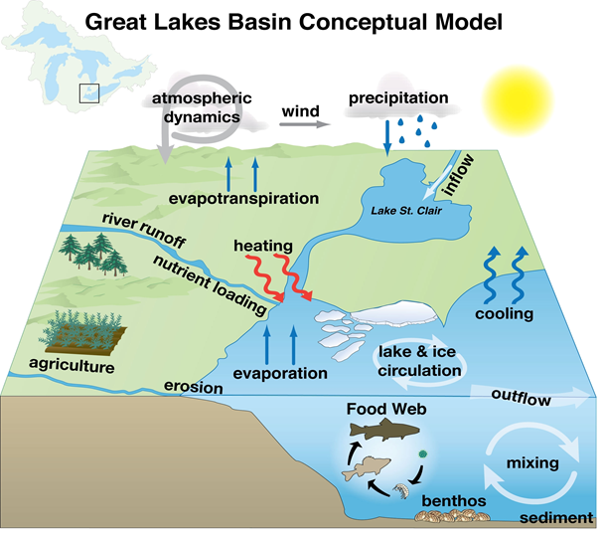
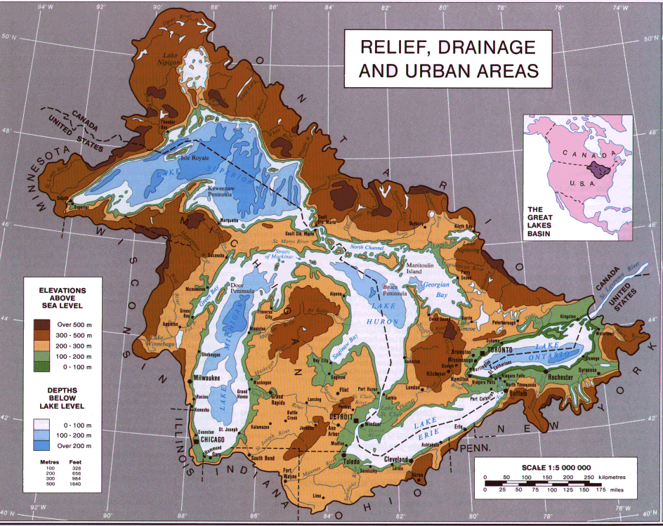
1. Background and Purposes of GLESM 1) Simulation of lake ice-circulation-ecosystem: Seasonal to decadal changes 2) Physical/ecological simulation and forecasting 3) Climate downscaling into all five lakes at depths, and primary productivity 4) Work toward Great Lakes Earth System Model (GLESM) for climate study
Hindcast the past and present climate (lake hydrodynamics, ice, ecosystems)
Project the future climate under various scenarios
Planning and management of Great Lakes resources
Climate resilience

Slide 4
2. GL FVCOM
1. FVCOM v3.1.6 (Chen, Univ. of MA. Dartmouth)
2. Five lakes model within the GL watershed
3. 500m-5km horizontal resolution and 21 vertical sigma layers
4. Add surface wind-wave mixing (Hu and Wang 2010, JGR):
5. Replace Euler-forward schemes with centered differencing (Wang et al. 2023)
6. CICE: multiple category, plastic-viscous-elastic rheology (LANL, Hunke)
7. Atmospheric forcing obtained from NCEP North America Regional Reanalysis (NARR) 3-hourly output (air temperature and humidity at 2m, wind at 10m),solar radiation and air longwave radiation calculated
8. Initial temperature field uses 2C everywhere
9. Spin-up: 1 year, and run for 1979-2021 continuous integration (42 years)!
10. External timing step: 10 sec, internal mode: 200 sec.

Slide 5
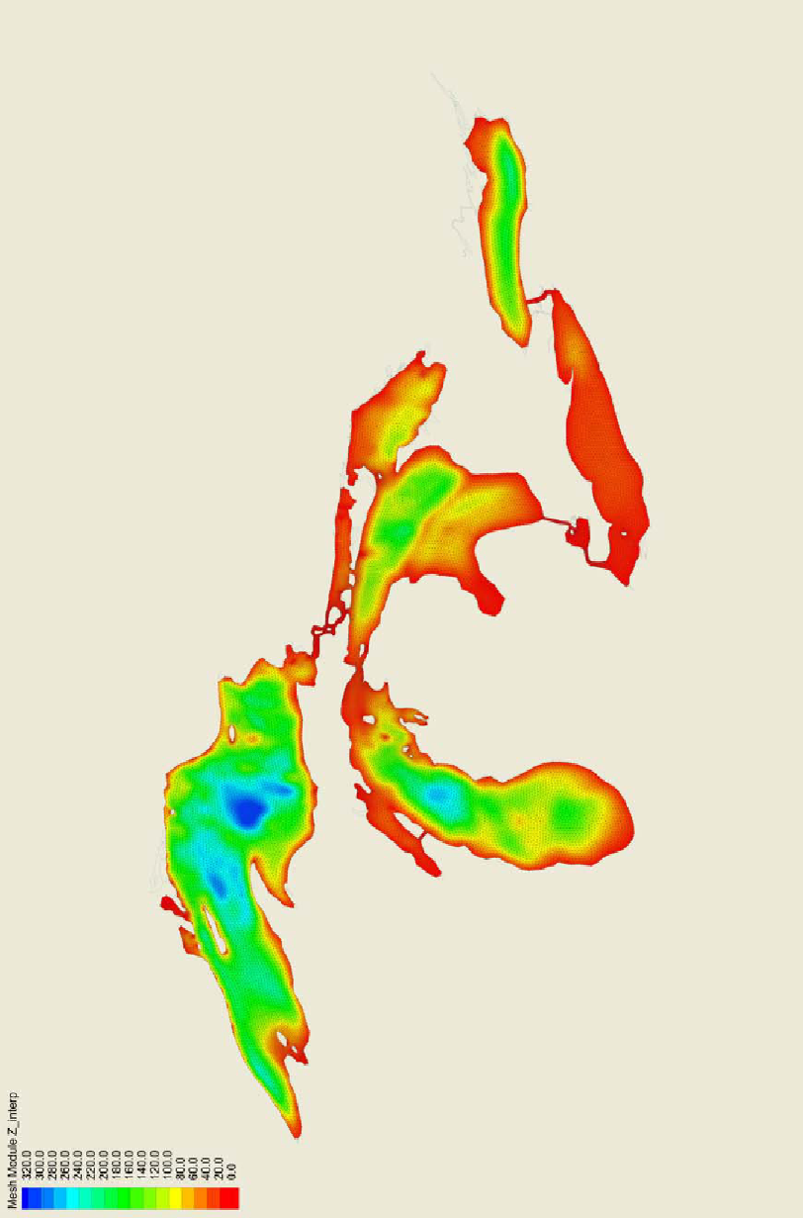
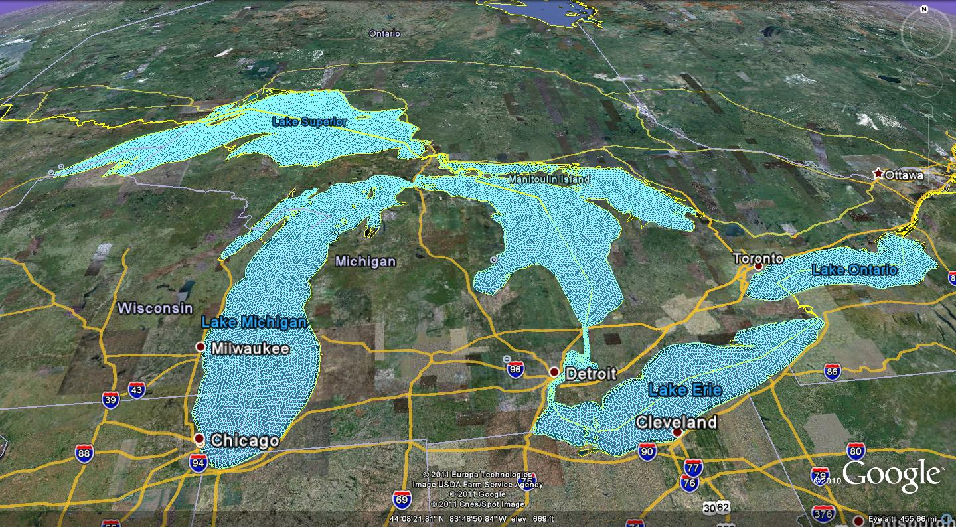
Topography and unstructured grids (Bai et al. 2013, OM)

Slide 6
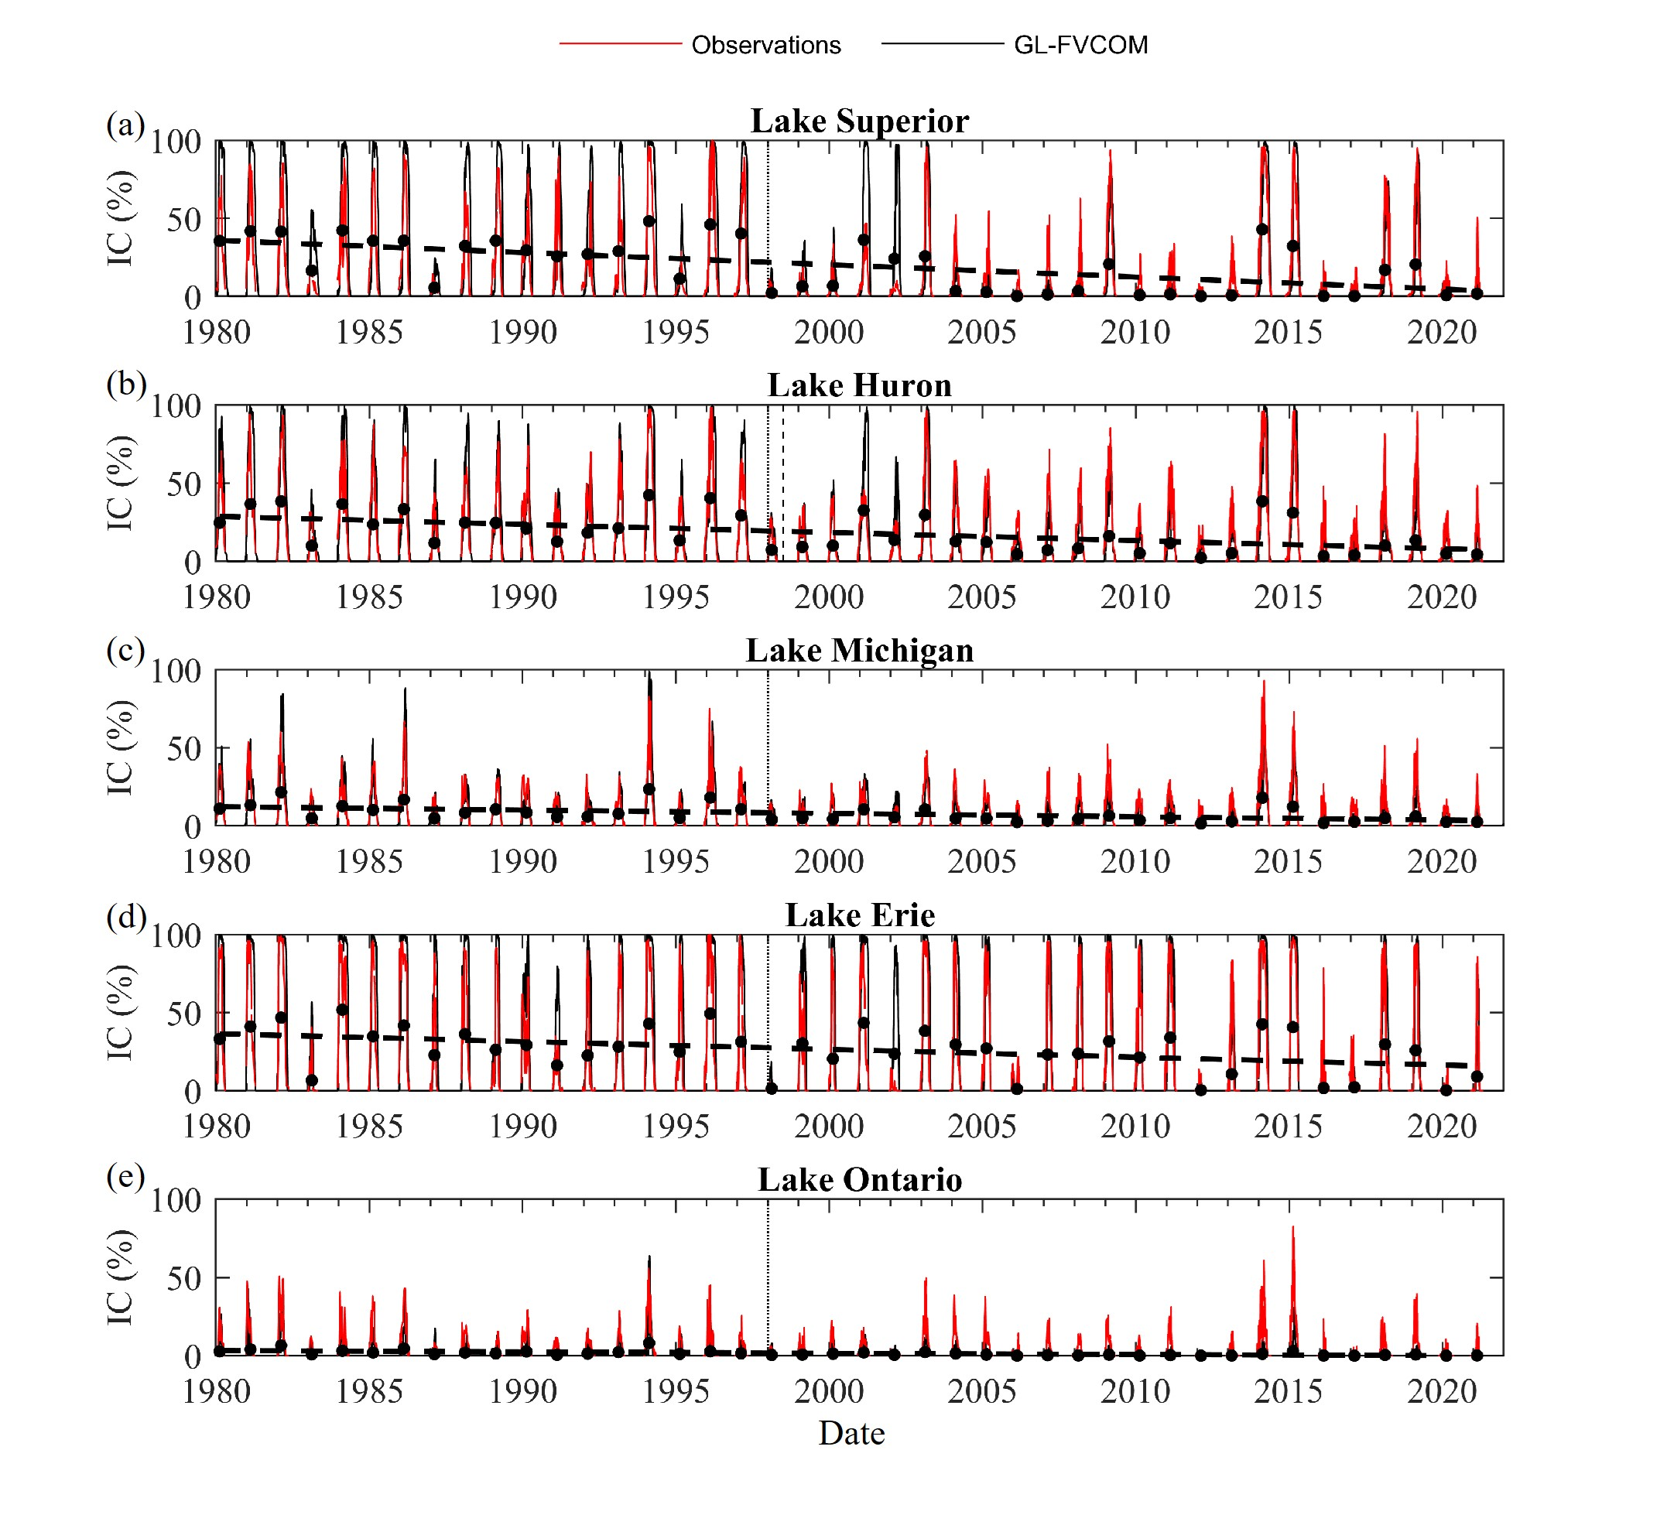
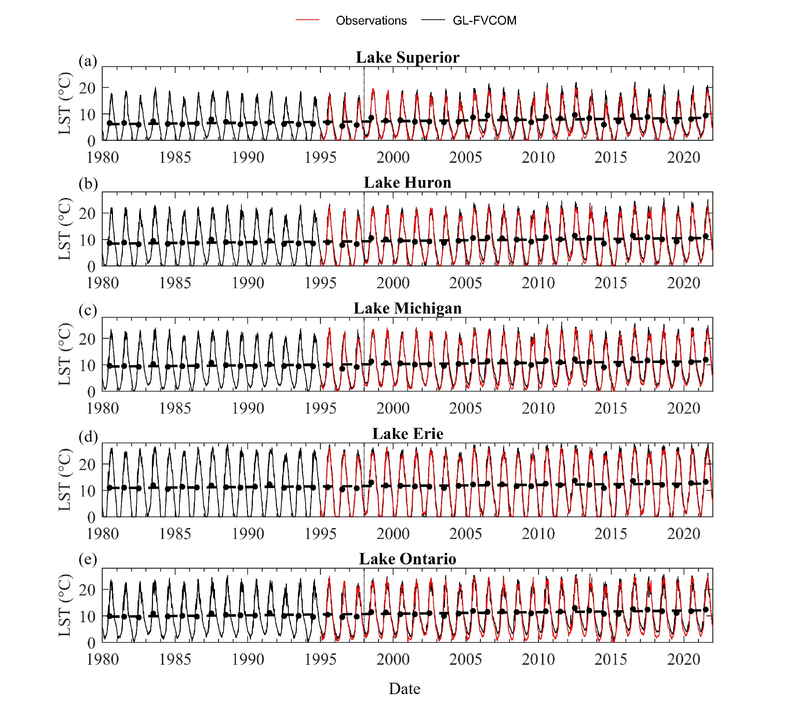
3. Results of Hindcast
Simulated ice cover lake surface temperature
Bai et al. (2013, OM), Fujisak-Manome and Wang (2016, IAHR), Cannon et al. (2023, ODYN; 2024, JClim)

Slide 7
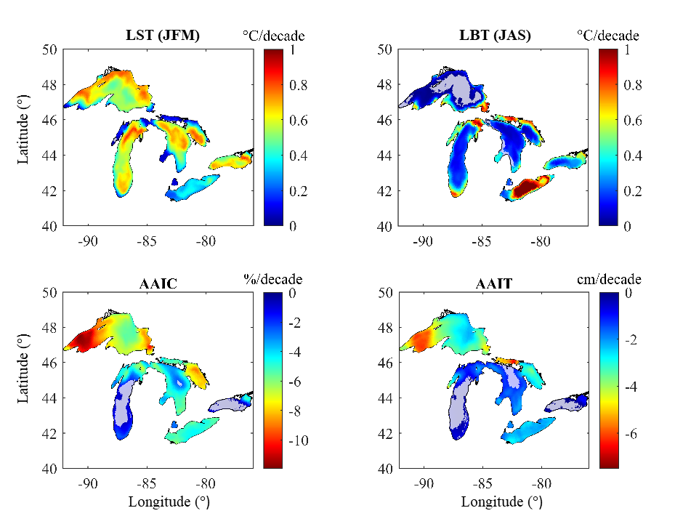
Results: Historical Spatial Trends
(+) surface temps: northern latitudes
(+) bottom temps: shallow regions
agree well w/ obs.
(-) ice cover: northern latitudes
(-) ice thickness: shallow, mid-lat
agree well w/ obs.
Notes:
Ok let’s get into results. This figure shows trends in annually averaged lake surface temperature, lake bottom temperature, ice cover, and ice thickness at all model grid cells
Trends were estimated using all simulations between 1980 and 2021. More extreme warming trends are shown in red, while less extreme trends are shown in blue.
Winter lake surface temperatures increased between 0.2 and 0.8C/decade with higher heating rates in offshore waters and at northern latitudes, results that agree with remote sensing observations.
Lake bottom temperatures also increased significantly, with summer warming rates in shallow regions in excess of 0.75C/decade.
This was especially evident in Lake Erie, where a deepening thermocline led to high heating rates.
Modelled ice cover decreased between 5 and 10%/decade, with the highest ice losses at northern latitudes. This also agrees really well with observations, which show the largest ice losses in Lake Superior,

Slide 8
Results: Historical Spatial Trends
(+) surface temps: northern latitudes
(+) bottom temps: shallow regions
agree well w/ obs.
(-) ice cover: northern latitudes
(-) ice thickness: shallow, mid-lat
agree well w/ obs.
Notes:
Ok let’s get into results. This figure shows trends in annually averaged lake surface temperature, lake bottom temperature, ice cover, and ice thickness at all model grid cells
Trends were estimated using all simulations between 1980 and 2021. More extreme warming trends are shown in red, while less extreme trends are shown in blue.
Winter lake surface temperatures increased between 0.2 and 0.8C/decade with higher heating rates in offshore waters and at northern latitudes, results that agree with remote sensing observations.
Lake bottom temperatures also increased significantly, with summer warming rates in shallow regions in excess of 0.75C/decade.
This was especially evident in Lake Erie, where a deepening thermocline led to high heating rates.
Modelled ice cover decreased between 5 and 10%/decade, with the highest ice losses at northern latitudes. This also agrees really well with observations, which show the largest ice losses in Lake Superior,

Slide 9
Results: Historical Spatial Trends
(+) surface temps: northern latitudes
(+) bottom temps: shallow regions
agree well w/ obs.
(-) ice thickness: shallow, mid-lat
(-) ice cover: northern latitudes
agree well w/ obs.
Notes:
Statistically significant trends in ice thickness were also detected across the model domain. It’s worth pointing out that simulations showed dramatic changes in ice thickness, even in regions with pretty weak trends in ice cover. This is something you can’t easily captre observationally, but it does have significant consequences for shipping and under-ice ecology.

Slide 10
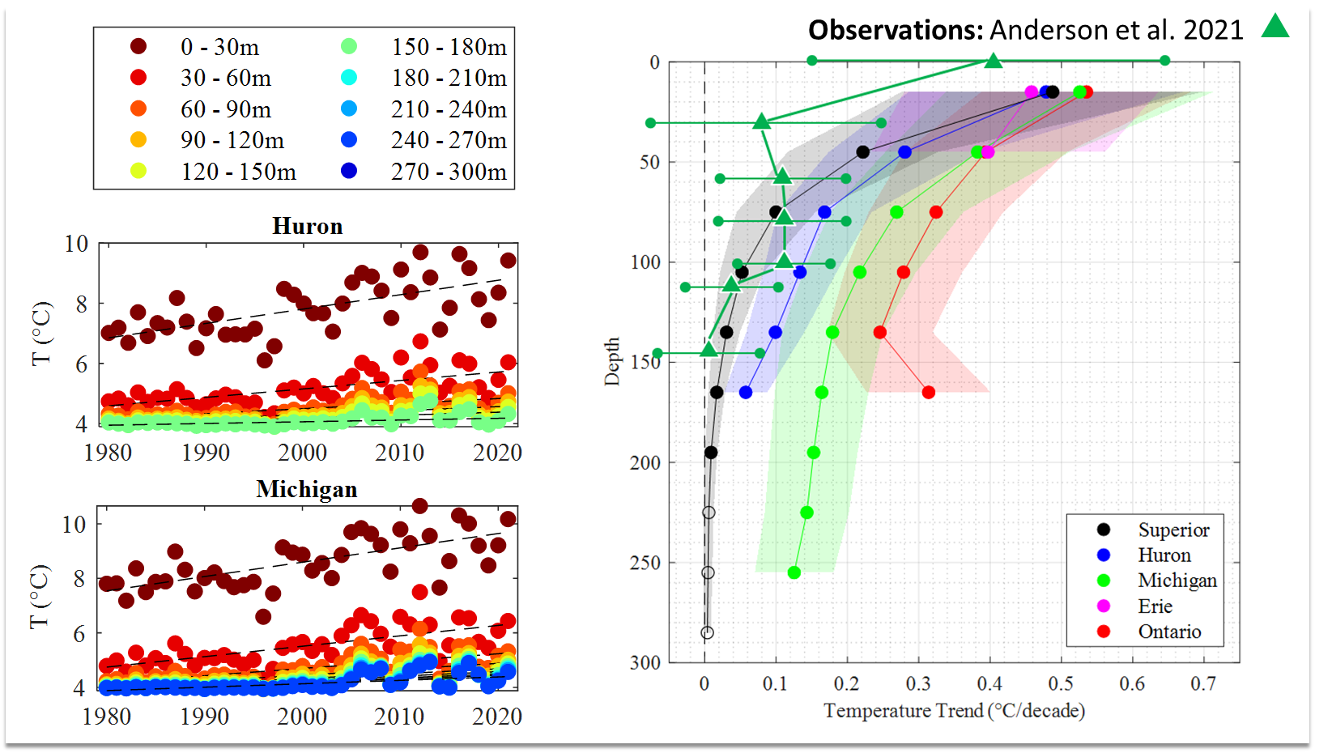
Results: Historical Subsurface Warming
Layer-Averaged Temperatures
0 – 30m
30 – 60m
60 – 90m
etc.
Notes:
Moving on, let’s look a little closer at warming trends below the surface.
Using the three-dimensional model output, we estimated layer averaged temperatures in 30m intervals across the depth in all lakes.
Layer-averaged time series (shown at left) show strong warming trends at all depths.
Heating rates decrease from ~0.4C/decade at the surface to ~0.1C/decade near the bed.
Warming rates were generally strongest in deep, lower latitude lakes that experience less annual ice cover, namely lakes Michigan and Ontario.
Importantly, simulated heating rates in Lake Michigan agree reasonably well with observational heating rates described in Anderson et al. 2021., with 95%CI that *mostly* overlap.
Again, by comparing to observations, we’re able to ground truth our simulation estimates and have more faith in our results.

Slide 11
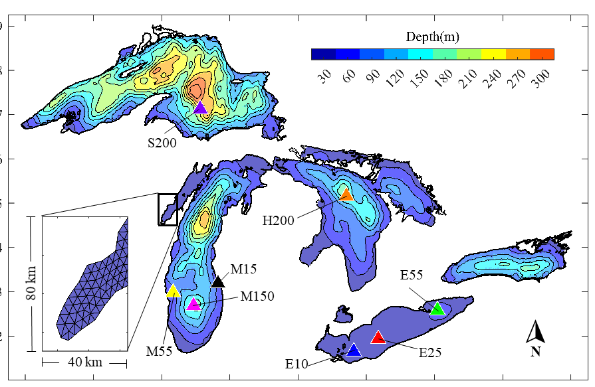
4. Results of Projection
Future Period (1979 -2100): CMIP6
MIROC6 – major warm bias
ECEarth3 – major cold bias
GFDL-ESM4 – minor cold bias
Ensemble – about right….
Notes:
To answer these questions, we used a hydrodynamic model to estimate historical thermal structure characteristics across the great lakes region.
In this study, we modelled three-dimensional thermal structure and ice characteristics using GL-FVCOM, a modified version of FVCOM v3.1.6
The model domain included all five great lakes (+ lake st clair), with a horizontal resolution of ~5km and a vertical resolution of 21 sigma layers. You can see a bit of the unstructured triangular grid here.
The model was forced with the North American Regional Reanalysis product, with hydrodynamic model output every 6 hours between 1979 and 2021.
We used a leapfrog time integration scheme to improve inertial stability for long, continuous model runs, and we implemented an optimized version of CICE to parameterize ice cover and ice volume.

Slide 12
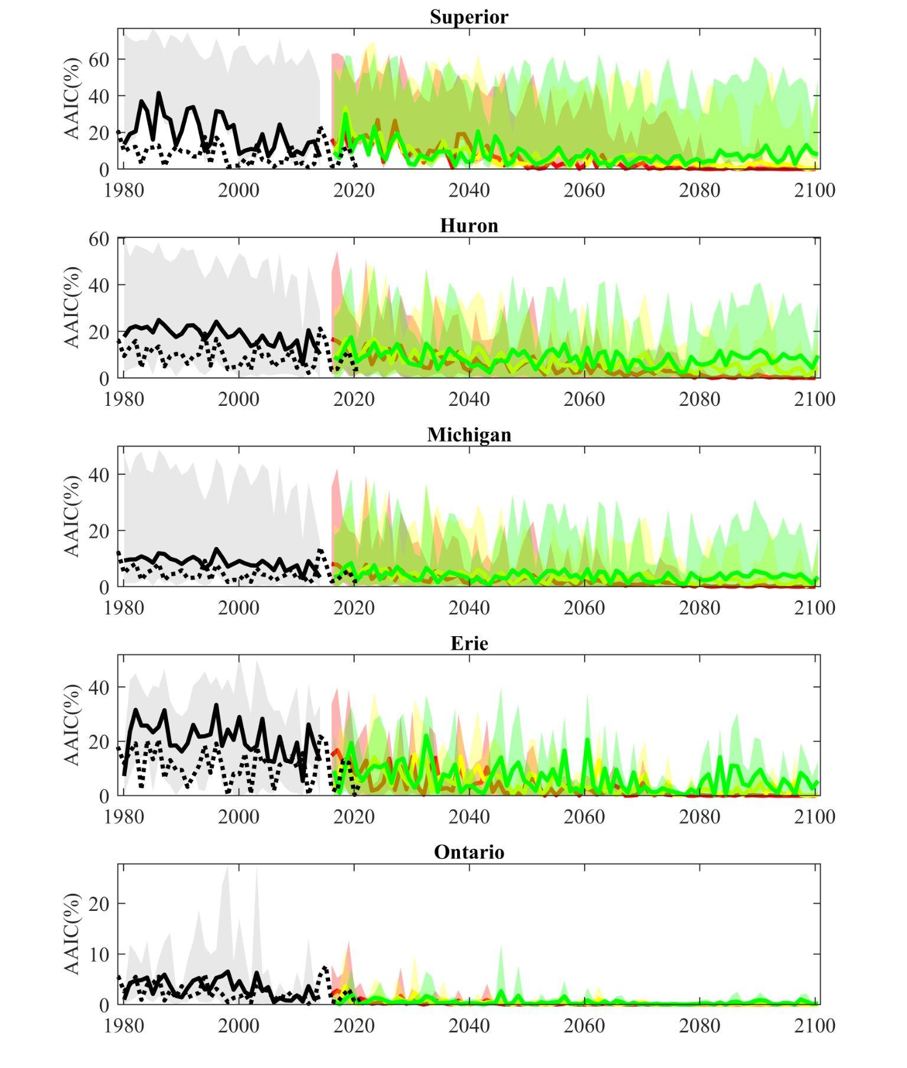
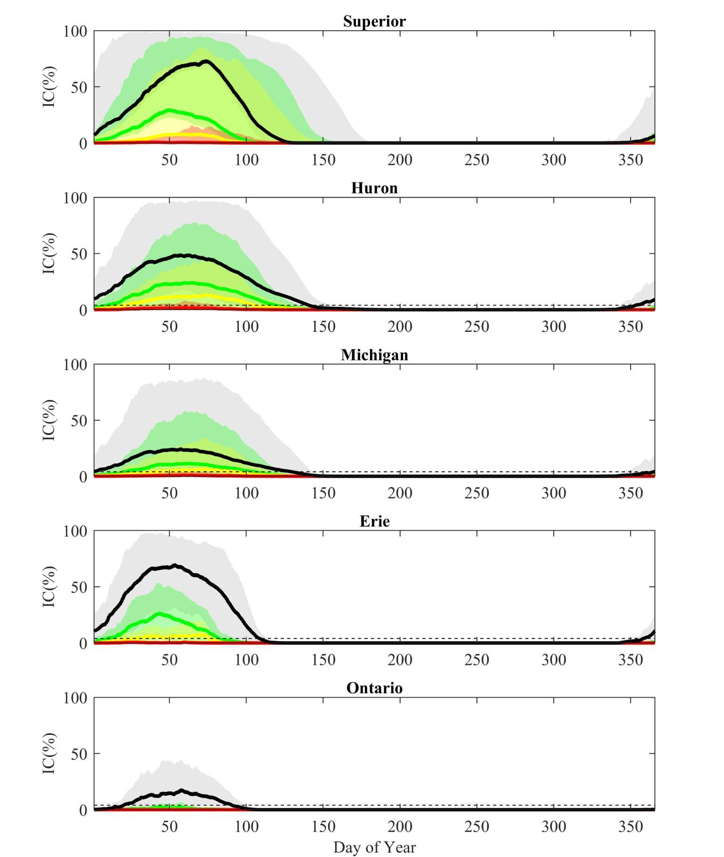
Project the Great Lakes to year 2100 with CMIP6 forcing using Great Lakes Earth System Model
(with leapfrog FVCOM-CICE)
Historical
SSP1-2.6
SSP2-4.5
SSP5-8.5
Cannon et al. (2024, in prep)

Slide 13
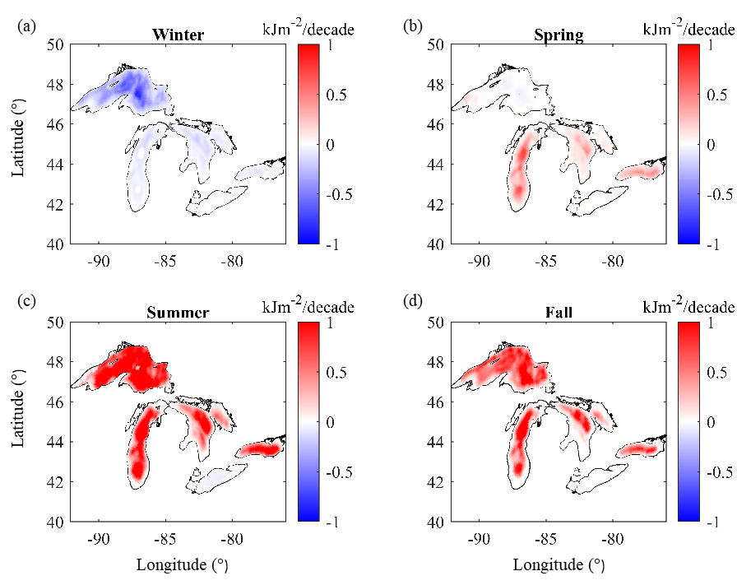
Results: Shifts in Lake Stability & Mixing
Schmidt Stability Index (SSI)
Definition: energy required to completely mix stratified lake
$$SSI=\frac{g}{A_{o}}\int_{0}^{z_{M}}{\left(z_{v}−z\right)\left(ρi−ρ_{v}\right)A\left(z\right)dz}$$
Increased summer stability…
…decreased winter stability
Notes:
Changing subsurface temperatures are also driving changes in stratification and lake stability.
One way to investigate lake stability is to look at the Schmidt Stability Index, which is a measure of the energy required to completely mix a stratified column of water.
Basically, higher values indicate a more strongly stratified water column, and lower values indicate a more isothermal water column.
Rising winter temperatures and decreasing ice cover are leading to decreased winter stability. Without surface ice to set a 0C boundary condition, the water column rarely becomes inversely stratified and remains isothermal for much of the winter season.
On the other hand, increasing summer temperatures are leading to intensified summer temperature gradients, which increase lake stability during the warmest part of the year.
Both of these changes can lead to dramatic shifts in seasonal lake mixing, with far-reaching ecological repercussions.

Slide 14
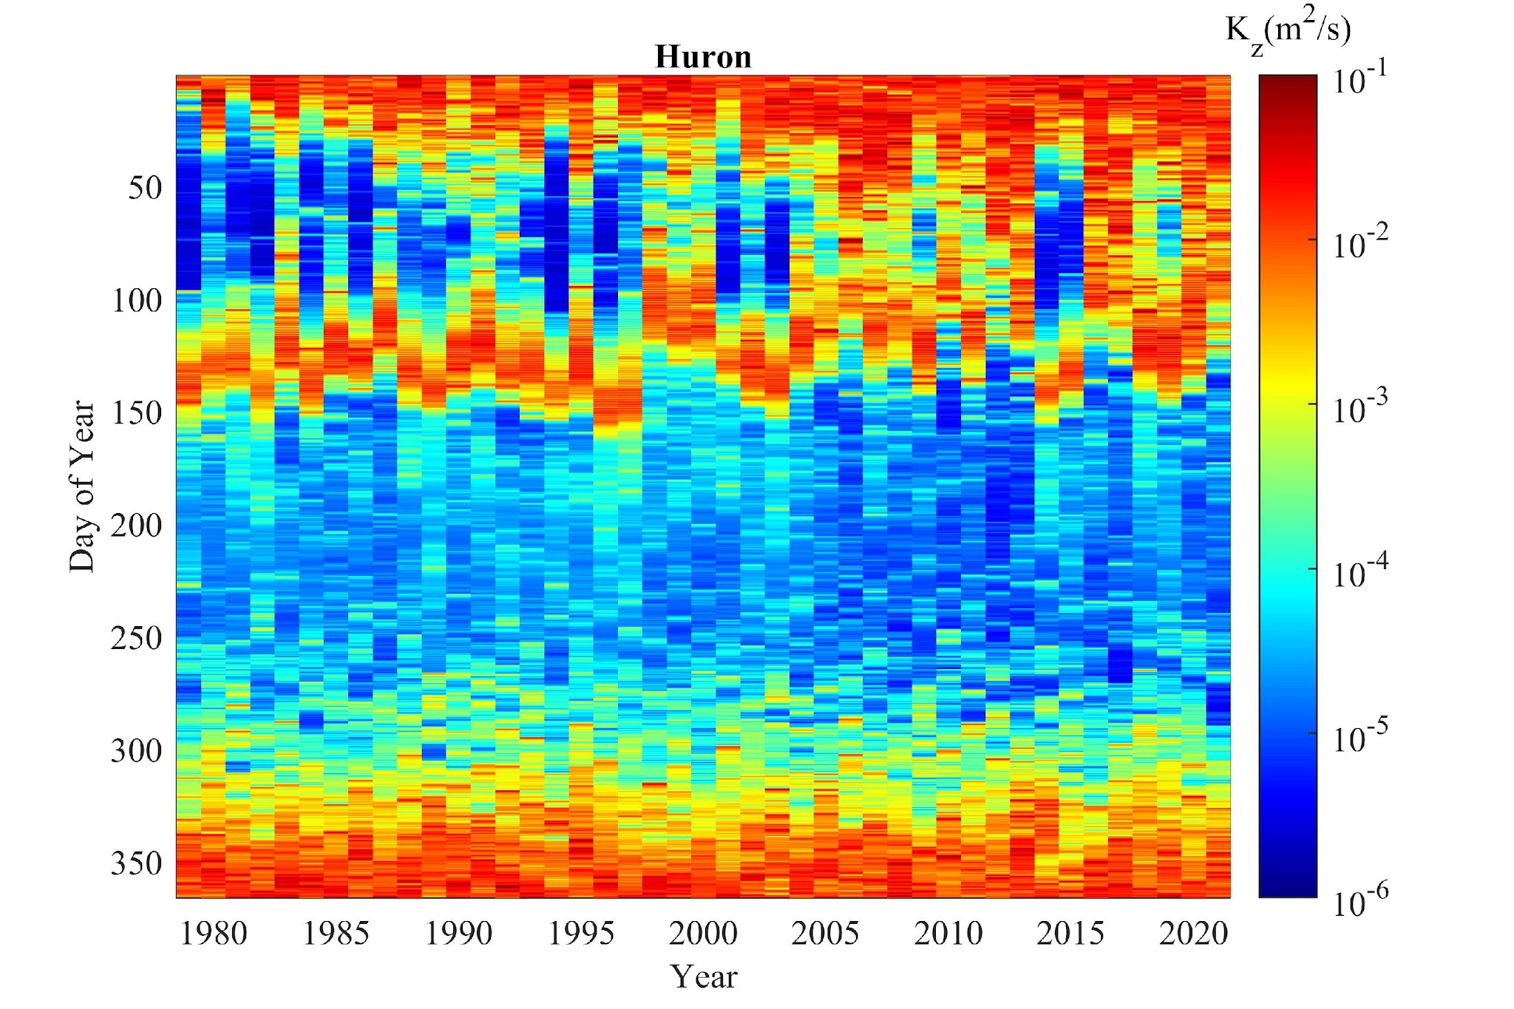
Results: Shifts in Lake Stability & Mixing
Winter
Spring
Disappearing winter stratified period…
Summer
…shift in mixing regimes
Fall
Notes:
These changes in lake stability are also reflected in vertical mixing rates. Here I’m showing lakewide volume-averaged diffusivities for Lake Huron, but the figures look similar for Lake Michigan, and Lake Ontario, too.
Individual years are shown in each column, with doy increasing from top to bottom.
In the beginning of the simulation period, you can see distinct fall and spring mixing periods. This is classic dimicitic mixing.
As time goes on, the quiescent winter period becomes shorter and more erratic, until we start converging on a monomicitic winter mixing regime.
This is a fundamental shift in physics for the Great Lakes. One that has been hypothesized as a potential consequence of climate change, but not yet described.
I posit that it might have already happened.

Slide 15
Results: Shifts in Lake Stability & Mixing
Winter
The Great Lakes have warmed dramatically, both above and below the surface, with significant effects on lake stability and mixing
What does the future hold?
Disappearing winter stratified period…
Spring
Summer
…shift in mixing regimes
Fall
Notes:
So, we know that the great lakes have warmed dramatically, both above and below the surface, but what might the future hold?

Slide 16
Results: Projected Changes in Ice Cover
Annual Average Ice Cover
Annual Maximum Ice Cover
Observations
Historical
SSP1-2.6
SSP2-4.5
SSP5-8.5
>50% ice loss
No ice by 2100 under SSP5-8.5
Notes:
For the following slides, I’m going to show ensemble averages for the historical, mid-century, and end-century periods under three warming scenarios; SSP1, SSP2, and SSP5 (colored green, blue, and red, respectively). Historical simulations are shown in black, and observations are shown in grey for validation.
Under all scenarios, there is 50% ice loss by mid century, and a nearly complete loss of ice by 2100, at least under SSP5-8.5.

Slide 17
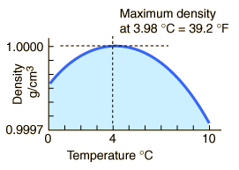
Results: Projected Changes in LST
Summer
Winter
Observations
Historical
SSP1-2.6
SSP2-4.5
SSP5-8.5
3 – 8$℃$ increase
Shift in stratification:
<4$℃$ to >4$℃$
Notes:
This ice loss leads to accelerated warming as ice-albedo feedbacks drive increased heat absorption.
Out simulations show up to +8C surface temperature increases during the summer and winter seasons, with minimum temperature increases of 3C, even under sustainability pathways.
One important consequence of this warming is a shift across the temperature of maximum density during the winter.
As temperatures rise above 4C in end-century simulations, the lakes become permanently stably stratified, producing significant changes in seasonal lake dynamics.

Slide 18
Results: Project Changes in Stability (SSI)
Summer
Winter
Observations
Historical
SSP1-2.6
SSP2-4.5
SSP5-8.5
Increase in summer stability/MLD
Late century increase in stability due to permanent stratification
Notes:
This shift in stratification and mixing dynamics is also reflected in the lake stability.
As summer stratification continues to intensify through mid- and end-century, winter stratification becomes weaker, allowing for more intense mixing during this historically inversely stratified period.
Again, there is a rebound in stability at end century for the most extreme warming cases, reflecting surface warming above 4C.

Slide 19
Results: Project Changes in Stability (SSI)
Summer
Winter
Observations
Takeaway:
Substantial warming expected, especially under high emission scenarios
Continued shifts in lake stability and mixing, with significant consequences for ecosystem
Zhang et al. 2023, Zhang et al. in prep
Historical
SSP1-2.6
SSP2-4.5
SSP5-8.5
Increase in summer stability/MLD
Late century increase in stability due to permanent stratification
Notes:
So what’s the takeway?
Substantial warming is expected across the great lakes, especially under high emission scenarios.
However, we need to remember that even the most optimistic scenarios show significant increases in surface temperatures, decreases in ice cover, and shifts in lake stability, which all have important consequences for a wide range of ecosystem services.
We’ve started to explore some of these changes using a coupled ecosystem model (Atlantis), which I’m happy to talk about after the talk.

Slide 20
5. Summary and Future Efforts
FVCOM_ice can run continuously (1979-2021) without data assimilation and has been validated
In the last 4 decades, temperature was warming, ice cover was decreasing
Use CMIP6 to force FVCOM_ice into the future, say 2023-2050, 2051-2100, with ensemble runs
The Great Lakes will be continuously warming, with a magnitude depending on scenarios: Impacting ecosystem, fisheries
Future efforts:
Use FVCOM_ice future projections to force Atlantis model, and project future scenarios of Great Lakes food web and fisheries with ensemble runs
Investigate the responses of cold/warm species to the warming climate change

