Slide 1
Building Federated MPAS Workflows For Research And Development With Chiltepin and UWTools
Christopher W. Harrop, Naureen Bharwani, Isidora Jankov
UIFCW - July 24, 2024, Jackson, MS

Slide 2
Our Collaborators
This work is funded by the NOAA Software Engineering for Novel Architectures (SENA) Program*
In collaboration with U.S. Department of Energy & Parallel Works (funded by DOE Small Business Innovation Research)
Special thanks to:
Eric Schnepp (GSL/ITS/RDHPCS)
Stefan Gary (Parallel Works)
Kyle Chard & Yadu Babuji (University of Chicago / ANL)
*NOAA cooperative agreement NA22OAR4320151

Slide 3
Emerging Technologies + NWP
We face two main workflow challenges:
Scale of problems we want to investigate (we need > 1M cores)
No single environment is large enough to contain the computations we want to run
< 4 Km global simulations & digital twins
100+ ensemble members
Diversity of emerging technologies and compute environments for research
No single environment has all the resources we require
CPUs, GPUs, TPUs, Quantum processors & Intel, AMD, NVIDIA, ARM
Proprietary data stores, Data lakes, NVRAM, test systems

Slide 4
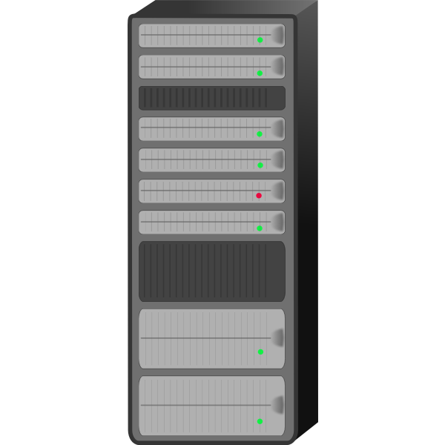
Diversification & Scale → Federated Workflows
Our Vision: Diversified federated workflows to enable NWP HPC Research
Federated
Identity

Slide 5
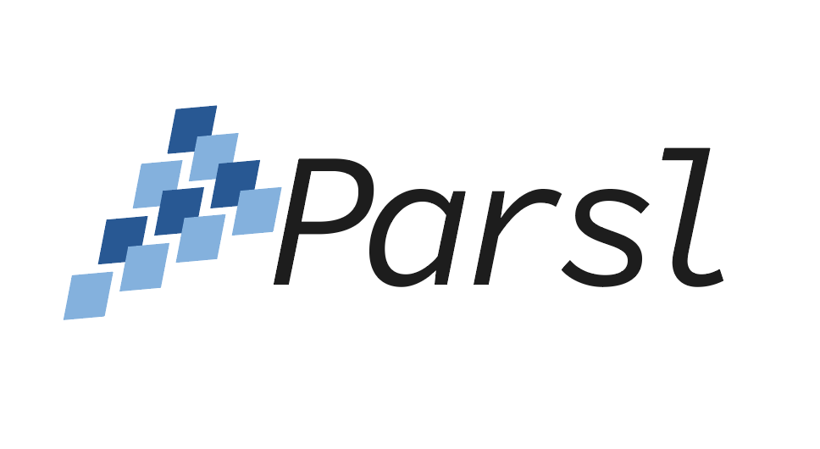
Federated Compute & Automation Services
Globus Compute → Federation
Parsl → Workflow Automation
Secure function as a service (FaaS) for remote, high performance, “fire and forget” execution
Globus Compute provides federated access to remote computation services. “Fire and forget” semantics provide robust workflow execution
Workflow programming in Python for execution of Python functions and external components across laptops and supercomputing resources

Slide 6
Introduction to
Chiltepin → A Python Framework for Building Federated NWP Workflows
Creation of NWP workflow “endpoints”
Configuration of resource pools on multiple systems
Encapsulation of NWP task configuration & execution
Wrap uwtools as federated Parsl workflow tasks
Workflows are Python programs
uwtools → A Python Package to automate common NWP workflow tasks
Configuration management
Multi-stage drivers for UFS model components
Provisioning of run environment
Execution of binaries

Slide 7
Workflows
# Run ungrib
ungrib = wps.ungrib(config_file, cycle_iso, …)
# Create initial conditions
mpas_init_ics = mpas.mpas_init(config, cycle_iso, "create_ics", ungrib, …)
# Create boundary conditions
mpas_init_lbcs = mpas.mpas_init(config, cycle_iso, "create_lbcs", mpas_init_ics, …)
# Run the forecast
mpas_forecast = mpas.mpas_forecast(config, cycle_iso, mpas_init_lbcs, …)
Workflow futures inject dependencies

Slide 8
Defining MPAS Tasks
Wrap uwtools CLI in a Parsl Bash App
@bash_app(executors=["mpi"])
def mpas_forecast(config, cycle, key, …):
return
f"""
uw mpas provisioned_run_directory --cycle {cycle} --config-file {config} --key-path {key}
cd {config[key]['mpas']['run_dir']}
$PARSL_MPI_PREFIX {mpas_path}/exe/atmosphere_model
"""

Slide 9
Defining MPAS Tasks
Wrap uwtools API in a Parsl Python App
@python_app(executors=["mpi"])
def mpas_forecast(config, cycle, key, …):
import uwtools.api.mpas
# Run mpas
mpas.execute(task="run", config=config, cycle=cycle, key_path=key)

Slide 10
uwtools Summary
Hardened uwtools drivers are wrapped into Parsl workflow tasks
Driver & configuration complexities delegated to uwtools
Wrapped uwtools drivers executed on remote Globus Compute Endpoints
Chiltepin handles federated workflow execution across disparate resources
Federated identity management delegated to Globus Auth
Remote execution delegated to Globus Compute
Workflow scheduling delegated to Parsl
Static Rocoto workflows → Dynamic federated Chiltepin workflows

Slide 11
Challenges & Future Work
Building a robust CI & testing environment is challenging
Testing requires a functional slurm cluster
Parsl apps must be serializable, adding design constraints
No access to global data, workflow tasks must be self-contained
1 workflow : 1 platform → 1 workflow : N platforms
Must manage injection of environment settings for multiple target platforms
Data management across platforms
Should we move the data? Or the computation? Or both?

Slide 12
Questions / Discussion

