Slide 1
The Common Community Physics Package and Single Column Model Version 7
Dustin Swales^{1,2}, Ligia Bernardet​^{1,2}, Grant Firl​^{1,2,3}​,​ Mike Kavulich^{2,4}, Jimy Dudhia^{2,5}, Sam Trahan^{1,2,6}, Man Zhang^{1,2,6}, Weiwei Li^{2,4}, Tracy Hertneky^{2,4}, Lulin Xue^{2,4}, Soren Rasmussen^{2,4}, and Mike Ek^{2,4}
¹National Oceanic and Atmospheric Administration (NOAA) Global Systems Laboratory
²Developmental Testbed Center
³Colorado State University, Cooperative Institute for Research in the Atmosphere
⁴NSF National Center for Atmospheric Research, Research Applications Laboratory
⁵NSF National Center for Atmospheric Research, Mesoscale and Microscale Meteorology Laboratory
⁶University of Colorado, Cooperative Institute for Research in Environmental Sciences

Slide 2
Common Community Physics Package
CCPP Physics
A library of physical parameterizations
https://github.com/NCAR/ccpp-physics
CCPP Framework
Software infrastructure that allows using the CCPP-Physics in a host model
https://github.com/NCAR/ccpp-framework
CCPP Single Column Model
A simple host model that employs the CCPP Physics and CCPP Framework
https://github.com/NCAR/ccpp-scm

Slide 3
Common Community Physics Package (cont’d)
Operational implementation of CCCP within the UFS:
Hurricane Analysis and Forecast System (HAFS) June 2023. V2.0.3 on 07/16/2024
UFS Air-Quality Model Version 7 (AQMv7) May 2024.
GEFS/GFS and RRFSv1 are future UFS applications planning on adopting the CCPP.
Adoption of CCPP outside the NOAA community:
NEPTUNE (US Naval Research Laboratory)
CAM-SIMA (NSF NCAR CGD)

Slide 4
New release! CCPP Version 7
CCPP Version 7 release planned for this summer (2024).
The most recent CCPP release, version 6, was June 2022.
This release includes:
Three new supported physics schemes, RRTMGP radiation, CLM Lake Model, and Unified Gravity Wave Drag Version 1, along with updates to existing schemes.
Updated Scientific Documentation, User’s Guide, Technical Documentation, and online tutorials.
CCPP Single Column Model (SCM) support for the latest operational/research physics configurations used across UFS applications.
Ability to generate SCM cases from UFS simulations. New SCM cases.
Support for single precision physics within the SCM.
More continuous integration (CI).

Slide 5
Supported physics for Version 7
Type | Operational | Developmental
Suites | GFS_v16 | GFS_v17_p8_ugwpv1 | GFS_v16_RRTMGP | HRRR_gf | WoFS_v0
Microp | GFDL | Thomp | GFDL | Thomp | NSSL
PBL | TKE EDMF | TKE EDMF | TKE EDMF | MYNN | MYNN
Sfc lay | GFS | GFS | GFS | MYNN | MYNN
Deep cu | saSAS | saSAS | saSAS | Grell-Freitas | —
Shal cu | saMF | saMF | saMF | Grell-Freitas | MYNN
Radiation | RRTMG | RRTMG | RRTMGP | RRTMG | RRTMG
GWP | UGWPV0 | UGWPV1 | UGWPV0 | Orographic drag | UGWPV0
LSM | Noah | NoahMP | Noah | RUC | Noah
Lake | — | — | — | CLM | —

Slide 6
New SCM cases
Several new cases have been added to the CCPP SCM repository:
MOSAiC-AMPS (from Amy Solomon):
Arctic mixed-phase stratocumulus cloud
Oct 31 - Nov 5 2019
MOSAiC-SS (from Amy Solomon):
Strongly stably stratified boundary layer
March 2-10 2020
COMBLE (from COMBLE-MIP team):
Cold-Air Outbreaks in the Marine Boundary Layer Experiment (COMBLE), provided by Model-Observation Intercomparison Project (MIP) for large-eddy simulation (LES) and single-column models (SCMs)
GdR-DEPHY (repository):
Catalog of cases that could be adapted for use with the CCPP SCM.

Slide 7
Generating SCM cases from UFS simulations
Included with the SCM are tools that can either (a) derive the forcings needed by the SCM from standard UFS history files or (b) use the tendencies from the dynamical core (additional diagnostics) to drive the physics.
A) Derived forcing
The horizontal advective forcing (𝑢 • ∇𝑋) is computed using a stencil of the surrounding UFS grid points.
Optionally, we can also “nudge” the SCM state back to the UFS state.
B) Native forcing
Uses forcing from dycore that is provided to the physics “inline”.
Requires rerunning the UFS in (expensive) diagnostic mode.

Slide 8
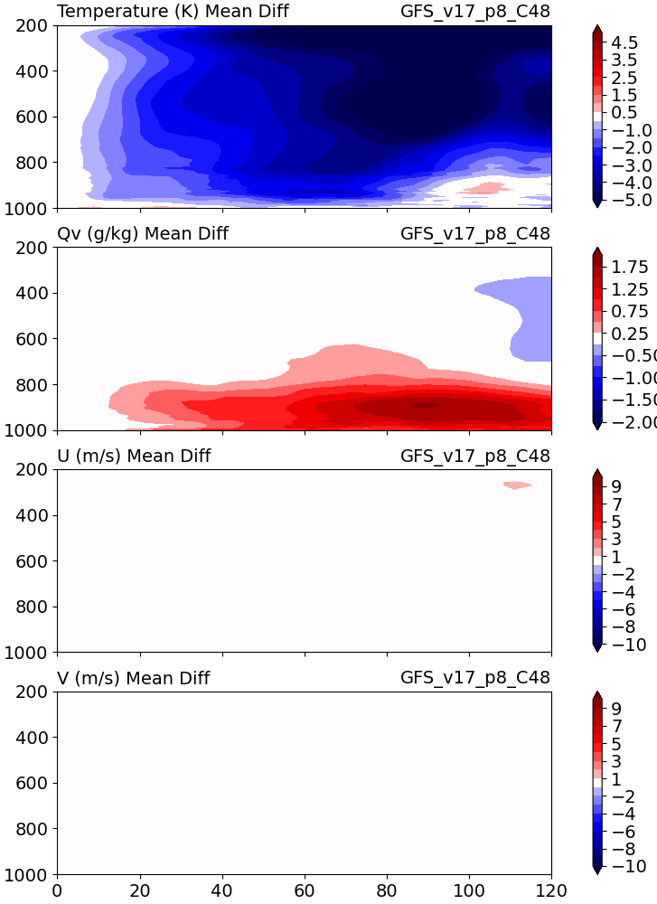
Comparison of Native and Derived simulations vs UFS
Native
Derived
Derived (nudged)
Mean differences, UFS - SCM.
200 SCM cases, roughly CONUS w/ some ocean points.
Initialized on March 23 2023.

Slide 9
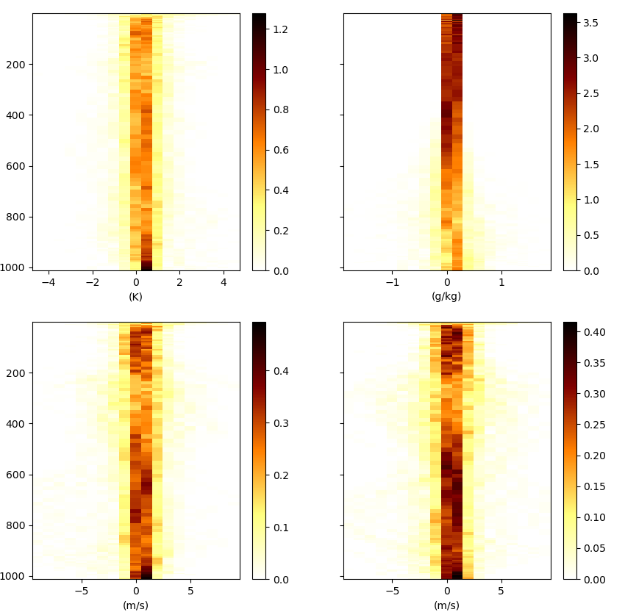
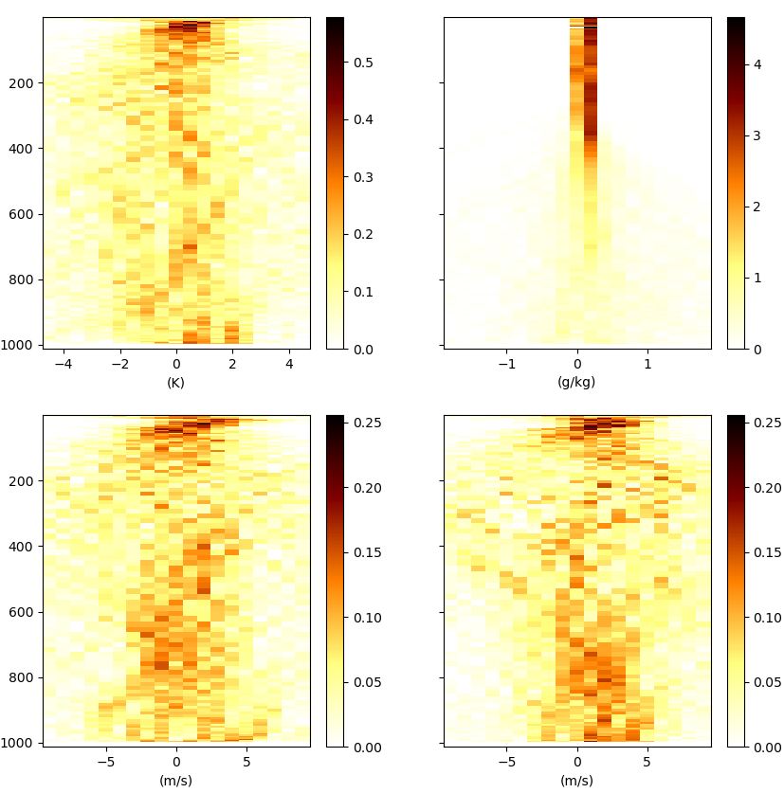
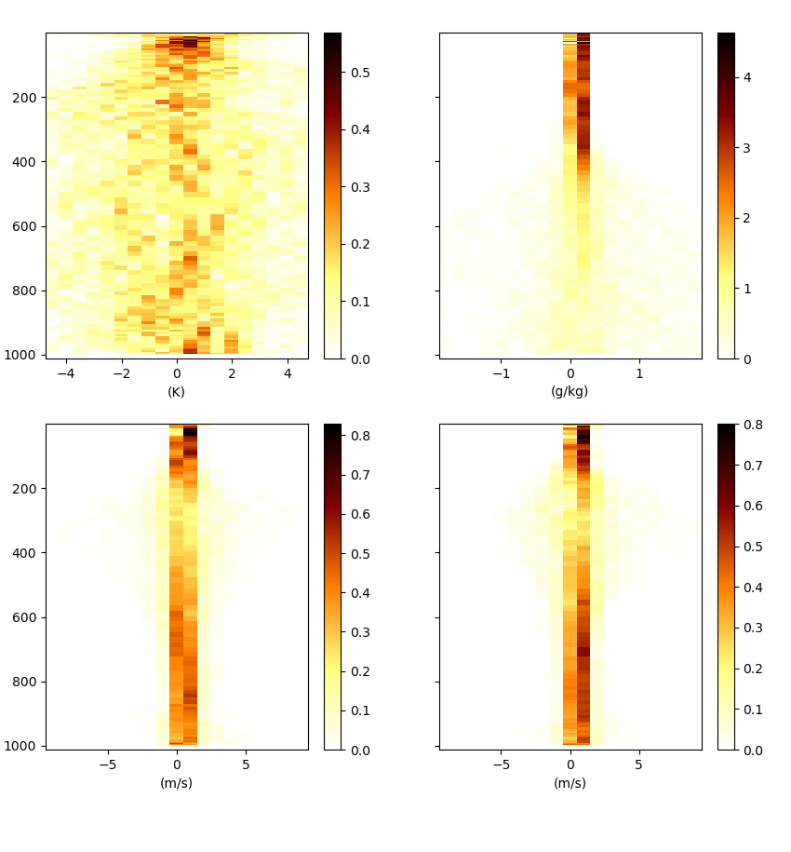
Comparison of Native and Derived simulations vs UFS
Error spread of at 12 hour forecast time for C48 UFS case.
Native
Derived
Derived (nudged)
Ensemble mean differences, UFS - SCM.
200 SCM cases, roughly CONUS w/ some ocean points.
Valid for March 23 2023 @ 12Z
T
q_{v}
T
q_{v}
T
q_{v}
U
V
U
V
U
V

Slide 10
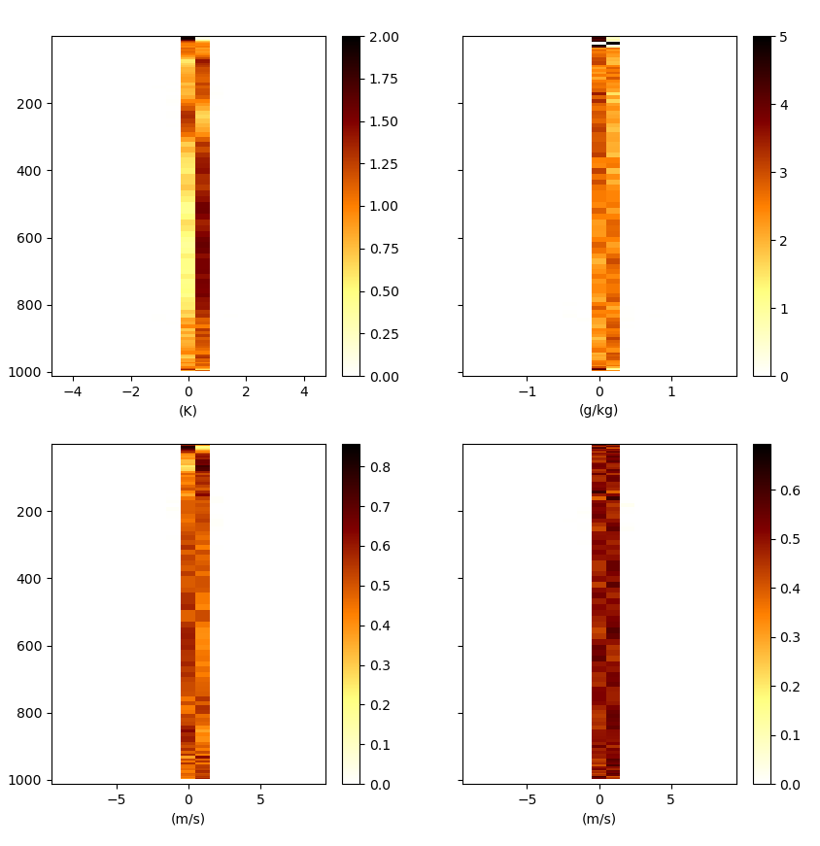
Comparison of Native and Derived simulations vs UFS
Error spread of at 12 hour forecast time for C192 UFS case.
Derived
Derived (nudged)
Ensemble mean differences, UFS - SCM.
200 SCM cases, roughly CONUS w/ some ocean points.
Valid for March 23 2023 @ 12Z
T
q_{v}
T
q_{v}
U
V
U
V

Slide 11
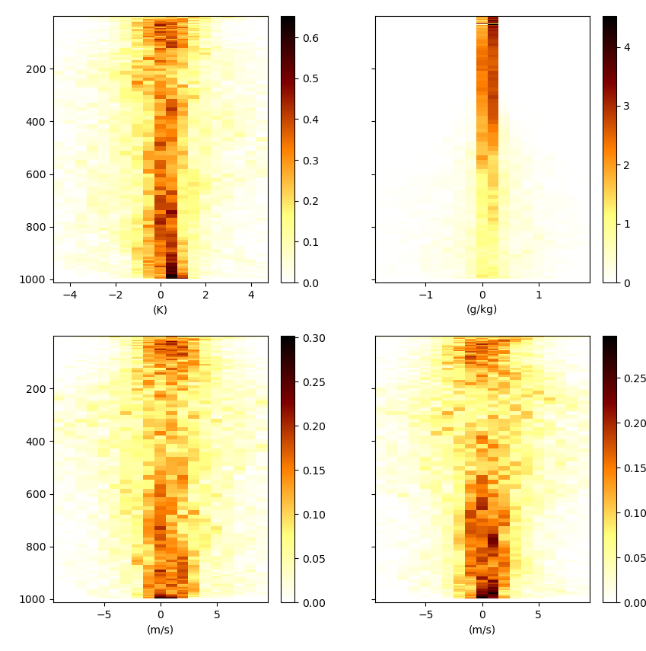
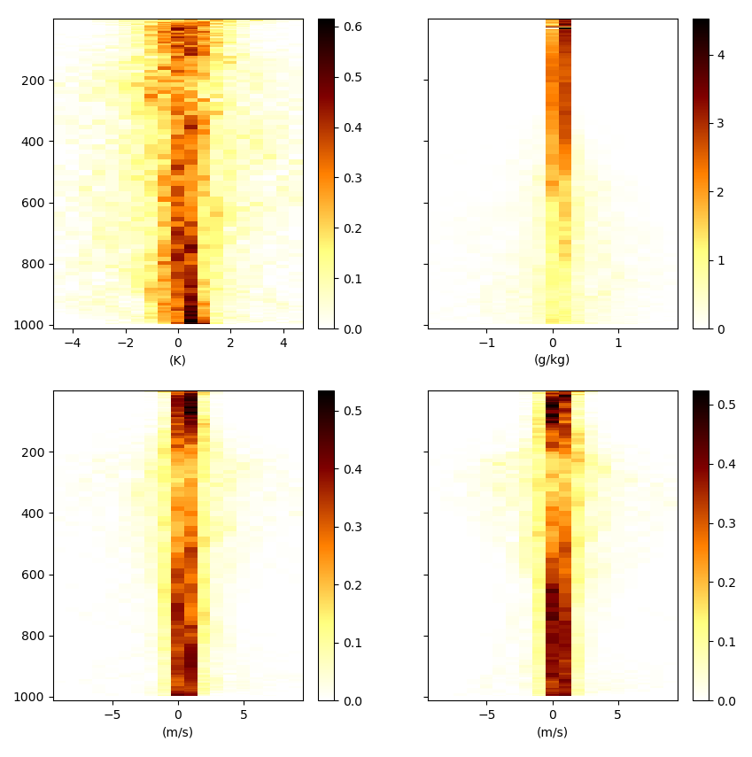
Comparison of Native and Derived simulations vs UFS
Error spread of at 96 hour forecast time for C192 UFS case.
Derived
Derived (nudged)
Ensemble mean differences, UFS - SCM.
200 SCM cases, roughly CONUS w/ some ocean points.
Valid for March 27 2023 @ 00Z
T
q_{v}
T
q_{v}
U
V
U
V

Slide 12
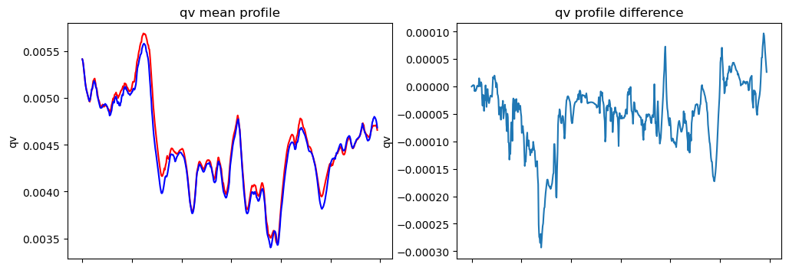
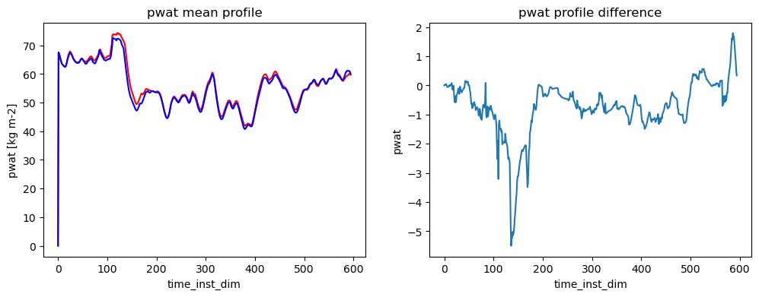
Single Precision Physics
There is a single physics suite, RRFS_v1, that has been tested for use in single-precision (32bit) configurations.

Slide 13
Conclusions
Version 7 includes
Support for the latest UFS based physics in the SCM
An expanded set of cases to run
Ability to generate SCM cases from UFS simulations
Single-precision physics
More CI testing for the CCPP SCM.
Support (limited) for use with Nvidia compilers.
The CCPP is fueled by contributions from the community and we welcome anyone with new innovations to engage with us early in the development process!

