Slide 1
Global-workflow on AWs Wei huang July 24, 2024
RTX Corporation (Corporate) - Unrestricted Content

Slide 2
Today’s talk
Run global-workflow on AWS has 3 steps:
Create Cluster on AWS (within NOAA-parallelworks)
Install global-workflow on AWS
Setup and run global-workflow on AWS

Slide 3
1. Create cluster on AWS
To Create Cluster on AWS
Log on to NOAA-parallelworks
Select a platform (here AWS, people can also choose Azure or Google)
Define a “controller” (like head node or log in node for on-prem machines)
Define “partition” (like compute nodes of on-prem machines)
Define “attached filesystem”
Start/stop the cluster

Slide 4
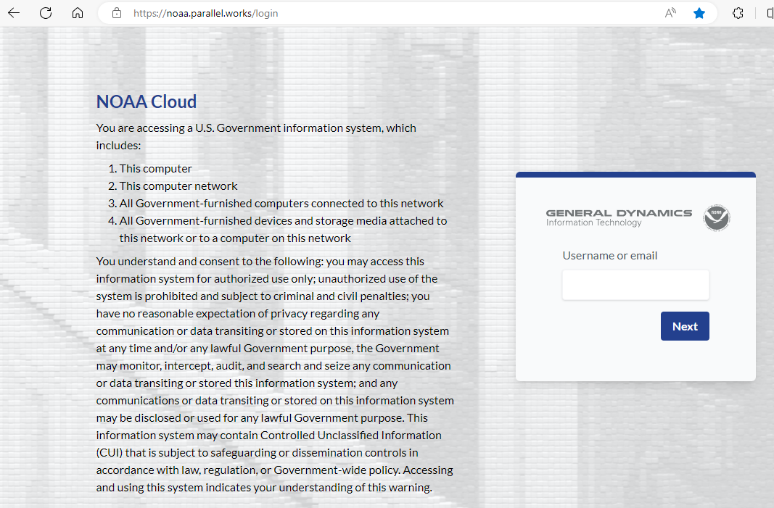
1. Log on to NOAA-parallel-works
Go to site: https://noaa.parallel.works/login
Use your NOAA email, and then follow the instructions as log on to NOAA on-prem machine

Slide 5
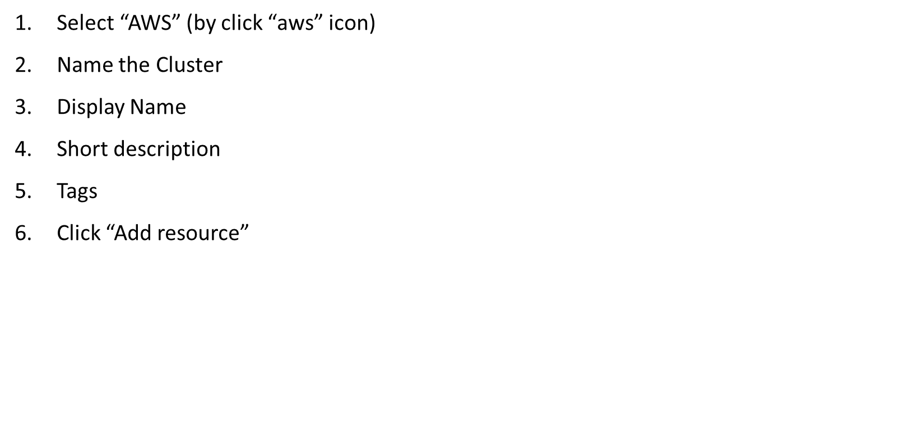
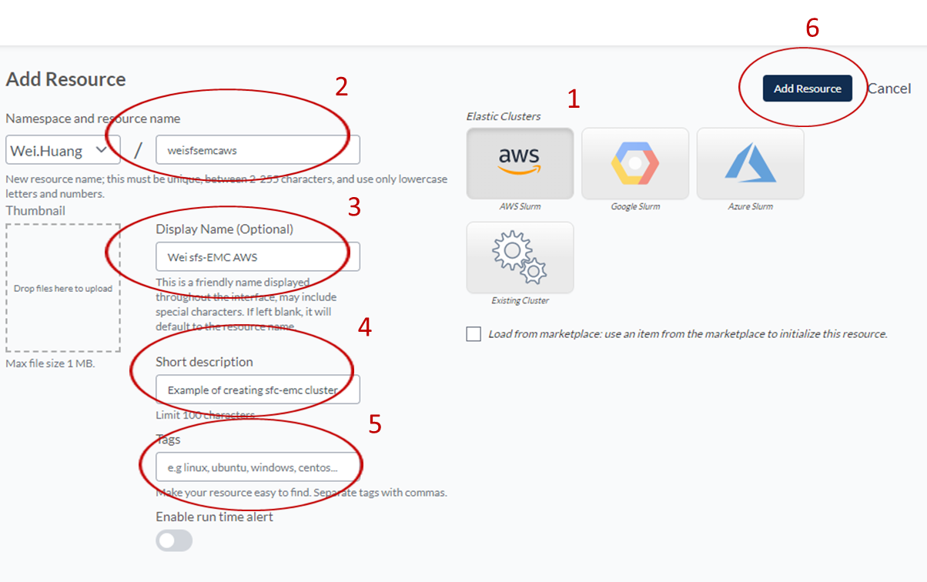
2. Select a platform (here AWS)

Slide 6
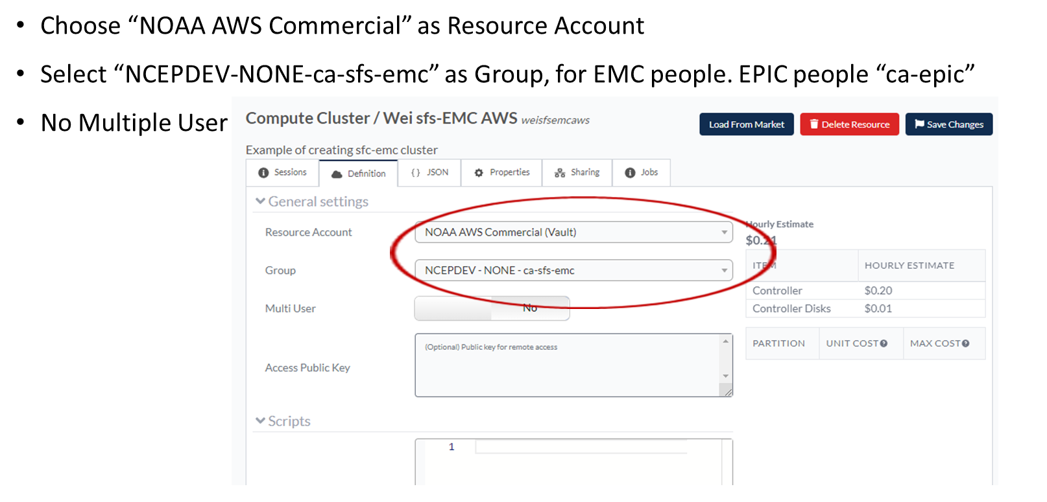
3. Define a “controller”

Slide 7
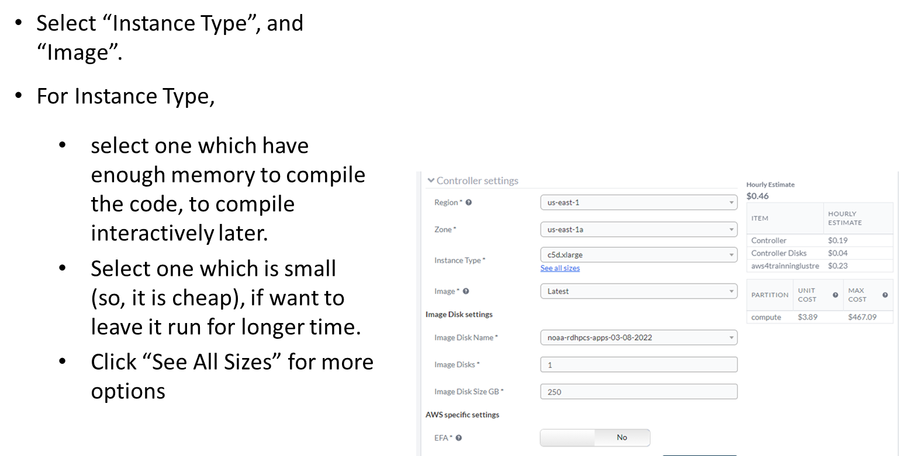
3. Define a “controller” (2 … many steps)

Slide 8
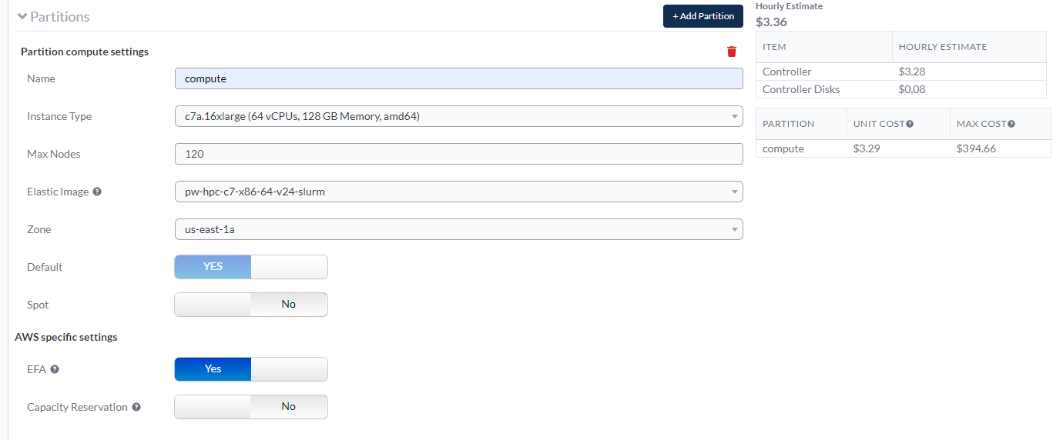
4. Define “partition”
Set the up-limit of the nodes can be used.

Slide 9
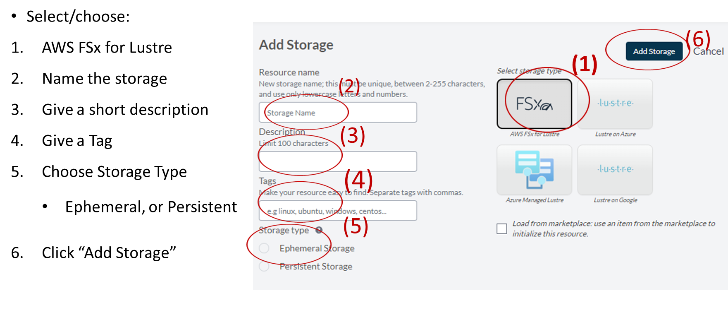
5 add filesystem (/lustre)

Slide 10
Start Cluster
Here we want to start cluster named: “AWS GW TRAINING”
The button (within red-circle) is grey. Click it, the center will blink green first.

Slide 11
Running Cluster
When the push button is full green, that means the cluster is ready to use.
See green dot at active 1
Click “i” in blue circle for more info about this cluster
Click the small square to copy the IP (represent the cluster) to clipboard (for later paste)
Click the IP in the circle get a terminal (within the tab, which we are already logged on the cluster and can truly working on it)
4
5
3
1
2

Slide 12
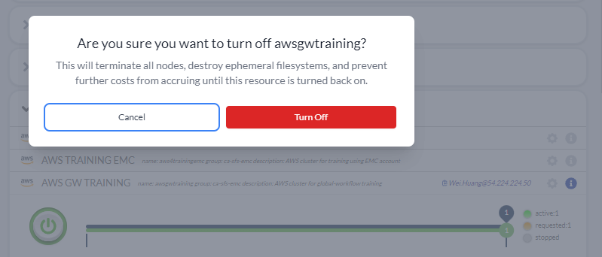
Stop Cluster
For a running cluster, click the green button (as in circle below)
A window pop up like below, click “Turn Off” in the red square to confirm.
When the cluster stopped, the button become grey, red dot before stopped, IP info is gone.

Slide 13
2. Install global-workflow (1)
Clone global-work:
Install git-lfs first, to allow large files cloned.
curl -s https://packagecloud.io/install/repositories/github/git-lfs/script.rpm.sh | sudo bash
sudo yum install git-lfs
git lfs install
git clone https://github.com/NOAA-EPIC/global-workflow-cloud.git
If familiar with spack-stack, one can find git-lfs withing spack-stack.

Slide 14
Get global-workflow from github (2)
As this repo use submodules now, one need to run:
cd global-workflow-cloud
git co aws-forecast-only (The branch works for AWS)
git submodule update –init –recursive

Slide 15
Build Global-workflow on AWS
cd global-workflow-cloud
cd sorc
build_all.sh # for forecast only
build_all.sh –gu # for DA
build_all.sh –h # for more information
Build individual packages:
build_xxxx.sh, which xxxx can be: ufs_model, ufs_utils, gsi_utils, upp, etc.
Use batch script to compile if you have a small controller

Slide 16
setup Global-workflow
#!/bin/bash
set -x
source workflow/gw_setup.sh
pslot=c48atm RUNTESTS=/lustre/Wei.Huang/run2 \
./workflow/create_experiment.py \
--yaml ci/cases/pr/C48_ATM.yaml

Slide 17
start Global-workflow
cd /lustre/Wei.Huang/run/expdir/c48atm
crontab c48atm.crontab
crontab –e
#################### c48atm ####################
MAILTO="“
SHELL="/bin/bash"
BASH_ENV="/etc/bashrc"
*/2 * * * * /apps/rocoto/1.3.3/bin/rocotorun -d /contrib/Wei.Huang/run/expdir/c48atm/c48atm.db -w /contrib/Wei.Huang/run/expdir/c48atm/c48atm.xml
#################################################

Slide 18
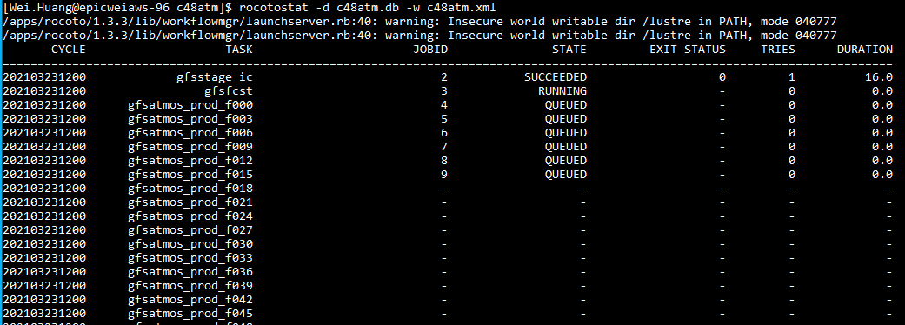
MONitoring Global-workflow (1)
Monitor global-workflow with rocotostat
cd /lustre/Wei.Huang/run/EXPDIR/c48atm
rocotostat –d c48atm.db -w c48atm.xml

Slide 19
Check Global-workflow
If something did not go well, do a rocotocheck
rocotocheck -d c48atm.db -w c48atm.xml -c : -a | more
Check logs file:
EXPDIR/c48atm/logs/2021032312.log
COMROOT/c48atm/logs/2021012312/*.log

Slide 20
Questions?
Thank you!

