Slide 1
The Research Repository for Data and Diagnostics (R2D2): A Distributed Data Management System for JEDI Data Assimilation Workflows
Eric Lingerfelt - UCAR / UCP / JCSDA (eric2@ucar.edu)
Tariq Hamzey - SSAI / NASA GMAO (tariq.hamzey@nasa.gov)
Maryam Abdi-Oskouei, Jérôme Barré, Fábio Diniz, Clémentine Gas, Ashley Griffin, Dominikus Heinzeller, Stephen Herbener, Evan Parker, Benjamin Ruston, Christian Sampson, Travis Sluka, Kristin Smith, and Yannick Trémolet - UCAR / UCP / JCSDA

Slide 2
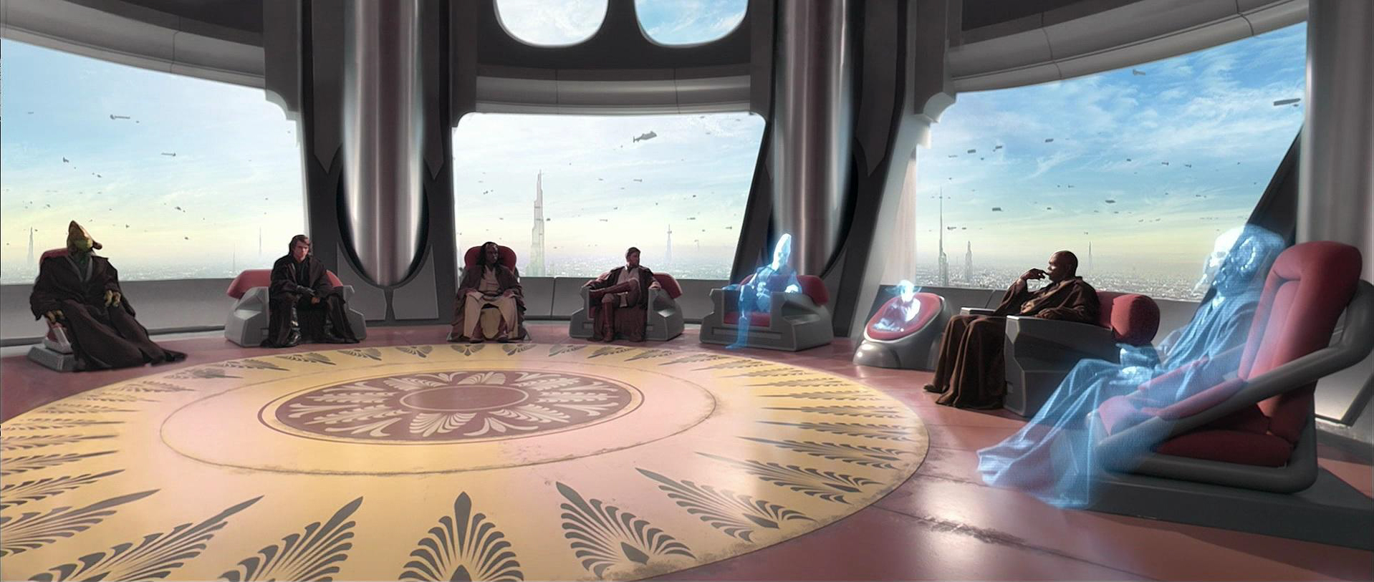
Joint Center for Satellite Data Assimilation (JCSDA)
Vision: An interagency partnership working to become a world leader in applying satellite data and research to operational goals in environmental analysis and prediction.
NOAA
NESDIS
NASA
GMAO
NCAR
UCAR
NOAA
OAR
JCSDA
Team
Observers
Air Force
Academia, private sector &
international
partners
NOAA
NWS
Navy

Slide 3
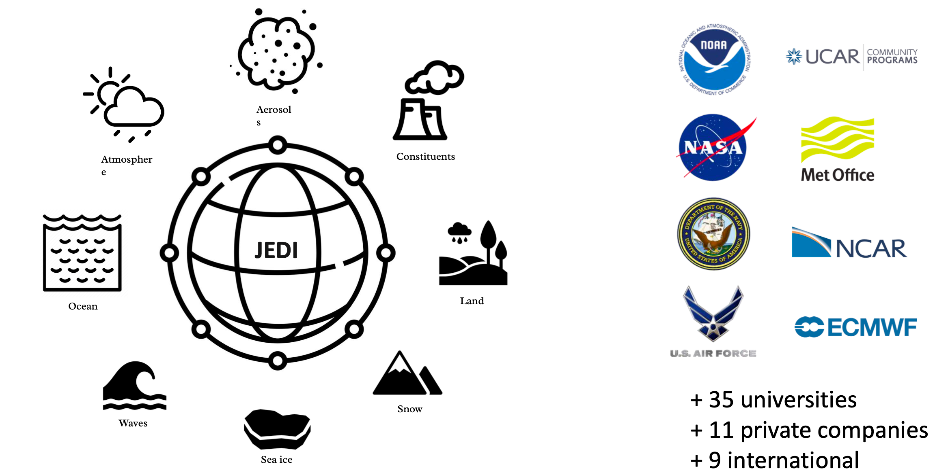
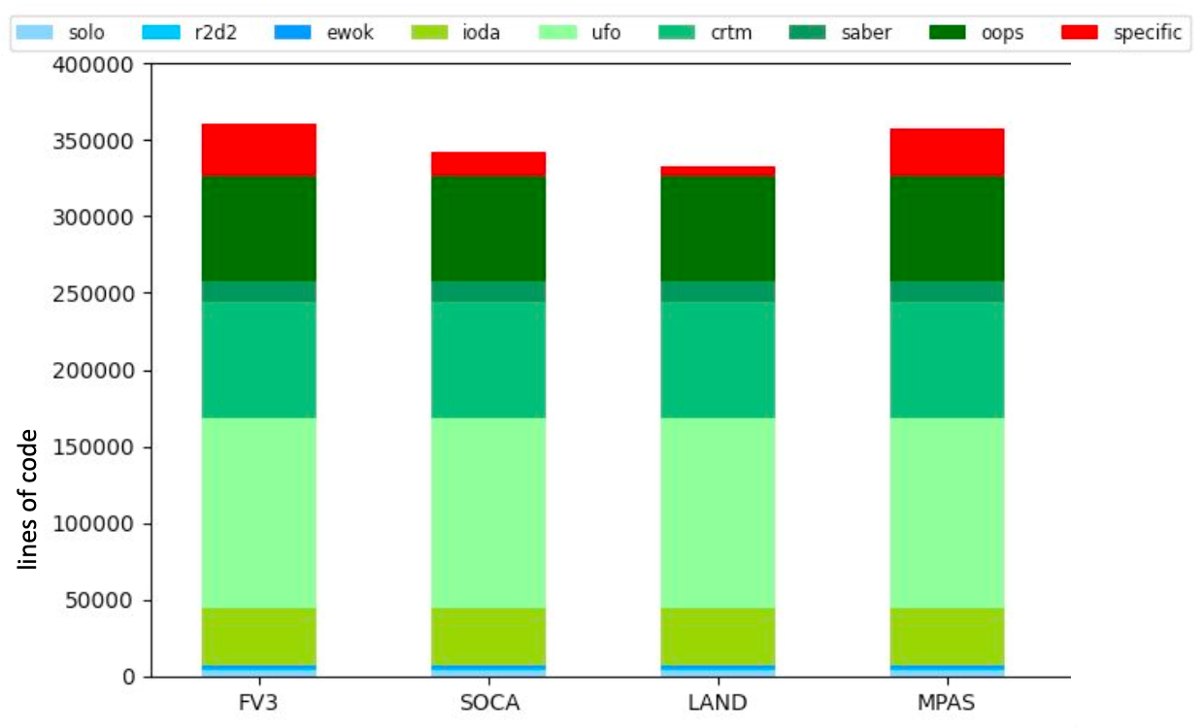
Joint Effort for Data assimilation Integration (JEDI)
Mission: To accelerate and improve the quantitative use of research and operational satellite data in weather, ocean, climate and environmental analysis and prediction models.
JEDI: A unified approach to algorithm development, observation processing, and maintenance of software. From toy models to coupled Earth system models, for research and operations.

Slide 4
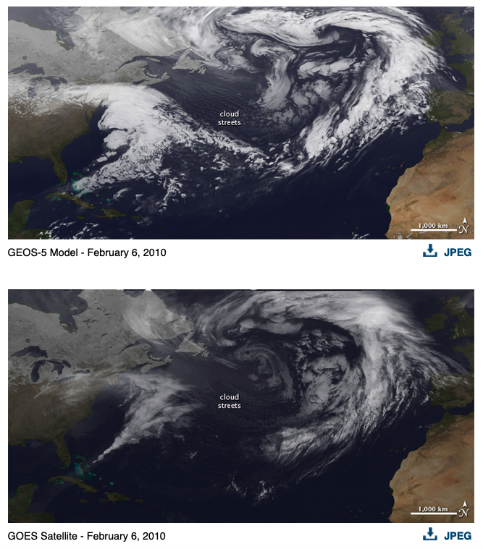
Global Modeling and Assimilation Office (GMAO)
The Global Modeling and Assimilation Office (GMAO) conducts modeling and assimilation activities that support NASA's current suite of Earth Observation missions, use data gathered by past and current missions, and help plan for future observing systems.
Goddard Earth Observing System Model Version 5 (GEOS-5), is the world’s highest resolution global climate model.
Reanalysis
Weather Prediction
Seasonal Prediction
Global Mesoscale Modeling
Observation Impact

Slide 5
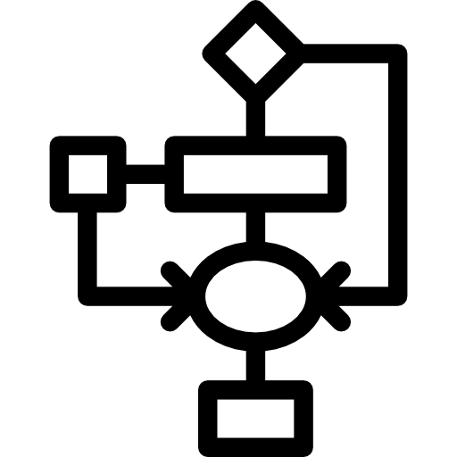
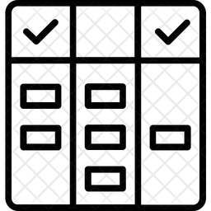
JEDI-Skylab
Ingest Use Evaluate
Observations
BUFR Tanks
Data Lake
Research Repository for Data and Diagnostics (R2D2)
Interface for Observation Data Access (IODA)
CDAAC
ODB
SkyLab-GMAO
FTP
SkyLab-EMC
Diagnostics
Experiment Workflow and Orchestration Kit (EWOK)
SkyLab-NRL
LDM
SkyLab-USAF
Config
SkyLab-Pathfinder
Config
Code

Slide 6
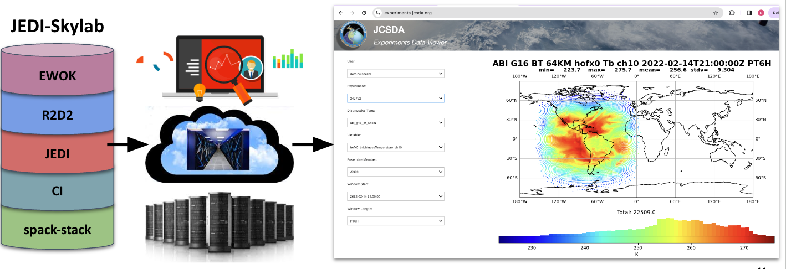
JEDI-Skylab
IODA
End-to-end DA system presented in a testbed workflow fashion
Highly configurable, highly portable and exercised by continuous integration (CI)
Enables rapid prototyping with new algorithms, new models and/or new observational data
Leveraging cloud computing environments
Fast integration of innovations for research and operations

Slide 7
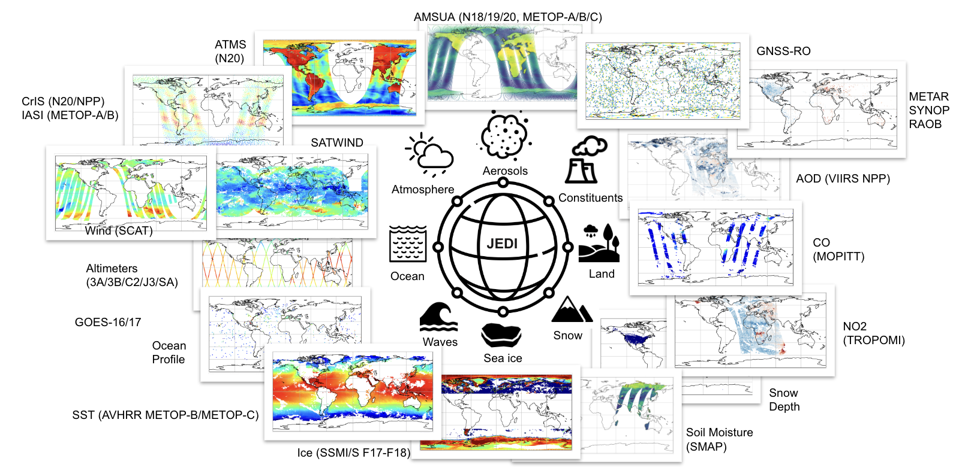
JEDI-Skylab
JEDI-Skylab v8 release
Applications
skylab-weather-land (UFS)
skylab-weather-variable-grid (MPAS)
skylab-aerosol-weather (GEOS)
skylab-trace-gas (GEOS)
skylab-marine (MOM6/CICE6)
Platform support
5 HPCs, 3 cloud systems, laptops
Code
26 repositories, 1.6 Mio lines of code
Close to 2500 unit tests
Continuous/nightly end-to-end tests
Experiment results of this and past releases: https://skylab.jcsda.org

Slide 8
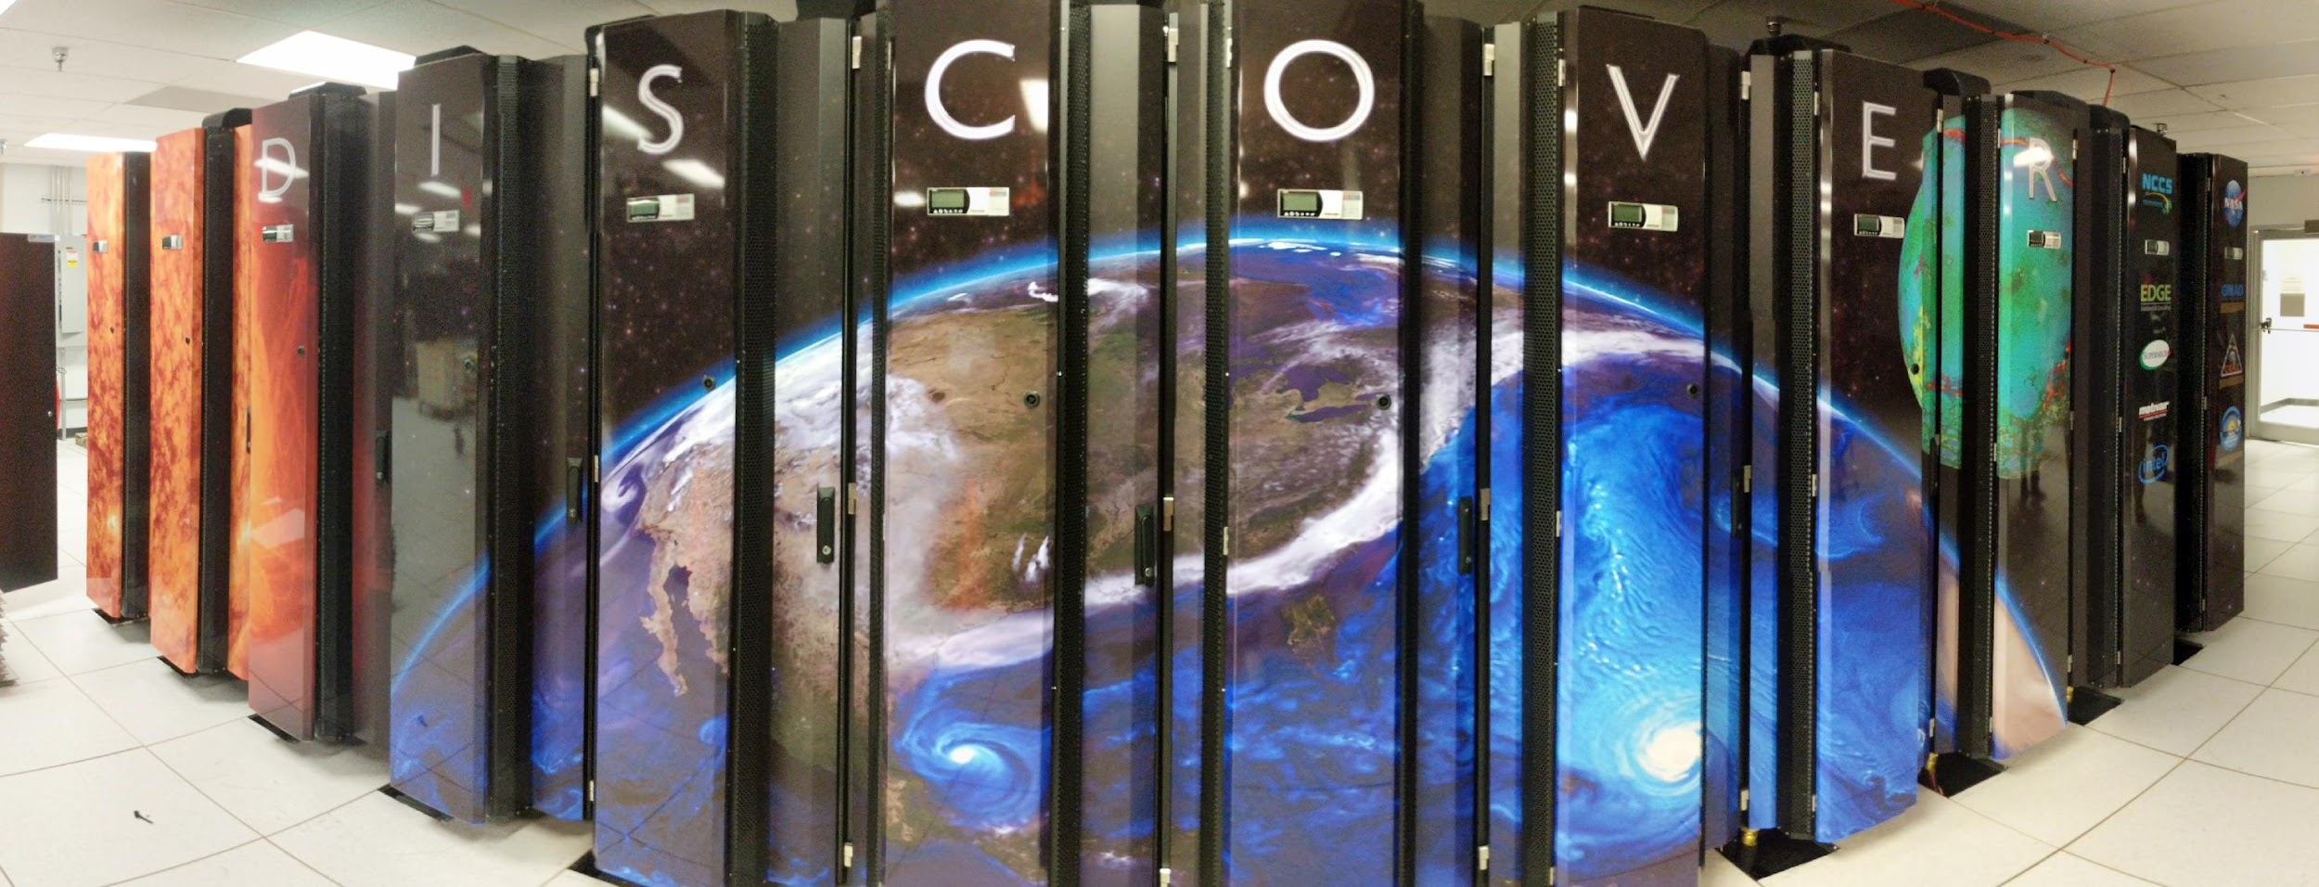
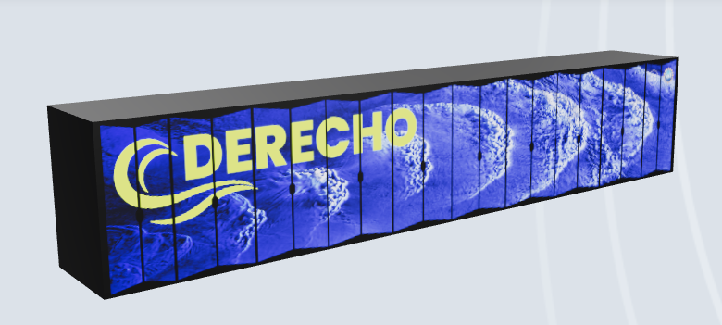
R2D2: Data Hubs, data stores, and compute hosts
R2D2’s cloud-based MySQL server tracks a rolling set of ~10M data files
totalling 0.5 PB across >30 curated data stores at 7 data hubs accessible by 6 HPC hosts
ORION & HERCULES
Satellite Simulations and Data Assimilation Studies (S4)

Slide 9
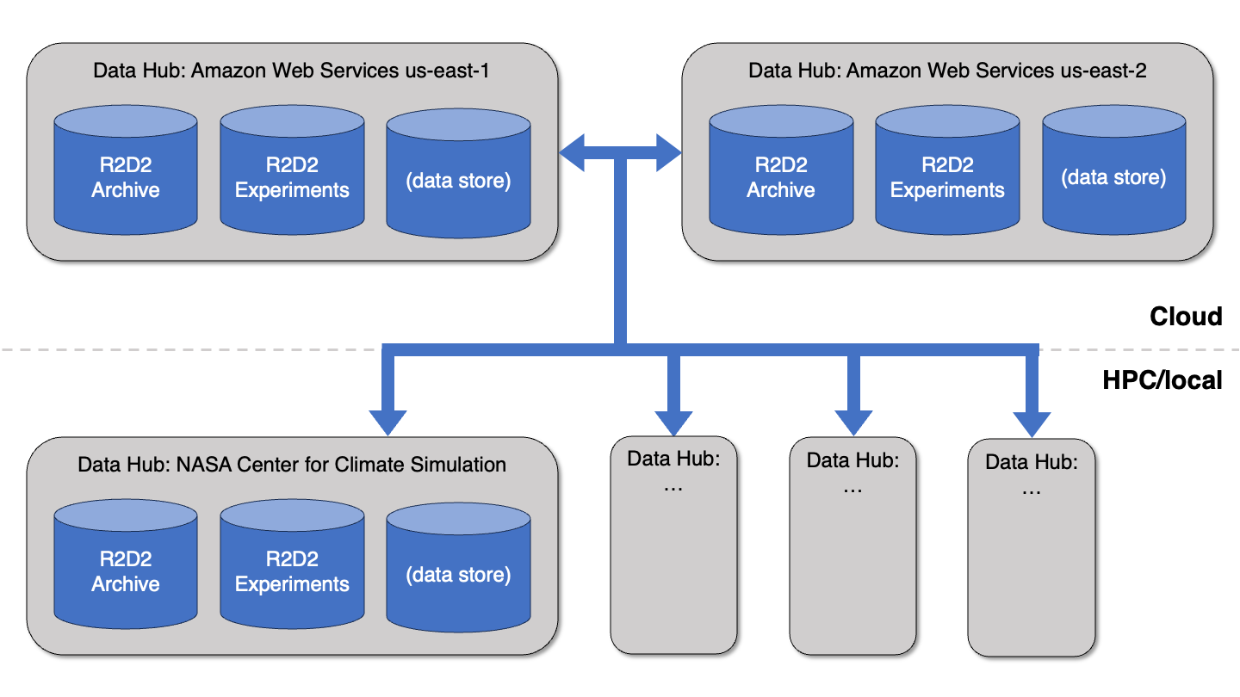
R2D2: Data store partitions

Slide 10
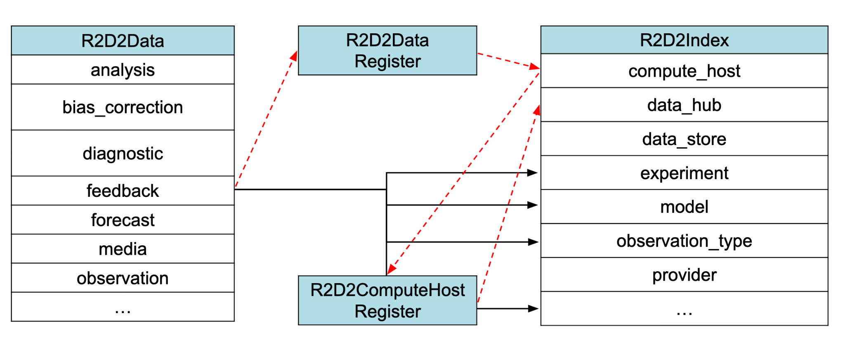
R2D2 V2: SQL Design and Implementation
MySQL is used to store metadata records pointing to ingested data files (i.e., R2D2Data) as well as other metadata (i.e., R2D2Index) such as Skylab experiment registrations, indexed vocabularies, supported hosts, and data stores.

Slide 11
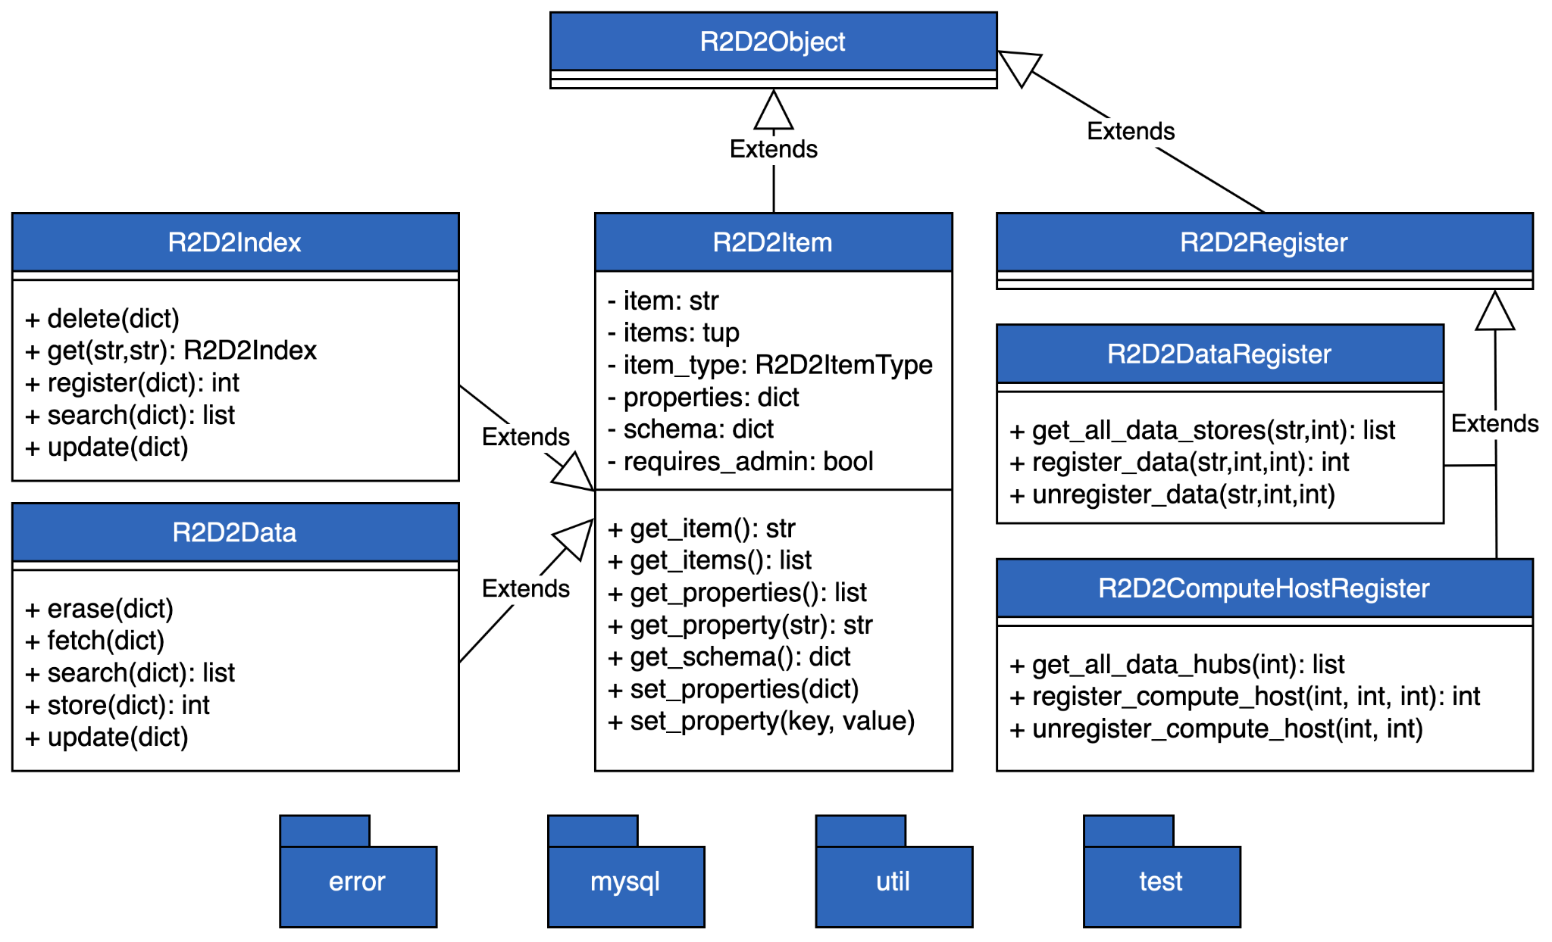
R2D2 V2: Software Architecture
R2D2 is implemented as a lightweight, intuitive Python API driven by a MySQL database.
R2D2’s classes are generic with each item’s schema extracted at runtime from the MySQL database.
This provides enhanced extensibility and a lower level of effort to add new types since R2D2’s item types are controlled by the MySQL database and not the codebase.

Slide 12
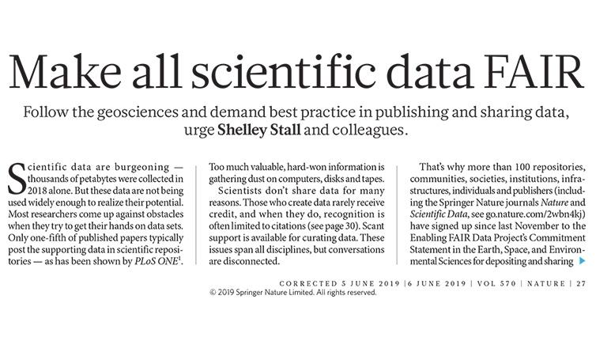
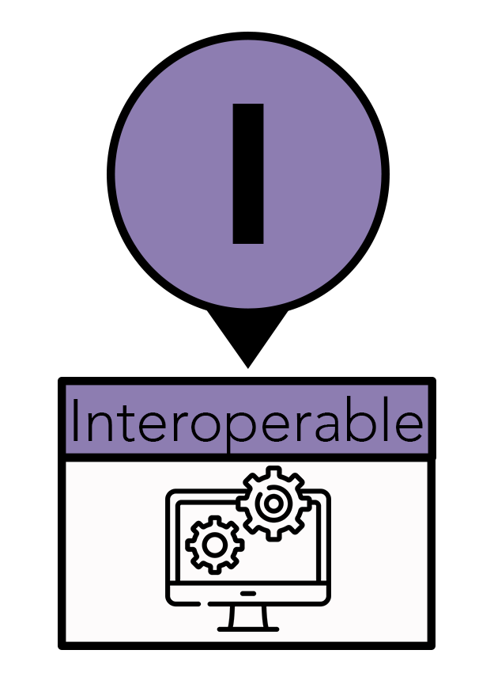
R2D2 and IODA: Implementing FAIR principles
R2D2 and IODA support FAIR principles at the design and technical level
1. Metadata and data are assigned a globally unique and persistent identifier
2. Metadata and data are retrievable by their identifier using a standardized communications protocol
3. Metadata and data use a formal, accessible, shared, and broadly applicable language for knowledge representation
R2D2
IODA

Slide 13
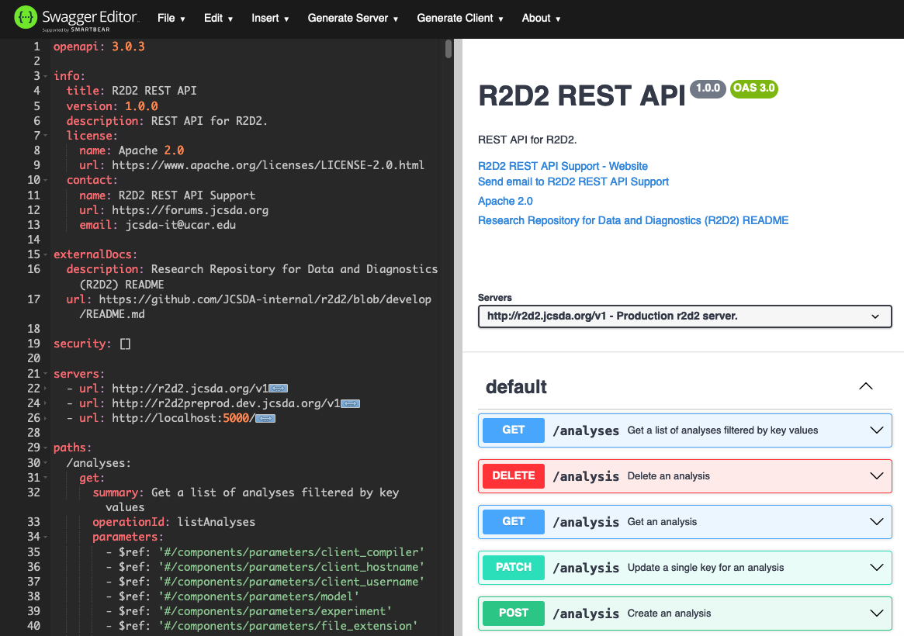
R2D2 V3: Conversion to client / server architecture
R2D2 V3 redesign and implementation began in March 2024 to be deployed this Summer
All backend database logic moved to the cloud
Greatly reduce maintenance time and increase performance
Utilization of OpenAPI 3.0 for standard REST API
Application of Flask for Python REST integration
Development of lightweight, user-friendly Python client
Python client API is dynamically generated from the OpenAPI specification
r2d2-client (user, skylab)
Data on disk or in cloud
IODA

