Slide 1
A Technical Overview of the Transition of the UFS-based AQMv7 into Operations
July 24th, 2024
Lin Gan^{a*}, Jacob R. Carley^{a*}, Steven Earle^{b}, Jianping Huang^{a*}
ªNOAA/Environmental Modeling Center, College Park, MD
^{b}NOAA/NWS Central Operations, College Park, MD

Slide 2
Outline
Introduction
Original Approach
Major challenge with the implementation standard
Design and architecture modification
Transition to ECFLOW workflow for operation
Conclusion
CAVEAT: This talk focuses only on modeling systems that run on the NWS Central Operational HPC Platform WCOSS

Slide 3
Introduction
The Air Quality Model (AQM) v7 package
Environmental Modeling Center (EMC) Engineering and Implementation Branch (EIB)
Environmental Equivalence (EE2)
ecFlow Workflow
Implementation and translation to operation
Notes:
AQMv7 uses the UFS based solution with many components of the package developed by the community.
EIB plays the role of facilitator in transitioning systems to operations
I first got involved in AQMv7 implementation around April of 2023. The task assigned was to work on ecFlow workflow development for AQM implementation.
From EIB point of view, we focus on creating the operational ecFlow workflow from the implementation branch of the package.
I will check out the latest version of the AQM package. Build the package and evaluate the condition of the package such as structure, build, control, major operational environment variable assignment, j-job naming, ex-script naming, executable naming, and file/directory softlink.
Use the rocoto based development workflow as the baseline; develop operational ready ecFlow workflow.
Test ecFlow workflow with retro and realtime parallel to ensure the result is identical to the control.
Work with (Environmental Equivalence) EE2 evaluator to ensure the AQM package is compliant to the implementation standard.
Work with operational staff from central operation to transition the AQM package and ecFlow workflow into the operational supercomputer environment.
Working with operational staff and AQM team to ensure smooth transition to operation.

Slide 4
Original Approach
The architecture design solution from 2023 AQMv7 that was used in first NCO code delivery attempt.
Hardwired major environment variable for example HOMEaqm, COMaqm
Workflow running configuration changed on each cycle - var_defns.sh.
Forecast and RESTART capability.
COM, shared DATA and unique DATA architecture.
J-Job and ex-script boundary.
Exception handling.
Move/Modify/Delete previous job product from different job.
Softlink files from DATA to COM.

Slide 5
Implementation Standard https://www.nco.ncep.noaa.gov/idsb/implementation_standards
Has the NCO script naming convention been followed?
Enable debug logging at the top of each shell script - set -x
Does the COM directory structure follow the standard:
$COMROOT/$NET/$model_ver/$RUN.$PDY?
Is the prod_util module loaded and used – compath.py, cpreq , err_chk, err_exit and ndate
Is the latest module been used?
Free of compile warning and absolute path assignment in makefile.
No hardcoded path assignment in ush scripts, parm files, fix files.
Do all executables match or resemble their top level source directory name?
Are standard production environment variable set in the J-job or workflow scripts and subsequently
exported to child scripts?
Have all modules been loaded in ecf scripts and nowhere else?
Have all version numbers been exported in the version file and nowhere else?
FATAL/WARNING messages should be meaningful with respect to troubleshooting job
failures/code errors.
Exception handling.
No zero byte files in the output directories.
Is pgmout and errfile cat’d to stdout file before being removed from $DATA?
Is restart capability added if the job runs greater than 15 minutes?

Slide 8
Design and Architecture Modification
Fix package issues that do not comply with the implementation standard.
Remove dynamic var_defns.sh approach.
Redesign forecast job and RESTART capability.
Design Umbrella shared DATA architecture – umbrella_forecast_data=${DATAROOT}/${RUN}_forecast_${cyc}_${aqm_ver}
shared_output_data=${umbrella_forecast_data}/output
shared_restart_data=${umbrella_forecast_data}/RESTART
New forecast manager job to handle forecast output and RESTART files.
Improve exception handling.

Slide 9
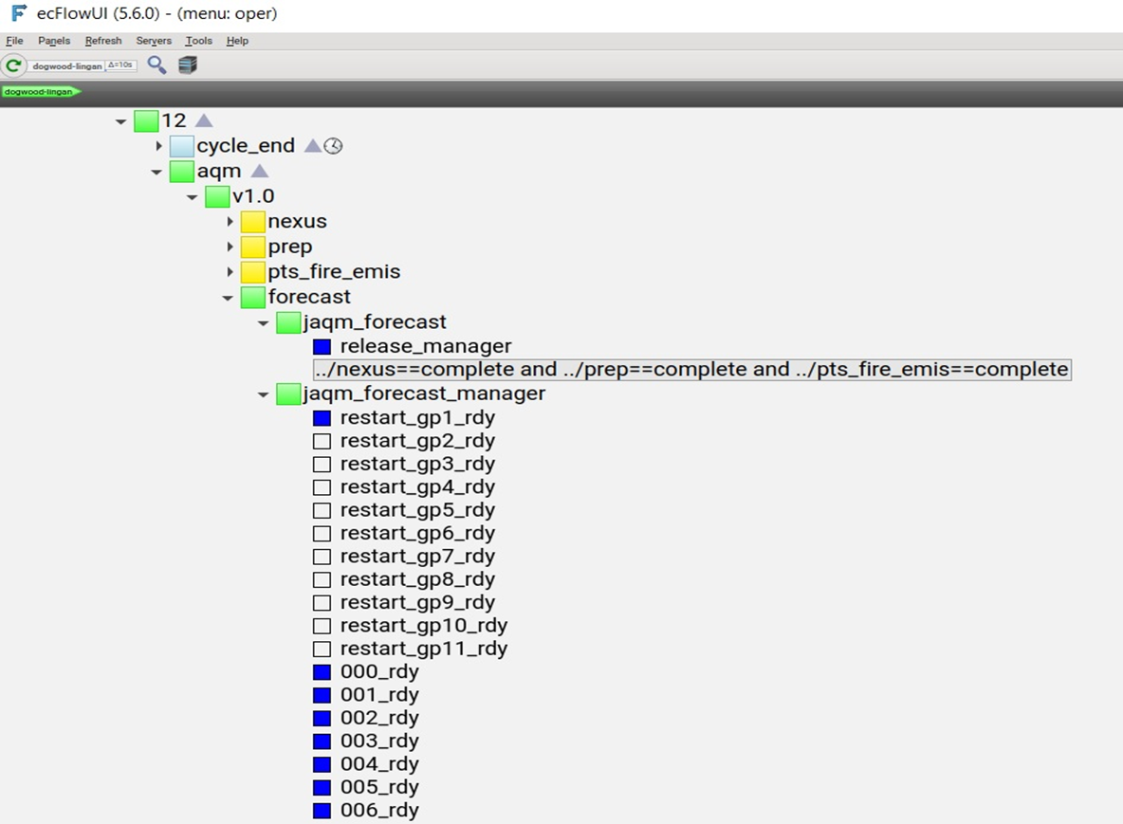
Transition to ecFlow Workflow for Operation

Slide 10
Conclusion
AQM was implemented on May 14th 2024. Congratulations to the full team!
How can we improve for next time?
The benefit that the EIB EE2 process can do to help transition to operation.
We should consider updating the implementation standards for the UFS.
Questions?

