Slide 1
Diabatic Heating and Vertical Motion in Coupled UFS
David Straus, Erik Swenson, Chul-Su Shin, Jim Kinter, Benjamin Cash
George Mason University
UIFCW 2024
With grateful acknowledgement of support from NOAA WPO

Slide 2
An Unexpected Path to R2O
David Straus, Erik Swenson, Chul-Su Shin, Jim Kinter, Benjamin Cash
George Mason University
UIFCW 2024
With grateful acknowledgement of support from NOAA WPO

Slide 3
Why Diabatic Heating?
Remote influence of surface anomalies, such as from ENSO, is communicated via the upper atmosphere through diabatic heating anomalies
  E.g. Teleconnections or ‘atmospheric bridge’
  Critical for seasonal predictability
Diabatic heating is very difficult to observe directly
  E.g., satellite measurements of condensation
  Generally includes large observational uncertainties

Slide 4
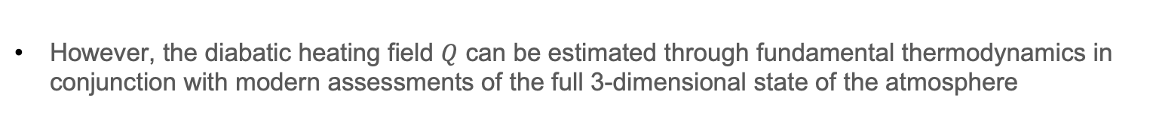
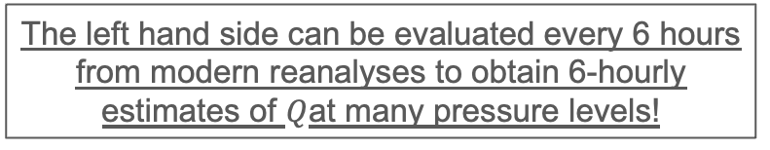
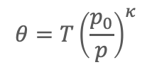

However, the diabatic heating field $Q$ can be estimated through fundamental thermodynamics in conjunction with modern assessments of the full 3-dimensional state of the atmosphere
$$\frac{∂Θ}{∂t}+\vec{u}∙\vec{∇}Θ+ω\frac{∂Θ}{∂p}=\frac{1}{C_{p}}{\left(\frac{p_{0}}{p}\right)}^{κ}Q$$
$$θ=T{\left(\frac{p_{0}}{p}\right)}^{κ}$$
Where
is the potential temperature and $ω$ = dp/dt (material derivative of pressure p)
The left hand side can be evaluated every 6 hours from modern reanalyses to obtain 6-hourly estimates of $Q$at many pressure levels!
Physics Department Colloquium 13 April 2018

Slide 5
Diabatic Heating in UFS Prototype-P8
Monthly mean diabatic heating diagnosed from January 01 starts for 2012-2018
  Data obtained from https://registry.opendata.aws/noaa-ufs-s2s
  Incredibly valuable resource
Assessed relative to monthly mean diabatic heating diagnosed via the same method from ERA5
0

Slide 6
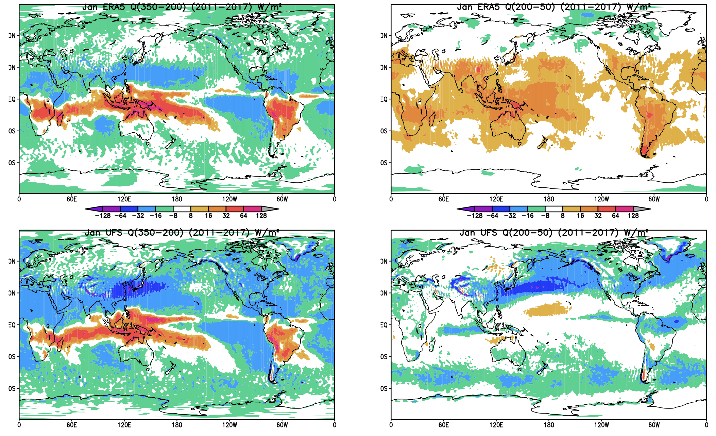
350-200 mb
200-50 mb
ERA5
ERA5
Large differences at upper levels
Good agreement at lower levels
(not shown)
ERA5
ERA5
UFS
UFS
UFS
UFS

Slide 7
Drilling Down
What is the source of the differences in upper level heating?
  Model error?
  Reanalysis error?
  Methodology error?
  All of the above?
Model tendency analysis
  We have performed an ensemble of P8 integrations, initialized October 01 2011-2017
  We have saved the individual temperature tendency terms from the parameterizations
    Not saved in standard prototype configuration
  Allows for direct comparison between residual method and temperature tendency from parameterizations
  Individual terms, such as contribution from longwave (dtend_temp_lw) available
  Total term (dtend_temp_phys) analyzed here

Slide 8
Diabatic Heating Comparison:
Zonal Mean
Residual vs dtend_temp_phys
Oct 2011 Zonal mean heating
Top Panel: Residual method
Middle panel: Alternate formulation of residual method
Bottom panel: dtend_temp_phys
Generally good agreement with dtend_temp_phys for 300 hPa and below

Slide 9
Diabatic Heating Comparison:
Zonal Mean
Residual vs dtend_temp_phys
Oct 2011 Zonal mean heating
Top Panel: Residual method
Middle panel: Alternate formulation of residual method
Bottom panel: dtend_temp_phys
Generally good agreement with dtend_temp_phys for 300 hPa and below
Opposite sign above 200 hPa

Slide 10
Diabatic Heating Comparison
Zonal Mean
Residual vs dtend_temp_phys vs ERA5
Top Panel: UFS zonal mean heating from directly from model temperature tendencies
Middle Panel: UFS zonal mean heating computed from the residual method.
Bottom Panel: ERA5 zonal mean heating Oct2011 computed from the residual method.
Much better agreement between direct model heating (top panel) and ERA5 residual heating (bottom panel) than P8 residual (middle panel)
Could upper level UFS ω fields be the cause?

Slide 11
Upper Level Omega
Zonal Mean
P8 vs ERA5
Top panel: Oct 2011 omega from UFS
Descending motion throughout most of the domain -> adiabatic warming
Bottom Panel: Oct 2011 omega from ERA5
Weak rising motion in the tropics
Large disagreement between model and reanalysis at upper levels
Theory and observations support ERA5
Is it a diagnostic problem?
Is model ω wrong?

Slide 12
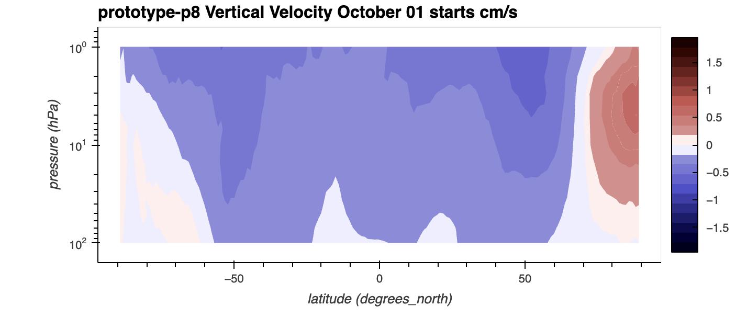
Upper Level Vertical Velocity
Zonal Mean
Vertical velocity diagnostic also indicates large-scale descent, small region of ascent concentrated at the poles
More than a simple issue with calculation of omega
Significant issue with stratospheric circulation

Slide 13
Conclusions
P8 residual diabatic heating closely matches ERA5 through most of the troposphere
  Also matches direct model output of dtend_temp_phys
  But residual heating is too negative at upper levels
Upper-level vertical motion was responsible
  Zonal mean P8 omega matches well with ERA5 through most of the troposphere
  P8 shows descent across most of the stratosphere in both ω and w
    Inconsistent with multiple reanalysis products
  Discussions with scientists at EMC confirmed the problem and led to PRs
    https://github.com/NOAA-EMC/fv3atm/pull/828
    https://github.com/ufs-community/ufs-weather-model/pull/2255
    https://github.com/NOAA-GFDL/GFDL_atmos_cubed_sphere/pull/337

Slide 14
Conclusions
Not something we were specifically looking for!
  Discovery of circulation problem was by-product of diabatic heating analysis, not a goal
  Illustrates strength of community modeling approach
    Combination of university and NOAA runs, all from the same code base
    “Always more data than eyeballs” (source: Me, probably)
    The more people who are working with the code and the data, the more we will learn

