Slide 1
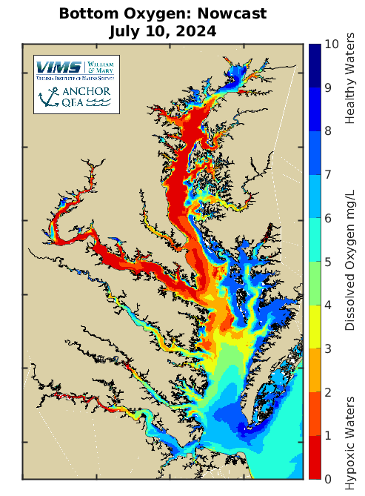




Coupled Hydrodynamic-Biogeochemical Forecasting using the Chesapeake Bay Environmental Forecast System (CBEFS)
Presented by:
Aaron Bever, Marjorie Friedrichs, and Pierre St-Laurent
July 2024
abever@anchorqea.com, marjy@vims.edu

Slide 2
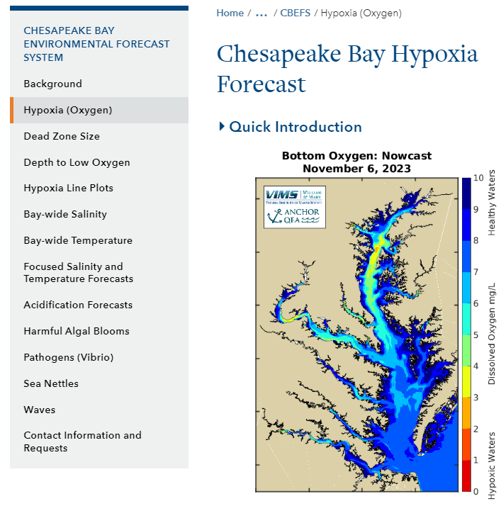
CBEFS Overview
Chesapeake Bay Environmental Forecast System
  3-D hydrodynamic, biogeochemical, sediment transport, and wave model (ROMS-ECB-SWAN)
  Automated 1-day nowcast and 2-day forecast nightly
  Results displayed on the internet (www.vims.edu/cbefs)
Salinity, temperature, O₂, harmful algal blooms, Vibrio, waves, acidification, sea nettles, water clarity
Used by a range of stakeholders (fishing, sea nettles, hypoxia, field sampling, etc.)
Model output available through THREDDS server

Slide 3
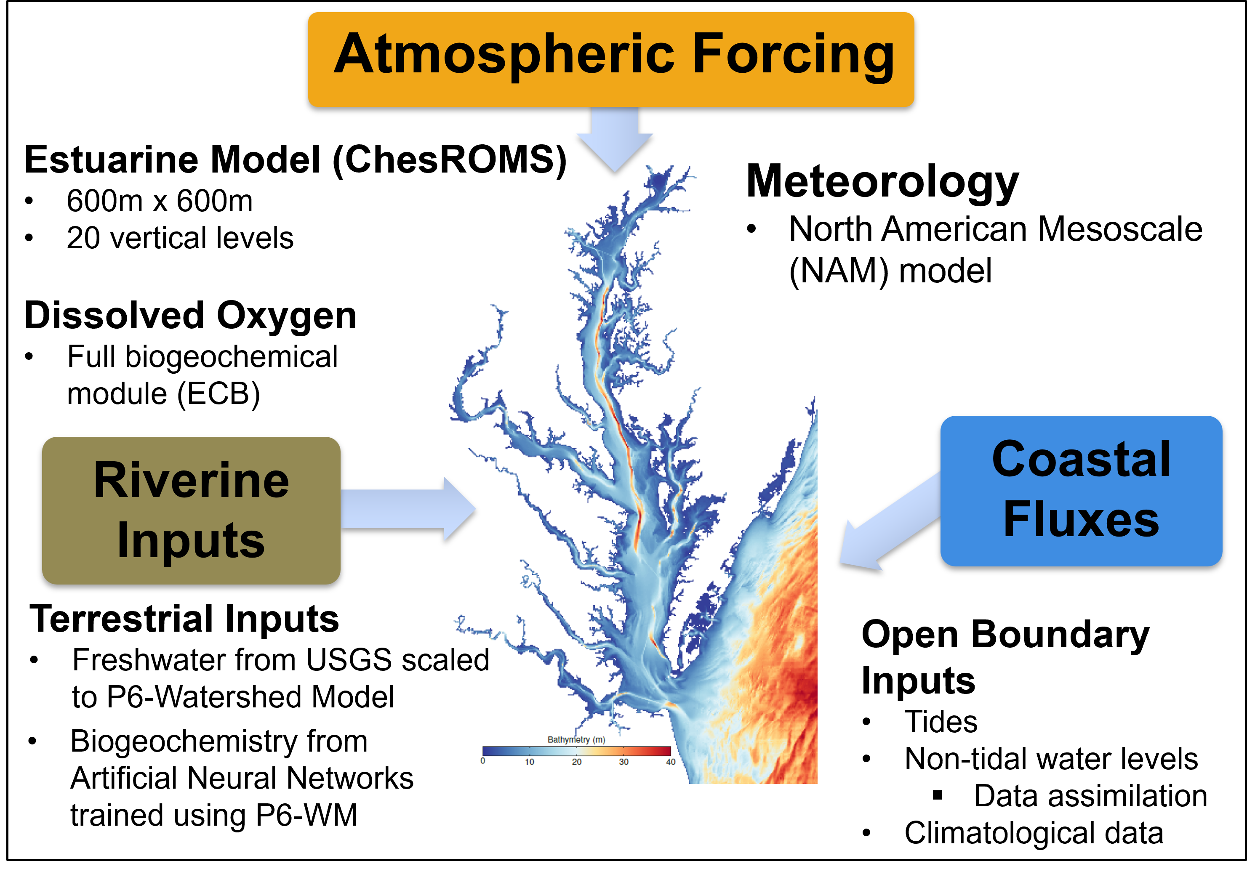
Chesapeake Bay Environmental Forecast System
www.vims.edu/cbefs

Slide 4
CBEFS Recent Notable Enhancements
Tributary inputs based on Artificial Neural Network (AI) models
Assimilation of non-tidal water surface elevations into ocean boundary conditions
Daily model-data comparison for forecast accuracy
Additions to graphics based on stakeholder requests
Comparison to long-term climatology
Routine updates to model code, parameters, grid, etc.

Slide 5
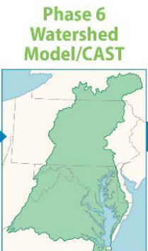
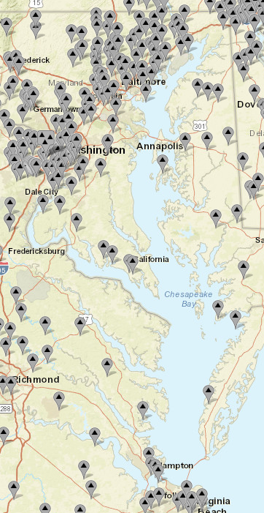
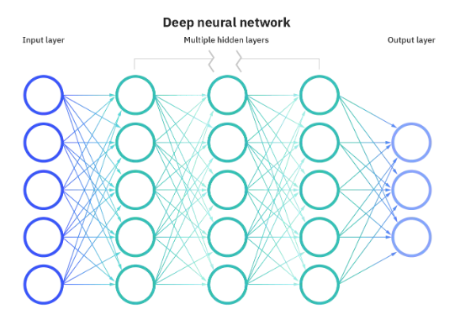
Tributary Inputs: Watershed Model and Artificial Neural Networks
USGS Data
Freshwater discharges based on
real-time USGS gauge data scaled based on the Chesapeake Bay Program Phase 6 watershed model
Tributary inflow realistically distributed around Chesapeake Bay
Biogeochemistry based on Artificial Neural Networks trained using CBP P6 watershed model
  E.g., nitrate, alkalinity, and
  suspended sediment concentration
Source: https://www.ibm.com/cloud/learn/neural-networks

Slide 6
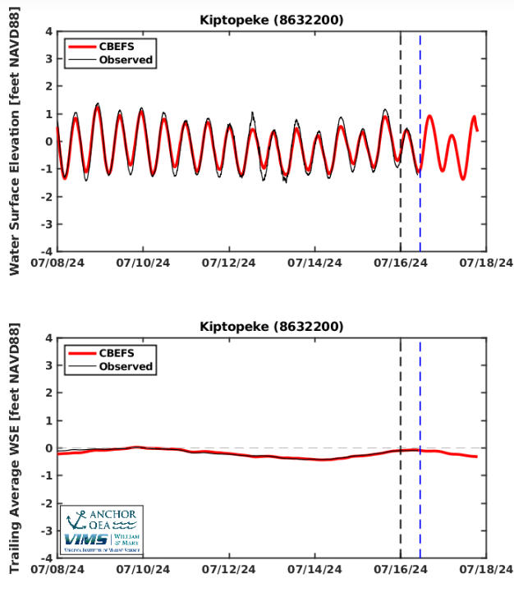
Assimilation of Non-Tidal Water Surface Elevation Data
NOAA water surface elevation data at the mouth of the Bay are assimilated to ensure correct nowcast water surface elevations
1) Simulate 1-day nowcast
Nowcast
2) Download NOAA data
3) Check nowcast bias and adjust boundary condition
4) Resimulate nowcast and then simulate 2-day forecast
Nowcast
Forecast Day 1
Forecast Day 2

Slide 7
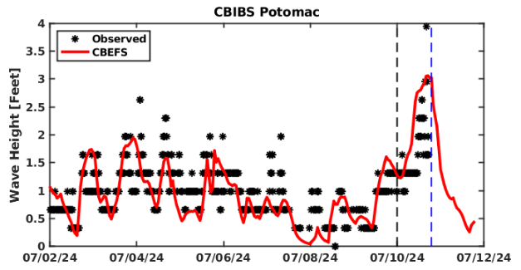
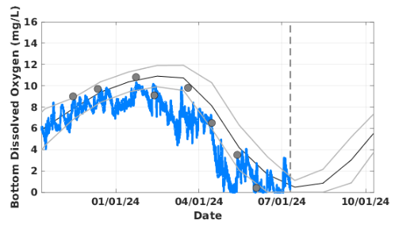
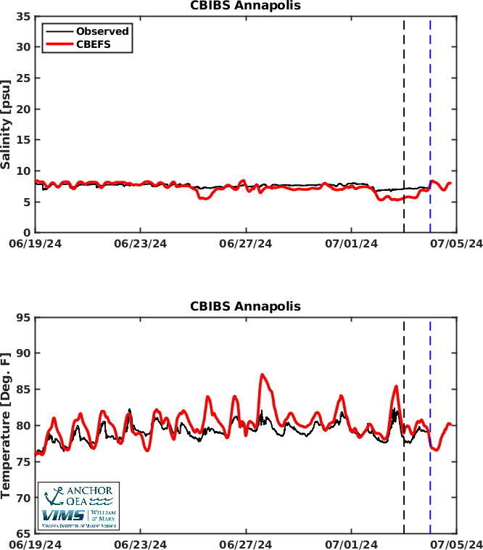
Daily Model-Data Comparison for Forecast Accuracy
Real-time data is downloaded hourly and compared to CBEFS to track model accuracy
  Salinity
  Temperature
  Water surface elevation
  Wind waves
Data from periodic cruises incorporated as they become available

Slide 8
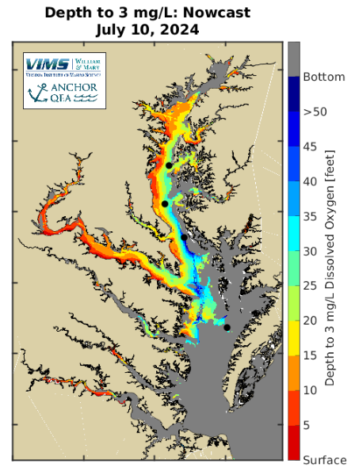
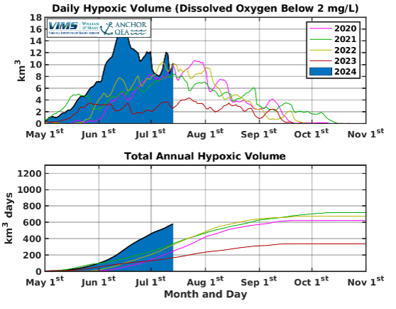
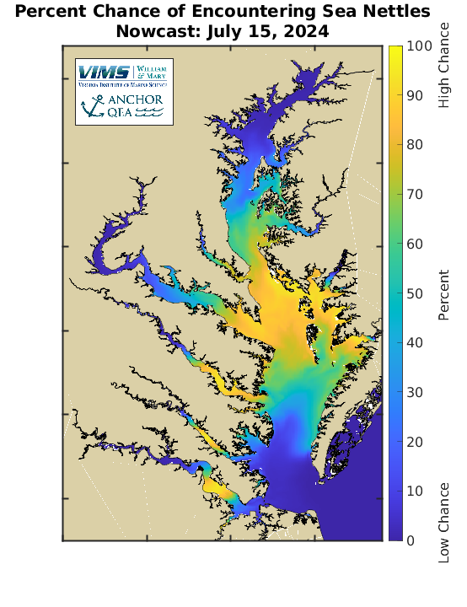
Visualization and Use by Stakeholders
Tailoring graphics to stakeholder needs is important
Automated alerts setup for select stakeholders

Slide 9
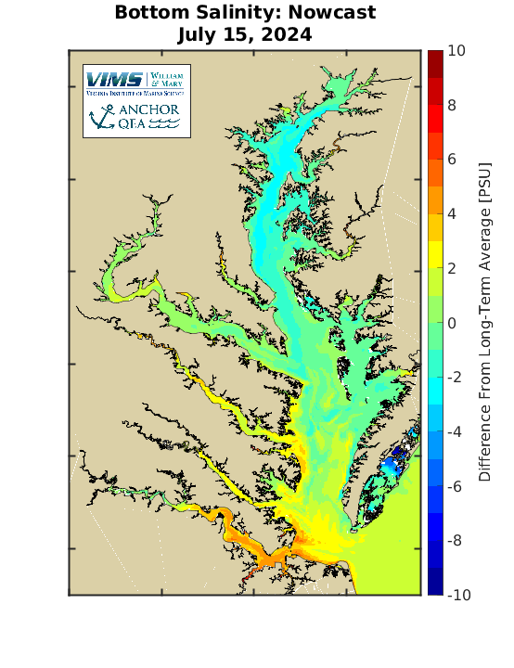
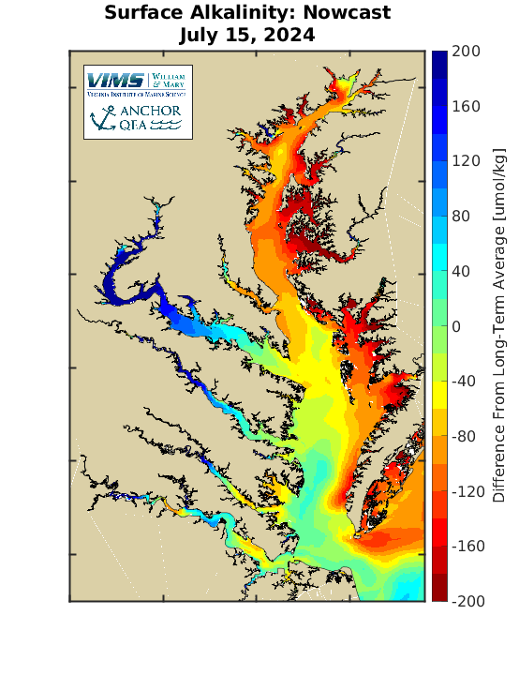
Comparison to Long-Term Climatology
Requested by stakeholders
Put current forecasts in perspective with long-term average conditions
How different is today from “normal” conditions?
Climatology from Chesapeake Bay Atlas St-Laurent and Friedrichs (2024)

Slide 10


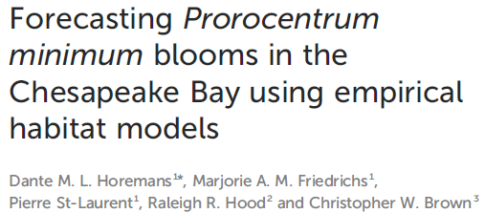
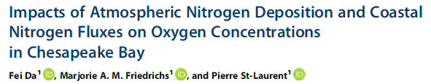

CBEFS Routine Updates
ROMS model code updated on a semiregular basis
Research improvements in biogeochemistry and hydrodynamics incorporated roughly yearly
CBEFS continually improved based on ongoing work from the research community

Slide 11
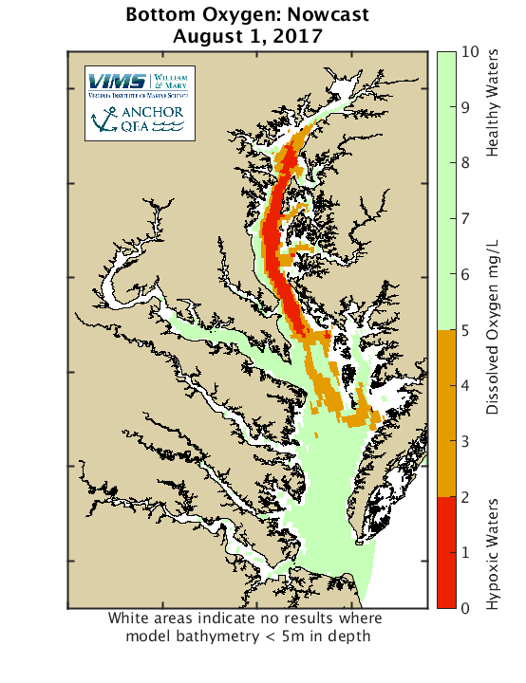
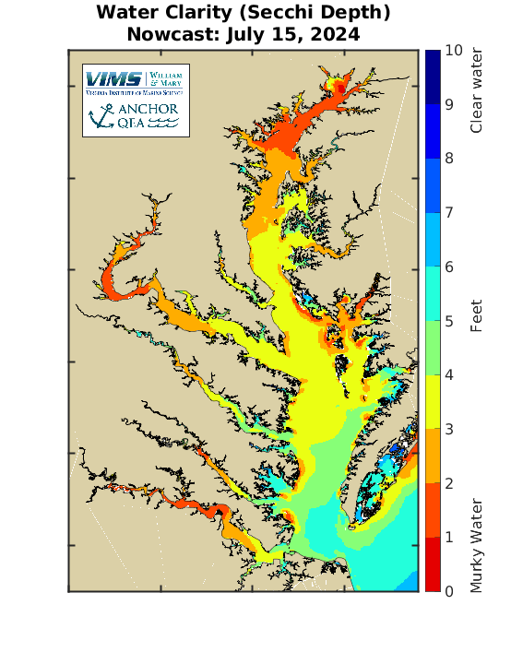
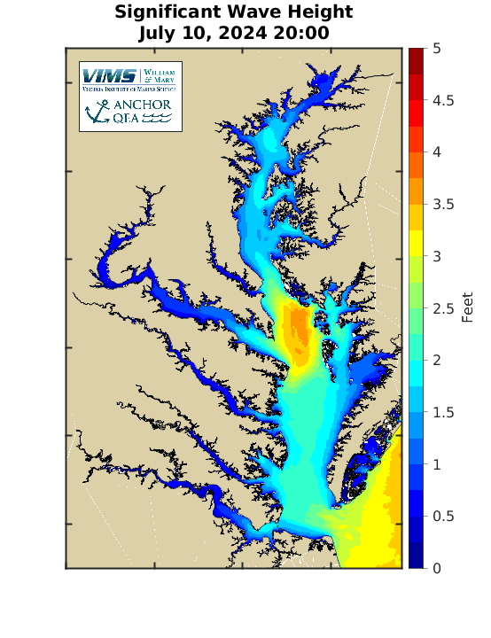
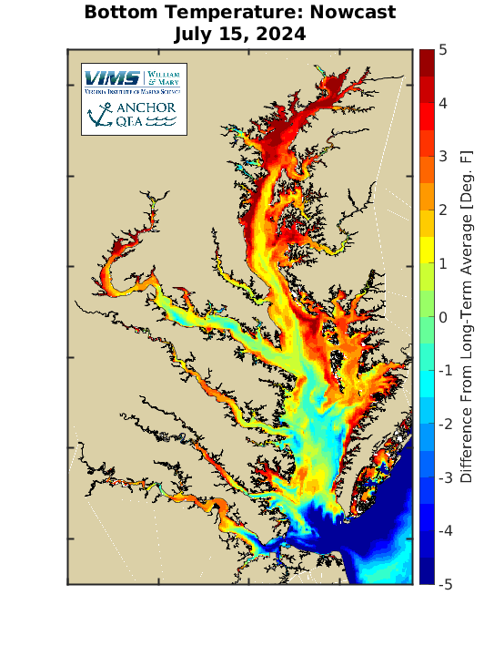
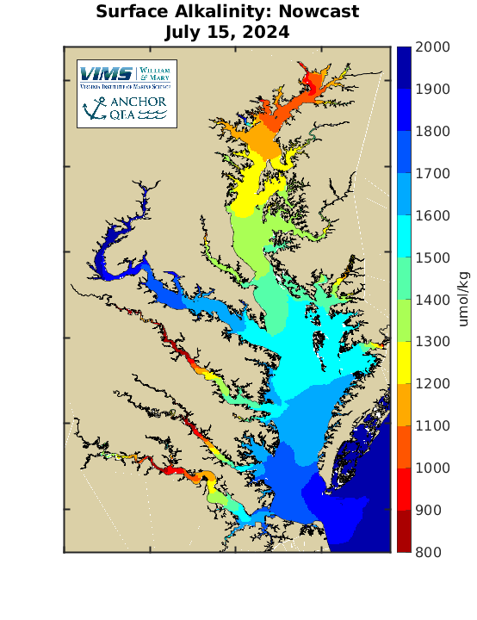
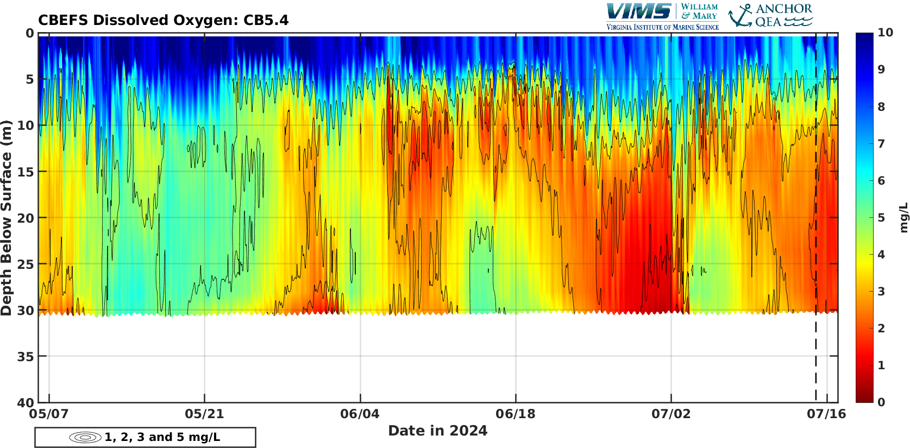
2017
2024
CBEFS Summary and Conclusions
Daily forecasts of environmental conditions since February 2017
Incremental improvements keep the model
state-of-the-art
Enhancements have expanded the utility of the forecast system
  Driven by research projects and stakeholder requests
Used by fisherman, aquaculturists, industry, general public, etc.
Also available through MARACOOS Chesapeake Bay OceansMap webpage

