Slide 1
Recent Collaborative Development of the 3DRTMA Using the SRW-App
Terra Ladwig
Manuel Pondeca, Guoqing Ge, Edward Colon, Craig Hartsough, Matt Morris, Ming Hu, Annette Gibbs, Sijie Pan, Gang Zhao, Junjun Hu, Jim Purser, Ruifang Li, Miodrag Rancic, Israel Jirak, Nathan Dahl, Ting Lei, Malaquias Pena, Steve Weygandt, Curtis Alexander, Jacob Carley
GSL, EMC, SPC, UConn
CIRES, CIRA, Lynker, SAIC
UIFCW July 25, 2024

Slide 2
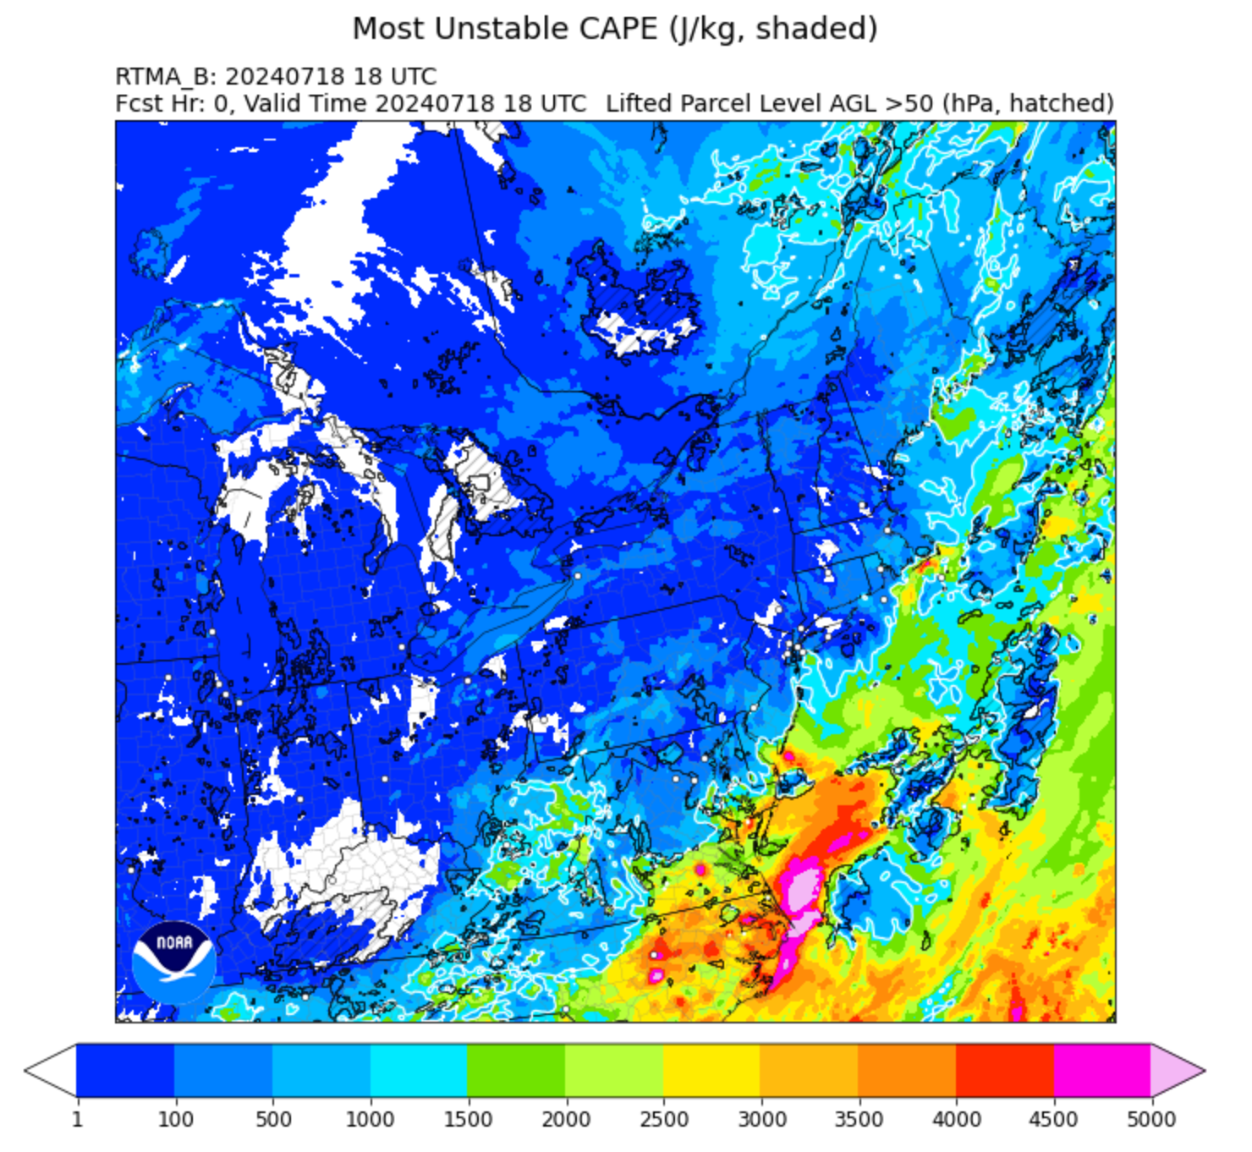
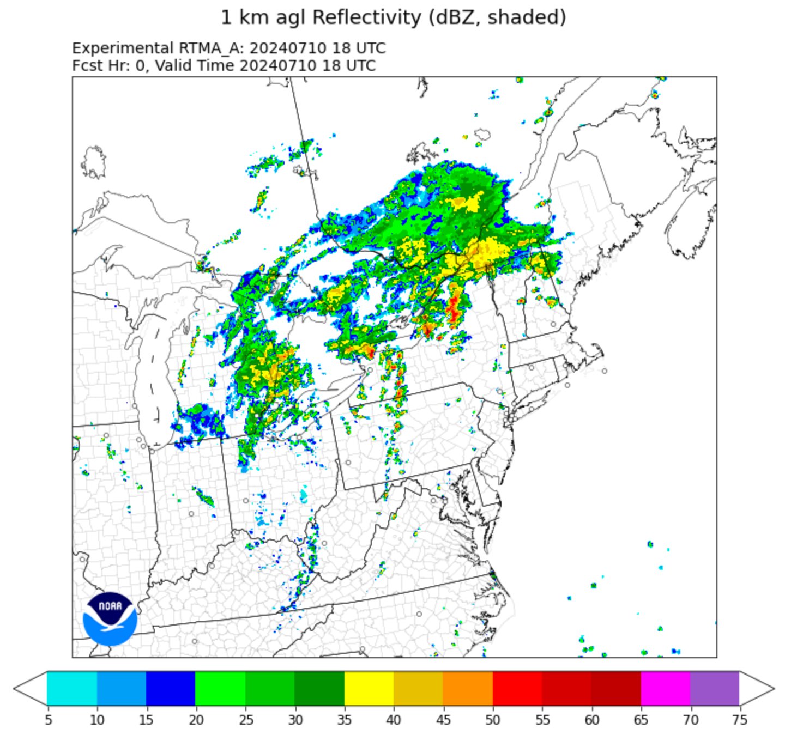
Real-Time Mesoscale Analysis (RTMA)
Operational 2DRTMA (hourly) and 2DRTMA-RU (15 mins). Uses 2DVar.
Transition to 3D whole atmospheric analysis, and later an ‘on demand’ continuous analysis system. Use 3DEnVar.
RTMA is a specific configuration of the Unified Forecast System (UFS) Short-Range Weather (SRW) Application.
Supports NWS National Digital Forecast Database (NDFD) operations, NWS national centers (e.g. SPC), and other user groups (e.g. aviation, fire wx, hydrology).
Used for situational awareness and nowcasting.

Slide 3
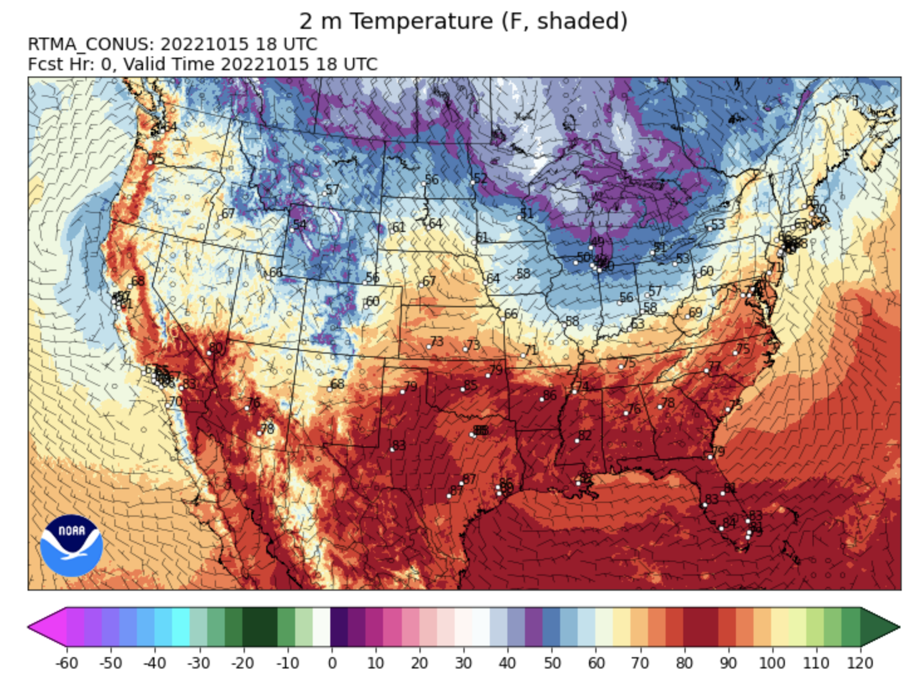
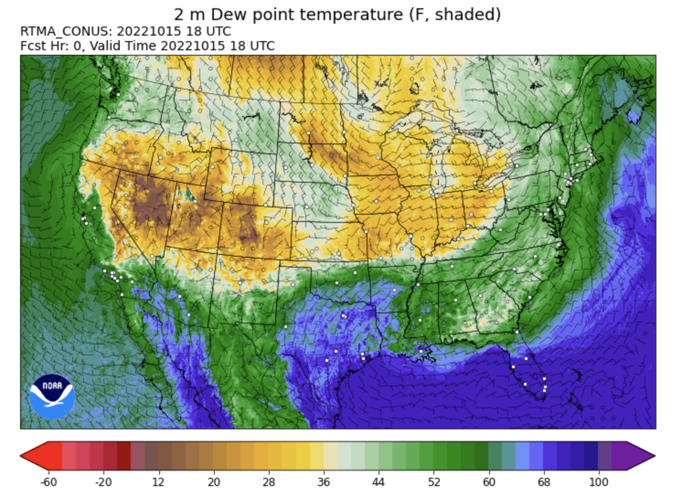
Companion system: UnRestricted Mesoscale Analysis (URMA)
Runs in delayed real-time to enable the use of late arriving obs.
Serves as NOAA’s analysis of record.
Used for verification and calibration in National Blend of Models (NBM).

Slide 4
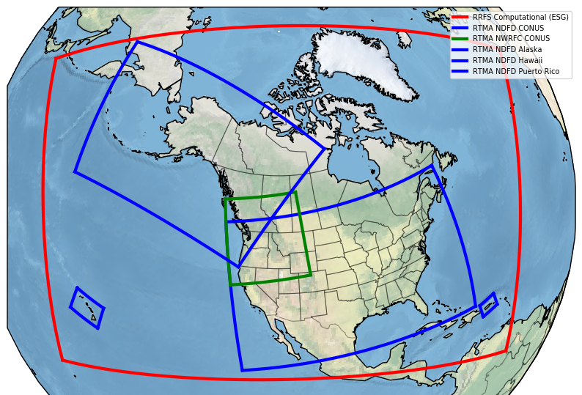
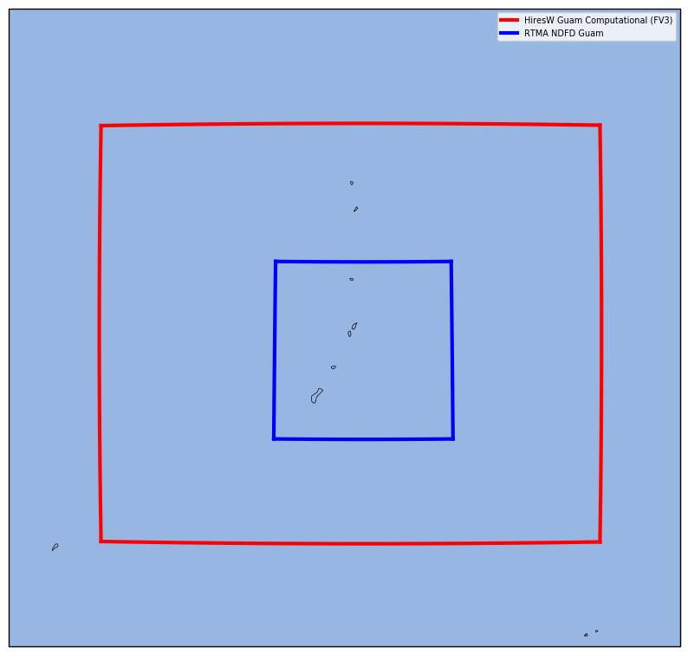
Analysis Domains
RTMA depends on the Rapid Refresh Forecast System (RRFS) to provide background data.
RTMA needs to provide products on the NDFD grids, which will be significantly more points than RRFS!
2.5 km grid for CONUS, Hawaii, & NWRFC,
1.25 km for Puerto Rico
3 km for Alaska
Separate domain for Guam with HiresW-Guam background

Slide 5
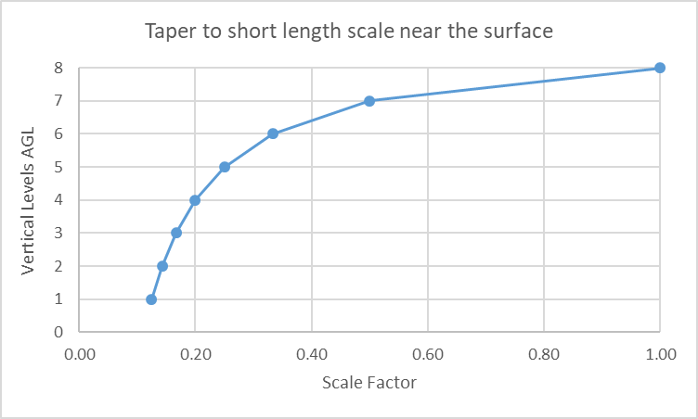
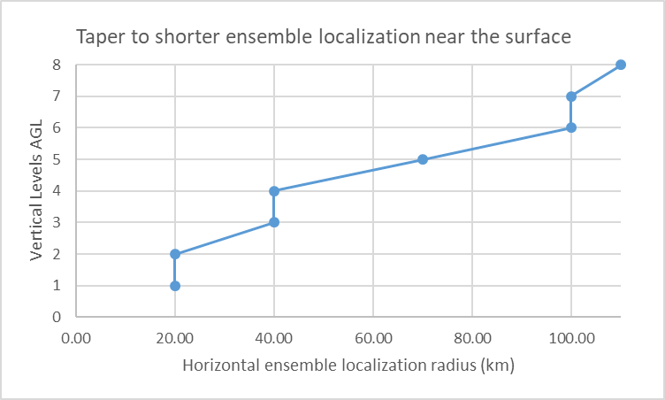
RTMA Differs from RRFS Analysis
 | 3DRTMA | RRFS
Horizontal decorrelation scale | height dependent rescaling of NMC stats (near surface, ~20km) | hzscl=0.7,1.4,2.80 (about ~200 km)
vertical decorrelation scale | vs=0.125 | vs=1.0 (scale factor)
horizontal localization radius | height dependent (near surface, 20km) | 110km
vertical localization radius | 1 grid point | 3 grid points
ensemble weight | GDAS 0.5/0.5 RDAS 0.9/0.1 | GDAS 0.85/0.15 RDAS 0.85/0.15
3DRTMA fits obs closely.
Not intended to initialize model forecast!

Slide 6
RTMA Differs from RRFS Analysis
 | 3DRTMA | RRFS
observation error | Reduced from RRFS values for surface observations | prescribed observation errors
Assimilated observations
--surface, aircraft, sounding radial velocity, satwind | yes | yes
--Radiance | no | yes
cloud analysis difference | cloud build for whole column for NASA LaRC cloud obs | cloud build up to 1.2km AGL for NASA LaRC cloud obs
 | all reflectivity data used | only use CREF<28 dBZ except snow
--reflectivity inversion | has graupel | no graupel
--cloud top data to model grids | nearest grid pixel | field-of-view average
 | cloud top data for build and clear | cloud top data for clear only
Reflectivity DA | empirical cloud analysis | Ref DA through 3DEnVAR
3DRTMA fits obs closely.
Not intended to initialize model forecast!

Slide 7
3DRTMA/3DURMA Products
All of the parameters from the operational 2D RTMA/URMA
Standard 3D fields: Temperature (T), Dew Point Temperature (DPT), Relative Humidity (RH), Zonal component of wind (U), Meridional component of wind (V), Geopotential Height (HGT), and Vertical Velocity (VVEL).
2D fields: Cloud ceiling height, horizontal visibility, total cloud amount, and significant wave height
Derived fields
3D and composite reflectivity, 3D cloud
Storm Prediction Center (SPC) severe weather parameters
Category 5 fields added to UPP for HWT 2021 SFE
SPC produces key severe weather products from the Standard 3D fields as well as existing UPP fields. These products include composite reflectivity, effective layer shear, mixed/surface/and most unstable CAPE, effective tornado parameter and effective layer helicity, which served as key assessment metrics during the last four HWT/SFEs.
Notes:
https://docs.google.com/spreadsheets/d/1GU5K1asFZY6TceJltNMaHJCNoyk02WimYwDlwfONWE8/edit?gid=0#gid=0

Slide 8
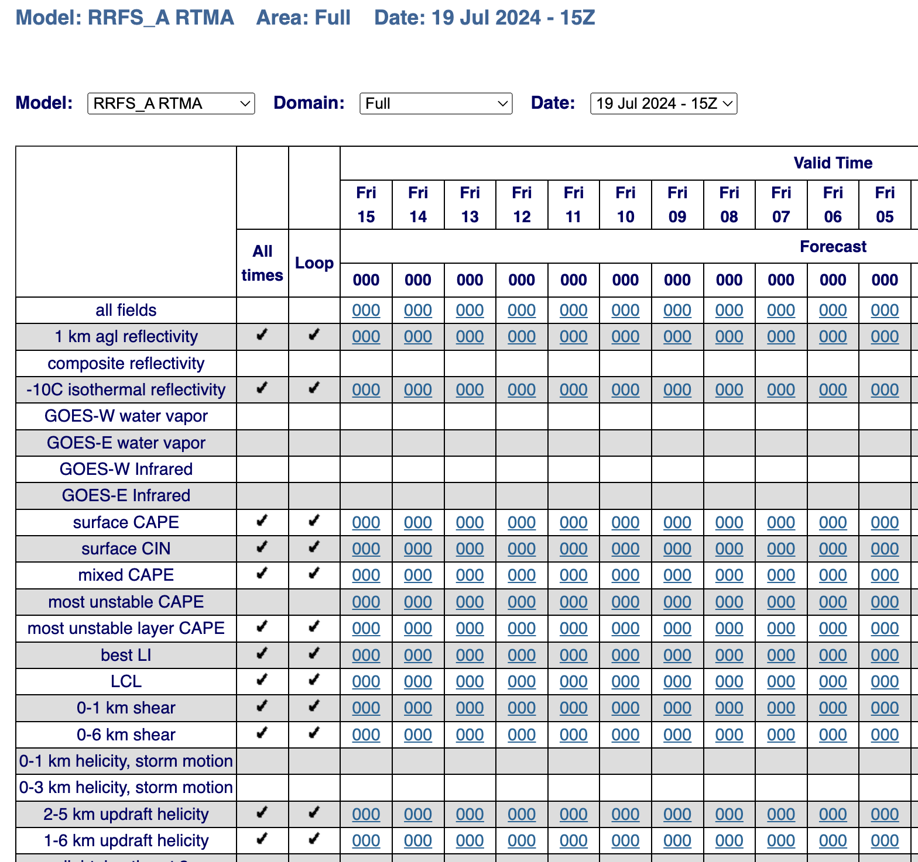
3DRTMA/3DURMA Products
Graphics are available on the EMC Graphics Portal.
https://www.emc.ncep.noaa.gov/mmb/rtma/rtma_graphics/index.html
GSL also has graphics available online.
https://rapidrefresh.noaa.gov/hrrr/HRRRrtma/Welcome.cgi

Slide 9
Previously Planned Implementation Schedule
Based on RRFSv1
It may be possible to keep this schedule using a HRRRv4 background for 3DRTMAv1.

Slide 10
Spring Forecast Experiment Evaluations
Participants were asked to arrive at a single subjective rating based on the evaluation of composite reflectivity, 2-m T, 2-m TD, and SB/ML/MUCAPE.
2019: The native resolution 3km 3DRTMA was the overwhelming favorite and was rated the highest-quality analysis more than the other analysis systems combined.
2020: Two RTMA versions were compared to assess the impact of using convective scale background error covariances, i.e. HRRRDAS instead of GDAS ensemble, and they were rated ‘about the same’.
2021: FV3-based RTMA was rated ‘much worse’ or ‘slightly worse’ than the HRRR first guess, especially for 2m dew point and reflectivity. But the FV3 version did not have the hydrometeor analysis.
2022: Both of the FV3-based versions were rated “slightly worse” to “about the same” as the HRRR-based version, which captured the convective effects on 2m temperature better than FV3 versions (e.g. size, shape, and magnitudes of cold pools and thunderstorm outflows).
2023: 3D-RTMA RRFS was ‘about the same’ to ‘slightly worse’ than the HRRR-based version.

Slide 11
RTMA Comparisons in 2023
FV3-based RTMA was rated “slightly worse” to “about the same” as the HRRR-based version.
Analyses are very similar in this case.

Slide 12
RTMA Comparisons in 2023
FV3-based RTMA was rated “slightly worse” to “about the same” as the HRRR-based version.
Thunderstorm outflows too early/cold/expansive.

Slide 13
RTMA Comparisons in 2023
FV3-based RTMA was rated “slightly worse” to “about the same” as the HRRR-based version.
Moist bias in RRFS version; too moist in dry air/behind dryline

Slide 14
RTMA Comparisons in 2024
SFE results are pending.
As in 2023, examples of colder cold pools for the RRFS based 3DRTMA were observed.

Slide 15
RTMA Comparisons in 2024
SFE results are pending.
As in 2023, examples of too much moisture in dry air (i.e. behind the dry line) for the RRFS based 3DRTMA were observed.

Slide 16
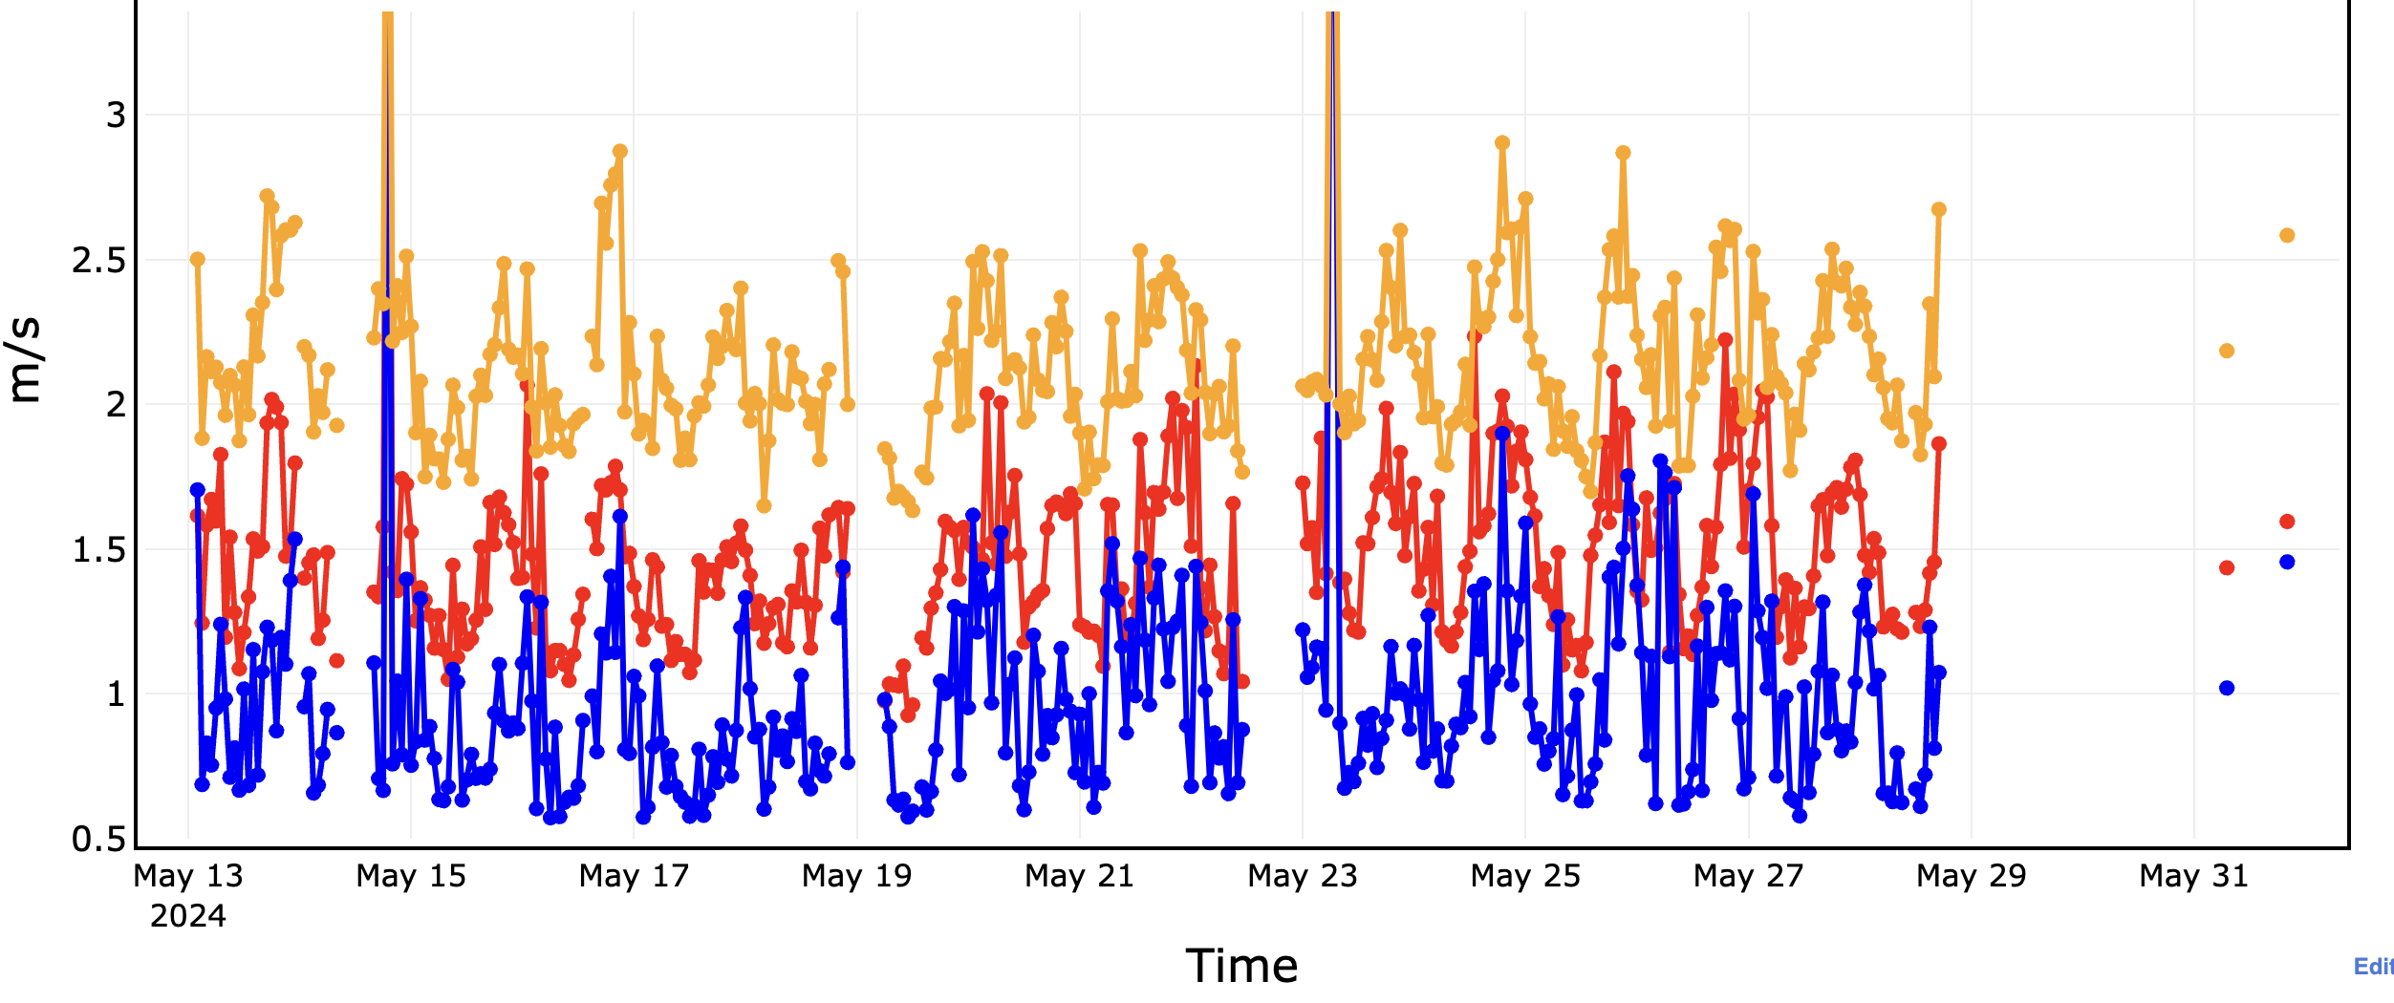
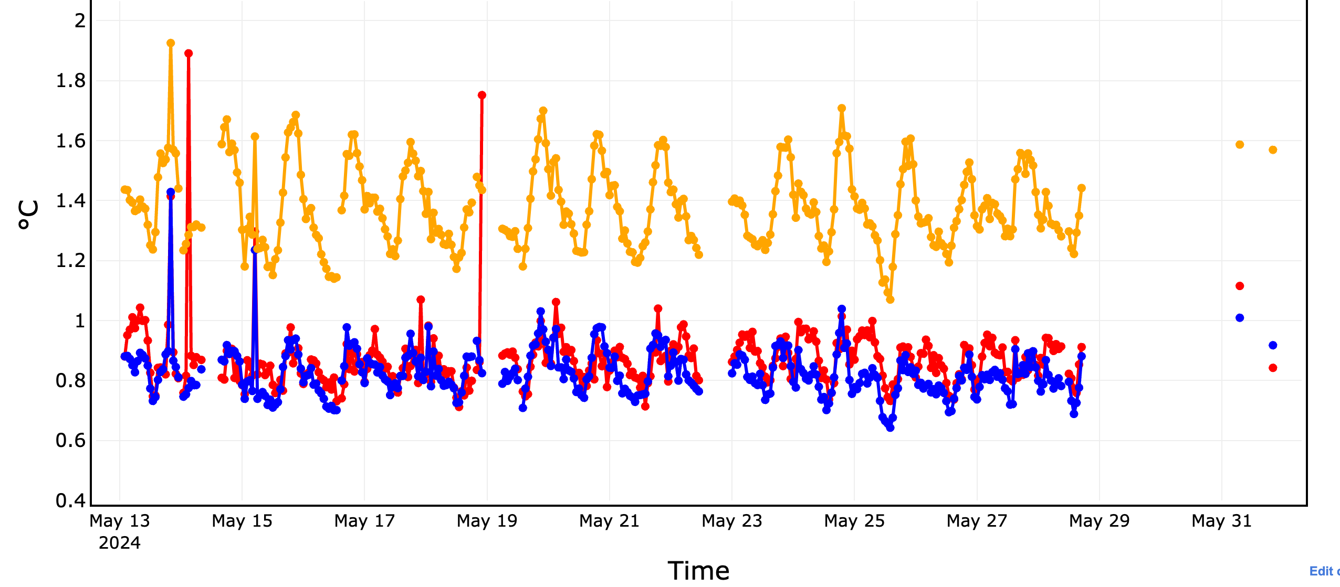
RRFS-3DRTMA Comparison to Operational 2D
2DRTMA
3DRTMA (RRFS)
1-hour RRFS
10m Wind RMS
2m Temp RMS
3DRTMA performs better for winds, similarly for temperature, worse for ceiling (not shown since it is under investigation).

Slide 17
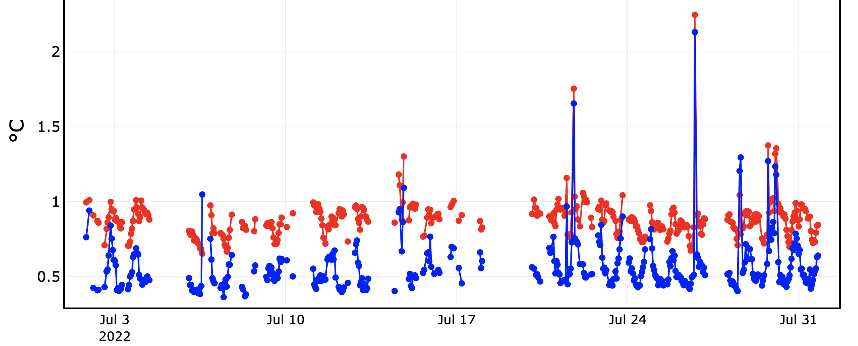
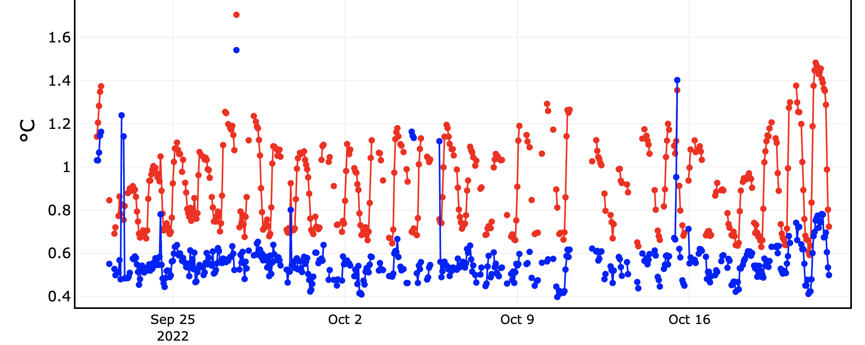
HRRR-3DRTMA Comparison to Operational 2D
2m Temp RMS
2m Temp RMS
2DRTMA
3DRTMA (HRRR)
July
Oct
3DRTMA performs better.
Working on direct comparisons of the background for May 2024.

Slide 18
Concluding Remarks

