Slide 1
Incorporating GFDL-AM4.1 chemistry into NOAA’s Unified Forecasting System for global air quality application
Section: Advancing UFS Applications – Air Quality
Jian He (jian.he@noaa.gov)^{1,2}, Li Zhang^{1,3}, Rebecca Schwantes², Barry Baker⁴, Ravan Ahmadov³, Larry Horowitz⁵, Vaishali Naik⁵, Zachary Moon^{4,6}, Jordan Schnell³, Georg Grell³, Quazi Rasool^{1,2}, Colin Harkins^{1,2}, Siyuan Wang^{1,2}, Patrick Campbell^{4,7}, Youhua Tang^{4,7}, Beiming Tang^{4,7}, Margaret Marvin^{4,7}, David Fillmore⁸, Matthew Dawson⁸, and Brian McDonald²
¹University of Colorado Boulder, Boulder, CO; ²NOAA Chemical Sciences Laboratory, Boulder, CO; ³NOAA Global Systems Laboratory, Boulder, CO; ⁴NOAA Air Resources Laboratory, College Park, Maryland; ⁵NOAA Geophysical Fluid Dynamics Laboratory, Princeton, NJ; ⁶Earth Resources Technology (ERT), Inc., Laurel, MD; ⁷George Mason University, Fairfax, VA; ⁸National Center for Atmospheric Research, Boulder, CO

Slide 2
UFS application for atmospheric chemistry and composition
Model | Chemistry | Application
RRFS-SD | Simplified Aerosols: smoke + dust tracers | Regional wildfire smoke forecasts
UFS-Aerosols | Simplified aerosols: GOCART | Global weather forecasts with aerosol feedbacks
UFS-AQM | Complex chemistry from CMAQ: ozone and aerosols | Regional air quality forecasts
UFS-RAQMS | Simplified chemistry with data assimilation: ozone and aerosols | Global air quality forecasts
Chemistry related code is duplicated
Divided infrastructure is not efficient for code maintenance and development

Slide 3
UFS with chemistry component (UFS-Chem)
ATM model: FV3
CATChem (Configurable ATmospheric Chemistry)
CCPP
Gas-phase
chemical mechanisms
Aerosol
schemes
None
None
Greenhouse gas tracers
Wildfire smoke tracers
Physics
Simple scheme
Simple scheme
Complex research scheme
Complex research scheme
Increasing complexity and computation cost

Slide 4
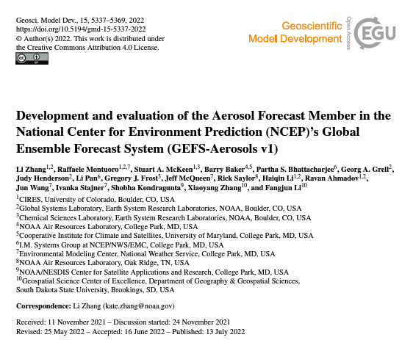
GSL-GOCART (CCPP version of GEFS-Aerosol)
GEFS-Aerosol (Zhang et al., 2022):
Simplified parameterization of sulfur/sulfate chemistry
Hydrophobic and hydrophilic black and organic carbon (BC and OC)
5-bin sea-salt
5-bin dust

Slide 5
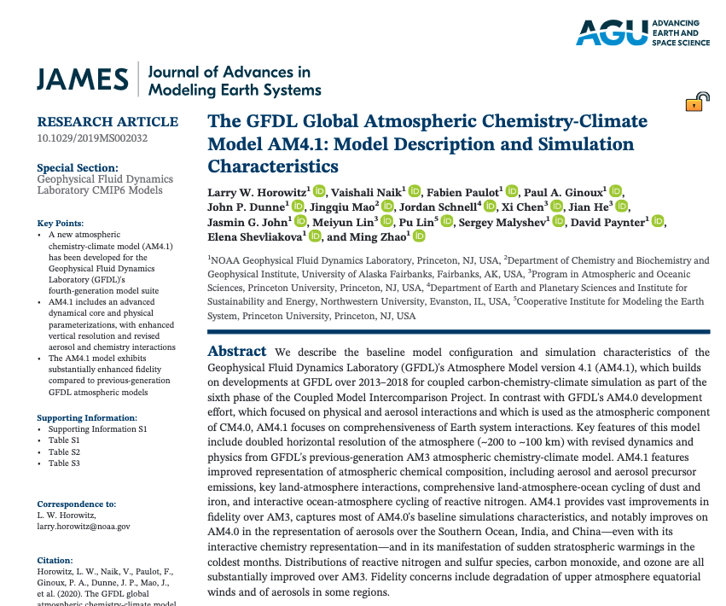
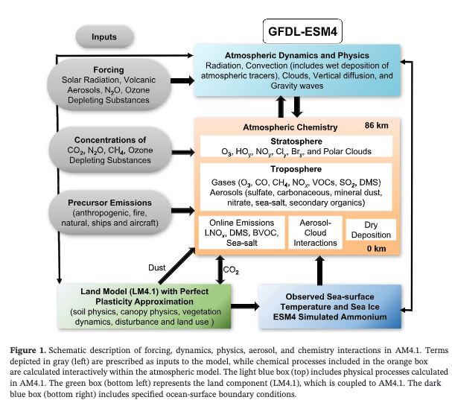
GFDL-AM4.1 chemistry
Horowitz et al., 2020

Slide 6
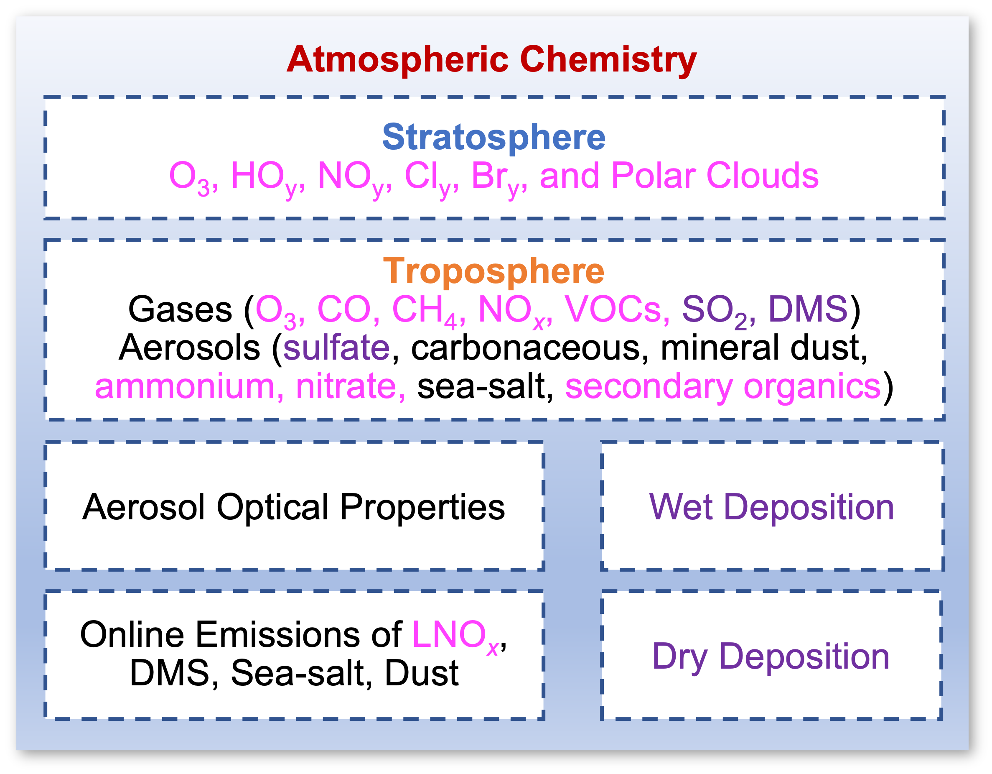
Processes included in CATChem
Existing processes are based on GEFS-Aerosols (Zhang et al., 2022)
New processes
Modified processes
First detailed gas-phase chemistry is based on GFDL-AM4.1 (Horowitz et al., 2020), with explicit tropospheric and stratospheric chemistry.

Slide 7
CATChem: global configurations
 | GSL-GOCART aerosol (Zhang et al., 2022) | GFDL-AM4.1 chemistry (Horowitz et al., 2020)
# of chemical tracers | 20 (all prognostic, 3 gases and 17 aerosols) | 128 (87 prognostic, 41 diagnostic, 21 aerosols)
# of chemical reactions | 3 (simple sulfur chemistry with prescribed oxidants) | 248 (43 photolysis, 205 kinetics)
Online emissions | DMS, sea-salt & dust | Same as GSL-GOCART for DMS, sea-salt & dust, but also include lightning NO_{x}
Inorganic aerosols | GOCART sulfate | ISORROPIA (sulfate-ammonium-nitrate)
Carbonaceous aerosols | GOCART | Same as GSL-GOCART
Secondary organics | N.A. | Simplified SOA formation
Dry & wet deposition | Gases and aerosols | Gases and aerosols
Aerosol optical properties | GOCART aerosols | Same as GSL-GOCART
Precursor emissions | Offline (for now), including anthropogenic (CEDS) and fires (GBBEPx) for SO₂ and aerosols | Same as GSL-GOCART, but with AM4 emissions for gases & AM4 biogenic emissions (offline for now)

Slide 8
UFS-Chem: CATChem with GFDL-AM4.1 chemistry
Simulation period: 2016/07/15 to 2016/08/23 (ATom-1 period with 14 days spin-up, total 40 days)
Met fields are reinitialized at 00z for each cycle (00-24z for each day)
First day: read chemical initial conditions (gases only, from GFDL-AM4.1 output)
Following days: read chemical tracers from restart files from previous day
Emissions: CEDS+GBBEPx+AM4
Resolution: C96 with 64 vertical layers (65 levels, up to 20 Pa)
Hourly output
Physics suite: suite_FV3_GFS_v17_p8_ugwpv1
ATM only run, no feedback on meteorology/radiation

Slide 9
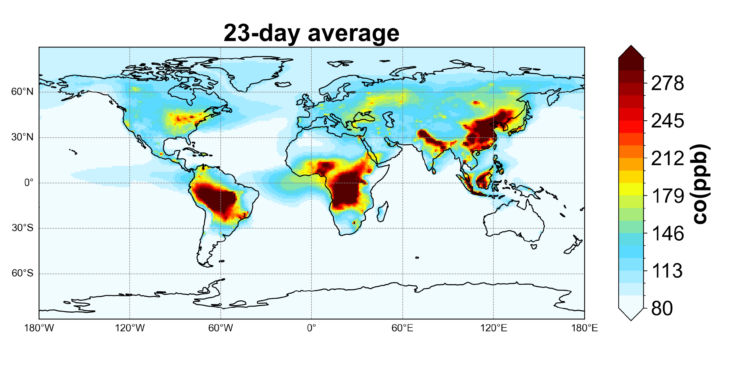
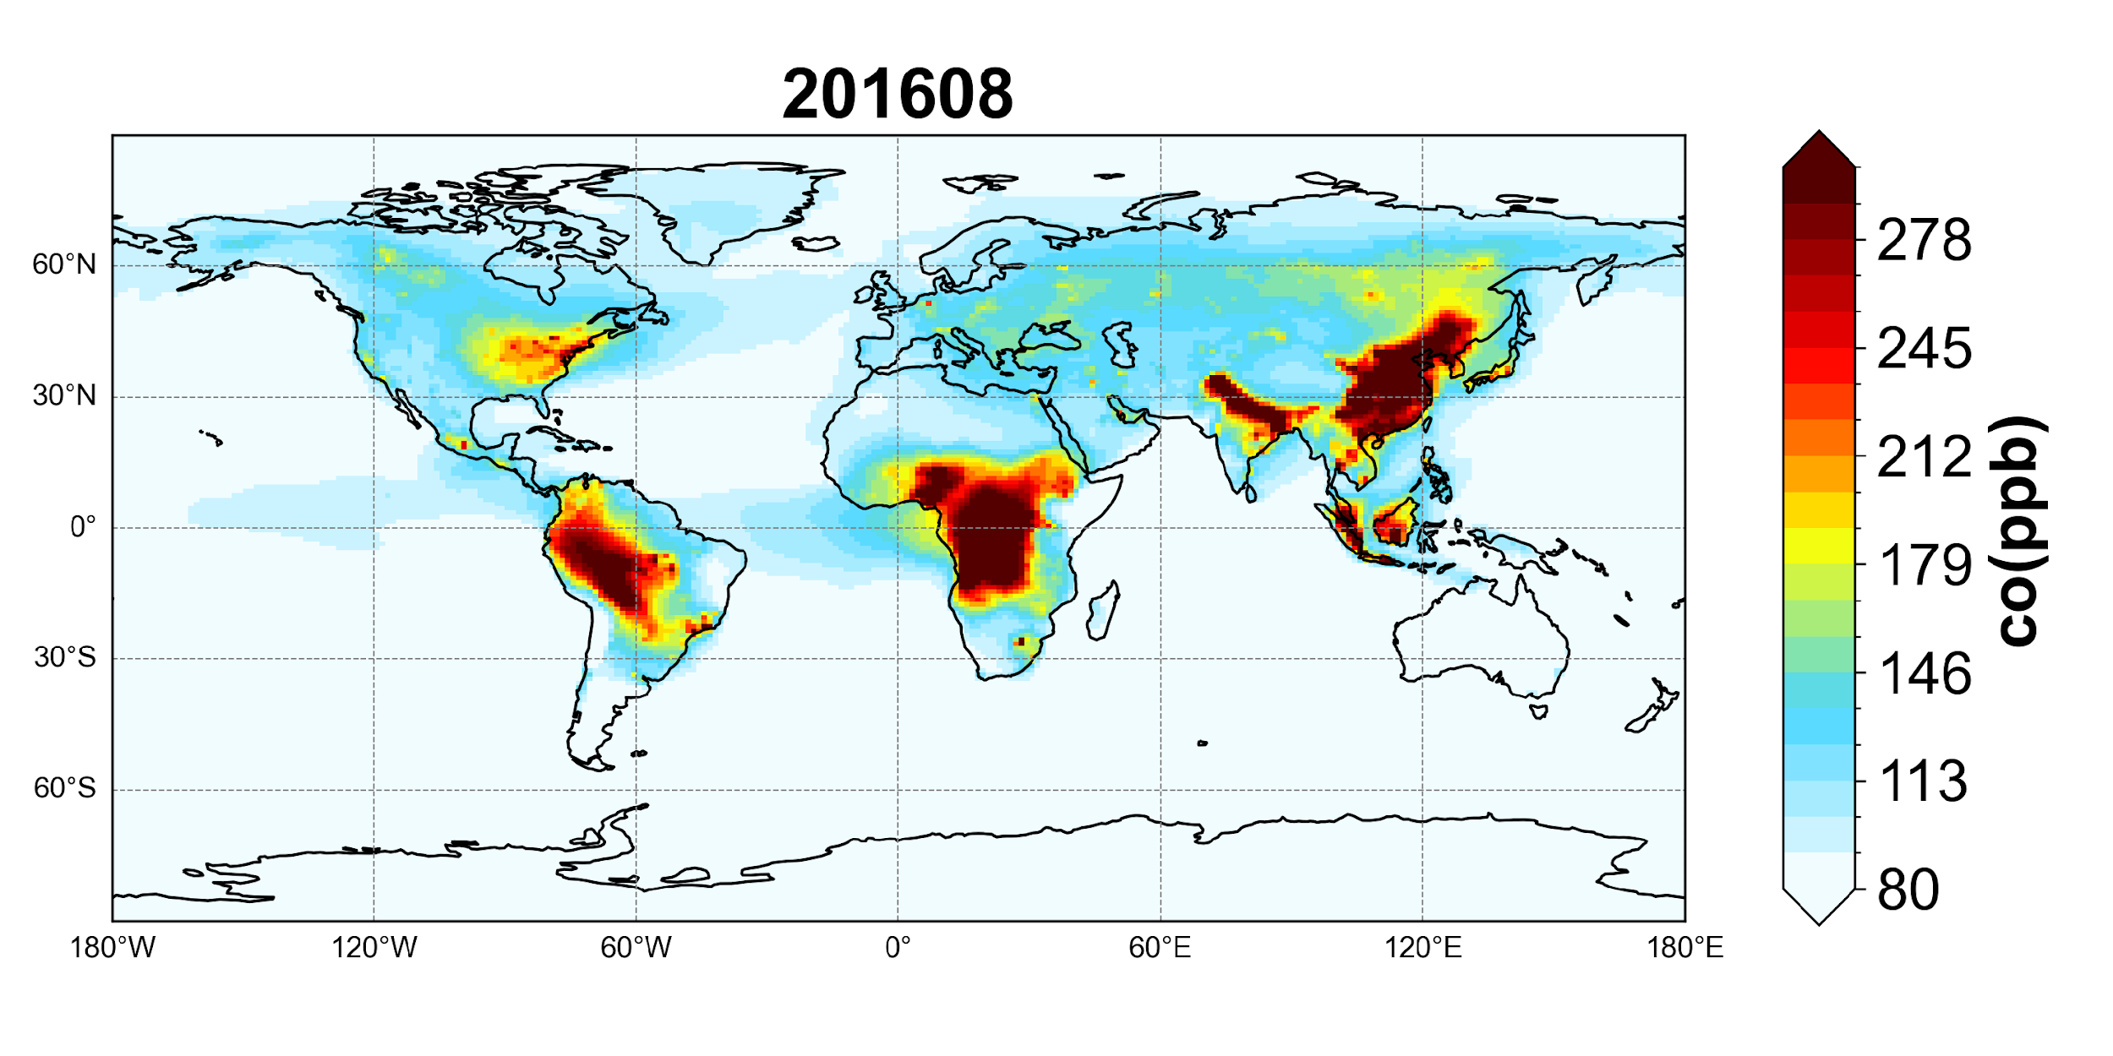
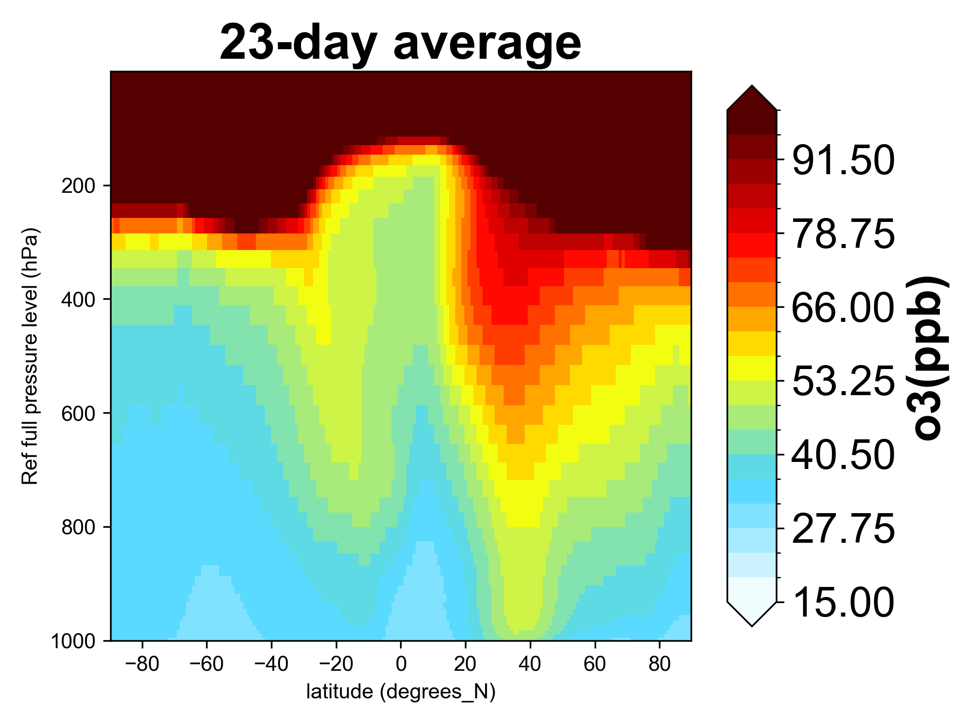
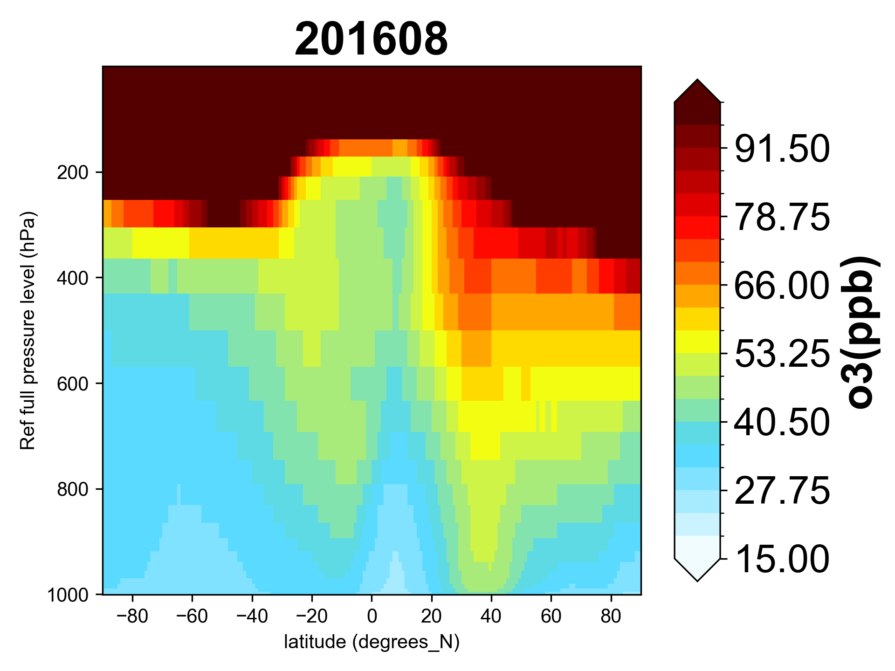
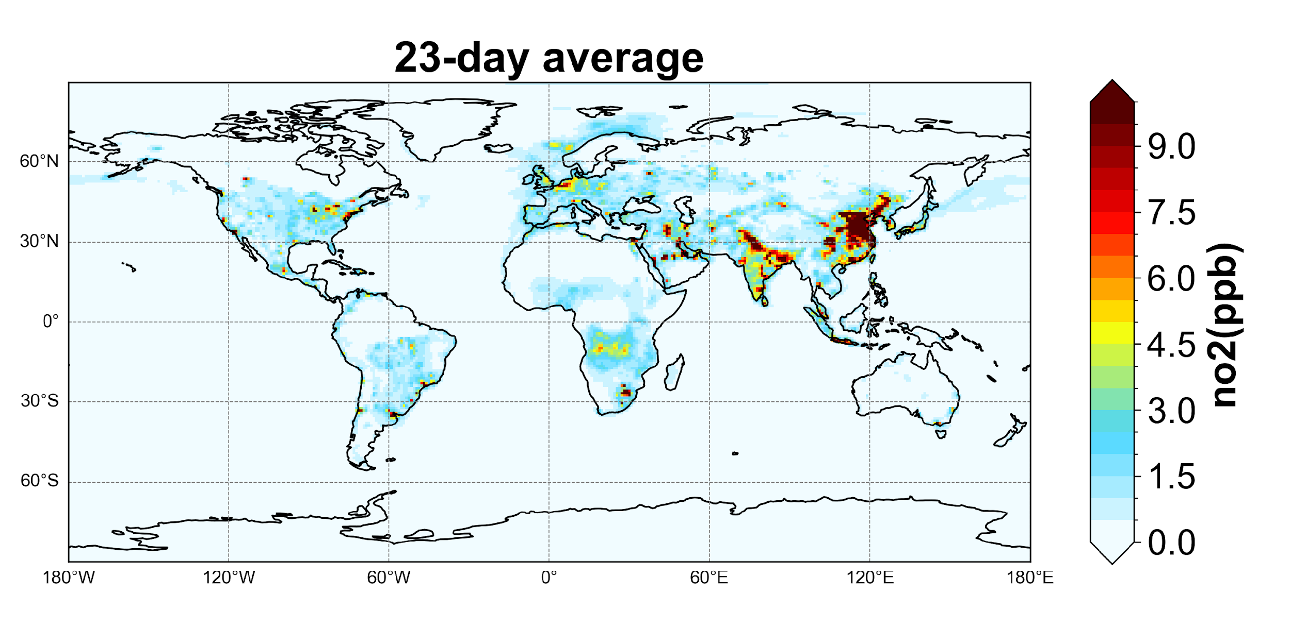
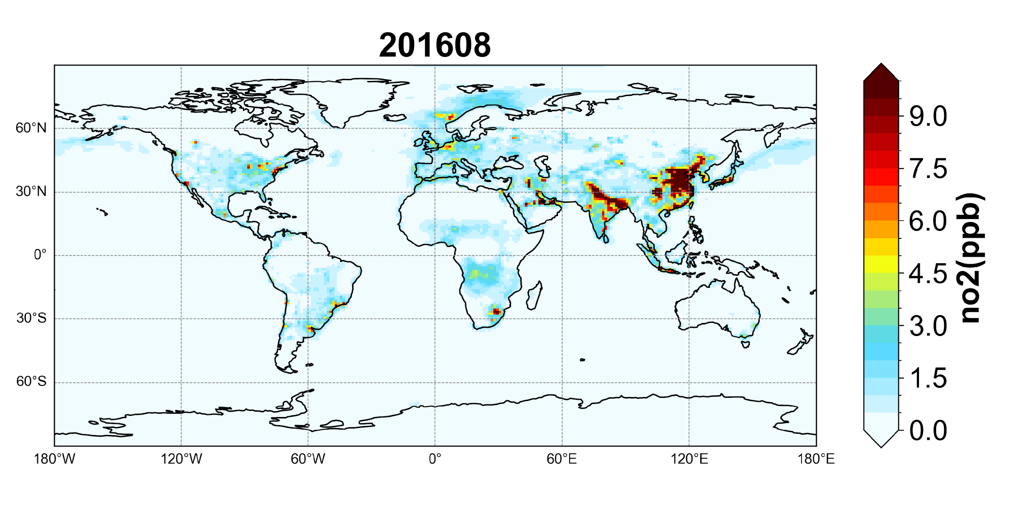
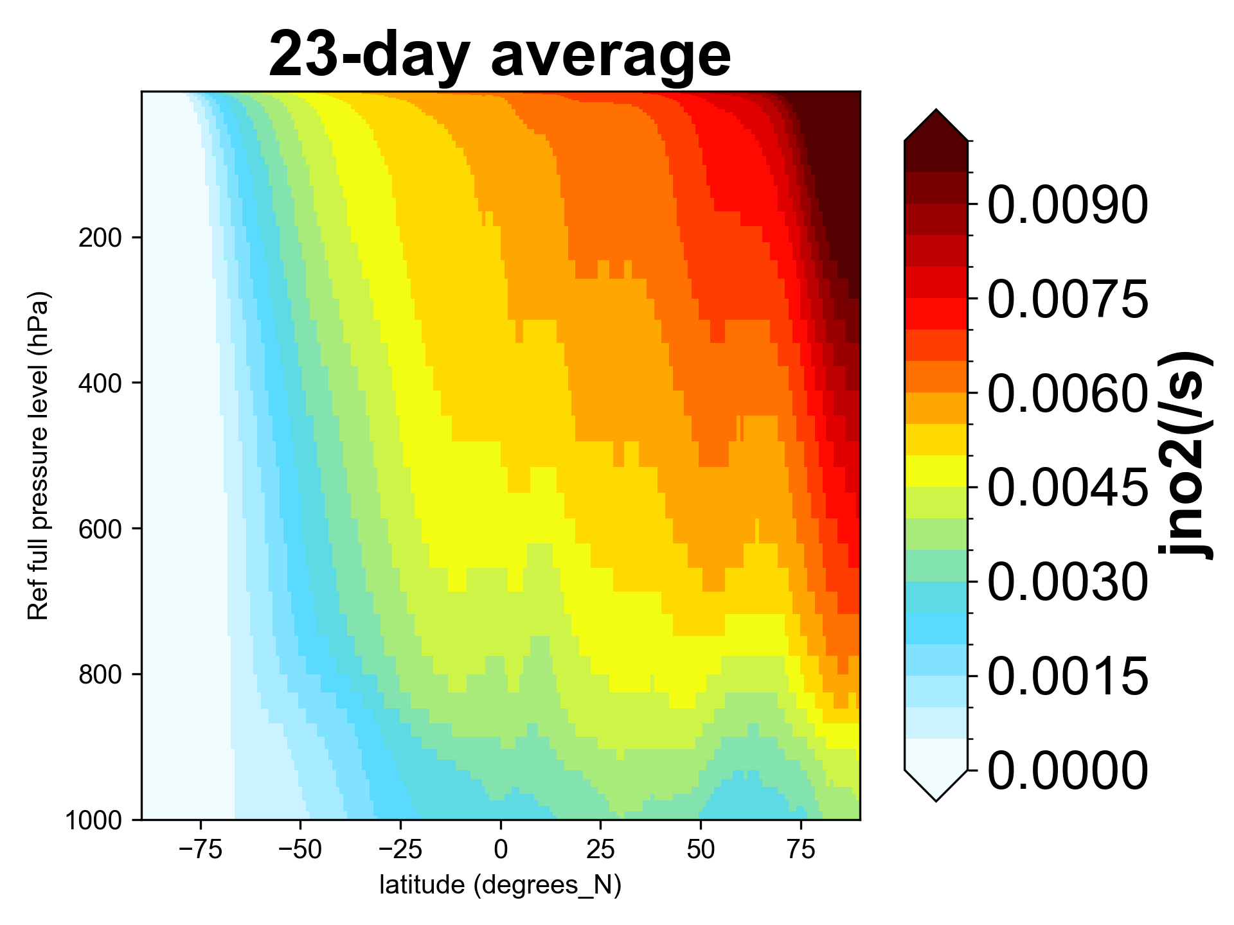
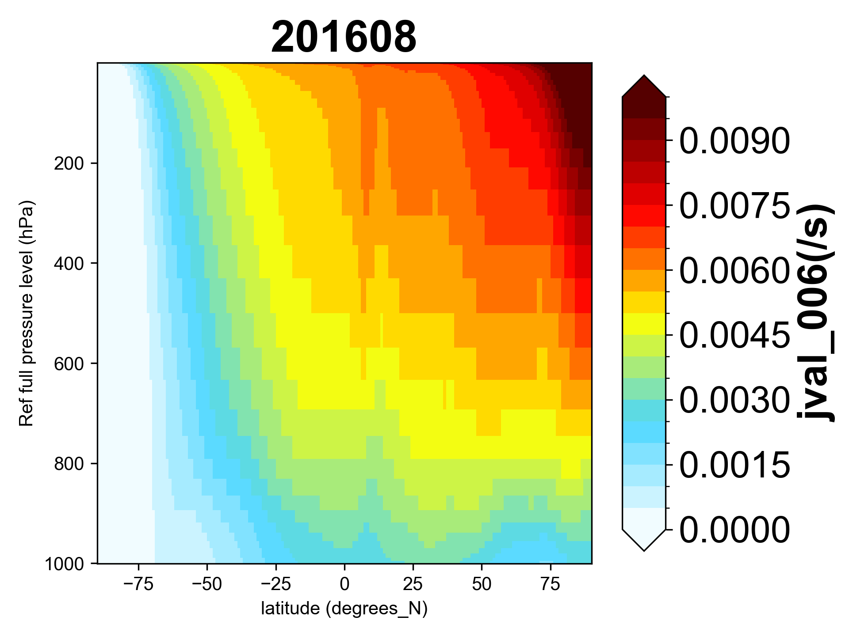
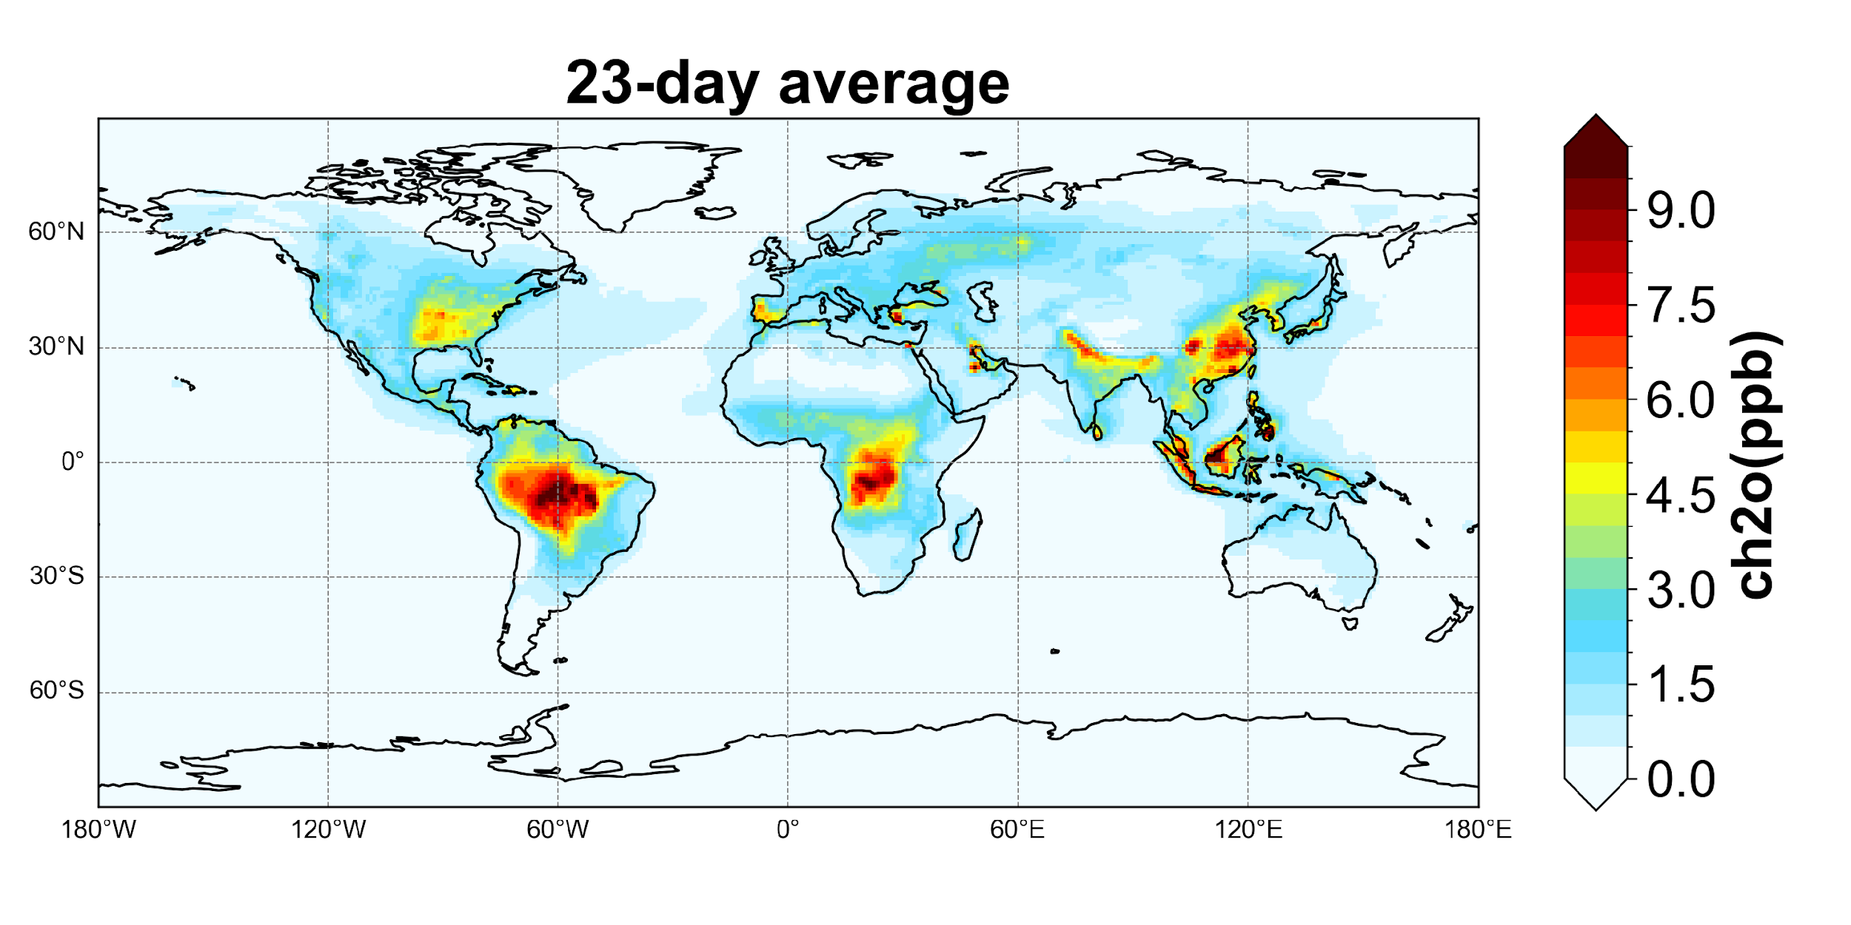
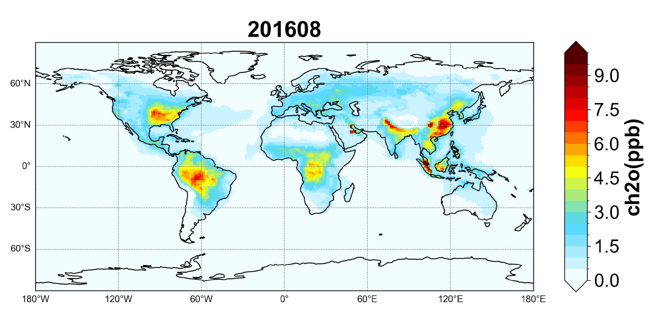
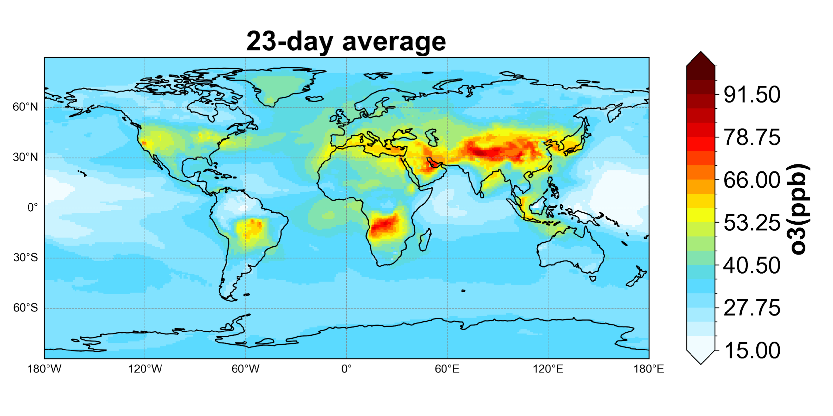
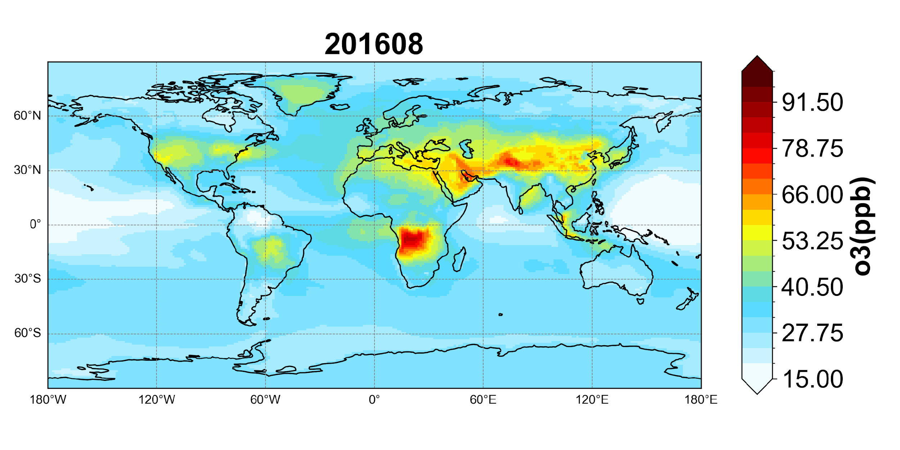
UFS-Chem vs GFDL-AM4.1: chemical tracers
UFS-Chem
GFDL-AM4.1
UFS-Chem
GFDL-AM4.1
Comparable gas tracers

Slide 10
UFS-Chem vs GFDL-AM4.1: global totals
Global Burden (Tg)
Tracer | Relative diff. (%) | Tracer | Relative diff. (%) | Tracer | Relative diff. (%)
Bry | -2.19 | CH3OH | 40.74 | ISOP | -25.44
C10H16 | -17.45 | CH3OOH | 3.34 | N2O5 | -12.51
C2H4 | 4.63 | CH4 | 1.14 | NH3 | 34.46
C2H5OH | 31.29 | CO | 1.93 | NO | -2.43
C2H6 | -0.72 | Cly | -1.26 | NO2 | -0.80
C3H6 | -1.27 | DMS | -16.02 | NOy | 15.19
C3H8 | 2.75 | H2 | 0.32 | O1D | -8.56
C4H10 | 7.54 | H2O2 | 13.77 | O3 | 0.99
CH2O | 12.96 | HNO3 | 22.05 | OH | 9.29
CH3CHO | 6.17 | HO2 | 3.76 | PAN | 17.13
Initial conditions
Physics options are different (PBL process, microphysics, convection, etc.)
Meteorology-dependent emission estimates are different (e.g., DMS, LNO_{x}, etc.)

Slide 11
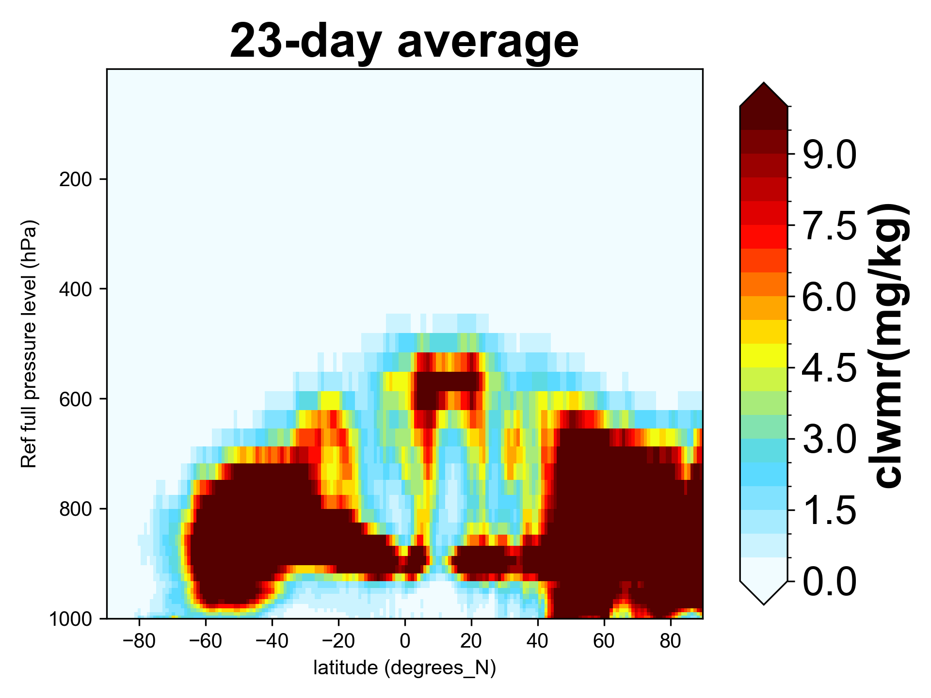
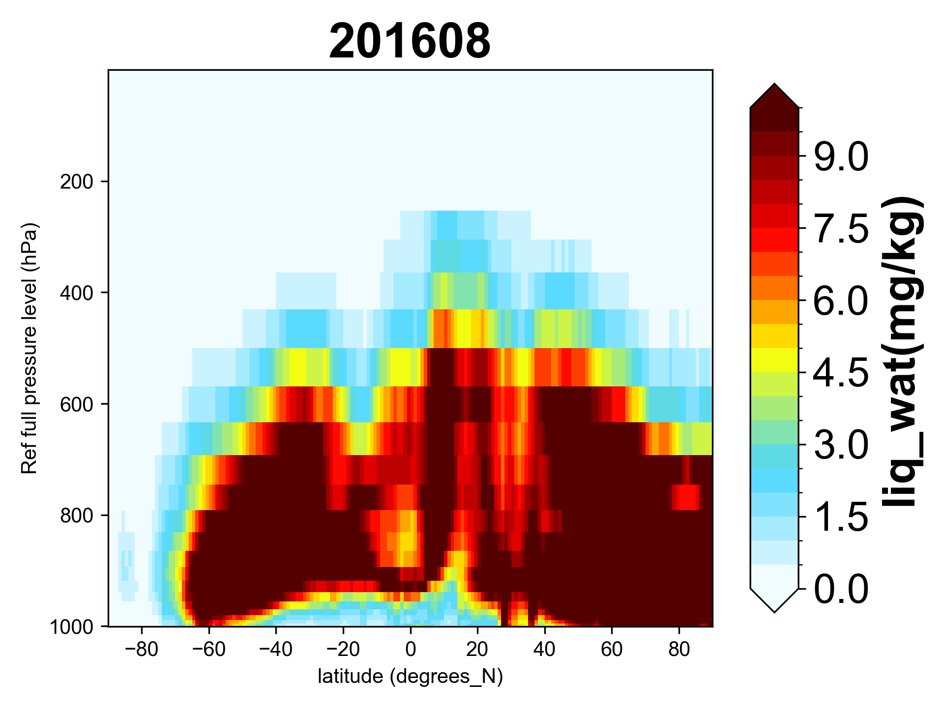
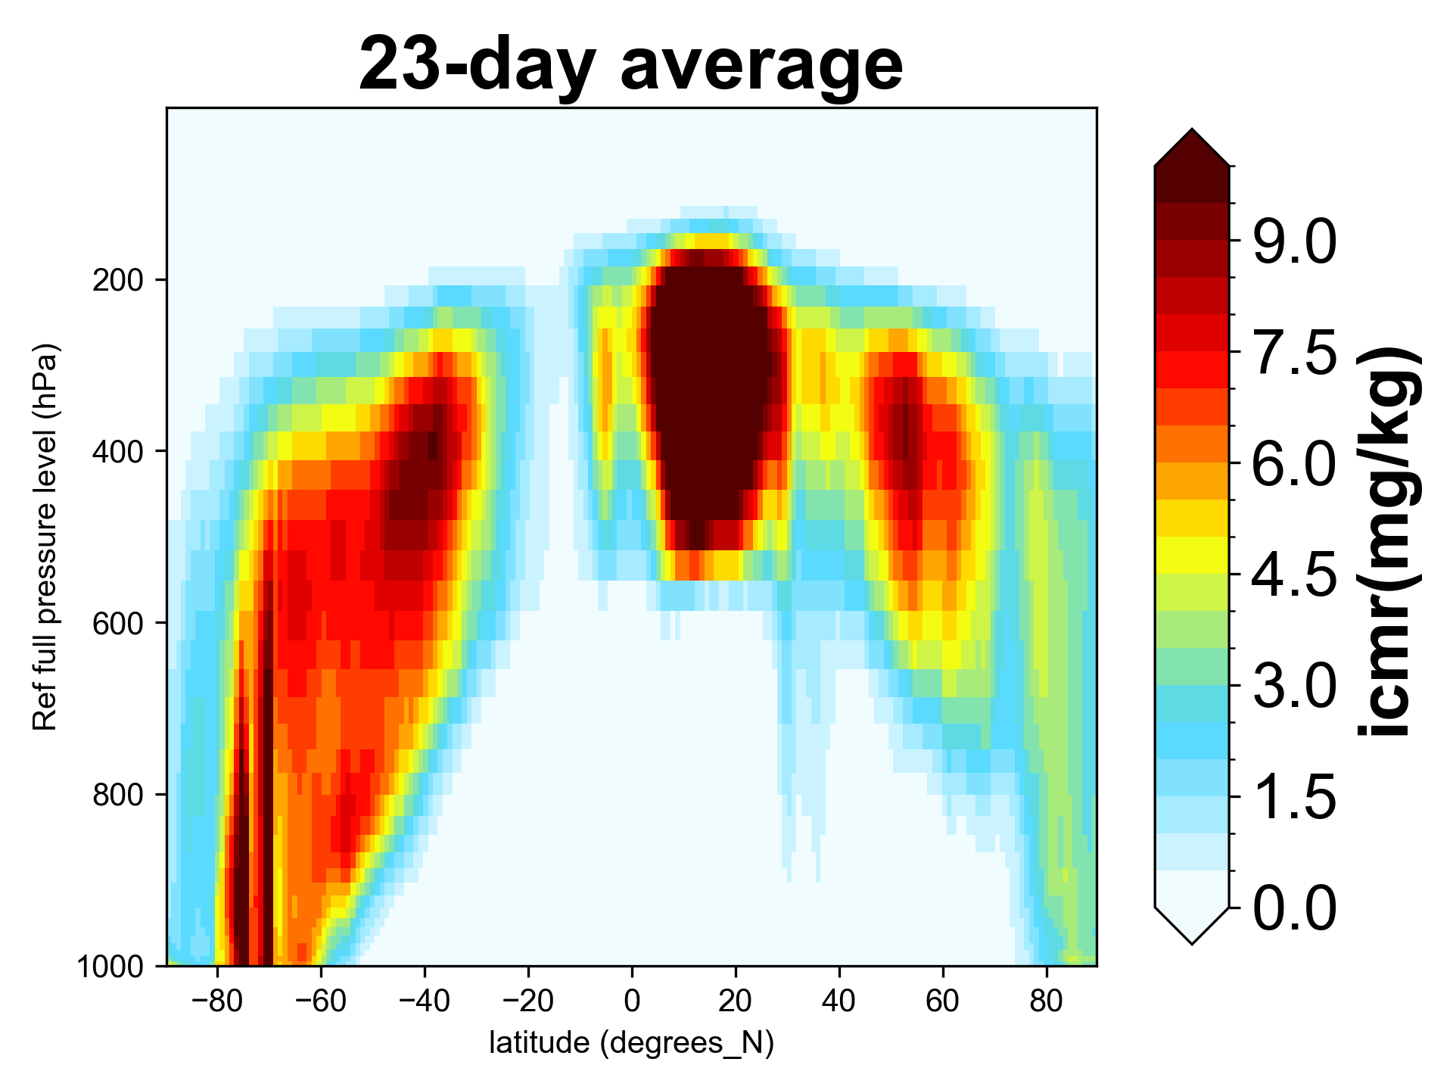
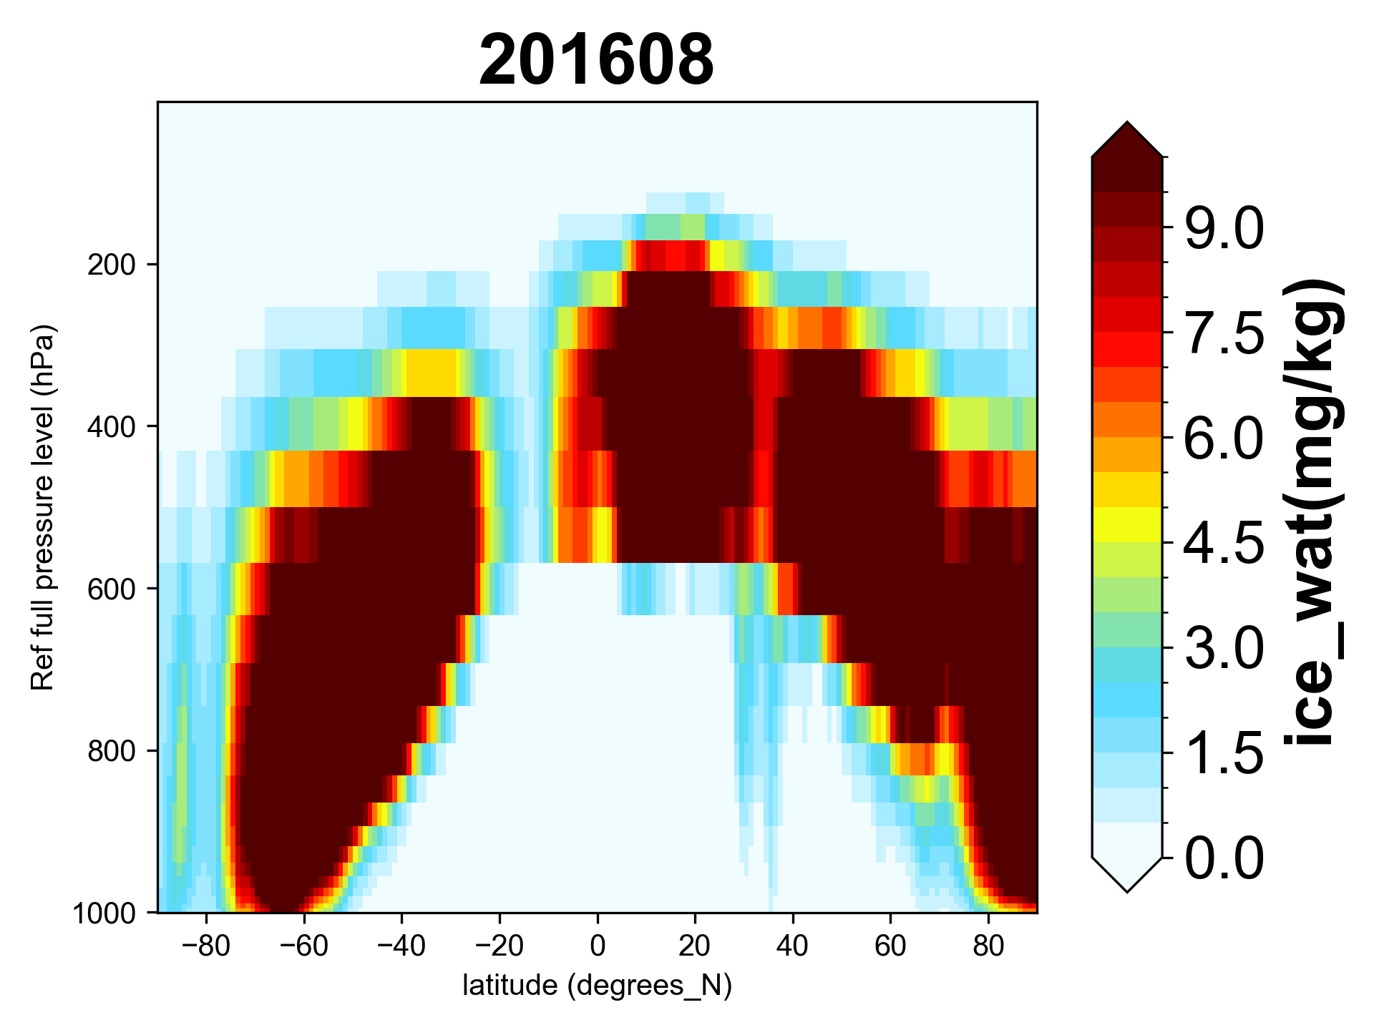
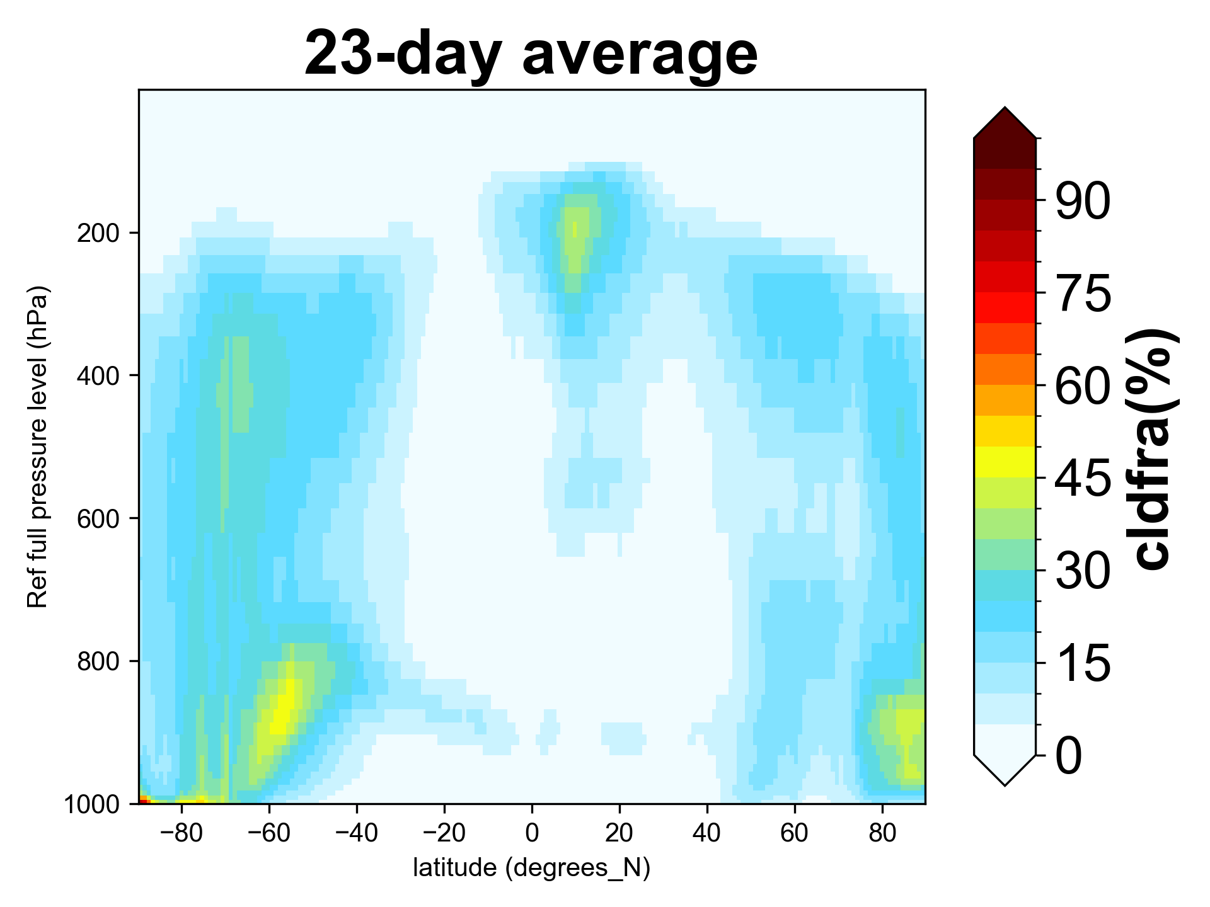
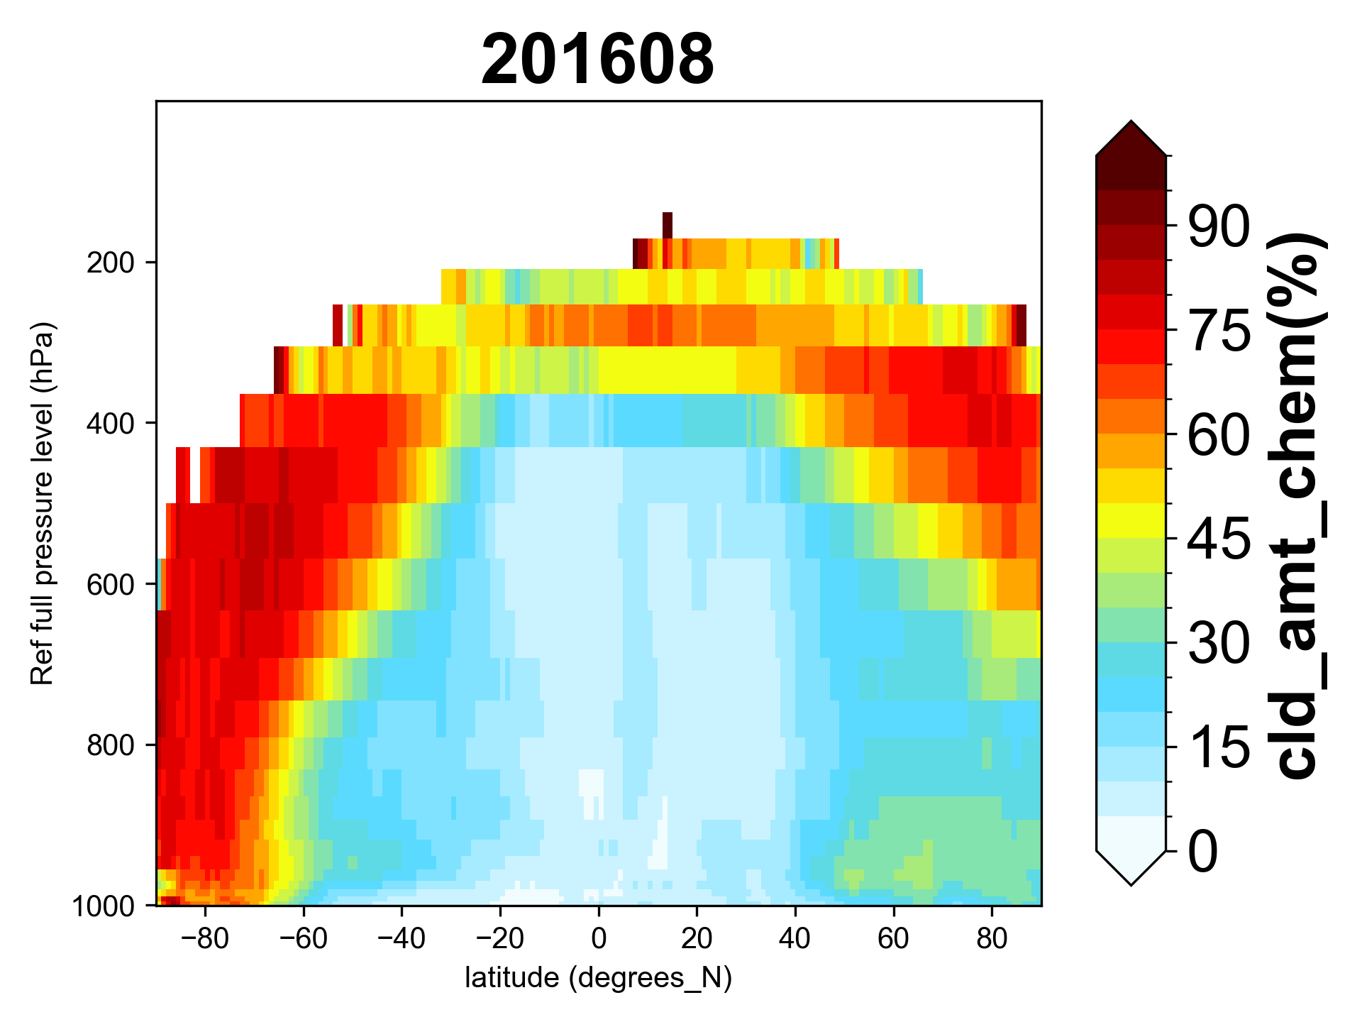
UFS-Chem vs GFDL-AM4.1: cloud variables
UFS-Chem
GFDL-AM4.1
UFS:
cloud liquid water, cloud ice water, rain water, snow water, graupel
AM4:
cloud liquid water, cloud ice water
Affect photolysis & cloud aqueous phase chemistry
Cloud
liquid water
Cloud
ice water
Cloud
fraction

Slide 12
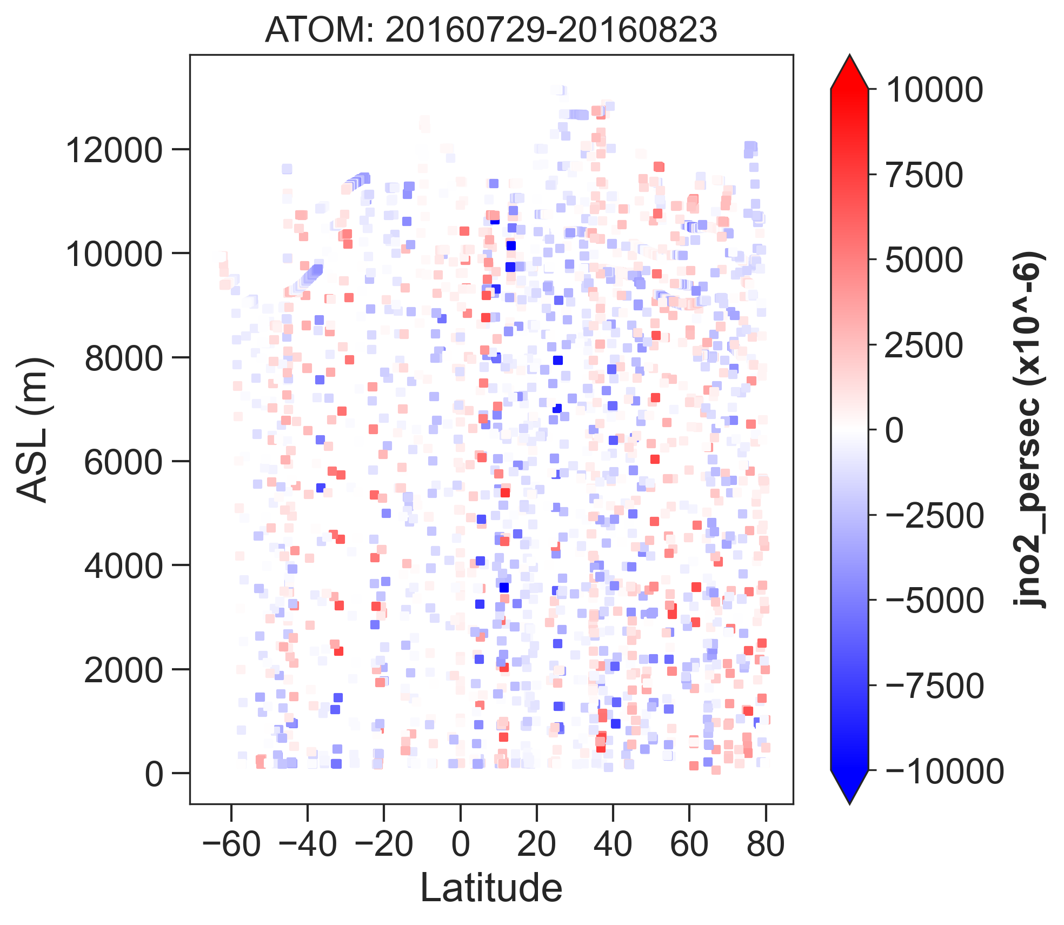
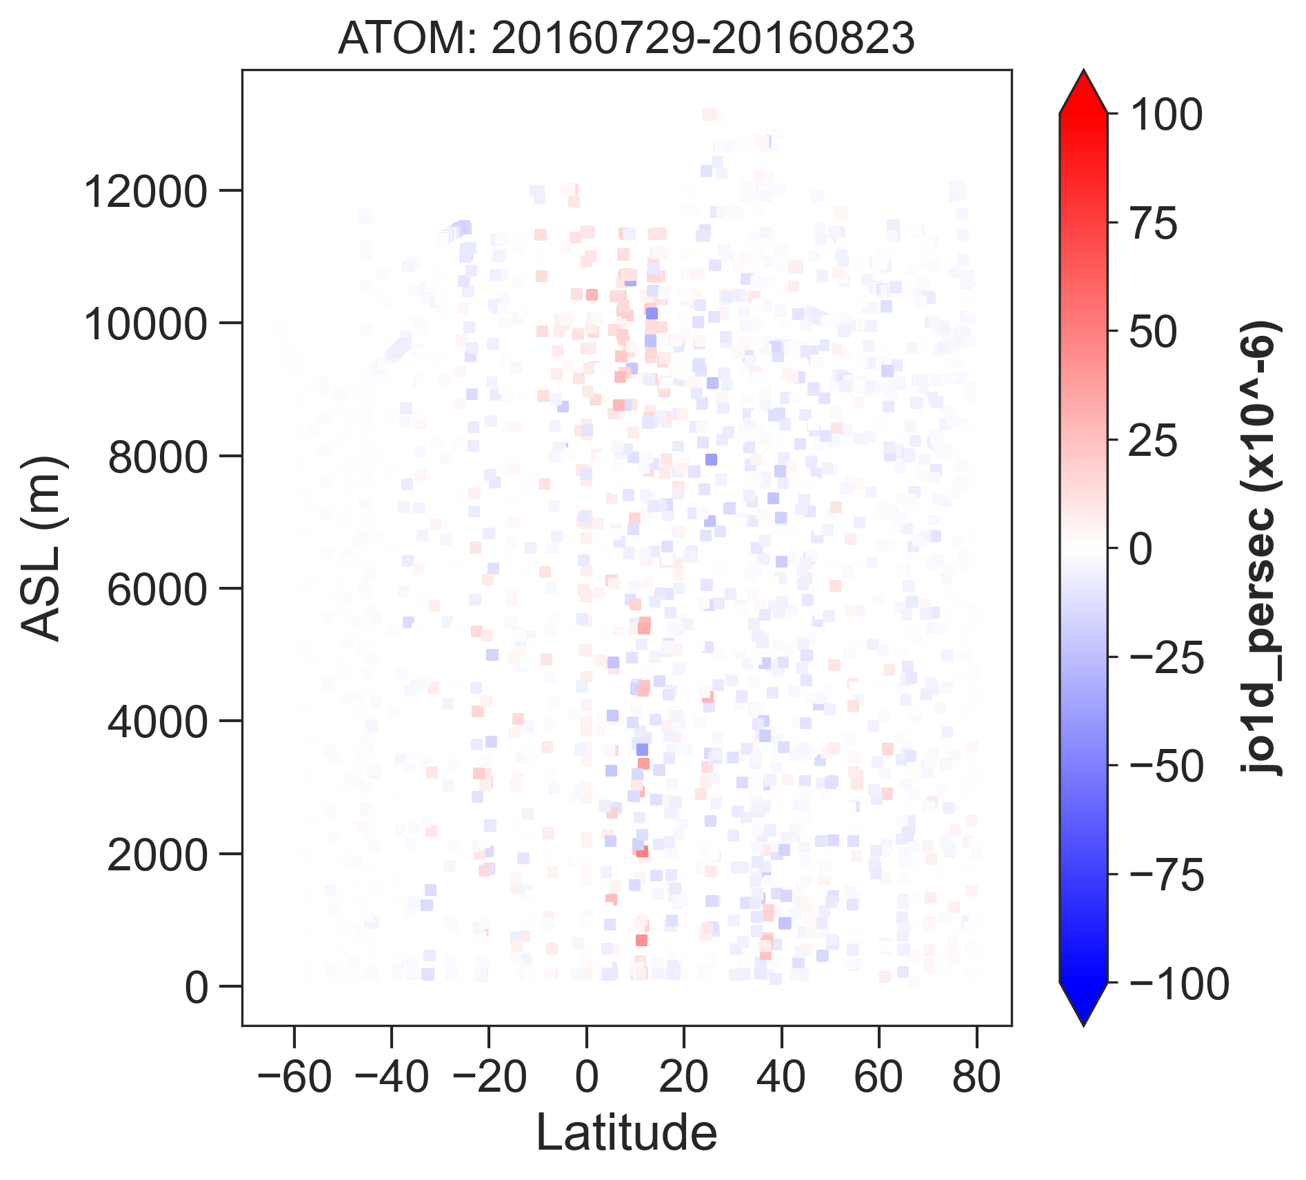
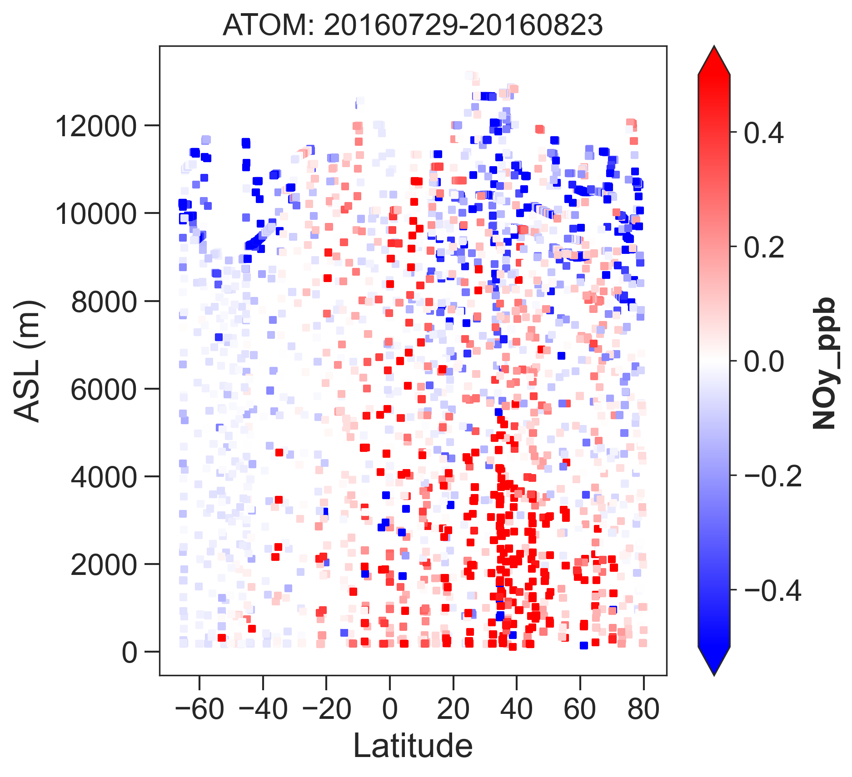
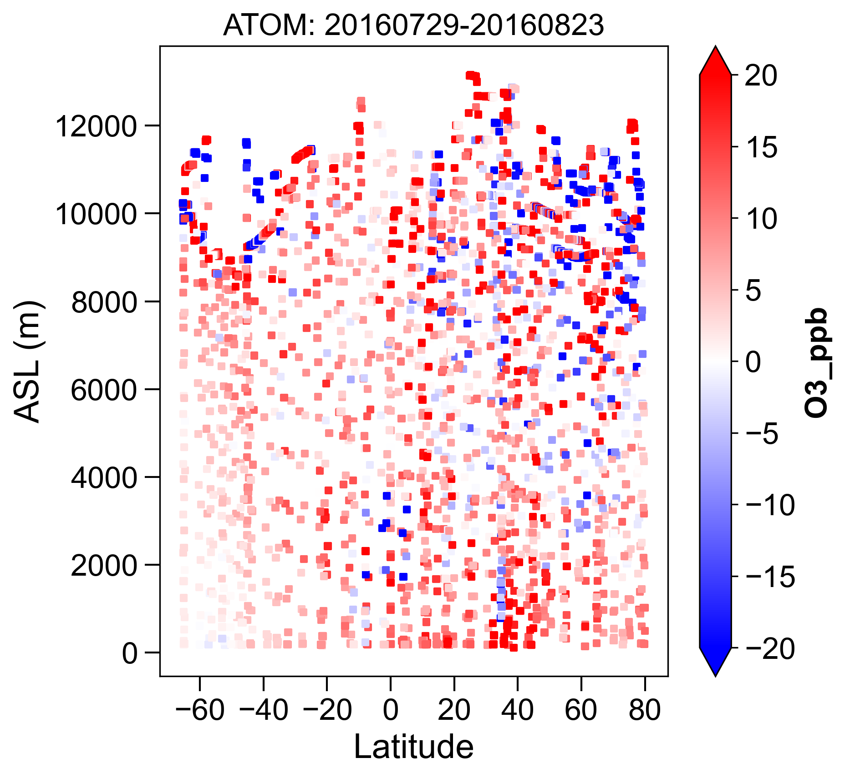
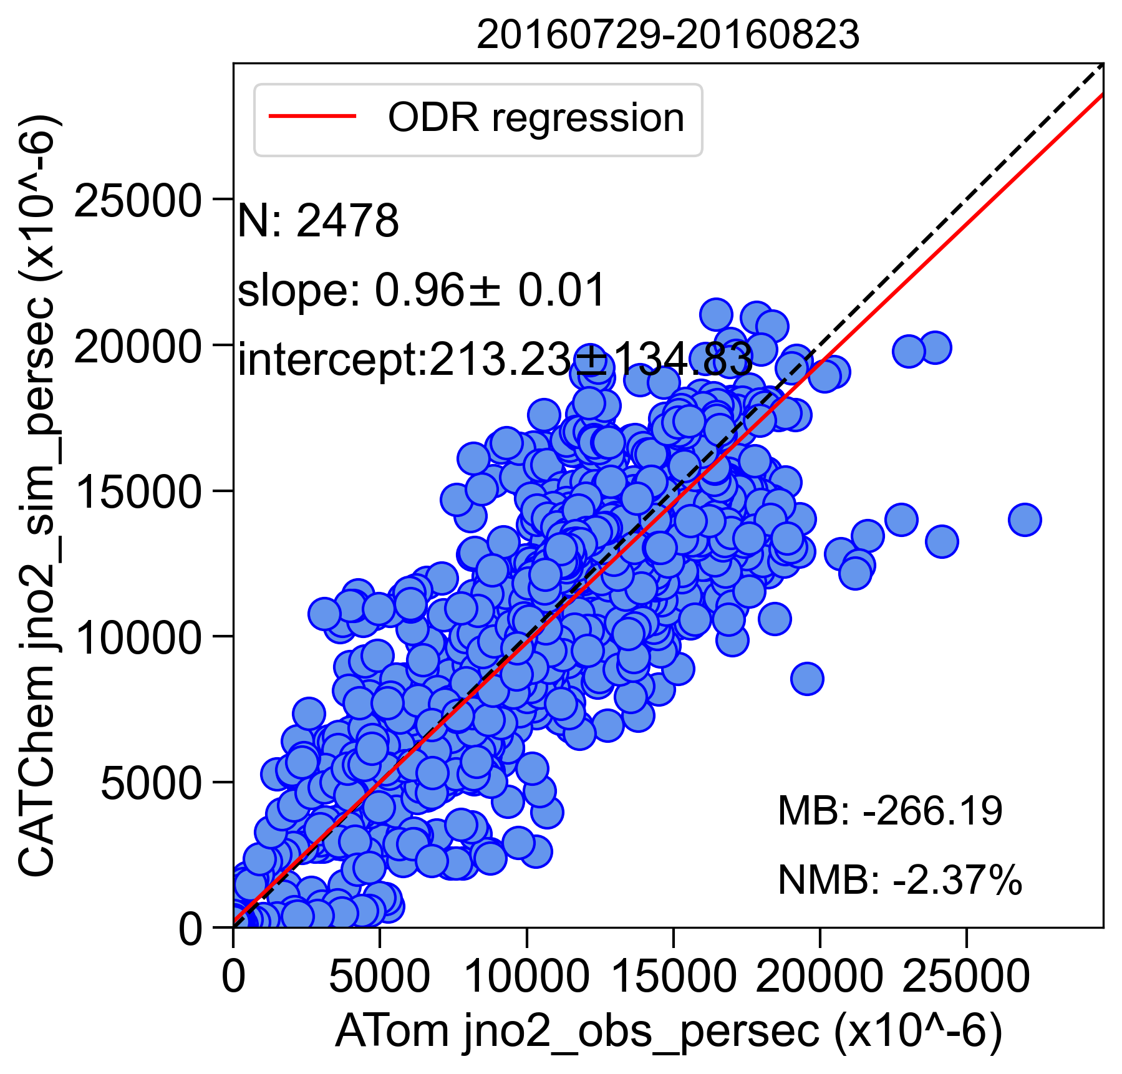
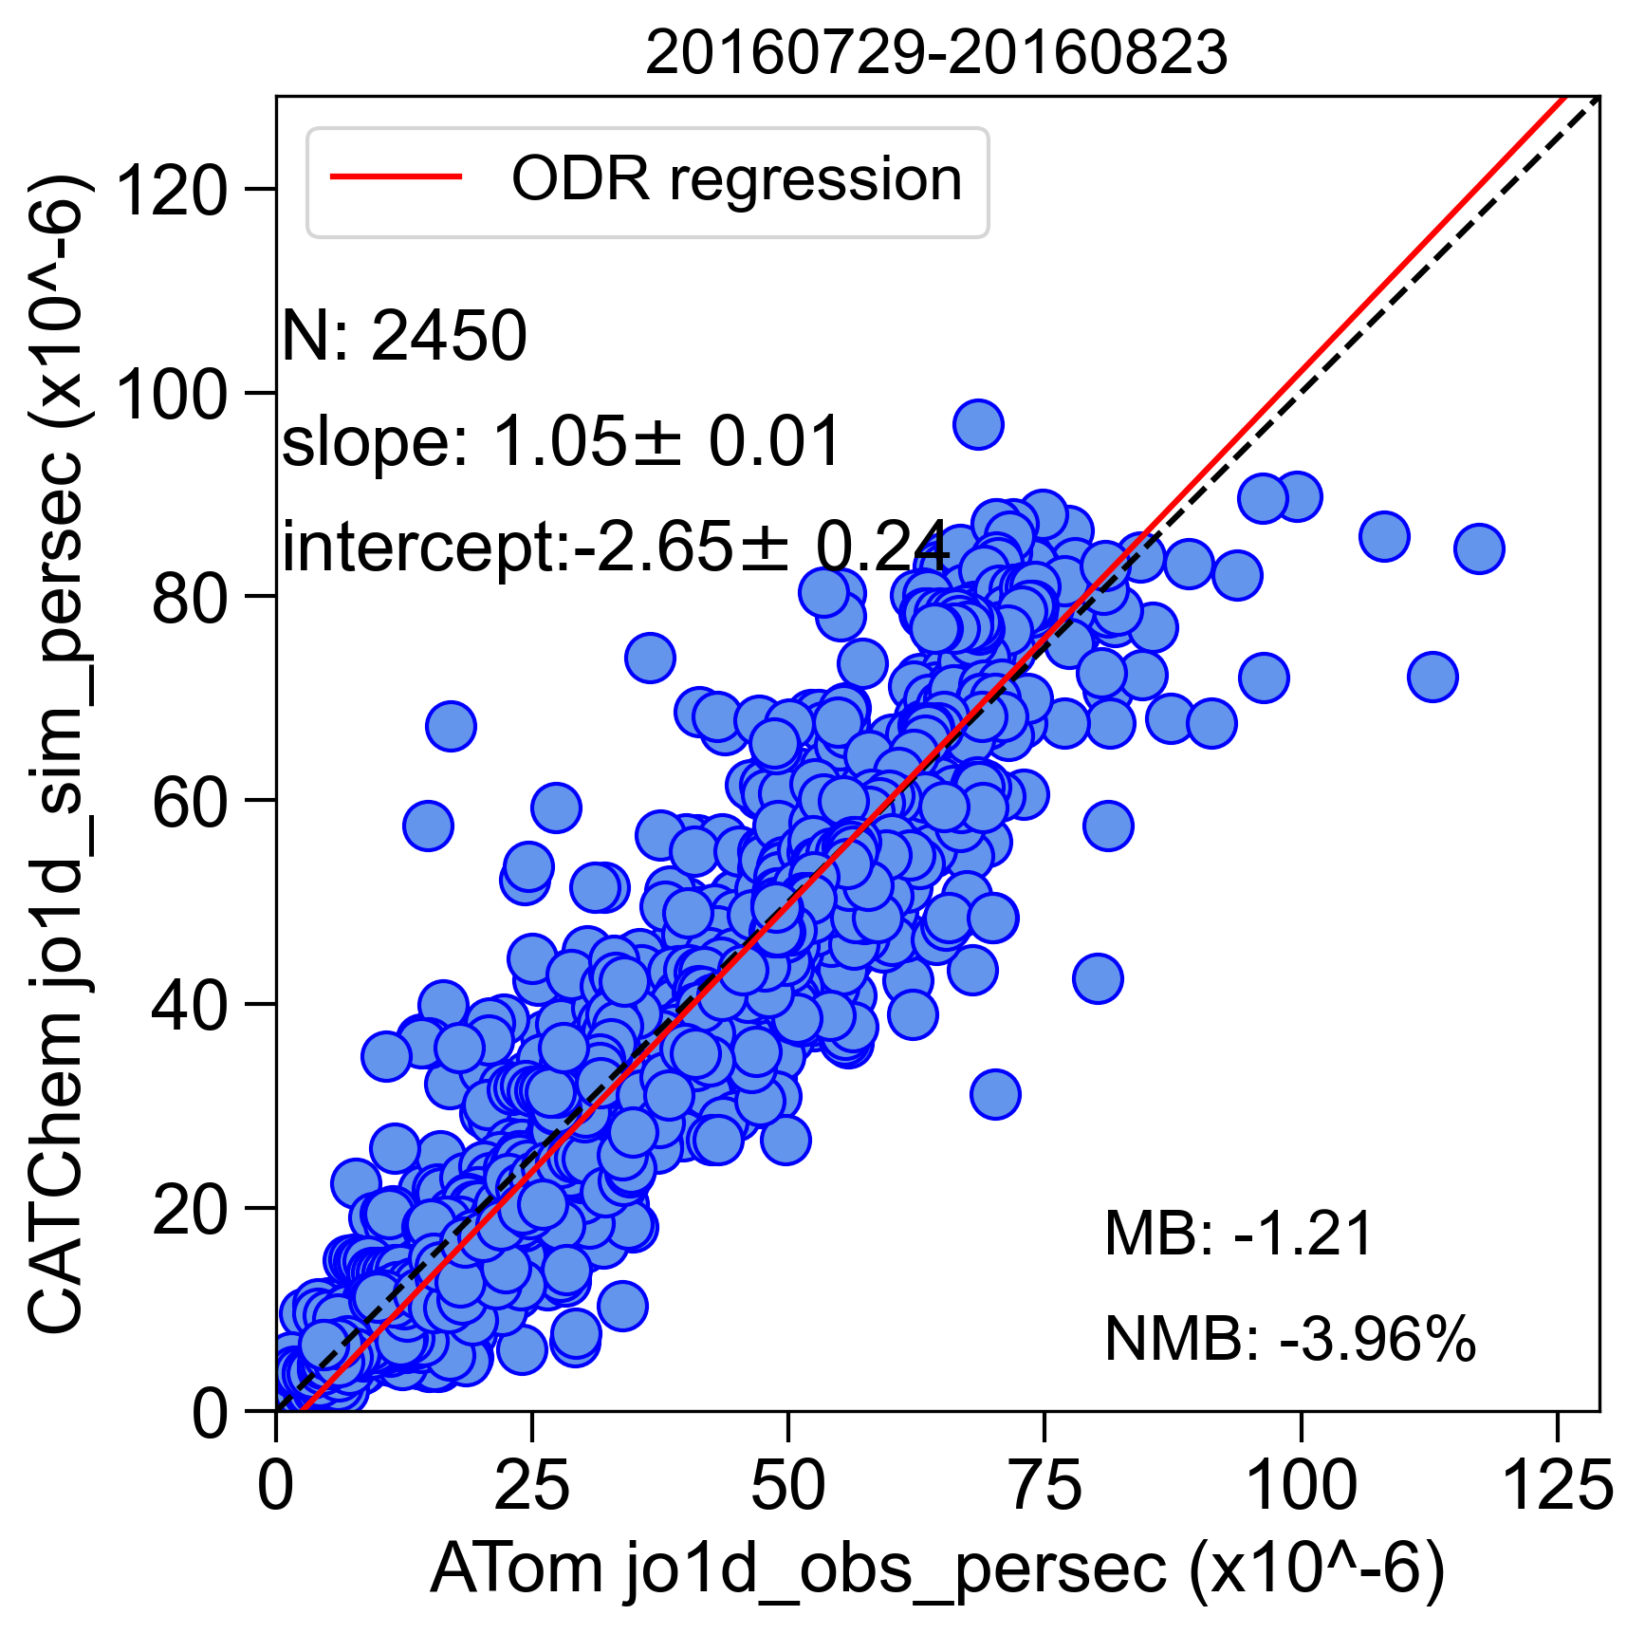
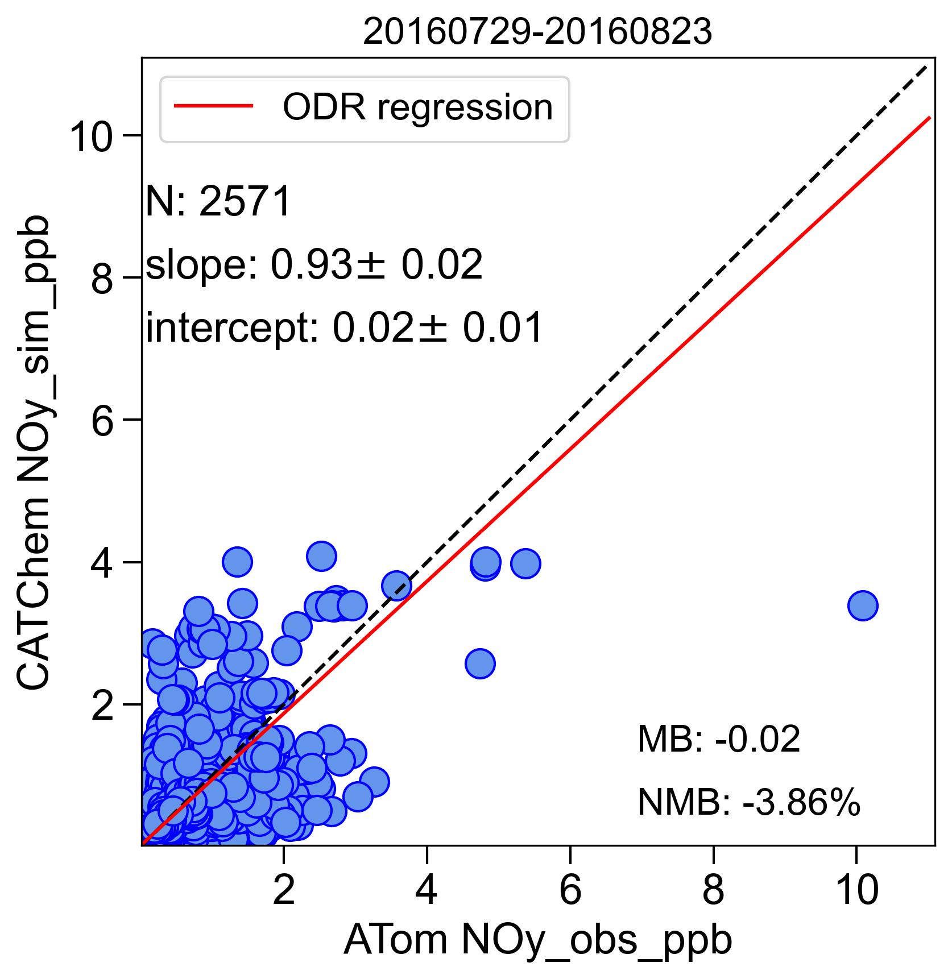
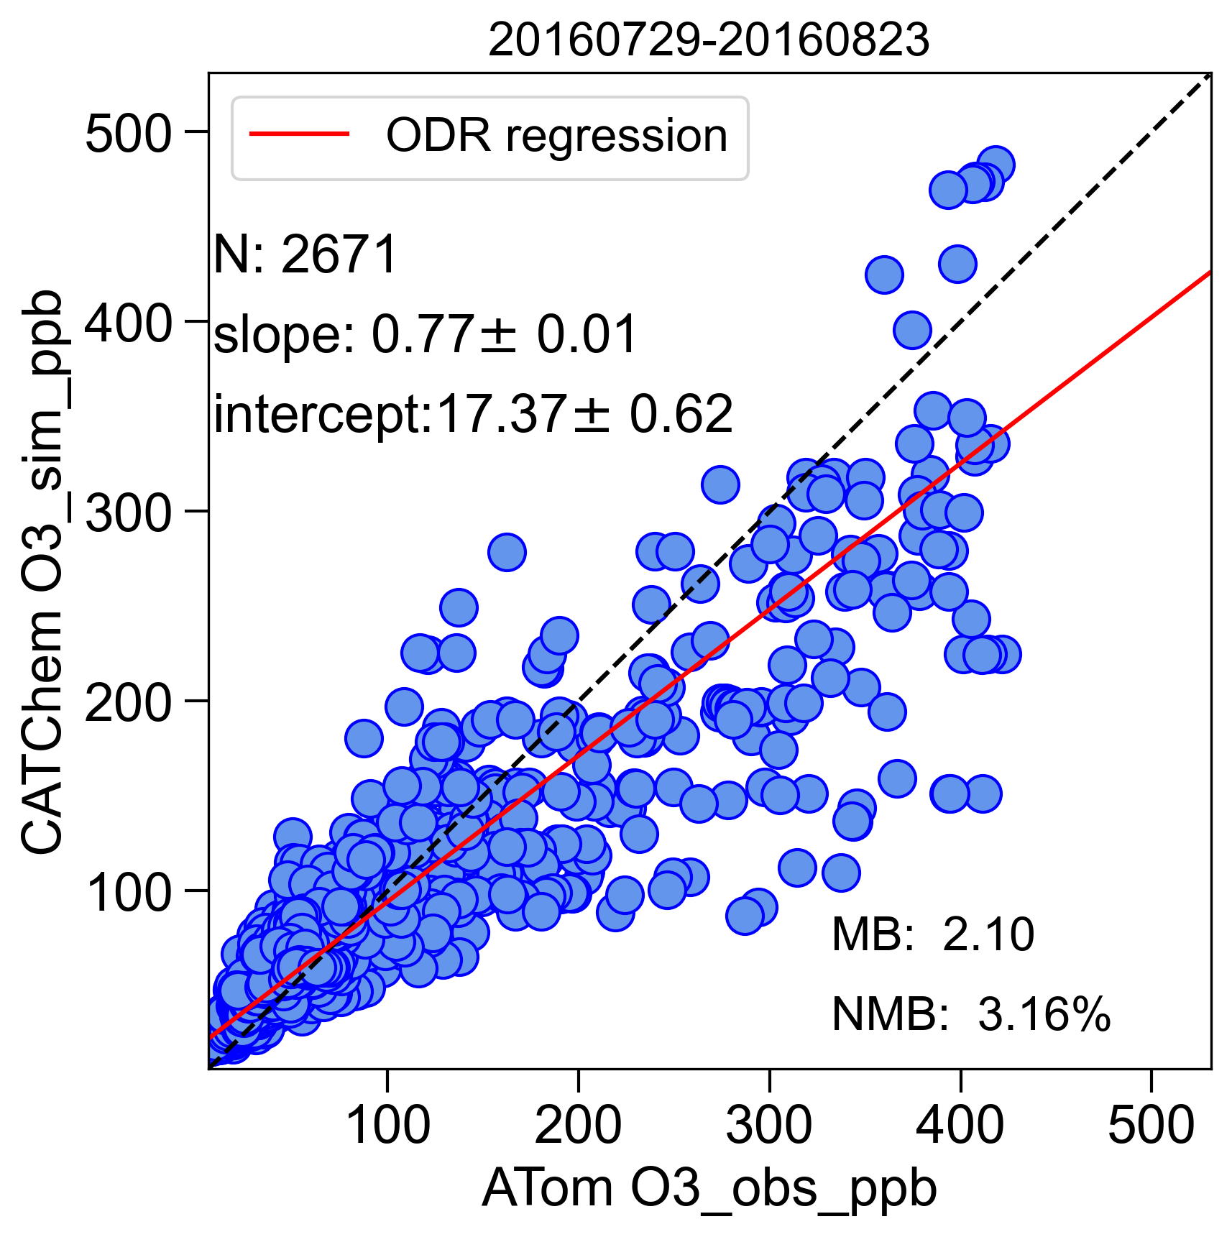
UFS-Chem vs ATom-1: preliminary
Photochemistry is overall well represented in the model.

Slide 13
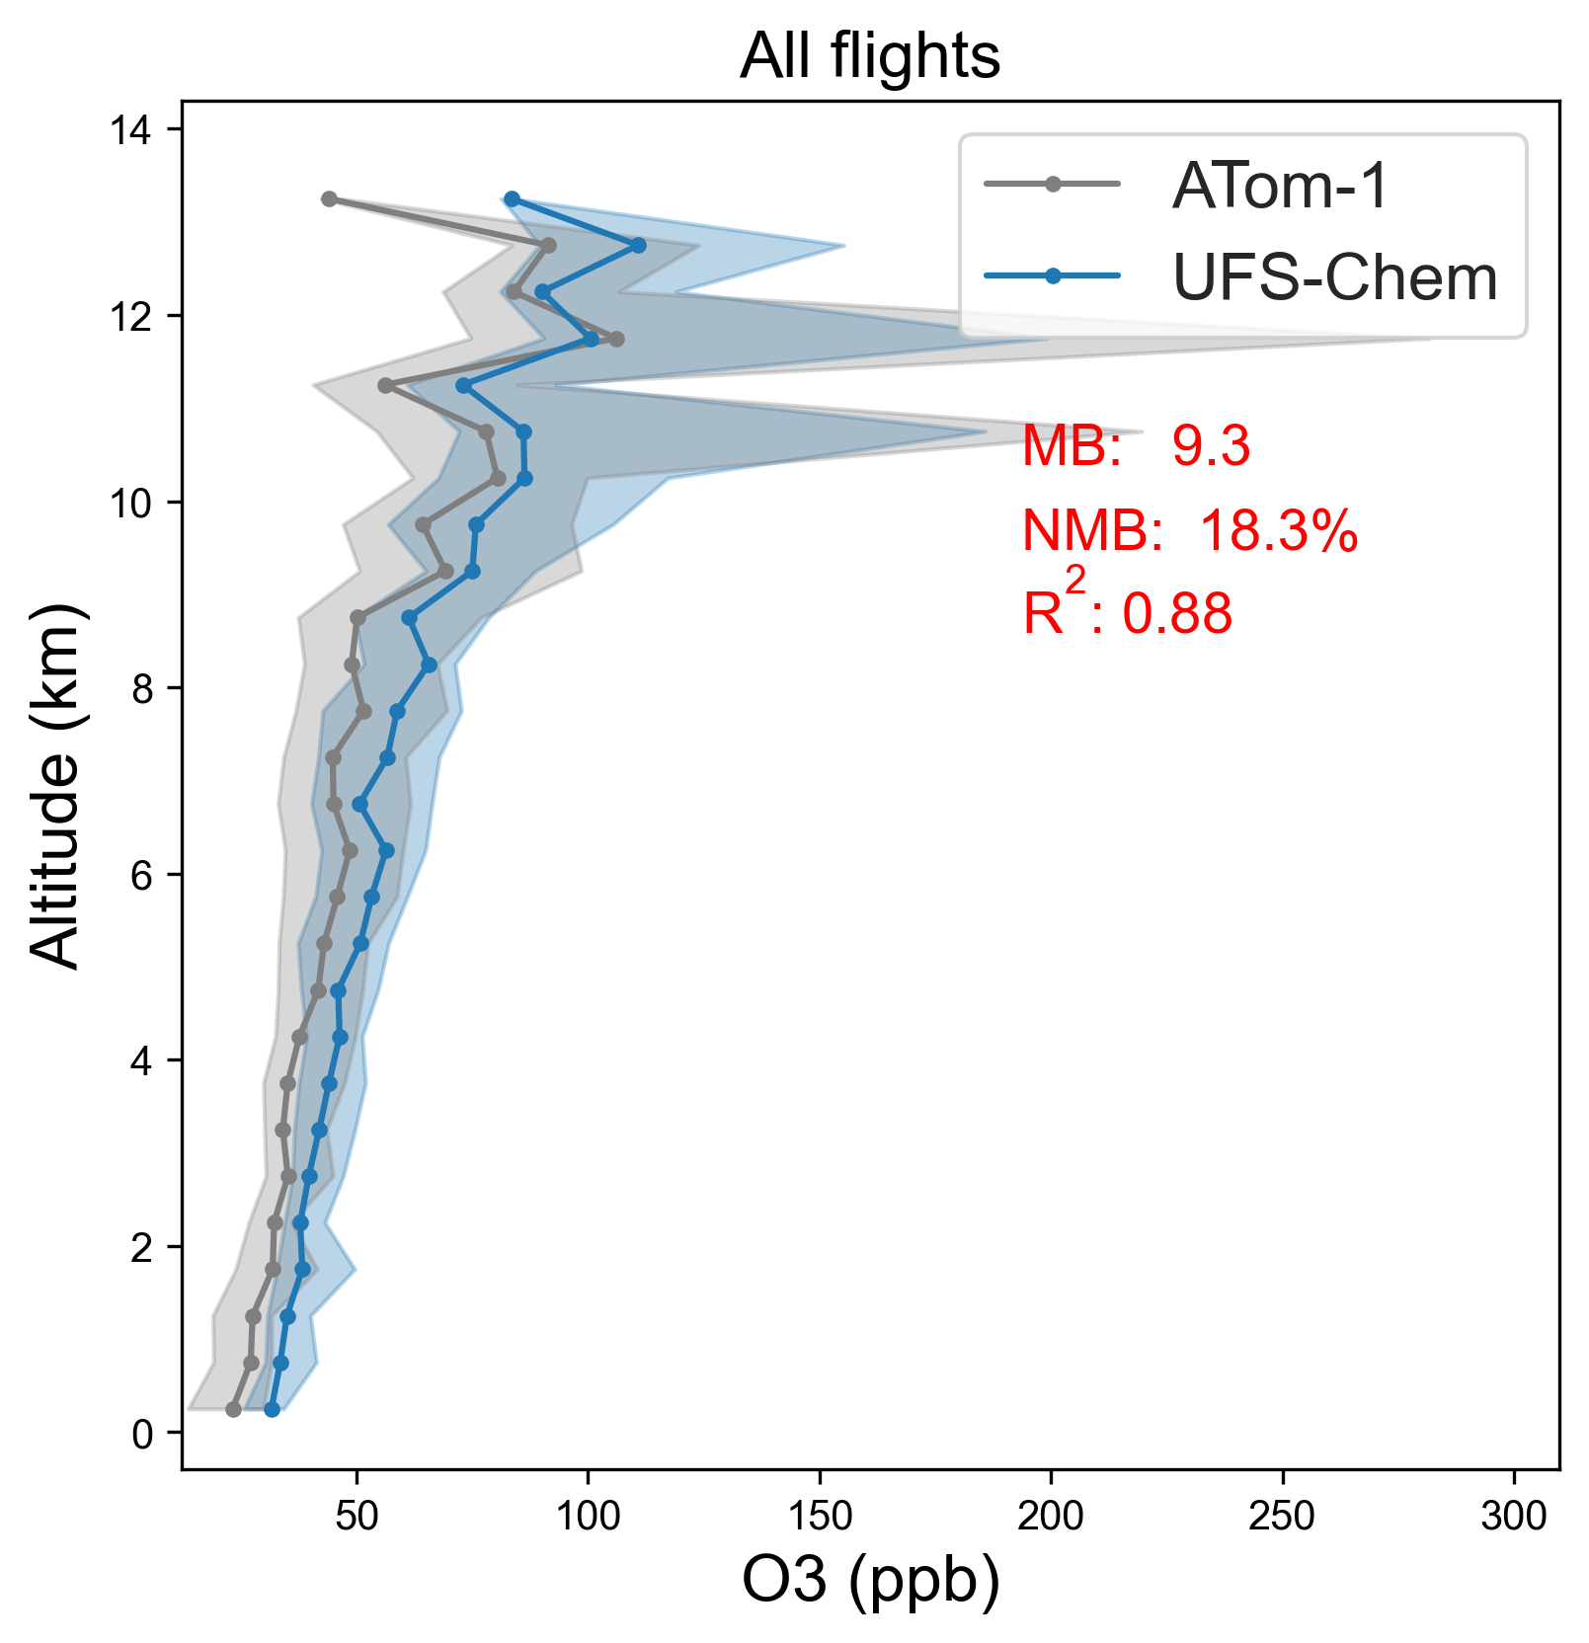
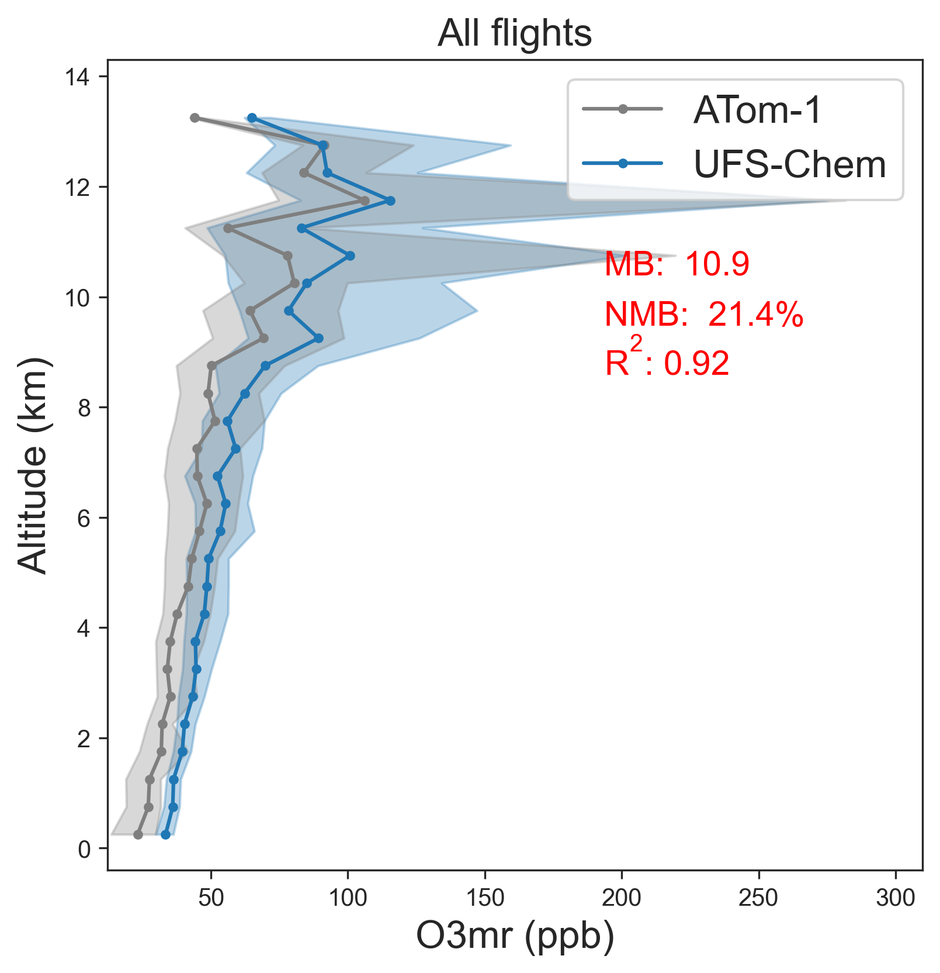
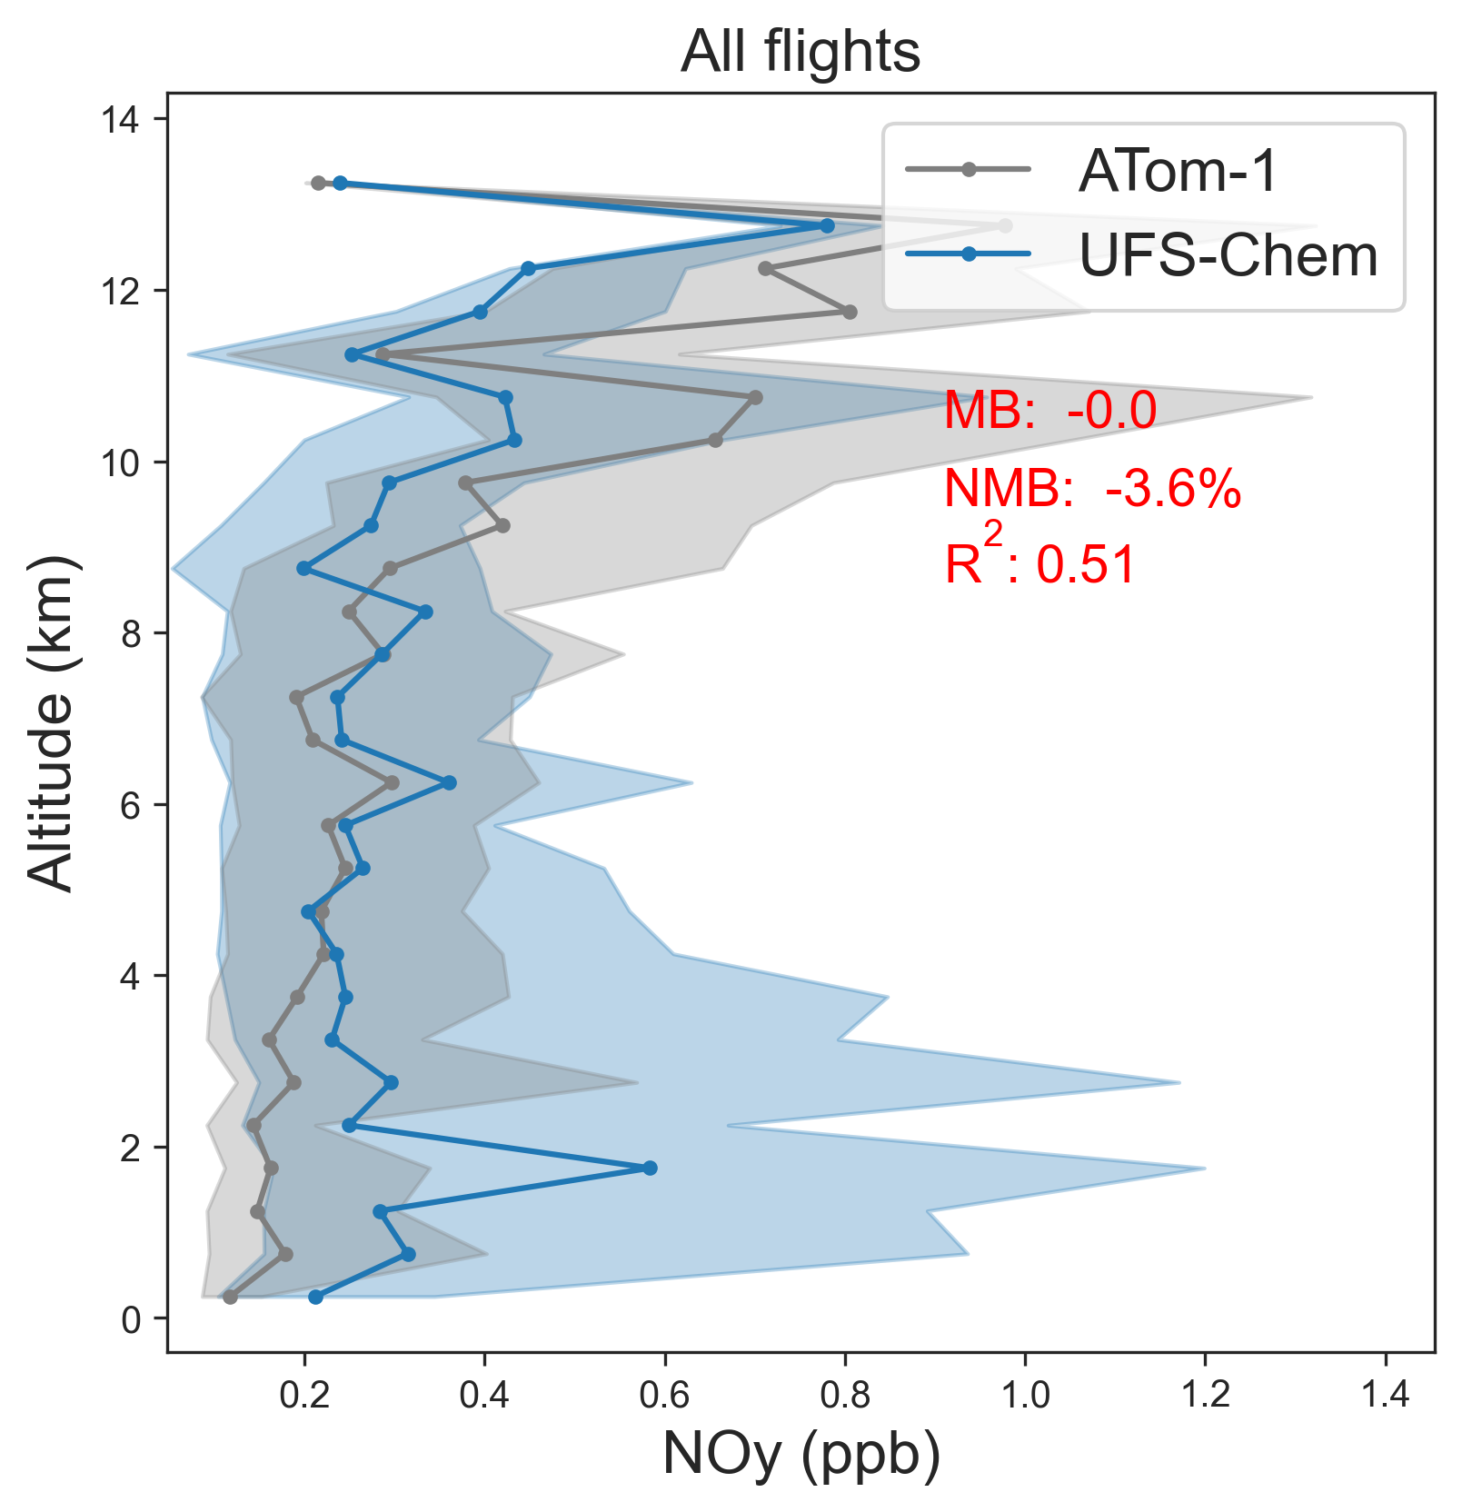
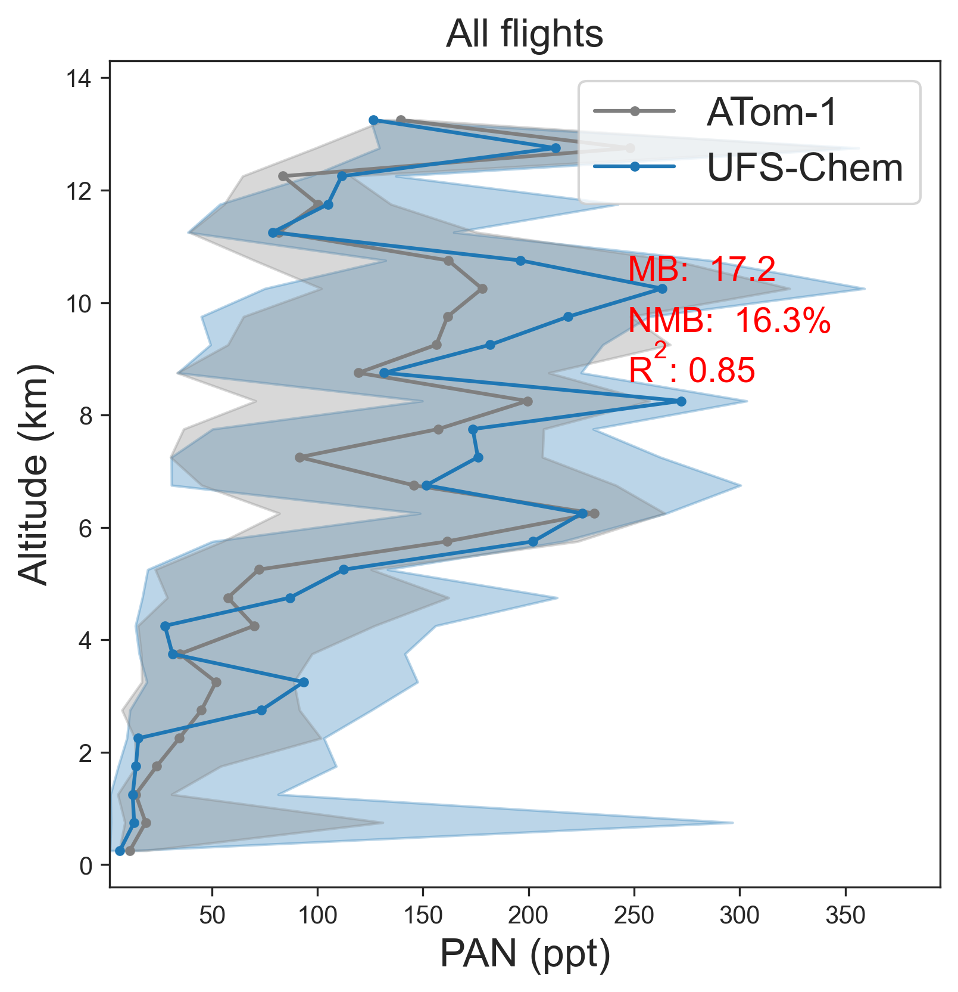
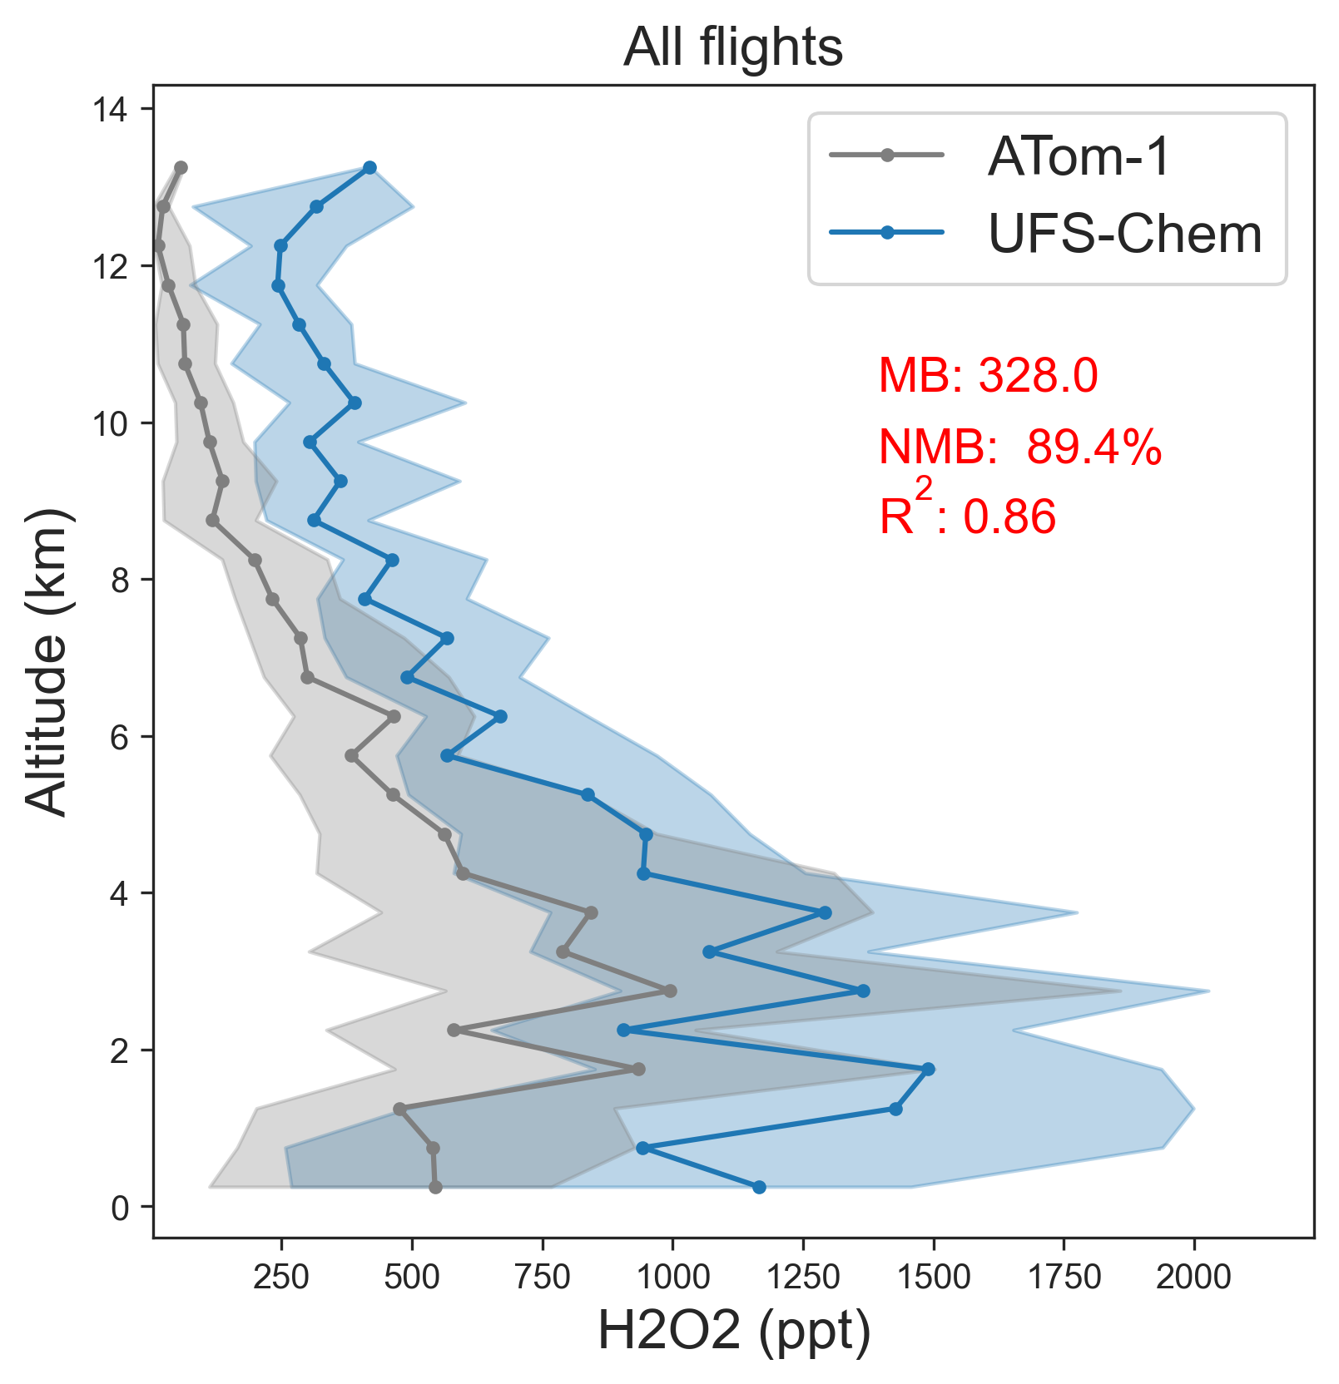
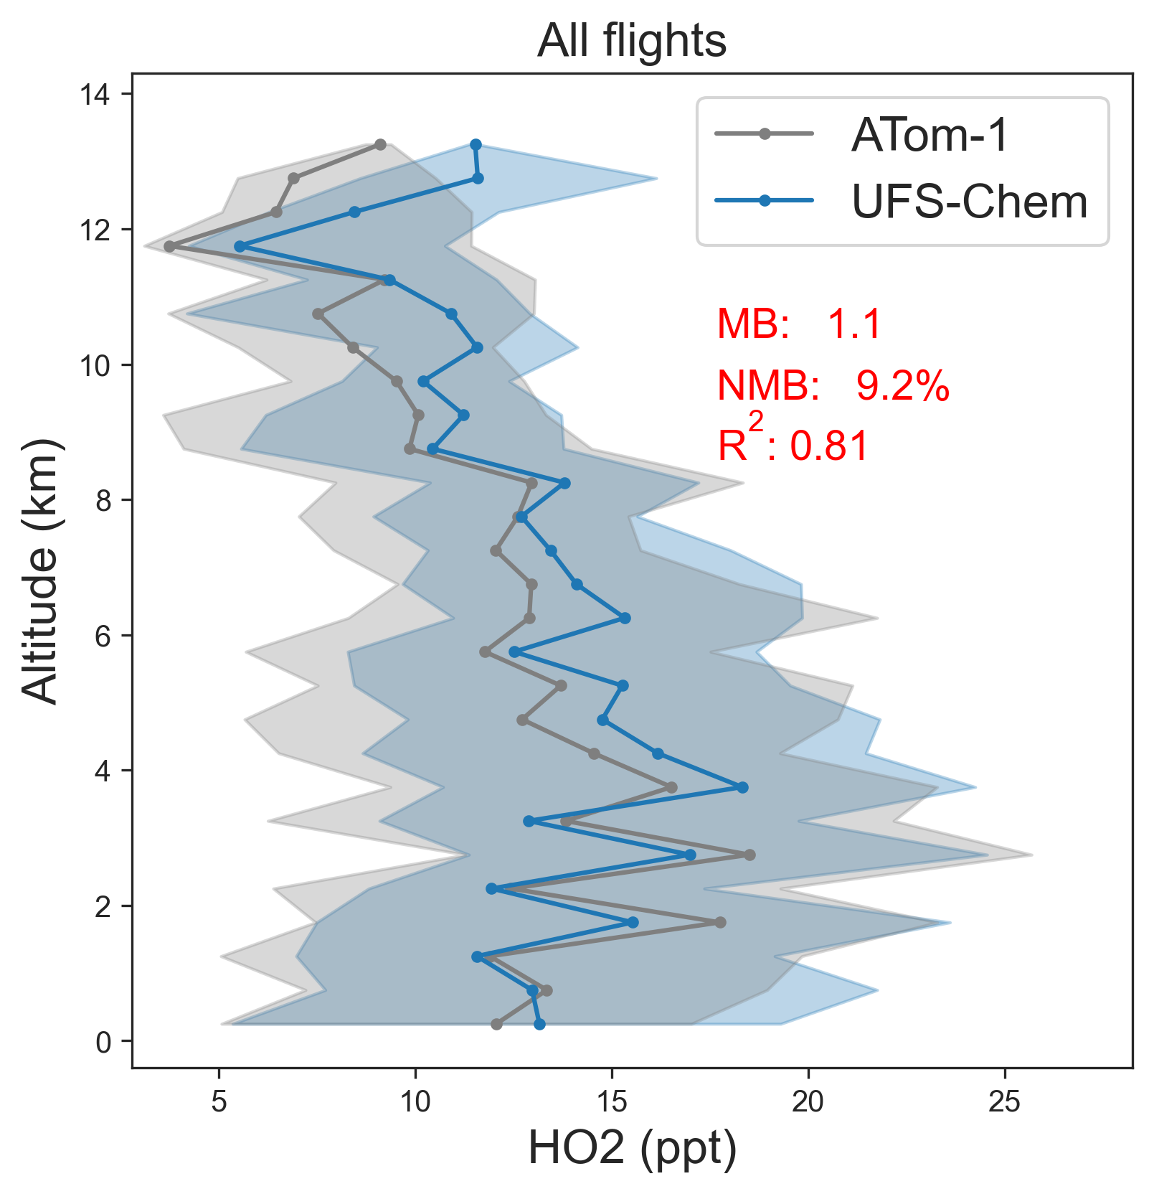
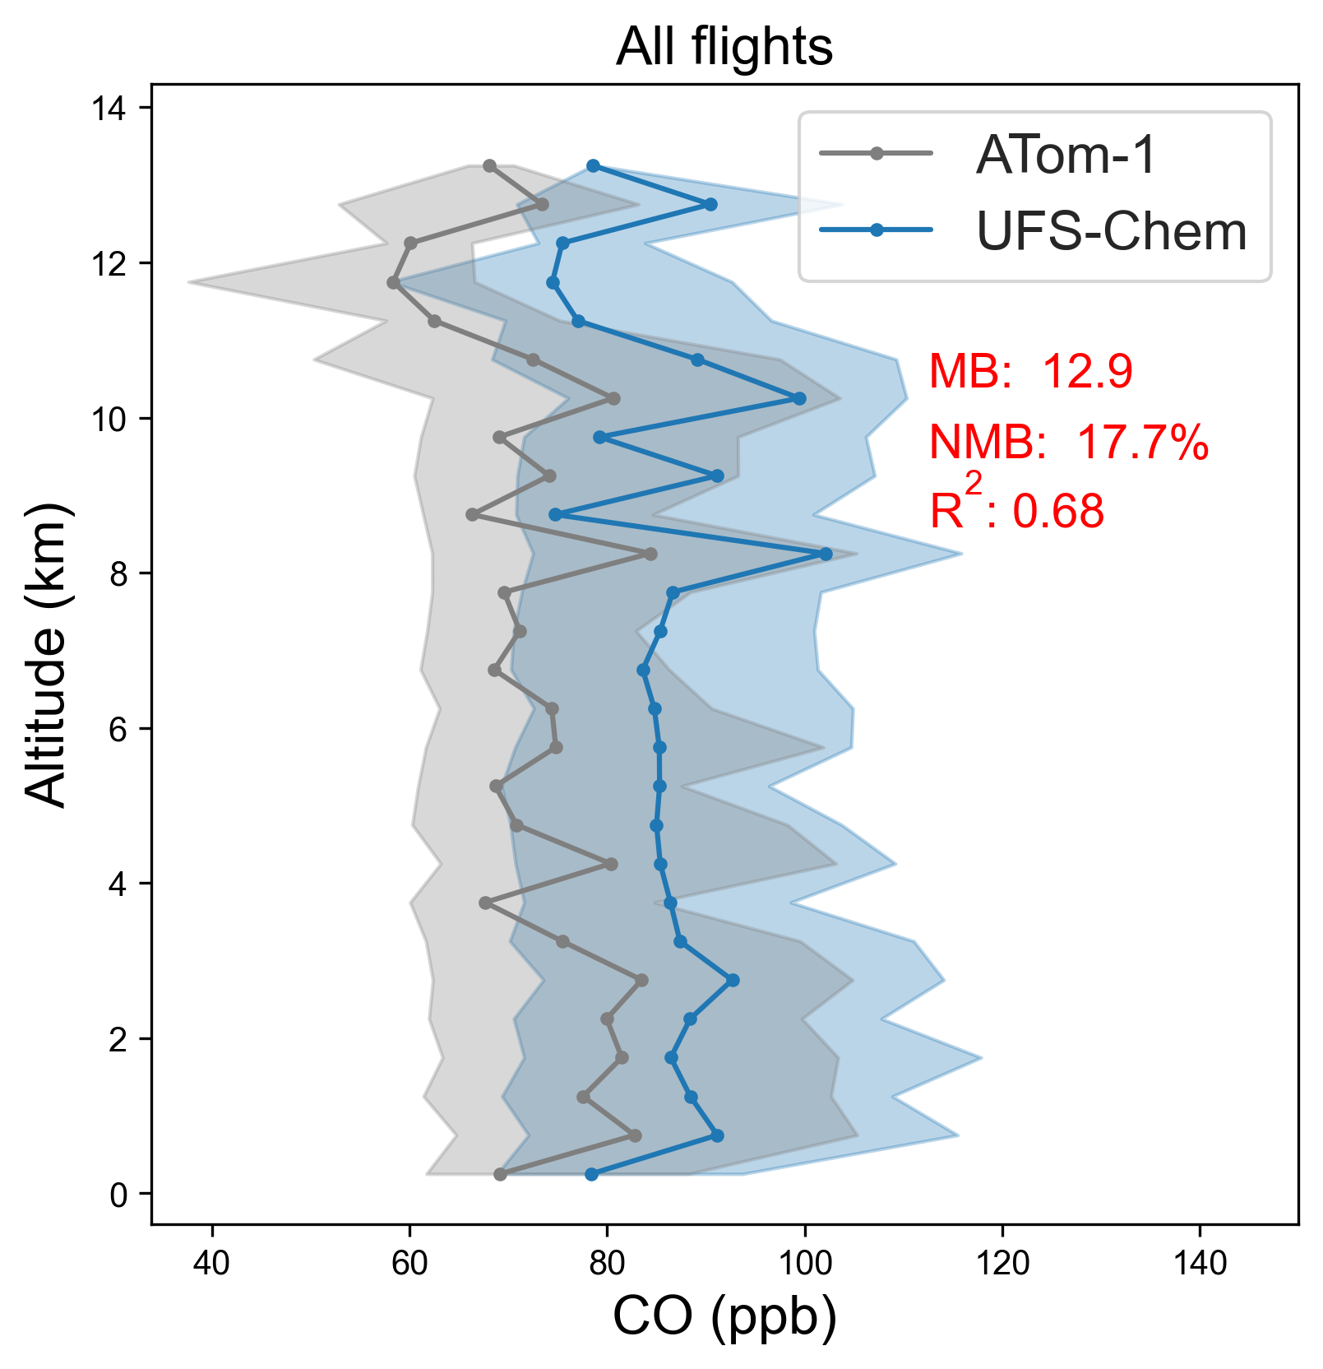
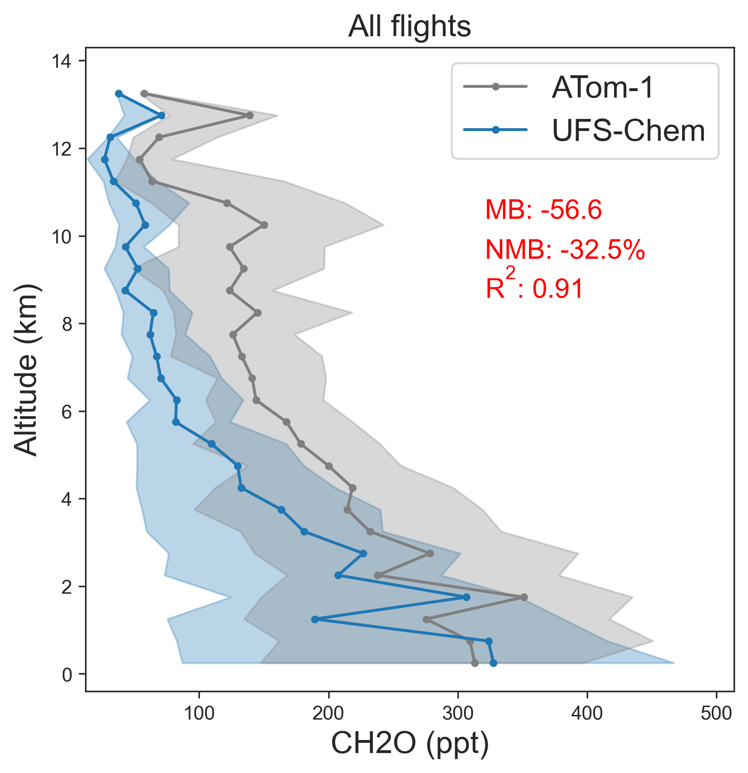
UFS-Chem vs ATom-1: preliminary
Model bias could be due to: 1) precursor emissions, 2) cloud processes, 3) dry/wet deposition…

Slide 14
Summary
Gas-phase chemistry (based on GFDL-AM4.1) is reasonably well simulated in the model.
Physical parameterizations show large impacts on chemistry.
Additional testing on wet deposition is needed.
Need to include new aerosols (ammonium, nitrate, and secondary organic aerosols) into AOD calculation.
Need to test with latest version of CEDS and GBBEPx emissions.

