Slide 1
Rapid Refresh Forecast System Development for Version 2
Curtis Alexander (NOAA/GSL)
Matthew Pyle (NOAA/EMC)
Stephen Weygandt (NOAA/GSL)
Jacob Carley (NOAA/EMC)

Slide 2
RRFSv2 Development Building Off of RRFSv1 Capabilities
3 km grid spacing over North America (some testing over CONUS)
Hourly cycled and updated
Deterministic and ensemble forecasts to 60 h, every 6 hours
Deterministic forecasts only to 18 h, all other hourly cycles
65 vertical layers
Hybrid 3DEnVar assimilation (30+ members)
Includes smoke and dust
Fire weather (one-way) “nest”
Air quality model component
FV3 🡪 MPAS regional dynamic core
GSI 🡪 JEDI data assimilation software framework

Slide 3
RRFSv2 Development Framework
Research to Demonstration
Demonstration to Operations
High Resolution Data Assimilation System “HRDAS”
JCSDA Testbed Application
JEDI SkyLab infrastructure and components
Scalable development, rigorous testing, effective demonstration, and comprehensive documentation
Demonstrate and validate new capabilities tailored to meet various stakeholder needs
Community development
RRFS Data Assimilation System “RDAS”
Operational app component of RRFS
WCOSS2 infrastructure and components
Meets NCO code standards
Rigorous testing and demonstration of new capabilities
NOAA GSL+EMC development
Short Range Weather Application “SRW App”
UFS application supported by EPIC
UFS infrastructure and components
Scalable development, rigorous testing, effective demonstration, and comprehensive documentation
Demonstrate and validate new capabilities tailored to meet various research and development needs
Community development
Rapid Refresh Forecast System “RRFS/REFS”
UFS NOAA operational application
WCOSS2 infrastructure and components
Meets NCO code standards
Rigorous testing and demonstration of new capabilities
NOAA GSL+EMC development

Slide 4
RRFSv2 Notional Development and Testing Timeline
JCSDA HRDAS app established
MPAS integration into UFS continues
RRFS JEDI-MPAS development
RRFS testbed experiment evaluations
RRFS MPAS-JEDI development
RRFS RDAS w/JEDI at-scale
RRFS testbed experiment evaluations
RRFSv2 science freeze
FY25
FY27
FY24
FY26
FY28
MPAS grid configuration tests
RRFS physics development into MPAS
GSI to JEDI development cut-over
MPAS integration into UFS begins
RRFS MPAS-JEDI development
MPAS integration into UFS complete
RRFS testbed experiment evaluations
RRFSv2 code freeze
RRFSv2 field evaluation (retros + RT)
RRFSv2 stability tests
RRFSv2 operational*
*Assumes NWS approval of MPAS, successful field evaluation and stability test

Slide 5
Physics Development for RRFSv2/MPAS
Component | Scheme | Primary Developers
Land-Surface: | RUC/Noah-MP | Tanya Smirnova (GSL), Mike Barlage (GSL)
Lake Model: | CLM | Tanya Smirnova (GSL), Sam Trahan (GSL)
Surface Layer: | MYNN | Joseph Olson (GSL), Tanya Smirnova (GSL)
PBL + shallow convection: | MYNN-EDMF | Joseph Olson (GSL), Xia Sun (GSL), Wayne Angevine (CSL), Dave Turner (GSL)
Deep Convection: | Grell-Freitas/C3? | Georg Grell (GSL), Saulo Freitas (NISR-Brasil), Haiqin Li (GSL), Jongil Han (EMC)
Drag: | Unified Drag Suite | Michael Toy (GSL), Bo Yang (EMC), Songyou Hong (PSL)
Radiation: | RRTMG | Mike Iacono (AER), Eli Mlawer (AER)
Microphysics: | Thompson Aero | Anders Jensen (GSL), Greg Thompson (UCAR), Ruiyu Sun (EMC), Eric Aligo (EMC)
Planned transition from RUC to Noah-MP for RRFSv2 (begin testing in Fall 2024)
Possible transition from RRTMG to RRTMGP (TBD)
Merged current physics codes with the MPAS v8.2 release (locally) on July 18th

Slide 6
Recent Challenges in GSL real-time 3-km MPAS
Intermittent crashes due to computational instabilities
The crash was in mpas_convective_diagnostics.F due to high wind speeds
Fixed on 5 June 2024: config_number_of_sub_steps = 4 (originally, it was a default =2)
A problem with albedo information in the static file
Fixed on 5 June 2024: re-created static file with config_supersample_factor = 3 (=1 before)
A lag in the SW radiation
Swint_opt available in WRF is not available in MPAS (swint_opt =1 computes radiation in the middle on the radiation time step).
Not fixed, but radiation time step is changed from 30 min to 15 min
Too opaque clouds
Default configuration used poorly specified effective radii.
Fixed on 31 May 2024 – using effective radii from microphysics scheme (Anders Jensen)
Daytime moist bias in 2-m dewpoint
Improvement from RUC LSM tuning starting 00 UTC, 7 June 2024
Tuning in other physics parameterization may be needed

Slide 7
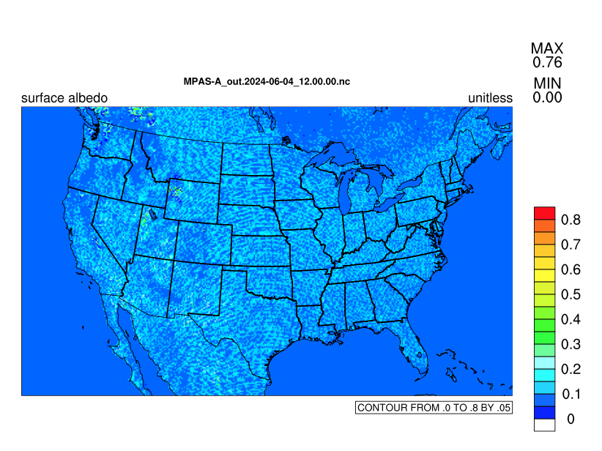
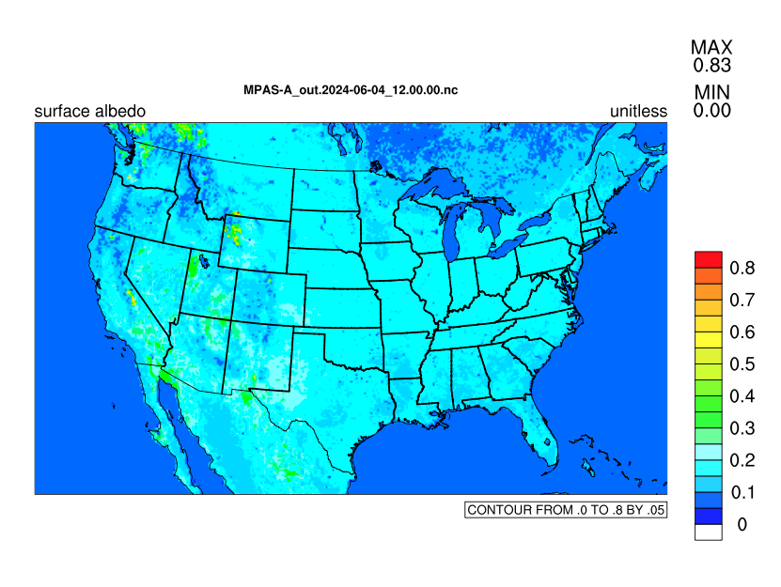
2. Albedo
before fix after fix

Slide 8
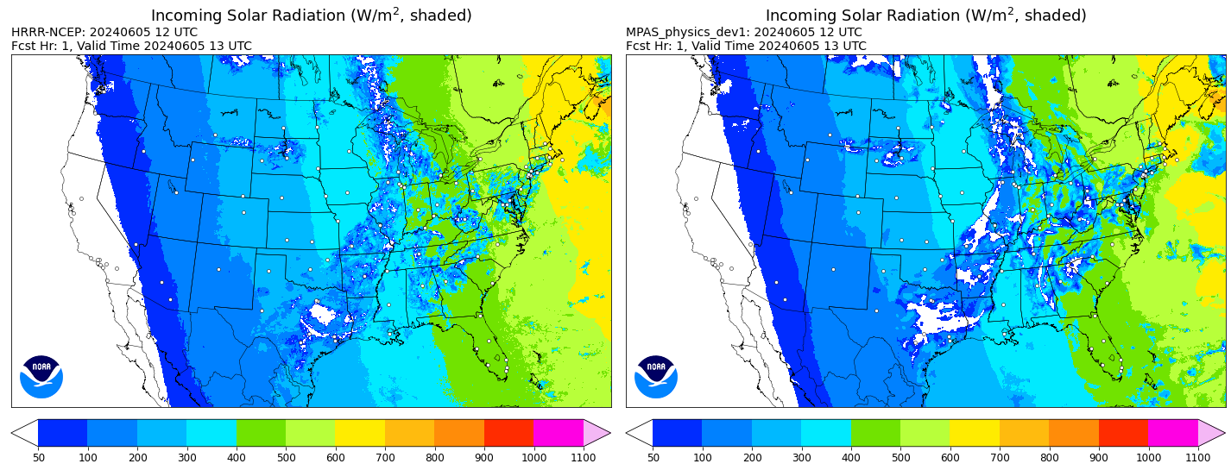
3. A lag in SW radiation

Slide 9
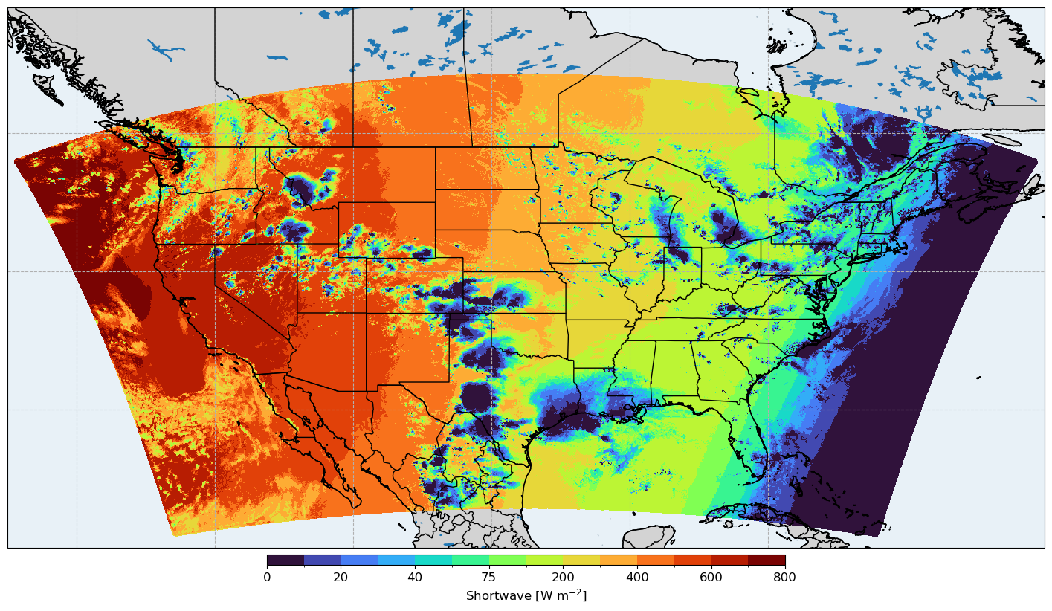
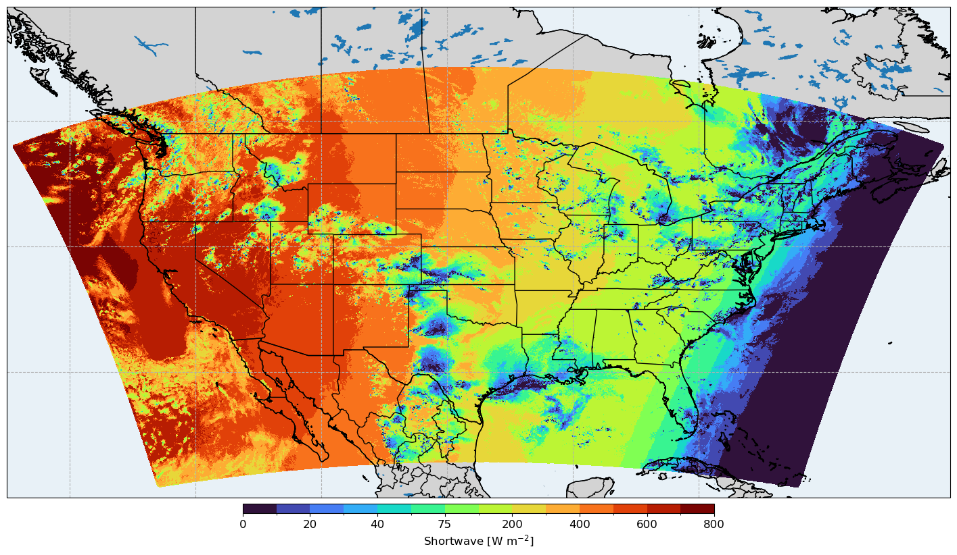
4. Opaque Clouds
Original Configuration
was not configured to use the effective radii from the microphysics; defaulted to very poorly set values, making clouds too opaque.
Update to use effective radii from microphysics
Changed the default value of config_microp_re to true
Currently working on a revision of the macrophysics tailored for MPAS.

Slide 10
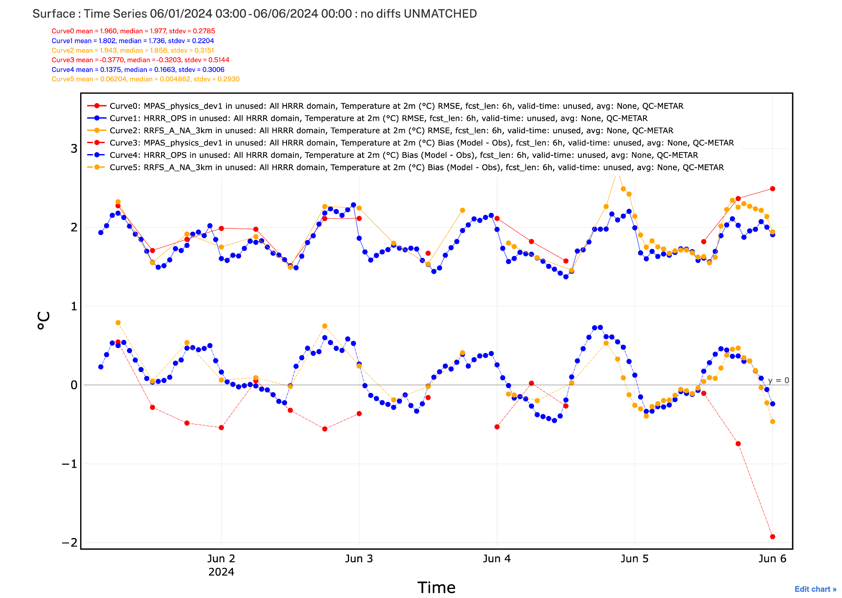
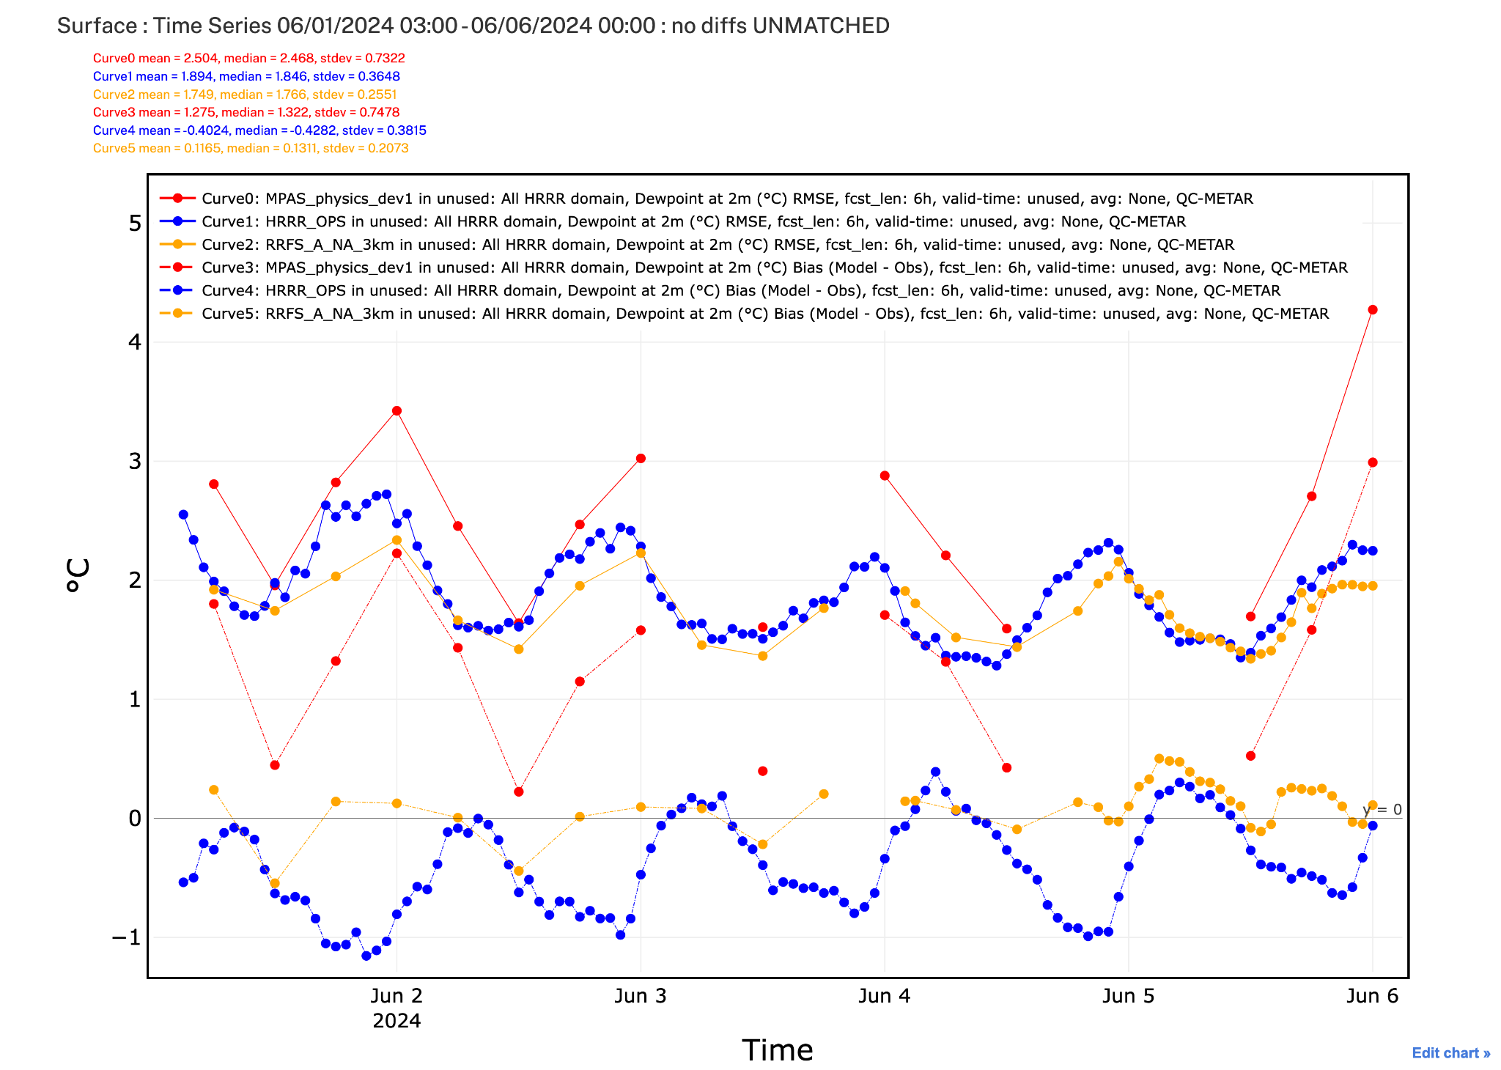
5. Daytime moist bias in 2-m dewpoint
RMSE
2-m temp
Tuning of RUC LSM parameters in MPAS
Soil resistance to evaporation from HRRR - too small for MPAS, overestimated direct soil evaporation;
Irrigation depends on cropland greenness in the updated version of RUC LSM. The climatological greenness fraction in MPAS is higher than real-time VIIRS greenness in RRFS over Western US, as a result irrigation is triggered too early, adds soil moisture
Fixes:
Increased soil resistance to evaporation (as in RRFS)
Irrigation is turned off for now.
2-m dewpoint
RMSE
bias
Red - MPAS
Blue - HRRR
Gold - RRFS

Slide 11
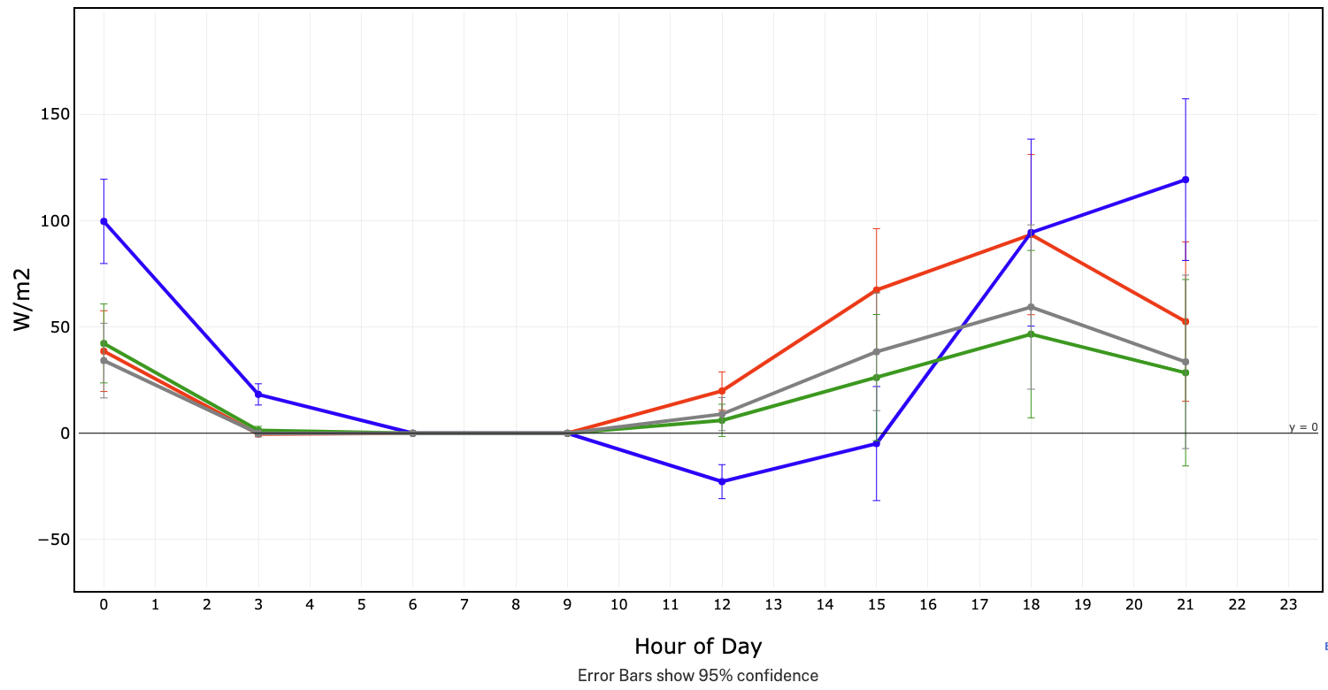
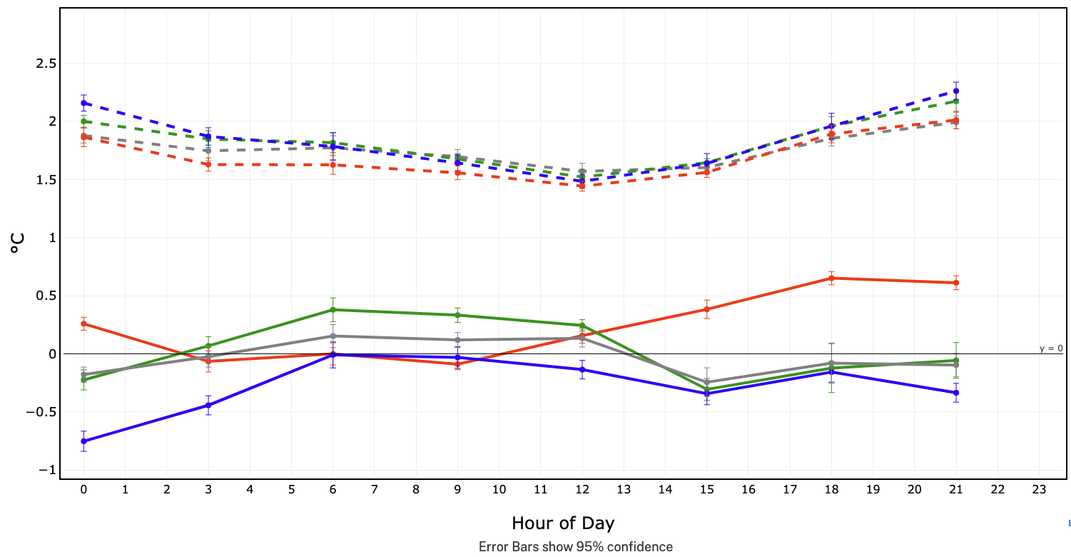
Testing for RRFSv2: CONUS-MPAS
We have begun optimizing the subgrid clouds for MPAS.
Statistics valid from 13 June-08 July 2024 (since last major physics update):
Bias of Shortwave Down at Surface at fhr 6
2-m Temperature Bias and RMSE at hr 6
RRFS
HRRR
RAP
MPAS
RMSE
Bias

Slide 12
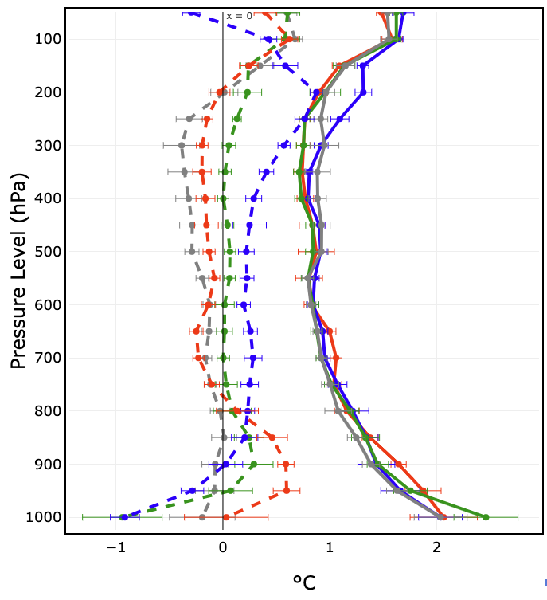
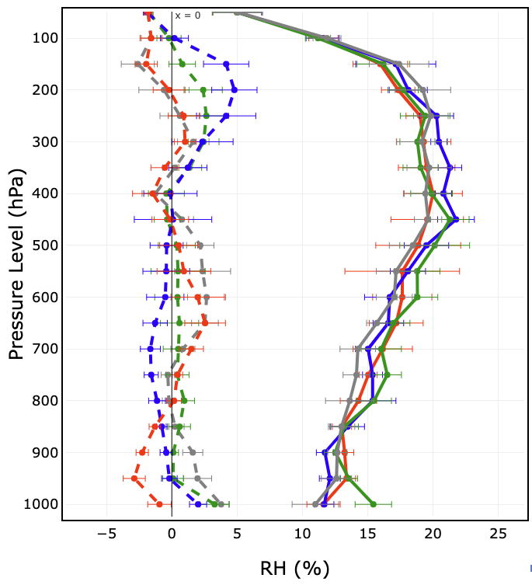
Early MPAS Results: fhr 12, valid 00 UTC, all CONUS
Time range: 26 June - 07 July 2024 (similar results for later dates in initial testing)
Temperature
RH(obT)
Bias
RMSE
MPAS
HRRR
RRFS
RAP
Bias
RMSE
This suggests that a lot less improvement is needed from the convection scheme when using MPAS (compared to FV3), which already looks good above 500 hPa.

Slide 13
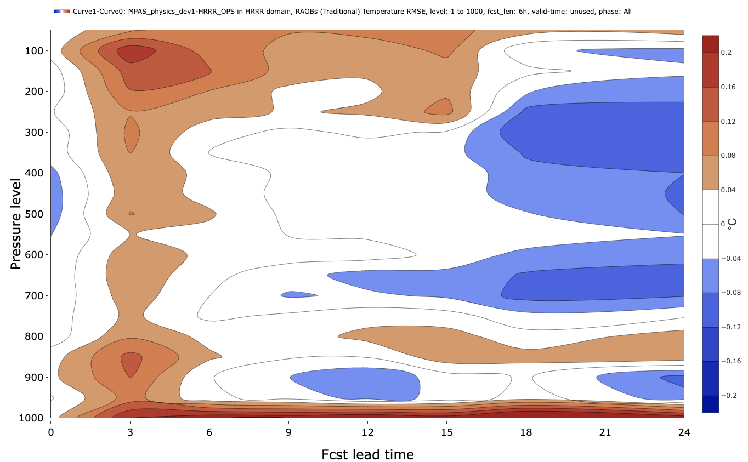
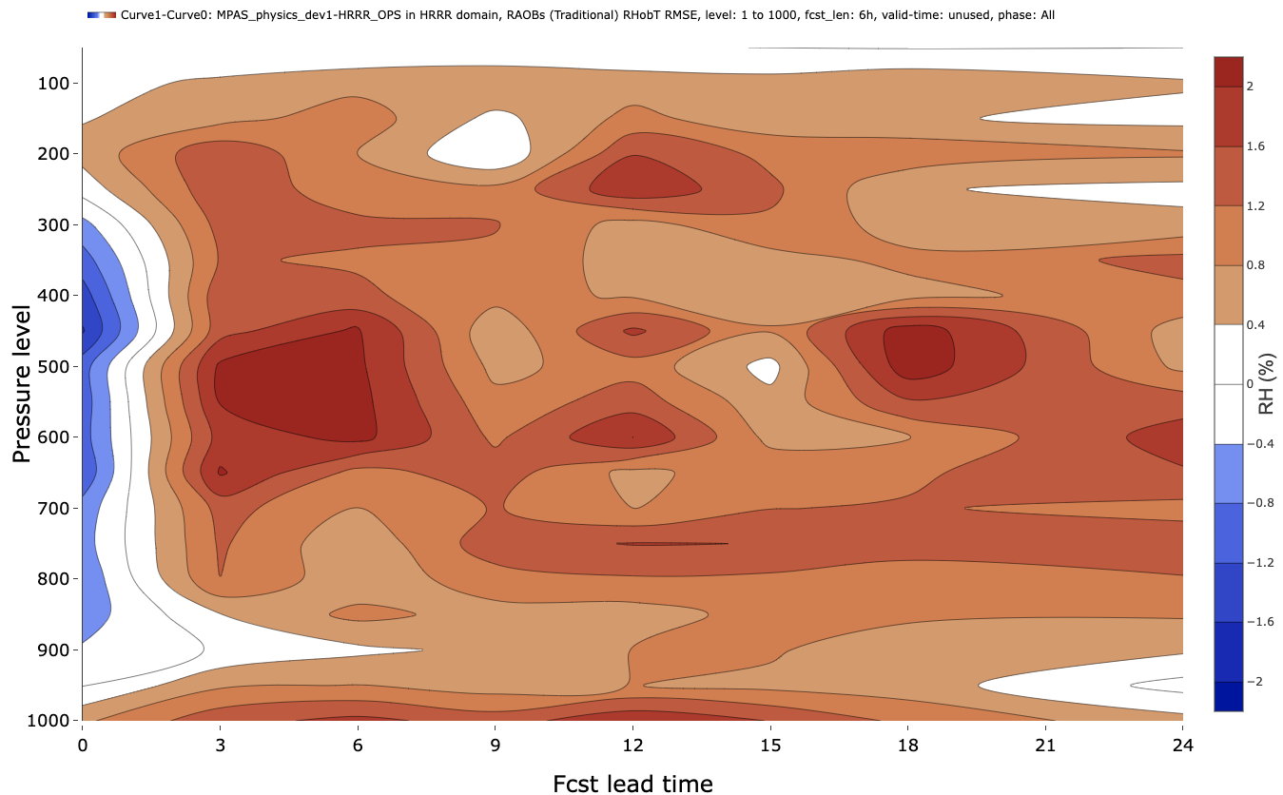
Preliminary (Cold-Start) MPAS-RRFSv2 Results vs. HRRR
RMSE Differences (MPAS-HRRR) - BLUE is better in MPAS
Temperature: -0.2 to +0.2°C
RH(obT): -2 to +2%
Still problematic
Generally improved in MPAS at later forecast hours
Even without DA, smaller temperature RMSEs can be found at long forecast hours.
RH is still problematic, but there are lingering implementation tasks that will improve RH (implementing real-time green vegetation fraction initializations, moving from RAP ICs).

Slide 14
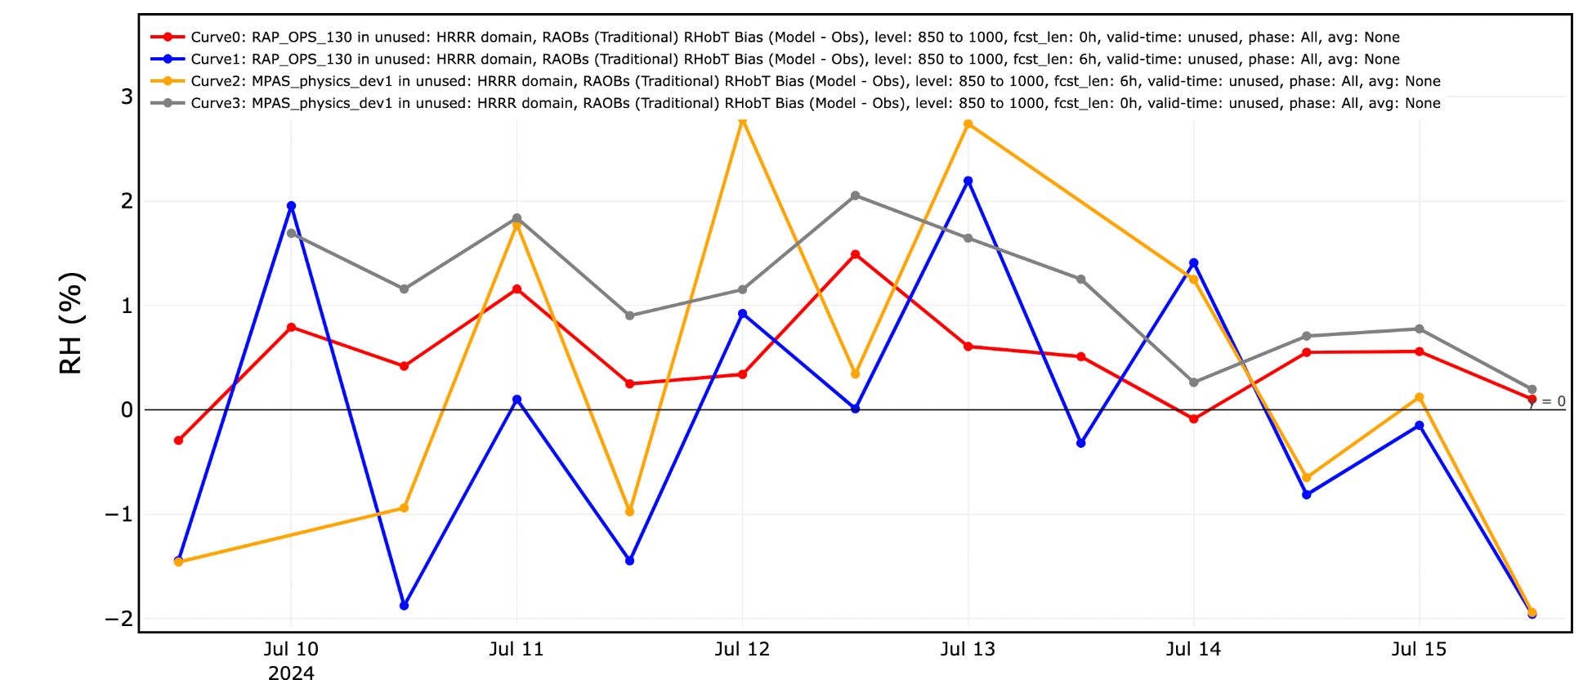
Improved Near-Surface (1000-850 hPa) RH Bias
RAP 0h
RAP 6h
MPAS 0h
MPAS 6h
Changed MPAS namelist to use the RAP specific humidity variable to initialize q_{vapor} in MPAS (was previously recomputing from RAP RH data) as of 14 July 2024 0000 UTC.

Slide 15
Overview of Modifications
Tuning MYNN PBL/Surface Layer for Hurricane Apps
Summary of modifications to date (will be applied to future runs)
Reduce eddy diffusivities at high wind speed conditions (already in MYNN-EDMF, but modified to further restrict turbulent mixing).
Reduce mass flux at high wind speed conditions (already in MYNN-EDMF, unchanged for HFIP).
Upper limit on the surface drag coefficient following Curic and Haus (2020, GRL).
Addition of TKE advection (in MPAS, already in WRF and CCPP).
Modify Smagorinsky horizontal mixing to use a ~700 m length scale (c_s = 0.23 at ∆x = 3 km).

Slide 16
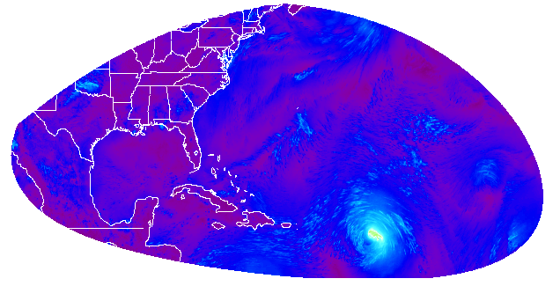
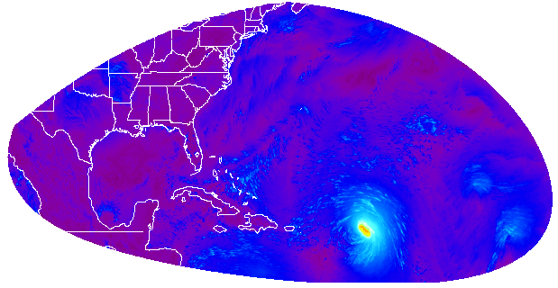
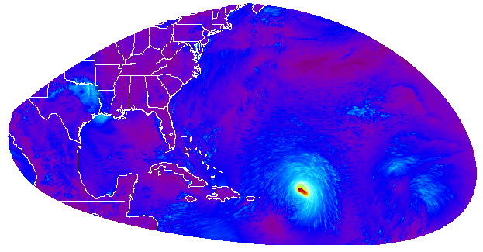
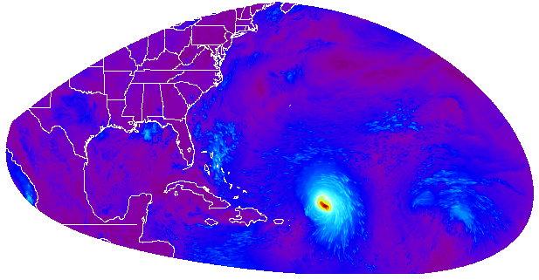
Case Study: Hurricane Lee (Sept. 2023)
8/0600 UTC
8/1800 UTC
Max = 39 m/s (cat-2)
minslp = 977 hPa
Max = 54 m/s (cat-3)
minslp = 955 hPa
Can simulate rapid intensification, but ~a day late and not intense enough.
9/0600 UTC
9/1800 UTC
Max = 65 m/s (cat-4)
minslp = 926 hPa
Max = 63 m/s (cat-4)
minslp = 930 hPa
m s⁻¹

Slide 17
GSL+EMC Data assimilation development and code management
RDASApp
https://github.com/NOAA-EMC/RDASApp
RDASApp replaces GSI and contains all required JEDI components to build, test and run RRFSv2 data assimilation experiments
Greatly facilitates the collaboration and discussions between GSL and EMC with issue tracking, PR reviewing and Wiki Documentation
GSL has participated in over 61 issues, 48 PRs so far; contributed to the developing, testing, evaluation, documentation, portability of RDASApp and establishing/maintaining FV3-JEDI, MPAS-JEDI test cases
Meet bi-weekly and established a preliminary code management and regression test policy

Slide 18
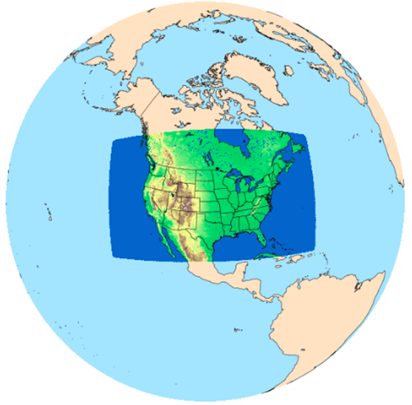
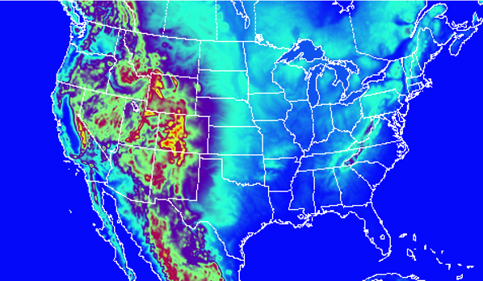
GSL MPAS-JEDI development sandbox
MPAS CONUS 12km domain
+ 30 ensembles for preliminary tests
Comparable RAP/HRRR-like domain, to be used by GSI baseline tests

Slide 19
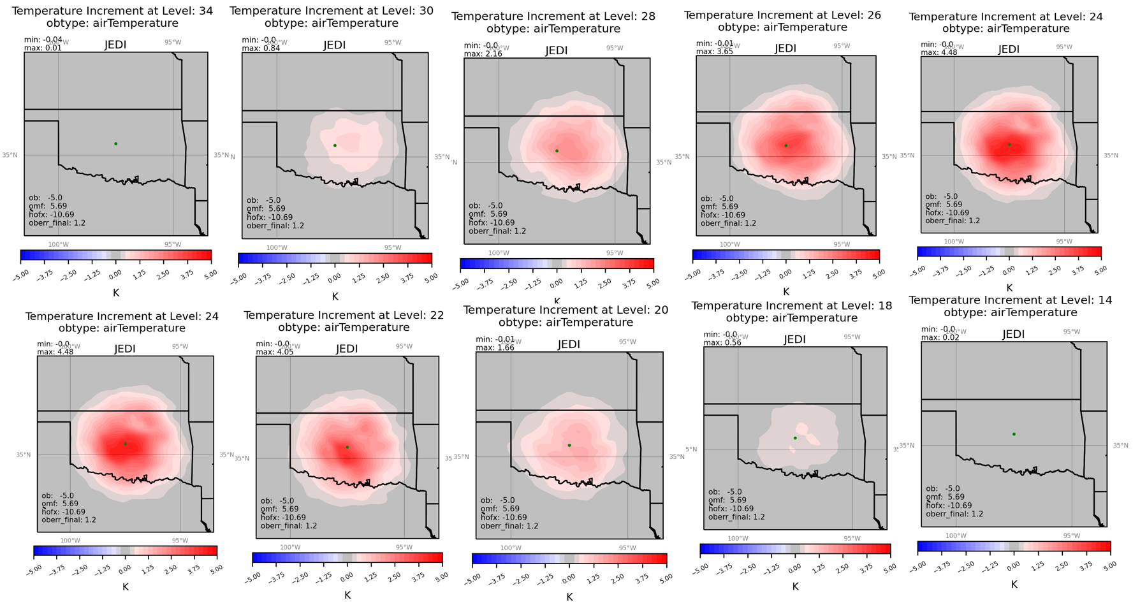
Single sonde obs MPASJEDI 3DEnVAR experiment with JEDI 401km horizontal localization radius and 11 vertical levels radius

Slide 20
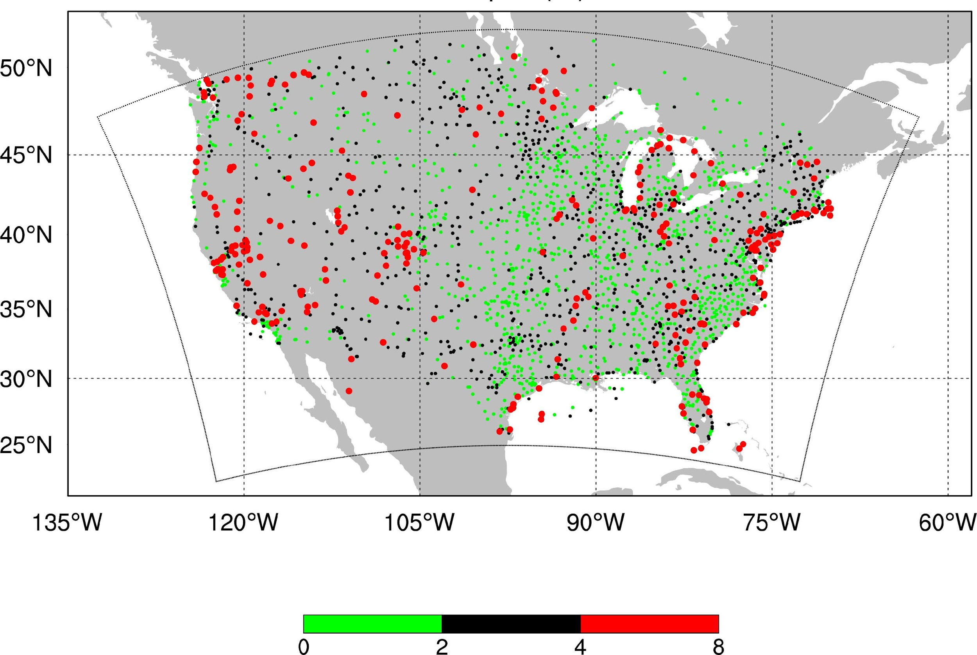
GSL MPAS-JEDI development for surface observations
METAR OBS MPAS-JEDI DA
O-B sanity check
Larger O-B near the coastlines
GSI has special treatment for observation near coastlines
Work is underway to bring this function to MPAS-JEDI
Courtesy of Hui Liu (EMC)

Slide 21
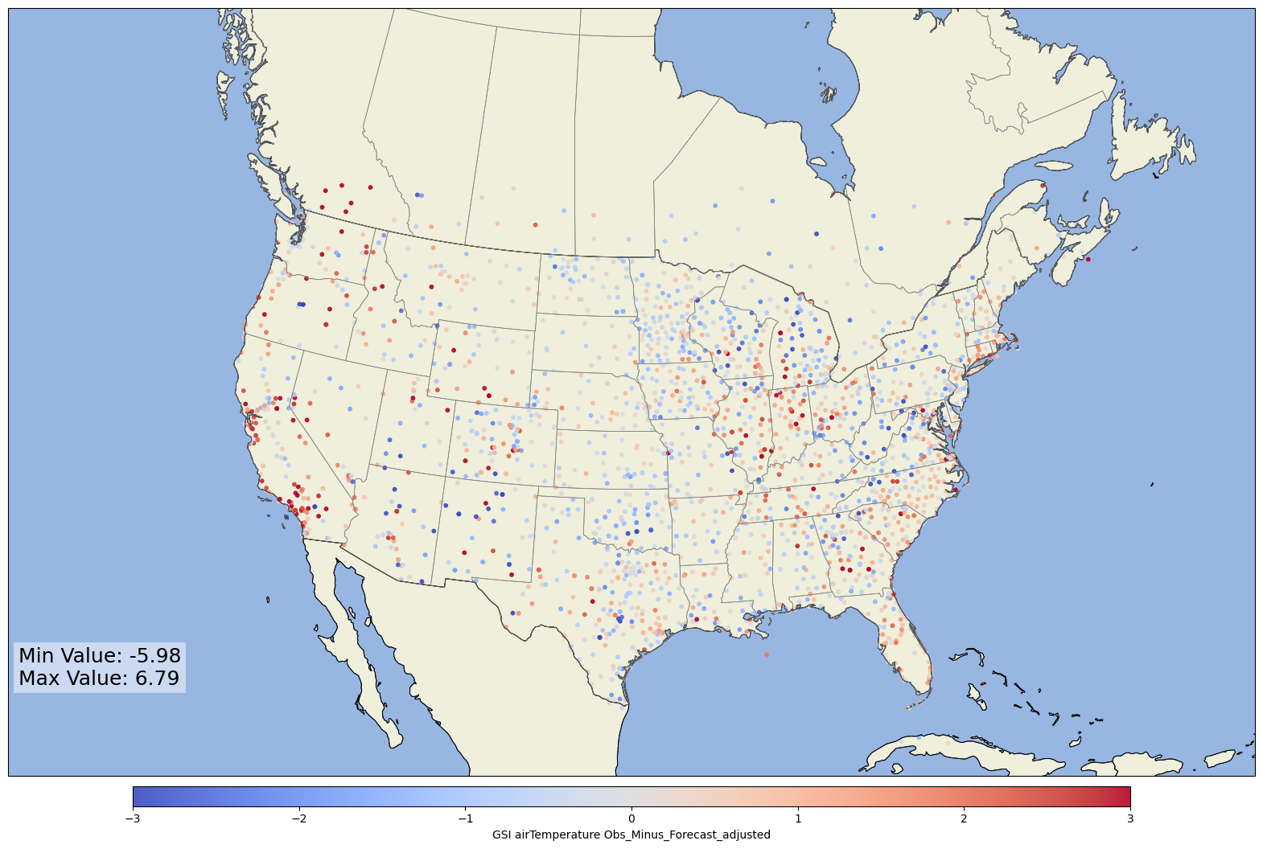
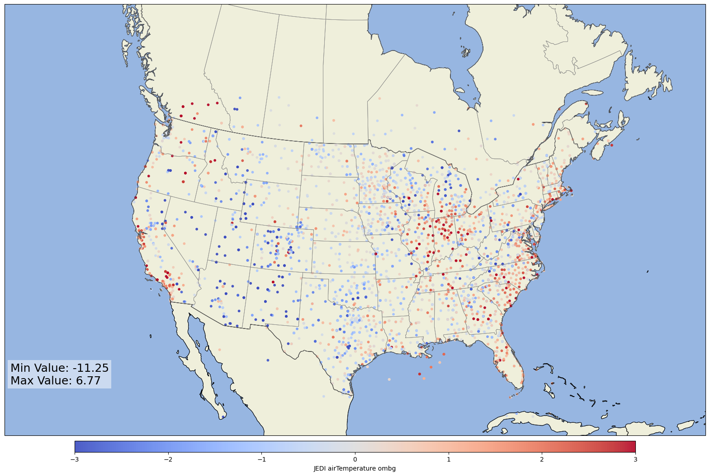
Testing the JEDI temporal filter to match GSI's l_closeobs capability:
GSI
JEDI
Uses observation closest to analysis time to avoid duplicative error inflation

Slide 22
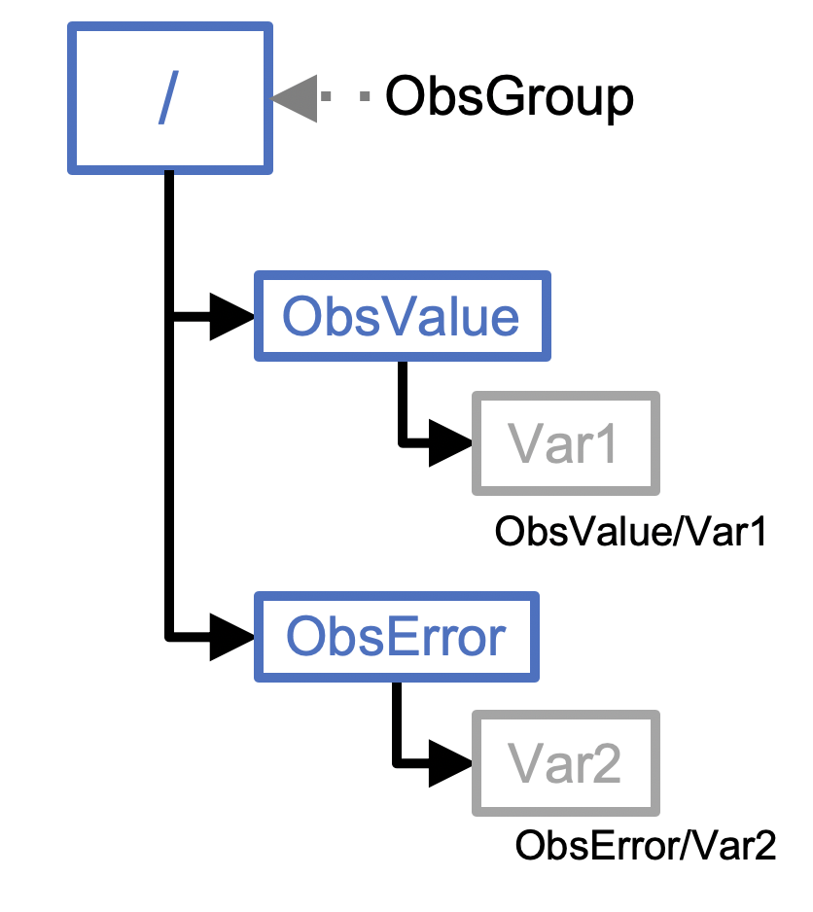
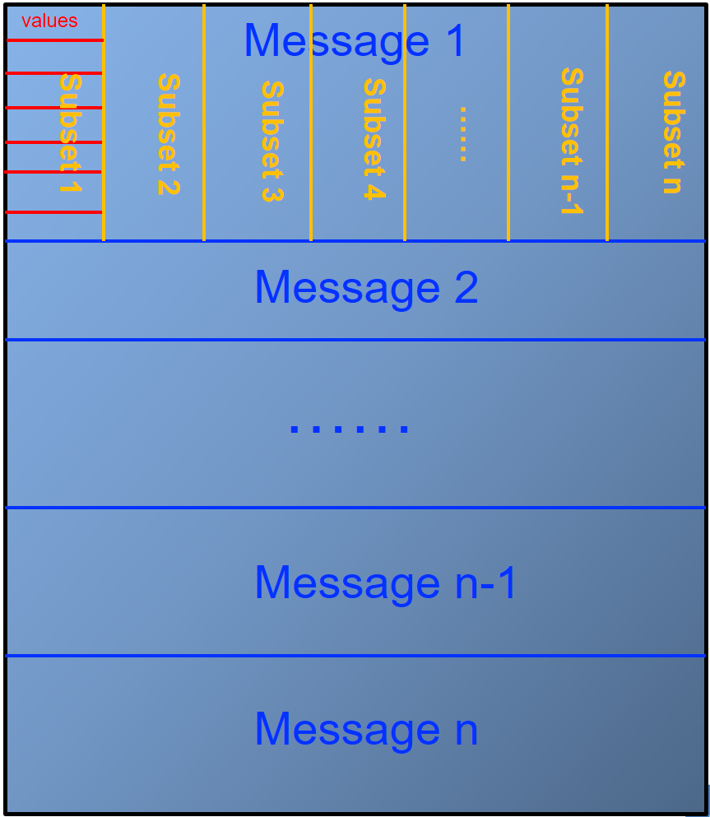
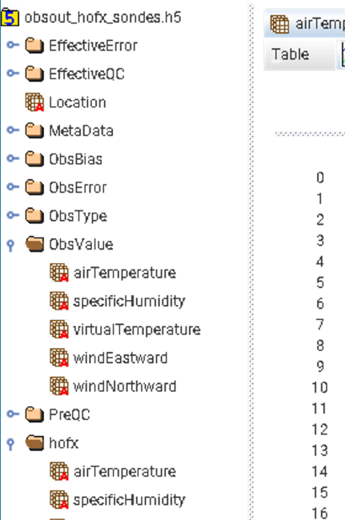
GSL MPAS-JEDI observation processing
BUFR2IODA
GSL tested the BUFR2IODA functionality and, in collaboration with EMC, made sure all operational observation files can be seamlessly and successfully converted to the IODA format needed by MPAS-JEDI

Slide 23
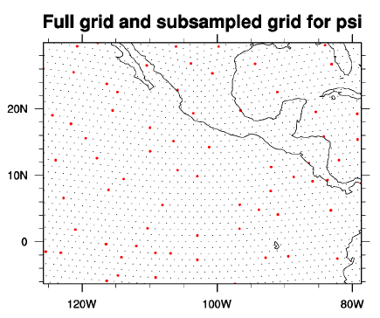
GSL MPAS-JEDI model background error
Static BE
Tests completed using pure 3DEnVAR
Work to generate a reasonable regional static BE
Meetings with the NCAR MPAS-JEDI team
Global test case provided to adapt procedure to generate a suitable static BE for regional MPAS-JEDI cases
Courtesy of Byoung-Joo Jung

Slide 24
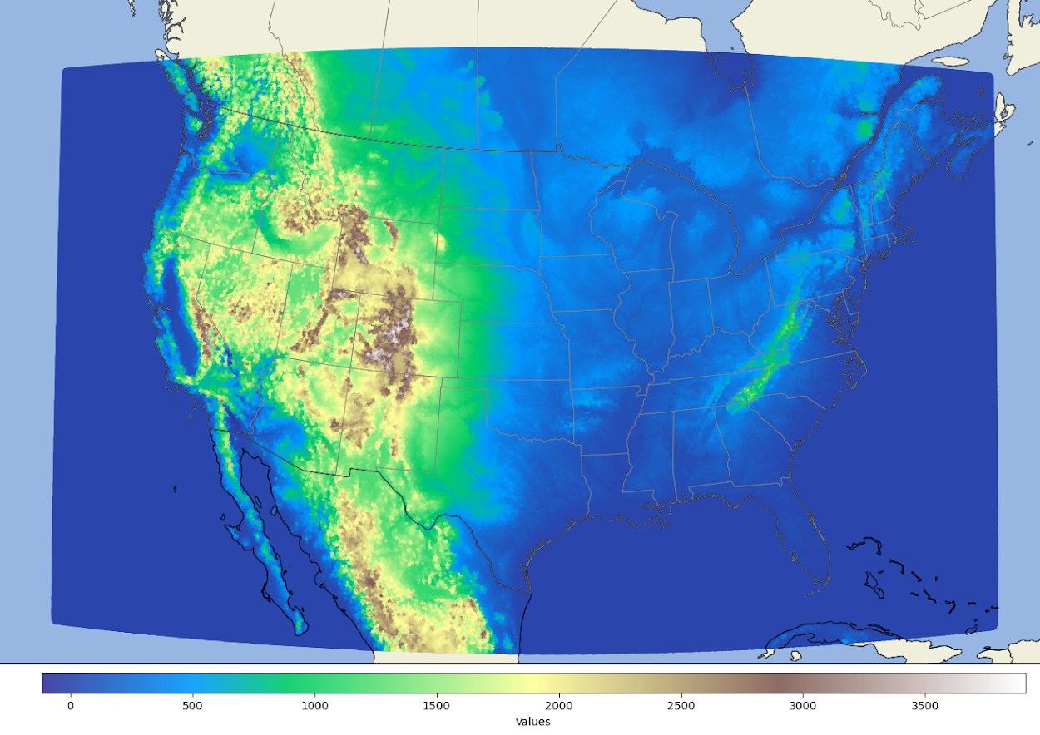
Cycling MPAS+JEDI sandbox: retro runs on Jet/Hera and real time runs on Jet (Orion/Hercules soon)
Two different configurations for different testing purposes:
conus12km: focusing on DA developments
conus3km : Model and DA developments
At the moment, the DA task is a just a pass through and doesn’t modify backgrounds
Initialize from GFS, RAP/HRRR or GEFS
Cold start at 03 and 15z
ioda_bufr
conus3km domain
ungrib_ic
ic
da
fcst
mpassit
upp
ungrib_lbc
lbc

Slide 25
JEDI RDAS development next steps:
1. GSL and EMC collaborate to advance RDASApp for a preliminary recommendation of DA configurations for RRFSv2
2. Dual resolution hybrid DA using 12km ensemble BEC on CONUS 3km runs
3. Regional static BEC interpolating from NCAR's global static BEC for CONUS 12km runs
4. Collect enough forecast samples to generate static BEC for CONUS 3km runs
5. Add and test the regional GSI BEC in JEDI
6. Test different ensemble initialization strategies

Slide 26
Broad engagement in MPAS and JEDI development Global and regional applications Hydrostatic through CAM to convection resolving scales Physics testing and development across forecast applications MPAS-JEDI data assimilation development including ensemble use Infrastructure work with UFS including physics-dynamics coupling,workflow, post, etc… GSL is committed to development and testing of MPAS-JEDI for use in future UFS-based Rapid Refresh Forecast System
GSL Summary

