Slide 1
Hierarchical Testing to Inform SFS Development: An Investigation from DYNAMO Field Campaign
UFS Application - Medium Range Weather (MRW)_Sub-seasonal to Seasonal (S2S)
July 24, 2024 (Wednesday)
Weiwei Li^{1,2} and Shan Sun³
¹NSF NCAR ²DTC ³NOAA/OAR/GSL
Acknowledgement: DTC UFS Phys T&E team - Man Zhang (NOAA/GSL & CIRES), Evelyn Grell (NOAA/PSL & CIRES), Jimy Dudhia (NSF NCAR & DTC) and Tracy Hertneky (NSF NCAR & DTC)
Notes:
14 minutes
11 slides - 2~3 min Q&A
Introduction (2 slides)
SST diurnal cycle issue (4 slides)
Convection development and physics (4 slides)
Summary (1 slide)

Slide 2
Motivations
Using a case study to discuss issues in fully-coupled SFS simulations:
Why does SST have a smaller diurnal amplitude?
Why are surface heat fluxes persistently high?
What are the key processes governing these issues?
What factors may inhibit the MJO development?
To what extent, does the CCPP SCM help understand these issues?

Slide 3
Model Setup
Fully-coupled (atmos, ocean & ice) SFS simulations
prototype/hr3 tag in ufs-weather-model repo.
Initialized at 00Z Oct 1 2011, for 3 months; C96 (~100 km) L127.
CCPP SCM simulations
CSU array-averaged analysis product version 3a: observation, large-scale forcing and initial conditions.
IC: 00Z Oct 1, 2011; 3-hourly forcing; 3 months.
Studied column: 2.5ºN, 77.5ºE; center of the Northern Sounding Array. Column size: equivalent to 100, 50, 25 km; L127.
SCM physics code base: same as SFS.
Atmos-only, NSST activated, no coupling to ocean.
Physics suites: HR3 prototype (GFS_v17_p8_ugwpv1 & GFS_v17_couple_p8_ugwpv1)
Notes:
Physics scalability: specific scale for deriving horizontal advective forcing terms is unknown - likely not very fine. But CNSM study (Abdel-Lathif et al. 2018) showed that CSU v3b forcing can well represent the observed strong convection.
But sensitivity not all due to physics scalability, since discrepancies exist between forcing scale and column area
Only climate, static MERRA-2 aerosol (no dynamic aerosol)
Namelist diff for fully-coupled and SCM (e.g., *cpl*)

Slide 4
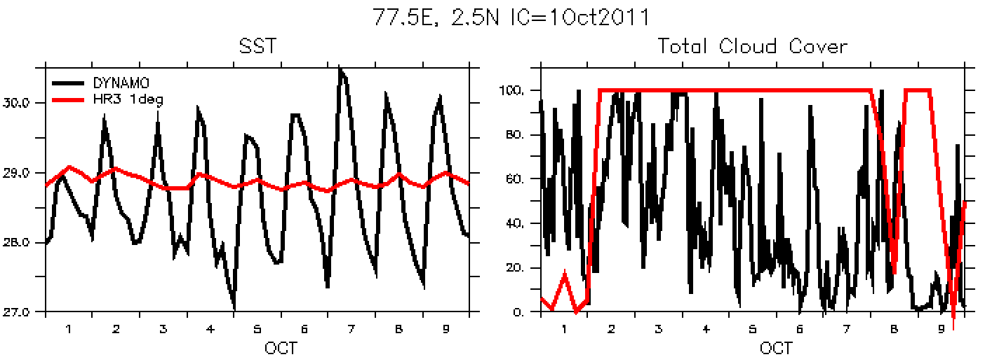
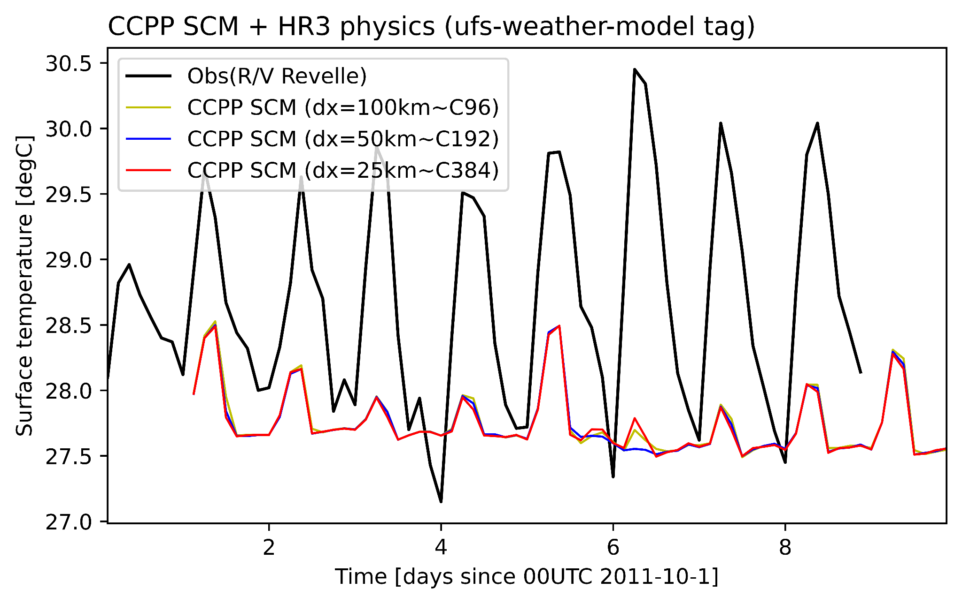
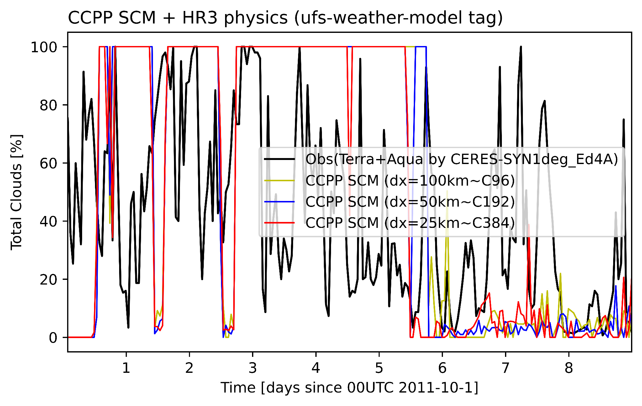
Fully-coupled SFS
CCPP SCM
SCM results - consistent with fully-coupled forecast: overcast with smaller amplitude of SST diurnal cycle.
Notes:
SFS type of fully-coupled simulation: prototype/hr3 tag in ufs-weather-model @C192 (~50km) and 1/4º ocean
Obs SST: 1.5-m depth - measured by R/V Revelle (a research vessel) carried RAMA mooring (Johnson and Ciesielski 2013).
SFS SST: 1.0-m depth - data from ocean archive.

Slide 5
Tskin & cloud fraction in SCM during full studied period
Obs SST: 1.5-m depth; SCM SST: Ocean surface - data from atm archive.
Phase 1
Phase 2
Phase 3
1) Strange min_SST (NSST in SCM - being investigated) 2) Smaller SST diurnal amp; 3) Too much clouds during inactive convective phase; 4) Connection b/t #2 and #3 requires understanding.

Slide 6
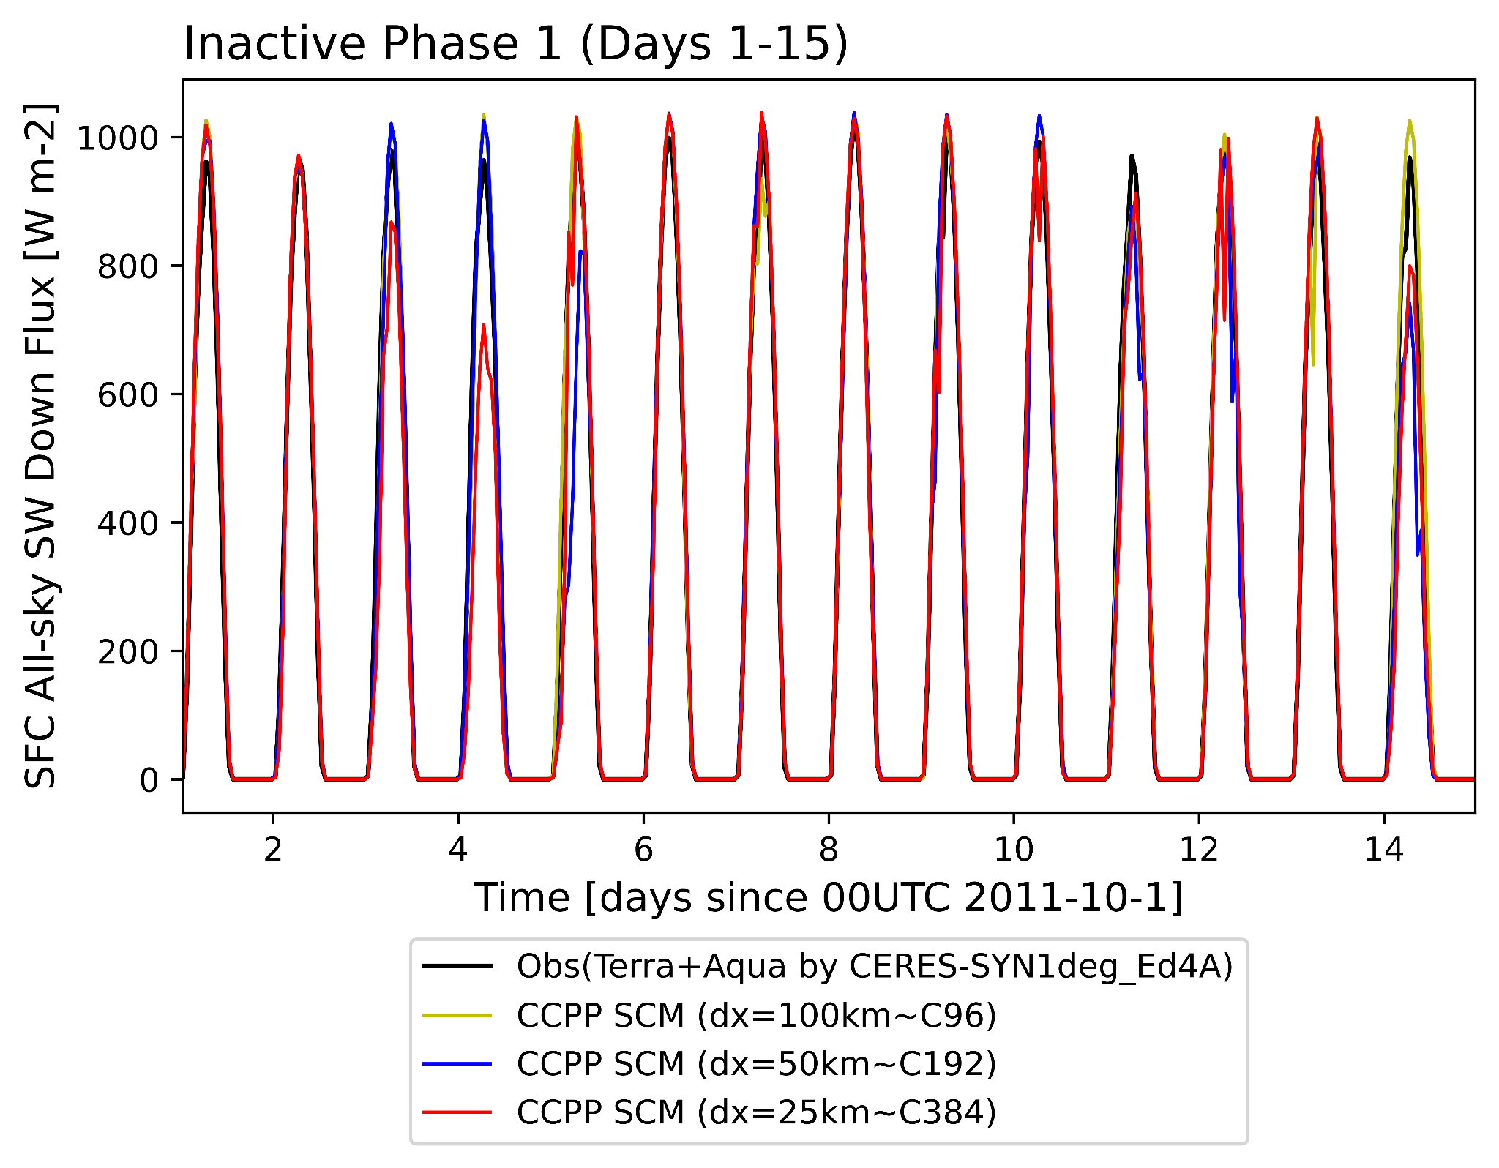
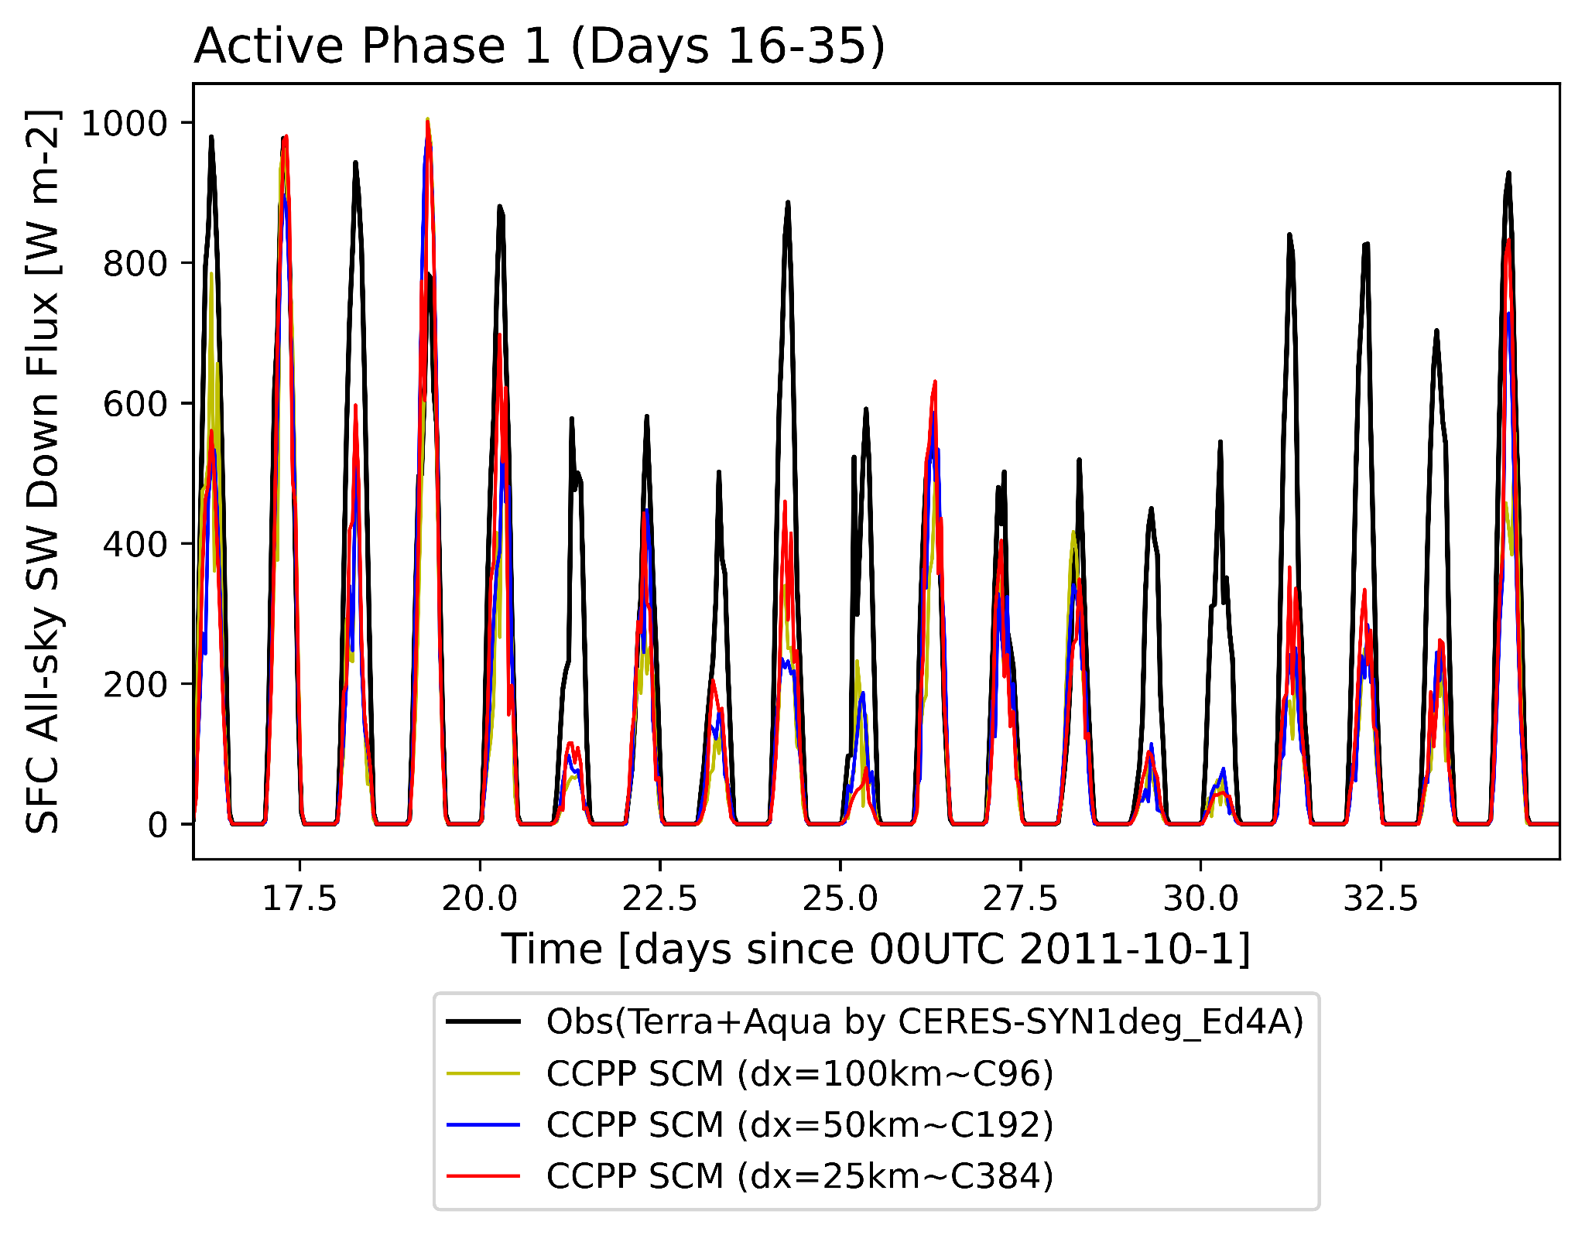
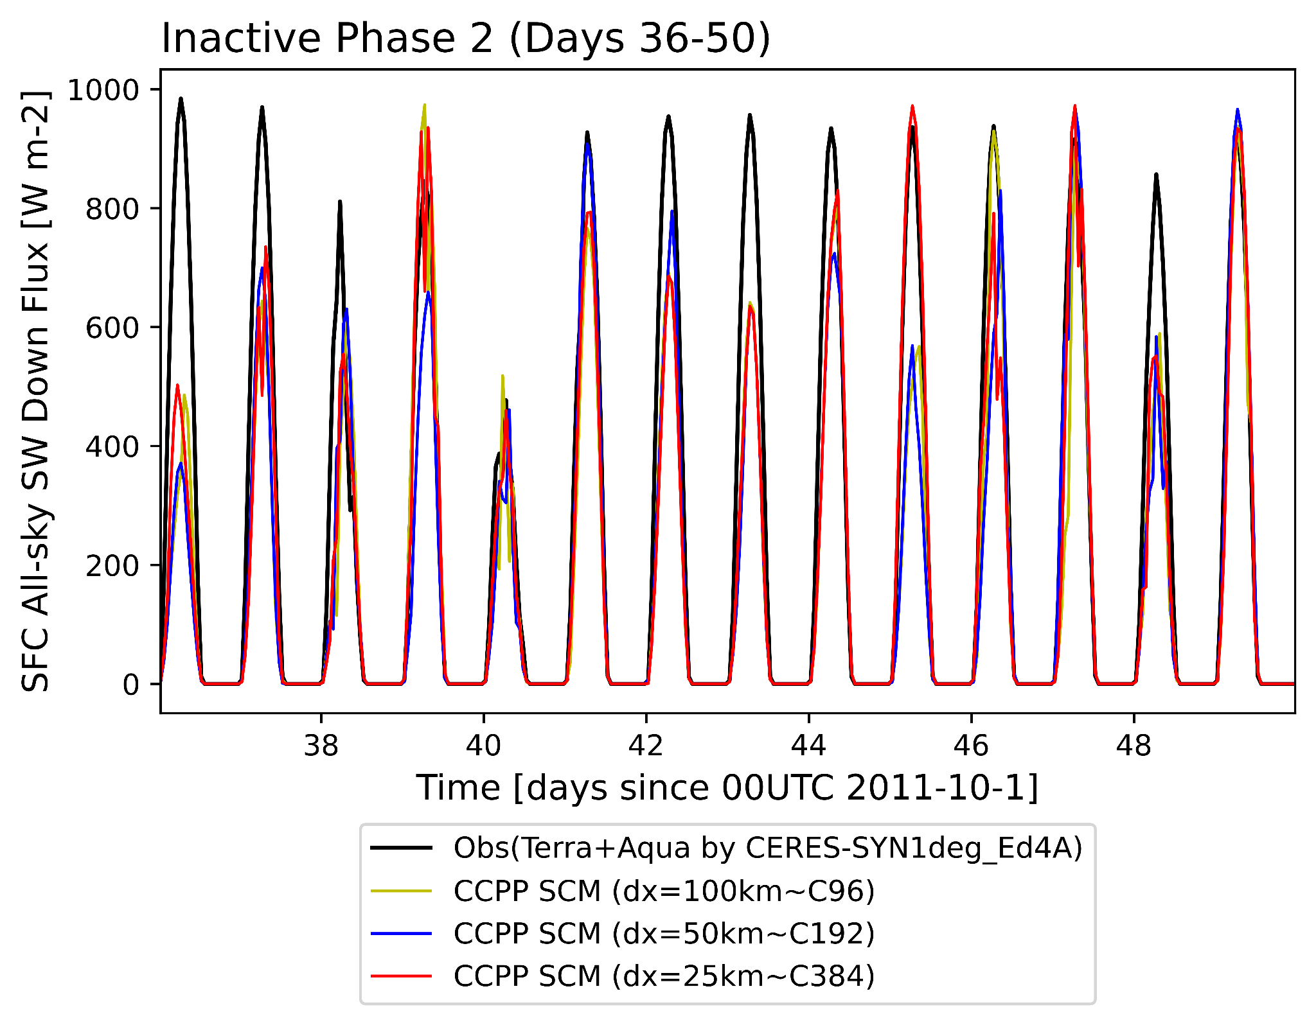
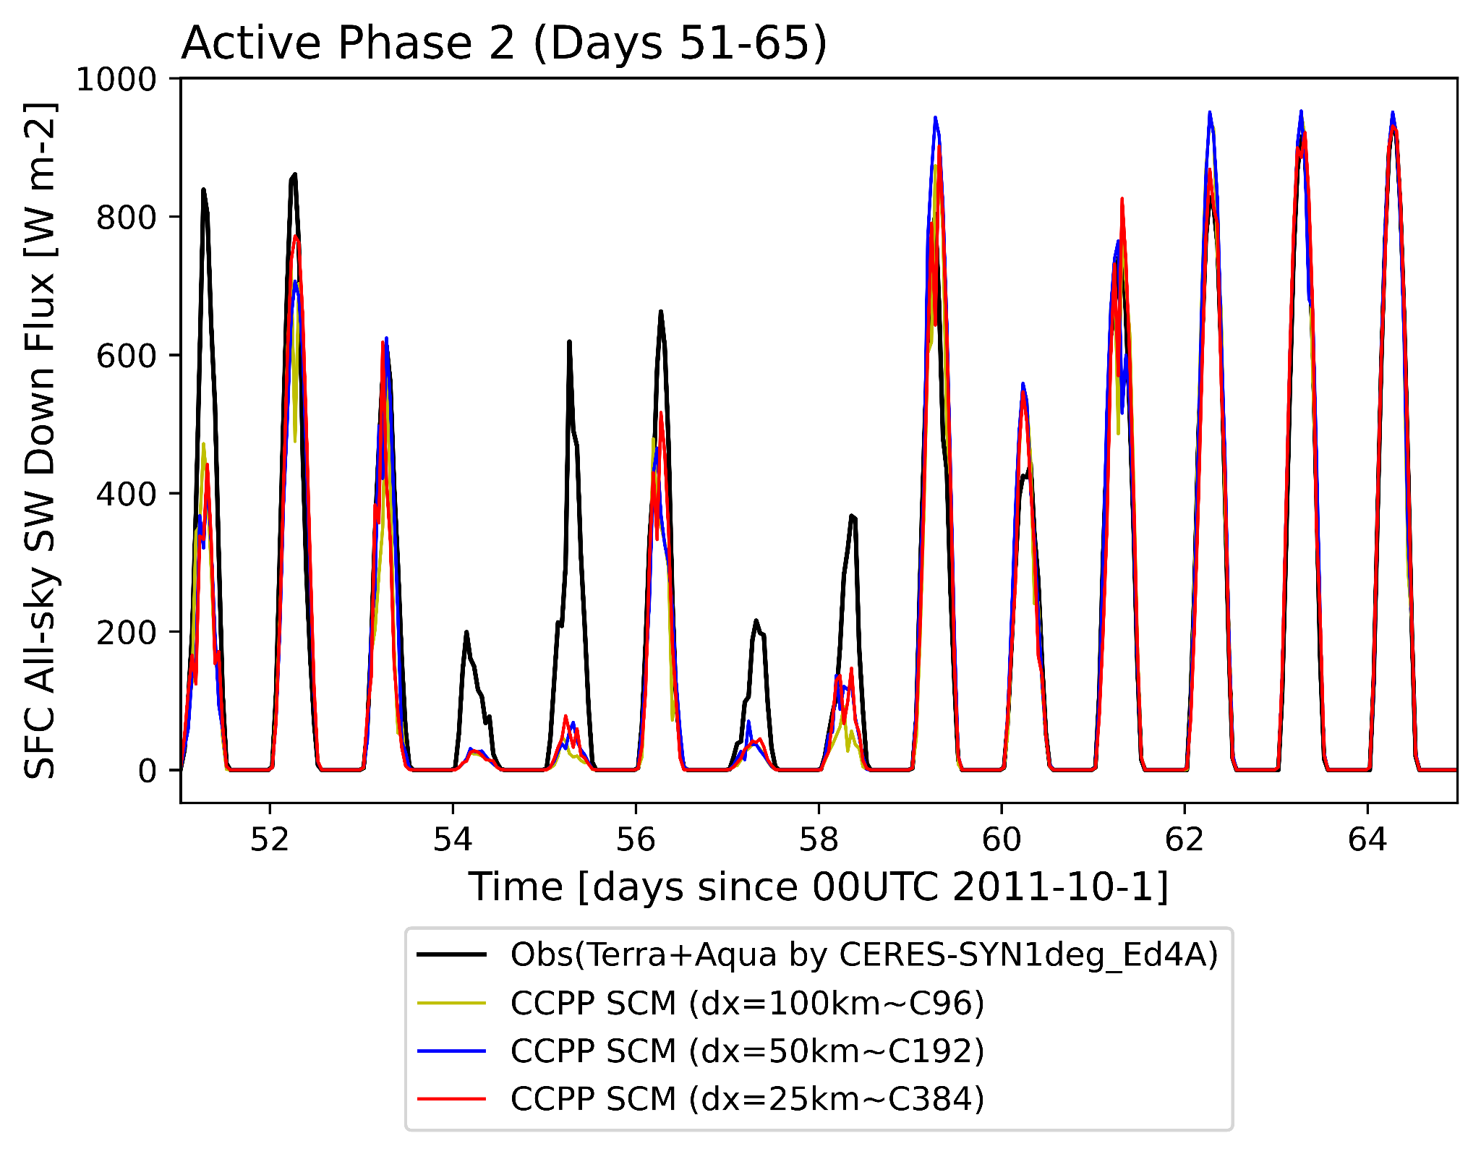
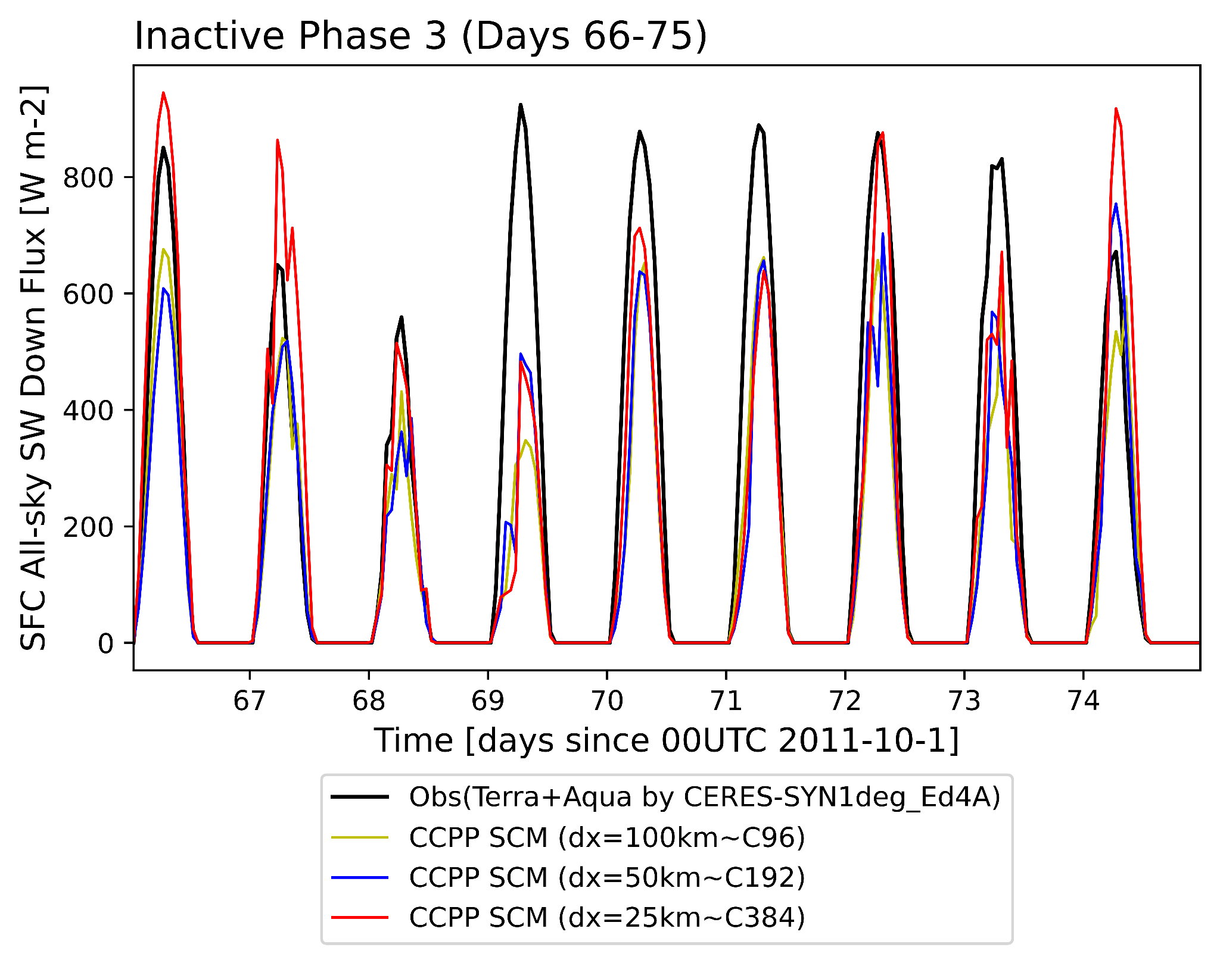
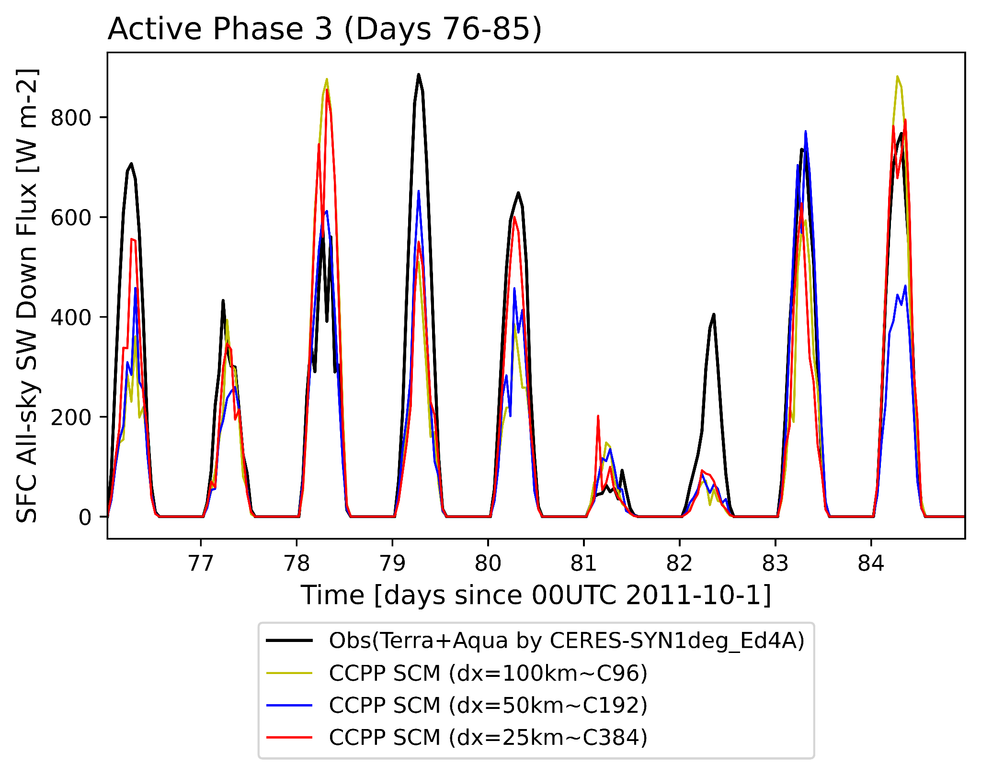
Surface all-sky SW down flux
Inactive MJO Phases
Active MJO Phases
Less SW to sfc overall → smaller SST diurnal amp.
C96 - more clouds, less SW (maybe improved in ufs/dev PR 216 by Lisa Bengtsson at NOAA PSL).
Notes:
Diff reasons for smaller SST amplitude in SCM (more clouds during active phase) vs SFS (winds)
Can do diurnal cycle (composite in active and inactive phases) later.

Slide 7
Near-surface winds
Sensible heat flux
Latent heat flux
Weaker near-surface winds not a contributor, but leads to smaller surface heat fluxes ONLY seen in CCPP SCM
Notes:
Surface scheme & PBL scheme - primary driver for stronger winds → smaller SST amp
Check PBL winds (at 1km) (profiles of winds), friction effect (roughness length)

Slide 8
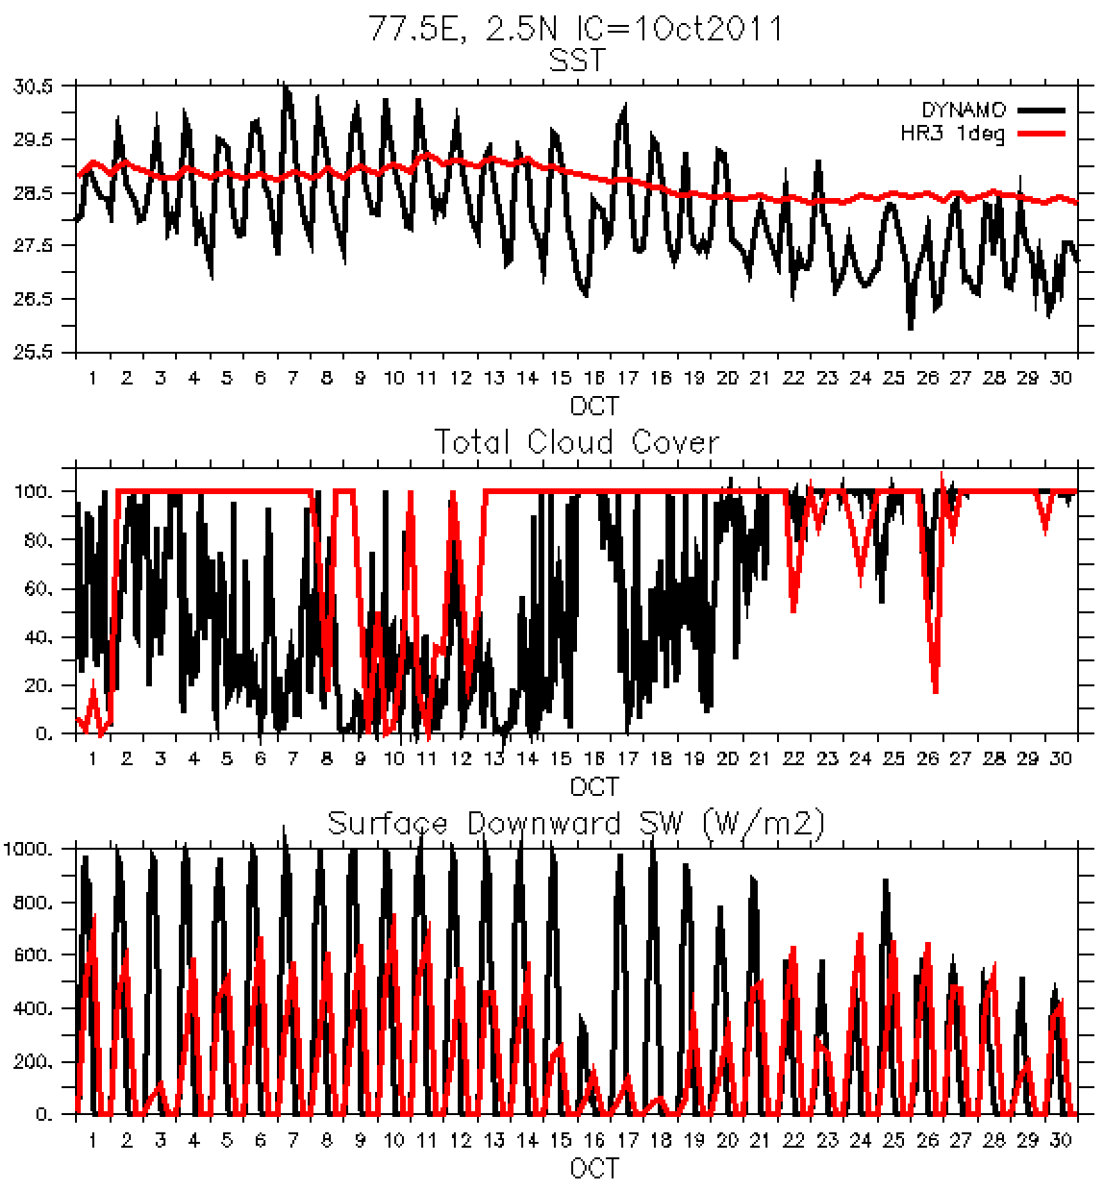
Consistent with SCM:
More clouds → less SW → smaller SST diurnal amplitude.
Fully-coupled SFS C96

Slide 9
Opposite to SCM:
Stronger near-surface winds (environmental flows diff from SCM)
Correlated positively with surface fluxes.
→ Smaller diurnal cycle of SST.
Fully-coupled SFS C96

Slide 10
Clouds, convection and the MJO
SCM
100 km
Phase 1
Phase 2
Phase 3
SFS
100 km
Unlike SCM, SFS challenged to simulate deep cu (less cloudy in active conv. phases) and shal-to-deep transition in MJO.
SFS vs SCM: environmental flow and/or atmosphere-ocean coupling.

Slide 11
Clouds, convection and the MJO
Phase 1
Phase 2
Phase 3
Both SCM & SFS - Dry condition in active phases.
SCM - related to atmospheric component (no coupling, prescribed flows).
SFS - Dryness amplified → inhibit convective development.

Slide 12
Summary
Smaller SST diurnal amp, seen in both SFS and SCM.
SCM & SFS: more clouds → less SW down → smaller SST diurnal amp.
SFS-only: stronger sfc winds → smaller SST diurnal amp + higher sfc heat fluxes (→ colder SST).
Opposite sfc wind effects in SFS vs SCM - env flows, coupling, etc.
Bias of surface heat flux attributable to wind bias.
Dryness inhibits convection and the MJO development. Bias, which is amplified in SFS fcst, may reside in atmospheric component.
Air-sea interaction fields are not noticeably sensitive to grid spacings, but clouds-induced radiation is.
Notes:
See if let SFS SST to drive SCM to exclude role of SST

