Slide 1
An NSST Alternative in UFS: SkinSST
Shan Sun¹, Rainer Bleck^{1,2} and Dongxiao Zhang³
¹NOAA Global Systems Laboratory
²CIRES, University of Colorado at Boulder
³CICOES, Univ of Washington and NOAA Pacific Marine Environmental Laboratory
Funded by OSTI
Unifying Innovations in Forecasting Capabilities Workshop
July 22-26, 2024
Jackson, Mississippi

Slide 2
Model Setup
Code base: coupled UFS (Unified Forecast System) HR3*
Atmosphere:FV3
Ocean: MOM6
Sea Ice: CICE6
Focus: ocean skin temperature parameterization
Present scheme: NSST (original purpose: mimic diurnal cycle)
New scheme: SkinSST (full use of oceanic mixed layer)
Experiments
NSST = No
NSST = Yes
SkinSST
Grid resolution
C384 atmosphere with ¼ deg ocean
2m ocean top layer thickness
*xr_cnvcld turned off

Slide 3
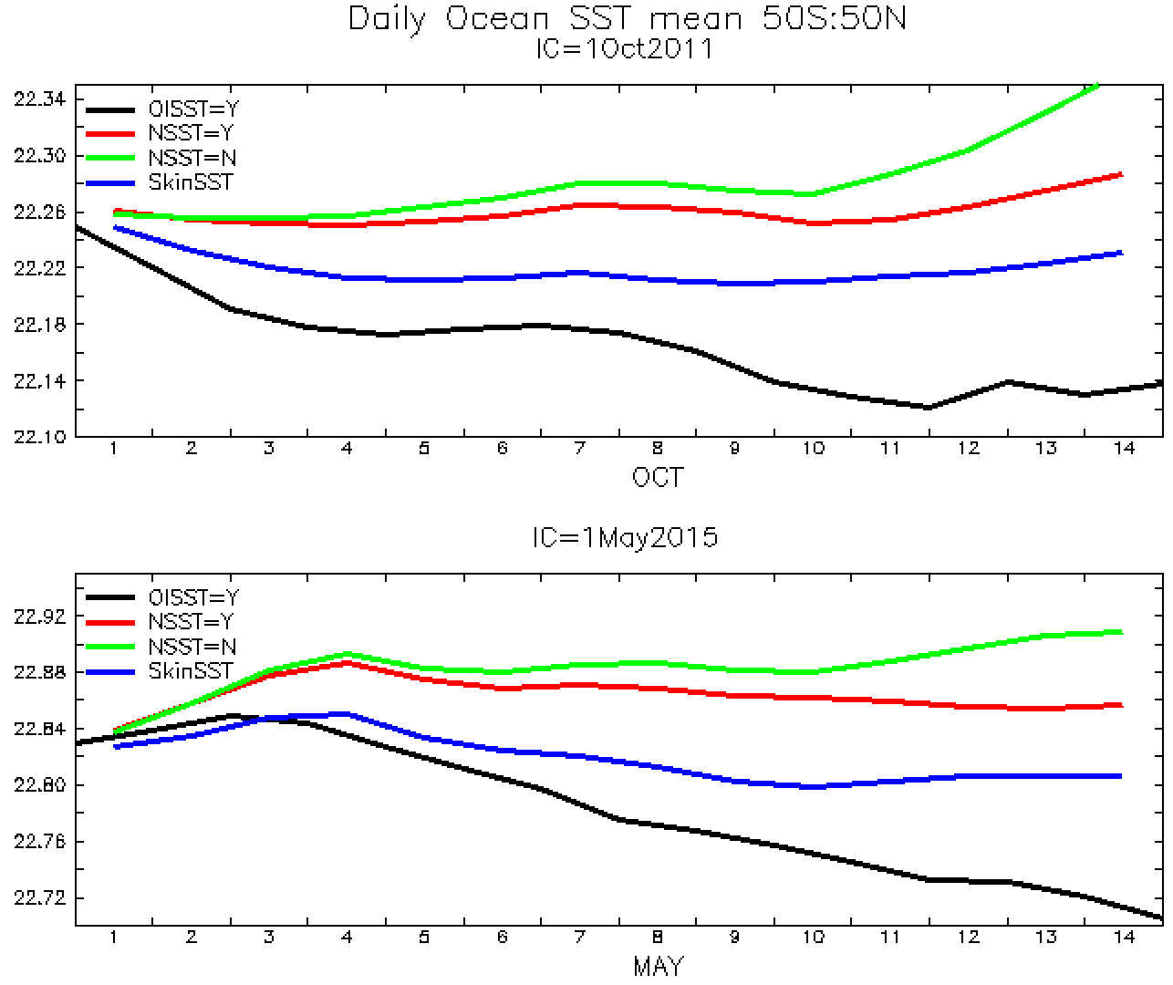
Daily Ocean SST Mean 50S-50N
NSST=No
NSST=Yes
SkinSST
OISST
NSST=No
NSST=Yes
SkinSST
OISST

Slide 4
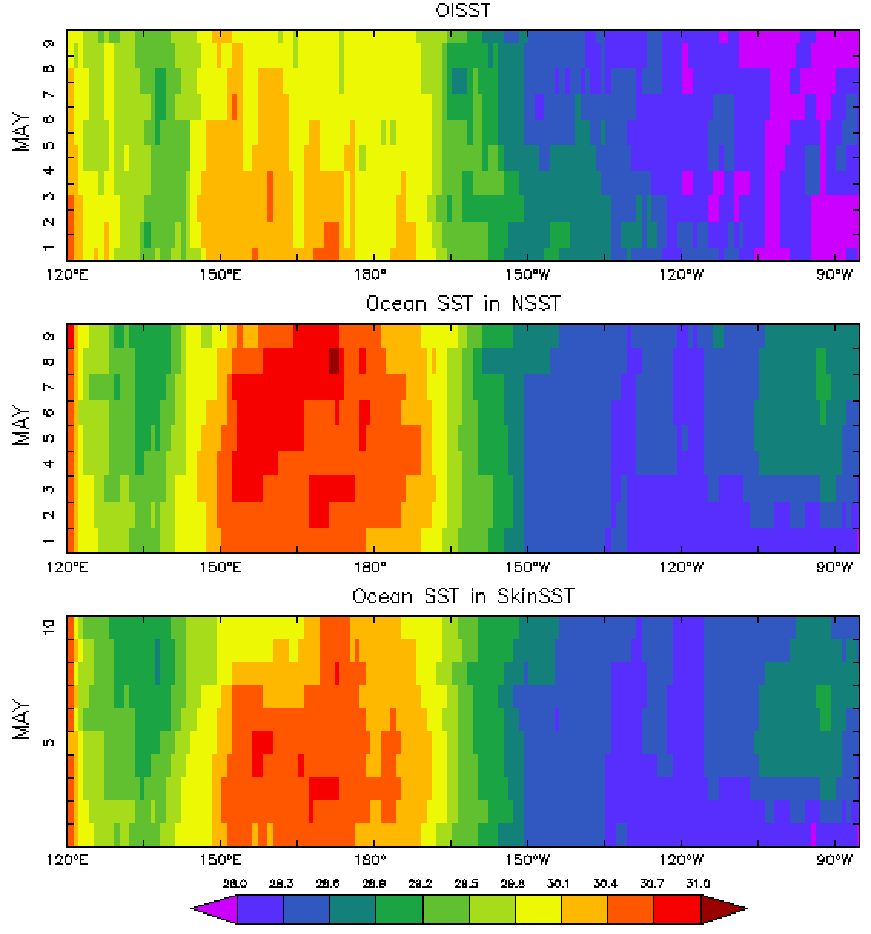
OISST
Near-equatorial SST (5S-5N) in Pacific with time (10days)
Compared to OISST, the warm bias is larger in NSST than SkinSST
NSST=Y
SkinSST

Slide 5
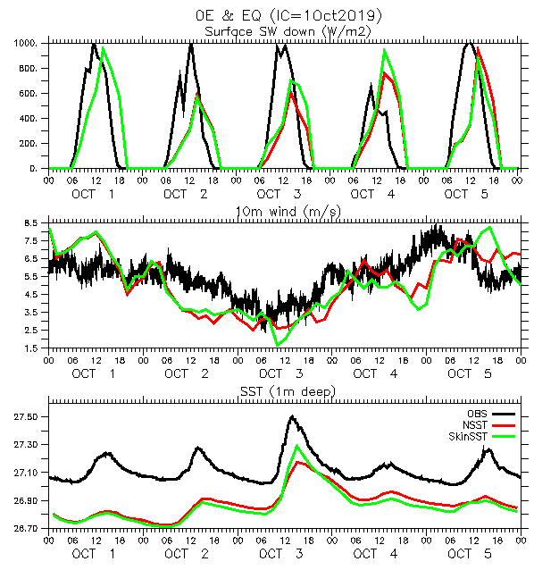
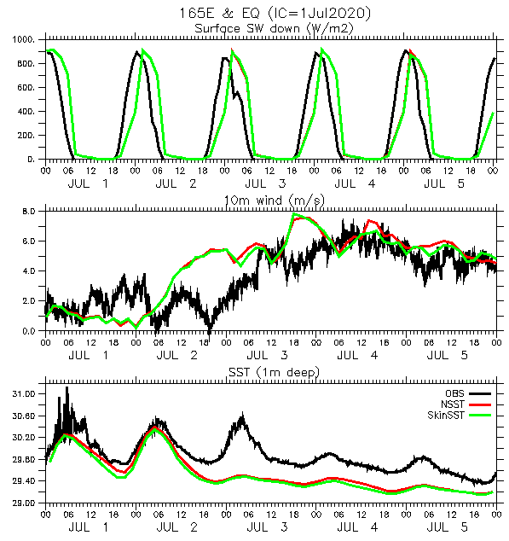
Case Studies at Selected Points
Diurnal warming case
Windy case
12pm
12pm
12pm
12pm
Diurnal warming normally peaks a few hours after noon
Diurnal warming only occurs when the surface wind is weak

Slide 6
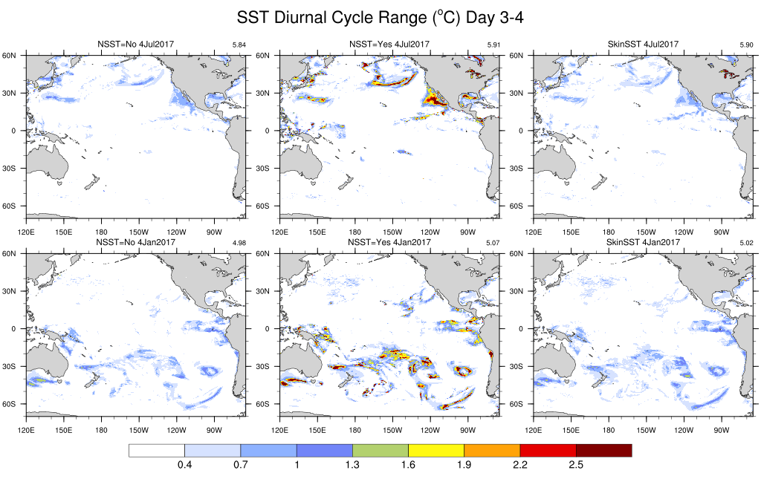
SST Diurnal Cycle Range (ºC) Day 3-4
NSST = N
NSST = Y
SkinSST
IC=1Jul2017
The diurnal warming depends on surface downward radiation
NSST=Y occasionally shows a much bigger diurnal cycle than NSST=N and SkinSST
IC=1Jan2017

Slide 7
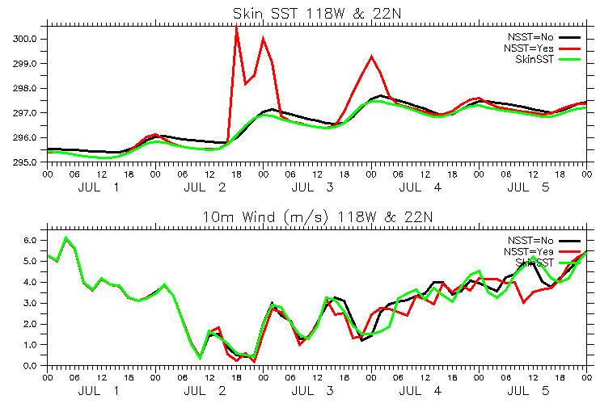
SST (0m) at 118w & 22N (IC=1July2017)
SST (0m)
NSST = N
NSST = Y
NSST=Y shows erratic warming of more than 4ºC at 10 a.m. local
10am
4pm
10m Wind
10am
4pm

Slide 8
Summary
To capture the diurnal cycle and improve overall accuracy in SST
Standalone atmospheric model
Coupled model with a dynamic ocean
NSST
SkinSST

