Slide 1
Globel Ensemble Forecast System Aerosol Physics v12-v13
Li Pan, Partha Bhattacharjee and Jeff McQueen (NOAA/NWS/NCEP/EMC)
July 24, 2024

Slide 2
Collaborators
Li (Kate) Zhang, Georg Grell
NOAA/OAR/GSL
Greg Frost
NOAA/OAR/CSL
Barry Baker, Patrick Campbell, Youhua Tang
(NOAA/OAR/ARL)
Xianwu Xue, Meng Wen, Walter Kolczynski, Jun Wang, Rahul Mahajan, Raffaele Montuoro, Cory Martin,AndrewTangborn,Ivanka Stajner (NOAA/NWS/NCEP/EMC)

Slide 3
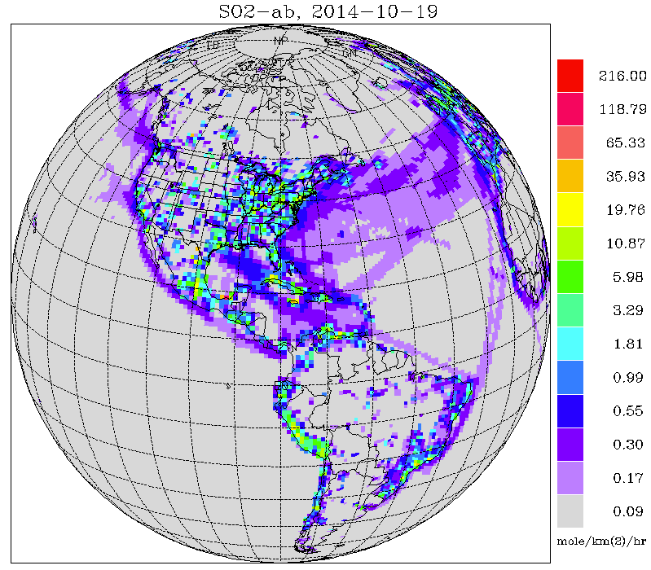
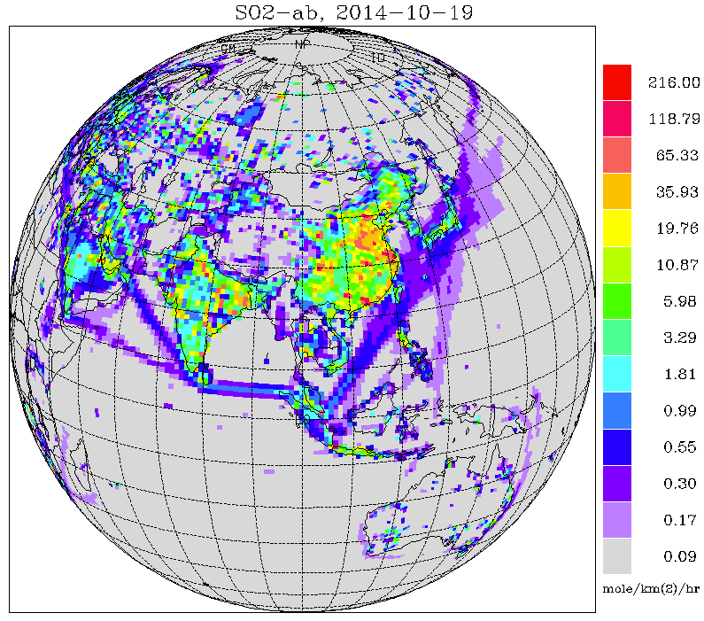
GEFS-Aero v12 Operational Model
One additional member of GEFSv12 for aerosols
Replace operational NGACv2
GEFS meteorology (based on GFSv15) at C384 (~25 km), 64 levels, to 120 hrs, 4x/day
Inline aerosol representation based on GOCART (FIM-Chem)
Sulfate, Organic Carbon, Black Carbon, Dust, Sea Salt
Emissions: CEDS-2019 (SO2, PSO4, POC, PEC), GBBEPx biomass burning, FENGSHA dust, GEOS-5 sea salt, marine DMS
Initial conditions: cycled for aerosols, but from GFS analysis for meteorology
Smoke plume rise: Wind shear dependent 1-d cloud model to simulate tilt of plume. Fire Radiative Power is used to calculate convective heat flux and determine injection height
Tracer transport and wet scavenging are included in Simplified Arakawa-Schubert (SAS) scheme. Fluxes are calculated positive definite.
CEDS-2014 SO2 emissions
Courtesy: Ivanka Stajner

Slide 4
GEFS-Aerosols v12.0
NGAC replaced by FV3GFSv15 GEFS-Aerosols, Aerosol model became a member of Global Ensemble Forecast System (September, 2020)
GEFS-Aerosols v12.1
FV3-GFS updated from version 15 to version 16, initial input for GEFS-aerosols changed from NEMSIO to NETCDF (March, 2021)
GEFS-Aerosols v12.2
Porting GEFS-Aerosols from WCOSS1 to WCOSS2 ( June, 2022)
GEFS-Aerosols v12.3
Chemistry components only, mainly focusing on bugs fixed in AOD calculation (October 19, 2022)

Slide 5
Dependencies
Models:
Regional AQMv7.0 (CMAQ) : Jianping Huang, NCEP/EMC; Barry Baker (NOAA/ARL)
Users:
International Centers for Aerosol Prediction(ICAP)
(Jeff Reid, NRL)
WMO Sand and Dust Storm Advisory Center: Barcelona Supercomputer Center
(Oriol Jorba, BSC)
Global Air quality Forecast International Center (GAFIS)
(Bihui Zhang)
Singapore Meteorological Center
NCEP/CPC (for UV index predictions)

Slide 6
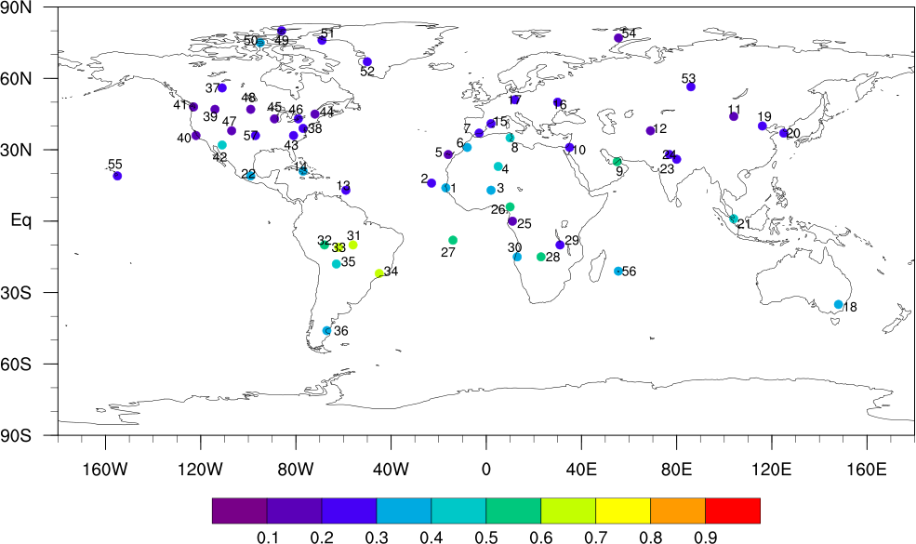
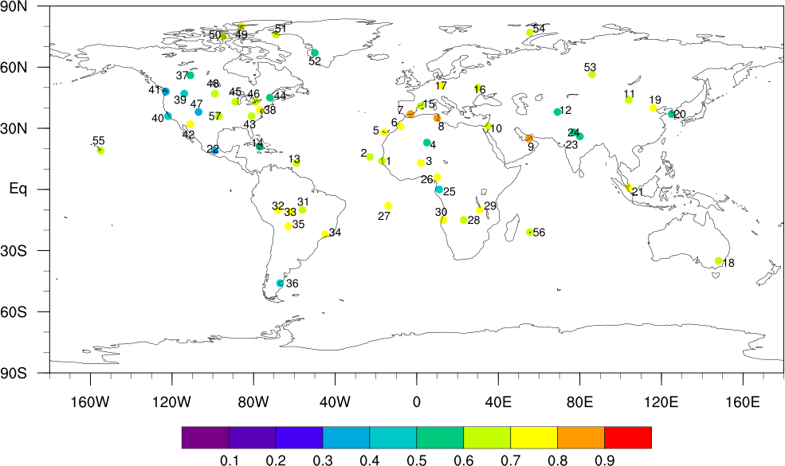
Correlation (R) based on Day 1 forecast of NGACv2 and AERONET
Correlation (R) based on Day 1 forecast of GEFSv12-Aersol and AERONET
Aug 2019-June 2020 annual average error: Significant improvement in aerosol forecasts from GEFSv12-Aerosol

Slide 7
V12.3 Scope of changes
Bug Fixes
Aerosol Optical Depth (AOD) calculation in Unified Post-Processor (UPP)
ARL Fengsha dust source code
Science updates
Aerosols large scale precip wet removal adjusted
Aerosols convective wet scavenging adjusted
GBBEPx OC emission process optimized
Aerosols anthropogenic emission inventory updated to 2019
UPP updates to include surface dust PM10 & 3 met fields in output

Slide 8
PROD vs EXP forecast total AOD Bias against MERRA2
(August & November 2021)
Production
Experimental
Notes:
Improvement around fires..overprediction now underprdiction over E. Asia

Slide 9
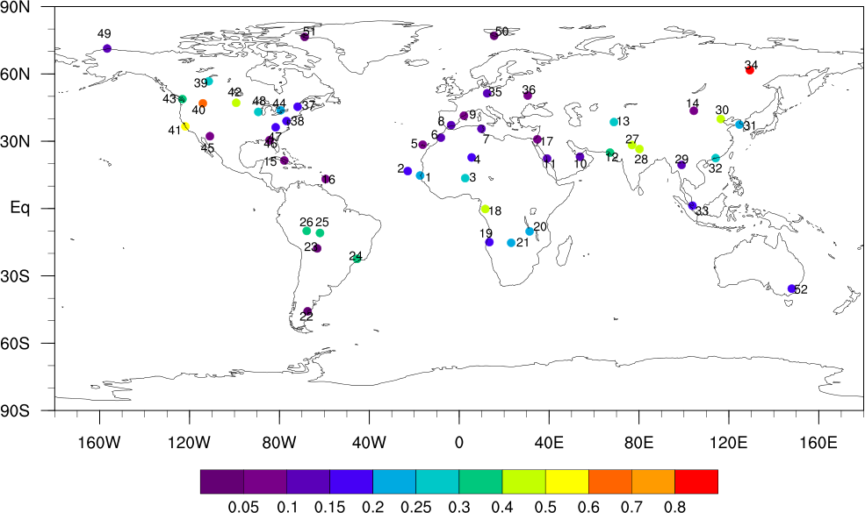
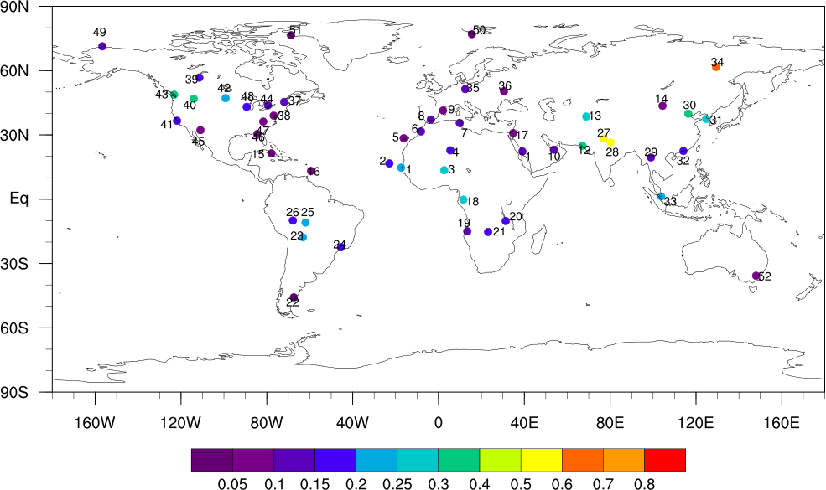
8
Production
EXP Retro
Total AOD RMSE against AERONET stations (May 2021 - Mar 2022)
Notes:
improvement in overprediction esp around fires in Africa, E. Asia AOD, North America

Slide 10
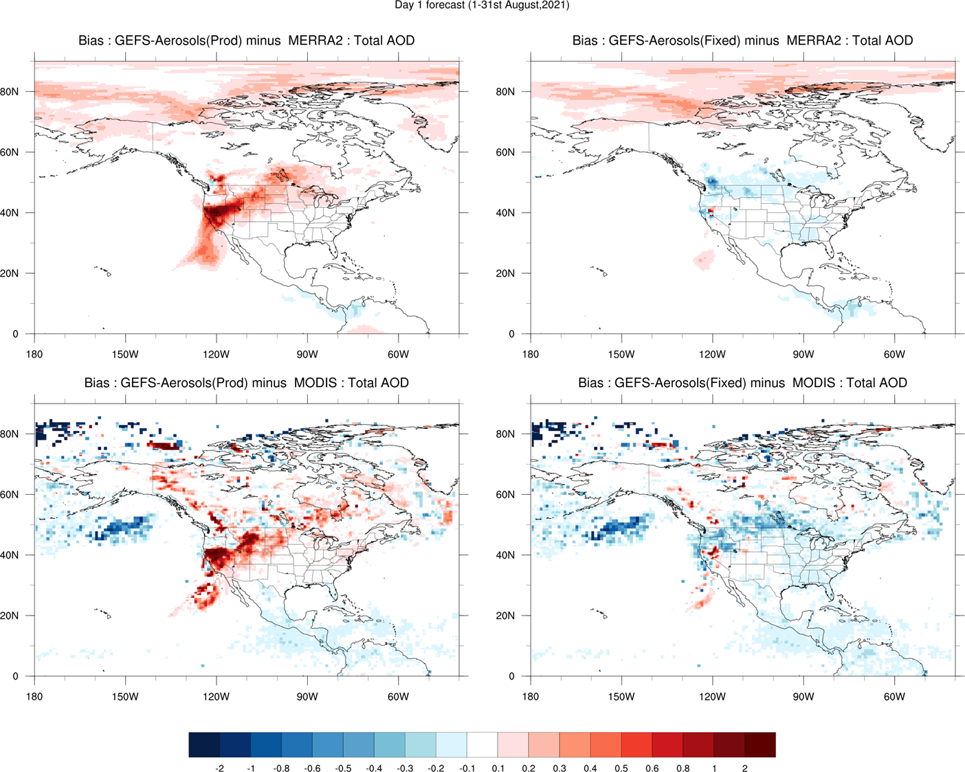
California Fires, August 2021
Production :
Total AOD bias
against MERRA2
and MODIS
V12.3Retro :
Total AOD bias
against MERRA2
and MODIS

Slide 11
EXP run CEDS Emission Test: January, 2021 (total AOD Bias)
CEDS 2014
CEDS 2019
Large improvement of total AOD bias over
East Asia with 2019 inventory

Slide 12
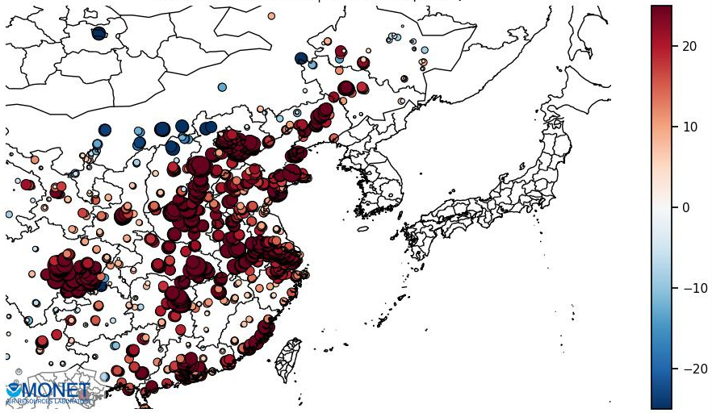
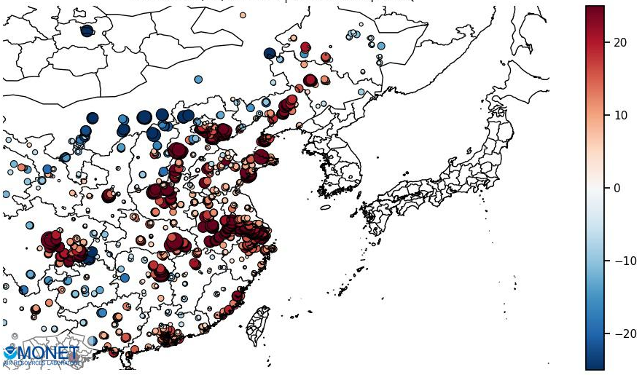
OPEN-AQ PM_{2.5} Regional Biases (µg m⁻³)
NMB | NME | IOA
91.87 | 110.3 | 0.46
NMB | NME | IOA
41.7 | 74.2 | 0.54
Oper CEDS 2014
Retro/Fix CEDS 2019
EAS
EAS
Significant Improvement
August 2021
Improved Performance
Degraded Performance
Notes:
improvement inPM2.5

Slide 13
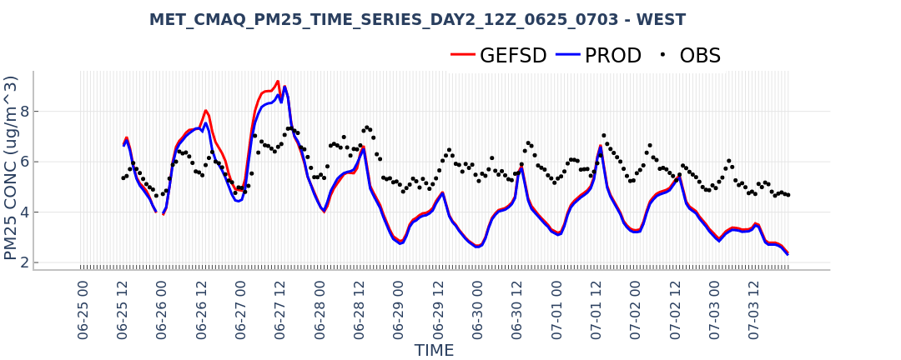
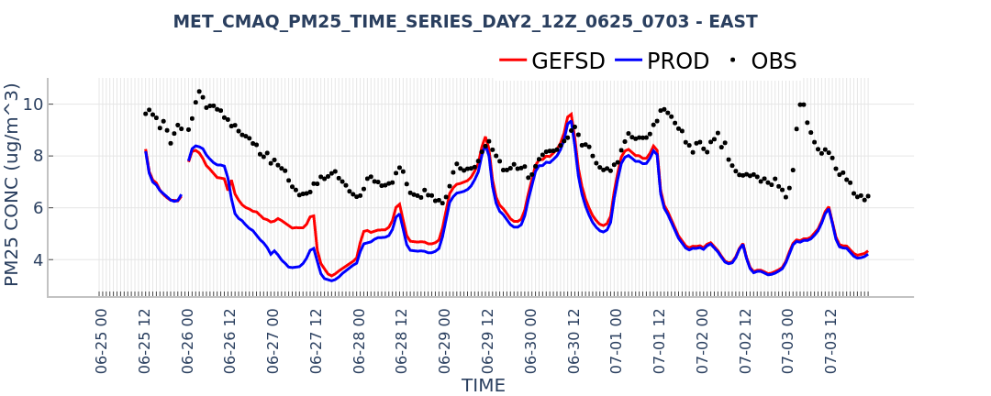
PM25
Time Series
GEFSv12.3 LBCs impact on
CMAQ PM2.5 forecast
6/25-7/03/22
For PM25, the performance is improved for the CONUS and the E US. The performance is slightly degraded in the W US (mainly due to the overestimate for 6/25-27 but slightly better for the remaining days).

Slide 14
V12.3 Summary
Reduced AOD bias against MODIS satellite and NASA MERRA2 re-analysis
Reduced GEFS-Aerosols AOD RMSE against AERONET stations over N. American and over biomass burning areas
Improved aerosol predictions for East Asia anthropogenically influenced areas
More of an underprediction bias overall
Experiments highlight the importance of
wet scavenging coefficiants and AOD calculation methods

Slide 15
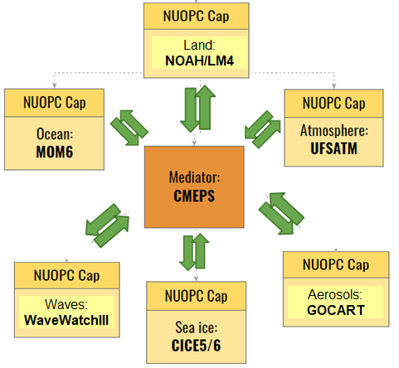
Operational Targets for Global UFS-Coupled
GFS v17/GEFS v13: Fully coupled system for MRW and Subseasonal predictions
FV3+MOM6+CICE6+WW3+NOAH-MP+ GOCART Coupled Model
Advanced Physics, Weakly Coupled DA
FY26: Implement GFS v17 & GEFS v13
Seasonal Forecast System (SFS v1.0)
Fully coupled Unified Forecast System
Seasonal ensemble forecasts with reanalysis and reforecasts
Advanced coupled DA
FY27+: Implement SFS v1.0
Notes:
all using nuopc esmf cap for coupling

Slide 16
GEFS v13 (2026)
Update all 31 members to GFSv17 Unified Coupled Forecast System (UFS)
~25 km, 127 vertical levels
Extend forecasts to 48 days
Include GOCART aerosols (EP5r2)
In all members
Aerosol radiation feedbacks in all members
probabilistic prediction of pm2.5, pm10, AOD
Update emissions:
Anthropogenic CEDS
Wild fire smoke from updated NESDIS GBBEPx hourly emissions;
Blend smoke emissions towards climatology after 5 days
Fengsha dust emission scheme updated to include albedo to diagnose dust sources; adjust threshold velocities

Slide 17
v13 test AOD: Accumulation of aerosols over arctic
2 m Temperature with radiation feedback Impact

Slide 18
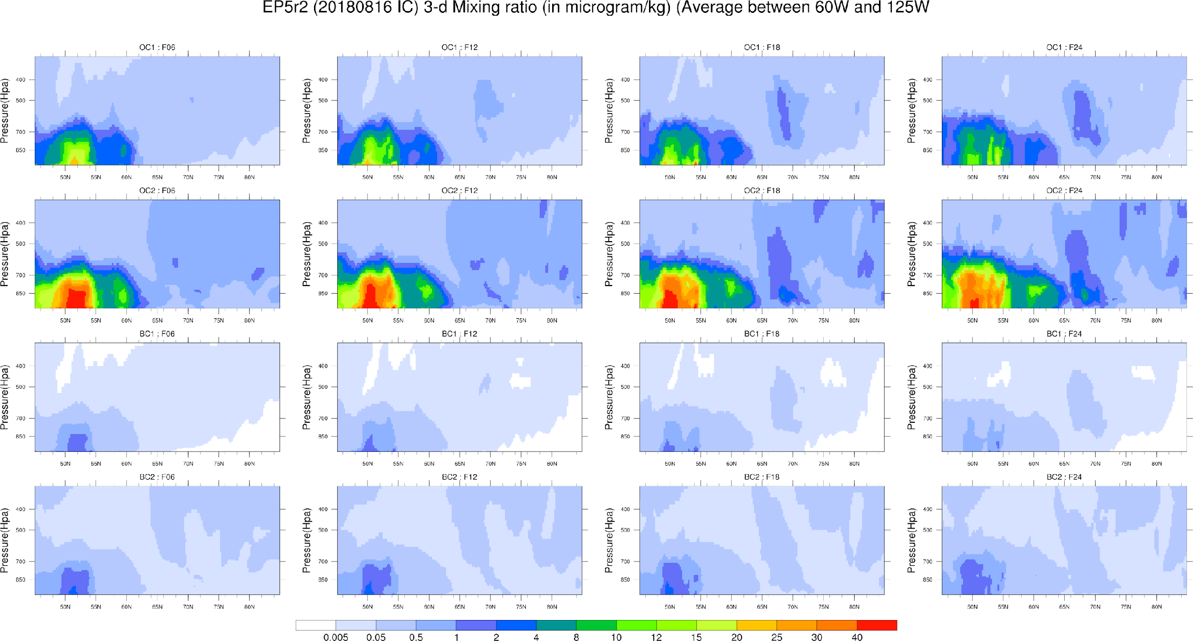
Day1, Western USA fire

Slide 19
GEFSv13 Summary
Overprediction of aerosol AOD compared to MERRA-II and AERONET observations.
Unrealistic accumulation of aerosols over the Arctic originated from wildfire events that started from the NH mid and high latitudes.
Significant impact on meteorology: Impact of prognostic aerosol during a large fire event led to lower tropospheric cooling, 500 mb height bias and zonal winds - the impact is mostly seen in NH (20-80N)
Surface cooling, reduction of downward solar radiation at the surface, co-located with large smoke transport over Western US and higher latitudes through the first week of forecast.
Likely that smoke emissions are too strong and emissions scaling will be employed

Slide 20
BACKUP SLIDES

Slide 21
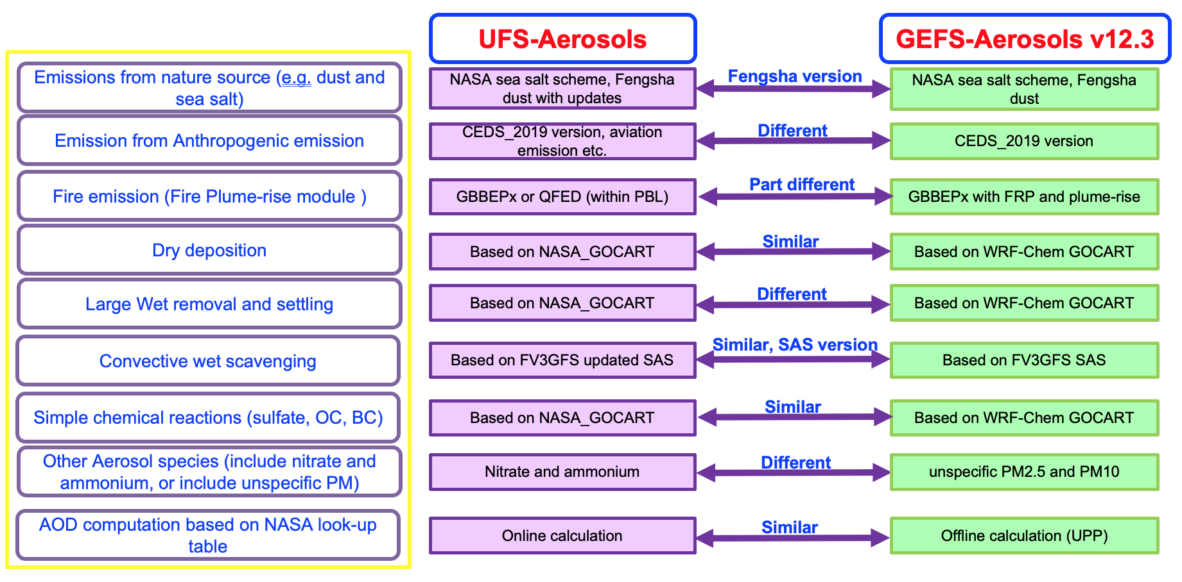
UFS-Aerosols vs. Operational GEFS-Aerosols v12.3
UFS-AEROSOLS Q3FY24
courtesy Greg Frost, NOAA/OAR/CSL

Slide 22
Climatological aerosols
Prognostic aerosols
Prog - Clim Difference
Boxes = Prog aerosols improve/degrade skill
Initial evaluations of meteorological impacts from radiation interactions with prognostic aerosols (UFS-Aerosols) relative to climatological aerosols (MERRA-2) are underway.
Inclusion of interactive prognostic aerosols in P8 generally improves mid-latitude and tropical surface temperature predictions in Weeks 3&4 relative to climatology:
(top) Bias in 2-m T vs. GEFSv12 reanalysis
(middle) Bias in maximum 2-m T vs. CPC obs
(bottom) Bias in minimum 2-m T vs. CPC obs
Interactive prognostic aerosols have minor impact on Week 1 meteorological predictions compared to climatology in the absence of major aerosol- generated events (not shown).
Weeks 3&4 July ICs 2-m T bias vs GEFSv12 reanalysis
Weeks 3&4 July ICs max 2-m T bias vs CPC gridded obs
Weeks 3&4 July ICs min 2-m T bias vs CPC gridded obs
Courtesy: Barry Baker, NOAA/ARL & Greg Frost, NOAA/CSL, UFS-Aero lead
UFS R2O AC team thanks Lydia Stefanova for this analysis

Slide 23
JTTI: “Atmospheric Composition Data Assimilation for the Unified Forecast System (UFS) on Global and Regional Scales”
PI: Cory Martin; Co-PIs: D. Kleist, J. McQueen, I. Stajner
Primary goal of project:
T2O initial global aerosol analysis capability using JEDI and VIIRS AOD observations
Explore improvements in global AOD DA (ensembles, VarQC, etc.)
Secondary goal for later half of project:
Develop initial capability to use TEMPO observations in JEDI
“Use” in regional AQ model but not necessarily enough time/resources to do so properly

Slide 24
ICAP Updates
Add back GEFS-Aerosols graphics to ICAP web site
Couple output to new ICAP server
Links
NRT Evaluation (P. Bhattacharjee)
https://www.emc.ncep.noaa.gov/gc_wmb/parthab/NCO-GEFSAerosol/html/fv3_aod_png.html
Evaluation of GEFS-Aerosols bug fix runs (w/ ICAP, MERRA-2, AERONET, MODIS, VIIRS using METPlus software)
Experimental run on WCOSS2

Slide 25
V12 Production run forecast Total AOD Bias against MERRA2
(April 2021 – February 2022)

Slide 26
V12.3 EXP run forecast Total AOD Bias against MERRA2
(April 2021 – February 2022)

Slide 27
File Size Resource changes ->
Adding surface dust PM10, cloud ceiling, surface visibility and surface frozen precipitation fraction.
Location | Production_v12.2 | GEFS-Aerosols_v12.3
chem/master files | 991 variables | 991 + 1 = 992 variables
chem/surface and 2-D variables (pgrb2ap25) | 31 variables | 31 + 1 = 32 variables
atmos/surface and 2-D variables (pgrb2sp25) | 35 variables | 35 + 3 =38 variable
NOMADS ftp access file size (pgrb2ap25, pgrb2sp25) | 34M/66 variables | 66 + 4 = 70 variables
Total Increase on NOMADS : | + 500 M /day

Slide 28
CPU Resource changes -> task “gefs_forecast”
On WCOSS2 | Production_v12.2 | GEFS-Aerosols_v12.3
Layout | 6x8 | 6x8
Task per node | 110 | 110
Threads | 1 | 1
Output frequency | 3 hourly | 3 hourly
Total forecast length | 120 hrs | 120 hrs
I/O groups and total nodes | 1, 42 | 1, 42
Total #nodes | 3 x 110 = 330 | 3 x 110 = 330
Wall Time | 3 hrs | 3 hrs
Duration | 2 hrs 13 mins | 2 hrs 13 mins
CPU time for gefs_forecast | 26.6 min/day | 26.6 min/day

Slide 29
Selected GEFS Bugzilla Issues
ID | Product | Comp | Status | Summary | Changed | Note
1013 | GEFS | post_pro | NEW | No restart ability for job gefs_atmos_ensstat | 2020-09-08 | Have resolved in develop branch
998 | GEFS | chem | NEW | Better handling array allocation in gefs | 2020-08-21 | Have solved (gefs_chem_prep_emssion)
1002 | GEFS | init | NEW | variable not defined in nemsio_read.fd | 2020-08-21 | Don't use "nemsio_read" now
337 | GEFS | post_pro | REOP | Remove goto statements from Fortran source code in gefs | 2020-09-04 | Have removed "goto" in ensstat source in develop branch
Add pqpf function back |  | Add another function: 3) Add part (1b): probabilistic forecasts ( PQPF, PQRF, PQFF, PQSF and PQIF ) to enspost ex-script

Slide 30
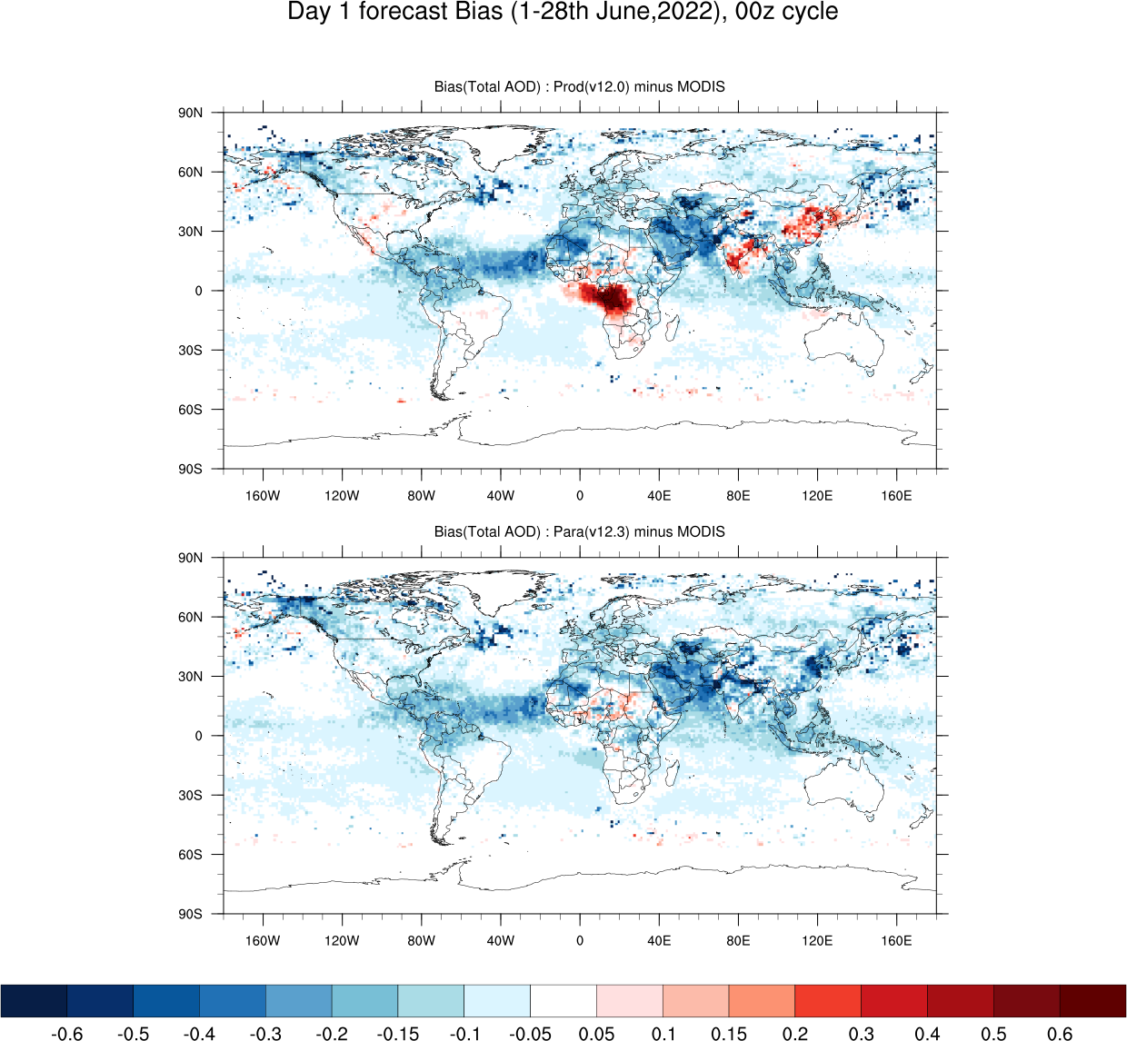
Production Total AOD
against MODIS
Parallel Total AOD
against MODIS

Slide 31
Background
GEFS-Aerosols v12.0
NGAC replaced by GEFS-Aerosols, Aerosol model became a member of GEFS (September, 2020)
GEFS-Aerosols v12.1
FV3 updated from version 15 to version 16, initial input for GEFS-Aerosols changed from NEMSIO to NETCDF (March, 2021)
GEFS-Aerosols v12.2
Porting GEFS-Aerosols from WCOSS1 to WCOSS2
(on going, July, 2022)

Slide 32
Code, Script and Input/Output changes
Code:
fv3gfs.fd/GSDCHEM/src/chem
fv3gfs.fd/FV3/gfsphysics/GFS_layer
gfs_post.fd/sorc/ncep_post.fd
Script
gfs_post.fd/parm
global-workflow.fd/scripts
Input/Output
fix/fix_emission

Slide 33
GEFS-Aerosols v12.0
NGAC replaced by GEFS-Aerosols, Aerosol model became a member of GEFS (September, 2020)
GEFS-Aerosols v12.1
FV3 updated from version 15 to version 16, initial input for GEFS-aerosols changed from NEMSIO to NETCDF (March, 2021)
GEFS-Aerosols v12.2
Porting GEFS-Aerosols from WCOSS1 to WCOSS2 (on going, June, 2022)
GEFS-Aerosols v12.3
Chemistry components only, mainly focusing on bugs fixed in AOD calculation (scheduled, September, 2022)

Slide 34
Current status: four-cycle real time forecasting at WCOSS2
GEFS-Aerosol(v12.3) in WCOSS2

Slide 35
FENGSHA Dust scheme bug fix
The fengsha bug fix corrects the calculation of the (kok, 2011) volume
distribution of emitted dust increasing the mass of the fine mode dust
No changes to the actual emission code, this only will change the distribution size. Distribution has large impact on the total transport AOD creating more fine particulates after the fix
More sources are picked up in regions where the model had some biases (Mid East, Takalamakan/Gobi).

Slide 36
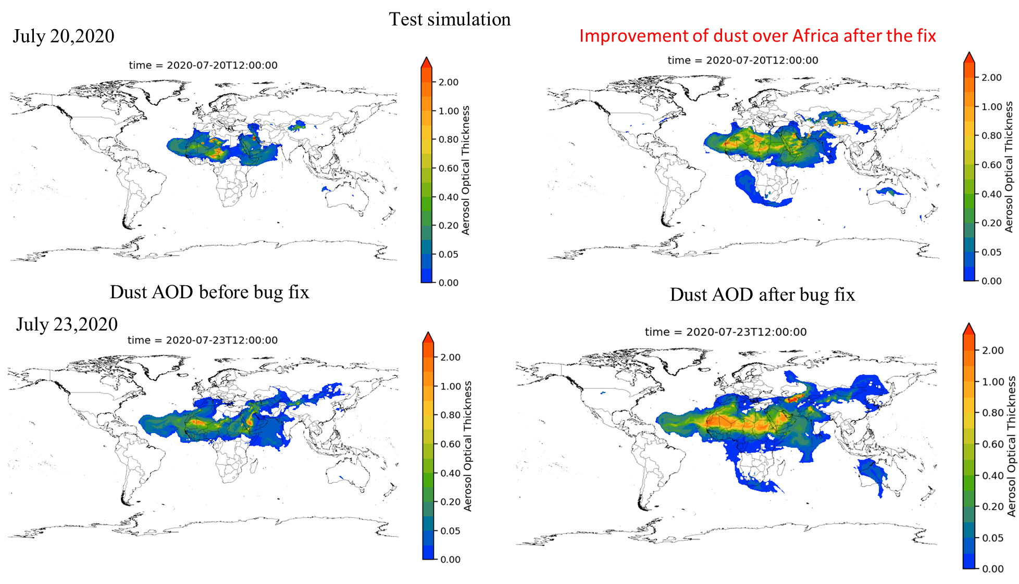

Slide 37
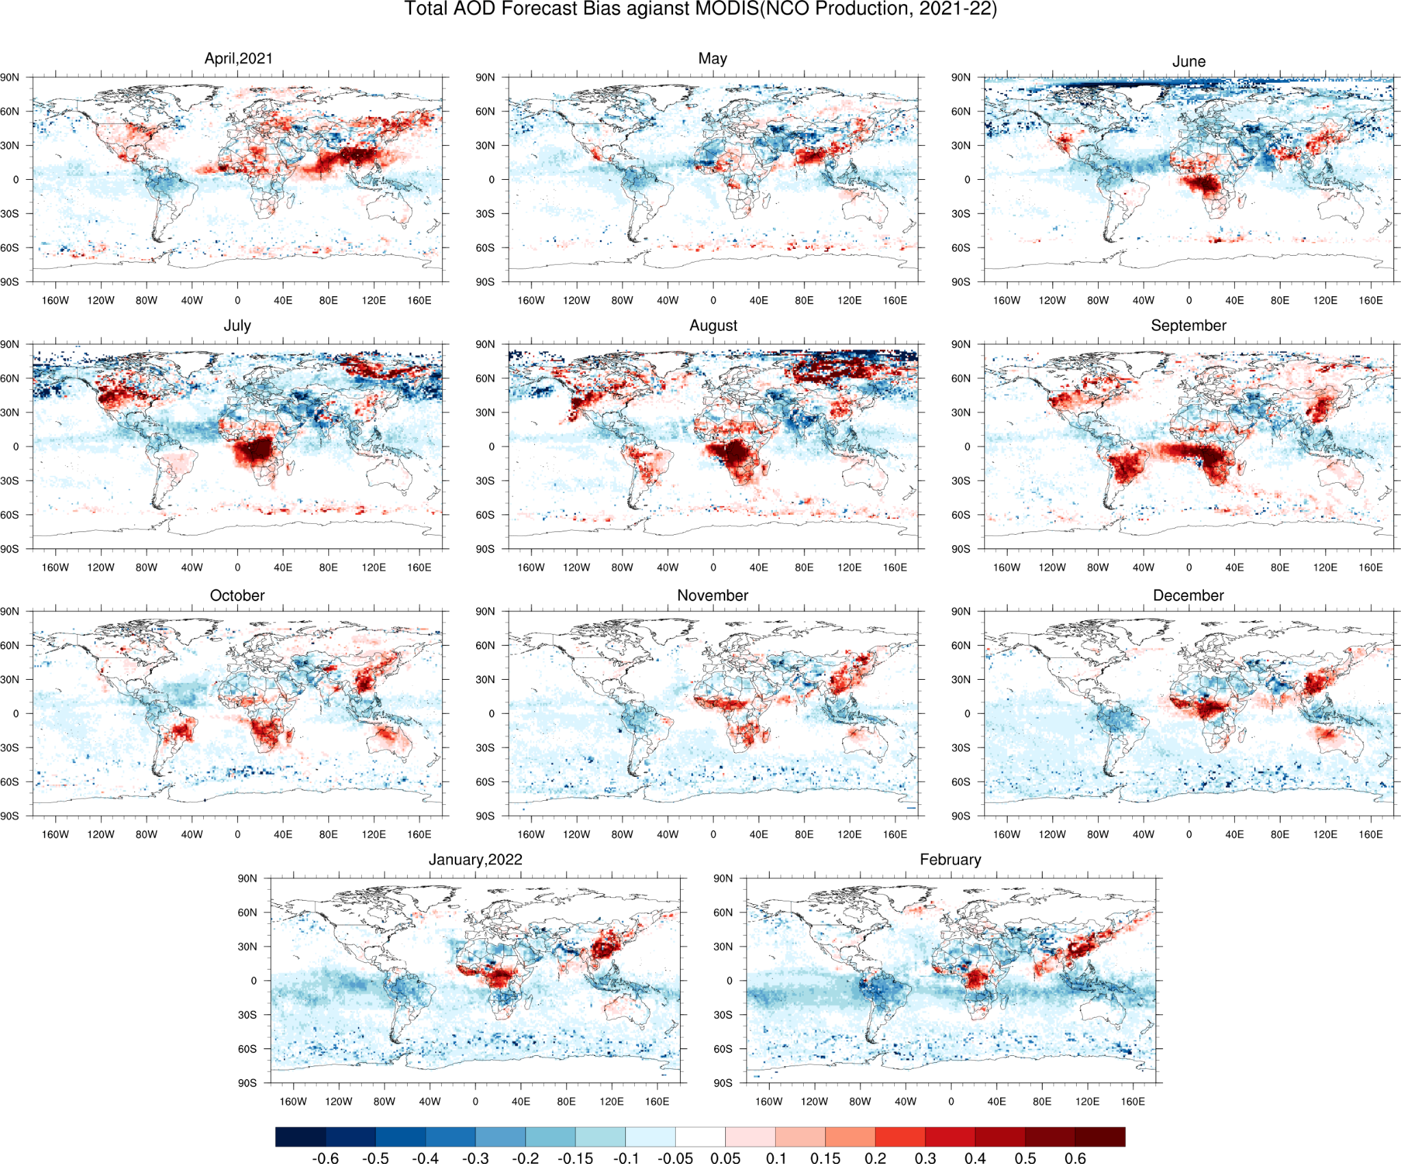
Production run
Day 1 forecast Bias against MODIS total AOD April 2021 – February 2022

Slide 38
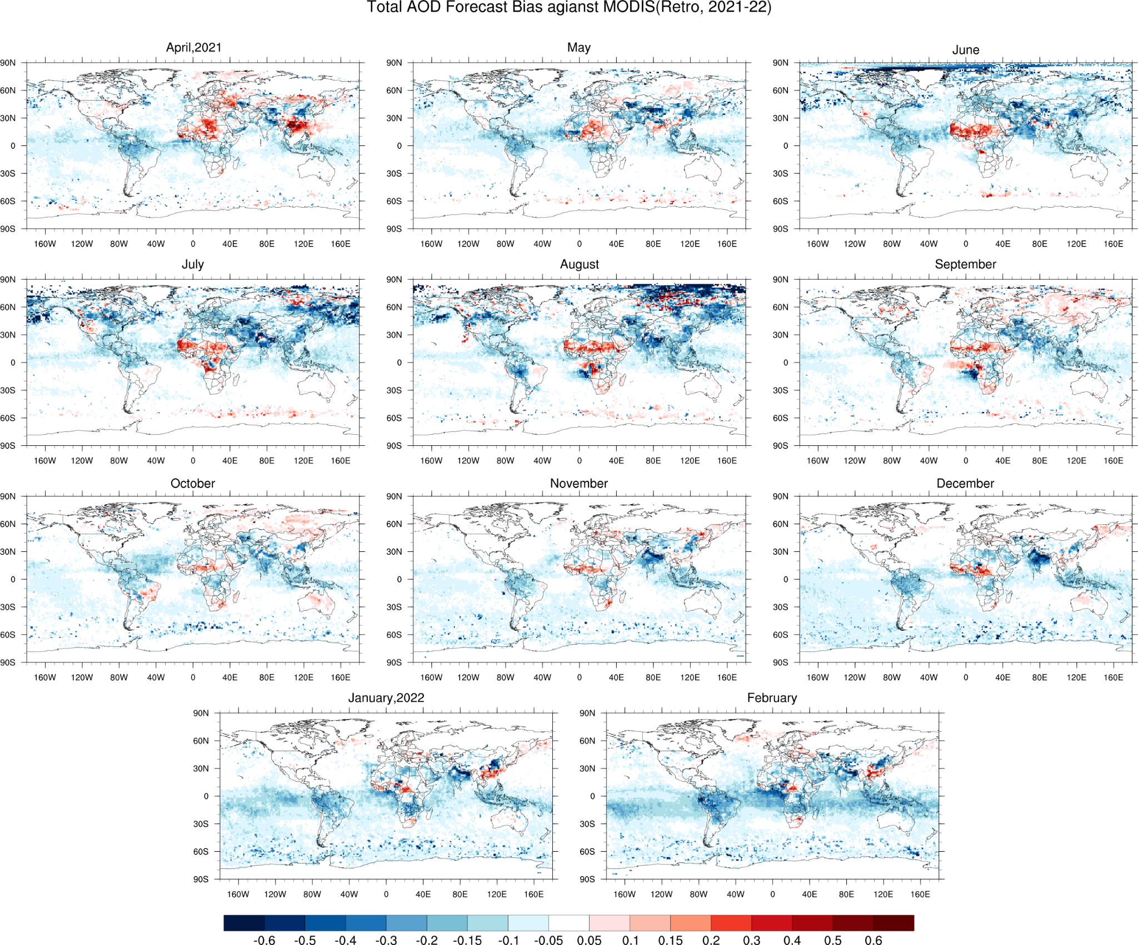
Retro run
Day 1 forecast Bias against MODIS total AOD April 2021 – February 2022

Slide 39
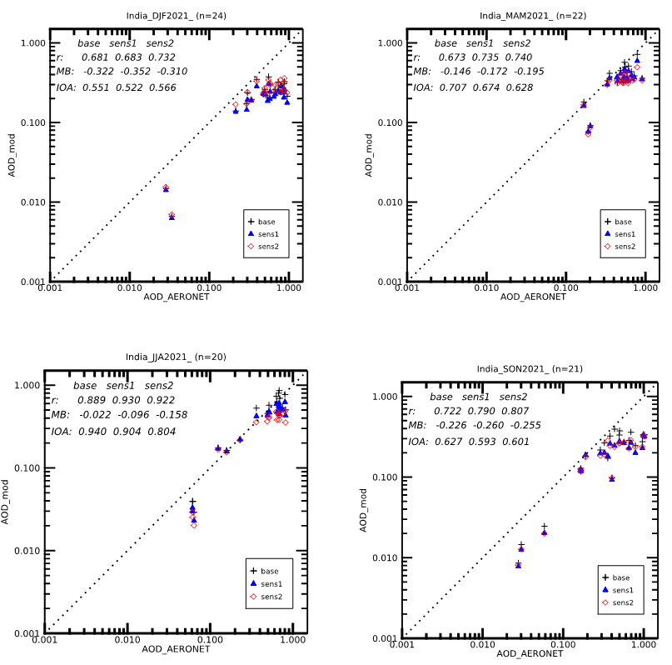
Total AOD Scatter/Statistical Analysis: Regional
Europe
Base=CEDS 2014
Sens1=CEDS 2019
Sens2=CEDS 2019 BiasScaled
Use of CEDS 2019 has mixed results compared to operational CEDS 2014, but the Bias Scaled can help improve in this region.

Slide 40
OPEN-AQ PM_{2.5} and PM₁₀ Global Statistics
August 2021 Global Stats | #Obs-Mod | MB (µg m⁻³) | NMB (%) | NME (%) | R | IOA
PM2.5
Oper. CEDS 2014 | 225285 | 8.87 | 66.90 | 113.48 | 0.24 | 0.15
Retro/Fix CEDS 2019 |  | 6.95 | 52.42 | 104.98 | 0.24 | 0.15
PM10
Oper. CEDS 2014 | 194198 | 2.83 | 12.32 | 80.40 | 0.14 | 0.24
Retro/Fix CEDS 2019 |  | 0.90 | 3.89 | 78.20 | 0.13 | 0.23
Improved Performance
Degraded Performance

Slide 41
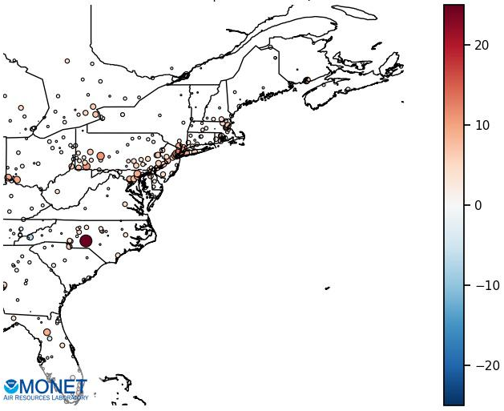
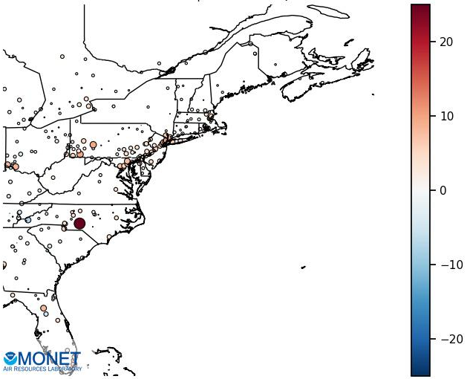
OPEN-AQ PM_{2.5} Regional Biases (µg m⁻³)
August 2021
Oper CEDS 2014
NMB | NME | IOA
31.12 | 56.68 | 0.44
Retro/Fix CEDS 2019
NMB | NME | IOA
18.26 | 50.85 | 0.45
ENA
ENA
Moderate Improvement
Improved Performance
Degraded Performance

Slide 42
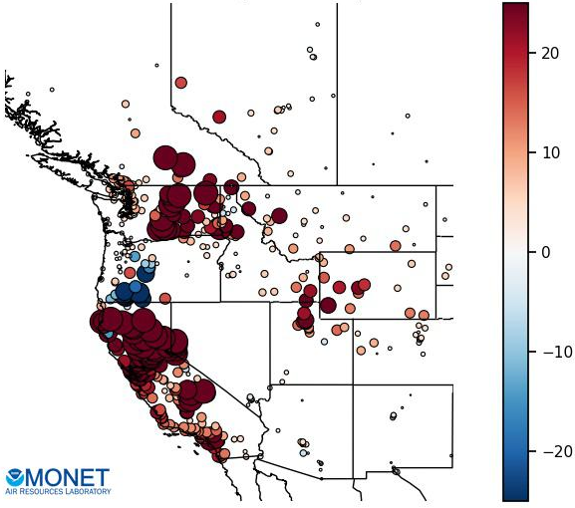
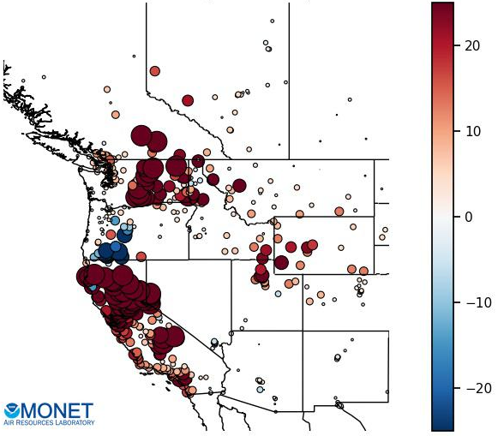
OPEN-AQ PM_{2.5} Regional Biases
August 2021
Oper CEDS 2014
Retro/Fix CEDS 2019
NMB | NME | IOA
146.9 | 190.9 | 0.13
NMB | NME | IOA
142.1 | 188.8 | 0.13
WNA
WNA
Very Slight Improvement
Improved Performance
Degraded Performance

Slide 43
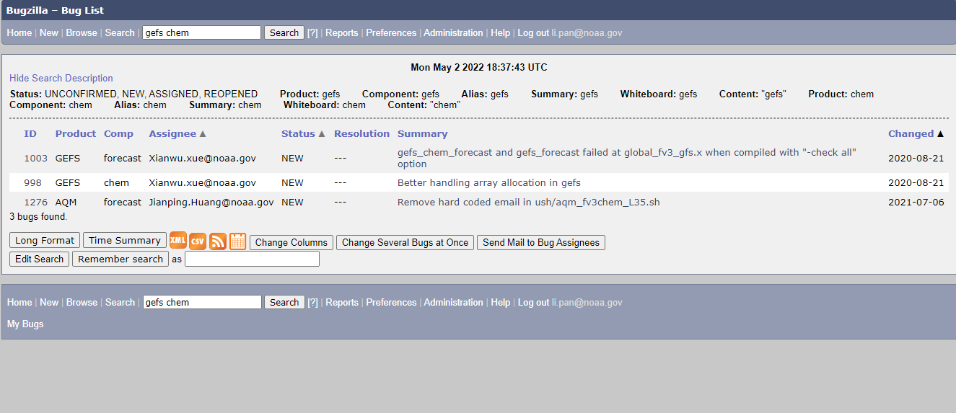
GEFS-Aerosols Bugzilla items: (Search “GEFS chem”)

