Slide 1
The Unified Workflow Tools and a Proposed UFS Applications Framework
Christina Holt and Paul Madden
Emily Carpenter, Naureen Bharwani, Brian Weir, Fredrick Gabelmann
UIFCW 2024, Jackson, MS

Slide 2
The Unified Workflow Project: The Goals
Unification:
Multiple apps using the same tools to perform the same tasks
Ease of Use:
Flattening the learning curve to get what you need out of a UFS App
Flexibility:
Empowering scientists to realize experiments without being limited to what already exists
Facilitate R2O:
Research and operations configuring and running the same components with the same languages and infrastructure

Slide 3
The Unified Workflow Project: The Software
A Python package that provides command line tools and a Python API to perform common workflow tasks and drive UFS components (forecast model, post processing, verification, etc.)
We publish each release to the ufs-community Anaconda channel for easy installation
The GSL MPAS App was the first fully-functional uwtools-based App
We’re planning to integrate the tools into multiple existing UFS Applications
Currently focused on Short Range Weather (a limited-area, static domain system)

Slide 4
uwtools v2.3.x
On GitHub:
Install it with conda:
$ conda install -c ufs-community uwtools=2.3.*
Use the command line tools:
On Read the Docs:
$ uw [mode] [action] [-h]
Use the API:
import uwtools.api as uwtools

Slide 5
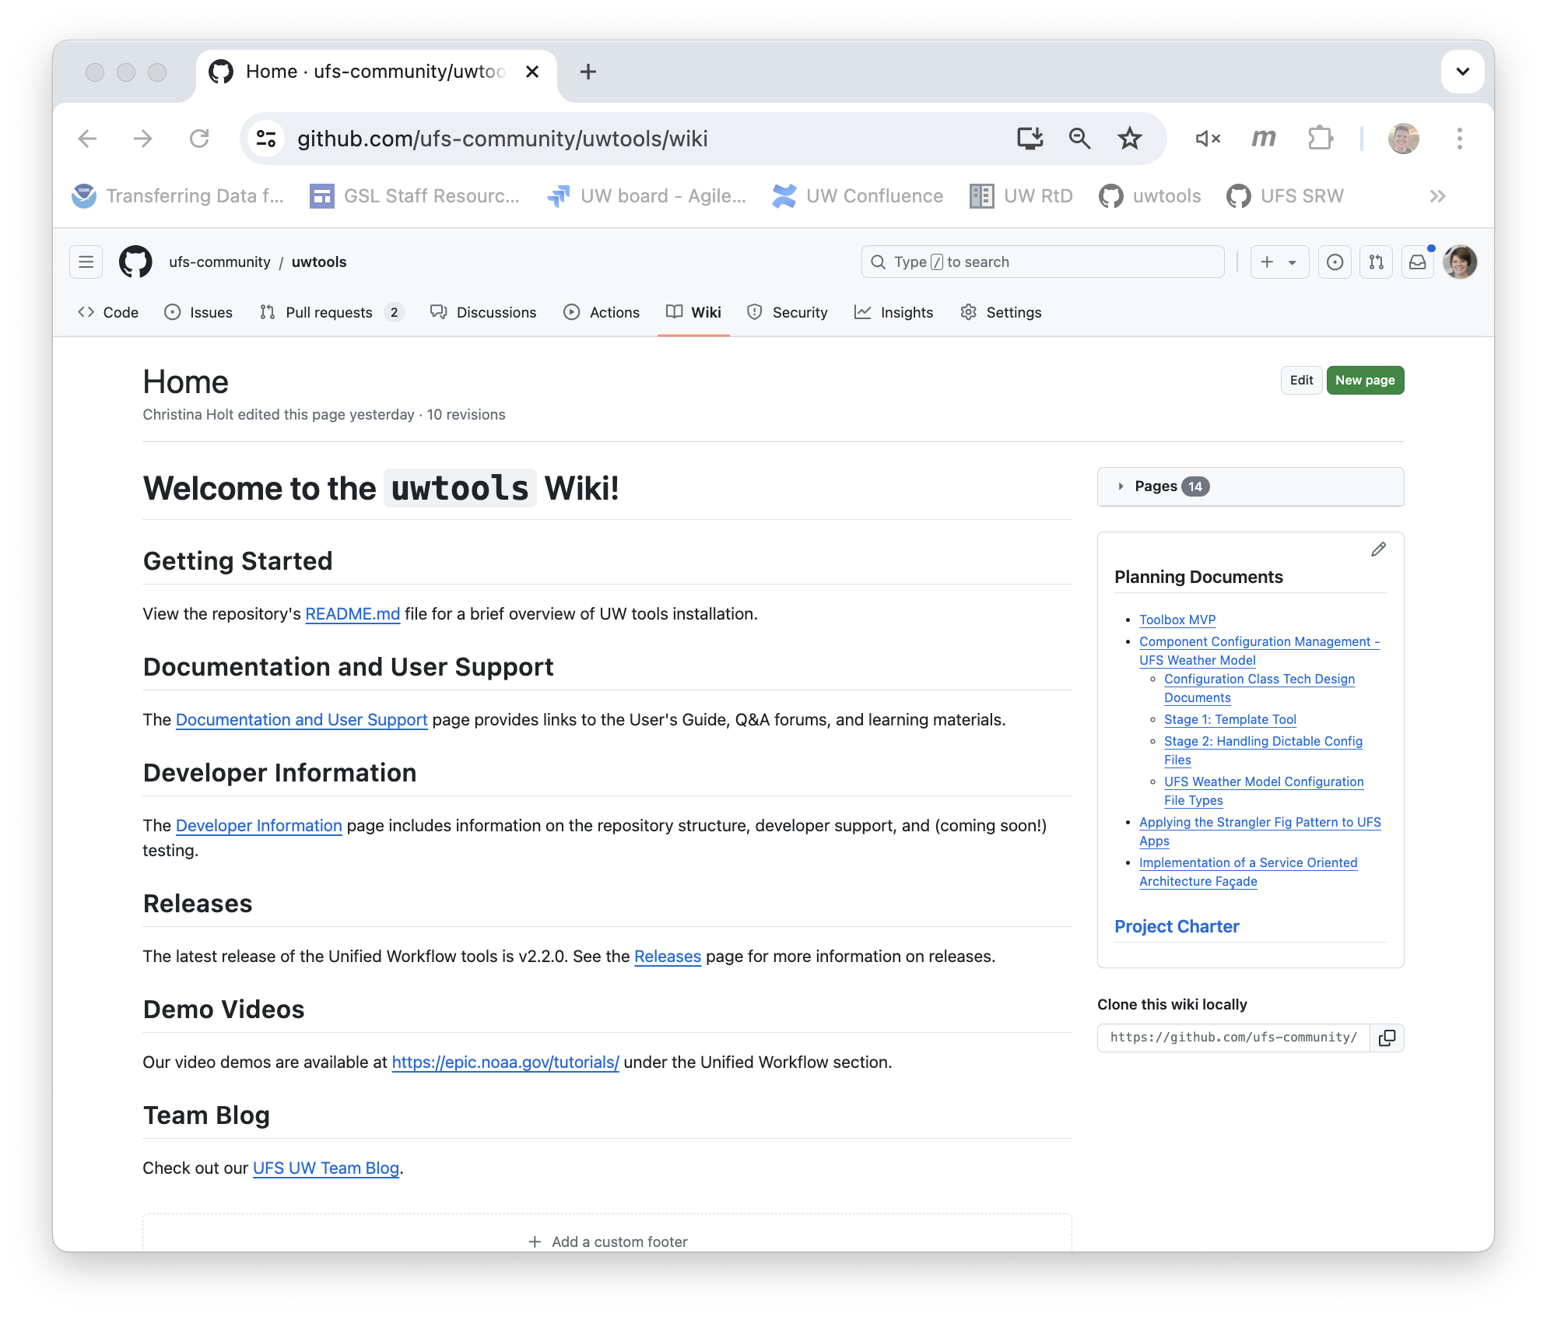
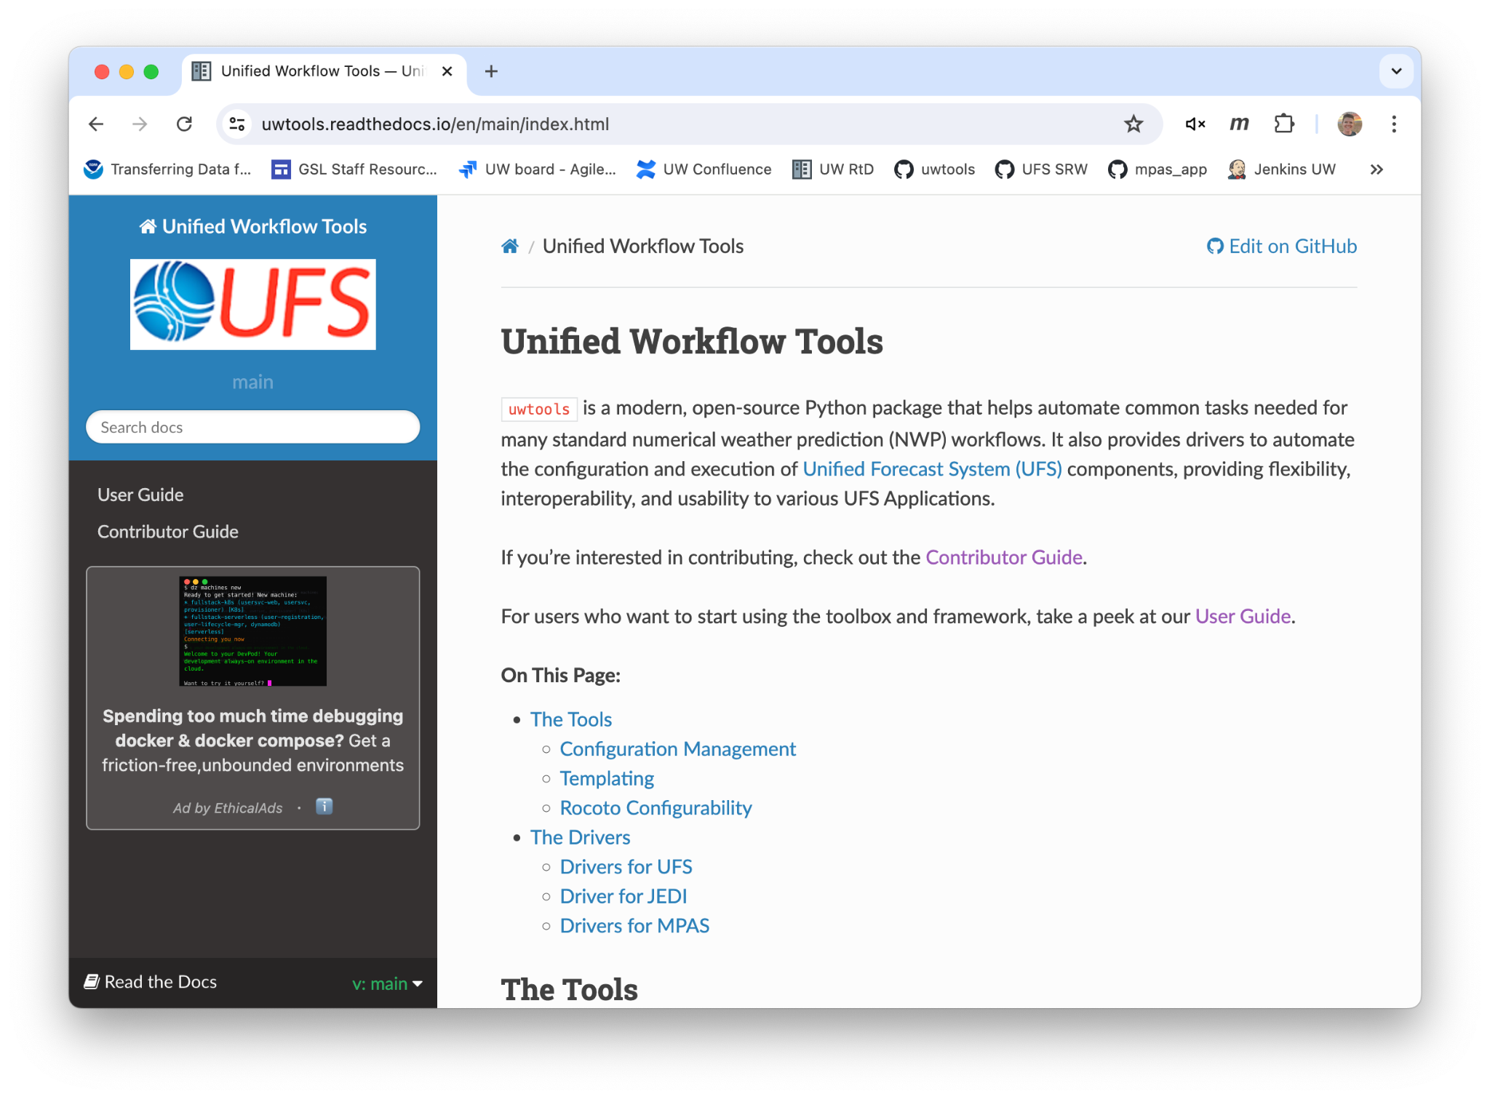
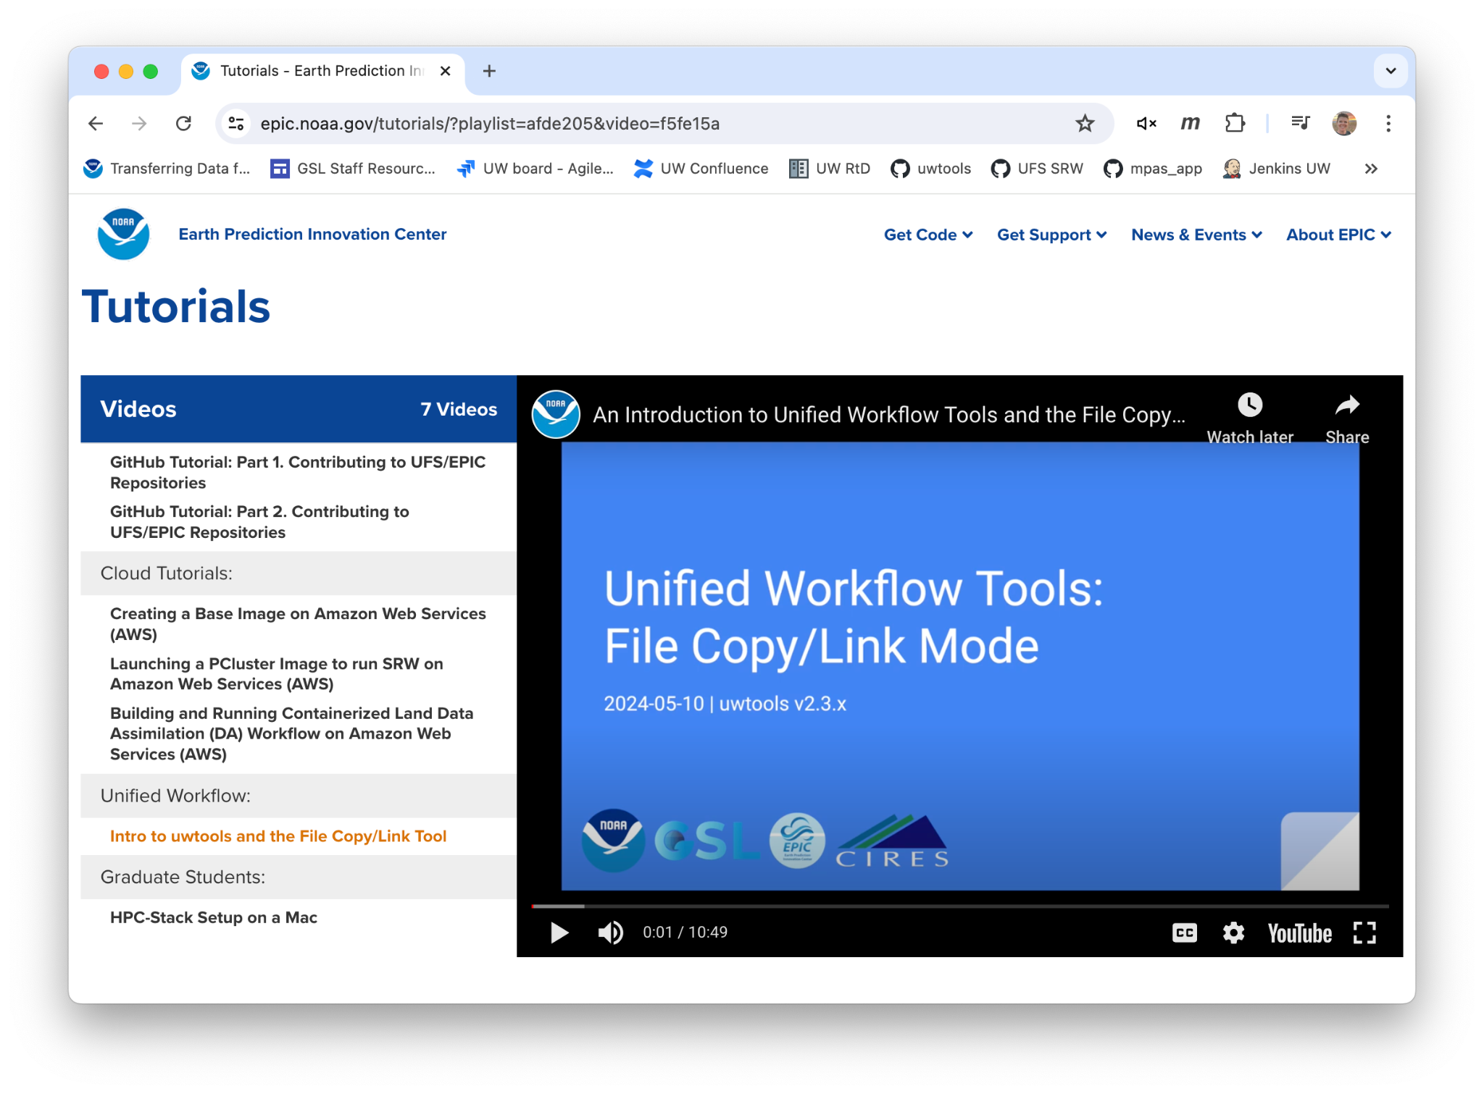
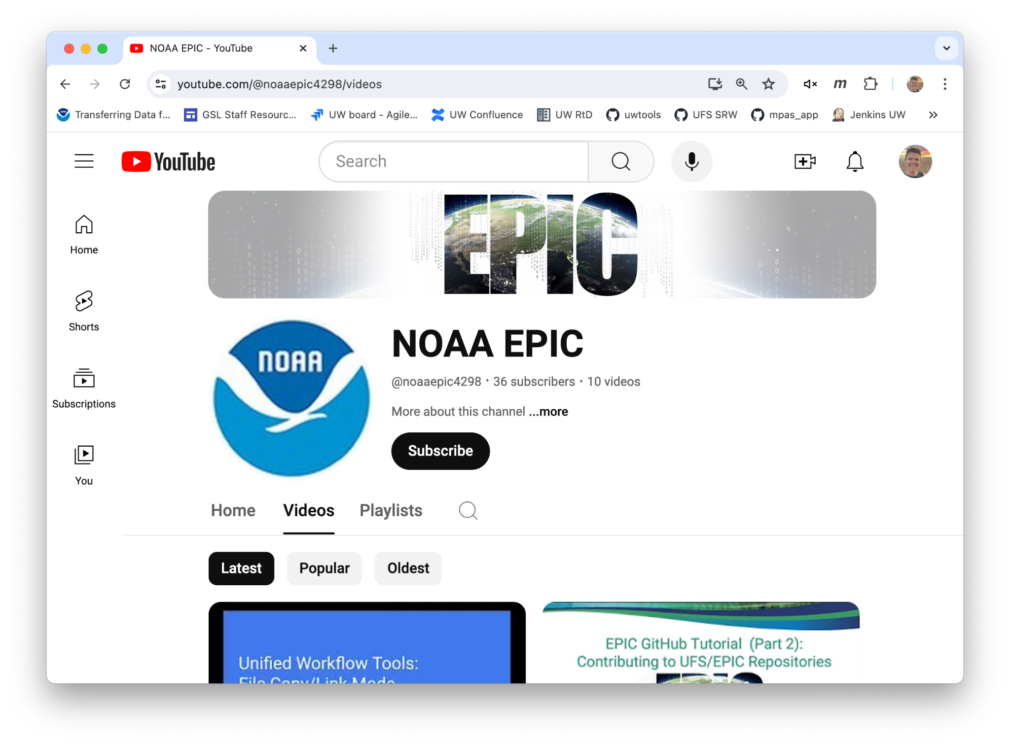
Check us out!

Slide 6
Intro to uwtools CLI
Every level has a help flag
One Interface: uw
Mode for what to act on
Action to take
Each combo has an API equivalent not shown here

Slide 7
Graph-oriented UW Drivers
For more detailed info on UW drivers, here’s a YouTube talk from UCAR’s ISS 2024 Conference
UFS Utils
Forecasts
UW Drivers help users configure and run a component using a pre-defined, schema-checked UW YAML file. Drivers require that the component supports the configuration the user is requesting.
chgres_cube
esg_grid
filter_topo
global_equiv_resol
make_hgrid
make_solo_mosaic
orog_gsl
sfc_climo_gen
shave
fv3 (uncoupled)
ungrib
mpas
mpas_init
Data Assimilation
Post
Processing
ioda
jedi
upp

Slide 8
NOAA GSL’s MPAS App: Config Layer (Our first uwtools-based App)

Slide 9
user:
mpas_files: "{{ user.mpas_app }}/src/MPAS-Model"
prepare_grib:
ungrib:
...
create_ics:
mpas_init:
boundary_conditions:
interval_hours: 6
length: 6
offset: 0
path: "{{ prepare_grib.ungrib['rundir'] }}"
execution:
batchargs:
cores: 4
walltime: 01:30:00
envcmds:
- module use {{ user.mpas_app }}/modulefiles
- module load build_{{ user.platform }}_intel
executable: "{{ user.mpas_app }}/exec/init_atmosphere_model"
mpiargs:
- "--ntasks={{ create_ics.mpas_init.execution.batchargs.cores }}"
mpicmd: srun
files_to_copy: &mpas_init_files_to_copy
stream_list.atmosphere.diagnostics: "{{ user.mpas_files }}/stream_list.atmosphere.diagnostics"
stream_list.atmosphere.output: "{{ user.mpas_files }}/stream_list.atmosphere.output"
stream_list.atmosphere.surface: "{{ user.mpas_files }}/stream_list.atmosphere.surface"
...
files_to_link: &mpas_init_files_to_link
CAM_ABS_DATA.DBL: "{{ user.mpas_files }}/CAM_ABS_DATA.DBL"
CAM_AEROPT_DATA.DBL: "{{ user.mpas_files }}/CAM_AEROPT_DATA.DBL"
...
namelist:
base_file: "{{ user.mpas_files}}/namelist.init_atmosphere"
update_values: &mpas_init_update_values
nhyd_model:
config_init_case: 7
...
rundir: '{{ user.experiment_dir }}/{{ cycle.strftime("%Y%m%d%H") }}/mpas_ics'
streams:
platform:
account: '{{ platform.account }}'
scheduler: '{{ platform.scheduler }}'
create_lbcs:
mpas_init:
...
forecast:
mpas:
...
user:
experiment_dir: /scratch2/place/for/output
mpas_app: "/path/to/clone"
mpas_files: "/path/to/clone/src/MPAS-Model"
...
prepare_grib:
ungrib:
...
create_ics:
mpas_init: &mpas_init_config
boundary_conditions:
interval_hours: 6
length: 6
offset: 0
path: "/path/to/ungrib/run/dir"
execution:
batchargs:
cores: 4
walltime: 01:30:00
envcmds:
- module use /path/to/clone/modulefiles
- module load build_hera_intel
executable: "/path/to/clone/exec/init_atmosphere_model"
mpiargs:
- "--ntasks=4"
mpicmd: srun
files_to_copy:
stream_list.atmosphere.diagnostics: "/path/to/clone/src/MPAS-Model/stream_list.atmosphere.diagnostics"
stream_list.atmosphere.output: "/path/to/clone/src/MPAS-Model/stream_list.atmosphere.output"
stream_list.atmosphere.surface: "/path/to/clone/src/MPAS-Model/stream_list.atmosphere.surface"
...
files_to_link: &mpas_init_files_to_link
CAM_ABS_DATA.DBL: "/path/to/clone/src/MPAS-Model/CAM_ABS_DATA.DBL"
CAM_AEROPT_DATA.DBL: "/path/to/clone/src/MPAS-Model/CAM_AEROPT_DATA.DBL"
...
namelist:
base_file: "/path/to/clone/src/MPAS-Model/namelist.init_atmosphere"
update_values: &mpas_init_update_values
nhyd_model:
config_init_case: 7
...
rundir: '{{ user.experiment_dir }}/{{ cycle.strftime("%Y%m%d%H") }}/mpas_ics'
streams:
platform:
account: 'my_account'
scheduler: 'slurm'
create_lbcs:
mpas_init:
...
forecast:
mpas:
...
user.yaml
experiment.yaml
defaults.yaml
user:
experiment_dir: /scratch2/place/for/output
mpas_app: /path/to/clone
platform: hera
platform:
account: my_account
envcmds:
- module use {{ user.mpas_app }}/modulefiles
- module load build_{{ user.platform }}_intel
executable: "{{ user.mpas_app }}/exec/init_atmosphere_model"
mpiargs:
- "--ntasks={{ create_ics.mpas_init.execution.batchargs.cores }}"
envcmds:
- module use /path/to/clone/modulefiles
- module load build_hera_intel
executable: "/path/to/clone/exec/init_atmosphere_model"
mpiargs:
- "--ntasks=4"
$ uw config realize -i defaults.yaml --update-file user.yaml --output-file experiment.yaml

Slide 10
NOAA GSL’s MPAS App: Run-time Layer

Slide 11
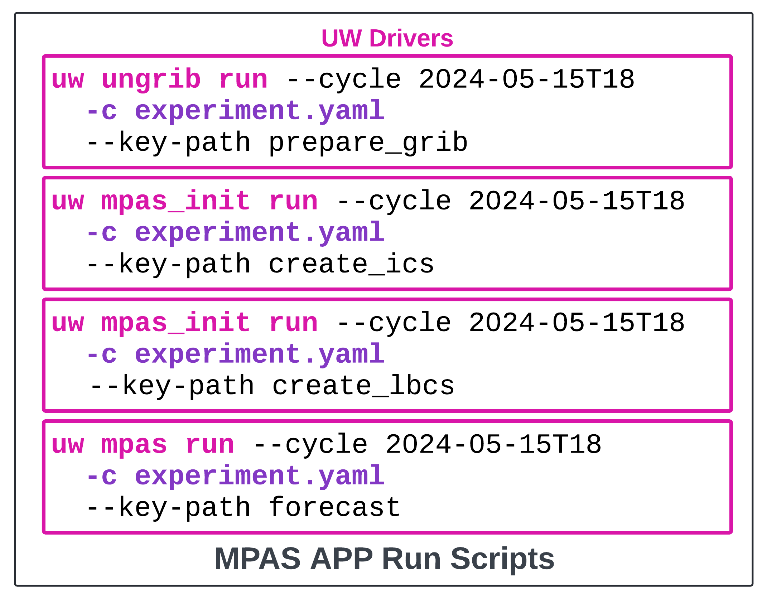
experiment.yaml
user:
experiment_dir: /scratch2/place/for/output
mpas_app: "/path/to/clone"
mpas_files: "/path/to/clone/src/MPAS-Model"
...
prepare_grib:
ungrib:
...
create_ics:
mpas_init: &mpas_init_config
boundary_conditions:
interval_hours: 6
length: 6
offset: 0
path: "/path/to/ungrib/run/dir"
execution:
batchargs:
cores: 4
walltime: 01:30:00
envcmds:
- module use /path/to/clone/modulefiles
- module load build_hera_intel
executable: "/path/to/clone/exec/init_atmosphere_model"
mpiargs:
- "--ntasks=4"
mpicmd: srun
files_to_copy:
stream_list.atmosphere.diagnostics: "/path/to/clone/src/MPAS-Model/stream_list.atmosphere.diagnostics"
stream_list.atmosphere.output: "/path/to/clone/src/MPAS-Model/stream_list.atmosphere.output"
stream_list.atmosphere.surface: "/path/to/clone/src/MPAS-Model/stream_list.atmosphere.surface"
...
files_to_link: &mpas_init_files_to_link
CAM_ABS_DATA.DBL: "/path/to/clone/src/MPAS-Model/CAM_ABS_DATA.DBL"
CAM_AEROPT_DATA.DBL: "/path/to/clone/src/MPAS-Model/CAM_AEROPT_DATA.DBL"
...
namelist:
base_file: "/path/to/clone/src/MPAS-Model/namelist.init_atmosphere"
update_values: &mpas_init_update_values
nhyd_model:
config_init_case: 7
...
rundir: '{{ user.experiment_dir }}/{{ cycle.strftime("%Y%m%d%H") }}/mpas_ics'
streams:
platform:
account: 'my_account'
scheduler: 'slurm'
create_lbcs:
mpas_init:
...
forecast:
mpas:
...

Slide 12
NOAA GSL’s MPAS App: Run-time Automation

Slide 13
coldstart.yaml
task_mpas_ics: &mpas_init_task
command: 'source &MPAS_APP;/load_wflow_modules.sh &PLATFORM; ; python &MPAS_APP;/scripts/mpas_init.py'
account: "{{ platform.account }}"
join:
cyclestr:
value: '&LOGDIR;/{{ jobname }}_@Y@m@d@H.log'
walltime: "{{ create_ics.mpas_init.execution.batchargs.walltime }}"
cores: !int "{{ create_ics.mpas_init.execution.batchargs.cores }}"
envars:
CONFIG_PATH: '&EXPERIMENT_CONFIG;'
CYCLE:
cyclestr:
value: "@Y-@m-@dT@H:@M:@S"
EXPT_SECT: create_ics
dependency:
taskdep:
attrs:
task: ungrib
<task name="mpas_ics">
<account>nrtrr</account>
<cores>4</cores>
<walltime>01:30:00</walltime>
<command>source &MPAS_APP;/load_wflow_modules.sh &PLATFORM; ; python &MPAS_APP;/scripts/mpas_init.py</command>
<jobname>mpas_ics</jobname>
<join>
<cyclestr>&LOGDIR;/mpas_ics_@Y@m@d@H.log</cyclestr>
</join>
<envar>
<name>CONFIG_PATH</name>
<value>&EXPERIMENT_CONFIG;</value>
</envar>
...
<dependency>
<taskdep task="ungrib"/>
</dependency>
</task>
rocoto.xml
$ uw rocoto realize -c coldstart.yaml -o rocoto.xml

Slide 14
Summary
uwtools is a tangible Python package that you should install today to help you with workflow tasks.
The tools are designed to help scientists be productive, and to help applications improve the automation of common tasks.
Graph-oriented drivers are more flexible than many existing solutions that are often hard-coded, procedural, and/or brittle.
Helps with hierarchical testing for research, and reliability and recovery in real time use cases

Slide 15
Our Next Steps
Integrate uwtools into SRW. The prototype will be ready for demonstration by October!
Build the framework for coupling drivers following ufs-weather-model design
Continue spreading the word using presentations, video demos, blog posts, etc.

Slide 16
Acknowledgements
This research was supported in part by
NOAA cooperative agreement NA22OAR4320151
An FY22 WPO JTTI award: Implementation of a Unified Workflow for the Unified Forecast System (UFS) Short Range Weather (SRW) Application
The OCIO Software Engineering for Novel Architectures program award to NOAA GSL
The EPIC Contract
The NOAA R2O Project
In-kind contributions from NOAA EMC, NOAA GSL, and George Mason University

