Slide 1
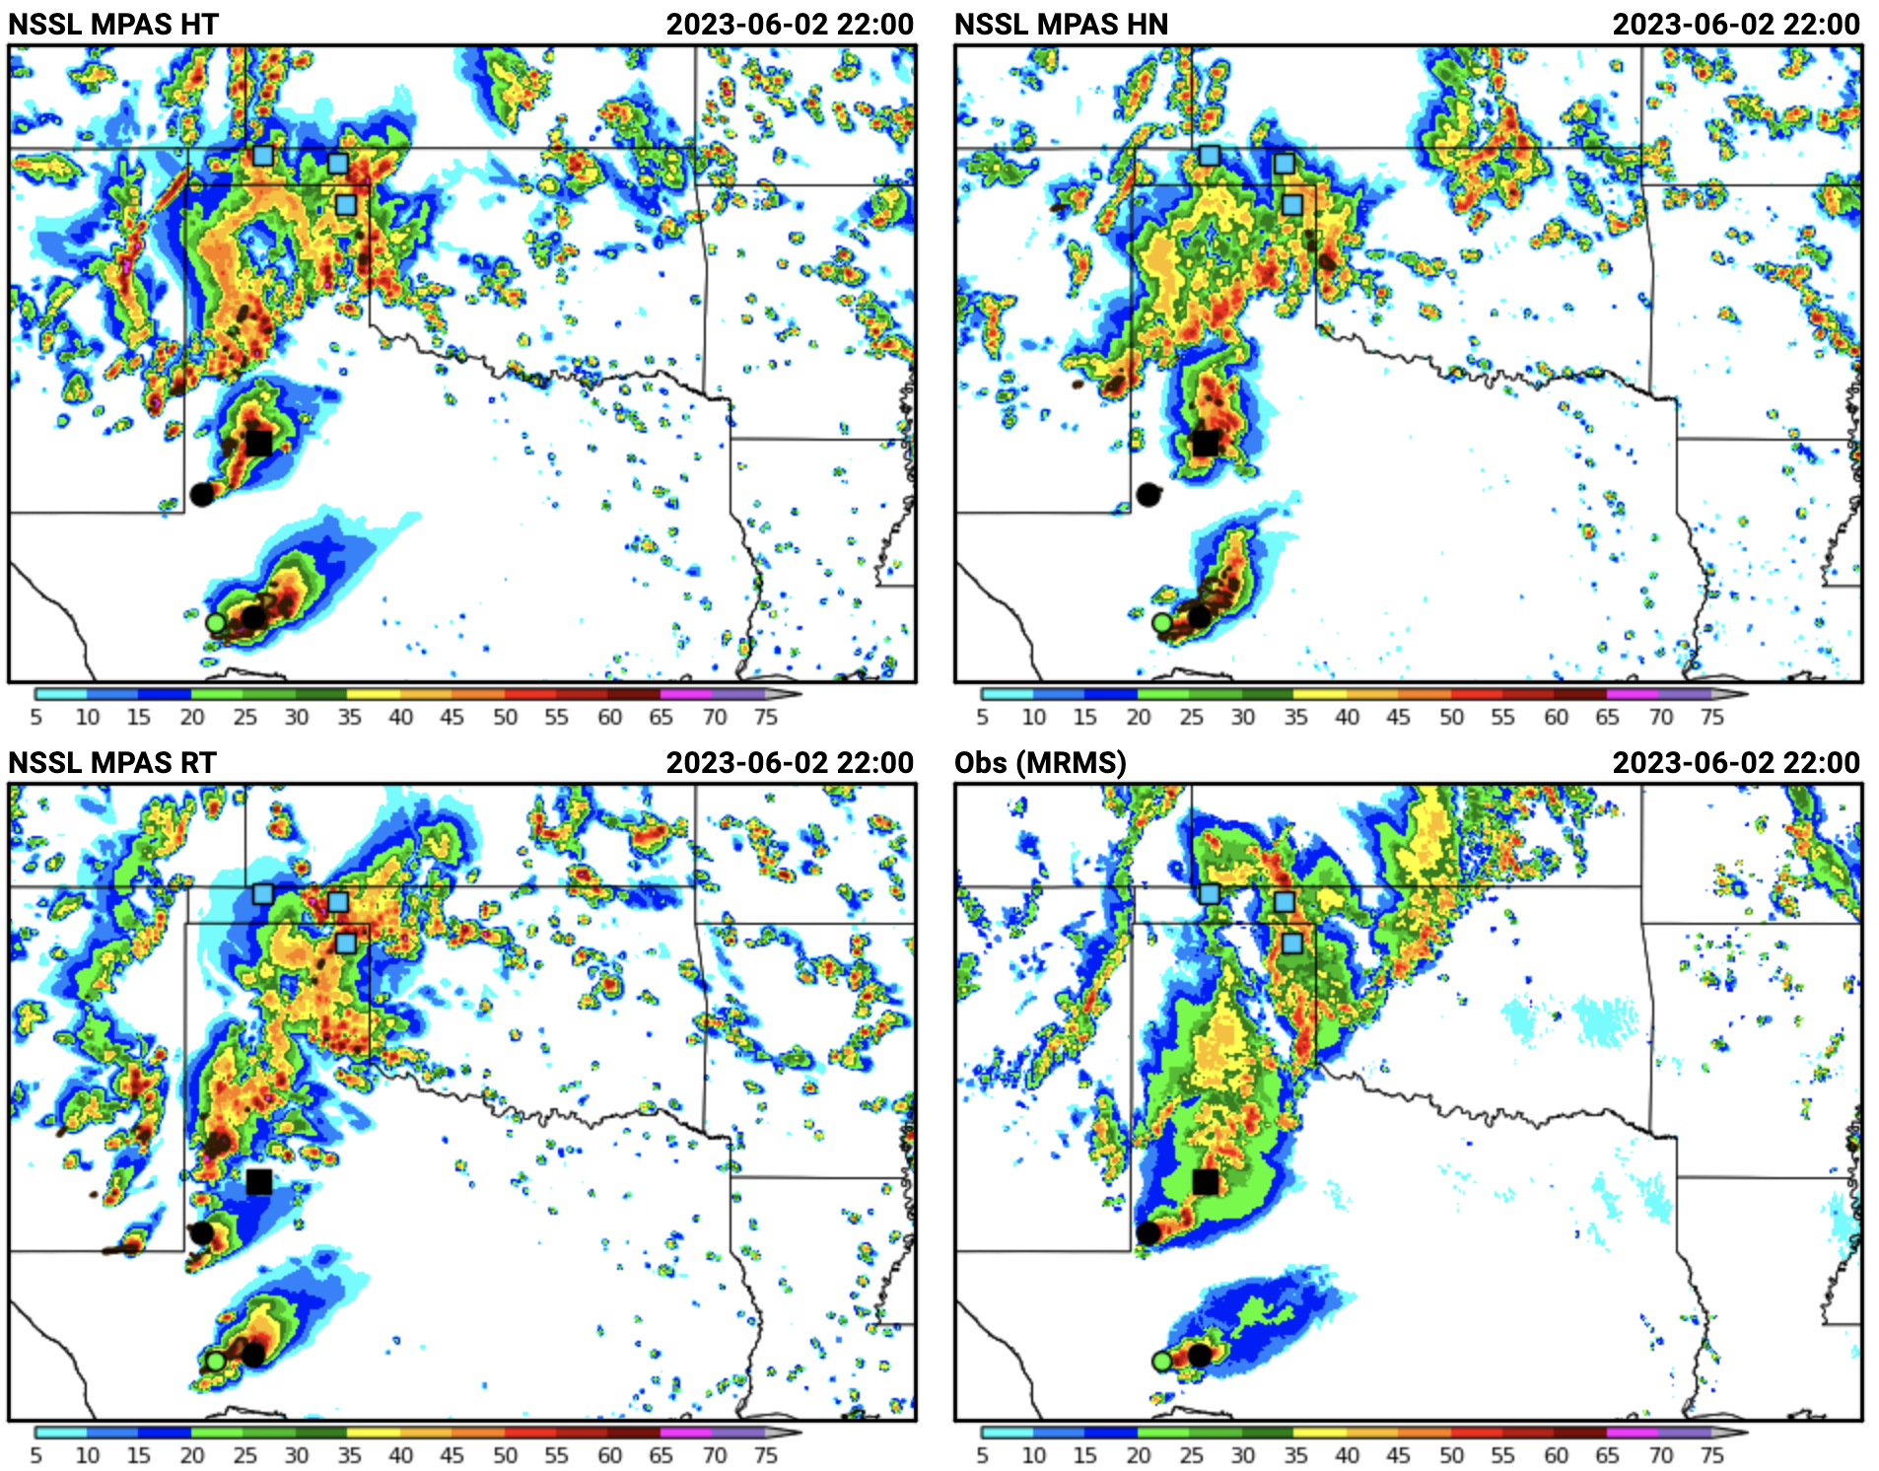
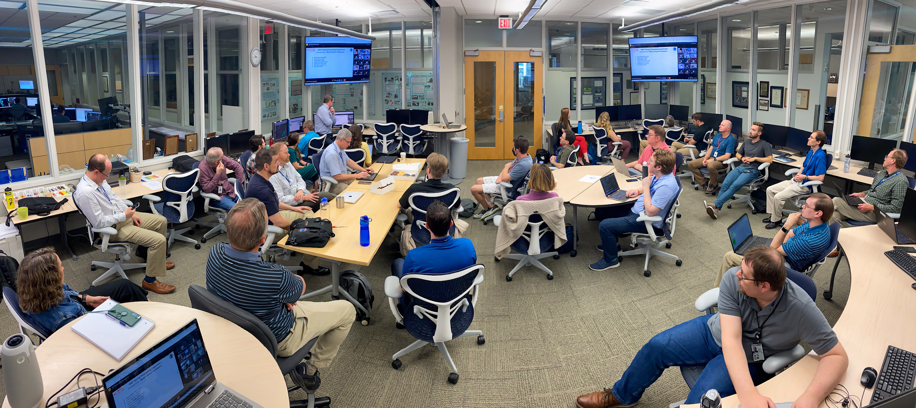
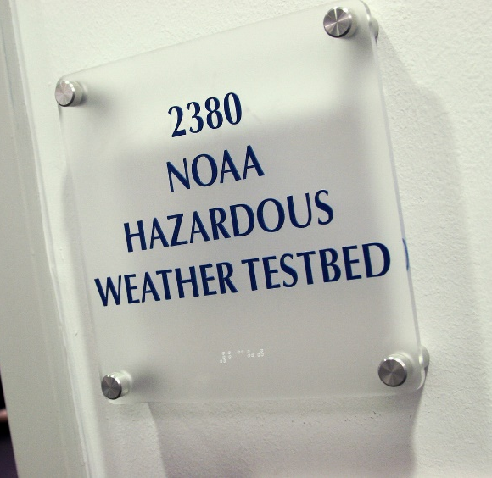
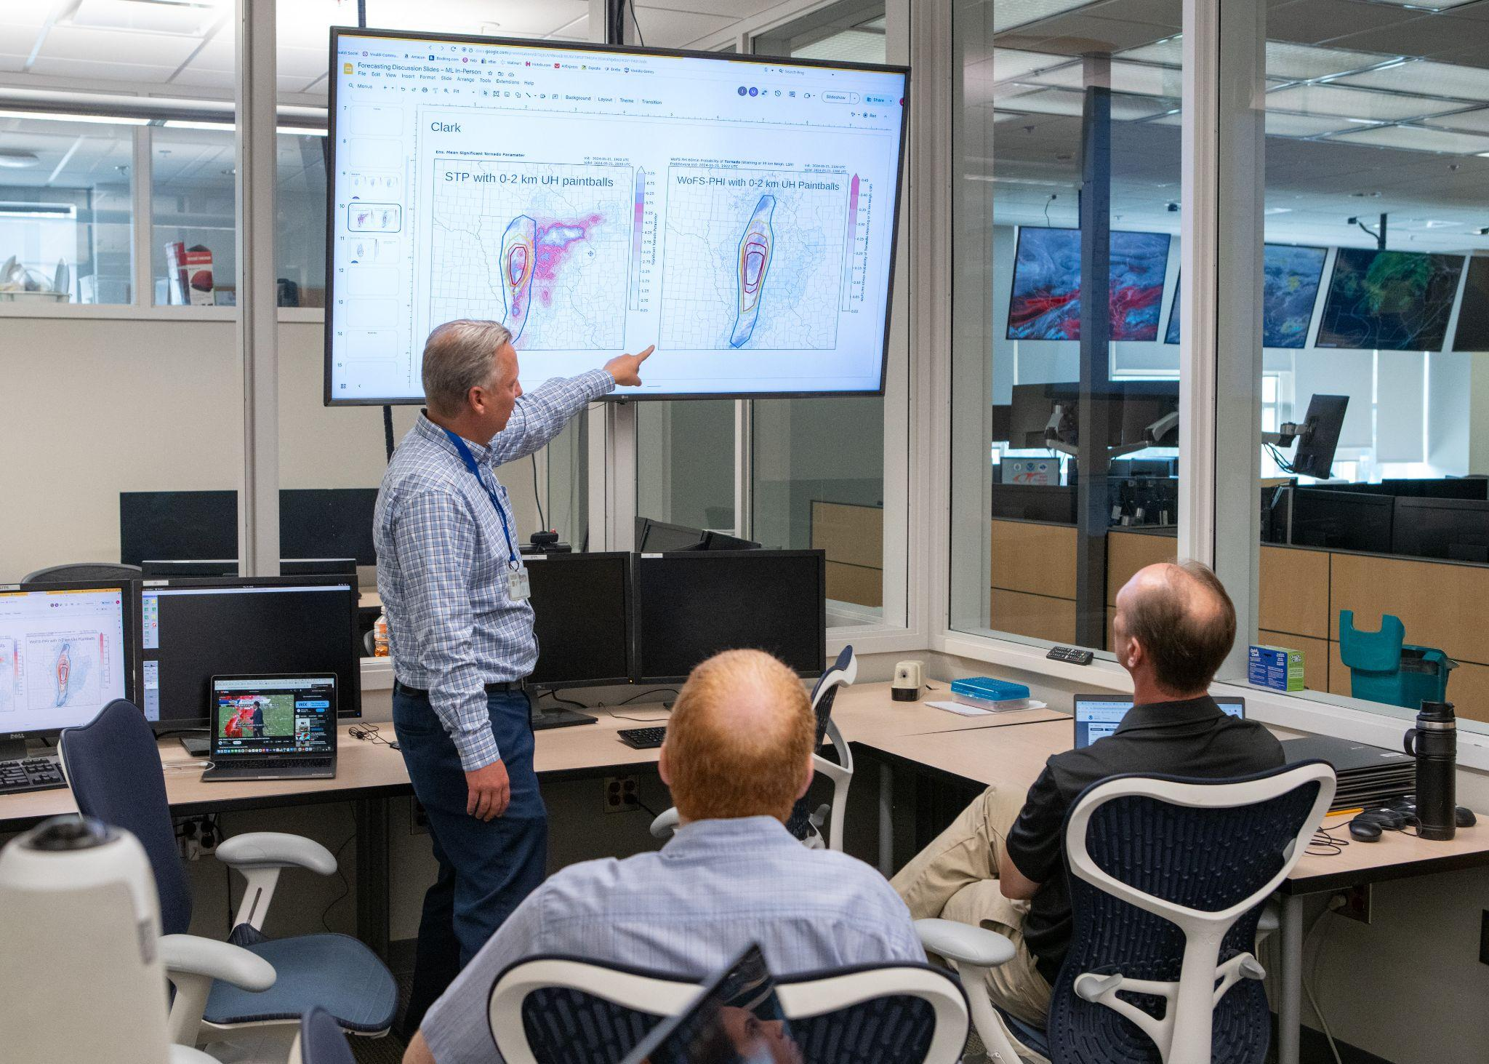
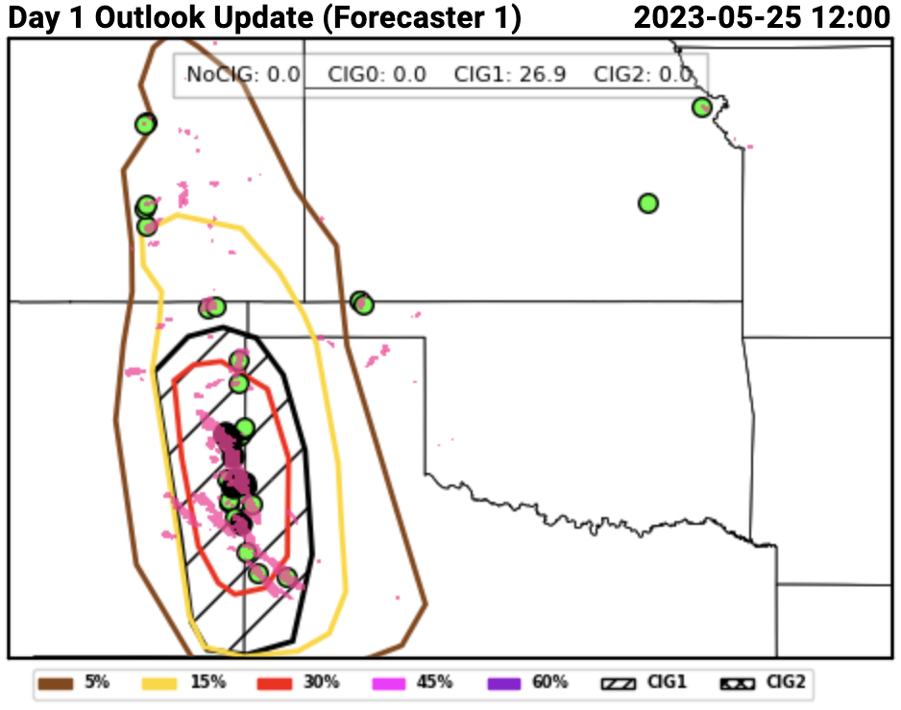
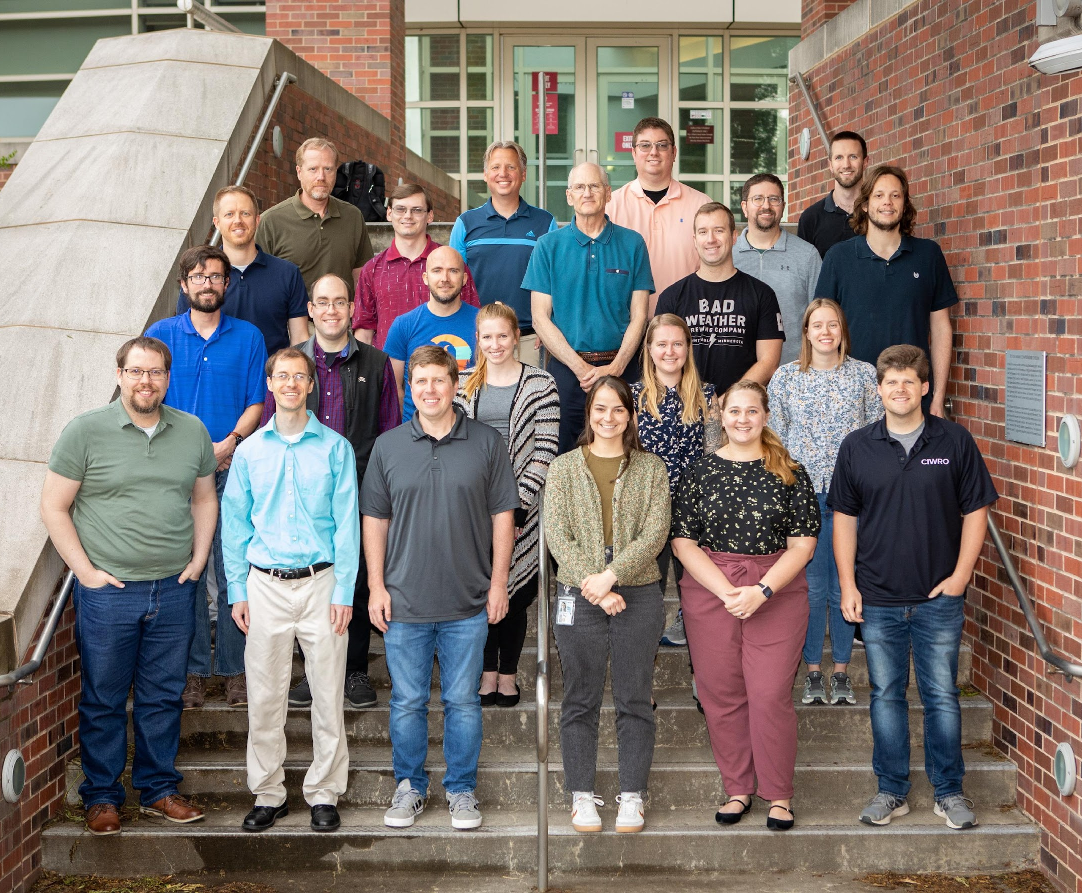
Evaluation of the Rapid Refresh Forecast System during the 2024 NOAA HWT Spring Forecasting Experiment
Israel Jirak, NOAA/NWS/SPC
Adam Clark (NSSL), Jake Vancil (CIWRO/SPC), Tim Supinie (SPC), & David Harrison (CIWRO/SPC)

Slide 2
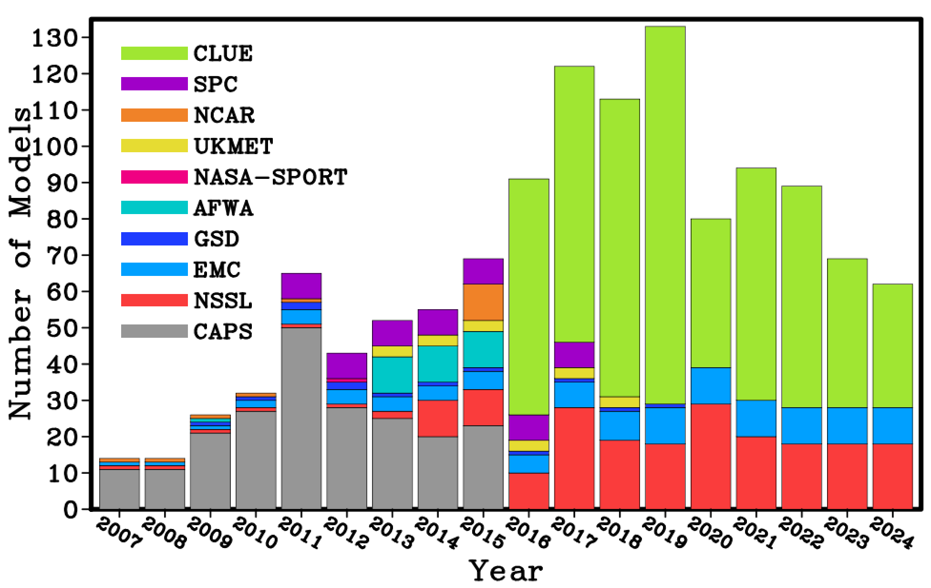
NOAA HWT Spring Forecasting Experiment
Five-week experiment jointly organized and facilitated by SPC and NSSL
Test and evaluate emerging technology for severe weather prediction
Develop and accelerate R2O and develop, strengthen O2R pathways
The HWT SFE over the past decade has been evaluating the performance of CAMs and CAM ensembles with various configurations to operational baselines
The focus of the HWT SFE in 2023 and 2024 was the evaluation of RRFSv1
HWT SFE Model Contributions

Slide 3
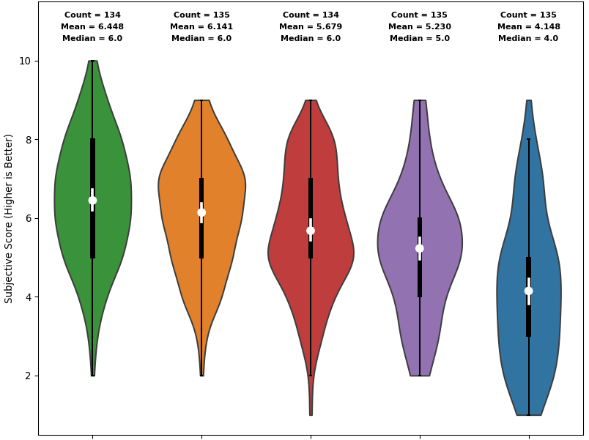
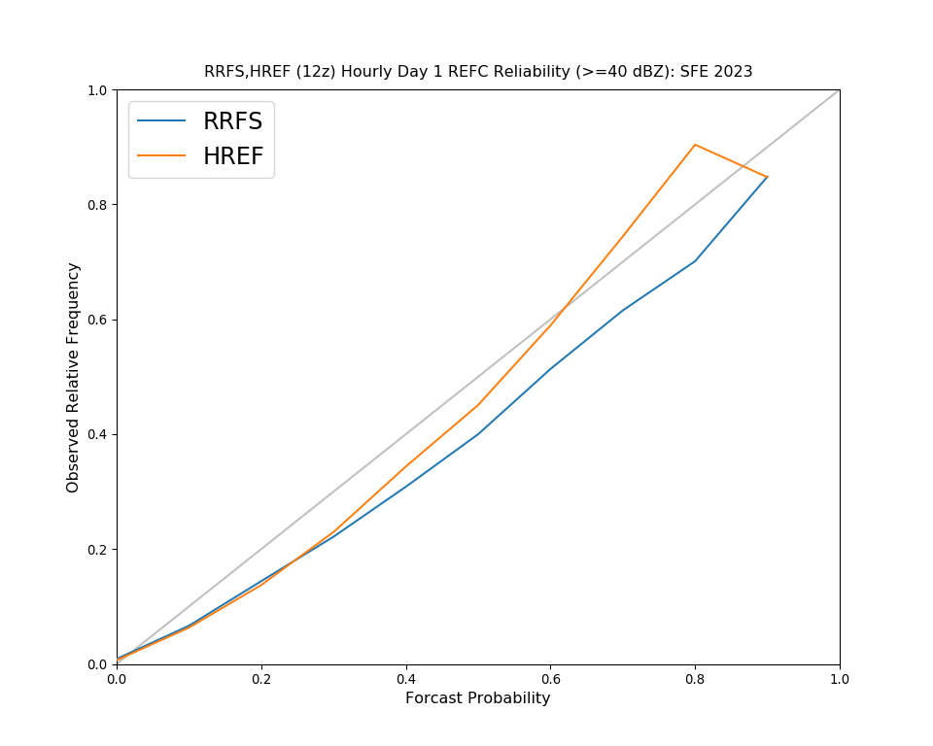
2023 HWT SFE Results
In short-term forecasts, the HRRR had superior performance compared to the RRFS control member
The RRFS systematically produced overly intense convection in the 1-h forecast with an abundance of spurious storms
This issue impacted the 00Z RRFS in Day 1 evaluations, as the RRFS was rated subjectively lower than the HRRR (and MPAS) runs and verified worse in terms of objective verification statistics
For 12Z runs, however, HRRR and RRFS performance was comparable
HREF probabilistic guidance was more skillful and reliable than the RRFS ensemble, which tended to be underdispersive and overconfident
HRRRv4
MPAS RT
RRFS
GFDL FV3
NASA GEOS
FV3

Slide 4
RRFS Updates for 2024
Concerns about RRFSv1 were documented following the 2023 HWT SFE in a NOAA whitepaper
In an attempt to mitigate the overly intense and spurious deep convection in the 2023 version of RRFSv1, convective parameterization schemes were implemented in the 3-km RRFS for 2024
CAMs with deep convective parameterization had never been evaluated in the HWT SFE, so characteristics and performance were unknown

Slide 5
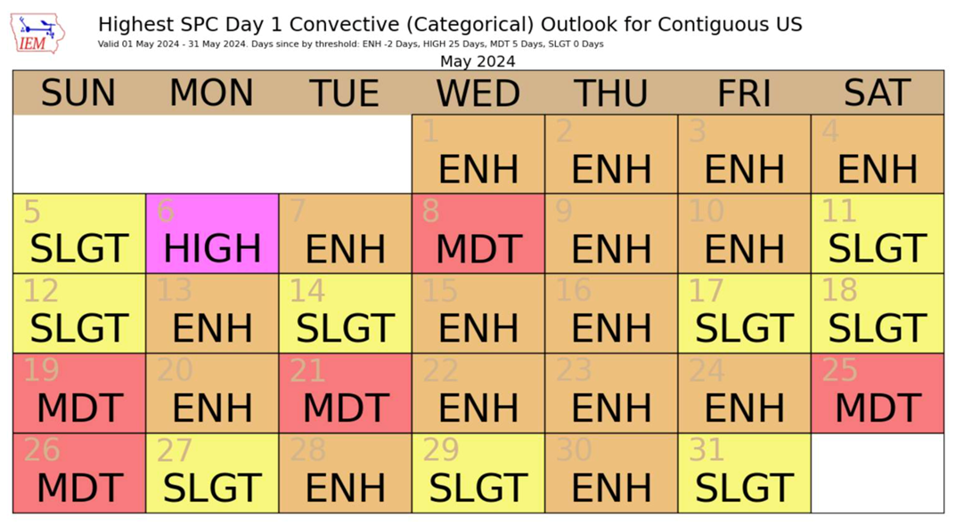
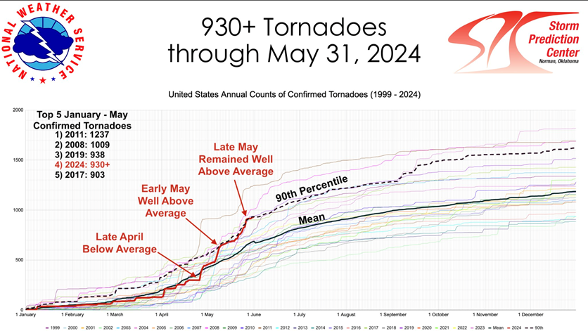
2024 HWT SFE Overview
Conducted on weekdays from April 29-May 31
Very active weather pattern; much more strongly forced and strongly sheared than the 2023 HWT SFE period
2024 only trailed 2011 in terms of number of April and May tornadoes

Slide 6
2024 REFS Configuration
Configuration of the 2024 RRFS Ensemble Forecast System (REFS):
Members: REFS | ICs | LBCs | Microphysics | PBL/SFC | LSM | Radiation | Convection | Dynamical Core
RRFS ctl | RRFS hybrid 3DEnVar | GFS | Thompson | MYNN/MYNN | RUC | RRTMG | GF-deep | FV3
REFS01 | RRFS enkf1 | GEFS m1 | Thompson* | TKE-EDMF/GFS | RUC* | RRMG* | GF-deep*+sh | FV3
REFS02 | RRFS enkf2 | GEFS m2 | Thompson* | MYNN*/MYNN* | RUC* | RRTMG* | saSAS deep | FV3
REFS03 | RRFS enkf3 | GEFS m3 | NSSL# | MYNN*/MYNN* | RUC* | RRTMG* | GF-deep* | FV3
REFS04 | RRFS enkf4 | GEFS m4 | NSSL# | TKE-EDMF/GFS | RUC* | RRTMG* | GF-deep*+sh | FV3
REFS05 | RRFS enkf5 | GEFS m5 | NSSL# | MYNN*/MYNN* | RUC* | RRTMG* | saSAS deep | FV3
HRRR | HRRRDAS | RAP -1h | Thompson | MYNN | RUC | RRTMG | None | WRF-ARW

Slide 7
2024 REFS Configuration
Configuration of the 2024 RRFS Ensemble Forecast System (REFS):
Members: REFS | ICs | LBCs | Microphysics | PBL/SFC | LSM | Radiation | Convection | Dynamical Core
RRFS ctl | RRFS hybrid 3DEnVar | GFS | Thompson | MYNN/MYNN | RUC | RRTMG | GF-deep | FV3
REFS01 | RRFS enkf1 | GEFS m1 | Thompson* | TKE-EDMF/GFS | RUC* | RRMG* | GF-deep*+sh | FV3
REFS02 | RRFS enkf2 | GEFS m2 | Thompson* | MYNN*/MYNN* | RUC* | RRTMG* | saSAS deep | FV3
REFS03 | RRFS enkf3 | GEFS m3 | NSSL# | MYNN*/MYNN* | RUC* | RRTMG* | GF-deep* | FV3
REFS04 | RRFS enkf4 | GEFS m4 | NSSL# | TKE-EDMF/GFS | RUC* | RRTMG* | GF-deep*+sh | FV3
REFS05 | RRFS enkf5 | GEFS m5 | NSSL# | MYNN*/MYNN* | RUC* | RRTMG* | saSAS deep | FV3
HRRR | HRRRDAS | RAP -1h | Thompson | MYNN | RUC | RRTMG | None | WRF-ARW

Slide 8
2024 HWT SFE Results: DA
HRRR – RRFS Rating Difference
 | 2024 | 2023
00Z @01Z | 0.98 | 0.41
00Z @06Z | 0.88 | 0.27
For reflectivity and UH, HRRR performs significantly better than RRFS for each initialization at every lead time examined.
Relative to 2023, HRRR advantage over RRFS was much larger in 2024.

Slide 9
2024 HWT SFE Results: DA
HRRR
RRFS
OBS
6 May 2024 (High Risk): RRFS (9 h forecast) fails to simulate southern extent of intense convection. Similar behavior was noted in the 00Z RRFS (not shown).
HRRR
RRFS
OBS
19 May 2024 (Tornadic supercell): RRFS (1 h forecast) immediately dissipates tornadic supercell in Oklahoma.
HRRR
RRFS
OBS
7 May 2024 (Ohio Valley storms): RRFS (9 h forecast) misses large area of storms over the Ohio valley and instead depicts light to moderate precipitation.

Slide 10
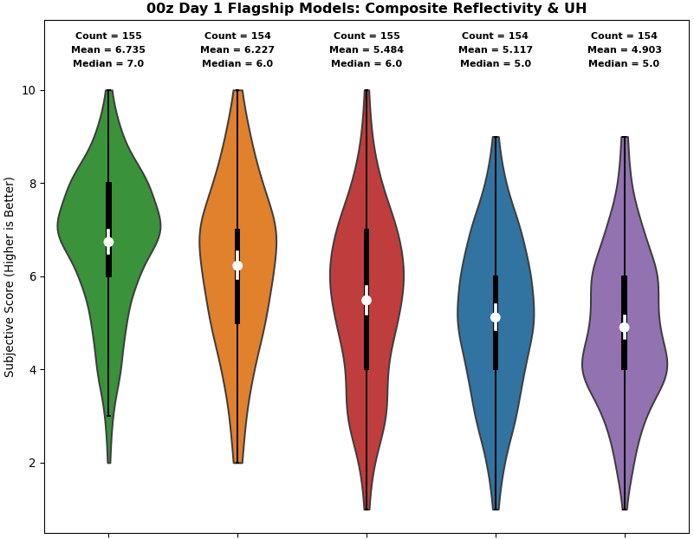
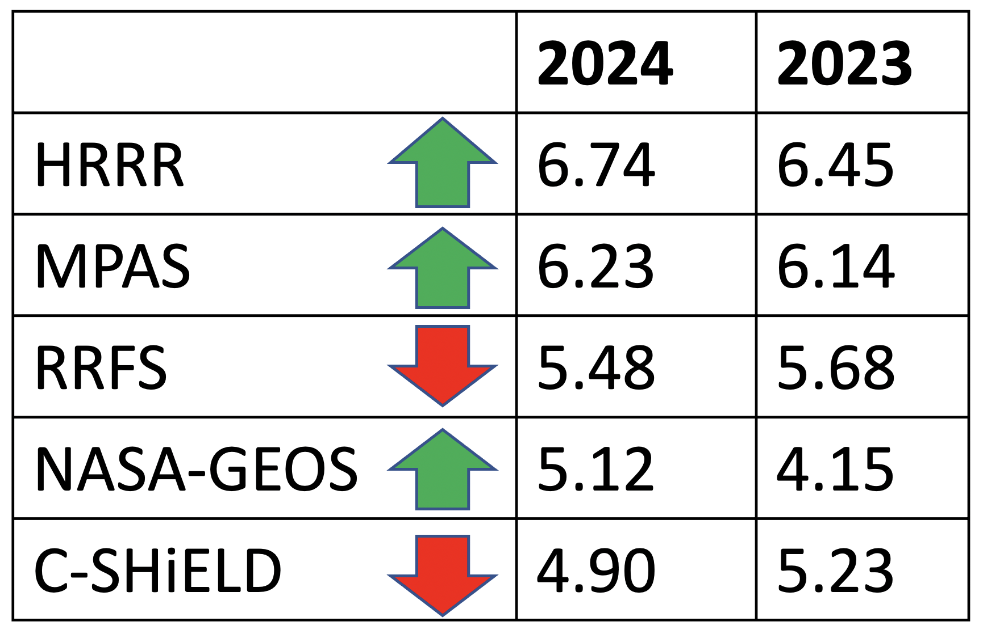
2024 HWT SFE Results: 00Z Day 1
Deterministic Subjective
Mean subjective ratings in 2024 & 2023
HRRRv4 was clear top performer & differences in average ratings were statistically significant (95% CI with 1000 bootstrapped samples).
MPAS HT was clear runner-up & differences w.r.t lower rated models were significant (including RRFS).
HRRR, MPAS, and NASA-GEOS ratings went up this year, while RRFS and C-SHiELD went down.
6.74
6.23
5.48
5.12
4.90
HRRR
MPAS HT
RRFS
NASA GEOS
FV3
GFDL FV3

Slide 11
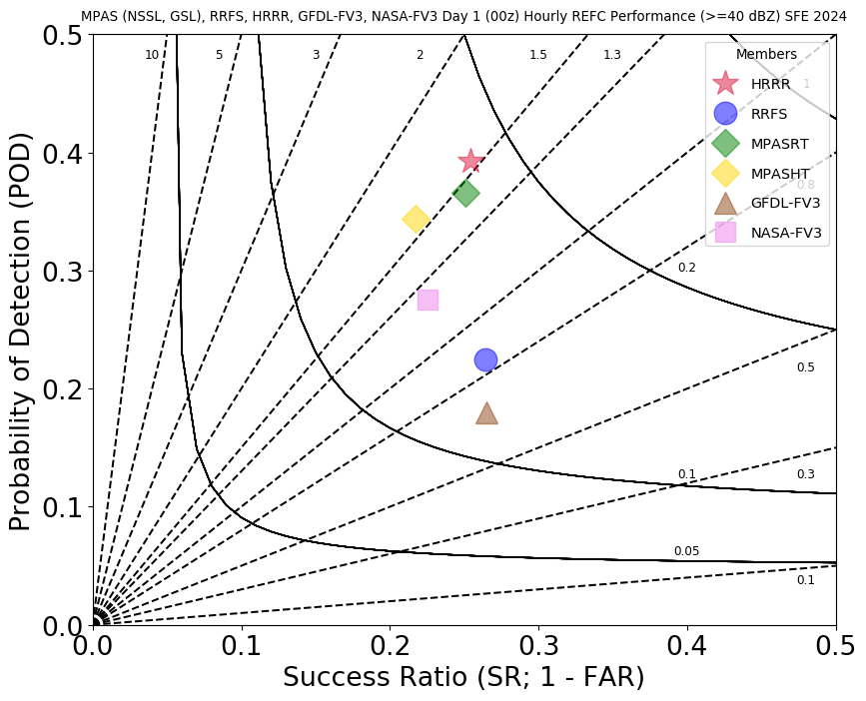
2024 HWT SFE Results: 00Z Day 1
Deterministic Objective
POD for 40 dBZ in 2024 and 2023:
 | 2024 | 2023
HRRR | 0.39 | 0.32
RRFS | 0.21 | 0.23
HRRR
Significant difference in POD (and CSI) between 00Z HRRR and 00Z RRFS control member
HRRR (RRFS) POD increased (decreased) in 2024 relative to 2023
For rare event, high impact forecasting, POD is more important than FAR and bias because the penalty is large for missing events
RRFS

Slide 12
2024 HWT SFE Results: 00Z Day 1
16 May 2024 - Houston Severe Event
HRRR 00F18
RRFS 00F18
OBS 18Z
The biggest story of the SFE was the suppression of deep convection by the GF convective scheme in the RRFS control
Despite displacement error in HRRR, still better guidance for high-impact Houston event on May 16
HRRR 00F24
RRFS 00F24
OBS 00Z

Slide 13
2024 REFS Configuration
Configuration of the 2024 RRFS Ensemble Forecast System (REFS):
Members: REFS | ICs | LBCs | Microphysics | PBL/SFC | LSM | Radiation | Convection | Dynamical Core
RRFS ctl | RRFS hybrid 3DEnVar | GFS | Thompson | MYNN/MYNN | RUC | RRTMG | GF-deep | FV3
REFS01 | RRFS enkf1 | GEFS m1 | Thompson* | TKE-EDMF/GFS | RUC* | RRMG* | GF-deep*+sh | FV3
REFS02 | RRFS enkf2 | GEFS m2 | Thompson* | MYNN*/MYNN* | RUC* | RRTMG* | saSAS deep | FV3
REFS03 | RRFS enkf3 | GEFS m3 | NSSL# | MYNN*/MYNN* | RUC* | RRTMG* | GF-deep* | FV3
REFS04 | RRFS enkf4 | GEFS m4 | NSSL# | TKE-EDMF/GFS | RUC* | RRTMG* | GF-deep*+sh | FV3
REFS05 | RRFS enkf5 | GEFS m5 | NSSL# | MYNN*/MYNN* | RUC* | RRTMG* | saSAS deep | FV3
HRRR | HRRRDAS | RAP -1h | Thompson | MYNN | RUC | RRTMG | None | WRF-ARW

Slide 14
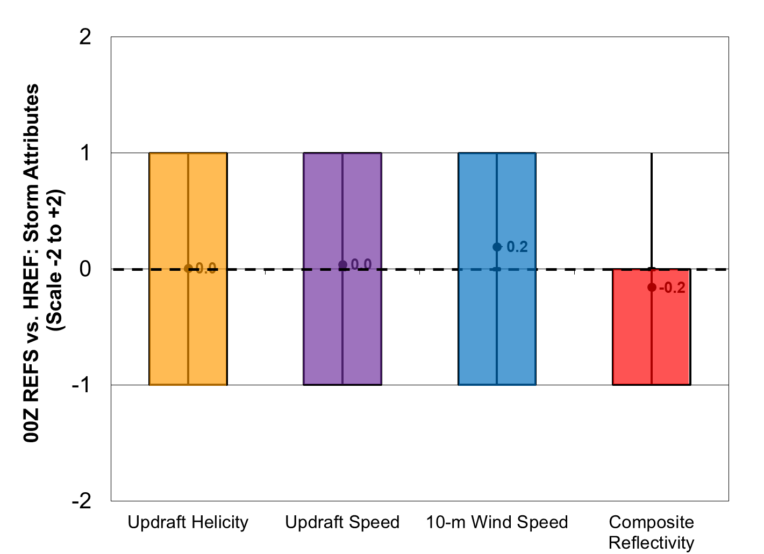
2024 HWT SFE Results: 00Z Day 1
Ensemble Subjective
Directly compared the 00Z EMC REFS to the HREF
For the storm-attribute fields, REFS was rated similarly to HREF for updraft helicity, updraft speed, & 10-m wind speed and slightly worse for composite reflectivity
This was somewhat surprising given the issues with the 00Z RRFS control member
REFS Better
REFS Worse

Slide 15
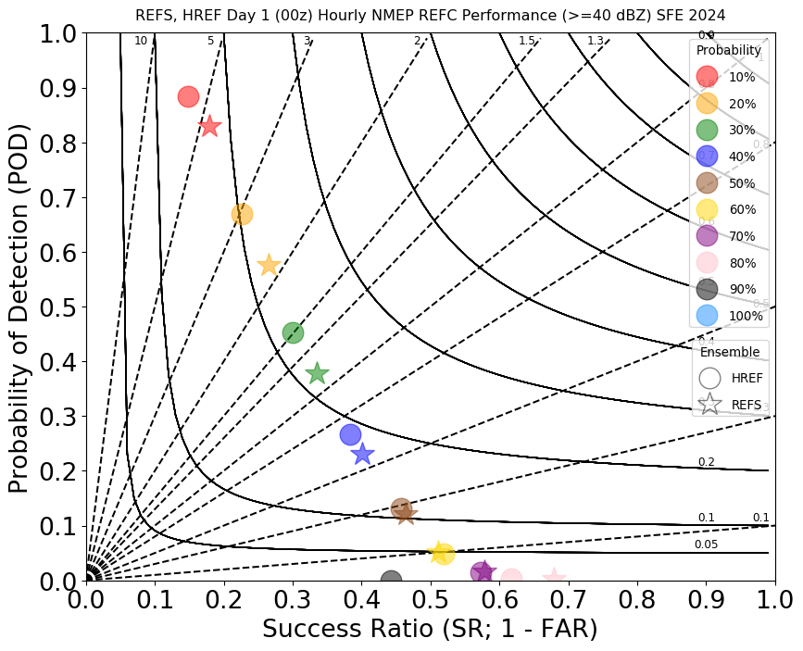
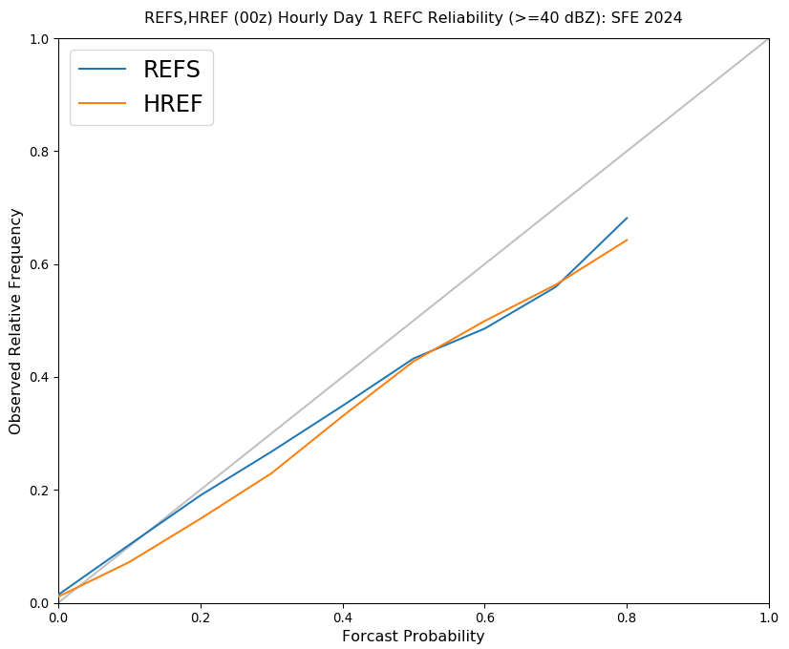
2024 HWT SFE Results: 00Z Day 1
Ensemble Objective
Objective reflectivity stats confirm similar performance for REFS and HREF
HREF - higher POD
REFS - lower FAR
REFS more reliable through 40%
It has been challenging to create an ensemble with spread approaching that of HREF, so this is a noteworthy accomplishment

Slide 16
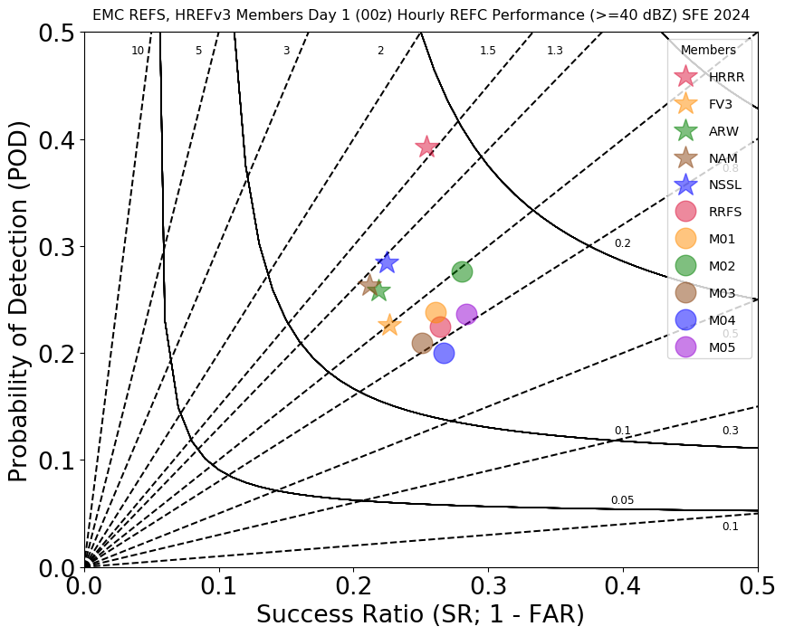
2024 HWT SFE Results: 00Z Day 1
Ensemble Member Objective
Performance of HREF and REFS members tend to cluster; HRRR is best performing member of each, but more of an outlier in REFS
All REFS members have a low bias in terms of deep convection - not a favorable characteristic for hazardous weather forecasting
The RRFS control member is not the best performing REFS member this year:
RRFS control: GF deep (red circle)
M03: GF deep (brown circle)
M02: saSAS deep (green circle)
M05: saSAS deep (purple circle)
HRRR
bias=1
HREF
saSAS
REFS
best

Slide 17
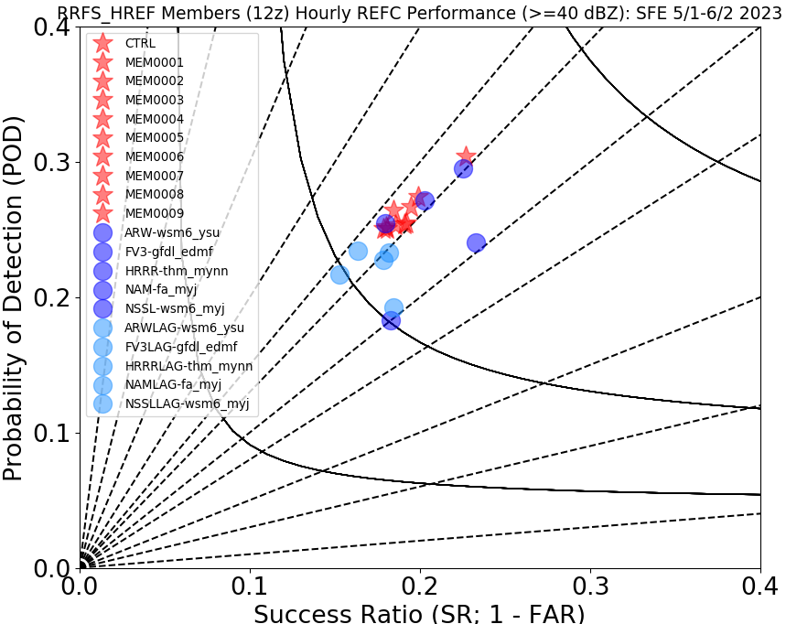
2023 HWT SFE Results: 12Z Day 1
Ensemble Member Objective
In 2023, the performance characteristics of the single-physics RRFS ensemble was much different than the REFS this year
The REFS members had a higher bias that was more in line with the HREF members
The RRFS control member was clearly the best performer, which is generally expected given better ICs
It appears that the GF convective parameterization scheme had a negative impact on the RRFS control run this year
RRFS Perturbed Members
RRFS Control
bias=1
HREF
Red: RRFS
Blue: HREF

Slide 18
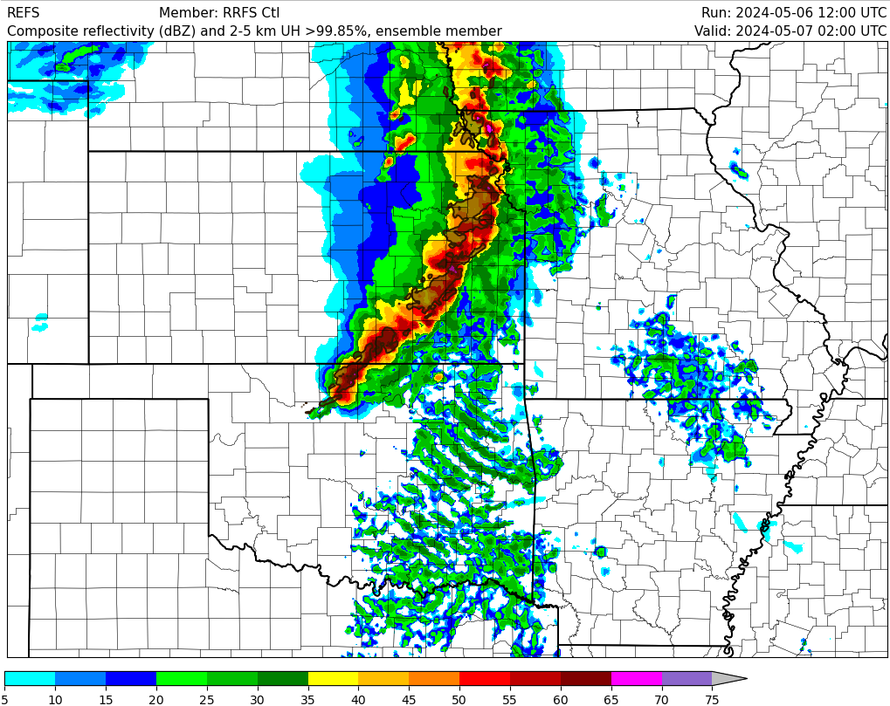
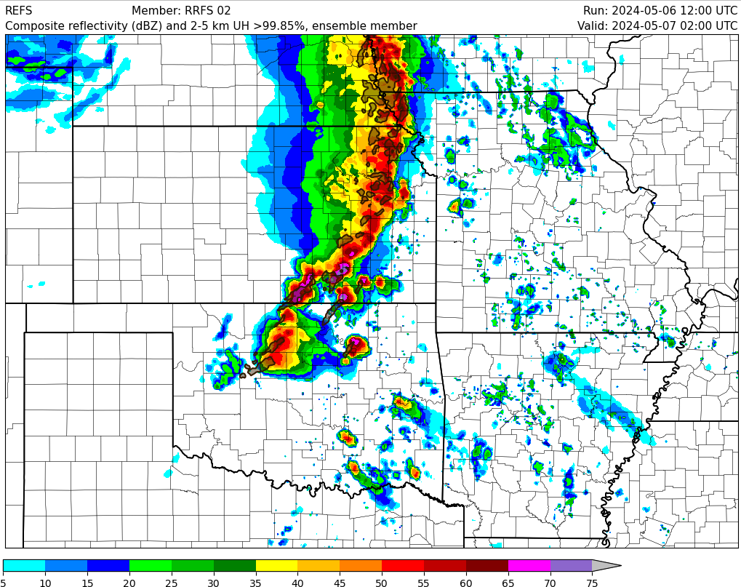
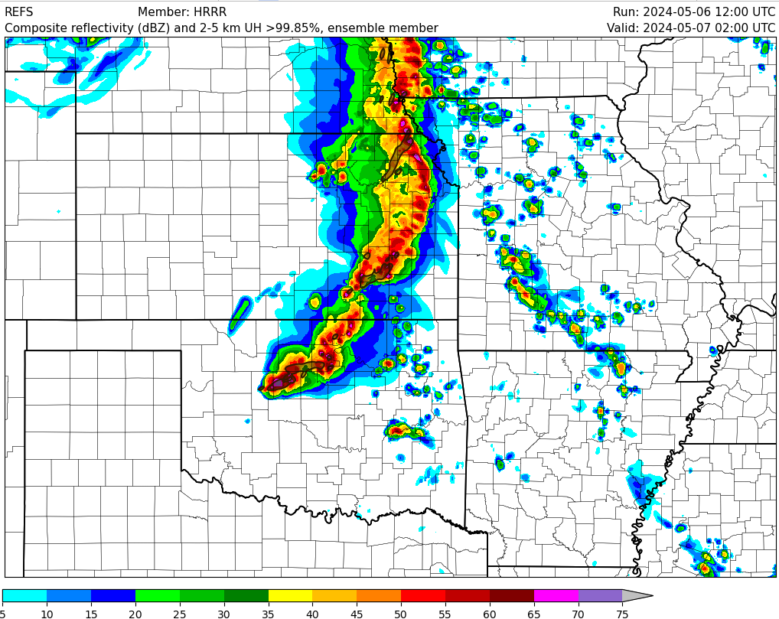
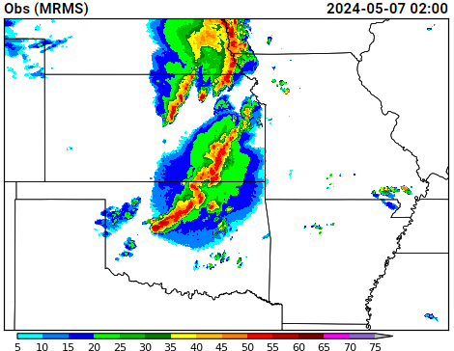
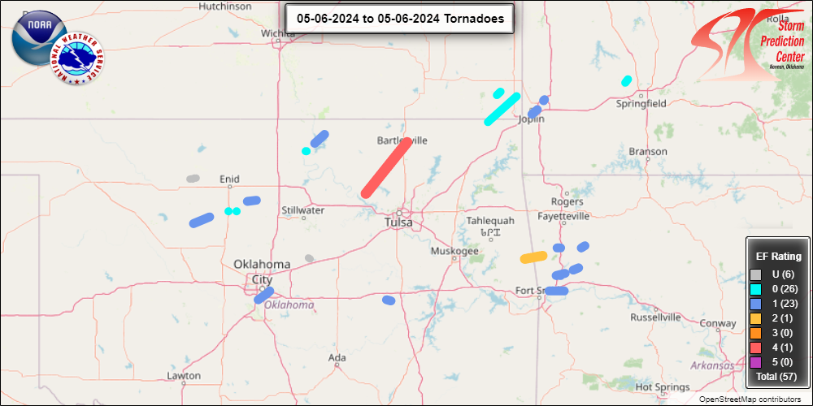
2024 HWT SFE High-Impact Events
7 May @ 02Z
RRFS CTL
REFS M02
High Risk across portions of northern OK and southern KS
Barnsdall EF4 moved northward ahead of the line of storms; exceptional forecast in REFS M02
Deep convection was suppressed in RRFS control member ahead of the line and with southward extent
HRRR
OBS

Slide 19
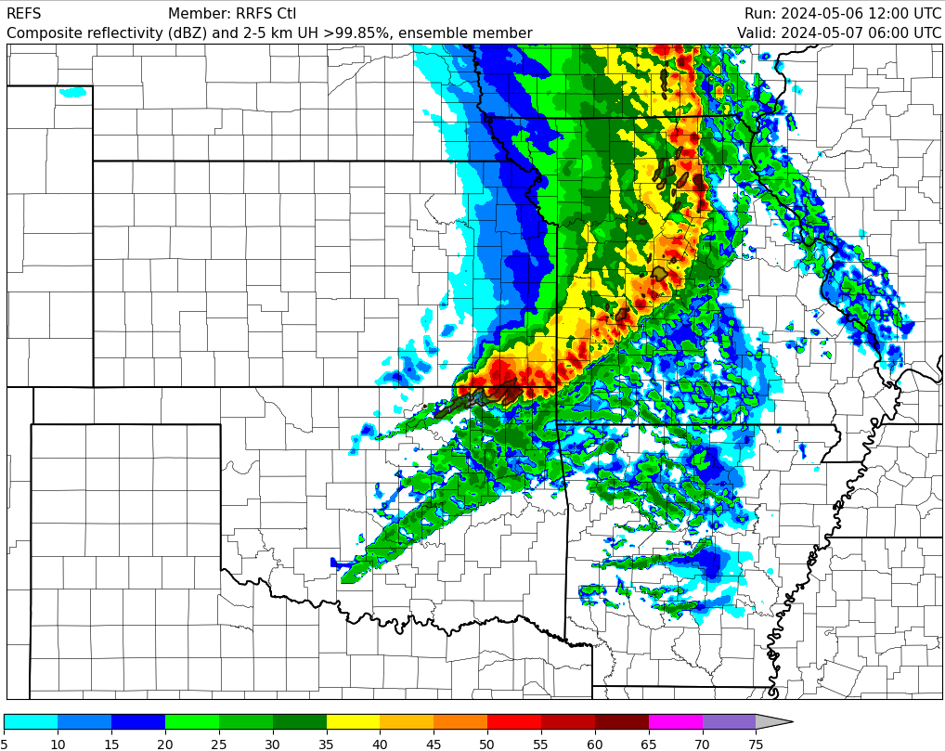
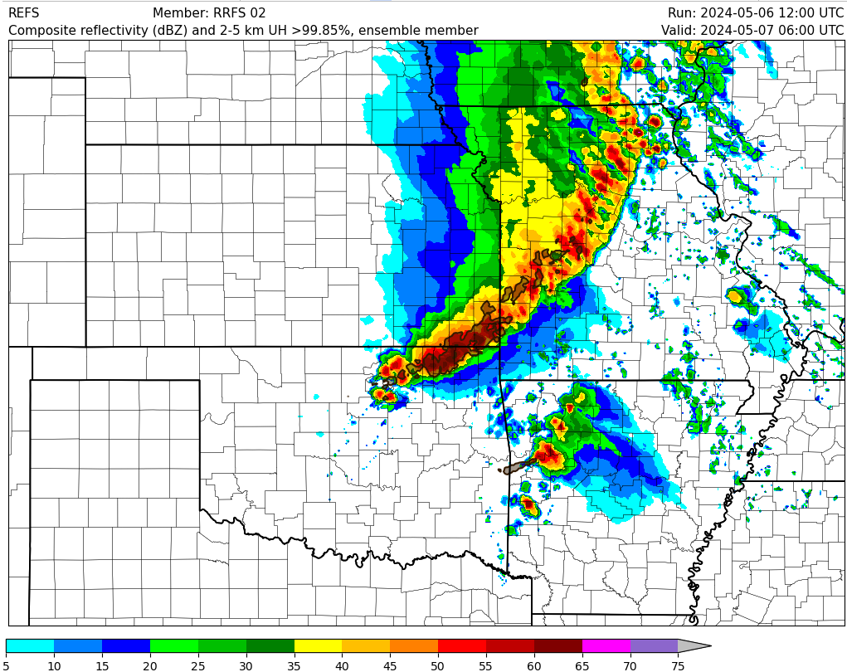
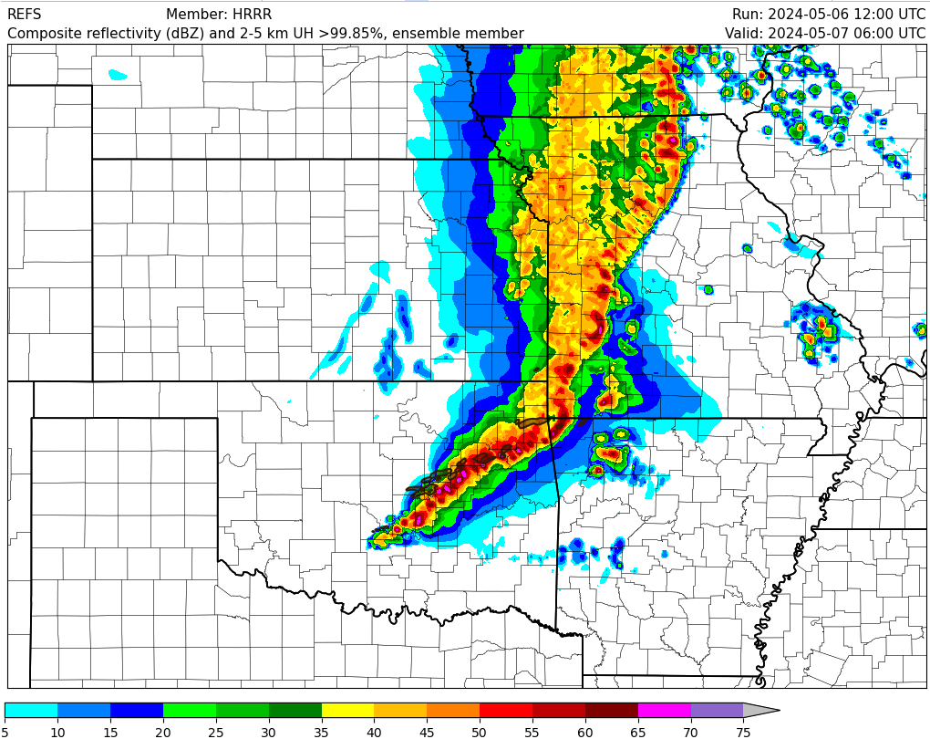
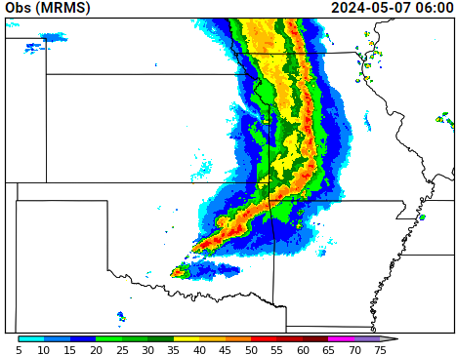
2024 HWT SFE High-Impact Events
7 May @ 06Z
RRFS CTL
REFS M02
High Risk across portions of northern OK and southern KS
HRRR forecast of southern extent of severe convective line was excellent
Severe convective line did not extend far enough south in RRFS control member or any REFS members
Deep convection was suppressed across OK in the control member; 25-35 “phantom” dBZ echoes are a common signature of this model configuration
HRRR
OBS

Slide 20
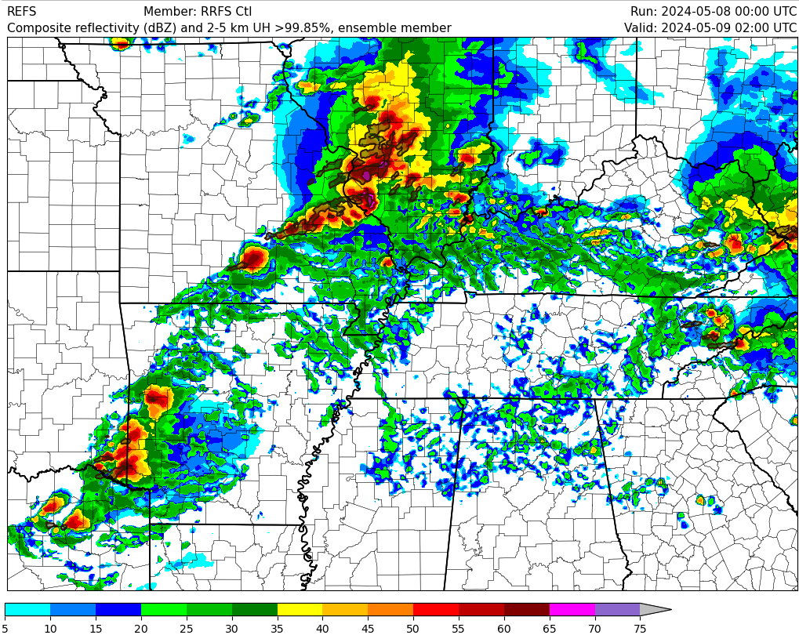
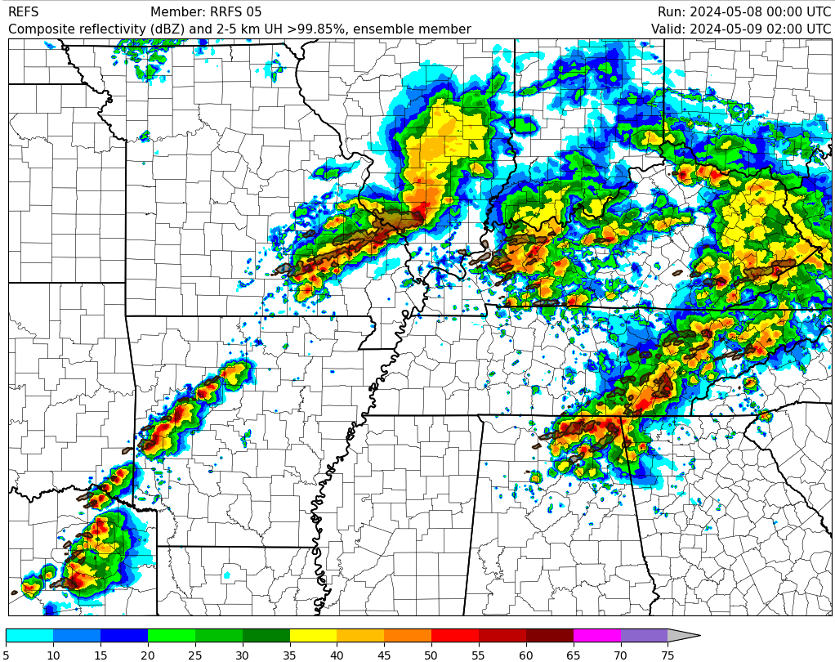
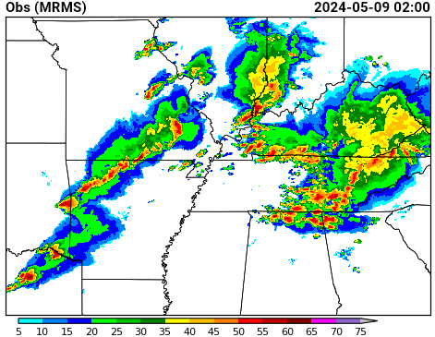
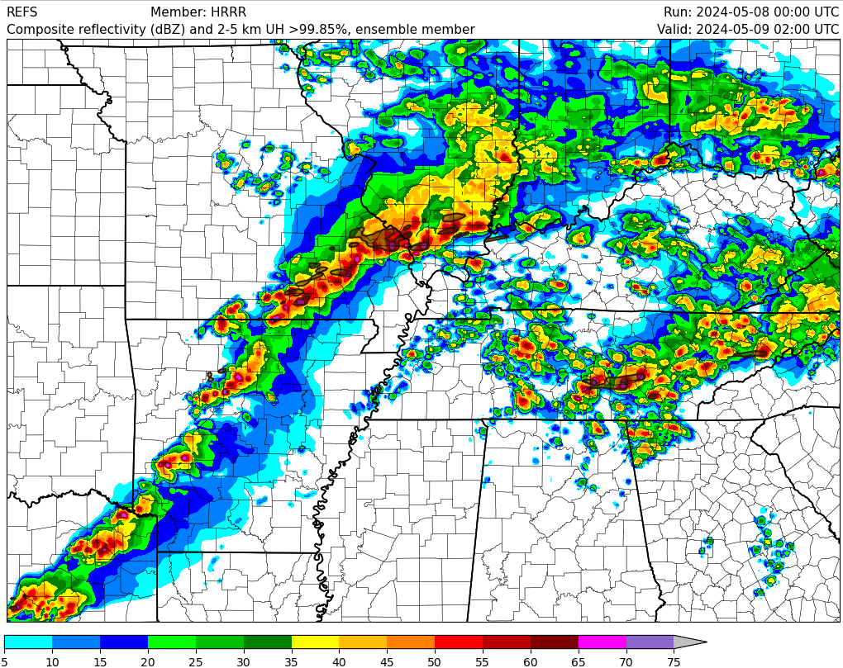
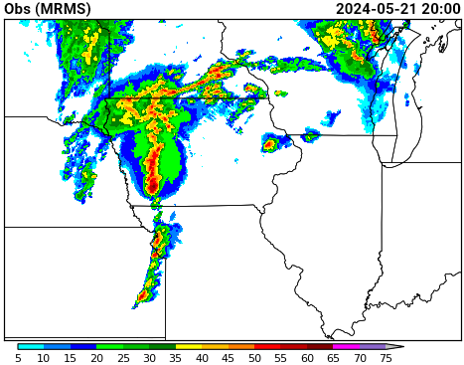
2024 HWT SFE High-Impact Events
9 May @ 02Z
RRFS CTL
REFS M05
Moderate Risk across portions of southern MO/IL & KY/TN
Strong tornadic supercells across southern TN & northern AL at this time - mini outbreak
RRFS control member has no deep convection in that area and completely misses that high impact event
HRRR and REFS M05 have some issues with placement and orientation, but provide a decent signal for severe weather
HRRR
OBS
Tornadic Supercells

Slide 21
Discussion
Performance of the RRFS control member was worse this year than last year in both an absolute and relative sense - added GF deep convection scheme
The performance of the REFS was similar to the HREF and comparably better than the deterministic control, which raised lots of questions during the SFE
The performance of the REFS members was strongly influenced by the convective parameterization schemes with saSAS members performing best
Most notably, the REFS members using the GF deep convective scheme performed poorly during high-impact severe weather events by overly suppressing areas of deep convection
The RRFS control member should be optimally configured to be the best- performing member since it runs hourly and is the most visible member
The potential improvement of reducing a high-intensity bias in RRFSv1 using convective parameterization schemes was strongly outweighed by erroneously suppressing high-impact severe convection

