Slide 1





Toward Global 6.5-km Weather Prediction and Storm-Resolving Simulation
Linjiong Zhou and the GFDL FV3 Team

Slide 2
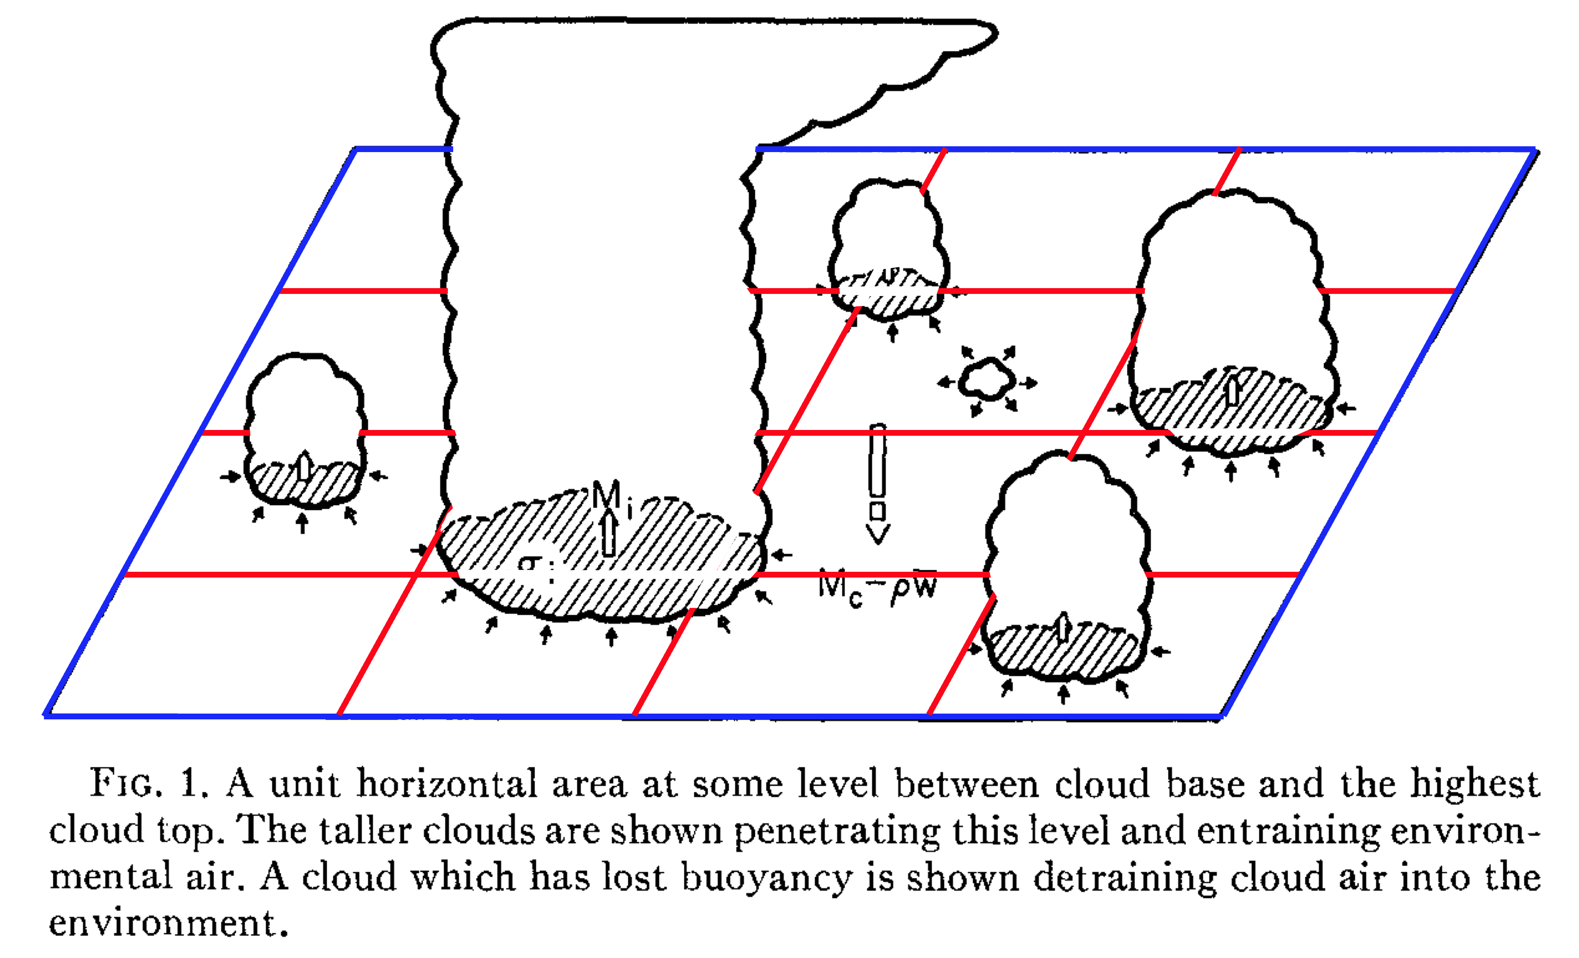
A key aspect of weather and climate modeling is pushing the limits of resolution
GCMs reach an area where uncertainties become increasingly significant - Gray Zone
Arakawa (2004)
Arakawa (2000), Randall (2000)
Arakawa and Schubert (1974)

Slide 3
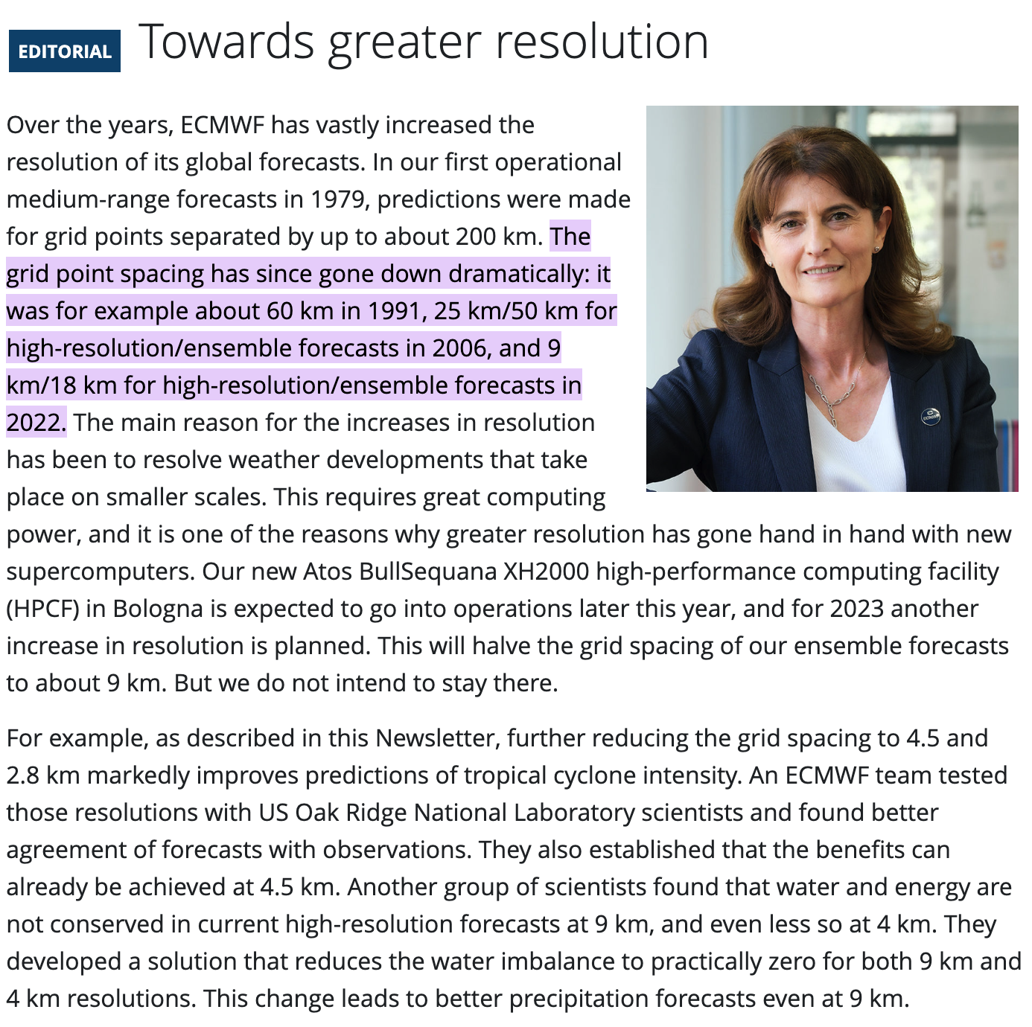
Source: Briefing to EMC CCB 9/30/2020 – Fanglin Yang
Improvements in the observations as well as the numerical methods and algorithms that are used for both the forecast model and data assimilation have led to significant skill over time, but a leading driver for improvements is the increase of spatial resolution … -- Wedi (2014), Bauer (2024)
ECMWF Newsletter #172– Summer 2022
Florence Rabier
Director-General

Slide 4
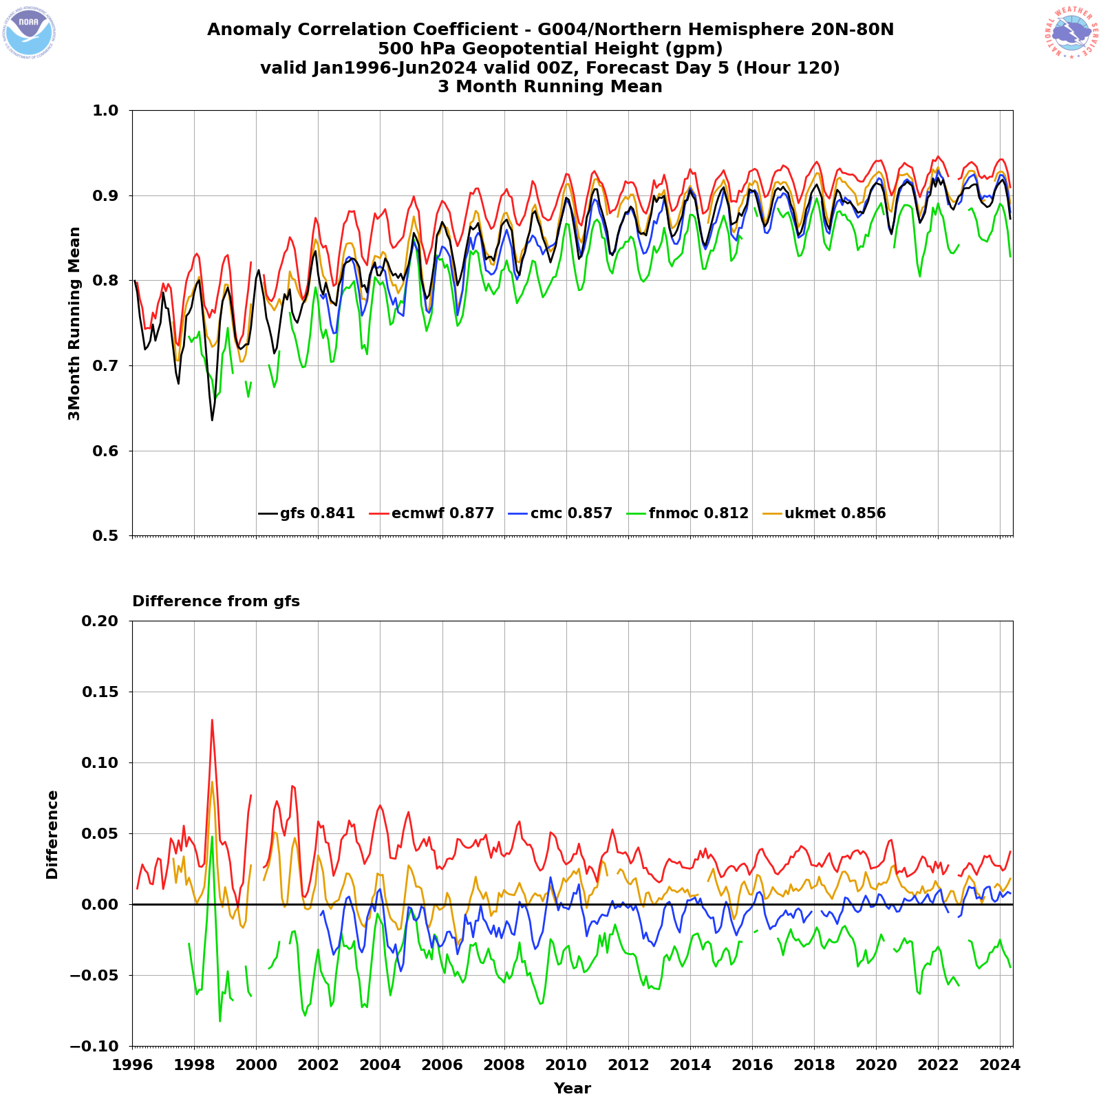
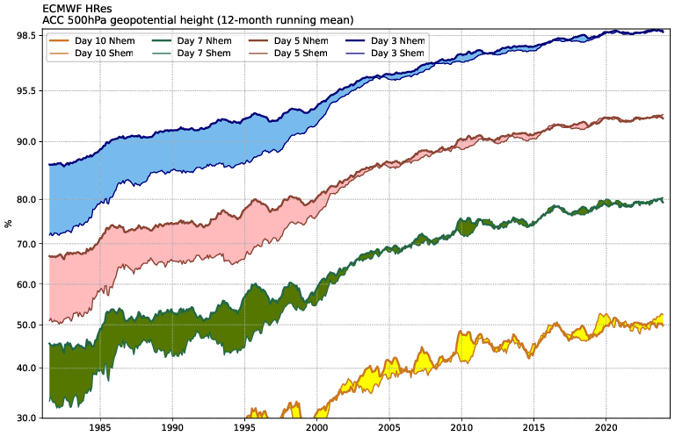
https://charts.ecmwf.int/products/plwww_m_hr_ccaf_adrian_ts?single_product=latest
https://www.emc.ncep.noaa.gov/users/verification/global/gfs/prod/atmos/long_term/monthly_yearly_stats/

Slide 5
Model Resolution at the Major Operational Centers
Model | Resolution | Levels
ECMWF | 9 km | 137
NCEP/EMC | 13 km | 127
CMC | 15 km | 80
Met Office | 10 km | 70
Meteo-France | 5-25 km | 105
DWD | 13 | 90
JMA | 20 | 100
Reference: Magnusson et al. (BAMS, 2022)

Slide 6
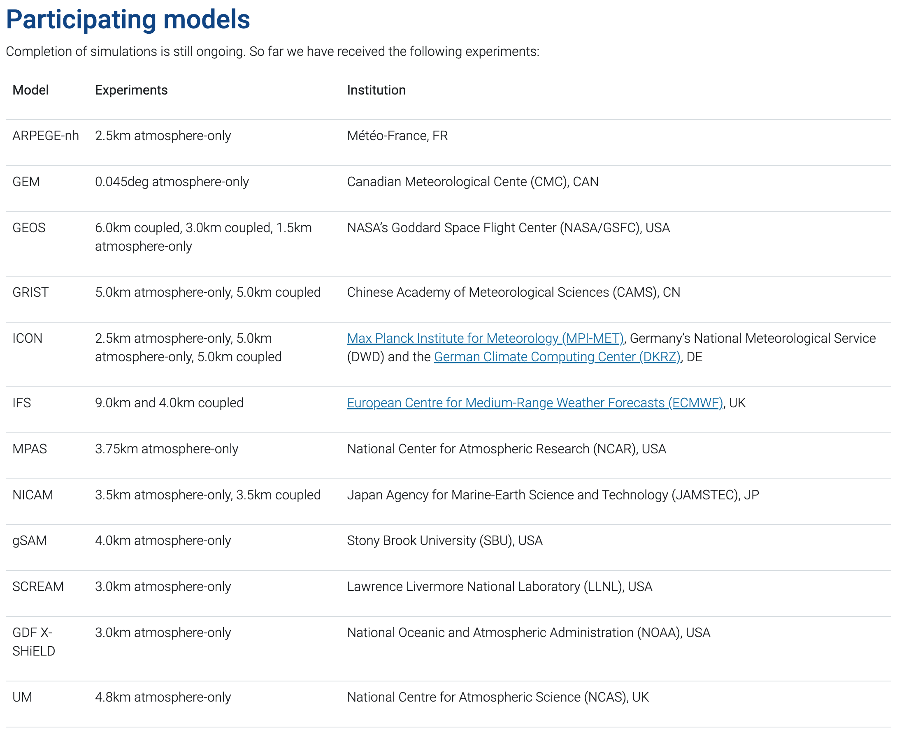
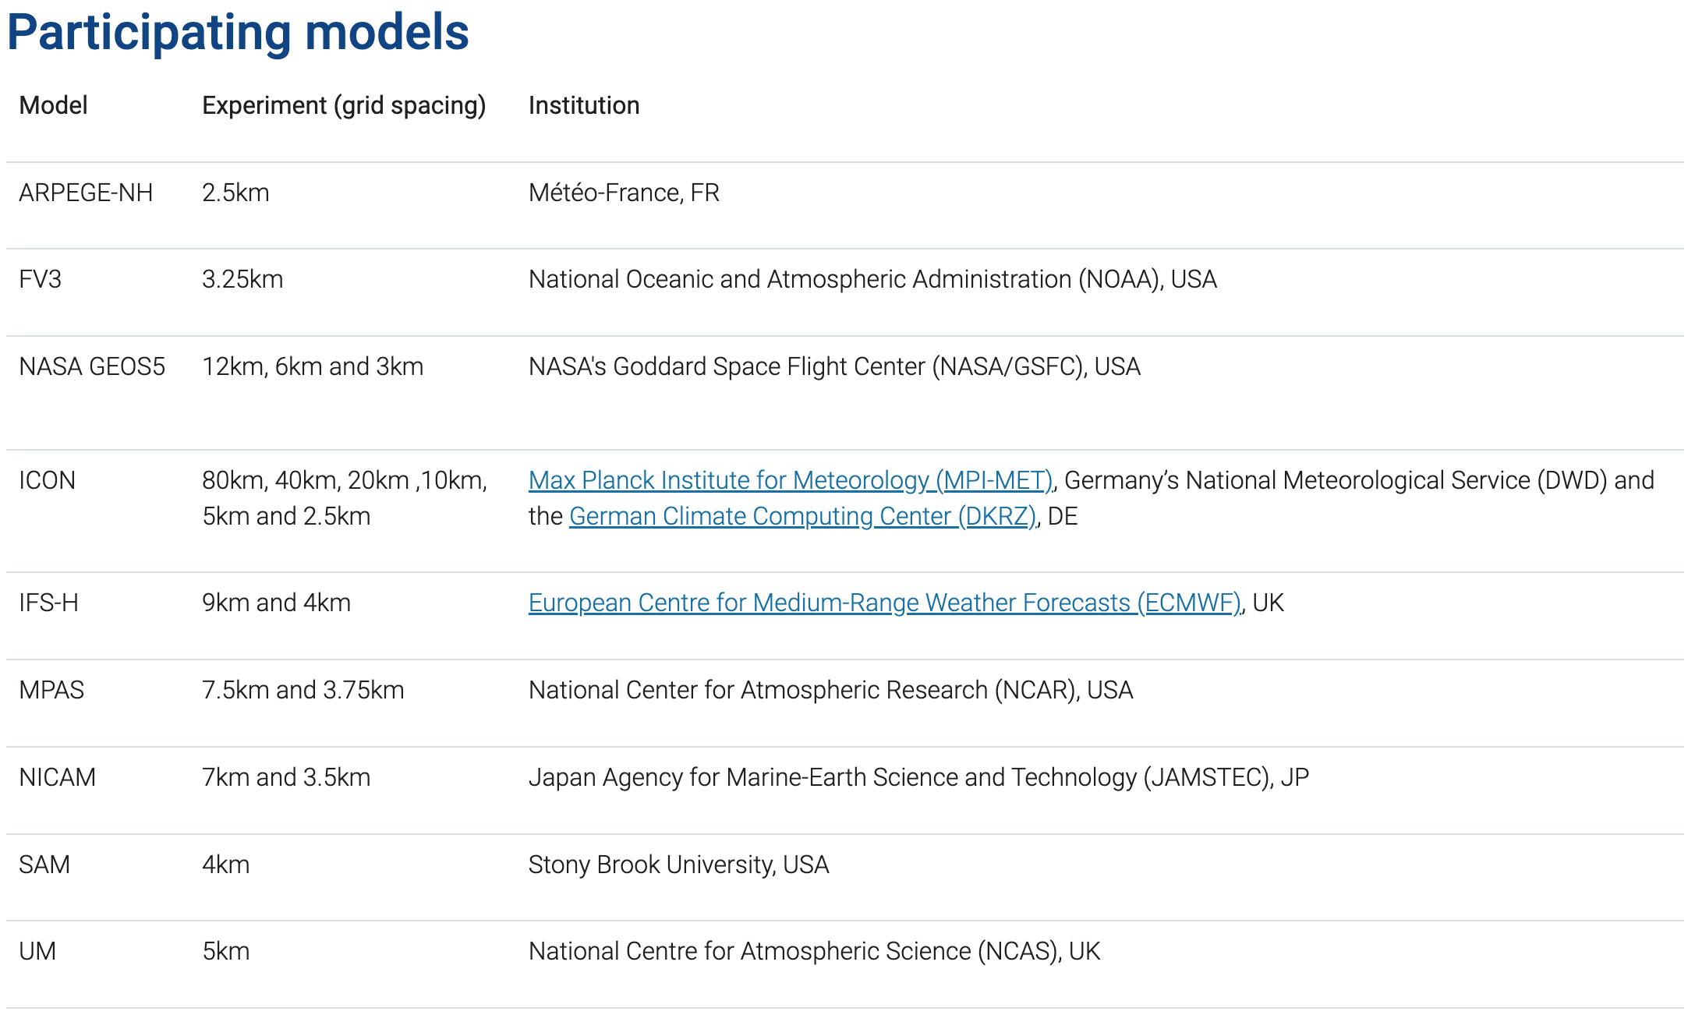
Global Storm-Resolving Models (GSRMs) in the
DYnamics of the Atmospheric general circulation Modeled On Non-hydrostatic Domains (DYAMOND) Project
The outcomes of the DYAMOND Initiative offer valuable insights into the behavior of global convective storms and demonstrating the potential for sub-10-km-resolution global weather prediction.
← DYAMOND Winter
DYAMOND Summer →

Slide 7
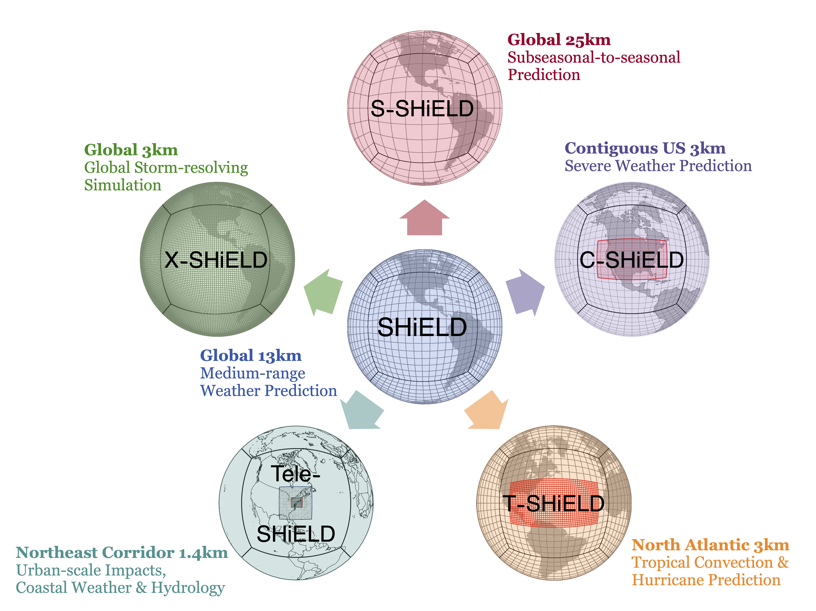
SHiELD is a research-oriented Unified Forecast System (UFS) prototype atmosphere model showing the power of a unified prediction system across a variety of time and space scales designed for a wide array of applications.
Our home address: https://www.gfdl.noaa.gov/shield/
Our near-real-time forecast system: https://shield.gfdl.noaa.gov/

Slide 8
The configuration of the 13-km and 6.5-km SHiELD
Zhou et al. (2022, 2024*)
Zhou and Harris (2022)
Double resolution → 4 times more grid cells
Half time step → maintain courant number
The dycore is 8 times more expensive, but the total model is 6 times slower
Half remapping time step → twice cloud microphysics loops (inline microphysics)
GFSv16 convection scheme v2021, with tuned shallow convection
Scale-awareness in microphysics, convection, and PBL parameterizations
Updated energy conservation formula in C1536
Each configuration runs for 10 days, initialized every 5 days, covering 3 years (222 cases)

Slide 9
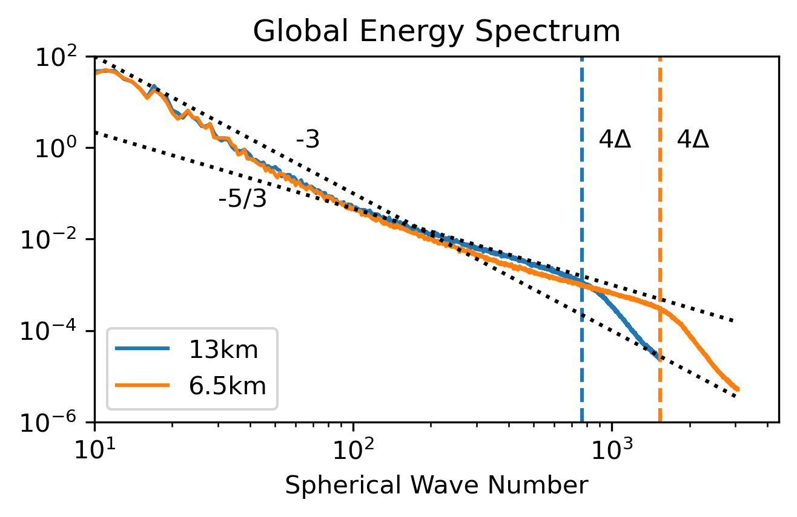
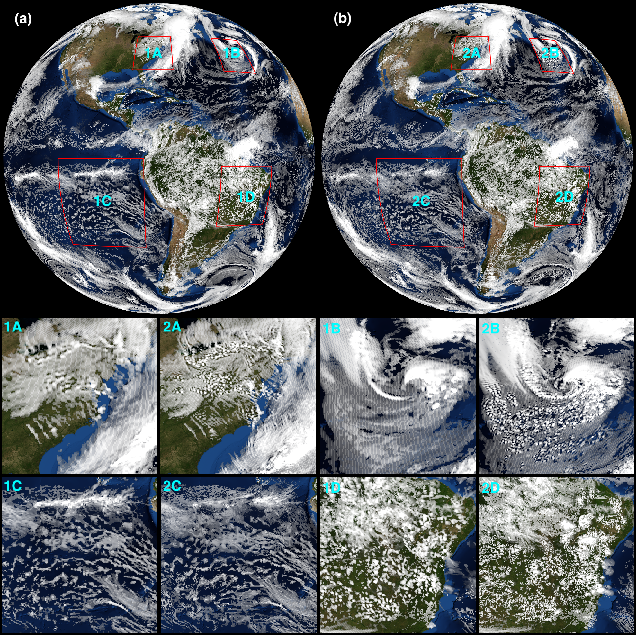
13km
6.5km
The 6.5-km SHiELD shows a superior energy spectrum at finer scales than the 13-km SHiELD → better suited for representing mesoscale convection .
The 6.5-km SHiELD better represents the detailed mesoscale scattered cumulus clouds associated with post-frontal systems and within extratropical cyclones, exhibits more intricate structures over marine stratocumulus cloud regions, and shows significantly more finer-scale convections across continental areas than the 13-km SHiELD.
Zhou et al. (2024*)

Slide 10
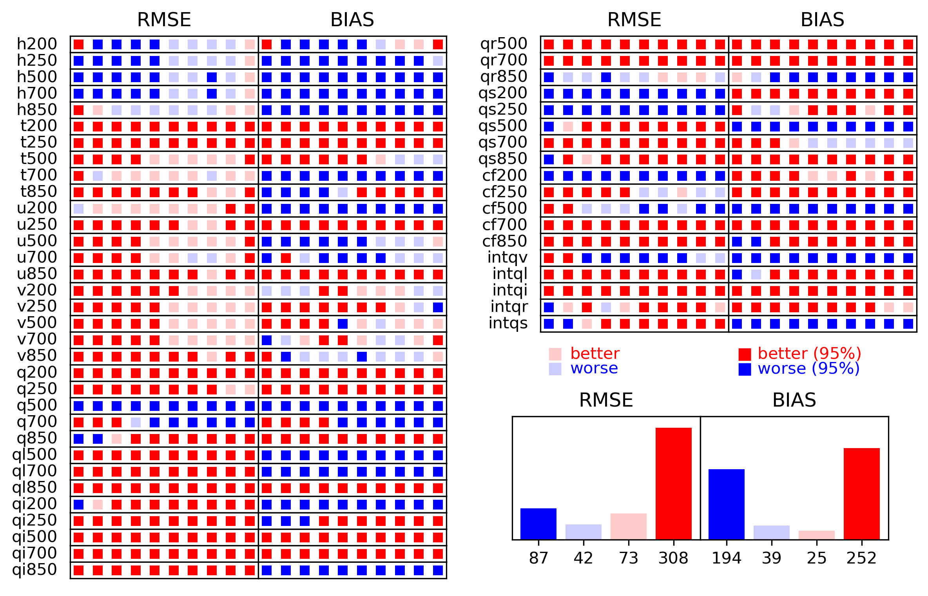
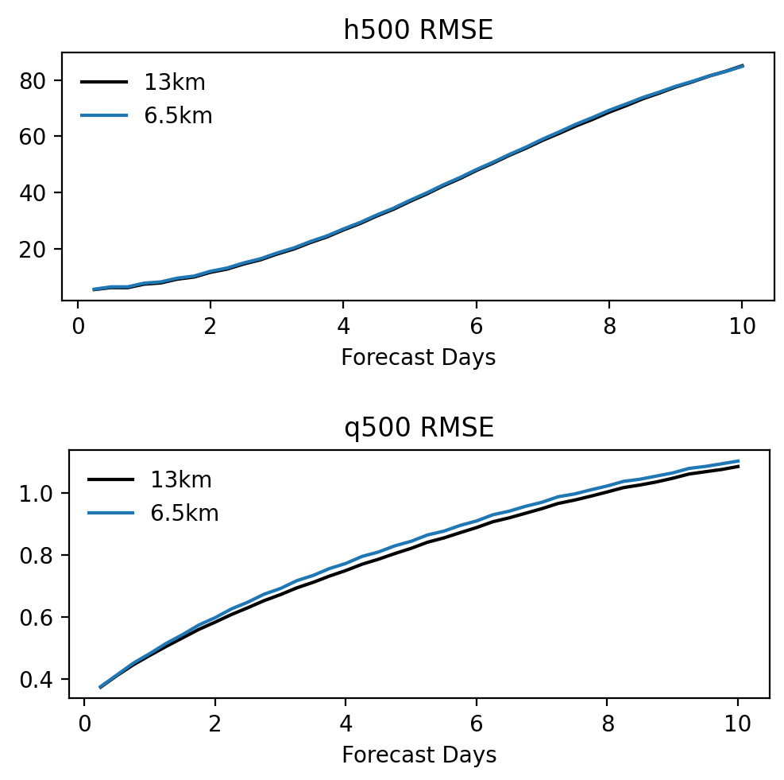
Forecast Skill on the Global Domain
Better:
lower RMSE or smaller absolute BIAS
Day 1 to 10
Zhou et al. (2024*)
We recently found that the degradation of H500 is related to the scale-awareness in physics schemes.

Slide 11
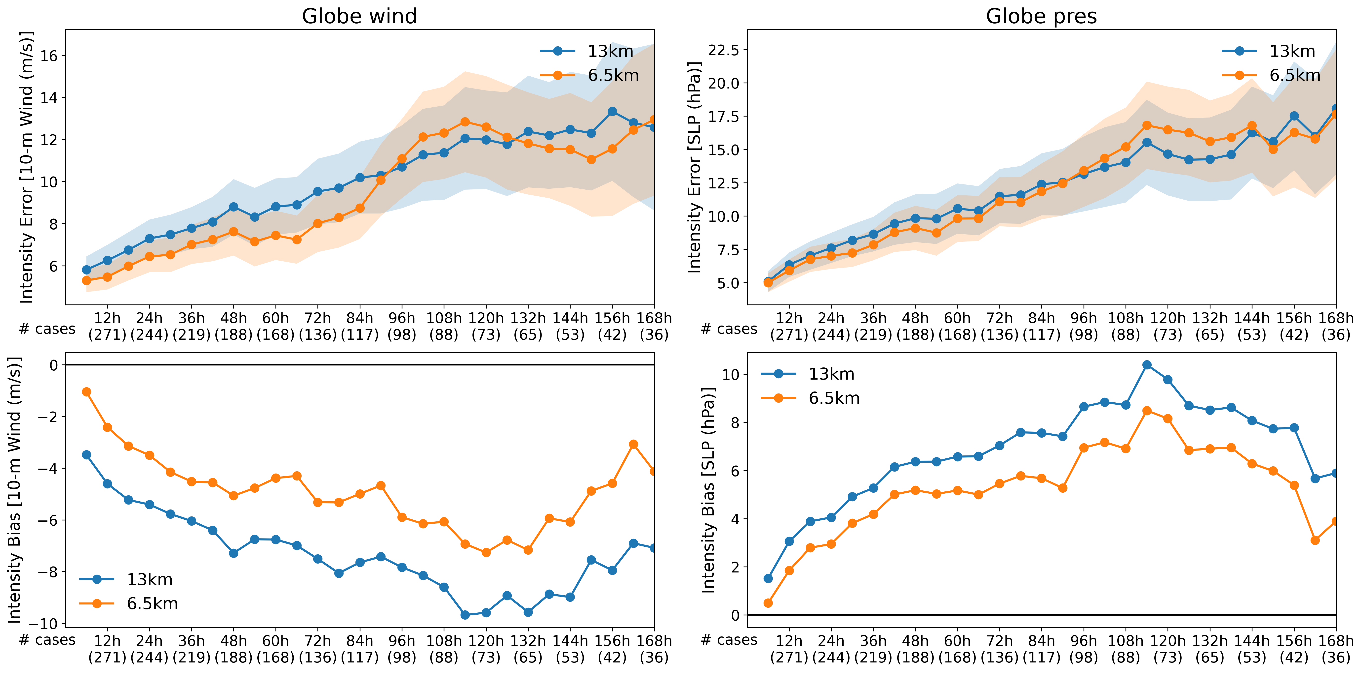
Improved Tropical Cyclone Intensity Prediction
Zhou et al. (2024*)

Slide 12
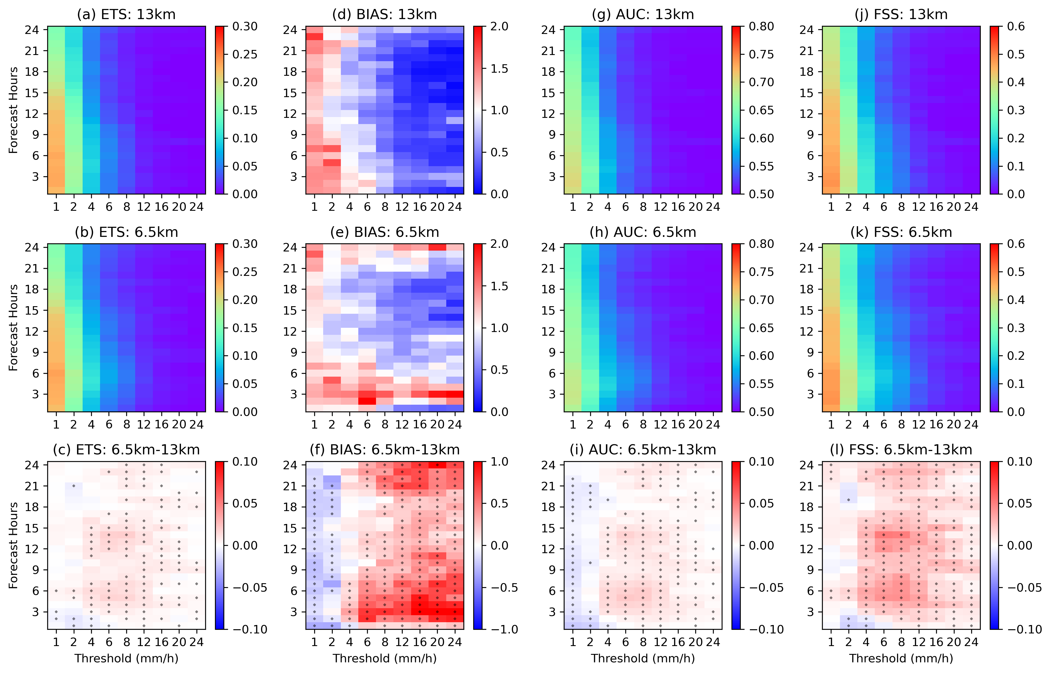
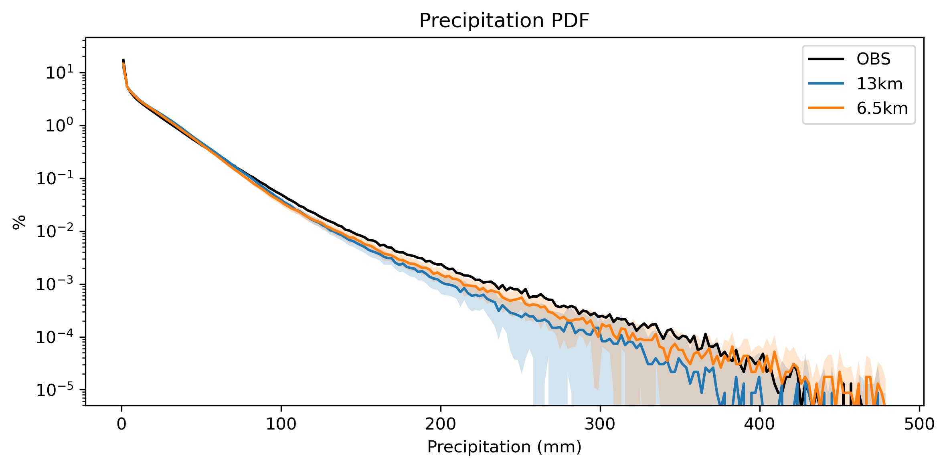
Prediction of continental convective precipitation over the CONUS – QPF Analysis
The 6.5-km SHiELD improves convective-prediction skills across ETS, AUC, and FSS, which are particularly noticeable for moderate to heavy precipitation during the first 6 hours and the 3-18 hour forecast period.
BIAS shows a notable improvement when transitioning from the 13-km SHiELD to the 6.5-km SHiELD, marked by a reduction in BIAS greater than 1 for light precipitation and a decrease in BIAS less than 1.
The 6.5-km SHiELD shows improvement in forecasting heavy precipitation, with a predicted frequency much closer to Stage IV observations.
Zhou et al. (2024*)

Slide 13
Summary
Increasing the model’s resolution is one of the key approaches to improving weather and climate prediction.
When the model’s resolution enters the kilometer scale crossing the ‘gray zone’, uncertainties arise rapidly.
Kilometer-scale weather prediction is achievable nowadays due to the expansion of computer power and the growing of global storm-resolving models.
GFDL is developing a global 6.5-km SHiELD prediction system to bridge the gap between global weather prediction and global storm-resolving simulation.
With the increase in resolution, 6.5-km SHiELD better represents the detailed mesoscale convections along frontal systems, over the stratocumulus cloud regions, and continental regions.
The 6.5-km SHiELD shows significantly improved global forecast skills, improved tropical cyclone intensity prediction, and improved continental convective precipitation.

