Slide 1


Recent Development of Research-, Education- and R2O-Friendly Workflow for Cycled JEDI UFS Regional and Global Data Assimilation
Yongming Wang, Xuguang Wang
Multi-scale data Assimilation and Predictability (MAP) Laboratory
School of Meteorology
University of Oklahoma, Norman, OK, USA
Acknowledgement: Anna Shlyaeva (JCSDA), Cory Martin & Daryl Kleist (NOAA/EMC), Curtis Alexander (NOAA/GSL)

Slide 2


Background
In the past decade, OU MAP lab, in close collaboration with NOAA EMC and OAR labs, has made extensive efforts to perform research and development (R&D) in advancing NOAA’s global and regional operational data assimilation (DA) systems within the GSI-based framework and to facilitate the transition of these R&D into NOAA operations.
GSI-based Var/EnKF/3D/4DEnVar hybrid
GFS
Convection-allowing Hurricane Prediction
CONUS Convective-scale Prediction
GSI-based 3DEnVar and 4DEnVar hybrid DA system for US NWS GFS (e.g., Wang* X. et al. 2013; Wang* X. and Lei* 2014; Huang* and X. Wang* 2018; Huang*, X. Wang* et al. 2020, Kay* and X. Wang* 2020, Jones* and X. Wang* 2023)
GSI-based Var/EnKF/hybrid DA system for US NWS HWRF and HAFS (e.g., Lu*, Wang* X. et al. 2017a,b; Lu* and X. Wang* 2019, 2020, 2021, 2023; Feng* and X. Wang* 2019, 2020; Davis* et al. 2021; Green* et al. 2022)
GSI-based EnKF/hybrid DA system on CONUS convective scale radar data assimilation (DA) for HRRR, RRFS and WoF (e.g., Johnson* et al. 2015, 2017, Wang* Y. and X. Wang* 2017, 2020, 2021, 2023a,b, 2024; Degelia* et al. 2018, 2023, Gasperoni* et al. 2021, 2022, 2023a,b)
*denote OU MAP lab authors

Slide 3
Motivation
Based on our past experiences, the following aspects would be needed for a DA system to support data assimilation research, education and R2O:
Flexible to be ported to multiple platforms (e.g. NOAA supported HPCs or University HPCs, etc.)
Easy to use for students who just enter the DA field or DA classroom teaching (e.g. Jupyter notebook)
Customizable
Allow simplified ”research mode”
Flexible to test various research ideas at different readiness levels (RLs)
Allow DA R&D to be contributed back for broader use and for R2O
Housing multiple DA solvers and cycling with various regional and global models

Slide 4
Outline
Introduce the newly developed, research-, education- and R2O-friendly workflow for cycled JEDI UFS DA
Test the new workflow for various UFS applications:
Regional MPAS
FV3-LAM
GFS
etc

Slide 5
1. Development of research-, education- and R2O-friendly workflow for JEDI UFS DA
Driver.py
experiment.yaml
A python-based workflow is developed for cycled JEDI UFS DA;
Flexible to port to different platforms (NOAA supported or University HPCs)
Flexibility to combine the functions (left) to achieve different purposes of DA research for different UFS models easily
R2O friendly
Easy for students and DA beginners to learn and run
getObs.py
Class GFS
getIni.py
Class FV3LAM
getForecast.py
Class MPAS
Class HAFS
getBTrain.py
…
getAnalysis.py
getAnalysisENS.py
getRecenter.py
getFreeFcst.py

Slide 6
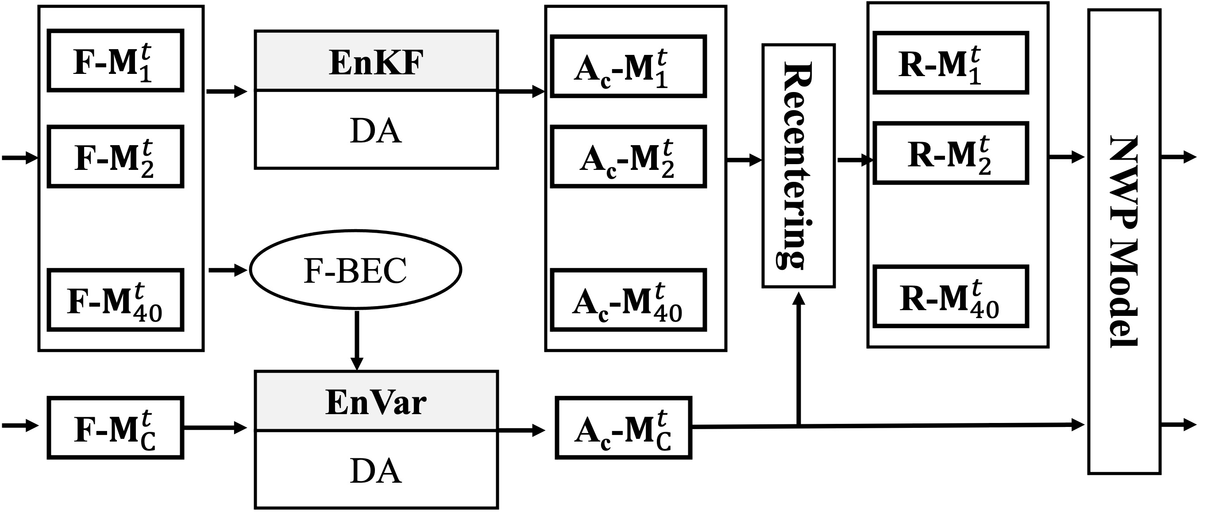
1. Development of research-, education- and R2O-friendly workflow for JEDI UFS DA
Workflow is flexibility to run end to end standalone Var, EnKF or hybrid EnVar DA (Wang*, X. et al. 2013)
House various DA solvers (Var, EnVar, LETKF and LGETKF) from JEDI
Given JEDI for UFS regional applications is immature, efforts have been made to achieve cycled JEDI DA for UFS regional models like MPAS, FV3-LAM, etc, with the workflow

Slide 7
2. Further develop and test the new workflow for cycled JEDI regional MPAS radar data assimilation
Additional efforts were made to enable
MPAS coupling with JEDI for cycled DA
direct radar reflectivity assimilation (Wang* Y. and X. Wang* 2017) in MPAS JEDI-EnVar/LETKF/GETKF
Specific developments
Develop a utility to convert 3D MRMS radar observations to IODA format
Modify/update Static-file to enable direct reflectivity assimilation and to enable MPAS regional model interfaced with JEDI
Enable w update for MPAS-JEDI
Testing
Single radar observation tests in MPAS/FV3LAM-JEDI/GSI-EnVar;
Single radar observation tests in MPAS/FV3LAM-JEDI-LETKF/GETKF/GSI-EnSRF;
Cycling tests in the analysis and forecast of the 11-12 May 2022 Minnesota bow-echo case.

Slide 8
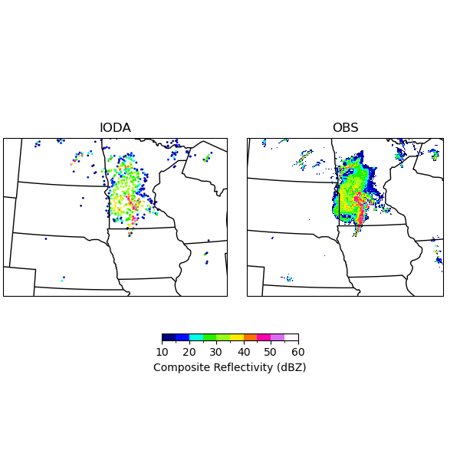
2. Further develop and test the new workflow for cycled JEDI regional MPAS radar data assimilation
IODA-converter Utility
dBZ
An example of the observed reflectivity at 3 km in the IODA and raw files.

Slide 9
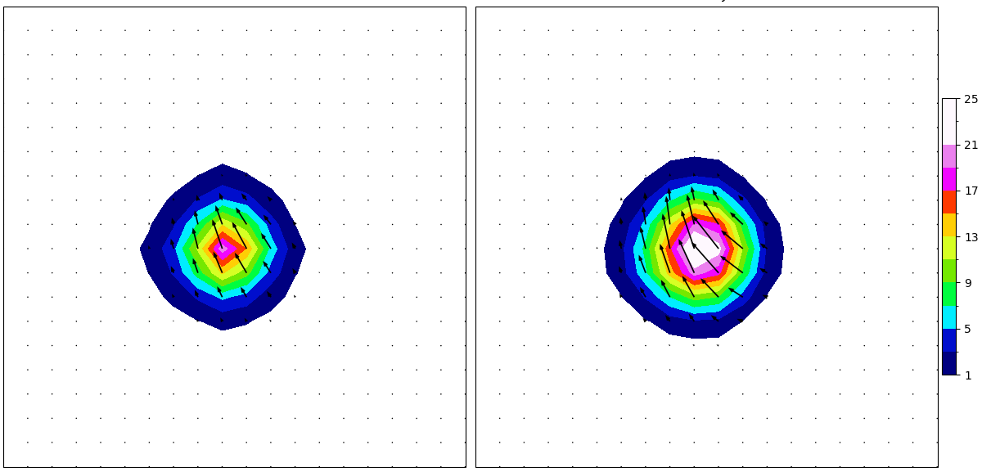
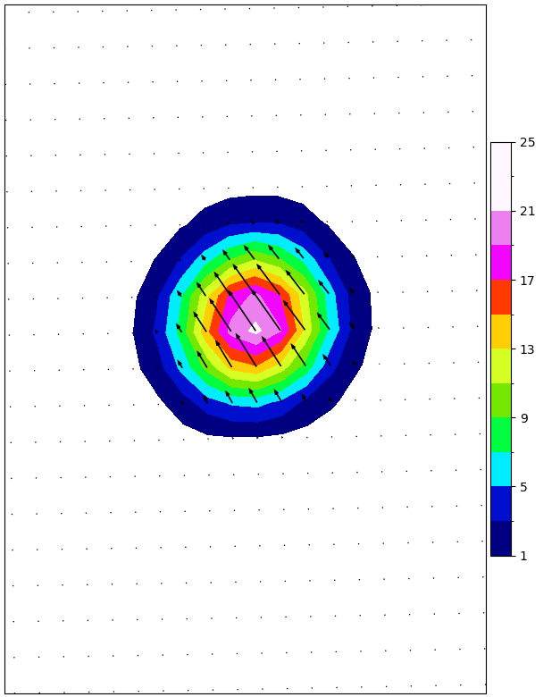
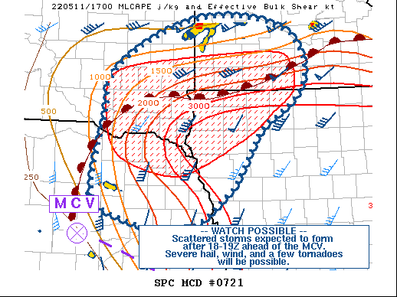
2. Further develop and test the new workflow for cycled JEDI regional MPAS radar data assimilation
Single-Observation EnVar tests
Single reflectivity obs: 46.6736N, -94.448W, 3000.0 m AGL, Z = 50 dBZ with 15 km cut-off radius
FV3LAM-GSI
FV3LAM-JEDI
A 36-member ensemble is used with the horizontal localization of 15 km.
All tests show a similar increment pattern.
The increase of reflectivity is consistent with the enhancement of convergence.
MPAS-JEDI
Analysis increments of dbz and winds near the obs level

Slide 10
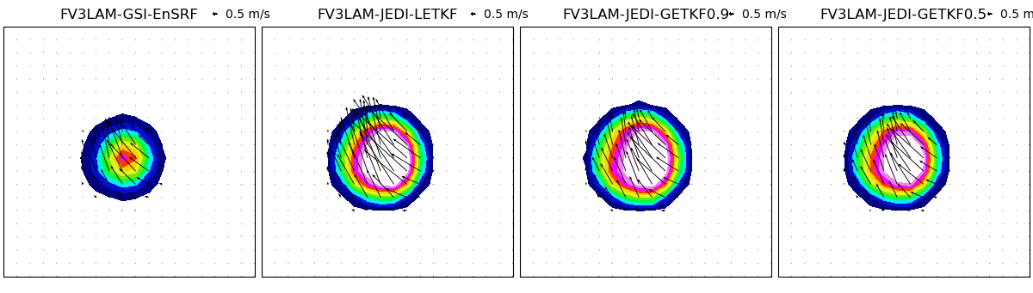
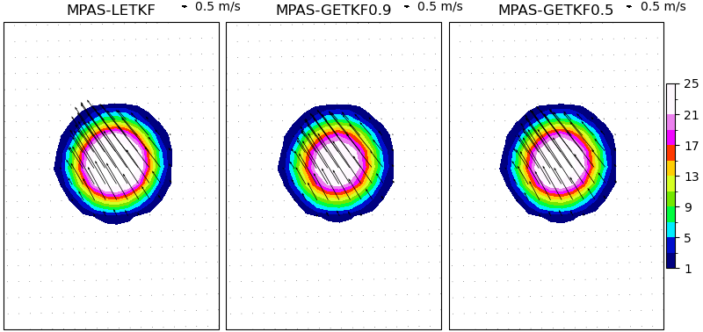
2. Further develop and test the new workflow for cycled JEDI regional MPAS radar data assimilation
Single-Observation LETKF/GETKF tests
FV3LAM-GSI-EnSRF
FV3LAM-JEDI-LETKF
FV3LAM-JEDI-GETKF0.9
FV3LAM-JEDI-GETKF0.5
All EnKF tests show a similar increment pattern with EnVar.
LETKF: no vertical localization
GETKF-0.5: 50% of the variance retained after the eigenspectrum of the vertical localization function is truncated
GETKF-0.9: 90% of the variance retained after the eigenspectrum of the vertical localization function is truncated
Localization radii of GETKF are the same as EnVar.
MPAS-JEDI-LETKF
MPAS-JEDI-GETKF0.9
MPAS-JEDI-GETKF0.5

Slide 11
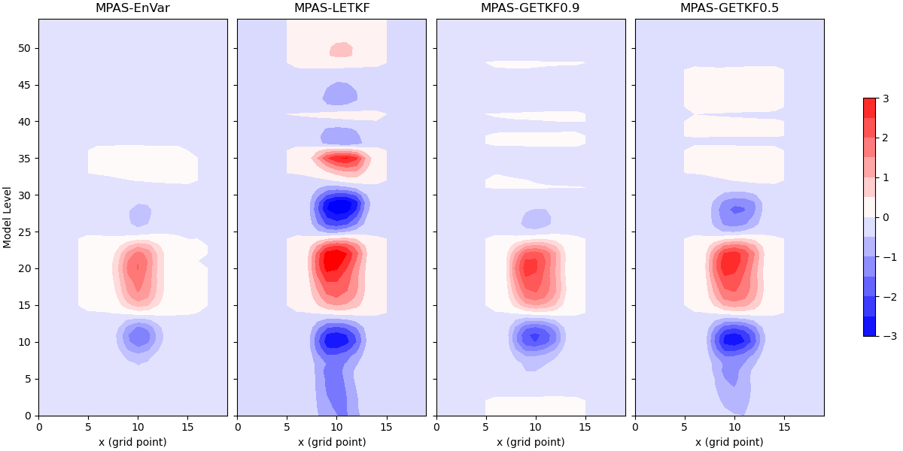
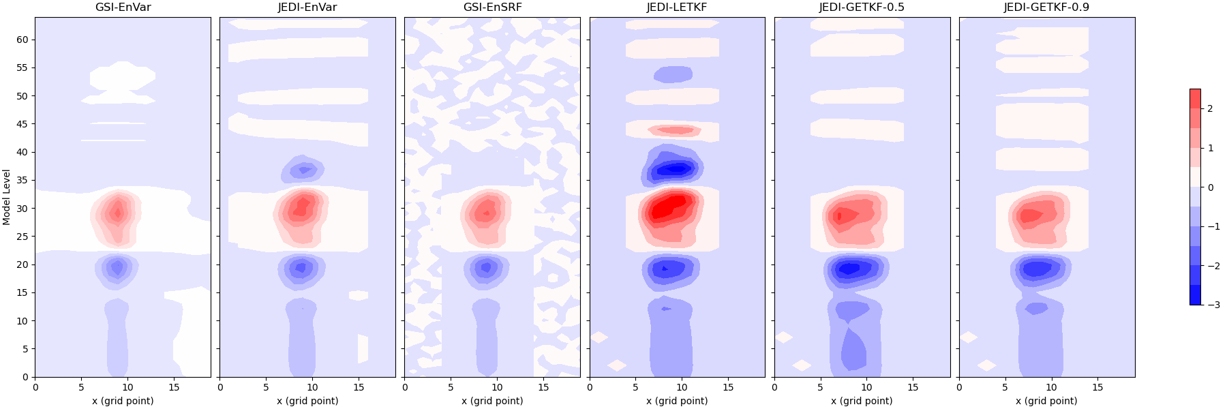
2. Further develop and test the new workflow for cycled JEDI regional MPAS radar data assimilation
Single-Observation tests
JEDI-EnVar
JEDI-LETKF
JEDI-GETKF0.9
JEDI-GETKF0.5
LETKF: no vertical localization
GETKF-0.5: 50% of the variance retained after the eigenspectrum of the vertical localization function is truncated
GETKF-0.9: 90% of the variance retained after the eigenspectrum of the vertical localization function is truncated
MPAS
Vertical Loc: 20 model levels
All tests show similar v-wind increment patterns.
LETKF without vertical localization produces increments throughout entire levels.
GSI-EnVar
JEDI-EnVar
GSI-EnSRF
JEDI-LETKF
JEDI-GETKF0.9
JEDI-GETKF0.5
FV3LAM
Vertical Loc: 1.1 in logp

Slide 12
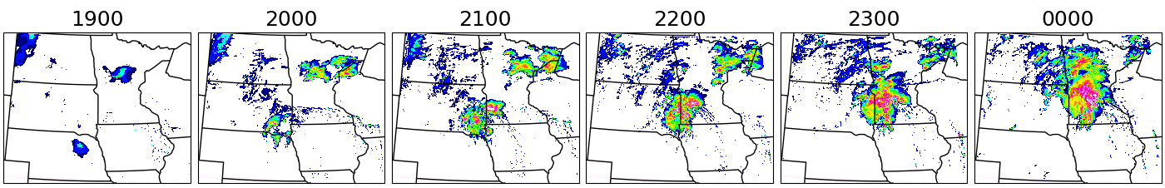
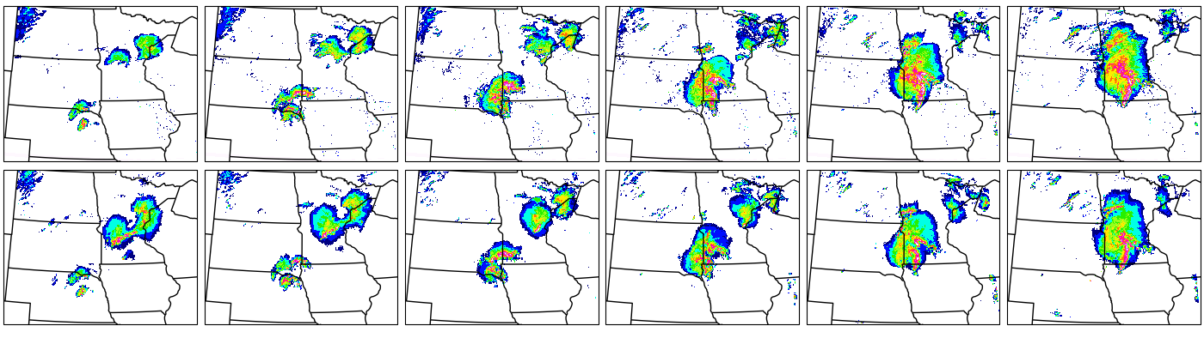
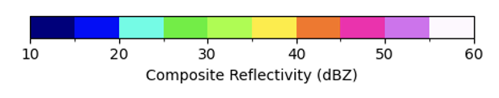
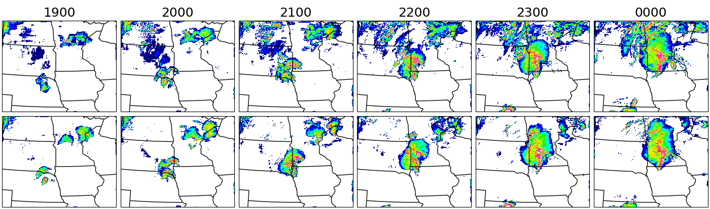
2. Further develop and test the new workflow for cycled JEDI regional MPAS radar data assimilation
Analysis of the 11-12 May 2022 Minnesota bow-echo case
FG
During earlier DA cycles, radar DA functions well by adding reflectivity for MCV in all experiments;
In the later DA cycles, analyses of all experiments reduce the overestimated reflectivity in the background.
Similar to EnVar, GETKF functions well to add/remove reflectivity as expected (not shown).
MPAS-AN
OBS
FV3LAM-GSI
FV3LAM-JEDI

Slide 13
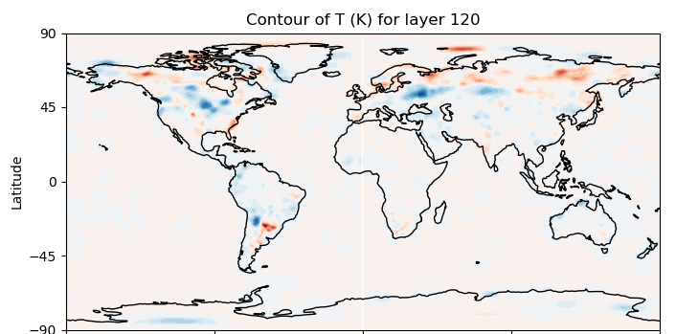
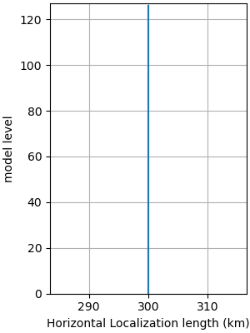
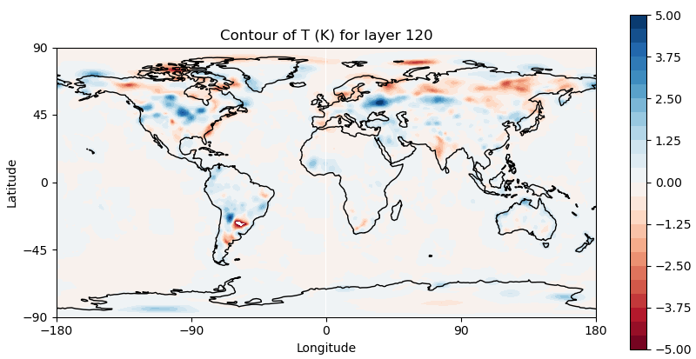
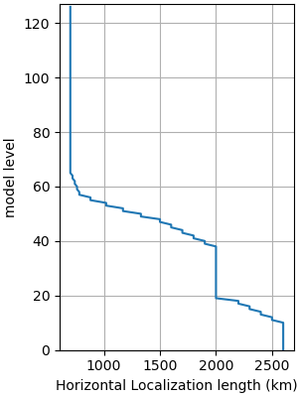
3. Test the new workflow for JEDI GFS data assimilation
3DEnVar tests
Various tests were conducted to examine JEDI hybrid EnVar and JEDI LETKF/GETKF in the assimilation of a myriad of insitu and satellite observations within the newly developed workflow.
Weaker analysis increments for temperature are produced with a stricter localization radius near surface.
Broader and stronger analysis increments for temperature are produced with a wider localization radius near surface.
Notes:
XW: use circle to highlight differences

Slide 14
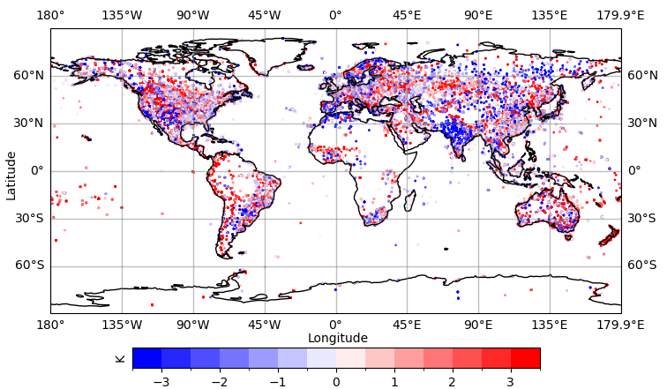
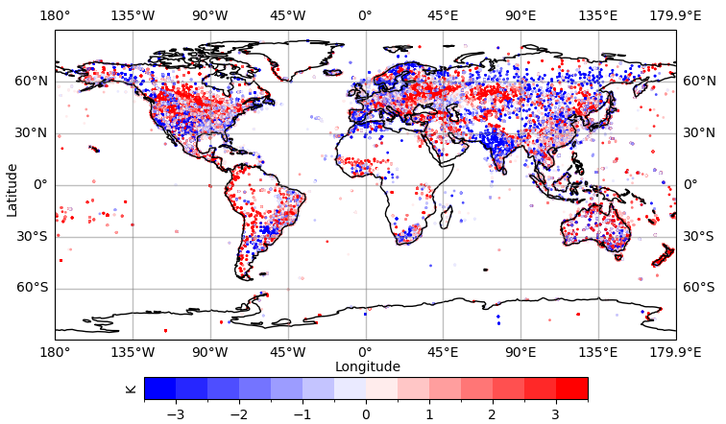
3. Test the new workflow for JEDI GFS data assimilation
Example of OMA/OMB
Consistent with analysis increments, OMA is greatly reduced in the green boxes.
K
OMA for air temperature with the assimilation of radiosonde and surface observations
K
OMB for air temperature
Notes:
XW: use circle to highlight differences

Slide 15
Summary and Future Plan
Summary
Research-, education-, and R2O friendly workflow is developed for cycled JEDI UFS regional and global model data assimilation
Additional efforts have been made to achieve cycled JEDI regional MPAS radar data assimilation for various solvers
Ongoing and future work by OU MAP lab using this JEDI system
Simultaneous MDA and multi-resolution background ensemble DA for GFS and RRFS
ABI all sky radiance DA for RRFS and HAFS
Ocean-atm. coupled DA for HAFS
Land-atm. coupled DA for RRFS
ML/AI and DA
Consortium for Advanced Data Assimilation Research and Education (CADRE)
This JEDI DA system will be used to support CADRE student/postdoc’s various RRFS and HAFS related DA research and their R2O​ (See Xuguang Wang talk on Tues.)

Slide 16
References
Davis, B.*, X. Wang, and X., Lu*, 2021: A Comparison of HWRF 6-Hourly 4DEnVar and Hourly 3DEnVar Assimilation of Inner Core Tail Dopper Radar observations for the Prediction of Hurricane Edouard (2014). Atmosphere, 12, 942, https://doi.org/10.3390/atmos12080942.
Degelia, S. K.*, X. Wang, Y. Wang*, and A. Johnson*, 2023: Assimilation of GOES-16 ABI All-sky Radiance Observations in RRFS using EnVar: System Development and Impacts for a Severe Convective Event. Mon. Wea. Rev., 151, 2739–2758, https://doi.org/10.1175/MWR-D-23-0057.1.
Feng, J.*, and X. Wang, 2019: Impact of assimilating upper-level dropsonde observations collected during the TCI field campaign on the prediction of intensity and structure of Hurricane Patricia (2015). Mon. Wea. Rev., 147, 3069–3089, https://doi.org/10.1175/MWR-D-18-0305.1.
Feng, J.*, and X. Wang, 2020: Impact of increasing horizontal and vertical resolution during the HWRF hybrid EnVar data assimilation on the analysis and prediction of Hurricane Patricia (2015). Mon. Wea. Rev., 149, 419-441, https://doi.org/10.1175/MWR-D-20-0144.1.
Gasperoni, N. A.*, X. Wang, and Y. Wang*, 2022: Using a cost-effective approach to increase background ensemble member size within the GSI-based EnVar system for improved radar analyses and forecasts of convective systems. Mon. Wea. Rev., 150, 667-689, https://doi.org/10.1175/MWR-D-21-0148.1.
Gasperoni, N. A.*, X. Wang, and Y. Wang*, 2023a: Valid time shifting for an experimental RRFS convection-allowing EnVar data assimilation and forecast system: Description and systematic evaluation in real-time. Mon. Wea. Rev., 151, 1229–1245, https://doi.org/10.1175/MWR-D-22-0089.1.
Gasperoni, N. A.*, X. Wang, Y. Wang*, and T. Li*, 2023b: Evaluating the multiscale implementation of valid time shifting within a real-time EnVar data assimilation and forecast system for the 2022 HWT Spring Forecasting Experiment. Wea. Forecasting, 38, 2343–2362, https://doi.org/10.1175/WAF-D-23-0096.1.
Green, T.*, X. Wang and X. Lu*, 2022: Impact of Assimilating Ground-Based and Airborne Radar Observations for the Analysis and Prediction of the Eyewall Replacement Cycle of Hurricane Matthew (2016) Using the HWRF Hybrid 3DEnVar System. Mon. Wea. Rev., 150, 1157-1175, https://doi.org/10.1175/MWR-D-21-0234.1.
Huang, B.*, and X. Wang, 2018: On the use of cost-effective valid-time-shifting (VTS) method to increase ensemble size in the GFS Hybrid 4DEnVar system. Mon. Wea. Rev., 146, 2973–2998, https://doi.org/10.1175/MWR-D-18-0009.1.
Huang, B.*, X. Wang, D. Kleist, and T. Lei, 2020: A Simultaneous Multi-scale Data Assimilation using Scale Dependent Localization in GSI-based Hybrid 4DEnVar for NCEP FV3-based GFS. Mon. Wea. Rev., 149, 479-501, https://doi.org/10.1175/MWR-D-20-0166.1.
Johnson, A.*, X. Wang, J. Carely, L. Wicker, and C. Karstens, 2015: A comparison of multiscale GSI-based EnKF and 3DVar data assimilation using radar and conventional observations for midlatitude convective-scale precipitation forecasts. Mon. Wea. Rev., 143, 3087–3108, https://doi.org/10.1175/MWR-D-14-00345.1.
Johnson, A.*, and X. Wang, 2017: Design and implementation of a GSI-based convection-allowing ensemble data assimilation and forecast system for the PECAN field experiment. Part I: Optimal configurations for nocturnal convection prediction using retrospective cases. Wea. Forecasting, 32, 289–315, https://doi.org/10.1175/WAF-D-16-0102.1.
Jones, E. A.*, and X. Wang, 2023: A multi-resolution ensemble hybrid 4DEnVar with variable ensemble sizes to improve global and tropical cyclone track numerical prediction. Mon. Wea. Rev., 151, 1145–1166, https://doi.org/10.1175/MWR-D-22-0186.1.

Slide 17
References
Kay, J. K.*, X. Wang, and Y. Masaya, 2022: An Observing System Simulation Experiment (OSSE) to study the impact of ocean surface observation from the Micro Unmanned Robot Observation Network (MURON) on tropical cyclone forecast. Atmosphere, 13, 779, https://doi.org/10.3390/atmos13050779.
Lu, X.*, X. Wang, Y. Li*, M. Tong, and X. Ma, 2017: GSI-based ensemble–variational hybrid data assimilation for HWRF for hurricane initialization and prediction: Impact of various error covariances for airborne radar observation assimilation. Quart. J. Roy. Meteor. Soc., 143, 223–239, https://doi.org/10.1002/qj.2914.
Lu, X.*, X. Wang, M. Tong, and V. Tallapragada, 2017: GSI-based, continuously cycled, dual-resolution hybrid ensemble-variational data assimilation system for HWRF: System description and experiments with Edouard (2014). Mon. Wea. Rev., 145, 4877–4898, https://doi.org/10.1175/MWR-D-17-0068.1.
Lu, X.*, and X. Wang, 2019: Improving hurricane analyses and predictions with TCI, IFEX field campaign observations, and CIMSS AMVs using the advanced hybrid data assimilation system for HWRF. Part I: What is missing to capture the rapid intensification of Hurricane Patricia (2015) when HWRF is already initialized with a more realistic analysis? Mon. Wea. Rev., 147, 1351–1373, https://doi.org/10.1175/MWR-D-18-0202.1.
Lu, X.*, and X. Wang, 2020: Improving hurricane analyses and predictions with TCI, IFEX field campaign observations, and CIMSS AMVs using the advanced hybrid data assimilation system for HWRF. Part II: Observation impacts on the analyses and predictions of Patricia (2015). Mon. Wea. Rev., 148, 1407–1430, https://doi.org/10.1175/MWR-D-19-0075.1.
Lu, X.*, and X. Wang, 2021: Improving the Four-Dimensional Incremental Analysis Update (4DIAU) with the HWRF 4DEnVar Data Assimilation System for Rapidly Evolving Hurricane Prediction. Mon. Wea. Rev., 149, 4027-4043, https://doi.org/10.1175/MWR-D-21-0068.1.
Lu, X.*, and X. Wang, 2023: A study of simultaneous assimilation of coastal ground-based and airborne radar observations on the prediction of Harvey (2017) with the hourly 3DEnVar system for HWRF. JGR-Atmos., 128, e2022JD037681, https://doi.org/10.1029/2022JD037681.
Wang, X., D. Parrish, D. Kleist, and J. S. Whitaker, 2013: GSI 3DVar-based ensemble–variational hybrid data assimilation for NCEP Global Forecast System: Single-resolution experiments. Mon. Wea. Rev., 141, 4098–4117, https://doi.org/10.1175/MWR-D-12-00141.1.
Wang, X., and T. Lei*, 2014: GSI-based four dimensional ensemble-variational (4DEnsVar) data assimilation: formulation and single resolution experiments with real data for NCEP Global Forecast System. Mon. Wea. Rev., 142, 3303–3325, https://doi.org/10.1175/MWR-D-13-00303.1.
Wang, Y.*, and X. Wang, 2017: Direct assimilation of radar reflectivity without tangent linear and adjoint of the nonlinear observation operator in the GSI-Based EnVar System: Methodology and experiment with the 8 May 2003 Oklahoma City tornadic supercell. Mon. Wea. Rev., 145, 1447–1471, https://doi.org/10.1175/MWR-D-16-0231.1.
Wang, Y.*, and X. Wang, 2020: Prediction of Tornado-Like Vortex (TLV) Embedded in the 8 May 2003 Oklahoma City Tornadic Supercell Initialized from the Subkilometer Grid Spacing Analysis Produced by the Dual-Resolution GSI-Based EnVar Data Assimilation System. Mon. Wea. Rev., 148, 2909–2934, https://doi.org/10.1175/MWR-D-19-0179.1.
Wang, Y.*, and X. Wang, 2021: Development of Convective-Scale Static Background Error Covariance within GSI-Based Hybrid EnVar System for Direct Radar Reflectivity Data Assimilation. Mon. Wea. Rev., 149, 2713-2736, https://doi.org/10.1175/MWR-D-20-0215.1.
Wang, Y.*, and X. Wang, 2023a: Simutaneoous multiscale data assimilation using scale- and variable-dependent localization in EnVar for convection allowing analyses and forecasts: Methodology and experiments for a tornadic supercell. Journal of Advances in Modeling Earth Systems, 15, e2022MS003430, https://doi.org/10.1029/2022MS003430.
Wang, Y.*, and X. Wang, 2023b: Improving CONUS Convective-Scale Forecasting with Simultaneous Multiscale Data Assimilation: A Squall-Line Case Study. JGR-Atmos., submitted.

Slide 18
BACKUP

Slide 19
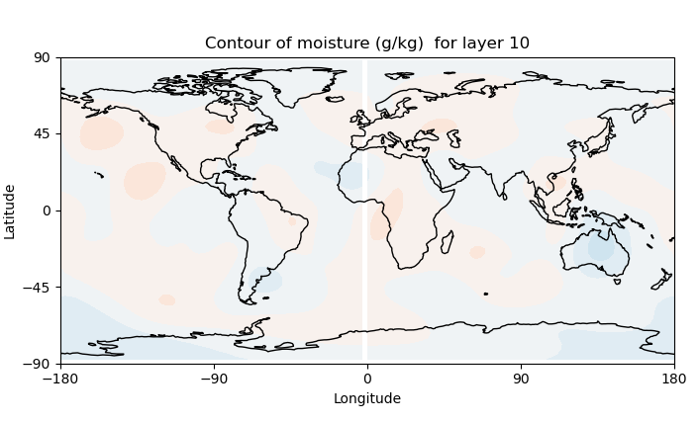
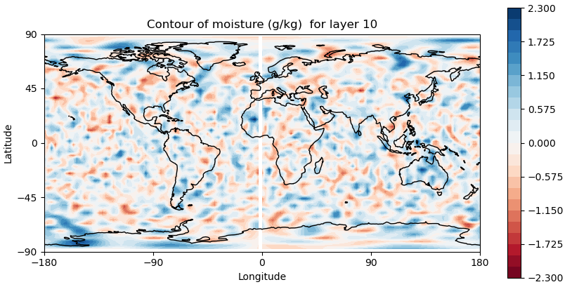
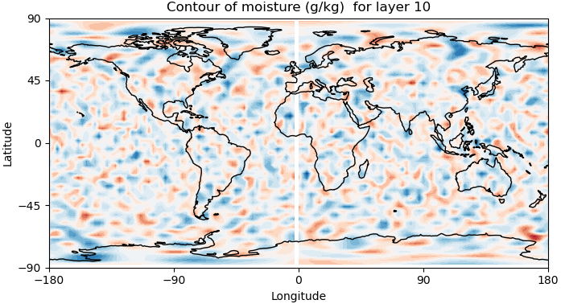
2. Implementation and examination of JEDI-based DA system in the GFS application
Developments of multiscale DA in JEDI: perturbation scale decomposition
Large-scale
Full-scale perturbation
Small-scale
Extension of JEDI SABER for FV3GFS is performed to decompose the perturbations.
A new executable was created. fv3jedi_processperts.x

