Slide 1
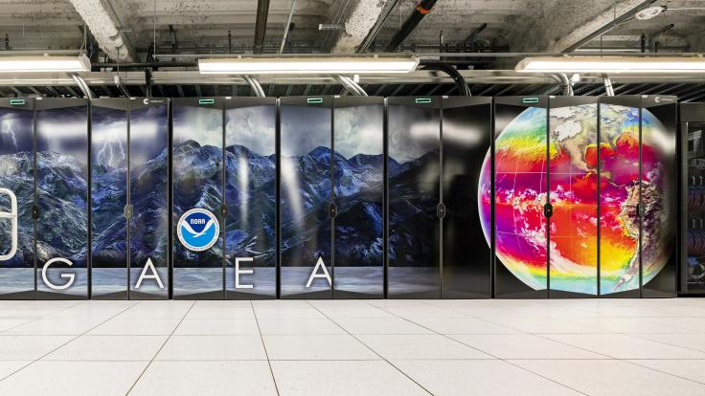
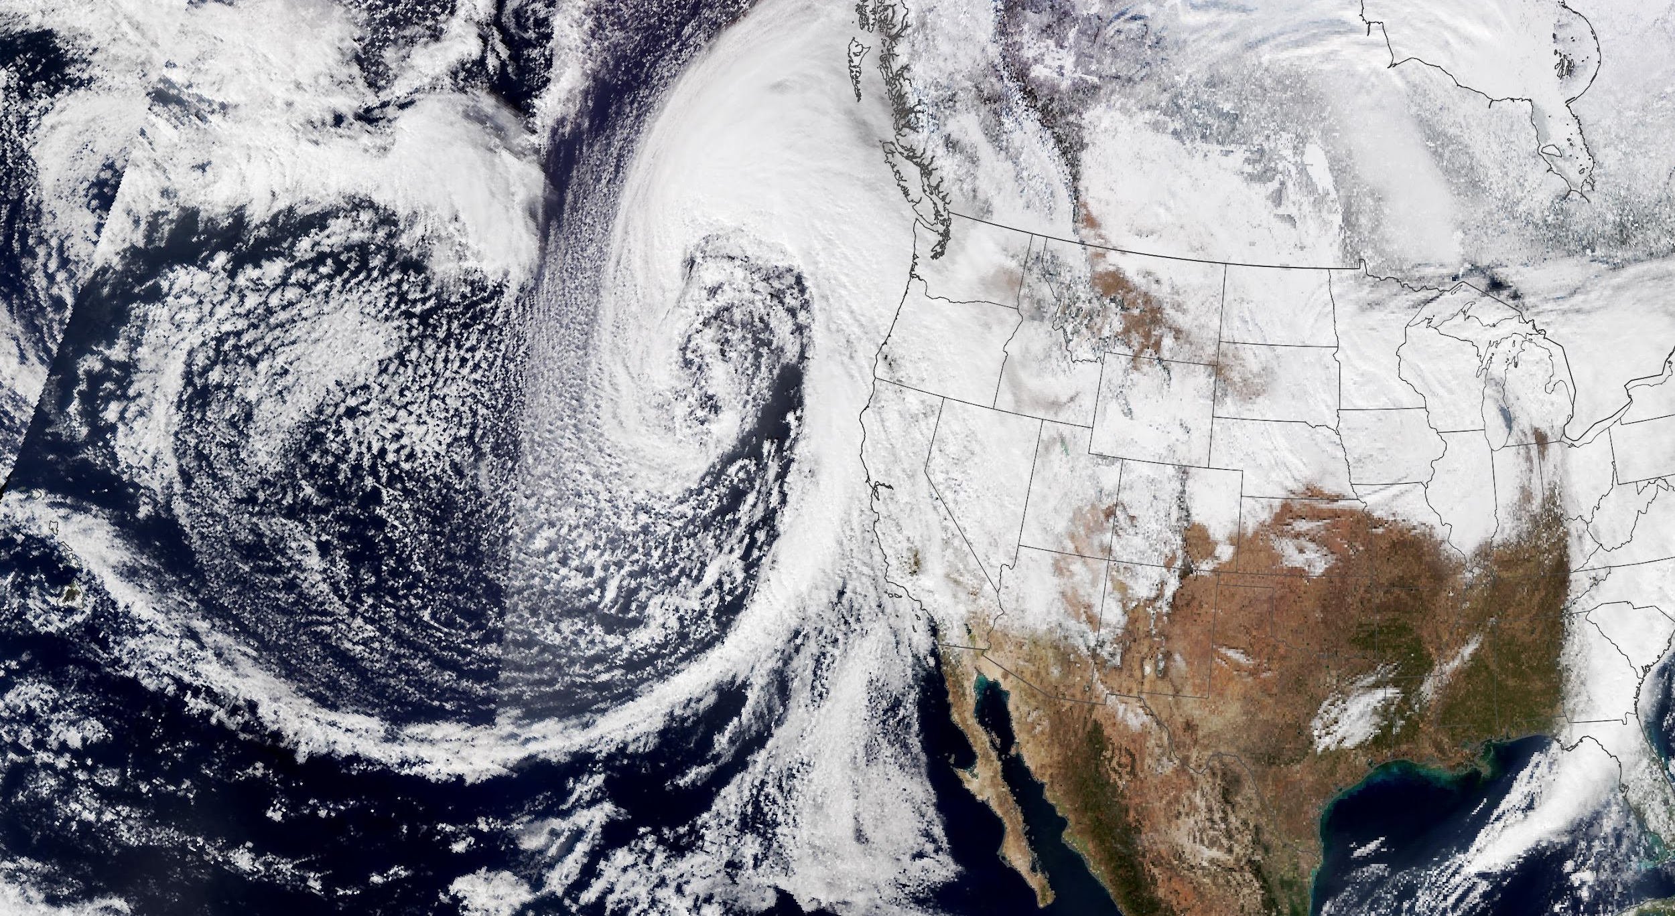
Porting of the Global-Workflow to Gaea-C5
An Atmospheric River Application
D. Alex Burrows* and Anil Kumar*
EPIC* EMC PSL GSL WPC CW3E JCSDA AOML
Raytheon Company - Unrestricted Content

Slide 2
Global Workflow System Architecture Data Staging Experiment Porting
Outline
Global Workflow
Atmospheric River Application
Porting to Gaea-C5
System Architecture
Data Staging
Experiment Porting
Raytheon Company - Unrestricted Content

Slide 3
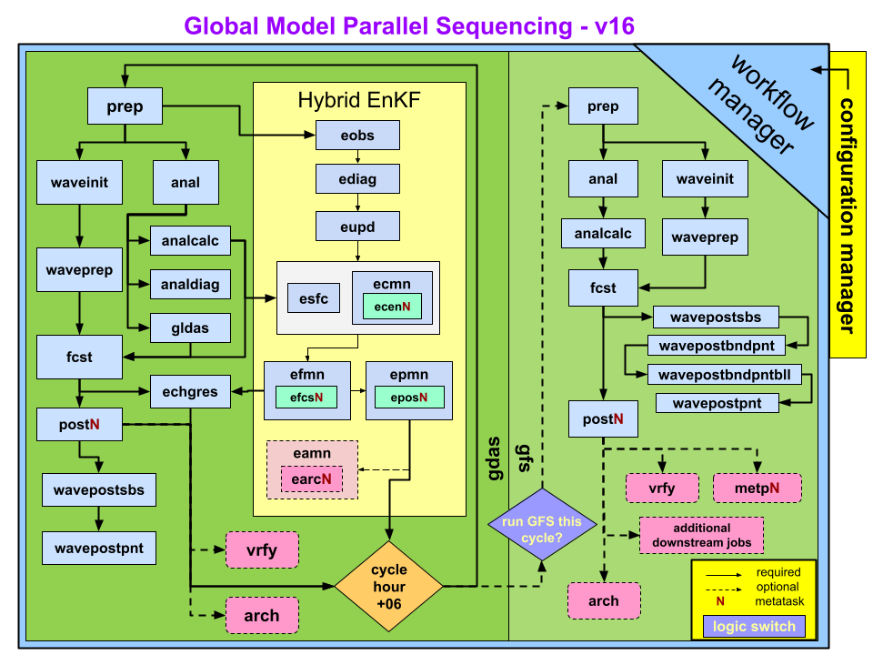
Global Workflow
Global Workflow System Architecture Data Staging Experiment Porting
GDAS: initial first guesses
GFS: IC and forecast
“Global workflow is the end-to-end workflow designed to run global configurations of medium range weather forecasts for the UFS weather model…it supports the GFS and GEFS configuration”
Global workflow components:
GDAS and GFS
Workflow manager
Configuration manager
Raytheon Company - Unrestricted Content
global-workflow.readthedocs

Slide 4
Global Workflow – Atmospheric River Application
Global Workflow System Architecture Data Staging Experiment Porting
Current Global Workflow Configuration | Atmospheric River Application Updates
Runs a global forecast model (no nest) | Upgrade to a high-resolution, nested capability option
GSI and GDAS cycling are 6-hourly (00, 06, 12, and 18Z) | Increase global-DA frequency to hourly but still run forecast 6-hourly
Supported machines in various configurations: Hera, Jet, Orion/Hercules, S4, AWS, and WCOSS | Port to more on-prem sites such as Gaea-C5 and *NOAA CSPs (see Wei Huang’s talk)*
Raytheon Company - Unrestricted Content

Slide 5
Global Workflow System Architecture Data Staging Experiment Porting
Porting to Gaea-C5
Gaea-C5 System Architecture
HPE Cray EX supercomputer
1920 compute nodes (2 x AMD Rome 64-core per node)
Slingshot 10 Interconnect
251 GB per node
Totaling: 449 TB
10.2 petaflop peak performance
Connected to a general parallel file system with 50 PB total usable memory
scratch
/gpfs/f5/<project-code>/…
proj-shared
world-shared*
Raytheon Company - Unrestricted Content

Slide 6
Global Workflow System Architecture Data Staging Experiment Porting
Porting to Gaea-C5
NOAA RDHPCS: Compute Node Configuration
 | kJet | Hercules | Orion | Hera | Gaea-C5
# compute nodes | 404 | 512 | 1792 | 1920 | 1920
cores/node | 40 | 80 | 40 | 40 | 128
memory/node | 96 GB | 512 GB | 192 GB | 96 GB | 251 GB
*not including bigmem or other type nodes
Raytheon Company - Unrestricted Content

Slide 7
Global Workflow System Architecture Data Staging Experiment Porting
Porting to Gaea-C5
File type
Initial conditions*
Fixed files*
Observation data*
Regression test data*
Spack-stack
scratch
/gpfs/f5/<project-code>/…
proj-shared
world-shared*
/ncrc/proj/epic/spack-stack/…
Raytheon Company - Unrestricted Content

Slide 8
Global Workflow System Architecture Data Staging Experiment Porting
Porting to Gaea-C5
File type | Location on Gaea | Size
Initial conditions* | /gpfs/f5/ufs-ard/world-shared/global/glopara/data/ICSDIR | 16 TB
Fixed files* | /gpfs/f5/ufs-ard/world-shared/global/glopara/fix | 289 GB
Observation data* | /gpfs/f5/ufs-ard/world-shared/global/glopara/data/dump | 91 TB
Regression test data* | GSI: /gpfs/f5/ufs-ard/world-shared/GSI_data | 98 GB
 | GDAS: /gpfs/f5/ufs-ard/world-shared/GDASApp | 22 GB
Spack-stack | /ncrc/proj/epic/spack-stack/spack-stack-1.6.0 | --
*world-shared directory is available to everyone
global/glopara follows the input data structure from other RDHPCS
Spack-stack is also available to everyone (even without an epic account)
Raytheon Company - Unrestricted Content

Slide 9
Global Workflow System Architecture Data Staging Experiment Porting
Porting to Gaea-C5
Model DA? Component Configuration
ATM ONLY
Forecast-only
ATM | Atmosphere only
ATMA | Atm, aerosols
S2S | Atm, ocn, ice
S2SA | Atm, ocn, ice, aerosols
S2SW | Atm, ocn, ice, wave
S2SWA | Atm, ocn, ice, wave, aerosols
EMC has 8 continuous integration tests that cover the model/DA/ component configuration space…
GFS
or
GEFS
DA
COUPLED
C48, C96, C192, C384, C768, C1152

Slide 10
Progress: Porting via GW CI tests
Global Workflow System Architecture Data Staging Experiment Porting
CI Test Name | Mode | Components | DA | Coupled | C5 ported?
C48_ATM | ATM | Atm | No | No
C48_S2SW
C48_S2SWA_gefs
C96_atm3DVar
C96_atmaerosnowDA
C48mx500_3DVarAOWCDA
C96C48_hybatmDA
Raytheon Company - Unrestricted Content

Slide 11
Progress: Porting via GW CI tests
Global Workflow System Architecture Data Staging Experiment Porting
CI Test Name | Mode | Components | DA | Coupled | C5 ported?
C48_ATM | ATM | Atm | No | No
C48_S2SW | S2SW | Atm, ocean, wave, ice | No | Yes
C48_S2SWA_gefs | S2SWA | Atm, ocean, wave, ice, aerosol | No | Yes with Aero
C96_atm3DVar | ATM | Atm | ATM | No
C96_atmaerosnowDA | ATMA | Atm, aerosols | ATM | No with Aero
C48mx500_3DVarAOWCDA | S2SW | Atm, ocean, wave, ice | ATM/OCN | Yes
C96C48_hybatmDA | ATM | Atm | ATM | No
Raytheon Company - Unrestricted Content

Slide 12
Progress: Porting via GW CI tests
Global Workflow System Architecture Data Staging Experiment Porting
CI Test Name | Mode | Components | DA | Coupled | C5 ported?
C48_ATM | ATM | Atm | No | No | Yes
C48_S2SW | S2SW | Atm, ocean, wave, ice | No | Yes | Yes
C48_S2SWA_gefs | S2SWA | Atm, ocean, wave, ice, aerosol | No | Yes with Aero | No
C96_atm3DVar | ATM | Atm | ATM | No | In progress
C96_atmaerosnowDA | ATMA | Atm, aerosols | ATM | No with Aero | No
C48mx500_3DVarAOWCDA | S2SW | Atm, ocean, wave, ice | ATM/OCN | Yes | No
C96C48_hybatmDA | ATM | Atm | ATM | No | No
Raytheon Company - Unrestricted Content

Slide 13
Concluding Remarks
Global Workflow System Architecture Data Staging Experiment Porting
Continue working through the global workflow’s continuous integration tests
Add support for higher resolution runs C48🡺C96🡺…🡺C768🡺C1152
Final goal for EPIC team:
Global- (C384) nested (C1152) global-workflow with atmospheric and surface DA (hourly cycled) running on the currently supported platforms, as well as Gaea C5 (C6?) and NOAA’s CSPs
CI Test Name | DA | C5 ported?
C48_ATM | No | Yes
C48_S2SW | No | Yes
C48_S2SWA_gefs | No | No
C96_atm3DVar | ATM | In progress
C96_atmaerosnowDA | ATM | No
C48mx500_3DVarAOWCDA | ATM/OCN | No
C96C48_hybatmDA | ATM | No
Raytheon Company - Unrestricted Content

Slide 14
Extra slides
Raytheon Company - Unrestricted Content

Slide 15
System Architecture Data Staging Experiment Porting
Model DA? Component Configuration
ATM*
Uncoupled
Forecast
EMC’s CI experiments
* are GFS experiments regression testing
ATM (no DA)
S2SW (DA)
ATM (DA)
ATMA (DA)
S2SW (DA)
** are GEFS experiments
S2SWA (no DA)
ATMA
Forecast-only
S2S
S2SA
Coupled
Forecast
S2SW*
S2SWA**
GFS
ATM*
Atmospheric
DA
or
ATMA*
DA
S2S
GEFS
S2SA
Coupled
DA
S2SW*
C48, C96, C192, C384, C768, C1152
S2SWA

Slide 16
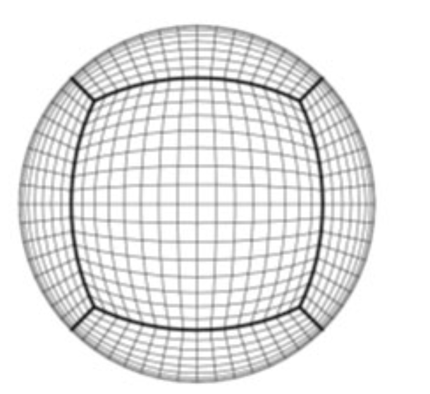
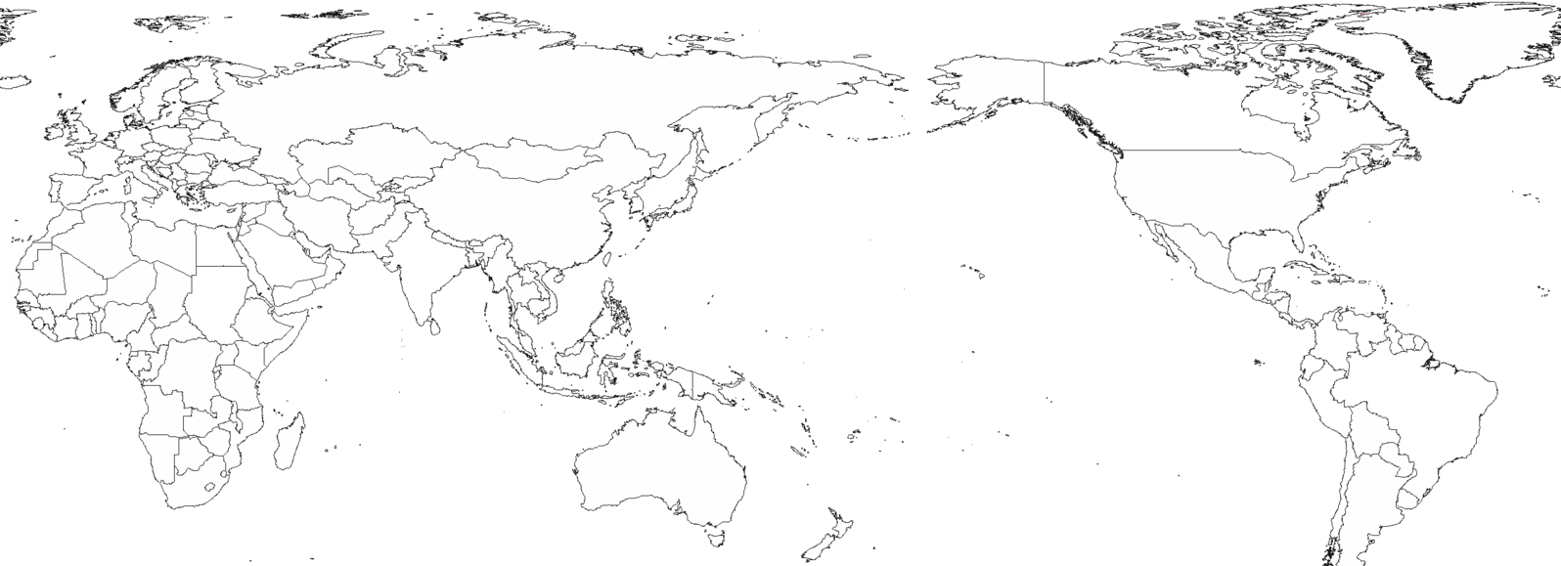
Global Workflow – Atmospheric River Application
Upgrades: 1) global-nested configuration 2) global-hourly cycling 3) multi-platform
1)
High-resolution nested configuration
6-tile Global Configuration
Regional nest
C1152 – 9 km
Global (tiled) domain
C384 – 25 km
Raytheon Company - Unrestricted Content

Slide 17
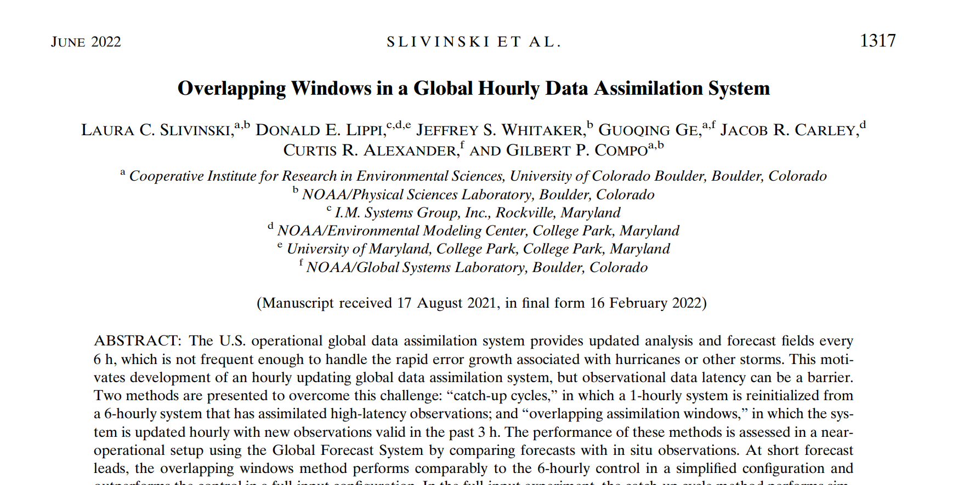
Global Workflow – Atmospheric River Application
Upgrades: 1) global-nested configuration 2) global-hourly cycling 3) multi-platform
2)
Goal: increase temporal frequency from 6-hourly to hourly
continue to run forecast at 6-hour intervals
Why? Evidence for better ICs
3)
Currently, global-workflow is supported on Hera, Orion/Hercules, Jet, WCOSS2, and S4
Goal: to utilize more pools of resources from different projects and groups increase the number of platforms that global-workflow runs on
Raytheon Company - Unrestricted Content

