Slide 1
Forecasting Hurricane Impacts in the US east coast and Gulf of Mexico
Maitane Olabarrieta, University of Florida
Arthriya Subgranon, Steven Klepac (University of Florida); John C. Warner, Mark Carson, Emma Manzella, Chris Sherwood, Dean Gesch (US Geological Survey); Joseph Zambon, Ruoying He (Fathom Science); George Xue, Yanda Ou, Muhamad Farid (LSU); Isabel Houghton (Sofar Ocean); Jim Thompson, Jake Davis (University or Washington), Martha Schonau, Luca Centurioni (Scripts Institution of Oceanography); Jim Doyle, Jon Moskaitis (Naval Research Laboratory)

Slide 2
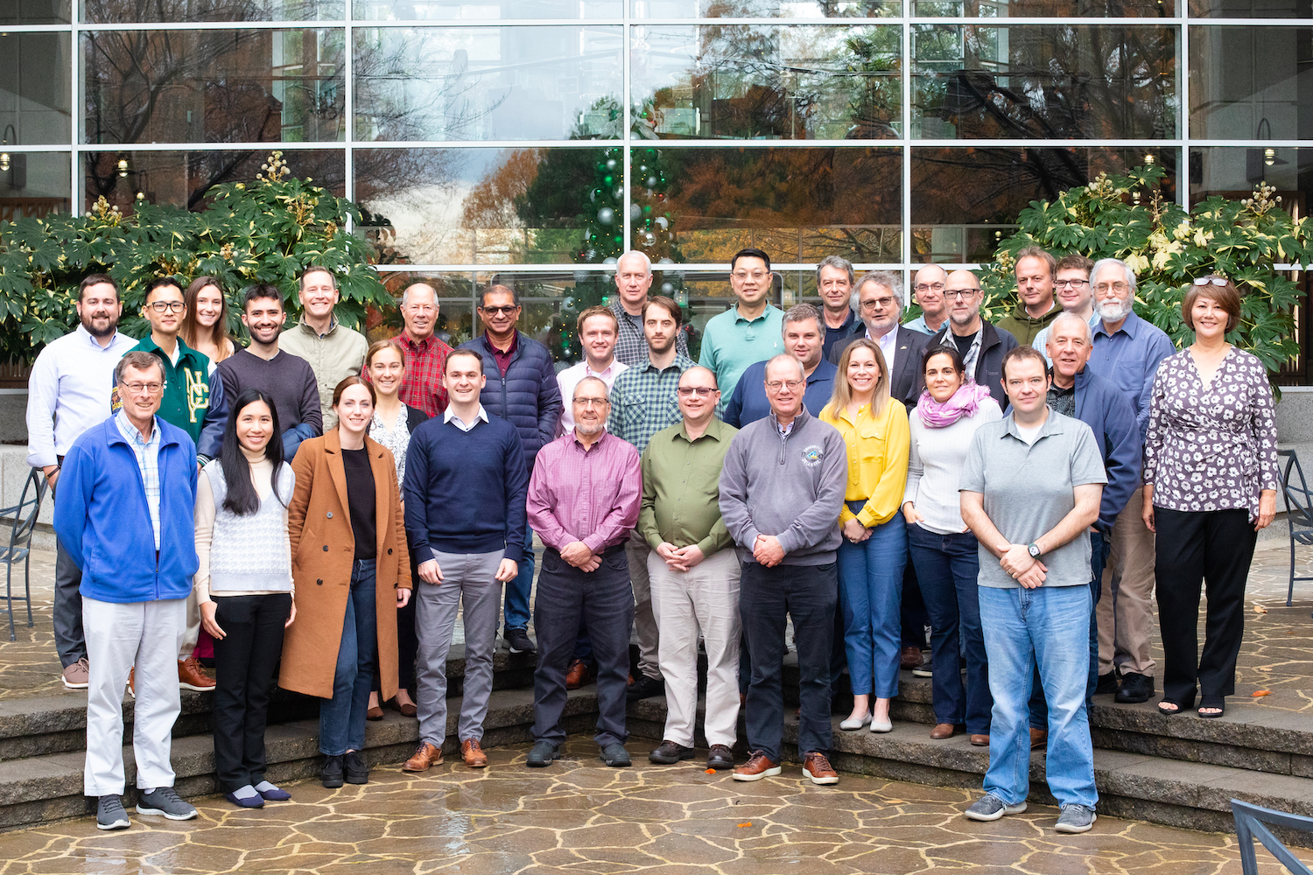
Main goal
To enable better understanding and predictive ability of hurricane impacts, to serve and protect coastal communities.

Slide 3
Build and apply a forecasting system
Water levels
Impacts on infrastructure
Currents
Sediment transport
Ocean surface gravity waves
Morphological changes
Provide a daily forecast of hurricane coastal impacts
Starting five days prior to landfall
Verify water levels, waves and impact forecasts
Notes:
Our main goal with ths project is to build a forecasting system to ultimately predict the water levels, currents and ocean waves, but we also want to forecast the morphological changes (erosion rates) and impacts on infrastructure.

Slide 4
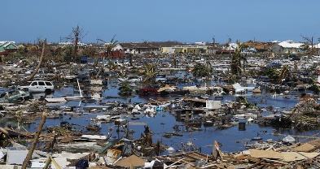
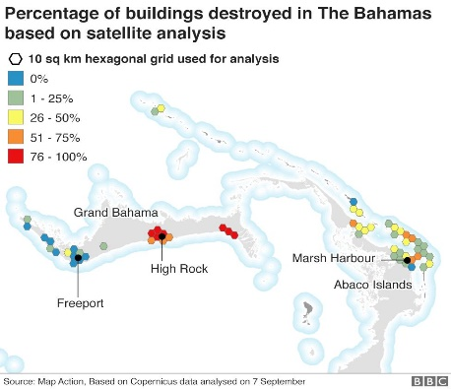
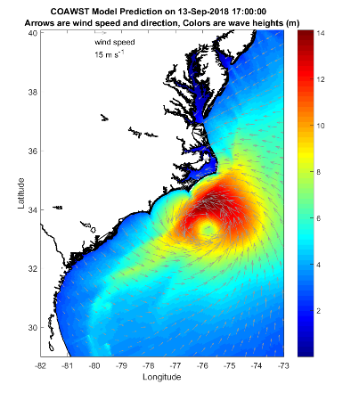
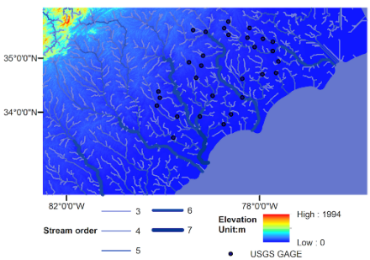
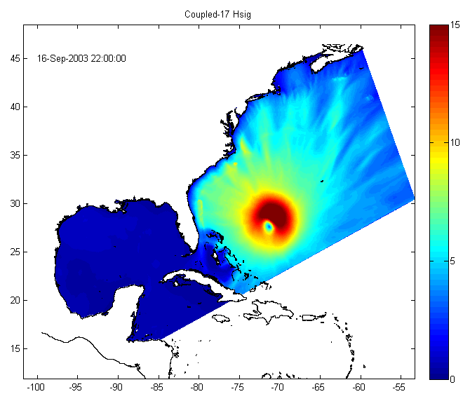
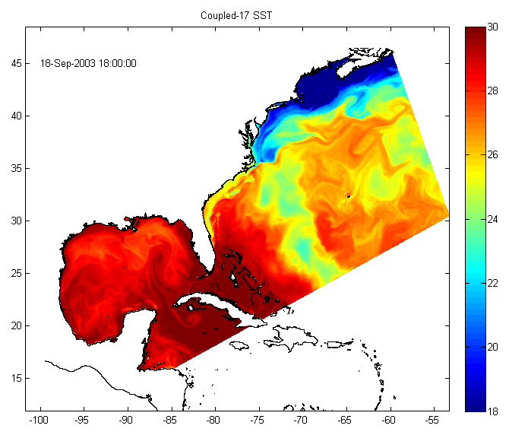
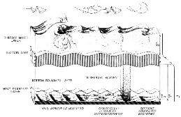
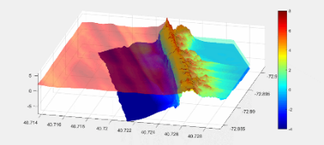
COAWST MODELING SYSTEM
(Warner et al., 2010)
WRF
Uwind, Vwind, RH, Tair,
cloud, rain, evap,
SWrad, Lwrad
H_{wave}, L_{pwave}, T_{psurf},
WRF-Hydro
MCT
Structures
Wind speed
SST
Stream Flow
MCT
U_{wind}, V_{wind}
Uwind, Vwind, Patm, RH, Tair,
cloud, rain, evap, SWrad, Lwrad
LH, HFX, Ustress, Vstress
SWAN or WW3
Water Levels
MCT
ROMS
Streamflow,
Water Levels, Vertical fluxes
Hsig
u_{s}, v_{s}, η, bath, Z₀
Vegetation
MCT
SST
InWave
H_{wave}, L_{mwave}, L_{pwave}, D_{wave}, T_{psurf}, T_{mbott}, Q_{b},
Diss_{bot}, Diss_{surf}, Diss_{wcap},
U_{bot}
SEDIMENT
Notes:
As I mentioned before we use the COAWST modeling system in this project. Since the atmospheric forces are given by the COAMPS model, we don’t use WRF (the atmospheric model) and neither the WRF-hydro components.

Slide 5
Cascading/telescoping nested grid approach
LEVEL 1: 1 km
LEVEL 2: 200 m
LEVEL 0: 4 km
LEVEL 3: ~5-20 m
Notes:
Our forecasting system is composed by several grids, in which we run the ROMS model (this is the ocean circulation model) and the wave propagation and generation models (either SWAN or WW3). The L0 grid covers the whole Gulf of Mexico and the US East COAST, with a resolution of ~4 km. Then we have higher resolution grids that we run if we think it covers the are that might be most impacted by the TC.

Slide 6
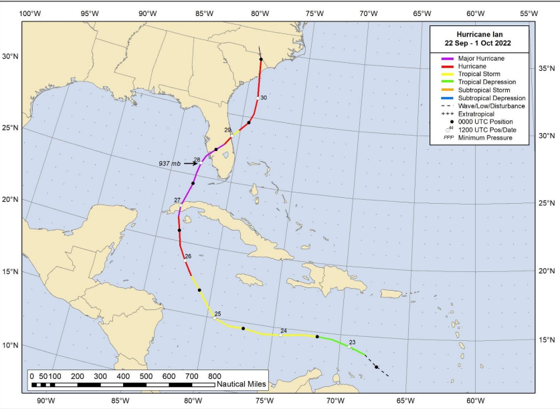
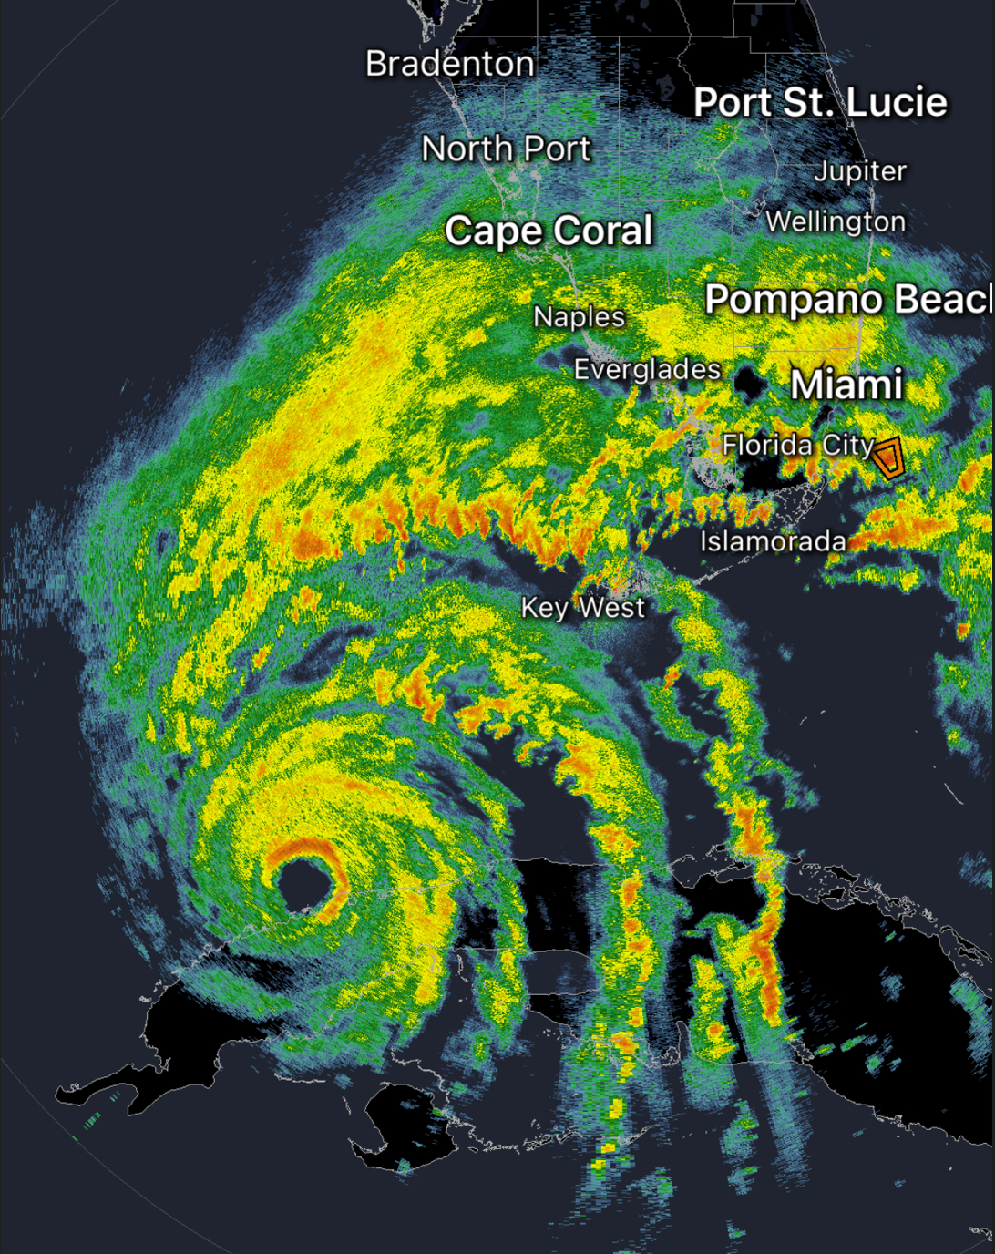
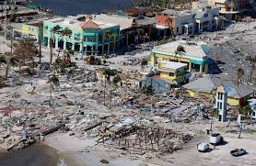
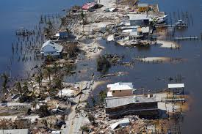
HURRICANE IAN (2022)
Radar of Hurricane Ian on September 27, 2022.
National Weather Service
Notes:
Overall, I think the results of the predictions in Michael were reasonable, although we did observe that the directional wave spectra was not that well captured. Now what happens when we have to forecast the impacts of a tropical cyclone?
Within this project we need to start providing forecast 5 days prior to the landfall of the hurricane. We need to provide a daily forecasts, and as you will see this is a challenge. I am going to use Ian as the example.

Slide 7
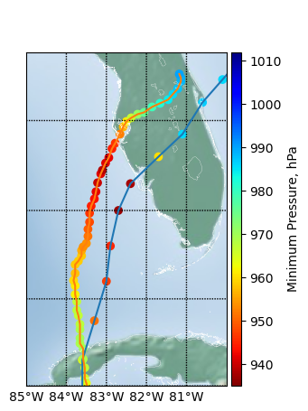
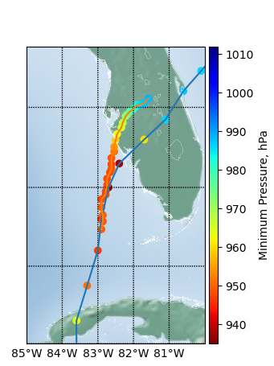
Observed vs forecasted track and minimum atmospheric pressure
NRL provides deterministic TC-COAMPS forecasts every 6 hours
26th Z00 Forecast
27th Z00 Forecast
28th Z00 Forecast
Notes:
We started forecasting this TC on September 23rd, but I am going to focus on these three days. This figure shows the measured path of the TC, and the observed minimum atmospheric pressure. Blue line and dots, and the orange line and the dots represent the TC path and minimum pressure of the COAMPS forecasts., for the forecasts of the 26th, the 27th and the 28th. The hurricane made landfall the 29th. As you can see the forecasted paths and intensities varied from day to day and as we approached to the landfall time, the forecasts became more accurate, at least as regards the path.

Slide 8
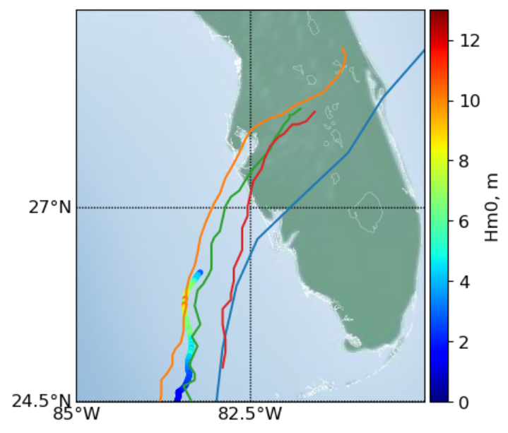
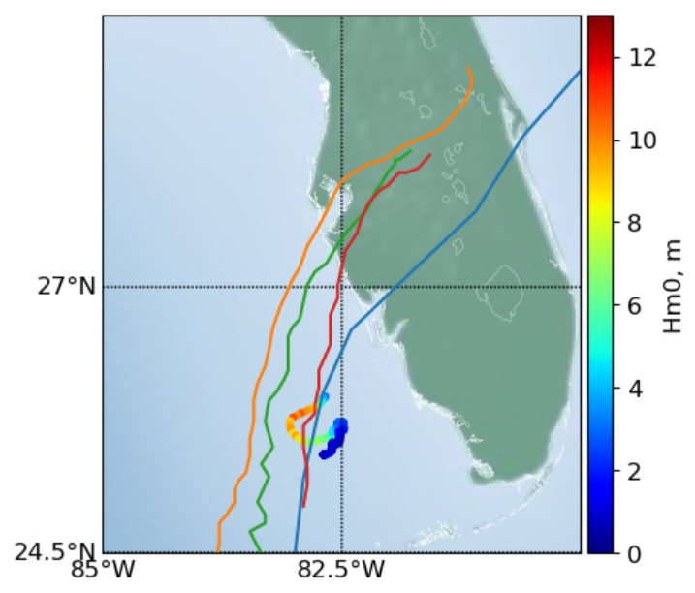
Wave observations vs forecats
Hm0 time series (Lagrangian)
Lower energy and better timing of peak related to change in path
Lower TC intensity and track variation resulted in ~2 m difference
Notes:
The same is tru for the lagrangian measuremenst in the left side of the TC. And close to the eye, the differences are mainly manifested as an underprediction of the wave energy.

Slide 9
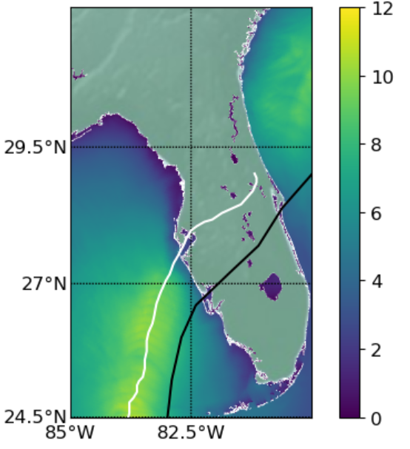
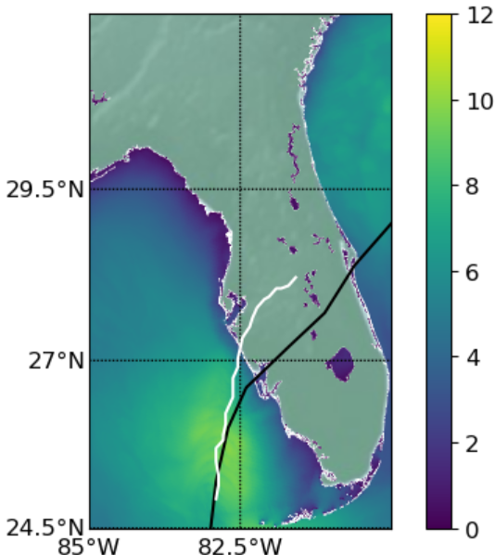
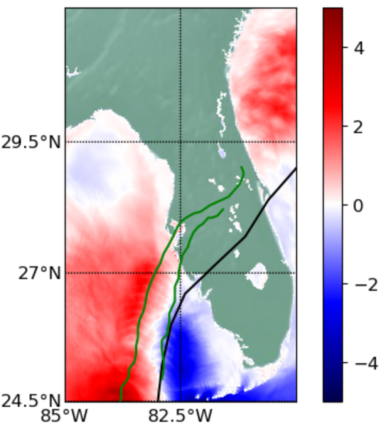
Maximum Hm0 (m)
Difference
26th - 28th Z00 Forecast
26th Z00 Forecast
28th Z00 Forecast
Notes:
Now if we compare the maximum significant wave height we can see that we can have differences of up to 4 m primarily because of change in the hurricane path.
One thing that I want to emphasize is that this atmospheric forecast are very good, so the error in their predictions are considered by the meteorologists small. So this is the uncertainty we need to live with if we are predicting the coastal impacts, and that means that somehow we need to start accounting for this uncertainty and communicating this uncertainty to government agencies and coastal communities.

Slide 10
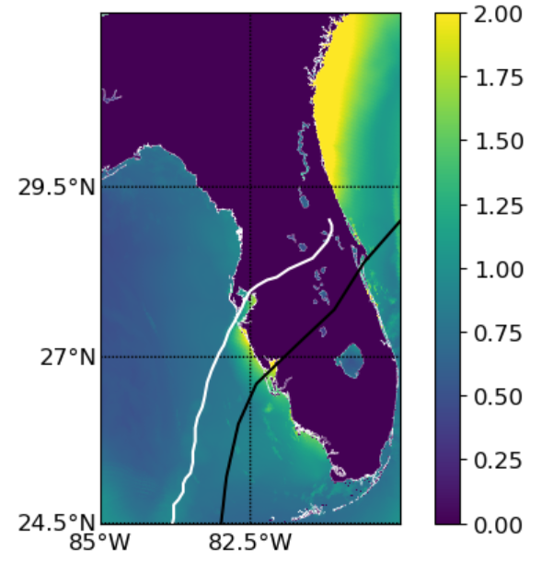
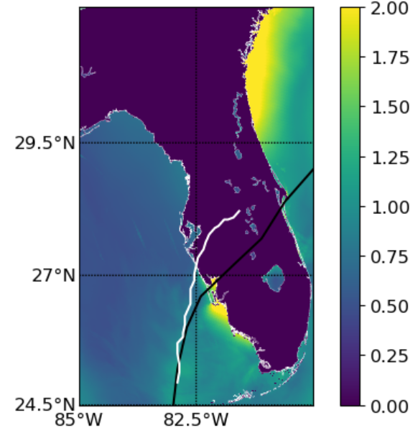
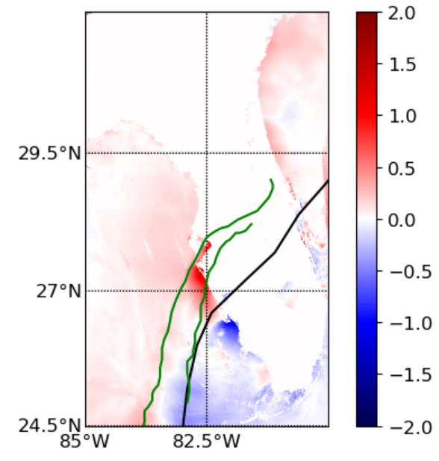
Maximum water level (m)
Difference
26th - 28th Z00 Forecast
26th Z00 Forecast
28th Z00 Forecast
Notes:
If we look at the differences of the modeled maximum water levels between predictions we can see how changes in the path of the hurricane can result in big changes in the estimated maximum water levels, in this case, the differences can be almost two meters at specific locations.

Slide 11
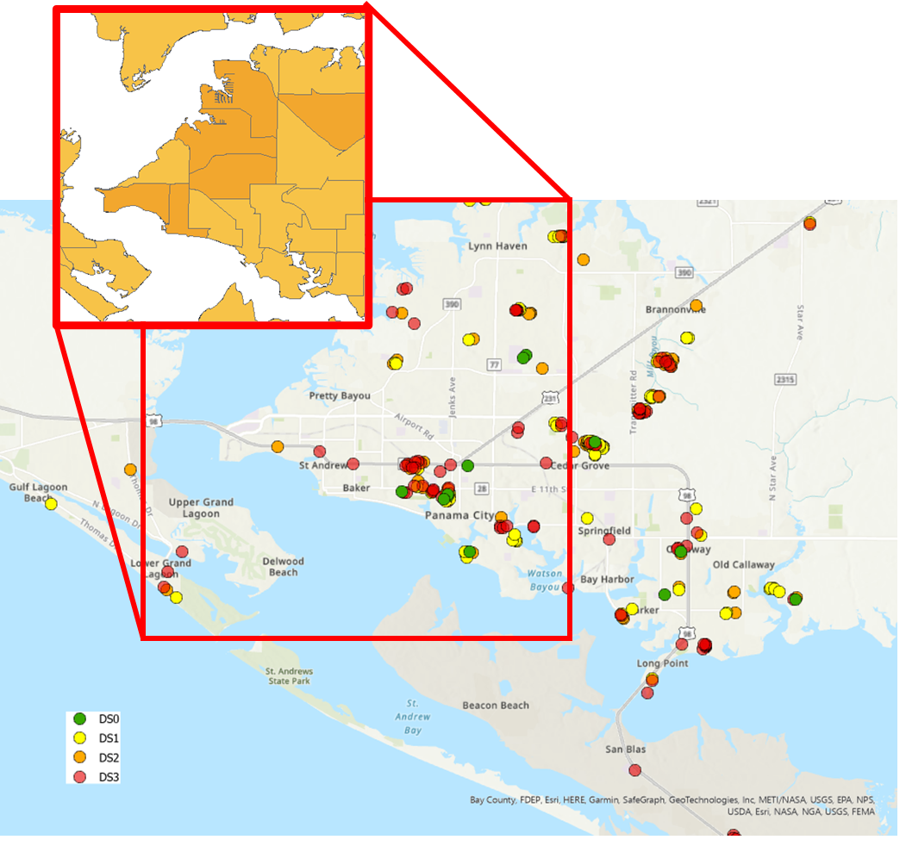
Building-Level Damage Predictions with ML
Building-level
A.k.a. parcel-level
Individual houses
Damage
Overall, qualitative damage states
Predictions
Estimations without prior knowledge
Data-driven machine learning (ML) approach
Real-time forecast
Concurrent to hurricane forecast
US Gulf and Atlantic Coasts
TX to NC
20km from coastline
Arthriya Subgranon
Steven Klepac
Existing Methods:
Tract-level damage
Our Method:
Parcel-level damage

Slide 12
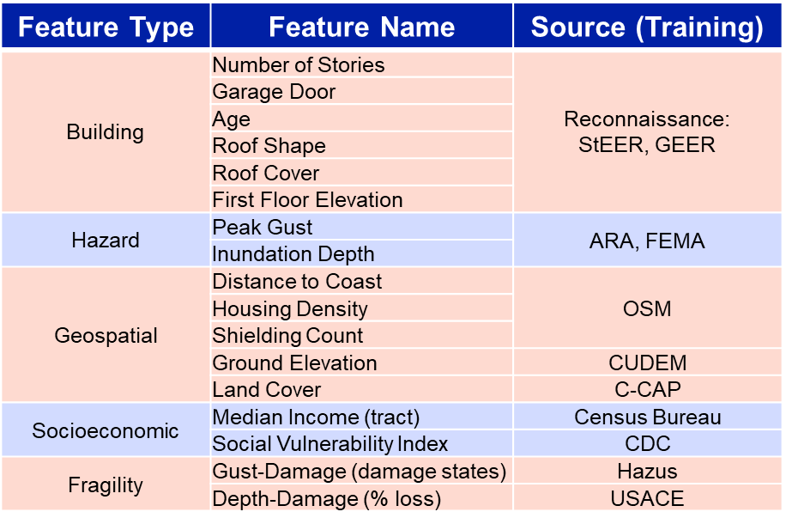
Machine Learning (ML) Approach
Model
Random Forest Classifier
Training Data
Hurricanes Michael, Laura, Harvey, Irma
2,555 houses
80% Training – 2,044 samples
Validation – 10-fold CV
20% Testing – 511 samples

Slide 13
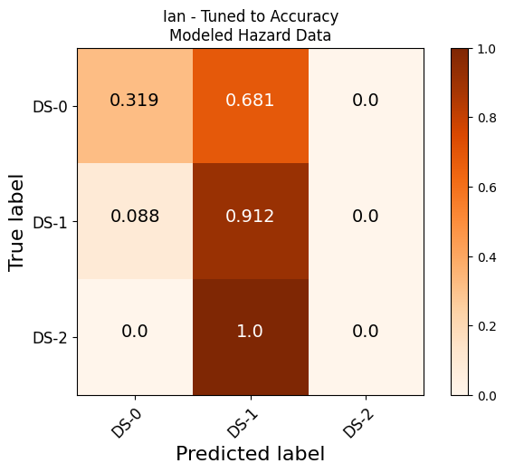
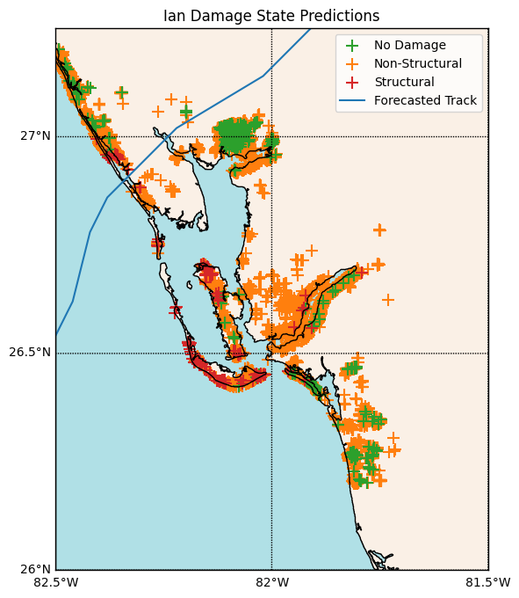
Hurricane Ian Damage Forecast
Testing set of 100 houses, manually assessed from post-event imagery
Bias in testing data
Forecasted hazard data
Acc. = 46%
50,000 houses throughout impacted region, within 10km of coastline
Notes:
We can see that also in the confusion matrixes, that compare the forecasted impacts in residential buildings, the accuracy of the forecasts is also much lower than what we got for Michael. This can be due to different factors but the uncertainty in this atmospheric forecast will have an impact in this sense as well.

Slide 14
Main take home messages
Forecasting the impacts due to TCs is challenging and affected by many sources of uncertainty (one of the biggest uncertainty is the atmospheric forcing).
The evolution of the directional wave spectra needs more analysis and improvement.
We have developed and applied a ML approach to forecast the impact of TCs at residential building
My acknowledgements to the excellent collaborators of the NHCI project!
Thanks for your attention!

Slide 15
COAWST TEAM
Maitane Olabarrieta
John C. Warner
Joseph Zambon
Arthriya Subgranon
Steven Klepac
Yanda Ou
Chris R. Sherwood
Elias Hunter
Jennifer Warrillow
Z. George Xue
Jose Maria Gonzalez
Ruoying He
Notes:
This is the COAWST modeling team, with reserachers from USGS, LSU, Fathom Science and University of Florida.

Slide 16
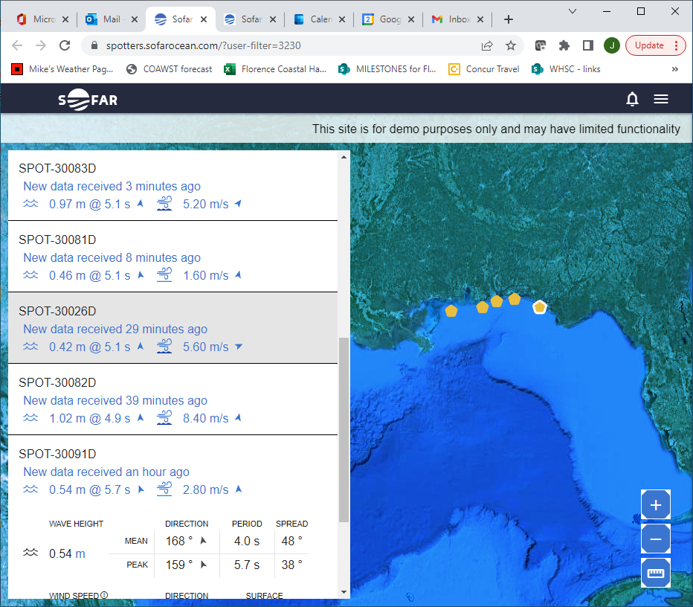
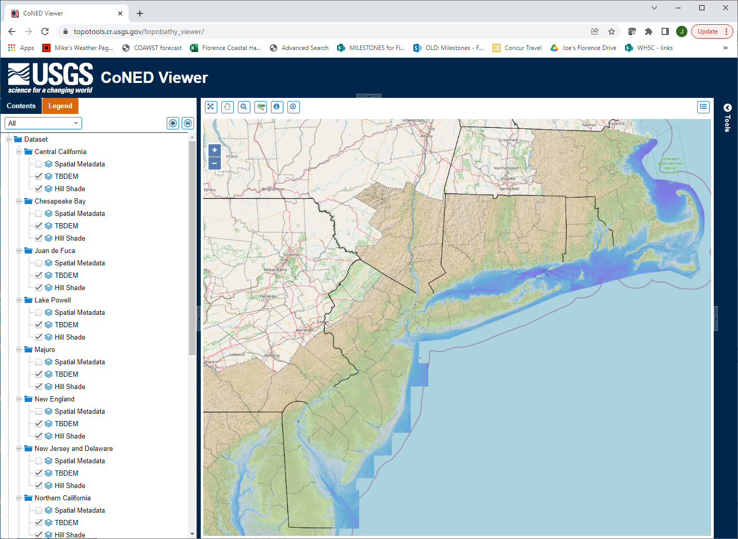
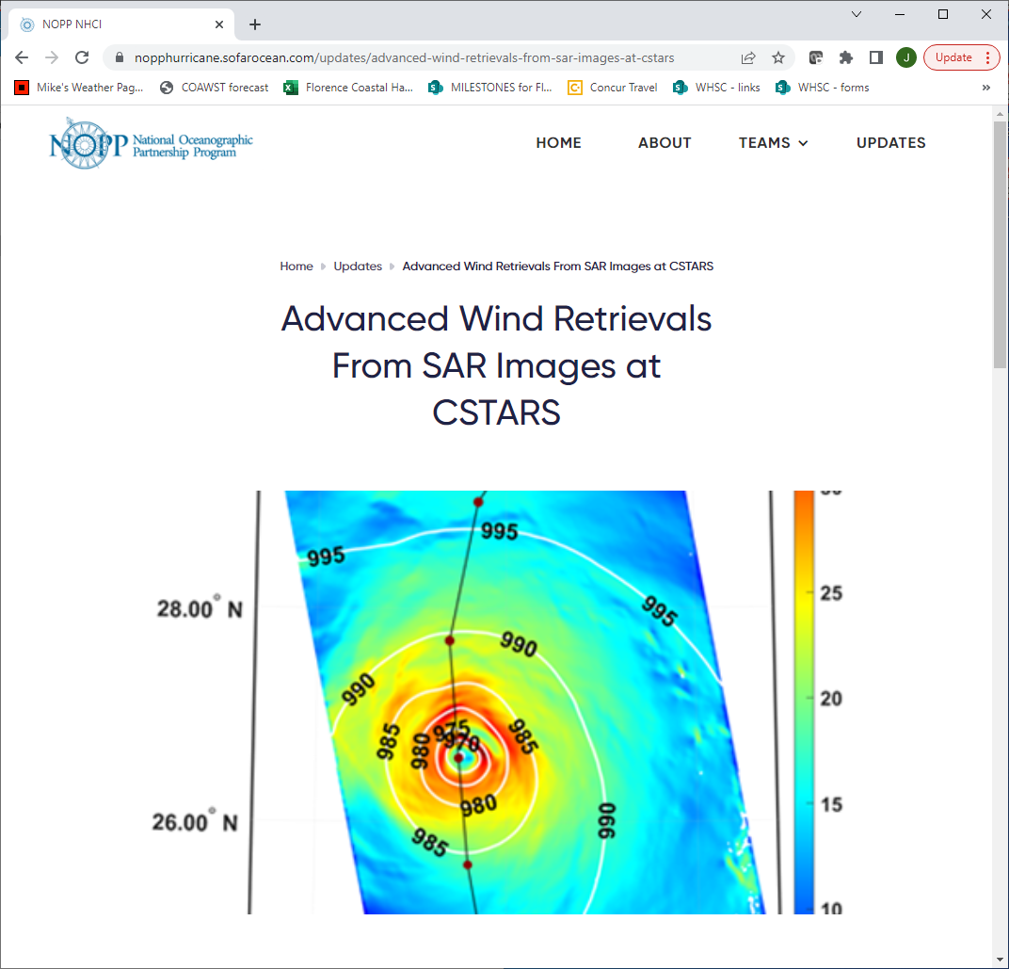
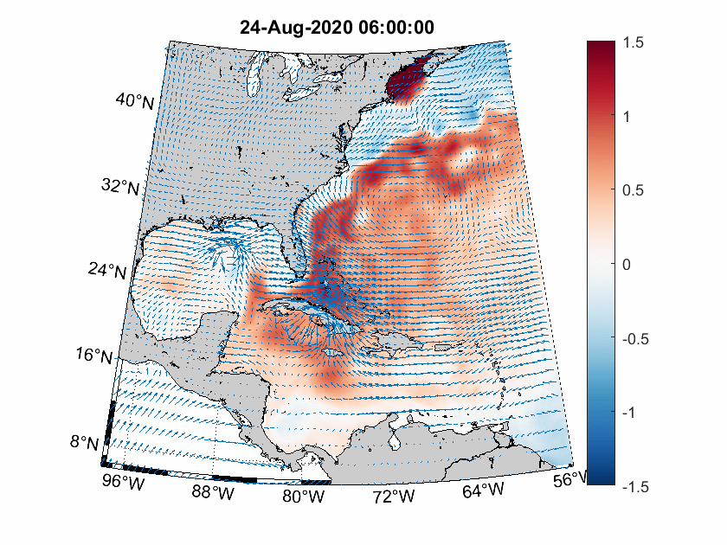
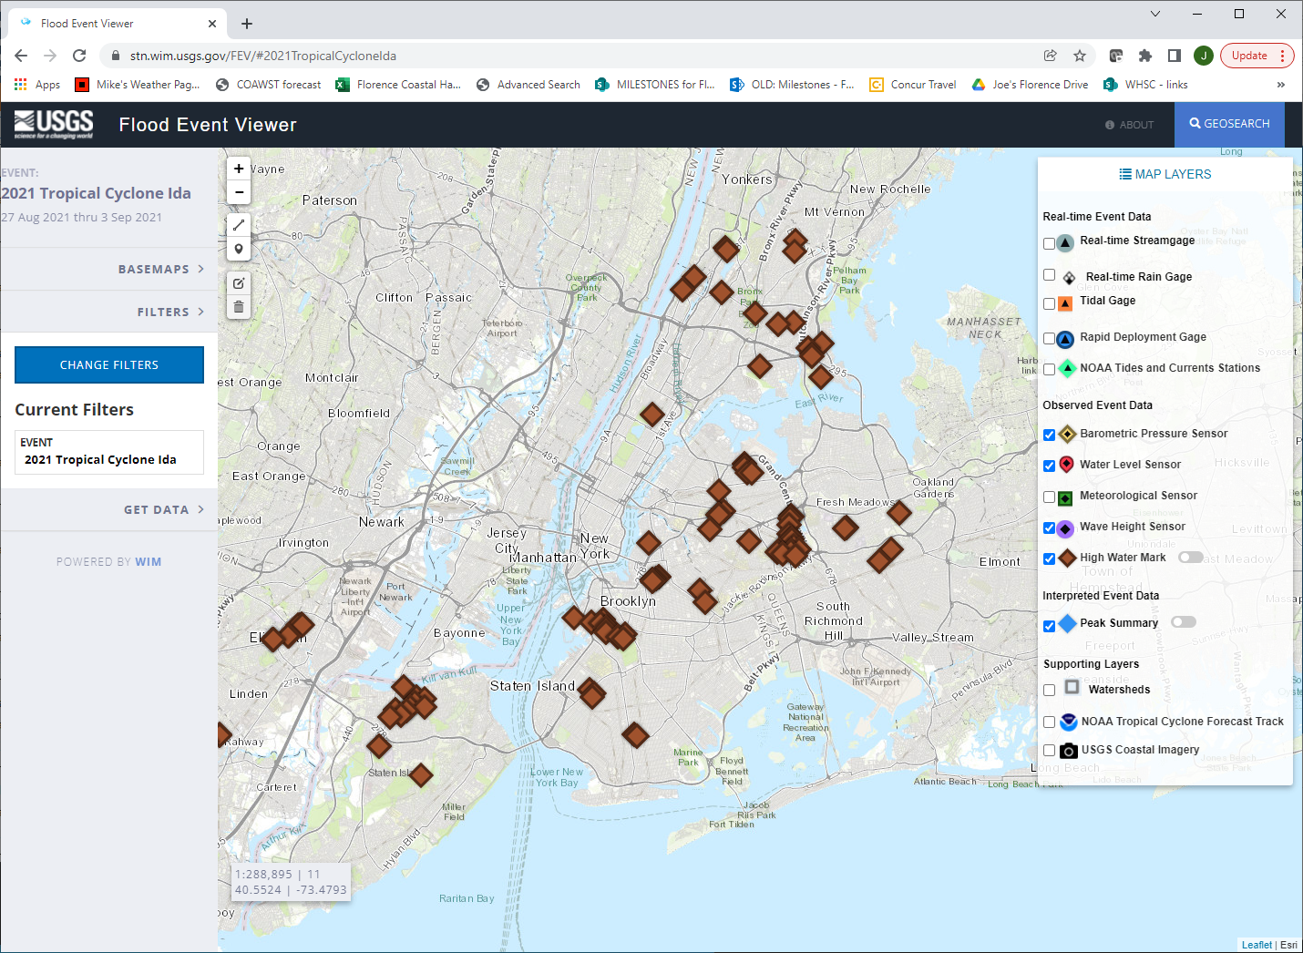
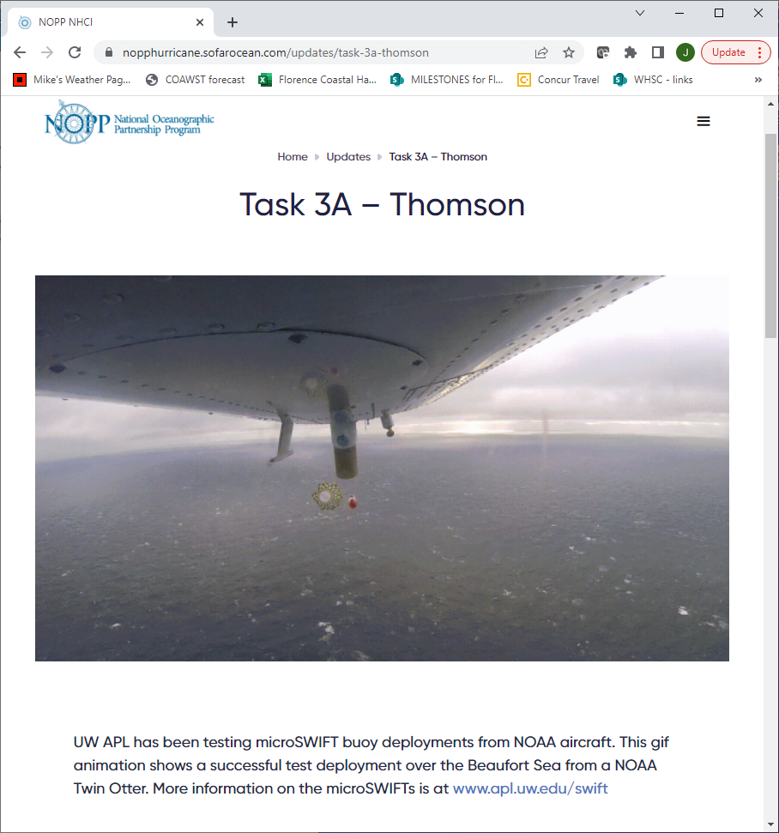
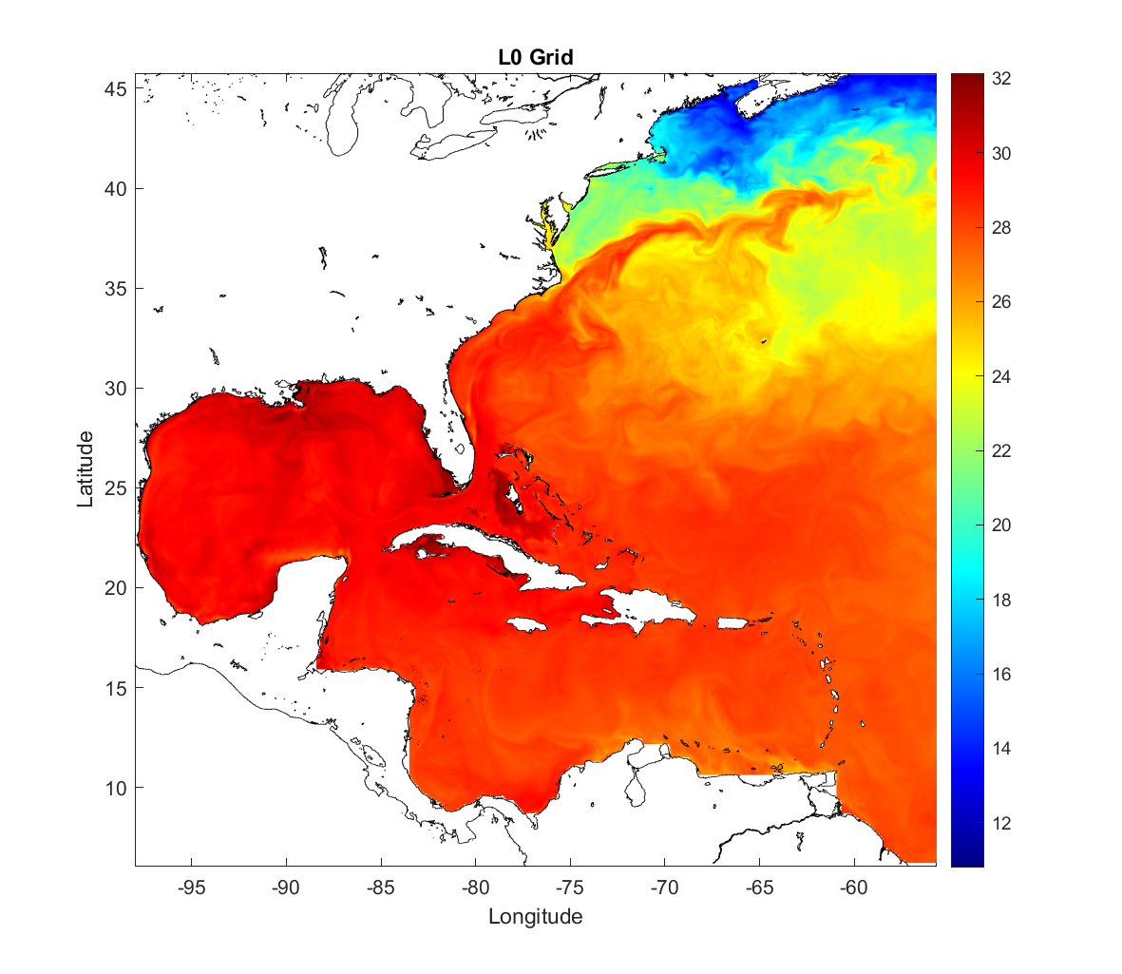
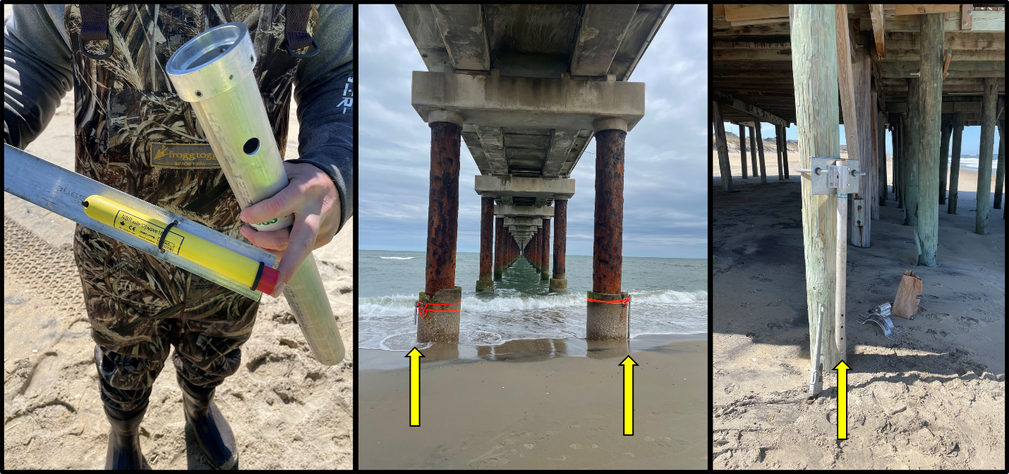
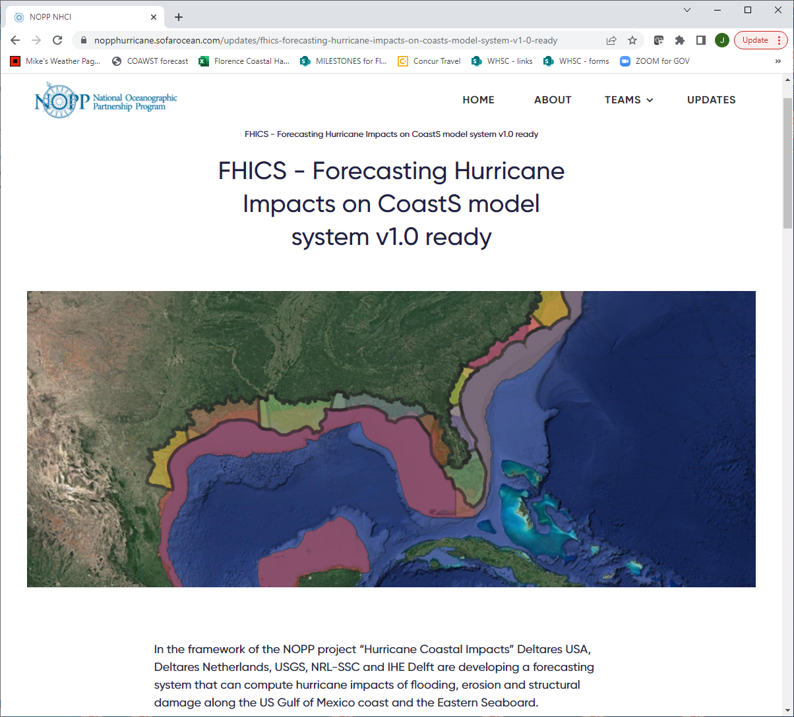
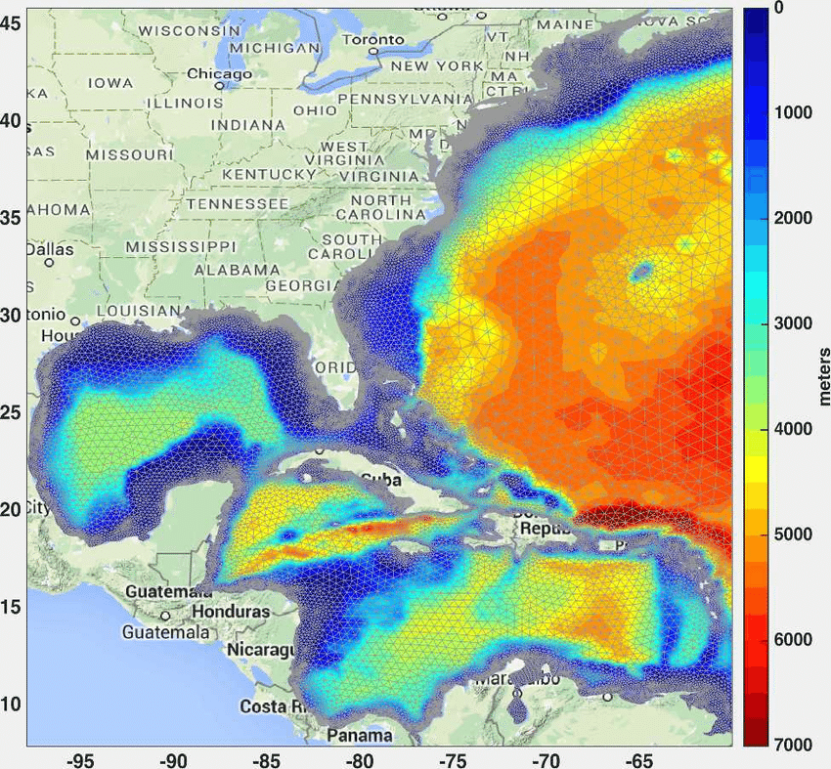
NOPP Hurricanes Project
https://nopphurricane.sofarocean.com/
Task 0: COAMPS
Task 1: coastal elev., land surface
Task 2: wind fields from SAR images
Task 4: coastal modeling teams
USGS/Deltares ADCIRC COAWST
Task 3: in’situ sensors, buoy drifters deployed from aircraft, moorings, Flood event viewer.
Notes:
The prediction of the impacts of tropical cyclones requires to have high resolution digital elevation models along the coastal areas. Not only that, we also need to know the vegetation characteristics, the land uses and the sediment characteristics. There is awhole team from USGS working on that taks. To be able to predict impacts we also need atmospheric forecast. A team led by Jim Doyle form the Naval Research Lab is in charge of those forecasts. There is another team analyzing satellite imagery, and specifically SAR imagery to better understand the wind fields associated with the tropical cyclones, that team is led by the University of Miami. There are also four different teams (SOFAR, Univertity of Washintong, ScRIPS and USGS) in charge of collecting wave information and water level measurements during hurricanes. The last task corresponds to the oceanic modellers. We have three different teams doing the numerical forecasts. One team, Deltares/USGS. Are using the model XBEACH; The team lead by Rich Luetic from Chapel Hill are using adcir and a one dimensional version of XBEACH and the team I led we use the COAWST modeling system.

Slide 17
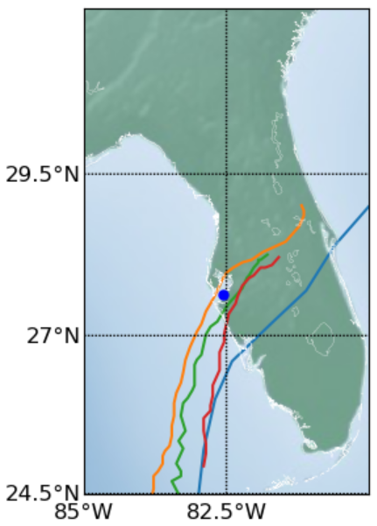
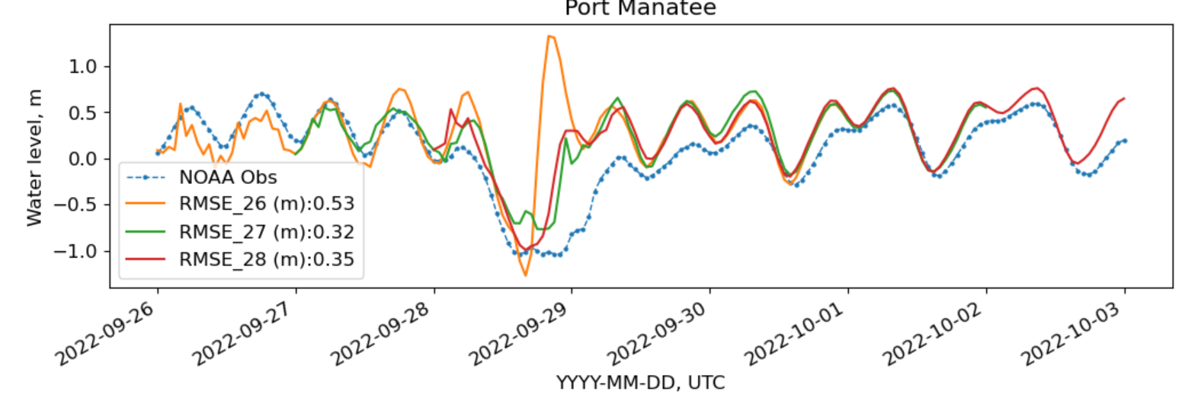
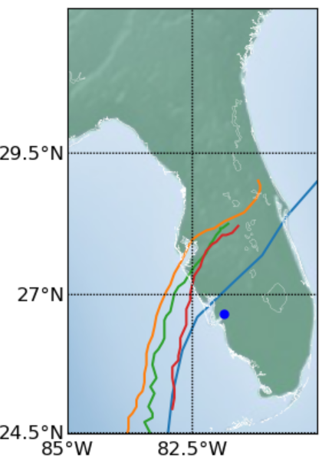
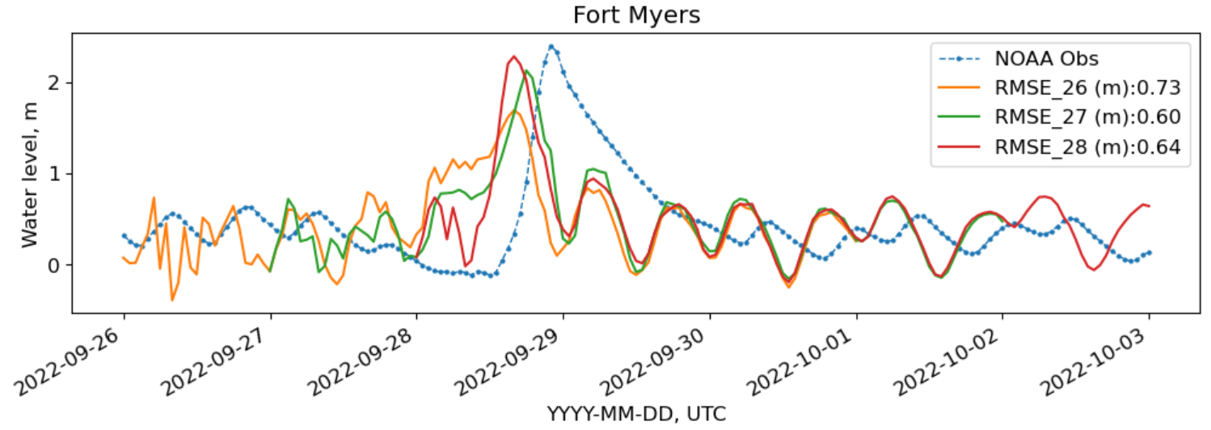
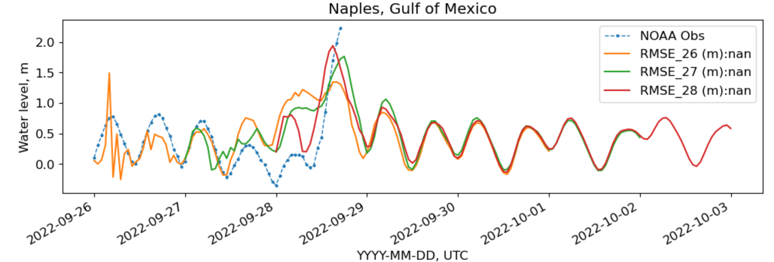
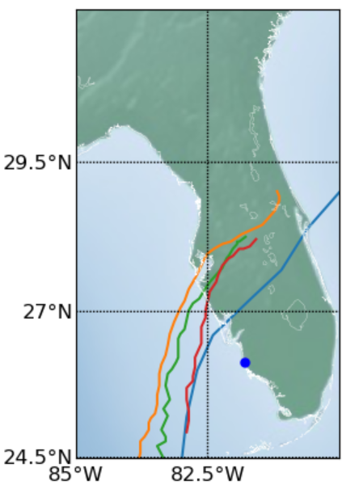
Water level observations vs forecasts
NOAA tide gauges
Time series
Notes:
Now I am comparing the modeled and observed water levels; these tide gauges (Clearwater Beach and Port Manatee) are located in the left side of the hurricane so the overall observed trend was a negative surge. The winds were primarily pushing the water oceanward. We see that differences in the path of the storm manifested in differences in the trends of the water levels (as expected).

Slide 18
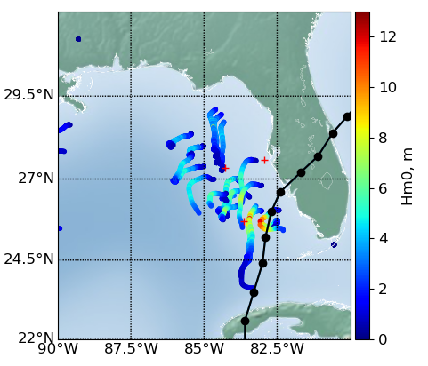
Wave observations
2 MicroSwifts
6 Spotters
10 DWDS buoys (in FL Western Shelf)
3 NDBC buoys
Notes:
In the case of Ian, there was a big uncertainty of the path that the hurricane was going to take; initially the forecasts were pointing to landfall areas in the area of Cedar Key, then most of the forecasts moved towards Tampa Bay and then to the South. At the moment we decided to deploy the buoy most of the hurricane tracks were towards Tampa and we decided to deploy most of the buoys close to Tampa. However, the track moved to the south and we were able to capture some measurements in the right side of the hurricane. What we usually want is to cover all the quadrants of the hurricane, but as you can see that is usually challenging. And the challenge increases as the uncertainty in the path of the TC increases.
Now lest see how the changes in the TC forecasts affect the wave predictions

