Slide 1
Investigation Of the Impact of Alluvial Flows in the UFS Dust Scheme
*Emily Faber ^{1,2}, Adriana Rocha Lima ¹, Barry Baker ³
¹ University of Maryland Baltimore County (UMBC)
² University Corporation for Atmospheric Research (UCAR)
³ National Oceanic and Atmospheric Administration

Slide 2
Where is the dust coming from?
How can we better represent outsized sources?
Notes:
Big questions

Slide 3
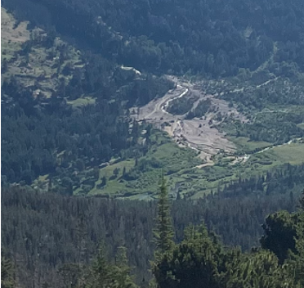
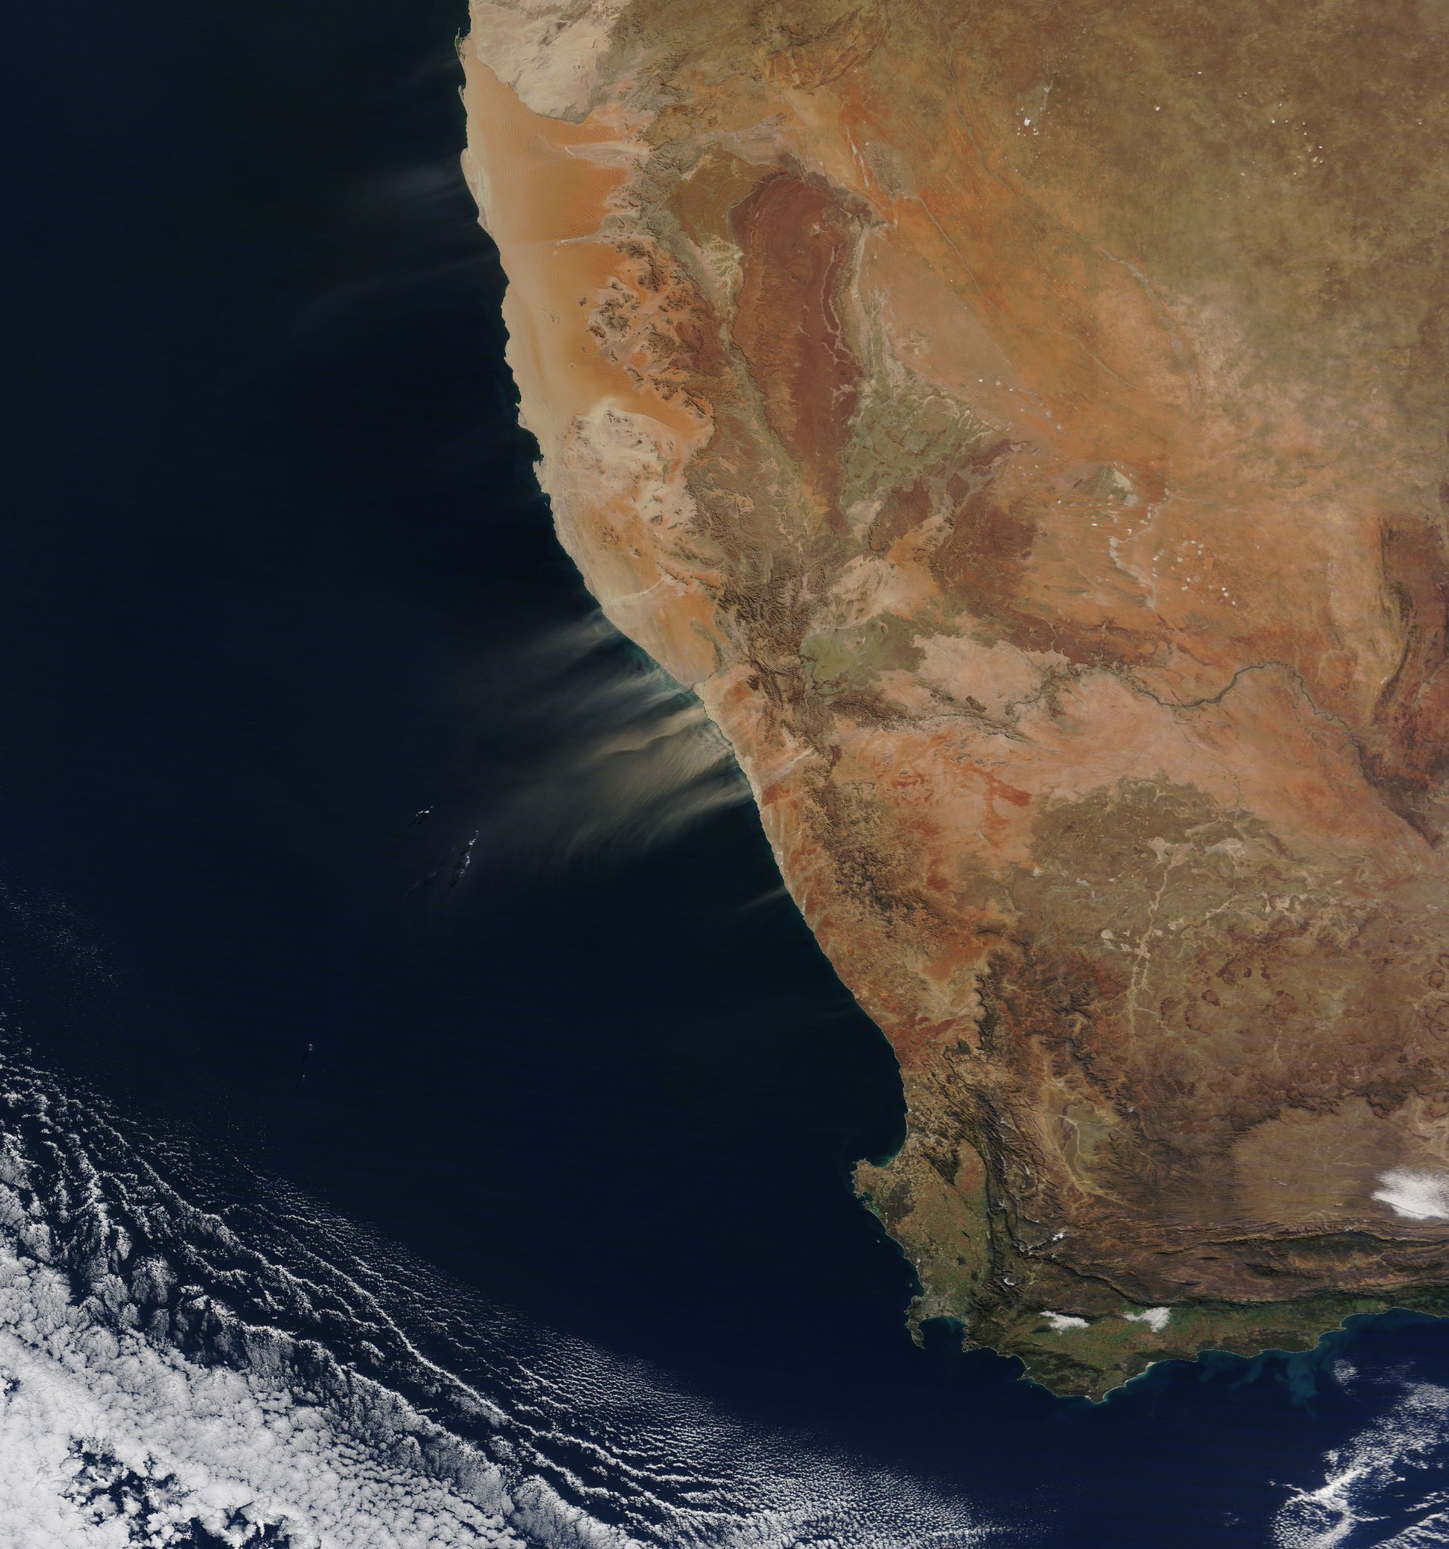
What is an Alluvial?
Alluvial fan in Rocky Mountain National Park
Alluvial sediments streaming off the coast of Namibia
Notes:
What is an alluvial, people really just don’t know

Slide 4
June 16th, 2020, AOD Comparison
Model vs MODIS
Left: UFS AOD using the FENGSHA dust emission scheme for June 16th ,2020 at 09 UTZ. Right: MODIS combined dark target and deep blue AOD grided to 500m resolution for June 16th, 2020
Notes:
Motivation/ UFS ohhh shiny

Slide 5
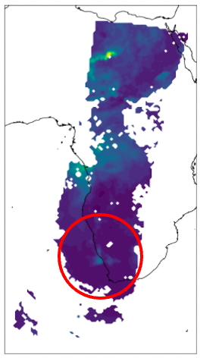
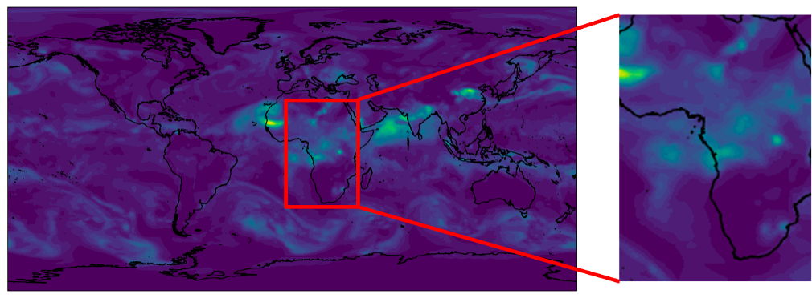
June 16th, 2020, AOD Comparison - Namibia
Model vs MODIS
Left: Modeled AOD on June 16th, 2020. Middle: Highlights the coast of Namibia and the missing emission due to alluvial flows. Right: MODIS AOD over the same region at the same time with highlighted retrieved AOD in line with the emissions seen in the RGB
Notes:
Motivation for days in one image

Slide 6
Methods:
Create a global map of alluvial flows at 500m resolution. (monthly resolution)
Use this map along with the SSM to show impact on global dust emissions and transport.
Notes:
methods

Slide 7
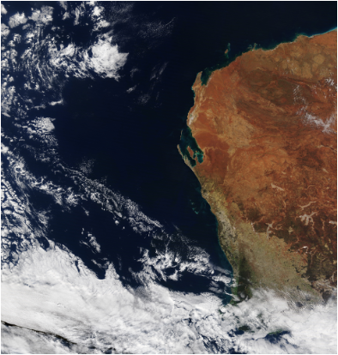
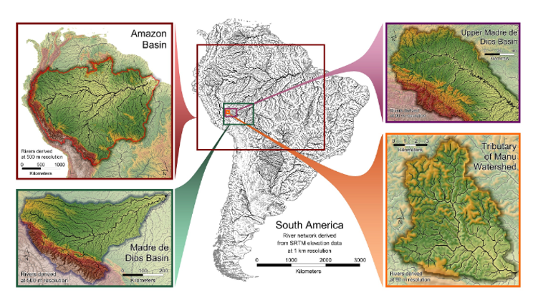
MYD09A1 Version 6.1
Surface reflectance bands at 500m resolution:
Band 1 (red) (620-670 nm)
Band 4 (green) (545-565 nm)
Band 3 (blue) 3 (459-479 nm)
HydroSheds
Flow accumulation - the extent of upstream area (either in number of cells or in hectares) draining into each cell.
Notes:
Tools for the methods

Slide 8
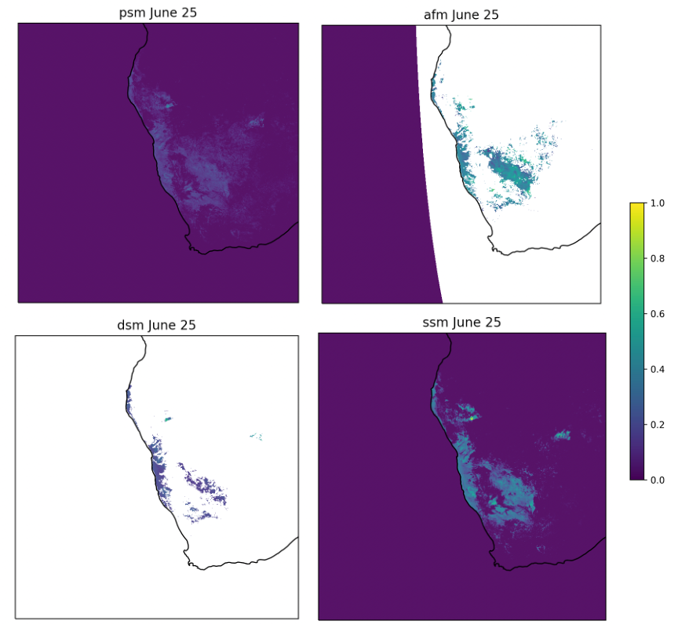
June 25th, 2020.
PSM, AFM, DSM, SSM.
Namibia
Notes:
What we get out of the methods

Slide 9
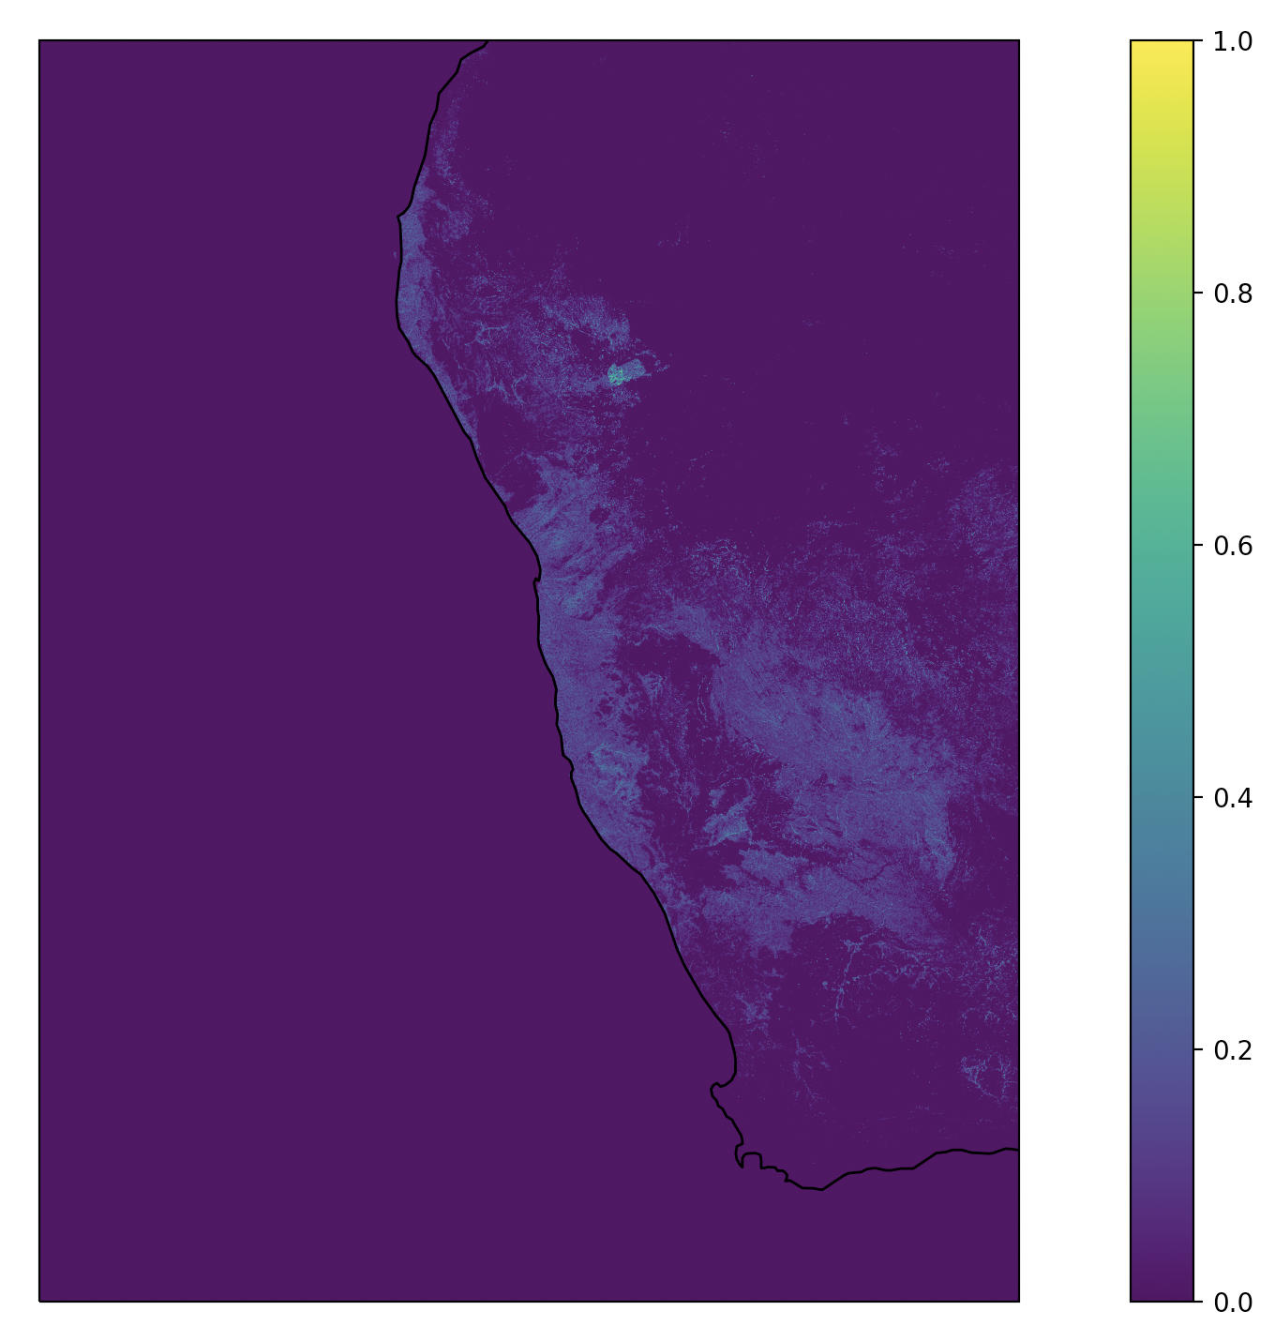
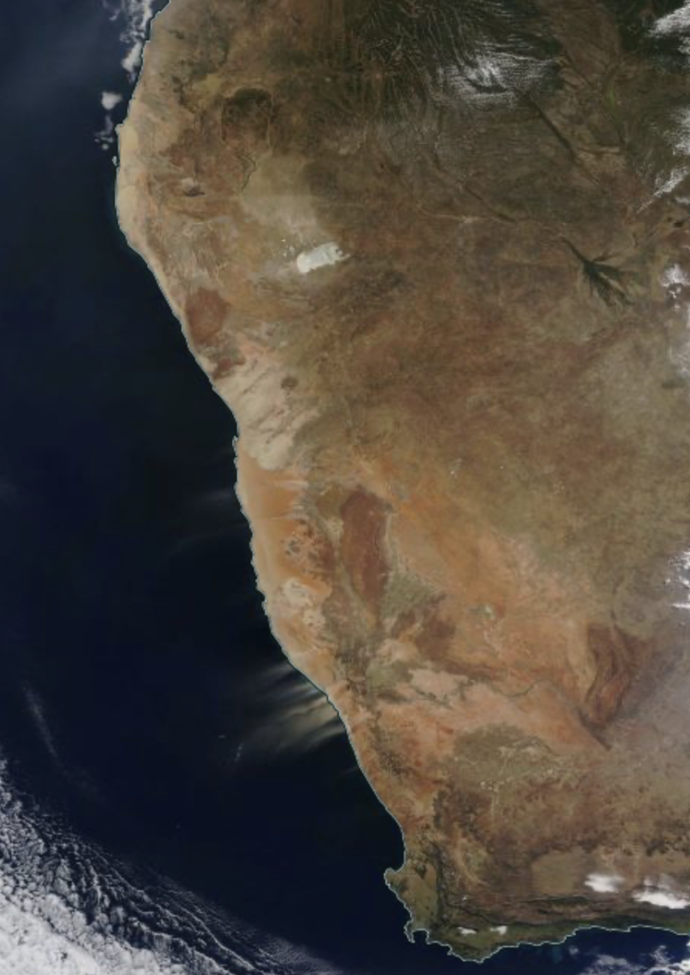
Notes:
Evaluating what we get out of the methods. Are we getting the features we’re after?

Slide 10
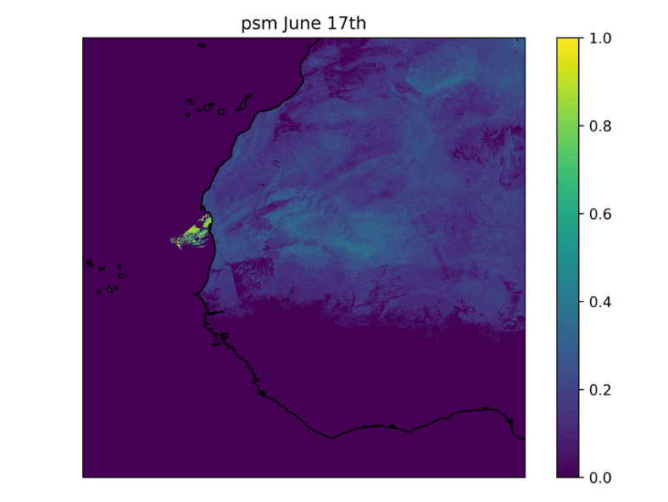
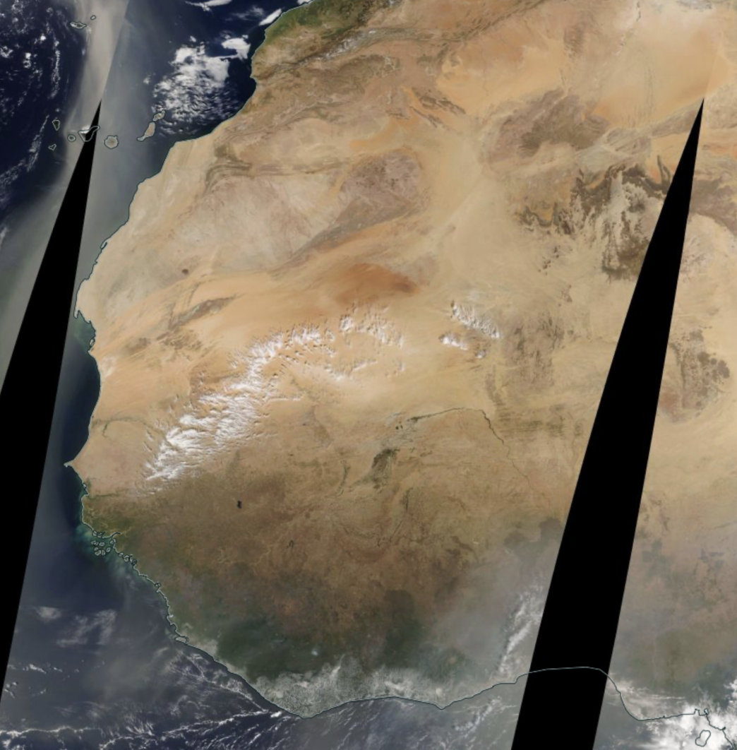
Notes:
Evaluating what we get out of the methods. Are we getting the features we’re after?

Slide 11
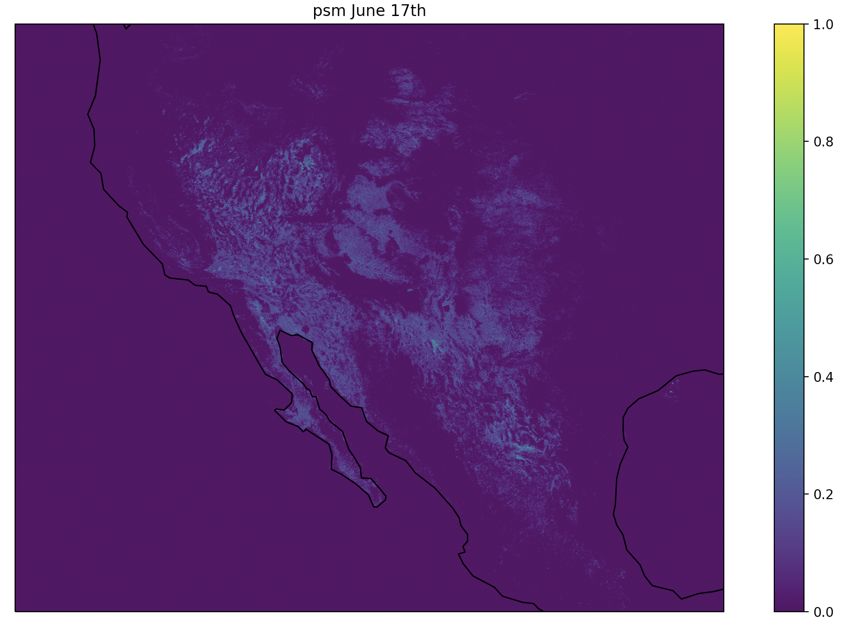
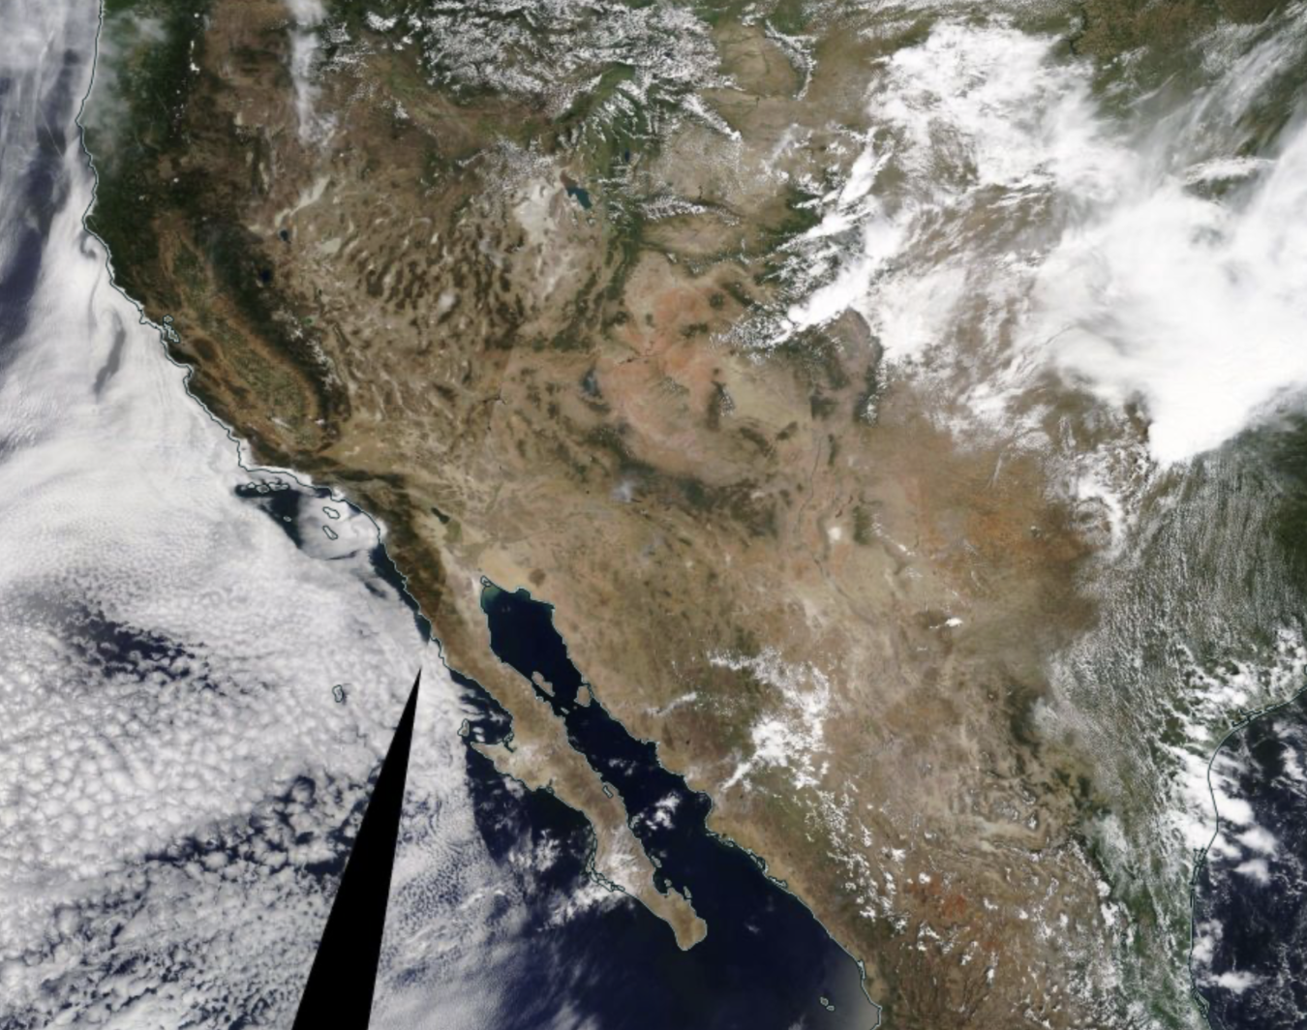
Notes:
Evaluating what we get out of the methods. Are we getting the features we’re after?

Slide 12
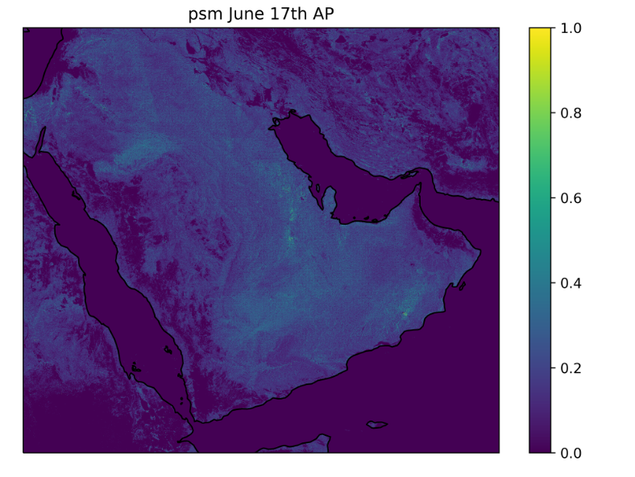
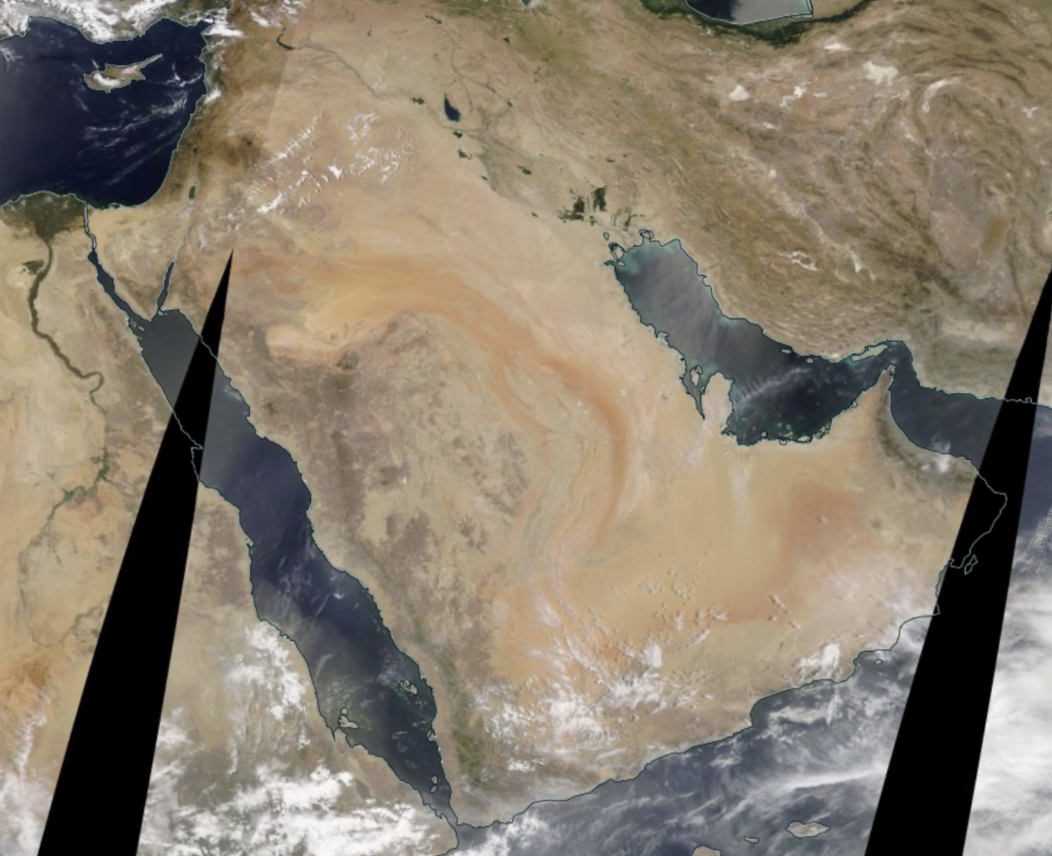
Notes:
Evaluating what we get out of the methods. Are we getting the features we’re after?

Slide 13
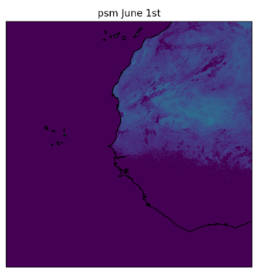
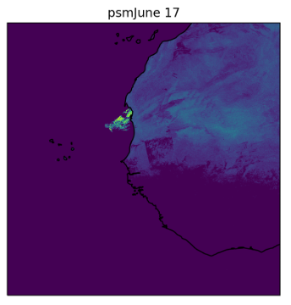
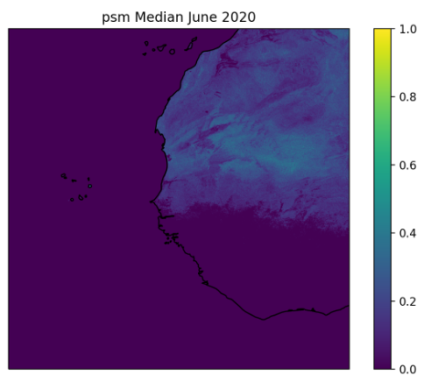
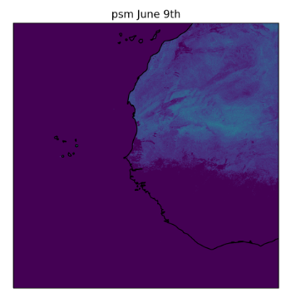
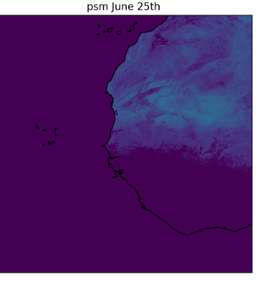
Notes:
Moving right along to how to improve the UFS

Slide 14
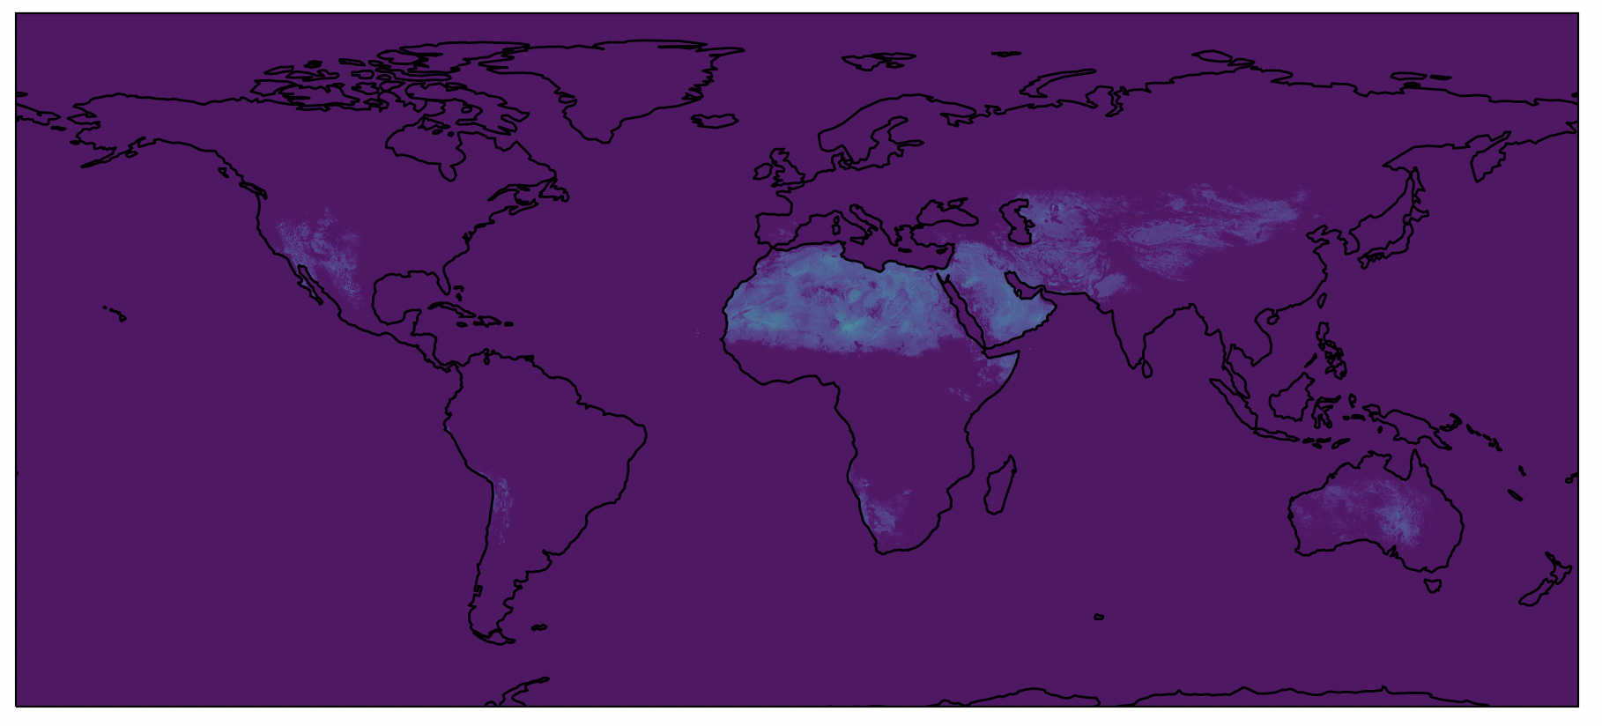
Global June 2020 Median PSM 500m
Notes:
OOOOHHHHH AHHHHHH global median captures seasonality and features quite well. Now our only problem is we can’t run [read: shouldn’t] the UFS at 500m resolution so we need to regrid up to 5km/CMG

Slide 15
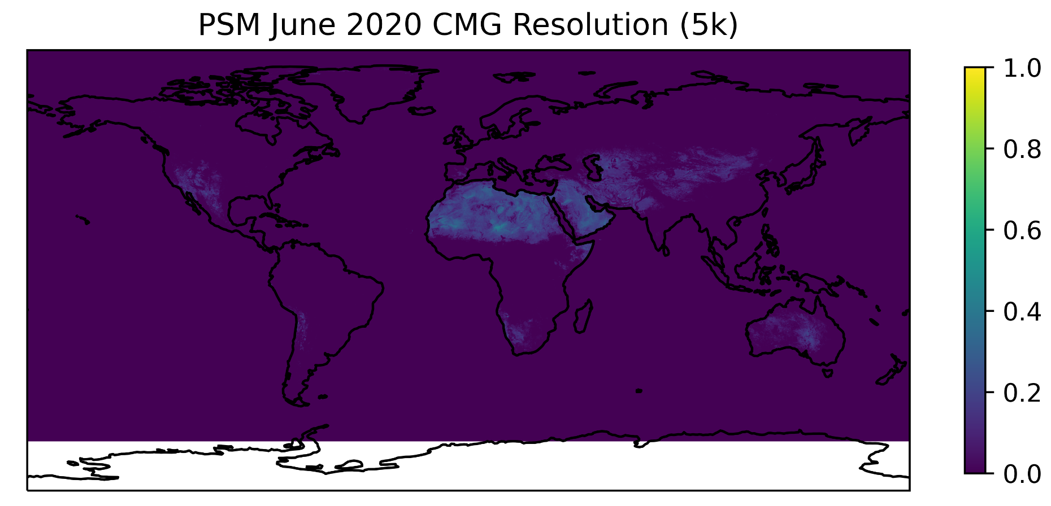
Global June 2020 Median PSM 5km
Notes:
Skipping a whole lot of details, we found the best way to regrid was either a bilinear or q3 interpolation, and here’s the 5km/CMG version

Slide 16
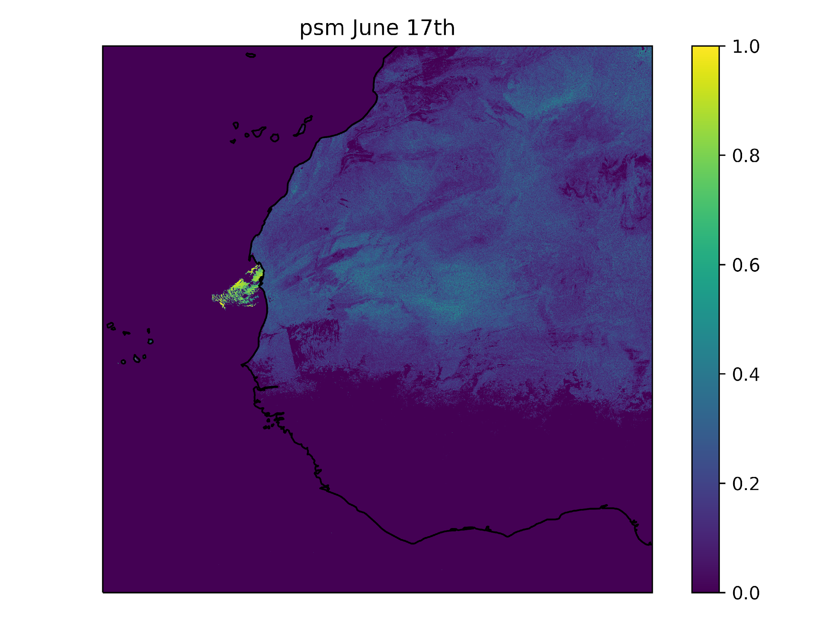
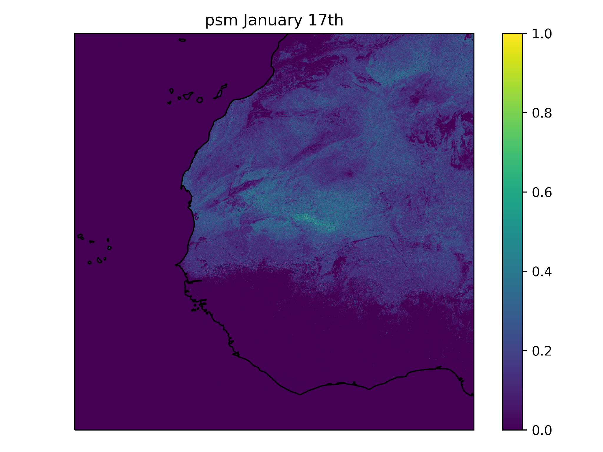
Conclusions:
1.
Alluvial flows are not currently well defined in the UFS, though they are impactful sources of dust emission in observed AOD.
Alluvial surfaces can be mapped using reflectance. Further, they can be geographically separated into physical features (Dunes vs alluvial)
2.
3.
Monthly mappings are good representations of physical processes and seasonality
Notes:
Mention you know the next step is now adding the PSM to the original SSM used in the UFS and giving it a run. You’ve already done a control run.

Slide 17
This research was supported by the NOAA OAR Weather Program Office (WPO) Innovation for Next Generation Scientists (WINGS) Dissertation Fellowship Program, administered by UCAR’s Cooperative Programs for the Advancement of Earth System Science (CPAESS) under the NOAA Science Collaboration Program award #NA21OAR4310383.
Thank you

Slide 18
Extra Slides

Slide 19
FENGSHA flux equation

Slide 20
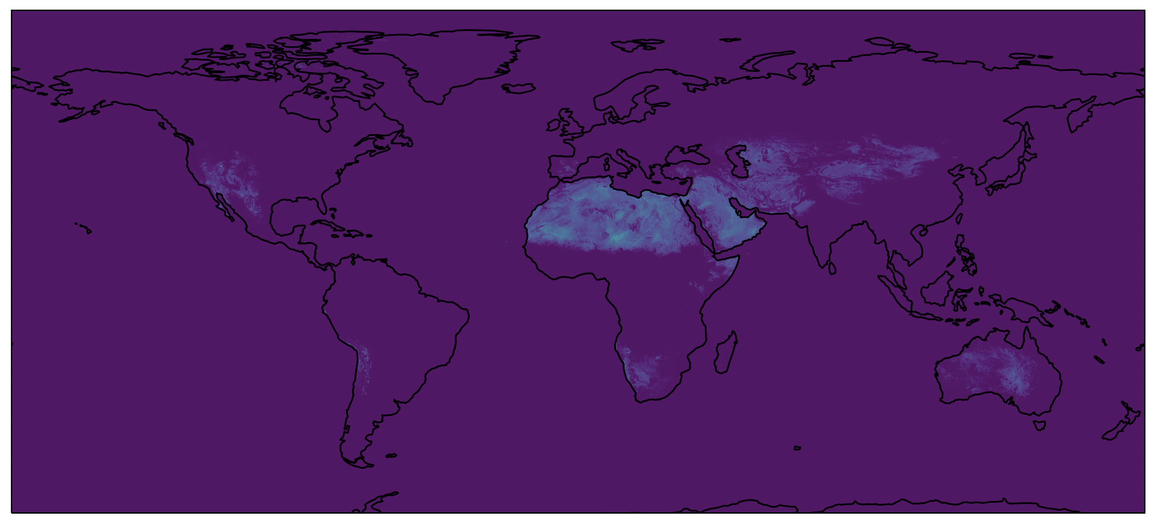
PSM Median July 2020
Notes:
Global map *oooohhh* *ahhhhhh* with a resolution problem to solve

