Slide 1
Rapid Refresh Forecast System Data Assimilation System:
overview and development status
Ming Hu¹, Shun Liu², David Dowell¹, Chunhua Zhou³, Ting Lei⁵, Haidao Lin¹, Xiaoyan Zhang⁶,, Donald Lippi⁶, Sho Yokota⁷, Ruifang Li³, Jaymes Kenyon³, amanda.back¹, Matthew Pyle², Jacob R. Carley², Terra Ladwig¹, Curtis Alexander¹, Stephen Weygandt¹, Daryl Kleist², Eric James¹, Hongli Wang³, Sijie Pan³
1. NOAA/OAR/Global System Laboratory, Boulder, CO
2. NOAA/NWS/NCEP/EMC, College Park, MD
3. CU/CIRES@ NOAA GSL
4: CSU/CIRA @ NOAA GSL
5 Lynker@ NOAA NWS NCEP EMC
6. SAIC@ NOAA NWS NCEP EMC
7. JMA/Numerical Prediction Development Center

Slide 2
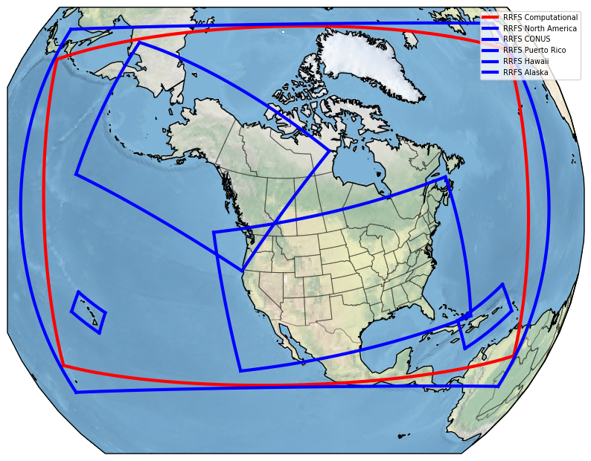
Rapid Refresh Forecast System (RRFS) version 1
Regional convection-allowing ensemble forecast system built upon FV3LAM and GSI
Jointly developed by EMC, GSL, UFS community
All key components are based on the community systems
Workflow evolved to meet operational requirements
Key features:
3 km grid covering North America
Hourly coupled deterministic and ensemble
data assimilation cycling
18-h forecast hourly from deterministic cycles
60-h forecast from deterministic and 5 member
ensembles at 00/06/12/18 Z cycle
RRFSv1 Compute Domain (red)

Slide 3
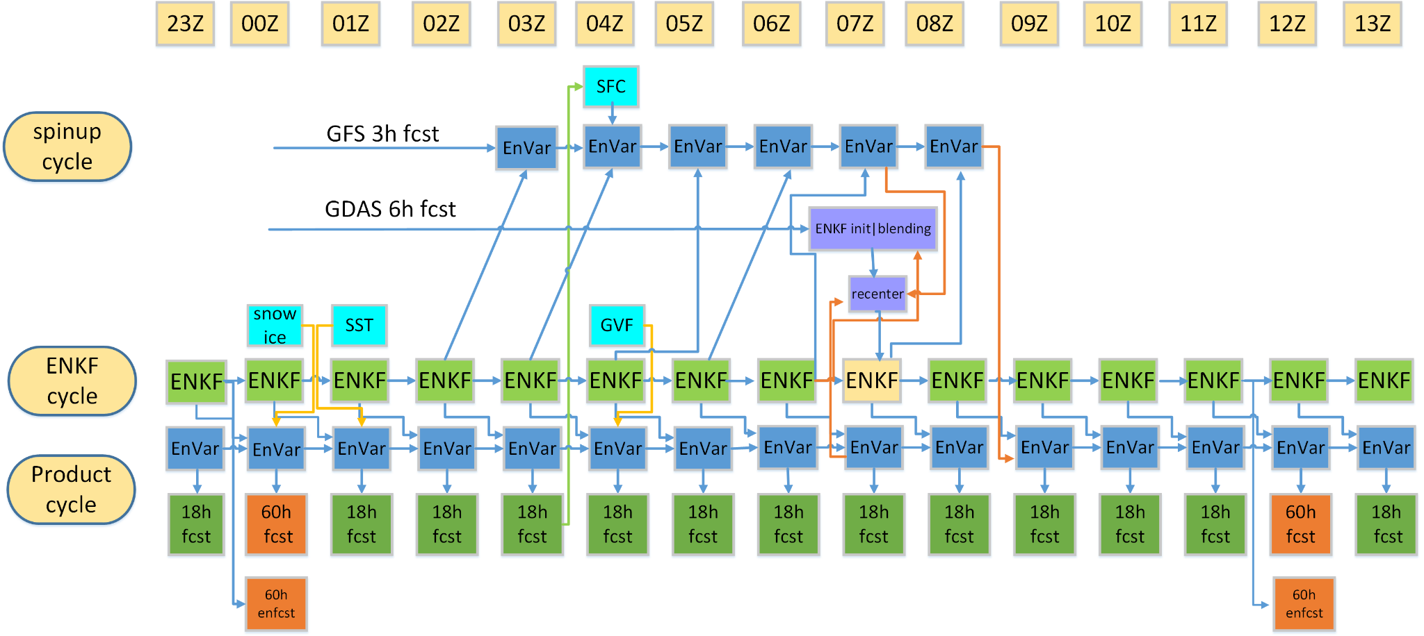
RRFS DA cycle and forecast strategy
Courtesy of Shun Liu

Slide 4
RRFS Data Assimilation System (RDAS)
Cycling to maximize positive impacts from all past observations / forecasts
Deterministic DA Spin-up Cycle | 03z-08z and 15z-20z Cold start at 03z and 15z and hybrid 3D EnVar with 80 GDAS ensemble members hourly cycled 04z-08z and 16-20z with Hybrid 3D EnVar with 30 RRFS ensemble members
Deterministic DA Product Cycle | hourly cycled from 00z to 23z Hybrid 3D EnVar with 30 RRFS ensemble members
Ensemble DA EnKF cycle | Hourly cycled from 00z to 23z Blend GDAS perturbation at 07/19Z cycle EnKF analysis with convention and radar dBz
Obs Platform | Variables
METAR, Mesonet, Buoy, C-Man, Ship | T, moisture, Wind, Ps, ceiling, vis
Rawinsonde | T, moisture, Wind
NEXRAD Radar | Reflectivity, Radial Wind, VAD Wind
Lightning | Flash Extent Density
Aircraft | T, moisture, Wind
GOES-16/18 | ABI, AMVs, cloud top pres. & T
Polar Orbiters | Radiances (AMSUA, MHS, ATMS, CRIS, IASI, SSMIS)
Analysis to maximize the impact from all current observations and forecasts
Large-Scale Blending
Multiscale DA
Satellite Radiance DA
Direct lightning analysis
Non-Var cloud analysis
Surface/Land DA
Direct radar dbz analysis

Slide 5
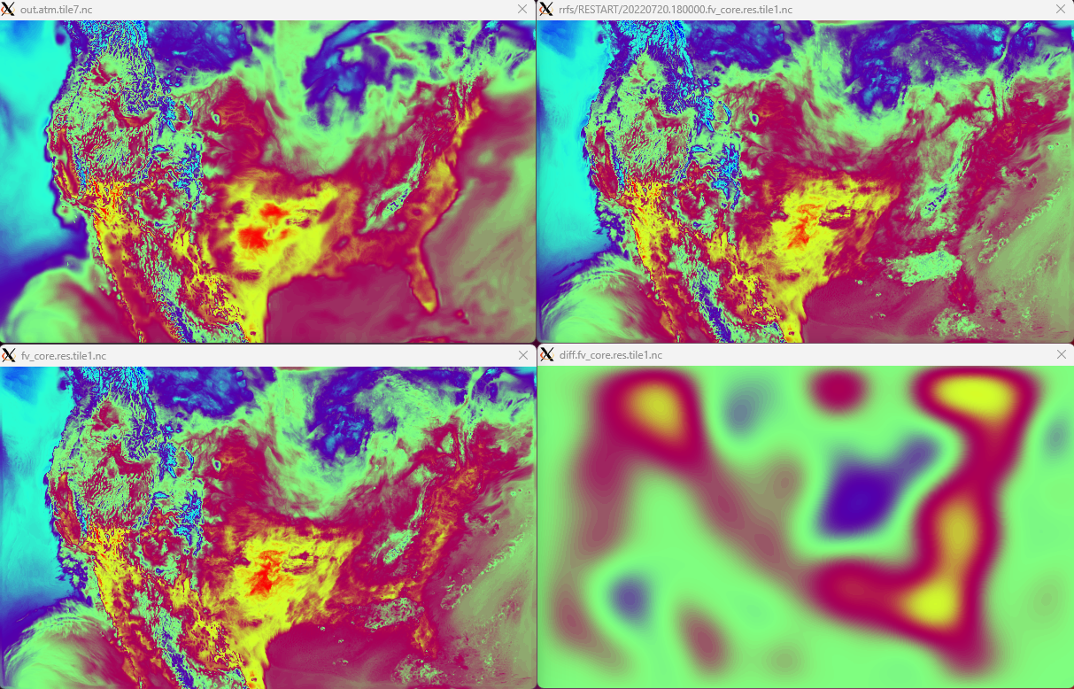
Large-scale Blending: Example
Replace twice per day ensemble (cold start) reinitialization step with blending 6h GDAS EnKF + 1h RRFS EnKF.
Retain representation of larger scales from the global system.
Retain representation of smaller scales from the RRFS.
Blended fields:
u, v, t, sphum, and delp
Using L_{x} = 960 km
Blended field retains some large scale and small scale features from (a) GDAS and (b) RRFS, respectively.
a) GDAS
b) RRFS
c) Blended
d) Blended - RRFS
Fig. Example of blending GDAS EnKF and RRFS EnKF members. Field is temperature at level 10 (from bottom). L_{x} = 960 km.
a) GDAS temperature, b) RRFS temperature, c) blended temperature, and d) difference between the blended and RRFS temperature (this shows the large-scale contribution from the global).
Courtesy of Donald Lippi

Slide 6
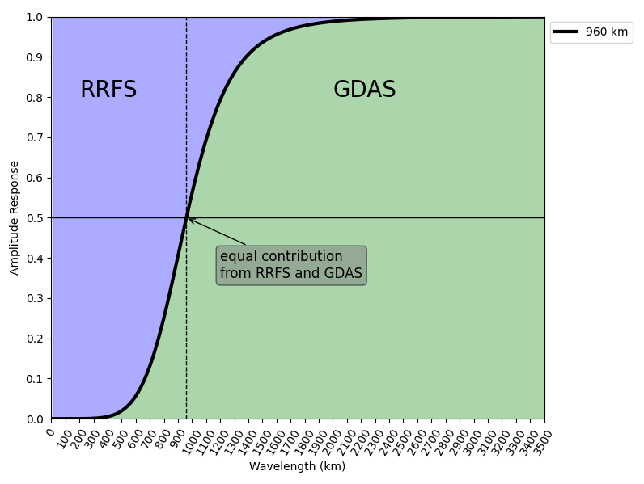
Large-scale Blending: Scale Seperation
To achieve scale separation, the Raymond filter was used (Raymond 1988; Raymond and Garder 1991).
A sixth-order low-pass implicit tangent filter.
As implemented in several other studies
Schwartz et al. 2021
Wang et al. 2014
Use 960 km as the cutoff length scale (L_{x})
Schwartz et al. 2021 found 960 km worked best among options of 640 km, 960 km, and 1280 km.
Height and variable invariant.
Fig. Amplitude response of sixth-order tangent filter as function of wavelength for specified cutoff length (Lx) of 960 km indicated by the dashed vertical line.
Courtesy of Donald Lippi

Slide 7
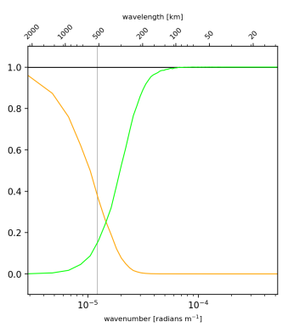
Multiscale DA: Scheme
Scale and variable dependent localization (SDL/VDL) employed in the EnVar DA algorithm (Yokota et al. 2024, JAMES [accepted])
Ensemble covariances undergo scale-selective filtering (short & long waves)
Localization radii appropriate for each scale and variable group are used
Allows for all observations to be assimilated simultaneously
Eliminates 2 step implementations with ad-hoc separation of observations (sondes vs radar)
Thanks to Sho Yokota, Ting and OU MAP for this work

Slide 8
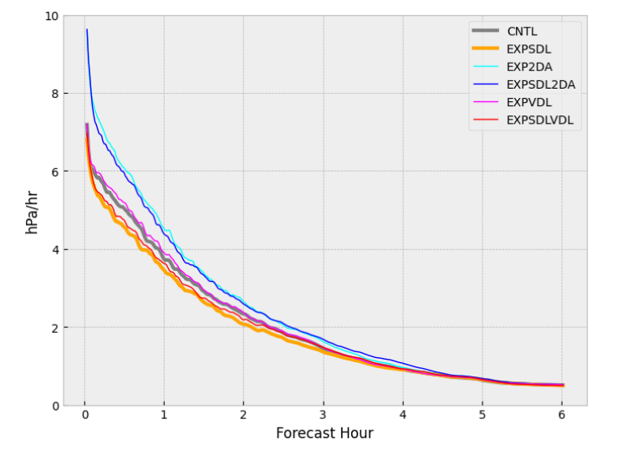
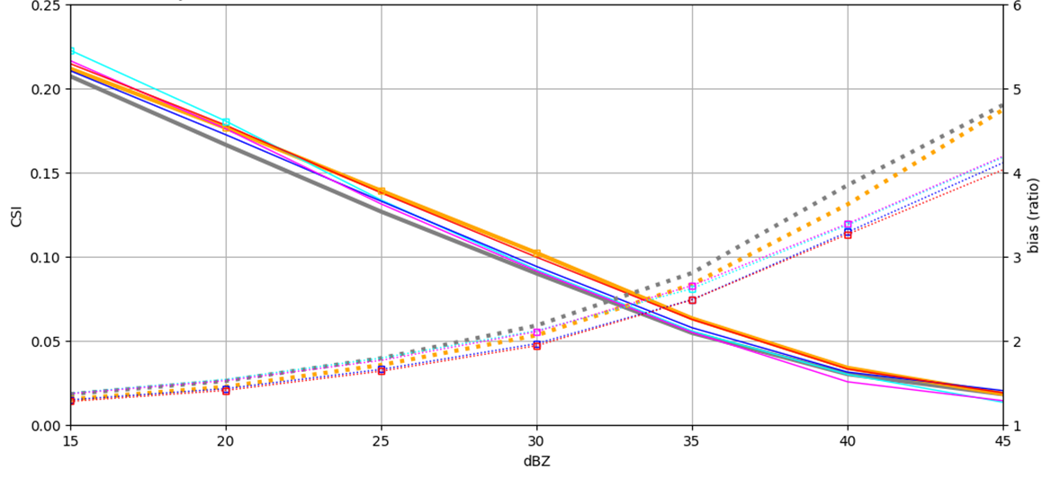
Multiscale DA: test results
Mean absolute pressure tendency (hPa hr^{–1})
CSI and BIAS of Reflectivity 12-hour forecast
Thanks to Sho Yokota Ting and OU MAP for this work

Slide 9
RRFS surface/land DA and forecast
Better surface boundary condition:
use of high-resolution 30” BNU soil, and 30” VIIRS vegetation information;
Snow updating from 4-km IMS data once per day at 01Z product cycle;
Real-time VIIRS GVF, updating once per day at 04Z spin-up cycle;
SST updating from NSST analysis once per day at 01Z product cycle.
Continue surface cycling and surface fields initialization
Continue surface cycling in partial cycling structure (04Z/16Z spin-up cycle)
Keep GFS ice in surface cycling (when cycle surface fields at 04Z/16Z spin-up cycle)
Use FVCOM for surface T and ice over Great Lakes (twice per day at 04Z/16Z spin up cycle)
soil surgery to initialize the soil fields from RAP/HRRR soil (beginning of retro or real-time run)
Improving surface fields through data assimilation cycles
Land data assimilation – MCLDA - (soil nudging/soil adjustment)
Using model forecast fields 2m T/Q as background for GSI surface T/Q observation analysis
Using Terrain-elevation matching surface temperature observations
The latest version of RUC LSM is implemented in CCPP: available for use as a land surface component in UFS.

Slide 10
RRFS Satellite Radiance DA
Assimilating similar satellites to those used in GDAS covering RRFS NA domain, but clear sky only
Similar QC and Bias Correction (VarBC) method as used in GDAS
VarBC coefficient and variance updated hourly
Channel selected below 2mb model top
Finer thinning box (60-km)
High resolution (3-km) and high frequency (hourly) assimilation cycle
Convective scale allowing microphysics
AMSU-A
NOAA_n15: channels 1-5, 7-10, 12,15;
NOAA_n18: channels 1-4,6-7, 10, 11, 12,15;
NOAA_n19: channels 1-6,9-10,11, 12, 15;
METOP-B: channels 8-10, 11, 12;
METOP-C: channels 1-10, 11,12, 15;
MHS
NOAA_n18: 1-5;
NOAA_n19: 1, 2, 4, 5;
SSMIS :
DMSP-17: channels 1, 5-7, 24;
IASI:
METOP-B and METOP-C : 141 channels; (98 vs. 141)
CrIS-FSR
NOAA-20: 98 channels; NOAA-21: 98 channels; (72 vs. 98)
ATMS
NPP, N20, and N21: channels 1-11, 12, 13, 16-22;
ABI :
GOES-16 and GOES-18: channels 8-10;
Courtesy of Xiaoyan Zhang and Haidoa Lin

Slide 11
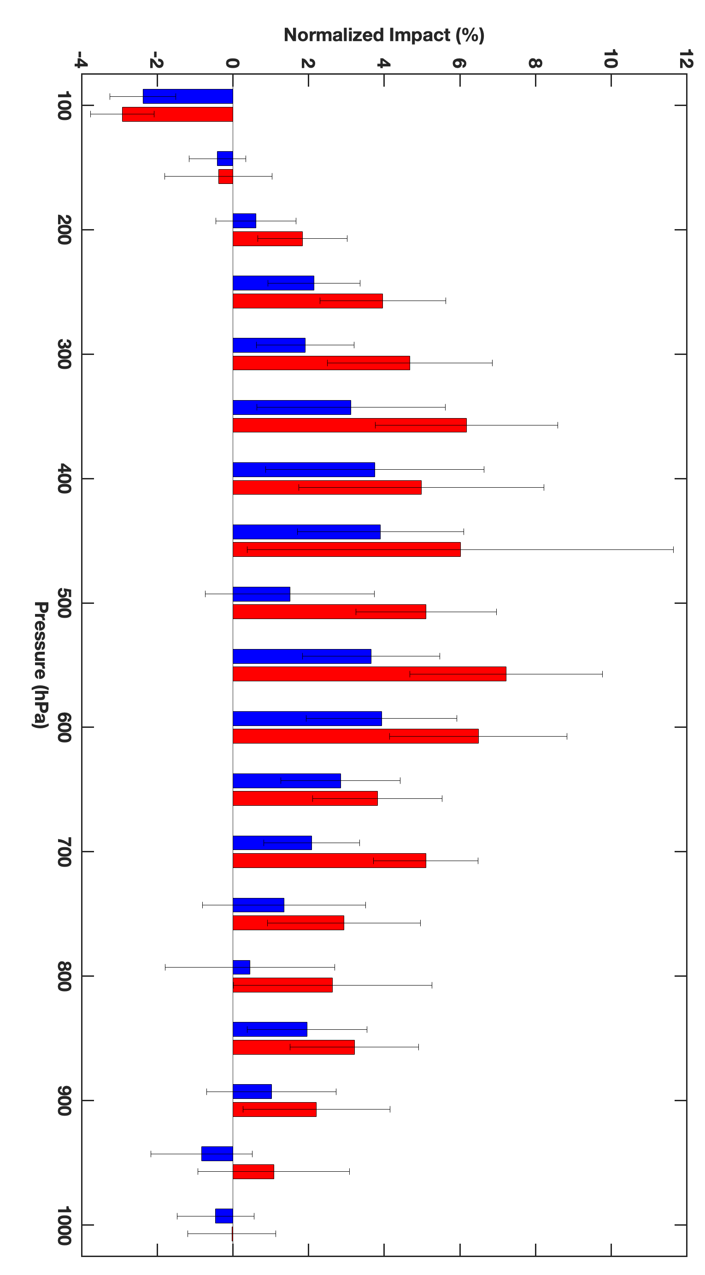
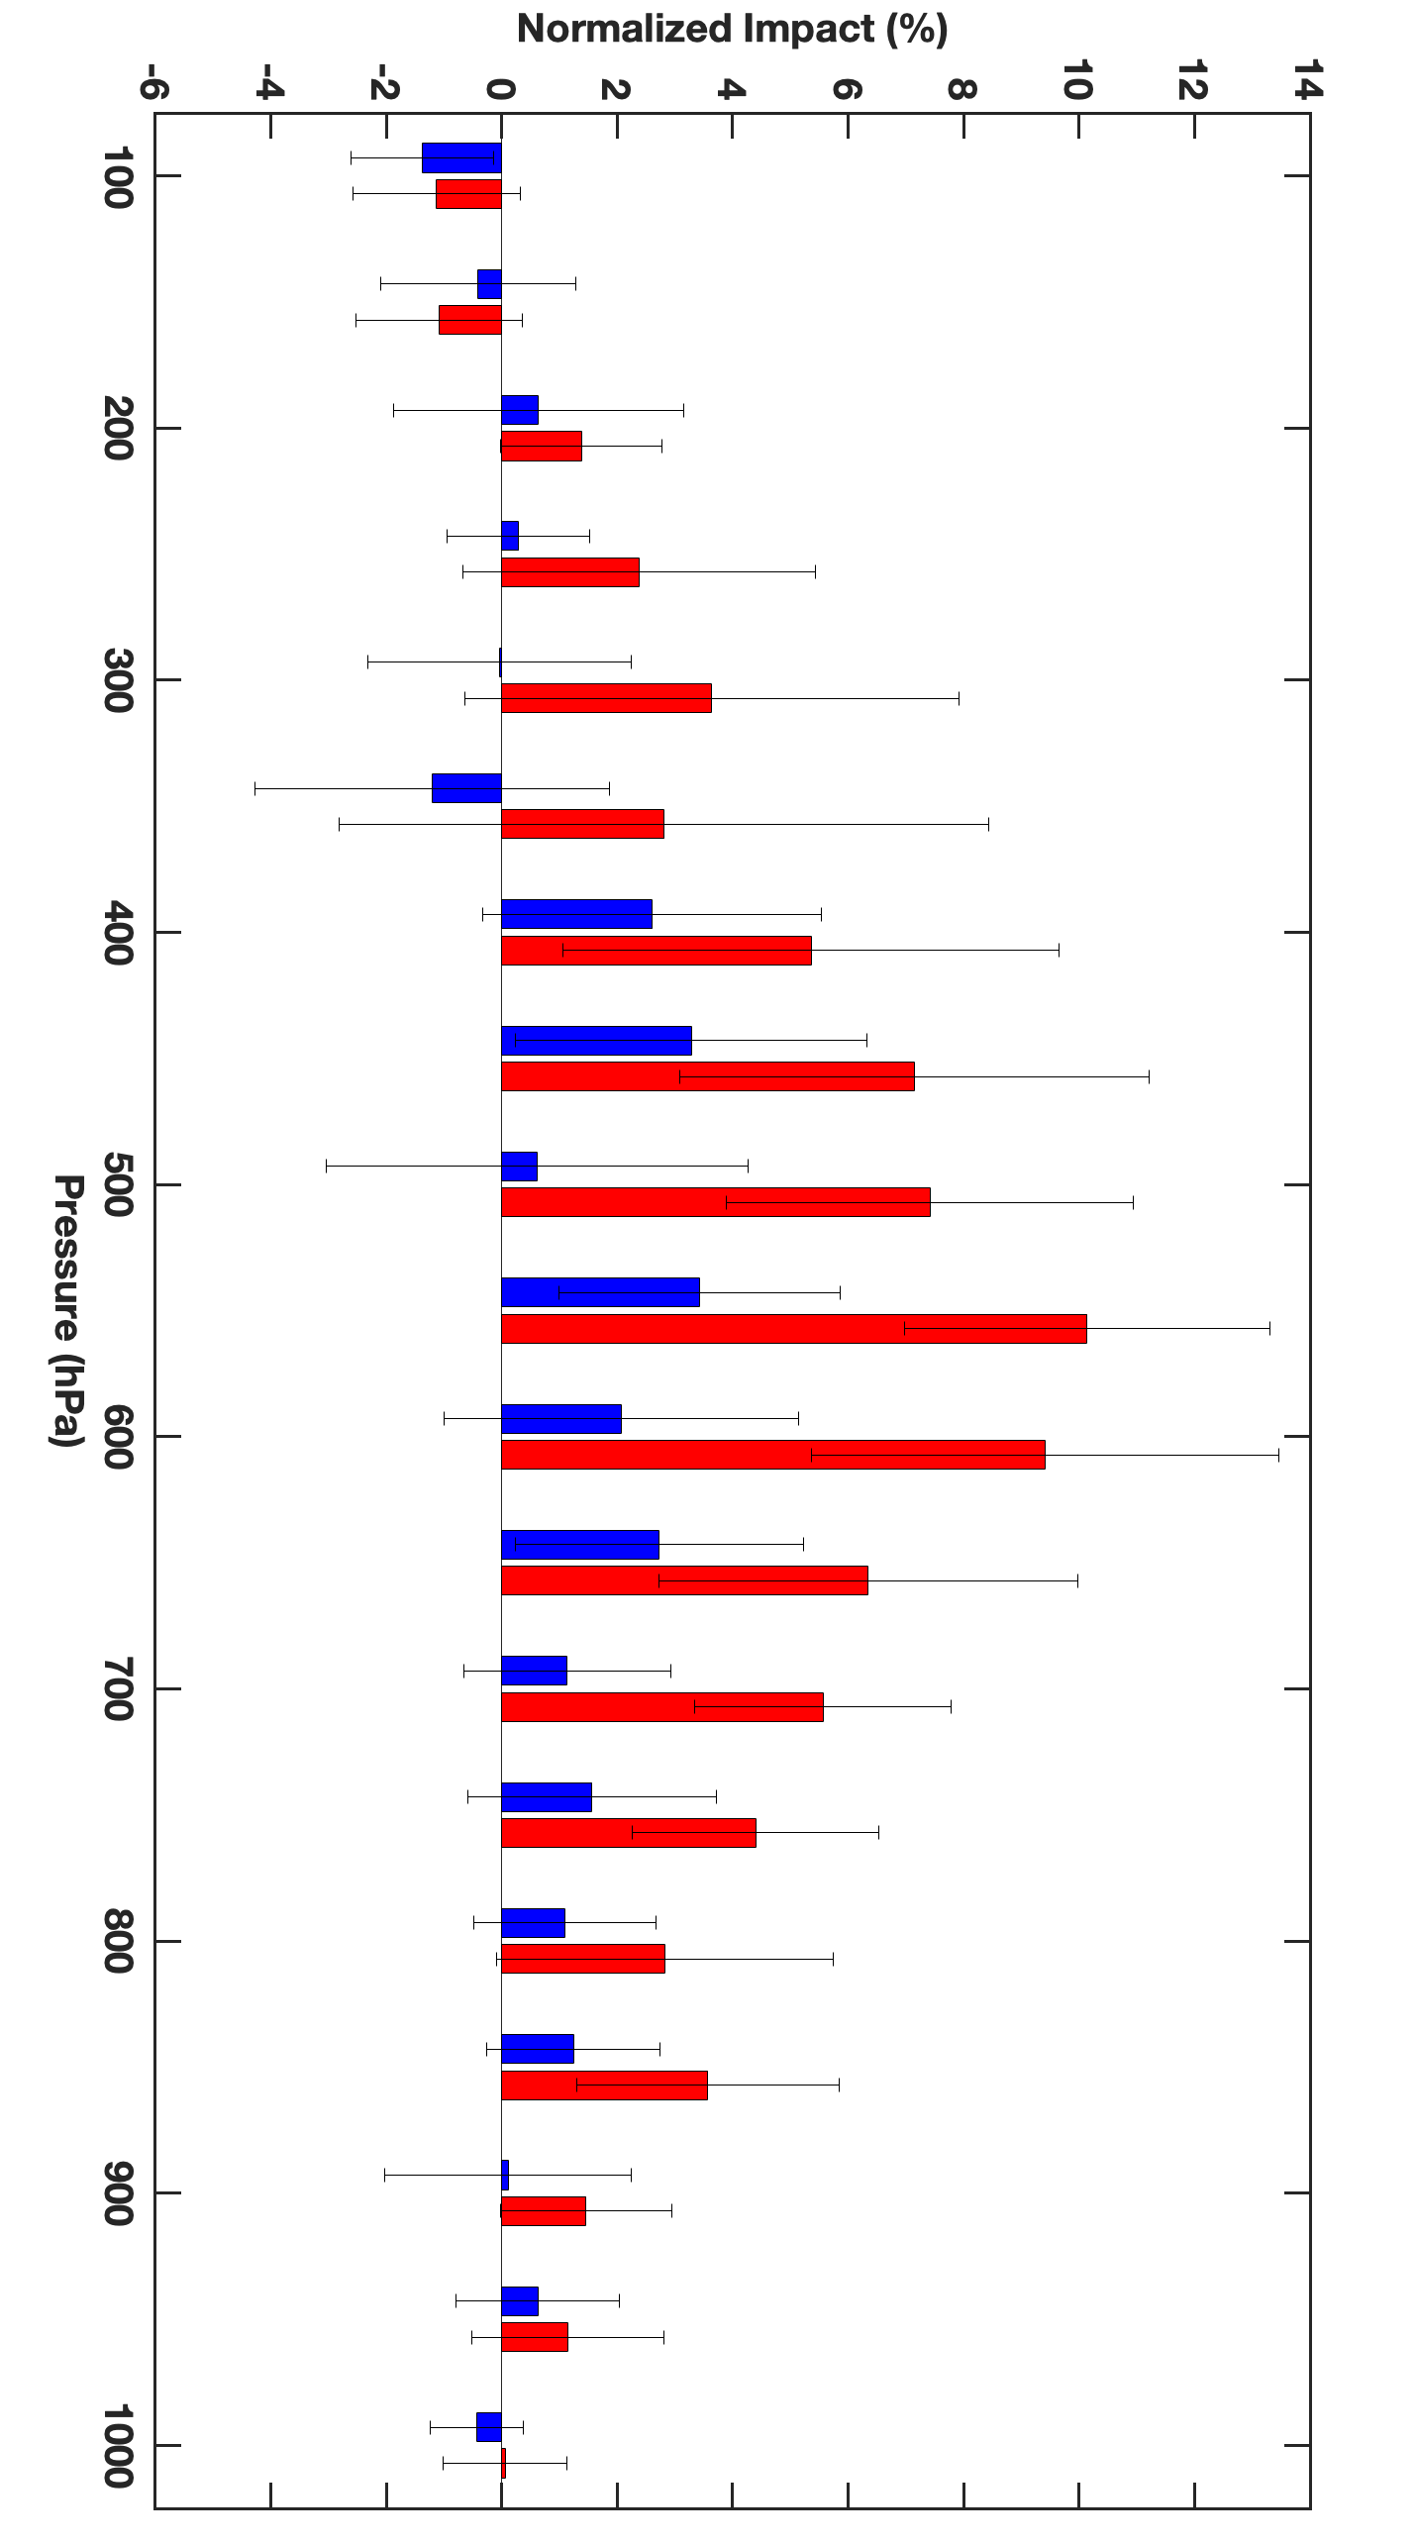
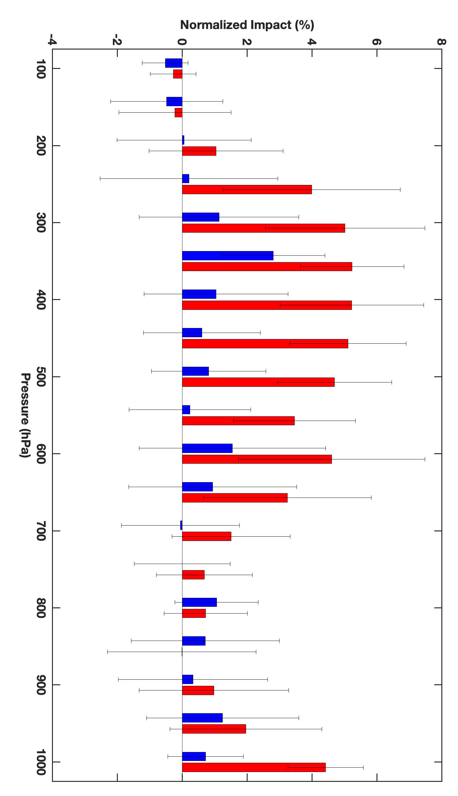
Satellite radiance data impact
Hyperspectral infrared data (N20/N21 CrIS-FSR and Metop-B/C IASI) denial run
All radiance data denial run
100
200
300
400
500
600
700
800
900
1000
hPa
4-IR data:
CrIS-FSR: N20/N21
IASI: Metop-B/C
Normalized Impact (%)
E_{N} = (EXPT – CNTL) / CNTL
Courtesy of Haidoa Lin
Temperature
Relative
Humidity
Wind
19-27 April 2023
verification within the Full RRFS domain
Radiosonde verification

Slide 12
Non-Var cloud analysis
Observations
Map to cloud field
Merge cloud field
Update hydrometeors
based on the cloud field
No cloud
Cloud
Unknown

Slide 13
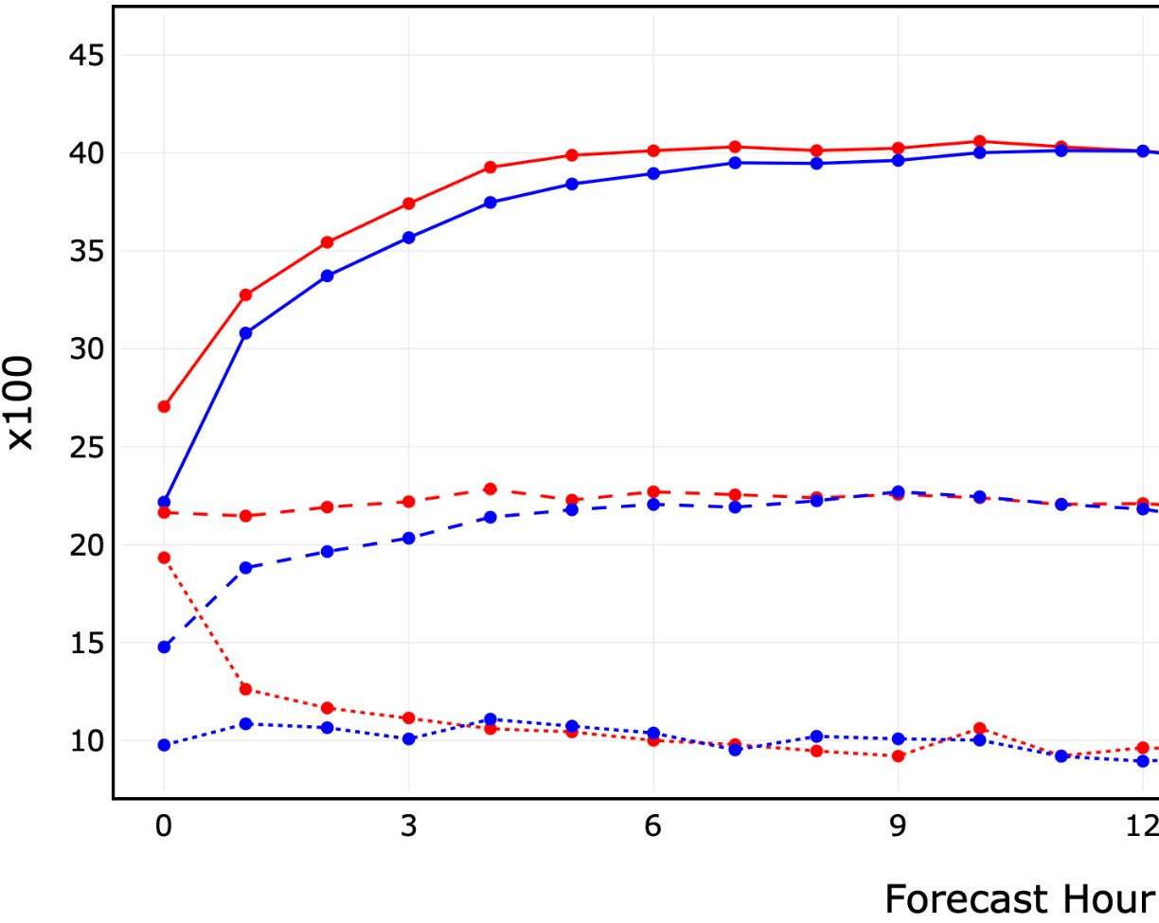
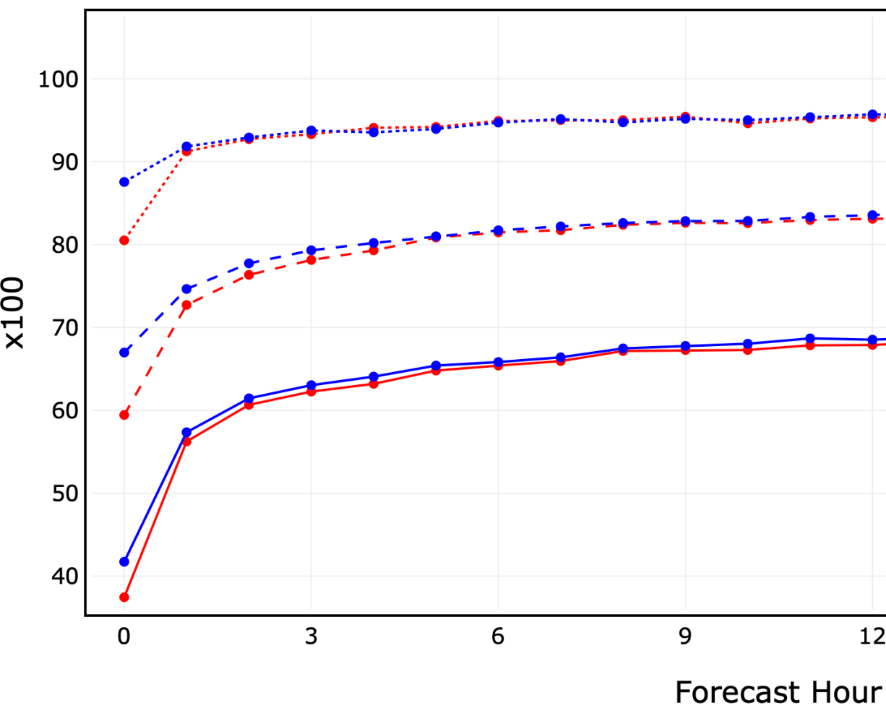
Satellite lightning DA (collaboration with OU CAPS)
GOES-R GLM satellite lightning detections cover most of RRFS domain (up to 52 degrees latitude) at ~12 km resolution
Lightning flash extent density (FED) empirically related to graupel mass summed over 5x5 model column area (OU CAPS method)
GLM assimilated into ensemble members and into control member through EnVar
June 2023 weeklong coupled retro results shown at right
Run over CONUS domain
Omitted hybrid radar DA from control member in all configs to simulate lightning DA impacts on OCONUS
Used all other elements of frozen RRFS code configuration including GF scheme
CREF skill by lead time:
POD on 20 km grid
FAR on 20 km grid
Blue=control run RED=FED assimilation
solid=20 dBZ, dashed=30 dBZ, dotted=40 dBZ
Courtesy of Amanda Back

Slide 14
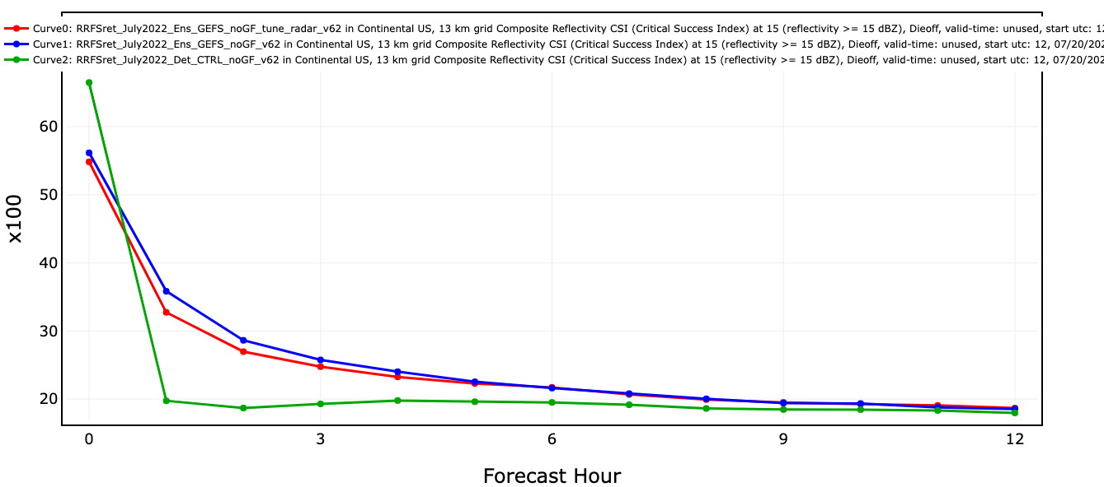
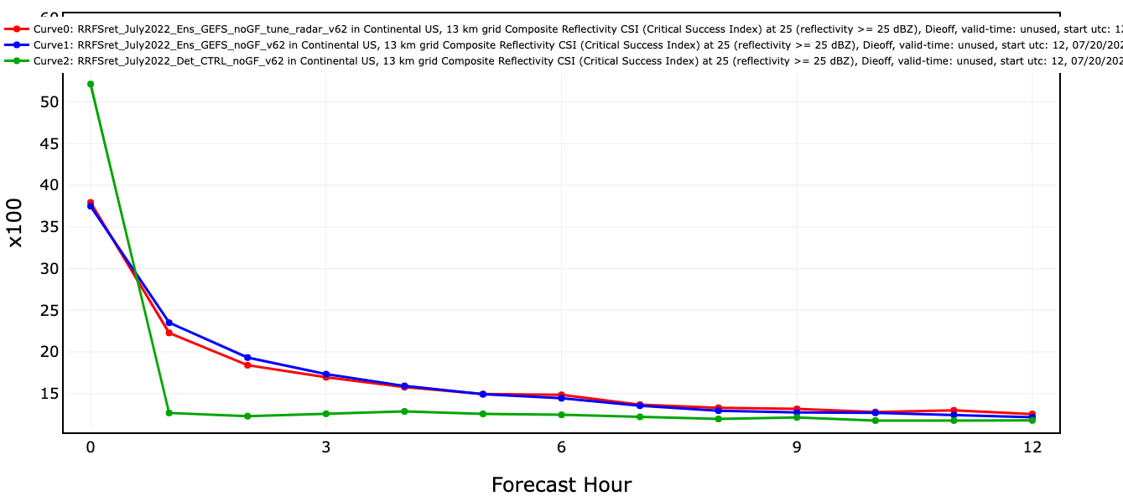
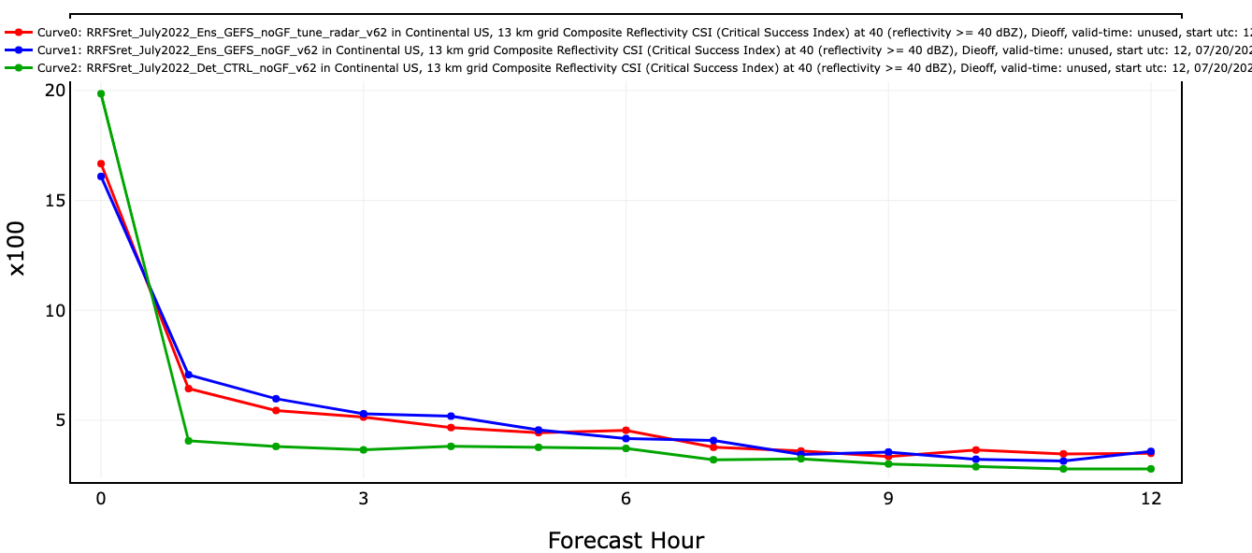
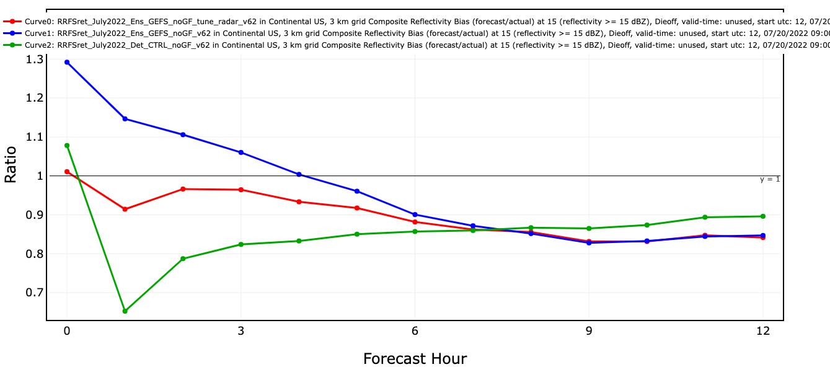
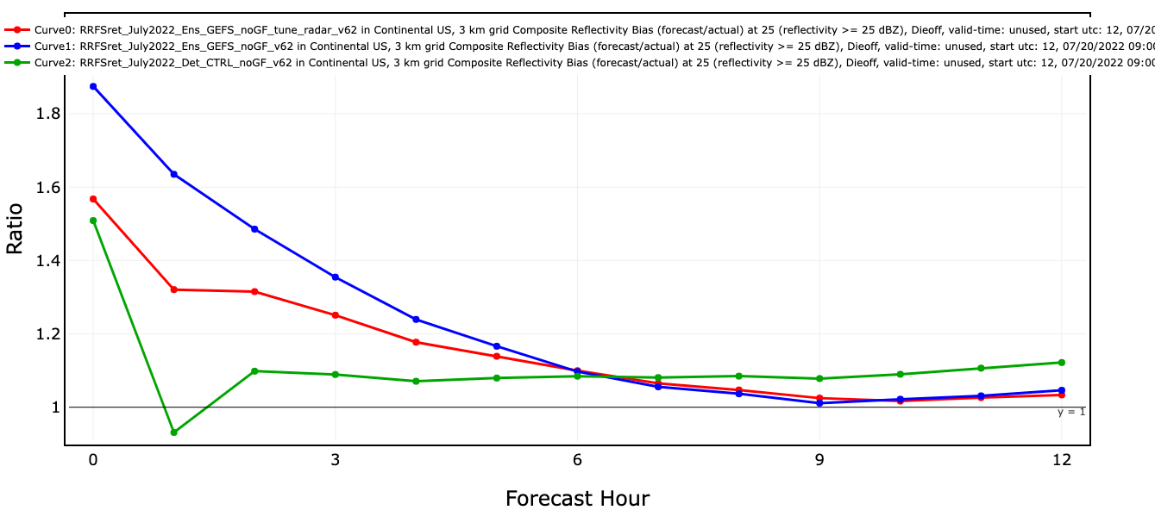
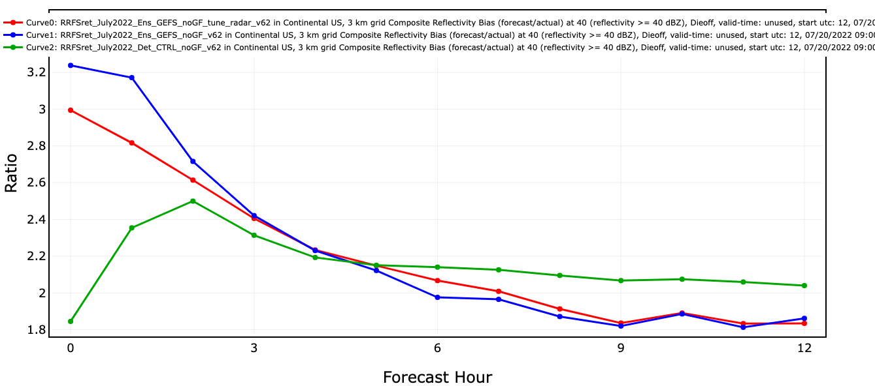
Direct radar reflectivity (dBZ) analysis
Radar reflectivity observation (dBZ) is used as analysis variable in hybrid 3D EnVar and EnKF analysis.
15dBz
25dBz
40dBz
CSI
Det_CTRL: only deterministic run with GDAS for its hybrid analysis, no ensemble coupling
Ens_CTRL: two-way coupled RDAS, with direct radar dBz analysis, only deterministic forecast verified
Tune_radar: same as Ens_CTRL, but with the following changes
Fewer (more thinned) reflectivity observations in precipitation for EnVar analysis
More (less thinned) non-precipitation reflectivity observations for EnKF analysis
BIAS
Reflectivity bias largely reduced, while maintaining similar CSI

Slide 15
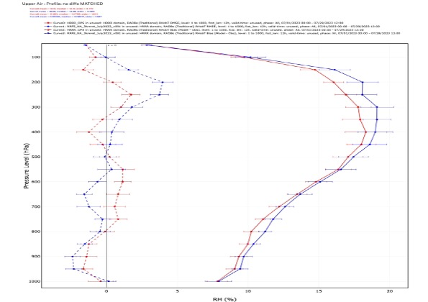
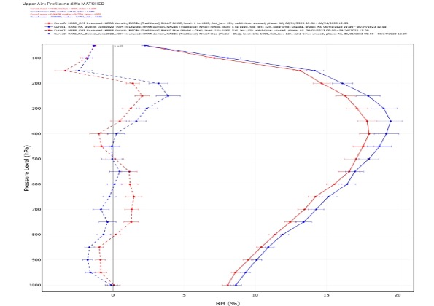
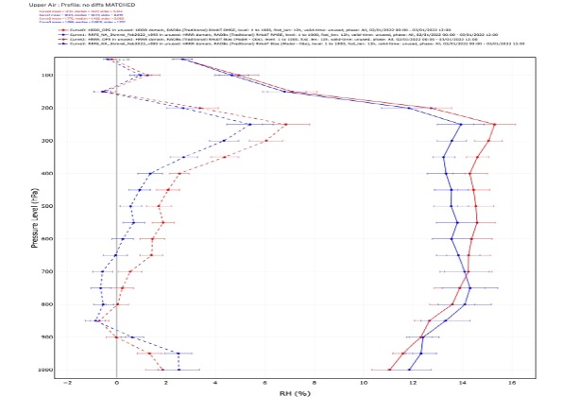
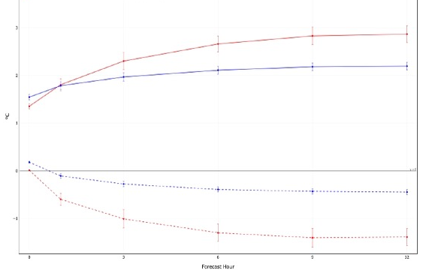
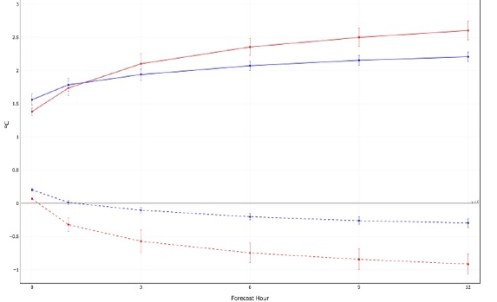
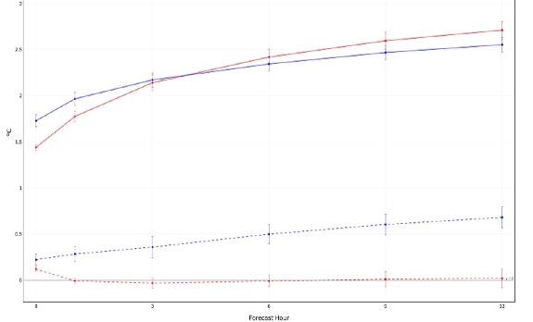
RRFS evaluation retros
Blue: RRFS
Red: HRRR
Solid: RMSE
Dash: BIAS
Upper air moisture (RH) RMSE and BIAS profile for RRFS 12-h forecast
Surface 2-meter dew point RMSE and BIAS die-off for RRFS 12-h forecast
Summer
July 1-31, 2023
Spring
June 1–24, 2023
Winter
Feb 1–28, 2022

Slide 16
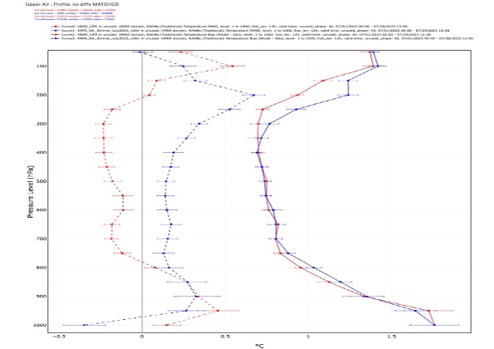
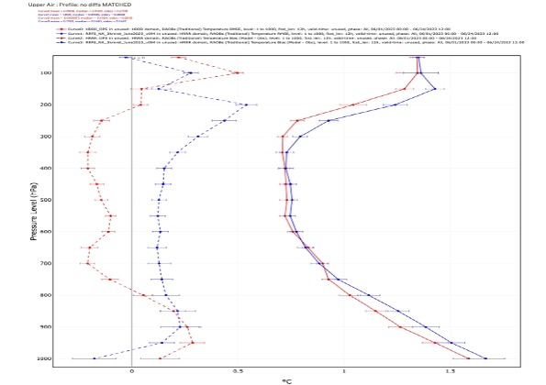
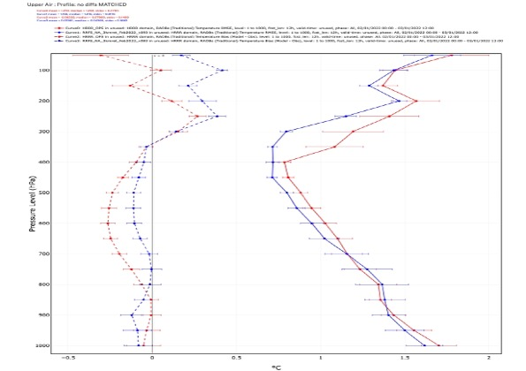
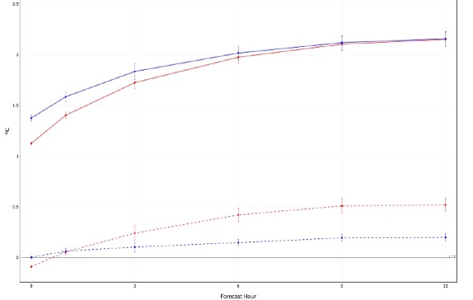
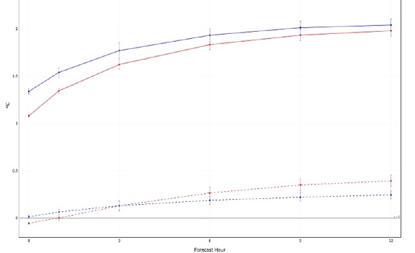
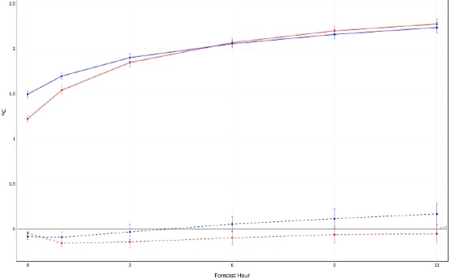
RRFS evaluation retros
Blue: RRFS
Red: HRRR
Solid: RMSE
Dash: BIAS
Upper air temperature RMSE and BIAS profile for RRFS 12-h forecast
Surface 2-meter temperature RMSE and BIAS Die-off for RRFS 12-h forecast
Summer
July 1-31, 2023
Spring
June 1–24, 2023
Winter
Feb 1–28, 2022

Slide 17
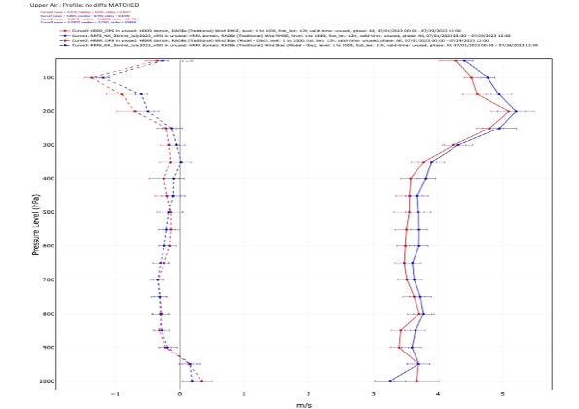
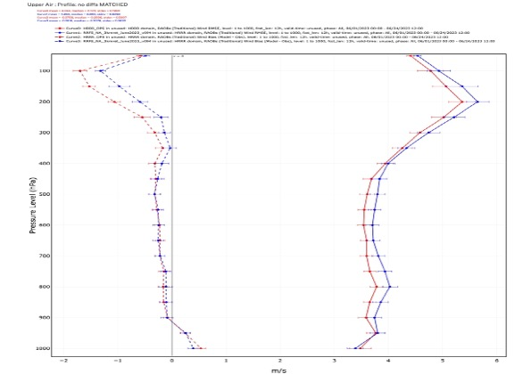
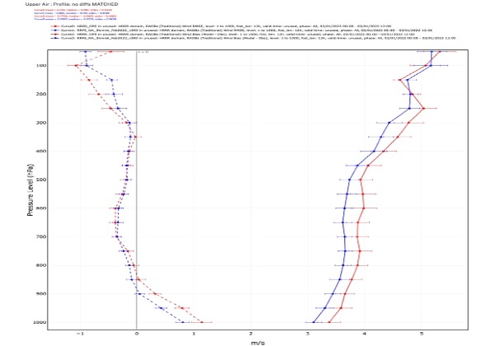
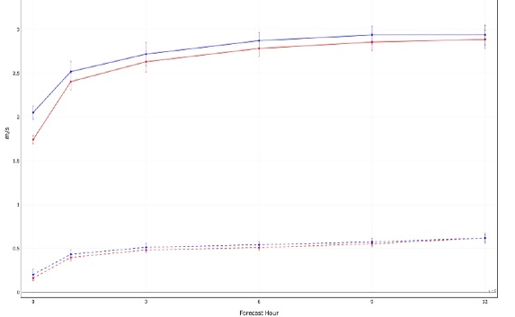
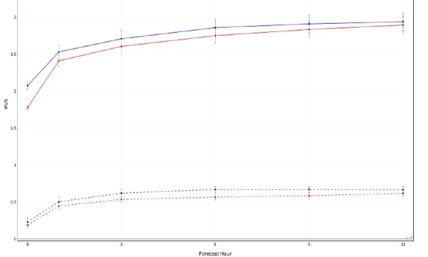
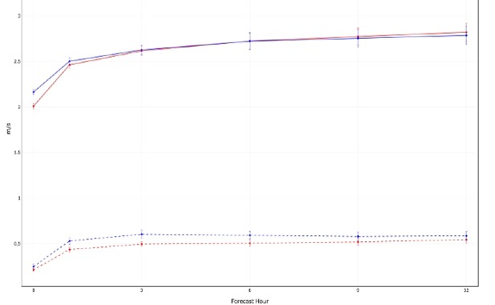
RRFS evaluation retros
Blue: RRFS
Red: HRRR
Solid: RMSE
Dash: BIAS
Upper air wind RMSE and BIAS profile for RRFS 12-h forecast
Surface 10-meter wind RMSE and BIAS die-off for RRFS 12-h forecast
Summer
July 1-31, 2023
Spring
June 1–24, 2023
Winter
Feb 1–28, 2022

Slide 18
Summary
Significant team efforts has been to build RRFS data assimilation system based on experience from RAP/HRRR/NAM and including recently developed new DA innovation techniques.
Clear improvement for near surface moisture field from RRFS data cycling and physics enhancements.
RRFS retro shows improvement during cold season, but some degradation during warm season compared to HRRR

Slide 19
Future RDAS
Regional convection-allowing ensemble forecast system built upon MPAS and JEDI
Jointly developed by EMC, GSL, UFS community, NCAR, JCSDA, NSSL, …
All key components are based on the community systems
All regional DA features from current RRFS DA will be ported or further developed to future RRFS MPAS+JEDI DA system
RRFS Data Assimilation team from EMC and GSL are actively testing and evaluating the key functions of JEDI for RRFS application, including
Build RDASApp (JEDI) repository to host RRFS test cases and configurations
UFO validation
Static BE and ensemble BE tuning
Analysis methods (hybrid 3DEnVar and LETKF) checking
Computer resources evaluation

